Slide 1
Energy Systems Analysis using OSeMOSYS
Introduction to Linear Programming Models
MSc. Fernando Plazas-Niño
February 2024

Slide 2
AGENDA
LP Model
Practice Exercise
OSeMOSYS Model

Slide 3
LP Model

Slide 4
OPTIMIZATION
"The main task of an engineer is to apply their scientific and technological knowledge to solve technical problems, optimizing these solutions while considering the constraints and requirements imposed by materials, technological, economic, legal, environmental, and human factors.“
G. Pahl and W. Beitz

Slide 5
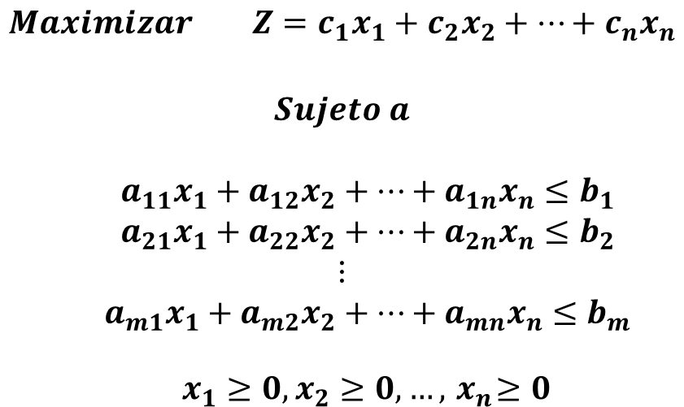
MATHEMATICAL LP MODEL
Función objetivo
Restricciones
Funcionales
No negatividad

Slide 6
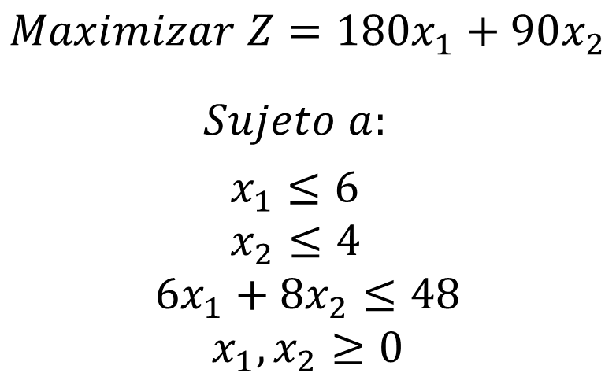
EXAMPLE OF FORMULATION

Slide 7
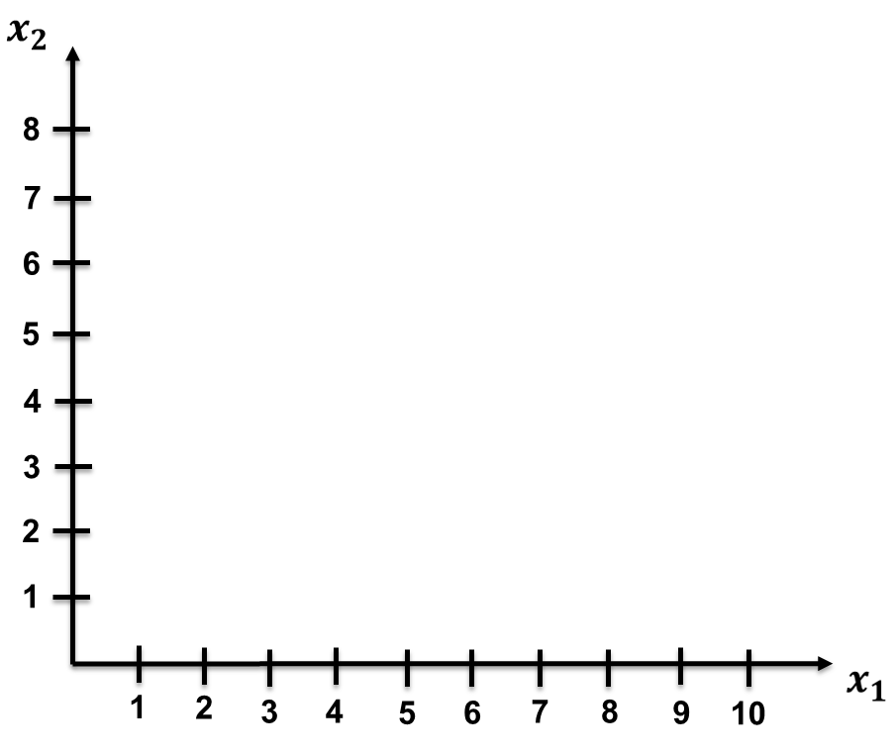

GRAPHICAL SOLUTION (1/7)
First quadrant

Slide 8
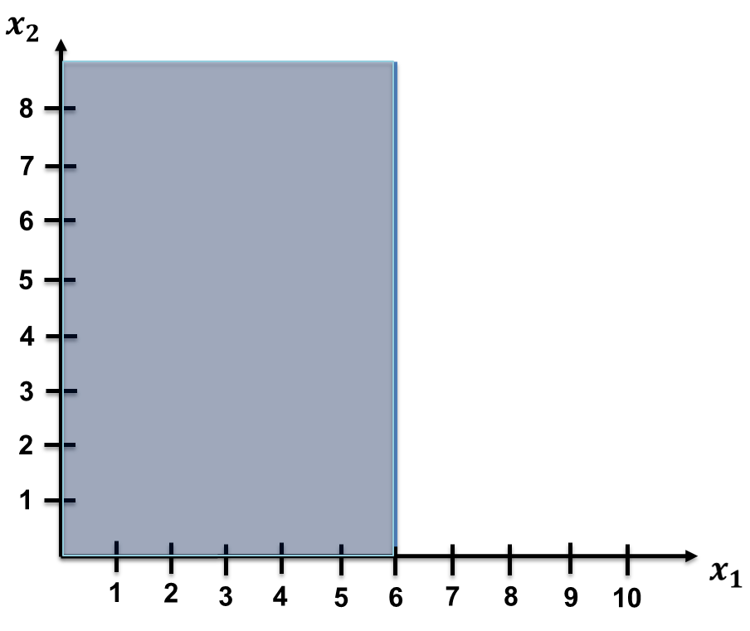

GRAPHICAL SOLUTION (2/7)

Slide 9
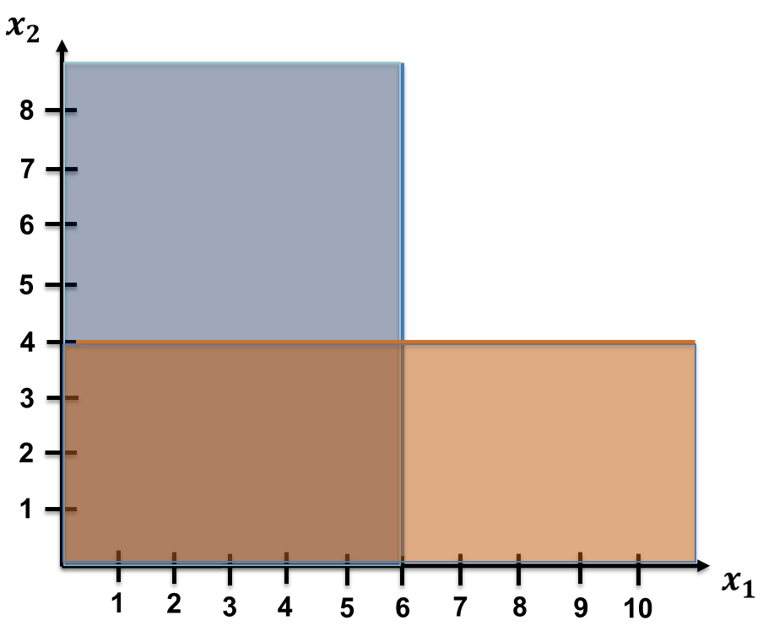
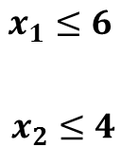
GRAPHICAL SOLUTION (3/7)

Slide 10
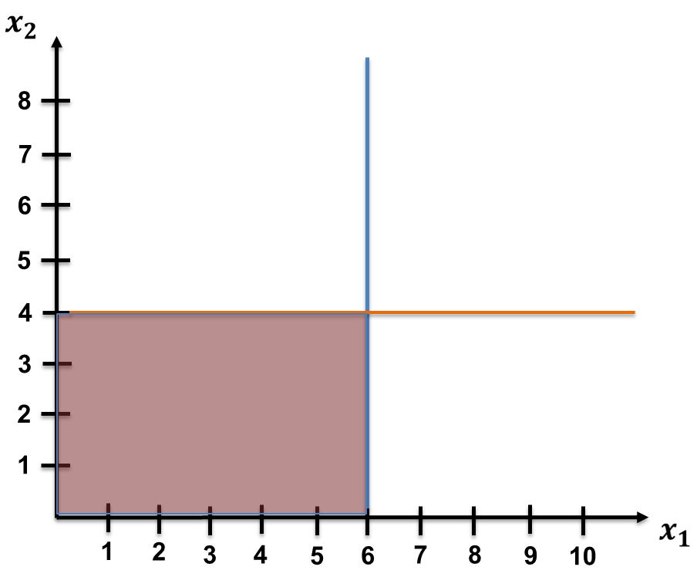
GRAPHICAL SOLUTION (4/7)

Slide 11
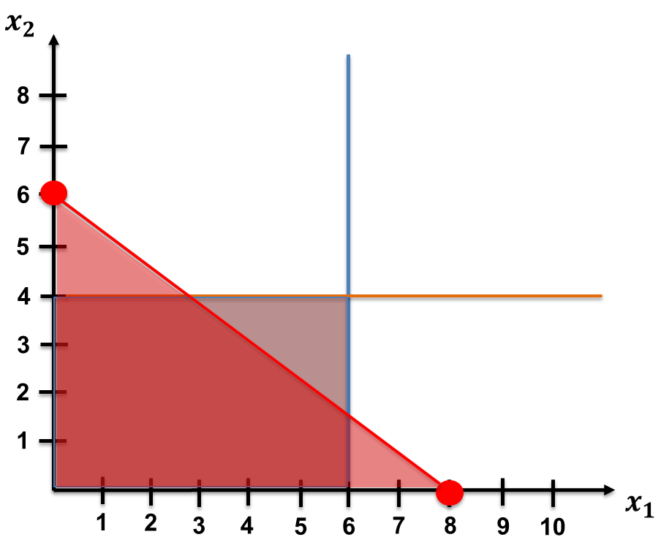
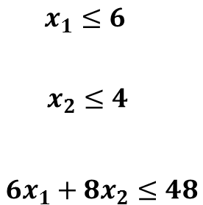
GRAPHICAL SOLUTION (5/7)

Slide 12
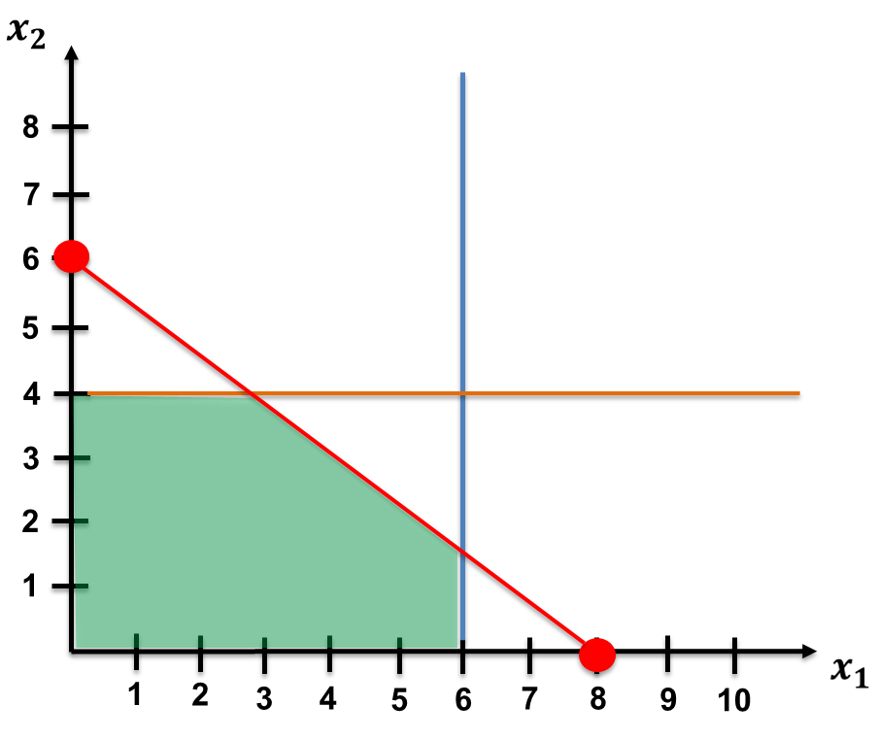
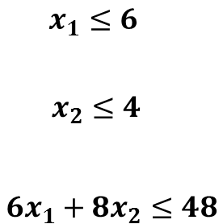
GRAPHICAL SOLUTION (6/7)
Feasible region – Feasible solutions

Slide 13
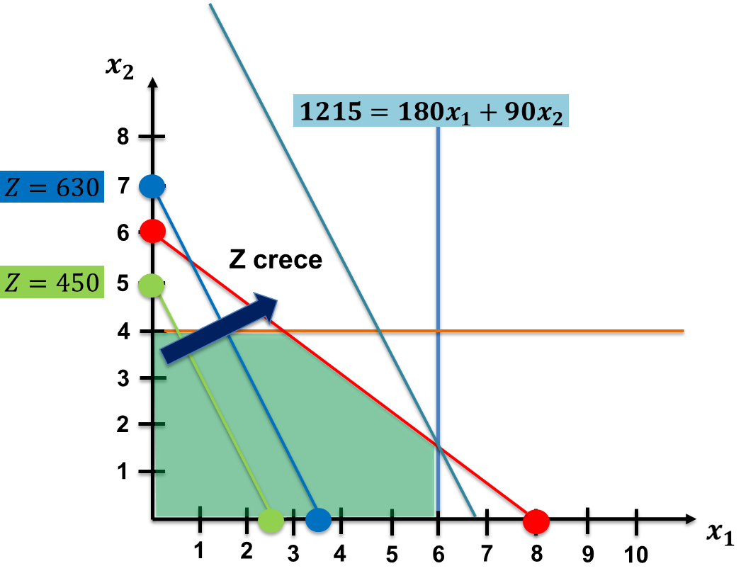
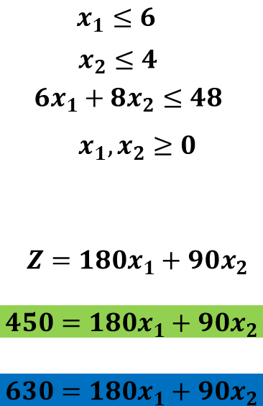
GRAPHICAL SOLUTION (7/7)

Slide 14
Practice Exercise

Slide 15

ELECTRICITY GENERATION ISLAND X
Annual Energy Planning for the Island
The island's electricity demand is 250 PJ.
There are two power plants on the island, one coal-fired and one natural gas-fired.
How much should each power plant produce to meet the annual electricity demand on the island at the minimum cost?
Table 1. Technical Data of Electricity Generation
Power Plant | Decision variable for production (PJ) | Fuel requirement per unit of production (PJ/PJ) | Production cost (USD / PJ) | Fuel availability (PJ)
Coal PP | XCL | 3 | 350 | 600 (coal)
Gas PP | XGS | 2 | 300 | 300 (gas)

Slide 16
INDIVIDUAL WORK – 15 MINUTES

Slide 17
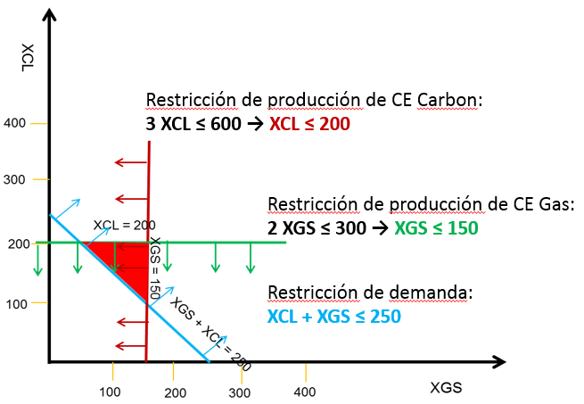
ELECTRICITY GENERATION ISLAND X
Formulation:
Variables:
XCL = Annual production (in PJ) for the Coal Power Plant (Coal PP)
XGS = Annual production (in PJ) for the Natural Gas Power Plant (Gas PP)
Objective function: Minimize the total production cost Minimize z = 350 * XCL + 300 * XGS
Constraint Formulation:
XCL ≥ 0, XGS ≥ 0
Demand: XCL + XGS ≥ 250
Coal availability: 3 * XCL ≤ 600
Natural gas availability: 2 * XGS ≤ 300
Coal PP Production Constraint:
Gas PP Production Constraint:
Demand Constraint:
XCL+XGS ≥ 250

Slide 18
ELECTRICITY GENERATION ISLAND X - SOLUTION USING GLPK
Alternative:
Use one text file for the model and another for the data.
# Set and Problem declaration
set PP;
# Parameter definition
param freq {i in PP};
param cop {i in PP};
param fav {i in PP};
# Variable description
var x {i in PP} >=0;
# Objective function
minimize z: sum{i in PP} cop[i]*x[i];
# Constraint Specification
s.t. Fuel {i in PP}: freq[i]*x[i]<= fav[i];
s.t. Demand : sum{i in PP} x[i]>=250;
# Solve statement
solve;
# End statement
end;
# Data section
data;
# Set Defintion
set PP:=
coal
gas;
# Fuel Requirement info
param freq :=
coal 3
gas 2;
# Cost of production info
param cop:=
coal 350
gas 300;
# Fuel Availability info
param fav:=
coal 600
gas 300;
# End statement
end;
Model file
Data file
Command line:
> glpsol
-m Isla_model.txt
-d Isla_data.txt
-o Isla_results.txt

Slide 19
OSeMOSYS model

Slide 20


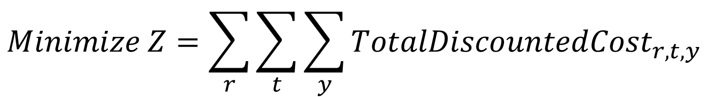



SIMPLIFIED MATHEMATICAL MODEL
$$Minimize Z=\sum_{r}{\sum_{t}{\sum_{y}{{TotalDiscountedCost}_{r,t,y}}}}$$
$$s.t.$$
$$Demand satisfaction$$
Languages: GNU MathProg, Python and GAMS
$$Capacity balance$$
$$Emission limits$$
$$Capacity/Activity constraints$$
$$Other constraints$$
Welcome to the OSeMOSYS’ documentation! — OSeMOSYS 0.0.1 documentation

Slide 21

WHAT DOES OSEMOSYS DO?
Determine the configuration of the energy system with the minimum discounted total cost for a given time period (e.g., 2016 – 2050), considering constraints such as:
Energy supply and demand (e.g., electricity)
Cost and performance of available technologies
Emission reduction objectives and renewable energy generation
Operational limitations
Others

Slide 22
SETS, PARAMETERS AND VARIABLES
Sets
REGION
Parameters
Discount Rate
Variables
New Capacity
YEAR
TIMESLICES
EMISSIONS
COMMODITY
TECHNOLOGY
MODE OF OPERATION
Residual Capacity
Year Split
Accumulated Annual Demand
Specified Annual Demand
Input / Output Activity Ratios
Capital, fixed, variable costs
Emission Activity Ratio
Availability / Capacity Factors
Constraints (Min/Max Capacity, Total Annual/Model Period, Lower/ Upper Activity Limits, etc…)
Total Annual Capacity
Total Annual Production by Technology
Annual Emissions
Annual Technology Emissions
Discounted Capital/Operating Costs
Model Period Discounted Cost
Total Technology Annual Activity
Use by Technology Annual

Slide 23
SETS IN OSEMOSYS
Sets
(Conjuntos)
REGION
YEAR
TIMESLICES
EMISSIONS
COMMODITY
TECHNOLOGY
MODE OF OPERATION
The 'Sets' define the physical structure of a model, typically independent of the specific scenarios that will be run.
They define the time domain and the time division, spatial coverage, technologies, and energy vectors to be considered, etc.

Slide 24
PARAMETERS IN OSEMOSYS
Parameters
Discount Rate
Residual Capacity
Year Split
Accumulated Annual Demand
Specified Annual Demand
Input / Output Activity Ratios
Capital, fixed, variable costs
Emission Activity Ratio
Availability / Capacity Factors
Constraints (Min/Max Capacity, Total Annual/Model Period, Lower/ Upper Activity Limits, etc…)
The 'Parameters' are used to characterize technologies and their processes.
A set of parameters and their input data are what distinguish one technology from others, as well as its position in the model's structure.
They are also used to characterize exogenous demands, emissions, and general assumptions (e.g., discount rate, time partitions).

Slide 25
TRENDS IN ESMs
Trayectorias de descarbonización
(Balyk et al., 2019; Burandt et al., 2019; Carvajal & Li, 2019; Chiodi et al., 2013; Dedinec et al., 2016; Ekins et al., 2011; Godínez-Zamora et al., 2020)
Sistemas basados en bioenergía
(Börjesson et al., 2015; Chiodi et al., 2015; Younis et al., 2020)
Rol de tecnologías
(Kato & Kurosawa, 2021; Hainoun et al., 2010; Yangka & Diesendorf, 2016)
Sistema energético 100% renovable
(Azzuni et al., 2020; Lawrenz et al., 2018; Limpens et al., 2020; Osorio-Aravena et al., 2020)
Seguridad energética
(Hainoun et al., 2010, Glynn et al., 2014, Anwar, 2016, Watts & Martinez, 2012)

Slide 26
Integrated Assessment Models (IAMs)

Slide 27
IAMs
GDP
Economy
Economic results
Population
Energy system
Emissions
Policies
Land and wáter systems
Energy mix
Other assumptions
Climate
Land and water uses
Source: Adapted from Carbon Brief, 2018

Slide 28
CLIMATE, LAND, WATER, ENERGY, ECONOMY NEXUS
 | Climate | Land | Water | Energy | Economy
Climate |  | Precipitations | Precipitations | Renewable energy potential | Attention to climate change consequences
Land | CO2 absortion, GHG emissions |  | Pollution | Biomass to energy | Exports/Imports
Water |  | Water for agriculture |  | Hydroelectric plants, water for cooling, hydrogen generation
Energy | GHG emissions | Energy for agriculture | Pollution, energy for water treatment and management |  | Exports/Imports
Economy |  | Investment, credit, subsidies | Investment, credit, subsidies | Investment, credit, subsidies
Source: Adapted from Ramos et al., 2022

