Slide 1

Model for Analysis of Energy Demand
LECTURE 9 INTRODUCTION TO MAED-EL & ELECTRICITY DEMAND CURVES
Version 2.0
1
Notes:
Licence: This work is licensed under the Creative Commons Attribution 4.0 International License (CC BY 4.0). To view a copy of this license, visit https://creativecommons.org/licenses/by/4.0/.
Attribution: Please cite as: Kiley, F. (2025) An Introduction to Simulating Energy Demand with MAED. Version 1. Climate Compatible Growth Teaching Kit Website, Climate Compatible Growth.

Slide 2

Intended Learning Outcomes (ILOs)
This lecture has four intended learning outcomes:
ILO1: explain the importance of matching electricity supply and hourly demand
ILO2: understand how MAED-EL can help with electric system expansion planning by predicting hourly electricity demand data
ILO3: account for MAED-D predicted growth trends in hourly demand data from a base year using the growth trend deflator
ILO4: calculate seasonal, daily, and hourly modulating coefficients using hourly demand data from a base year
9.1. Electricity supply and demand
9.2. Purpose of MAED-EL
Course Name
9.3 Representing hourly demand
9.4. Time coefficients
Mini Lecture Learning Objective
2
Notes:
This lecture has four Intended Learning Outcomes:
Explain the importance of matching electricity supply and hourly demand
Understand how MAED-E.L. can help with electric system expansion planning by predicting hourly electricity demand data
account for MAED-D predicted growth trends in hourly demand data from a base year using the growth trend deflator
calculate seasonal, daily, and hourly modulating coefficients using hourly demand data from a base year

Slide 3





Lecture 9.1 Electricity supply and demand
The challenge of electricity use
Energy vector
Storage
End-use
3
Notes:
Electricity is an energy vector, or way of moving energy from place to place, that is used to power many modern technologies, from light bulbs to cell phones. One unique challenge of using electricity is storage. Liquid fuels like petroleum and diesel can be stored in tanks until we are ready to use them, and buildings can be heated a few hours before we need them to be warm. However, electricity has to be used right away. This means that electricity has to be generated, transmitted, and distributed at exactly the same time that it is demanded.

Slide 4
Lecture 9.1 Electricity supply and demand
Electricity balance
Electricity supply
Electricity demand
=
At all times!
4
Notes:
The electricity system must always supply enough electricity to meet demand
We have ways to store small amounts of electricity, and significant research efforts are focused on developing affordable technologies to store larger quantities of electricity.
To decide how much electricity generation capacity to build, we need to know how much electricity demand there is likely to be throughout the year. Knowing the average or total annual electricity demand is not sufficient. In order to know the generation and transmission capacities that will be required at each moment in time, we need to know electricity demand for each month, week, day, and hour.
These hourly patterns in electricity demand depend on different factors, like the geography and weather, the population’s lifestyle, electrification level, technologies, and working schedule within the economic sectors.

Slide 5
Lecture 9.1 Electricity supply and demand
Consequences of mismatch
Large electricity grids transport alternating current and are designed for a specific current frequency
Depending on the country, this frequency may be 50 or 60 Hz
If there is more electricity demand than supply, the frequency of the grid will drop
If the frequency of the grid gets low enough, generators will disconnect because they do not match the grid frequency well enough
Generators disconnecting cause blackouts that can go on for hours or even days until the generators are restarted
To avoid blackouts, most grids have load shedding plans to disconnect electricity loads
Planning to match supply and demand is important for keeping the lights on!
5
Notes:
An example of the negative consequences of a demand and supply mismatch is as follows.
Large electricity grids transport alternating current and are designed for a specific current frequency.
If there is more electricity demand than supply, the frequency of the grid will drop.
If the frequency of the grid gets too low, generators may disconnect because they do not match the grid frequency well enough.
Generators disconnecting can cause blackouts that can go on for hours or even days until the generators are restarted.
To avoid blackouts, most grids have load shedding plans to disconnect electricity loads and reduce the demand.
Therefore, planning to match supply and demand is important for keeping the lights on.

Slide 6
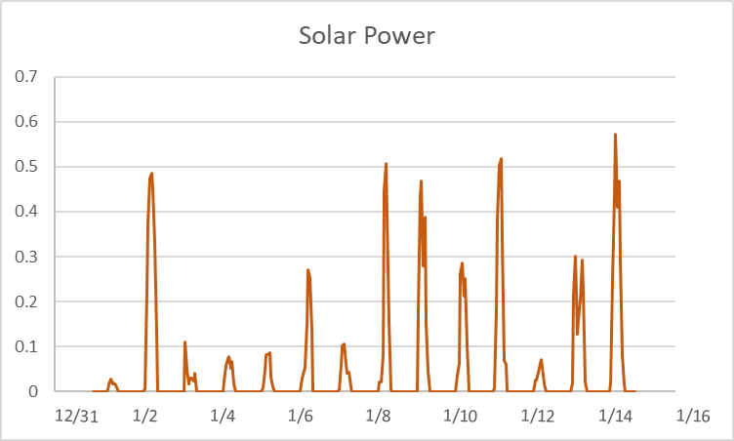
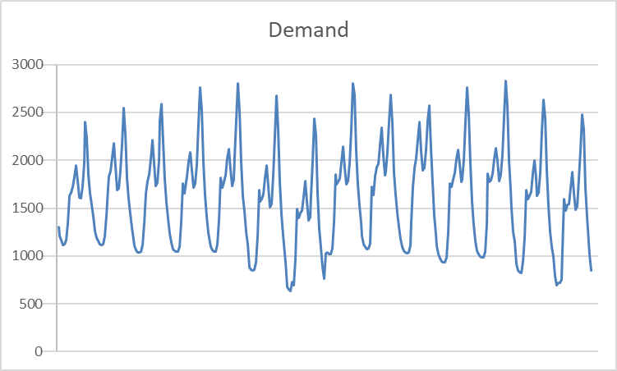
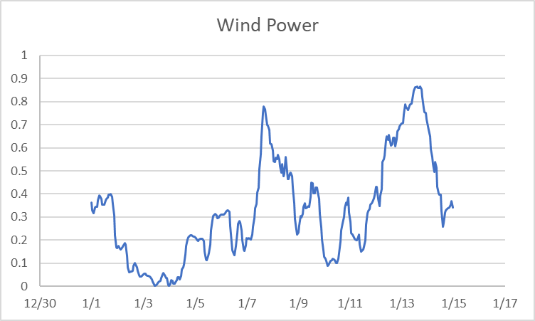
Lecture 9.1 Electricity supply and demand
Intermittent renewables
=
+
?
6
Notes:
Renewable technologies like wind turbines and solar cells have become more important electricity generators as their prices have fallen and decision-makers work to reduce greenhouse gas emissions from fossil fuel powered generators. One of the biggest challenges for wind and solar is that they are intermittent, or non-continuous, sources of power. While electricity demand tends to follow a predictable pattern, wind and solar output changes with the weather and can be difficult to predict more than a few days in advance.
On the left, you can see a graph of electricity demand for the first two weeks of the year, based on the example hourly demand data used in the hands-on exercises. As you can see, the demand follows a consistent pattern each day, with peaks in demand in the morning and evening and less electricity used overnight. Even though the amount of electricity demand changes a little bit from day to day, it is fairly predictable.
Compare the demand data to the graphs on the right. The top graph shows solar power generation from an example 1 kilo watt plant in Oxford, U.K., for the first two weeks of 2015. As you can see, the amount of solar power generated each day depends on whether the weather is clear or cloudy, and no solar power is generated once the sun has set. On a cloudy winter day in the Northern Hemisphere, there can be very little solar power.
The bottom right-hand graph shows wind power generation from an example 1 kilo watt plant in Oxford, U.K., for the first two weeks of 2019. The amount of wind power changes every few days, depending on whether the weather is windy or still.
As we try to meet more electricity demand using wind and solar resources, we have to figure out how to meet consistent demand patterns from intermittent generation.

Slide 7
Lecture 9.1 Electricity supply and demand
Electricity storage and load flexibility
Electricity storage
Current technology
Developing technology
Load flexibility
Shiftable loads
Non-shiftable loads
Pumped hydro
Li-ion batteries
Long-duration batteries
Hydrogen & clean fuels
Thermal energy storage
Compressed air storage
Space heating and cooling
Water heating
Laundry cycles
Computation at data centres
Lighting
Cooking
Kinetic energy storage
EV charging
7
Notes:
One option for meeting consistent electricity demand patterns with intermittent wind and solar power is using electricity storage. Electricity storage allows us to store extra power from wind and solar generation to use when electricity demand is high and renewable output is low.
As mentioned earlier in this lecture, we do have some ways to store electricity. The most common storage technologies used in the electricity grid today are pumped hydro and small devices like lithium ion batteries. Pumped hydro technology is generally limited to geographies where water can be stored in an elevated reservoir. Lithium ion batteries are becoming more common on the electricity grid as their cost has dropped dramatically in the last decade. However, these devices are limited because they cannot store energy indefinitely over long periods of time. Some solutions for affordable, large-scale storage that researchers and entrepreneurs are working on include long-duration batteries, hydrogen and other clean fuels, thermal energy storage, compressed air storage, and other kinetic energy storage.
Another way to match electricity demand with supply from intermittent renewables is to shift the demand, often called load flexibility. While storage shifts electricity supply in time, load flexibility shifts electricity demand in time. This means that certain electricity-consuming activities, such as electric vehicle charging, space heating and cooling, water heating, laundry cycles, and even computation at data centres are rescheduled to happen when there is a lot of renewable electricity generation. Of course, there are certain electricity-consuming activities that customers may be resistant to rescheduling to match renewable generation, such as lighting and cooking. No one wants to be stuck in the dark or with a cold oven waiting for the wind to blow.
In order for load flexibility to be used in an electric system, smart communications systems are needed to allow loads to coordinate with the system. Policies that enable and reward load flexibility are also needed to encourage consumer participation. Data privacy policies are needed to ensure that electricity use information from homes and companies is not misused or stolen.

Slide 8

Lecture 9.2 Purpose of MAED-EL
Intro to MAED-EL
8
Notes:
Now that we have covered the importance of understanding electricity demand profiles, we will consider MAED-E.L..
MAED-E.L. is the second module of the MAED model. It converts projected annual electricity demand into predicted hourly electricity demand curves to help with electric system expansion planning.

Slide 9
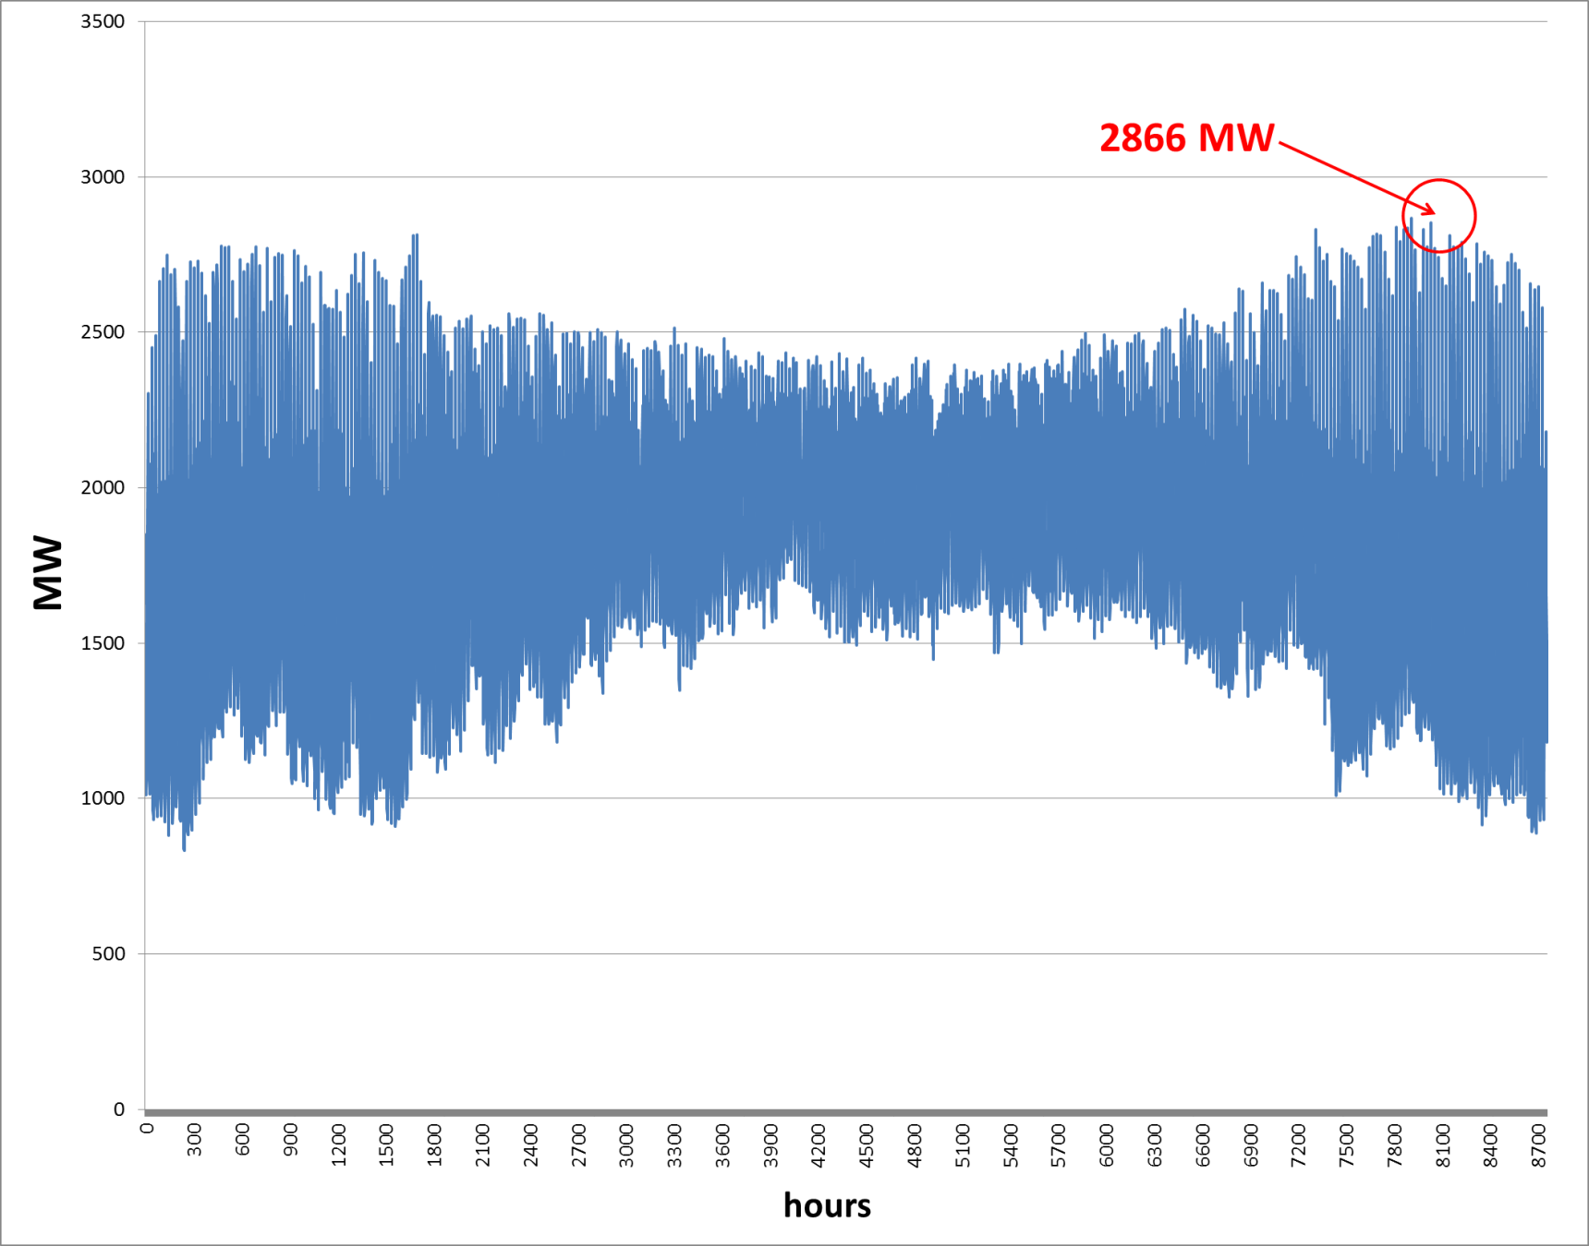
Lecture 9.2 Purpose of MAED-EL
Annual vs. hourly demand
1820 MW
9
Notes:
Why do we need MAED-E.L. to give us the hourly demand profile instead of just using the average electricity load for the year?
The annual electricity demand gives us the average electricity load level during the course of a year, as shown in red on this graph. If we only used this value to assess the graph shown, we would estimate that a capacity of 1,820 mega watts would be sufficient to meet electricity demand for this year, without taking into account reserve capacity. This is the red line.
However, this graph shows the importance of having more detailed information about hour-by-hour electricity load information, shown in blue on the graph. This data shows the huge range of electricity demand throughout the year. It is particularly important that, for a large part of the year, demand is above the average. If we built an electricity system with 1,820 megawatts of generation capacity, it would be unable to meet electricity demand for nearly half of the year!
Also notice that the peak electricity demand reaches a maximum value of 2,866 megawatts. This means that nearly 1,000 megawatts more generation capacity is needed to meet peak demand than we estimated using just average electric load.
As this example shows, using just the average electricity demand to calculate the capacity requirements for the electricity generation system will lead to an underestimation of real requirements. The large difference in generation capacity requirement estimates shows how important it is to use hourly electric load for electric system expansion planning. For this reason, hourly electricity demand is crucial input data for models that determine the necessary characteristics of the electricity generation system for system expansion planning.

Slide 10
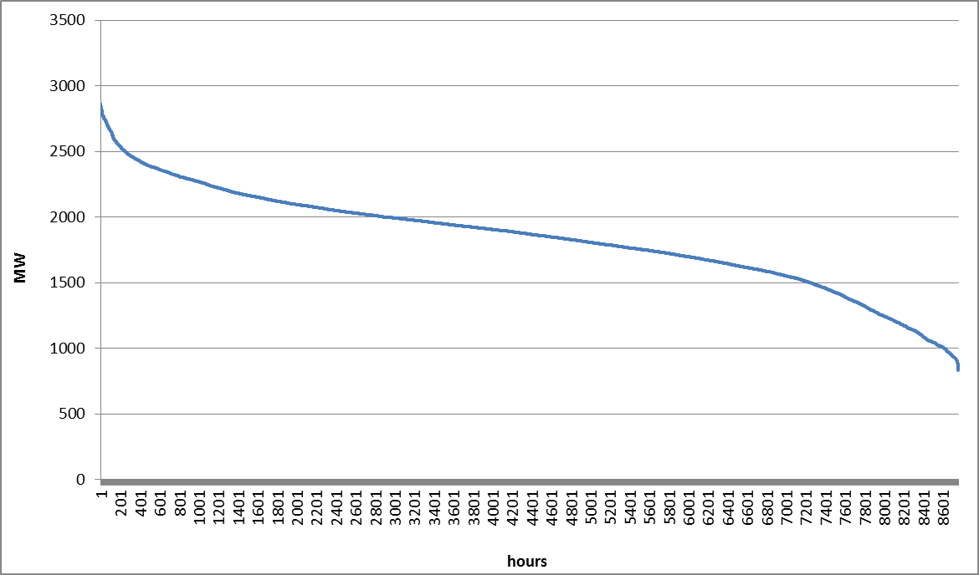
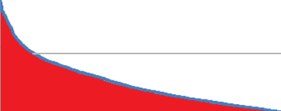
Lecture 9.2 Purpose of MAED-EL
Load curves and load duration curves
Load curve
Load duration curve
2000 MW
Same data, same axes
2918 hours
Chronological order
Ranked by demand level
10
Notes:
A load curve shows electricity demand variations in chronological order, that is, in the order that they happen, during a certain period. Load curves are useful for identifying patterns in electricity demand and understanding when demand is high.
A load duration curve shows the same electricity demand data ranked from highest to lowest demand instead of in chronological order. Load duration curves are useful for identifying the amount of time that the demand is within a certain range. This information is useful for determining how long you will need to run a generator that is built to meet the maximum demand, and how much electricity generation you will always have to run.
We can use the load duration curve to do quick analysis of demand behaviour during the year. For example, we can easily see that demand is above 2,000 megawatts, or 70 percent of peak demand, for about 2,900 hours (2,918 hours to be exact), or 33 percent of the year. This information could help in estimating how often the electricity system is under high stress to schedule infrastructure maintenance and replacement.

Slide 11
Lecture 9.2 Purpose of MAED-EL
Where MAED-EL fits into electricity system planning
MAED-D
Projected annual demand
MAED-EL
Projected hourly demand
WASP
Optimal electricity generation expansion plan
Electricity System Planning
11
Notes:
This slide shows you where the MAED-E.L. module fits into the electricity system planning process. MAED-E.L. takes the projected annual demand from MAED-D, covered earlier in this course, as an input. In the following slides, you will learn how to use MAED-E.L. to create projections of hourly electricity demand.
These projections can then be exported into the format used by WASP, the Wein Automatic System Planning Package, to help find the optimal expansion plan for an electric power generating system. Hourly demand projections can also be exported into Excel for use in the electricity system expansion planning software of your choice.

Slide 12
Lecture 9.2 Purpose of MAED-EL
How MAED-EL models demand in an electricity system
Nation
Industry
Steelmaking
Agriculture
Household
Service
National demand
Sector demand
Other
Transport
Personal
Freight
Client demand
12
Notes:
The hourly electricity demand in MAED-E.L. can be estimated for the economic sectors considered in MAED-D: Industry, Household, Service, and Transport, or for sectors that the user defines in the case that is being developed in MAED-E.L..
MAED-E.L. also allows us to calculate the hourly electricity demand for clients within the sectors. This means that the user can split the annual energy demand of each sector into different subsectors or client groups in order to describe the differences in power demand and load patterns among these users.
Splitting demand into sectors and clients allows us to account for how the predicted growth in demand in some industries and predicted decrease in demand from other industries affects the national hourly demand profile.

Slide 13
Lecture 9.3 Representing hourly electricity demand
Steps for predicting hourly electricity demand
Predicting hourly electricity demand in MAED-EL
Reconstruction of base year hourly demand
Scenario development
Results analysis
13
Notes:
Using MAED-E.L. to predict hourly electricity demand involves 3 steps.
First, the user reconstructs the hourly demand for a historical base year for which they already have hourly demand data. This process involves using the demand data to calculate the modulating coefficients that MAED-E.L. uses to represent hourly demand. The user should ensure that the output from MAED-E.L. matches the actual demand data, understanding that there may be a margin of error.
Next, the user should input their scenario assumptions into MAED-E.L.. Scenario assumptions include the sectors and clients to model, the time patterns that impact electricity consumption, and other information about electricity use.
Finally, one must analyse the hourly demand projections to ensure that they seem reasonable and agree with other demand projections, as well as understanding how your scenario assumptions impact projected demand.
In the remainder of this mini-lecture, you will learn how MAED-E.L. represents hourly demand so you can reconstruct base year demand from hourly data.

Slide 14
Lecture 9.3 Representing hourly electricity demand
Steps for predicting hourly electricity demand
Input: Average annual demand
Growth trend
Seasonal variations
Increasing time detail
Weekly variations by day
Daily variations by hour
Result: Hourly load
14
Notes:
The annual electricity demand of a given client is converted into the hourly electricity demand for that client using the following factors:
The demand growth during the course of the year.
The variation by season, which could be semesters, quarters, months, or weeks, or other time divisions during the year.
The variation on different types of days, such as working days, weekend days, and holidays.
The hourly variation at different times of day.
Each of these factors is represented by a load-modulating coefficient. These load-modulating coefficients allow MAED-E.L. to convert the annual electricity demand of a client into demand load of the client in a given hour, day, and week of the year.
The average growth rate of electricity demand can be found from the results of MAED-D or can be defined by the user.
The seasonal variation coefficients are defined for each week or other period in a year.
The weekly variation coefficients are defined by days in each week.
The daily variation coefficients are specified for 24 hours in each type of day defined.
To find the electricity demand of a client for a particular hour, the product of all of these coefficients are multiplied by average electricity demand for that client and adjusted with annual demand growth. Therefore, knowing all these coefficients for a client in a year allows us to calculate the chronological hour-by-hour electricity demand for all the 8,760 hours of that year. This calculation is repeated for each client, and the load for the same hour for all clients in a sector can then be added to calculate the hourly electricity demand for that sector. Adding the demand from all sectors gives the total hourly load values on the power system in a particular year.

Slide 15
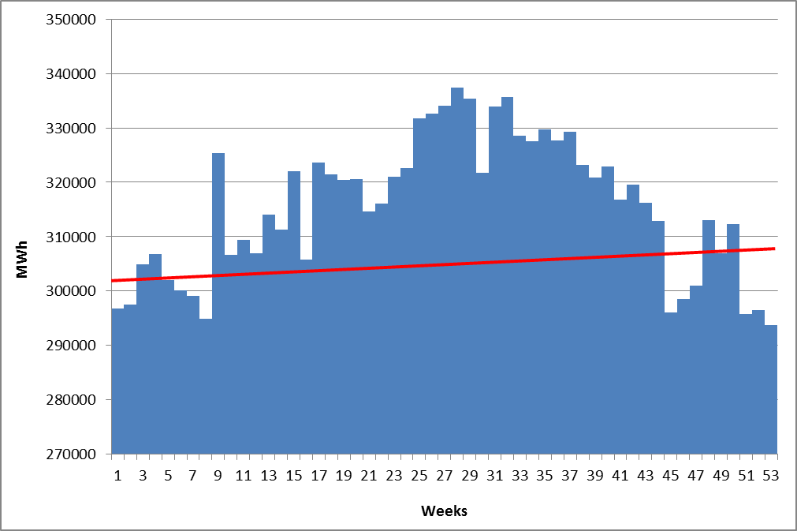
Lecture 9.3 Representing hourly electricity demand
Demand growth trend
With growth trend
15
Notes:
In the next mini-lecture, we will explore how to find these modulating coefficients from the hourly demand data for a base year. Before finding these coefficients, one must account for growth in demand over the base year. As shown in this load curve with weekly energy consumption for a year, electricity demand grows slightly throughout the year, shown by the red line. This growth may be due to factors like population growth, increased electrification, and growth in appliance use.

Slide 16
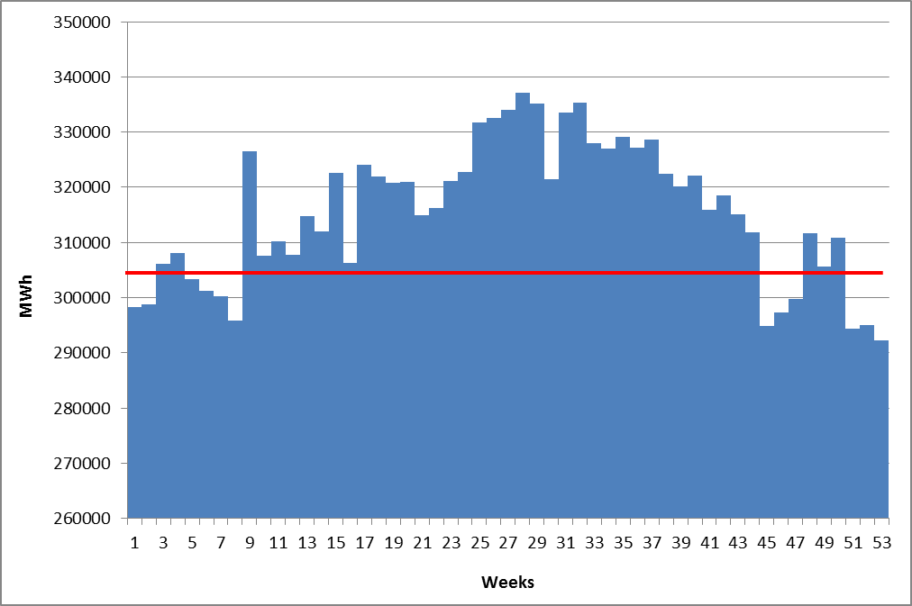
Lecture 9.3 Representing hourly electricity demand
Growth trend deflator visualization
With growth trend
Without growth trend
16
Notes:
In order to account for demand growth over the base year, we will use the growth trend deflator. The growth trend deflator for a given year is a single value that represents the demand growth between the year of interest and the next year. The red line on the left graph shows the linear growth trend. To see the effect of removing this growth, compare the load curve on the left, which shows the weekly energy consumption and growth trend, and the graph on the right, which shows the same load curve with the growth trend removed. Accounting for load growth allows us to see trends more accurately, such as the high level of demand in the summer weeks and lower levels of demand in winter weeks.

Slide 17
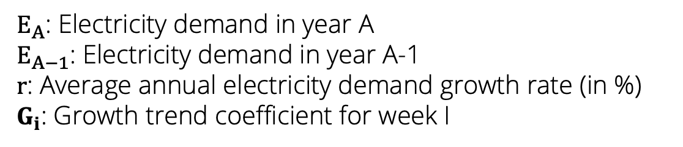
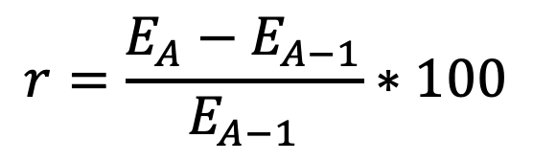
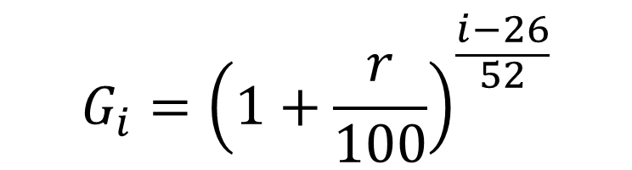
Lecture 9.3 Representing hourly electricity demand
Growth trend deflator calculation
$$G_{i}={\left(1+\frac{r}{100}\right)}^{\frac{i−26}{52}}$$
$$r=\frac{E_{A}−E_{A−1}}{E_{A−1}}∗100$$
Where:
$E_{A}$: Electricity demand in year A
$E_{A−1}$: Electricity demand in year A-1
r: Average annual electricity demand growth rate (in %)
$G_{i}$: Growth trend coefficient for week I
17
Notes:
In MAED-E.L. the week has been selected as the elementary time unit for representing the seasonal variations, so the growth trend deflator as well as the seasonal coefficients should be calculated on a weekly basis. Because the first and last week of the year may not be complete weeks, 53 values for the growth trend deflator should be calculated.
The growth trend deflator (or G.i.) for each week i is calculated as shown in the first equation. i is the week number, and r is the average annual electricity demand growth rate, in percent, between the previous year, A minus 1, and the current year, A.
The average annual electricity growth rate is specified by the user for the first year and the programme calculates it for the rest of the study years from the MAED-D results.

Slide 18
Lecture 9.4 Modulating coefficients
Subscripts
Subscript | Meaning | Values
 | Week number of year | 1…53
 | Day type of week | 1…7
 | Season of the year | (specified by user)
 | Client | (names of clients)
 | Hour of the day | 1…24
i
id
is
ic
h
18
Notes:
In this mini-lecture, we will use a number of subscripts to specify the time frame or client that a coefficient applies to. In order to avoid confusion, here is a preview of the subscripts that we will use in this lecture.
i denotes the week number of the year, from 1 to 53 (accounting for incomplete weeks)
i.d. denotes the day type of the week, 1 to 7.
i.s. denotes the season of the year, as specified by the user. We’ll talk more about designating seasons next lecture.
i.c. denotes the client that the coefficient applies to, from the list of clients that the user inputs.
h denotes the hour of the day, from 1 to 24.

Slide 19






Lecture 9.4 Modulating coefficients
Seasonal coefficients
Where:
i: number of weeks in the year (1…53)
$E_{i}$: Electricity demand in week i
$G_{i}$: Growth trend coefficient for week I
AWC: Average weekly consumption
$S_{i}$: Seasonal coefficient
$$\frac{E_{i}}{G_{i}}$$
$$E_{i}^{′}=$$
$$AWC=\frac{1}{53}\sum_{i=1}^{53}{E_{i}^{′}}$$
$$S_{i}=\frac{E_{i}^{′}}{AWC}$$
$$\sum_{i}{S_{i}=53}$$
19
Notes:
In order to determine the seasonal coefficients for each week, the first step is to remove the growth trend.
As shown in the first equation, we do this by dividing the electricity demand in week i, E.i., by the growth trend deflator for the same week, G.i.. This calculation gives us a new value, E.i prime, which is the electricity demand in week i without the growth trend.
Then, we calculate average weekly consumption for the year, using these new values for the weekly electricity demand. Average weekly consumption, A.W.C., is the sum of the weekly electricity demand values for the entire year divided by the total number of weeks, 53.
Once the average weekly consumption, A.W.C., and the weekly electricity demand, E.i prime, are known, we can define the seasonal coefficients S.i., by dividing the electricity demand in each week by the average weekly consumption.
The overall summation of the seasonal coefficients must be equal to 53.

Slide 20



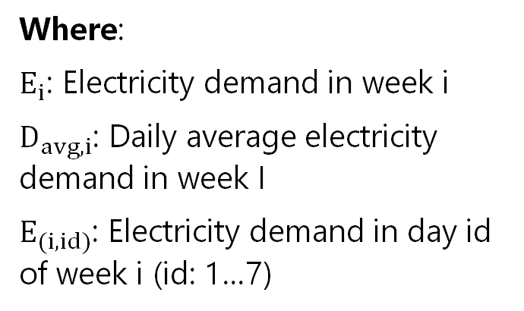


Lecture 9.4 Modulating coefficients
Daily coefficients
Where:
$E_{i}$: Electricity demand in week i
$D_{avg, i}$: Daily average electricity demand in week I
$E_{(i,id)}$: Electricity demand in day id of week i (id: 1…7)
$$\frac{E_{i}}{7}$$
$$E_{avg, i}=$$
$$\frac{E_{(i,id)}}{E_{avg,i}}$$
$$D_{(i,id)}=$$
$$\sum_{i}{D_{(i,id)}}=7$$
20
Notes:
Next, we calculate the daily coefficients. These coefficients reflect the fluctuations in electricity demand due to the type of day, such as Monday, Tuesday, weekday, or holiday. The daily coefficients should be defined for each day of the week.
As shown in the first equation, the first step is to calculate the daily average electricity demand, E average i, for the week i. We find E average i by dividing the electricity demand in week i by 7, the number of days in a week.
Then we find the daily coefficients, D.i.i.d., by dividing the electricity demand of the day i.d. in week i, E i.i.d., by the daily average electricity demand of the week i, E average i, as shown in the second equation.
As noted in the third equation, the sum of the daily coefficients in each week must be equal to 7.

Slide 21


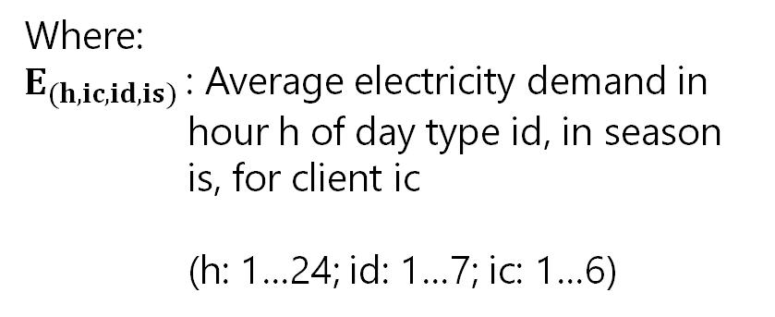

Lecture 9.4 Modulating coefficients
Hourly coefficients
$$\frac{E_{(h,ic,id,is)}}{\left(\frac{\sum_{h=1}^{24}{E_{(h,ic,id,is)}}}{24}\right)}$$
Where:
$E_{(h,ic,id,is)}$: Average electricity demand in hour h of day type id, in season is, for client ic
(h: 1…24; id: 1…7; ic: 1…6)
$$H_{(h,ic,id,is)}=$$
$$\sum_{h}{H_{(h,ic,id,is)}}=24$$
21
Notes:
The objective of the hourly coefficients is to allocate the energy demand over the 24 hours of the day. For each hour of the day, a coefficient will be given according to the demand level in that hour.
Thus, the hourly coefficient, capital H, is calculated as the average electricity demand, capital E, in the hour h of the day i.d., in season i.s. for client i.c., divided by the average hourly electricity demand, capital E, of the day i.d., in season i.s. for client i.c..
The sum of the hourly coefficients of each day must be equal to 24.

Slide 22




Lecture 9.4 Modulating coefficients
Steps for predicting hourly electricity demand
Input: Average annual demand
$$G_{i}$$
Growth trend
$$S_{i}$$
Seasonal variations
Increasing time detail
$$D_{i,id}$$
Weekly variations by day
$$H_{h,ic,id,is}$$
Daily variations by hour
Result: Hourly load
22
Notes:
Now we’ve seen how you can calculate coefficients to account for time variation in demand.
The growth trend over the year is represented using the growth trend deflator capital G for each week i.
Seasonal variations are accounted for with the seasonal coefficients capital S for each week i.
Daily variations are represented using the daily coefficients capital D for each week i and each type of day i.d..
Finally, hourly variations are accounted for with the hourly coefficients capital H for each of the 24 hours in a day h, each client i.c., each type of day i.d., and each season i.s..
This concludes lecture 9 which provided an introduction to MAED-E.L. and the electricity demand curve.
In the next lecture, you will learn how MAED-E.L. uses these coefficients to calculate hourly electricity demand profiles for each client, sector, and the entire system.

Slide 23

Cannone, C., Collett, K.A., Charbonnier F., Ahsan A., Halloran C., Vijay,A.,Berdellans I., Hasanovic S., Gritsevskyi A,Stankeviciute L., Tot M.; Welsch M., Hirmer S., 2023. Lecture 9: "INTRODUCTION TO MAED-EL & ELECTRICITY DEMAND CURVES" , Energy Demands Projections with MAED (Model for Analysis of Energy Demand). Release Version 2.0. [online presentation]. Climate Compatible Growth & Programme and International Atomic Energy Agency.
CCG courses (this will take you to the website link http://www.ClimateCompatibleGrowth.com/teachingmaterials)
23

