Slide 1

Model for Analysis of Energy Demand
LECTURE 8
INPUT DATA CONSISTENCY AND STRUCTURE
Version 2.0
Notes:
Licence: This work is licensed under the Creative Commons Attribution 4.0 International License (CC BY 4.0). To view a copy of this license, visit https://creativecommons.org/licenses/by/4.0/.
Attribution: Please cite as: Kiley, F. (2025) An Introduction to Simulating Energy Demand with MAED. Version 1. Climate Compatible Growth Teaching Kit Website, Climate Compatible Growth.

Slide 2
Intended Learning Outcomes (ILOs)
This lecture has four Intended Learning Outcomes (ILOs):
ILO1: obtain an overview of the input data approach of the MAED software
ILO2: learn about the structure of the input data
ILO3: learn about specific examples for obtaining input data parameters
ILO4: understand how the input data can then be implemented
8.1. Overview of Input Data for MAED
8.2. Structure of Input Data
8.3. Examples of Input Data
8.4. From Data Collection to Implementation
2
Notes:
This lecture has four Intended Learner Outcomes:
To obtain an overview of the input data approach of the MAED software
To learn about the structure of the input data
To learn about specific examples for obtaining input data parameters
And to understand how the input data can then be implemented.

Slide 3


Lecture 8.1 Overview of input data for MAED
Challenges for input data preparation in MAED
Being an end-use type model, MAED requires a considerable amount of input data
List of input data definitions and units in user manual
Delete all data when using the model for the first time in your country
Key issue: consistency of data → Use separate files for input data preparation
3
Notes:
As MAED is an end-use type model, it requires a considerable amount of input data. Be aware that the input data must be entered in to the model in the units specified for each parameter. The input variables and their units are listed and defined in chapter 4 of the MAED manual over 19 pages. This large number of pages indicates the size of the task of data preparation. Moreover, the amount of data is heavily dependent on the number of subsectors defined by the user.
It must be remembered that all input data, should be typed manually in the white cells. To avoid accidentally using data from the “Demo case Manual data” provided as an example with the program, we recommend deleting all data when using the model for the first time in your country.
One of the key issues in the process of data preparation is consistency of the data. MAED does not have any internal mechanism to check it. The user should be very careful and pay attention to this issue.
For this reason, it is highly recommended to use a separate file with sets of information for input data preparation. Only after verification of consistency of data in various tables should the data be entered into the corresponding cells of MAED.
You can build a file with information from different sources to prepare all the input data needed following the main structure of MAED. Please be aware that MAED has been updated throughout the years and different versions are labelled with version numbers.

Slide 4
Lecture 8.1 Overview of input data for MAED
Input data sources
Data from general statistical information | Data requiring analysis | Data that can be derived | Data that relies on assumptions
GDP and GDP structure Demographic data Car ownership Number of houses | Energy balance by sectoral end-use Efficiencies of processes and equipment Load factors of transportation modes | Energy intensities of specific processes Household size by type of dwelling Mobility of the population | Assumptions based on, Surveys, Direct measurements, Judgment of experts Share of traditional biomass in industry Heat by temperature level in a given industry Energy intensity for cooking
4
Notes:
Acquiring input data may be more or less straightforward. There are four main types of input data:
Firstly, some data could be directly obtained from general statistical information. Among them are G.D.P. and its structure, most demographic data, car ownership, number of houses, and so on.
Secondly, input data may require analysis of different sources at the level of activity. For example, energy balance by sectoral end-use, efficiencies of various technological processes and equipment, load factors of different transportation modes, and so on.
Thirdly, there are data that do not exist in statistical information at all but that could be calculated from available information. For example, energy intensities of specific processes can be derived from information on G.D.P. and energy consumption from the energy balance. Other examples include deriving household size or number of people per family by the type of dwellings or economic stratus, mobility of population, and so forth.
Finally, there are some other data which an only be evaluated using assumptions based on various surveys, direct measurements, professional judgment of experts, and or a combination of these.
Examples are the share of traditional biomass in the industry, the share of heat by temperature level in a given industry, and the energy intensities for cooking.

Slide 5
Lecture 8.1 Overview of input data for MAED
            Execution of MAED study
            Reconstruction of the energy consumption in the base year. Total energy
            consumption by sectors, by end-use, and by energy carriers. Consumption
            output from the MAED model must be equal to actual data in the base year.
            Establishing scenarios of economic, social, and technological development.
            Analysis of energy demand projections arising from the scenarios.
1. Base year reconstruction
2. Scenario development
3. Results Analysis
5
Notes:
The remainder of this mini-lecture will provide a recap of what was discussed in lecture 6.4.
The execution of a MAED study consists of three phases:
First: Reconstruction of the energy consumption in the base year. The MAED model output structure and quantities must be equal to the country’s actual consumption in the base year.
Second: Establishing scenarios of economic, social, and technological development.
And finally: Analysis of energy demand projections arising from the scenarios.
Accordingly, the input data should be collected for the first two steps.
Phase one. Base year input data. These data are defined on the basis of real consumption in this year.
Phase two: The scenario input data. Data for future years are prepared on the basis of establishing scenarios of economic, social, and technological development.

Slide 6
Lecture 8.1 Overview of input data for MAED
            Base year selection and reconstruction
            The base year must be selected from a most recent year in the past for which energy and economic statistics are available, reliable, and consistent.
            The base year should represent stable conditions of energy consumption.
            Unusual situations should prevent a year from being selected.
1. Base year reconstruction
2. Scenario development
3. Results Analysis
Gather/Adjust MAED parameters for the base year
Compute Input Data for the base year
Check accuracy of MAED results for the base year
Run the MAED model
6
Notes:
The value of specific energy consumption for the base year is a crucial parameter for estimation of the future energy demand. This makes the selection of the base year a very important issue.
There are several criteria for the selection of the base year. Firstly, the base year must be selected from the most recent year in the past for which energy and economic statistics are available, reliable, and consistent. Secondly, the base year should be selected to represent stable conditions of energy consumption. Finally, if unusual situations, like an economic crisis, extreme climatic conditions, or a political crisis, occurred during a given year, it should not be selected as a baseline.
To reconstruct the base year, an iterative process is adopted. First, statistical data on energy consumption by sectors, by end-use, and by fuels for the selected base year should be gathered. Then, MAED input data for the base year, are calculated. The MAED model is in turn run with this input data. The MAED results are compared with statistical values for that year. In case of discrepancy, the procedure should be repeated with adjusted MAED parameters.
The objective of this phase is to establish a benchmark and to validate the program for the energy system of the specific country.
When defining the base year, the user must decide the units they will use in their model.
Each time the user creates a case, we recommend entering the case study description or some special feature of the problem they are studying for record keeping.

Slide 7
Lecture 8.1 Overview of input data for MAED
            Types of data
Base year reconstruction
Scenario development
Energy demand projections
Economy
Demography
Lifestyle
Technology
GDP
GDP growth rate
Share of subsectors
Labour Force
Population Growth rate
Size of family
Urbanization
Household size
Mobility
Car ownership
Electrification
Appliances
Energy intensities
Specific energy
consumptions
Efficiency
Market penetrations
7
Notes:
Following the completion of the first stage of the study, the reconstruction of the base year energy consumption, the user may move to the second stage: development or construction of the scenarios.
A scenario in MAED is a set of parameters describing a possible long-term pattern of a country's development, including such aspects as its economic, demographic, social, and technological situation.
The amount of input data for MAED is relatively large, as for all disaggregated type models. This is the price to pay for the ability to provide reasonably detailed output information.
All input data belong to one of four groups. Economy, demography, lifestyle, and technology.
Each group has its own set of input data.
Economy will comprise G.D.P., its growth rate, and the structure of the economy in terms of G.D.P. share of each sector. Labour force is also needed.
Demography will comprise population, population growth rate, share of urban and rural population, and family size. Lifestyle will comprise size of the dwellings, mobility, car ownership, electrification, and use of appliances. Technology input data comprise energy intensities in all sectors, efficiency of end-use equipment and processes, and market penetration of different technologies and energy carriers.

Slide 8
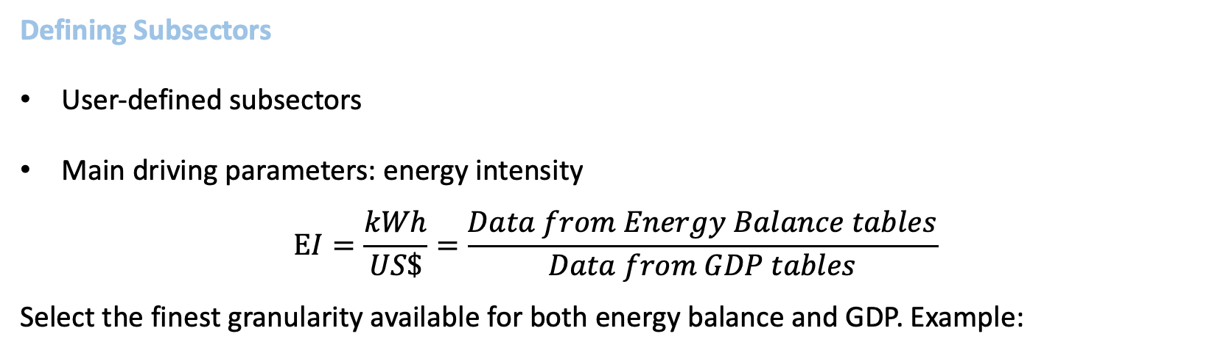
Lecture 8.2 Structure of input data
Defining Subsectors
User-defined subsectors
Main driving parameters: energy intensity
$$EI=\frac{kWh}{US\$}=\frac{Data from Energy Balance tables}{Data from GDP tables}$$
Select the finest granularity available for both energy balance and GDP. Example:
Sector
Industry
Service
Household
Transport
Subsector
Agric.
Constr.
Mining
Manufact.
Passenger
Freight
Materials
Equipment
Non-durables
Miscell.
8
Notes:
Within each sector, using the add or delete buttons, the user decides the number of subsectors to model, and the user writes the subsector names.
By default, all sectors must have at least one subsector. The delete option is not available for the first subsector of each sector.
After this has been done, the following question presents itself: What criteria should the user employ to define the number of subsectors?
Data from different sources will help us in defining the number of subsector in each sector. In all these subsectors the main driver will be energy intensities. And to find energy intensities we have to divide energy consumption by the value added. It means data from an energy balance is divided by data from G.D.P. tables.
Data on G.D.P. must have the same disaggregation level as the data on energy balance. The user is therefore limited by the coarser granularity available.
Once the subsectors are defined, all input data tables should reflect the new structure of the model, for both the economic data and the technical data.
According to the selection of subsectors, the structure of the MAED model is modified, as reflected in the shape of the input data and results tables.

Slide 9
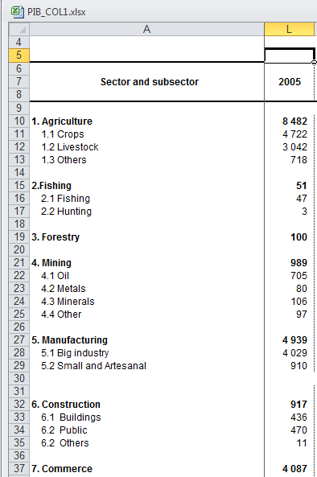
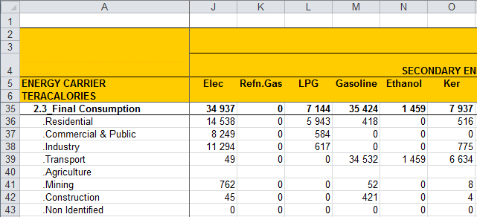
Lecture 8.2 Structure of input data
Subsector disaggregation example
Subsectors should be compatible with both GDP and energy balance data
Take the coarser resolution
9
Notes:
It may be the case that the user has a thorough disaggregation of G.D.P. data. However, they may have very low disaggregation for the energy balance. This is what the data tables might look like. If subsector data is available for the energy balance but not the G.D.P., one cannot define all the subsectors. The user should therefore select the finest granularity that is available for both energy balance and G.D.P..
Let’s take the Construction sector to develop an example. In this case, on the left table we have good information on G.D.P., where the value added is divided into Buildings, Public Construction, and others. But there is no such disaggregation of the energy consumption in the right-hand table. We are, therefore, limited by the coarser granularity available and must work with the total value added of the construction subsector to make these two sets of data compatible.

Slide 10
Lecture 8.2 Structure of input data
Disaggregation for transport sector
Transport type | Recommended maximum number of modes | Recommended maximum number of fuel
Passenger (national level) Intercity Urban | 15 5 car type 10 public modes | 8 8 8
Freight (national level) | 15 | 8
International | 1 aggregated type | 1 aggregated type
10
Notes:
Over the next few slides we will discuss two specifics of input data. Firstly, disaggregation of the transport sector and secondly, data sources.
For the transport sector, there are some recommendations the user should be aware of. It is suggested that no more than 15 modes should be defined for the intercity sector and the national freight subsectors, and no more than 5 car types and 10 public modes in the urban subsector. Only one aggregated type is defined for international travel.
International and other miscellaneous fuel consumption in transport is calculated as a linear function of total G.D.P.. Coefficients are found fitting historical data.
The energy demand is met by competing modes: Car, bus, plane, truck, train, etc. The specific energy needs, and load factors of each mode, are specified. For passenger transportation in urban and intercity, and for freight transportation, at least one transport mode must be defined.

Slide 11
Lecture 8.2 Structure of input data
Data source: Office for National Statistics data
Census
Size of the dwellings in terms of person per households, in both rural and urban areas
Population in large cities
Some other data that can be used to characterize the lifestyle
If the population growth rate is given, it can be used to set up the demography base scenario
Distribution of the population by ages, or groups of ages
Economy
Demography
Lifestyle
Technology
11
Notes:
Secondly, data sources must be carefully considered.
One important source of data is the Office for National Statistics, or similar institutions. These kinds of entities get and maintain a lot of information about the country. Usually, they have the official demography data. In some cases, they also have information of surveys in various sectors that can be used in data preparation for MAED. From this source most of the demography and lifestyle groups of data can be found.
Normally, it is given by the Office of National Statistics, and it is derived from the census. This office also will provide the size of the dwellings in terms of person per households, in both rural and urban areas, the population in large cities, and some other data that can be used to characterize the lifestyle. If the population growth rate is given, it can be used to set up the demography base scenario.
The office of statistics should also have the distribution of the population by ages, or groups of ages. This information can be used to find the labour force, which is another parameter needed by MAED and is included in the Demography data sheet. You must be careful about legislation in your country, regarding minimum and maximum legal ages to be included in the labour force.

Slide 12
Lecture 8.2 Structure of input data
Data source: Central Bank and Ministry of Energy
Central bank
GDP
Economic targets of the government
Ministry of Energy
Energy balance
Ministry of Transportation:
e.g., freight data statistics
Economy
Demography
Lifestyle
Technology
12
Notes:
The Ministry of Energy and the Central Bank of the country are also important sources of data.
Normally the central bank gives G.D.P. growth rates, as well as some economic targets of the government. This data can be used to set up the G.D.P. base scenario.
The Ministry of Energy will provide the energy balance.
For transportation, economic, and technical data, the Office of National Statistics, the Ministry of Transportation, or a specialised organization in transport should have the data needed. The transport sector data is not easy to find or interpret. The energy planner must ask for support from experts in transport.
With these pieces of information, we can build most of the figures needed for the other groups of data. Namely, all economic data, base year market penetration of different energy carriers, and energy intensities.
Most MAED input data are related to technology. In general, the data depend largely on each country's conditions, and we cannot provide a list of default values​​. For this reason, the user must calculate many values ​based on information from the energy balance and other energy-related databases, information from surveys, measurements, and sometimes expert judgements.

Slide 13
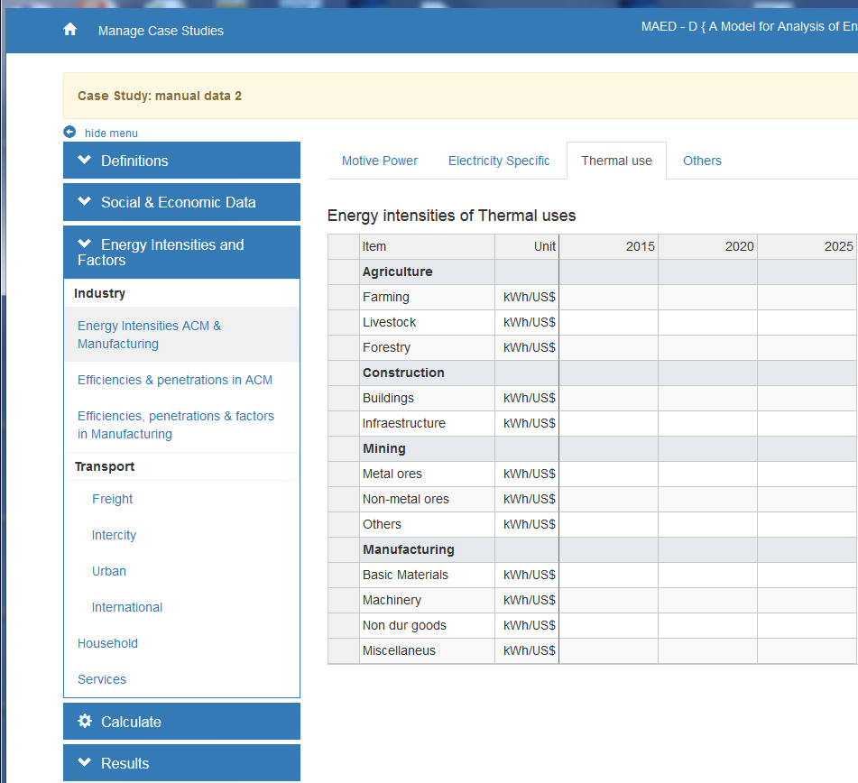
Lecture 8.3 Examples of input data
Industry sector
Industry
Subsector
Agriculture
Construction
Mining
Manufacturing
Materials
Equipment
Durables
Miscellan.
End-Use
Specific Use of Electricity
Heat for Thermal Use
Motive Power
Final energy form
Feedstock/Coke
Electricity
Heat Pump
Heat from Cogeneration
Motor Fuel
District Heat
Solar System
Fossil Fuels
Traditional & Modern Biomass
13
Notes:
In this mini-lecture, we discuss some examples of input data.
The first group of data, in MAED, are the Energy Intensities in the Industry. We will choose one subsector to perform the calculations. The user can use the same methodology to reproduce calculations in the other subsectors. There is one table to fill in for each end-use: specific uses of electricity, thermal uses, and motive power. For specific uses of electricity and motive power there is only one category of final energy carrier to be considered and he equations used in the calculations are in terms of final energy. There is no need to deal with efficiencies. For the thermal uses, almost all energy carriers in the category of final energy can be considered. Only motor fuels can not. In this case, we must deal with efficiencies and market shares.

Slide 14
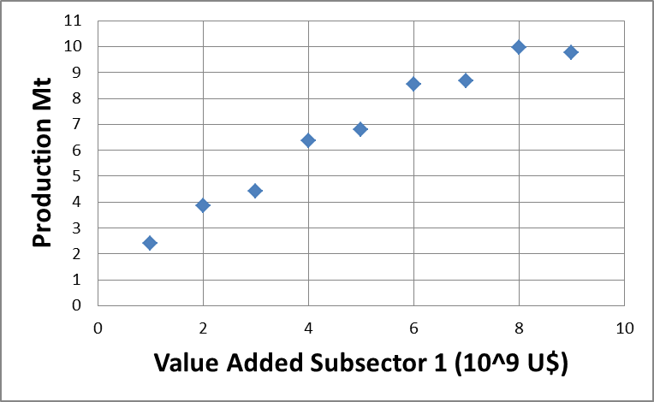
Lecture 8.3 Examples of input data
Steel and petrochemical industries: linear fit
Industry
const. (1.46)
Subsector
Agriculture
Construction
Mining
Manufacturing
Slope = var. (1.91)
Materials
Equipment
Durables
Miscellan.
End-Use
Specific Use of Electricity
Heat for Thermal Use
Motive Power
Final energy form
Feedstock/Coke
Electricity
Heat Pump
Heat from Cogeneration
Motor Fuel
District Heat
Solar System
Fossil Fuels
Traditional & Modern Biomass
14
Notes:
In the last input table of MAED for the manufacturing subsector, specific factors of the steel and petrochemical industries are needed. The steel production and feedstock requirements of the petrochemical industry are calculated in the model as a function of the value added of the first Manufacturing subsector. They are calculated using a linear equation, with the value added as an independent variable. Coefficients are found by fitting a linear trend on historical data. The first coefficient is the intercept of the line, expressed in millions tons of steel or feedstock. The second is the slope of the line, expressed in million tons of steel or feedstock per thousand millions of monetary units of value added.

Slide 15
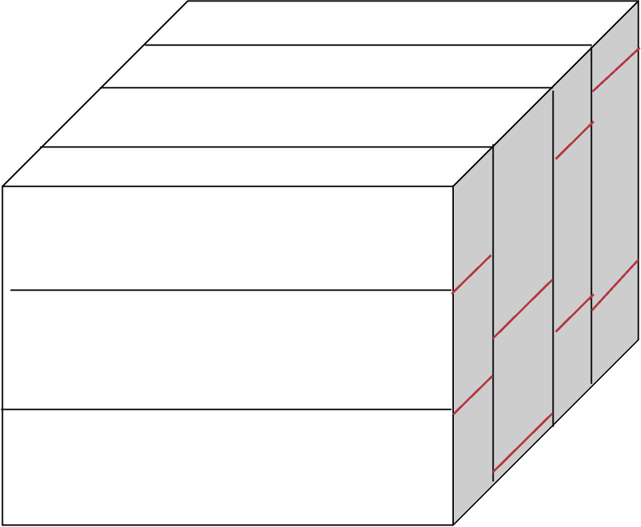
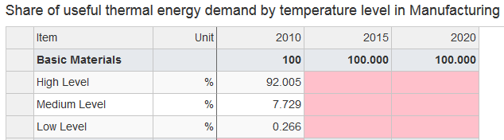
Lecture 8.3 Examples of input data
SL + SM + SH = 1
Miscellaneous
SH
Thermal uses for manufacturing
Durables
Equipment
SM
Materials
Furnaces
(High)
SL
Steam generation
(Medium)
Space / water heating
(Low)
Process of Thermal Use
15
Notes:
There is one extra step we must cover in the manufacturing subsectors. According to the MAED methodology, in manufacturing, three ranges of thermal uses are defined. Low temperature, for space and water heating. Medium temperature, for steam generation. And high temperature for industrial furnaces.
Each subsector has its own industrial processes. For this reason, in each subsector needs for low, medium, and high temperatures are different. The share of useful thermal energy demand by each subsector should be separated by temperature range.
In each subsector, the sum of the shares of low, medium, and high temperatures must equal 1. In the new version of MAED, the user can choose which levels will be modelled. The useful energy, by temperature range, is also converted into final energy, taking into account the penetration and the efficiency of each alternative energy source.
A screenshot from the MAED software illustrates how the values may be input.

Slide 16
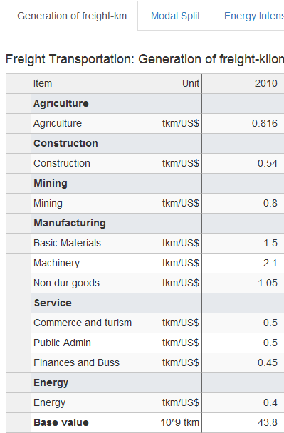
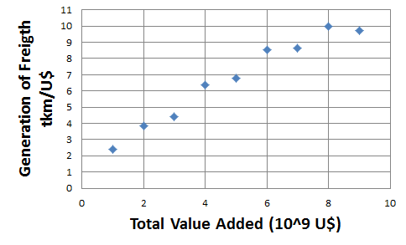
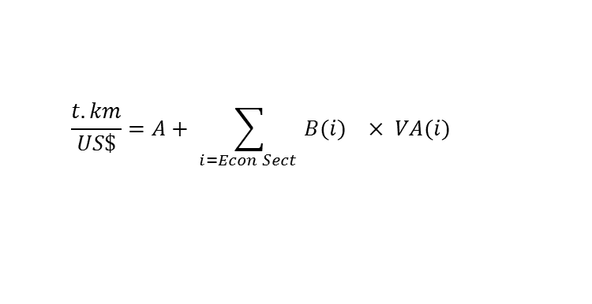
Lecture 8.3 Examples of input data
Freight transportation
Transportation
Intercept = A
Subsector
Urban
Intercity
Freight
Slope= B
  $$\frac{t.km}{US\$}=A+ \sum_{i=Econ Sect }{{B(i)}_{}× {VA(i)}_{}}$$
16
Notes:
Let us now look at an example of inputting data for freight transportation.
There are only 3 tables to be completed in the freight transportation.
The first table corresponds to the need of moving goods by the different productive sectors in terms of ton-kilometre per monetary unit of value added. Remember that, MAED will use a linear equation, to calculate the total freight ton-kilometres in the country, which is the driving parameter. The base value is the intercept of the linear fitting of total freight against the total value added. The variable coefficients should be found for each productive subsector, using the same methodology explained for the steel and feedstock production. Once you input these values, the program calculates the total freight ton-kilometres in the country.
The second table corresponding to the modal split must then be inputted, in terms of the share of the total freight transport in ton-kilometres by each mode, such as diesel and electric trains.
The third table stores data on energy intensities, or specific fuel consumption for each freight transportation mode. Be careful with the units, it is not the simple performance of the vehicle in terms of litres per 100 kilometres. This intensity is the energy per 100 ton-kilometres transported.
Once you have filled in the 3 tables, the programme performs the respective calculations and the results for the freight transport sector in the base year are displayed in different tables.

Slide 17
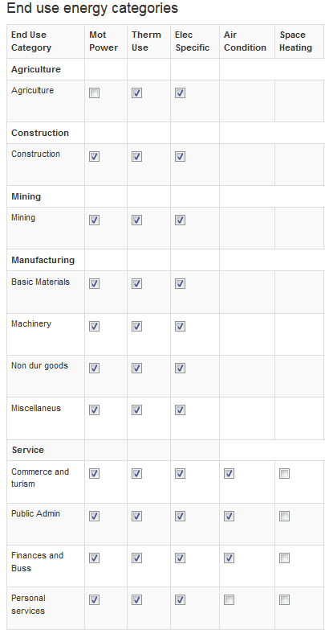
Lecture 8.3 Examples of input data
Service sector: obtaining driving parameters
Total Population
PO
Potential labour force
PLF
Actual labour force
PARTLF
PLSER
Labour force in Service Sector
17
Notes:
In MAED, for the Service Sector the uses of space heating and air conditioning are considered. And the driving parameter is the specific requirement for heat or cooling the area.
Working with the information we have on demography, the number of employees in the service sector can be found. Then, making an assumption of floor area per employee and specific requirements, all information needed can be estimated and input to the program.
Normally, the labour force of a country consists of everyone at working age, typically above a certain minimum age and below retirement age. Both minimum and retirement ages are country specific.
In the service sector, the driving factor for space heating and cooling is the floor area, which is defined from the number of employees in this sector. This value is calculated as a fraction of actual labour force.
The final data for the service sector are efficiencies and penetrations.

Slide 18
Lecture 8.4 From data
collection to implementation
Entering input data
General tables
Per subsector
Economy
Demography
Lifestyle
Technology
“GDP”
“Demography”
Industry
Service
Household
Transport
18
Notes:
Once the input data is collected and the subsectors are defined, input data can be entered first in the G.D.P. and demography general tables in MAED, then specific to each subsector in the relevant tables for the Industry, Service, Household, and Transport sectors.
The user must make sure to create a “description” worksheet. This will allow them to keep track of the scenario and input data sources they are using.
It is recommended that, in the input data preparation file, the worksheets for G.D.P. and Energy Balance should have a similar structure as the required input data in MAED.

Slide 19
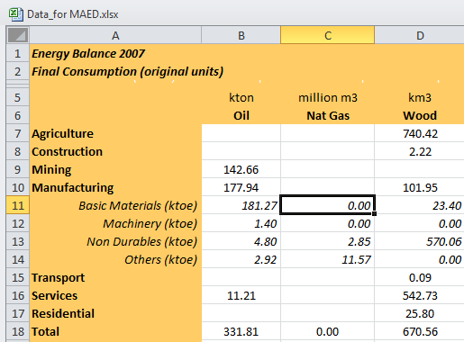
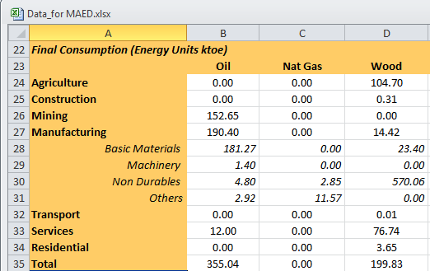
Lecture 8.4 From data
collection to implementation
Energy Balance: unit conversion
19
Notes:
Once the user has obtained energy balance data, the focus is on the final energy consumption portion. The first step is to adapt it to the defined structure of MAED and move the necessary data to the input preparation file.
Normally, the energy balance is given in original units. The user must apply conversion factors to produce this portion of information in any physical units. In this case, thousands of tons of oil equivalent was chosen as the energy unit.
Remember to check the specified units in MAED when entering input data. For example, the MAED model will ask for the energy intensities in terms of kilo watt hours per dollar. We will therefore need a conversion factor.

Slide 20
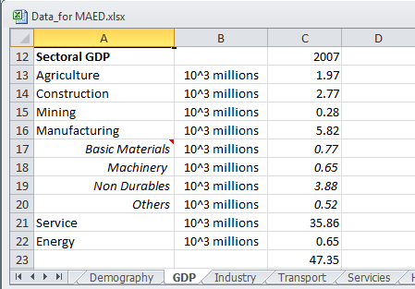
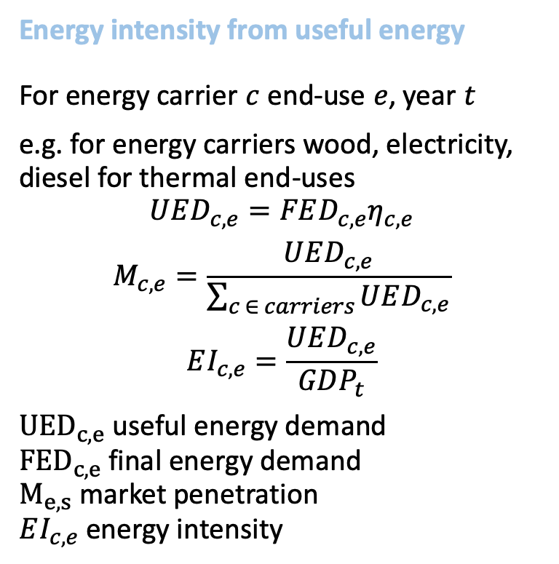
Lecture 8.4 From data
collection to implementation
Energy intensity from useful energy
For energy carrier $c$ end-use $e$, year $t$
e.g. for energy carriers wood, electricity, diesel for thermal end-uses
$$UED_{c,e}=FED_{c,e}η_{c,e}$$
$$M_{c,e}=\frac{UED_{c,e}}{\sum_{c ∈ carriers}{UED_{c,e}}}$$
$$EI_{c,e}=\frac{UED_{c,e}}{GDP_{t}}$$
$UED_{c,e}$ useful energy demand
$FED_{c,e}$ final energy demand
$M_{e,s}$ market penetration
$EI_{c,e}$ energy intensity
 |  |  | ktoe to kWh | 11630000
Agriculture
Final Energy |  | Wood | Electricity | Diesel | Total
Electricity | ktep |  | 25.70 |  | 25.70
Thermal Uses | ktep | 104.70 |  | 86.58 | 191.28
Efficiency |  | Wood | Electricity | Diesel |  | Weight Averages
Thermal uses | % | 0.20 | 0.95 | 0.80
Efficiency in MAED | % | 0.21 | 1.00 | 0.84
Useful Energy |  | Wood | Electricity | Diesel | Total (ktoe) | Total - kWh | Energy Intensity
Electricity | ktep |  | 25.70 |  | 25.70 | 298853784.0 | 0.152
Thermal Uses | ktep | 22.04 |  | 72.91 | 94.95 | 1104305551.2 | 0.560
Shares |  | Wood | Electricity | Diesel | Total
Thermal Uses | % | 23.21 |  | 76.79 | 100.00
20
Notes:
For thermal uses, the final energy demand should be converted to useful energy demand so that the energy intensities may be computed.
To obtain the final energy demand for thermal uses, we must first check the final consumption in our data preparation file. For example, the agriculture subsector is using wood, electricity, and diesel. The final energy demand for each energy carrier for thermal uses in agriculture can be found from the Ministry of Energy.
One can then assume or measure, for example, an efficiency of 20 percent for wood, 95 percent for electricity, and 80 percent for diesel. These are not default values, as each value should be determined for a given country.
These efficiencies must then be recalculated relative to the efficiency of electricity before inputting the values in MAED. Remember that, MAED always calculates electricity in terms of final energy.
Now, we can calculate the useful energy demand of each use, by multiplying the final energy demand by the efficiency. Finally, we can find the shares of wood, and diesel, for the thermal uses, by just dividing the useful energy demand provided by each source, into the total useful energy demand.
The final step is to find the energy intensities. This is done by dividing the useful energy demand by the correspondent G.D.P.. This can be inputted in the MAED input data.
On this slide, the total kilo watt hour for electricity and thermal uses are divided by the sectoral G.D.P. for agriculture to obtain the respective energy intensities

Slide 21
Lecture 8.4 From data
collection to implementation
            Base year selection and reconstruction
Once the input data is computed, run MAED for the base year and compare the results with the statistics
Check the reconstruction of the base year
Base year reconstruction
Scenario development
Energy demand projections
Gather/Adjust MAED parameters for the base year
Compute Input Data for the base year
Check accuracy of MAED results for the base year
Run the MAED model
21
Notes:
Now, the user can compare the results with the statistics, and check the reconstruction of the base year.
Results should be analysed and compared against the statistics of the energy balance for the base year.
The user must check whether they have the same data. If there are some different values, the user must track the error, and find where they have different input values. Before going forward, the user must clear any significant difference.
If the MAED results match those of the statistics, the user is ready to input the scenario data.

Slide 22
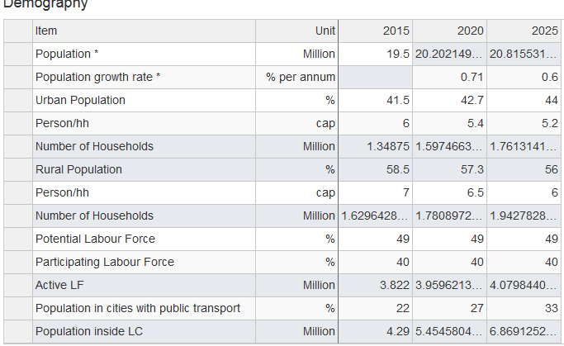
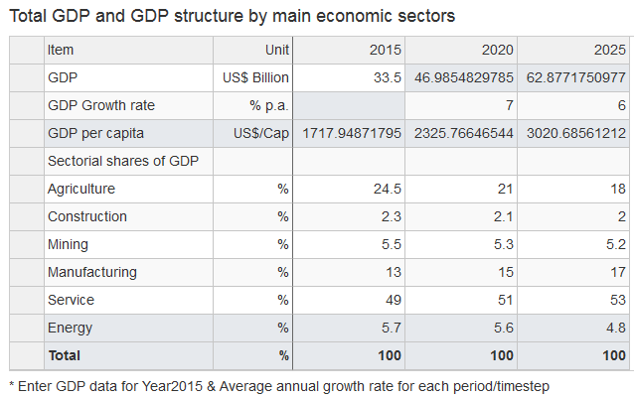
Lecture 8.4 From data
collection to implementation
            Scenario development
Base year reconstruction
Scenario development
Energy demand projections
22
Notes:
Finally, the scenarios can be designed such that the projections may be computed.
As explained in lecture 6, scenario data are input data values for future years. They correspond to expected future demographic evolution, and economic development goals and targets of the government. These data are the socio-economical component of what we call the “base” scenario. From this base scenario, it is easy to create, for instance, a “high” economic growth scenario just by changing the growth rate. The total G.D.P. will be different and so will be the total final energy demand. The user can do this kind of exercise before they have established a reasonable “base case”.
A “Business as usual” scenario can be built by just copying the values for the base year in the rest of the columns for all the technical data.
Alternatively, the user can create an “energy saving in appliances” scenario with the target of a 10% reduction of the consumption every period.
There should be a strong rationale behind every scenario created.
This concludes lecture 8 which considered input data consistency and structure.

Slide 23

Cannone, C., Collett, K.A., Charbonnier F., Ahsan A., Halloran C., Vijay,A.,Berdellans I., Hasanovic S., Gritsevskyi A,Stankeviciute L., Tot M.; Welsch M., Hirmer S., 2023. Lecture 8: "INPUT DATA CONSISTENCY AND STRUCTURE" , Energy Demands Projections with MAED (Model for Analysis of Energy Demand). Release Version 2.0. [online presentation]. Climate Compatible Growth & Programme and International Atomic Energy Agency.
CCG courses (this will take
you to the website link http://www.ClimateCompatibleGrowth.com/teachingmaterials)
23

