Slide 1
Lecture 8
Funding Baseline
Open Learn Collection
Financial Modelling for Energy Transitions: MINFin, FinTrack & FinCoRE

Slide 2
Lecture Outline
Financial Modelling for Energy Transitions
 | Learning Objectives
Part 1 | Funding Availability Overview
Part 2 | In-Country Public Funding
Part 3 | Foreign Funding
Part 4 | Other Sources of Funding

Slide 3
Learning Objectives
Identify the five key components of the funding baseline including SOE cashflows, government expenditure, international grants, fossil fuel expenditure savings, and monetization of carbon savings.
Learn how historical data is projected over the modelling period to estimate future funding requirements and trends.
Understand how MINFin forecasts future SOE cashflows by considering macroeconomic factors and sector-specific drivers.
Explore methods for estimating future government expenditure on energy transitions and understand the challenges of distinguishing clean energy spending in national budgets.
Recognise the role of government expenditure in supporting the energy transition and how public funds are allocated and utilized in clean energy investments.

Slide 4
Funding Availability Overview
Part 1

Slide 5
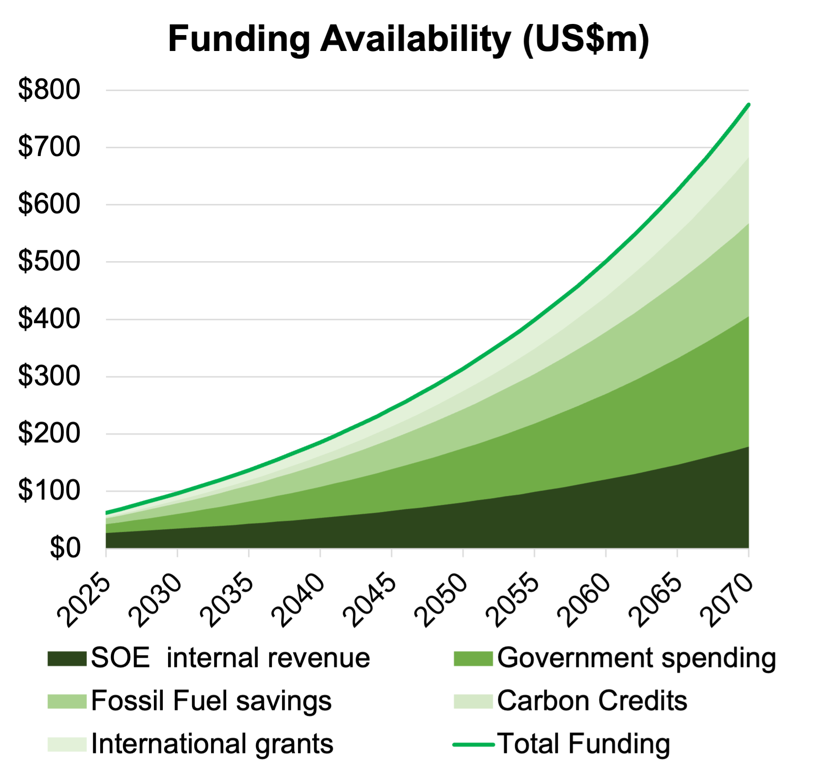

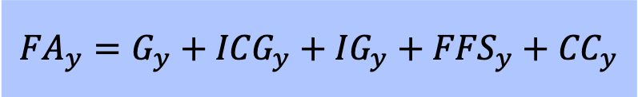
Funding Availability
Recap from Lecture 2:
The Funding Availability (FA) represents the future annual cash flow available to cover the Financing Requirement (FR).
The Funding Availability (FA) is composed of the sum of (1) Government Expenditure (G), (2) SOE Cash Generation (ICG), (3) International Grants (IG), (4) Fossil Fuel Expenditure Savings (FFS), and (5) Carbon Credit Revenues (CC).
$${FA}_{y}=G_{y}+{ICG}_{y}+{IG}_{y}+{FFS}_{y}+{CC}_{y}$$
Notes:
In the previous lecture, we discussed the concept of Funding Availability (FA) and its critical role in covering the Financing Requirement (FR) for the energy transition. Funding Availability represents the annual cash flow that can be directed toward repaying financing needs over the transition period. It is derived from five key sources:
Government Expenditure (G):
This refers to the public funds allocated to the energy sector from the government’s annual budget. Such expenditures are sourced from tax revenues or government borrowing and provided without an expectation of repayment. These funds often come in the form of capital or operating subsidies. Future government expenditure can be estimated by analyzing historical budgetary trends and evaluating how energy transition plans might influence budget priorities.
Internal Cash Generation (ICG):
This includes cash flows generated by state-owned enterprises (SOEs) or utility providers in the energy sector, which can be used to support new energy projects after meeting existing financial obligations. Projections of internal cash generation rely on financial statements and anticipated future performance of these entities.
International Grants (IG):
These are non-repayable financial contributions from international organizations, development finance institutions (e.g., World Bank, African Development Bank), and climate finance mechanisms (e.g., Green Climate Fund, Global Environment Facility). Estimating future grant availability involves examining historical trends and identifying current and emerging funding windows.
Fossil Fuel Expenditure Savings (FFS):
As countries transition from fossil fuel-based to renewable energy-based systems, significant cost savings are achieved by eliminating the need to purchase fossil fuels for power generation. These savings can be calculated using least-cost planning models such as OSeMOSYS.
Carbon Credit Revenues (CC):
The reduction in carbon emissions during the energy transition can generate revenue through the sale of carbon credits. This revenue is calculated by multiplying the volume of carbon savings, as determined by models like OSeMOSYS, with anticipated carbon credit prices.
The MINFin model integrates these funding sources to estimate the evolution of Funding Availability (FA) year-on-year, enabling stakeholders to align financing strategies with the requirements of the transition.

Slide 6
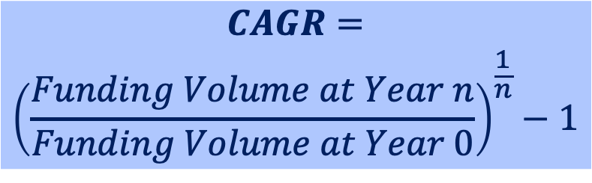
Projecting Funding Availability in MINFin
The model is calibrated using historical data on sector cashflows.
Future funding availability is projected using Compound Annual Growth Rates (CAGRs), where the value from the preceding modelling year is compounded by the CAGR to estimate the funding for the following year.
This methodology is applied uniformly across all funding baseline components, with the exception of SOE cashflows, which are projected using an alternative approach that will be outlined later in the lecture.
$$CAGR=$$
$${\left(\frac{Funding Volume at Year n}{Funding Volume at Year 0}\right)}^{\frac{1}{n}}−1$$
Where:
Funding Volume (USD) at Year 0 = the initial funding volume in Millions at the start of the period.
Funding Volume (USD) at Year n = the funding volume in Millions at the end of the period (after n years).
n = the number of years over which the growth is measured.
Notes:
To project future Funding Availability (FA), MINFin relies on historical data to calibrate the model and uses Compound Annual Growth Rates (CAGRs) for forward-looking estimates. The CAGR formula is as follows:
Now let’s take a closer look at the equation used to project Funding Availability: the Compound Annual Growth Rate (CAGR) formula. This equation allows us to calculate the average annual growth rate of funding over a set period, even if the growth isn't the same each year.
In this formula, the Funding Volume at Year 0 represents the starting amount of funding at the beginning of the period, while the Funding Volume at Year n represents the funding amount at the end of the period, after n years. The ratio of these two values gives the total growth factor over the period. Taking this ratio to the power of 1/n spreads the growth evenly across all n years, providing the equivalent annual growth rate if the growth had been steady each year. Finally, subtracting 1 isolates the growth portion of the result, converting it into a percentage format.
This approach ensures consistent projections across all funding components, with the exception of SOE cashflows, which are treated differently due to their unique financial dynamics. The alternative approach for projecting SOE cashflows will be explained later in the lecture.
By compounding the funding volume for each subsequent year, MINFin provides a framework for analyzing how financial resources may evolve to meet the needs of the energy transition.

Slide 7
In-Country Public Funding
Part 2

Slide 8
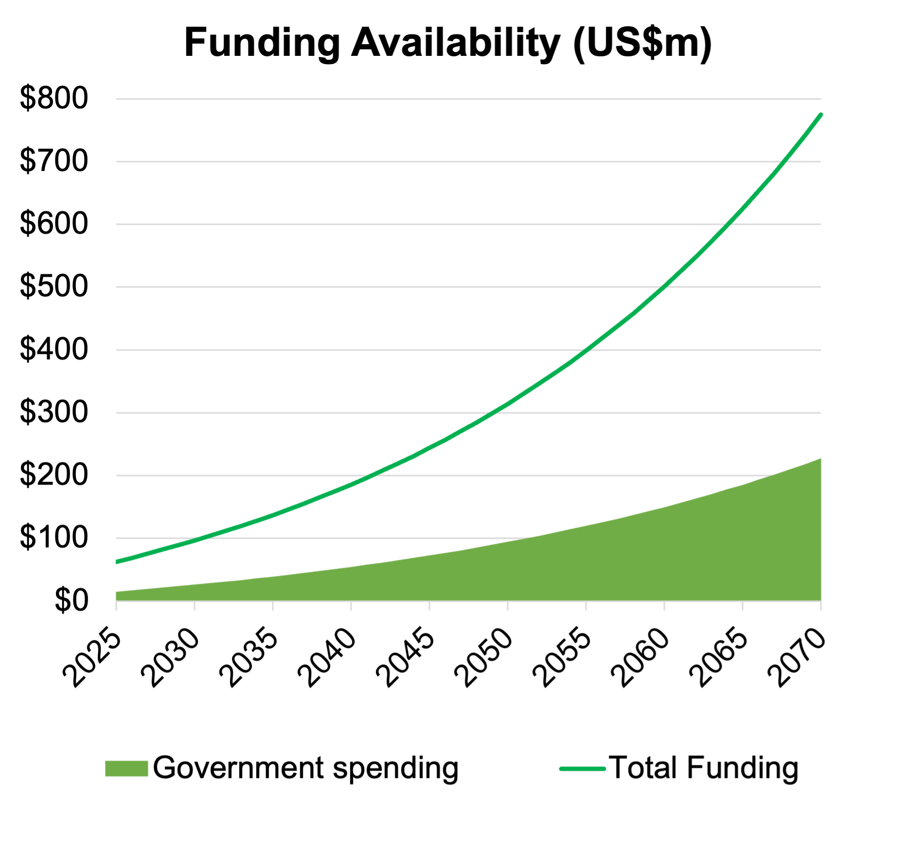
(1) Government Expenditure (G)
Government expenditure (G) constitutes one of the five key components that contribute to the overall funding availability for the sector.
Government Expenditure represents the portion of public funds allocated to the energy sector through the annual budget, which is primarily sourced from tax revenues and government borrowing.
The allocated funds are provided without expectation of repayment, either as capital or operating subsidies.
Notes:
Government expenditure, or G, is one of the five key components contributing to the funding availability for the energy sector.
This represents the portion of public funds allocated to the energy sector through the government’s annual budget. These funds, sourced from tax revenues and borrowing, are provided without expectation of repayment.
Typically, government expenditure is used to provide either capital or operating subsidies for energy sector projects.

Slide 9
(1) Estimating and Reporting Government Expenditure
Government funds typically support both conventional and clean energy projects. However, the share dedicated to clean energy transitions is often difficult to isolate due to the high-level of aggregation in national budget reports.
Future expenditure can be estimated by analysing historical trends and evaluating how energy transition plans impact government spending in the energy sector.
Notes:
Government funds play a dual role, supporting both conventional and clean energy projects. However, isolating the portion dedicated specifically to clean energy transitions can be challenging due to the high-level aggregation found in national budget reports.
Estimating future government expenditure involves analyzing historical trends and evaluating how energy transition strategies impact budget allocations. This approach provides a basis for understanding the government's financial commitment to the energy sector.

Slide 10
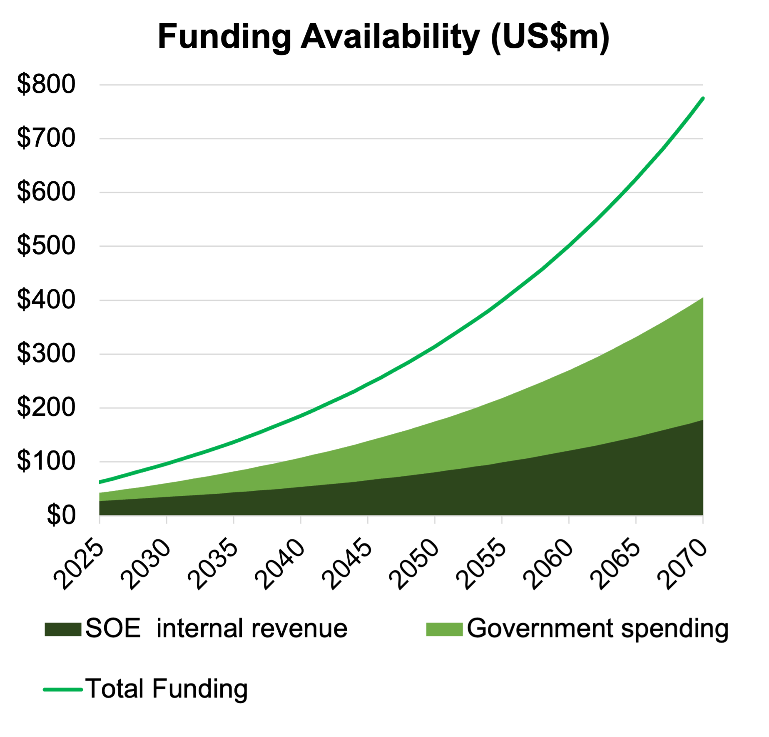
(2) SOE Internal Cash Generation (ICG)
SOE Cash Generation (ICG), constitutes the second of the five key components that contribute to the overall funding availability for the sector.
SOEs in the power sector play a central role in funding energy infrastructure investments directly from their balance sheets.
Cashflows generated from core operations are essential for repaying the financing required for these projects.
Notes:
State-Owned Enterprises, or SOEs, are instrumental in funding energy infrastructure, and their Internal Cash Generation, or ICG, constitutes the second major funding component.
SOEs are essential to many national power sectors, managing everything from generation and transmission to distribution. Their ability to finance infrastructure projects often hinges on the cashflows they generate from their operations. This cash is used to cover operational expenses, invest in new capital projects, and repay loans and bonds.
Sources of cashflow for SOEs include revenues from electricity tariffs, service charges, and government subsidies. These subsidies are particularly important for funding strategic or unprofitable projects that are critical for public welfare. Additionally, SOEs often raise funds through debt instruments such as loans and bonds, which are repaid using operational revenues.
However, generating sufficient cashflows can be challenging. SOEs face pressures from rising operational costs, tariff limitations, and delayed payments. Strengthening ICG is essential to ensure that SOEs can effectively support the energy transition without compromising their financial stability.

Slide 11
(2) SOE Cashflows for Funding Energy Investments
Free Cashflow to Firm (FCFF) is the key metric used to assess an SOE’s contribution to funding availability within the MINFin model
While there isn't a single figure that perfectly captures a company’s ability to finance new investments, Free Cashflow to Firm (FCFF) is the closest proxy.
FCFF represents the cash generated from operations after adjusting for working capital needs and the capital expenditures required to maintain current operations
Beyond FCFF, factors like government-provided capital subsidies and debt service obligations influence cashflow availability for repayments.
Notes:
Free Cash Flow to Firm (FCFF) is the key metric used in MINFin to assess how much funding an SOE can contribute to the energy sector.
FCFF measures the cash generated from the company’s core operations after covering operating expenses, working capital needs, and necessary capital expenditures. This metric is an essential indicator of financial health and reflects the SOE’s capacity to fund future investments.
Beyond FCFF, other factors also influence an SOE’s ability to finance projects. These include the capital expenditure requirements for new infrastructure, debt service obligations on existing loans, and government-provided capital subsidies. Together, these elements determine the overall financial flexibility of SOEs and their ability to support the energy transition.
SOEs that consistently generate robust FCFF are better positioned to invest in renewable energy projects, grid upgrades, and other clean energy initiatives. Conversely, those with limited FCFF may struggle to meet their investment needs, potentially hindering progress toward energy transition goals.

Slide 12
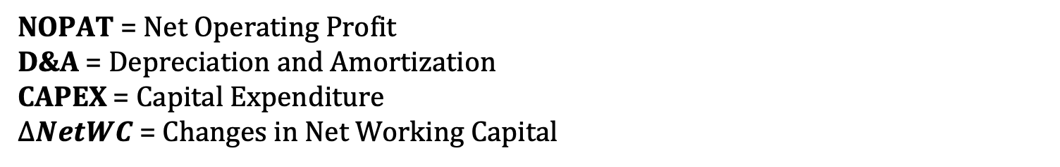

(2) How to Derive the Free Cash Flow
Free Cashflow to Firm (FCFF) is the key metric used to assess an SOE’s contribution to funding availability within the MINFin model
$$Free Cashflow to Firm=$$
$$NOPAT+D\&A −CAPEX − ∆NetWC$$
Where:
NOPAT = Net Operating Profit
D&A = Depreciation and Amortization
CAPEX = Capital Expenditure
$∆NetWC$ = Changes in Net Working Capital
Notes:
FCFF measures the cash generated from the company’s core operations after covering operating expenses, working capital adjustments, and the necessary capital expenditures required to maintain and expand its infrastructure. This metric provides a clear picture of the cash available for reinvestment in initiatives such as renewable energy projects, grid upgrades, and other clean energy advancements.
If detailed financial statements are unavailable, FCFF can be derived from the Income Statement and Balance Sheet using the extended formula shown in the slide:
NOPAT (Net Operating Profit After Taxes): Reflects the company’s operational profitability after taxes.
Non-Cash Expenses: Items such as depreciation and amortization are added back since they do not represent actual cash outflows.
Increase in Working Capital: Accounts for changes in the funds needed to support day-to-day operations.
Capital Expenditures: Capture the investments made in maintaining and growing the company’s infrastructure.
Accurately calculating FCFF allows policymakers and stakeholders to assess how much funding SOEs have available to allocate toward clean energy initiatives and other future projects without compromising their financial stability.

Slide 13
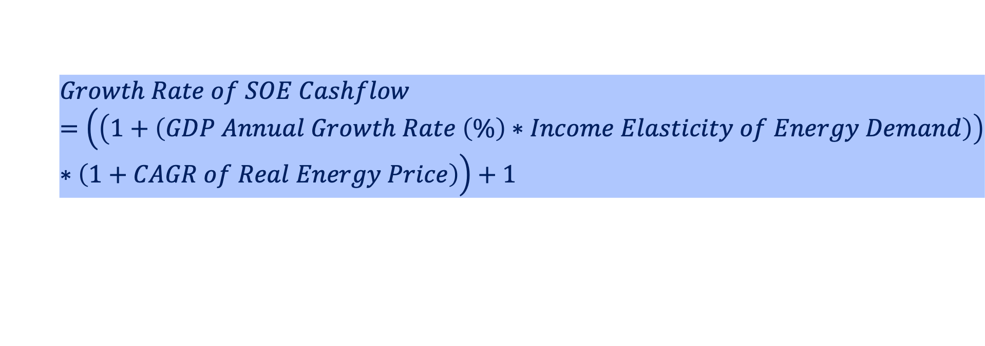
(2) How Does MINFin Project SOE cashflows?
Unlike other funding modalities that project future cashflows using CAGRs, the estimation of the annual growth rate of SOE cashflows in the power sector by MINFin incorporates a combination of economic growth, energy demand elasticity, and real energy price changes.
The first component of the formula captures the impact of economic expansion on cashflows by multiplying GDP growth by the income elasticity of energy demand. This reflects how increases in economic activity influence energy consumption and, consequently, revenues.
The second component adjusts for the effect of real energy price changes, using the CAGR of real energy prices to reflect how price trends contribute to cashflow growth.
$$Growth Rate of SOE Cashflow=\left(\left(1+\left(GDP Annual Growth Rate \left(\%\right)∗Income Elasticity of Energy Demand\right)\right)∗\left(1+CAGR of Real Energy Price\right)\right)+1$$
Notes:
Unlike other funding modalities that project future cashflows using CAGRs, the estimation of the annual growth rate of SOE cashflows in the power sector by MINFin incorporates a combination of economic growth, energy demand elasticity, and real energy price changes.
This formula projects the annual growth rate of State-Owned Enterprise (SOE) cashflows in the power sector by integrating three critical macroeconomic and sectoral drivers.
The term $1+\left(GDP Annual Growth Rate \left(\%\right)∗Income Elasticity of Energy Demand\right)$captures the combined effect of GDP growth and income elasticity of energy demand, reflecting how increases in economic output drive energy demand and, consequently, revenues.
The factor $\left(1+CAGR of Real Energy Price\right)$ incorporates the impact of changes in real energy prices, adjusting for price-driven revenue changes.
By multiplying these components and subtracting 1, the formula provides the net projected annual growth rate, accounting for both demand-side and price-driven influences on cashflows. This approach allows for a structured, data-driven estimation of SOE financial performance under varying economic and market conditions.
In simple terms, this formula estimates the annual growth rate of SOE cashflows in the power sector by combining the effects of economic growth, energy demand elasticity, and real energy price changes.

Slide 14
(2) Challenges and Financial Sustainability of SOEs
Operational Efficiency: High operational costs, inefficiencies, and energy losses (technical or commercial) reduce the available cashflow.
Revenue Collection: Delayed payments from consumers or government departments impact the speed at which cash is available.
Tariff Adjustments: Regulatory delays in adjusting tariffs to reflect market conditions or inflation can limit revenue growth and cashflow.
Government Subsidies: Dependence on government subsidies to cover CAPEX or operational costs may impact cashflow stability, particularly if subsidies are delayed or reduced.
Debt Service Obligations: Rising interest rates or an increasing debt load can strain available cashflows for other needs.
Notes:
Despite their critical role, SOEs face several challenges that threaten their financial sustainability:
Operational Efficiency: High costs and energy losses—whether technical or commercial—reduce cashflows and profitability.
Revenue Collection: Delayed payments from customers or government departments slow cash inflows.
Tariff Adjustments: Regulatory delays in updating tariffs can limit revenue growth, especially during periods of inflation.
Government Subsidies: Dependency on subsidies can destabilize cashflows if subsidies are reduced or delayed.
Debt Obligations: Rising debt levels and higher interest rates can strain financial resources, limiting funds available for new projects.
Addressing these issues is critical for ensuring that SOEs can remain financially viable while supporting the energy transition.

Slide 15
(2) Capital Injections into SOEs
An additional method to boost sector cashflows within MINFin is through capital injections.
Whether in the form of equity or grants, these injections directly channel funds into SOEs, enhancing their cashflows. This, in turn, improves financial stability, addresses operational needs, and fosters growth within the sector.
Capital can come from government budgets or external donors, such as international organiaations and private sector entities, to support SOE growth and improve sector cashflows.
Notes:
Capital injections are a vital tool for strengthening SOEs’ financial capacity. These injections, which can come in the form of equity or grants, provide direct funding to address operational challenges, improve cashflows, and support sector growth.
Sources of capital injections include government budgets, international organizations, and private sector entities. These funds can be used to modernize infrastructure, expand clean energy investments, and enhance operational efficiency.
By bolstering SOE cashflows, capital injections enable these enterprises to play a more active role in achieving national energy transition goals while maintaining financial stability.

Slide 16
Foreign Funding
Part 3

Slide 17
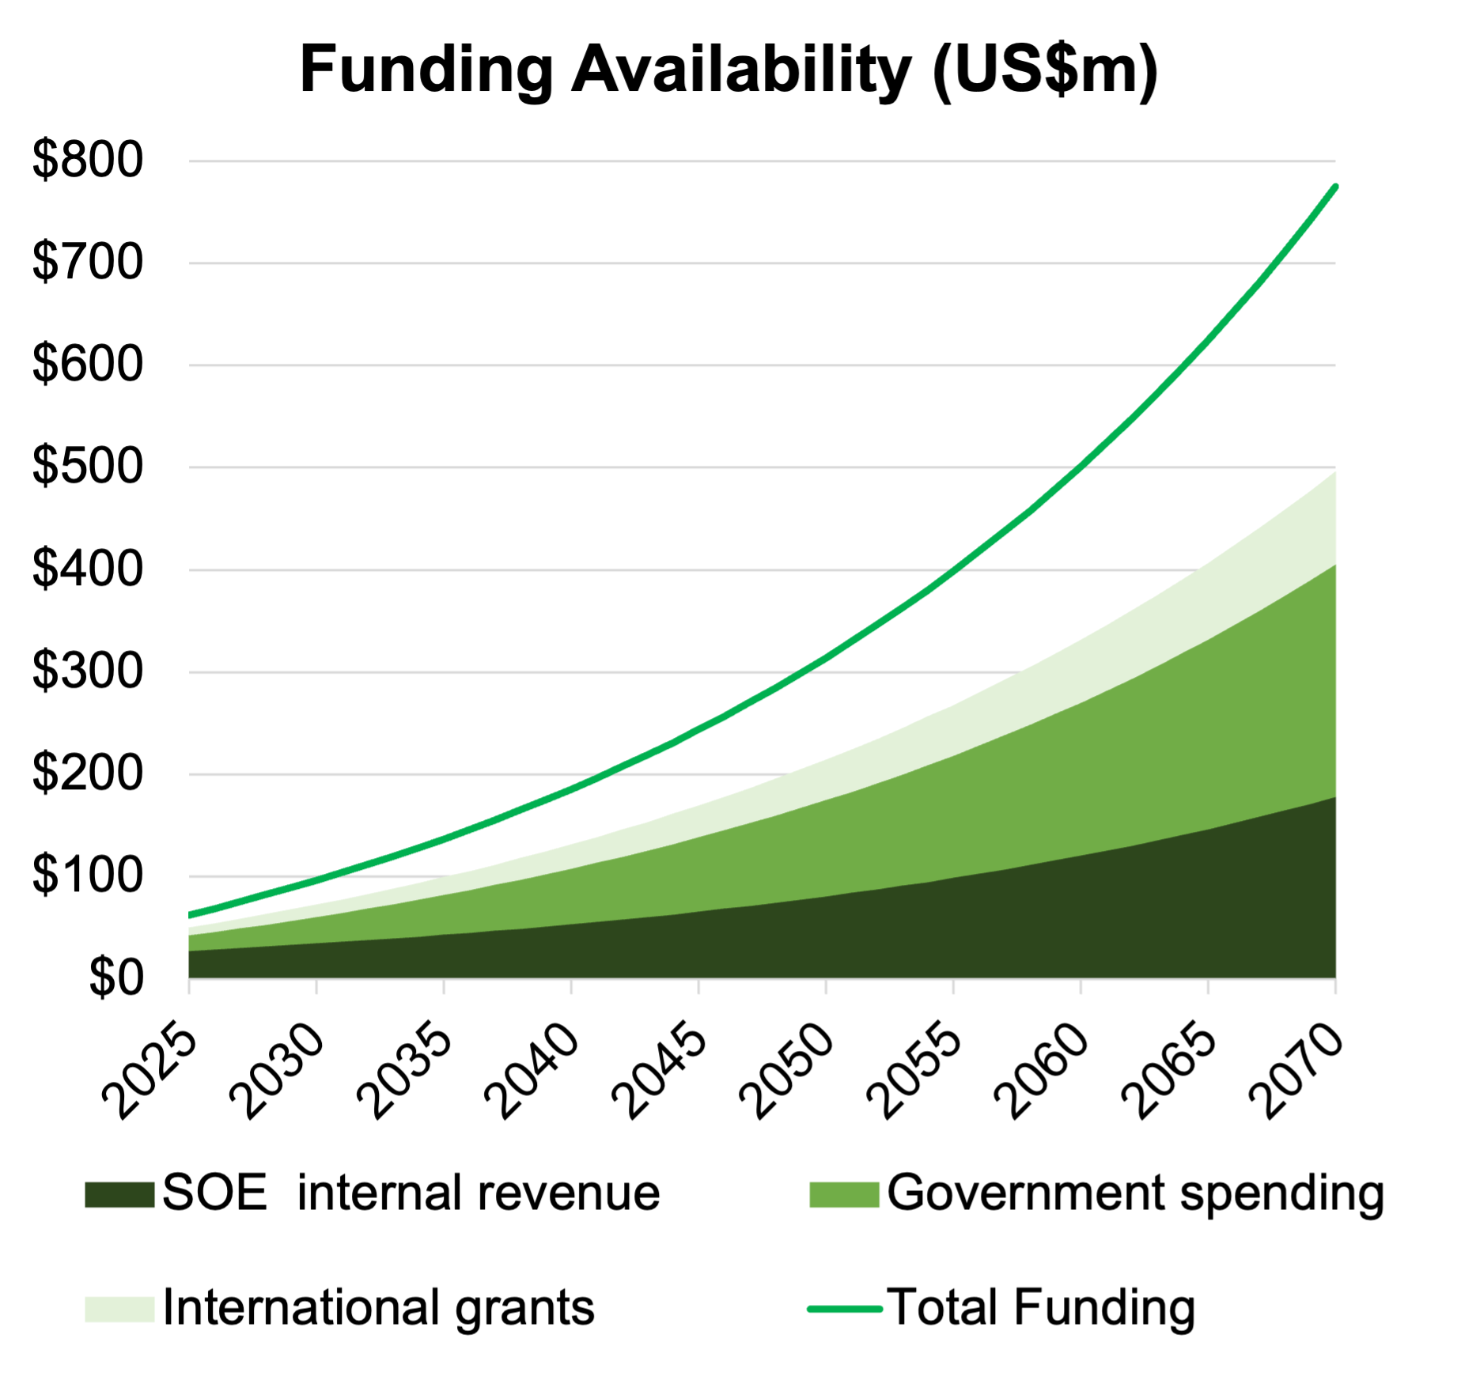
(3) International Grants (IG)
International Grants (G) represent the third of the five key components contributing to the overall funding availability for the sector.
These grants provide limited amounts of international concessional finance that do not require repayment.
Grants are often directed toward project preparation rather than direct investment. They also support small-scale or innovative projects, particularly in low-income countries or for low-income populations.
Notes:
International Grants (G) are a crucial component of the overall funding available for the energy transition. They represent a form of concessional finance that does not require repayment, making them an attractive source of funding for various projects.
However, these grants are often limited in scope and are typically directed toward specific stages of project development, such as project preparation, rather than the direct implementation of large-scale investments. International grants are particularly valuable for supporting small-scale or innovative projects, especially in low-income countries or for low-income populations that may not have access to traditional funding sources.
These grants are typically provided by development finance institutions like the World Bank and the African Development Bank, or through climate finance mechanisms such as the Green Climate Fund and the Global Environment Facility. Future international grants can be estimated based on historical trends, as well as horizon-scanning to identify emerging finance opportunities within these channels.

Slide 18
(3) Estimating Grant Contributions
International grants are primarily channelled through:
  Development Finance Institutions: e.g., World Bank, African Development Bank.
  Climate Finance Mechanisms: e.g., Green Climate Fund, Global Environment Facility.
Quantification Approach:
  Analyse historical trends in grant disbursements using databases like OECD DAC, Climate Funds Update, and reports from institutions.
  Conduct horizon scanning by monitoring funding pipelines, reviewing institutional strategies, and identifying upcoming grant finance windows.
Notes:
International grants are primarily channelled through two key sources: development finance institutions and climate finance mechanisms.
Development finance institutions, like the World Bank and the African Development Bank, play a significant role in funding energy transition projects, especially those that support large-scale infrastructure developments. Climate finance mechanisms, such as the Green Climate Fund and the Global Environment Facility, provide targeted funding for projects aimed at mitigating climate change and supporting low-carbon transitions.
To estimate the contribution of international grants, we need to analyse historical trends in grant disbursements, using resources such as the OECD DAC and Climate Funds Update. These databases offer insights into the volume of grants provided by various institutions over time. Additionally, horizon scanning is important to identify upcoming funding opportunities by monitoring institutional strategies, reviewing funding pipelines, and keeping track of the latest announcements regarding grant finance windows.
This approach helps to form an understanding of the potential value of international grants for the energy transition, allowing us to plan for future contributions and identify financing opportunities that can support various stages of project implementation.

Slide 19
Other Sources of Funding
Part 4

Slide 20
Net Zero Savings
While net-zero requires increased upfront capital investment, it also delivers:
Financial Savings:
  Clean technologies have lower operating costs compared to fossil fuels.
  Fuel-importing countries benefit from reduced fuel expenditures, enhancing economic stability and shielding against global price shocks.
Economic Benefits:
  Monetizable carbon savings as carbon markets evolve.
  Improved air quality and health outcomes
These factors, including reduced fossil fuel expenses and carbon savings, can be quantified and incorporated into the funding baseline.
Notes:
Achieving net-zero emissions requires a significant increase in upfront capital investment. However, this is accompanied by substantial financial and economic benefits that can offset the initial costs over time.
From a financial perspective, clean technologies have significantly lower operating costs compared to fossil fuel-based systems. For fuel-importing countries, transitioning to renewable energy reduces dependency on volatile international markets and mitigates exposure to global price shocks, enhancing economic stability.
Economically, the transition enables monetizable carbon savings as global carbon markets mature. Additionally, improved air quality leads to better public health outcomes, reducing healthcare expenditures.
Together, reduced fossil fuel costs, monetizable carbon savings, and health improvements can be quantified and integrated into the overall funding baseline, highlighting the long-term savings and benefits of net-zero investments.

Slide 21
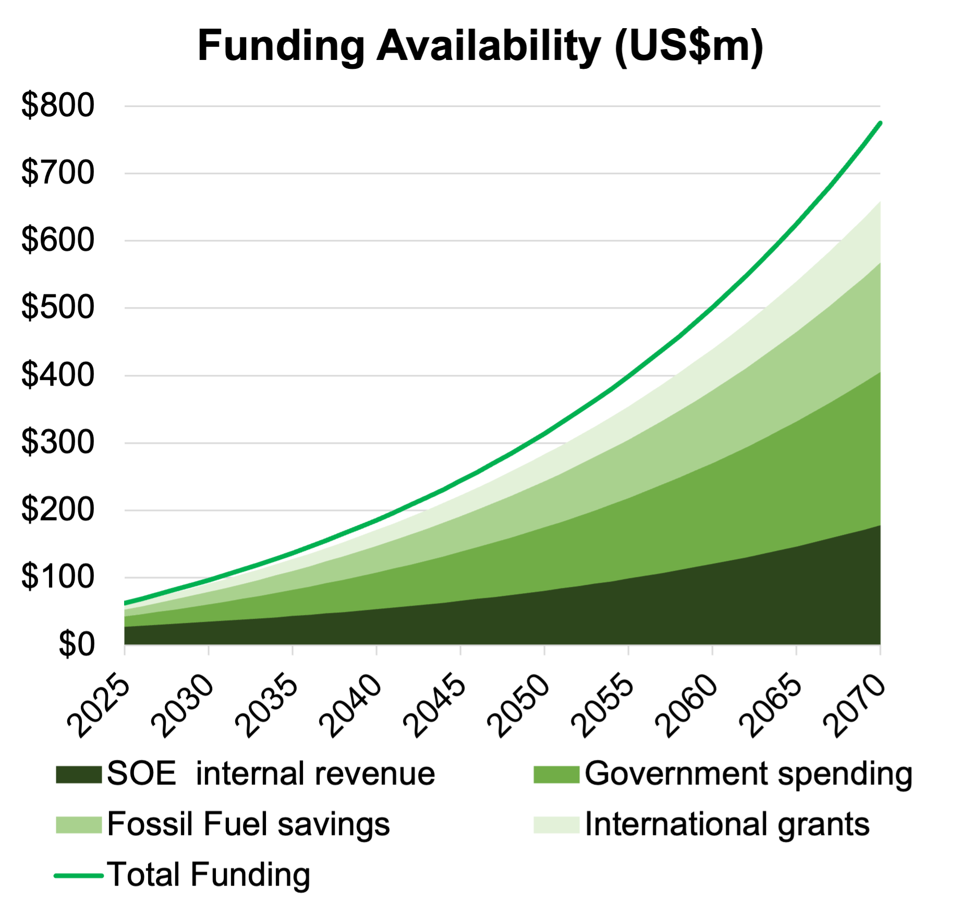
(4) Fossil Fuel Expenditure Savings (FFS)
Fossil Fuel Expenditure (FFS) represent the fourth of the five key components contributing to the overall funding availability for the sector.
For energy transitions, high capital costs (CapEx) for clean technologies often come with lower operational costs (OpEx) over time.
This is partly because the country no longer needs to buy fossil fuels for plant operations, allowing these savings to be redirected into investments in clean energy projects.
Notes:
One of the key financial advantages of transitioning to renewable energy is the reduction in fossil fuel expenditures. Fossil Fuel Expenditure Savings (FFS) represent a significant component of the sector’s funding availability.
While the capital costs (CapEx) of clean energy technologies are often higher, their operational costs (OpEx) are substantially lower over time. This is largely because renewable energy systems do not require the ongoing purchase of fossil fuels for plant operations.
These savings can be redirected into clean energy investments, making the transition more financially sustainable. Using a least-cost planning model like OSeMOSYS, it is possible to estimate the amount of money that will no longer be spent on fossil fuels as the energy sector shifts from fossil-based to renewables-based power generation.

Slide 22
(4) Quantifying Fossil Fuel Expenditure Savings
The transition from fossil-based to renewables-based power generation reduces operational costs by eliminating the need to purchase fossil fuels.
Savings can be calculated using least-cost planning models like OSeMOSYS, which provide variable operating cost outputs.
The financial savings associated with reduced fossil fuel use are quantified as the variance in expenditure between the Net Zero and Least Cost scenarios,
$$\text{Fossil} \text{fuel} \text{E}\text{xpenditure} \text{S}\text{avings}\text{ = }$$
$$\text{Fossil} \text{fuel} \text{e}\text{xpenditure} \text{under} \text{LC}\text{ – }\text{Fossil} \text{fuel} \text{expenditure} \text{under} \text{NZ}$$
Notes:
The financial savings from reduced fossil fuel usage can be quantified using least-cost planning models such as OSeMOSYS. These models provide detailed outputs on variable operating costs, allowing for a direct comparison of expenditure between fossil-based and renewables-based power systems.
The transition eliminates the need for fossil fuel purchases, significantly lowering operational costs. The difference in fossil fuel expenditures between the Least Cost (LC) and Net Zero (NZ) scenarios provides the measure of Fossil Fuel Expenditure Savings. This calculation helps to estimate how much funding can be freed up to support the clean energy transition.

Slide 23
(5) Potential Value of Carbon Credits (CC)
Carbon Credits (CC) represent the final of the five key components contributing to the overall funding availability for the sector.
This is the amount of revenue that could potentially be obtained from sale of carbon credits as a result of the reduction in carbon emissions associated with the energy transition.
Notes:
Carbon Credits (CC) form another critical component of funding availability for the energy sector. These credits represent a potential revenue source derived from reducing carbon emissions during the energy transition.
The revenue from carbon credits is directly tied to the decrease in emissions achieved through transitioning to renewable energy. As carbon markets evolve, these credits can be sold to generate additional funding, creating a financial incentive for reducing greenhouse gas emissions.

Slide 24
(5) Quantifying the Potential Value of Carbon Credits
OSeMOSYS output will provide estimate of year-on-year carbon emissions savings from comparison on Least Cost and Net Zero scenarios
Multiplying carbon emissions savings by notional carbon market price provides the estimate of potential value
$$\text{Carbon} \text{Emissions} \text{Savings}\text{ = }$$
$$\text{CO}\text{2 }\text{Emissions} \text{Under} \text{LC}\text{ – }\text{CO}\text{2 }\text{Emissions} \text{Under} \text{NZ}$$
$$\text{Potential} \text{Value} \text{of} \text{Carbon} \text{Credits}\text{ = }$$
$$\text{Notional} \text{Carbon} \text{Market} \text{Price} \text{x} \text{Carbon} \text{Emissions} \text{Savings}$$
Notes:
The revenue from carbon credits can be calculated by combining carbon savings data with anticipated market prices for carbon credits. Least-cost planning models like OSeMOSYS estimate annual carbon emissions savings by comparing the emissions between Least Cost (LC) and Net Zero (NZ) scenarios.
Mathematically: Carbon Emissions Savings = CO2 Emissions under LC – CO2 Emissions under NZ.
The potential value of carbon credits is then derived by multiplying these savings by the notional carbon market price: Potential Value of Carbon Credits = Notional Carbon Market Price × Carbon Emissions Savings.
This calculation helps policymakers understand the revenue potential from participating in carbon markets and supports financial planning for the transition.

Slide 25
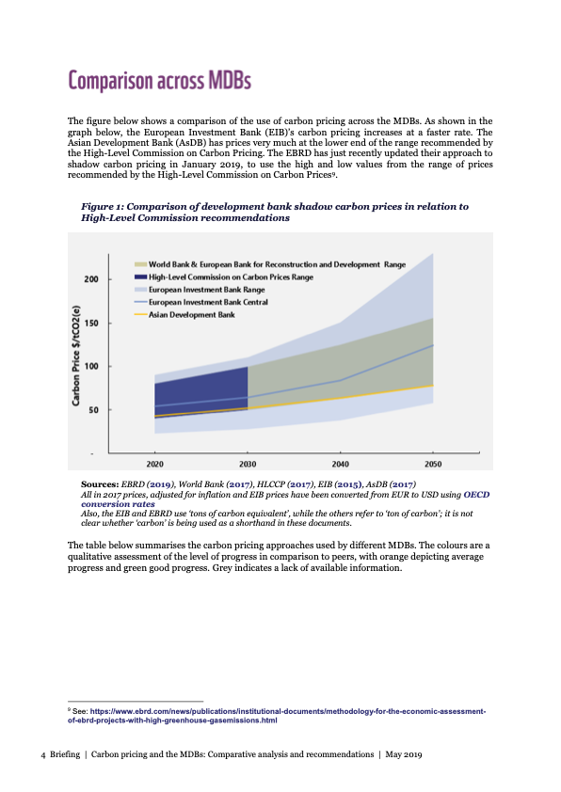
(5) Setting The Carbon Price
A carbon price must be set at the right level to work.
Within MINFin, the midpoint recommended by the High-Level Commission on Carbon Prices is typically applied, though this can be adjusted to reflect more precise in-country estimates when available.
The figure presents a comparison of development bank shadow carbon prices relative to the recommendations of the High-Level Commission on Carbon Prices.
Notes:
Setting an appropriate carbon price is critical to maximising the value of carbon credits. Within MINFin, the midpoint of the range recommended by the High-Level Commission on Carbon Prices is often applied as a benchmark. However, this figure can be adjusted to reflect country-specific conditions and more precise in-country estimates where available.
A comparison of shadow carbon prices used by development banks and the recommendations of the High-Level Commission on Carbon Prices provides a useful reference for setting this value. Ensuring the carbon price is calibrated correctly is essential for accurately quantifying the financial benefits of carbon savings.

Slide 26
Part 4: References
[1] WWF (2019) Shadow carbon pricing and multilateral development banks: comparative analysis and recommendations. WWF. Available at: https://wwfeu.awsassets.panda.org/downloads/wwf_e3g_oci_shadow_carbon_pricing_and_mdbs_may19.pdf (Accessed: 11/02/2025).
[2] High-Level Commission on Carbon Prices (2017) Report of the High-Level Commission on Carbon Prices. World Bank. Available at: https://openknowledge.worldbank.org/server/api/core/bitstreams/e49473de-ad98-5d26-8add-102687c9dc80/content (Accessed: [insert date of access]).

Slide 27
Thank you
Contact Information: v.foster@imperial.ac.uk or hannah.luscombe@ouce.ox.ac.uk

