Slide 1

Model for Analysis of Energy Demand
LECTURE 7 TRANSPORT AND SERVICE SECTORS
Version 2.0
Notes:
Licence: This work is licensed under the Creative Commons Attribution 4.0 International License (CC BY 4.0). To view a copy of this license, visit https://creativecommons.org/licenses/by/4.0/.
Attribution: Please cite as: Kiley, F. (2025) An Introduction to Simulating Energy Demand with MAED. Version 1. Climate Compatible Growth Teaching Kit Website, Climate Compatible Growth.

Slide 2
Intended Learning Outcomes (ILOs)
This lecture has four Intended Learning Outcomes (ILOs):
ILO1: learn about the service sector and its subsectors
ILO2: learn how to collect the raw data needed for the base year reconstruction
ILO3: learn about the transport sector and its subsectors
7.1 Service Sector and its sub-sectors
7.2 Base Year Reconstruction - Collection of Raw Data
7.3 Transport Sector and its sub-sectors
2
Notes:
This lecture has four Intended Learner Outcomes: to learn about the service sector and its subsector, how to collect the raw data for the base year reconstruction and about the transport sector.

Slide 3








Lecture 7.1 Service sector
7.1.1. The Service Sector, Subsectors, End-use and Final Energy Demands
Industry
Service
Household
Transport
Sectors
Commercial and turism
Public administration
Finance and Business
Personal Services and others
Subsectors
Motive Power
Electricity Specific Uses
Thermal Uses
Air Conditioning
Space Heating
End-use
Category of Final Energy Demand (FED)
Fossil Fuels
Modern Biomass
Traditional Fuels
Solar Thermal
Electricity
District Heating
Electricity Heat Pump
3
Notes:
The service sector is divided into four sub-sectors called Commercial and Turism, Public Administration, Finance and Business and Personal Services and others.

Slide 4

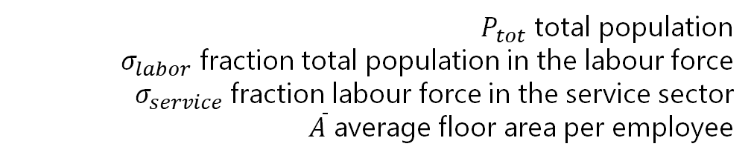
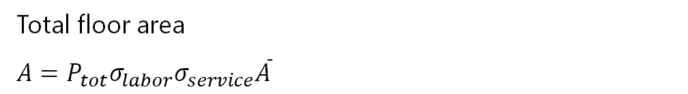
Lecture 7.1 Service sector
7.1.2. Raw Data Service Sector and Driving Parameters
We need to define the type of Service subsector – in this example they are 4 as defined on the left
$P_{tot}$ total population
$σ_{labor}$ fraction total population in the labour force
$σ_{service}$ fraction labour force in the service sector
$\overline{A}$ average floor area per employee
Total floor area
$A=P_{tot}σ_{labor}σ_{service}\overline{A}$
4

Slide 5

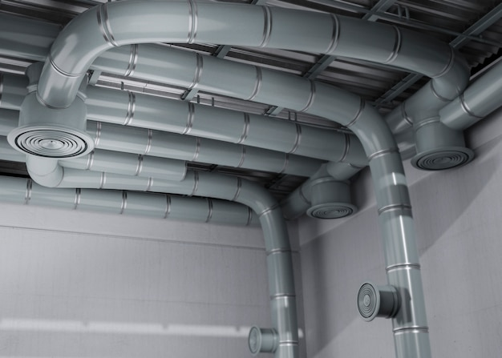
Lecture 7.1. Service Sector
7.1.3. Space Heating Raw Data
We need to define Low Rise Buildings, COP Heat Pumps and Solar Thermal Share
Source: https://www.freepik.com/free-photo/3d-rendering-ventilation-system_22894132.htm#query=space%20heating&position=33&from_view=search&track=ais, Freepik</a>
5
Notes:
To calculate the Useful Energy Demand for Space Heating we need to gather some raw data on the Floor Area (%) requiring space heating and the % of area actually heated. Also, we need to know the Low Rise Building percentage, the COP Heat Pumps Ratio and the Share of Solar Thermal.

Slide 6

Lecture 7.1 Service sector
7.1.4. Space Heating Reconstruction and Formulas
$$UED_{heating}=Aσ_{heat}SEC_{heat}$$
$A$ total area of the service sector
$σ_{heat}$Fraction total area to be heated
$SEC_{heat}$specific energy consumption per area heated
Source: https://www.freepik.com/free-photo/3d-rendering-ventilation-system_22894132.htm#query=space%20heating&position=33&from_view=search&track=ais, Freepik</a>
6
Notes:
The Useful Energy Demand for Space Heating end-use is calculated multiplying the total area of the service sector, the fraction of that area that needs to be warmed up and the specific energy consumption per area heated.
In general, space heating is needed only during the winter months; in MAED a factor called Degree-Day is defined to represent this seasonal behavior.
The degree day coefficient is defined as the sum over those months when the average temperatures is less than 18 degrees Celsius, or the difference between 18 degree Celsius and the monthly average temperature (M.A.T.), multiplied by the number of days per month (N.D.m.). Heating is only required for those months when the average temperature is less than 18 degrees Celsius.

Slide 7
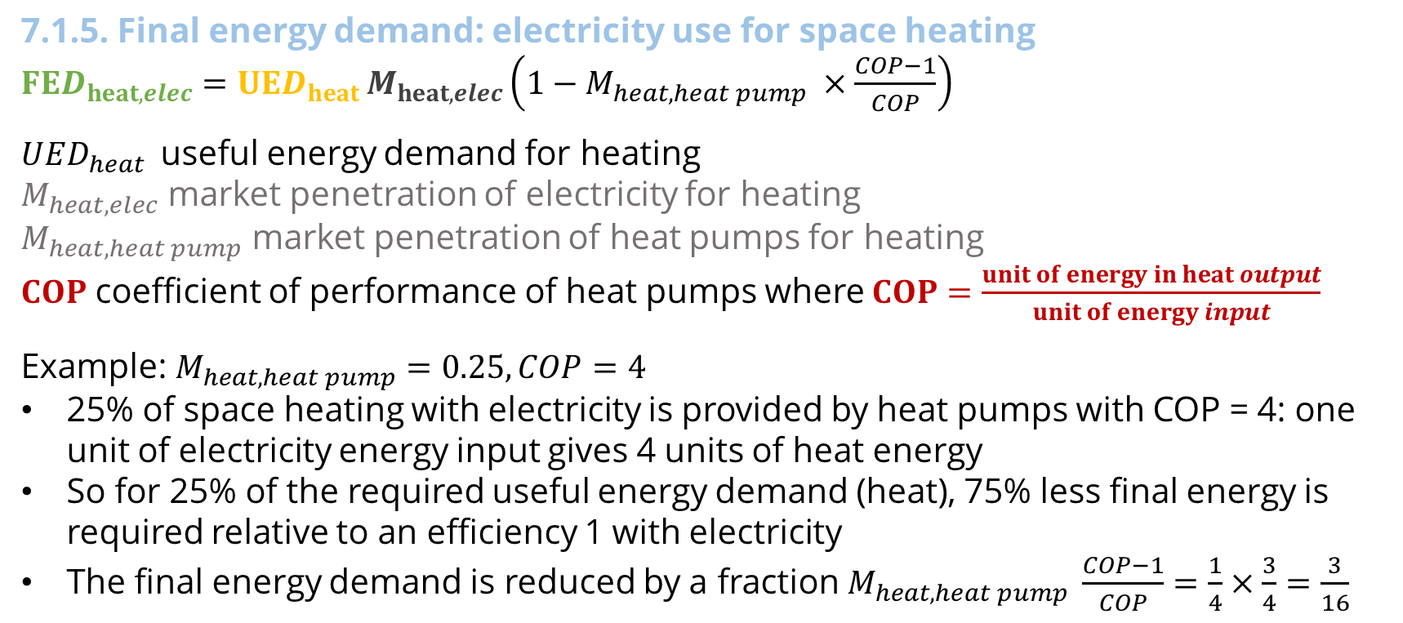
Lecture 7.1 Service sector
7.1.5. Final energy demand: electricity use for space heating
$FED_{heat,elec}=UED_{heat }M_{heat,elec}\left(1−M_{heat,heat pump} ×\frac{COP−1}{COP}\right)$
$UED_{heat }$ useful energy demand for heating
$M_{heat,elec}$ market penetration of electricity for heating
$M_{heat,heat pump}$ market penetration of heat pumps for heating
$COP$ coefficient of performance of heat pumps where $COP=\frac{unit of energy in heat output}{unit of energy input}$
Example: $M_{heat,heat pump}=0.25,COP=4$
25% of space heating with electricity is provided by heat pumps with COP = 4: one unit of electricity energy input gives 4 units of heat energy
So for 25% of the required useful energy demand (heat), 75% less final energy is required relative to an efficiency 1 with electricity
The final energy demand is reduced by a fraction $M_{heat,heat pump} \frac{COP−1}{COP}=\frac{1}{4}×\frac{3}{4}=\frac{3}{16}$
7
Notes:
When converting useful energy demand for space heating into final energy demand for the electricity energy carrier, the fraction of that useful energy requirement which is met by heat pumps should be considered.
In MAED, electricity is assumed to have an efficiency of 1. However, heat pumps often have an efficiency, which in this context is called the coefficient of performance (C.O.P.), larger than 1. Coefficients of performance can typically range from 3 to 5. For heat pumps, the coefficient of performance is the ratio of the number of units of energy obtained in heat output and the number of units of energy inputted. This means that when using heat pumps, one unit of electricity inputted yields more than one unit of heat energy.
When calculating the final energy demand for space heating using electricity, we use the usual formula taking into account the market penetration of electricity for heating, but reduce the total amount by a fraction highlighted in red on the slide.
For example, if 25 percent of space heating useful energy demand is provided by heat pumps with coefficient of performance equal to 4 (meaning with one unit of electricity energy input giving 4 units of heat energy), 25 percent of the total required useful energy demand for heat requires 75 percent less final energy relative to an efficiency 1 with electricity. The total final energy demand is therefore reduced by the market penetration of heat pumps (M) multiplied by the difference between the coefficient of performance and 1, divided by the coefficient of performance. In this example, that is one over four times three over four, which equals three over sixteen.
This concludes lecture 7 on the sectors of MAED-D.

Slide 8


Lecture 7.2 Other Service End-uses
7.2.1. Air Conditioning Raw Data
We need to define the Floor Area (%) with Air Conditioning and the Specific Cooling Requirements.
Source: https://www.freepik.com/free-photo/close-up-ventilation-system_25777554.htm#query=air%20conditioning%20office&position=5&from_view=search&track=ais, Freepik</a>
8
Notes:
To calculate the Useful Energy Demand for Air conditioning we need to gather some raw data on the Floor Area (%) requiring air conditioning and the specific cooling requirements.

Slide 9
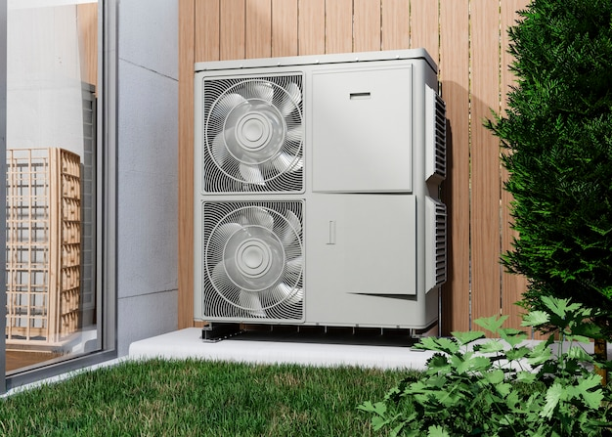
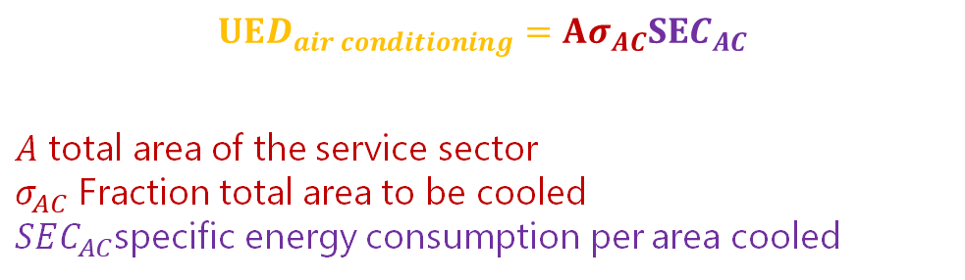
Lecture 7.2 Other Service End-uses
7.2.2. Air Conditioning Reconstruction and Formulas
Useful energy demand for air conditioning:
$$UED_{air conditioning}=Aσ_{AC}SEC_{AC}$$
$A$ total area of the service sector
$σ_{AC}$ Fraction total area to be cooled
$SEC_{AC}$specific energy consumption per area cooled
Source: https://www.freepik.com/free-photo/close-up-heat-pump-outside-home_22118722.htm#query=heat%20pump&position=24&from_view=search&track=ais, Freepik</a>
9
Notes:
The Useful Energy Demand for Air conditioning end-use is calculated multiplying the total area of the service sector, the fraction of that area that needs to be cooled down and the specific energy consumption per area cooled.

Slide 10


Lecture 7.2 Other Service End-uses
7.2.3. Appliances and Lightning Raw Data
10
Notes:
Electricity for specific uses and lighting is calculated directly as final energy demand.
Electricity for specific uses equals the total number of dwelling times the fraction of dwelling with electricity multiplied by the specific electricity consumption per dwelling. The equation for lighting is the same.
Using the fraction of electrified dwellings, the fraction of non-electrified dwellings is used to obtain the final energy demand for fossil fuels used for appliances in non-connected households.

Slide 11
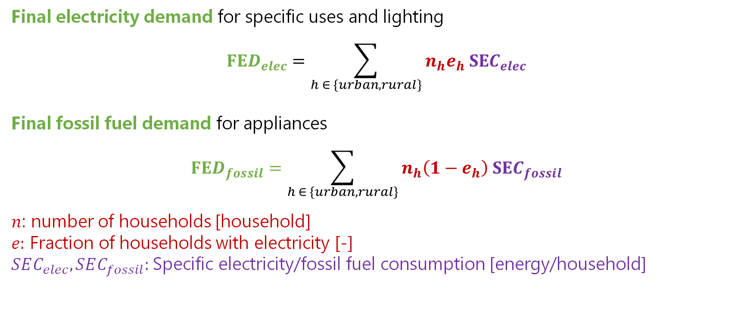
Lecture 7.2 Other Service End-uses
7.2.4. Appliances and Lightning Reconstruction and Formulas
Final electricity demand for specific uses and lighting
$$FED_{elec}=\sum_{h ∈ \{urban, rural\}}{n_{h}e_{h} SEC_{elec}}$$
Final fossil fuel demand for appliances
$$FED_{fossil}=\sum_{h ∈ \{urban, rural\}}{n_{h}\left(1−e_{h}\right) SEC_{fossil}}$$
$n$: number of households [household]
$e:$ Fraction of households with electricity [-]
$SEC_{elec},SEC_{fossil}:$Specific electricity/fossil fuel consumption [energy/household]
11
Notes:
Electricity for specific uses and lighting is calculated directly as final energy demand.
Electricity for specific uses equals the total number of dwelling times the fraction of dwelling with electricity multiplied by the specific electricity consumption per dwelling. The equation for lighting is the same.
Using the fraction of electrified dwellings, the fraction of non-electrified dwellings is used to obtain the final energy demand for fossil fuels used for appliances in non-connected households.

Slide 12
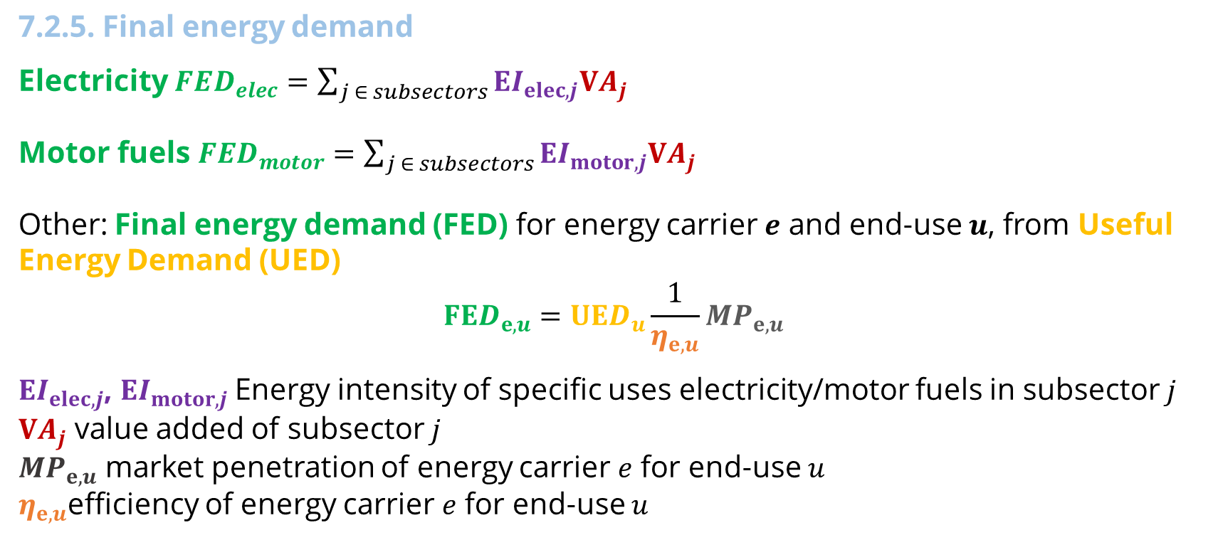
Lecture 7.2 Service sector
7.2.5. Final energy demand
Electricity ${FED}_{elec}=\sum_{j ∈ subsectors}{EI_{elec,j}VA_{j}}$
Motor fuels ${FED}_{motor}=\sum_{j ∈ subsectors}{EI_{motor,j}VA_{j}}$
Other: Final energy demand (FED) for energy carrier $e$ and end-use $u$, from Useful Energy Demand (UED)
$$FED_{e,u}=UED_{u}\frac{1}{η_{e,u}}{MP}_{e,u}$$
$EI_{elec,j}$, $EI_{motor,j}$Energy intensity of specific uses electricity/motor fuels in subsector $j$
$VA_{j}$ value added of subsector $j$
${MP}_{e,u}$ market penetration of energy carrier $e$ for end-use $u$
$η_{e,u}$efficiency of energy carrier $e$ for end-use $u$
12
Notes:
Specific uses of electricity for appliances and motor fuels for motive power are also calculated by subsector. In this case, they are calculated directly in terms of final energy demand. Equations are of the same form. Final energy demand for electricity or motor fuels equals energy intensity of electricity or motor fuels in each subsector times the value added of each subsector. Total final energy demand in the service sector for specific uses of electricity and motor fuels are found adding up the contribution of each subsector.
For uses where the useful energy demand was obtained, that useful energy is then converted into final energy, taking into account the penetration of each energy carrier into the market and the efficiency of each alternative energy source. Market penetration and efficiencies are specified as scenario parameters.
It should be mentioned that all the efficiencies in the MAED model are expressed in relative terms versus the efficiency of electricity for the same end-use.
For example, the final energy demand for modern biomass for space heating equals the useful energy demand for space heating times the market penetration of modern biomass for space heating, times the inverse of the efficiency of space heating with biomass.
For space heating, heat pumps can be used. In this case, they are included in the equation of electricity using their coefficient of performance.

Slide 13








Lecture 7.3 Transportation sector
7.3.1. The Transport Sector, Subsectors, End-use and Final Energy Demands
Industry
Service
Household
Transport
Sectors
Transportation of passengers (passenger-km)
Subsectors
Freight (ton-km)
International
Urban
Intercity
Car
Bus
Plane
Truck
Train
End-use
Category of Final Energy Demand (FED)
Electricity
Steam Coal
Diesel
Gasoline
Jet Fuel
LPG
Alcohol
CNG
13
Notes:
In MAED, the energy demand of the transportation sector is calculated directly in terms of final energy, as a function of the total demand for transportation of passengers, freight, and international travel.
For the transport of passengers, a distinction is made for urban and intercity transport.
The fuels are user defined as needed. Each mode is defined for a single type of fuel. For example, gasoline, diesel cars, and electric cars should be defined as three different modes to allow separate fuel type calculations.
Each transport mode has a fuel associated.
International and other miscellaneous fuel consumption in transport is calculated as a linear function of total G.D.P.. Coefficients are found fitting historical data.
The energy demand is met by competing modes such as car, bus, plane, truck, train, etc. The specific energy needs, and load factors of each mode, are specified. For passenger transportation in urban and intercity, and for freight transportation, at least one transport mode must be defined..
Final Energy demand is a function of the total demand for transportation (passengers, freight, international)
Transport of passengers is split between urban (intracity), and Intercity
International/other energy in transport is calculated as a linear function of total GDP fitting historical data
Energy demand is met by competing modes, each with specified fuel type, energy intensity, and load factor

Slide 14
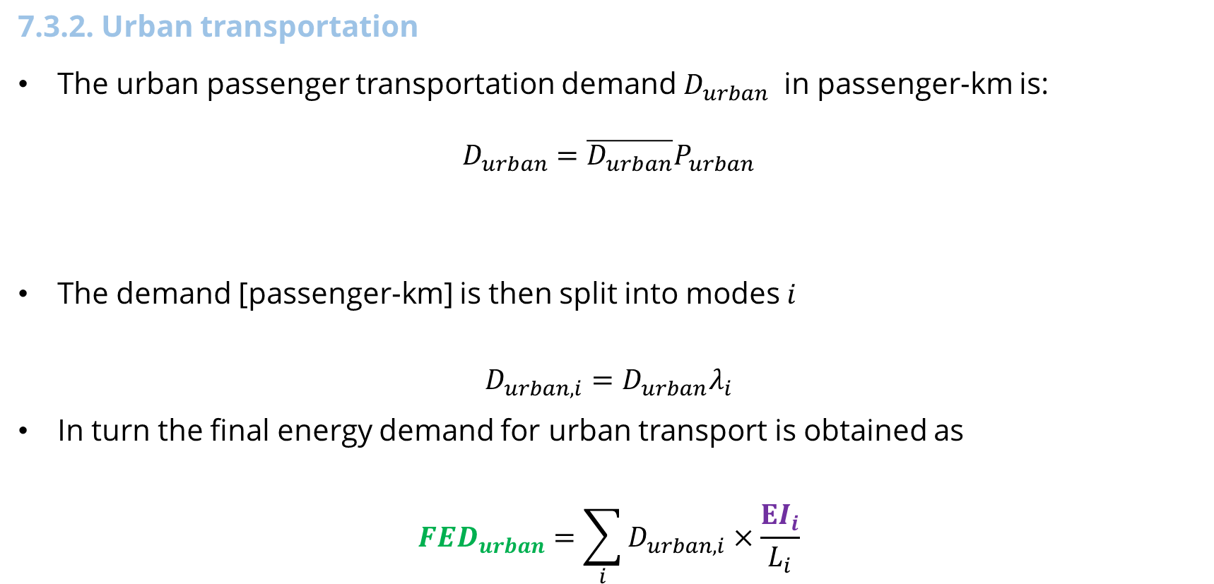
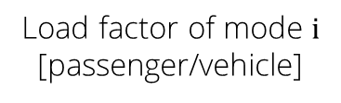
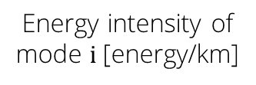

Lecture 7.3 Transportation sector
7.3.2. Urban transportation
The urban passenger transportation demand $D_{urban}$ in passenger-km is:
$$D_{urban}=\overline{D_{urban}}P_{urban}$$
The demand [passenger-km] is then split into modes $i$
$$D_{urban, i}=D_{urban}λ_{i}$$
In turn the final energy demand for urban transport is obtained as
$${FED}_{urban}=\sum_{i}{D_{urban, i}×\frac{EI_{i}}{L_{i}}}$$
Average distance travelled by a person living in a large city
Population living in large cities
Share of mode $i$ [-]
Energy intensity of mode $i$ [energy/km]
N.B. Final Energy Demand is measured in energy units, while Urban Passenger Demand is in passenger kilometres (p-km)
Load factor of mode $i$ [passenger/vehicle]
14
Notes:
Urban travel in MAED is considered as the travel of people living in large cities, (where public transportation exists or could be considered in the future) and trips that are done as part of one’s normal daily routine, (for example, daily commute to work).
Urban passenger transportation demand is calculated as a function of the population living in large cities and the average distance travelled per person.
The urban demand is then split into modes i as the product total urban passenger kilometre multiplied by the share of urban mode i.
Each urban transportation mode has assigned a fuel type and a specific energy intensity, which is expressed in energy units per 100 kilometres.
The total energy demand is a function of the energy intensity of urban transportation modes i in energy unit per kilometer and the load factor of each transportation mode.

Slide 15
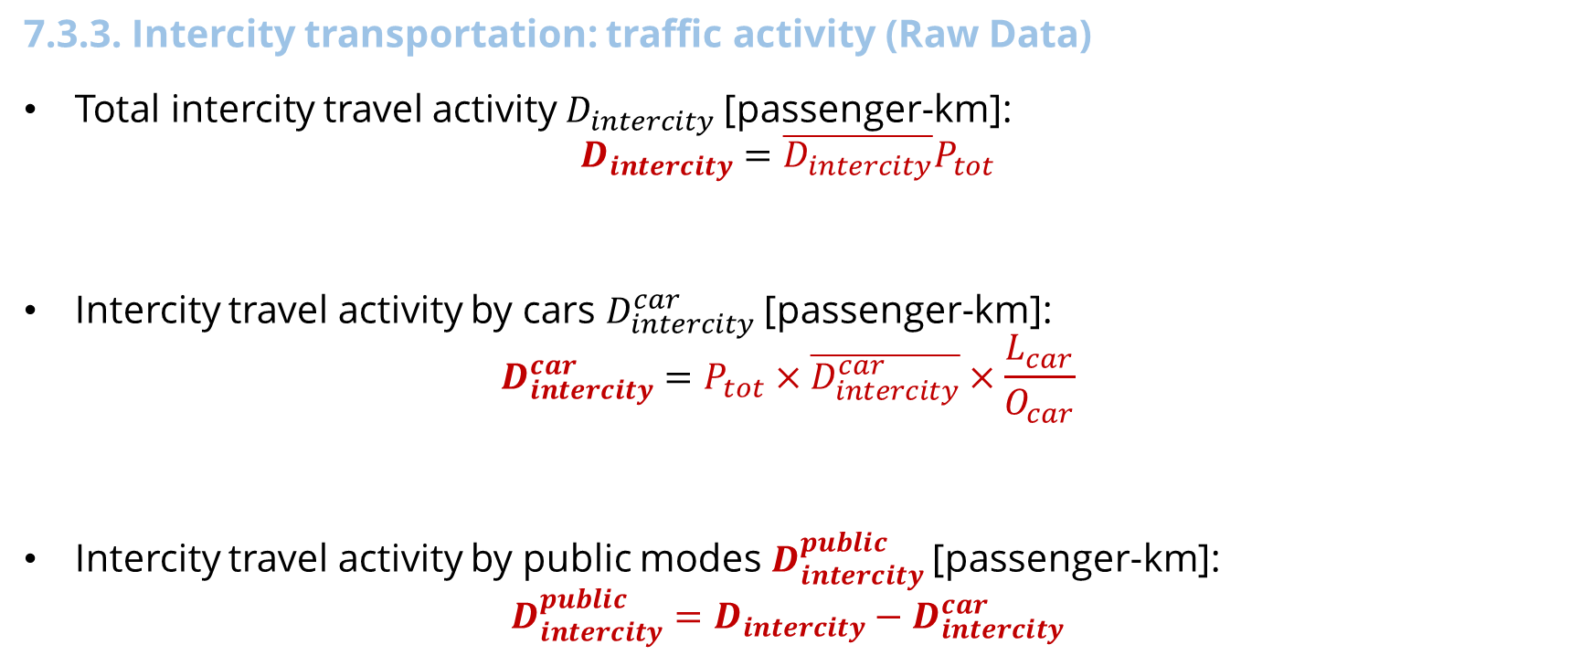
Lecture 7.3 Transportation sector
7.3.3. Intercity transportation: traffic activity (Raw Data)
Total intercity travel activity $D_{intercity}$[passenger-km]:
$$D_{intercity}=\overline{D_{intercity}}P_{tot}$$
Intercity travel activity by cars $D_{intercity}^{car}$[passenger-km]:
$$D_{intercity}^{car}=P_{tot}×\overline{D_{intercity}^{car}}×\frac{L_{car}}{O_{car}}$$
Intercity travel activity by public modes $D_{intercity}^{public}$[passenger-km]:
$$D_{intercity}^{public}=D_{intercity}−D_{intercity}^{car}$$
Total population
Average distance travelled/person/year
Loading factor [person/car]
Car ownership [car/passenger]
Average distance travelled/person/year by car
15
Notes:
Energy demand for intercity passengers is found in a similar way as it was found in urban areas.
First, the user provides data on the average distance travelled by a person per year. The travel activity in passenger-km is obtained using demography data.
The total intercity traffic activity equals the total population multiplied by the average distance travelled by a person per year.
The share of the traffic activity covered by cars is then calculated by the product of the total population, the average intercity distance driven per car per year, the load factor for cars and the inverse of the car ownership ratio in passengers per car. The same load factor is assumed for all types of cars in intercity passenger transportation. The rest of the demand is covered by public modes.

Slide 16
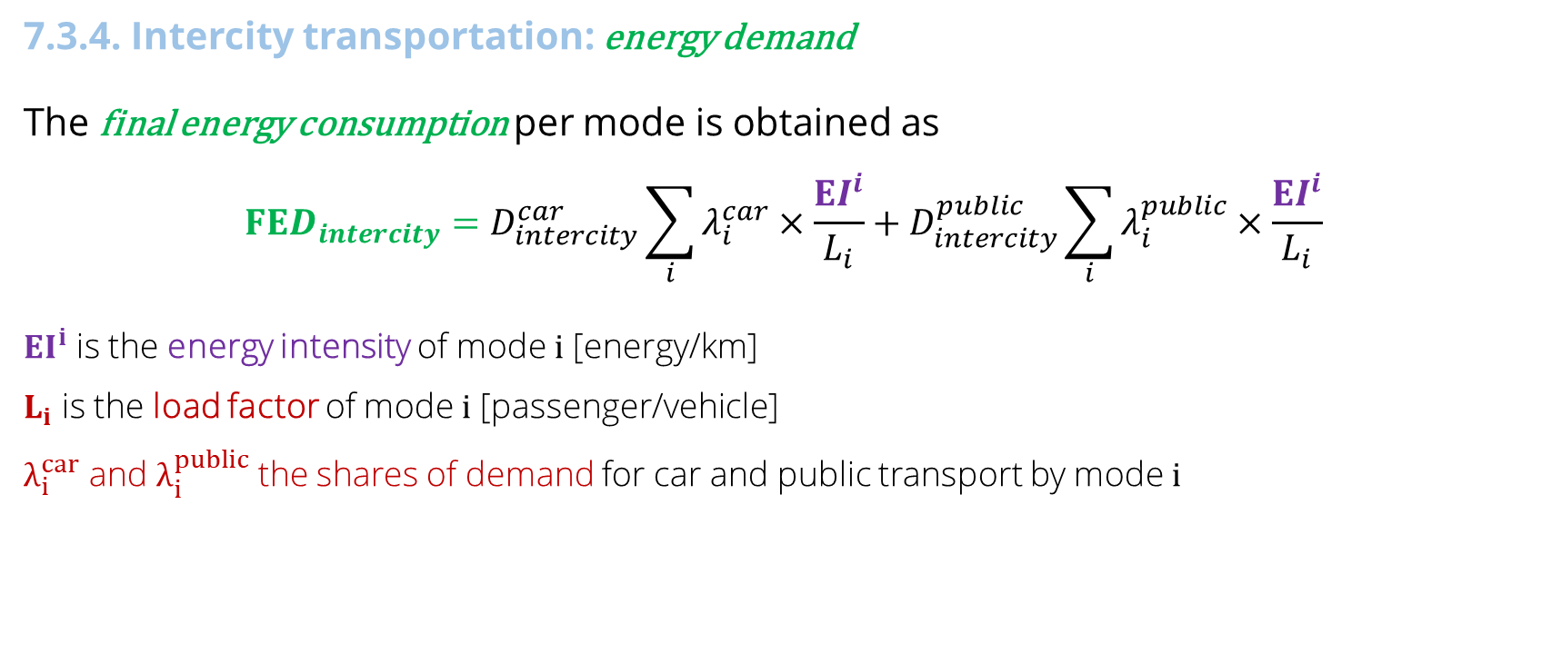
Lecture 7.3 Transportation sector
7.3.4. Intercity transportation: energy demand
The final energy consumption per mode is obtained as
$$FED_{intercity}=D_{intercity}^{car}\sum_{i}{λ_{i}^{car}×\frac{EI^{i}}{L_{i}}}+D_{intercity}^{public}\sum_{i}{λ_{i}^{public}×\frac{EI^{i}}{L_{i}}}$$
$EI^{i}$ is the energy intensity of mode $i$ [energy/km]
$L_{i}$ is the load factor of mode $i$ [passenger/vehicle]
$λ_{i}^{car}$ and $λ_{i}^{public}$ the shares of demand for car and public transport by mode $i$
16
16
Notes:
The model splits the total energy demand by modes for both car and public transport, using proportions given by the user.
Each transportation mode has assigned a fuel type, specific energy consumption or energy intensity, and loading factor given by the user in energy units per km.
Summing over all modes for both car and public transport, the final energy demand for intercity transportation is obtained.

Slide 17
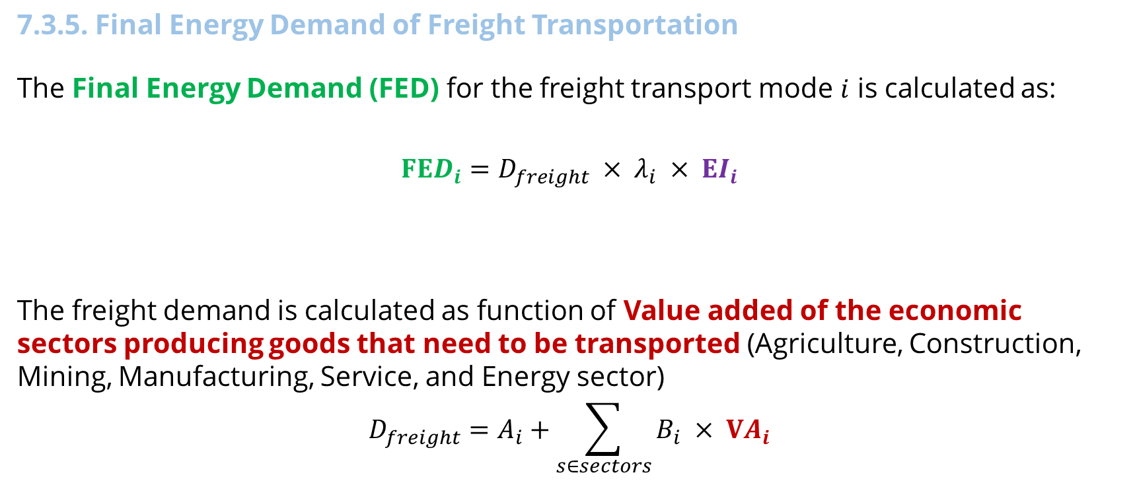
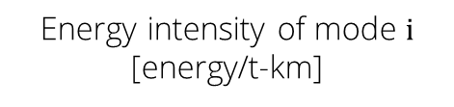
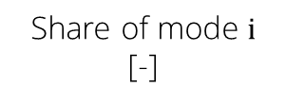
Lecture 7.3 Transportation sector
7.3.5. Final Energy Demand of Freight Transportation
The Final Energy Demand (FED) for the freight transport mode $i$ is calculated as:
$$FED_{i}=D_{freight} × λ_{i} × EI_{i}$$
The freight demand is calculated as function of Value added of the economic sectors producing goods that need to be transported (Agriculture, Construction, Mining, Manufacturing, Service, and Energy sector)
$$D_{freight}=A_{i}+\sum_{s∈sectors}{B_{i} × VA_{i}}$$
Freight demand
[t-km]
Share of mode $i$
[-]
Energy intensity of mode $i$
[energy/t-km]
N.B. Final Energy Demand is measured in energy units, while Freight Demand is in ton kilometres (tkm)
Value added
Constant
Variable
17
Notes:
The energy demand for the freight transportation mode i is calculated as a function of the freight demand in ton kilometres, the share of the demand met by this transportation mode i, and the energy intensity of the respective mode, given in energy units per ton kilometre.
The total freight demand is calculated as a function of the value added of the economic sectors producing goods that need to be transported such as Agriculture, Construction, Mining, Manufacturing, Service, and the Energy sector.
The total ton kilometres of freight equals a base value (here A.i.) plus the sum across all the economic sectors of a variable (B.i.) which represents the transport activity multiplied by the value added for each respective sector. The variable B.i. is given in terms of ton kilometres per unit of value added.

Slide 18

Cannone, C., Collett, K.A., Charbonnier F., Ahsan A., Halloran C., Vijay,A.,Berdellans I., Hasanovic S., Gritsevskyi A,Stankeviciute L., Tot M.; Welsch M., Hirmer S., 2023. Lecture 7: "TRANSPORT AND SERVICE SECTORS, AND SCENARIOS DEFINITION IN MAED" , Energy Demands Projections with MAED (Model for Analysis of Energy Demand). Release Version 2.0. [online presentation]. Climate Compatible Growth & Programme and International Atomic Energy Agency.
CCG courses (this will take you to the website link http://www.ClimateCompatibleGrowth.com/teachingmaterials)
18

