Slide 1
Lecture 6
Introduction to FinCoRE
Open Learn Collection
Financial Modelling for Energy Transitions: MinFIN, FinTrack & FinCoRE

Slide 2
Lecture Outline
Financial Modelling for Energy Transitions
 | Learning Objectives
Part 1 | Motivations for estimating costs of capital
Part 2 | Methods for cost of capital estimation
Part 3 | Methods for cost of capital estimation
Part 4 | The Financing Costs for Renewables Estimator (FinCoRE)
Notes:
In this lecture, we will be discussing the motivations for estimating the cost of capital, factors that influence the overall cost, and the range of methods that are available for estimation. The final section will cover Climate Compatible Growth's FinCoRE model, which can be used to estimate the cost of capital for renewable technologies.

Slide 3
Learning Outcomes
Understand the challenges in accessing empirical data on the cost of capital and the need to make estimates
Learn and identify the key risks contributing to the cost of capital for renewable projects
Learn and understand the different approaches to estimating the cost of capital used in academia and policymaking
Learn and understand the approach used by the FinCoRE tool to estimate and project renewable financing costs at a country level
Notes:
The corresponding learning outcomes are summarised in this slide, for each section.

Slide 4
Motivations for estimating costs of capital
Part 1

Slide 5


Why estimate the costs of capital?
As discussed in Lecture 6, the cost of capital is an important input parameter to the economic analysis of renewables and makes up a significant portion of the lifecycle cost of renewable projects
It is also a key assumption for energy system modelling and inaccurate values can bias the results substantially
Notes:
As we covered in Lecture 6, the cost of capital is a key input parameter in the economic analysis of renewables and power system dynamics. It significantly influences the overall cost of electricity from renewable and other low-carbon projects and so is an important assumption. If the cost of capital is underestimated, it can lead to overly optimistic projections, whilst an underestimate can bias s. On the other hand, overestimating it can result in overly pessimistic evaluations of the viability of renewable technologies.
Therefore, ensuring accurate figures for the cost of capital is fundamental to producing reliable and unbiased results.

Slide 6
Why estimate the costs of capital?
Data on the cost of capital is typically regarded as trade secrets by financial institutions, so availability of empirical data is limited
Many renewable projects are financed off-balance sheet under "project finance", so financial information is limited
Where data is available, it is often limited to individual regions, technologies and project contexts and is typically outdated
Notes:
Let's delve into some challenges related to accessing data on the cost of capital for renewable energy projects.
Firstly, financial institutions often treat this data as trade secrets, making empirical data scarce. This lack of transparency can hinder accurate economic analysis.
Secondly, many renewable projects are financed off-balance sheet under 'project finance' structures. This means financial information is not always readily available, adding another layer of complexity.
Lastly, when data is available, it tends to be specific to certain regions, technologies, and project contexts. Available data is often outdated, which can lead to inaccuracies in modeling and analysis.

Slide 7
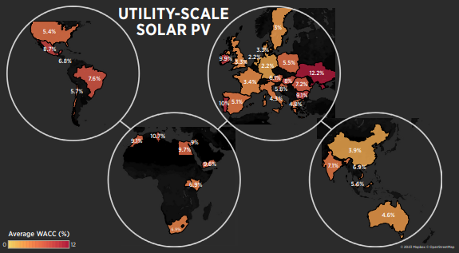
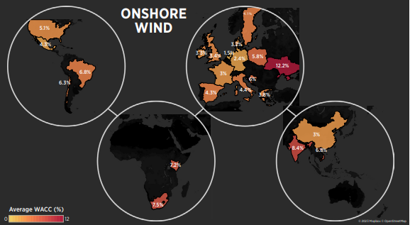
Why estimate the costs of capital?
Data that is available (e.g., from IRENA for 2021) shows a strong variance in the cost of capital across countries, regions and technologies
Substantial uncertainty over the cost of capital in emerging and developing economies, which have had little renewable investment to date
Visualisation taken from IRENA 2023
Notes:
Data that is available on the cost of capital (also referred to as the WACC) shows that the values range substantially across countries, regions and technologies. Maps are shown for onshore wind and solar PV here, with values ranging from 2% or below to highs above 12% for both technologies. The plots are taken from IRENA's engagement with experts and are depicted for the year 2021. As you can see from the mapping, there are a number of countries and regions where there was little or no data. These regions are predominantly emerging and developing economies, which have seen little renewable or low-carbon generation deployment compared to the developed world. The cost of capital is also likely to be much higher in these countries, due to factors such as country risk premiums and lack of experience deploying these technologies.

Slide 8
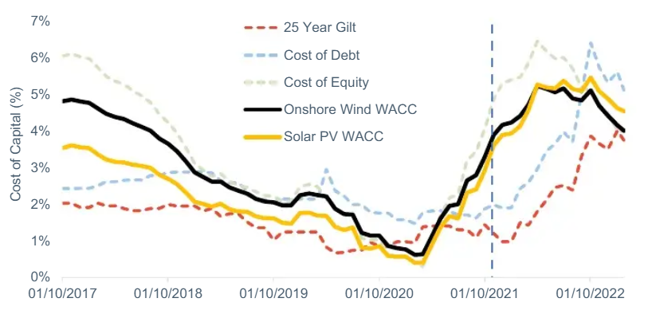
Why estimate the costs of capital?
The cost of capital also varies temporally due to changes in the macroeconomic environment e.g., interest rates and inflation
Even if data is available for the corresponding country and technology, changes in these factors mean that the data may not reflect actual costs from investors
Changes in market regulation and the policy landscape can also affect the cost of capital, as can an increase in technology maturity
Notes:
Data that is available also shows that the cost of capital varies with time, as the macroeconomic environment in individual countries changes. The plot on the top right is taken from Cornwall insights and demonstrates how the cost of capital for onshore wind and solar PV in the UK varied with time over 5 years, in line with other benchmarks (for example, the yield on a 25 year UK Treasury Bond). Whilst data on the cost of capital may be available for a specific region or technology of interest, if it is outdated then the actual cost of capital could differ substantially. These changes can be caused by macroeconomic factors, but also changes in the policy and regulatory landscape. Increased experience with deploying new technologies can also help reduce the cost of capital, as it becomes regarded as more technologically mature (and so regarded as less risky).

Slide 9
Methods for cost of capital estimation
Part 2

Slide 10




Methods for estimating the cost of capital
As discussed in the previous section, data on the cost of capital is outdated, limited and/or difficult to assess
From a developer perspective, understanding the cost of capital that is accessible will be key to understanding the viability of renewable projects
From a government and researcher angle, accurate assumptions about the cost of capital is key to effective modelling of the energy transition
Estimation methods are therefore very useful
Notes:
Building on the previous section, let's consider the implications of outdated, limited, and difficult-to-access data on the cost of capital for renewable energy projects.
From a developer's perspective, understanding the cost of capital that they can access is key for assessing the viability of renewable projects. This knowledge helps in making informed investment decisions and securing necessary funding.
For governments and researchers, accurate assumptions about the cost of capital are important for effective modeling of the energy transition. These assumptions influence policy-making, planning, and the overall strategy for achieving climate and energy goals.
Therefore, reliable estimation methods for the cost of capital are very important. They help bridge the data gaps and provide a more accurate basis for economic analysis and energy system modeling. In the following slides, we will discuss five methods for estimating the cost of capital.

Slide 11
Methods for estimating the cost of capital
Method 0: Use of assumptions
In many cases, the level of uncertainty over cost of capital and the limited ability to access data means that assumptions are typically used
For example, for emerging technologies such as green hydrogen, a cost of capital of 8-10% is typically used
However, these assumptions can bias results of energy system models substantially and do not accurately depict the cost of capital
Notes:
The first method is the use of uniform or standard assumptions, though it has been marked as method zero as it is not really a method for estimating the cost of capital. Due to the high level of uncertainty and limited access to data, assumptions are often used to avoid potential inaccuracies. This approach is commonly used for emerging technologies, such as green hydrogen, where there is little or no data globally on the cost of capital. Standard assumptions of 8 – 10 % are typically employed, with sensitivity analyses used to explore the impacts of these assumptions.
However, relying on these assumptions can significantly bias the results of energy system models. They may not accurately reflect the true costs of capital, leading to potential inaccuracies in economic analysis and decision-making.
Whilst assumptions can be a practical solution in the absence of concrete data, they come with the risk of skewing model outcomes and so should be used with caution.

Slide 12
Methods for estimating the cost of capital
Method 1: Elicitation of project finance data
Collection and analysis of the cost of capital from specific project financing structures e.g., through accessing the finance term sheet
Typically challenging given the confidential nature of the empirical data being collected
Difficulties in verifying the data that has been collated, and/or publishing it (aside from in aggregate)
Notes:
The second method involves collecting and analysing the cost of capital from specific project financing structures, through close examination of the terms of finance associated with a project. This approach is the most accurate, as involves extracting empirical data from projects that have received financing. However, it is typically challenging due to the confidential nature of the empirical data, with financial institutions and project developers often not happy to share this information freely. These factors can make it difficult to obtain the empirical data.
There are also significant difficulties in extracting relationships from the empirical data, as financing terms will encompass the whole range of project and sector risks – which may not be directly transferable to other projects, even operating in similar geographic regions and markets. Even when a range of data is available, publishing it can be difficult and is often limited to publishing in aggregate forms.

Slide 13
Methods for estimating the cost of capital
Method 2: Estimates derived from an expert survey
Estimates of the cost of capital are collected by interviewing experts in the industry and aggregating their estimates
Can include consultants, investors, financiers, academics and industry professionals
Introduces a level of uncertainty in the estimates that are provided, as they are unverifiable and based off of perceptions (rather than empirical data)
Notes:
To address issues with extracting empirical data, the third method involves the used of expert surveys with industry professionals. Estimates of the cost of capital for different regions, markets, and time periods are collecting by interviewing industry experts and aggregating their insights on the likely cost of capital. These experts can include consultants, investors, financiers, academics and industry professionals
Whilst this approach can provide valuable perspectives, it does introduce a level of uncertainty, as the estimates are based on expert perceptions rather than empirical data. This makes them potentially unverifiable and subjective, with potential biases. It is also limited to the projects and regions that the stakeholders engaged with have operated in, making it challenging to translate estimates to different geographies, technologies and time periods.

Slide 14
Methods for estimating the cost of capital
Method 3: Replication of Renewable Auctions
In many countries, renewable projects are awarded power purchase agreements or subsidies through competitive auctions
In auctions, whilst the cost of capital is not available, many other important parameters are e.g., price and cost data
A financial model can easily be constructed to estimate the likely cost of capital for renewable developers, based on assumptions over the profitability of the investment
Notes:
In many countries, renewable projects are awarded power purchase agreements or subsidies through competitive auctions. While the cost of capital is not directly available from these auctions, developers who bid into the auctions typically have to provide other key parameters, such as price and cost data, as part of the auction process. Using the data that is available, a financial model can be constructed to estimate the likely cost of capital for renewable developers. This model would be based on assumptions about the profitability of the investment and likely operating structure.
Replicating renewable auctions offers a practical approach to estimating the cost of capital by leveraging available auction data and financial modelling, with some small inaccuracies based on the assumptions made within the financial model.

Slide 15
Methods for estimating the cost of capital
Method 4: Analysis of Financial Market Data
Costs of equity and costs of debt can be estimated based on macroeconomic and financial parameters
For example,. country level interest rates, country level risks and estimates of equity risk premiums
By applying an assumption for the capital structure (i.e. the debt-equity split), the cost of capital can be evaluated
Notes:
Finally, the fourth method involves estimating the cost of equity and cost of debt for energy investments, based on macroeconomic and financial data about the project and country of interest. Through making these estimates and applying assumptions for the capital structure of a project (i.e. the debt-equity split), you can evaluate the overall cost of capital for a given investment. Data used in this approach includes country-level interest rates, risk premiums at a national level, and estimates of the equity risk premium, which can all be combined to form estimates of the cost of capital. Whilst this approach may miss some of the project and sector-level risks that affect the cost of capital for infrastructure projects, the approach can be replicates for countries and time periods where there is little or no data on the cost of capital.

Slide 16
Methods for cost of capital estimation: Macroeconomic estimates
Part 3

Slide 17
Risks affecting low-carbon infrastructure projects
To estimate the cost of capital at a national level for a range of low-carbon technologies, geographies and years, the final method (analysis of financial market data) is typically the most suitable:
  Assumptions introduce biases into energy system models
  Elicitation of project finance data can be costly and return limited results
  Expert surveys can be time consuming and does not return information on technologies and geographies where there is limited deployment
  Auctions are limited to a small subset of countries, which typically have higher renewable market development
Notes:
To estimate the cost of capital at a national level for various low-carbon technologies, geographies, and years, the final method—analysis of financial market data—is typically the most suitable.
Using assumptions can introduce biases into energy system models, potentially skewing results and impairing the accuracy of insights
Elicitation of project finance data can be both costly and yield limited results due to the confidential nature of the data, whilst data is often only available for a subset of countries and technologies.
Expert surveys, while valuable, can be time-consuming and may also not provide information on technologies and geographies with limited deployment.
Lastly, auctions are confined to a small subset of countries, which typically have more developed renewable markets, so estimates of the cost of capital from auctions may not be representative of other geographies,.
In summary, analyzing financial market data offers a more comprehensive and reliable approach for estimating the cost of capital across different contexts

Slide 18
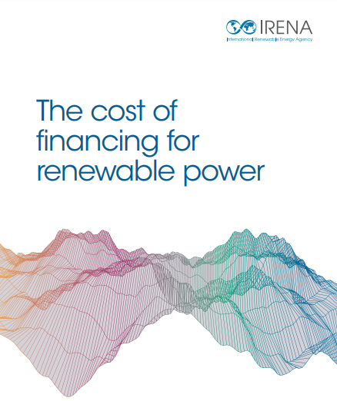
Risks affecting low-carbon infrastructure projects
IRENA's methodology uses data on renewable deployment, country risks and interest rates to estimate costs of capital
Contributions of different risks to the cost of debt and equity are assessed individually:
  Risk free rate
  Instrument risk
  Country risk
  Technology risk
Methods adapted from IRENA 2023
Notes:
In the next few slides, we will discuss an approach that IRENA has developed for estimating the cost of capital for renewable technologies across different geographies. It uses data on renewables deployment, country risks, U.S. interest rates and assumptions over debt and equity premiums to calculate the cost of debt and cost of equity individually. Assumptions on the debt-equity split are then used to calculate the overall cost of capital.
The cost of debt and cost of equity are both calculates respectively by assessing how different risks contribute quantitatively to the cost, including the risk free rate, instrument risk, country risk and technology risks. Its method has been adapted for use in Climate Compatible Growth's FinCoRE tool, which is the focus of the next section.

Slide 19
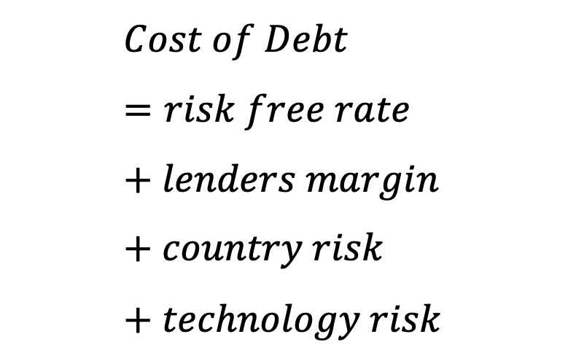
Risks affecting low-carbon infrastructure projects
Cost of Debt
$$Cost of Debt=risk free rate+lenders margin+country risk+technology risk$$
Taken as the yield on a U.S. 10 year Treasury bond
Taken as 2% based on data for large-scale infrastructure projects
Estimates made based on credit rating of sovereign bonds
Modelled based on renewables maturity in a given country, measured using renewable grid penetration. Countries are categorized into Mature, Intermediate and Emerging markets, with technology risk falling with penetration and maturity
Methods adapted from IRENA 2023
Notes:
In this slide, we will be discussing how the cost of debt is estimated at a national level. The equation shows that the cost of debt is disaggregated into four parameters – the risk free rate, lenders margin, country risk and technology risk. The risk free rate is taken as the yield on a U.S. 10 year Treasury bond, which is generally regarded as one of the most stable and secure investments. The lenders margin, meanwhile, represents the profit margin for debt lenders, and is taken as 2% based on data collected by IRENA for large-scale infrastructure projects. The country risk is taken from modelling conducted by Professor Aswan Damodaran at NYU, who analyses the credit rating of sovereign bonds and extracts the spread (i.e. the additional cost) above a default free government bond. It is then used to assess the risk for a given country.
Finally, the technology risk is modelled based on the renewable technology penetration in the country, which is assessed using data on renewable and total generating capacity at a yearly resolution. Based on the penetration, countries are categorised into corresponding market categories, with technology risk falling as penetration and maturity increases. For further information on the method, check out the full paper linked in the bottom left.

Slide 20
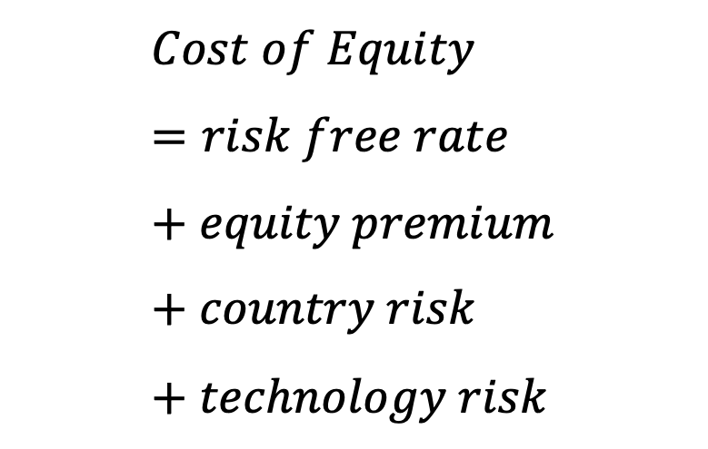
Risks affecting low-carbon infrastructure projects
Cost of Equity
$$Cost of Equity=risk free rate+equity premium+country risk+technology risk$$
Taken as the yield on a U.S. 10
year Treasury bond
Estimates made for mature markets
Estimates using country default spreads / equity risk premiums
Modelled based on renewables maturity in a given country, measured using renewable grid penetration. Countries are categorized into Mature, Intermediate and Emerging markets, with technology risk falling with penetration and maturity
Methods adapted from IRENA 2023
Notes:
The cost of equity is also calculated using a similar approach at a national level. It is disaggregated into four parameters, with the only difference between the cost of debt and cost of equity being that the equity premium replaces the lenders margin. The equity premium is extracted from analysis also conducted by Aswan Damodaran at NYU, who estimates the equity risk premium using data on bond risk premiums in mature markets and assumptions over the relative spread with bond and equity financing terms. All other parameters are estimated using the same approach as for the cost of debt.

Slide 21
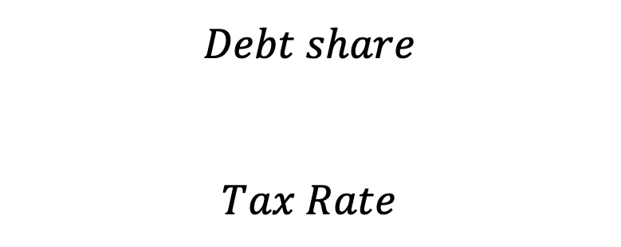
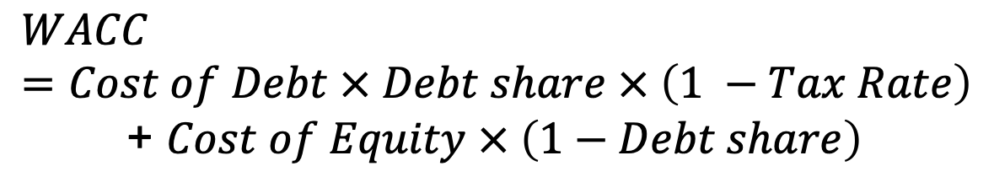
Risks affecting low-carbon infrastructure projects
Capital Structure
$$WACC=Cost of Debt × Debt share × \left(1 −Tax Rate\right)$$
+ $Cost of Equity × \left(1−Debt share\right)$
$$Debt share$$
$$Tax Rate$$
Taken as 60% for Emerging Markets, 70% for Intermediate and 80% for Mature
Corporate tax data taken from KPMG’s global database
Methods adapted from IRENA 2023
Notes:
Once estimates of the cost of debt and cost of equity are made, they are combined using the equation on this slide to give the overall cost of capital (i.e. the WACC). As discussed, debt financing is tax-deductible, so the effect of corporate tax rates must be accounted for. The debt share is taken as 60% for emerging markets, 70% for intermediate and 80% for mature, with the market maturity based on the renewable grid penetration for a given year. The tax rates are extracted from KPMG's database on corporate tax rates, which publishes data on rates by country for over 100 countries.

Slide 22
The Financing Costs for Renewables Estimator (FinCoRE)
Part 4

Slide 23
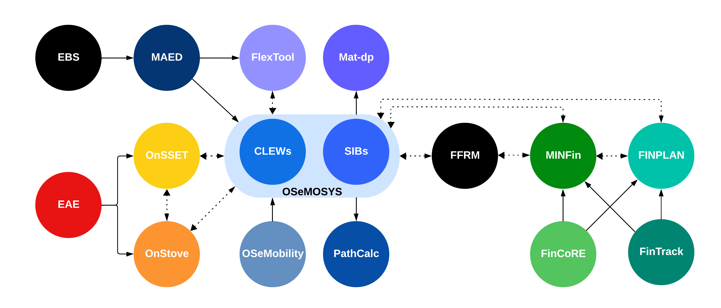
The FinCoRE tool: an online dashboard to explore estimates of the cost of capital
Alongside MinFin, FinTrack and FinPlan it constitutes a key part of CCG’s Energy Finance modelling suite
FinCoRE allows the estimation of the cost of capital for key clean technologies in the power sector
These estimates can be integrated into MinFin and FinPlan analysis
Check out the FinCoRE dashboard online!
Notes:
Climate Compatible Growth have developed their own cost of capital estimation tool, which is called FinCoRE. In this final section, we are going to discuss some of the uses of the tool and how it can be used with the other modelling tools that form part of Climate Compatible Growth's energy finance modelling suite. The principal tools it can be used with are MinFin, FinTrack and FinPlan, all of which are covered in this lecture series. Estimates from FinCoRE on the cost of capital can be integrated into MinFin and FinPlan analysis, allowing for more accurate modelling of country and technology-level financing contexts. A link to the FinCoRE online dashboard is included in the bottom right hand corner, below the visualisation of Climate Compatible Growth's full modelling offer.

Slide 24
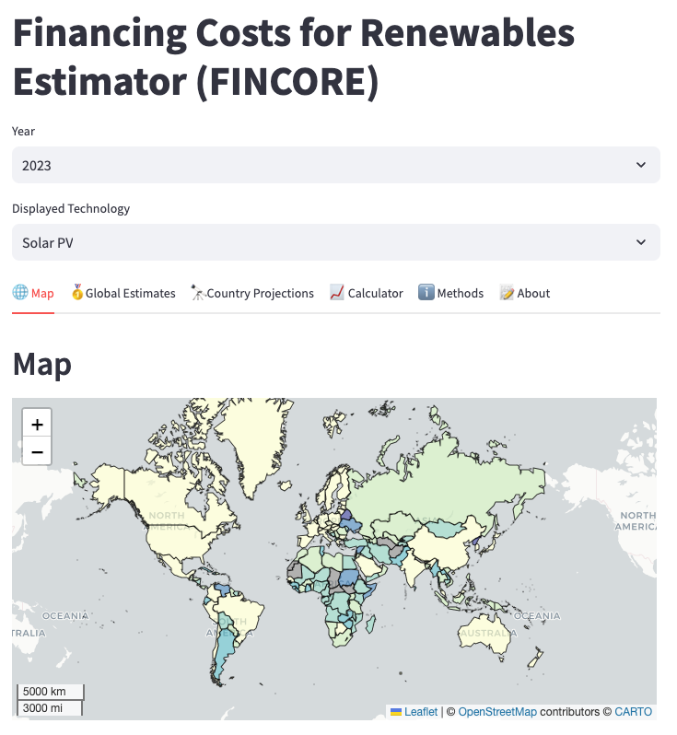
The FinCoRE tool: an online dashboard to explore estimates of the cost of capital
Country Projections: Projections of the cost of capital out to 2030 and beyond based on current forecasts. Allows for user-defined scenarios and exploration of assumptions
Map: Geographic mapping of the cost of debt, equity, debt share and overall CoC
Global Estimates:
Comparison of the cost of capital in a set number of countries and the relative contributions from different risk factors
Calculator:
Allows for individual country-level calculations, based on modifying existing assumptions used in the model e.g., debt share
Notes:
Here, the slide shows the online FinCoRE dashboard, which will open up when you first follow the link in the previous slide. The first tab, named Map, includes a geographic mapping of the cost of debt, cost of equity, debt share and overall cost of capital for all countries that there is data available for. It changes depending on the Year and Technology selected through the two select boxes on the top, which are also used for the other tabs.
The second tab, Global Estimates, allows for a comparison of the cost of capital in a given number of countries. It includes a breakdown of the risks contributing to the overall cost of capital, which can be used to highlight the different drivers of the cost of capital in different regions.
The third tab, Country Projections, allows for exploration of future costs of capital for a given technology and country under user-defined assumptions. This section is particularly useful for integration with MINFin, which typically runs on historical data – more on this in the hands on exercise!
The fourth tab, Calculator, allows for exploration of individual countries and technology costs of capital by modifying existing assumptions used in the model. These include parameters such as the overall debt share, country risk premium, and any other inputs to the calculation. Please feel free to have a play around with these settings to see how they affect the overall cost of capital.
Finally, the Methods and About tabs contain information about the approach and background to the FinCoRE tool.

Slide 25
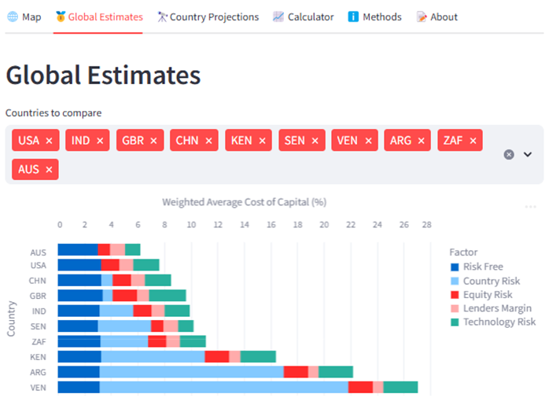
The FinCoRE tool: an online dashboard to explore estimates of the cost of capital
FinCoRE is based on IRENA’s method of risk disaggregation, discussed in the previous section
Calculations are performed for all countries with available data (>150)
Estimates can be made for both historical and future years
Users can explore the impact of different scenarios and assumptions
Notes:
As detailed in the Methods tab, FinCoRE's modelliong approach is based on IRENA's method of risk disaggregation, which was discussed in the previous section. It calculates the cost of capital for all countries with available data, which is over 150 countries for 2023. It has the functionality to make both forward looking and historical estimates, with forecasted based on assumptions over how the input parameters will change. For example, how the country risk, renewable penetration, and risk-free rates are likely to change in the next five years. As a user, you can explore the impact of different scenarios and assumptions.

Slide 26
The FinCoRE tool: an online dashboard to explore estimates of the cost of capital
Breakdowns of the contributions to the overall cost of capital for each country and technology are produced
For example, in Argentina the risk-free rate and country risks are the key drivers of the cost of capital for solar PV
Estimates are made in nominal terms, assuming hard currency lending from international sources
Notes:
The screenshot on the right shows the global estimates tab, with a select number of country estimates of costs of capital for solar PV in 2023. We can see that in countries such as Venezuela and Argentina, it is the country risk that is driving extremely high costs of capital, due to their macroeconomic and inflationary economic climates. In Australia and the USA, on the other hand, the risk-free rate is a key driver of the cost of capital, accounting for over half of the weighted average cost of capital. Estimates are all made in nominal terms and assume that investors are international and are lending or investing in hard currencies (such as the US dollar) from abroad.

Slide 27
Thank you
Contact Information: v.foster@imperial.ac.uk or hannah.luscombe@ouce.ox.ac.uk

