Slide 1

Model for Analysis of Energy Demand
LECTURE 6
BASE YEAR RECONSTRUCTION WITH THE HOUSEHOLD SECTOR EXAMPLE
Version 2.0
Notes:
Licence: This work is licensed under the Creative Commons Attribution 4.0 International License (CC BY 4.0). To view a copy of this license, visit https://creativecommons.org/licenses/by/4.0/.
Attribution: Please cite as: Kiley, F. (2025) An Introduction to Simulating Energy Demand with MAED. Version 1. Climate Compatible Growth Teaching Kit Website, Climate Compatible Growth.
Lecture 6: Base Year Reconstruction Households

Slide 2
Intended Learning Outcomes (ILOs)
This lecture has four Intended Learning Outcomes (ILOs):
ILO1: learn about the household sector and its subsectors
ILO2: learn how to collect the raw data needed for the base year reconstruction
ILO3: learn how to calculate the MAED input data for the base year
ILO4: learn how to check that the Base year was successfully reconstructed.
6.1 Household Sector and its sub-sectors
6.2 Base Year Reconstruction (1/3) – Collection of Raw Data
6.3 Base Year Reconstruction (2/3) - MAED Input Data calculation for the base year
6.4 Base Year Reconstruction (3/3): Run, Results, Check for Accuracy
2
Notes:
This lecture has four Intended Learner Outcomes:
ILO1: learn about the household sector and its subsectors
ILO2: learn how to collect the raw data needed for the base year reconstruction
ILO3: learn how to calculate the MAED input data for the base year
ILO4: learn how to check that the Base year was successfully reconstructed.

Slide 3







Lecture 6.1 Household sector
            6.1.1. The Household Sector, Subsectors, End-use and Final Energy Demands
Industry
Service
Household
Transport
Sectors
Urban
Rural
Subsectors
Cooking
Lightening
Air Conditioning
Specific electricity use
Space Heating
Water Heating
End-use
Heat Pump
Non-Heat Pump
Heat Pump
Non-Heat Pump
Category of Final Energy Demand (FED)
Substitutable Fossils
Modern Biomass
Traditional Fuels
Solar Thermal
Electricity
Electricity Heat Pump
3
Notes:
The household sector can be further divided into the Urban and the rural subsector.

Slide 4
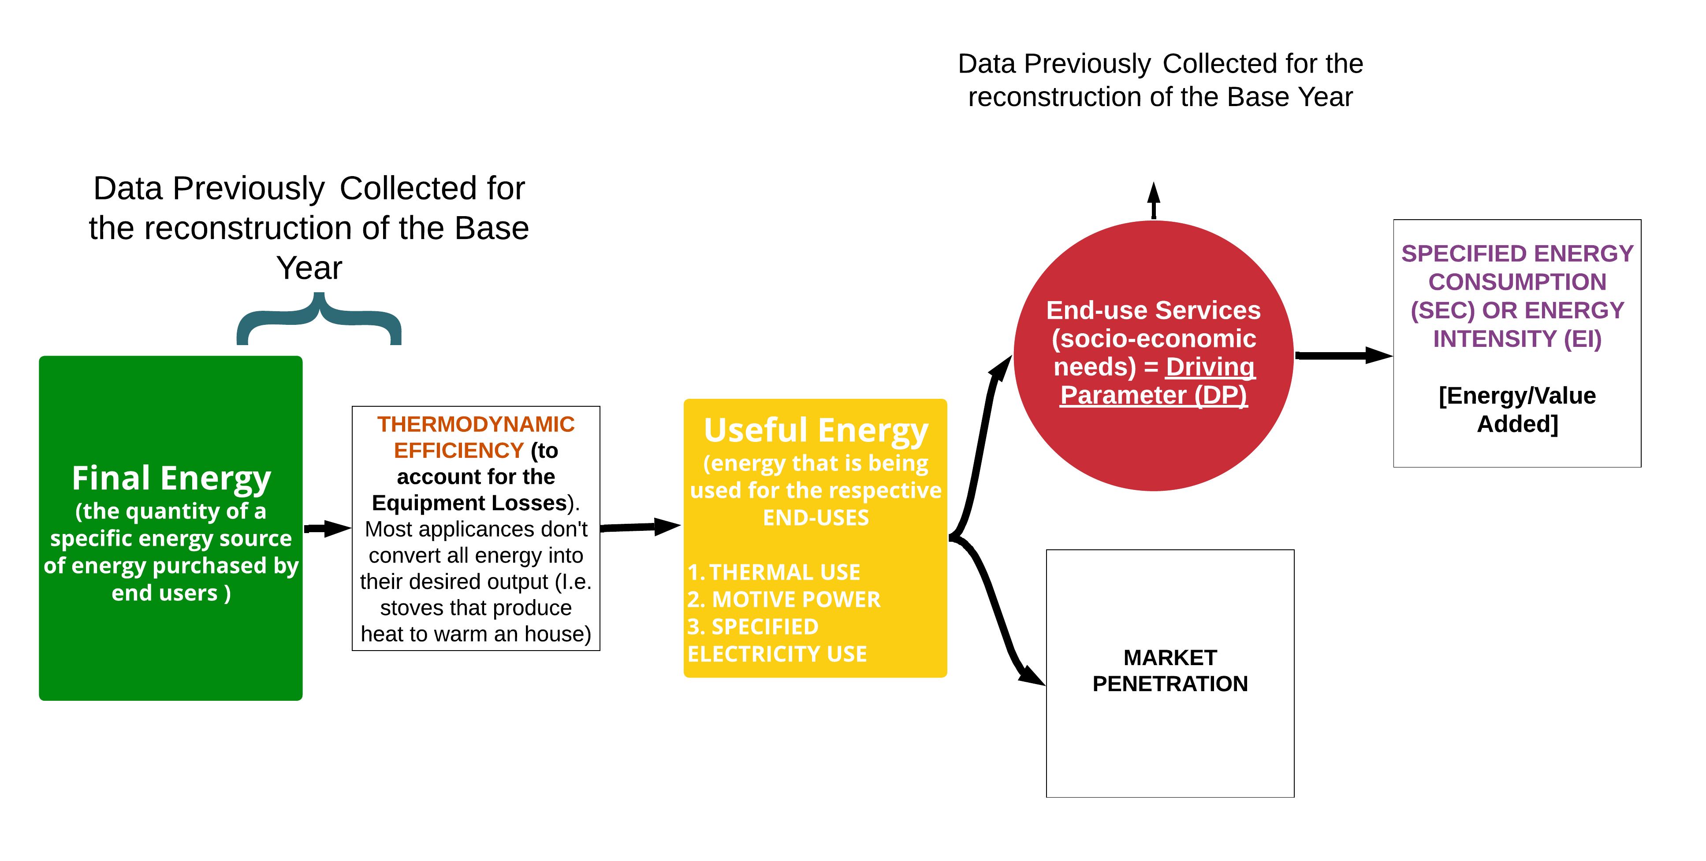
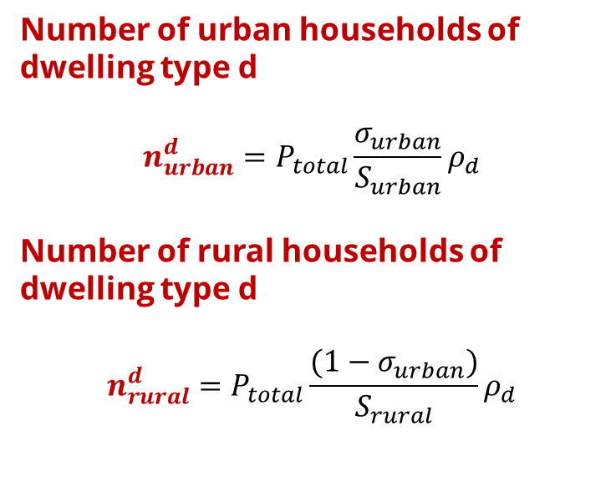


Lecture 6.1 Household sector
6.1.2. Subsectors: Urban VS Rural
Number of urban households of dwelling type d
$$n_{urban}^{d}=P_{total}\frac{σ_{urban}}{S_{urban}}ρ_{d}$$
Number of rural households of dwelling type d
$$n_{rural}^{d}=P_{total}\frac{{(1−σ}_{urban})}{S_{rural}}ρ_{d}$$
    Share population in urban areas [-]
    Share by dwelling type
    Average urban household size [person/household]
    Total population [persons]
$${FED}_{u}^{e}×η_{u }^{e}{=UED}_{u}$$
$${SEC}_{u}=\frac{UEDu}{DP}$$
    Average rural household size [person/household]
4
Notes:
The main driving parameter in the household sector’s calculations is the number of dwellings, which is a parameter derived from the total population.
Some demographic parameters, such as the share of urban population and the average household size in urban, and in rural areas, are defined exogenously in the model by the user.
From these, the number of urban households, the share of rural population, and the number of rural households can be derived.
It is assumed that the number of dwellings is equal to the number of households in both urban and rural areas.
In the following slides, we present equations for obtaining the useful energy demand for the subsectors. The equations are the same for urban and rural areas. The useful energy demand (U.E.D.) can then be converted to final energy demand (F.E.D.) based on the process efficiency and the carrier market penetration (M.P.), similarly to the industry sector.
Market penetration and efficiencies are specified as scenario parameters.
It should be mentioned that all the efficiencies in the MAED model are expressed in relative terms versus the efficiency of electricity for the same end-use.

Slide 5

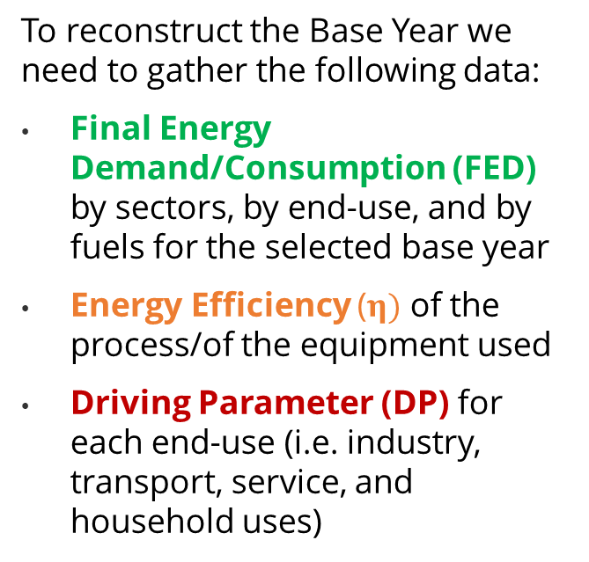
Lecture 6.1 Base Year Reconstruction (1/3)
Gather/Adjust MAED parameters for the base year
Calculate MAED Input Data for the base year
            6.1.3. Gather MAED Parameters for the Base Year - Example
Check accuracy of MAED results for the base year
Run the MAED model
            To reconstruct the Base Year we need to gather the following data:
            Final Energy Demand/Consumption (FED) by sectors, by end-use, and by fuels for the selected base year
            Energy Efficiency ($η)$ of the process/of the equipment used
            Driving Parameter (DP) for each end-use (i.e. industry, transport, service, and household uses)
5
Notes:
To reconstruct the Base Year we need to gather the following data:
Final Energy Demand/Consumption (FED) by sectors, by end-use, and by fuels for the selected base year
Thermodynamic Energy Efficiency ($η)$ of the process/of the equipment used.
Driving Parameter (DP) for each end-use (i.e. industry, transport, service, and household uses).
We have to make sure that units are consistent across MAED.

Slide 6


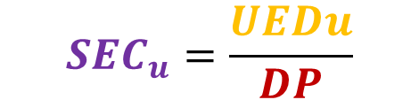
Lecture 6.1 Base Year Reconstruction (2/3)
Gather/Adjust MAED parameters for the base year
Calculate MAED Input Data for the base year
Check accuracy of MAED results for the base year
Run the MAED model
            6.1.4. Calculate MAED Input Data for the Base Year
With the Final Energy Consumption data and the Efficiency we calculate the Useful Energy and then the Market Penetration.
The ratio of the Useful Energy and the Driving Parameter will give us the Specified Energy Consumption (or Energy Intensity).
$${SEC}_{u}=\frac{UEDu}{DP}$$
$${FED}_{u}^{e}×η_{u }^{e}{=UED}_{u}$$
$${MP}_{u}^{e}$$
6
Notes:
To reconstruct the Base Year we need to gather the following data:
Final Energy Demand/Consumption (FED) by sectors, by end-use, and by fuels for the selected base year
Thermodynamic Energy Efficiency ($η)$ of the process/of the equipment used.
Driving Parameter (DP) for each end-use (i.e. industry, transport, service, and household uses).
We have to make sure that units are consistent across MAED.

Slide 7

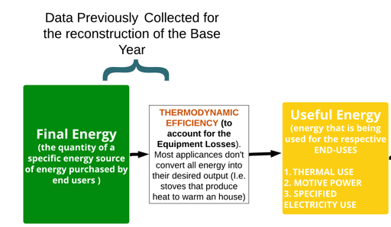
Lecture 6.1 Base Year Reconstruction (2/3)
            6.1.5. Calculate MAED Input Data for the Base Year
$${FED}_{u}^{e}×η_{u }^{e}{=UED}_{u}$$
Gather/Adjust MAED parameters for the base year
Calculate MAED Input Data for the base year
Check accuracy of MAED results for the base year
Run the MAED model
7

Slide 8
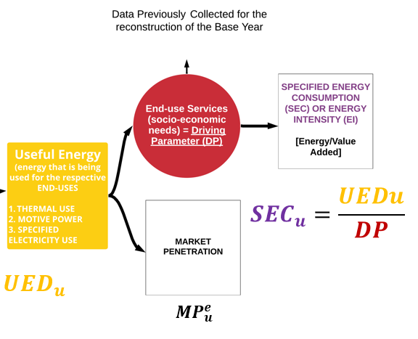
Lecture 6.2 Base Year Reconstruction (2/3)
            6.2.1. Calculate MAED Input Data for the Base Year
Gather/Adjust MAED parameters for the base year
Calculate MAED Input Data for the base year
Number of urban dwellings
Check accuracy of MAED results for the base year
Run the MAED model
Number of urban dwellings of the defined house type
8

Slide 9
Lecture 6.2 Base Year Reconstruction (2/3)
Gather/Adjust MAED parameters for the base year
Calculate MAED Input Data for the base year
Check accuracy of MAED results for the base year
Run the MAED model
            6.2.2. Calculate MAED Input Data for the Base Year
Household Sector – Cooking - MAED Input Data
9

Slide 10
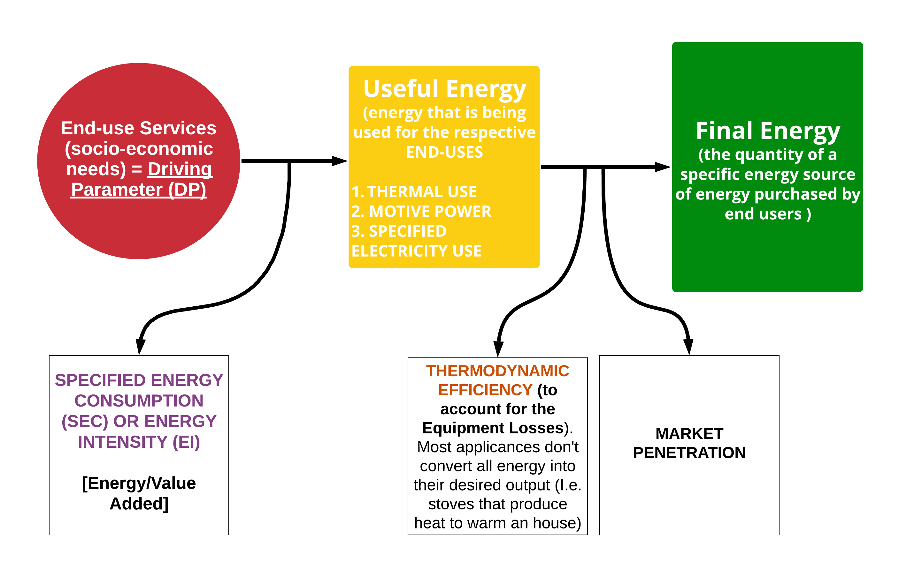




Lecture 6.2 Base Year Reconstruction (3/3)
Gather/Adjust MAED parameters for the base year
Calculate MAED Input Data for the base year
Check accuracy of MAED results for the base year
Run the MAED model
            6.2.3. How does MAED calculate the Final Energy Demands for the various energy sources? What happens inside the MAED model?
$${FED}_{u}^{e}={UED}_{u}×\frac{{MP}_{u}^{e}}{η_{u}^{e}}$$
$DP$ ${{×SEC}_{u}=UED}_{u}$
Where:
$$e →\{Energy Carrier\}$$
$$u →\{End−Use\}$$
10

Slide 11
Lecture 6.2 Base Year Reconstruction (3/3)
Gather/Adjust MAED parameters for the base year
Calculate MAED Input Data for the base year
Check accuracy of MAED results for the base year
Run the MAED model
            6.2.4. Calculate MAED Input Data for the Base Year
Household Cooking Expected MAED Output
We need to check that these numbers are the same as our raw data for the total final energy demand
$${FED}_{u}^{e}$$
11

Slide 12
Lecture 6.2 Base Year Reconstruction (3/3)
Gather/Adjust MAED parameters for the base year
Calculate MAED Input Data for the base year
Check accuracy of MAED results for the base year
Run the MAED model
            6.2.5. Calculate MAED Input Data for the Base Year
Household - Cooking reconstruction
$${FED}_{u}^{e}$$
First we need to calculate the Total Specific Final Energy Demand, summing up the Final Energy Demand per each end-use (in this case just Cooking)
Then we convert these numbers in Gwyr, the unit of the MAED output data, and check if they are identical. If so, we have successfully reconstructed the Base Year.
12

Slide 13


Lecture 6.3 Other Household End-uses
            6.3.1. The Household Sector, Subsectors, End-use and Final Energy Demands
Industry
Service
Household
Transport
Sectors
Urban
Rural
Subsectors
Cooking
Lightening
Air Conditioning
Specific use of electricity
Space Heating
Water Heating
End-use
Heat Pump
Non-Heat Pump
Heat Pump
Non-Heat Pump
Category of Final Energy Demand (FED)
Substitutable Fossils
Modern Biomass
Traditional Fuels
Solar Thermal
Electricity
Electricity Heat Pump
13
Notes:
In MAED, the structure of the final energy consumption of the country is broken down in a consistent manner, dividing the consumption into 4 major consuming sectors: industry, service, household, and transport.
This level of decomposition is predefined.
The user can further disaggregate the sectors into subsectors, such as agriculture, construction, mining, manufacturing, as shown in this diagram for the Industry Sector. The user can also define urban and rural sub-sectors as well as passenger and freight transport.
The aim of disaggregation is to analyse more closely their projected evolution. The breakdown to the end-uses in most subsectors could be defined by the analyst, depending on actual activity and availability of information.
Also predefined is the form of useful energy required (fuels) for the end-use processes, such as motive power, heat, and specific use of electricity.
The category of final energy depends on technological options available for the satisfaction of the useful energy needs, as some fuels may not be substitutable or may not be available.

Slide 14

Lecture 6.3 Other Household
End-uses
            6.3.2. Space Heating Raw Data
We need to define the type of Dwelling (houses) in our case-study – here generally defined as Urban_house_type1, 2 and 3.
14

Slide 15
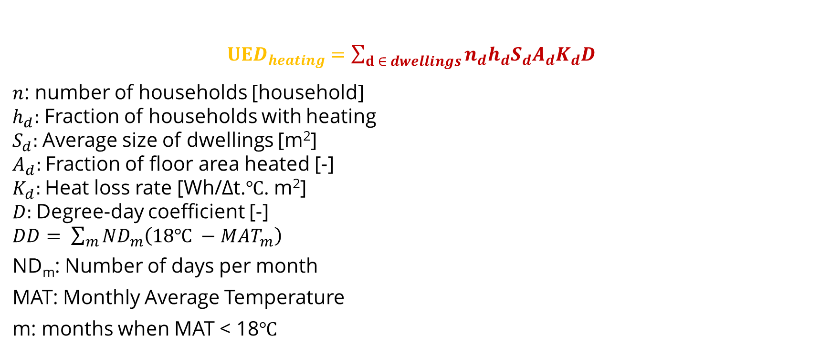
Lecture 6.3 Other Household End-uses
            6.3.3. Space Heating Reconstruction and Formulas
$UED_{heating}=\sum_{d ∈ dwellings}{n_{d}h_{d}S_{d}A_{d}K_{d}D}$
$n$: number of households [household]
$h_{d}:$ Fraction of households with heating
$S_{d}:$Average size of dwellings [m²]
$A_{d}:$Fraction of floor area heated [-]
$K_{d}:$Heat loss rate [Wh/Δt.℃. m²]
$D:$Degree-day coefficient [-]
$DD= \sum_{m}{{ND}_{m}\left(18℃ −MAT_{m}\right)}$
ND_{m}: Number of days per month
MAT: Monthly Average Temperature
m: months when MAT < 18℃
15
Notes:
The useful energy demand for space heating is equal to the product of: the total number of dwellings (n), the fraction of households with heating (h), the average size of dwelling type d in square metres (S), the fraction of area actually heated (A), the heat loss rate coefficient (K), and the degree day coefficient (D).
Total useful energy demand for space heating is found by summing the contribution of each type of dwelling.
In general, space heating is needed only during the winter months; in MAED a factor called Degree-Day is defined to represent this seasonal behavior.
The degree day coefficient is defined as the sum over those months when the average temperatures is less than 18 degrees Celsius, or the difference between 18 degree Celsius and the monthly average temperature (M.A.T.), multiplied by the number of days per month (N.D.m.). Heating is only required for those months when the average temperature is less than 18 degrees Celsius.

Slide 16

Lecture 6.3 Other Household End-uses
            6.3.4. Water Heating Raw Data
16

Slide 17
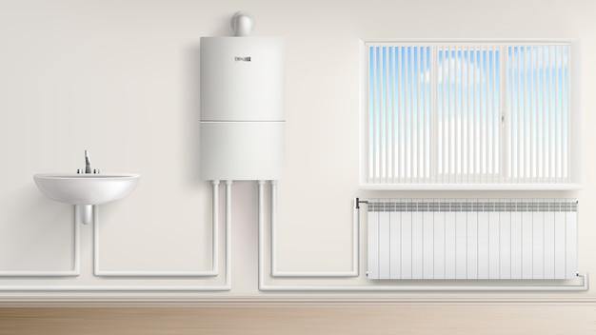
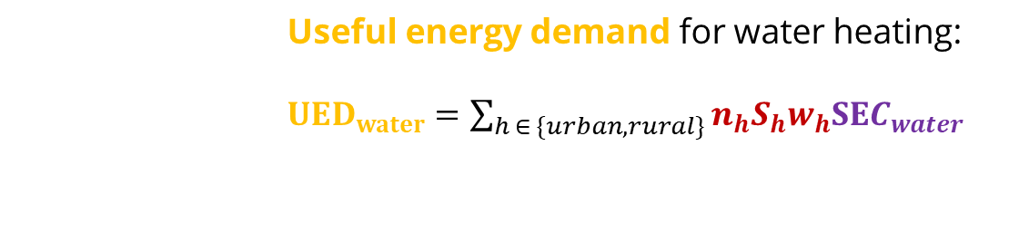
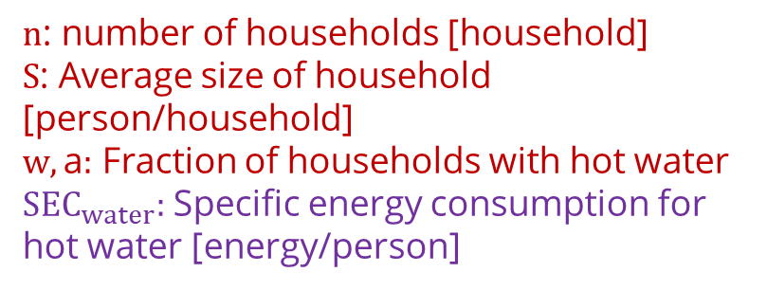
Lecture 6.3 Other Household End-uses
            6.3.5. Water Heating Reconstruction and Formulas
Useful energy demand for water heating:
$UED_{water}=\sum_{h ∈ \{urban, rural\}}{n_{h}S_{h}w_{h}SEC_{water}}$
$n$: number of households [household]
$S$: Average size of household [person/household]
$w,\text{a}:$ Fraction of households with hot water
$SEC_{water}:$Specific energy consumption for hot water [energy/person]
Source: https://www.freepik.com/free-vector/boiler-water-heater-with-radiator-washbasin_6198191.htm#query=water%20heating&position=38&from_view=search&track=ais, Image by vectorpocket</a> on Freepik.
17

Slide 18

Lecture 6.4 Other Household End-uses
            6.4.1. Air Conditioning Raw Data
18

Slide 19
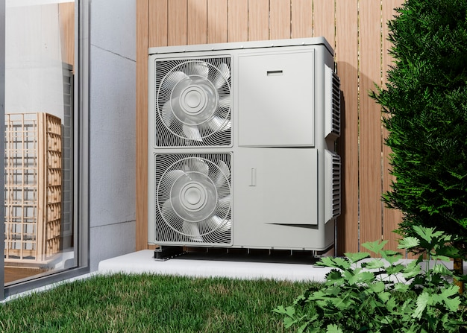
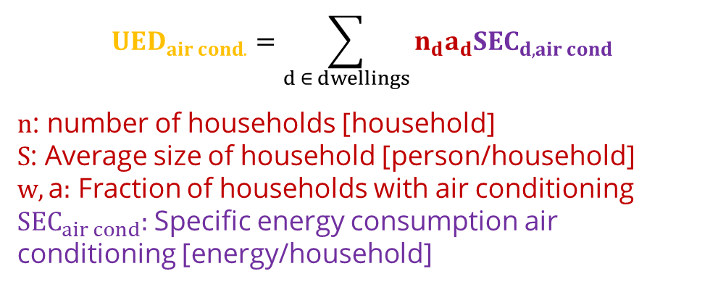
Lecture 6.4 Other Household End-uses
            6.4.2. Air Conditioning Reconstruction and Formulas
Useful energy demand for air conditioning:
$$UED_{air cond.}=\sum_{d ∈ dwellings}{n_{d}a_{d}SEC_{d,air cond}}$$
$n$: number of households [household]
$S$: Average size of household [person/household]
$w,\text{a}:$ Fraction of households with air conditioning
$SEC_{air cond}:$Specific energy consumption air conditioning [energy/household]
Source: https://www.freepik.com/free-photo/close-up-heat-pump-outside-home_22118722.htm#query=heat%20pump&position=24&from_view=search&track=ais, Freepik</a>
19

Slide 20
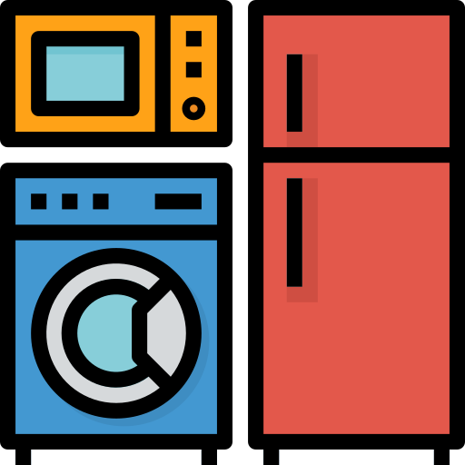

Lecture 6.4 Other Household End-uses
            6.4.3. Appliances and Lightning Raw Data
20
Notes:
Electricity for specific uses and lighting is calculated directly as final energy demand.
Electricity for specific uses equals the total number of dwelling times the fraction of dwelling with electricity multiplied by the specific electricity consumption per dwelling. The equation for lighting is the same.
Using the fraction of electrified dwellings, the fraction of non-electrified dwellings is used to obtain the final energy demand for fossil fuels used for appliances in non-connected households.

Slide 21
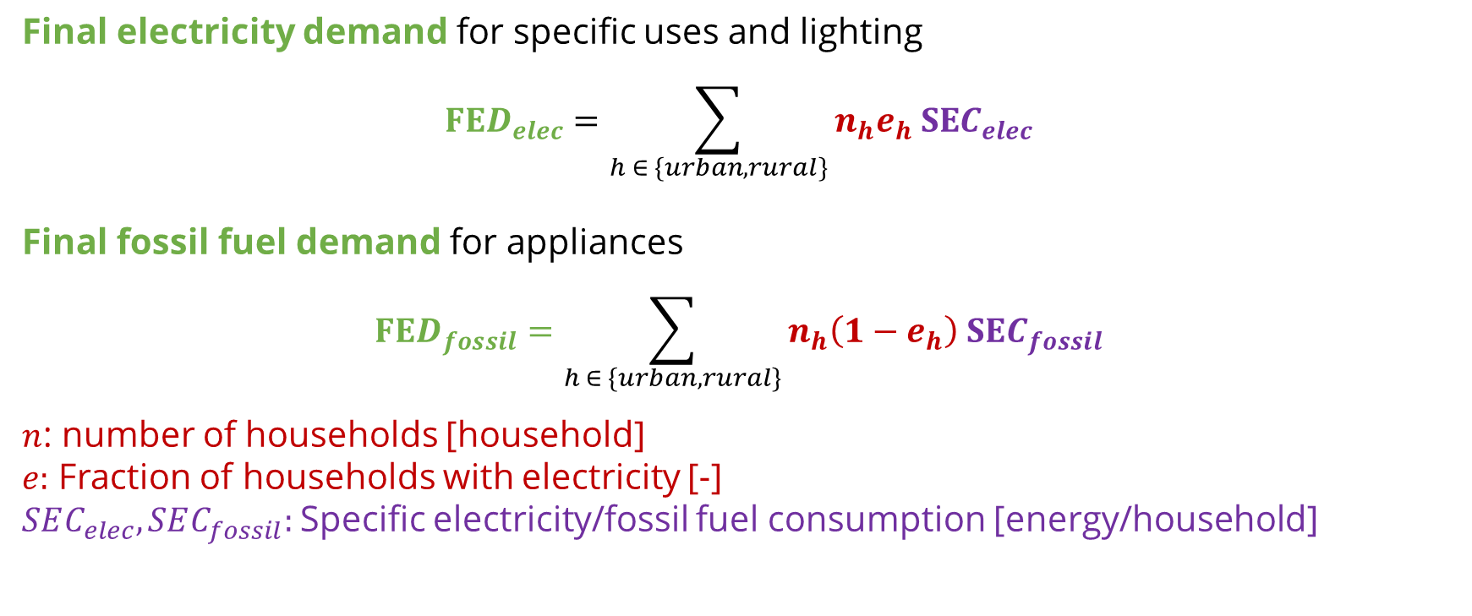
Lecture 6.4 Other Household End-uses
            6.4.4. Appliances and Lightning Reconstruction and Formulas
Final electricity demand for specific uses and lighting
$$FED_{elec}=\sum_{h ∈ \{urban, rural\}}{n_{h}e_{h} SEC_{elec}}$$
Final fossil fuel demand for appliances
$$FED_{fossil}=\sum_{h ∈ \{urban, rural\}}{n_{h}\left(1−e_{h}\right) SEC_{fossil}}$$
$n$: number of households [household]
$e:$ Fraction of households with electricity [-]
$SEC_{elec},SEC_{fossil}:$Specific electricity/fossil fuel consumption [energy/household]
21
Notes:
Electricity for specific uses and lighting is calculated directly as final energy demand.
Electricity for specific uses equals the total number of dwelling times the fraction of dwelling with electricity multiplied by the specific electricity consumption per dwelling. The equation for lighting is the same.
Using the fraction of electrified dwellings, the fraction of non-electrified dwellings is used to obtain the final energy demand for fossil fuels used for appliances in non-connected households.

Slide 22

Cannone, C., Collett, K.A., Charbonnier F., Ahsan A., Halloran C., Vijay,A.,Berdellans I., Hasanovic S., Gritsevskyi A,Stankeviciute L., Tot M.; Welsch M., Hirmer S., 2023. Lecture 6: "BASE YEAR RECONSTRUCTION with the HOUSEHOLD SECTOR EXAMPLE" , Energy Demands Projections with MAED (Model for Analysis of Energy Demand). Release Version 2.0. [online presentation]. Climate Compatible Growth & Programme and International Atomic Energy Agency.
CCG courses (this will take
you to the website link http://www.ClimateCompatibleGrowth.com/teachingmaterials)
22

