Slide 1
Lecture 6
Financing Baseline – Part 2
Open Learn Collection
Financial Modelling for Energy Transitions: MINFin, FinTrack & FinCoRE
Notes:
Welcome to Lecture 6 of Climate Compatible Growth's Energy Finance course, which will continue to build on the content covered in lecture 4 on financing baselines.

Slide 2
Lecture Outline
Financial Modelling for Energy Transitions
 | Learning Objectives
Part 1 | High costs of capital as a barrier to the energy transition
Part 2 | Debt financing for renewables
Part 3 | Equity financing for renewables
Part 4 | Weighted Average Cost of Capital
Notes:
This lecture is split into four parts: the first section explores the role of costs of capital in the energy transition, whilst the second and third dive into how debt and equity financing for low-carbon infrastructure projects function. The final section covers how the cost of capital is derived from debt and equity financing terms

Slide 3
Learning Outcomes
Learn and understand how high costs of capital are acting as a barrier to the energy transition in developing countries
Understand the risk factors contributing to the cost of commercial financing through debt
Understand the risk factors contributing to the cost of financing from commercial equity investors
Learn and understand what factors influence the capital structure for infrastructure infrastructure investments and how this influences the affordability of financing
Notes:
The corresponding learning outcomes are summarised in this slide, for each section.

Slide 4
High costs of capital as a barrier to the energy transition
Part 1

Slide 5

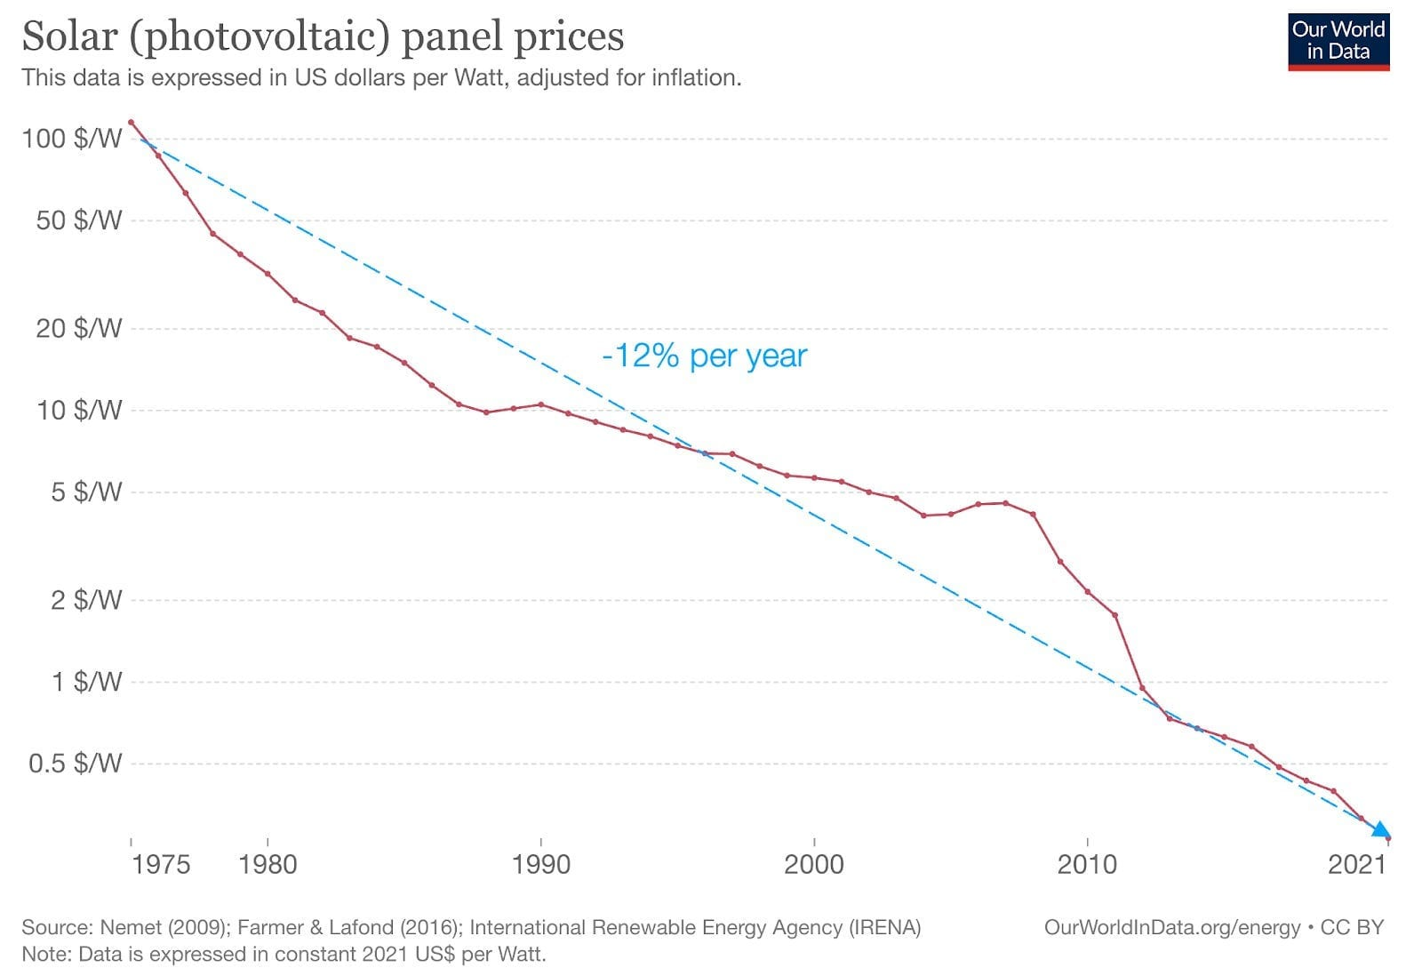
Costs of capital and the energy transition
Renewable technologies e.g., solar panels have experienced rapid reductions in cost over recent decades
Further reductions will lead to their increasing cost competitiveness
The cost of capital will also need to fall in many regions for cost competitiveness
Visualisation taken from OurWorldInData 2023
Notes:
Over the past few decades, there has been a remarkable reduction in the costs of renewable technologies. The graph on the right, taken from Our World in Data, shows that the cost of solar panels has plummeted from US$100 per watt in 1975 to below US$0.5 per watt in 2021. The rapid cost decline has been driven by advances in technology, economies of scale and increased manufacturing efficiencies.
Looking ahead to the future, continued cost reductions in renewable technologies driven by the rapid expansion of wind and solar over the next few decades to meet climate targets are expected to further enhance their cost competitiveness. In many regions, the cost of electricity from renewables is already below the cost of new fossil fuel generation capacity.
To achieve cost competitive renewable power, many regions will also need to see a decrease in the cost of capital, alongside cost reductions in solar and wind components. But what really is the cost of capital, and why is it so important to the viability of renewable projects?

Slide 6

Costs of capital and the energy transition
The cost of capital describes the terms of finance that an energy infrastructure project receives, from debt and equity investors
Low-carbon infrastructure projects (e.g., renewable generation such as onshore wind) typically have high upfront costs with low or minimal operating costs
Due to this investment profile, terms of finance (i.e. the cost of capital) has a strong impact on project viability
Notes:
The cost of capital refers to the financing terms provided to an energy infrastructure project by both debt and equity investors. It encompasses the interest rates on loans and the expected returns on equity.
Low-carbon infrastructure projects, such as onshore wind farms, typically require substantial upfront investments for construction and installation, but benefit from low or minimal operating costs once operational. For example, once a wind farm is built, the only ongoing costs are maintenance and operational requirements, rather than the purchasing of fuel. This investment profile differs to fossil fuel generation, where ongoing fuel costs are a substantial portion of the final cost of electricity.
Given their unique investment profile, the terms of finance, or the cost of capital, plays a key role in determining the economic viability of these projects. It affects how well the upfront costs can be spread across the lifetime of the project.

Slide 7
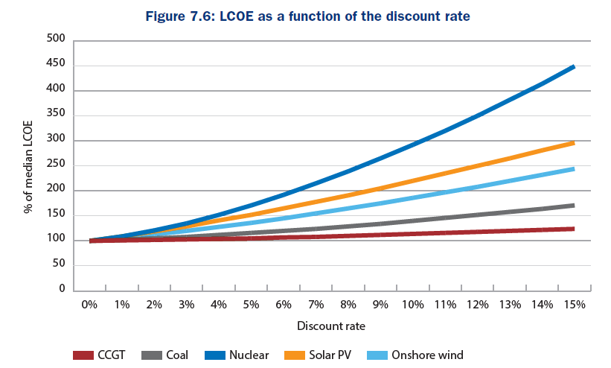

Costs of capital and the energy transition
Renewable breakeven electricity costs ( "levelised costs") particularly sensitive to the cost of capital
It is even more pronounced for nuclear, due to long lifetimes and high upfront costs
Visualisation taken from Nuclear Economics
Notes:
Due to the high upfront costs of renewables and other low-carbon infrastructure projects, their breakeven cost of electricity is particularly sensitive to the cost of capital. For wind and solar projects, the cost of generating electricity is influenced more by the cost of capital than the available renewable resources.
The sensitivity is presented in the graph on the right, which shows the levelised cost of electricity against the discount rate (another term used for the cost of capital). Due to its long lifetimes and high upfront construction costs, the cost of capital has an even greater impact on the overall economics of nuclear projects. Fossil fuel generation projects, including coal and combined cycle gas turbines (or CCGTs), are much less sensitive to the cost of capital.

Slide 8
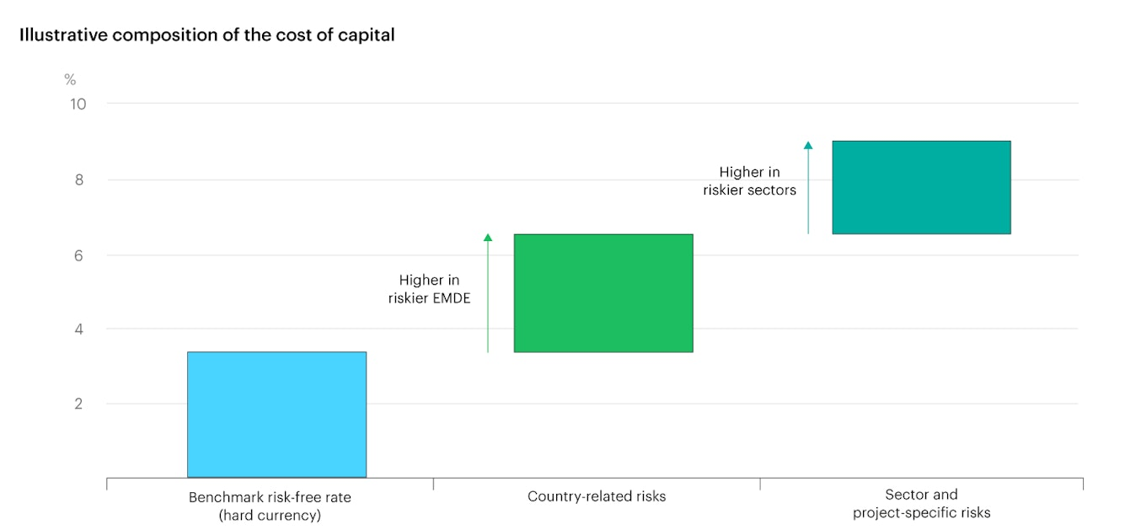
Costs of capital and the energy transition
The cost of capital for energy investments is influenced by various factors:
  Risk free rates
  Country level risks
  Sector level risks
  Project level risks
                Costs of capital can be up to 2-3x higher in developing countries
Visualisation taken from International Energy Agency 2024
Notes:
The cost of capital for energy investments is influenced by several factors, at the macroeconomic, country, sector and project level, all of which influence the risk of project failure and so the return demanded by investors. Firstly, the interest rate or yield on low-risk securities (such as U.S. Treasury Bonds) affects the cost of capital for other projects, by providing a base level of expected returns. Country-level risks, including political instability or economic volatility, can demand higher returns in exchange for the increased risks. In addition to these , there are a whole host of sector and project level risks that investors need to account for when determining their financing terms.
The graph on the right demonstrates how the cost of capital is influenced by these factors in developing countries, which typically see much higher financing terms. These can reach levels of up to 2 to 3 times above those in high-income countries.

Slide 9
Costs of capital and the energy transition
Sources of risk | Examples
Country risk | political risks, security, government stability, status & transparency of legal system
Financial and economic risk | economic growth, inflation, interest rates, currency & exchange rates
Policy, and regulatory risk | changes to tariff structures, subsidy regimes, permitting requirements
Technical and project risk | construction risk, technological risk, environmental risk, operational / performance risk
Market risk | future demand and supply balance, market pricing risks, fuel prices, subsidy prices
Notes:
Here, we provide a non exhaustive list of the types of risks that investors may account for at the different levels when assessing the cost of capital.
Firstly, country risk encompasses political risks, such as security, government stability, and the status and transparency of the legal system. These factors can significantly impact investor confidence and financing terms.
Next, financial and economic risks include economic growth, inflation, interest rates, and currency exchange rates. These elements affect the overall economic environment in which energy projects operate.
Policy and regulatory risks arise from changes to tariff structures, subsidy regimes, and permitting requirements. Unpredictable regulatory environments can deter investment by adding uncertainty and potential costs.
Technical and project risks involve construction risks, technological uncertainties, environmental challenges, and operational or performance risks. These can affect the feasibility and success of energy projects.
Lastly, market risks relate to the future demand and supply balance, market pricing risks, fuel prices, and subsidy prices. Market dynamics can influence the profitability and attractiveness of energy investments.

Slide 10
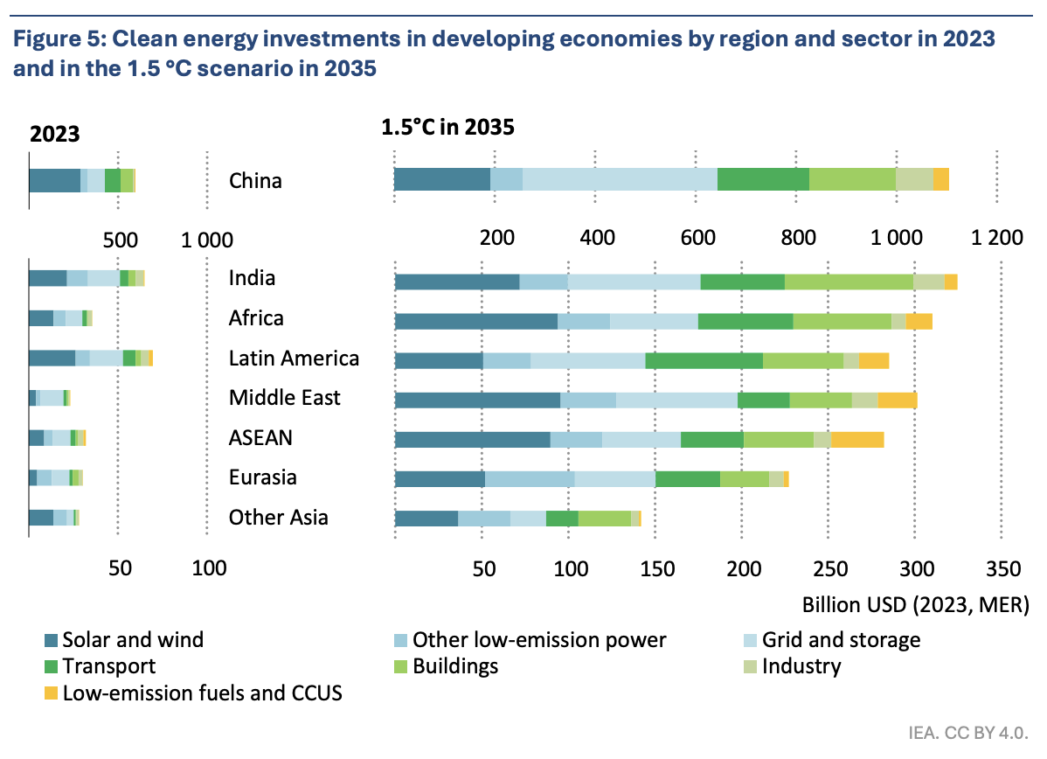
Costs of capital and the energy transition
Addressing factors causing high costs of capital will be key to scaling up investment in developing countries
Will require policy reform and international support (e.g., grants & concessional finance)
Concessional financing will need to at least triple by 2030
Visualisation taken from International Energy Agency 2024
Notes:
Addressing the underlying factors leading to high costs of capital will be essential to scaling up investment in developing countries. The graph on the right is taken from the International Energy Agency and shows the level of investment required in emerging and developing economies needed for a 1.5C compatible pathway. In these countries, annual energy-related investment will need to increase by orders of magnitude by 2035.
To attract investment at low costs of capital, reforming the policy and regulatory landscape will be important. Governments need to create stable and transparent business environments that foster investor confidence. However, there is only so far that domestic policy reform can go.
International support through grants and concessional financing will be key to reducing the cost of capital. Concessional financing, which offers more favorable terms than market-based loans, also plays an important role in attracting and mobilising private finance. Estimates show that the level of concessional finance will need to at least triple by 2030 to support the scale up of investments.

Slide 11
Debt financing for renewables
Part 2

Slide 12
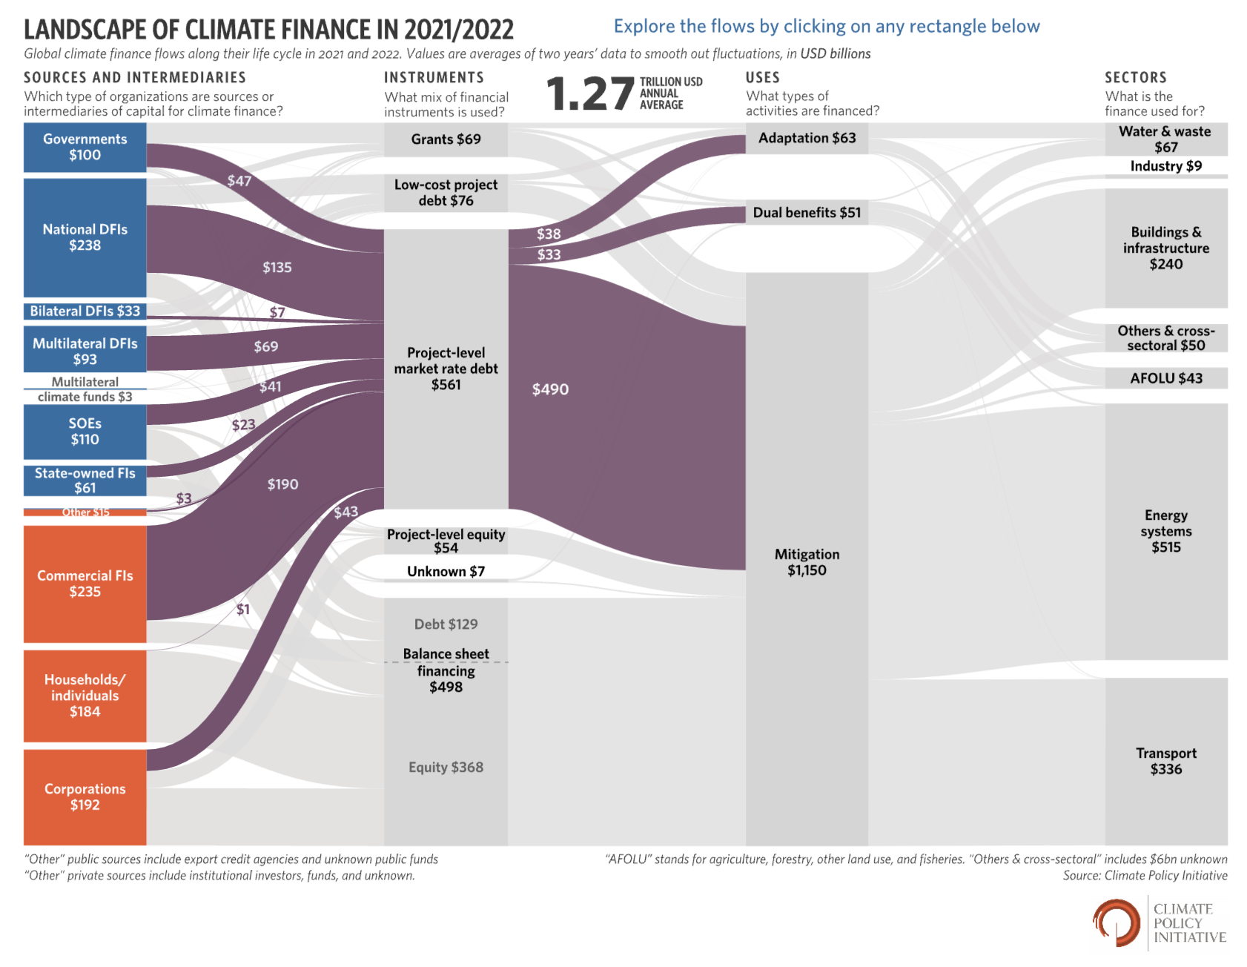
Debt financing for low-carbon infrastructure
Debt financing plays an important role in global climate financial flows
In debt financing, capital is exchanged for specified loan repayments
Debt financing can either be on or off balance sheet
Visualisation taken from Climate Policy Initiative 2023
Notes:
Debt financing plays a key role in global climate financial flows, as the graph on the right taken from Climate Policy Initiative shows in its breakdown of global climate finance flows. It is principally made available at market-level rates, although there is some provision of low-cost debt from concessional sources such as the World Bank, other multilateral development banks, and from national government programmes.
In debt financing, capital is provided to projects in exchange for specified loan repayments over time, which pay back both the initial loan and interest charged on the loan.
It can be categorised as either on-balance sheet or off-balance sheet, which we will discuss in further detail in the next slide.

Slide 13
Debt financing for low-carbon infrastructure
Debt (and equity) financing can take place either on- or off- balance sheet, depending on project context
On-balance sheet: projects are financed by a company and the debt taken on to finance it shows up on its balance sheet
Off-balance sheet: a separate financing structure is set up for the project, with debt and equity repaid from the project cashflow
Off-balance sheet financing structures typically allow for higher shares of debt and reduces the risks in the event of project failure
Notes:
Debt and equity financing can occur either on- or off-balance sheet, depending on the project's context.
On-balance sheet financing means that projects are financed directly by a company, and the debt taken on to finance these projects is recorded on the company's balance sheet. This approach makes the debt and associated obligations transparent to investors and stakeholders.
Off-balance sheet financing, on the other hand, involves setting up a separate financing structure for the project. In this case, both debt and equity are repaid from the project's cash flow rather than the company's overall finances. This method helps to isolate the project's financial risks from the company's balance sheet.
Off-balance sheet financing structures typically allow for higher shares of debt and reduce the risks in the event of project failure. By keeping the debt off the company's main balance sheet, companies can manage their financial ratios more effectively and attract more investors to specific projects

Slide 14
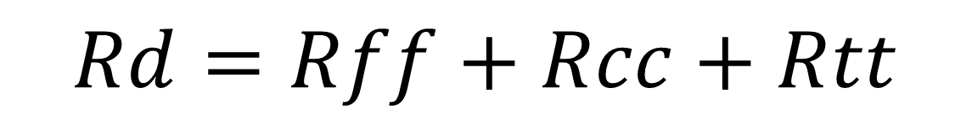
Debt financing for low-carbon infrastructure
Cost of debt (Rd) can be disaggregated into several components:
Risk-free rate (Rff)
Country risk premium (Rcc)
Other risk premiums (Rtt)
$$Rd=Rff+Rcc+Rtt$$
Notes:
The cost of debt financing is influenced by several factors. Firstly, the risk-free rate forms the baseline for the cost of debt. It reflects the return expected from an investment with no risk of financial loss, typically regarded as highly rated government bonds (e.g., U.S. Treasuries)
Risk premiums, from the country, sector and project level, also influence the cost of debt. As discussed earlier, there are a wide range of risks that affect the risk-return profile of an investor that must be accounted for. In a developing country context, the country risk premium is one of the largest risks to an investor, encompassing political instability, macroeconomic conditions, and currency risks.

Slide 15
Debt financing for low-carbon infrastructure
Annual loan repayment (AR) is based on several components:
Principal (V)
Interest rate (Rd)
Principal refers to the amount of money taken out from the debt provider (i.e. the loan)
Interest rate refers to the interest charging on the outstanding balance of the loan
Notes:
The annual repayments for a loan, is determined by several key factors: the principal, interest rate, grace period, maturity and repayment periods.
The principal is the initial amount of money borrowed for the project. It is the base amount that needs to be repaid over the loan's duration.
Next, the interest rate represents the cost of borrowing the principal amount and is the same as the cost of debt discussed in the previous slide. It is therefore influenced by the total risk of the project, with higher risk projects observing higher interest rates.

Slide 16
Debt financing for low-carbon infrastructure
Annual loan repayment (AR) is based on several components:
Grace period (g)
Maturity (m)
Repayment periods (n=m-g)
Grace periods refer to the period of time where repayments are not due
Maturity refers to the final payment date of the loan
Repayment periods of the loan refers to how long the debt can be paid off over
Notes:
The grace period (g) is the initial period during which the borrower is not required to make any repayments. Grace periods are often provided to give projects time to start generating revenue before loan repayments begin.
The maturity of a loan (m) refers to the total length of the loan term, from the time the loan is issued until it is fully repaid. The maturity period can vary depending on the terms agreed upon by the lender and borrower.
Finally, repayment periods are calculated based on the grace period and maturity and refers to the number of periods during which actual loan repayments are made. It is calculated by subtracting the grace period from the maturity period.

Slide 17
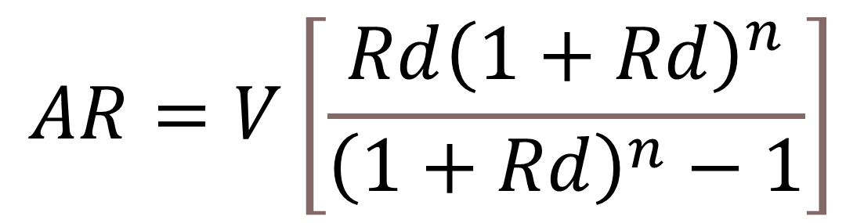
Debt financing for low-carbon infrastructure
Annual loan repayment (AR) is based on several components:
Principal (V)
Interest rate (Rd)
Grace period (g)
Maturity (m)
Repayment periods (n=m-g)
$$AR=V\left[\frac{Rd{\left(1+Rd\right)}^{n}}{{\left(1+Rd\right)}^{n}−1}\right]$$
Notes:
The annual loan repayment is calculated based on these five parameter: the principal, interest rate, grace period, maturity and repayment periods, using the equation shown on the right.

Slide 18

Debt financing for low-carbon infrastructure
Debt financing is also exposed for foreign currency risk (FOREX), if the investor and project are operating using different currencies
Fluctuations in exchange rates could significantly increase the value of debt repayments e.g., if the US-UK exchange rate changes from 1.5 to 1.25
Notes:
Debt financing is also exposed to foreign currency risk, or FOREX, when the investor and the project are operating using different currencies (for example, the pound and the dollar). This exposure can lead to significant fluctuations in the value of debt repayments due to changes in exchange rates.
For instance, if the exchange rate of the dollar falls from 1.5 to 1.25 against the pound, a UK-based project with dollar-denominated annual debt repayments of $100,000 could see its repayment amount increase from £67,000 to £80,000. Such fluctuations can drastically impact the financial stability and cost structure of a project.

Slide 19
Debt financing for low-carbon infrastructure
Exchange rate exposure is particularly an issue in developing countries.
Uncertainty over the value of future repayments in local currencies can increase the costs of financing low-carbon infrastructure.
International debt is typically denominated in "hard" currencies (e.g., the US dollar) by financiers to avoid exchange rate risks.
Notes:
Exchange rate exposure is a significant concern in developing countries, where inflation and macroeconomic instability can drive volatility in currency values. This volatility creates uncertainty over the value of future repayments in local currencies, which can significantly increase the costs of financing low-carbon infrastructure projects and so push up their cost of debt
To mitigate these risks, international debt is typically denominated in 'hard' currencies, such as the US dollar, by financiers. Hard currencies are more stable and less susceptible to sudden fluctuations, helping to avoid exchange rate risks and provide more predictable financial outcomes for both investors and project developers

Slide 20
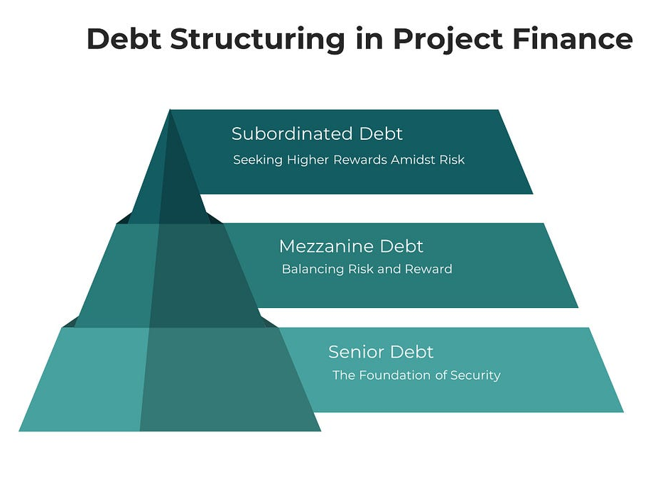
Debt financing for low-carbon infrastructure
Under project finance (a method for off-balance sheet financing), there are typically different tiers of debt financing:
  Senior: paid first in the event of project failure
  Mezzanine: paid following senior debt under project failure
  Subordinated: paid last and so carries the highest risk
Notes:
Under project finance, which is a key method for off-balance sheet financing, there are typically different tiers of debt financing with different risk-return profiles.
Senior debt is paid first in the event of project failure. This type of financing has the highest claim on project assets and cash flow, making it the least risky for lenders and so sees the lowest cost of debt.
Mezzanine debt is paid following senior debt in the event of project failure. This type of financing sits below senior debt in the capital structure and often carries higher interest rates to compensate for the increased risk.
Subordinated debt is paid last, after both senior and mezzanine debt. Because it has the lowest priority in the event of project failure, subordinated debt carries the highest risk and typically offers higher returns to attract investors willing to take on that risk.

Slide 21
Cost of Commercial Equity
Part 3

Slide 22
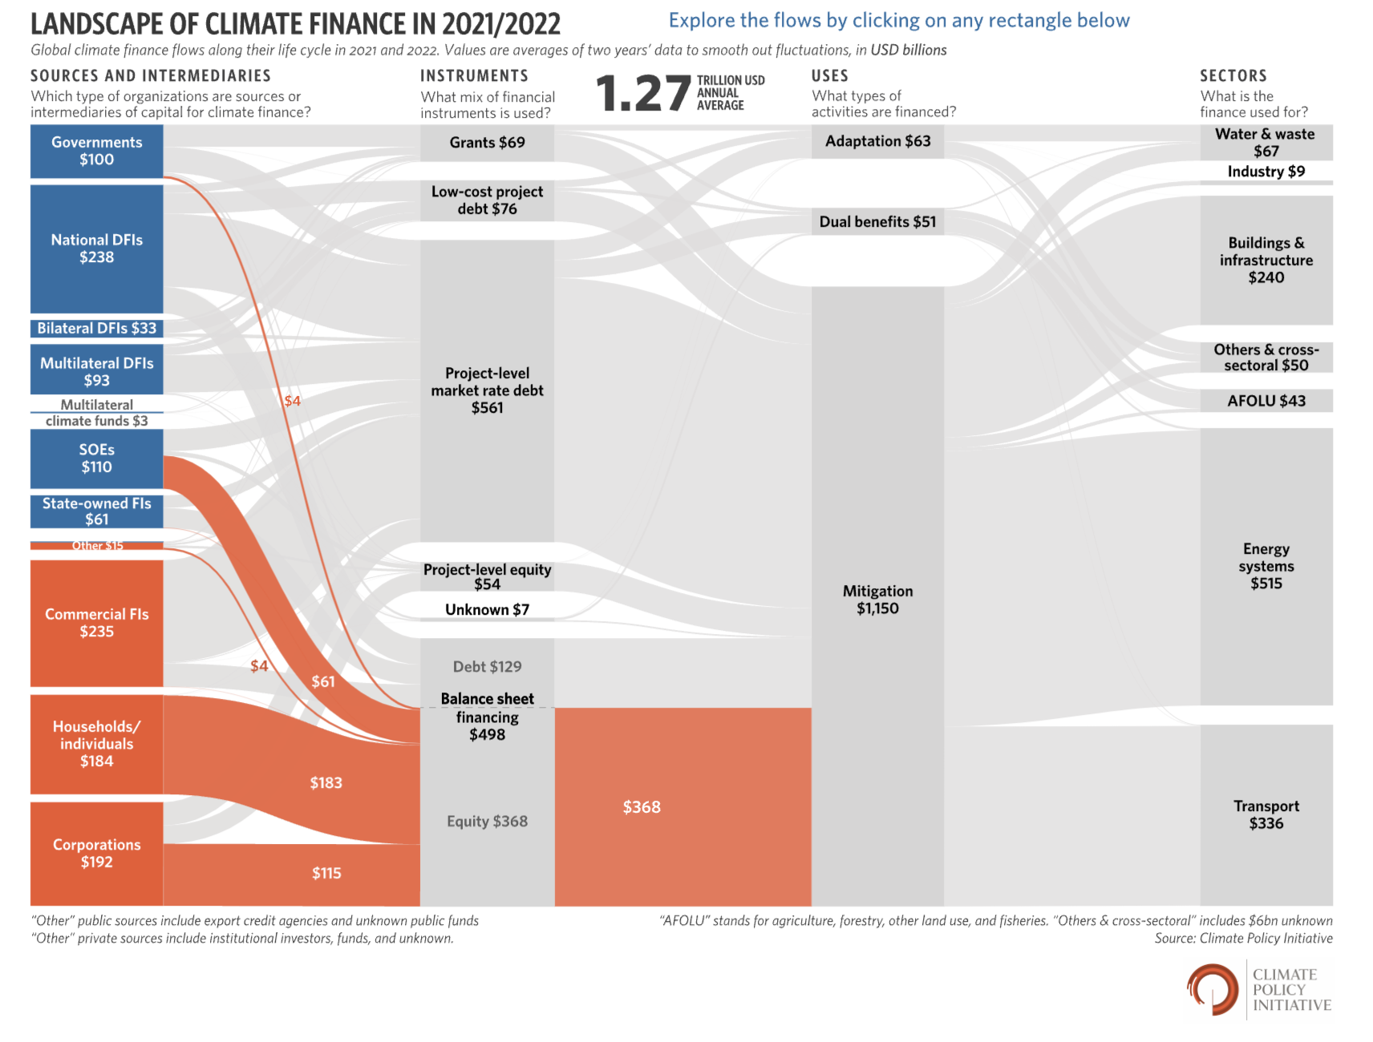
Equity financing for low-carbon infrastructure
Equity financing plays a smaller, but still important, role in climate financial flows
In equity financing, capital is exchanged for a stake in the company or project
Equity financing also can be either on- or off- balance sheet
Visualisation taken from Climate Policy Initiative 2023
Notes:
Equity financing, though smaller in scale compared to debt financing as the graph shows, still plays an important role in global climate financial flows. In this type of financing, capital is exchanged for a stake in the company or project. This means investors become partial owners and share in the profits and risks associated with the venture. Debt financing typically cannot make up the full share of an investment, so equity investors are important to project viability.
Equity financing can also occur either on- or off-balance sheet. On-balance sheet equity financing is recorded directly on the company's financial statements, making it transparent to stakeholders. Off-balance sheet equity financing involves creating separate entities or structures for the project, thereby isolating the risks and returns from the company's main financial activities

Slide 23
Equity financing for low-carbon infrastructure
With equity finance there is no guaranteed return
Ex ante: investors will have an expectation of return on equity that will affect their decision to invest and is based on market benchmarks
Ex post: investors will receive each year what is left over after all other creditors have been repaid
Notes:
However, unlike debt financing, with equity financ, there is no guaranteed return for investors. Instead, returns are contingent on the performance of the project or company.
Prior to the investment, investors will have an expectation of return on equity based on market benchmarks. These expected returns influence their decision to invest, considering the potential risks and rewards.
After the investment, investors receive what is left over after all other creditors have been repaid. This means equity holders are last in line for any distributions, making their returns variable and dependent on the project's overall success.

Slide 24
Equity financing for low-carbon infrastructure
Equity financing is therefore more expensive than commercial debt financing, as investors run the risk of completely losing the capital invested
Whereas debt investors are still entitled to their loan repayments if the project or company goes under
The “equity risk premium” above debt varies by sector and with time but typically ranges between 5-10%
Notes:
Equity financing is typically more expensive than commercial debt financing because investors face the risk of losing their entire capital investment. Unlike debt investors, who are still entitled to their loan repayments even if the project or company fails, equity investors are last in line for any remaining assets and so run the largest risk of losing their invested capital/
As a result, equity investors require a higher return to compensate for this higher risk. This additional return is known as the 'equity risk premium'. The equity risk premium varies by sector and over time, but it typically ranges between 5-10%.

Slide 25

Equity financing for low-carbon infrastructure
Cost of equity (Re) can be disaggregated into several components:
Risk-free rate (Rff)
Equity risk premium (Ree)
Beta coefficient (ß): measure of the risk relative to the market
$$Re=Rff+ßRee$$
Notes:
"The cost of equity, often represented as Re, can be broken down into several key components.
Firstly, as with debt, the risk-free rate (Rff) is the foundation. This rate represents the return expected from an investment with no risk of financial loss, typically represented by government bonds.
Secondly, we have the equity risk premium (Ree). This is the additional return required by investors to compensate for the risk of investing in equities compared to risk-free assets. This premium varies by market and over time.
Lastly, the beta coefficient (ß) measures the risk of the investment relative to the overall market. A beta greater than one indicates higher volatility than the market, while a beta less than one indicates lower volatility. This coefficient helps in assessing the sensitivity of the investment to market movements.

Slide 26
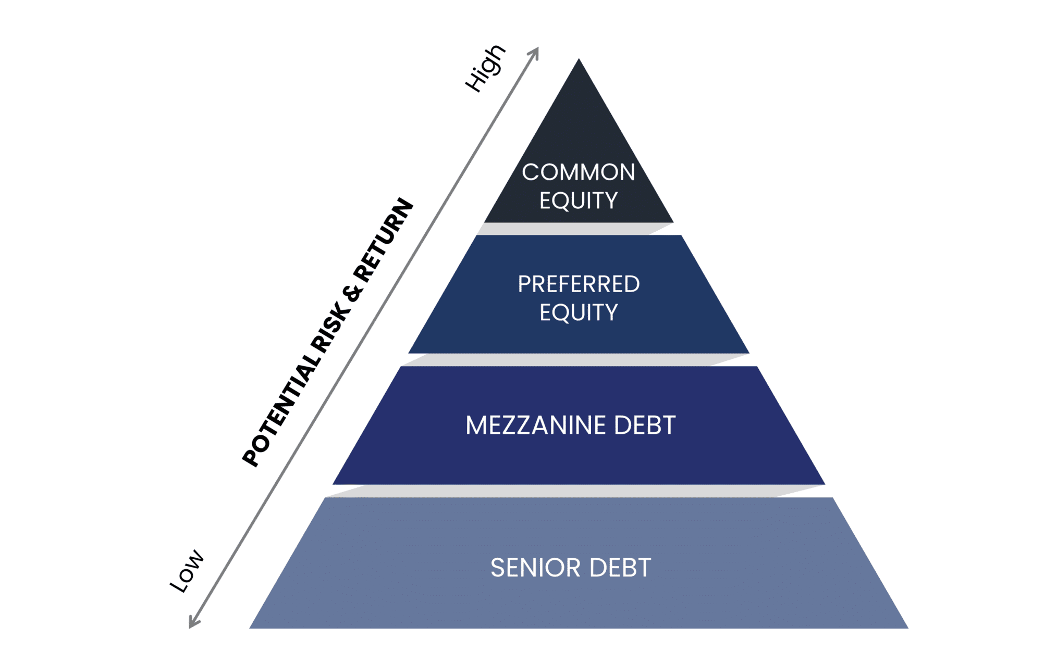
Equity financing for low-carbon infrastructure
Equity financing, much like debt, has different levels with varying risk-returns
  Preferred: entitled to receive late dividends payments and
  Common: paid last in the event of project failure
Both preferred and common equity are paid after debt (at any seniority level) in the event of project failure
Notes:
Equity financing, much like debt, includes different levels with varying risk-returns.
Preferred equity holders are entitled to receive late dividend payments and have a higher claim on assets compared to common equity holders. This makes preferred equity less risky but with typically lower returns than common equity.
Common equity holders are paid last in the event of project failure, making it the riskiest type of equity but with the potential for higher returns.
Both preferred and common equity are paid after all levels of debt, regardless of seniority, in the event of project failure. This hierarchy ensures that debt obligations are prioritized before any equity distributions

Slide 27
Weighted Average Cost of Capital
Part 4

Slide 28
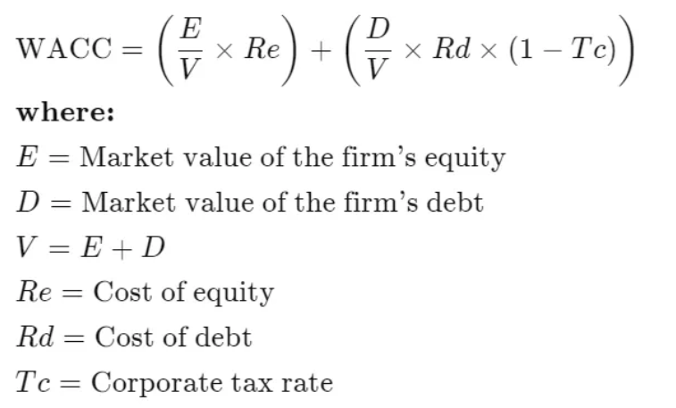
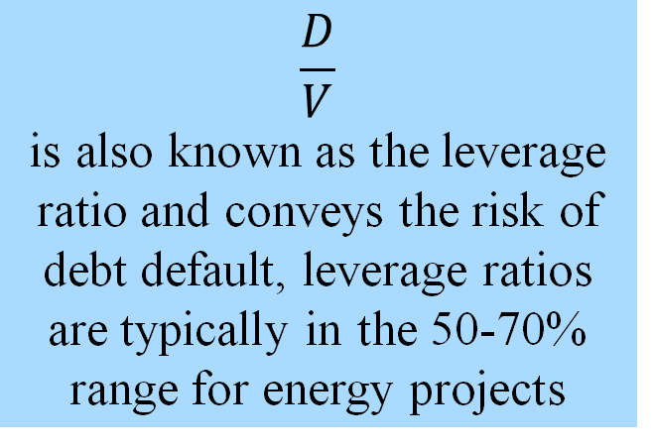
Contributions to the overall cost of capital
$$\frac{D}{V}$$
is also known as the leverage ratio and conveys the risk of debt default, leverage ratios are typically in the 50-70% range for energy projects
Notes:
The overall cost of capital is calculated from the cost of debt and equity, and is weighted by share in the project or firm. The equation here demonstrates how the calculation is performed, accounting for the value of equity (E), value of debt (D), relative costs (Re and Rd) and the overall value of the project or firm ((V). Interest repayments to debt investors are typically tax deductible, so the corporate tax rate is also used alongside the cost of debt to calculate the cost of capital.
The leverage ratio measures the ratio of debt to equity. It's used to assess financial stability and risk by indicating the extent to which a company or project is using borrowed money to finance itself. A higher leverage ratio suggests greater financial risk, as the company relies more on debt, while a lower ratio indicates more reliance on equity. It varies depending on project and country context but is typically in the range of 50-70% for energy projects.

Slide 29
Contributions to the overall cost of capital
The cost of debt, equity and overall cost of capital can be given in one of two forms (real or nominal), depending on whether inflation is accounted for
Nominal | Real
The actual interest being repaid on a percentage basis | Takes into account future inflation
Provides information on the repayments that will be made in and out of a project cashflow | Provides an indication of the “real” cost of capital, accounting for inflation eroding the future value of money
Example: A headline interest rate of 8% on a loan from a debt investor | Example: future inflation of 3% in the long term, so the real value of the repayments is 5%
Notes:
When considering financial terms, it's important to distinguish between nominal and real interest rates or costs of capital.
Nominal interest rates represent the actual interest being repaid on a percentage basis. They provide information on the repayments that will be made in and out of a project cash flow. For example, a headline interest rate of 8% on a loan from a debt investor is a nominal rate.
Real interest rates, on the other hand, take future inflation into account. They provide an indication of the 'real' cost of capital, accounting for inflation eroding the future value of money. For instance, if future inflation is 3% in the long term, the real value of the repayments would be 5%

Slide 30
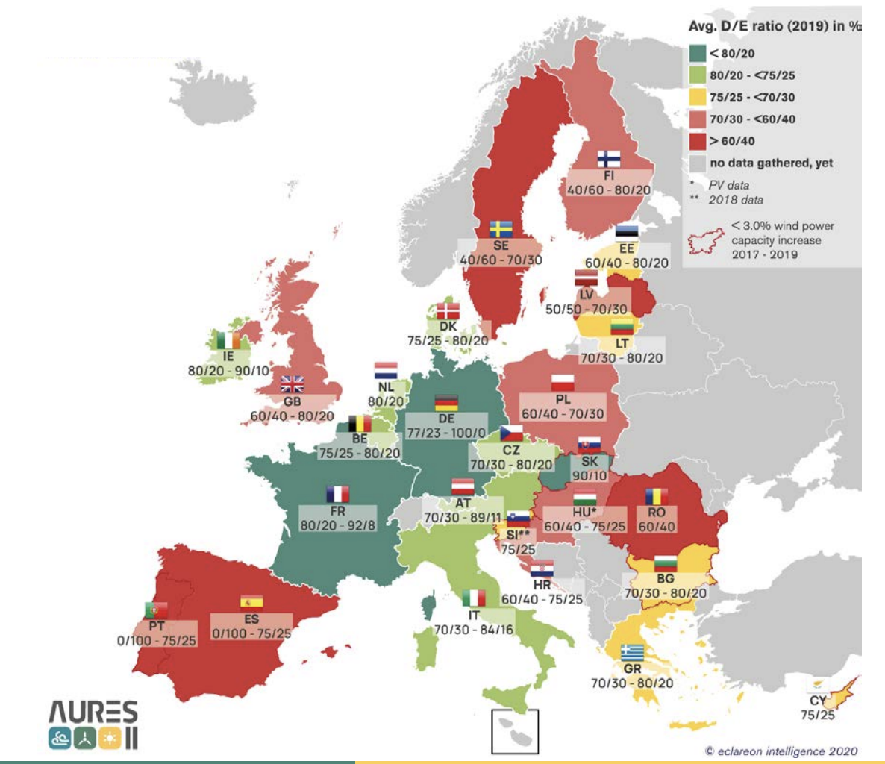
Contributions to the overall cost of capital
As discussed in Lecture 4, the capital structure of infrastructure projects varies but is typically close to 80:20 Debt to Equity split
Between countries, the Debt to Equity ratio for infrastructure investments varies widely
Countries perceived as risky typically have reduced debt shares (though other factors affect this)
Notes:
"As discussed in Lecture 4, the capital structure of renewable energy projects varies but is typically close to an 80:20 Debt to Equity split. This means that 80% of the project's financing comes from debt, while 20% comes from equity.
However, between countries, the Debt to Equity ratio for renewable investments can vary widely, as shown in the plot taken from AURES-II on the right. Factors such as local economic conditions, regulatory environments, and availability of financing influence the ratio of debt to equity.
In countries perceived as risky, debt shares are often reduced due to higher perceived risks. This leads to a higher reliance on equity financing, though other factors, such as government policies and support mechanisms, also play a role in shaping the capital structure

Slide 31
Contributions to the overall cost of capital
Other factors that affect D-E ratios are interest rates, market actor type, and whether it is on- or off-balance sheet financing
Higher levels of debt typically reduce the cost of capital, as:
  Debt is available at a lower cost than equity
  Interest repayments to banks are exempt from tax
Notes:
"Other factors that affect Debt to Equity (D-E) ratios include interest rates, the type of market actors involved, and whether the financing is on- or off-balance sheet.
Higher levels of debt typically reduce the overall cost of capital for two main reasons. Firstly, debt is generally available at a lower cost than equity, as lenders assume less risk compared to equity investors. As discussed earlier, this is because equity investors are paid last in the event of project failure. Secondly, interest repayments on debt are often tax-deductible, providing a financial advantage by reducing taxable income.

Slide 32
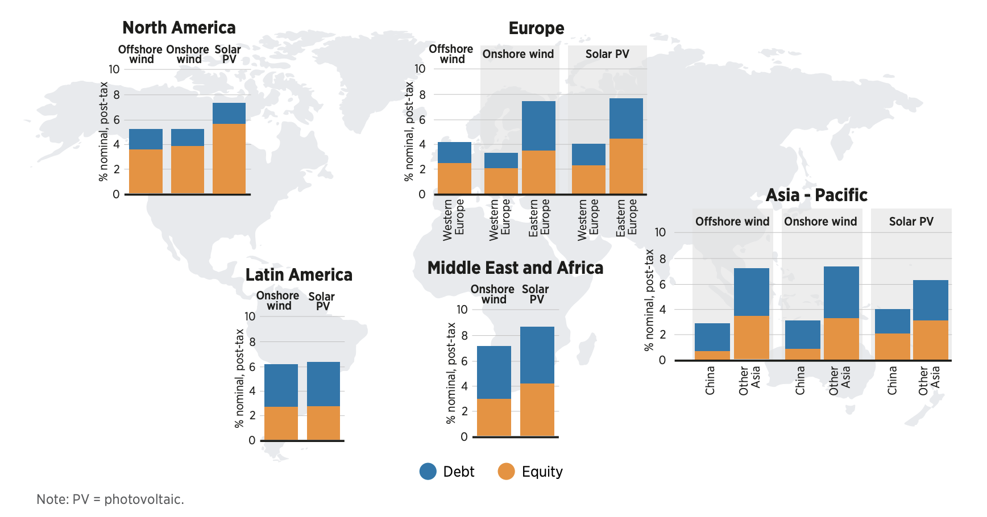
Contributions to the overall cost of capital
Geographically varying D-E splits and the cost of equity and debt combine to give different costs of capital between regions
Visualisation taken from IRENA 2023
Notes:
The diagram here is taken from IRENA's Cost of Financing Renewables Report and shows the overall cost of capital for renewable investments by region. Geographically varying Debt to Equity splits, along with the differing costs of equity and debt, combine to create different costs of capital between regions. For instance, regions with higher perceived risks may have higher costs of equity, while regions with more stable economies might benefit from lower debt costs. These variations drive the differences in the overall cost of capital in different regions and countries

Slide 33
Thank you
Contact Information: v.foster@imperial.ac.uk or hannah.luscombe@ouce.ox.ac.uk

