Slide 1

Model for Analysis of Energy Demand
LECTURE 5
BASE YEAR RECONSTRUCTION using the INDUSTRY SECTOR EXAMPLE
Version 2.0
Notes:
Licence: This work is licensed under the Creative Commons Attribution 4.0 International License (CC BY 4.0). To view a copy of this license, visit https://creativecommons.org/licenses/by/4.0/.
Attribution: Please cite as: Kiley, F. (2025) An Introduction to Simulating Energy Demand with MAED. Version 1. Climate Compatible Growth Teaching Kit Website, Climate Compatible Growth.
Lecture 5: Base Year Reconstruction in Industry.

Slide 2
Intended Learning Outcomes (ILOs)
This lecture has four Intended Learning Outcomes (ILOs):
ILO1: learn about the industry sector and its subsectors
ILO2: learn how to collect the raw data needed for the base year reconstruction
ILO3: learn how to calculate the MAED input data for the base year
ILO4: learn how to check that the Base year was successfully reconstructed.
5.1 Industry Sector and its sub-sectors
5.2 Base Year Reconstruction (1/3) – Collection of Raw Data
5.3 Base Year Reconstruction (2/3) - MAED Input Data calculation for the base year
5.4 Base Year Reconstruction (3/3): Run, Results, Check for Accuracy
2
Notes:
This lecture has four Intended Learner Outcomes:
ILO1: learn about the industry sector and its subsectors
ILO2: learn how to collect the raw data needed for the base year reconstruction
ILO3: learn how to calculate the MAED input data for the base year
ILO4: learn how to check that the Base year was successfully reconstructed.

Slide 3









Lecture 5.1 End-use categories
            5.1.1. The Industry Sector, Subsectors, End-use and Final Energy Demands
Industry
Service
Household
Transport
Sectors
Agriculture
Construction
Mining
Manufacturing
Subsectors
Motive power: Conveyer, drilling, etc.
Thermal use: Vapor, water heat, etc.
Specific use of electricity, Appliances , etc.
End-use
Category of Final Energy Demand (FED)
Motor Fuels
Modern Biomass
Fossil Fuels
Electricity
Solar Thermal
Traditional Fuels
3
Notes:
In MAED, the structure of the final energy consumption of the country is broken down in a consistent manner, dividing the consumption into 4 major consuming sectors: industry, service, household, and transport. We will now look more in detail into the Industry sector and its four subsectors: Agriculture, Construction, Mining and Manufacturing.

Slide 4
Lecture 5.1 Base Year Reconstruction (1/3)
            5.1.2. Base year selection and reconstruction
1. Base year reconstruction
2. Scenario development
3. Results Analysis
            The base year must be selected from a most recent year in the past for
            which energy and economic statistics are available, reliable, and consistent.
            The base year should represent stable conditions of energy consumption.
            Unusual situations should prevent a year from being selected.
Gather/Adjust MAED parameters for the base year
Calculate MAED Input Data for the base year
Check accuracy of MAED results for the base year
Run the MAED model
4
Notes:
As was already pointed out, the value of specific energy consumption for the base year is a crucial parameter for estimation of the future energy demand. This makes the selection of the base year a very important issue.
There are several criteria for the selection of the base year. Firstly, the base year should be selected as the most recent year for which energy and economic statistics are available, reliable, and consistent. Secondly, the base year should be selected to represent stable conditions of energy consumption. Finally, If unusual situations like an economic crisis, extreme climatic conditions, or a political crisis occurred during a given year, it should not be selected as a baseline and a previous year should be used.
To reconstruct the base year, an iterative process is adopted. First, statistical data on energy consumption by sectors, by end-use, and by fuels for the selected base year should be gathered. Then, MAED input data for the base year are calculated on the basis of this information. The MAED model is in turn run with this input data. The MAED results are compared with statistical values for that year. In case of discrepancy, the procedure should be repeated, with adjusted MAED parameters.
The objective of this phase is to establish a benchmark and to validate the programme for the energy system of the specific country.

Slide 5
Lecture 5.1 Base Year Reconstruction (1/3)
            5.1.3. Base year reconstruction
1. Base year reconstruction
2. Scenario development
3. Results Analysis
            The base year must be selected from a most recent year in the past for
            which energy and economic statistics are available, reliable, and consistent.
            The base year should represent stable conditions of energy consumption.
            Unusual situations should prevent a year from being selected.
Gather/Adjust MAED parameters for the base year
Calculate MAED Input Data for the base year
Check accuracy of MAED results for the base year
Run the MAED model
5
Notes:
To reconstruct the base year, an iterative process is adopted. First, statistical data on energy consumption by sectors, by end-use, and by fuels for the selected base year should be gathered. Then, MAED input data for the base year are calculated on the basis of this information. The MAED model is in turn run with this input data. The MAED results are compared with statistical values for that year. In case of discrepancy, the procedure should be repeated, with adjusted MAED parameters.
The objective of this phase is to establish a benchmark and to validate the programme for the energy system of the specific country.

Slide 6
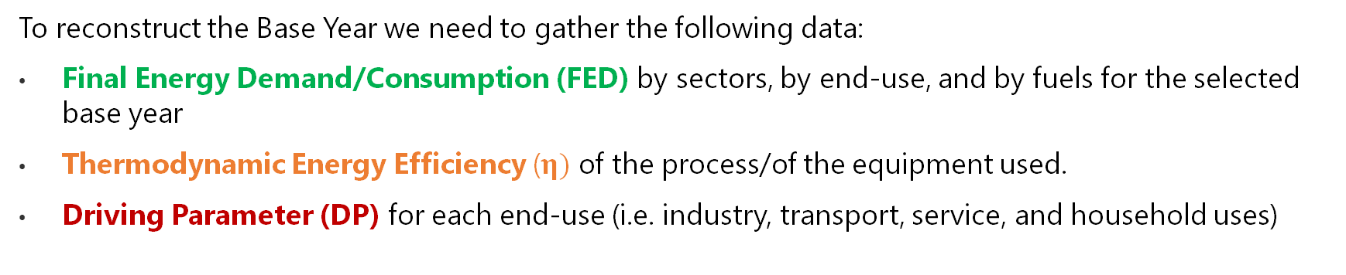
Lecture 5.1 Base Year Reconstruction (1/3)
            5.1.4. Gather MAED Parameters for the Base Year
1. Base year reconstruction
2. Scenario development
3. Results Analysis
            To reconstruct the Base Year we need to gather the following data:
            Final Energy Demand/Consumption (FED) by sectors, by end-use, and by fuels for the selected base year
            Thermodynamic Energy Efficiency ($η)$ of the process/of the equipment used.
            Driving Parameter (DP) for each end-use (i.e. industry, transport, service, and household uses)
Gather/Adjust MAED parameters for the base year
Calculate MAED Input Data for the base year
Check accuracy of MAED results for the base year
Run the MAED model
6
Notes:
To reconstruct the Base Year we need to gather the following data:
Final Energy Demand/Consumption (FED) by sectors, by end-use, and by fuels for the selected base year
Thermodynamic Energy Efficiency ($η)$ of the process/of the equipment used.
Driving Parameter (DP) for each end-use (i.e. industry, transport, service, and household uses).
We have to make sure that units are consistent across MAED. We will see an example later in this lecture.

Slide 7
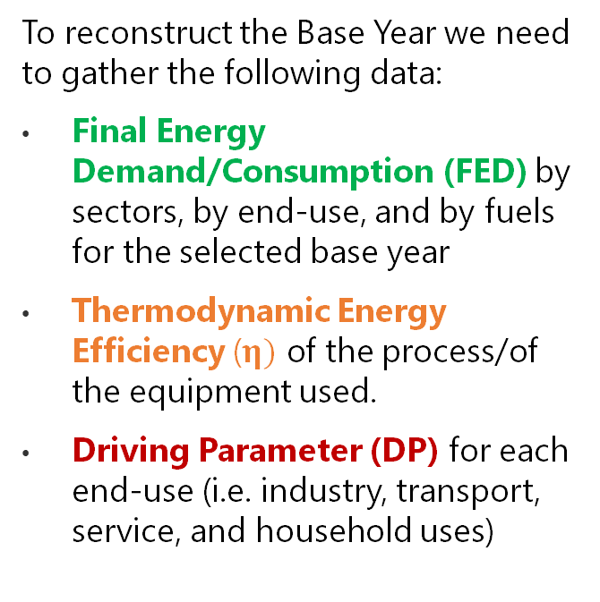
Lecture 5.1 Base Year Reconstruction (1/3)
Gather/Adjust MAED parameters for the base year
Calculate MAED Input Data for the base year
            5.1.5. Gather MAED Parameters for the Base Year - Example
Check accuracy of MAED results for the base year
Run the MAED model
            To reconstruct the Base Year we need to gather the following data:
            Final Energy Demand/Consumption (FED) by sectors, by end-use, and by fuels for the selected base year
            Thermodynamic Energy Efficiency ($η)$ of the process/of the equipment used.
            Driving Parameter (DP) for each end-use (i.e. industry, transport, service, and household uses)
7
Notes:
To reconstruct the Base Year we need to gather the following data:
Final Energy Demand/Consumption (FED) by sectors, by end-use, and by fuels for the selected base year
Thermodynamic Energy Efficiency ($η)$ of the process/of the equipment used.
Driving Parameter (DP) for each end-use (i.e. industry, transport, service, and household uses).
We have to make sure that units are consistent across MAED.

Slide 8
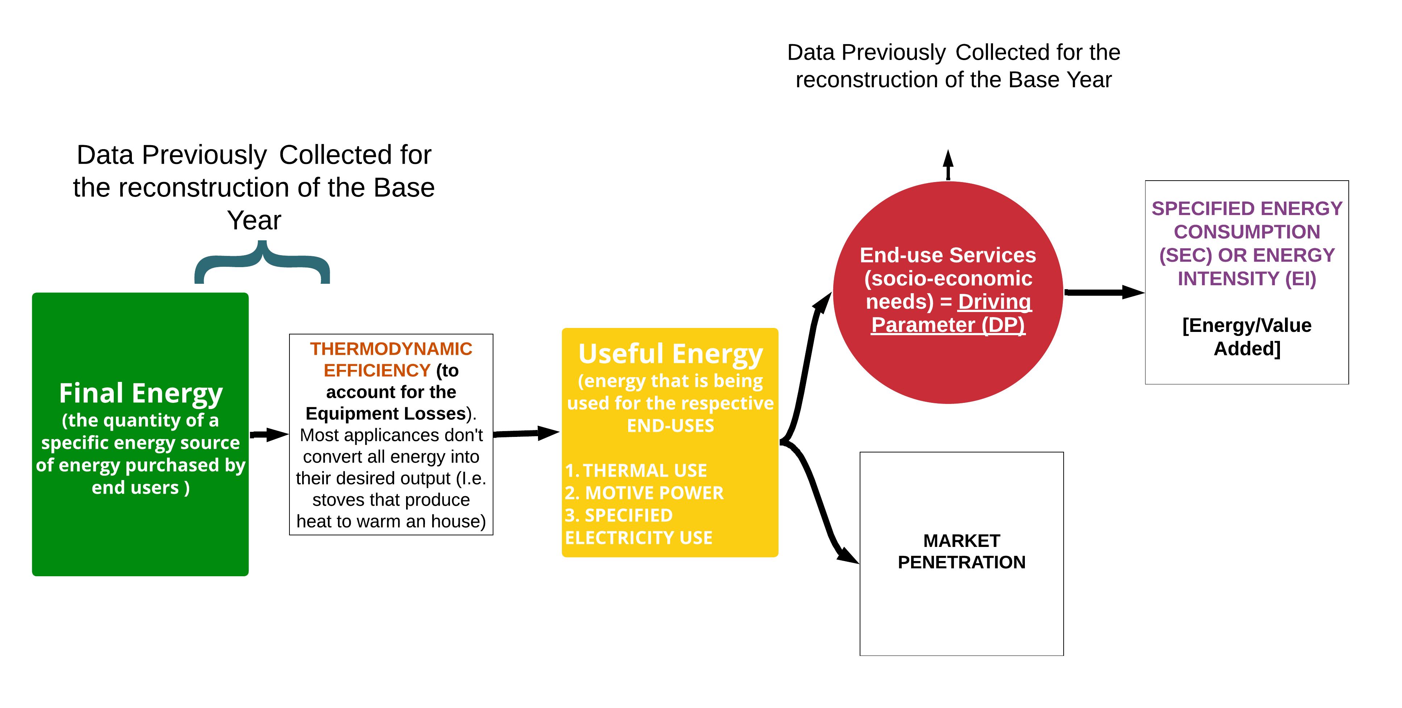


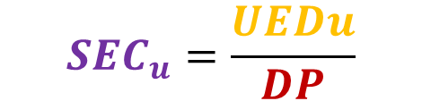
Lecture 5.2 Base Year Reconstruction (2/3)
Gather/Adjust MAED parameters for the base year
Calculate MAED Input Data for the base year
Check accuracy of MAED results for the base year
Run the MAED model
            5.2.1. Calculate MAED Input Data for the Base Year
With the Final Energy Consumption data and the Efficiency we calculate the Useful Energy and then the Market Penetration.
The ratio of the Useful Energy and the Driving Parameter will give us the Specified Energy Consumption (or Energy Intensity).
$${SEC}_{u}=\frac{UEDu}{DP}$$
N.B. MAED treats Final Energy Consumption = Useful Energy for Specific Electricity Uses and Motive Power.
$${FED}_{u}^{e}×η_{u }^{e}{=UED}_{u}$$
$${MP}_{u}^{e}$$
8
Notes:
To reconstruct the Base Year we need to gather the following data:
Final Energy Demand/Consumption (FED) by sectors, by end-use, and by fuels for the selected base year
N.B. MAED treats Final Energy Consumption = Useful Energy for Specific Electricity Uses and Motive Power. Therefore, for Specific Electricity Uses and Motive Power, Market Penetration and Energy Intensity are calculated in terms of Final Energy Consumption, while for Thermal Uses, they are calculated in terms of Useful Energy Demand.
Thermodynamic Energy Efficiency ($η)$ of the process/of the equipment used.
Driving Parameter (DP) for each end-use (i.e. industry, transport, service, and household uses).
We have to make sure that units are consistent across MAED.

Slide 9
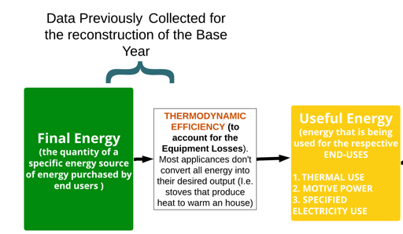

Lecture 5.2 Base Year Reconstruction (2/3)
            5.2.2. Calculate MAED Input Data for the Base Year
$${FED}_{u}^{e}×η_{u }^{e}{=UED}_{u}$$
N.B. this equation is only relevant for Thermal Uses as FED=UED for Specific Electricity Uses and Motive Power
9
Notes:
To calculate the Useful Energy demand we need to multiply the Efficiencies by the Final Energy Demands.

Slide 10
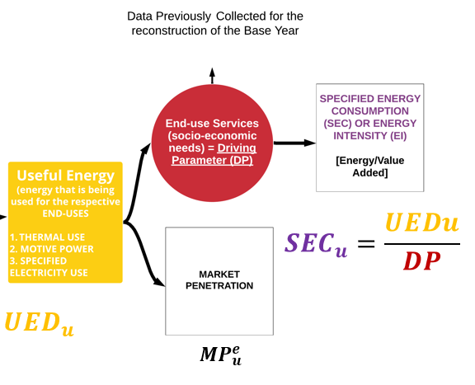
Lecture 5.2 Base Year Reconstruction (2/3)
            5.2.3. Calculate MAED Input Data for the Base Year
Gather/Adjust MAED parameters for the base year
Calculate MAED Input Data for the base year
Check accuracy of MAED results for the base year
Run the MAED model
10
Notes:
Once we have the Driving Parameter (sectoral contribution to GDP in Monetary Units) and the Useful Energy Demand (remember FED=UED for Specific Electricity Use and Motive Power) we can calculate the Specified Energy Consumption for each end-use.
We can also calculate Market Penetration/Fuel Penetration into Useful Energy for Thermal Uses with Useful Energy Demand too. This is done by calculating the ratio of Useful Energy Demand in Thermal Uses for a specific fuel compared to the total Useful Energy Demand for Thermal Uses.
By definition in MAED, MP is always 1 for Electricity and Specific Electricity Uses, and 1 for Motor Fuels and Motive Power. As a result, in the interface, these values can’t be changed.

Slide 11
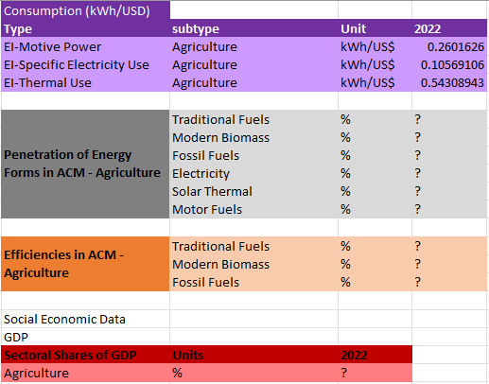
Lecture 5.2 Base Year Reconstruction (2/3)
Gather/Adjust MAED parameters for the base year
Calculate MAED Input Data for the base year
Check accuracy of MAED results for the base year
Run the MAED model
            5.2.4. Calculate MAED Input Data for the Base Year
Agriculture MAED Input Data
We still need to calculate these data
11
Notes:
The data calculated in the previous slide now needs to be converted into MAED units.

Slide 12
Lecture 5.2 Base Year Reconstruction (2/3)
Gather/Adjust MAED parameters for the base year
Calculate MAED Input Data for the base year
Check accuracy of MAED results for the base year
Run the MAED model
            5.2.5. Calculate MAED Input Data for the Base Year
We have calculated percentages of the original data for:
- Penetration of Energy Forms in ACM - Agriculture
- Efficiencies in ACM - Agriculture
The data are now ready to be input in MAED.
Agriculture MAED Input Data
12

Slide 13
Lecture 5.2 Base Year Reconstruction (2/3)
Gather/Adjust MAED parameters for the base year
Calculate MAED Input Data for the base year
Check accuracy of MAED results for the base year
Run the MAED model
            5.2.6. Calculate MAED Input Data for the Base Year
Agriculture MAED Input Data
Agriculture Raw Data
Sectoral Shares of GDP for Agriculture
Sectoral Shares of GDP for Agriculture (%)
=
10
Total GDP
13
Notes:
Another set of Raw data needed for the reconstruction are the Social Economic Data, in this case for the agriculture sector.

Slide 14
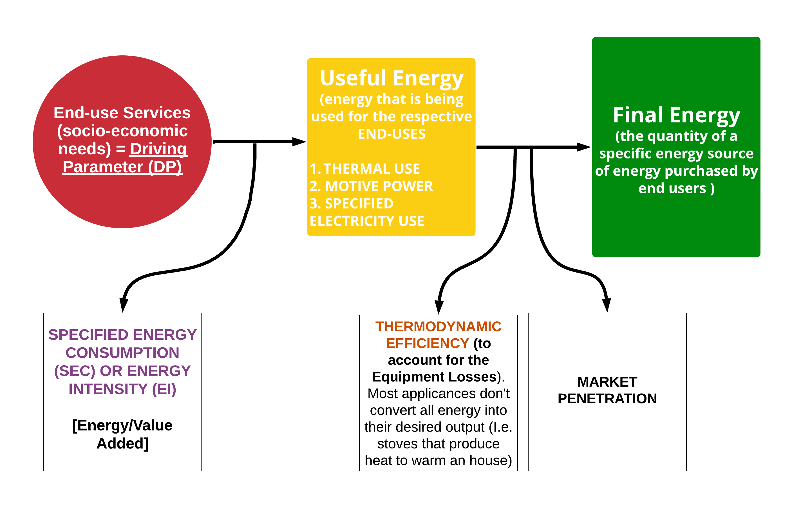


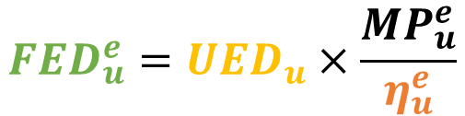

Lecture 5.3 Base Year Reconstruction (3/3)
Gather/Adjust MAED parameters for the base year
Calculate MAED Input Data for the base year
Check accuracy of MAED results for the base year
Run the MAED model
            5.3.1. How does MAED calculate the Final Energy Demands for the various energy sources? What happens inside the MAED model?
$${FED}_{u}^{e}={UED}_{u}×\frac{{MP}_{u}^{e}}{η_{u}^{e}}$$
$DP$ ${{×SEC}_{u}=UED}_{u}$
Where:
$$e →\{Energy Carrier\}$$
$$u →\{End−Use\}$$
14
Notes:
We have seen how it works the reconstruction of the base year, which follows an opposite direction of the way in which MAED software operates. MAED goes from the Driving Parameter to the Final Energy Calculations.

Slide 15


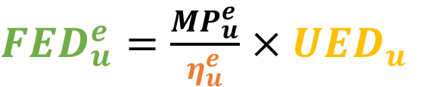

Lecture 5.3 Base Year Reconstruction (3/3)
Gather/Adjust MAED parameters for the base year
Calculate MAED Input Data for the base year
Check accuracy of MAED results for the base year
Run the MAED model
5.3.2. An illustrative example: from UED to FED
$DP$ ${{×SEC}_{u}=UED}_{u}$
${FED}_{u}^{e}=\frac{{MP}_{u}^{e}}{η_{u}^{e}}$ ${×UED}_{u}$
Fossil Fuel
Coal
Furnace
30 %
100 % Process Heat
Electricity
Electric
Furnace
70 %
Where:
$$e →\{Energy Carrier\}$$
$$u →\{End−Use\}$$
15
Notes:
The final energy demand of a specific energy source (the quantity of energy purchased by end users, that reaches the final consumer's door) is given by the product of the inverse of the efficiency of the process where energy is used, the market penetration of the given energy source type, and the final useful energy demand.
In the model, energy demand of the ultimate consumers is calculated in terms of the useful energy wherever possible.
Useful energy demand can be provided either by only one energy form, or by two or more energy forms, according to market penetration. This fact is used in MAED to consider fuel substitutions.
Sometimes various energy forms, for example, electricity and fossil fuels, are competing for a given end-use category of energy demand. This demand is calculated first in terms of useful energy and then converted into final energy, taking into account the penetration into the given market and the efficiency of each alternative energy source. Market penetration and efficiencies are specified as scenario parameters.

Slide 16
Lecture 5.3 Base Year Reconstruction (3/3)
Gather/Adjust MAED parameters for the base year
Calculate MAED Input Data for the base year
Check accuracy of MAED results for the base year
Run the MAED model
            5.3.3. Calculate MAED Input Data for the Base Year
Agriculture Expected MAED Output
We need to check that these numbers from MAED are the same as our raw data for the total final energy demand
$${FED}_{u}^{e}$$
16

Slide 17
Lecture 5.3 Base Year Reconstruction (3/3)
Gather/Adjust MAED parameters for the base year
Calculate MAED Input Data for the base year
Check accuracy of MAED results for the base year
Run the MAED model
            5.3.4. Calculate MAED Input Data for the Base Year
Agriculture reconstruction
$${FED}_{u}^{e}$$
First we need to calculate the Total Specific Final Energy Demand, summing up the Final Energy Demand per each end-use
Then we convert these numbers (by dividing them by 8760) in Gwyr the unit of the MAED output data, and check if they are identical. If so, we have successfully reconstructed the Base Year.
17

Slide 18


Lecture 5.4 Other Industry Sub-sector
            5.4.1. The Industry Sector, Subsectors, End-use and Final Energy Demands
Industry
Service
Household
Transport
Sectors
Agriculture
Construction
Mining
Manufacturing
Subsectors
Motive power: Conveyer, drilling, etc.
Thermal use: Vapor, water heat, etc.
Specific use of electricity, Appliances , etc.
End-use
Category of Final Energy Demand (FED)
Motor Fuels
Modern Biomass
Fossil Fuels
Electricity
Solar Thermal
Traditional Fuels
18
Notes:
As seen before the Industry sector can be further broken down into four subsectors: agriculture, construction, mining and manufacturing. We have covered the Agriculture sub-sector. Let’s now see what needs to be done for the other ones.

Slide 19

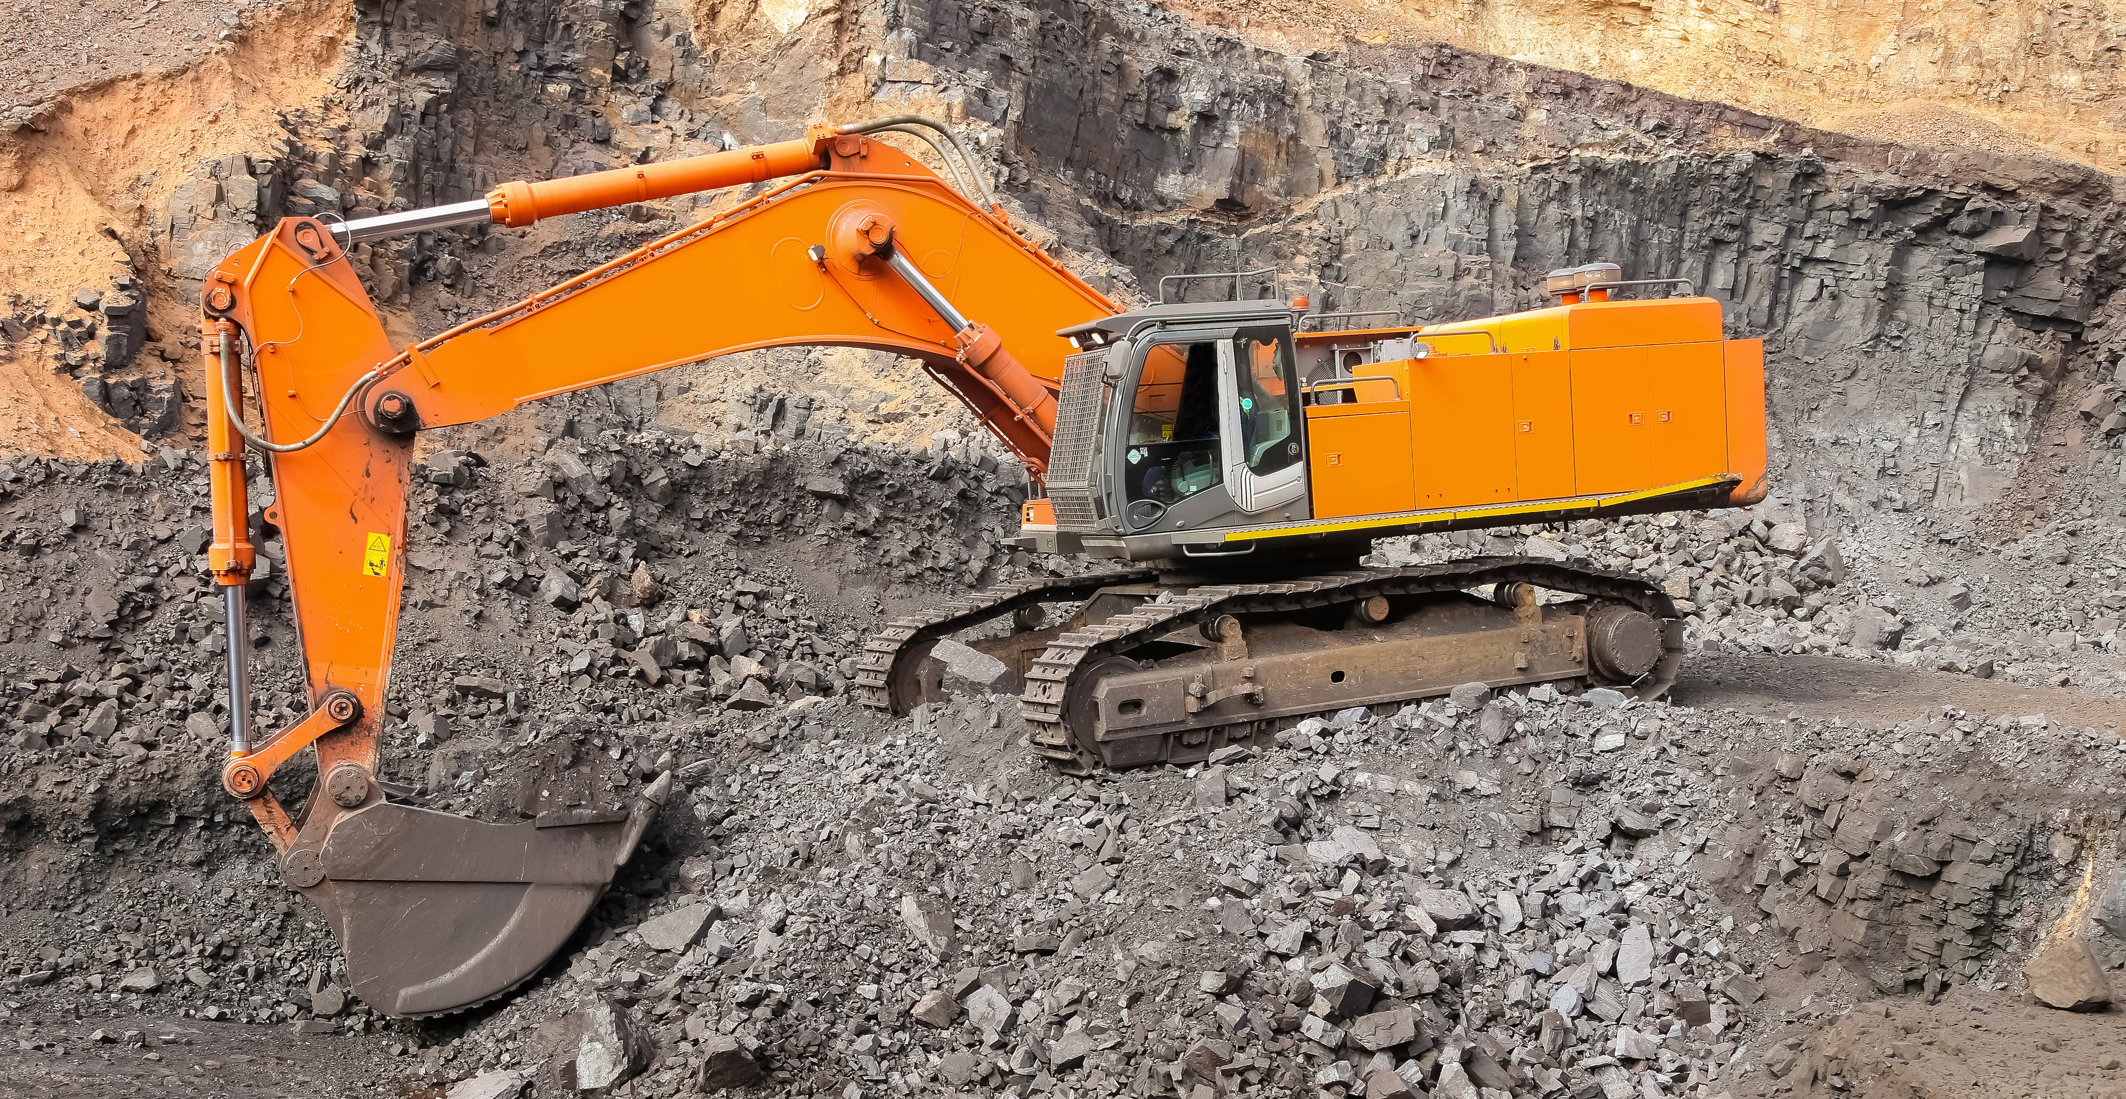
Lecture 5.4 Other Industry
Sub-sector
            5.4.2. Construction and Mining Subsectors
Source: https://www.freepik.com/free-photo/construction-site-silhouettes_1243080.htm#query=construction&position=7&from_view=search&track=sph, Image by evening_tao</a> on Freepik.
Source: https://www.freepik.com/free-photo/yellow-excavator-digging-ore-rich-rock-open-pit-mine_17344806.htm#query=mining%20sector&position=34&from_view=search&track=ais, Image by wirestock</a> on Freepik
In MAED, the Construction and Mining Subsectors follow the same structure of the Agriculture subsector.
19

Slide 20
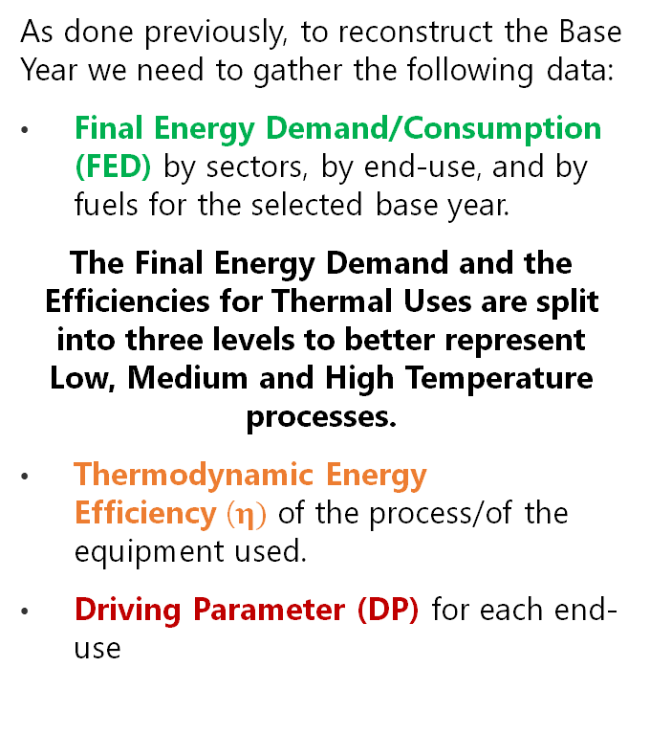
Lecture 5.4 Other Industry Sub-sector
            5.4.3. Manufacturing Subsector
            As done previously, to reconstruct the Base Year we need to gather the following data:
            Final Energy Demand/Consumption (FED) by sectors, by end-use, and by fuels for the selected base year.
            The Final Energy Demand and the Efficiencies for Thermal Uses are split into three levels to better represent Low, Medium and High Temperature processes.
            Thermodynamic Energy Efficiency ($η)$ of the process/of the equipment used.
            Driving Parameter (DP) for each end-use
20
Notes:
In the manufacturing subsector, the thermal use of heat can be further divided into low, medium, and high temperature. The driving parameter is still the value added of the subsector.
The specific energy consumption is now the product of the specific energy intensity of the subsector and the share of thermal use at that temperature.

Slide 21

Lecture 5.4 Other Industry Sub-sector
            5.4.4. Manufacturing Subsector
$${FED}_{u}^{e}×η_{u }^{e}{=UED}_{u}$$
Additional steps compared to the Agriculture Subsector
21

Slide 22
Lecture 5.4 Other Industry
Sub-sector
            5.4.5. Manufacturing Subsector
Additional steps compared to the Agriculture Subsector
22
Notes:
In the manufacturing subsectors we have additional steps compared to the agriculture subsector, namely related to the split of the temperature into three levels.

Slide 23

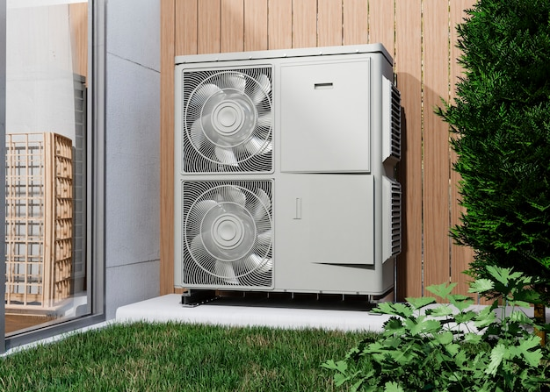
Lecture 5.4 Other Industry
Sub-sector
            5.4.6. Manufacturing Extras
Steam (Heat)
Electricity (Power)
Source: https://www.flaticon.com/free-icons/power-plant" title="power plant icons, Power plant icons created by photo3idea_studio - Flaticon</a>.
Source: https://www.freepik.com/free-photo/close-up-heat-pump-outside-home_22118722.htm#query=heat%20pump&position=24&from_view=search&track=ais, Freepik</a>
In the Manufacturing subsector is possible to model both Cogeneration power plants and heat pumps.
23

Slide 24

Cannone, C., Collett, K.A., Charbonnier F., Ahsan A., Halloran C., Vijay,A.,Berdellans I., Hasanovic S., Gritsevskyi A,Stankeviciute L., Tot M.; Welsch M., Hirmer S., 2023. Lecture 5: "BASE YEAR RECONSTRUCTION using the INDUSTRY SECTOR EXAMPLE" , Energy Demands Projections with MAED (Model for Analysis of Energy Demand). Release Version 2.0. [online presentation]. Climate Compatible Growth & Programme and International Atomic Energy Agency.
CCG courses (this will take
you to the website link http://www.ClimateCompatibleGrowth.com/teachingmaterials)
24

