Slide 1
Lecture 5
Introduction to FinTrack
Open Learn Collection
Financial Modelling for Energy Transitions: MINFin, FinTrack & FinCoRE

Slide 2
Lecture Outline
Financial Modelling for Energy Transitions
 | Learning Objectives
Part 1 | The need for Climate Fund Tracking
Part 2 | Fund and Project Characteristics
Part 3 | Determinants for Costs of Capital
Part 4 | Allocations of Climate Finance
Notes:
The outline for this lecture is as follows:
Part 1. The need for Climate Fund Tracking
Part 2. Fund and Project Characteristics
Part 3. Determinants for Costs of Capital
Part 4. Allocations of Climate Finance

Slide 3
Learning Objectives
Learn how country use of funds may differ from estimated allocations
Learn why it is important for countries to track their fund use in relation to potential allocations
Learn what criteria define cost of capital from both fund and project perspectives
Learn what barriers to access may be faced by projects aiming to access concessional climate finance from climate and development funds
Notes:
In lecture 4 of this series our learning objectives will be to:
Learn how country use of funds may differ from estimated allocations
Learn why it is important for countries to track their fund use in relation to potential allocations
Learn what criteria define cost of capital from both fund and project perspectives
Learn what barriers to access may be faced by projects aiming to access concessional climate finance from climate and development funds

Slide 4
The need for Climate
Fund Tracking
Part 1

Slide 5

The need for Climate Fund Tracking (FinTrack)
Whilst there has been significant growth in the
global commitments to climate finance,
uptake of these funds has consistently
fallen short of commitments and targets.
Many countries face significant investment
needs in their energy transition strategies
Sustainably managing debt burdens is a key
component of ensuring just energy transitions, and as such it is important
to prioritise access to funds carrying highly concessionality
Notes:
Whilst there have been leaps in commitments to climate finance throughout recent years, with agreements at COP29 reaching US$ 300Bn annually towards climate finance, there has been significant shortfalls in the uptake of these climate commitments, hindering global efforts to meet climate targets.
With countries committing to increasingly ambitious NDCs and climate targets regarding energy transitions and power sector development, many countries face challenges in accessing sufficient financing to afford their transition plans.
Among these challenges lies the successful management of additional burdens of debt used to finance national transitions. With high costs of capital in many developing countries acting as a barrier to developing many projects and the successful implementation of transition strategies, ensuring that countries maximise their access to concessional and affordable financing is key to ensuring that countries make these transitions under favourable and just terms. A further barrier to the access of these funds is the lack of transparency around access to these funds, including allocations, terms of finance and the criteria and barriers that lie between project developers and the ability to draw upon these funds.
https://unfccc.int/news/cop29-un-climate-conference-agrees-to-triple-finance-to-developing-countries-protecting-lives-and#:~:text=With%20a%20central%20focus%20on,300%20billion%20annually%20by%202035.

Slide 6
The need for Climate Fund Tracking (FinTrack)
The additional available funds potentially
available to countries from concessional
Climate and Development Funds may
help address issues around debt
sustainability
FinTrack aims to highlight historic fund use
as well as potential fund allocations moving
forwards in order to highlight key sources of
concessional finance
Notes:
With many countries facing energy transitions currently facing national debt crises, maximising use of concessional funds can help reduce reliance on more commercial sources of finance and leverage more concessional terms of co-financing helping to address issues around debt sustainability. As mentioned in the previous lecture, the accumulation of debt stocks and outstanding financial obligations can prove to be a significant challenge to many sectoral stakeholders. As such FinTrack aims to highlight the gaps between historic fund use, and potential national allocations in climate finance to minimise the financial burden of these repayments, and improve the affordability of national transitions.

Slide 7
What is FinTrack?
FinTrack aims to take inventory of many of the key climate and development funds committed to addressing issues around global climate change.
Using allocation data and historic borrowing data it highlights the use and under-use of funds allocated to countries
FinTrack also presents information regarding the terms of finance and concessionality of each fund to each country
Lastly FinTrack assesses barriers and criteria required to access these funds, by mapping the requirements specified by each fund onto 12 universal criteria used within FinTrack for clearer comparison of fund accessibility
Notes:
FinTrack aims to take inventory of many of the key global funds committed to addressing issues around climate and the financing of national transitions. This includes efforts towards both mitigation and adaptation, as well as commitments from both climate funds, and climate commitments from several development funds.
Fintrack uses allocation data, and methodologies from several key funds to estimate current national level allocations of these funds, and assesses this in the context of historic national borrowing and use of these climate funds in order to assess the performance and use or possible under-use of each fun with regard to its allocation to that country.
This is combined with fund-specific data on national terms of financing to help highlight the concessionality of each of these funds, and prioritise access to larger volumes of finance that may be offered under highly concessional terms.
Lastly FinTrack maps each fund and its associated barriers to access onto 12 universal criteria in order to help clarify and minimise the barriers to accessing these funds. This helps users balance these three aspects of climate fund use; Volume, Concessionality and Criteria required to access.
This data can be used alone, or in conjunction with models such as Minfin in order to highlight possible flows of concessional finance within national transition strategies

Slide 8
Fund and Project Characteristics
Part 2

Slide 9
Project Characteristics
To help categorise and match projects to funds that they will be eligible to access, several Project characteristics are assessed. These include:
Project Stage:
Project Target:
Project Sector:
Prefeasibility and Project Preparation – Early-stage project development.
Investment – Scaling and implementing projects
Mitigation – projects that reduce greenhouse gas emissions
Adaptation – projects that build resilience to climate impacts
Energy – Energy sector infrastructural development
Transport – Transport sector development and transition
Agriculture – sustainable agricultural practices
Etc.
Notes:
There are several key characteristics to note when considering climate and development funds.
These characteristics determine what projects are eligible to access funds, as well as potential allocations. As such FinTrack allows users to filter funds assessed by each of these characteristics including Stage, Target and Sector, before sorting by other characteristics such as grant element or interest rate in order to help stakeholders identify concessional funds that best meet their financing requirements.
These project characteristics informing eligibility include:
Project Stage:
This covers Project preparation – early stages of project development that support costs associated with developing bankable projects including Feasibility studies, risk assessments and project planning to attract investments. Project Preparation funds represent a very limited pool of concessional finance.
Investments – financing that covers the capital costs of project construction. Typically, these are less concessional than Project Preparation funds but represent a far larger pool of concessional finance.
Project Target
Mitigation Finance – Funds targeting efforts to reduce greenhouse gas emissions, supporting renewable energy, energy efficiency, and low-carbon projects through public and private investments.
Adaptation Finance – Funds targeting efforts to reduce vulnerability to climate change, funding resilience projects like infrastructure, disaster risk reduction, and sustainable agriculture through public and private investments.
Project Sector – Climate and development funds can cover many sectors including:
The Energy Sector – Ffinancing renewable energy, energy efficiency, and low-carbon technologies to reduce emissions and enhance sustainability.
Transport Sector – Financing clean mobility, public transit, and low-emission technologies to reduce carbon footprints.
Agriculture - financing sustainable farming, climate-resilient practices, and low-emission technologies.
Although these represent some of the key targets of climate funds, there are many more sectors addressed.

Slide 10
Fund Characteristics
To help categorise and match funds to project requirements, several fund characteristics are assessed. These include:
Fund Type:
Financial Instrument:
Concessionality:
Climate Fund – Concessional funds targeting climate projects
Development Fund – Largely concessional funds targeting
country development
Grants – Funds that require no repayment
Loans/Debt– Funds that must be repaid
Grant – Highest Concessionality (no repayment)
High Concessionality – low interest rate and long grace and loan term
Low Concessionality – High interest rate and shorter grace and loan term
Notes:
Fund eligibility, allocation and concessionality to projects are dependent on several characteristics. To ensure that projects prioritise access to the source of finance that best meets their requirements and goals, Fintrack lets users filter funds based on several key characteristics, these include:
Fund Type:
Climate Funds – Specialised Funds raised through international commitments targeting addressing climate mitigation and adaptation efforts helping reduce emission and build resilience.
Development Funds – International Funds allocated to promote economic growth, poverty reduction, infrastructural development and climate issues in low income regions.
Financial Instruments:
Grants – Climate finance grants addressing issues around costs of capital by offering volume of finance that do not require repayment.
Loans – Typically concessional financing committed to addressing adaptation and mitigation that require repayment typically with interest.
Concessionality:
As mentioned previously, Grants are the most concessional source of financing requiring no repayment
High concessionality financing offers financing at below market rates, carrying below market rate terms including low interest rates and long maturities
Low concessionality financing offers financing at around market rates, carrying interest rates that are approximately reflective of market rates, and have relatively short maturities.

Slide 11
Funding Project Stage
It is important to ensure that project stage and type match the criteria of targeted funds to ensure proper funding:
Early project preparation focuses on grant instruments
to help develop proper project proposals including
feasibility and financial analyses
Project finance should target concessional funds
in order to leverage higher concessionality in other
sources of financing
Notes:
Different funds will offer financing for different stages of project development. Whilst Investment funds are typically the most common form of project financing, it is important to address barriers to project development during the early stages. This includes Pre-feasibility studies and Project Preparation.
development and climate funds requiring a range of criteria regarding the undertaking of feasibility studies and impact assessments. Meeting these requirements can be pivotal to not only accessing funds, but also increasing the concessionality and volumes of funds allocated to projects. However, these can be financially demanding for many projects in the early stages of development, and accessing funds that can help meet these financial obligations is key to ensuring the success of projects.
When considering sources of funding for later stages of project finance and raising investments, it is still important to consider the concessionality of these sources. Aiming to access high levels of concessional financing can help to raise additional commercial and private sector co-financing, and lower costs of capital within the project, increasing the financial viability of these projects.

Slide 12
Determinants for
Costs of Capital
Part 3

Slide 13
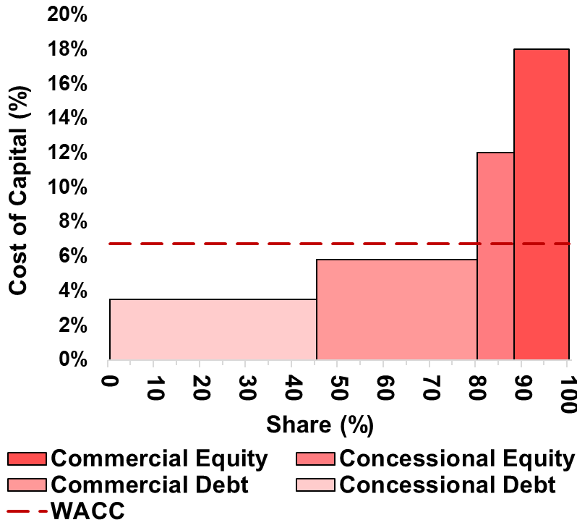
Determinants of Project’s Cost of Capital
Cost of Capital is determined by the
interest rate carried by loans and equity
Project finance is dependent on the amounts
committed from each of these sources
Whilst commercial sources of finance traditionally
carry costs that are reflective of market rates,
concessional development and climate funds offer
loans below market rates, as well as grant instruments
Commercial Cost of Capital | Concessional Cost of Capital
Based on a calculated compound risk profile which considers various risk factors associated with the project. | Typically based on operational margin, level of country needs and commitment currency
Notes:
Project costs of capital are determined by the rates carried by the blend of debt and equity within the project, with project developers having to balance each source and volumes available to the project to best meet their financing needs. As shown in the example graph on the right of this slide, each source of finance carries different volumes and interest rates that alter the overall WACC of the project. As covered in the last lecture, increasing either the share of concessional financing, or increasing the concessionality of financing (by accessing either lower interest rates and softer lending terms) can bring down this overall cost of capital, and increase the viability of projects.
Whilst concessional financing can be limited in terms of the proportion of project finance, by maximising this contribution of concessional finance, projects can not only lower the project WACC by increasing the shares of concessional costs of capital, this can also be used to leverage lower costs of capital from commercial sources through mitigation of project specific risk components.

Slide 14
Determinants of Project’s Cost of Capital
Concessional Cost of Capital is determined by several factors; however, the key components include:
  Country Income Level – MDB specific income level or Development Classification
  Currency of Commitments – Often based on currency floating rates
  Loan Type – Policy Based Loans, Technical Assistance etc.
  Loan Structure – Many concessional funds offer maturity-based pricing
  Operational Margin – Institution specific operational margins
Notes:
From the perspective of Climate Funds, there are several factors that impact the concessionality of the commitment.
The first of these is Country income level, this is often used as a metric of needs, informing concessional sources of finance as to the capacity to take on debts, and repay these commitments, with lower income per capita countries receiving more concessional financing.
The second attribute of each loan that may determine its cost of capital is the currency in which it is committed, as different currencies carry different exchange risks, denominating loans in each currency may add this currency specific risk premium.
Loan concessionality is also informed by the type of loan, with large policy-based loans often carrying highly concessional terms, compared to investment loans.
Loan structure can also play a role in determining the costs of capital, with many institutions offering maturity based loans, whereby the interest rate is determined by the bracket that the overall average maturity of the loan falls into.
Lastly each institution may choose to add their own operational margin to the loan, this is often where concessional financing sources differ more significantly compared to commercial sources, with far lower operational margins.

Slide 15
Determinants of Project’s Cost of Capital
FinTrack presents the components for the costs of capital for each fund in several outputs, this includes a breakdown of the typical rates and terms for each fund under high or low concessional terms. This is set to demonstrate the terms of finance that may vary based
Notes:
FinTrack outputs each characteristic of these climate funds in several figures, such as the one shown here that breaks down the terms of financing for each of these climate funds into Interest Rate, Loan Term and grace period.
Whilst projects have certain constraints for each of these attributes, this is often not the most comprehensive picture of concessionality and can make it hard to compare between funds. For this we aim to use a single metric such as Grant Element.

Slide 16
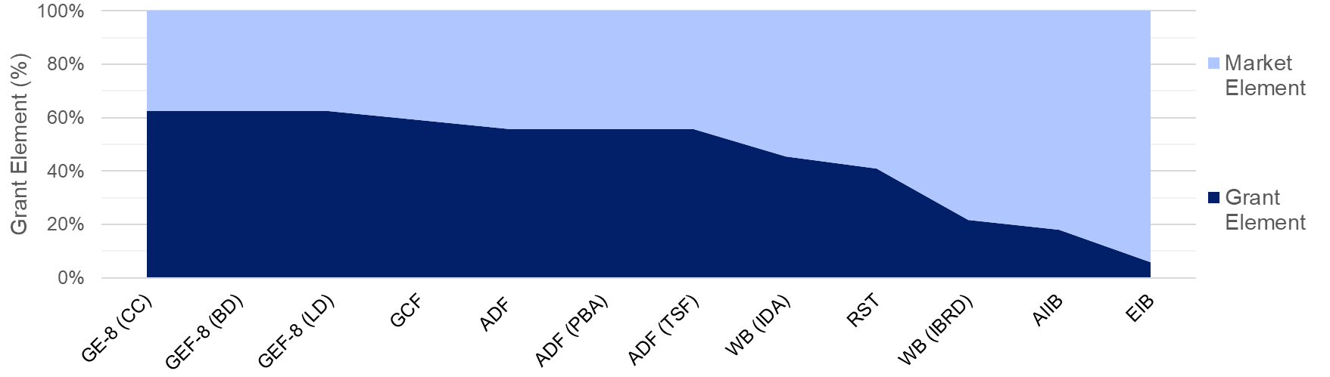

Determinants of Project’s Cost of Capital
Based on these variables, each institution will offer financing carrying different loan terms. As discussed in pervious lectures, this can be summarised as a single statistic called “Grant Element”. FinTrack calculates the grant element for each fund and allows users to sort funds available in order to prioritise the most concessional funds.
Notes:
As mentioned in the previous slide and preceding lectures, Grant Element can offer a single metric for concessionality that enables us to compare easily between funds. Whilst FinTrack does let users sort by Interest Rates, Loan Terms and Grace periods independently, sorting funds by a single metric that covers all three of these parameters can help users easily sort funds from the most to the least concessional.
Shown in the graph below, we can see the decline in grant element across funds as terms of financing become increasingly close to market rates. This is typically signified by higher interest rates, shorter loan term and shorter grace periods, although each of these contributing factors may vary.

Slide 17
Allocations of
Climate Finance
Part 4

Slide 18
Allocations of Climate Finance – Climate Funds
Allocation of Climate finance is determined by several weightings and factors
For Climate Funds:
Climate fund allocation frameworks such as the STAR Allocation system from the GEF focus on weightings based on:
An overall county portfolio performance index
Country needs as a measure of Population and GDP
Global Benefits:
Mitigation potential through emissions reduction
Adaptation potential through Land Use
Biodiversity protection
Notes:
When determining national allocations for climate commitments, each fund may consider a number of different factors that determine both weighting of allocations and ease of access.
Development funds and climate funds each have slightly different missions, and as such consider slightly different issues.
Climate fund allocation targets issues and national needs with regards to addressing Climate Change.
Funds use allocations systems such as the Global Environmental Facilities - System for Transparent Allocation of Resources (STAR) allocation system.
This includes:
Countries Portfolio Performance Index – an assessment of the countries performance with regards to projects meeting outlined climate objectives upon completion, as well as overall project performance
Country needs, based on Population and GDP per capita
Global benefits focusing on:
National mitigation potential, targeting countries where there is significant potential for emissions reductions and transition to renewable power generation and transport sector
Adaptation potential, targeting countries where land degradation and ecosystem resilience are critical for climate adaptation
Biodiversity protection, providing funding to countries containing areas of high biodiversity importance, directly enhancing adaptation by supporting ecosystem resilience and the conservation of natural resources essential for climate adaptation.

Slide 19
Allocations of Climate Finance – Development Funds
Allocation of Climate finance is determined by several weightings and factors
For Development Funds
Different development funds use different approaches and weightings such as the World Bank’s CPIA and the African Development Bank's AIDI, However, they tend to revolve around the same factors:
Country's policy and institutional framework and transparency
Infrastructural and sanitation development
Country needs based on population and growth
Overall country portfolio performance index and GDP
Notes:
Whereas climate funds focus on issues around climate change, development funds typically have a more holistic approach to fund allocation, considering a wide range of national development needs.
Whilst there is some discrepancy between development funds regarding their objectives, they often tend to focus on several key core principles when determining national allocations.
These include:
The development of a countries Policy and Institutional frameworks and transparency with regards to their ability to address issues surrounding sustainable growth, poverty reduction and effective use of aid allocations.
Development and needs regarding Infrastructure for both access to energy and clean water and cooking, as well as improvements to public sanitation and healthcare.
Needs are also weighted to account for the size of population and the national income level using population and GDP per Capita.
Lastly many development funds assess country performance with regards to a country performance index – this is used to evaluate how well a countries government has succeeded in terms of the management and implementation of funded projects, assessing disbursement rates, project delays, and the success of projects in meeting their targeted goals upon completion.

Slide 20
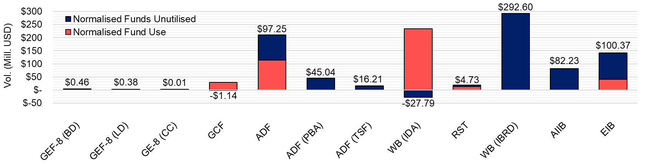
Allocations of Climate Finance – Development Funds
FinTrack Analysis highlights the historic use of funds (red) and estimates of annual fund allocations (blue) across different fund climate commitments.
Here we can see the volumes of allocated funds that remain under-utilised; whilst this country has accessed over its initial allocation of World Bank IDA funds, there remains significant ADF and IBRD allocations yet to be accessed
Notes:
By estimating country level allocations from each of these sources, we are able to compare this estimated allocation to historic fund use, highlighting funds where countries may currently be under utilising significant volumes of concessional finance.
In this case below, we can see that sources such as the African Development Fund (ADF) and World Bank’s International Bank for Reconstruction and Development (IBRD) as well as the European Investment Bank (EIB) and Asian Infrastructure Investment Bank (AIIB) have historically been underutilised, whilst other sources such as the World Bank’s International Development Agency (IDA) has been accessed beyond its initial allocation.
These large volumes of concessional financing are key to addressing large-scale project finance and energy transitions, whilst smaller volumes of high concessionality financing are likely to help with smaller more financially challenging project development, however, these highly concessional funds are often far less readily available and challenging to access.

Slide 21



Allocations of Climate Finance – Criteria
In order for countries to gain access to concessional climate funds, countries often are required to meet stringent criteria.
FinTrack maps these criteria onto 12 core principles:
Sustainable Debt and Risk Mitigation
Successful In-Country Fund Engagement
Aligns with Long Term Planning and Science
$
Ensuring that on taking further debt is sustainable and does not
deepen national debt crises. Indications of national debt status
can be found from the IMF’s Global Debt Database.
For access to concessional commitments, some funds require
proof of a successful prior engagement and existing interactions.
Ensuring that implemented projects are underpinned by evidence
based research and country ownership.
Notes:
Due to the limited availability of concessional climate funds, they often carry stringent criteria to ensure that funds are allocated effectively and used efficiently.
In order to map these criteria, FinTrack maps the criteria required from each fund to 12 core principles in order to help standardise and allow comparison between funds with regards to barriers to access.
These criteria are:
Criteria 1 – Sustainable Debt and Risk Mitigation
New debt should be sustainable and not exacerbate national debt crises. The IMF’s Global Debt Database provides insights into a country’s debt status to guide responsible borrowing.
Criteria 2 – Successful In-country Fund Engagement
Funds require evidence of prior successful engagement and existing interactions to access concessional commitments, ensuring credibility and effective fund utilization.
Criteria 3 – Aligns with Long Term Planning and Science
Projects must be grounded in evidence-based research, aligns with NDCs, and support long-term sustainable development goals.

Slide 22





Allocations of Climate Finance – Criteria
Policies Enable and Align with Climate Agreements
Existing or Development of Institutional Capacity
Climate Mitigation/Adaptation Potential
Ensures that projects targeted by funds align enabling progress
towards goals outlined under climate targets such as the Paris
Agreement, among others.
Ensuring that there is either sufficient existing, or development
of institutional capacity to ensure knowledge transfer and country
ownership of project development and planning efforts.
Choosing projects that align with fund specified targets with
regard to mitigation and adaptation potential.
Notes:
Criteria 4 to 6 of this approach include:
Criteria 4 – Policies Enable and Align with Climate Agreements
Projects must align with climate agreements such as the Paris Agreement, ensuring they contribute to global climate targets and objectives.
Criteria 5 – Existing or Development of Institutional Capacity
Projects should be supported by existing institutional capacity or focus on developing it, ensuring effective knowledge transfer and ownership of project development and planning.
Criteria 6 – Climate Mitigation/Adaptation Potential
Projects should be selected based on their ability to meet the specific climate mitigation and adaptation targets outlined by the fund, ensuring they address the most pressing environmental challenges

Slide 23




Allocations of Climate Finance – Criteria
Project Scalability
Potential For Transformative Change
Environmental, Social Impact and Feasibility Studies
Projects targeted should offer opportunities to scale the
regional impact and deployment of the project and technology.
Focuses on projects with potential for transformative change
regarding regional technology costs and policy environments.
Some funds will require projects to present evidence of
Environmental and Social Impact assessment studies, as well as
potential feasibility studies.
Notes:
Criteria 7 to 9 of this approach are:
Criteria 7 – Project Scalability
Projects must have the potential to expand beyond their initial scope, creating broader regional impact and facilitating widespread adoption of the technology.
Criteria 8 – Potential for Transformative Change
Projects that can drive significant change, whether by reducing technology costs, influencing policy, or accelerating market transformation in the region
Criteria 9 – Environmental Social Impact and Feasibility Studies
Funds require thorough assessments prior to funding, including Environmental and Social Impact studies, as well as feasibility studies, to demonstrate the project's viability and sustainability.

Slide 24





Allocations of Climate Finance – Criteria
Gender Equality and Social Inclusion and Transparency
Independent Cost-Effective Project Management
Requires External Co-Financing / Private Sector Engagement
Targeted funds should report on gender inclusion, and take steps
to ensure stakeholder engagement and transparent decision-making
Projects should offer cost-effective project management as well as
standing as independent legal entities held accountable for their
financial obligations.
Requires projects to maximise cofinancing from private sector funds
in order to develop domestic and international private sector
engagement and capacity for further investments.
Notes:
Lastly, criteria 10 to 12 cover:
Criteria 10 – Gender Equality and Social Inclusion and Transparency
Projects should report on gender inclusion, actively engage stakeholders, and ensure transparent decision-making processes to promote equity and accountability.
Criteria 11 – Independent and Cost-effective Project Management
Projects should ensure efficient resource utilization, maintain financial accountability, and operate as independent legal entities responsible for their financial obligations.
Criteria 12 – Requires External Cofinancing and Private Sector Engagement
To maximize impact, projects should leverage private sector cofinancing, fostering both domestic and international investment opportunities, helping to develop private capital markets, lowering the cost of capital and

Slide 25

Allocations of Climate Finance – Criteria
Each fund will require a different combination of these criteria, and under different levels of inflexibility. Whilst for some funds a criteria may be a categoric barrier to access, in other funds criteria may act as a weighting towards access and allocations.
To account for this, FinTrack categorises criteria as either:
  Requirement
  Contributes
Criteria categorically required by funds from countries and projects in order to access this source of concessional financing.
Criteria that are not categorically required, however play a significant role in determining the allocations and levels of access or priority that a country or project receive from this source of concessional financing.
Notes:
Funds will typically required different combinations of these 12 criteria in order to access or inform the allocation of resources. As well as this difference in criteria, the way in which each criteria informs the allocation of resources changes between funds; whilst some criteria may be a categoric requirement for access in some funds, this same criteria may only contribute to the weighting of allocations within other funds.
In order to help to clarify the differences in stringency between funds, we categorise criteria as either:
A Requirement – where the criteria is categorically required to be met prior to accessing funds. In this instance, failure to meet said criteria will result in projects failing to access funds from this source.
Contributes – this is where criteria are not categorically required to access funds, however, the criteria play a significant role in determining the level of access and allocation committed to the country or project. Failure to meet this criteria does not mean the country or project will not access funding; however it may severely restrict potential allocations.
Understanding how these criteria play a role in determining national allocations of climate funds can help countries and projects to leverage increased volumes of concessional financing and help to address issues around financing shortfalls and high costs of capital through policy reforms.

Slide 26
Allocations of Climate Finance – Criteria
Below is an example output regarding the criteria required from countries in order to access specific funds.
These are ranked based on a user defined characteristic – in this case Grant Element from high to low, and a count of the criteria to access each fund is automatically calculated.
Fund . |  |  | GEF-8 (BD) GEF | GEF-8 (LD) GEF | GEF-8 (CC) GEF | GCF GCF (Multi) | ADF AfDB | ADF (PBA) AfDB | ADF (TSF) AfDB | WB (IDA) WBG | RST IMF | WB (IBRD) WBG | AIIB AIIB | EIB EIB
Criteria | Key: | Requirement | 9 | 9 | 9 | 10 | 9 | 9 | 9 | 7 | 6 | 7 | 6 | 7
 |  | Contributes
Sustainable Debt and Risk Mitigation
Successful In-Country Fund Engagement
Aligns with Long Term Planning and Science
Policies Enable and Align with Climate Agreements
Existing or Development of Institutional Capacity
Climate Mitigation/Adaptation Potential
Project Scalability
Potential For Transformative Change
Environmental, Social Impact and Feasibility Studies
Gender Equality and Social Inclusion and Transparency
Independent Cost Effective Project Management
Requires External Co-Financing / Private Sector Engagement
Notes:
Below we can see a demonstration of how the Criteria are visualised in FinTrack, these funds are sorted based on Grant Element. Looking at the counts of criteria that are either required or contribute to projects access to these funds, we can see a general trend with lower concessionality resulting in lower barriers to access represented by a lower count in criteria. This reflects both the adjusted risk margins, and the increasing availability of less concessional funds in comparison to commercial.

Slide 27
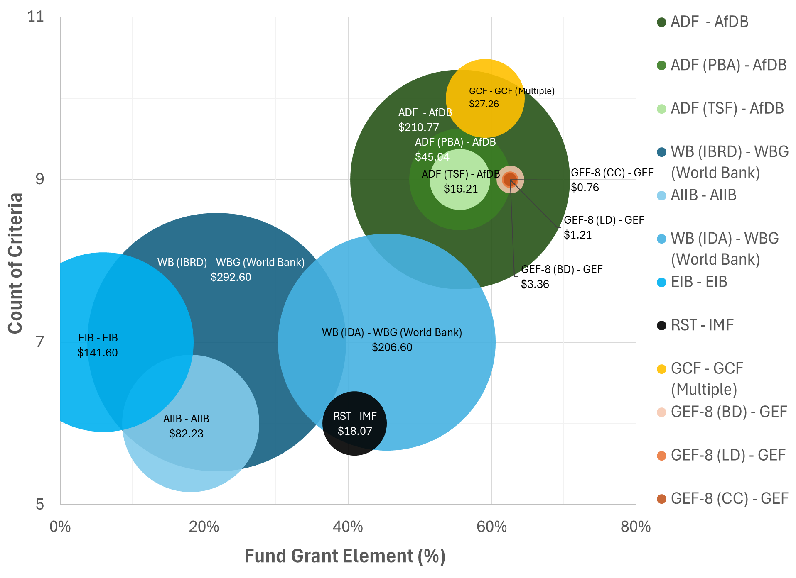
Allocations of Climate Finance – Criteria
We can visualise the results of this analysis in order to create a hierarchy of ease-of-access relative to the volumes committed.
In this example we can see that the World Bank’s IDA carries large volumes of accessible concessional finance
Meanwhile the AfDB is marginally more concessional but carries more criteria to access.
Notes:
Here we combine the metrics of concessionality and accessibility or criteria to access. We can see an overall trend of larger commitments typically carrying lower concessionality, but also lower barriers to access, whilst there is a wide selection of high concessionality, smaller allocations of climate funds, that carry far higher barriers to access. Targeting funds that meet some middle ground between these extremes is likely to be the most effective strategy, with the World Bank’s IDA offering relatively high concessionality, and relatively low barriers to access, whilst also representing a large volume of finance, making this well worth accessing.

Slide 28
Linking FinTrack to MinFin
Linking to MinFin:
FinTrack highlights annual volumes of concessional financing that may be available to meet financing gaps projected by MinFin
Additionally, the terms of finance and levels of concessionality can be used in MinFin to assess how the addition of these concessional sources of climate finance affect the overall affordability of projected scenarios.
MinFin allows us to assess how the scaling up of these concessional sources of finance may change the national costs of capital and financing requirements to close incremental financing costs.
Notes:
Linking to MinFin:
When using the outputs of FinTrack in relation to a Minfin study, we know that FinTrack highlights annual volumes of concessional financing. This can be used to assess what volumes of concessional financing may be available to meet financing gaps projected by Minfin. Additionally, the terms of finance and levels of concessionality can be used in MinFin to assess how the addition of these concessional sources of climate finance affect the overall affordability of projected scenarios.
Whilst FinTrack assesses the current standings regarding allocations to concessional financing, Minfin allows us to assess how the scaling up of these concessional sources of finance may change the national costs of capital and financing requirements to close incremental financing costs.

Slide 29
Thank you
Contact Information: v.foster@imperial.ac.uk or hannah.luscombe@ouce.ox.ac.uk

