Slide 1

Model for Analysis of Energy Demand
LECTURE 4
INTRODUCTION
TO MAED-D
Version 2.0
Notes:
Licence: This work is licensed under the Creative Commons Attribution 4.0 International License (CC BY 4.0). To view a copy of this license, visit https://creativecommons.org/licenses/by/4.0/.
Attribution: Please cite as: Kiley, F. (2025) An Introduction to Simulating Energy Demand with MAED. Version 1. Climate Compatible Growth Teaching Kit Website, Climate Compatible Growth.
Lecture 6, introduction to MAED-D.

Slide 2
Intended Learning Outcomes (ILOs)
This lecture has four Intended Learning
Outcomes (ILOs):
            ILO1: have an overall understanding of the generic equation in the MAED model
            ILO2: have learnt what the driving parameters of the model are
            ILO3: know about the MAED-D end-use categories
            ILO4: know the three-main-steps of a MAED Study
4.1. MAED overview
4.2. Driving Parameters (DP)
4.3. End-Use categories
4.4. MAED Three-Main-Steps
2
Notes:
This lecture has four Intended Learning Outcomes:
ILO1: have an overall understanding of the generic equation in the MAED model
ILO2: have learnt what the driving parameters of the model are
ILO3: know about the MAED-D end-use categories
ILO4: know the three-main-steps of a MAED Study

Slide 3

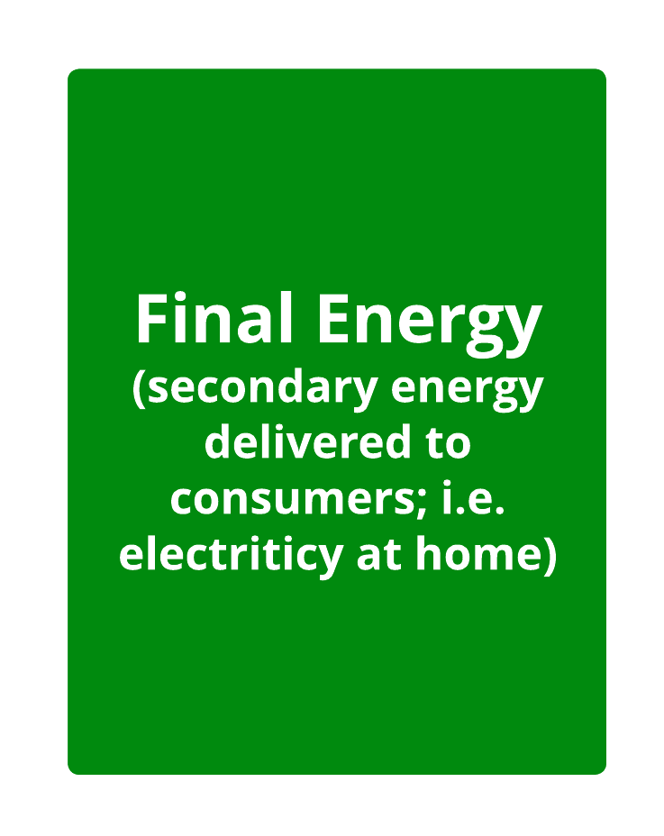
Lecture 4.1 MAED overview
            4.1.1. Main features of MAED
            MAED: Model for Analysis of the Energy Demand
            Simulation model best applicable for long-term analysis.
            Using bottom-up scenario approach for evaluating Final Energy Demand in a country or region.
            MAED main results that we want to obtain are Final Energy Demands (FED) by each group of end-uses.
            MAED has been designed to reflect:
            Structural changes in the Final Energy Demand by means of detailed analysis of the social, economic, and technological factors.
            Evolution of the potential behaviour for each energy form (Final Energy Demand (FED) for electricity, fossil fuels, motor fuels, etc.)
3
Notes:
MAED stands for Model for Analysis of the Energy Demand.
The MAED model is a simulation model best applicable for long-term analysis. It is based on the disaggregated bottom-up approach and uses scenarios to evaluate the energy demand in a country or region based on a set of assumptions.
The MAED model has been specifically designed to investigate structural changes, both in the evolution of energy end-uses driving energy demand and in the make-up of the energy source mix.
On the one hand, a detailed analysis of social, economic, and technological factors allows for an analysis of structural changes in energy demand. On the other hand, the model investigates which types of energy forms will be able to meet this demand, evaluating the potential evolution of energy sources.
MAED has two aspects to it, MAED-D considers scenario-based forecasts of future demand by the defined sectors and fuel type. MAED-E.L. can be used to understand electricity demand profiles. MAED-E.L. forecasts hourly electric power demand for each client, sector, and the entire system based on the input data. This lecture focuses on MAED-D.

Slide 4

Lecture 4.1 MAED overview
            4.1.2. Generic equation in MAED
            To perform calculation of the Final Energy Demand (FED) by each group of end-uses, a corresponding set of equations is used in MAED. All equations have the same form.
            The Final Energy Demand (FED) in any specific year in the future is calculated as a product of the Driving Parameter (DP) in a corresponding future year and the Specific Energy Consumption (SEC) per unit of Driving Parameter (DP) in future years.
            When the Driving Parameter (DP) is the production of monetary units, value added, or G.D.P., the Specific Energy Consumption (SEC) is the Energy Intensity (EI).
Energy demand in year t
            $${FED}_{t}= {SEC}_{t} × {DP}_{t}$$
Driving Parameter in year t
$${ FED}_{t }= {EI}_{t} × G{DP}_{t}$$
Special Case
4
Notes:
To perform calculations of energy consumption for each group of end-uses, a corresponding set of equations is used in MAED. But all those equations have the same form. Energy demand (or E.D.) in any specific year in the future, is calculated as a product of two variables.
The first key variable is the specific energy consumption (or S.E.C.). This is the energy consumption per unit of driving parameter (or D.P.). For instance, the energy needed to produce a ton of steel. When the driving parameter is the production of monetary units, value added, or G.D.P., the specific energy consumption is the Energy Intensity (or E.I.). Specific energy consumption and Energy intensity are the first set of key factors used in MAED, to calculate the energy demand in future years.
The second key variable is the driving parameter in the corresponding future year. Different driving parameters can be used for different segments of energy demand, for example value added in industry, passenger-kilometers travelled in transport, etc. Some examples will be provided through the course.
The product of these two parameters is the generic, fundamental equation used in the MAED model.
A key factor that should govern end-uses grouping, is the specific energy consumption per unit of driving parameter. for instance, the energy needed to produce a ton of steel.
When the driving parameter is the production of monetary units, value added, or G.D.P., the specific energy consumption is the Energy Intensity.
Specific energy consumption and Energy intensity are the main factors used in MAED, to calculate the energy demand in future years.

Slide 5
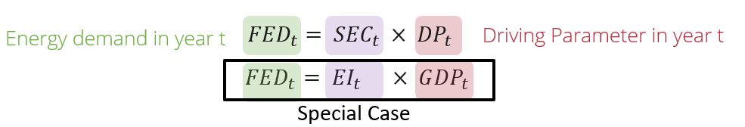

Lecture 4.1 MAED overview
4.1.3. Energy intensity (EI) and Combining activities
Do you remember this equation from Lecture 3, slide 13?
$$EI= \frac{FEC}{PSP}=\frac{Final Energy Consumption }{Product Service Provided}$$
Activity | Energy Intensity | Fraction in total
 | MJ /$ | Base year | Year in future
Steel industry | 50 | 0.4 | 0.2
Textile industry | 10 | 0.6 | 0.8
Weighted average | MJ /$ | 26 | 18
5
Notes:
Even it is not recommended, by way of example, let’s assume we must include production of Steel and textile in the same group. In this example, production of textile has relatively low energy consumption per monetary equivalent of product, 10, and the production of steel has relatively high energy intensity, 50. The value of energy intensity for this aggregated group will be a weighted average of values for both activities. A weighted average is calculated by multiplying the energy intensity for an activity by the fraction it makes up in total and then summing these for all activities. In this case the result is 26 for the base year.
In case the share of energy consumption between both products, in the total production, remains the same, the same intensity shall be used in the future. But if one of the activities develops faster, for example textile, and its relative contribution to the aggregated product increases, the weighted average should be recalculated.

Slide 6

Lecture 4.1 MAED overview
General and special case terminology
SEC
4.1.4. Specific energy consumption (SEC)
            Specific energy consumption (SEC) may change over time
            Replacement of animal power to tractors
            Improvement of standard of living
            Passenger-km transported
            Technological improvements
EI
Electricity per dwelling
Fossil fuels per VA in Agriculture
1
Fuel per 100 km
2000
2030
$$SEC=EI= \frac{FEC}{PSP}=\frac{Final Energy Consumption }{Product Service Provided}$$
6
Notes:
While preparing the input data for the model, the user should be aware that the energy intensity or the specific energy consumption may change in future years.
Take the example of specific motor fuel consumption by tractors in agriculture. If, in the base year, animal traction power is used, then this energy is not taken into account in the definition of energy intensity. With the replacement of animal power by tractors, more fuel will be consumed to produce the same product. This means an increase in energy intensity in future years.
Another example for changes in specific energy consumption could be an improvement in standards of living. As they improve, more electrical appliances will be used in households: a T.V. set, washing machine, dish-washing machine, and so on. This causes an increase in electricity consumption per dwelling.
In some cases, the combination of multiple factors can lead to more complicated changes. For example, as the number of electrical appliances reaches their saturation level and technological improvement plays a larger role. This means that the cumulative value of electricity per dwelling will go down after the growth period.

Slide 7
Lecture 4.2 Driving parameters
            4.2.1. Driving parameters
            Each end use has one Driving Parameter (DP).
            The value of Driving Parameter (DP) is directly used to calculate the Energy Intensity (EI), or more generally, the Specific Energy Consumption (SEC), in the base year and future energy demand for the corresponding end-use.
            The factors used as Driving Parameter (DP) for various activities are predefined in MAED.
            There are different Driving Parameter (DP) for industry, transport, service, and household uses
7
Notes:
One factor is defined as a driving parameter for each end-use.
The value of driving parameter is directly used to calculate the energy demand for the corresponding end-use in both the base year and in the future.
The factors used as driving parameters for various activities are predefined in the MAED model.
There are different driving parameters for industry, transport, service, and household uses, which are listed in the following slides.

Slide 8
Lecture 4.2 Driving parameters
            4.2.2. Driving parameters in industry
Sector activity | End-use | Driving parameter
Agriculture | Steam | Value Added of sector (GDP, $)
Construction | Direct heat
Mining | Specific uses of electricity
Manufacturing | Etc.
8
Notes:
In the MAED model, the industry sector is divided into Agriculture, Construction, Mining, and Manufacturing. Each subsector can be further disaggregated by the user.
The Value Added of each corresponding subsector is defined as the driving parameter for all end-uses in industry.
This monetary equivalent of production is selected for various reasons.
Using the total value added for each sector prevents the user from having to consider the numerous different products of each subsector. This decreases the uncertainty of the projection as it is difficult to predict the specific amount of steel, textile, or rice to be produced in the future years.
The total production of heavy industry and agriculture production in a monetary equivalent can be evaluated more easily.

Slide 9

Lecture 4.2 Driving parameters
            4.2.3. Driving parameters in transportation
Sector activity | End-use | Driving parameter
Freight | Modes of freight transportation, train, truck, … | Ton-km transported
Passenger | Modes of passenger transportation, bus, train, car, … | Passenger-km transported
9
Notes:
In the case of the transport sector, the Value Added does not directly reflect the level of activity in relation to energy consumption. There is another factor that could play this role much better – transportation activity. These are ton-kilometre of goods transported by freight and passenger-kilometre of transported passengers. The user should keep in mind that the demand for energy is indirect. What drives energy demand is the demand for services such as transportation of people and goods. The energy demand analysis thus starts with the projection of the demand for those services, which can then be translated into energy demand through the projected specific energy consumption per unit of such service provided.
The evolution of the relative importance of different technologies to provide transportation services in future years should be considered when performing future energy demand projections. For example, the demand by private passengers for aviation services has been increasing worldwide, but investments in rail and road infrastructure may drive an increase in demand for those as cheaper, less carbon-intensive options.

Slide 10

Lecture 4.2 Driving parameters
            4.2.4. Driving parameters in the household sector
Sector activity | End-use | Driving parameter
Urban area | Space heating Air conditioning Cooking Water heating Electric appliances | Number of dwellings
Rural area
10
Notes:
In the household sector, the factor that determines the evolution of energy consumption is the number of dwellings. This is the most natural and obvious factor to be selected as a driving parameter.
The choice of driving parameter is a trade-off between providing enough detail to infer total energy demand, while limiting data requirements, which require significant time and money. At one extreme, the global population is a widely available indicator but does not provide enough detail in terms of the related energy demand, which is largely driven by space heating and cooling. On the other hand, listing the energy consumption of each appliance in each dwelling in a country would provide more detail in terms of the resulting energy demand, but would be expensive and challenging to collect such data at a country-scale. The number of dwellings is selected as an effective alternative. While there is significant variance between the dwellings within a country, this allows for a relevant estimation of the total energy use at the scale of a country.

Slide 11

Lecture 4.2 Driving parameters
            4.2.5. Driving parameters in the service sector
Sector activity | End-use | Driving parameter
Government | Space heating Space cooling Motive power Water heating Electric appliances | Floor area Service sector value added
Communication
Banking
Trade & other
11
Notes:
In the service sector, the selection of driving parameter is more complicated. This sector combines rather different activities, so practically, the only option for selecting a driving parameter is the value added. But at the same time, energy consumption, for such end-uses as space heating and cooling, is not defined by economic activity of the sector. The number of square metres of service sector floor area is selected as the driving parameter for these two end-uses and the Value Added for any other end-use.
Once again, while there is significant variance between the energy use per value added in all companies, this provides a relevant indicator for inferring the total energy demand at the scale of a country.

Slide 12
Lecture 4.3 End-Use categories
            4.3.1. Sectoral disaggregation
            For the purpose of GDP accounting, the whole economy is broken down into 6 large sectors: Manufacturing, Agriculture, Construction, Mining, Service, and Energy.
            For the purpose of energy accounting, two sector are added to the previous 6 ones:
            the household sector and the transport sector.
            The energy consumed is not included in the total final energy demand. It is part of the supply side of the energy system.
$$Value Added (VA)sector = GDP × share Sector$$
Total GDP
Agriculture
Construction
Mining
Manufacturing
Energy
Service
Machinery Equipment
Manufacturing
Subsectors
Basic Materials
Non-Durables
Miscellaneous
12
Notes:
For the purpose of G.D.P. accounting, in MAED the whole economy is broken down into 6 large sectors. Manufacturing, Agriculture, Construction, Mining, Service, and Energy.
For the purpose of energy accounting, two sectors are added to the previous 6. The household sector, which does not directly contribute to G.D.P. generation. And the transport sector, which usually contributes to the G.D.P. as part of the Service sector.
The energy consumed in the energy sector is considered self-consumption and not included in the balance of total final energy demand. This consumption is considered in the supply side of the energy system.
The contribution of each sector to the total G.D.P. (so the Value Added (V.A.) of that specific sector) can be calculated as a fraction of the total GDP value.
Each of the sectors could be broken further down. For example, in this slide, the manufacturing sector is disaggregated into 4 subsectors. Those subsectors too could be further divided into end-use categories and individual activities. It is important for the MAED user to consider the level of detail they will consider to account for energy demand.

Slide 13
Lecture 4.3 End-use categories
            4.3.2. End-Use categories
            All single energy-consuming activities cannot practically be listed at the scale
            of a country for modelling purposes.
            Individual end-use categories are therefore introduced, which group together similar activities
            End-use categories are selected as the “right” amount of detail considered, given the data available to the modeller and the objectives of the analysis
            In the MAED model individual activities are grouped in end-uses, with some flexibility for the modeller as to which level of detail is most adequate.
13
Notes:
In the MAED model, energy demand is disaggregated into a large number of end-use categories. To do so, activities are combined into homogenous groups. These end-use categories are selected by the user considering the data available and the objectives of the analysis. While providing more detail helps paint a more accurate picture, listing all energy-consuming activities in a country is not an effective or possible solution. Therefore, in the MAED model, individual activities are grouped in end-uses, with some flexibility for the modeller as to which level of detail is most adequate.

Slide 14
Lecture 4.3 End-use categories
            4.3.3. Criteria for combining activities into homogeneous end-use groups
            Criteria for combining activities include:
            Similar activity or role in economy (i.e., production of agricultural product)
            Similar pattern of energy consumption (i.e., such as cooking in the service sector)
            Similar socio-economic or cultural characteristics (i.e., the use of electrical appliances in urban households)
            Similar energy carriers (i.e., motor fuels in transportation)
            Same Driving Parameter (DP).
            Specific Energy Consumption (SEC) and Energy Intensity (EI) are the main factors used in MAED, to calculate the Final Energy Demand (FED) in future years.
14
Notes:
There are several principles for grouping end-user activities into these kind of groups. For instance, by similar activity, like production of agricultural product. By similar pattern of energy consumption, such as cooking in the service sector. By similar socio-economic or cultural characteristics, like the use of electrical appliances in urban households. By similar energy carriers, like motor fuels in transportation. Another criterion for grouping end-uses is the driving factor. If the driving factor is the same, they could be considered as a group.
A key factor that should govern end-uses grouping, is the specific energy consumption per unit of driving parameter. for instance, the energy needed to produce a ton of steel.
When the driving parameter is the production of monetary units, value added, or G.D.P., the specific energy consumption is the Energy Intensity.
Specific energy consumption and Energy intensity are the main factors used in MAED, to calculate the energy demand in future years.

Slide 15
Lecture 4.3 End-use categories
            4.3.4. The level of decomposition is a trade-off
            Specific energy consumption per unit of driving parameter
Level of decomposition | Main sectors, few groups | Many activities, end-uses
Amount of data required | Small | Large
Ability for insight analysis | Low | High
15
Notes:
The level of decomposition is a trade-off between the knowledge of specifics in energy consumption and the amount of information to be provided.
Aggregation at the high level, that is, having few groups combining activities of different end-uses, like total industrial production or total agricultural production, would require a small amount of initial information. However, this weakens the main strength of such models, which is their ability to capture specifics of those end-uses in energy consumption, and the ability for insight analysis is very low.
On the other hand, decomposition to the level to individual activities, like cement production or rice production, captures all the specificities. However, the amount of data to be collected makes this approach impractical, but the ability for insight analysis is high.

Slide 16
Lecture 4.3 End-use categories
            4.3.5. Decomposition in MAED
Sectors
Industry
Service
Household
Transport
Subsectors
Constr.
Mining
Manufact.
Passenger
Freight
Agric.
Materials
Equipment
Non-durables
Miscell.
End-use
Motive power: Conveyer, drilling, etc.
Thermal use: Vapor, water heat, etc.
Specific use of electricity, Appliances , etc.
Category of Final Energy Demand (FED)
Motor Fuel
Fossil Fuel
Soft Solar
Trad. Fuels Biomass
Electricity
District Heat
16
Notes:
In MAED, the structure of the final energy consumption of the country is broken down in a consistent manner, dividing the consumption into 4 major consuming sectors: industry, service, household, and transport.
This level of decomposition is predefined.
The user can further disaggregate the sectors into subsectors, such as agriculture, construction, mining, manufacturing, as shown in this diagram for the Industry Sector. The user can also define urban and rural sub-sectors as well as passenger and freight transport.
The aim of disaggregation is to analyse more closely their projected evolution. The breakdown to the end-uses in most subsectors could be defined by the analyst, depending on actual activity and availability of information.
Also predefined is the form of useful energy required (fuels) for the end-use processes, such as motive power, heat, and specific use of electricity.
The category of final energy depends on technological options available for the satisfaction of the useful energy needs, as some fuels may not be substitutable or may not be available.

Slide 17
Lecture 4.4 MAED Three-Main-Steps
            4.4.1. What do YOU need to do to execute MAED
            Reconstruction of the energy consumption in the base year. Total energy consumption by sectors, by end-use, and by energy carriers.
            Establishing scenarios of economic, social, and technological development.
            Analysis of energy demand projections (results) arising from the scenarios.
1. Base year reconstruction
2. Scenario development
3. Results Analysis
17
Notes:
The execution of a MAED study consists of three phases:
First: Reconstruction of the Final Energy Demand/Consumption in the base year. The MAED model output structure and quantities must be equal to the country’s actual Final Energy Consumption in the base year.
Second: Establishing scenarios of economic, social, and technological development.
And finally: Analysis of energy demand projections, arising from the scenarios.

Slide 18
Lecture 4.4 MAED Three-Main-Steps
            4.4.2. Base year selection and reconstruction
1. Base year reconstruction
2. Scenario development
3. Results Analysis
            The base year must be selected from a most recent year in the past for
            which energy and economic statistics are available, reliable, and consistent.
            The base year should represent stable conditions of energy consumption.
            Unusual situations should prevent a year from being selected.
Gather/Adjust MAED parameters for the base year
Calculate MAED Input Data for the base year
Check accuracy of MAED results for the base year
Run the MAED model
18
Notes:
As was already pointed out, the value of specific energy consumption for the base year is a crucial parameter for estimation of the future energy demand. This makes the selection of the base year a very important issue.
There are several criteria for the selection of the base year. Firstly, the base year should be selected as the most recent year for which energy and economic statistics are available, reliable, and consistent. Secondly, the base year should be selected to represent stable conditions of energy consumption. Finally, If unusual situations like an economic crisis, extreme climatic conditions, or a political crisis occurred during a given year, it should not be selected as a baseline and a previous year should be used.
To reconstruct the base year, an iterative process is adopted. First, statistical data on energy consumption by sectors, by end-use, and by fuels for the selected base year should be gathered. Then, MAED input data for the base year are calculated on the basis of this information. The MAED model is in turn run with this input data. The MAED results are compared with statistical values for that year. In case of discrepancy, the procedure should be repeated, with adjusted MAED parameters.
The objective of this phase is to establish a benchmark and to validate the programme for the energy system of the specific country.

Slide 19
Lecture 4.4 MAED Three-Main-Steps
            4.4.3. Scenarios input data
1. Base year reconstruction
2. Scenario development
3. Results Analysis
Economy
Demography
Lifestyle
Technology
GDP
GDP growth rate
Share of subsectors
Labour Force
Population Growth rate
Size of family
Urbanization
Household size
Mobility
Car ownership
Electrification
Appliances
Energy intensities
Specific energy
consumptions
Efficiency
Market penetrations
19
Notes:
Following the completion of the first stage of the study, reconstruction of the base year energy consumption, the user may move to the second stage: construction of the scenarios.
Scenarios are not predictions or forecast. A forecast is supposed to identify the most likely pathway, while the scenarios help to explore a range of possible pathways. They are descriptions of images of future development that reflect different perspectives based on past and present.
A scenario in MAED is a set of parameters describing a possible long-term pattern of a country's development, including such aspects as its economic, demographic, social, and technological level.
The amount of input data for MAED is relatively large, as is the case for all disaggregated type models. This is the price to pay for the ability to provide reasonably detailed output information.
All input data belong to one of four groups: economy, demography, lifestyle, and technology.
Each group has its own set of input data.
Economy will comprise G.D.P., its growth rate, and the structure of the economy in terms of G.D.P. share of each sector. Labour force is also needed.
Demography will comprise population, population growth rate, share of urban and rural population, and family size.
Lifestyle will comprise size of the dwellings, mobility, car ownership, electrification, and use of appliances.
Technology input data comprise energy intensities in all sectors, efficiency of end-use equipment and processes, and market penetration of different technologies and energy carriers.

Slide 20
Lecture 4.4 MAED Three-Main-Steps
            4.4.4. Energy demand projection
1. Base year reconstruction
2. Scenario development
3. Results Analysis
            The MAED run is executed to produce energy demand projection
            arising from each scenario.
2050
2025
2020
Final Energy Demand
By sectors
Industry
Transport
Service
Household
End-Uses
Electricity
Fossil Fuel
Motor Fuel
District Heat
Soft Solar
Traditional fuels, Biomass
By category of final energy demand
20
Notes:
At the final phase, MAED will produce energy demand projections for each scenario. The results of MAED provide valuable information for further analysis within the energy planning process.
Energy consumptions are calculated, for each group of end-uses, and are aggregated by energy carriers, by sectors, and subsectors, for each year of the study, including the base year.
The model calculates the results for each year of projection, resulting from the set of scenario assumptions.
This total energy demand projection should not be taken as a certain prediction, but as the result of the, if dot dot dot, then dot dot dot, exercise.
The assumptions both in terms of scenario input data and in terms of the structural limitations of the model should be acknowledged when using the results.

Slide 21
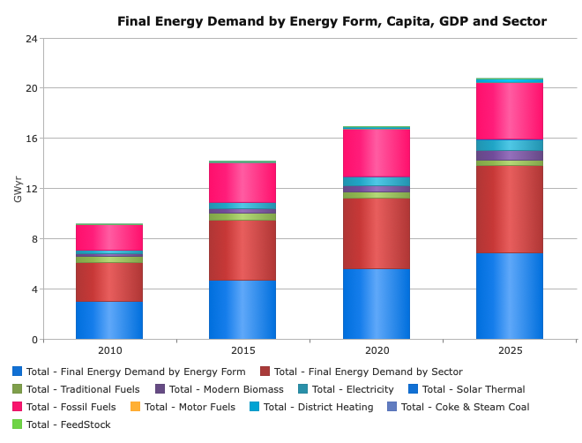
Lecture 4.4 MAED Three-Main-Steps
            4.4.5. Energy demand projection: output example
1. Base year reconstruction
2. Scenario development
3. Results Analysis
Reference scenario
Low scenario
Intermediate scenario
High scenario
21
Notes:
The MAED output is a set of calculated values of energy demand by sector and by energy form. These outputs are for all years in the future as specified by the user.
There are multiple outputs for a specified country. The modeller can examine both the share of each energy type and the total final energy demand. MAED is particularly useful for showing the future changes in total energy demand, as well as the future changes in the structure of that demand.
There are several output tables in MAED, including useful energy demand, final energy demand, and some energy indicators, including total energy intensity, among others.
Scenarios are created for a number of different possible futures and cases, considering a set of plausible economic growth scenarios, a set of energy system configuration scenarios, and combinations of these two groups of parameters. For example, one could imagine very different results depending on the scenario chosen that may differ from the reference scenario: a very high, an intermediate, and a low scenario. Note that we are not able to attach probabilities to each of these scenarios. The middle scenario is not necessarily the most probable one and should not be used as such.
This concludes lecture 5 which provided an introduction to MAED-D.

Slide 22

Cannone, C., Collett, K.A., Charbonnier F., Ahsan A., Halloran C., Vijay,A.,Berdellans I., Hasanovic S., Gritsevskyi A,Stankeviciute L., Tot M.; Welsch M., Hirmer S., 2023. Lecture 4: "INTRODUCTION
TO MAED-D" , Energy Demands Projections with MAED (Model for Analysis of Energy Demand). Release Version 2.0. [online presentation]. Climate Compatible Growth & Programme and International Atomic Energy Agency.
CCG courses (this will take
you to the website link http://www.ClimateCompatibleGrowth.com/teachingmaterials)
22

