Slide 1

Model for Analysis of Energy Demand
LECTURE 3
THE ENERGY CHAIN
Version 2.0
1
Notes:
Licence: This work is licensed under the Creative Commons Attribution 4.0 International License (CC BY 4.0). To view a copy of this license, visit https://creativecommons.org/licenses/by/4.0/.
Attribution: Please cite as: Kiley, F. (2025) An Introduction to Simulating Energy Demand with MAED. Version 1. Climate Compatible Growth Teaching Kit Website, Climate Compatible Growth.

Slide 2
Intended Learning Outcomes (ILOs)
This lecture has four Intended Learning Outcomes (ILOs):
ILO1: be familiar with basic energy terminology
ILO2: learn about the concept of the energy chain
ILO3: be able to compare energy intensities
ILO4: understand energy balances
3.1. Energy terminology
3.2. Energy chain
3.3. Energy Intensity
3.4. Energy Balance
2
Notes:
The Intended Learning Outcomes of this lecture are to:
1) be familiar with basic energy terminology,
2) learn about the concept of the energy chain,
3) be able to compare energy intensities, and,
4) understand energy balances.

Slide 3
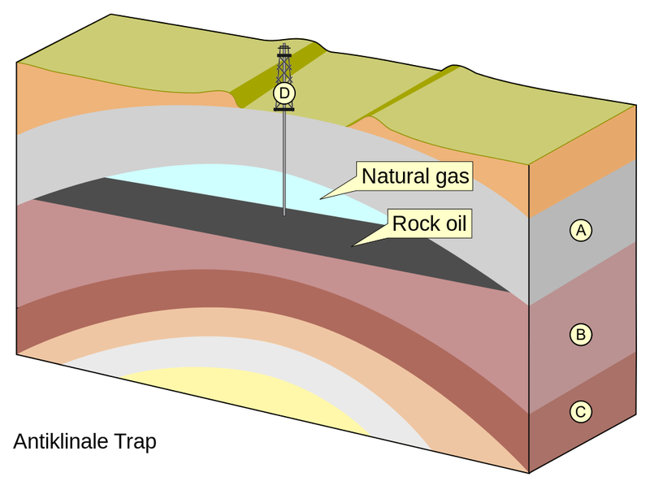
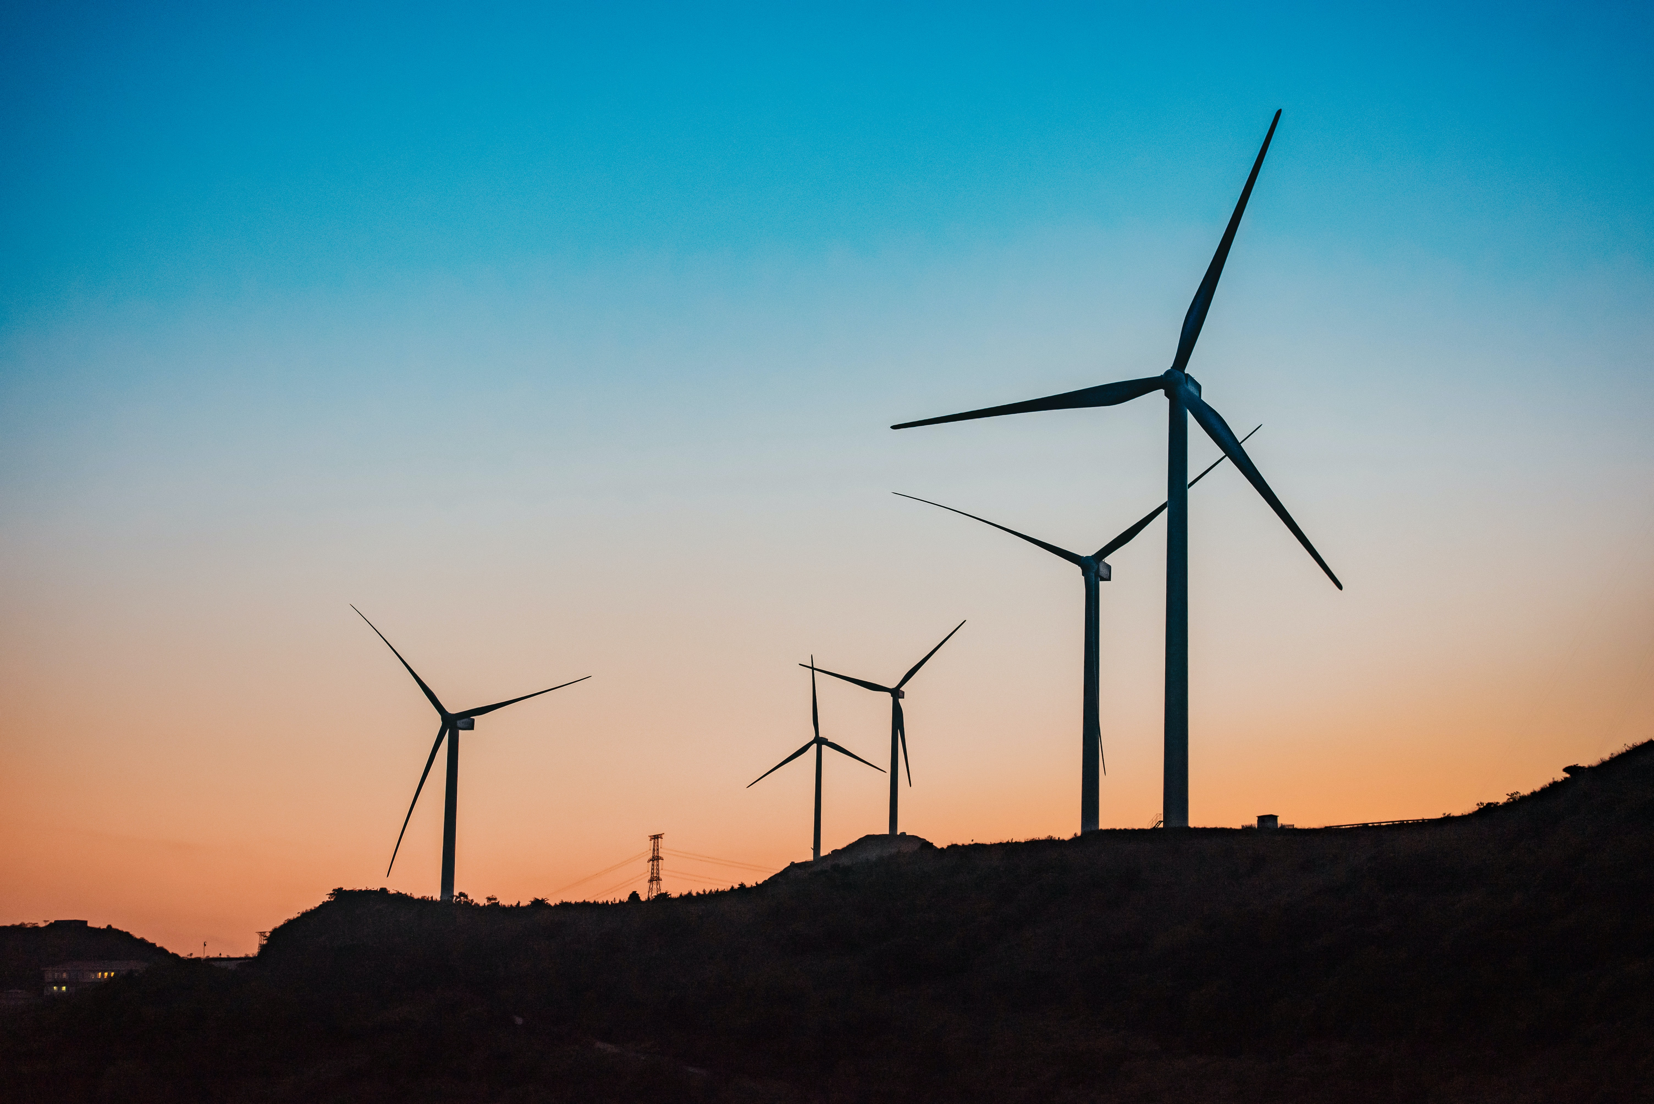
Lecture 3.1 – Energy terminology
Energy Reserves and Resources
Depletable Energy Reserves/Resources
            Example: Crude oil reserves (billion barrels or bbls.)
            This energy material has not yet been extracted
            Resources: entire quantity of energy material
            Reserves: the economically recoverable portion of the Resources
Renewable Energy Resources
            Examples: Hydro power, Biomass, Wind power
Energy reserves & resources
Primary energy
Secondary energy
Final Energy
Useful Energy
Product / Service
3
Notes:
We will start by defining some key terms of energy terminology.
Energy reserves and resources are the first step of the energy chain. They can be split between depletable reserves and renewable energy resources.
Depletable energy resources are resources whereby the whole stock decreases whenever the resource is being used and does not increase over the timescale relevant for economic decision-making. Examples include deposits of coal, oil, or minerals. For example, oil takes around 50 million years to form. The replenishment is not relevant for the human economy timescale. Therefore, practically speaking, oil is said to be depletable. We speak of reserves or resources to refer to material which has not yet been extracted. Resources usually refer to the entire quantity of energy material and reserves refer to the part of the resource which is technically and economically recoverable. Note that this share of recoverable material depends on technological progresses and on market dynamics. If prices for oil decrease, the share of the economically recoverable portion decreases.
Renewable energy resources on the other hand replenish in the same timescale as they are used. Examples include hydro, solar, wind power, and biomass use. Note, however, that renewable energy resources may stop being renewable if the environment is degraded. For example, hydro power is renewable so long as the infrastructure does not cause excess sedimentation which constrains the water flow. Biomass resources such as trees are renewable so long as we cut trees at a lower rate than the rate of growth so that the total stock does not decrease over the years.

Slide 4
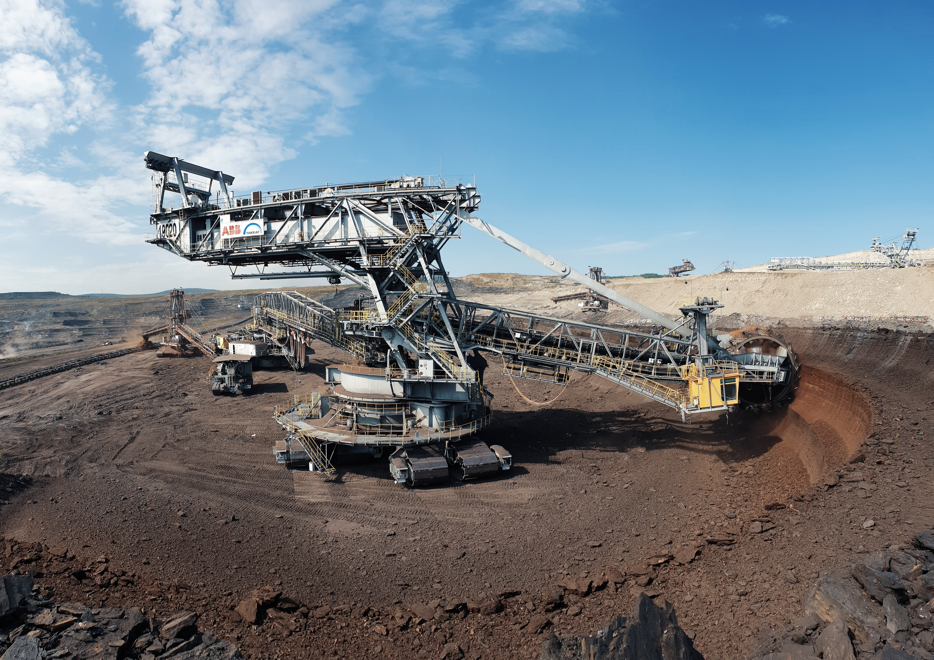
Lecture 3.1 – Energy terminology
Energy reserves & resources
Primary energy
Secondary energy
Final Energy
Useful Energy
Product / Service
Primary Energy Production
Energy material that is extracted,
from the reserves over a time period
For example: crude oil production (barrels or bbl per day)
Secondary Energy Production
Measured at the gate of the
energy supplier
For example: refinery for gasoline production (million litres/day)
4
Notes:
Primary Energy Production refers to the amount of energy material that is extracted from the reserves over a given time period. Examples include crude oil production (can be measured in barrels, also know as b.b.l., per day), natural gas production (can be measured in cubic meters per day), and coal production (can be measured in tons per year).
Secondary Energy Production is the quantity of energy that is converted from one form to another and that is suitable for delivery to end users. Examples include petroleum products (gasoline, diesel, fuel oil) that are processed from crude oil, electricity that can be generated from coal, and ethanol that can be converted from corn. Secondary energy production is measured at the gate of the energy supplier (for example, at the refinery gate or at the electric power plant gate).

Slide 5

Lecture 3.1 – Energy terminology
Energy reserves & resources
Primary energy
Secondary energy
Final Energy
Useful Energy
Product / Service
Final Energy Consumption
The quantity of energy purchased by end users - what a consumer buys and receives, such as electricity in their home; heating; or gasoline at the fuel pump.
It differs from secondary energy production as it includes the losses in transporting energy from the supplier to the end user
5
Notes:
Final Energy Consumption is the quantity of energy purchased by end users. It is the energy which reaches the final consumer's door and excludes that which is used by the energy sector itself. It differs from secondary energy production as it includes the losses in transporting energy from the supplier to the end user. For example, electricity transmission and distribution losses reduce the amount of energy that is available for purchase by consumers.
Final energy consumption covers quantities consumed by private households, commerce, public administration, services, industry, agriculture, road transport, air transport, and fisheries.

Slide 6

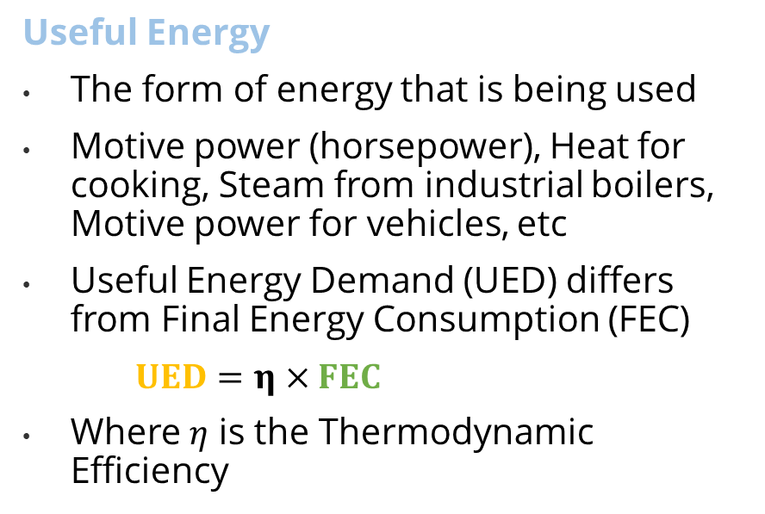
Lecture 3.1 – Energy terminology
Energy reserves & resources
Primary energy
Secondary energy
Final Energy
Useful Energy
Product / Service
    $FEC×η=UED$
Useful Energy
The form of energy that is being used
Motive power (horsepower), Heat for cooking, Steam from industrial boilers, Motive power for vehicles, etc
  Useful Energy Demand (UED) differs from Final Energy Consumption (FEC)
    $UED=η×FEC$
  Where $η$ is the Thermodynamic Efficiency
Final Energy Consumption (FEC)
4 tons of coal
100 Giga joules
Useful Energy (UED)​
50 m³ steam​
70 Giga joules​
Thermodynamic Efficiency (η)​ 70%
6
Notes:
Useful Energy Demand is the form of energy that is being used after final conversion to the consumer for their respective use. In final conversion, electricity becomes, for instance, light, mechanical energy, or heat.
Examples include uses such as heat for cooking, the energy contained in the steam from industrial boilers, motive power for vehicles, etc. Useful energy demand differs from final energy consumption by the efficiency of the equipment being used.
This is an example of the relation between final energy consumption (or F.E.C.) and useful energy demand (or U.E.D.). The final energy is used as the input for the machine, whose thermodynamic efficiency expressed in percentage will determine the useful energy. This relationship is calculable by the formula given on the slide: useful energy demand equals efficiency multiplied by final energy consumption.

Slide 7



Lecture 3.1 – Energy terminology
Energy reserves & resources
Primary energy
Secondary energy
Final Energy
Useful Energy
Product / Service
Product/Service Provided
The ultimate use for which energy is being consumed
Travel (vehicle-km travelled)
  Vehicle kilometre travelled for automobiles
  Tons of steel production
  Floor area of buildings being heated or cooled
7
Notes:
Products and Services provided are the ultimate use for which energy is being consumed. It is generally not measured in energy units, but in some physical units. Examples include vehicle kilometres travelled for automobiles, tons of steel production, or floor area of buildings being heated or cooled.
Energy is a derived demand. The consumer does not value the amount of energy that arrives at their door, but the service they can get from it. The energy use and the value of the service are not always proportional. The same energy service can be obtained using different energy amounts, if, for example, one used more energy by driving to the service provider instead of obtaining the service remotely. The aim of energy provision is always the end products and services provided.

Slide 8
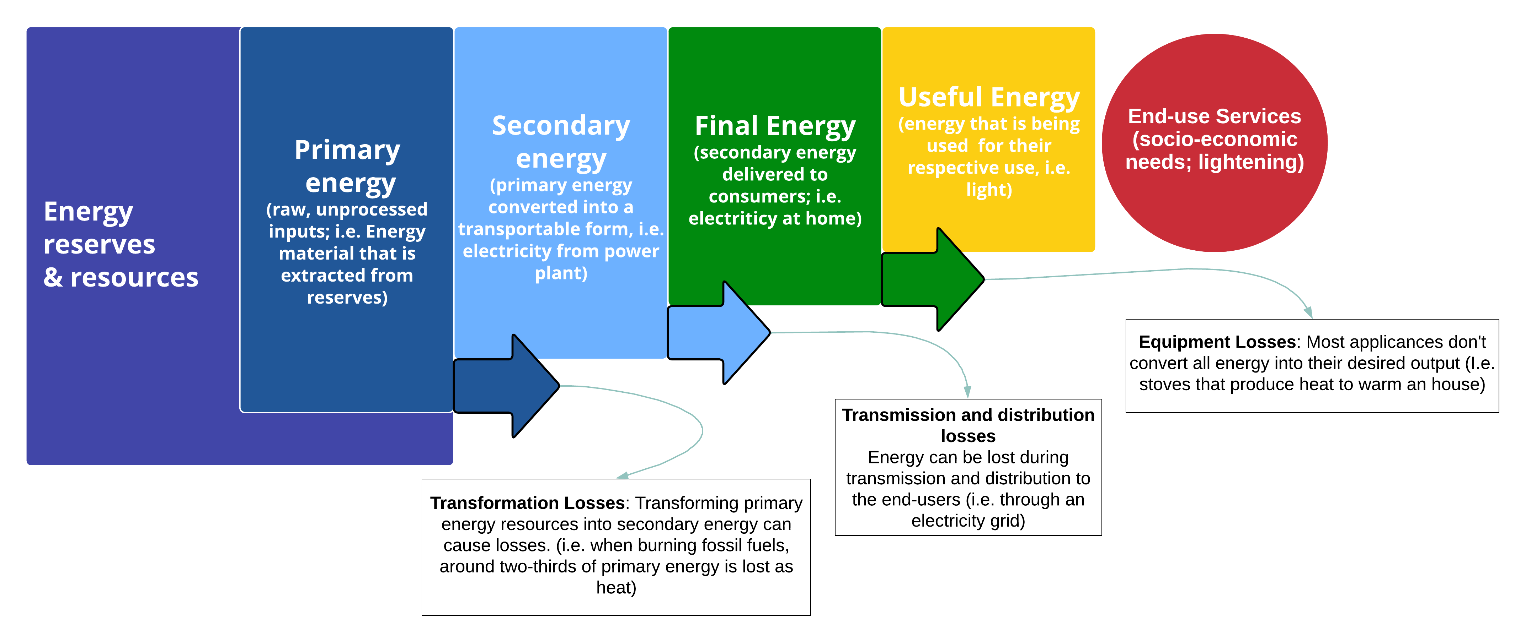
Lecture 3.2 – The energy chain
Each step of the energy chain results in losses due to inefficiencies
Adapted from Our World in Data. Licensed under CC-BY by the author Hannah Ritchie
8
Notes:
As the illustration above showed, at each stage of the energy chain, some energy is lost or wasted. The four metrics capture energy losses in the following ways.
Primary to secondary energy: the conversion of primary to secondary energy can be very inefficient. In thermal power plants – which convert fossil fuels, biomass or nuclear into electricity, up to two-thirds of the primary energy is wasted as heat. For every three units of energy we put in, you get just one unit of electricity out.
Because primary energy losses are particularly large for fossil fuels, their contribution to energy demand is much higher in primary energy terms compared to the other three ways of measuring energy. This is important to know because it can skew our perception of how much of a contribution low-carbon sources make: in primary energy terms they can appear smaller because they are diluted by the wasted energy that comes along with fossil fuel burning.
Secondary to final energy: we also lose energy in the process of delivering it to the consumer. This is called a ‘transmission and distribution’ loss. When we transport electricity from a power plant (secondary energy) to homes (final energy), for example, we lose some while transmitting it through power lines.
Final to useful energy: no appliance is completely efficient in providing only the desired output that we want.
For a lightbulb, the useful energy – what we want – is the light (to satisfy the socio economical need of lightening a space). But bulbs also produce some heat. The useful energy from cars is movement. But engines also produce heat and noise. To get from Final Energy Consumption (FED) to the Useful Energy Demand (UED) we need to do the ratio of FED/the Thermodynamic Efficiency of the specific equipment used.
Any energy that is not used specifically for the desired use of an appliance is waste.
The energy we need as the end-user is often a small fraction of what goes into the top of the system (the primary energy). We see this in the schematic.
The world produces a lot of energy, and most of it is lost along the way. [OurWorldInData]

Slide 9
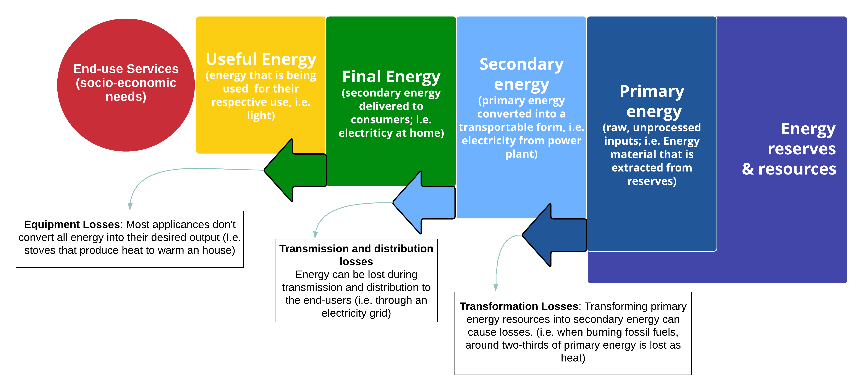
Lecture 3.2 – The energy chain
The energy chain can be thought of backwards in this context
Adapted from Our World in Data. Licensed under CC-BY by the author Hannah Ritchie
8
Notes:
The energy chain can also be thought of backwards, from the perspective of provision. We care less about providing an amount of energy than about providing services. We can thus start with the socio-economic needs that we seek to meet and work backwards to determine the implications for the energy chain.
From the socio-economic needs, one can determine the useful energy demand.
The useful energy demand determines in turn the final energy needs. The amount of final energy determines the amount of seconday and primary energy needed.
Finally, the primary energy needs can be fulfilled with the existing resources, or imports.

Slide 10




Lecture 3.2 – The energy chain
The building blocks of the energy system
… are linked together by the energy chain
Electrical Plant, Refinery
Transmission lines,
Pipelines
Consumer
Mine, Well, Import
Extraction
Conversion / Transformation
Transmission &
Distribution
Final Conversion
RESOURCES
PRIMARY
SECONDARY
FINAL
USEFUL
Oil, Gas, Coal, Flowing water, Sun
Diesel, Kerosene, Gas, Electricity
Diesel, Kerosene, Gas, Electricity
Heat, Light, Mechanical energy
10
Notes:
The building blocks of the energy system are linked together by the energy chain.
Extraction links resources to primary energy. Note that not all energy resources have to be extracted. Flowing water and sunshine, for example, are already available forms of primary energy. This primary energy is converted to secondary energy. For example, oil is converted to diesel and kerosene, flowing water to electricity. The secondary energy is transmitted to the point of energy use, which incurs costs and losses. The final energy which reaches the consumers is converted to useful energy, for example gas or electricity converted to usable heat in homes.

Slide 11
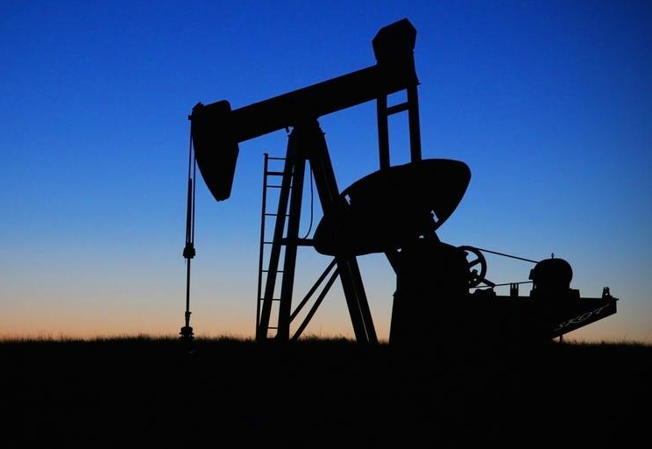
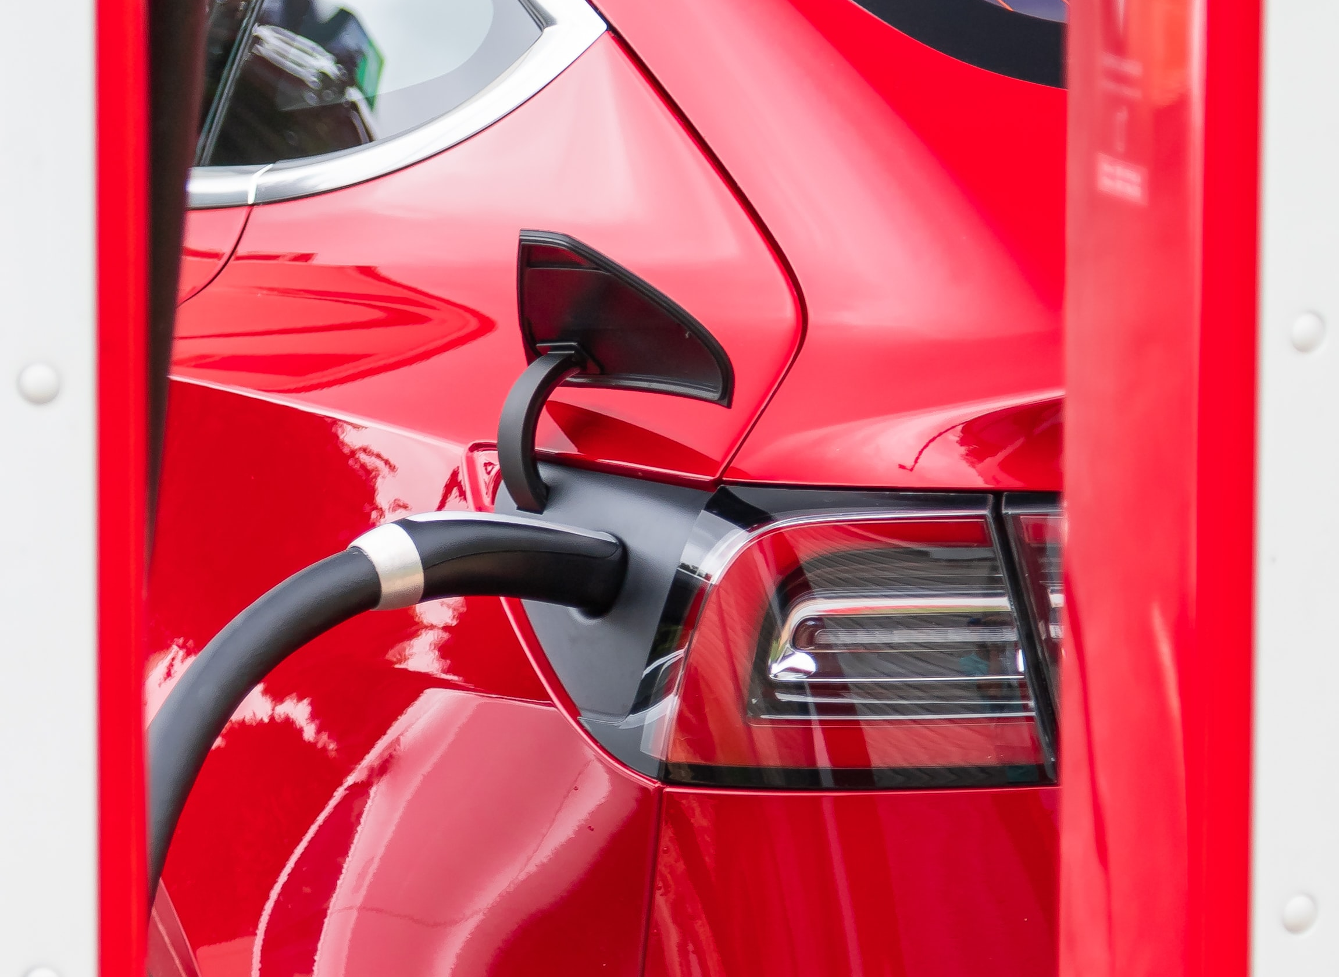


Lecture 3.2 – The energy chain
Energy Demand Analysis focuses on the last three items of the energy chain.
Energy reserves & resources
Primary energy
Secondary energy
Final Energy
Useful Energy
Product / Service
11
Notes:
Energy demand analysis is the first step needed to quantify the objective that the energy chain must work towards. Energy demand analysis focuses on the last three items: What products or services are needed? How much useful energy is needed to perform them? How much final energy is required to produce that useful energy?
This has consequences on the rest of the chain: how much secondary and primary energy is required to provide final or useful energy? How is the demand on resources affected?

Slide 12
Lecture 3.2 – The energy chain
An Energy Balance can be built to represent each step between energy flows in the energy chain:
May be represented in:
Flow diagram
Matrix form (tables)
More on this in mini-lecture 3.4
Energy reserves & resources
Primary energy
Secondary energy
Final Energy
Useful Energy
Product / Service
12
Notes:
An Energy Balance can be constructed to represent each step between energy flows in the energy chain. At each step of the energy chain, there are flows of energy coming in and flows of energy going out in different forms.
According to the law of conservation of energy, energy can neither be created nor destroyed; rather, it can only be transformed or transferred from one form to another. Therefore, the flow of energy in and out must be equal.
However, there are losses in practical terms, as not all of the energy in a process can be recovered in a usable form at the end of the process. For example, energy is lost in the form of heat when using gas to power a turbine to form electricity and when transmitting electricity in the grid, and again when transforming that electricity into light in a light bulb.
Energy balances can quantify the flows of different forms of energy in and out of those processes in the energy chain.
Energy balance may be represented in the form of flow diagrams or in matrix form. There will be more on this in mini-lecture 3.4.

Slide 13
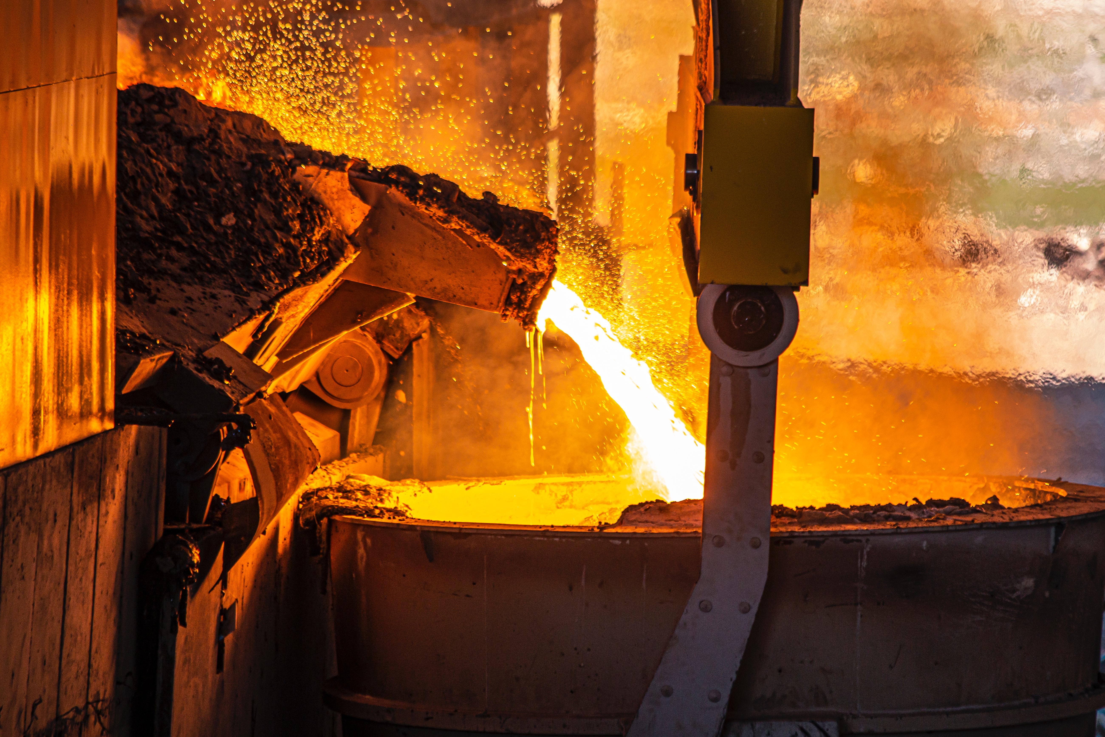
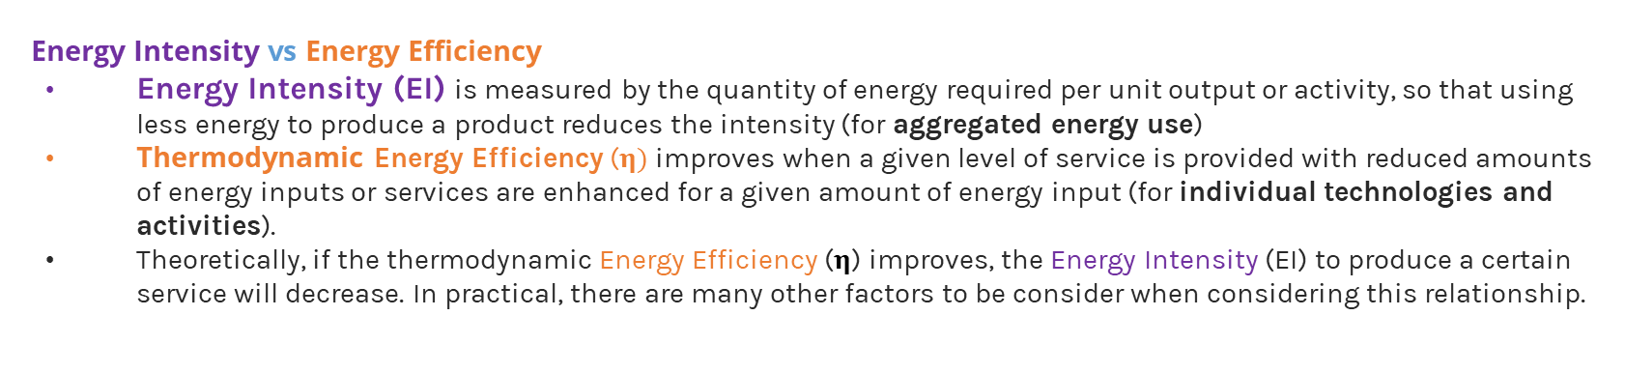

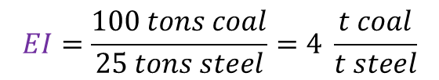

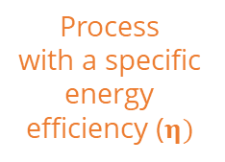
Lecture 3.2 – The energy intensity
  Energy Intensity vs Energy Efficiency
Energy Intensity (EI) is measured by the quantity of energy required per unit output or activity, so that using less energy to produce a product reduces the intensity (for aggregated energy use)
Thermodynamic Energy Efficiency ($η)$improves when a given level of service is provided with reduced amounts of energy inputs or services are enhanced for a given amount of energy input (for individual technologies and activities).
Theoretically, if the thermodynamic Energy Efficiency ($η$) improves, the Energy Intensity (EI) to produce a certain service will decrease. In practical, there are many other factors to be consider when considering this relationship.
Process
with a specific energy efficiency ($η)$
Final Energy Consumption (FEC)
Product/Service Provided (PSP)
$$EI= \frac{FEC}{PSP}=\frac{Final Energy Consumption }{Product Service Provided}$$
100 tons coal
25 tons steel
$$EI=\frac{100 tons coal}{25 tons steel}=4 \frac{t coal}{t steel}$$
5 liters gasoline
100 vehicle-km travelled
$EI=\frac{5 liters gasoline}{100 vehicle−km}=0.05 \frac{liters gasoline}{vehicle−km}$
13
Notes:
To work from the service required to the amount of energy that needs to be provided, we introduce the concept of energy intensity. Energy intensity denotes the amount of energy needed to produce a certain service. This is different to the useful energy: if we were to calculate the useful energy from the Final Energy Consumption (FEC) we would multiply the FEC by the Thermodinamic efficiency of the equipment used. Here instead we measure the amount of energy needed to produce one unit of a certain service or product. For example, to produce steel, coal can be used as an energy source. If 100 tons of coal must be burned to produce 25 tons of steel, then the energy intensity is, 4 tonnes of coal per tonne of steel produced.
In the transport sector, energy intensity is calculated with respect to the service provided. In the case of passengers, energy consumed per 100 kilometres travelled. In the case of freight, energy consumed per ton kilometre. Theoretically, if the thermodynamic Energy Efficiency ($η$) improves, the Energy Intensity (EI) to produce a certain service will decrease. In practical, there are many other factors to be consider when considering this relationship

Slide 14
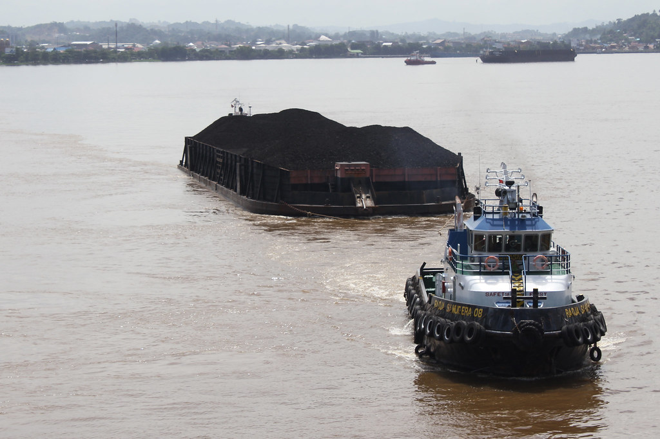
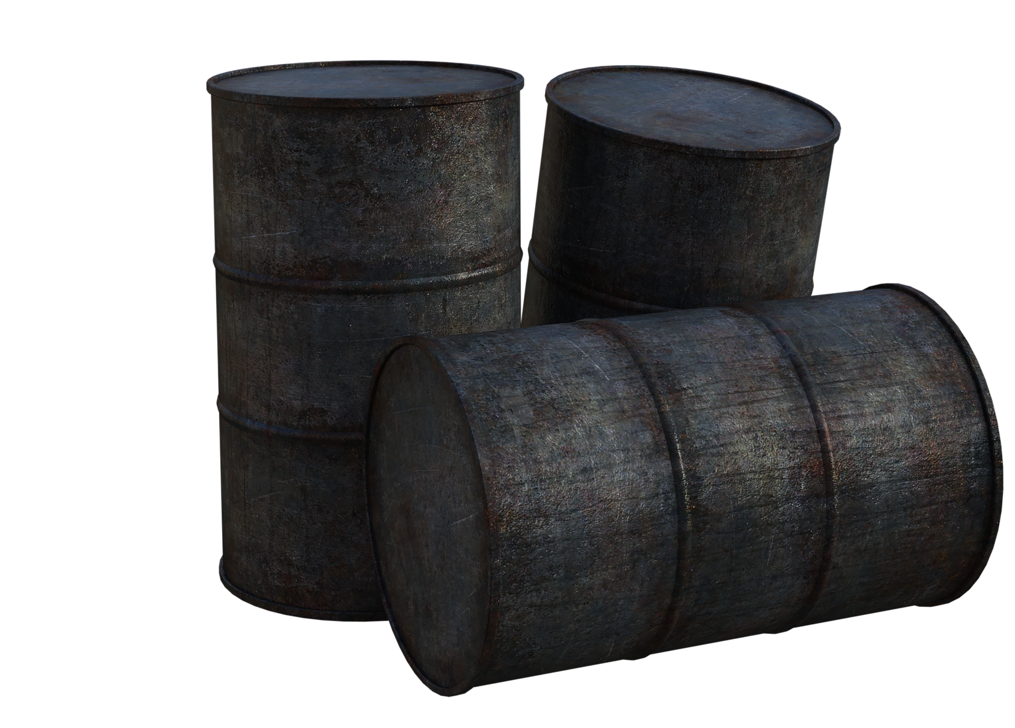

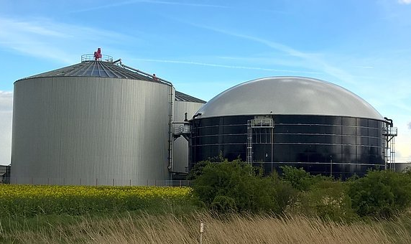
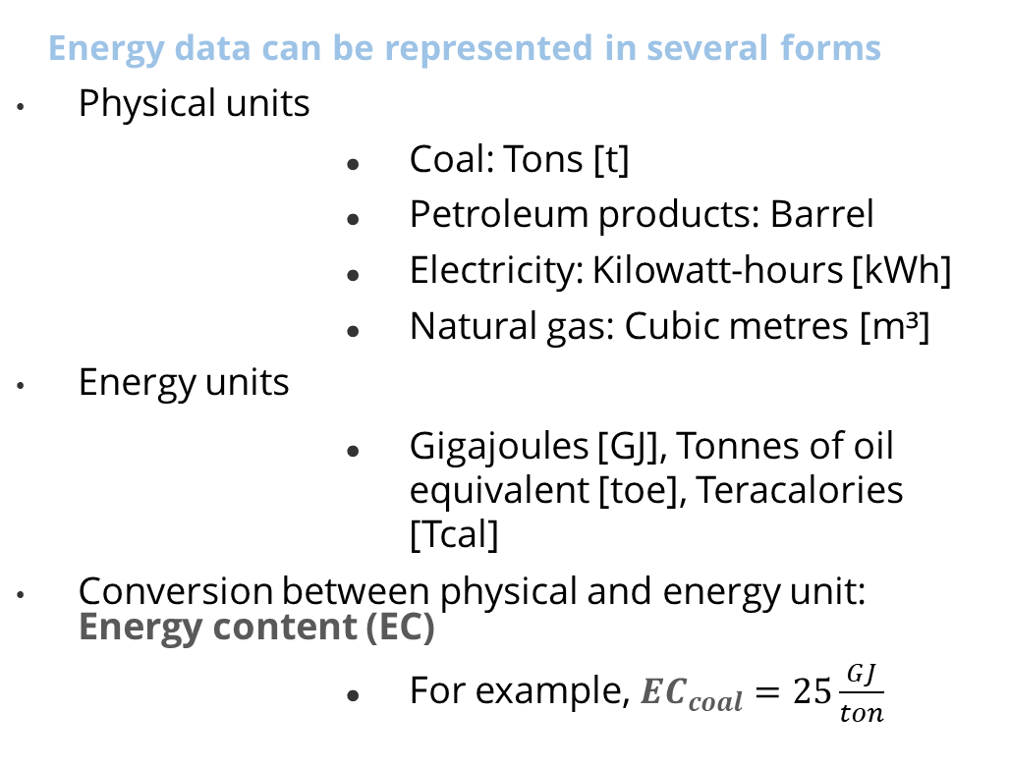
Lecture 3.3 – Energy intensity
Energy data can be represented in several forms
Physical units
      Coal: Tons [t]
      Petroleum products: Barrel
      Electricity: Kilowatt-hours [kWh]
      Natural gas: Cubic metres [m³]
      Energy units
      Gigajoules [GJ], Tonnes of oil equivalent [toe], Teracalories [Tcal]
      Conversion between physical and energy unit: Energy content (EC)
      For example, ${EC}_{coal}=25\frac{GJ}{ton}$
Tons of coal
Barrels of oil
kWh of electricity
m³ of gas
14
Notes:
In the third mini-lecture we will now look at the concept of energy intensity.
Energy data can be represented in several forms:
Physical Units represent the physical quantity of the energy type. For example, barrels for liquid petroleum products, cubic metres for natural gas, tons for coal, kilowatt hours for electricity.
Energy Units represent a conversion of the physical units to a common energy unit. For example, Gigajoules, ton of oil equivalent, Tera calories, and others.
Reporting energy data in these units requires converting the physical quantities into energy quantities based on the energy content of the fuel.
For example, let’s assume that a given kind of coal contains 25 gigajoules per ton. So 100 tons of coal represents 2500 giga joules of energy. This calculates the energy content (or E.C.) as shown on the slide.
The advantage of using such energy units is that it allows different types of energy forms to be compared on a common basis.
The energy content is a physical characteristic of the energy material and is directly related to the quality of the fuel. As already shown, it is used to translate the physical units into energy units.

Slide 15
Lecture 3.3 – Energy intensity
Energy data can be represented in several forms, in different physical and energy units
To
Example : 1MJ = 0.2778 kWh
From
15
Notes:
Energy data can be represented in several forms. There are several energy units, and they can be converted from one to another.
This is a conversion units table. As an example, it is shown how to use it to convert from Mega Joules to kilo watts hours.
The joule is a derived unit of energy in the International System of Units. It is equal to the energy transferred to an object when a force of one newton acts on that object in the direction of the force's motion through a distance of one metre.
A mega Joule is one million Joules or 10 to the power of 6 Joules. A tera Joule is 10 to the power of 12 Joules.
The watt is a unit of power, meaning the rate of use of energy. A watt equals to one joule per second.
The kilo-Watt-hour is equal to a power of 1000 Watt being maintained for one hour. In other words, one kilo-Watt-hour is the energy which equals to 1000 Joules per second for an hour.

Slide 16
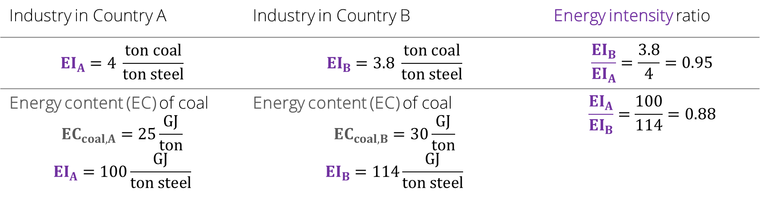
Lecture 3.3 – Energy intensity
Energy intensity (EI) as indicator:
Industry in Country A | Industry in Country B | Energy intensity ratio
$$EI_{A}=4 \frac{ton coal}{ton steel}$$ | $$EI_{B}=3.8 \frac{ton coal}{ton steel}$$ | $$\frac{EI_{B}}{EI_{A}}=\frac{3.8}{4}=0.95$$
Energy content (EC) of coal $${EC}_{coal,A}=25\frac{GJ}{ton}$$ $${EI}_{A}=100\frac{GJ}{ton steel}$$ | Energy content (EC) of coal $${EC}_{coal,B}=30\frac{GJ}{ton}$$ $${EI}_{B}=114\frac{GJ}{ton steel}$$ | $$\frac{EI_{A}}{EI_{B}}=\frac{100}{114}=0.88$$
16
Notes:
Energy intensity is a powerful indicator. It allows us, for example, to compare efficiencies of industries producing the same product or service in different countries.
Let’s assume in country A, the steel industry is using 4 tons of coal to produce 1 ton of steel. But in country B, they are using only 3.8 tons of coal to produce the same ton of steel.
We can say that the steel industry of country B is 5 percent more efficient than in country A.
But it depends on the quality of the coal that they are using. Specially the physical characteristic of the energy content.
If the energy content of coal in country A, is 25 Gigajoules per ton of coal, while in country B it is of 30 Gigajoules per ton, then the energy intensity in country A is lower than in country B. Therefore the steel industry in country A is around 12 per cent more efficient than the industry in country B.
This example shows the importance of using common physical units to make comparisons in the right way, and it shows one of the other factor (the Energy Content of the energy resource) that influence the Energy Intensity of a specific activity.

Slide 17
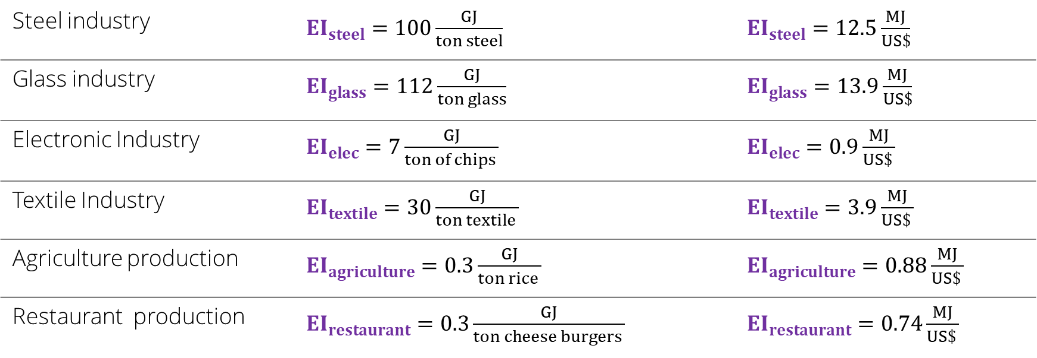
Lecture 3.3 – Energy intensity
Energy intensity (EI) as indicator:
Steel industry | $EI_{steel}=100\frac{GJ}{ton steel}$ | $EI_{steel}=12.5\frac{MJ}{US\$}$
Glass industry | $EI_{glass}=112\frac{GJ}{ton glass}$ | $EI_{glass}=13.9\frac{MJ}{US\$}$
Electronic Industry | $EI_{elec}=7\frac{GJ}{ton of chips }$ | $EI_{elec}=0.9\frac{MJ}{US\$ }$
Textile Industry | $EI_{textile}=30\frac{GJ}{ton textile }$ | $EI_{textile}=3.9\frac{MJ}{US\$ }$
Agriculture production | $EI_{agriculture}=0.3\frac{GJ}{ton rice }$ | $EI_{agriculture}=0.88\frac{MJ}{US\$ }$
Restaurant production | $EI_{restaurant}=0.3\frac{GJ}{ton cheese burgers }$ | $EI_{restaurant}=0.74\frac{MJ}{US\$ }$
17
Notes:
By using the energy intensity per unit of product produced, it is possible to compare different kinds of industries. This is effective when you compare two heavy industries, like the steel and glass industries, which both produce tons of a product. However, it may be less useful when comparing heavy industries with light industries like electronics. Should the production of the electronic industry be measured in tons? Is it not better to consider, for instance, thousands of chips produced? The same question can be asked for the textile industry, where it is probably better to measure the production in metres of textile.
The question can be extended to making comparisons among different productive sectors. You can talk about tons of rice, but it is very unusual to speak of tons of cheeseburgers.
The problem is easily solved by changing the unit of the service provided by the energy into a common unit.
The number of monetary units produced, or amount of value added, are the most natural units to make these kinds of comparisons. Therefore, we generally discuss energy intensity of G.D.P..

Slide 18
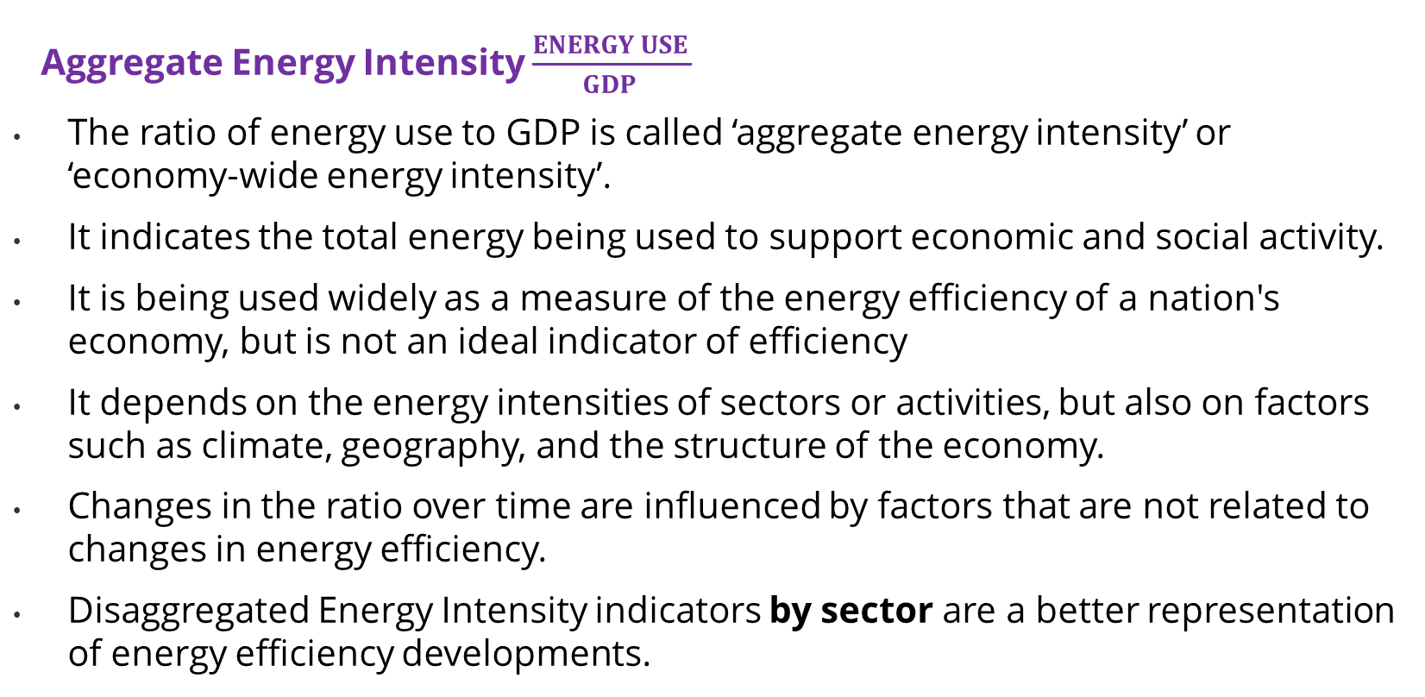
Lecture 3.3 – Energy intensity
Aggregate Energy Intensity $\frac{ENERGY USE }{GDP }$
The ratio of energy use to GDP is called ‘aggregate energy intensity’ or ‘economy-wide energy intensity’.
It indicates the total energy being used to support economic and social activity.
It is being used widely as a measure of the energy efficiency of a nation's economy, but is not an ideal indicator of efficiency
It depends on the energy intensities of sectors or activities, but also on factors such as climate, geography, and the structure of the economy.
Changes in the ratio over time are influenced by factors that are not related to changes in energy efficiency.
Disaggregated Energy Intensity indicators by sector are a better representation of energy efficiency developments.
18
Notes:
The ratio of energy use to Gross Domestic Product, or G.D.P., is also called aggregate energy intensity, or economy-wide energy intensity. The ratio of energy use to G.D.P. indicates the total energy being used to support economic and social activity. It represents an aggregate of energy use, resulting from a wide range of production and consumption activities. Energy intensity, when calculated as units of energy per unit of G.D.P., is widely being used as a measure of the energy efficiency of a nation's economy. But this is not an ideal indicator of energy efficiency, sustainability of energy use, or technological development.
This indicator depends on the energy intensities of sectors or activities, but also on factors such as climate, geography and the structure of the economy. Consequently, changes in the ratio over time are influenced by factors that are not related to changes in energy efficiency (such as changes in economic structure). It is thus important to supplement the energy use per G.D.P. indicator, with energy intensities disaggregated by sector, since these disaggregated indicators are a better representation of energy efficiency developments.

Slide 19
Lecture 3.4 – Energy balance
Energy balance is a representation that establishes the balance of the energy system.
The balance is established between energy inflows by type of energy carrier or fuel, and the outflows by sector of consumption.
In the energy system, as energy is produced, losses occur. The energy balance helps you keep track of these changes and losses.
Original energy data shall be converted into a common energy unit (for example Ton oil equivalent or Joules), based on net calorific values)
Inputs
Outputs
Oil
STOCK
Power plants
Coal
Industry
Natural Gas
Households
19
Notes:
In the fourth mini-lecture, we now look at the concept of energy balance.
Energy balance is a representation that establishes the balance of the energy system.
The balance is established between energy inflows by type of energy carrier or fuel, and the outflows by sector of consumption.
Energy balance could reflect the energy flows of a specific energy carrier, or the total energy mix. The stocks of each energy carrier flow to where they are consumed. In this example, fossil fuels are the energy carriers and the consumers are electric power plants, industry, and households.
In the energy system, as energy is produced, losses occur.
The energy balance helps you keep track of these changes and losses.
Original energy data shall be converted into a common energy unit.

Slide 20

Lecture 3.4 – Energy balance
Flow diagram format
Import
P
R
I
M
A
R
Y
Oil
Oil
Products
(Final)
Import
Electricity
(Final)
Export
Losses
Import
Gas
Products
(Final)
Gas
Losses
Export
Losses
Import
Elec. not from Fossil Fuel
Coal
Coal
Products
(Final)
Export
Losses
Import
Sun, wind and hydro
Export
Losses
20
Notes:
This diagram shows an example of energy balance as a flow diagram. This form is more applicable when a qualitative presentation is required.
To each primary source imports have been added, and losses and exports have been subtracted. In this case they are going to electric power plants, which produce final electricity.
The energy balance also has to take into account the imports of electricity from foreign grids, and the electricity not from fossil fuel, and of course, the transmission losses.

Slide 21
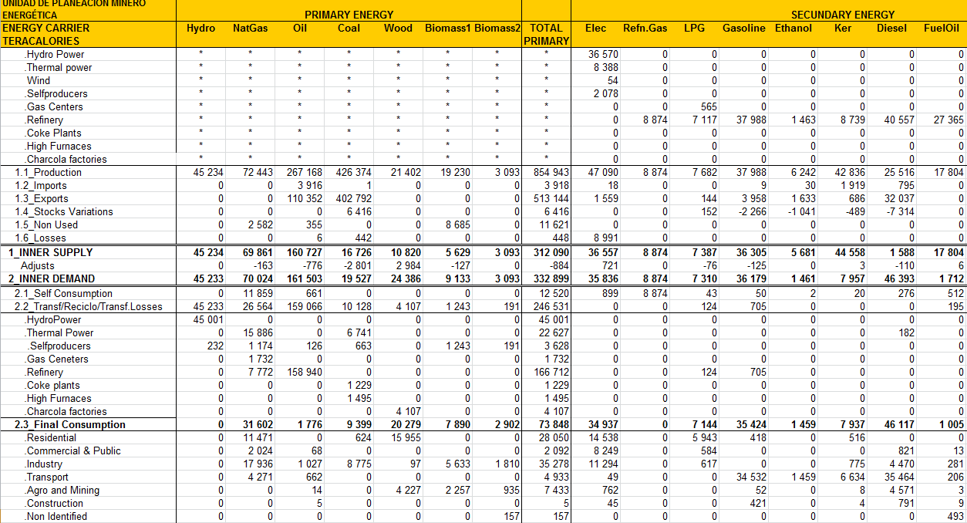
Lecture 3.4 – Energy balance
Tabular format
An Energy balance table has three main components:
The supply section (total primary energy supply)
The conversion section (total final consumption)
The consumptions and uses section (total final consumption disaggregated)
21
Notes:
For the detailed quantitative presentation of energy balances, the tabular format is more suitable.
Energy Balance is a matrix which includes in the columns the energy forms, and in the Rows the energy transactions: Primary, Transformations, and consumption by sector. If information is available, the energy balance can also show consumption by uses.
The Energy balance table has three main components: The supply section, the conversion section, and the consumptions and uses section.

Slide 22
Lecture 3.4 – Energy balance
Supply section | Conversion section | Uses and consumption section
Production Exportations of primary and secondary sources Importations of primary and secondary sources Deposits/stocks and bunkers | Primary energy transformation plants Refineries, Electric plants, Coal plants, Other transformations Losses in conversion, transportation and distribution process | Consumptions of fuels by sector and subsectors of the economy If information is available, consumption by uses can be shown
22
Notes:
The supply section includes domestic production, the imports and exports balance, and the stocks.
The conversion section includes the primary energy transformation plants, such as refineries, electric power plants, coal plants, and other big transformation centres. This section must show the losses which have occurred in the process of conversion, transportation, and distribution.
The uses and consumption section shows the consumption by sector and sub-sectors of the economy. If information is available, consumption by uses can be shown.

Slide 23
Lecture 3.4 Energy balance
Final energy balance in a household sector
There could be partial energy balance tables.
For example, for specific energy form, by sector, by consumers, and by end-use.
Sector | Fossil Fuels | Centralized Heat | Electricity | Traditional Fuels | Modern biomass | Grand Total
Urban | 2529.0 | 117.1 | 507.9 | 0.0 | 0.0 | 3154.0
Space heating | 1770.2 | 97.1 | 125.0 |  |  | 1992.3
Cooking | 379.3 | 0.0 | 25.0 |  |  | 404.3
Hot water | 379.3 | 20.0 | 50.0 |  |  | 449.3
Lighting with fossil fuel | 0.1 | _ | _ |  |  | 0.1
Appliances & Lighting | _ | _ | 257.9 |  |  | 257.9
Air conditioners | 0.0 | 0.0 | 50.0 |  |  | 50.0
Rural | 459.0 | 0.0 | 587.1 | 5.7 | 0.0 | 1051.8
Space heating | 181.6 | 0.0 | 264.2 | 3.0 |  | 448.8
Cooking | 181.6 | 0.0 | 88.1 | 2.0 |  | 271.7
Hot water | 90.8 | 0.0 | 88.1 | 0.7 |  | 179.6
Lighting with fossil fuel | 5.0 | _ | _ |  |  | 5.0
Appliances & Lighting | _ | _ | 142.7 |  |  | 142.7
Air conditioners | 0.0 | _ | 4.1 |  |  | 4.1
Total by areas | 2988.0 | 117.1 | 1094.9 | 5.7 | 0.0 | 4205.8
23
Notes:
There could be partial energy balance tables. For example, for a specific energy form, by sector, by consumer, and even by end-use.
This slide gives an example of one energy balance, built for the total final energy consumption by fuels and by end-uses in household sectors. It shows the amount of each fuel in energy units consumed in each end-use categories.
This type of analysis is useful to define adequate policy targets, for example to prioritize investments in energy efficiency for the specific end-use.
This concludes lecture 3 on the energy chain.

Slide 24

Cannone, C., Collett, K.A., Charbonnier F., Ahsan A., Halloran C., Vijay,A.,Berdellans I., Hasanovic S., Gritsevskyi A,Stankeviciute L., Tot M.; Welsch M., Hirmer S., 2023. Lecture 3: "THE ENERGY CHAIN" , Energy Demands Projections with MAED (Model for Analysis of Energy Demand). Release Version 2.0. [online presentation]. Climate Compatible Growth & Programme and International Atomic Energy Agency.
CCG courses (this will take
you to the website link http://www.ClimateCompatibleGrowth.com/teachingmaterials)
24

