Slide 1
Lecture 3
Investment Needs
Open Learn Collection
Financial Modelling for Energy Transitions: MINFin, FinTrack & FinCoRE

Slide 2
Lecture Outline
Financial Modelling for Energy Transitions
 | Learning Objectives
Part 1 | What are Investment Needs?
Part 2 | Scenarios
Part 3 | OSeMOSYS
Part 4 | FFRM

Slide 3

Learning Objectives
Define investment needs and Identify the key components of investment needs.
Understand the key factors affecting the magnitude of a country's investment needs.
Explain the purpose of comparing different scenarios in investment planning.
Describe the OSeMOSYS model and its role in financial planning and strategy.
Explain the limitations of OSeMOSYS and the need for additional models to assess investment needs comprehensively.
Define the fossil fuel retirement model and explain its purpose in investment analysis.
Notes:
In this lecture, we will define investment needs and identify their key components. We will examine the factors that influence the scale of a country’s investment needs and explore why comparing different scenarios is essential for effective investment planning. We will also introduce the OSeMOSYS model, explain its role in financial strategy, and discuss its limitations. Finally, we will highlight the need for additional models, including the fossil fuel retirement model, and explain its significance in investment analysis.

Slide 4
What are investment needs?
Part 1

Slide 5
What are Investment Needs?
Definition: Investment needs, also known as capital costs, refer to the upfront expenses required to develop or implement an energy project.
These costs are incurred before the revenue-generating phase of the project.
They cover physical assets, infrastructure, and project development efforts.
Why It Matters:
Understanding capital costs is crucial for determining the feasibility and financial viability of energy transition plans.
It directly influences funding, financing, and profitability analysis.
Notes:
Investment needs, also known as capital costs, represent the upfront expenses required to develop or implement a project—in our case, energy projects. These costs are incurred during the initial stages, before the project begins generating any revenue. They encompass a wide range of expenditures, including the purchase of physical assets, the development of infrastructure, and the efforts required for project planning and design.
Understanding investment needs is critical because they directly impact the feasibility and financial planning of energy transition projects. Without a clear picture of these costs, it’s impossible to accurately assess funding requirements, secure financing, or determine the profitability of a project. In short, investment needs form the financial blueprint for building a sustainable energy future.

Slide 6

Investment Needs in MINFin
Recap from Previous Lecture:
The Investment Need (IN) is the amount of capital needed each year of the transition to both allow the construction of New Infrastructure (NI) and to provide compensation for early Fossil Fuel Retirement (FFR) of old plant before the end of its life.
${IN}_{y}={NI}_{y}+{FFR}_{y}$
Note: numbers are fictional and purely illustrative
Notes:
In the previous lecture, we introduced the concept of what constitutes Investment Needs (IN), which represents the annual capital required throughout the energy transition. This capital is essential to achieve two key objectives: first, to construct the New Infrastructure (NI) necessary for meeting demand, and second, to provide financial compensation for the early Fossil Fuel Retirement (FFR) of older plants before they reach the end of their operational lifespan.
The MINFin model begins with detailed year-on-year inputs of these Investment Needs for the entire duration of the transition.
The first type of input relates to investments in New Infrastructure (NI). This annual investment is required to satisfy growing energy demand while simultaneously meeting decarbonization targets. In the bar chart, this is represented by the grey segment, illustrating the critical role of NI investments in driving the transition.
The second type of input is the financial compensation necessary for the early retirement of fossil fuel plants. In some cases, achieving decarbonization targets requires shutting down fossil fuel plants ahead of their planned operational lifespan, particularly in countries heavily reliant on fossil fuels or where these plants were built relatively recently. The compensation accounts for unamortized debt and the anticipated profits of plant owners. This component is represented by the grey segment of the bar chart, emphasizing the financial challenges associated with transitioning away from fossil fuels.

Slide 7
Quantifying Investment Needs
Investment Needs are calculated externally using specialised models, which will be explored in greater detail later in the lecture.
New Infrastructure (NI): Investment needs are determined using least cost planning models, such as OSeMOSYS, which calculate infrastructure requirements based on energy demand, system cost, and decarbonization policy constraints. MINFin supports multiple investment scenarios generated by these models.
Fossil Fuel Retirement (FFR): Early shutdown of fossil fuel plants requires financial compensation, which depends on unamortized debt, anticipated profits, and plant-specific factors. Tools like the Fossil Fuel Retirement Model (FFRM) estimate these costs, complementing OSeMOSYS outputs that identify the need and timing for shutdowns.
Notes:
The two key components of Investment Needs (IN) are calculated outside the MINFin model using specialized modelling tools. These external tools generate outputs that serve as critical inputs to MINFin, forming the foundation for sector financial analysis. Two distinct types of model inputs are relevant here, both of which can be integrated with MINFin and used in conjunction with each other. These will be explored in greater depth during Lecture 3.
1. Calculating New Infrastructure (NI) Investment Needs
For New Infrastructure investment needs, a least-cost planning model is required. Such models are widely used to determine the necessary investments for energy infrastructure, ensuring energy demand projections are met at the minimum system cost.
MINFin is specifically configured to utilize outputs from the Open-Source Energy Modelling System (OSeMOSYS), which was developed by KTH and curated by CCG. OSeMOSYS not only optimizes costs but also allows for the incorporation of policy-driven constraints, such as decarbonization targets. By adjusting these constraints, multiple investment scenarios can be generated, providing a flexible basis for decision-making. MINFin can process and analyse more than one investment scenario, offering comprehensive insights into the impacts of various energy transition pathways.
2. Calculating Compensation for Early Fossil Fuel Retirement (FFR)
The second component is the financial compensation required for the early retirement of fossil fuel plants. While least-cost planning models like OSeMOSYS determine if and when early shutdowns are necessary, they do not account for the financial implications of these actions.
Providing financial compensation is critical to facilitate early plant closures, particularly in cases where fossil fuel plants are relatively new or were built under long-term contractual agreements. Compensation typically includes covering unamortized debt and ensuring that plant owners receive the profits they were contractually entitled to expect.

Slide 8
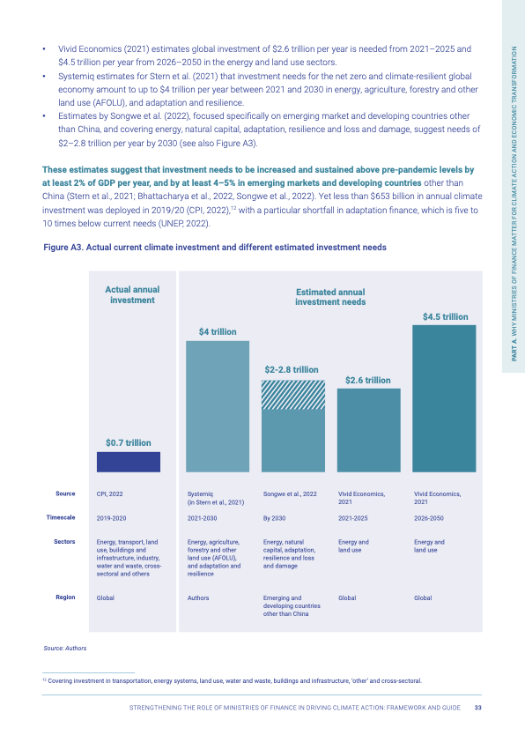
Investment Surge for Net Zero Emissions
Achieving net-zero emissions by 2050 requires a surge in investment needs compared to baseline levels in the mid-2020s. This surge is driven by two main factors:
Capital Intensity: Clean energy technologies require higher upfront investments compared to fossil fuels, despite lower lifecycle costs [1].
Accelerated Replacement: Fossil fuel plants may need premature retirement to meet decarbonization targets, necessitating investment in:
  Replacing retired capacity.
  Some countries may also need to compensate investors for stranded assets.
Figure: Actual current climate investment and different estimated investment needs [2].
Notes:
Achieving net-zero emissions by 2050 is an ambitious but essential goal that demands a significant surge in investment needs, particularly when compared to baseline levels in the mid-2020s. This increase is primarily driven by two key factors: capital intensity and accelerated replacement of existing energy infrastructure.
1. Capital Intensity of Clean Energy Technologies
Clean energy technologies, while offering lower lifecycle costs, require substantially higher upfront investments compared to fossil fuels. This capital intensity is a defining characteristic of the energy transition. Whether it’s building solar farms, wind turbines, or storage systems, the initial cost of deploying these technologies is significantly higher than the costs of establishing fossil fuel-based systems. However, these investments are necessary to unlock long-term economic and environmental benefits.
2. Accelerated Replacement of Fossil Fuels
The second major driver is the need for accelerated replacement of fossil fuel infrastructure. Decarbonization targets often require fossil fuel plants to be retired prematurely, even before the end of their operational life. To address this, two types of investments are necessary:
First, investments to replace the retired capacity with clean energy alternatives that can meet energy demand without compromising reliability.
Second, in some cases, countries may need to compensate investors for stranded assets. Stranded assets refer to fossil fuel plants that are forced into early retirement, leaving owners unable to recover the expected return on their investments. Compensation for these assets can include covering unamortized debt or anticipated profits, and it represents an additional financial challenge for the transition.

Slide 9
The Magnitude of the Investment Surge
The magnitude of the net-zero burden is shaped by several country-specific factors, including:
Current Reliance on Fossil Fuels: Higher baseline fossil fuel usage necessitates more extensive and costly renewable energy scaling.
Age Profile of Fossil Fuel Plants: Younger plants have longer profitable lifespans, increasing early closure costs and investor compensation [3].
Availability of Renewable Energy Resources: Countries with abundant renewable resources (solar, wind, hydro) can transition more cost-effectively.
Cost of Capital Available to the Country: Local factors (technology maturity, skilled labour access, financing conditions) significantly impact project costs [4].
Demand Projections: Rapidly growing energy demand increases the scale of investment required to expand clean energy capacity and meet future needs.
Notes:
The magnitude of the investment burden required to achieve net-zero emissions varies significantly from country to country. Several country-specific factors determine the scale and cost-effectiveness of this transition, each influencing both the pace and the financial demands of decarbonization efforts.
Current Reliance on Fossil Fuels
Countries with high levels of fossil fuel dependence face a more challenging transition to renewable energy. A greater reliance on fossil fuels means that scaling up renewable energy capacity will require more extensive and costly infrastructure development to replace the existing fossil fuel-based systems.
2. Age Profile of Fossil Fuel Plants
The age of a country’s fossil fuel plants also affects the transition. Younger plants, with longer remaining lifespans, pose greater challenges when it comes to premature retirement. Early shutdowns of these plants increase the cost of replacement energy infrastructure and often require more substantial compensation to plant owners.
3. Availability of Renewable Energy Resources
Countries with rich renewable energy resources—such as abundant sunlight, wind, or hydro—can more efficiently transition to clean energy. The availability of these resources reduces the overall cost of energy production, making the transition less expensive and easier to implement.
4. Cost of Capital Available to the Country
Local financing conditions and economic factors also play a significant role in shaping transition costs. The cost of capital, influenced by factors such as the maturity of renewable energy technologies, access to skilled labor, and availability of financing, impacts the cost structure of energy projects. Countries with higher borrowing costs face a steeper financial burden.
5. Demand Projections
Lastly, projections of future energy demand are crucial. Countries experiencing rapid energy demand growth will need to scale up clean energy capacity quickly, which increases both the investment scale and urgency of the transition.

Slide 10
Part 1: References
[1] Hirth, L. and Steckel, J.C., 2016. The role of capital costs in decarbonizing the electricity sector. Environmental Research Letters, 11(11), p.114010. Available at: https://doi.org/10.1088/1748-9326/11/11/114010 [Accessed 30 January 2025].
[2] Finance Ministers for Climate, 2020. Strengthening the role of Ministries of Finance in driving action. Available at: https://www.financeministersforclimate.org/sites/cape/files/inline-files/Strengthening%20the%20role%20of%20Ministries%20of%20Finance%20in%20driving%20action%20FULL%20REPORT.pdf [Accessed 30 January 2025].
[3] Maamoun, N., Kennedy, R., Jin, X. and Urpelainen, J., 2020. Identifying coal-fired power plants for early retirement. Renewable and Sustainable Energy Reviews, 126, p.109833. Available at: https://doi.org/10.1016/j.rser.2020.109833 [Accessed 30 January 2025].
[4] Clean Air Task Force (CATF), 2020. Evaluating the Weighted Average Cost of Capital (WACC) for the power sector in African countries. Available at: https://www.catf.us/resource/evaluating-weighted-average-cost-capital-wacc-power-sector-african-countries/ [Accessed 30 January 2025].

Slide 11
Scenarios
Part 2

Slide 12
Understanding how Net Zero compares to baseline scenarios
How Scenarios Help Us Understand Investment Needs:
Scenarios help us explore how investment needs differ under various pathways to meet future energy demand. Two key scenarios are typically considered:
Least Cost (LC):
  Represents the path countries would follow in the absence of climate constraints, otherwise known as Business as Usual.
  Prioritizes the lowest-cost solutions, often allowing continued reliance on fossil fuels when they are cheaper than renewable alternatives.
Net Zero (NZ):
  Focuses on achieving zero carbon emissions in the power sector by 2050.
  Requires a shift to clean energy technologies, even when they involve higher upfront investments.
Notes:
To understand the investment needs for achieving net-zero emissions, we must explore different scenarios that represent distinct pathways to meet future energy demand. By comparing these scenarios, we can gain insights into the financial challenges of transitioning to a net-zero energy system versus maintaining the current energy landscape.
1. Least Cost (LC) Scenario
The Least Cost (LC) scenario represents the pathway that countries would follow in the absence of climate constraints. In this scenario, the priority is to minimize costs, and as such, the focus remains on the cheapest energy solutions available. Fossil fuels are often favored in this scenario, as they may be less expensive than renewable alternatives, even if they lead to higher long-term environmental costs. The result is a continued reliance on fossil fuels, which delays the shift toward cleaner energy systems.
2. Net Zero (NZ) Scenario
In contrast, the Net Zero (NZ) scenario is centered on achieving zero carbon emissions in the power sector by 2050. This pathway requires a fundamental shift away from fossil fuels, with a rapid transition to clean energy technologies, such as solar, wind, and storage. Even though these technologies often involve higher upfront capital costs, the NZ scenario focuses on long-term sustainability and the environmental benefits of decarbonization.

Slide 13
Understanding how Net Zero compares to baseline scenarios
However, scenarios within MINFin are not limited to just Least Cost (LC) or Net Zero (NZ). You can model a wide range of scenarios, such as:
        Adaptation Scenarios: Evaluating the costs of adapting to climate impacts (e.g., infrastructure upgrades for flooding, drought resilience).
        Why Compare Scenarios?
        By contrasting these scenarios, we can better understand the financial challenge of transitioning to a net-zero energy system compared to maintaining the status quo.
Notes:
While Least Cost and Net Zero are commonly used scenarios, MINFin is flexible enough to analyze a wide range of scenarios. For example, we can explore Adaptation Scenarios, which assess the costs of responding to physical climate impacts. This could include investments in flood protection, drought resilience, or infrastructure upgrades. By comparing adaptation and non-adaptation pathways, we gain insight into the financial trade-offs of proactive climate resilience versus potential damage costs. Because MINFin uses annual, technology-specific investment costs, updating and customizing scenarios is straightforward, allowing us to explore different futures with ease
Why Compare Scenarios?
By comparing the scenarios, we can better understand the financial implications of each approach. For example, the LC scenario reflects the cost of maintaining the status quo, where reliance on fossil fuels continues, while the NZ scenario illustrates the additional investment required to meet decarbonization targets. This comparison highlights the financial challenge of transitioning to a net-zero energy system, as it involves significant upfront investments in clean energy infrastructure and technologies, which is a stark contrast to the more gradual, lower-cost pathway of the LC scenario.

Slide 14
OSeMOSYS
Part 3

Slide 15

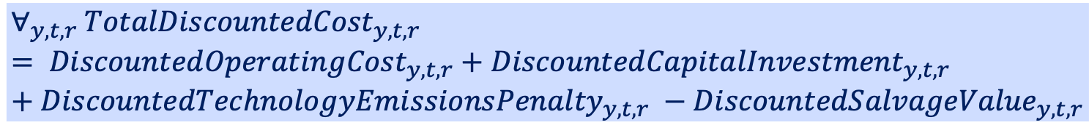
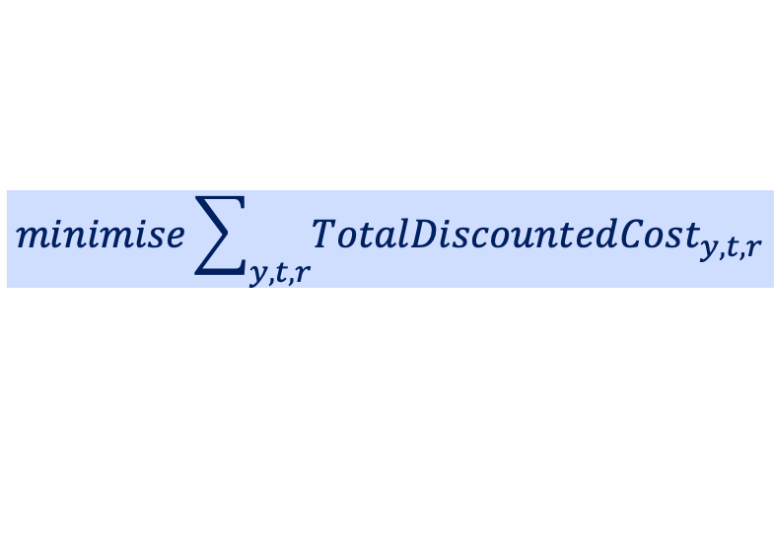
What is OSeMOSYS?
OSeMOSYS (Open Source Energy Modelling System) is an open-source, linear optimisation model designed to model energy systems and evaluate the impact of various policy scenarios on energy production, emissions, and investment needs.
It helps policymakers and analysts explore different pathways for transitioning to low-carbon energy systems by assessing the costs, technical requirements, and environmental impacts of each option.
OSeMOSYS Objective function:
$$minimise\sum_{y,t,r}{{TotalDiscountedCost}_{y,t,r}}$$
Where:
$$∀_{y,t,r} {TotalDiscountedCost}_{y,t,r}= {DiscountedOperatingCost}_{y,t,r}+{DiscountedCapitalInvestment}_{y,t,r}+{DiscountedTechnologyEmissionsPenalty}_{y,t,r} −{DiscountedSalvageValue}_{y,t,r}$$
Notes:
OSeMOSYS, which stands for Open Source Energy Modeling System, is a widely-used open-source tool designed for energy system modelling. It employs linear optimization techniques to evaluate the effects of different policy scenarios on energy production, emissions, and investment requirements.
OSeMOSYS helps policymakers and analysts explore various pathways to transition towards low-carbon energy systems. By simulating different energy mix scenarios, it provides insights into the costs, technical needs, and environmental impacts of each option. This makes it an invaluable tool for understanding how to meet decarbonization targets while maintaining energy security and economic stability.
Through OSeMOSYS, stakeholders can better evaluate the trade-offs involved in different energy system strategies and plan for the transition to cleaner, more sustainable energy sources.
The model's objective function aims to minimize the total discounted cost, aggregated across years, technologies, and regions. This total discounted cost comprises the discounted operating cost, discounted capital investment, and discounted technology emissions penalty, minus the discounted salvage value. For further details on the equations, see Howells et al (2011).

Slide 16
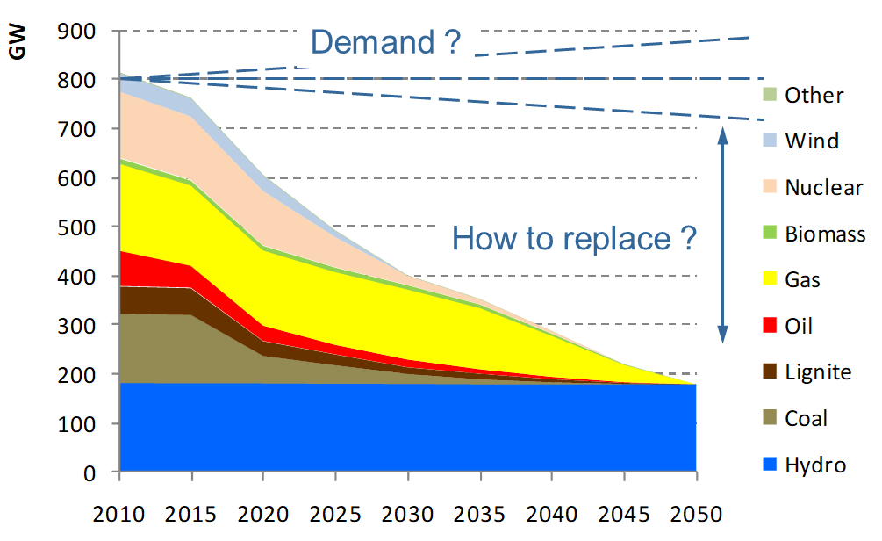
What does OSeMOSYS do?
OSeMOSYS uses linear optimisation to minimise the total cost of energy systems while meeting energy demand, emissions constraints, and other system requirements.
It evaluates trade-offs between different technologies, resources, and infrastructure over long time horizons to provide an optimal energy mix.
*Values are purely illustrative
Notes:
OSeMOSYS uses linear optimisation techniques to provide an optimal energy system that minimizes the total cost while meeting several crucial constraints.
It considers energy demand, emissions constraints, and system requirements in its calculations. By doing so, OSeMOSYS identifies the most cost-effective way to satisfy energy needs over long time horizons, taking into account the trade-offs between different technologies, resources, and infrastructure options.
The model evaluates how to balance the integration of renewable energy sources like solar and wind with the continued use of fossil fuels or other energy systems. Over time, OSeMOSYS determines when and how to introduce new technologies, as well as how to phase out older, less efficient ones.
In essence, OSeMOSYS provides an optimization framework for planning an energy system that balances costs, emissions reductions, and energy demand over time, while considering both technological feasibility and environmental objectives

Slide 17
What does OSeMOSYS tell us?
The results provide insights into key questions, including:
Which technologies will phase out, and when?
What are the optimal investments in new technologies to meet future demand, and when is the best time to invest?
What are the key generation technologies in the energy mix?
What are the costs associated with the energy system?
What emissions result from the energy mix?
Notes:
OSeMOSYS delivers valuable insights into several key questions that are essential for planning the energy transition.
One of the primary outputs is understanding which technologies will phase out and when. The model helps determine the optimal timeline for retiring fossil fuel plants and investing in cleaner, renewable technologies like wind and solar.
Additionally, OSeMOSYS provides insights into the optimal investments in new technologies necessary to meet future demand. It helps identify when the best time to invest in new technologies is, ensuring that financial resources are allocated efficiently.
It also provides a clear picture of the key generation technologies that will make up the energy mix, highlighting which sources of energy will dominate the system in the future.
Further, OSeMOSYS tells us about the costs associated with the energy system, including capital, operating, and maintenance costs for different technologies. It also projects the emissions resulting from different energy mixes, helping us understand how specific choices impact environmental goals.
In summary, OSeMOSYS gives a comprehensive view of the path forward, offering detailed projections on technology adoption, investments, and the environmental consequences of various energy system configurations.

Slide 18
OSeMOSYS Results
One of the key results shown in the graph is the capital investment required for each technology over the modelled time period. This chart helps us understand the level of investment needed for various energy technologies (e.g., wind, solar, fossil fuels) to meet future demand.
The capital cost variable is used to calibrate the investment needs within MINFin.
*Values are purely illustrative
Notes:
One of the key outputs from OSeMOSYS is the capital investment required for each technology over the modelled time period. This result provides valuable insights into the financial needs of transitioning to a low-carbon energy system.
The graph presented shows the capital investment for various energy technologies—such as wind, solar, and fossil fuels—over time. This helps us understand how much investment is needed to develop and maintain each technology to meet future energy demand.
The capital cost data generated by OSeMOSYS is then used to calibrate the investment needs within the MINFin model. This allows us to translate the results from OSeMOSYS into actionable financial data, enabling detailed financial analysis of energy transition scenarios.
By providing a clear view of the investment required for each technology, OSeMOSYS not only informs the energy system design but also feeds directly into the financial planning process, helping to ensure that the transition to low-carbon energy is financially feasible.

Slide 19
OSeMOSYS Results
Other key results from OSeMOSYS also include CO₂ emissions, capacity, generation, and operating expenses.
This graph compares CO₂ emissions from two different scenarios in OSeMOSYS, illustrating how each scenario performs against the other.
*Values are purely illustrative
Notes:
One of the key outputs from OSeMOSYS is the CO2 emissions associated with each energy scenario. This result helps us understand the environmental impact of different energy systems and their contribution to climate change mitigation.
The graph here compares CO2 emissions across two scenarios in OSeMOSYS. This allows us to visually assess the differences in emissions and evaluate which scenario results in lower carbon footprints over time.
These emissions results are crucial for understanding the sustainability of energy transition pathways and guiding policy decisions.

Slide 20
Part 3: References
[5] Howells, M., Rogner, H., Strachan, N., Heaps, C., Huntington, H., Kypreos, S., Hughes, A., Silveira, S., DeCarolis, J., Bazillian, M. and Roehrl, A. (2011). OSeMOSYS: The Open Source Energy Modeling System: An introduction to its ethos, structure and development. Energy Policy, 39(10), pp. 5850-5870. https://doi.org/10.1016/j.enpol.2011.06.033

Slide 21
FFRM
Part 4

Slide 22
Why do we need a plant retirement model?
Classical engineering planning models, like OSeMOSYS, are likely to underestimate the financing needs for the climate transition
This is because planning models produce scenarios where plants are shut down before the end of their useful life, without estimating necessary damages to asset owners.
In practice, early shutdown of fossil fuel plants is necessary for decarbonisation and only possible if owners are financially compensated for foregone profits.
Most of the plants operate under long-term financial contracts (e.g., PPAs), with guaranteed returns for up to 25 years. These agreements often set compensation levels significantly higher than stranded capital costs or economic compensation levels.
Notes:
Classical engineering planning models, such as OSeMOSYS, focus primarily on optimizing the energy system while considering cost minimization and emissions reductions. However, these models tend to underestimate the financing needs for the climate transition, particularly in the context of fossil fuel plant retirements.
One of the key limitations of traditional planning models is their assumption that plants can be shut down before the end of their useful life without accounting for the financial impact on asset owners. In reality, early shutdown of fossil fuel plants is often necessary to meet decarbonization targets. However, such shutdowns are only feasible if plant owners are compensated for the lost profits they would have otherwise earned over the remaining lifespan of the plant.
Many fossil fuel plants operate under long-term financial agreements, such as Power Purchase Agreements (PPAs), which guarantee returns for periods of up to 25 years. These contracts often stipulate compensation levels far above the stranded capital costs or economic compensation levels typically used in engineering models. As a result, there is a need for more comprehensive models that can accurately estimate the compensation required to ensure a just transition.

Slide 23
Fossil Fuel Retirement Model (FFRM)
Tools such as the World Bank’s Fossil Fuel Retirement Model can be used to estimate the magnitude of the requisite compensation based on several basic input parameters, such as the age and cost structure of the plant and the associated power purchase arrangements.
The model is designed to complement more detailed long-term planning models such as OSeMOSYS.
Retirements are determined by both the age and cost of stations, with fixed costs being the primary factor in the PPA regime, while variable costs drive decisions in the market price regime.
It is important to note that there are substantial social and environmental issues to consider, including both direct and indirect job losses
which are not factored into this model.
Notes:
To address the financial implications of early fossil fuel plant retirements, tools such as the World Bank’s Fossil Fuel Retirement Model (FFRM) are used to estimate the compensation required for plant owners. This model provides a more nuanced view of the financial needs of the transition compared to traditional energy planning models.
The FFRM is designed to estimate the compensation needed for premature retirements based on several key input parameters, such as the plant’s age, cost structure, and the terms of associated Power Purchase Agreements (PPAs). It works alongside long-term energy planning models like OSeMOSYS, filling in the gaps by assessing the financial impacts of early shutdowns.
Plant retirements are determined by both the age and cost structure of the power stations. For plants under PPAs, fixed costs are the primary factor driving retirement decisions, while for those in a market-based regime, it is the variable costs that influence whether it remains profitable or not. However, it’s important to recognize that this model does not account for substantial social and environmental impacts, such as direct and indirect job losses, which must also be considered in the broader energy transition planning.

Slide 24
Objective Function
The objective function of the model is set as maximisation of the net revenue at the fleet, based on either:
Financial analysis of Power Purchase Agreements (PPAs), where these are in place with known contractual terms,
Or economic optimization of the market price, where marginal costs derived from a least-cost planning model are used
The difference in net revenue between the BAU and a decarbonization scenario is used as a measure of forgone revenue
In simple terms, under a Market-based regime where generators compete solely on cost, disregarding obligations or fixed costs from the PPA regime, a substantial portion of the coal fleet would become unprofitable. Consequently, compensation requirements would decrease by at least half, even under the most stringent AD scenario.
Notes:
The objective function of the Fossil Fuel Retirement Model (FFRM) is designed to maximize net revenue across the fleet of plants, either by analyzing Power Purchase Agreements (PPAs) or through economic optimization based on market price dynamics.
Where PPAs are in place with known contractual terms, the model maximizes revenue by assessing the financial implications of those agreements. In market-based regimes, where plants compete on cost and price, the model uses marginal costs derived from least-cost planning models to optimize decisions.
The model compares the difference in net revenue between a Business-As-Usual (BAU) scenario and a decarbonization scenario. This difference is used to measure the forgone revenue, essentially representing the amount of financial loss the plant owners would incur if they were required to shut down early.
In a market-based regime, where generators compete solely on cost, disregarding fixed costs associated with PPAs, a significant portion of the coal fleet would become unprofitable. Consequently, the compensation required to retire these plants prematurely would decrease substantially, potentially by as much as 50%, even under the most stringent decarbonization scenarios.

Slide 25
FFRM Results
The findings include plant retirement schedules and discounted net revenue under both the PPA and Market regimes across scenarios such as least cost and net zero.
As previously noted, the main gauge of stranded costs for each decarbonization scenario is calculated relative to the baseline or least cost, representing the reduction in discounted revenue.
 | Scenario 1 (Least Cost) | Scenario 2 (Net Zero)
Total Revenue (Billion US$) | 207 | 126
Stranded Cost Compensation (Billion US$) | - | 81
In this instance, the total cost requiring compensation for prematurely retiring plants amounts to $81 billion USD.
Notes:
The results from the Fossil Fuel Retirement Model (FFRM) provide critical insights into the financial implications of plant retirements under different policy scenarios. These results help to quantify the compensation required to ensure a fair and economically feasible transition to a low-carbon energy system.
The FFRM produces plant retirement schedules and discounted net revenue calculations for both Power Purchase Agreement (PPA) and market regimes across various scenarios such as least cost and net zero. A key measure of stranded costs in each decarbonization scenario is the reduction in discounted revenue, calculated relative to the baseline or least-cost scenario.
According to the FFRM results, the total cost requiring compensation for prematurely retiring plants amounts to approximately $81 billion USD. This figure underscores the financial magnitude of compensating fossil fuel plant owners for early shutdowns, a necessary component of achieving decarbonization targets.

Slide 26
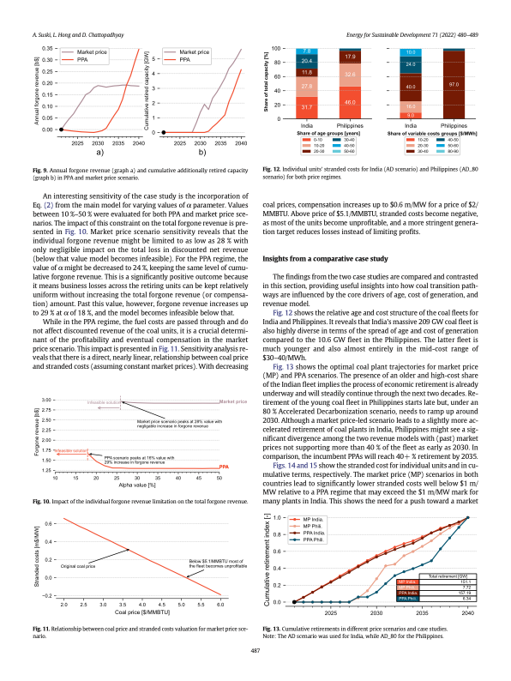
FFRM Results
These graphs present results from the FFRM, illustrating revenue losses across scenarios and the composition of stranded assets.
Figures from Suski, Hong and Chattopadhyay [6].
Notes:
This slide highlights key findings from the FFRM, with graphs sourced from Suski, Hong, and Chattopadhyay (2022). The full paper provides more detail—refer to the references for the link.
The left graph shows foregone revenue and retired capacity under two price scenarios. For fixed contracts, both revenue loss and retirements are delayed until the second half of the modeling horizon, accelerating quickly afterward. In contrast, the market price scenario shows stabilized forgone revenue post-2030, with retirement rates leveling off after 2028.
The right graph compares the coal fleet structures in India and the Philippines. India’s large, 209 GW fleet is diverse in age and cost, while the Philippines’ smaller 10.6 GW fleet is younger and mainly in the mid-cost range of $30-40/MWh.
These insights aid policymakers in understanding the financial impacts of plant retirements and help design compensation mechanisms for a just transition.

Slide 27
Part 4: References
[6] Suski, A., Hong, L. and Chattopadhyay, D. (2022). Modeling coal plant stranded costs for decarbonization pathway analyses. Energy for Sustainable Development, 71, pp. 480-489. https://doi.org/10.1016/j.esd.2022.10.020

Slide 28
Thank you
Contact Information: v.foster@imperial.ac.uk or hannah.luscombe@ouce.ox.ac.uk

