Slide 1
Lecture 1
The Climate Finance Context
Open Learn Collection
Financial Modelling for Energy Transitions: MINFin, FinTrack & FinCoRE

Slide 2
Lecture Outline
Financial Modelling for Energy Transitions
 | Learning Objectives
Part 1 | Global Climate Financing Gap
Part 2 | The Data-to-Deal Framework
Part 3 | IMPAACT Analytical Workflow
Part 4 | Introducing MINFin

Slide 3
Learning Objectives
By the end of this lecture, you should be able to understand:
Challenges faced by LMICs in raising finance for the climate transition
The Data-to-Deal framework for addressing climate financing challenges
How the MINFin model can be a useful tool in this context

Slide 4
Global Climate Financing Gap
Part 1

Slide 5
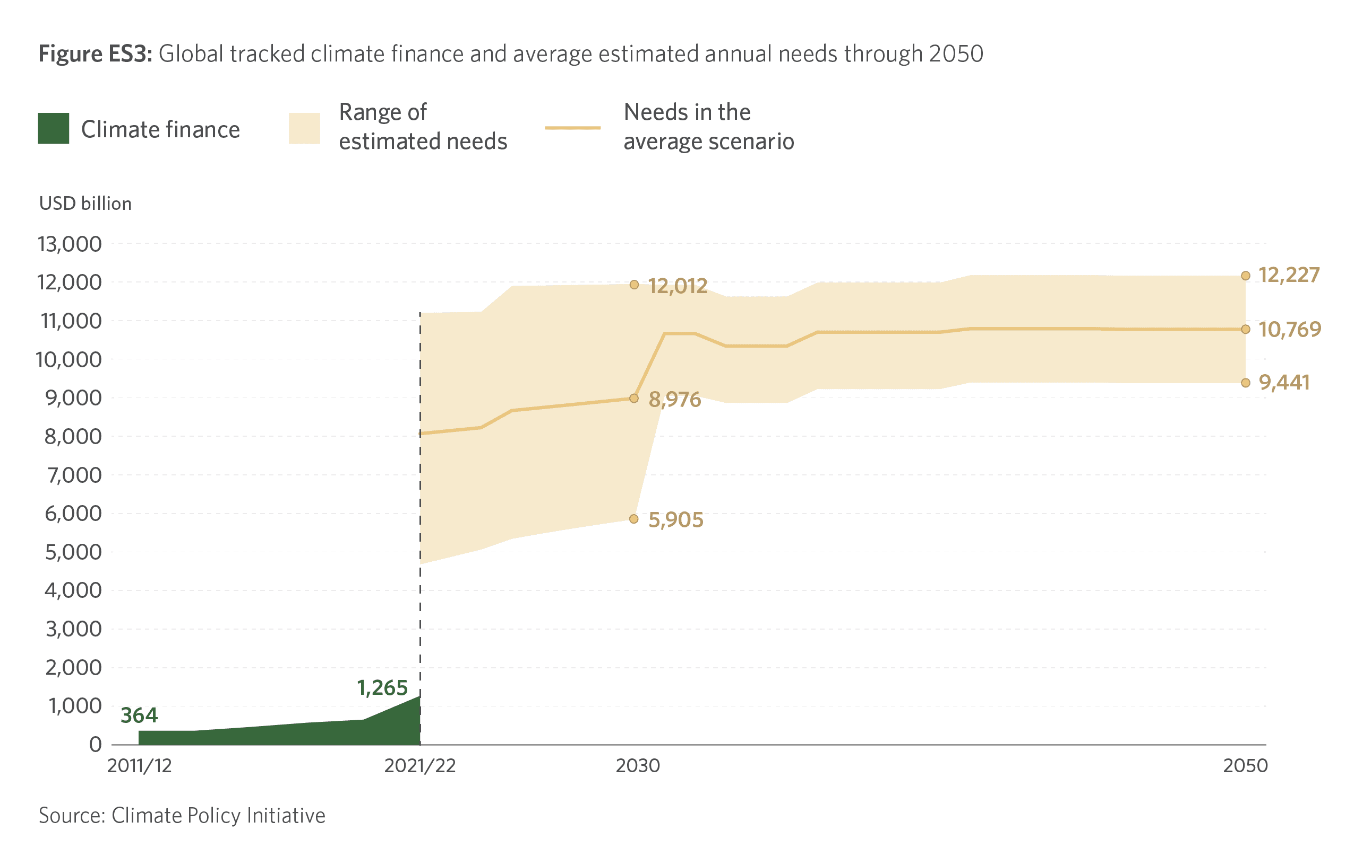

The Global Climate Finance Gap
Notes:
Achieving the climate transition calls for substantial investments in clean energy technology. Numerous estimates have been made of the global magnitude of the investments needed by a variety of international organizations. The Climate Policy Initiative recently conducted a review of these estimates and concluded that the global annual investment needs to deliver on the goals of the Paris agreement are estimated to range between US$6-12 billion by 2030 and a narrower range of US$9-12 billion by 2050. This is represented by the beige area on the chart.
This is a far cry from the climate finance resources that have been mobilized in the recent past, which are represented by the green area on the chart. The Climate Policy Initiative estimates that these started out as a modest US$0.4 billon in 2011/12. Although climate finance flows have tripled in the decade up to 2021/22, they still fall well short of the US$8 billion that is already considered necessary.
The difference between current climate financing flows and estimated climate financing needs is known as the global climate finance gap. Unless this gap can be rapidly closed, climate transition will prove unachievable….

Slide 6
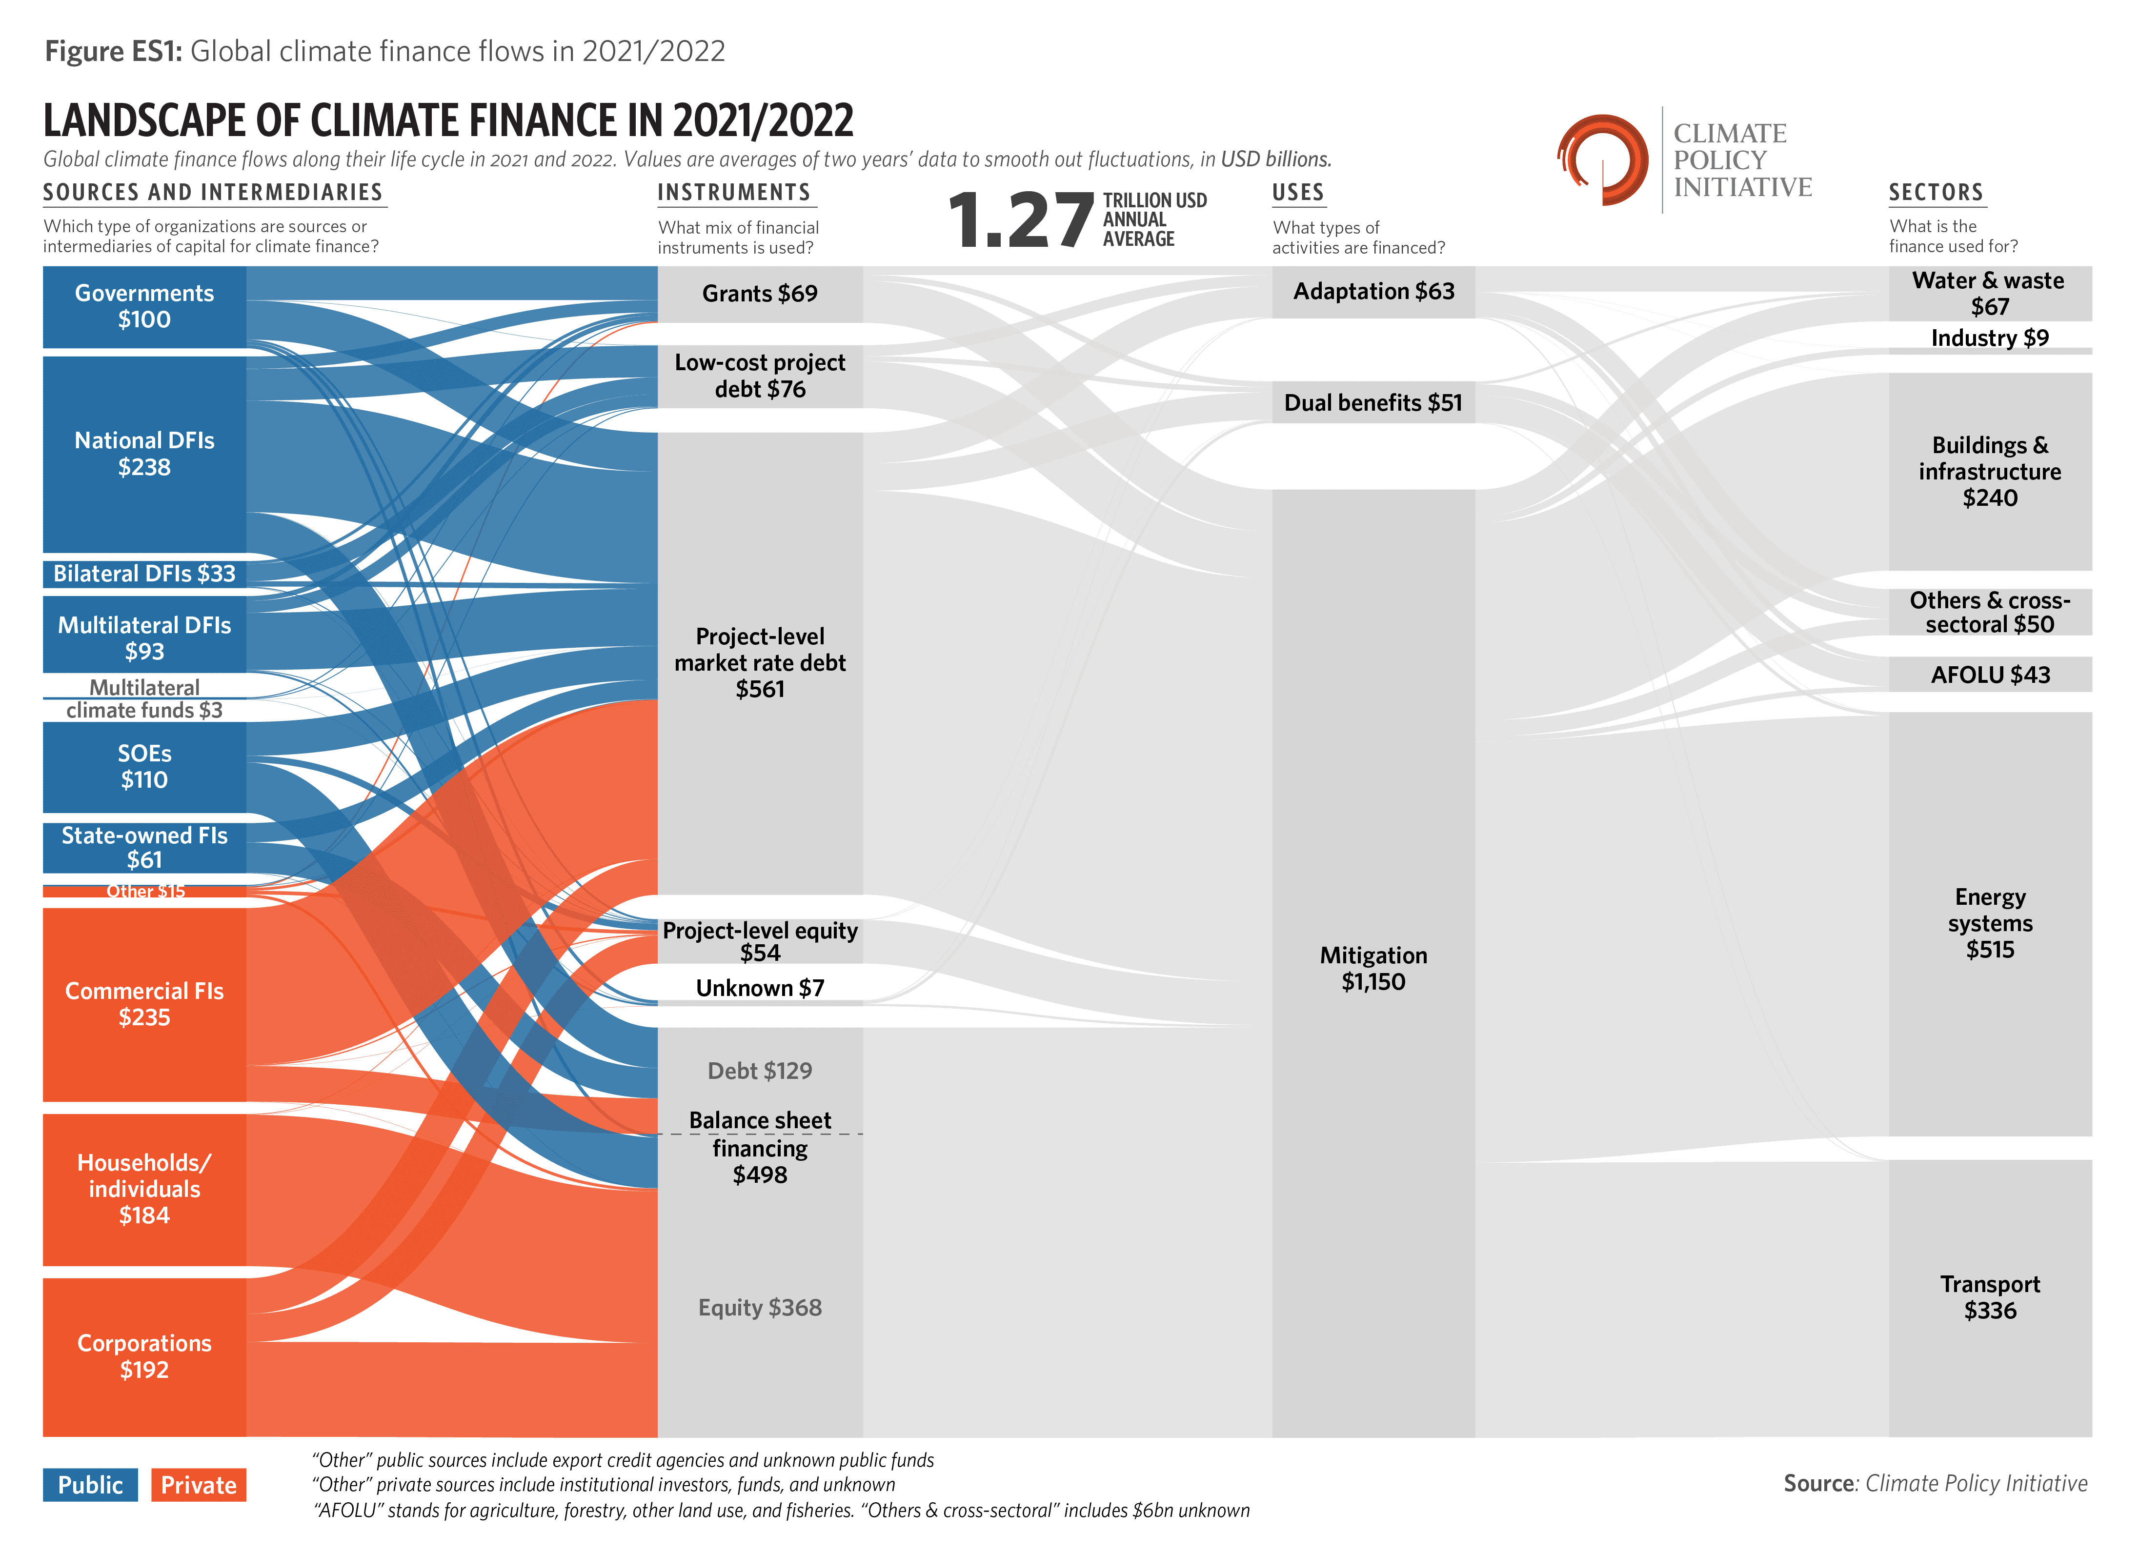
Global Climate Finance Flows
Notes:
As mentioned, there are US$1.27 billion of climate finance flowing annually at present. It is interesting to ask where this money is coming from and what kinds of climate action does it support? A recent survey of sources and uses of climate finance compiled by the Climate Policy Initiative from a range of international data sources, makes it possible to visualize the climate finance landscape, as shown in the Sankey diagram. A few features stand out.
As shown in the left-hand-most column of the chart, climate finance is split almost evenly between public finance (shown in blue) and private sector sources of finance (shown in orange). Public finance comes mainly from governments, national development banks, and national state-owned enterprises, with multilateral development banks playing a much smaller role. Private finance divides quite evenly between three groups: commercial banks, corporations and households (who also invest directly in climate measures, such as energy efficiency, for instance).
When it comes to financing instruments, the next column of the chart shows that the bulk of the finance is evenly distributed between project financing structures that ring-fence the costs and revenue streams of a particular project, and balance sheet finance that consider the financial creditworthiness of the entire corporation implementing the project.
One of the most striking findings, which is displayed in the third column of the chart, is that over 90 percent of climate finance flows are directed to climate mitigation projects (such as clean technologies) rather than climate adaptation projects (such as infrastructure resilience).
Finally, the right-hand-most column details the sectoral split of current climate finance flows. About half of the total goes to the energy sector alone, relating mainly to renewable energy generation, and a further quarter to the transport sector, for infrastructure such as electric buses or urban rail. The remaining quarter is split across general buildings and infrastructure, with a tiny amount going to the water and agricultural sectors.

Slide 7
Climate Finance Challenges at Country Level
LMICs only capture <25% of global climate finance flows due to the numerous challenges they face in raising such finance.
Lack of political consensus
Lack of technical capacity
Planning deficits
Policy barriers
Limited access to finance
Notes:
The global climate financing gap is just the sum of a series of climate financing gaps that present themselves in many countries around the world. Low- and Middle-Income Countries (LMICs), in particular, struggle to mobilize resources on an adequate scale, and only capture under a quarter of global climate finance flows, despite being in the greatest need. LMICs face a variety of different challenges when it comes to financing the climate transition.
Lack of political consensus. The climate transition is often politically controversial, because it creates winners and losers, and may change the overall development trajectory of a country. The implications of climate change mitigation and adaptation are often not well understood and may raise concerns about trade-offs with broader development goals. Lack of political will creates an uncertain environment for potential financiers of climate transition.
Lack of technical capacity. The climate transition is technically complex and entails adoption of new technologies that may be unfamiliar and untested. The technical skills needed to understand climate transition, perform related modelling tasks, and adopt innovative approaches, may not yet be available in many countries. Without such skills, countries may not be equipped to do the due diligence needed to make climate transition projects bankable.
Planning deficits. The existence of technically sound sector investment plans provides financiers with the assurance that projects that come-up for financing are economically justified and are legitimately needed. However, many countries do not have institutions with a clear planning remit, nor governance structures to ensure that planning is fully integrated into political decision-making.
Policy barriers. The implementation of climate transition plans may encounter barriers in the policy and regulatory framework. It may be that certain components of the policy and regulatory framework are missing because they have not been needed before. Or it may be that existing regulations are incompatible with the adoption of new technologies. Such policy barriers are likely to discourage or altogether impede finance of projects.
Limited access to finance. The investments associated with climate transition are potentially very large. LMICs are often limited in their access to finance. This is due to two separate factors. The first factor is the limited development of local capital markets due to low levels of savings and under-developed financial institutions. The second factor is limited access to international capital markets due to poor creditworthiness, exchange rate risk, macroeconomic instability, and an unattractive investment climate.

Slide 8
The Data-to-Deal Framework
Part 2

Slide 9




Origins of the Data-to-Deal Framework
$2.4 Billion mobilised, Costa Rica stands out for its systematic process of technical analysis and stakeholder engagement
Dominican Republic
Costa Rica
$6.5 Billion mobilised, The Dominican Republic stands out for actively involving the private sector and power plant owners in modelling discussions
$832 Million mobilised, Uruguay's LTS ensures comprehensive sustainability across the entire economy, covering environmental, economic, and social aspects
Uruguay
$2.2 Billion mobilised, Chile stands out for its legislative progress having enacted a Climate Change Framework Law that codifies its climate commitments into law
Chile
Notes:
The Data-to-Deal framework was developed by a large group of technical experts by reflecting on the case of Costa Rica, a small middle-income country in Central America that was particularly successful in mobilizing climate finance.
Costa Rica mobilised US$2.4 billion of climate finance by 2022, based on a very successful programme of evidence-based modelling and stakeholder engagement that cost no more than about US$200,000 in 2019.
Soon after, this case, several other Latin American countries followed suit and achieved a similar degree of success.
The Dominican Republic mobilized US$6.5 billion, including a significant amount of funding for retrenchment of coal-fired plant. The case stands out for actively involving power plant owners in technical discussions and raising a significant portion of private finance.
Chile mobilized US$2.2 billion of climate finance. The Chilean case stands out for codifying its climate commitments into legislation by enacting the Climate Change Framework Law, which helps to give assurance of policy commitments to potential investors.
Uruguay mobilized US$0.8 billion of climate finance for a cross-economy Long Term Strategy to invest in climate transition, covering environmental, social and economic aspects.
By studying and comparing these cases, together with another similar case in Cyprus, technical experts identified a series of common elements and approaches underpinning each stage. These have become known as the data-to-deal framework, and are increasingly being applied by national governments and international organizations.

Slide 10
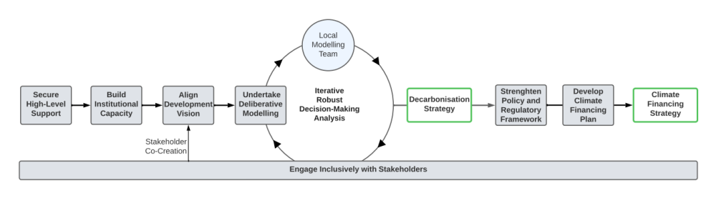
The seven steps of the Data-to-Deal framework
Data-to-Deal refers to actions taken throughout an entire process that runs from data collection, system modelling, and development planning, all the way through to national financing strategies and project finance arrangements to the agreement of a deal (investment), all driven by a strong stakeholder engagement process.
Notes:
Without being narrowly prescriptive, the Data-to-Deal pipeline provides a framework of options to help countries enhance their core capabilities according to national circumstances. The Data-to-Deal engagement process can be broken down into seven stages, as shown in the figure. Different countries will find themselves at different stages, and suitable entry points will vary from one case to another. The seven stages can be identified as follows, and each of them will be discussed in further detail below.
Politics: The first step involves garnering high-level political support for the climate transition
Preparation: The second step entails establishing adequate institutional capacity to implement the transition
Vision: The third step focuses on aligning climate change objectives with a country’s wider development goals
Modelling: The fourth step entails quantitative modelling of climate transition pathways undertaken interactively
Consultation: The fifth step involves engaging inclusively and intensively with a broad cross-section of stakeholders
Operationalisation: The sixth step focuses on addressing bottlenecks in the policy and regulatory framework
Finance: The seventh step requires the development of a financing strategy in support of climate transition investment plans
Notice that stakeholder engagement continues throughout the entire process, while the modelling process is likely to be iterative until broad consensus in support of the plan has been achieved.

Slide 11

1. Politics: Securing high-level support for decarbonisation
High-level political mandates break down working siloes within governments and help to:
  Align policy priorities across ministries
  Ensure consistency across different areas of planning
  Enable collaborative cross-sectoral workflows
This can be supported by the formation
of a central coordination team
Notes:
Given the cross-cutting nature of climate change, a high-level political mandate is particularly important because it helps to align policy priorities, ensure consistency across different areas of planning, and enable collaborative cross-sectoral workflows. Otherwise, ineffective horizontal coordination on climate change, among national government departments, can create a siloed culture. This poses challenges for securing funds to implement Nationally Determined Contributions (NDCs) and associated policies. A significant hurdle in securing political commitment lies in the misconception that emission reduction policies are not drivers of social and economic development but rather constitute a burden or restriction on the development process.
Once a mandate for decarbonisation is established, the formation of a central coordination team is recommended. This will drive effective collaboration among ministries, advocate for the decarbonisation process within government, and act as a hub for facilitating collaboration, understanding, and alignment among various domestic and international entities. The team should ideally encompass a diverse group of stakeholders, including government officials, academics, researchers, businesses, civil society organisations (CSOs), and relevant experts.

Slide 12
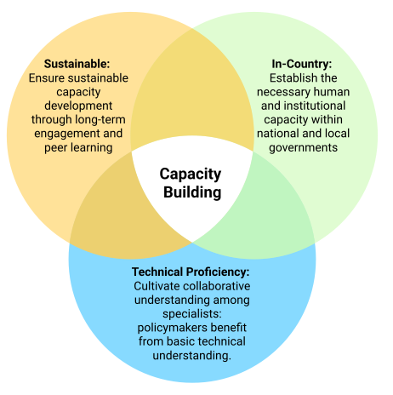
2. Preparation: Laying the foundations of institutional capacity
Building sustainable, in-country, technical proficiency is essential to ensure that climate transition plans are well-grounded and locally-owned.
This is essential to avoid excessive reliance on external consultants.
Notes:
As attention turns towards implementation, a problem commonly encountered is a lack of in-country capacity, knowledge, and skills to undertake critical analysis including modelling. Building sustainable, in-country, technical proficiency is essential to ensure that climate transition plans are well-grounded and locally-owned. This is essential to avoid excessive reliance on external consultants.
Technical proficiency. This is best achieved through an approach that develops capacity across multiple institutions, rather than focusing on a single entity. Ideally, capacity building should encompass both government institutions where decisions are made, and research institutions where longer-term technical expertise can reside, thereby safeguarding against capacity loss during political transitions.
In-country. It is important both for individual practitioners to be proficient in the relevant analytical methods, and for national institutions to embed the skills and capacity needed locally, to provide adequate local context and detail while building country ownership of decarbonisation plans. The required capacity and skills include consensus building, technical analysis, scenario development, and effective translation of modelling results into policy insights.
Sustainable. It is important to prolong capacity-building efforts until in-country capacity becomes robust and self-sustaining. This entails long-term engagement and train-the-trainer or peer learning approaches.

Slide 13

3. Vision: Aligning climate objectives with broader development goals
Countries need to begin by identifying their broad development aspirations beyond climate issues
Decarbonization pathways must be designed so as support (as opposed to conflict with) development goals
Open discussion with a wide range of stakeholders fosters consensus-building and supports alignment
Local ownership ensures that the country’s political, economic and social context is adequately reflected
Once a long-term vision is adopted, a work plan must be decided allowing the country to move the next phase
The existence of a widely shared vision and associated political commitment ​​will increase the chances of more funding being made available at this point to support
the subsequent work plan.
Notes:
Before modelling efforts begin, the country must identify the broad development aspirations that provide the context for any discussion of long-term national decarbonisation targets. Unless a country’s decarbonization pathway supports the achievement of its wider development vision, there is unlikely to be political support for the decarbonization process. Building on this foundation, it should be possible to co-create narratives that provide the basis for alternative future modelling scenarios, through an extensive and iterative consultation process.
Open discussion with a wide range of stakeholders fosters consensus-building and identifies the most critical policy questions. Country ownership ensures that the country’s context is adequately reflected: including political, economic, and social factors This helps to foster consensus-building, enhance transparency, empower stakeholders, and build trust in the process. As a result, the subsequent modelling process will be more robust. Countries should have full ownership of the modelling exercise and associated skills, with non-prescriptive guidance from international partners. In-country modellers and stakeholders possess valuable understanding of the local context, including political, economic, and social factors. This nuanced knowledge needs to be incorporated into the scenario development process to add value.
`
Once a long-term vision is drafted and validated, a work plan must be decided allowing the country to move into a deeper phase. The existence of a widely shared vision and associated political commitment ​​will increase the chances of more funding being made available at this point to support the subsequent work plan.

Slide 14
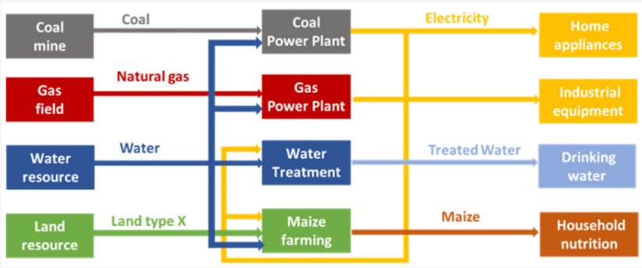
4. Modelling: Undertaking the data-driven quantification of scenarios
A robust modelling process must:
encompass multiple dimensions: technical, economic and social.
capture cross-sectoral and macroeconomic linkages.
Stakeholders play a critical role in:
Model calibration
Establishing a strong partnership enables access to accurate and reliable data ​​sources
Calibrating the model with such data enhances stakeholders’ confidence in results
Scenario development
Co-creating scenarios with stakeholders fosters involvement and builds trust
Providing stakeholder feedback mechanisms facilitates consensus-building
Notes:
A robust modelling process is of paramount importance in informing the design of the strategy. This encompasses technical, economic, and social dimensions of decarbonisation scenarios, using sectoral and macro-economic modelling tools. Adequate attention should be given to modelling demand as well as supply. To ensure political support, it is important to undertake analysis of sectoral interlinkages between energy plans and other sectors such as agriculture, land use, forestry, waste, and industry. It is also crucial to incorporate social aspects – such as poverty, justice, and gender – which can help garner stakeholder buy-in and align with the mandates of international financial institutions.
Model calibration. The absence, or at least inaccessibility, of high-quality data often threatens to compromise the reliable calibration of models. To address this challenge, close collaboration between the modelling team and government ministries is essential both to provide the modelling team with the best data currently available and to afford government ministries guidance on prioritisation of future data collection efforts. Calibrating the model using data provided by stakeholders instils confidence in a model, ensuring it reflects reality accurately.
Scenario development. Co-creating scenarios with stakeholders is crucial as it fosters a sense of involvement in the assessment, enhances transparency, and empowers stakeholders to embrace and trust the analysis. Clear mechanisms should be established to effectively integrate stakeholder feedback into the modelling process: to facilitate this models should be understandable, subject to scrutiny, and capable of garnering support from stakeholders. Scenarios must also align with political objectives to foster trust. Incorporating sectoral interlinkages and social dimensions helps to ensure wider buy-in and facilitates the mobilisation of finance.

Slide 15

5. Consultation: Engaging inclusively across stakeholder groups
Engage early: Engagement should begin early and be deep, iterative, and transparent. Emphasising the ongoing and unfinished nature of the consultation builds transparency and trust, which are pivotal factors in successfully mobilising funds
Communicate effectively: Stakeholder engagement is greatly enhanced when communication is tailored to stakeholders' specific language and interests
Involve finance: The Ministry of Finance has the power to shape economic norms and policies and brings a comprehensive understanding of the overall national landscape, including the economic and distributional impacts of different policies
Notes:
Deep, iterative, and transparent stakeholder consultation is an indispensable element throughout the entire Data-to-Deal pipeline. It plays a critical role in fostering consensus and shaping a shared vision for the country. This entails engaging with society at large on the decarbonisation strategy, to ensure that the chosen approach aligns with social, political, and environmental considerations and achieves a balanced solution. Typically, a large number of people would be involved in the consultation process, representing a very wide range of social sectors and interests. Stakeholder consultation should be informed by the following principles.
Engage early: Engagement should begin early and be deep, iterative, and transparent. Emphasising the ongoing and unfinished nature of the consultation builds transparency and trust, which are pivotal factors in successfully mobilising funds.
Communicate effectively: Stakeholder engagement is greatly enhanced when communication is tailored to stakeholders' specific language and interests, rather than being expressed in very broad terms or in very technical language.
Involve finance: Transition planning is often led by line ministries that focus primarily on technical aspects, but ultimately these plans need to be financed. The Ministry of Finance has the power to shape economic norms and policies and brings a comprehensive understanding of the overall national landscape, including the economic, fiscal and distributional impacts of different policies. It is important to bring the Ministry of Finance into the planning process to ensure that plans are financially realistic and that financial arrangements can be expedited.

Slide 16

6. Operationalisation: Strengthening the policy and regulatory framework
Shifting away from standalone projects towards providing strategies that incorporate integrated, multisectoral, and cross-cutting policies offers certainty to investors
These strategies must articulate a clear strategic vision, supported by tangible short-, medium- and long-term milestones and strong accountability frameworks
Notes:
Once a decarbonisation strategy is developed, it is important to identify and address any related gaps in the policy environment. Governments play a critical role in establishing an enabling environment for policies and regulations to support climate-aligned investment. Well-designed policies facilitate capital mobilisation by reducing downside risks. These include articulating a clear strategic vision, supported by tangible short-, medium- and long-term milestones and strong accountability frameworks.
Shifting away from standalone projects towards providing strategies that incorporate integrated, multisectoral, and cross-cutting policies offers certainty to investors. The macro-economic implications of the climate transition also need to be understood and managed. These may include an overall increase in investment, as well as a shift in its sectoral composition, with potential consequences for economic growth and employment, as well as possible impacts on vulnerable groups. Given the prevalence and fiscal significance of fuel taxation and energy subsidisation, the transition will also call for adjustments to a country’s fiscal systems to ensure that revenue bases are preserved and fiscal incentives support the chosen trajectory.

Slide 17
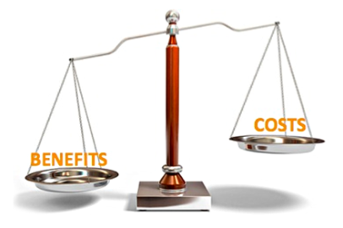
7. Finance: Developing investment plans and financing strategies
Ministries of Finance should be engaged to convert decarbonisation plans into specific financing requirements
MoF’s should tap into a diverse range of financial sources, and realign existing streams of finance towards decarbonisation objectives
It is important to quantify associated long-term benefits and related fiscal and macroeconomic impacts as this will impact the viability of projects
Notes:
Given the urgency of climate goals, the decarbonisation plans developed by line ministries are likely to represent a surge in investment relative to historic levels. The Ministry of Finance needs to convert such plans into specific financing requirements, evaluating whether the associated debt service costs are affordable relative to sector cashflows. The greater the country risk, the higher the cost of capital and the larger the burden of financing a particular plan.
Ministries of Finance must tap into a diverse range of capital sources, including domestic and international, as well as public and private. To ensure an efficient use of available financing options, there must be clear guidance on the role of public funds, the use of state guarantees, and the suitability of different financing instruments. An important part of the process is to realign existing streams of finance towards decarbonisation objectives. For example, energy spending under the national budget should gradually shift towards supporting the transition while gradually winding down support for fossil fuel-related infrastructure.
As well as estimating financing costs of investment projects, it is important to quantify associated long-term benefits – both financial (such as fuel savings) and economic (such as carbon savings) – as these will affect the viability of the projects and guide the allocation of scarce concessional finance.

Slide 18
Key Policy Recommendations
International organisations supporting LMICs to develop credible investment cases should structure assistance using the Data-to-Deal framework
Country stakeholders should be technically equipped and empowered to determine their own consensus-based and nationally-owned decarbonisation pathways
High-level leadership should drive a process of cross-government collaboration, with the Ministry of Finance engaging from an early stage with the critical line ministries
Capacity-building efforts in-country should be sustained over time, building individual technical skills, as well as strengthening relevant institutions, with the central involvement of local academia
Notes:
Some of the main takeaways from the Data-to-Deal framework can be summarized as follows.
International organisations supporting LMICs to develop credible investment cases should structure assistance using the Data-to-Deal framework
Country stakeholders should be technically equipped and empowered to determine their own consensus-based and nationally-owned decarbonisation pathways
High-level leadership should drive a process of cross-government collaboration, with the Ministry of Finance engaging from an early stage with the critical line ministries
Capacity-building efforts in-country should be sustained over time, building individual technical skills, as well as strengthening relevant institutions, with the central involvement of local academia

Slide 19
Part 2: References
[1] Luscombe, H., Richardson, E., Foster, V., Howells, M., Quirós-Tortós, J. et al. (2024). Data-to-Deal (D2D): An Emerging and Effective Approach to Financing the Climate Transition. Version 3. Working Paper. Cambridge Open Engage. Available at: https://doi.org/10.33774/coe-2024-21xv4-v3 (Accessed: 30 January 2025).
[2] Luscombe, H., Foster, V., Howells, M., Quiros-Tortos, J., and Jaramillo Gil, M. Data-to-Deal: An Emerging and Effective Approach to Supporting Countries in Climate Transition. Climate Compatible Growth Programme COP28 Policy Brief Series.
[3] Jaramillo, M., Quiros-Tortos, J., Vogt-Shilb, A., Money, A. and Howells, M. , 2023. Data-to-Deal: Open Data and Modelling of Long-Term Strategies to Financial Resource Mobilisation – The Case of Costa Rica. Climate Compatible Growth Programme D2D Policy Brief Series.
[4] Quirós-Tortós, J., Boza-Nuñez, E., Amador-Pérez, D., Abreu, C., Marte, M., Luscombe, H., Agnelli, L., Foster, V., and Howells, M. (2024). Data-to-Deal (D2D) in the Dominican Republic: Mobilising Financial Resources Through a Long-Term Plan. Climate Compatible Growth. D2D Policy Brief Series.
[5] Chacón, M. J. S., Quirós-Tortós, J., Boza-Nuñez, E., Amador-Pérez, D., Luscombe, H., Agnelli, L., Foster, V., and Howells, M. (2024). Data-to-Deal (D2D) in Uruguay: Mobilising Financial Resources Through a Long-Term Plan. Climate Compatible Growth. D2D Policy Brief Series.
[6] Rodríguez-Zúñiga, M., Boza-Nuñez, E., AmadorPérez, D., Quirós-Tortós, J., Luscombe, H., Agnelli, L., Foster, V., and Howells, M. (2024). Data-to-Deal (D2D) in Chile: Mobilising Financial Resources Through a Long-Term Plan. Climate Compatible Growth. D2D Policy Brief Series.

Slide 20
IMPAACT Analytical Workflow
Part 3

Slide 21
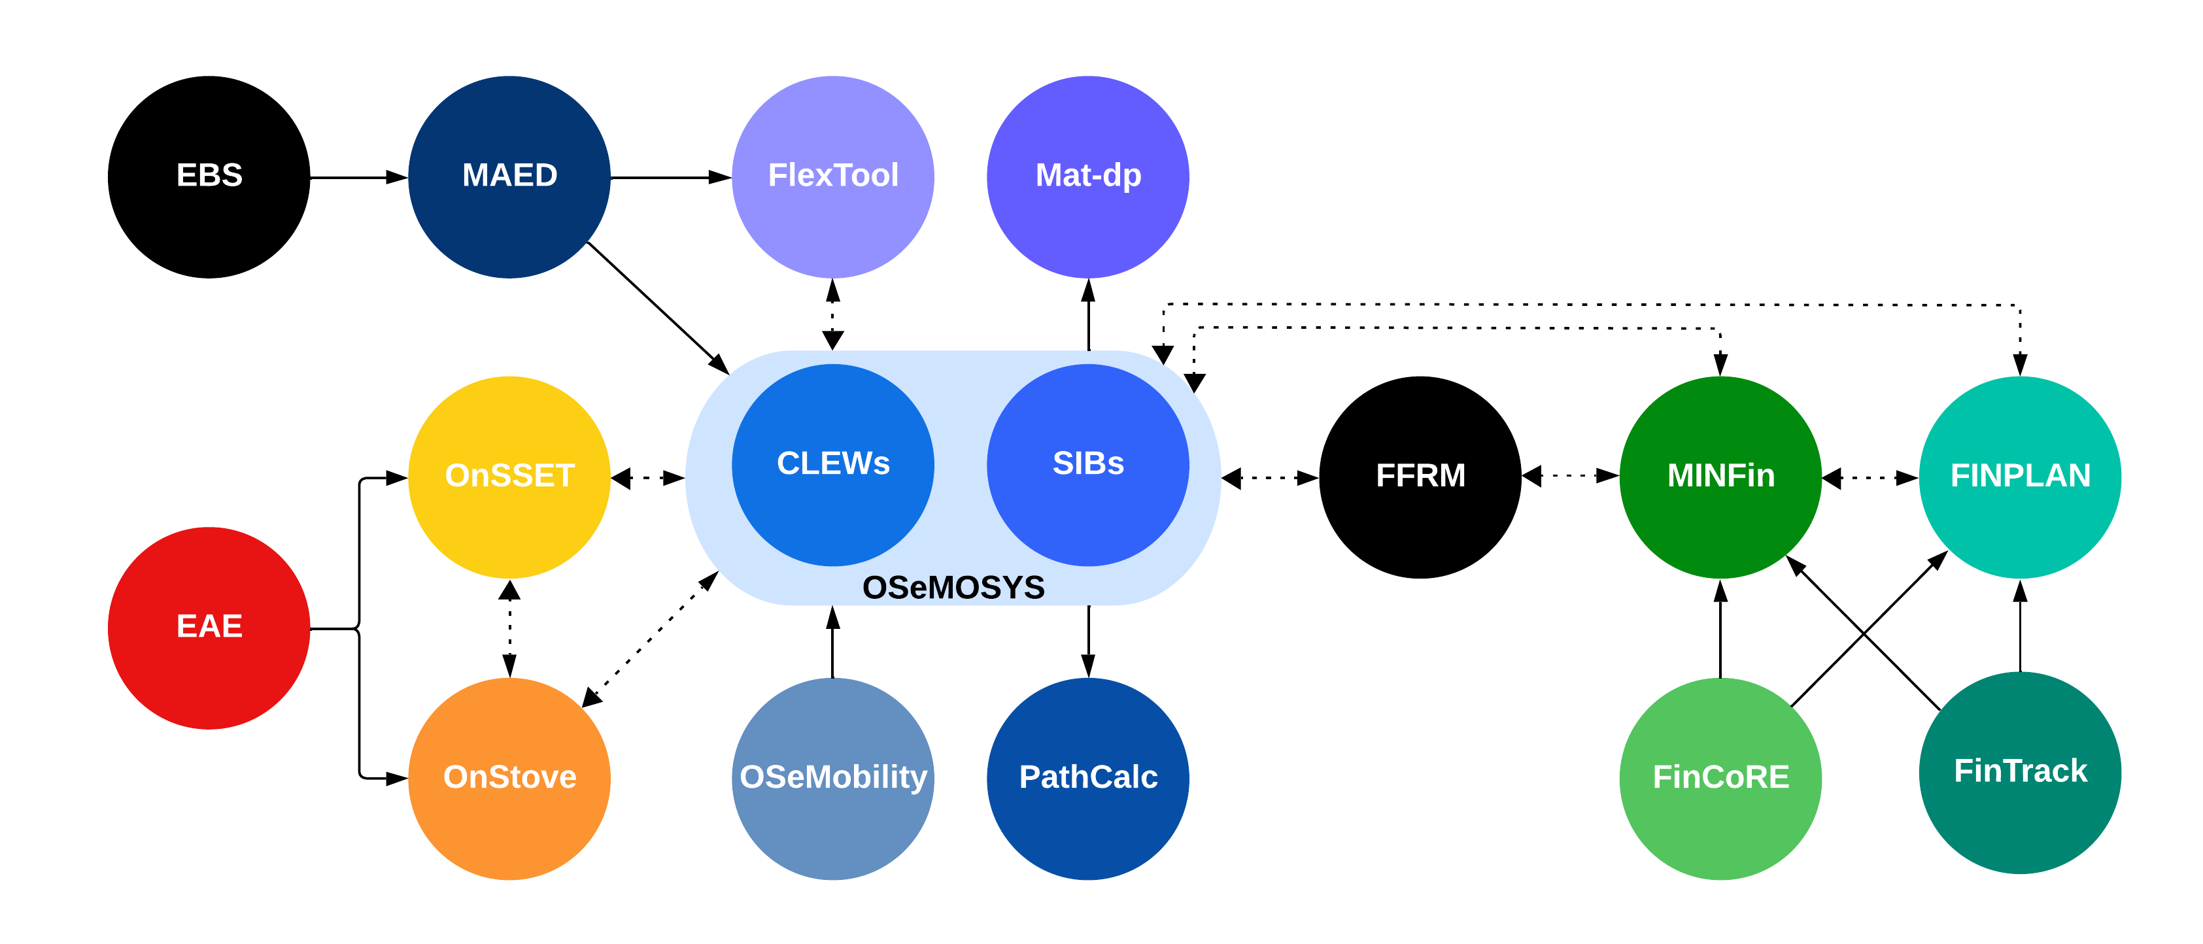
The Role of Modelling in Data-to-Deal
Notes:
At the heart of the Data-to-Deal framework is an iterative scenario modelling supported by technical tools. Models allow the implications of different political objectives to be explored by identifying what actions need to be taken today to meet goals for tomorrow. They also provide a reality check regarding the time and cost implications of meeting certain objectives. A wide range of open-source modelling tools are available to support different aspects of climate transition modelling in the CCG ecosystem, illustrated in the red circle, and these will be explained in greater detail below.

Slide 22
CCG’s Ecosystem of Open-Source Modelling Tools
Notes:
CCG’s ecosystem of open-source modelling tools support the different stages in the planning and financing process associated with Data-to-Deal. The tools towards the left of the diagram represent the most upstream stages of planning, while the tools towards the right of the diagram support the process of financial mobilisation. Courses designed to support basic competence in all these tools are available in the Open Learn Collection.
Each of these tools can be briefly described as follows. While each of them can be separately used, they can also be combined with each other. Together they form an integrated workflow with outputs from one tool providing inputs to the next tool.
EAE is an interactive geospatial platform that enables energy planners, clean energy entrepreneurs, donors and development institutions to identify high-priority areas for energy access interventions.
OnSSET and OnSTOVE are geospatial tools that support planning for the achievement of universal access to electricity and clean cooking respectively.
EBS is a tool to help create and analyse energy balance tables, showing how energy is produced, transformed and used in a country.
MAED is a tool that supports rigorous forecasting of energy demand across a wide range of end-use sectors.
FlexTool is a tool that allows evaluation of the flexibility of a determined future energy system to integrate variable renewable energy.
Mat-dp is a model to calculate the amounts and types of materials needed for building any system or resource transformation including those found along any supply chain.
OSeMOSYS is a model that conducts least cost planning for system capacity expansion to meet forecast demand.
CLEWS is a modelling framework that permits exploration of linkages between climate, land, energy, and water systems.
OSeMobility is a modelling framework that allows stakeholders to explore credible transport futures through a socio-technical approach.
PathCalc is a tool that visualizes carbon emission trajectories associated with different plans and policies.
MINFin is a model that supports the development of a national financing strategy for the delivery of a climate transition plan.
FINPLAN is a tool that conducts project finance analysis to establish bankability of specific transition energy projects.
FinCoRE is a tool to estimate the cost of capital for renewable projects financed by international commercial investors, broken down by year, country, and components like risk-free rate and technology risk
FinTrack is a tool to monitor climate and development fund commitments to countries, including concessionality and historical usage.
The remainder of this course provides in-depth training on the MINFin tool.

Slide 23
Part 3: References
[7] Tan, N., Vrochidis, I., Luscombe, H., Richardson, E., Plazas Niño, F.A., Alexander, K., Martindale, L., Fields, N., Harrison, J., Howells, M. and Foster, V. (2024). Data-to-Deal: Developing an Energy Modelling Analytical Workflow to Enhance Political and Financial Decisions. Zenodo. Available at: https://zenodo.org/records/11162538 (Accessed: 30 January 2025).

Slide 24
Introducing MINFin
Part 4

Slide 25



MINFin Focuses on the Sector Level Plan
Introducing Model for Informed National Financing (MINFin)
Individual Project
Investment
MINFin is a framework for thinking holistically about the financial implications of energy transition at the sector level.
MINFin examines the feasibility of financing the entire transition investment plan, rather than the looking at the bankability of individual projects.
Complete Investment Plan
Notes:
The Model for Informed National Financing (MINFin) is designed to support countries that have already developed energy transition plans and are now seeking to mobilize financing to implement those plans. In contrast to project finance tools, such as FINPLAN, that focus on financial structuring of individual projects, MINFin examines the feasibility of financing the entirety of the investment plan. As such, MINFin is a tool that examines the financing challenge holistically at the overall sector level.
Often countries focus on how to finance individual projects but lose sight of the bigger challenge of financing the whole plan. In principle, any individual project can be made bankable by incorporating enough concessional finance or risk mitigation measures into the project design. However, these solutions are seldom scalable to the entire investment plan.

Slide 26




MINFin Bridges Between Planning and Finance
MINFin supports interactions between Ministries of Energy and Ministries of Finance, by presenting the financial implications of implementing a plan.
Ministry of Energy
Ministry of Finance
Energy Transition Plan
Notes:
Transition plans are typically developed by line ministries like the Ministry of Energy, who have considerable technical expertise, but are not so familiar with financing aspects. But ultimately, any national investment plan will need to go to the Ministry of Finance to examine whether it is possible to finance. Ministries of Finance have considerable finance expertise but are less familiar with the technical aspects of energy planning. This creates an institutional disconnect, which often results in transition plans that cannot be adequately financed.
MINFin is designed to bridge the gap between planning and finance, thereby supporting interactions between Ministries of Energy and Ministries of Finance. MINFin starts from an energy transition plan and works through its financial implications. Specifically, Ministries of Finance are likely to be interested in the following kinds of questions that are not typically part of the energy planning process.
What sources of finance are available to finance the plan?
What will be the financing costs associated with the plan?
How will the plan affect government revenues and expenditures?
How will the plan affect the finances of state-owned-enterprises?
To what extent will user tariffs contribute to the financing of the plan?
How will the plan contribute to public debt?

Slide 27
MINFin Encompasses Both Financing and Funding
Financing: is a source of capital that can be provided to cover the upfront cost of an investment project on the condition that it is repaid over time with a return to compensate the financier
Funding: is a source of cashflow that is available and can be dedicated to the repayment of a financing arrangement, which ultimately comes from citizens whether:
    Taxpayers via the government budget
  Energy consumers through utility tariffs
Take note: there can be no financing without funding!
Notes:
Discussions about financing too often overlook the fact that financiers need to be repaid. There is no free lunch! So, any discussion about financing needs to consider not only where the financing will come from, but where the repayment (or funding) for that financing will come from. The following two definitions will play an important role during the rest of this course, and are important to understand from the outset.
Financing is a source of capital that can be provided to cover the upfront cost of an investment project on the condition that it is repaid over time with a return to compensate the financier for giving-up access to the capital over a period of time.
Funding is a source of cashflow that is available and can be dedicated to the repayment of a financing arrangement. There are typically only two ways that investments can be funded, either by taxpayers through the government budget, or by energy consumers through utility tariffs. Since, ultimately, taxpayers and energy consumers refer to the same people, ultimately all funding comes out of citizens’ pockets.
Moreover, the first question that potential financiers will ask is who will be funding the project. To provide finance, they will need to be convinced that the funding streams associated with the project are both adequate and reliable, otherwise they will find the project too risky and simply withdraw. MINFin is built on this basic idea: there is no financing without funding!

Slide 28
MINFin Supports Development of Financing Strategies
MINFin supports the development of financing strategies for transition investment plans by addressing the following types of questions:
How much finance is needed to implement a transition investment plan?
What are the potential sources of finance for a transition investment plan?
How much will it cost to finance the transition investment plan?
What are the potential sources of funding for the transition investment plan?
Is there enough funding available to support the necessary finance?
What actions can be taken to reduce the costs of finance?
What actions can be taken to increase the availability of funding?
What support is needed from the international community and in what form?
Is the transition investment plan too ambitious to be affordable?
Notes:
MINFin is designed to support the development of financing strategies for transition investment plans. It does so by providing concrete answers to the following types of questions.
How much finance is needed to implement a transition investment plan?
What are the potential sources of finance for a transition investment plan?
How much will it cost to finance the transition investment plan?
What are the potential sources of funding for the transition investment plan?
Is there enough funding available to support the necessary finance?
What actions can be taken to reduce the costs of finance?
What actions can be taken to increase the availability of funding?
What support is needed from the international community and in what form?
Is the transition investment plan too ambitious to be affordable?

Slide 29
Thank you
Contact Information: v.foster@imperial.ac.uk or hannah.luscombe@ouce.ox.ac.uk

