Slide 1

Model for Analysis of Energy Demand
LECTURE 1
COURSE INTRODUCTION TO MAED
Version 2.0
1
Notes:
Licence: This work is licensed under the Creative Commons Attribution 4.0 International License (CC BY 4.0). To view a copy of this license, visit https://creativecommons.org/licenses/by/4.0/.
Attribution: Please cite as: Kiley, F. (2025) An Introduction to Simulating Energy Demand with MAED. Version 1. Climate Compatible Growth Teaching Kit Website, Climate Compatible Growth.

Slide 2

Learning Outcomes
By the end of this lecture, you will:
ILO1: understand the components of energy systems and the relationship to the Sustainable Development Goals (SDGs)
ILO2: have an insight into the importance of energy system planning
ILO3: have had an introduction to the Model for Analysis of Energy Systems (MAED)
ILO4: have knowledge of the course outline and learning objectives
1.1. Energy systems & the SDGs
1.2. Energy Planning
1.3. Intro to Model for Analysis of Energy Systems (MAED)
1.4 Course outline & Objectives
2
Notes:
This lecture has four intended learning outcomes. By the end of this lecture you will:
Understand the components of energy systems and the relationship to the Sustainable Development Goals
Have an insight into the importance of energy system planning
Have had an introduction to the Model for Analysis of Energy Systems, known as MAED.
Have knowledge of the course outline and learning objectives

Slide 3

















Lecture 1.1 Energy Systems & the SDGs
1.1.1 What is the Energy System?
Supply
Demand
3
Notes:
We all use energy every day to provide many different services. This energy comes in many different forms, from firewood to nuclear fission. This is the supply (on the left). And the energy is used for many different reasons, from cooking and heating, to agriculture and transport. This is the demand (on the right).
In between supply and demand there can be complex transmission and distribution systems and energy system operators, making sure that supply is able to meet instantaneous demand at all times.
Energy provision is vital to developing and sustaining our economies.

Slide 4


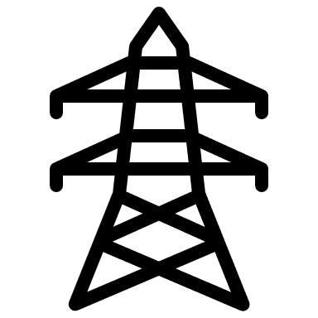

Lecture 1.1 Energy Systems & the SDGs
1.1.2 Traditional stages in the Energy System
Mine, Well, Import
Electrical Plant, Refinery
Transmission lines, Pipelines
Consumer
Final Conversion
Extraction
Conversion
Transmission
4
Notes:
Traditionally, the majority of our energy supply has come from fossil fuels. These require extraction and conversion. This conversion can either be to electricity at a power station or some fossil fuels can be refined to produce motive fuels and jet fuel, for example. Other products are also produced.
At some point in this process fuels are often traded and transported geographically to meet the demand. In the case of electricity, after generation it will be transmitted via transmission and distribution networks before reaching its final destination, the consumer. When the energy reaches the consumer, perhaps as electricity to power lighting or as motor fuel to facilitate transport, it must be converted to be able to provide this energy service.
At every stage of this process there will be loses.

Slide 5
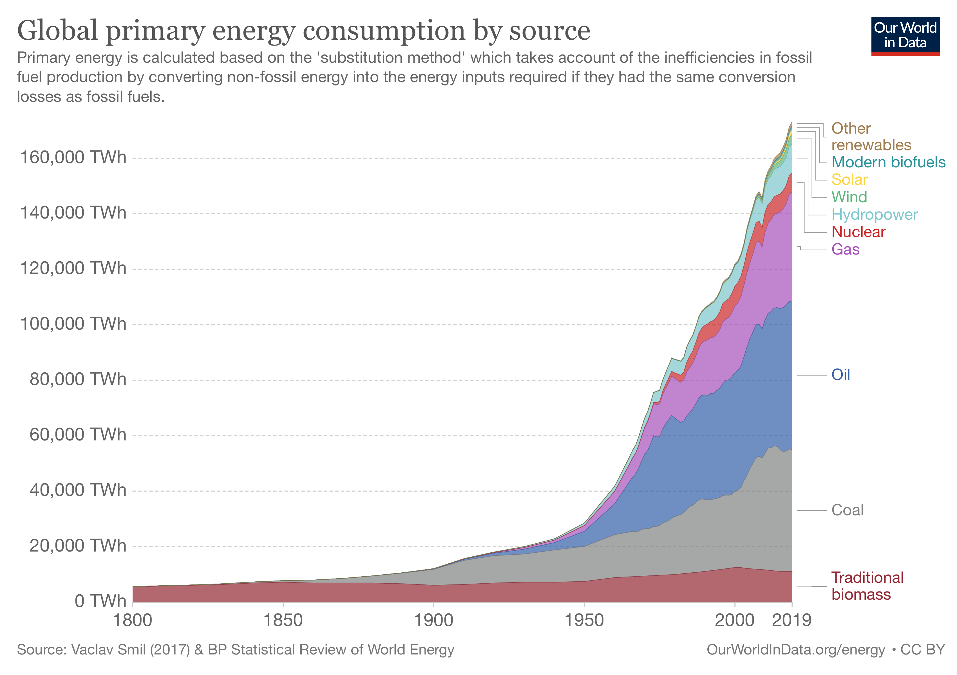
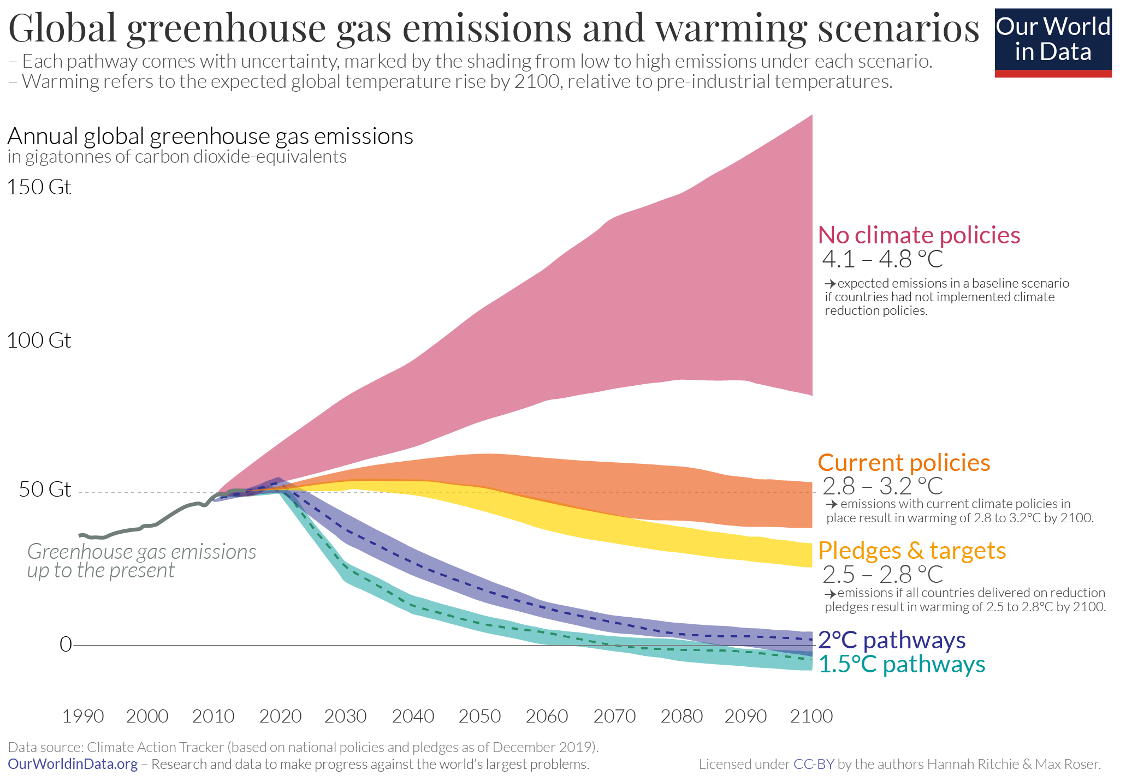
Lecture 1.1 Energy Systems & the SDGs
1.1.3 Transitioning to a new, AFFORDABLE, and CLEAN energy system
5
Notes:
You can see in the left figure by Our World in Data that fossil fuel consumption has been growing year on year, with significant increases since 1950. Please visit their website to explore the interactive version of this figure and access the underlying data, if you are interested.
However, our current consumption of fossil fuels as our main source of energy is unsustainable if we want to limit global warming to 1.5 degrees Celsius, as outlined in the special report by the International Panel on Climate Change. If global temperature rise exceeds this average increase, there are significant risks to agriculture production and of increased natural disasters and biodiversity loss, to name a few. The drastic reduction in greenhouse gas emissions necessary to limit global temperature increase to 1.5 degrees Celsius are shown in the figure on the right.
Fossil fuels contribute to climate change as they produce significant carbon dioxide emissions but they are by no means the only option for energy generation. As you can see in the right hand-side of the left graph renewables such as solar, wind, hydropower, and biofuels are becoming more popular. In fact, these generation sources can offer some advantages, which we will cover on the next slide.

Slide 6

Lecture 1.1 Energy Systems & the SDGs
1.1.4 The Sustainable Development Goals
6
Notes:
The U.N. has deemed the provision of affordable and clean energy so important to societies that it is one of the Sustainable Development Goals, namely goal 7. Goal 7 strives to ensure access to affordable, reliable, sustainable, and modern energy for all.
The goal specifies that the energy should be affordable and clean. These are two characteristics which renewable generation can offer.
Let us consider the three dominant advantages of renewable energy over fossil fuels.
1 Some can be modular, a small generation capacity can be installed. This requires much less capital than building an entire new coal power plant, assisting with affordability.
2 The price is dropping, making the energy itself more affordable. In many areas of the globe, the price of energy generated by solar is equivalent, if not cheaper, than energy produced by fossil fuels.
3 Renewable energy generation has significantly lower greenhouse gas emissions than the use of fossil fuels, making it a cleaner alternative.
However, as energy underpins much of our economies, the transition to this affordable and clean energy system requires significant planning.

Slide 7
Lecture 1.2 Energy System Planning
1.2.1 Energy system analysis and Planning
Energy system analysis....
considers the impact of technologies on energy and material use
allows us to understand the interactions between different energy technologies and different energy sectors such as heat, power, and transport
…informs energy system planning, which involves
developing long-term policies to help guide the future of a local, national, regional, or global energy system.
using integrated approaches to consider both energy supply to meet demand and the role of energy efficiency in reducing demand.
understanding future energy consumption, population growth, and economic development.
7
Notes:
To conduct informed energy system planning, one needs to conduct energy system analysis.
The goal of energy system analysis is to develop a methodology for measuring the impact of technologies on energy and material use.
It allows us to understand the interactions between different energy technologies and different energy sectors such as heat, power, and transport.
Energy system analysis informs energy system planning.
Energy system planning involves:
developing long-term policies to help guide the future of a local, national, regional, or global energy system
using integrated approaches to consider both energy supply to meet demand and the role of energy efficiency in reducing demand
understanding future energy consumption, population growth, and economic development

Slide 8
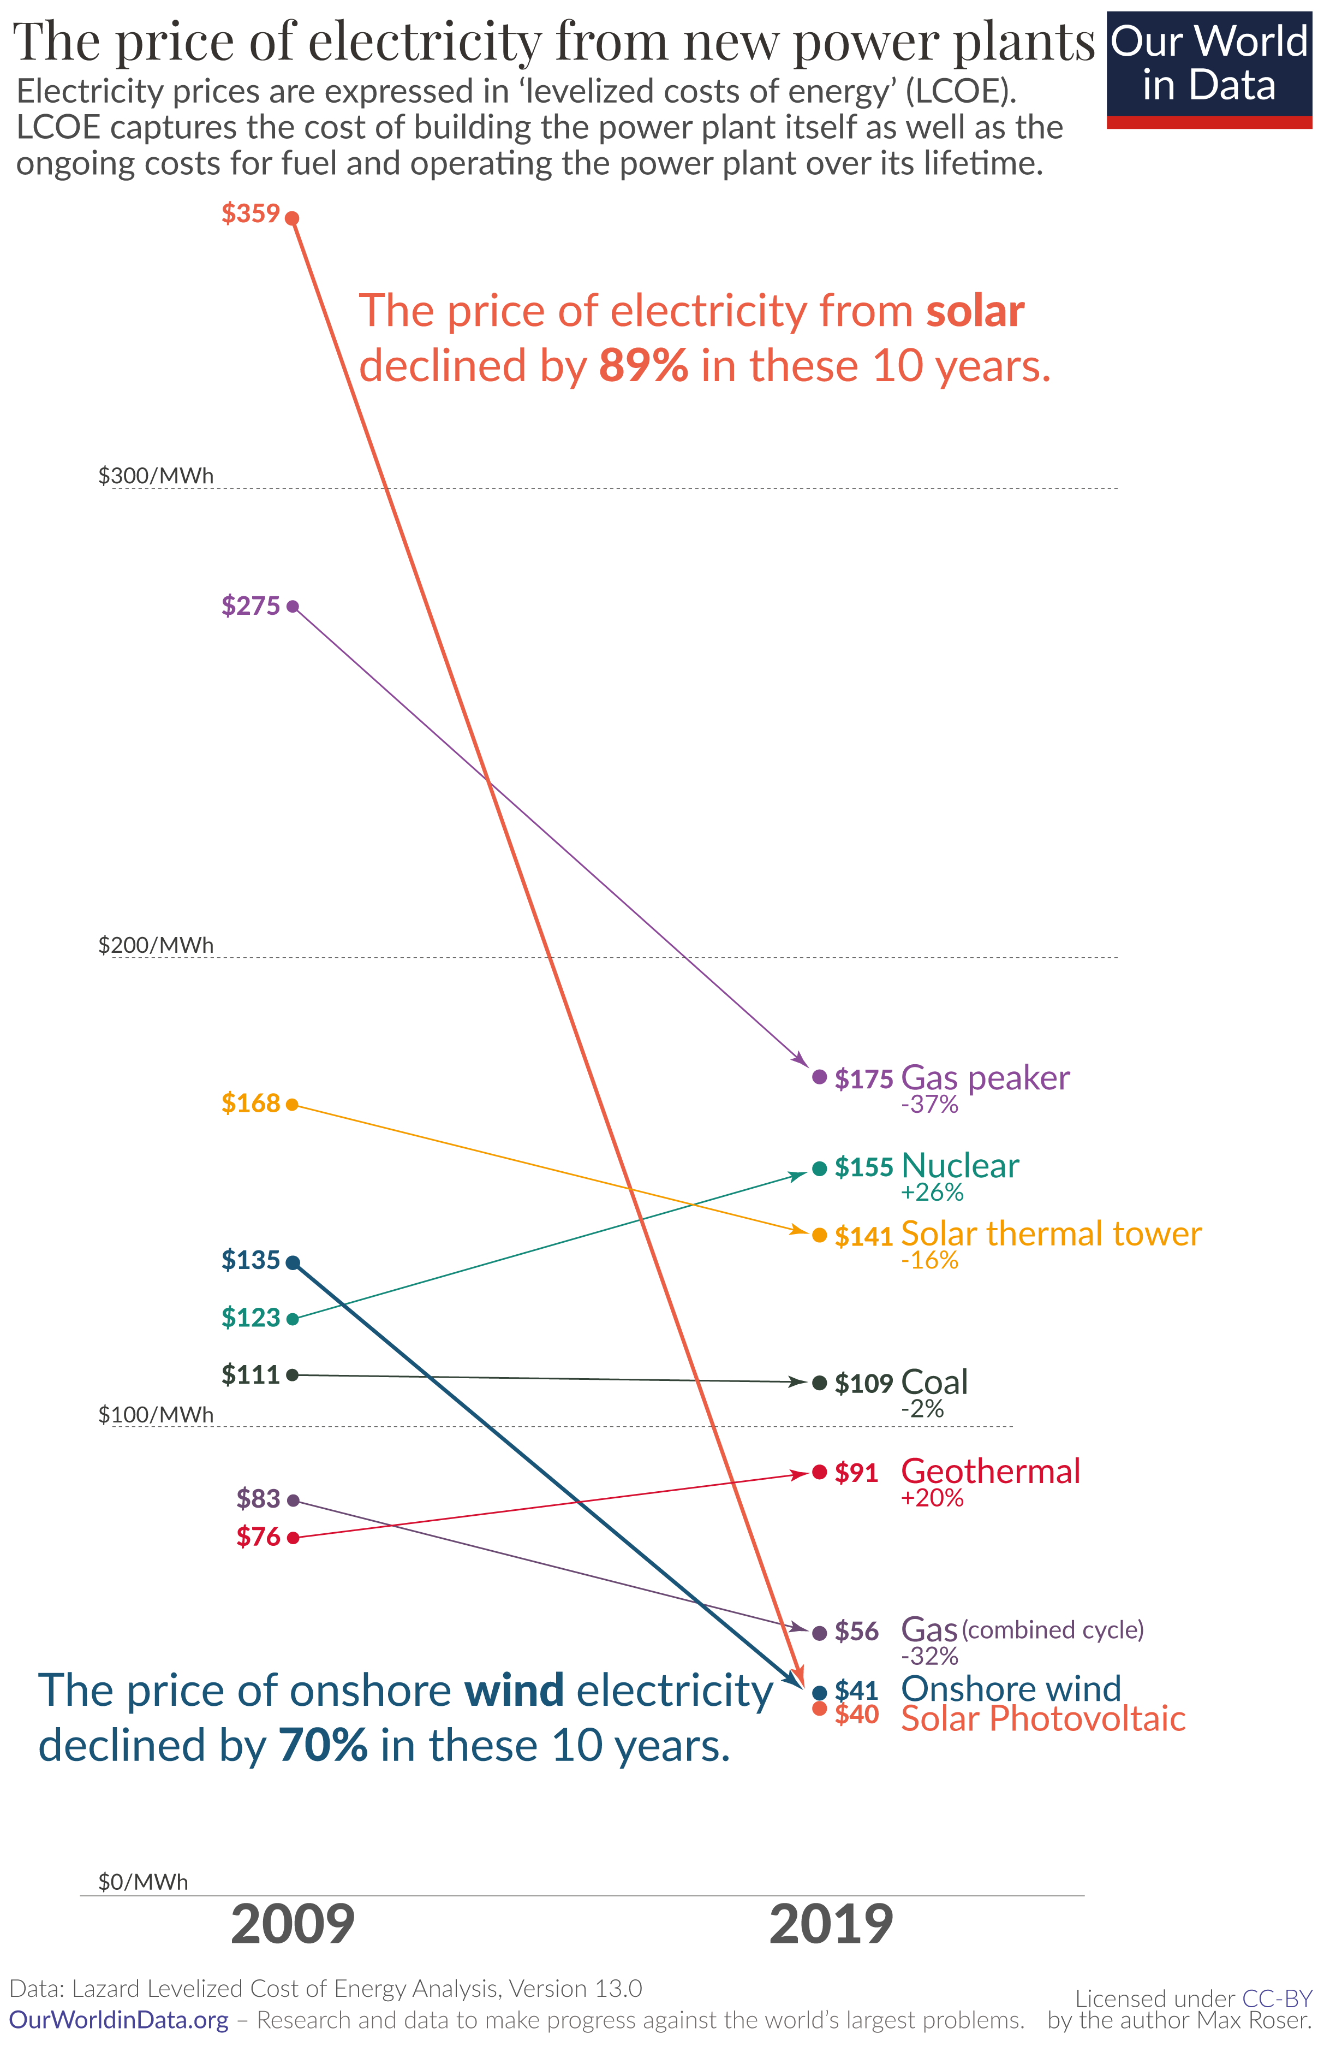
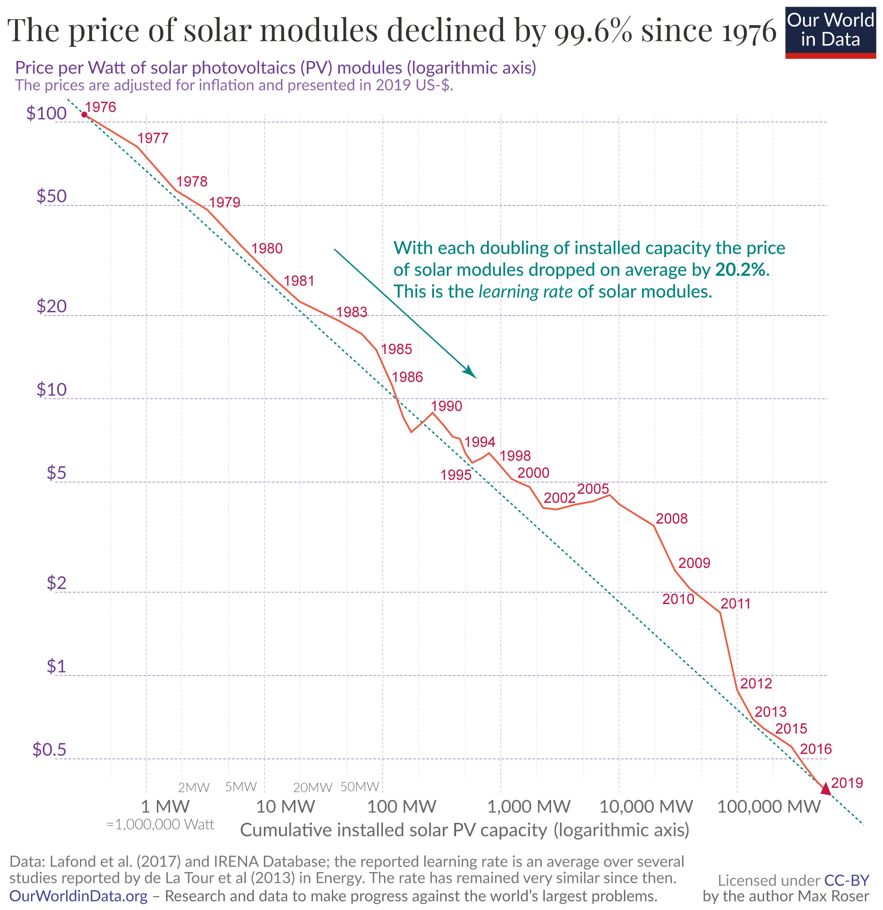

Lecture 1.2 Energy System Planning
1.2.2 Why is energy system planning as important as ever?
SDG 7: affordable, clean energy for all
8
Notes:
Energy system planning is as important as ever because the system is changing rapidly. Supply and demand and even the system architecture could change in the coming years.
First, let’s consider affordability. Although the energy system is far broader than the provision of electricity, we’ll focus on electricity for now.
The figure on the left, from Our World in Data, shows how drastically the price of solar photovoltaic modules has fallen as greater and greater capacity has been installed worldwide. The price per watt, which is the unit of power, fell from 106 U.S. dollars to 38 U.S. cent between 1978 and 2019. That is a drastic drop in cost of 99.6 percent.
However, the useful cost value is often the cost per Kilowatt hour, a unit of energy. If we consider the cost of solar P.V. in the context of other electricity generation sources, as is shown in the right figure, it is clear that it is one of the cheapest options out there. In fact, wind and solar are both undercutting the price of gas and coal. In the case of coal, the cost has effectively remained the same over the past 10 years, whereas the price of solar fell 89 percent, and the price of wind fell 70 percent.
This indicates there is likely to be a drastic cost driven shift in generation sources over the coming decades, making renewables a very attractive alternative to traditional forms of energy.

Slide 9
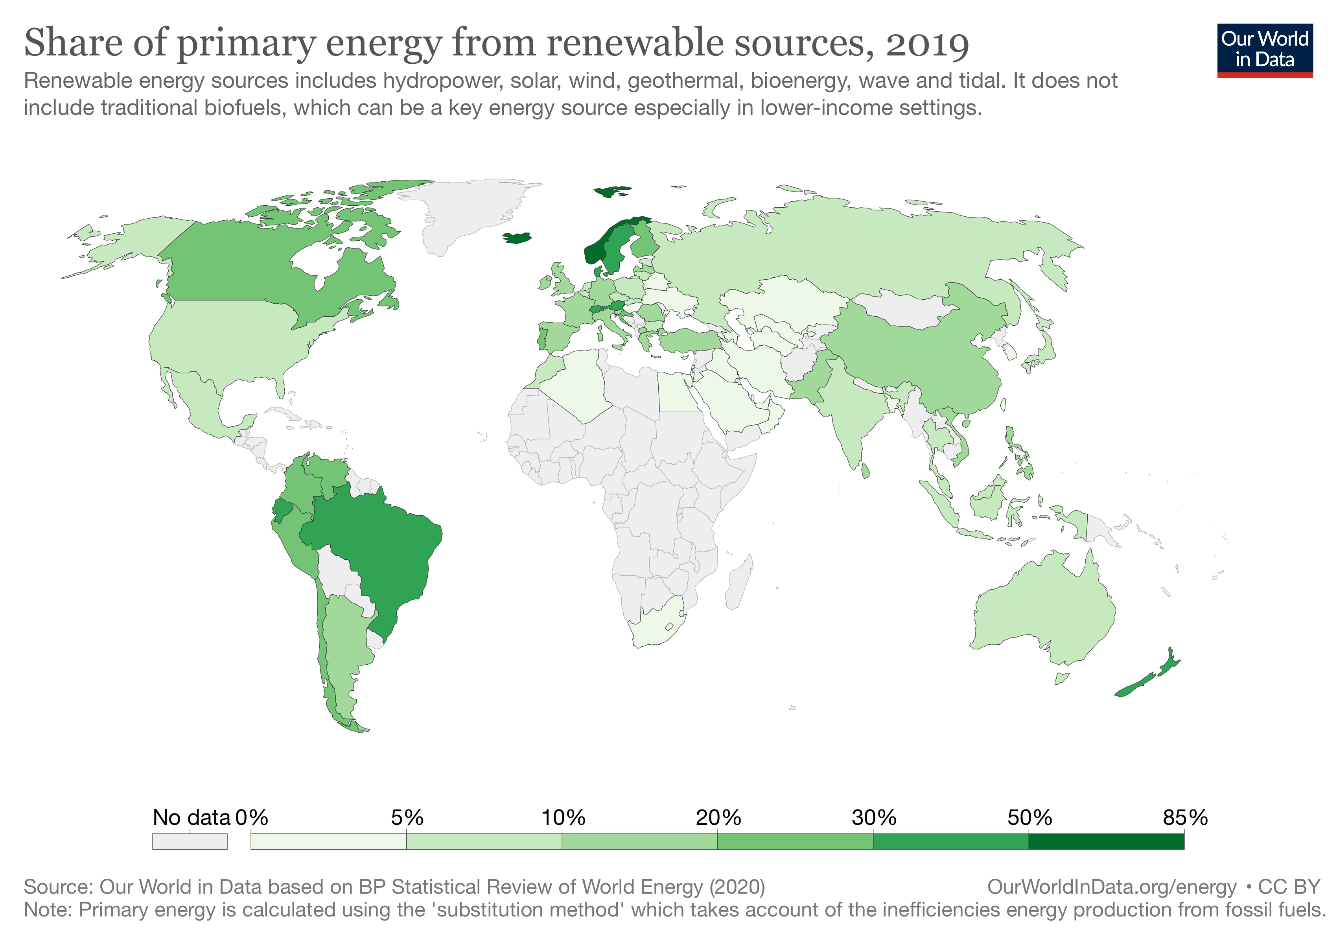
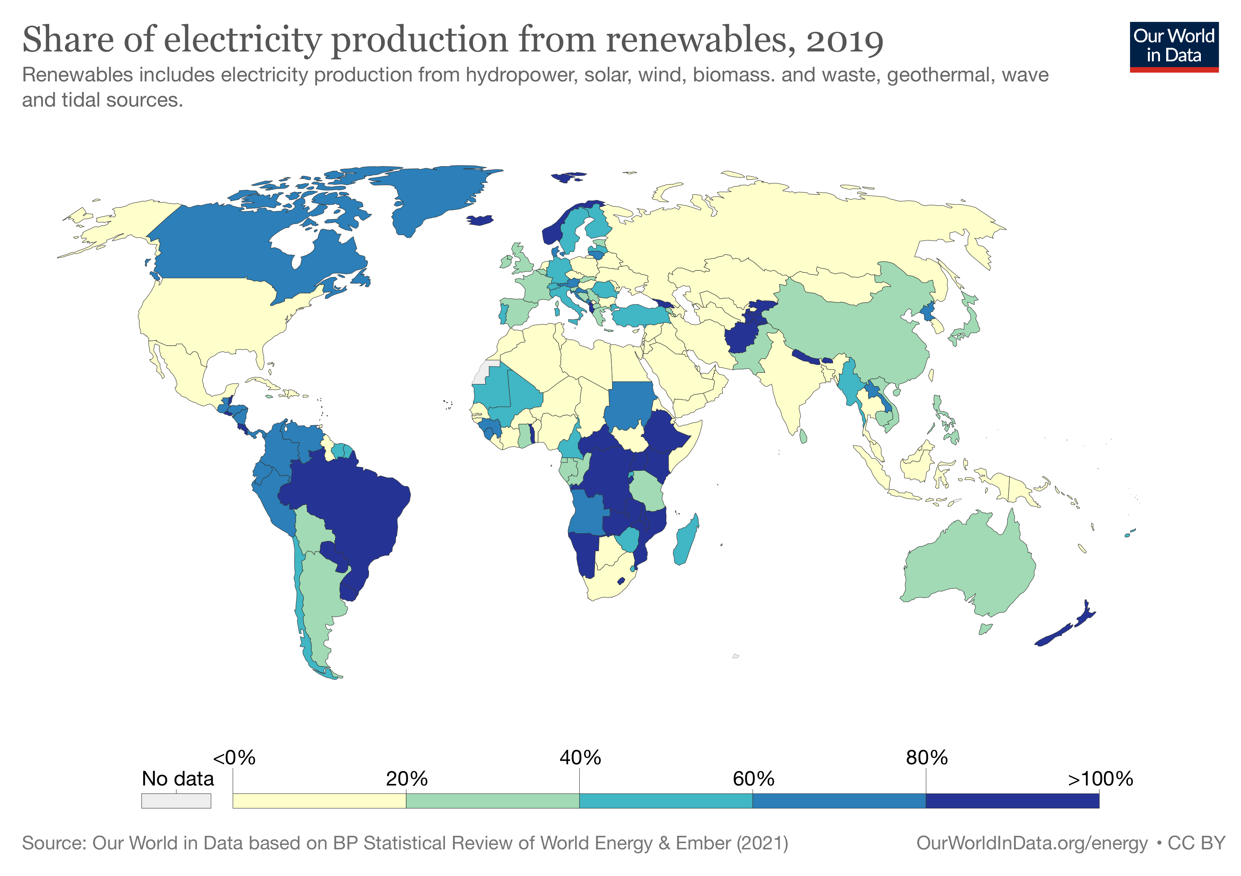
Lecture 1.2 Energy System Planning
1.2.3 Renewable Energy Generation
9
Notes:
The provision of clean energy is already under way, driven by the falling costs.
The figure on the left shows the share of primary energy from renewables – this is for energy, so includes electricity, transport and space heating or cooling. Transport and heating systems are dominated at the moment by fossil fuels such as oil and gas. In 2019, approximately 11 percent of global energy was produced by renewables.
The figure on the right zooms in to the electricity system, discounting the transport and space heating and cooling sectors. Electricity systems tend to be easier to decarbonise. It is clear that our transition to renewable generation is under way. In 2019, over 7 thousand tera watt hours of energy were produced from renewable technologies.
However, renewable energy generation is very different to fossil fuels, generation is intermittent and cannot be ramped up and down to meet demand in the same way. Renewables may need to be coupled with energy storage. This is why energy system planning is even more valuable.

Slide 10
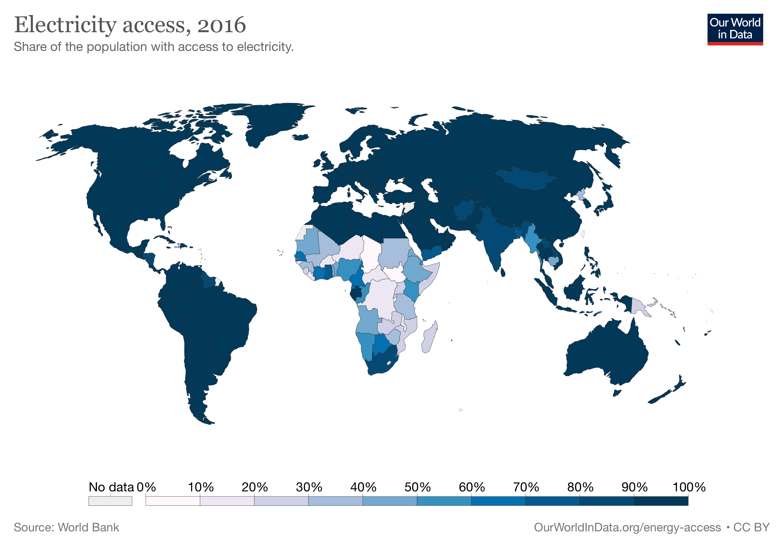
Lecture 1.2 Energy System Planning
1.2.4 Electricity Access
10
Notes:
Energy system planning can also assist with energy for all. In 2016, the majority of countries had achieved 100 percent access to electricity for their populations. However, there are some countries, mainly concentrated in Sub-Saharan Africa, where this was not the case. In some instances, the access to electricity was under 10 percent.
Energy System Planning can assist with meeting this goal of energy access for all by understanding demand and local renewable resources which may assist with supplying the required energy generation.

Slide 11
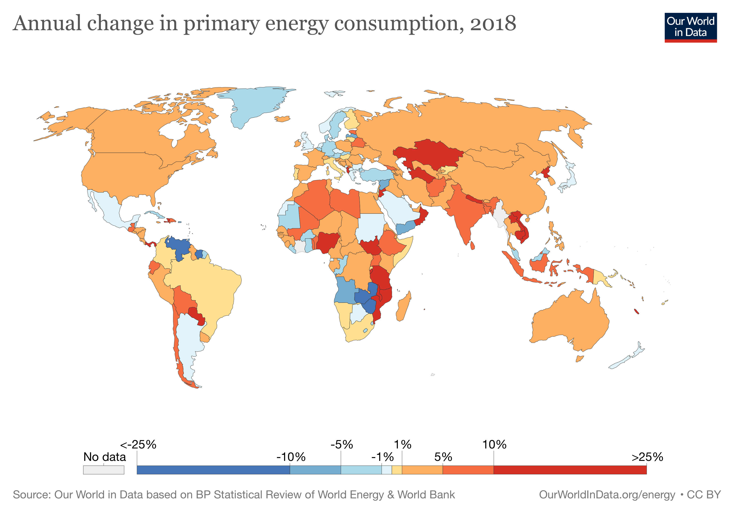
Lecture 1.2 Energy System Planning
1.2.5 Understanding possible growth scenarios
11
Notes:
One final point is that the energy system is changing, both in terms of supply (as shown by the uptake of renewable generation) and in terms of demand (also termed consumption).
This figure by Our World in Data shows the change in energy consumption in countries across the globe during 2018. In the majority of the map, the consumption of energy increased. This trend could well continue, and energy planning will assist in meeting these changes.
Changes could also occur in the structure of the demand. For example, if electric vehicles gain market share, this would increase demand for electricity and decrease demand for fossil fuels. Understanding these possible scenarios is invaluable in energy system planning and supporting climate compatible growth.

Slide 12
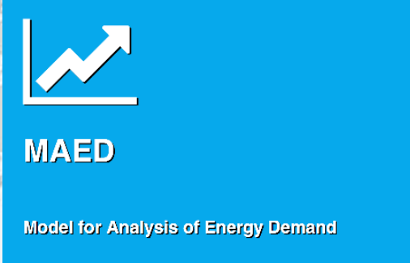

Lecture 1.3 Intro to MAED
1.3.1 What is MAED?
MAED-D
Energy Demand Projections
MAED-EL
Electricity Demand Profile Calculations
12
Notes:
The Model for Analysis of Energy Demand, short for MAED was created by the International Atomic Energy Agency, known as the I.A.E.A.
These models have been developed over many years to make the user’s life easier for reasons outlined in the next slides.
MAED has two components to it: MAED-D and MAED-E.L.
MAED-D considers scenario-based forecasts of future demand by the defined sectors and fuel type.
MAED-E.L. can be used to understand electricity demand profiles.

Slide 13
Lecture 1.3 Intro MAED-D
1.3.2 Model for Analysis of Energy Demand (MAED-D)
It is suitable for modelling the impact of alternative policies for energy use.
MAED allows you to evaluate the impact of technological development.
MAED can be used to model the effect of changes in the lifestyle of society
The scenario approach helps you make conditional assumptions about the future state of your country.
It uses a scenario methodology (simulation approach) based on bottom-up disaggregated data of energy end-use.
13
Notes:
The Model for Analysis of Energy Demand (MAED) is suitable for energy planning in developing countries thanks to the following characteristics:
MAED is suitable for modelling the impact of alternative policies for energy use. For example, the impact of investing in individual car use or mass transit, in electricity or in the direct use of fossil fuels.
MAED allows you to evaluate the impact of technological development. For example, you can model how improvements in efficiency of end-use equipment may impact future demand.
Finally, MAED can be used to model the effect of changes in the lifestyle of society. For example, how increasing the income in households will shape demand.
Its scenario approach, which helps you make conditional assumptions about the future state of your country. The results are therefore always of the conditional type, dependent on the assumptions that the modeller makes.
The scenario approach is one of the main advantages of the model. For example, you can investigate the consequences of different socio-economic development policies for the country, such as different economic growth trajectories, emphasis on industry or agriculture, or development in rural areas.
It uses a scenario methodology (simulation approach) based on bottom-up disaggregated data of energy end-use.

Slide 14
Lecture 1.3 Intro to MAED-D
1.3.3 Main steps to perform a MAED-D Analysis
            Reconstruction of the energy consumption in the base year. Total energy consumption by sectors, by end-use, and by energy carriers.
            Establishing scenarios of economic, social, and technological development.
            Analysis of energy demand projections arising from the scenarios.
Base year reconstruction
Scenario development
Energy demand projections
14
Notes:
The model provides a systematic accounting framework for evaluating the effect on energy demand of a change in economics or in the standard of living of the population.
The starting point for using the MAED model is construction of base year energy consumption patterns within the model.
This requires compiling and reconciling necessary data from different sources, deriving and calculating various input parameters and adjusting them to establish a base year energy balance. We'll learn how to do that later on in this course.
This helps to calibrate the model to the specific situation of the country. The next step is developing future scenarios, specific to a country’s situation and objectives.
The last step is to generate the Energy Demand projections for all the scenarios modelled and proceed with their analysis.

Slide 15
Lecture 1.3 Intro to MAED-D
1.3.4 Intro to Sectors, Sub-Sector, End-Use and Final Energy Form
2050
2025
2020
Final Energy Demand
By sectors
Industry
Transport
Service
Household
End-Uses
Electricity
Fossil Fuel
Motor Fuel
District Heat
Soft Solar
Traditional fuels, Biomass
By category of final energy
15
Notes:
The MAED run is executed to produce energy demand projections from each scenario. The results of MAED provide valuable information for further analysis within the energy planning process.
Energy consumptions are calculated, for each group of end-uses, and are aggregated by energy carriers, by sectors, and subsectors, for each year of the study, including the base year.
The model calculates the results for each year of projection, resulting from the set of scenario assumptions.
This total energy demand projection should not be taken as a certain prediction, but as the result of the, if dot dot dot, then dot dot dot, exercise.
The assumptions both in terms of scenario input data and in terms of the structural limitations of the model should be acknowledged when using the results.
In the upcoming lectures we will analyse each sector with its sub-sectors, end-uses and category of final energy.

Slide 16

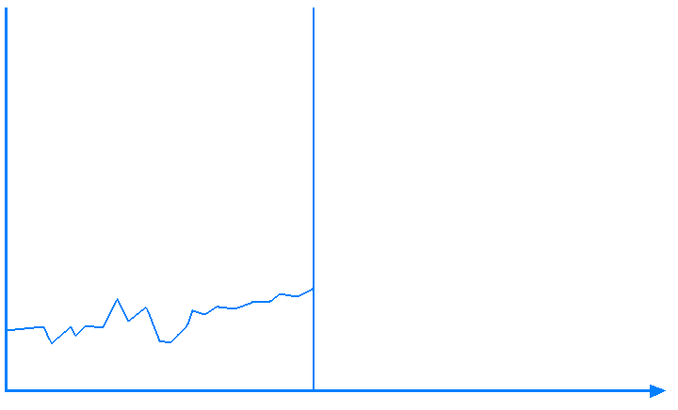


Lecture 1.3 Intro to MAED
1.3.5 Outputs of MAED-D and MAED-EL
5% Growth
2.8% Growth
Historical
Projected
MAED-D
Energy Demand Projections
MAED-EL
Electricity Demand Profile Calculations
Result: Total Electricity
Consumption [kWh] under different scenarios
Result: Hourly load
16
Notes:
The two components of MAED produce different results:
MAED-D evaluates future energy demands based on medium- to long-term scenarios of socio-economic, technological and demographic developments, while
MAED-E.L. forecasts hourly electric power demand for each client, sector, and the entire system based on the input data.

Slide 17
Lecture 1.4
Course outline and objectives
1.4.1 The Intended Learning Outcomes of this Course
You have now had an introduction to why MEAD is important. By the end of this course, you will:
ILO1: understand energy planning and energy system analysis.
ILO2: be able confidently describe the energy chain and use its terminology and definitions.
ILO3: have used MAED-D to produce a simple case-study for an ideal country and generate scenario-based predictions of future energy demand
ILO4: be able to operate MAED-EL to generate hourly load curves.
21
Notes:
You have now had an introduction to MEAD is important. By the end of this course you will:
understand energy planning and energy system analysis.
be able confidently describe the energy chain and use its terminology and definitions.
have used MAED-D to produce a simple case-study for an ideal country and generate scenario-based predictions of future energy demand
be able to operate MAED-EL to generate hourly load curves.

Slide 18
Lecture 1.4
Course outline and objectives
1.4.2 Course Structure
Lecture (Learn the theoretical concepts)
Hands-on
Hands-on exercises
(Learn how to use the tool)
Mini-lecture 1
Mini-lecture 2
Mini-lecture 3
Mini-lecture 4
Quiz
Quiz
18
Notes:
The course is structured as a mixture of Lectures and Hands-on material.
Each lecture is split into 4 mini-lectures with two multiple choice questions at the end of each Lecture that will assess your knowledge of the theoretical concepts explained.
Every hands-on guides you through exercises to help you become familiar with the MAED tool. At the end of the exercises there will be quizzes to check that you correctly completed the practical part of the training.

Slide 19
Lecture 1.4
Course outline and objectives
1.4.3 The Lectures
Lecture 1 – Intro to SGDs, Energy Planning and the MAED Tool
Lecture 2 – Overview of Modelling Tools and Energy System Analysis
Lecture 3 – The Energy Chain
Lecture 4 – Intro to MAED-D
Lecture 5 – The Industry Sector & Input Data
Lecture 6 – The Household Sector & Input Data
Lecture 7 – Transport and Service Sectors & Input Data
Lecture 8 – Input Data Consistency and Structure
Lecture 9 – Introduction to Maed-EL & Electricity Demand Curves
Lecture 10 – MAED-EL Structure
19
Notes:
After this Lecture introducing the course,
Lecture 2 will provide an Overview of Modelling Tools and Energy System Analysis
Lecture 3 will cover The Energy Chain and Energy Vocabulary
Lecture 4 is an Introduction to MAED-D
In Lecture 5 Energy System Analysis presents the Industry Sector and its Input Data.
Lecture 6 explains the Household Sector and the necessary input data.
In Lecture 7 the scenarios development process is highlighted.
An introduction to MAED-E.L. is covered in Lecture 9.
And finally the structure of MAED-E.L. is explained in Lecture 10.

Slide 20
Lecture 1.4
Course outline and objectives
1.4.4 The Hands-on
Hands-on 1 – MAED Software Installation
Hands-on 2 – Setting Up the Structure Part I
Hands-on 3 – Setting Up the Structure Part II
Hands-on 4 – Define the Transport Sector, Configure End Uses.
Hands-on 5 – Reconstruction of Base Year: General Information, Socio-Economic, and Industry (Agriculture)
Hands-on 6 – Reconstruction of Base Year: Manufacturing and Household Sector
Hands-on 7 – Entering Scenario Data for the Case-Study
Hands-on 8 – MAED-EL Input Data Preparation
Hands-on 9 – Inputting Data to MAED-EL
Hands-on 10 – Reviewing Results in MAED-EL
19
Notes:
In Hands-on 1, you will learn how to access and install MAED
Hands-on 2 will show you how to set create, manage and edit a simple case-study in MAED-D
Hands-on 3 explains how to reconstruct the Base Year for the Agriculture Sector;
While In Hands-on 4, will illustrate how to repeat the reconstruction for the Household Sector;
Hands-on 5 gives guidance on how to create scenarios for your simple MAED case-study.
In Hands-on 6, will teach you how to install MAED-EL and finally in Hands-on 7 you will learn how to develop a case-study and input data into MAED-EL.

Slide 21

Cannone, C., Collett, K.A., Charbonnier F., Ahsan A., Halloran C., Vijay,A.,Berdellans I., Hasanovic S., Gritsevskyi A,Stankeviciute L., Tot M.; Welsch M., Hirmer S., 2023. Lecture 1: "COURSE INTRODUCTION TO MAED" , Energy Demands Projections with MAED (Model for Analysis of Energy Demand). Release Version 2.0. [online presentation]. Climate Compatible Growth & Programme and International Atomic Energy Agency.
CCG courses (this will take
you to the website link http://www.ClimateCompatibleGrowth.com/teachingmaterials)
23

