Slide 1

8. Scenario Development
Produced in partnership with the International Atomic Energy Agency (IAEA)
Notes:
Licence: This work is licensed under the Creative Commons Attribution 4.0 International License (CC BY 4.0). To view a copy of this license, visit https://creativecommons.org/licenses/by/4.0/.
Attribution: Please cite as: Kiley, F. (2025) An Introduction to Simulating Energy Demand with MAED. Version 1. Climate Compatible Growth Teaching Kit Website, Climate Compatible Growth.

Slide 2

What Are Scenarios
Scenarios are not predictions or forecast
Scenarios are description of images of future created from mental maps or models
Notes:
Prediction refers to the act of making an assertion about a future event based on current data and trends. It often relies on statistical models, historical data, and algorithms to estimate outcomes. Predictions can be quantitative, such as forecasting sales figures, or qualitative, such as anticipating consumer behavior changes. The accuracy of predictions largely depends on the quality of the data used and the methods applied.

Slide 3
Qualitative and Quantitative Scenarios
Qualitative scenarios are based on narratives, like stories, qualitatively describing the future state of a system.
Quantitative scenarios are quantified description about temporal states of a system and consequences of actions taken by different players.

Slide 4
Quantitative Description
Driving Parameter
Energy Intensity
Useful Energy Demand
Useful Energy Demand
Penetration
1/Efficiency
Final Energy Demand
Change input parameters to create scenarios

Slide 5
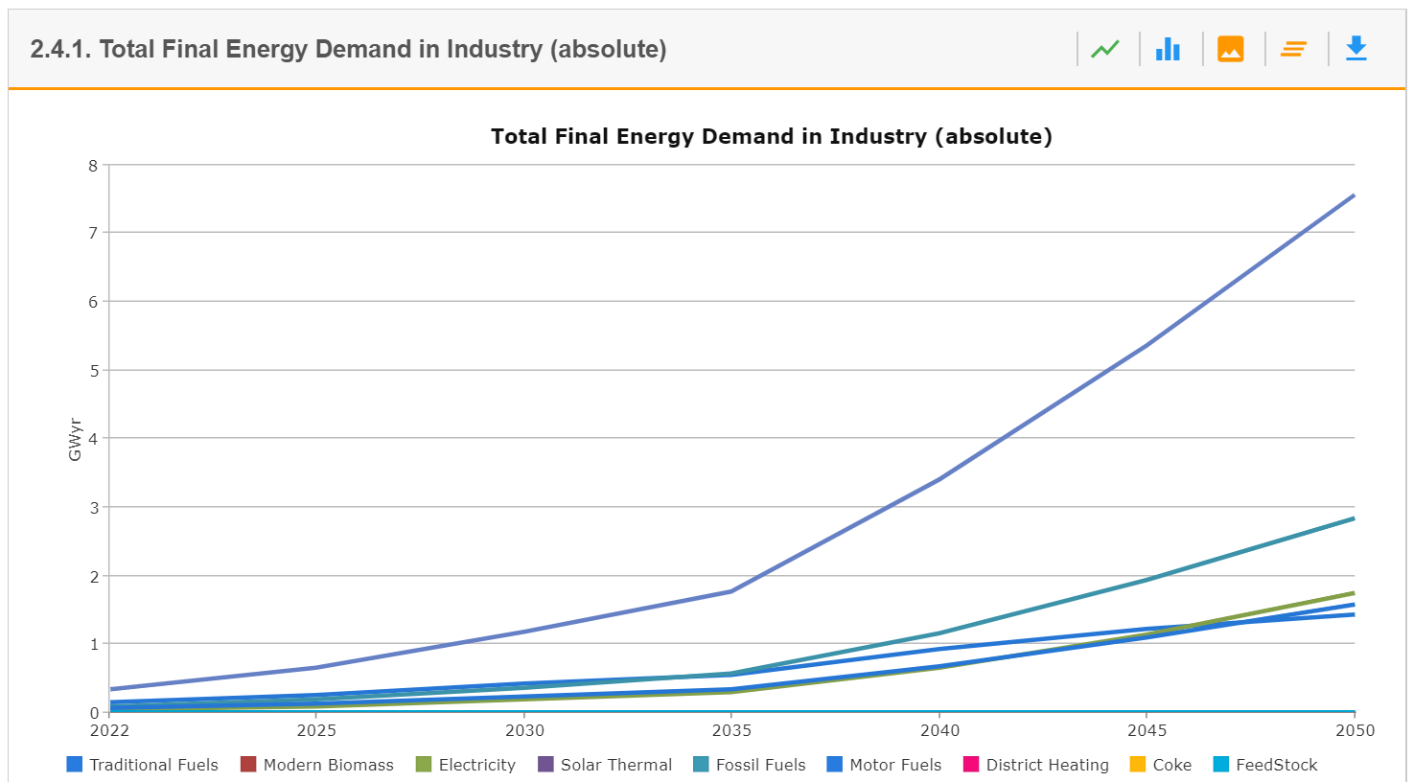
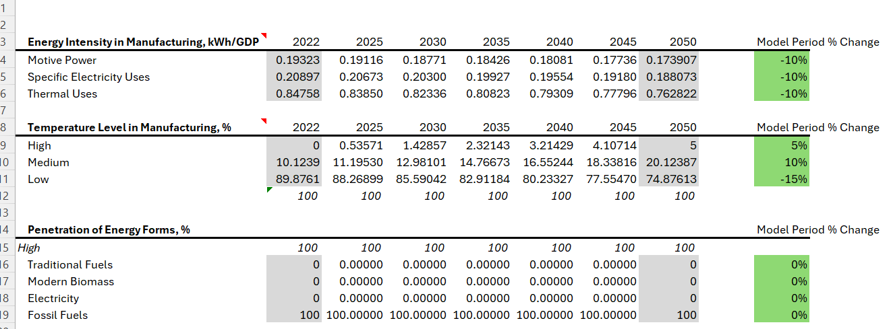
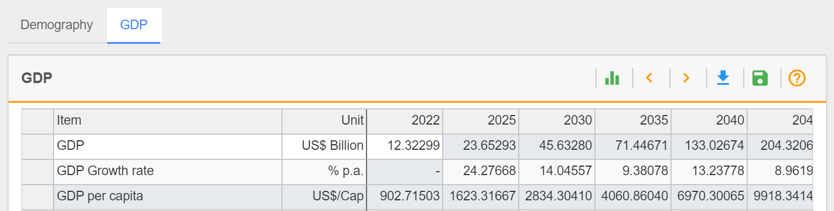
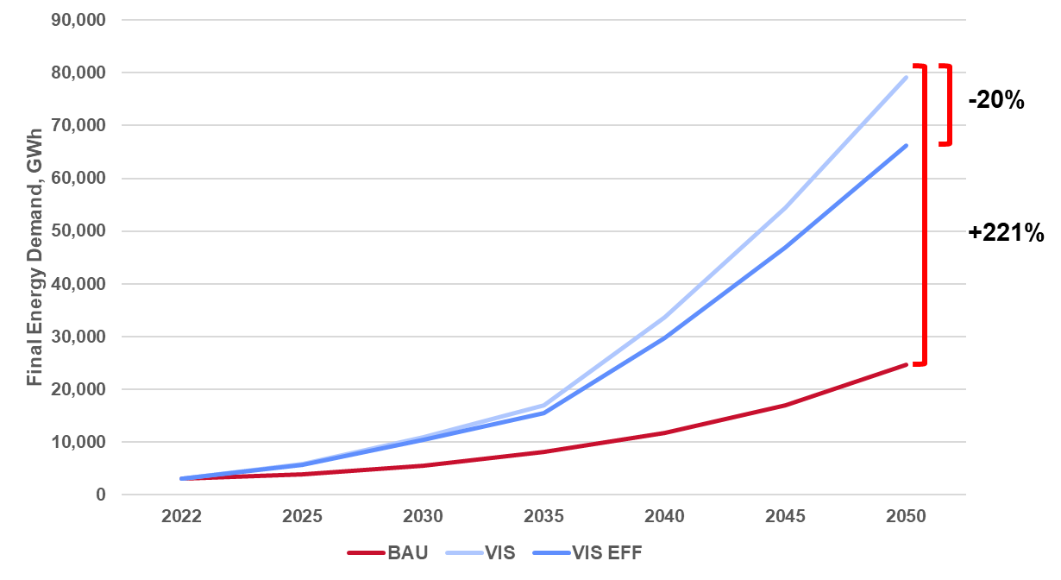
Scenario Construction Workflow
Policy Research
Define Narrative
Translate Narrative
Input Data into MAED
Run and Verify Results
Analyse and Interpret Results

Slide 6
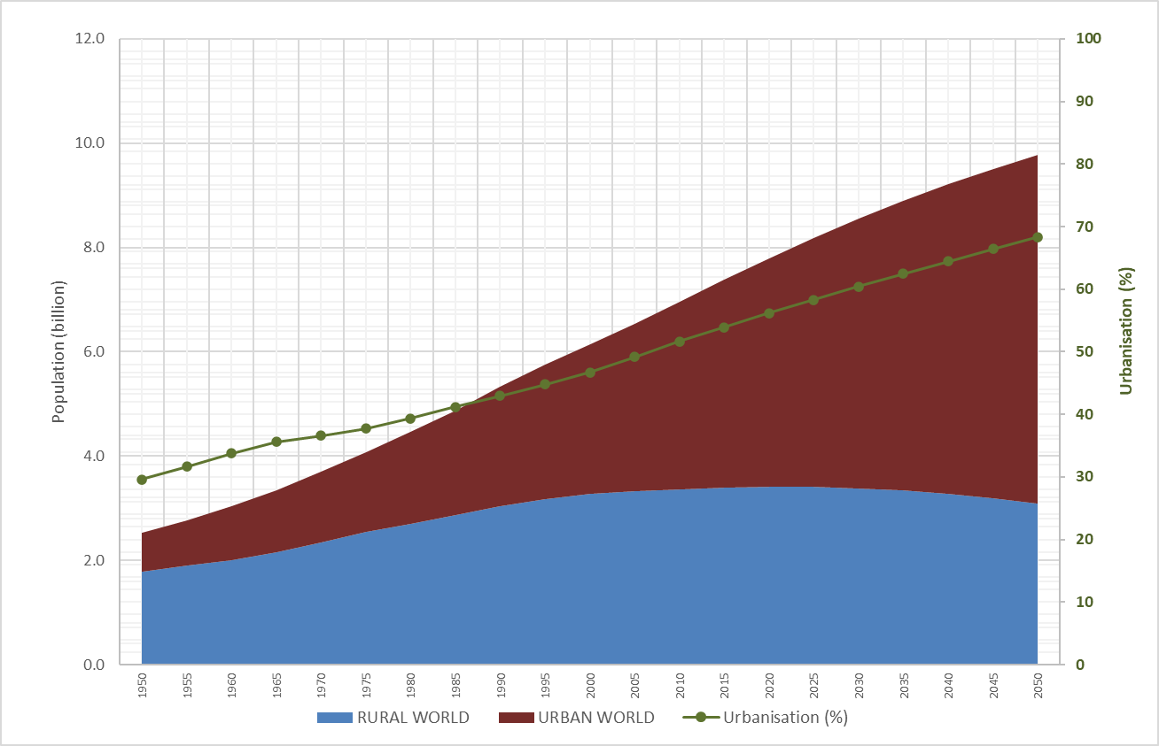
Global Trend in Population and Urbanisation
Source: https://population.un.org/wup/downloads

Slide 7
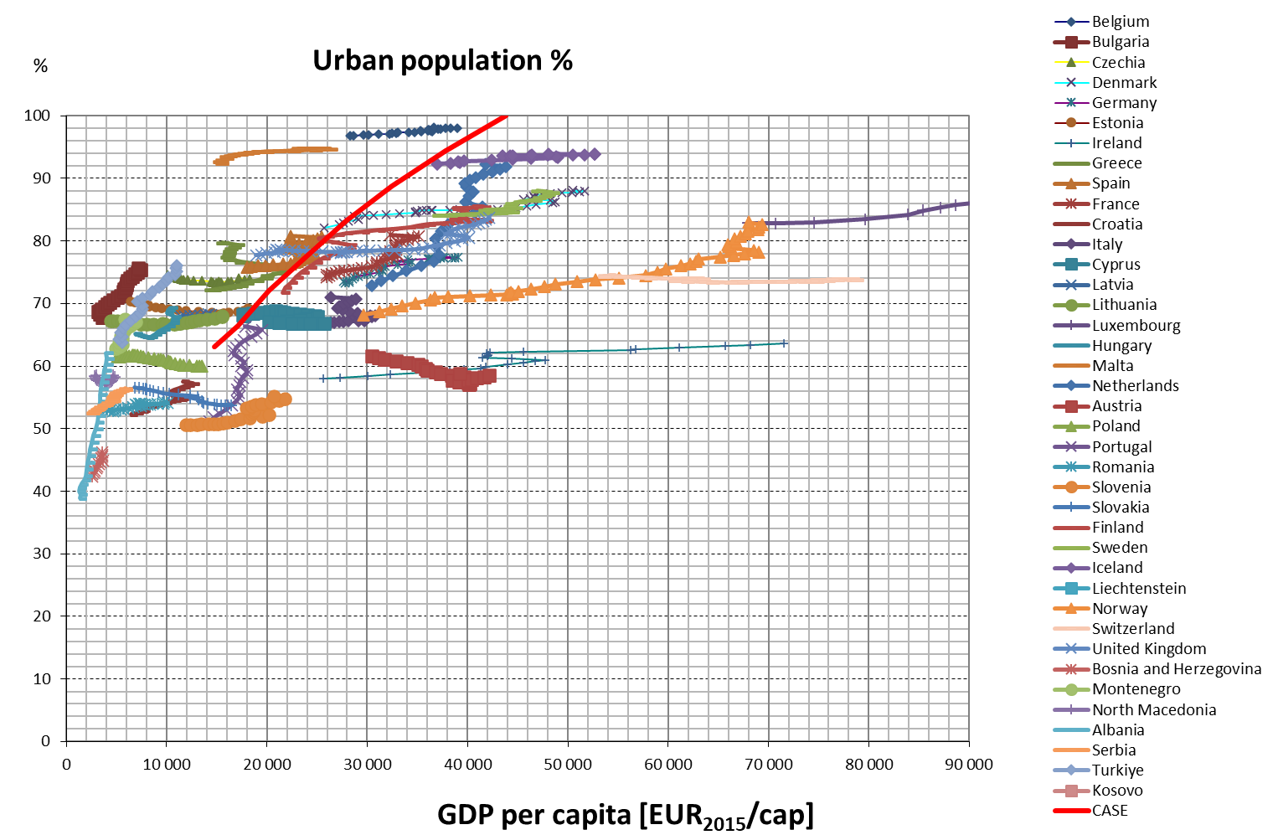
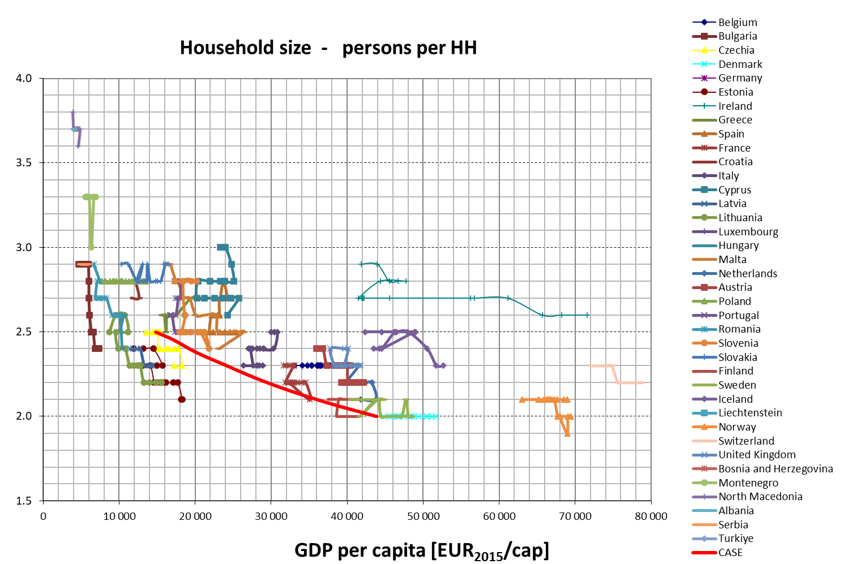
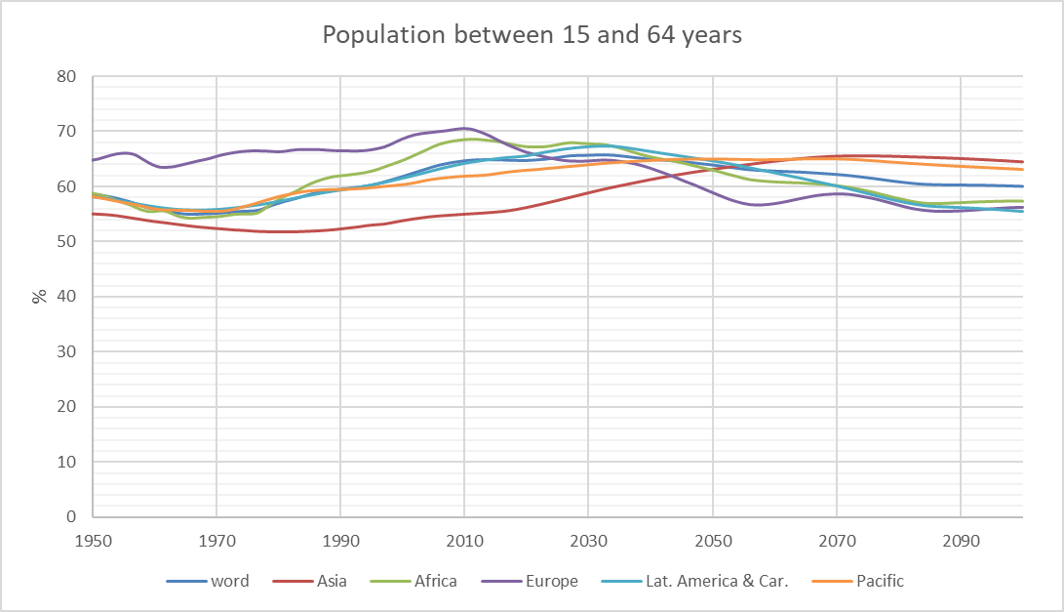
Other Demographic Trends

Slide 8
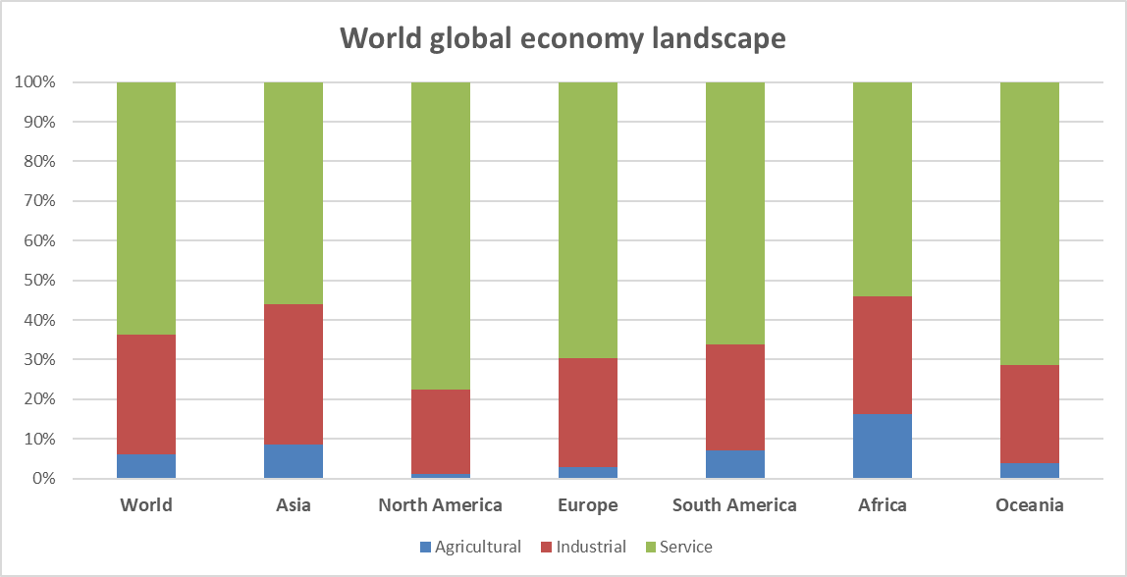
Structural Changes in the Economy
Source: https://en.wikipedia.org/wiki/World_economy

Slide 9
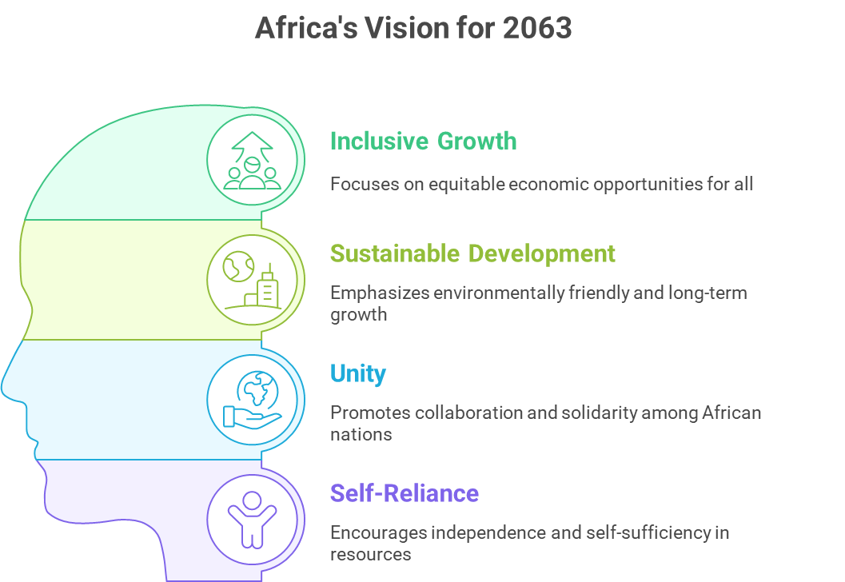

Which Targets for Given Policies?
Notes:
The SDGs, adopted by all United Nations Member States in 2015, consist of 17 goals that address various global challenges, including poverty, inequality, climate change, environmental degradation, peace, and justice. Each goal has specific targets and indicators that countries are encouraged to achieve by 2030.
Agenda 2063 is Africa's blueprint for achieving inclusive and sustainable development. It envisions a prosperous Africa based on inclusive growth and sustainable development, with a strong emphasis on unity and self-reliance.
Countries often develop strategic documents that outline their specific goals, objectives, and action plans to achieve national development. These documents should align with both the SDGs and Agenda 2063 to ensure a coherent approach to development.

Slide 10
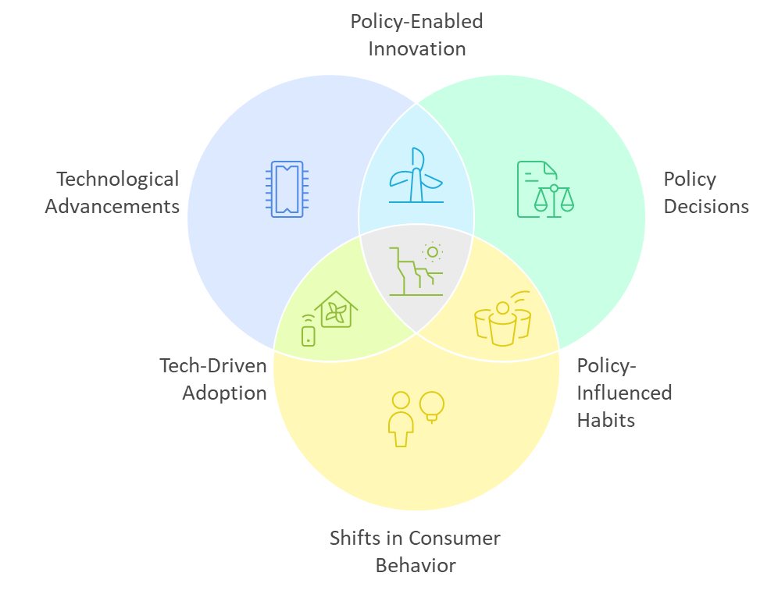
The Evolution of Energy Intensity
Notes:
Energy intensity is a vital indicator of how effectively an economy utilizes energy resources. It reflects the relationship between energy consumption and economic activity, and its future trajectory will be influenced by technological advancements, policy decisions, and shifts in consumer behavior.

Slide 11
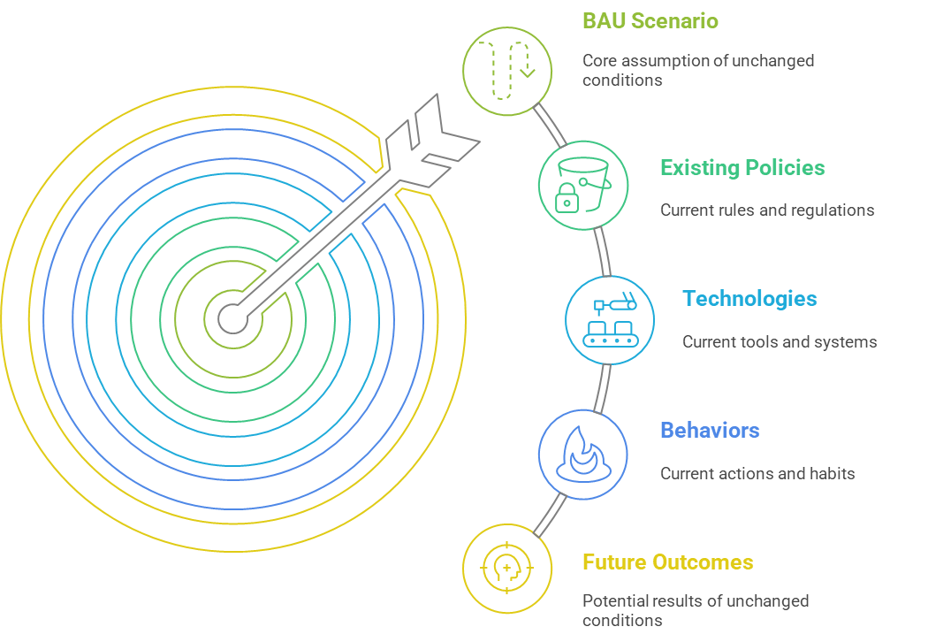
Business as Usual (BAU) Scenario
Notes:
The BAU scenario serves as a benchmark against which other scenarios can be compared. It typically assumes that existing policies, technologies, and behaviors will persist over time. In this context, the BAU scenario helps stakeholders understand the potential future outcomes if no new actions are taken to alter the current trajectory.
The Business As Usual (BAU) scenario is a concept often used in various fields such as economics, environmental studies, and strategic planning. It represents a baseline or reference case that assumes current trends and practices will continue without significant changes or interventions.

Slide 12
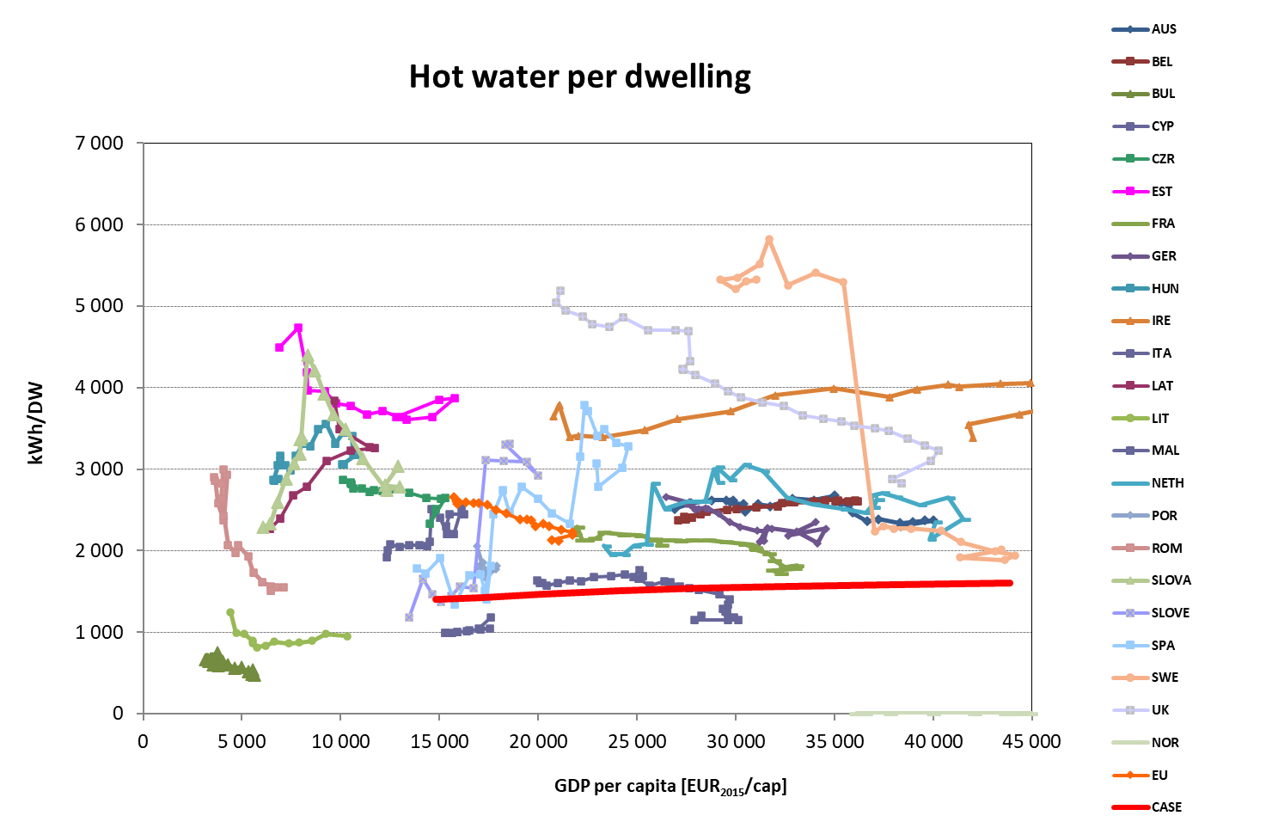
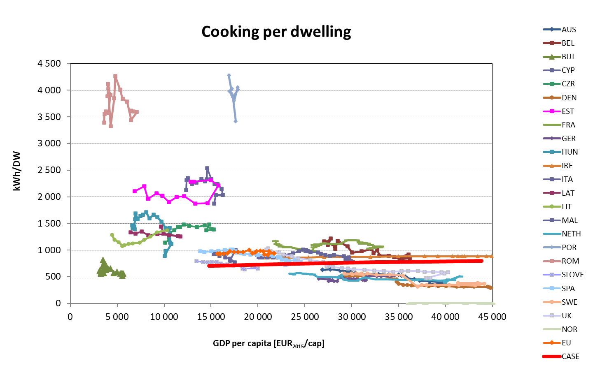
Trends in Households

Slide 13
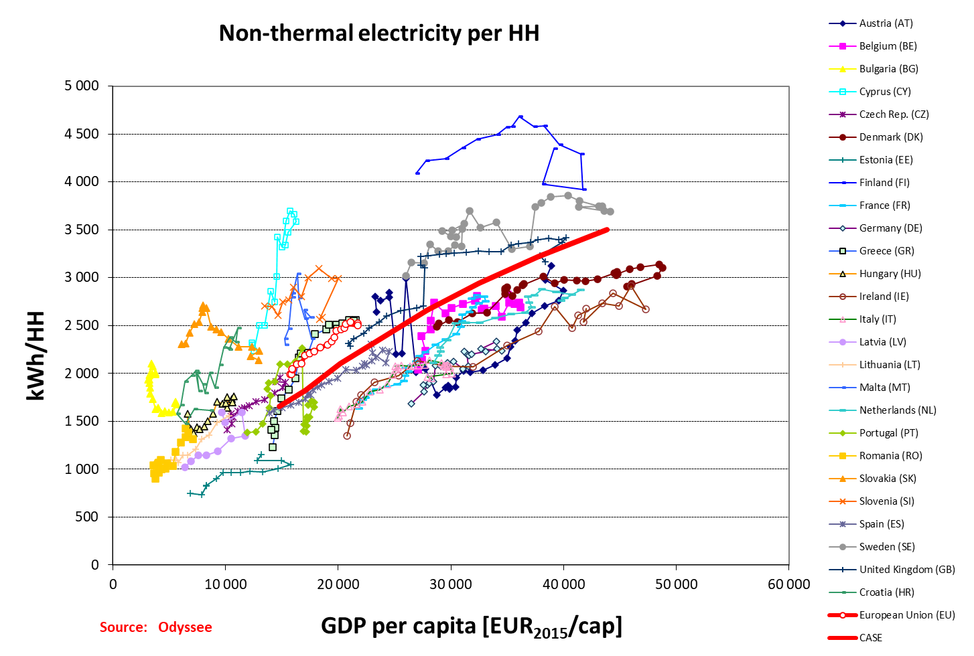
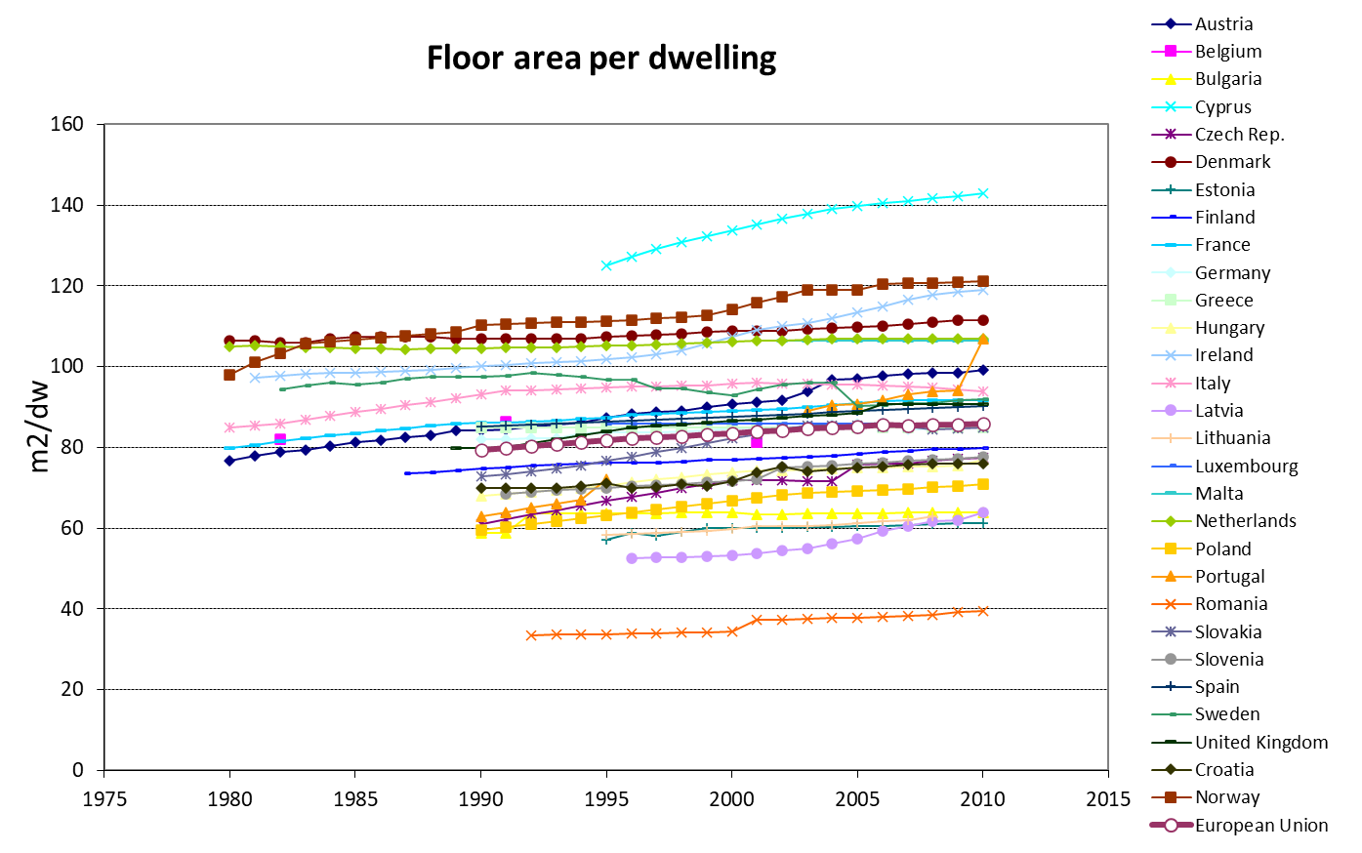
More Trends in Households

Slide 14
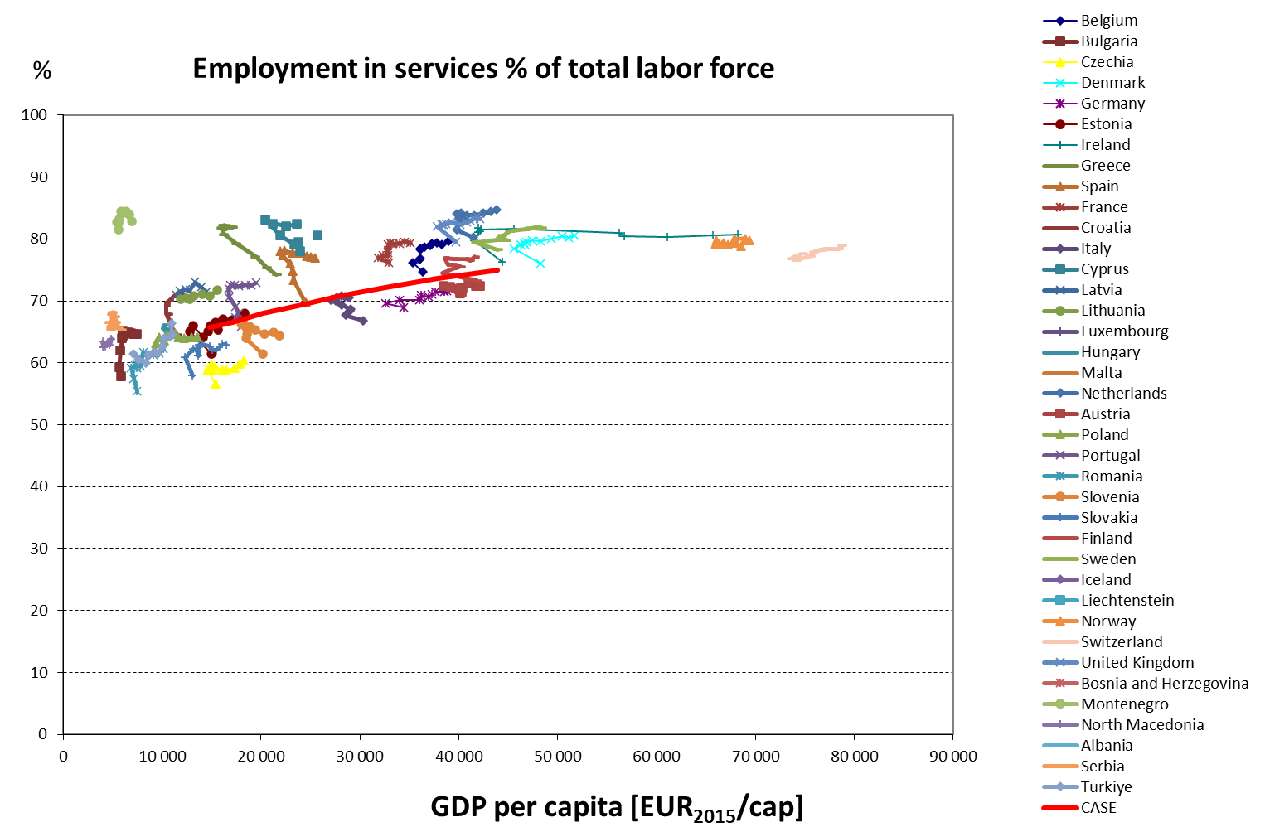
Trends in Services

Slide 15
Example of Policies
Sector | Policy
Agriculture | Mechanisation Promotion of off-season agriculture Shift towards alternative crops/livestock
Construction | Reduction in labour intensity of projects through mechanisation
Mining | Modernisation of equipment used
Manufacturing | Promotion of thermal energy efficiency Shift towards less energy intense industries
Household | Improve access to clean cooking Improved energy efficiency in households Improved access to electricity
Services | Modernisation of technical equipment Improve thermal insulation of buildings
Passenger Transport | Promoting the use of public transport Electrifying the car fleet
Freight Transport | Promotion of high load factor for long distance trucks
All sectors | Net zero by 2050

Slide 16
Interpreting and Presenting Results
Understand Narratives
Draft the storyline and elements of each scenario
Contextual Analysis
Evaluate scenarios within broader trends and conditions
Identify Implications
Determine the potential impacts and outcomes of scenarios
Communicate Insights
Share findings with stakeholders for informed decision-making

Slide 17
Sensitivity Analysis
Identifying Influential Variables
Pinpointing variables significantly impacting model results.
1
2
Assessing Model Robustness
Evaluating model stability under varying conditions.
Sensitivity Analysis
Analyzing model output by varying input variables.
3
Understanding Model Reliability
Determining model consistency and dependability.
4
Managing Uncertainty
Addressing uncertainties in model parameters effectively.
Notes:
Sensitivity analysis is a powerful tool that enhances our understanding of complex systems by revealing the relationships between input variables and outputs.
Sensitivity analysis involves changing one or more input variables in a model to observe the effect on the output. By systematically varying inputs, analysts can identify which variables have the most influence on the results, thereby providing insights into the robustness and reliability of the model. This technique is particularly useful when dealing with uncertainty in model parameters.

Slide 18
Quality Check for Useful Scenarios
Transparency
Consistency
Plausibility
All assumptions should be clearly stated and sources of data clearly cited
The set of assumptions should be internally consistent
The images of the future should be plausible and grounded in sound logic

Slide 19
Thank you
www.climatecompatiblegrowth.com
Produced in partnership with the International Atomic Energy Agency (IAEA)

