Slide 1

5. Transport
Produced in partnership with the International Atomic Energy Agency (IAEA)
Notes:
Licence: This work is licensed under the Creative Commons Attribution 4.0 International License (CC BY 4.0). To view a copy of this license, visit https://creativecommons.org/licenses/by/4.0/.
Attribution: Please cite as: Kiley, F. (2025) An Introduction to Simulating Energy Demand with MAED. Version 1. Climate Compatible Growth Teaching Kit Website, Climate Compatible Growth.

Slide 2
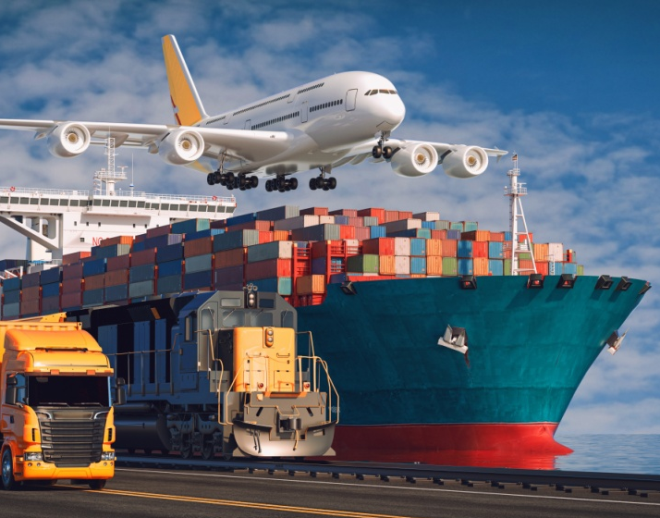
Contents
5.1 Overview and Structure
5.2 Freight
5.3 Urban
5.4 Intercity
5.5 International

Slide 3
5.1 Overview and Structure

Slide 4
Overview of the Transport Sector
income, value-added and tax revenue
Employment
Trade & supply-chain
Mobility & social inclusion
Globally worth ≈ USD 6.8 trillion in 2021 – about 7 % of world GDP (Transport in focus REN21)
Roughly 193 million people (5.6 % of the global workforce) were employed in transport and warehousing in 2021
Without reliable, affordable freight, supply chains is affected, and prices rise in all sectors.
Access to jobs, education, health care and culture. → high rural incomes and school attendance (World Bank rural-roads studies).
In short, transport is very useful for a modern economy and society—when it flows smoothly, prosperity and inclusion grow; when it clogs, everyone feels the pain.

Slide 5
Challenges
GHG emissions
Traffic congestion
Transport sector contributes ~16% of global GHG emissions
The grow of motoriasation goes with challenges of roads expansion and strategy of organising transport

Slide 6
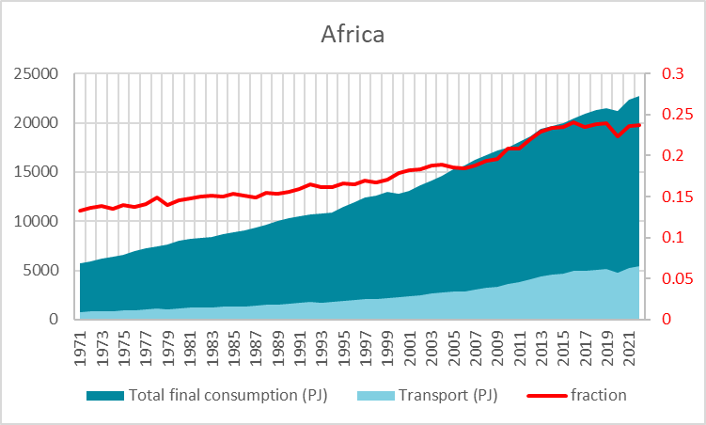
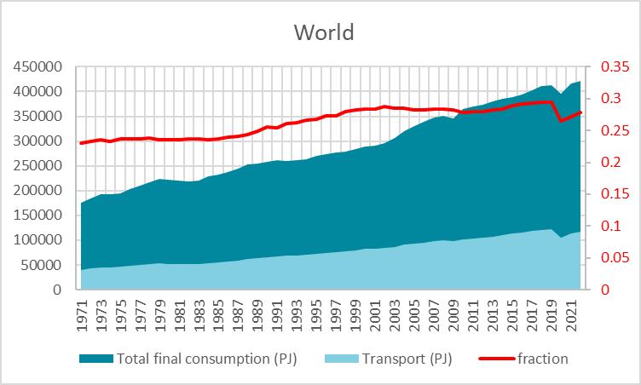
Energy Demand in Transport Grows in Line with Development
25%
Service Sector
Transport sector
30%
Because of its importance, it is treated particularly and more accurately in MAED

Slide 7
Transport Structure in MAED
Transport Sector
Freight
Intercity
Urban
International & other
Passenger

Slide 8
Transport Structure in MAED
Freight
Intercity
Cars
Public transportation
Urban
Cars
Passenger
Trucks
Train
Boat
Freight activity
Public modes
International
International activity
Train
Boat
Plane
Sectors and subsectors
Modes
Motor fuels
Diesel
Gasoline
Electricity
Jet Fuel

Slide 9
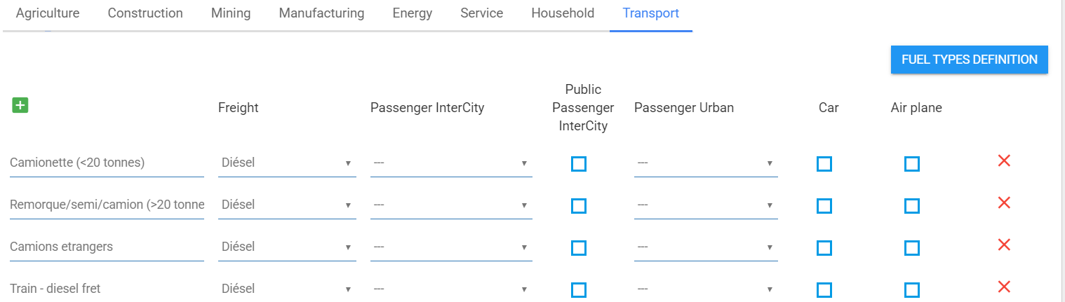
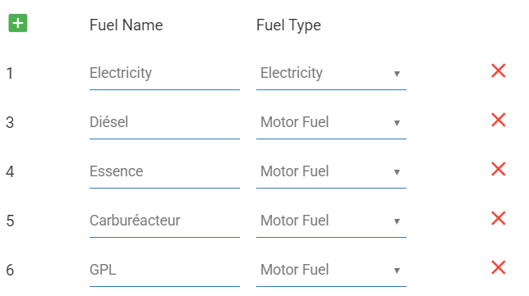
Transport Structure in MAED

Slide 10
5.2 Freight Transport

Slide 11
Freight Transport Equations
Final Energy Demand
Share of mode I, %
Final energy demand, mode I
$$ECFT\left(i\right)=TKFT×SFTM(i)×EIFT(i)$$
Activity (useful demand), 10^9 t-km
Energy intensity of mode I, kWh/100 t-km

Slide 12
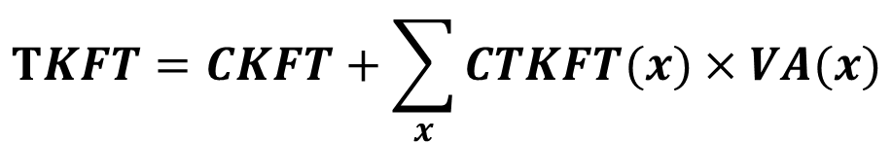
Freight Transport Equations
Useful Energy Demand / Activity
Gradient of the curve, t-km/GDP
Activity (useful demand), 10^9 t-km
$$TKFT=CKFT+\sum_{x}{CTKFT(x)}×VA(x)$$
Intercept of the curve, 10^9 t-km (base value)
Value Added of subsector i

Slide 13
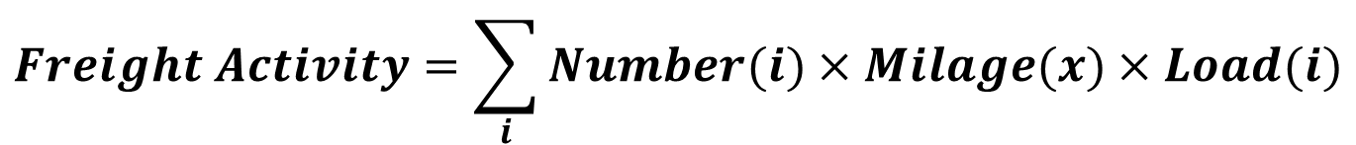
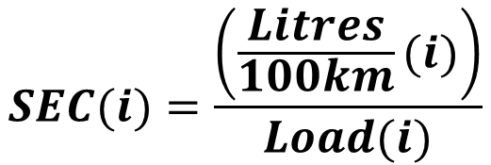
Freight Transport Equations
Activity, Model Split, and SEC
$$Freight Activity=\sum_{i}{Number(i)}×Milage(x)×Load(i)$$
t-km
km
ton
$$Modal Split(i)=\frac{Number (i)×Milage(i)×Load(i)}{\sum_{i}{Number(i)}×Milage(i)×Load(i)}$$
$$SEC(i)=\frac{\left(\frac{Litres}{100km}(i)\right)}{Load(i)}$$
Litres/100t-km
i=freight transport mode

Slide 14
5.3 Urban Transport

Slide 15

Urban Transport Demography
Total Population
Urban Population
Population in large Cities (with public transport)
Urban Transportation
$$POPLC=\frac{Population in large cities}{Total population}$$

Slide 16
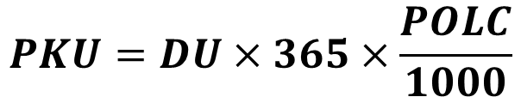
Urban Transport Equations
Activity (Useful Energy Demand)
Average daily distance travelled per person, km
Population living in cities with public transport
$$PKU=DU×365×\frac{POLC}{1000}$$
Activity, 10^9 p-km
Passenger transportation in cities with public transport system
  The public transport system can already exist or be planned
The average daily distance travelled represents a normal behaviour (for example: commuting to/from work, going for daily shopping, etc.)

Slide 17

Urban Transport Equations
Activity by Mode
Total Activity, 10^9 p-km
$$PKUTM(j)=PKU×SUMT(j)$$
Share of transport mode j
Activity by mode j, 10^9 p-km
  The user can define as many transport modes and fuel types as needed
  If there are similar transport modes that use different fuels (for example, cars using gasoline, diesel or electricity), each of these needs to be defined as a separate transport mode

Slide 18
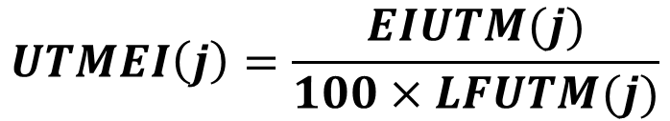
Urban Transport Equations
Energy Intensity
Energy intensity mode j, kWh/100km
$$UTMEI\left(j\right)=\frac{EIUTM(j)}{100×LFUTM(j)}$$
Energy intensity mode j, energy unit/p-km
Load factor mode j
  The user must define for each transport mode one type of fuel and specific energy consumption (energy intensity) in energy units/100 km.
  MAED converts the energy intensity per 100 km to energy intensity per p-km using the load factor of the transport mode

Slide 19
Urban Transport Equations
Final Energy Demand
Activity mode j, 10^9 p-km
$$ECUTM\left(j\right)=PKUTM(j)×UTMEI(j)$$
Final energy demand mode j, energy units
Energy intensity mode j, energy units/p-km
  The final energy demand is calculated per each transport mode using the previously described parameters of:
        energy intensity
        share of transport mode
        total activity

Slide 20
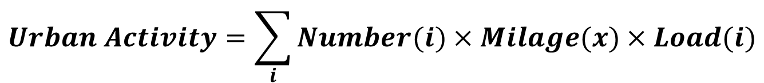
Urban Transport Equations
Activity, Modal Split, Distance Travelled
$$Urban Activity=\sum_{i}{Number(i)}×Milage(x)×Load(i)$$
p-km
km
Pass/vehicle
$$Modal Split(i)=\frac{Number (i)×Milage(i)×Load(i)}{\sum_{i}{Number(i)}×Milage(i)×Load(i)}$$
P-km
$$Distance travelled per day=\frac{urban activity}{Population in Large Cities×365}$$
km
i=urban passenger mode

Slide 21
5.4 Intercity Transport

Slide 22
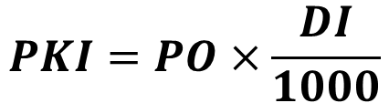
Intercity Transport Equations
Activity
Total population, millions
Distance Travelled per person per year, km
$$PKI=PO×\frac{DI}{1000}$$
Activity, 10^ p-km

Slide 23

Intercity Transport Equations
Private vs Public
Total activity, 10^9 p-km
$$PKIP=PKI−PKIC$$
Public activity, 10^9 p-km
Private activity, 10^9 p-km
  Activity is split between Public and Private modes
  In MAED 2.0, private transportation in intercity refers to CARS, all other modes can be represented in Public to capture specific load factors.

Slide 24
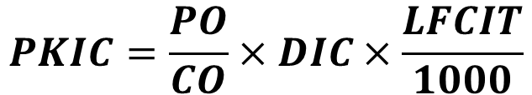
Intercity Transport Equations
Private Activity
Total population, millions
Car load factor
$$PKIC=\frac{PO}{CO}×DIC×\frac{LFCIT}{1000}$$
Private activity, 10^9 p-km
Inverse of car ownership, people per car
Average distance travelled per car

Slide 25


Intercity Transport Equations
Activity by Mode
Private activity, 10^9 p-km
Private
$$PKICT(i)=PKIC×SITC(i)$$
Private activity by mode, 10^9 p-km
Share of mode
Public activity, 10^9 p-km
Public
$$PKIPM(i)=PKIP×SITM(i)$$
Public activity by mode, 10^9 p-km
Share of mode

Slide 26

Intercity Transport Equations
Energy Intensity
Energy intensity mode j, kWh/100km
$$UTMEI\left(j\right) = \frac{EIUTM\left(j\right)}{100∗LFUTM(j)}$$
Energy intensity mode j, kWh/p-km
Load factor mode j
  For airplanes, energy intensity is expressed in natural units per 1000 seat-km

Slide 27

Intercity Transport Equations
Final Energy Demand
Activity by mode, 10^9 p-km
$$ECITM(i)=PKITM(i)×ITMEI(i)$$
Energy demand by mode, energy units
Energy intensity by mode, energy units/p-km

Slide 28
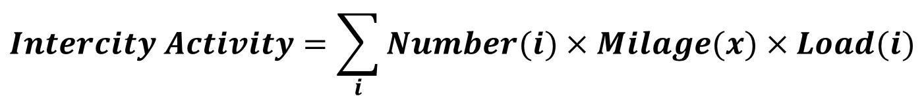
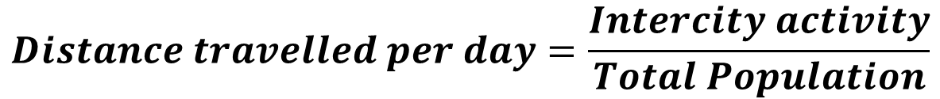
Intercity Transport Equations
Activity, Modal Split, Distance Travelled
$$Intercity Activity=\sum_{i}{Number(i)}×Milage(x)×Load(i)$$
p-km
km
Pass/vehicle
$$Modal Split(i)=\frac{Number (i)×Milage(i)×Load(i)}{\sum_{i}{Number(i)}×Milage(i)×Load(i)}$$
p-km
$$Distance travelled per day=\frac{Intercity activity}{Total Population}$$
km
i=Intercity passenger mode

Slide 29
Intercity Workflow Reminder
Raw Data
MAED Inputs
Result
Total Vehicle Stock, no.
Intercity Vehicle Stock, no.
Demand per Vehicle, Mio veh-km/year
Demand per Passenger, Mio p-km/year
Final Energy Demand, kWh
Conversion factor
Fraction of Stock for Urban and Intercity, %
Annual Milage, km/veh
Load Factor, pass/veh
Modal Split, %
Energy Intensity, kWh/100km
Vehicle efficiency, e.g. l/100 km
% occupation
kWh/1000 seat km

Slide 30
Continued…
Raw Data
MAED Inputs
Total Vehicle Stock (cars), no.
Total Vehicle Stock (cars), no.
Demand per Passenger, Mio p-km/year
Distance Travelled by Car, km/car/year
Car Ownership, pers/car
Distance Travelled, km/pers/year
Demand per Vehicle, Mio veh-km/year
Total Population, no.
Total Population, no.

Slide 31
5.5 International Transport

Slide 32
International Transport Equation
Final Energy Demand
Line intercept, energy units
Total GDP, monetary units
$$TMFMIS=Coef\left(1\right)+Coef(2)×GDP)$$
Final Energy demand, energy units
Curve of the slope, energy unts/monetary unit

Slide 33
Thank you
www.climatecompatiblegrowth.com
Produced in partnership with the International Atomic Energy Agency (IAEA)

