Slide 1

7. Service
Notes:
Licence: This work is licensed under the Creative Commons Attribution 4.0 International License (CC BY 4.0). To view a copy of this license, visit https://creativecommons.org/licenses/by/4.0/.
Attribution: Please cite as: Kiley, F. (2025) An Introduction to Simulating Energy Demand with MAED. Version 1. Climate Compatible Growth Teaching Kit Website, Climate Compatible Growth.

Slide 2

Contents
7.1 Structure and Driving Parameters
7.2 Equations

Slide 3
5.1 Overview and Driving Parameters

Slide 4
MAED Structure
Energy consumer sector
Economic sector
(GDP structure)
Industry
Agriculture
Transport
Household
Services
Construction
Mining
Manufacturing
Service (including transport)
Energy

Slide 5
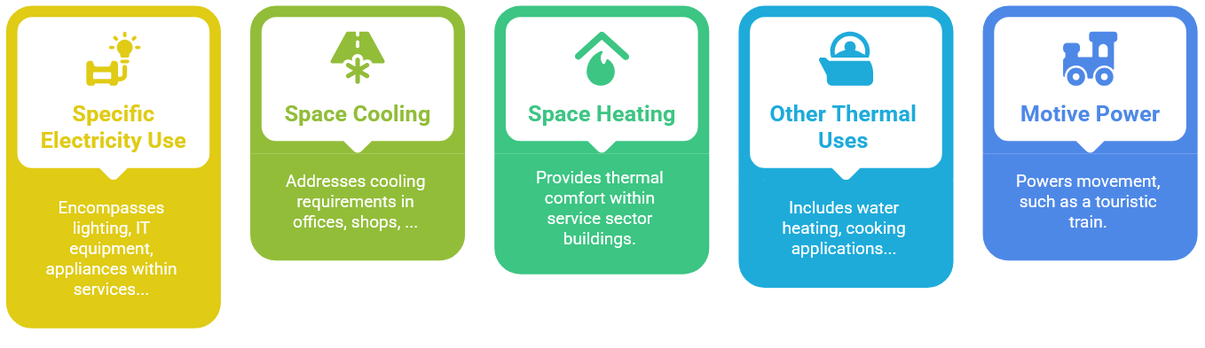
End Uses in the Service Sector

Slide 6
Energy Demand in Service
Sub Sector 1
Sub Sector 2
Sub Sector 3
…
Motive Power
Thermal Uses
Specific Electricity Uses
Air Conditioning
Space Heating
End Use
Motor Fuels
Heat Pump
Electricity
Fossil Fuels
Energy Carrier
Solar Thermal
Modern Biomass
Traditional Fuels
District Heat

Slide 7
Driving Parameters
Motive Power
Thermal Uses
Specific Electricity Uses
Air Conditioning
Space Heating
Contribution of Sector/Sub-sector to GDP (VA)
Total floor area of service sector

Slide 8
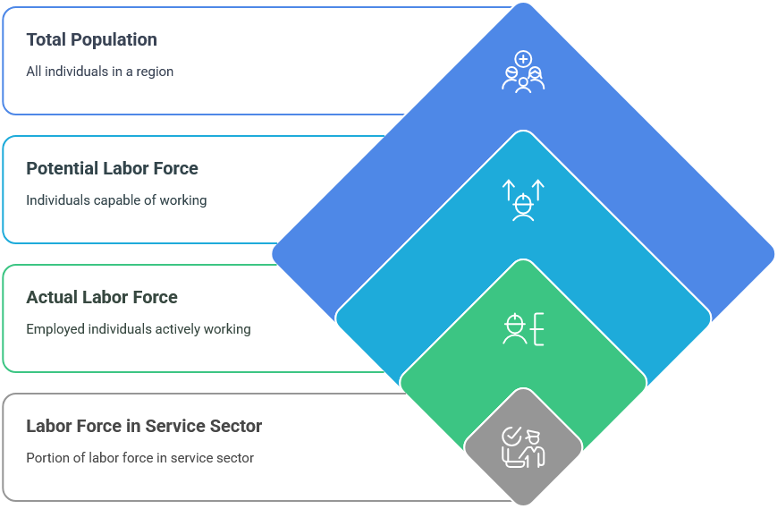
Defining the Labour Force

Slide 9
5.2 Equations

Slide 10
Equations in the Service Sector
Floor Area
Fraction of Potential Labour Force
Fraction of labour force in service sector
Total service sector floor area
$$TAREA=PO×PLF×PARTLF×PLSER×AREAL$$
Total Population
Fraction of actual labour force
Average floor area per employee

Slide 11
Equations in the Service Sector
Useful Demand for Space Heating
Fraction of service sector where SH required
Useful energy demand space heating
Specific energy requirements for SH
$$SHSER=TAREA×ARSH×AREAH×SSHE$$
Service sector floor area
Fraction of sector actually heated

Slide 12
Equations in the Service Sector
Useful Demand for Air Conditioning
Useful energy demand air conditioning
Fraction of service sector where AC required
$$ACSER=TAREA×AREAAC×SACR$$
Service sector floor area
Specific energy requirements for AC

Slide 13
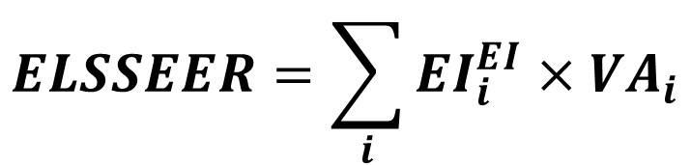
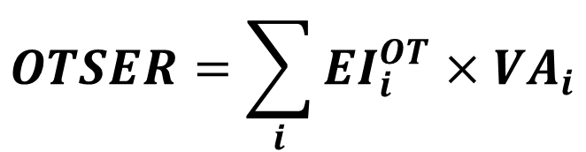
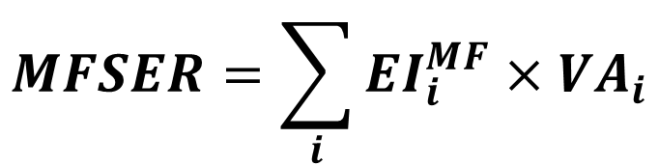
Equations in the Service Sector
Other End Uses
$$OTSER=\sum_{i}{{EI}_{i}^{OT}×VA_{i}}$$
Other Thermal
$$ELSSEER=\sum_{i}{{EI}_{i}^{EI}×VA_{i}}$$
Specific Electricity Uses
$$MFSER=\sum_{i}{{EI}_{i}^{MF}×VA_{i}}$$
Motive Power
Value added
Final/Useful Energy demand
Energy Intensity
i = subsector

Slide 14
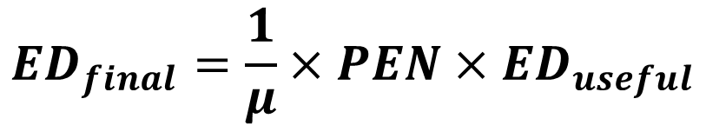
Equations in the Service Sector
Useful and Final Energy
Penetration of energy form
$${ED}_{final}=\frac{1}{μ}×{PEN×ED}_{useful}$$
Efficiency
70%
Process Heat
Electricity
Electric Heater
Fossil Fuels
Boiler
30%

Slide 15
Thank you
www.climatecompatiblegrowth.com

