Slide 1

6. Households
Notes:
Licence: This work is licensed under the Creative Commons Attribution 4.0 International License (CC BY 4.0). To view a copy of this license, visit https://creativecommons.org/licenses/by/4.0/.
Attribution: Please cite as: Kiley, F. (2025) An Introduction to Simulating Energy Demand with MAED. Version 1. Climate Compatible Growth Teaching Kit Website, Climate Compatible Growth.

Slide 2
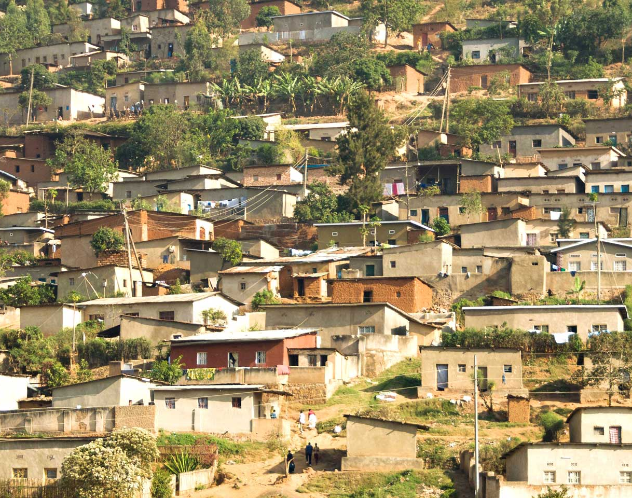
Contents
6.1 Structure in MAED
6.2 Equations
6.3 Data Processing and Input

Slide 3
6.1 Structure in MAED

Slide 4
MAED Sectors
Energy consumer sector
Economic sector
(GDP structure)
Industry
Agriculture
Transport
Household
Services
Construction
Mining
Manufacturing
Service (including transport)
Energy

Slide 5
Subsector Definition
Household
Urban
Rural
…
…
…
…
…
…
More detail possible if data allows
BUT
Energy balances rarely distinguish between urban and rural consumption
Complimentary data can fill gaps: household surveys, census, other national studies/surveys.
Higher detail enables more accurate modelling of energy consumption patterns
BUT don’t overcomplicate if not necessary

Slide 6
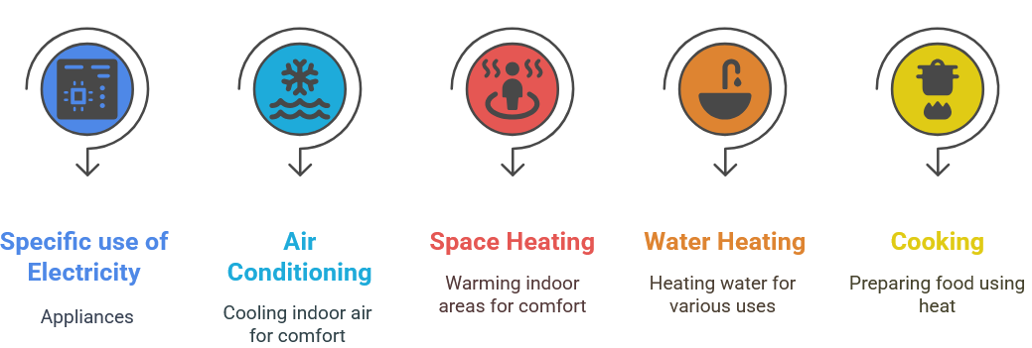


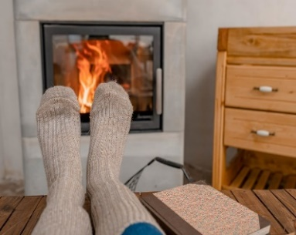
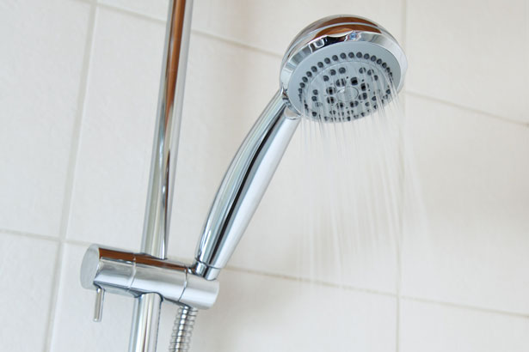
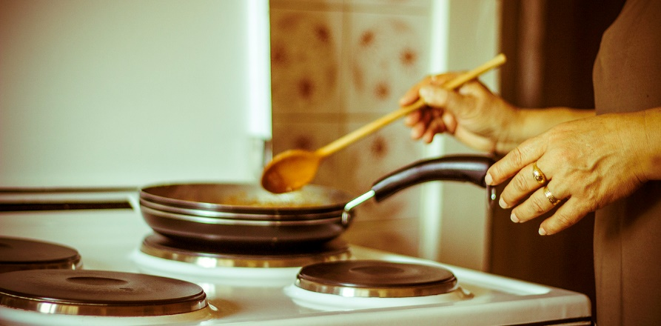
End Uses in Household

Slide 7
Structure
Urban
Rural
Air Conditioning
Cooking
Specific Electricity Uses
Water Heating
Space Heating
End Use
Fossil Fuels
Electricity
Heat Pump
Energy Carrier
Solar Thermal
Modern Biomass
Traditional Fuels
District Heat

Slide 8
6.2 Equations

Slide 9
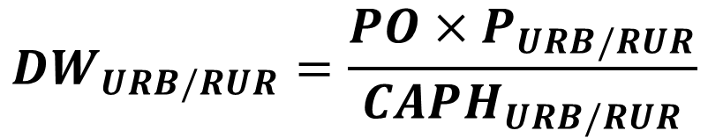
Household Equations
Number of Households
Fraction of population in urban or rural areas
Total population
$$DW_{URB/RUR}=\frac{PO×P_{URB/RUR}}{CAPH_{URB/RUR}}$$
Number of Dwellings in urban or rural areas
Persons per household in urban or rural areas

Slide 10
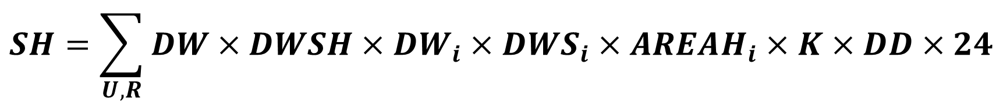
Household Equations
Space Heating
Number of dwellings
Fraction of dwellings of type i
Floor area actually heated in dwelling type i
Useful energy demand for space heating
Degree days
$$SH=\sum_{U,R}{DW×{DWSH×DW}_{i}×DWS_{i}×AREAH_{i}×K×DD×24}$$
Fraction of dwellings requiring space heating
Size of dwelling of type i
Heat loss rate

Slide 11
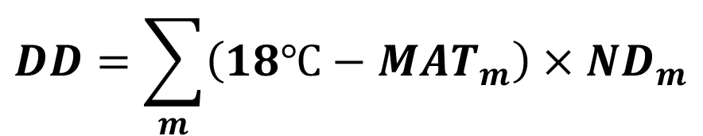
Household Equations
Degree Days
MAT (Monthly Average Temperature)
18ºC
ND Number of days per month
31 28 31 30 31 30 31 31 30 31 30 31
$$DD=\sum_{m}{\left(18℃−MAT_{m}\right)×ND_{m}}$$
Only for months when MAT is less than 18 (yellow)

Slide 12
Household Equations
Heat Transfer Coefficient of Buildings, K Value
Typical figures for the heat transfer coefficient (Wh/sqm/°C/h), depending on the material composition and insulation method:
Building element Wh/sqm/°C/h
Solid 225 mm brick wall 2.0
Wall, Internal insulation 0.45 - 0.48
Wall, External insulation 0.44
Wall, Cavity insulation 0.19 - 0.40
Straw-bale wall 0.13
Window, Single glazing 5.6
Window, Double glazing 2.8
Window, Double glazing, with Argon 2.6
Window, Double glazing, Low-E 1.8
Window, Double glazing, Low-E with Argon 1.5
Roof 0.16 - 0.25
Floor 0.45

Slide 13
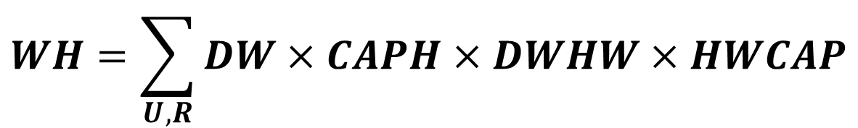
Household Equations
Water Heating
Number of dwellings
Fraction of dwellings with hot water facilities
Useful energy demand for water heating
$$WH=\sum_{U,R}{DW×CAPH×DWHW×HWCAP}$$
Persons per household
Specific Hot water energy consumption per person

Slide 14
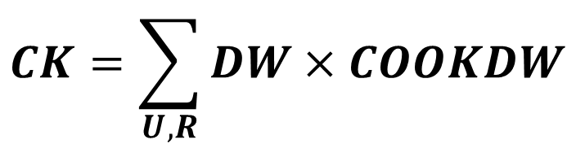
Household Equations
Cooking
Number of dwellings
Useful energy demand for cooking
$$CK=\sum_{U,R}{DW×COOKDW}$$
Specific energy consumption for cooking

Slide 15
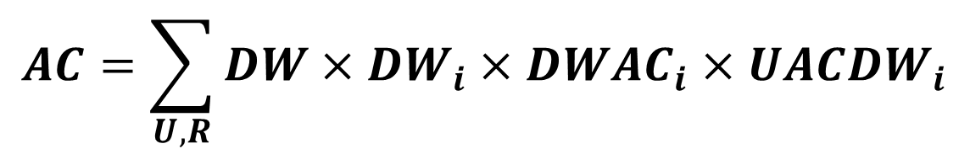
Household Equations
Air Conditioning
Fraction of dwellings with air conditioning
Number of dwellings
Useful energy demand for air conditioning
$$AC=\sum_{U,R}{DW×DW_{i}×{DWAC}_{i}×{UACDW}_{i}}$$
Fraction of dwellings of type i
Specific cooling requirements

Slide 16
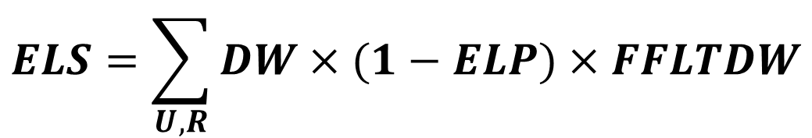
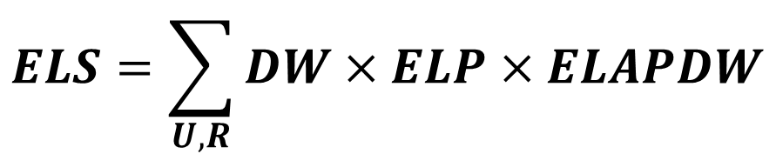
Household Equations
Appliances and Lighting
Total number of dwellings
Specific electricity consumption for appliance/lighting
Final energy demand for appliances/lighting by electricity
$$ELS=\sum_{U,R}{DW×ELP×ELAPDW}$$
Fraction of electrified dwellings
Specific fossil fuel consumption for appliances/lighting
Final energy demand for appliances/lighting by fossil fuels
$$ELS=\sum_{U,R}{DW×(1−ELP)×FFLTDW}$$

Slide 17


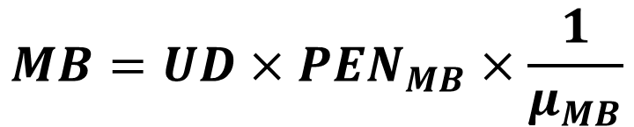
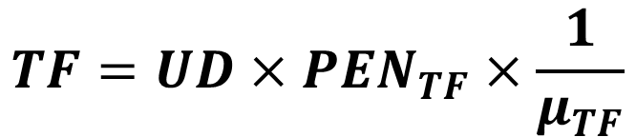
Household Equations
Useful to Final: Space Heating, Water Heating, Cooking
$$DH=UD×PEN_{DH}$$
District Heating
$$SS=UD×PEN_{SS}$$
Solar Thermal
$$TF=UD×PEN_{TF}×\frac{1}{μ_{TF}}$$
Traditional Fuels
$$MB=UD×PEN_{MB}×\frac{1}{μ_{MB}}$$
Modern Biomass

Slide 18
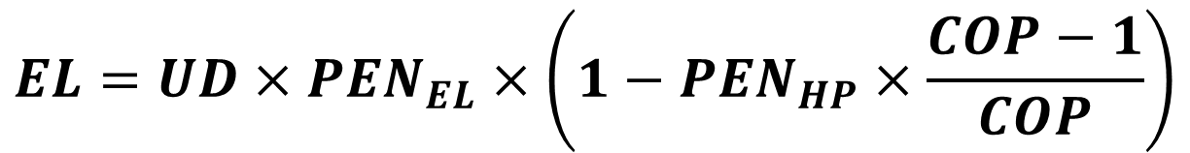

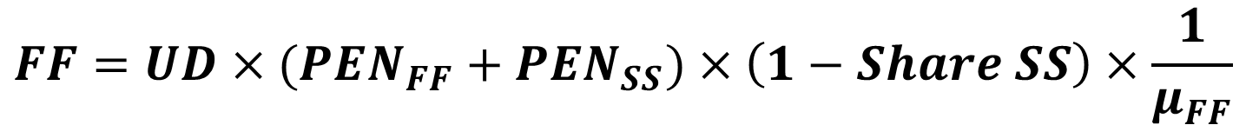
Household Equations
Useful to Final: Space Heating, Water Heating, Cooking continued
$$EL=UD×PEN_{EL}$$
Electricity
Coefficient of performance
$$EL=UD×PEN_{EL}×\left(1−PEN_{HP}×\frac{COP−1}{COP}\right)$$
If PEN Heat Pumps >0…
Approximate share of space heating (SH) demand in households that can be met with solar installations. The rest of the demand will have to be met by a backup system.
$$FF=UD×(PEN_{FF}+PEN_{SS})×\left(1−Share SS\right)×\frac{1}{μ_{FF}}$$
Fossil Fuels
Penetration of solar thermal in space heating

Slide 19
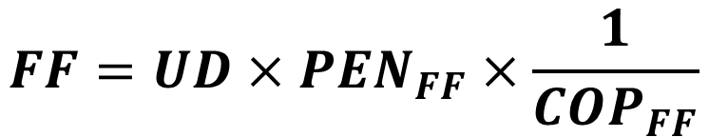
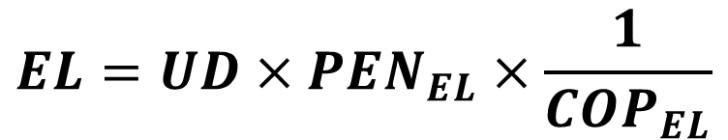
Household Equations
Useful to Final: Air Conditioning
$$EL=UD×PEN_{EL}×\frac{1}{{COP}_{EL}}$$
Electricity
$$FF=UD×PEN_{FF}×\frac{1}{{COP}_{FF}}$$
Fossil Fuels

Slide 20
6.3 Data Processing and Input

Slide 21
Input Data
Shares by type of dwelling (%)
Average house size (m ² )
Specific requirements per person in useful energy (energy/ cap /year)
Percentage of homes with water heating systems (%)
Participation of energy sources within useful energy (%)
Energy efficiency (%)
water heating
Cooking
Specific requirements for houses in useful energy (energy/ dwelling /year)
Participation of energy sources within useful energy (%)
Energy efficiency (%)
Heat losses rate per dwelling (Wh/m2/C/h)
Percentage of houses with heating (%)
Participation of energy sources within useful energy (%)
Energy efficiency (%)
Heating

Slide 22
Continued…
Specific requirements for houses in useful energy (energy/ dwelling /year)
Percentage of homes with air conditioning systems (%)
COP
Air-conditioning
Specific uses of electricity and lighting
Electrification rate (%)
Specific electricity requirements for equipment per dwelling (energy/ dwelling /year)
Specific electricity requirements for lighting per dwelling (energy/ dwelling /year)
The Urban and Rural sectors are modeled the same, so the explanations given below are valid for all houses of the two subsectors.

Slide 23
Data Processing
N.B. In the MAED UI, when dealing with energy units other than GWyr, a conversion factor needs to be used for your Final Energy Demand e.g. if using Energy Units of PJ, final energy demands derived from an energy balance need to be converted to PJh (multiply PJ value by 8760) and the Useful Energy Demand and Energy Intensity calculated from that value.
Divide by end uses: census/ survey results or expert judgment can be used
GWh

Slide 24
Divide by Household type

Slide 25
Water Heating
Calculate the specific requirements per person in useful energy (energy / cap / year)
$$HWCAP= \frac{Total useful energy}{people with hot water system}$$
$$people with hot water system=total_population∗\%_householdswith hot water system∗\#persons_by_household$$

Slide 26

Cooking
Calculate the specific requirements per house in useful energy (energy/ dwelling /year)
$$CKWD= \frac{Total useful energy}{\#Households}$$

Slide 27
Space Heating
Calculate heat losses by type of dwelling ( Wh / m2 /°C/h)
$$K_{j}= \frac{Total useful energy}{\#Households∗\%_{Household with heat}∗total_area_household∗\%_area_with_heat∗DD∗24}$$

Slide 28
Air Conditioning
Number of homes with air conditioning
$$\#households_{total}∗\% Dwelling with air conditioning$$
COP
Efficiency ( Coefficient of performance)
Calculate the specific requirements per household in useful energy (energy/ dwelling /year)
$$ACDW= \frac{Final energy consumption for AC}{\#Dwelling with air conditioning}∗COP$$

Slide 29

Appliances and Lighting
Electrification percentage
Calculate the number of electrified homes
$$ELP=\#households_total∗\%Electricity Penetration$$
Calculate the specific consumption of electricity (ELAPDW) / lighting (LIGHTDW) per household
$$ELAPDW= \frac{Total final consumption for appliances}{ELP}$$
$$LIGHTDW= \frac{Total final consumption lighting}{ELP}$$

Slide 30
Thank you
www.climatecompatiblegrowth.com

