Slide 1

4. Industry
Produced in partnership with the International Atomic Energy Agency (IAEA)
Notes:
Licence: This work is licensed under the Creative Commons Attribution 4.0 International License (CC BY 4.0). To view a copy of this license, visit https://creativecommons.org/licenses/by/4.0/.
Attribution: Please cite as: Kiley, F. (2025) An Introduction to Simulating Energy Demand with MAED. Version 1. Climate Compatible Growth Teaching Kit Website, Climate Compatible Growth.

Slide 2
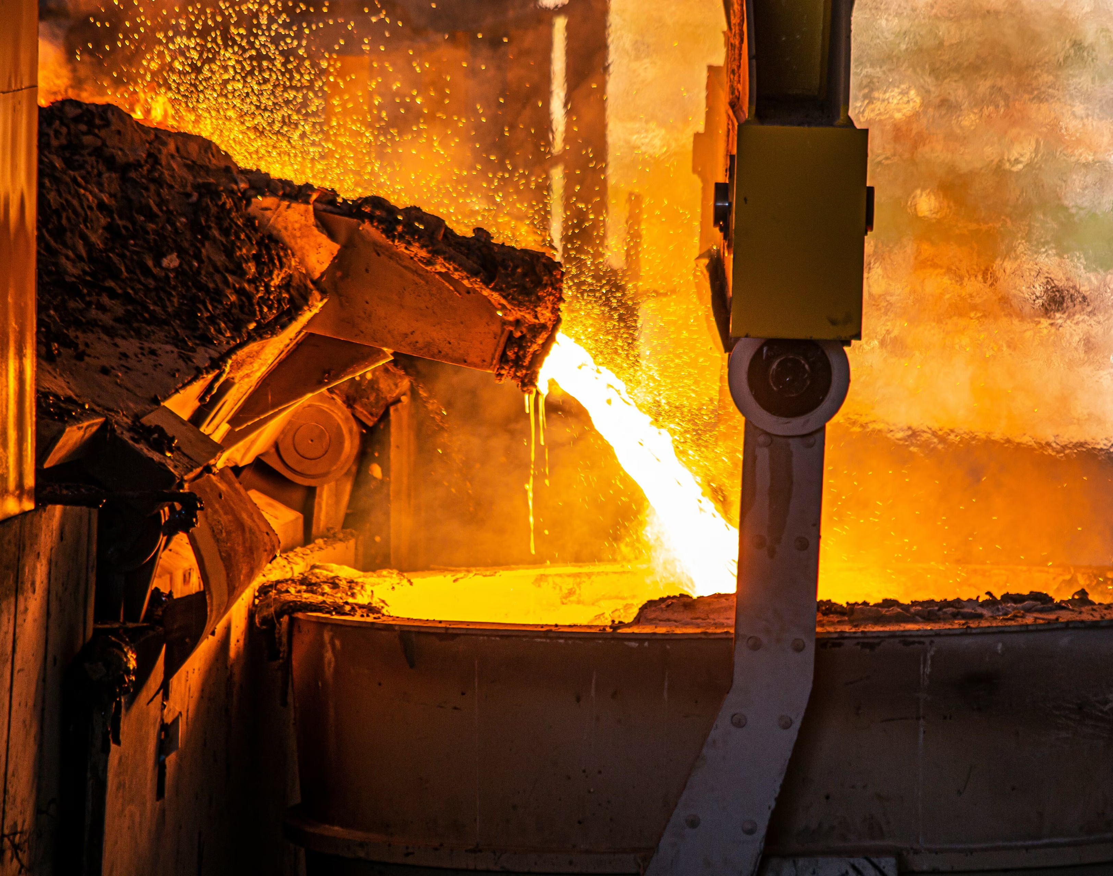
Contents
4.1 Introduction to the Sub-Sectors
4.2 Sector Structure and End Uses
4.3 Mathematical Formulation
4.4 Input Data Preparation
4.5 Inputting into MAED-D
4.6 Example Model Outputs

Slide 3
4.1 Introduction to the Sub-Sectors

Slide 4

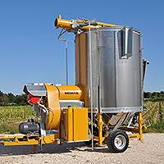
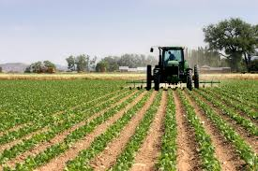
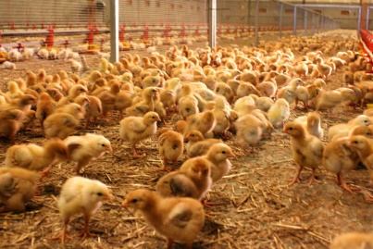
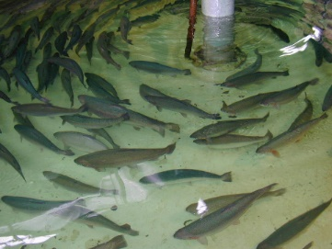
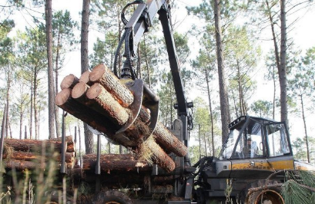
Agriculture

Slide 5
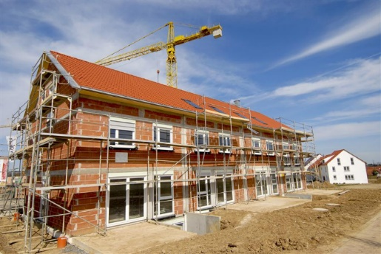
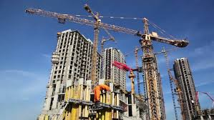

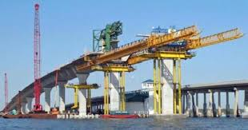
Construction

Slide 6
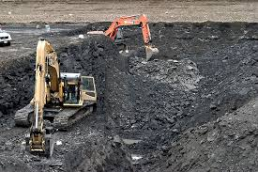
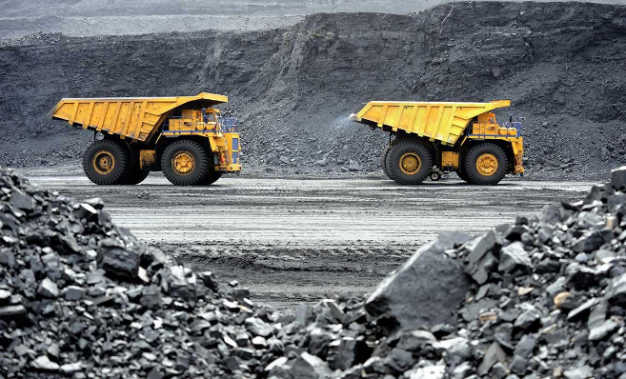
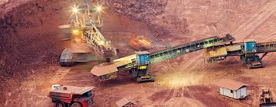
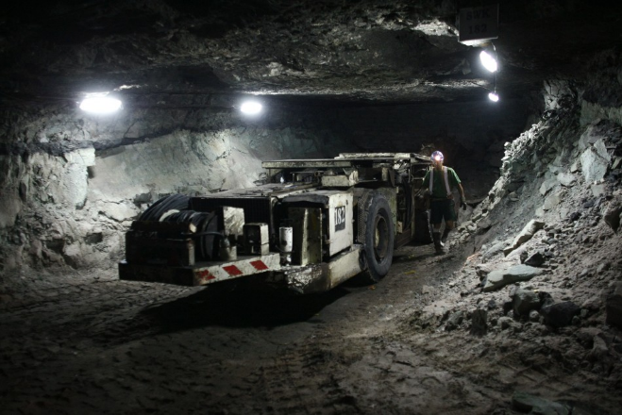
Mining

Slide 7
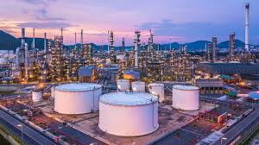
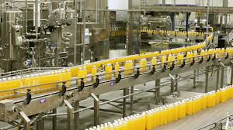
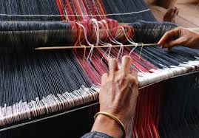
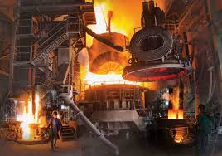
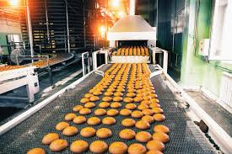
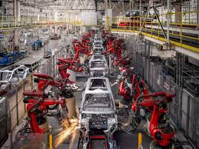
Manufacturing

Slide 8
4.2 Sector Structure and End Uses

Slide 9
MAED Sectors
Energy consumer sector
Economic sector
(GDP structure)
Industry
Agriculture
Transport
Services
Household
Construction
Mining
Manufacturing
Service (including transport)
Energy

Slide 10
Continued…
Example Sector Structure
Main economic sector structure in MAED is pre-defined:
  Agriculture
  Construction
  Mining
  Manufacturing
But Subsectors are a user decision based on the research question and input data availability
Agriculture
Mining
Construction
Manufacturing
Sugar Industry
Other industries

Slide 11
Industry Structure
Agriculture
Construction
Mining
Manufacturing
Specific Electricity Uses
Thermal Uses
Motive Power
End Use
Feedstock and Coke
Electricity
Heat Pump
Cogeneration (Heat)
Motor Fuels
Energy Carrier
Solar Thermal
Fossil Fuels
Modern Biomass
Traditional Fuels
District Heat

Slide 12



End Use Options: ACM
Agriculture
Mining
Construction
Motive power
Electricity specific uses
Thermal uses

Slide 13
End Use Options: Manufacturing
Manufacturing
Electricity specific uses
Motive power
Thermal uses
High (furnace/direct heat)
Medium (steam generation)
low (water/space heating)

Slide 14
Thermal Uses in Manufacturing
Other subsectors
Non-durables
Machineries and equipment
Thermal processes (temperature levels: high HT; medium MT; low LT)
Basic materials
MT
HT
LT
HT
Furnaces/Direct heat (high)
MT
MT
LT
Steam generation (medium)
LT
LT
Water/Space heating (low)
HT + MT + LT = 1

Slide 15
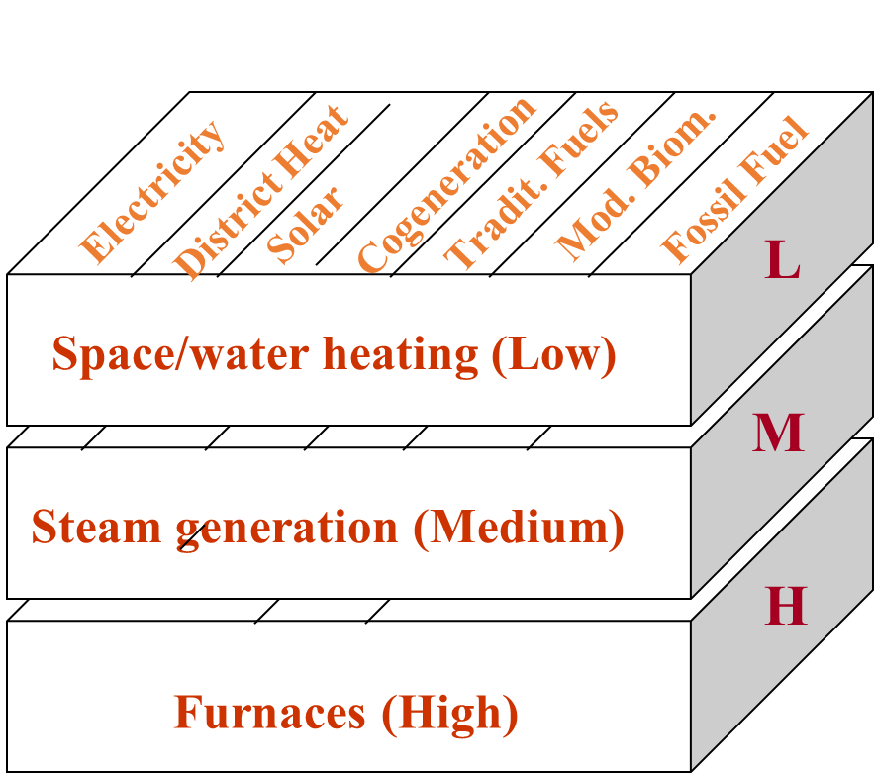
Final Energy for Thermal Uses in Manufacturing

Slide 16
4.3 Mathematical Formulation

Slide 17
Demand in ACM
Specific use of electricity and motor fuels
Non-substitutable energy forms (no competition with other energy forms for providing a particular end-use service)
Useful energy demand = final energy demand
Thermal use
Substitutable energy forms (electricity, fossil fuels, traditional fuels, modern biomass, solar systems)
Useful energy demand = final energy demand * efficiency

Slide 18

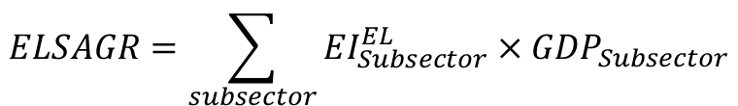
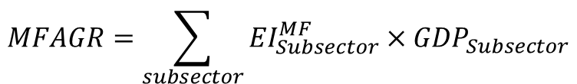
Equations ACM
Final Energy: Motor Fuels and Specific Uses of Electricity
Energy intensity
Final/Useful energy demand
$${ED}_{t}={EI}_{t}×{DP}_{t}$$
Driving Parameter
Final/Useful energy Demand, Motor Fuels
$$MFAGR=\sum_{subsector}{{EI}_{Subsector}^{MF}×{GDP}_{Subsector}}$$
Final/Useful energy Demand, Specific Electricity
$$ELSAGR=\sum_{subsector}{{EI}_{Subsector}^{EL}×{GDP}_{Subsector}}$$

Slide 19
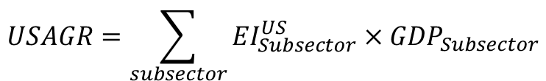

Equations for ACM
Useful Energy: Thermal Uses
$${UED}_{t}={EI}_{t}×{DP}_{t}$$
Useful energy Demand, Thermal Uses
$$USAGR=\sum_{subsector}{{EI}_{Subsector}^{US}×{GDP}_{Subsector}}$$

Slide 20
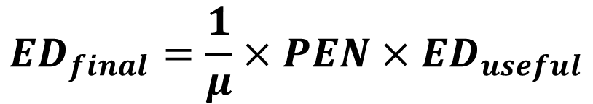
Equations for ACM
Useful and Final Energy for Thermal Uses
Final energy demand is transformed by an efficiency and penetration associated for an energy carrier to derive useful energy
Penetration of energy form
$${ED}_{final}=\frac{1}{μ}×{PEN×ED}_{useful}$$
Efficiency
70%
Process Heat
Electricity
Electric Heater
Fossil Fuels
Boiler
30%

Slide 21
Equations for ACM
Efficiencies: An Important Note
In MAED, Electricity for Thermal Uses is assumed to be 100% efficient.
All other efficiencies need to be expressed in relation to the electricity efficiency of the same process (fair competition among participating fuels:
Fuels | Electricity | Coal | Fuelwood
Actual efficiency | 90 % | 75 % | 20 %
Efficiency in MAED | 100 % | 83.3 % | 22.2 %

Slide 22





Equations for ACM
Final Energy Demand for Thermal Uses in ACM
$$FFAGR=\frac{1}{μ_{FF}}×PEN_{AGR}^{FF}×USAGR$$
Fossil Fuels
$$SSAGR=PEN_{AGR}^{SS}×USAGR$$
Solar Thermal
$$ELAGR=PEN_{AGR}^{EL}×USAGR$$
Electricity
$$TFAGR=\frac{1}{μ_{TF}}×PEN_{AGR}^{TF}×USAGR$$
Traditional Fuels
$$MBAGR=\frac{1}{μ_{MB}}×PEN_{AGR}^{MB}×USAGR$$
Modern Biomass

Slide 23
Demand in Manufacturing
Specific use of electricity and motor fuels
Non-substitutable energy forms (no competition with other energy forms for providing a particular end-use service)
Useful energy demand = final energy demand
Thermal use
Substitutable energy forms (electricity, fossil fuels, traditional fuels, modern biomass, solar systems)
Broken down into three types of thermal process
  Space and water heating (low temperature)
  Steam generation (mid temperature)
  Furnace and direct use of fuels (high temperature)
Useful energy demand is converted to final energy through penetration and efficiency

Slide 24
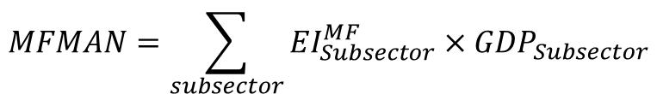
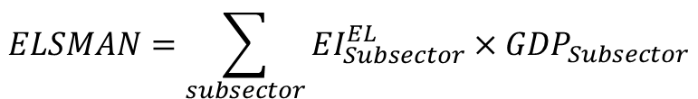
Equations for Manufacturing
Final Energy: Motor Fuels and Specific Uses of Electricity
Energy intensity
Final/Useful energy demand
$${ED}_{t}={EI}_{t}×{DP}_{t}$$
Driving Parameter
Final/Useful energy Demand, Motor Fuels
$$MFMAN=\sum_{subsector}{{EI}_{Subsector}^{MF}×{GDP}_{Subsector}}$$
Final/Useful energy Demand, Specific Electricity
$$ELSMAN=\sum_{subsector}{{EI}_{Subsector}^{EL}×{GDP}_{Subsector}}$$

Slide 25
Equations for Manufacturing
Useful Energy: Thermal Uses
Useful energy Demand, Thermal Uses
$$USMAN_{L,M,H}=\sum_{subsector}{{EI}_{Subsector}^{US}×{GDP}_{Subsector}×PUSIND_{L,M,H}}$$
Temperature Level
Useful energy shares by temperature level and subsector

Slide 26
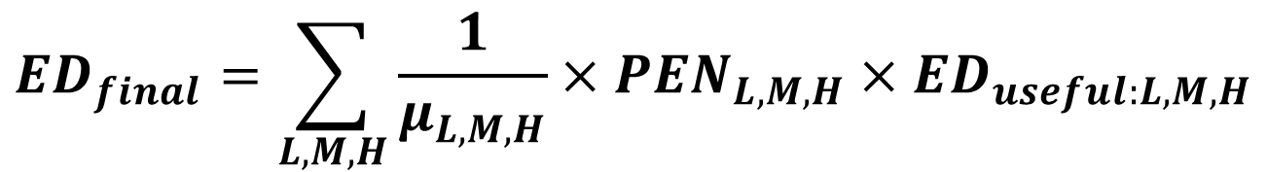
Equations for Manufacturing
Useful and Final Energy for Thermal Uses
$${ED}_{final}=\sum_{L,M,H}{\frac{1}{μ_{L,M,H}}×{PEN_{L,M,H}×ED}_{useful:L,M,H}}$$
70%
Steam generation for thermal uses
Electricity
Electric Boiler
Fossil Fuels
Coal Boiler
30%

Slide 27
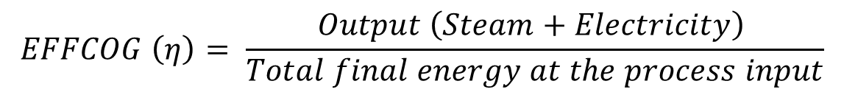
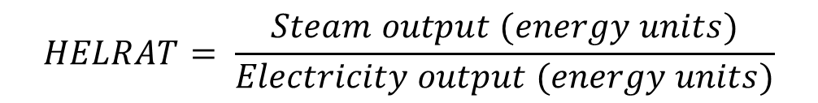
Equations for Manufacturing
Cogeneration
Electricity Output
(Useful)
Final Energy Input
of Fossil Fuel
COGENERATION
Useful Energy
Output
Heat Output (Useful)
COGSTH
$$HELRAT= \frac{Steam output (energy units)}{Electricity output (energy units)}$$
Heat and electricity ratio
$$EFFCOG \left(η\right)= \frac{Output \left(Steam+Electricity\right) }{Total final energy at the process input}$$
Cogeneration efficiency

Slide 28
Equations for Manufacturing
Cogeneration Efficiency
Cogeneration HELRAT
State-of-the-art cogeneration systems have efficiencies ranging from 65% to 85%.
Those systems that produce large amounts of steam relative to electricity (high heat/electricity ratio) generally have the higher efficiencies
Those that produce greater proportions of electricity (low heat/electricity ratio) have lower efficiencies
Source: International Energy Agency, Energy Efficiency Initiative, Vol. I, Chapter 6, Sectoral Policies and Programmes, 1998
Installation Type | Capacity | HELRAT
Steam Turbin Back Pressure | 50 kWe – 100 MWe | 4-10
Steam Turbine Steam Extraction | 50 kWe – 100 MWe | 3-4
Gas Turbine | 100 kWe – 100 MWe | 1-3
Diesel Motor | 100 kWe – 60 MWe | 0.5-1
Source: Rapport AMPERE, Belgium, October 2000

Slide 29

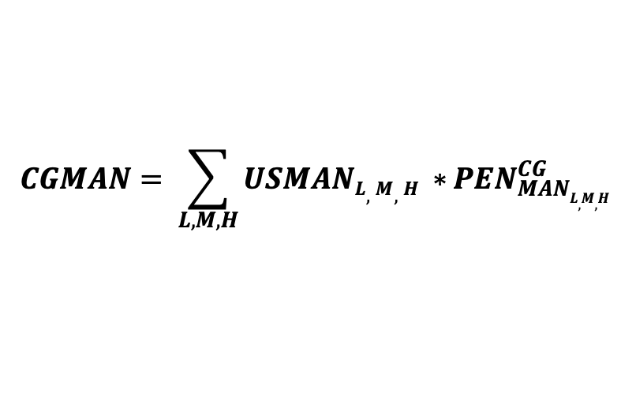

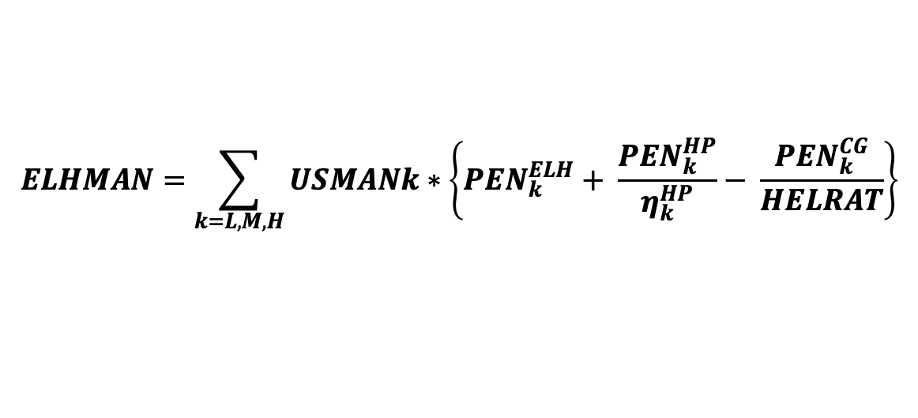
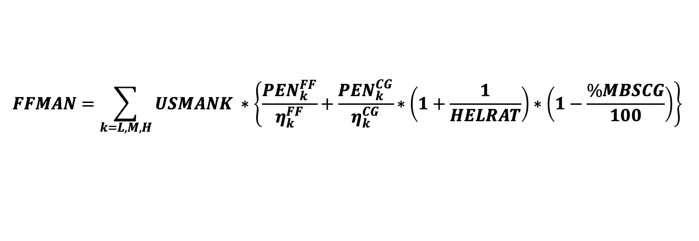

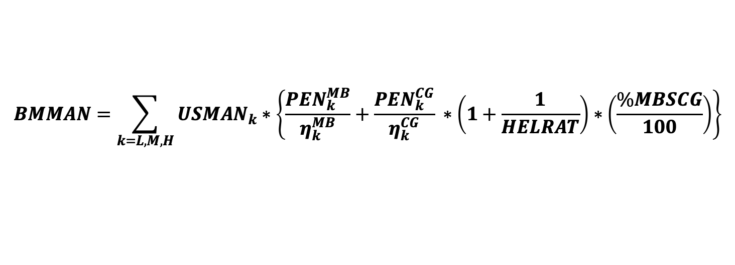

Equations: Manufacturing
Final energy for thermal uses
$$CGMAN= {\sum_{L,M,H}{USMANL,M,H ∗}PEN}_{MANL,M,H }^{CG}$$
$$(cogeneration)$$
$$BMMAN=\sum_{k=L,M,H}{{USMAN}_{k}∗\left\{\frac{{PEN}_{k}^{MB}}{η_{k}^{MB}}+\frac{{PEN}_{k}^{CG}}{η_{k}^{CG}} ∗\left(1+\frac{1}{HELRAT}\right)∗\left(\frac{\%MBSCG}{100}\right)\right\}}$$
$$(modern biomass)$$
$$FFMAN=\sum_{k=L,M,H}{USMANK ∗\left\{\frac{{PEN}_{k}^{FF}}{η_{k}^{FF}}+\frac{{PEN}_{k}^{CG}}{η_{k}^{CG}}∗\left(1+\frac{1}{HELRAT}\right)∗\left(1−\frac{\%MBSCG}{100}\right)\right\}}$$
$$(fossil fuels)$$
$$ELHMAN=\sum_{k=L,M,H}{USMANk}∗\left\{{PEN}_{k}^{ELH}+ \frac{{PEN}_{k}^{HP}}{η_{k}^{HP}}− \frac{{PEN}_{k}^{CG}}{HELRAT}\right\}$$
$$(electricity)$$
Notes:
$HELRAT$ = Heat and electricity ratio

Slide 30
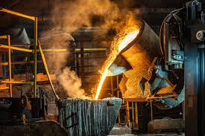
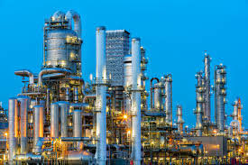
Equations for Manufacturing
Steel and Petrochemicals
In MAED, energy forms for non-energy uses in the steel industry and feedstocks for the petrochemical industry are calculated as a function of the GDP (value added) of the first subsector of the Manufacturing sector
Thus, the energy use and the GDP of these two industries must be included within the values of the first subsector defined for the Manufacturing

Slide 31
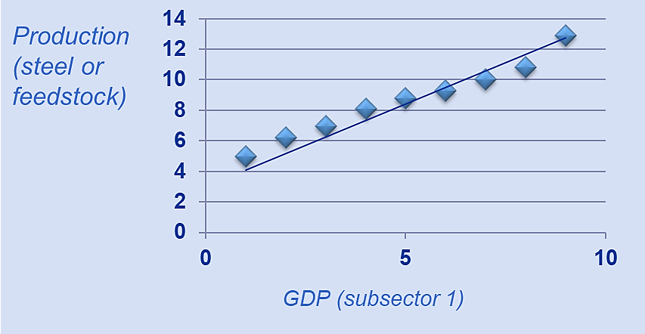
Equations for Manufacturing
Final Energy Demand for Coke
Coke used for pig iron production
Specific consumption of pig iron, ton pig iron / ton steel
Conversion factor from Mtoe to alternative energy units
Final energy demand for coke
$$COKE=PSTEEL×BOF×IRONST×EICOK×CF$$
Production of steel, 10^6 ton
Share of steel in non-electric furnaces, %
Coke input per unit of pig iron output, kg coke / ton pig iron
$$PSTEEL=CPST\left(1\right)+CPST(2)×VAIG$$
Constants derived from regression analysis (see graph)
Value added in the 1st sub sector in manufacturing

Slide 32
Equations for Manufacturing
Final Energy Demand for Feedstock
Non-energy use of energy sources
Conversion factor from Mtoe to TWh
Final Energy Demand for Feedstock
$$FEED=PFEED×CF1×CF2$$
Total feedstock consumption, 10^6 tons
TWh to alternative energy units
$$PFEED=CFEED\left(1\right)+CFEED(2)×VAIG$$
Constants derived from regression analysis (see graph)
Value added in the 1st sub sector in manufacturing

Slide 33
4.4 Input Data Preparation

Slide 34
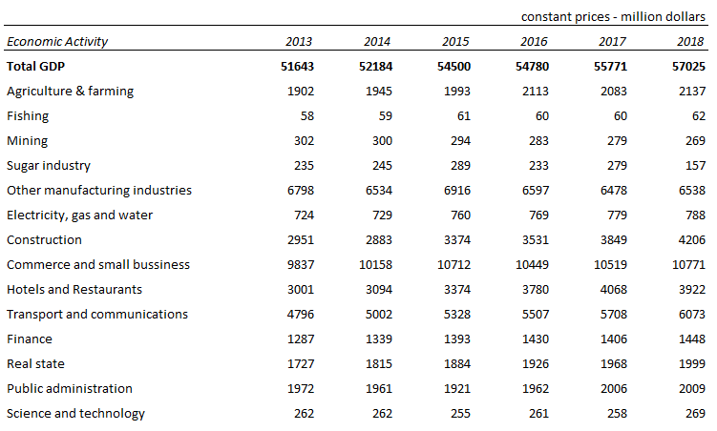
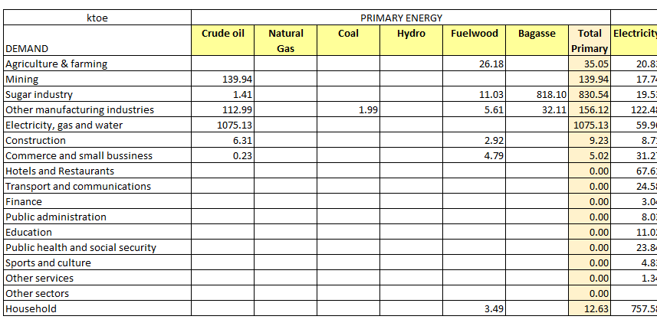
Sectoral Structure and End Uses
Defined according to economic and energy data available
GDP
Energy balance

Slide 35
End Uses Input Data
Motive power
Electricity specific uses
Final energy
Energy intensity =
GDP (sector or subsector)
Useful energy
Energy intensity =
GDP (sector or subsector)
Thermal uses
Participation of energy forms in useful energy demand
(In Manufacturing the values are defined by temperature level)
Efficiencies (traditional fuels, modern biomasses, fossil fuels)

Slide 36
Input Data Preparation
Example: Manufacturing (Specific Electricity and Motive Power)
Energy balance
Divide by end-uses
Electricity specific uses
$$EI=\frac{electricity}{GDP sector}= \frac{97.99 (ktoe)}{6.5 ({10}^{9} USD)}=0.0151 toe/{10}^{6}USD$$
Motive power
$$EI=\frac{motor fuel}{GDP sector}= \frac{(11.03+0.05) (ktoe)}{6.5 ({10}^{9} USD)}=0.0017 toe/{10}^{6}USD$$

Slide 37
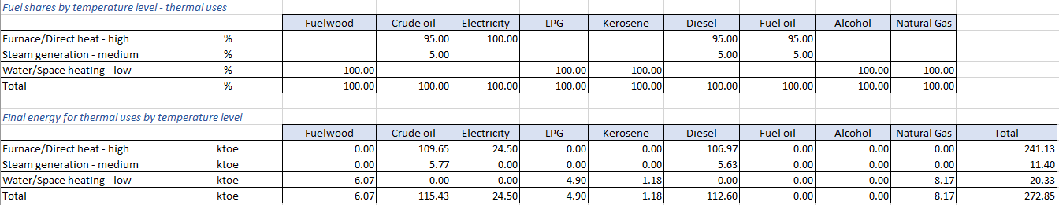
Input Data Preparation
Example: Manufacturing (Thermal Uses)
Energy balance
Divide by end-uses
Divide the final energy for thermal uses by temperature levels

Slide 38
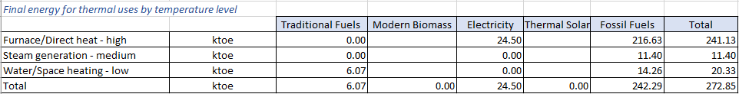
Input Data Preparation
Example: Manufacturing (Thermal Uses Continued)
Group by fuel types – MAED categories
Crude oil
LPG
Kerosene
Diesel
Fuel oil
Natural gas
Fuelwood

Slide 39
Input Data Preparation
Example: Manufacturing (Thermal Uses Continued)
Calculation of efficiencies
Calculate the efficiencies as needed in MAED (considering that the electricity is treated as final energy, thus efficiency=1)
Calculate the average weighted efficiencies (considering the fuel shares in each fuel group type)
$$EfficFF_{High}= \frac{Crudel oil∗effic+Diesel∗efic}{Crude oil+Diesel}= \frac{109.65∗0.74+106.97∗0.84}{109.65+106.97}=0.7888$$

Slide 40
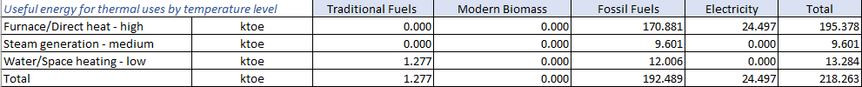
Input Data Preparation
Example: Manufacturing (Thermal Uses Continued)
Useful energy (final demand times efficiencies)
Calculate the useful energy (using the average weighted efficiencies)
Calculate the fuel shares into the useful energy

Slide 41
4.5 Inputting into MAED-D

Slide 42
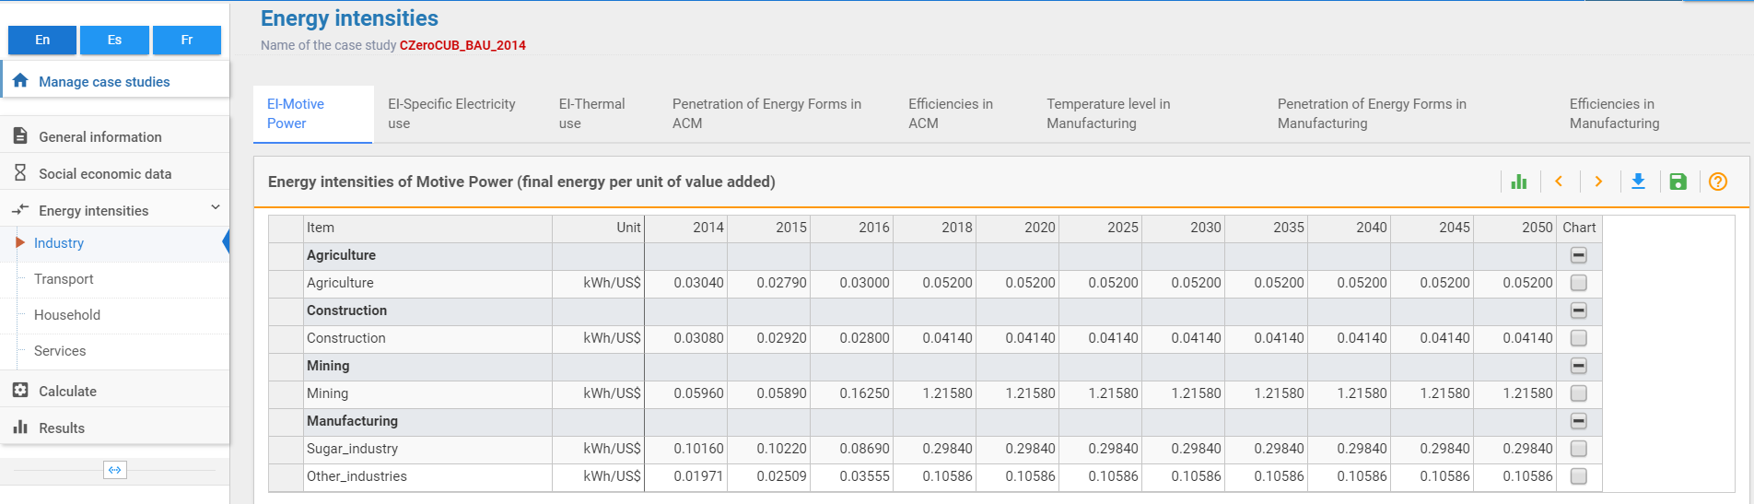
Energy intensities
Motive Power

Slide 43
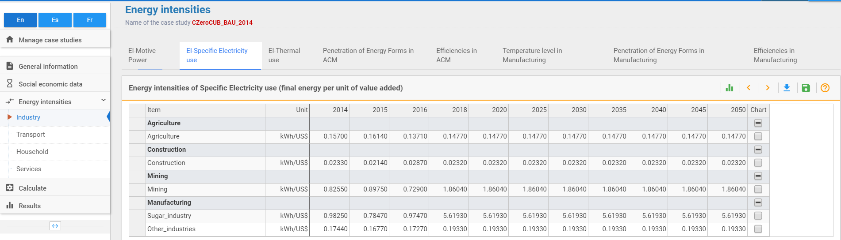
Energy intensities
Electricity specific uses

Slide 44
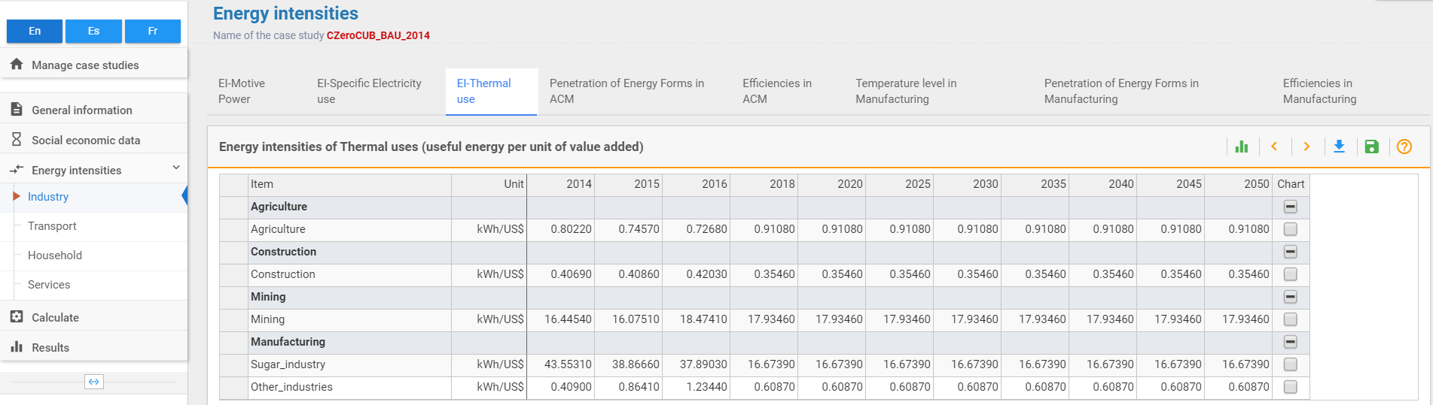
Energy intensities
Thermal uses

Slide 45
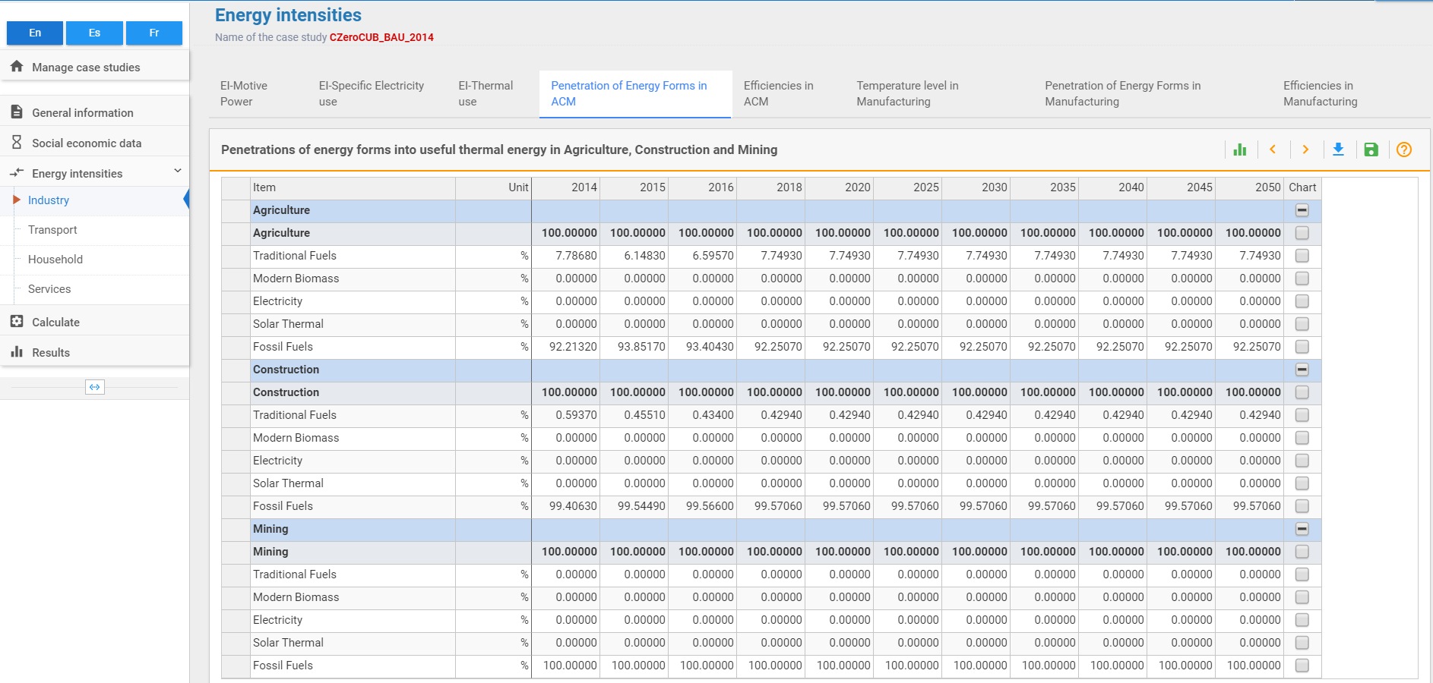
Fuel shares into useful energy – thermal uses
ACM

Slide 46
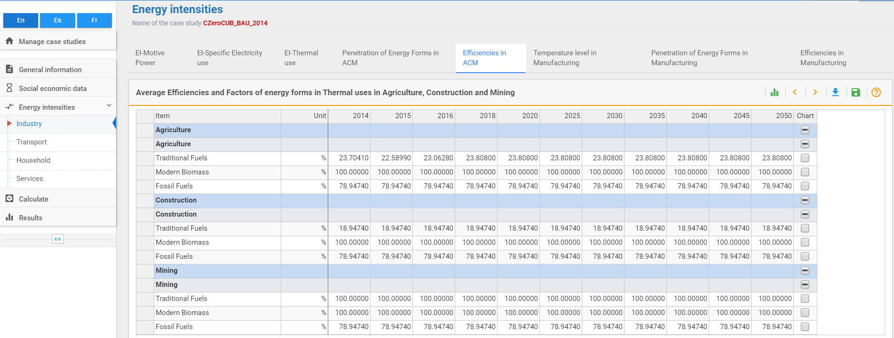
Fuel average weighted efficiencies
ACM

Slide 47
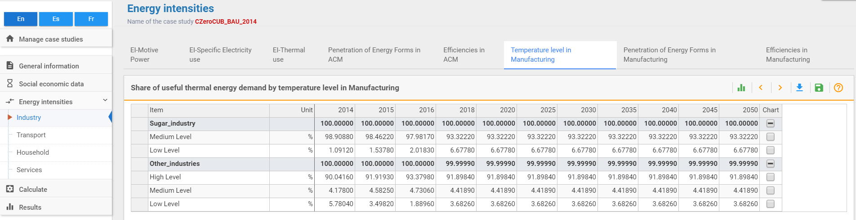
Shares of useful energy by temperature levels
Manufacturing

Slide 48
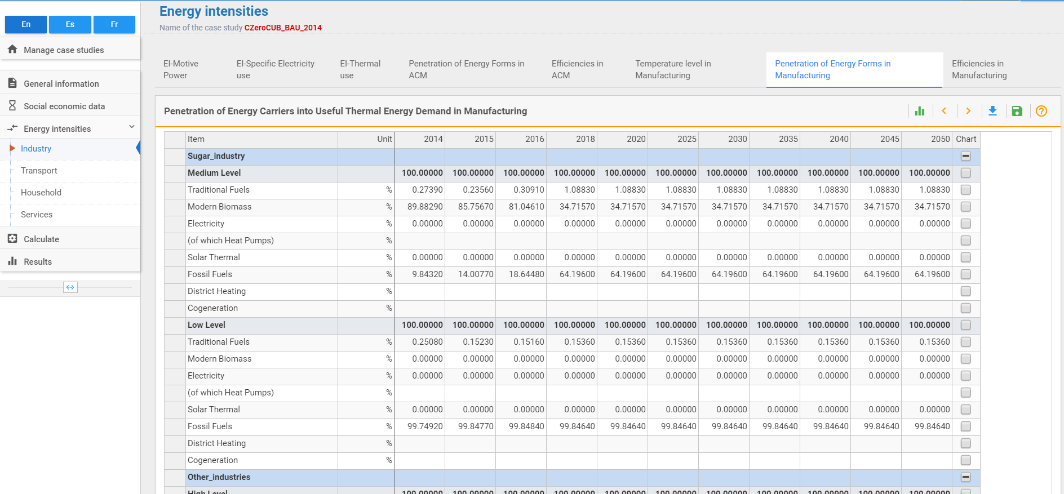
Shares of energy forms into useful thermal energy by temperature levels
Manufacturing

Slide 49
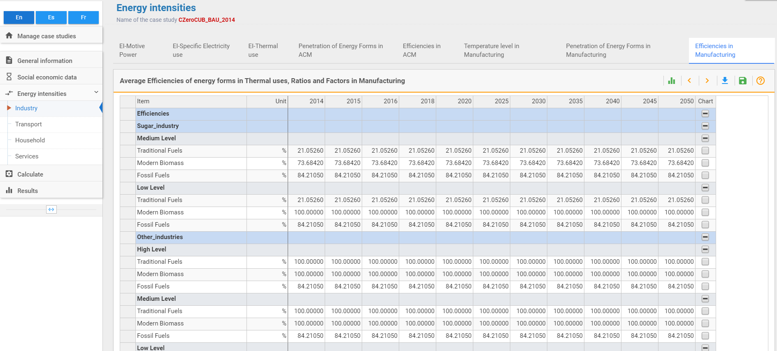
Average weighted energy efficiencies by temperature levels
Manufacturing

Slide 50
4.6 Example of the Model Outputs

Slide 51

Extraction of Results

Slide 52
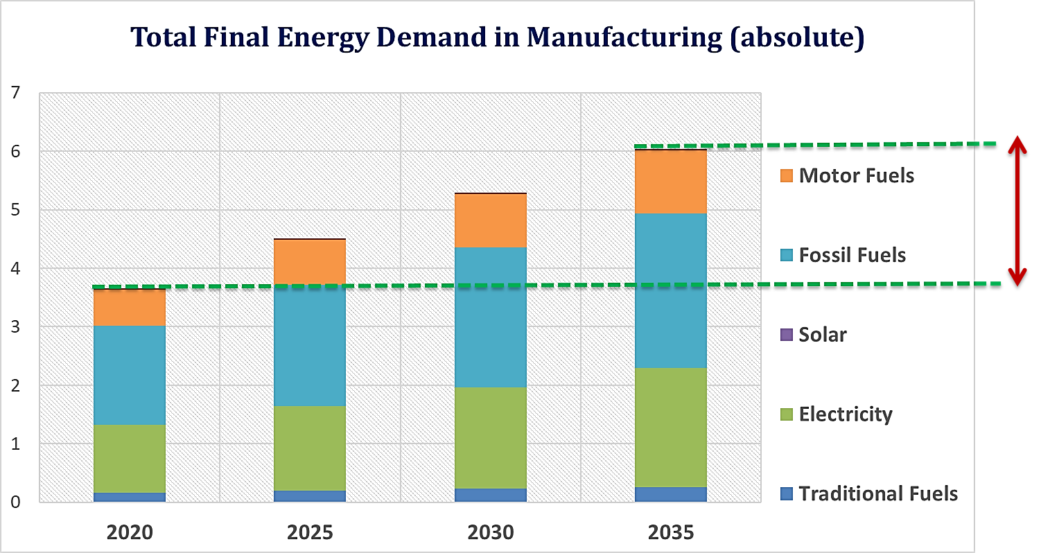


Final energy demand in manufacturing sector
Useful Thermal Energy Demand in Manufacturing
1,6 times higher
relative to 2020

Slide 53


Final energy demand projection by sector and energy form
1.5 times higher
relative to 2020
21%
43%
17%

Slide 54
Thank you
www.climatecompatiblegrowth.com
Produced in partnership with the International Atomic Energy Agency (IAEA)

Slide 55
Additional Material
Average efficiency of fossil fuel use for steam generation
Absolute efficiencies:
  Coal-fired industrial boiler: 60 %
  Oil-fired industrial boiler: 68 - 73 % (average: 70.5 %)
  Gas-fired industrial boiler: 70 - 75 % (average: 72.5 %)
  Electric industrial boiler: 90 - 95 % (average: 92.5 %)
Relative efficiencies:
  Coal-fired industrial boiler: 60.0 % / 92.5 % = 65 %
  Oil-fired industrial boiler: 70.5 % / 92.5 % = 76 %
  Gas-fired industrial boiler: 72.5 % / 92.5 % = 78 %
Source: United Nations, Department of International Economic and Social Affairs, Statistical Office, Energy Statistics: A manual for developing countries, Studies in methods, Series F, No. 56 (ST/ESA/STAT/SER.F/56), New York, 1991

Slide 56
Average efficiency of fossil fuel use for furnace/direct heat
Absolute efficiencies:
  Cement kilns: 30 – 40 % (average: 35 %)
  Glassworks radiation furnace: 40 %
  Coal-fired industrial furnace: 60 %
  Oil-fired industrial furnace: 68 - 73 % (average: 70.5 %)
  Gas-fired industrial furnace: 70 – 75 % (average: 72.5 %)
  Blast furnace: 70 – 77 % (average: 73.5 %)
  Electric industrial furnace: 90 - 95 % (average: 92.5 %)
Relative efficiencies:
  Cement kilns: 35 % / 92.5 % = 38 %
  Glassworks radiation furnace: 40 % / 92.5 % = 43 %
  Coal-fired industrial furnace: 60 % / 92.5 % = 65 %
  Oil-fired industrial furnace: 70.5 % / 92.5 % = 76 %
  Gas-fired industrial furnace: 72.5 % / 92.5 % = 78 %
  Blast furnace: 73.5 % / 92.5 % = 79.5 %
  Source: United Nations, Department of International Economic and Social Affairs, Statistical Office, Energy Statistics: A manual for developing countries, Studies in methods, Series F, No. 56 (ST/ESA/STAT/SER.F/56), New York, 1991

Slide 57
Efficiency of cogeneration plants
State-of-the-art cogeneration systems have efficiencies ranging from 65% to 85%.
Those systems that produce large amounts of steam relative to electricity (high heat/electricity ratio) generally have the higher efficiencies
Those that produce greater proportions of electricity (low heat/electricity ratio) have lower efficiencies
Source: International Energy Agency, Energy Efficiency Initiative, Vol. I, Chapter 6, Sectoral olicies and Programmes, 1998

Slide 58
Efficiency of biomass-fired cogeneration plants
  Power range Overall net efficiency (%, LHV)
0.1 – 1 MWe 60 - 90
1 – 10 MWe 80 - 99
Source: United Nations Development Programme (UNDP), United Nations – Department of Economic and Social Affairs, World Energy Council (WEC), World Energy Assessment: Energy and the Challenge of Sustainability, p. 224

Slide 59
Typical processes in manufacturing subsectors
Basic materials production industries (iron, steel, other primary metals and building materials) are characterized by heavy use of direct process heat (direct use of fuels) for activities such as: metals heating, melting, ore agglomeration, lime and cement calcining, clay and brick firing, and glass melting, cutting and forming
Machinery and equipment industries generally shape materials by cutting, forming, assembly, etc., and are thus heavily reliant on machine drive systems
Non-durable goods industries (textile, food etc.) use in their processes :
  a great amount of steam-based heat and pressure
  direct process heating (direct use of fuels) , such as fluid heating and materials drying, and
  machine drive systems

Slide 60
Typical energy forms used in manufacturing processes (1)
steam generation
  the largest thermal energy end-use category
  the main fuel in most industries is natural gas
  process by-products are also used in several branches: wood and black liquor in the pulp and paper industry, blast furnace gas in the steel industry
  not always the most efficient method of delivering heat to a process stream. Trends are less use of steam and greater use of direct heat or vapor recompression in manufacturing thermal processes
Direct use of fuels
  the second largest thermal energy end-use category
  also fueled mostly by natural gas
  is the most diverse , encompassing a variety of heating, treating, melting, forming, drying, calcining, firing, agglomerative and smelting operations carried out in furnaces, ovens, dryers, kilns, and other process vessels

Slide 61
Typical energy forms used in manufacturing processes (2)
Machine drive systems include motors, pumps, fans, compressors, etc. mostly powered by electricity

Slide 62


Slide 63


Slide 64


Slide 65


Slide 66


Slide 67


