Slide 1

Model for Analysis of Energy Demand
LECTURE 10
MAED-EL STRUCTURE
Version 2.0
Notes:
Licence: This work is licensed under the Creative Commons Attribution 4.0 International License (CC BY 4.0). To view a copy of this license, visit https://creativecommons.org/licenses/by/4.0/.
Attribution: Please cite as: Kiley, F. (2025) An Introduction to Simulating Energy Demand with MAED. Version 1. Climate Compatible Growth Teaching Kit Website, Climate Compatible Growth.

Slide 2

Intended Learning Outcomes (ILOs)
By the end of this lecture, you will be able to:
ILO1: Describe how MAED-EL calculates annual hourly electricity demand from
client and sector demand
ILO2: Understand the time-related scenario inputs
ILO3: Understand the technical scenario inputs
ILO4: Evaluate the accuracy of MAED-EL-projected hourly electricity demand profiles
10.1. Aggregating hourly demand
10.2. Scenario development: Time-related inputs
Course Name
10.3. Scenario development: Technical inputs
10.4. Results analysis
Mini Lecture Learning Objective
2
Notes:
This lecture has four Intended Learning Outcomes:
Describe how MAED-E.L. calculates annual hourly electricity demand from client and sector demand
Understand the time-related scenario inputs
Understand the technical scenario inputs
Evaluate the accuracy of MAED-E.L. projected hourly electricity demand profiles

Slide 3
Lecture 10.1
Aggregating hourly demand
Reconstruction of base year hourly demand
Scenario development
Results analysis
Steps for predicting hourly electricity demand
Predicting hourly electricity demand in MAED-EL
3
Notes:
As discussed in the last lecture, there are three general steps for predicting hourly electricity demand in MAED-E.L.. In the first two sections of this lecture, we’ll continue our discussion of step 1, reconstruction of base year hourly demand.

Slide 4
Lecture 10.1
Aggregating hourly demand
How MAED-EL models demand in an electricity system
Nation
Industry
Steelmaking
Agriculture
Household
Service
3. National demand
2. Sector demand
Other
Transport
Personal
Freight
1. Client demand
4
Notes:
As discussed in the previous lecture, MAED-E.L. models hourly electricity demand using a three-tier system. Hourly demand is calculated from the bottom up: first demand for each client is calculated, then each sector, then finally the entire nation or system. This structure allows MAED-E.L. to account for the growth or decline of different clients in sectors in the years being considered. For example, if you expect electricity demand from personal transport to increase due to increasing penetration of electric vehicles, you can account for how this will increase the demand in the personal client of the transport sector.

Slide 5

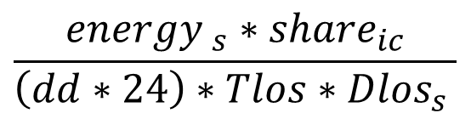

Lecture 10.1
Aggregating hourly demand
Hourly electricity demand by client
$${P′}_{\left(ic,s,h\right)}=S_{i}∗D_{\left(i,id\right)}∗H_{\left(h,ic,id,is\right)}∗P_{avg,ic}$$
Where:
${P′}_{ic,s,h}:$ $Hourly client electric power demand$
$P_{avg,ic}:$ $Average client electric power demand$
$$S_{i}:Seasonal coefficients$$
$D_{(i,id)}$: $Daily coefficients$
$H_{\left(h,ic,id,is\right)}$: $Hourly coefficients$
${energy}_{s}$:$Total annual electricity demand of the sector$
${share}_{ic}$: $Client share of sector demand$
$Tlos$: $Transmission losses of system$
${Dlos}_{s}$: $Distribution losses of the sector$
$dd$: $Number of days of the year (365 or 366)$
$$P_{avg,ic}=$$
$$\frac{{energy }_{s}∗{share}_{ic}}{\left(dd∗24\right)∗Tlos∗{Dlos}_{s} }$$
5
Notes:
When the seasonal, daily, and hourly coefficients, as well as the other input data such as distribution and transmission losses and client share, are specified by the user, the hourly electricity demand can be calculated.
MAED-E.L. calculates the electricity demand by client for a particular hour by multiplying the corresponding seasonal, daily, and hourly coefficients by the average client electric power demand, as shown in this equation.
The total annual energy demand for the sector, multiplied by the client share, divided by the total hours of the year and the transmission and distribution losses, gives us the average client electricity demand, P average i.c..
Note that P prime i.c.s.h. is calculated without including the growth trend that was taken out when the seasonal coefficients were calculated. Once the hourly electricity demand by client is determined, MAED-E.L. recalculates it to include the growth trend. We will call this value P i.c.s.h., with no prime. From now on, we will use the hourly electricity demand by client including the growth trend for further calculations.

Slide 6

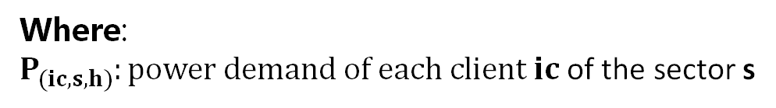
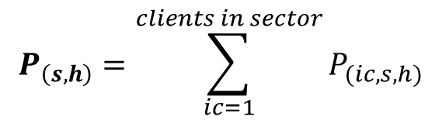
Lecture 10.1
Aggregating hourly demand
Hourly electricity demand by sector
$$P_{\left(s,h\right)}=\sum_{ic=1}^{clients in sector}{P_{(ic,s,h)}}$$
Where:
$P_{(ic,s,h)}:power demand of each client ic$ of the sector s
6
Notes:
As was previously explained, the hourly electricity demand by sector is calculated as the sum of the hourly electricity demand by each client after the growth trend has been taken into account, P i.c.s.h.

Slide 7
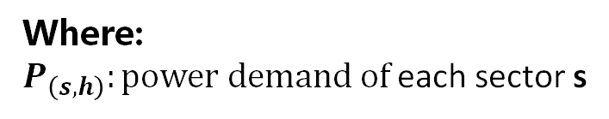
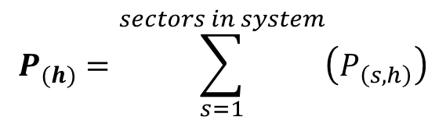
Lecture 10.1
Aggregating hourly demand
Total hourly electricity demand
$$P_{(h)}=\sum_{s=1}^{sectors in system}{\left(P_{\left(s,h\right)}\right)}$$
Where:
$P_{\left(s,h\right)}:power demand of$each sector s
7
Notes:
Finally, the total hourly electricity demand is calculated as the sum of the hourly electricity demand in each sector. These values will be used to construct the load duration curve.

Slide 8
Lecture 10.2 Scenario development: time-related inputs
Reconstruction of base year hourly demand
Scenario development
Results analysis
Steps for predicting hourly electricity demand
Predicting hourly electricity demand in MAED-EL
8
Notes:
In this mini-lecture, we will learn about the first part of the second step: scenario development.

Slide 9
Lecture 10.2 Scenario development: time-related inputs
Scenario inputs
From MAED-D
Time horizon of the study period (base and reference years)
From user
Seasons
Average electricity demand by sectors, by years
Day types (normal weekdays)
Share of electricity supplied by the grid, by sectors
Share of clients by sectors
Transmission losses
Distribution losses by sectors
Seasonal, daily, and hourly coefficients
Holidays (every week, during the year)
9
Notes:
The input data in MAED-E.L. can be divided into two groups. The first group is related to the data obtained from MAED-D, including the structure of the study period and the average annual electricity demand by sector in each year.
The second group includes the input data supplied by the user, on the right hand side of the slide. The user input information can be further divided into two categories: time-related inputs, shown in the red boxes, and technical inputs, shown in the blue boxes.
In this mini-lecture, we will focus on the time-related inputs in red, including holidays, seasons, and types of days that the user must input. The user must also input the seasonal, daily, and hourly modulating coefficients. We covered these in detail in the last lecture.

Slide 10
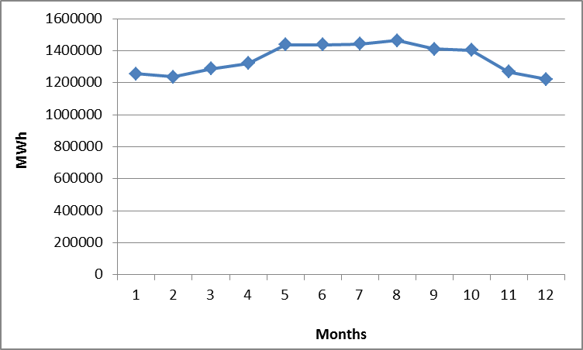
Lecture 10.2 Scenario development: time-related inputs
Seasons
1st season begins January 1st
2nd season begins April 1st
3rd season begins November 1st
I
II
III
10
Notes:
In MAED-E.L., seasons are defined as a period of the year when the electricity demand has similar behaviour. The user could define the seasons as winter, spring, summer, and autumn or choose different seasons. The most important thing is that seasons are chosen in a way that captures the changes in electricity demand. Up to 12 seasons can be defined.
In order to decide which seasons best describe the year, we recommended that the user makes a monthly load curve. Using the hourly load data for the base year, the user can find the total monthly consumption, as shown in this example graph. This will help with choosing appropriate start and end points for each season through visual inspection of the curve or data analysis if necessary. In this example data, three seasons can be defined: the first from January 1st until the end of March; the second from April 1st until the end of October, and the last one includes November and December.

Slide 11
Lecture 10.2 Scenario development: time-related inputs
Day types
Monday
Tuesday
Wednesday
Thursday
Friday
Saturday
Sunday
Monday
Tuesday
Wednesday
Thursday
Friday
Saturday
Sunday
11
Notes:
We also need to provide MAED-E.L. information about day types. The user can select the first day of the week, as well as working and non-working days of each week, which can vary between countries.

Slide 12
Lecture 10.2 Scenario development: time-related inputs
Holidays
Every week
Sundays
Holidays
January 1st
May 1st
December 25th
…
Free days
12
Notes:
In addition to designating day types, we also need to define holidays. Two types of days should be defined for the holiday characterization. The first are the non-working days that take place every week of the year, like Sundays for some countries. And the second group are the non-working days that occur on specific days throughout the year, such as religious and national holidays; for example: in some countries, January 1st, May 1^{st,} or December 25th are holidays.

Slide 13
Lecture 10.3 – Scenario development: technical inputs
Reconstruction of base year hourly demand
Scenario development
Results analysis
Steps for predicting hourly electricity demand
Predicting hourly electricity demand in MAED-EL
13
Notes:
In this mini-lecture, we will learn about the second part of the second step: scenario development.

Slide 14
Lecture 10.3 Scenario development: technical inputs
Scenario inputs
From MAED-D
Time horizon of the study period (base and reference years)
From user
Seasons
Average electricity demand by sectors, by years
Day types (normal weekdays)
Share of electricity supplied by the grid, by sectors
Share of clients by sectors
Transmission losses
Distribution losses by sectors
Seasonal, daily, and hourly coefficients
Holidays (every week, during the year)
14
Notes:
Let us now consider the other inputs from the user, those in blue on the right hand side. There are the technical inputs.

Slide 15
Lecture 10.3 Scenario development: technical inputs
Share of electricity supplied by grid, an example
Grid electricity
Industry (95%)
Household (80%)
Service (100%)
Transportation (100%)
Rooftop solar (15%)
Backup generators (5%)
Backup generators (5%)
15
Notes:
The first technical input we’ll discuss is the share of electricity supplied by the grid for each sector. This value is specified so that local generation can be accounted for in each sector. This diagram shows an example of what share of electricity is supplied by the grid for each sector. In this example, both service and transportation are completely reliant on the central grid for electricity. The industry sector gets 95 percent of its electricity from the grid, with backup generators providing the remaining 5 percent. The household sector relies on the grid for 80 percent of their demand, with rooftop solar meeting 15 percent and backup generators providing 5 percent. The electricity from backup generators and rooftop solar is to give an example of other electricity supplies: you only need to provide the percent of electricity supplied by the grid for each sector. This value is specified for each year modelled, so you can change it to account for any expected increase in local generation in different sectors, if applicable.

Slide 16
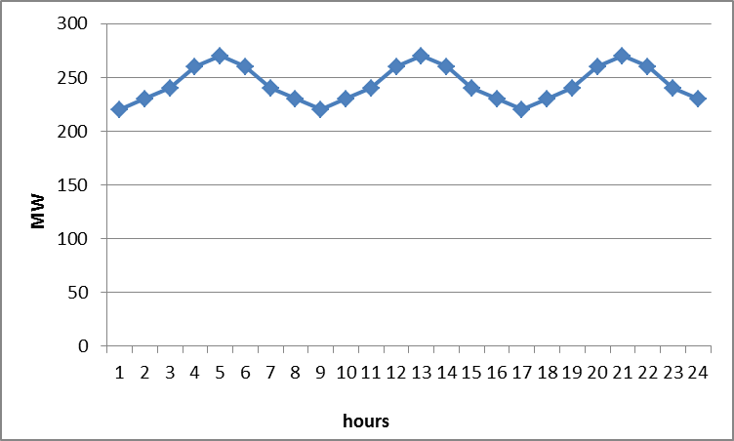
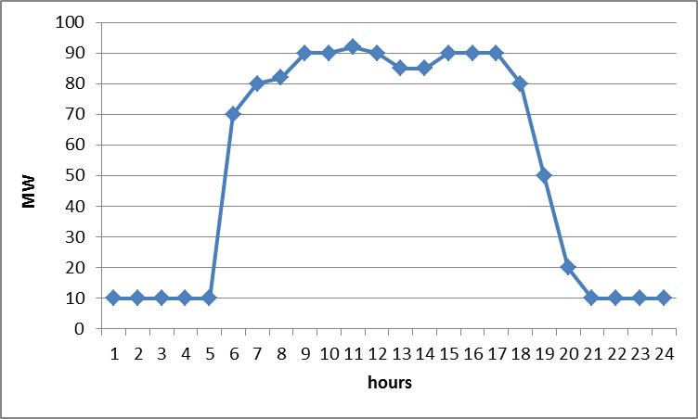
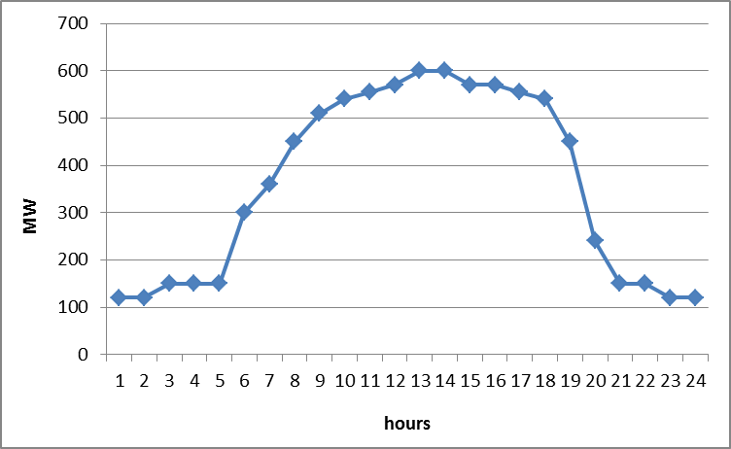
Lecture 10.3 Scenario development: technical inputs
Share of clients by sector
Industry
Steelmaking
40%
Agriculture
10%
2. Sector demand
Other
50%
1. Client demand
16
Notes:
The second technical input is the share of clients by sector.
As we have seen, in MAED-E.L., it is possible to define clients within the sectors. This option allows us to model subsectors with different load demands and patterns.
For example, let us suppose that the Industry sector includes three sub-sectors or clients; the steel industry, agriculture, and a third one comprising all other clients. The steel industry is a large consumer that works continuously, leading to a high but even electricity load. For the agriculture sector the electricity demand is lower and most work - and therefore the electricity demand - occurs during day-light hours. The rest of the industries mainly follow regular working hours and have a similar load pattern. In this case, it is possible to define 3 clients for the Industry sector, and in order to model them each of the client’s share of total demand for the sector must be defined.
To be able to model individual clients in MAED-E.L., it is necessary to have load data for each of them. This is because for each defined client the modulating coefficients must be input.
It is therefore important to ensure that the necessary load information is available before deciding to pursue this option. If all subsectors within a sector have a similar hourly behaviour or if the hourly data is available only for the sector as a whole and not for the subsectors, it is recommended that the sector is modelled as a single client.
If multiple clients are included in the same sector, we also need to designate the portion of that sector’s demand that each client makes up. In this example, the relatively large steelmaking industry accounts for 40 percent of industry demand, while agriculture only accounts for 10 percent. You can input different values for each year modelled to account for the rise and fall of different clients over time.

Slide 17
Lecture 10.3 Scenario development: technical inputs
Transmission and distribution losses
System-wide transmission losses
Industry distribution losses
Household distribution losses
Service distribution losses
Transportation distribution losses
17
Notes:
The third and fourth technical inputs are transmission and distribution losses.
MAED-E.L. is designed to model the hourly electric power demand that the electricity system will have to provide. This means that the total transmission losses at system level and the sectoral distribution losses should be added to the electricity demand. This is done in order to obtain the total electricity that the power system should supply.
The electricity losses, either transmission or distribution, are caused by different factors. These could be technical like the Joule and Corona effects, and non-technical, due to electricity theft or inaccuracies in metering and billing, among other issues. The technical losses are caused by energy dissipation in the conductors and equipment used for transmission, transformation, and distribution, which depend on the load level, the pattern of the energy use, and the capacity and configuration of the transmission and distribution systems. However, due to the difficulties in making actual measurements, it is common for the electricity losses to simply be calculated as the difference between the actual electricity generation and the electricity sales. This is usually presented as a percentage of total generation for a certain period. In long-term planning studies, a yearly average value is most often used, and this is what is used in MAED-E.L..
Because the different sectors share the same transmission system, only one system-wide transmission loss value is input for each year that is modelled. However, sectors may have very different distribution losses, so these are defined for each sector for each year modelled. Because the user can input different transmission and distribution losses for each year modelled, they can account for system efficiency improvements or degradation of infrastructure over time.

Slide 18
Lecture 10.4 Results Analysis
Reconstruction of base year hourly demand
Scenario development
Results analysis
Steps for predicting hourly electricity demand
Predicting hourly electricity demand in MAED-EL
18
Notes:
In this mini-lecture, we will learn about the final step: results analysis.

Slide 19

Lecture 10.4 Results Analysis
Checking the results for the base year, like spot the difference
MAED results for base year
Published statistics for the base year
19
Notes:
In the previous steps, all the input data were defined. These included: the annual electricity demand, the percentages of electricity supplied by the grid to clients, the structure per sector, transmission and distribution losses, as well as seasonal, daily, and hourly coefficients. Therefore, the next step is to check if the results for the base year are satisfactory, a process which is like spot the difference. The hope, of course, is that they are similar, with negligible differences, meaning the input data is sound and you can proceed with the analysis.

Slide 20
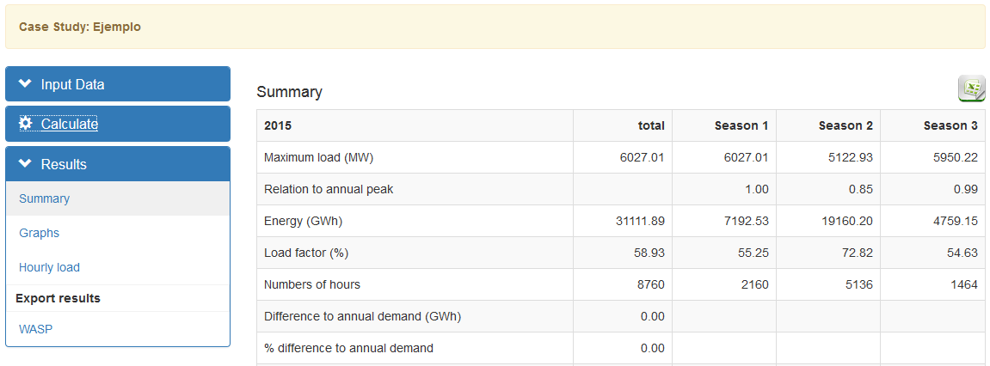
Lecture 10.4 Results Analysis
Checking the base year results
20
Notes:
As you will know from the hands-on, the user has access to the results after calculating them using the option in the navigation menu. Once the calculations are done, the results of each year are presented in their respective table. In order to check the results of the base year, the user must compare the maximum load values with the statistical data. The season in which the peak load occurs must also be checked.
Similarly, the user must evaluate whether the values of the load factors in each season and for the year on the whole are consistent with the base year values.
If the base year results from MAED-E.L. are similar to those published in the statistical data, the user can then analyse the results for the other years of the study. Otherwise, the user must review the input data in order to find the source of the differences and repeat this process until all issues have been solved and the results are satisfactory.

Slide 21
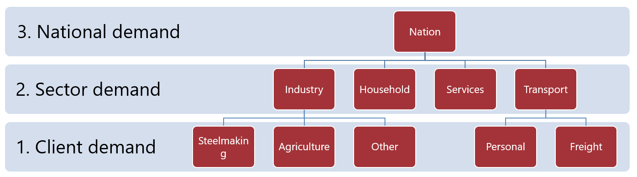
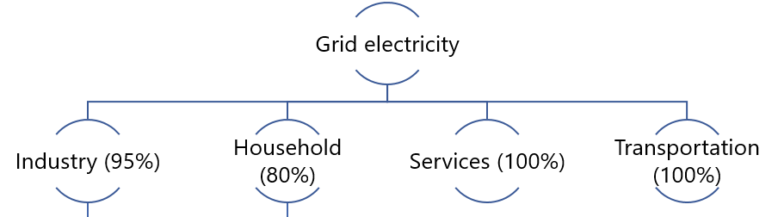
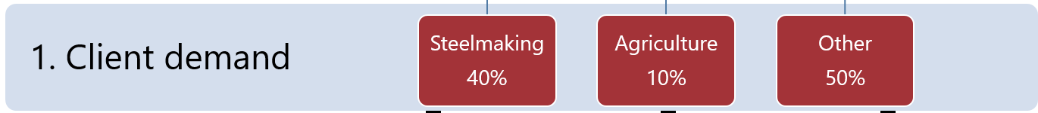
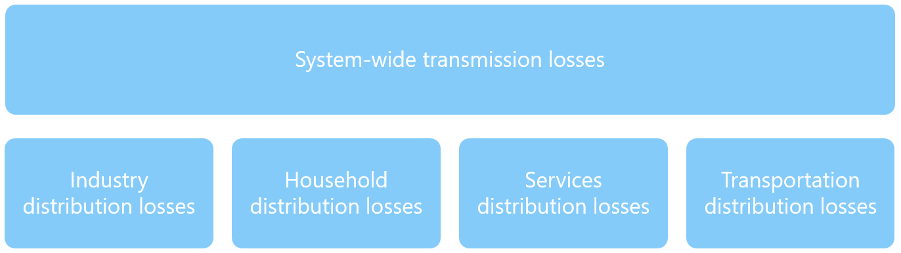
Lecture 10.4 Results Analysis
Implementing the scenarios
Annual Demand
Percentage supplied by grid
Structure of Clients
Losses
Seasonal, daily, hourly
coefficients
21
Notes:
Once the base year results are satisfactory, the user must implement the scenarios as described in mini-lecture two and three of this lecture.
To develop the scenarios, the user must define the data for the reference years related to the annual demand, the percentage of electricity supplied by the grid, the clients, the transmission and distribution losses, as well as the seasonal, daily, and hourly coefficients.
Once this is done, the scenarios can be used to forecast future electricity demand profiles.

Slide 22
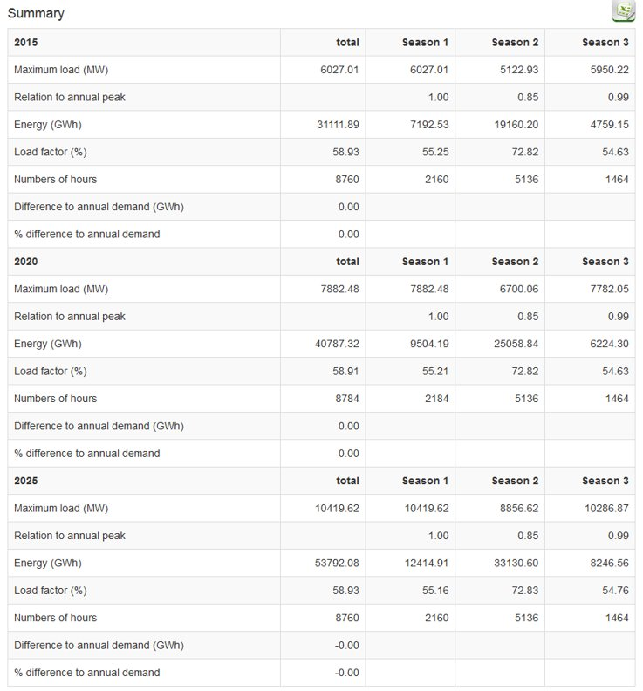
Lecture 10.4 Results Analysis
Analysing all the results
The results for future years must be sense-checked because there will be no statistical data to compare them to.
The user must rely on their experience to assess the validity of the results.
Results from other models could also be used to assist in checking the MAED results.
22
Notes:
Once the user has conducted the calculations under the given scenarios. The results for the future years must be sense-checked.
The table shows results for a simulation run using 2015 as the base year, considering scenarios for the years 2020 and 2025. At the time this simulation was run, both of these years would have been in the future.
The maximum load per season must be sense-checked, including the season in which it occurs as well as the load factor.
Because these results are for the future and there is no statistical data to compare the results with, the user should rely on their experience to assess the validity of the results.
Results from other models could be used as reference values to assist in checking the results.
This concludes lecture 10 on the structure of MAED-E.L. This is the final lecture in this course, you still have one hands-on to complete. Thank you for joining us, we hope you enjoyed it!

Slide 23

Cannone, C., Collett, K.A., Charbonnier F., Ahsan A., Halloran C., Vijay,A.,Berdellans I., Hasanovic S., Gritsevskyi A,Stankeviciute L., Tot M.; Welsch M., Hirmer S., 2023. Lecture 10: "MAED-EL STRUCTURE" , Energy Demands Projections with MAED (Model for Analysis of Energy Demand). Release Version 2.0. [online presentation]. Climate Compatible Growth & Programme and International Atomic Energy Agency.
CCG courses (this will take
you to the website link http://www.ClimateCompatibleGrowth.com/teachingmaterials)
23

