Slide 1
Lecture 10
Closing the Net Financing Gap
Open Learn Collection
Financial Modelling for Energy Transitions: MINFin, FinTrack & FinCoRE

Slide 2
Lecture Outline
Financial Modelling for Energy Transitions
 | Learning Objectives
Part 1 | Understanding the Net Gap
Part 2 | Grants, Loans and Blended Finance
Part 3 | Pay-as-you-go Carbon Credits
Part 4 | Debt Write-Offs

Slide 3
Learning Objectives
Define the net financing gap and its significance
Identify and explain the range of financing instruments used to address the financing gap in MINFin
Calculate the quantum of each financing instrument
Analyse the impact of these instruments on the gross financing gap

Slide 4
Understanding the Net Gap
Part 1

Slide 5

Net Financing Gap
Recap from Previous Lecture:
We examined the concept of the financing gap, which represents the shortfall between available funding (sector cash flows) and the financing required (capital borrowing) to support the energy transition plan. This gap can be addressed through two primary approaches:
(1) Enhancing Funding Availability
(2) Reducing Financing Requirement
This Lecture Focus:
In this lecture, we will explore another type of financing gap and examine the financial mechanisms to bridge these gaps, including: Grants, Loans, Carbon Credits and Debt Write-Offs.
Notes:
In the previous lecture, we examined the concept of the financing gap, which reflects the disparity between the funding available—often derived from sector cash flows—and the capital needed to meet the financing requirements of energy transition plans. To effectively address this gap, we can adopt two primary strategies:
Enhancing Funding Availability: This involves increasing the amount of available funding for energy transition projects through various sources, such as private investments, public sector contributions, or international climate funds.
Reducing Financing Requirements: This focuses on minimizing the cost or need for financing by optimizing resource use, adopting more cost-effective technologies, or reducing the scope of investments required for achieving energy transition goals.
In this lecture, we will explore a related but distinct form of financing gap: the one that arises specifically from the additional costs associated with transitioning to a Net Zero (NZ) economy. We will also discuss various financial mechanisms designed to bridge these gaps, including grants, loans, carbon credits, and debt write-offs.

Slide 6
How much climate finance do individual countries need?
In 2009, developed nations committed to mobilizing $100 billion annually by 2020 to support climate action in developing countries.
At COP29, this commitment was revised under the NCQG discussion, with an agreement to triple finance to $300 billion annually by 2035.
Now that the global climate finance target has been established, the key question is: How should this finance be allocated to individual countries? And, based on what principles and instruments?
MinFin can be used to explore various principles for allocating climate finance to countries, as well as different mechanisms for delivering this finance effectively.
Notes:
To understand the scale of climate financing required, it's important to consider the commitments made by developed nations in the past and their subsequent evolution. In 2009, developed countries pledged to mobilize $100 billion annually by 2020 to support climate action efforts in developing countries. However, this initial commitment was revised during COP29 under the framework of the NCQG discussion, which resulted in an updated goal to increase the finance commitment to $300 billion annually by 2035.
With this global target in place, we now face the crucial question: How should these financial resources be allocated to individual countries? Furthermore, what principles and instruments should guide this allocation to ensure it is both equitable and effective in promoting climate resilience and sustainability in developing nations?
In this context MinFin can help us explore various principles for the distribution of climate finance and the mechanisms through which it can be delivered to countries in a fair and efficient manner. By understanding these mechanisms, we can better support the global transition to a low-carbon economy.

Slide 7
Quantifying Additional Repayment for NZ versus BAU as a Key Metric for Financial Commitment
To determine the financing needs for the power sector at the national level, comparing the financing costs between a Net Zero (NZ) and a Business-as-Usual (BAU) energy investment plan provides a clear framework. This comparison helps establish the minimum funding that should be allocated to developing countries through the NCQG commitment from developed nations, ensuring they are no worse off under NZ than under BAU.
This approach assumes that the international community will bear the additional costs of achieving NZ beyond the BAU path, offering one possible method of burden-sharing.
Notes:
When determining the financing needs of the power sector, it is crucial to compare the costs associated with transitioning to Net Zero (NZ) versus maintaining a Business-as-Usual (BAU) energy investment strategy. This comparison is valuable because it allows us to quantify the additional financial commitment required for NZ compared to BAU.
By contrasting these two investment paths, we can establish the minimum level of funding that should be allocated to developing countries through the NCQG commitment from developed nations. This ensures that developing countries are not at a financial disadvantage when pursuing NZ goals, ensuring that they are no worse off than if they had followed a BAU scenario.
This approach assumes that the international community, particularly developed nations, will take on the extra costs associated with achieving Net Zero beyond what would have been required under the BAU scenario. It provides a framework for burden-sharing, ensuring that the costs of mitigating climate change are distributed more equitably across countries.

Slide 8
The additional quantum of repayment for NZ versus BAU is a useful metric to determine the financial burden of climate targets
Under historic financing conditions, BAU is expected to be far more affordable for this country than the NZ plan. As a result, efforts to reduce emissions are imposing a substantial financial burden on the nation
Note: All numbers are fictional and purely illustrative
Notes:
Under traditional financing conditions, pursuing a Business-as-Usual (BAU) path is typically more affordable than transitioning to a Net Zero (NZ) strategy. For many countries, this transition imposes a significant financial burden, as the costs associated with implementing cleaner technologies and reducing emissions are often higher than the costs of continuing with the status quo.
In this slide, we observe a graphical representation from the MinFin dashboard that shows two distinct scenarios: the Net Zero pathway and the Least Cost (or BAU) scenario. The shaded areas in the graph represent the additional financial burden of transitioning to NZ—essentially, the "delta" or difference between the two scenarios.
This metric is instrumental in identifying the gap in financing that needs to be covered by developed nations. By calculating the delta between NZ and BAU, we can better understand the extent of additional capital required and thereby define the financial commitment that developed countries should make to support the energy transition in developing nations.

Slide 9
Climate finance could potentially be delivered via a range of different financial instruments
Grants
Loans
Grant & Loan Combination
Softening Financing Terms
Carbon Credits
Debt Write-Off
The following section explores six financial instruments to deliver climate finance and close the gap: upfront capital grants, loans, a combination of grants and loans, reducing the weighted average cost of capital (WACC) through increased concessional finance contributions, a pay-as-you-go carbon credit scheme, and debt forgiveness.
Notes:
Now that we have a clear understanding of the financial gap between the NZ and BAU scenarios, let’s explore the various mechanisms available to close this gap. In this section, we will examine six potential financial instruments that can be used to deliver climate finance and bridge the financing gap. These instruments include:
Upfront Capital Grants: Direct financial contributions that can reduce the upfront investment burden.
Loans: Debt-based financing that can be repaid over time, offering an alternative to grants.
A Combination of Grants and Loans: Hybrid mechanisms that blend both concessional grants and loans.
Reducing the Weighted Average Cost of Capital (WACC): By increasing concessional finance contributions, we can lower the WACC and make financing more affordable.
Pay-As-You-Go Carbon Credit Scheme: A model that ties financial support to the generation of carbon credits over time.
Debt Forgiveness: Writing off a portion of external debt to reduce the financial burden on countries, enabling them to allocate more resources to their climate goals.
In the following slides, we will take a closer look at each of these instruments, exploring their role in bridging the climate financing gap.

Slide 10
Climate finance could potentially be delivered via a range of different financial instruments
Grants
Calculates grant requirement to compensate for the additional financial burden of NZ relative to BAU – with possibility of netting out benefits
Loans
              Evaluates the financial viability and MIRR of cashflows by considering the investment plan as a loan and the savings from the transition as revenue.
Combination
              Determines the cash injection in 2025 to attain financial breakeven, i.e., for MIRR to exceed WACC, treating the injection as a non-repayable grant.
Concessional
Finance
Calculates the WACC needed to equalise financing repayments between NZ and BAU, along with the additional concessional funding required from IFIs.
Carbon Credits
Calculates the carbon credit price needed to equalise financing costs between NZ and BAU.
Debt Write-offs
Determines the external debt amount to be forgiven to equalise NZ investment needs with BAU.
* MIRR: Modified Internal Rate of Return, WACC: Weighted Average Cost of Capital
Notes:
This slide dives deeper into the financial instruments mentioned earlier, offering a detailed look at how they function to close the financing gap:
Grants: In this model, we calculate the amount of grant funding required to compensate for the additional financial burden of transitioning to NZ compared to BAU. This could involve “netting out” potential benefits from the transition, thus ensuring that developing countries are not left worse off financially.
Loans: This approach involves evaluating the financial viability and Modified Internal Rate of Return (MIRR)of cash flows, considering the investment plan as a loan. The savings generated from the energy transition can then be treated as revenue, allowing countries to repay the loan over time.
Combination of Grants and Loans: This mechanism determines the necessary cash injection in 2025 to achieve financial breakeven, where the MIRR exceeds the WACC. In this scenario, the cash injection is treated as a non-repayable grant, making the financing less burdensome.
Concessional Finance: Here, we calculate the WACC required to balance the financing repayments between the NZ and BAU scenarios. This mechanism explores the additional concessional funding needed from international financial institutions (IFIs) to make the financing more affordable.
Carbon Credits: This mechanism assesses the carbon credit price required to equalize financing costs between the NZ and BAU pathways. The goal is to ensure that revenue from carbon credits offsets the additional investment required for NZ.
Debt Write-Off: Finally, we explore the potential for writing off external debt to reduce the financial burden of NZ investments. By forgiving a portion of the country’s debt, we can ensure that the country’s financing needs are more aligned with the BAU scenario, making the transition to NZ more feasible.
Each of these mechanisms offers unique advantages, and the choice of which instrument(s) to use will depend on the specific financial context of each country.

Slide 11
Grants, Loans and Blended Finance
Part 2

Slide 12
Modality 1: Grants
Grants play a crucial role in closing the financing gap, particularly in countries with limited fuel resources and low carbon savings.
These grants effectively eliminate the capital cost of new clean infrastructure for reaching Net Zero in the country, as they represent "free money." As a result, these costs are integrated into the funding projections.
This figure shows the net investment need gap, representing the capital required to close the difference in investment needs between Net Zero and Business-as-Usual scenarios, as illustrated by the grey-shaded area on the graph.
Within this framework, the capital indicated by this volume should be supplied by the global north through grants. These grants will, in turn, be allocated to the funding baseline.
Notes:
Grants are a crucial financial mechanism in closing the financing gap, especially for countries with limited fuel resources and low carbon savings. These grants are particularly effective because they essentially eliminate the capital cost of new infrastructure, as they represent "free money" that doesn’t need to be repaid. This significant financial support helps reduce the burden of upfront capital investment required for energy transition projects.
As a result, the costs covered by grants are excluded from the investment and financing needs typically shown on the MinFin dashboard. Instead, they are integrated into the funding dashboard, as grants directly increase the available capital for investment without incurring repayment obligations.
The annual grant requirement is calculated by assessing the difference (or delta) in the investment needed to achieve a Net Zero (NZ) scenario compared to a Business-as-Usual (BAU) or Low Carbon (LC) scenario. This calculation takes into account the additional costs of reaching Net Zero and subtracts the savings generated from the return on Net Zero investments. Additionally, savings from reduced fossil fuel expenditures and the value of carbon credits (measured by the CO₂ price) are factored in.
This figure illustrates the net investment need gap, which represents the capital required to bridge the difference between the Net Zero and Business-as-Usual scenarios, as shown by the grey-shaded area.
Within this framework, the capital highlighted by this gap should be provided by the Global North through grants. These grants will then be directed toward the funding baseline.

Slide 13
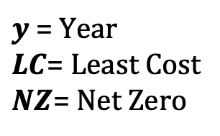
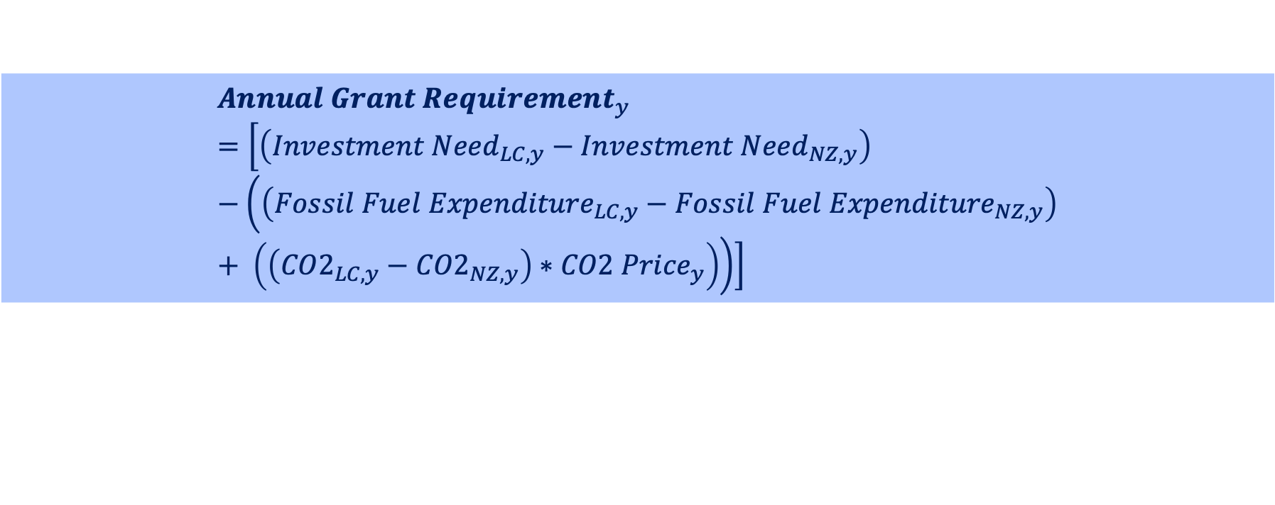
Modality 1: Grants
The grant volume is calculated by assessing the delta in investment required for the transition and subtracting the savings that represent a return on net-zero investments.
$${Annual Grant Requirement}_{y}=\left[\left({Investment Need}_{LC, y}−{Investment Need}_{NZ, y}\right)−\left(\left({Fossil Fuel Expenditure}_{LC, y}−{Fossil Fuel Expenditure}_{NZ, y}\right)+ \left(\left({CO2}_{LC,y}−{CO2}_{NZ,y}\right)∗{CO2 Price}_{y}\right)\right)\right]$$
Where:
$y$ = Year
$LC$= Least Cost
$NZ$= Net Zero
The annual grant requirement is calculated for each year $y$, and then summed
over the modelling horizon
Notes:
The formula shown on the slide calculates the annual grant requirement by considering the investment need for the Low Carbon (LC) and Net Zero (NZ) paths, the changes in fossil fuel expenditure, and the value of emissions reductions, which are monetized by the CO₂ price. This approach ensures that the calculated grant amount covers the full additional costs of transitioning to a Net Zero energy system whilst also considering savings.

Slide 14
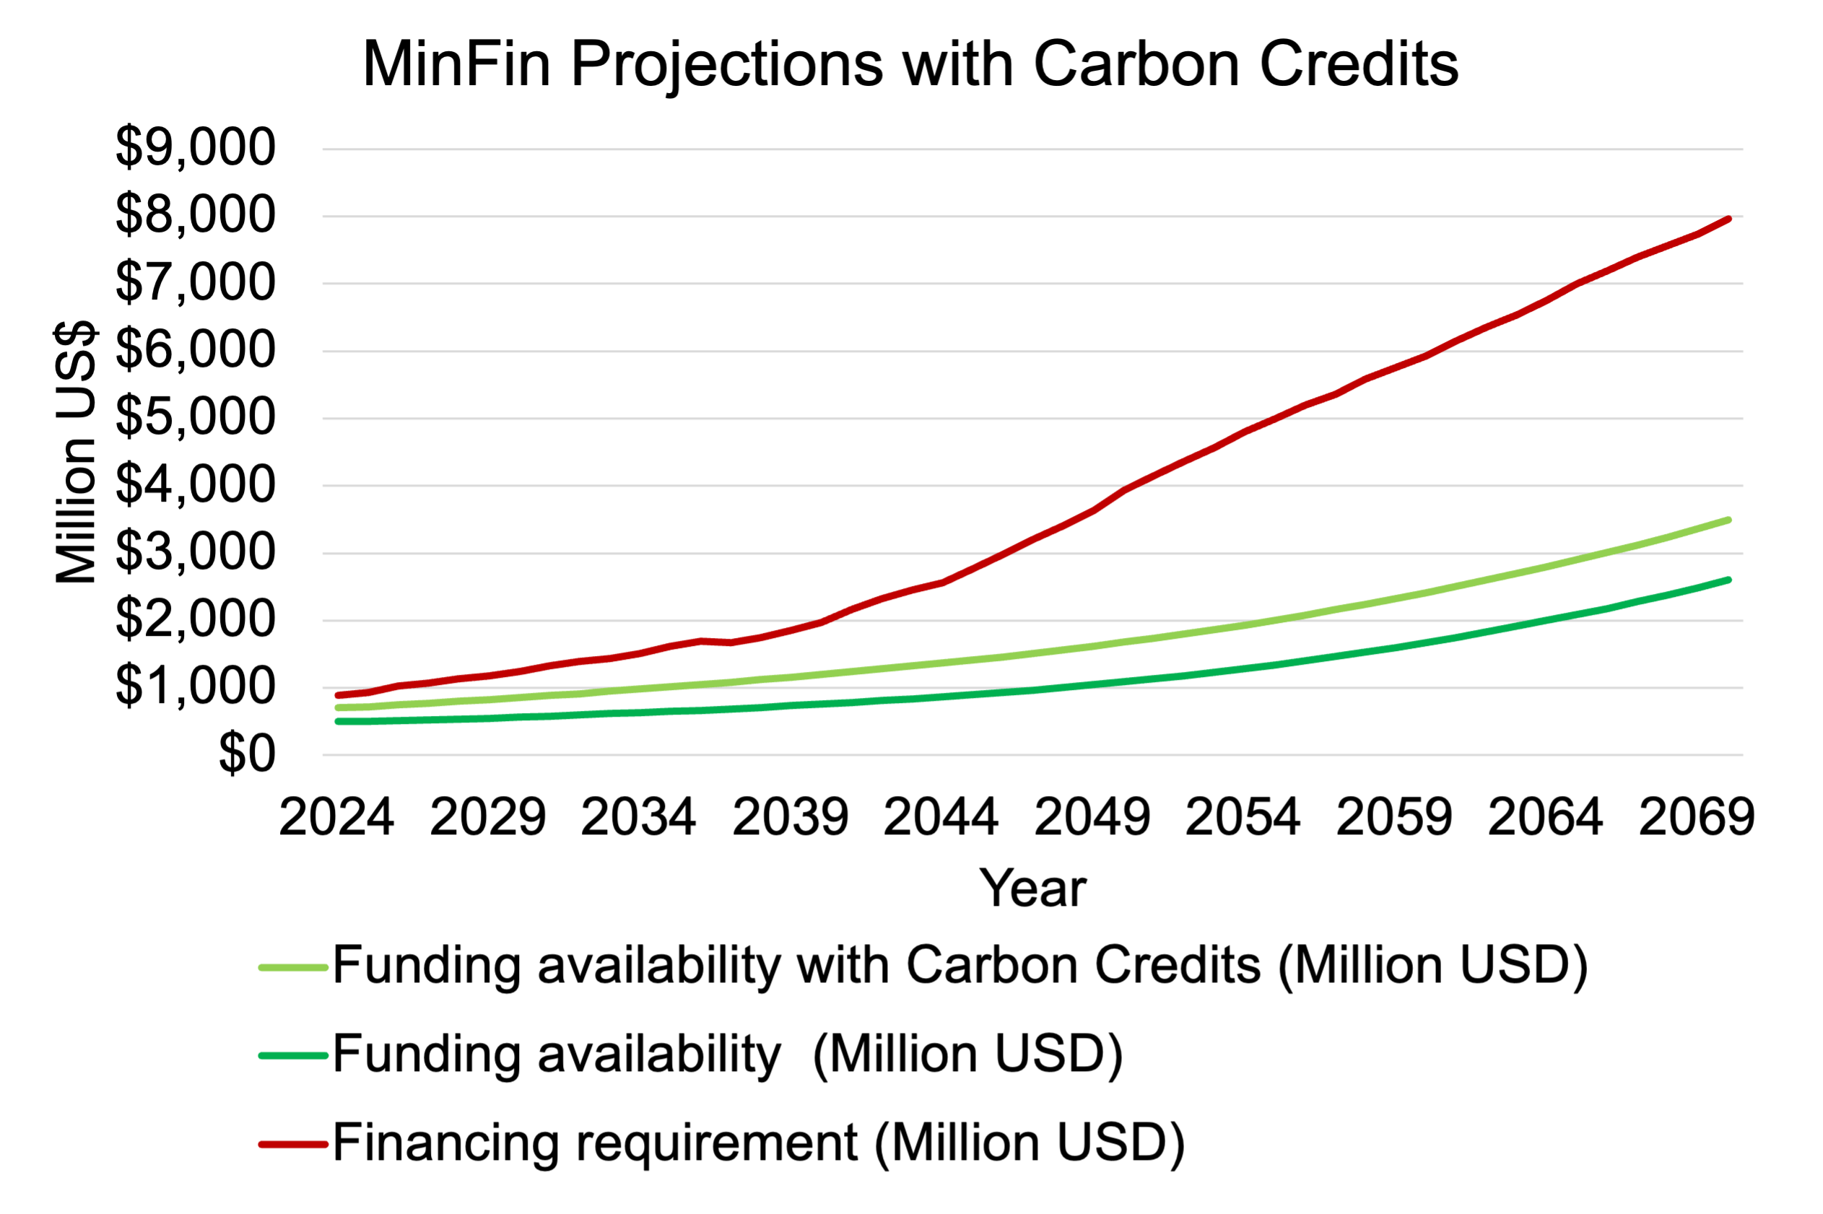
Modality 1: Grants
This figure shows funding availability before and after incorporating additional grants, against financing requirement for NZ.
The diagram illustrates how this additional grant affects the overall gap between the financing required and the available funding. While it helps close the gap between NZ and BAU, it does not fully close the gap between sector cash flow and the financing requirement.
Grants
Grants (Million USD)
Notes:
This figure showcases the MinFin dashboard, where:
The dark green funding line represents funding without the additional grant volume,
The light green line indicates the integration of the additional grant volume required to close the gap between the Net Zero (NZ) and Business-as-Usual (BAU) scenarios.
While these grants help narrow the investment gap, the diagram shows that they do not fully close the discrepancy between required financing and available funds, as the light green funding availability still remains below the financing requirement.
This illustrates that, although grants are essential in supporting the transition, they may not entirely resolve the financial shortfall in the broader energy sector. Therefore, in this hypothetical scenario, while grants play a vital role in facilitating the transition, additional financial mechanisms will likely be necessary to address the remaining funding needs for the energy transition.

Slide 15
Modality 2: Loans
In this approach, climate finance is structured as a loan that provides capital to cover incremental investment costs, with repayments derived from the savings generated.
The net cash flows are used to calculate the Modified Internal Rate of Return (MIRR), which assesses whether the additional net-zero investments break even when accounting for the savings.
If the MIRR exceeds the country's Weighted Average Cost of Capital (WACC), the investment is considered profitable, indicating that the returns justify the investment. For example:
(1) If MIRR > WACC, the investment presents a positive proposition.
(2) If MIRR < WACC, the investment is not favourable, and additional positive cash flows, such as grants, are required to make it viable.
Notes:
In this approach, climate finance is structured as a loan, where the capital provided covers the incremental investment costs required for the transition to a Net Zero (NZ) scenario. The repayments for this loan are derived from the savings generated through net-zero investments, such as the reduction in fossil fuel expenditures and the revenues from carbon credits.
The financial viability of these investments is assessed using the Modified Internal Rate of Return (MIRR). The MIRR helps determine whether the additional net-zero investments break even when accounting for the savings generated by the transition. Specifically, the MIRR compares the future value of the savings (positive cash flows) with the current cost of the investment (negative cash flow).
If the MIRR exceeds the country's Weighted Average Cost of Capital (WACC), the investment is considered profitable, meaning the returns from the investment will outweigh the costs. Conversely:
If MIRR > WACC, the investment is considered financially viable, indicating that the returns justify the investment.
If MIRR < WACC, the investment is not favorable, meaning additional financial support, such as grants, would be required to make the investment feasible.
In other words, the MIRR serves as a tool to evaluate whether the financial returns from net-zero investments are sufficient to cover the capital cost, and if not, it signals the need for supplementary funding.

Slide 16
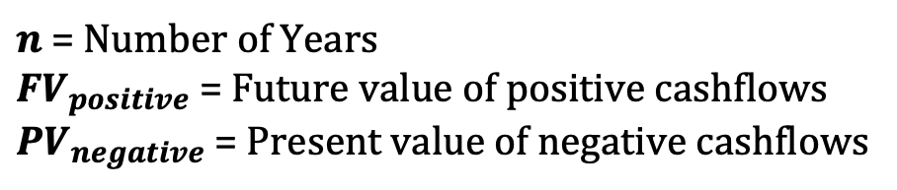

Modality 2: Loans
The MIRR is determined by evaluating the net cash flow of a given scenario. This involves treating the required investment for the transition as a negative cash flow or cost, while the savings generated from net-zero investments, such as carbon credits and reduced fossil fuel expenditures, are incorporated as positive cash flows.
When calculating the MIRR, three key factors are considered: (1) the future value of positive cash flows, which is discounted at the reinvestment rate, (2) the present value of negative cash flows, discounted at the financing rate, and (3) the number of periods involved in the investment.
$$MIRR= {\left(\frac{{FV}_{positive}}{{PV}_{negative}}\right)}^{\frac{1}{n}}−1$$
Where:
$n$ = Number of Years
${FV}_{positive}$ = Future value of positive cashflows
${PV}_{negative}$ = Present value of negative cashflows
Notes:
The MIRR is determined by evaluating the net cash flow of a given scenario. This involves treating the required investment for the transition as a negative cash flow or cost, while the savings generated from net-zero investments, such as carbon credits and reduced fossil fuel expenditures, are incorporated as positive cash flows.
When calculating the MIRR, three key factors are considered: (1) the future value of positive cash flows, which is discounted at the reinvestment rate, (2) the present value of negative cash flows, discounted at the financing rate, and (3) the number of periods involved in the investment.
In this section, we will walk through the Modified Internal Rate of Return, or MIRR, calculation used to assess the financial viability of transitioning from a Least Cost scenario to a Net Zero scenario. Unlike traditional IRR, MIRR accounts for both the cost of capital and the reinvestment rate, providing a more realistic measure of returns.
We will break down this calculation into four key steps: computing annual cash flows, determining the present value of negative cash flows, calculating the future value of positive cash flows, and finally deriving the MIRR itself

Slide 17
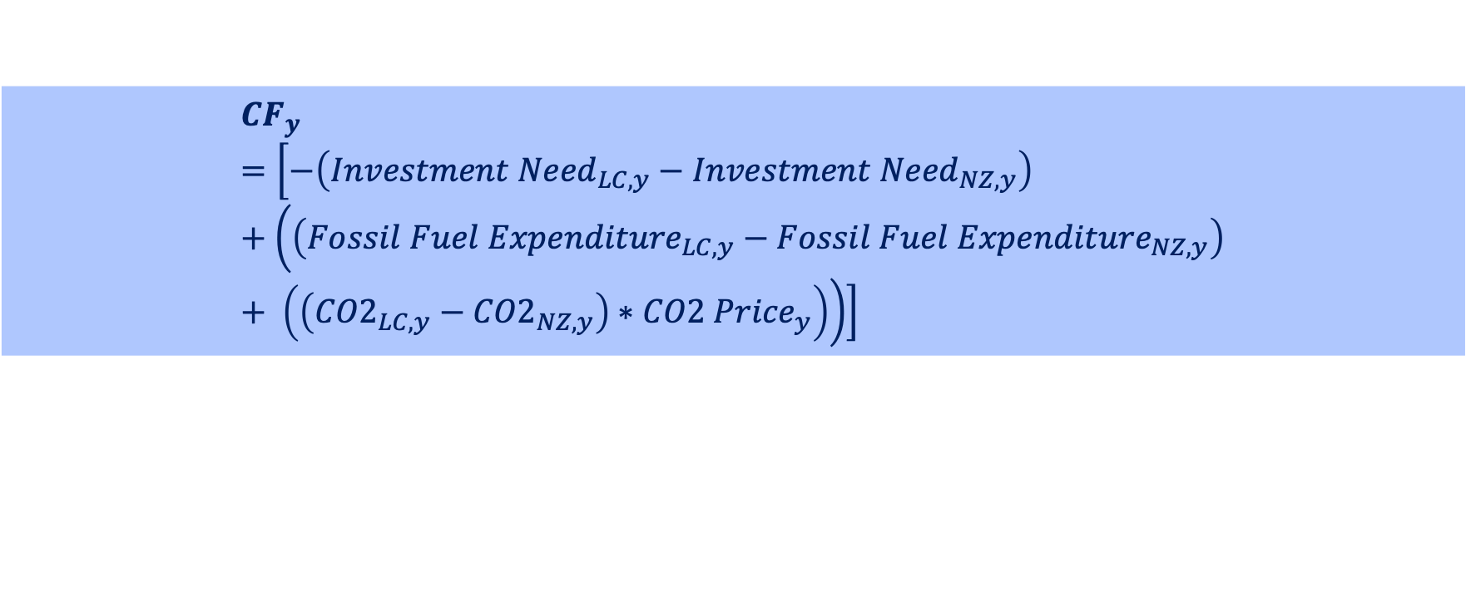
Modality 2: Loans, MIRR Calculation Step 1
Step 1: Annual Cash Flow Calculation
For each year $y$, the net cash flow ${CF}_{y}$ is computed as follows:
$${CF}_{y}=\left[−\left({Investment Need}_{LC, y}−{Investment Need}_{NZ, y}\right)+\left(\left({Fossil Fuel Expenditure}_{LC, y}−{Fossil Fuel Expenditure}_{NZ, y}\right)+ \left(\left({CO2}_{LC,y}−{CO2}_{NZ,y}\right)∗{CO2 Price}_{y}\right)\right)\right]$$
Where:
First term: additional capital required for Net Zero vs Least Cost
Second term: fossil fuel expenditure savings in Net Zero vs Least Cost
Third term: revenue from carbon pricing due to lower emissions in Net Zero
Notes:
The first step is to determine the annual cash flows for each year from 2025 to 2070.
Each year’s cash flow is composed of three key elements:
The additional capital investment required to transition from the Least Cost scenario to Net Zero. This represents the extra financial burden of adopting cleaner technologies and infrastructure.
The savings from reduced fossil fuel expenditures in the Net Zero scenario compared to the Least Cost scenario. As reliance on fossil fuels decreases, these savings help offset the transition cost.
The revenue generated from carbon pricing, which is calculated by multiplying the difference in CO₂ emissions between the two scenarios by the carbon price in that year. This reflects the financial benefit of lower emissions.

Slide 18
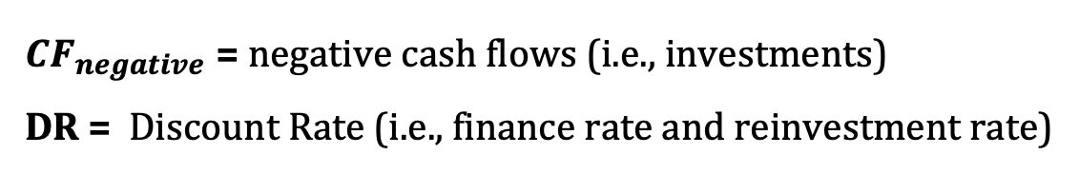

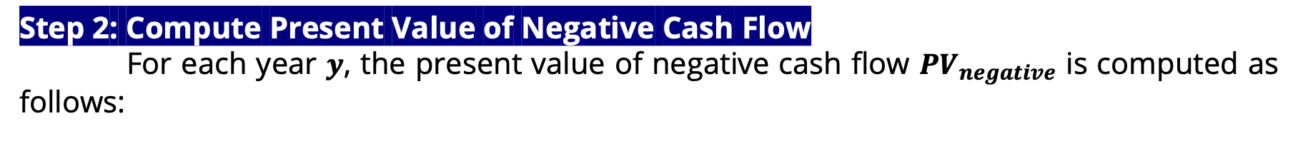
Modality 2: Loans, MIRR Calculation Step 2
Step 2: Compute Present Value of Negative Cash Flow
For each year $y$, the present value of negative cash flow ${PV}_{negative}$ is computed as follows:
$${PV}_{negative}= \sum_{y=0}^{n}{\frac{{CFnegative}_{y}}{{\left(1+DR\right)}^{y}}}$$
Where:
${CF}_{negative}$ = negative cash flows (i.e., investments)
DR = Discount Rate (i.e., finance rate and reinvestment rate)
Notes:
Now that we have the annual cash flows, we separate out the negative cash flows, which represent investment costs, and discount them back to present value.
This is done using the Capital Provider Discount Rate, which accounts for the time value of money—the idea that money today is worth more than the same amount in the future due to opportunity costs and inflation.
By discounting these investment costs, we translate future expenditures into today’s financial terms. This allows us to make a fair comparison between upfront costs and long-term financial benefits."*

Slide 19
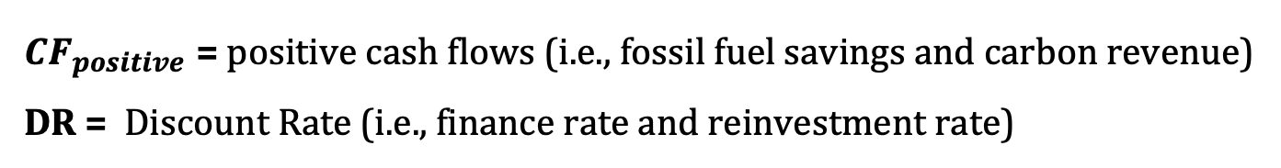
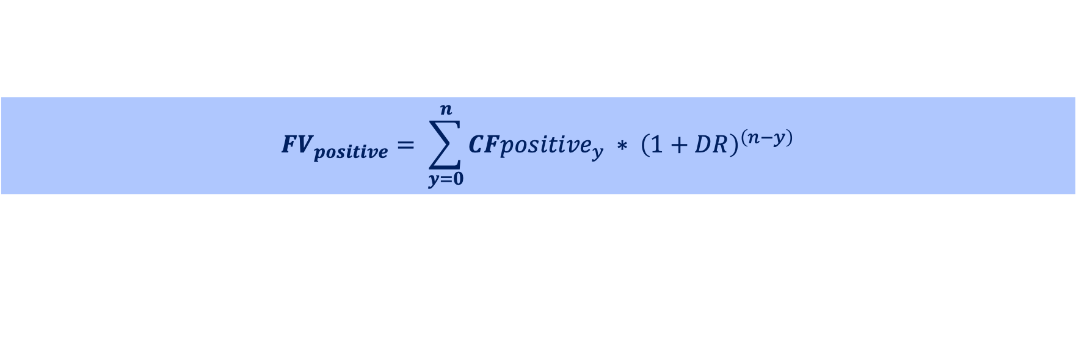
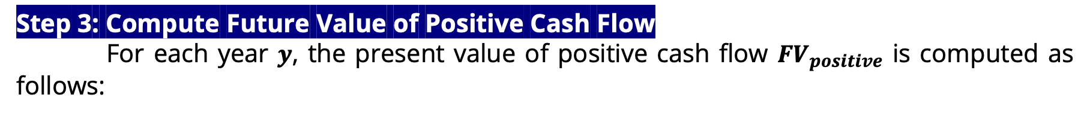
Modality 2: Loans, MIRR Calculation Step 3
Step 3: Compute Future Value of Positive Cash Flow
For each year $y$, the present value of positive cash flow ${FV}_{positive}$ is computed as follows:
$${FV}_{positive}= \sum_{y=0}^{n}{{CFpositive}_{y} ∗ {\left(1+DR\right)}^{\left(n−y\right)}}$$
Where:
${CF}_{positive}$ = positive cash flows (i.e., fossil fuel savings and carbon revenue)
DR = Discount Rate (i.e., finance rate and reinvestment rate)
Notes:
Next, we take all the positive cash flows, which include savings from lower fossil fuel expenditures and revenue from carbon pricing, and project them forward to the end of the period in 2070.
Instead of discounting, these cash flows are compounded forward using the same Capital Provider Discount Rate. This assumes that any positive cash flows are reinvested at this rate, reflecting potential financial growth. This step provides a clear picture of the total financial benefit generated by the Net Zero transition over time, expressed in terms of its value at the end of the period

Slide 20
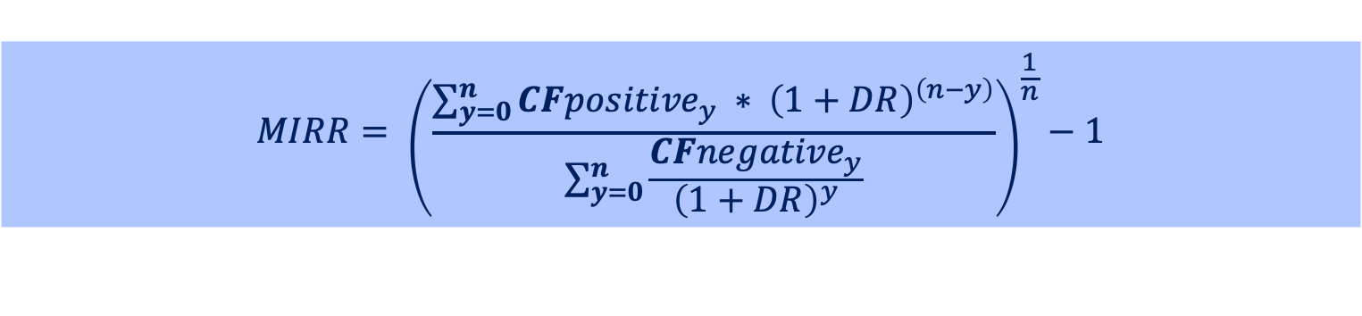
Modality 2: Loans, MIRR Calculation Step 4
Step 4: Calculating MIRR
Now, we’re substituting ${FV}_{positive}$ and ${PV}_{negative}$ into the MIRR equation:
$$MIRR= {\left(\frac{\sum_{y=0}^{n}{{CFpositive}_{y} ∗ {\left(1+DR\right)}^{\left(n−y\right)}}}{\sum_{y=0}^{n}{\frac{{CFnegative}_{y}}{{\left(1+DR\right)}^{y}}}}\right)}^{\frac{1}{n}}−1$$
Regarding its integration into the MINFin dashboard, this method is not directly implemented, as the cash flow streams for investments and revenues are already incorporated within the dashboard.
Instead, this approach serves as a benchmarking exercise, providing insights into the investment proposition of transitioning to Net Zero.
Notes:
Now that we have both the present value of negative cash flows and the future value of positive cash flows, we can calculate the Modified Internal Rate of Return (MIRR). This formula takes the ratio of future benefits to upfront costs, adjusts for the number of years in the investment period, and derives an annualized return rate.
Unlike traditional IRR, which assumes that positive cash flows are reinvested at the same rate as the IRR itself, MIRR provides a more realistic assessment by assuming reinvestment at the capital provider’s discount rate. This makes it a better metric for evaluating long-term investments like the Net Zero transition.
Regarding its integration into the MinFin dashboard, this method is not directly implemented, as the cash flow streams for investments and revenues are already incorporated within the dashboard. Instead, this approach serves as a benchmarking exercise, providing insights into the investment proposition of transitioning to Net Zero.

Slide 21
Modality 3: Combination Grant and Loan Instrument
When the incremental investment cannot be repaid through fuel and carbon savings, and the grant requirement is significant (i.e., when MIRR < WACC), countries may choose to combine grants with loans.
This blended financing approach integrates both grants and loans. It calculates the 2025 grant needed to enable the loan to reach financial breakeven, which is defined as the point where the MIRR equals or exceeds the WACC. In this model, the grant covers the portion of the investment that exceeds what the project can finance through its savings.
What grant is required to ensure that MIRR > WACC?
21
Notes:
In cases where the incremental investment cannot be fully repaid through fuel and carbon savings, and the required grant funding is substantial—specifically, when the Modified Internal Rate of Return (MIRR) is lower than the Weighted Average Cost of Capital (WACC)—countries may opt for a blended financing approach that combines grants with loans.
This method integrates both funding sources, calculating the grant needed in 2025 to bring the loan to financial breakeven. Financial breakeven is achieved when the MIRR equals or exceeds the WACC. In this model, the grant covers the portion of the investment that cannot be financed through savings alone.
So, the key question is: What level of grant funding is required to ensure that MIRR exceeds WACC?

Slide 22
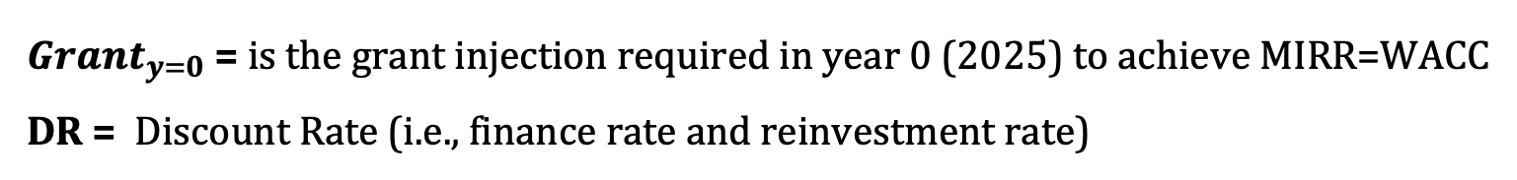
Modality 3: Combination Grant and Loan Instrument
The objective of this method is to calculate the required revenue injection in 2025 that ensures the MIRR = WACC
$${Grant}_{y=0}=\frac{{FV}_{positive}}{{\left(1+DR\right)}^{n}} −{PV}_{negative}$$
Where
${Grant}_{y=0}$= is the grant injection required in year 0 (2025) to achieve MIRR=WACC
DR = Discount Rate (i.e., finance rate and reinvestment rate)
22
Notes:
In this step, our goal is to find the revenue injection in 2025 that would cause the MIRR to be equal to the WACC, effectively matching the investment return rate with the cost of capital.
To do this, we calculate the required revenue injection using the formula above. The formula compares the future value of positive cash flows, discounted to present value terms, and adds the required adjustment to the 2025 cash flow, represented as Grant y=0. This ensures that when we calculate the MIRR, it matches the target WACC, thus adjusting the investment proposition to the required rate of return

Slide 23
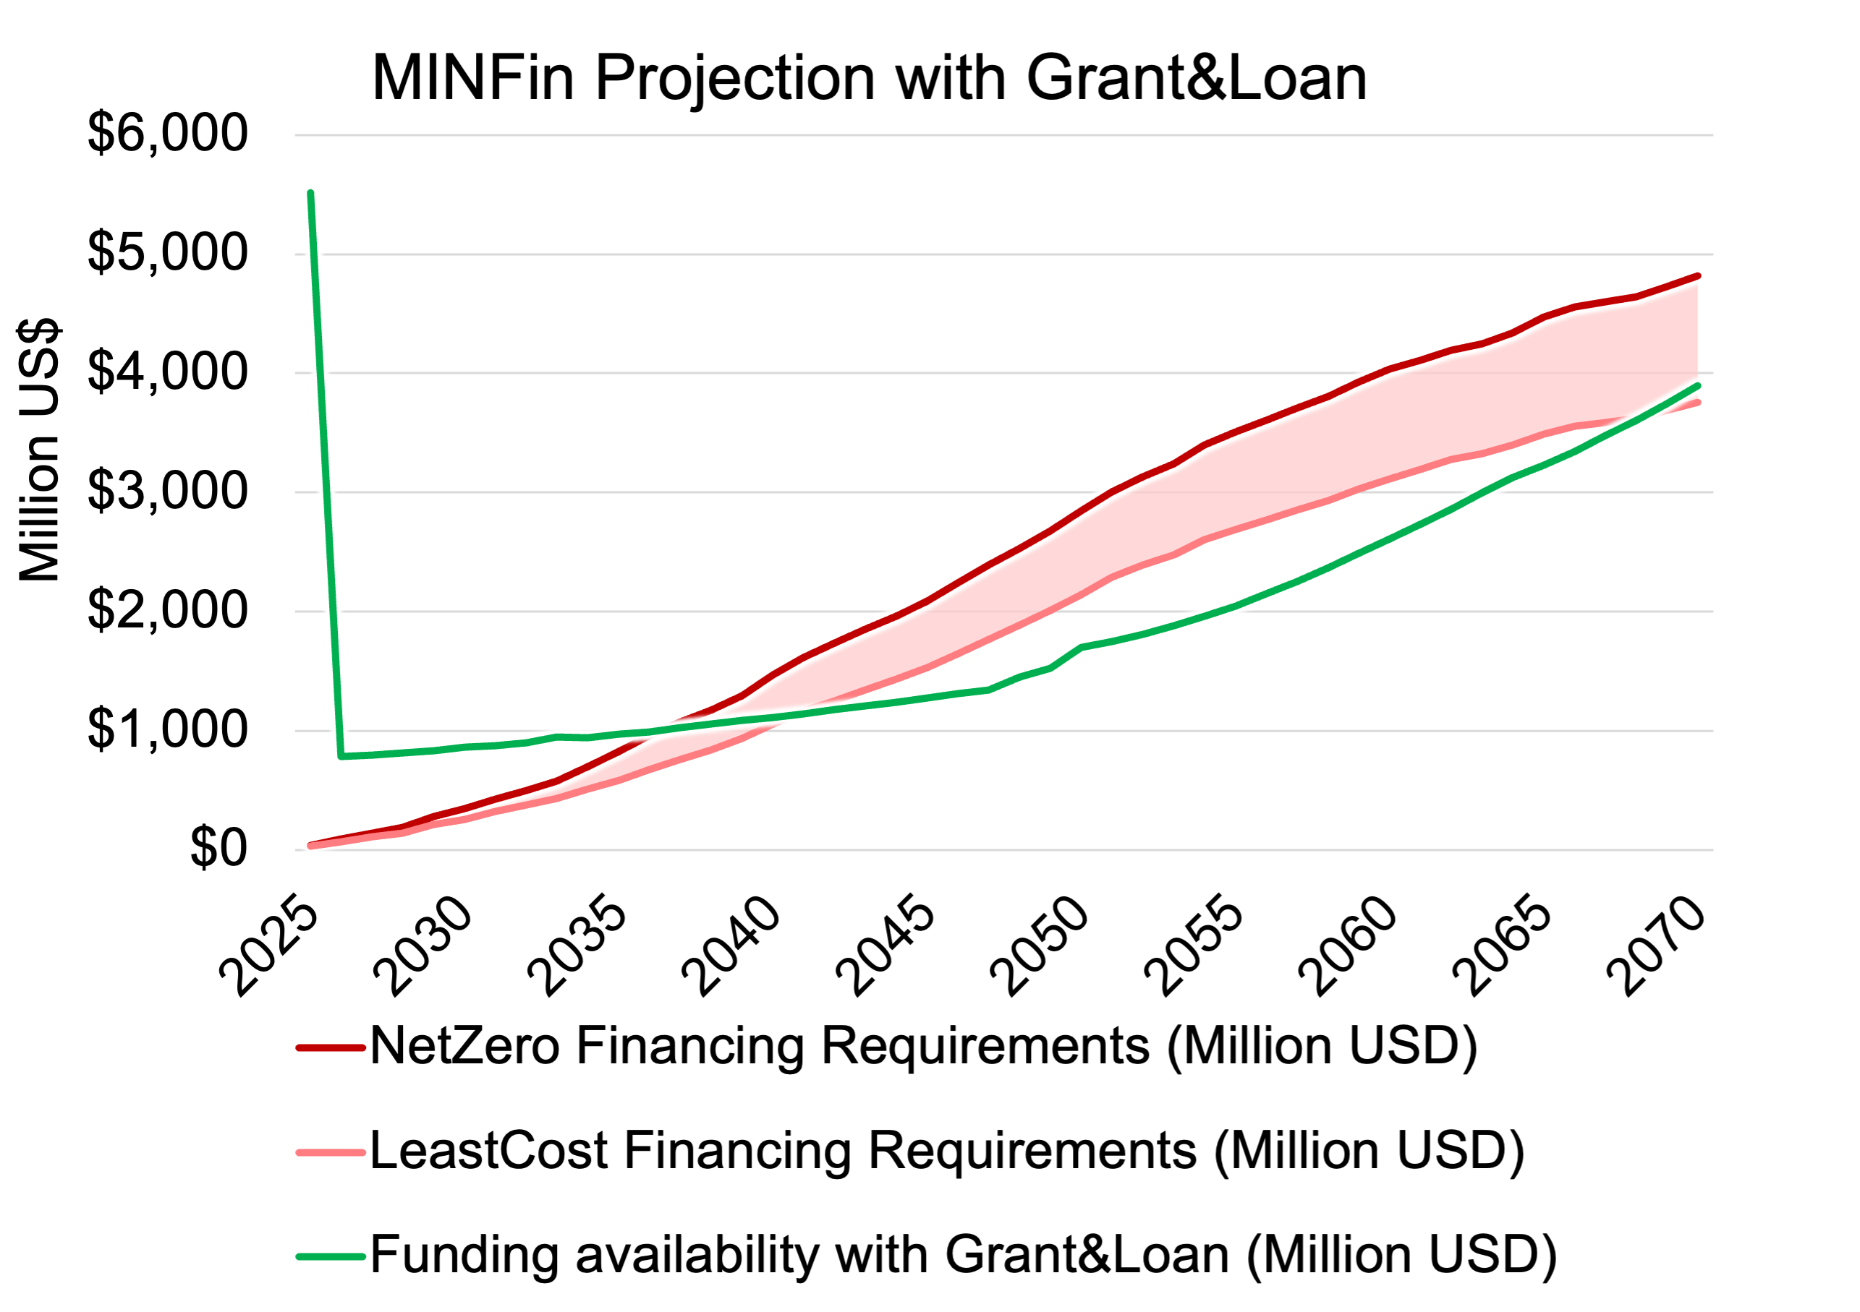
Modality 3: Combination Grant and Loan Instrument
This figure shows funding availability before and after incorporating additional grants, against financing requirement for NZ.
The diagram illustrates how this additional grant affects the overall gap between the financing required and the available funding. While it helps close the gap between NZ and BAU, it does not fully close the gap between sector cash flow and the financing requirement.
Notes:
Similarly to the grant methodology, the blended grant and loan instrument is implemented in the high-level dashboard by adjusting the funding baseline with a grant injection, this time only in 2025.
The figure shows the funding availability before and after the additional grants are incorporated, alongside the financing requirement for the Net Zero scenario.
This diagram illustrates how the grant injection impacts the overall financing gap. While it quantitatively reduces the gap between the Net Zero and Business-as-Usual scenarios over the modeling horizon, it does not fully close the shortfall between sector cash flow and the total financing requirement, as the grant is provided as a single lump sum. This method can be adapted to spread the grant volume over the entire horizon, rather than offering it all at once.

Slide 24
Modality 4: Softening Financing Terms
An alternative approach is to adjust the financing terms of the net-zero (NZ) investment profile to ensure that the financial repayment obligations align with those under the Business-As-Usual (BAU) scenario.This method estimates:
(1) The percent increase in concessional finance shares: How much the weight of concessional international finance must change across the NZ investment plan to bring repayment levels in line with BAU.
(1) The reduced WACC: How much softer the Weighted Average Cost of Capital (WACC) must be across the entire NZ investment plan to bring repayment levels in line with BAU.
(2) Additional concessional funding: The level of concessional financing required from International Financial Institutions (IFIs) to achieve this adjustment.
By reducing the WACC, this approach effectively lowers the "red line" of financial
burden, ensuring affordability and financial sustainability for the transition.
Notes:
The fourth modality involves adjusting the financing terms of the net-zero (NZ) investment profile so that the financial repayment obligations align with those under the Business-As-Usual (BAU) scenario. This method focuses on three key estimates:
Firstly, we first determine how much the weight of concessional international finance must change across the NZ investment plan to bring repayment levels in line with BAU. This helps identify the required shift in financing mix to achieve more favorable repayment terms.
Next, we estimate the degree to which the WACC must be lowered across the entire NZ investment plan. A reduced WACC means a softer cost of capital, which directly translates to lower repayment obligations. By lowering the WACC, we effectively decrease the financial burden—or the "red line"—making the transition more affordable.
Finally, we calculate the level of additional concessional financing required from International Financial Institutions (IFIs). This funding is essential to achieve the necessary adjustments in both the finance share and WACC.
By reducing the WACC, this approach effectively lowers the "red line" of financial burden, ensuring affordability and financial sustainability for the transition.

Slide 25
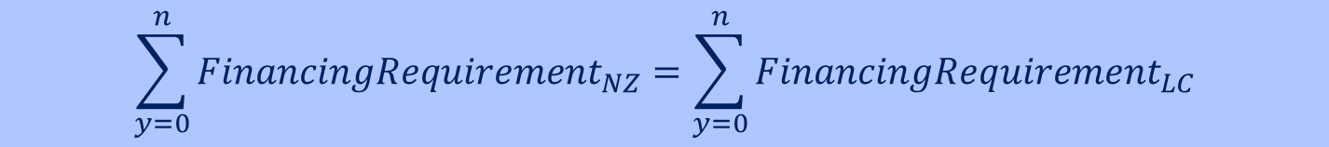
Modality 4: Softening Financing Terms
The calculation involves determining the increase in the weight of concessional International financing within the overall financing package required to zero the delta between the Net Zero and least-cost scenarios. This is achieved by increasing the share of concessional IFI financing while proportionally reducing the shares of the other components.
This is reflected in the dashboard by modifying the percentage allocation of concessional IFI financing within the overall financing structure.
Modality 4: Objective Equation
The total financing requirement for each scenario is the sum of financing needs across all years (y = 0 to n), with the key objective being zeroing the delta between the two:
$$\sum_{y=0}^{n}{{FinancingRequirement}_{NZ}}=\sum_{y=0}^{n}{{FinancingRequirement}_{LC}}$$
Notes:
The core of this calculation is determining how much we need to increase the weight of concessional international financing—specifically from International Financial Institutions—within the overall financing package. By boosting the share of concessional IFI financing, and simultaneously reducing the shares of the other components, we work toward zeroing the delta between the two scenarios.
This adjustment is reflected in our dashboard, where you can see the percentage allocation of concessional IFI financing modified within the overall financing structure.
To formalize this approach, we use what we call the objective equation for modality 4. Here’s the idea:
The total financing requirement for each scenario is calculated as the sum of financing needs across all years, from year 0 to year n. Our objective is to achieve parity between the Net Zero and least-cost scenarios, which we express in the formula above. This equation ensures that by adjusting the financing mix—increasing concessional finance and reducing other components—we effectively align the financing needs of the Net Zero scenario with those of the least-cost scenario.
In summary, by recalibrating the share of concessional IFI financing in the Net Zero scenario, we can zero the delta between scenarios, ensuring that the investment profile remains financially sustainable and aligned with our overall objectives.

Slide 26
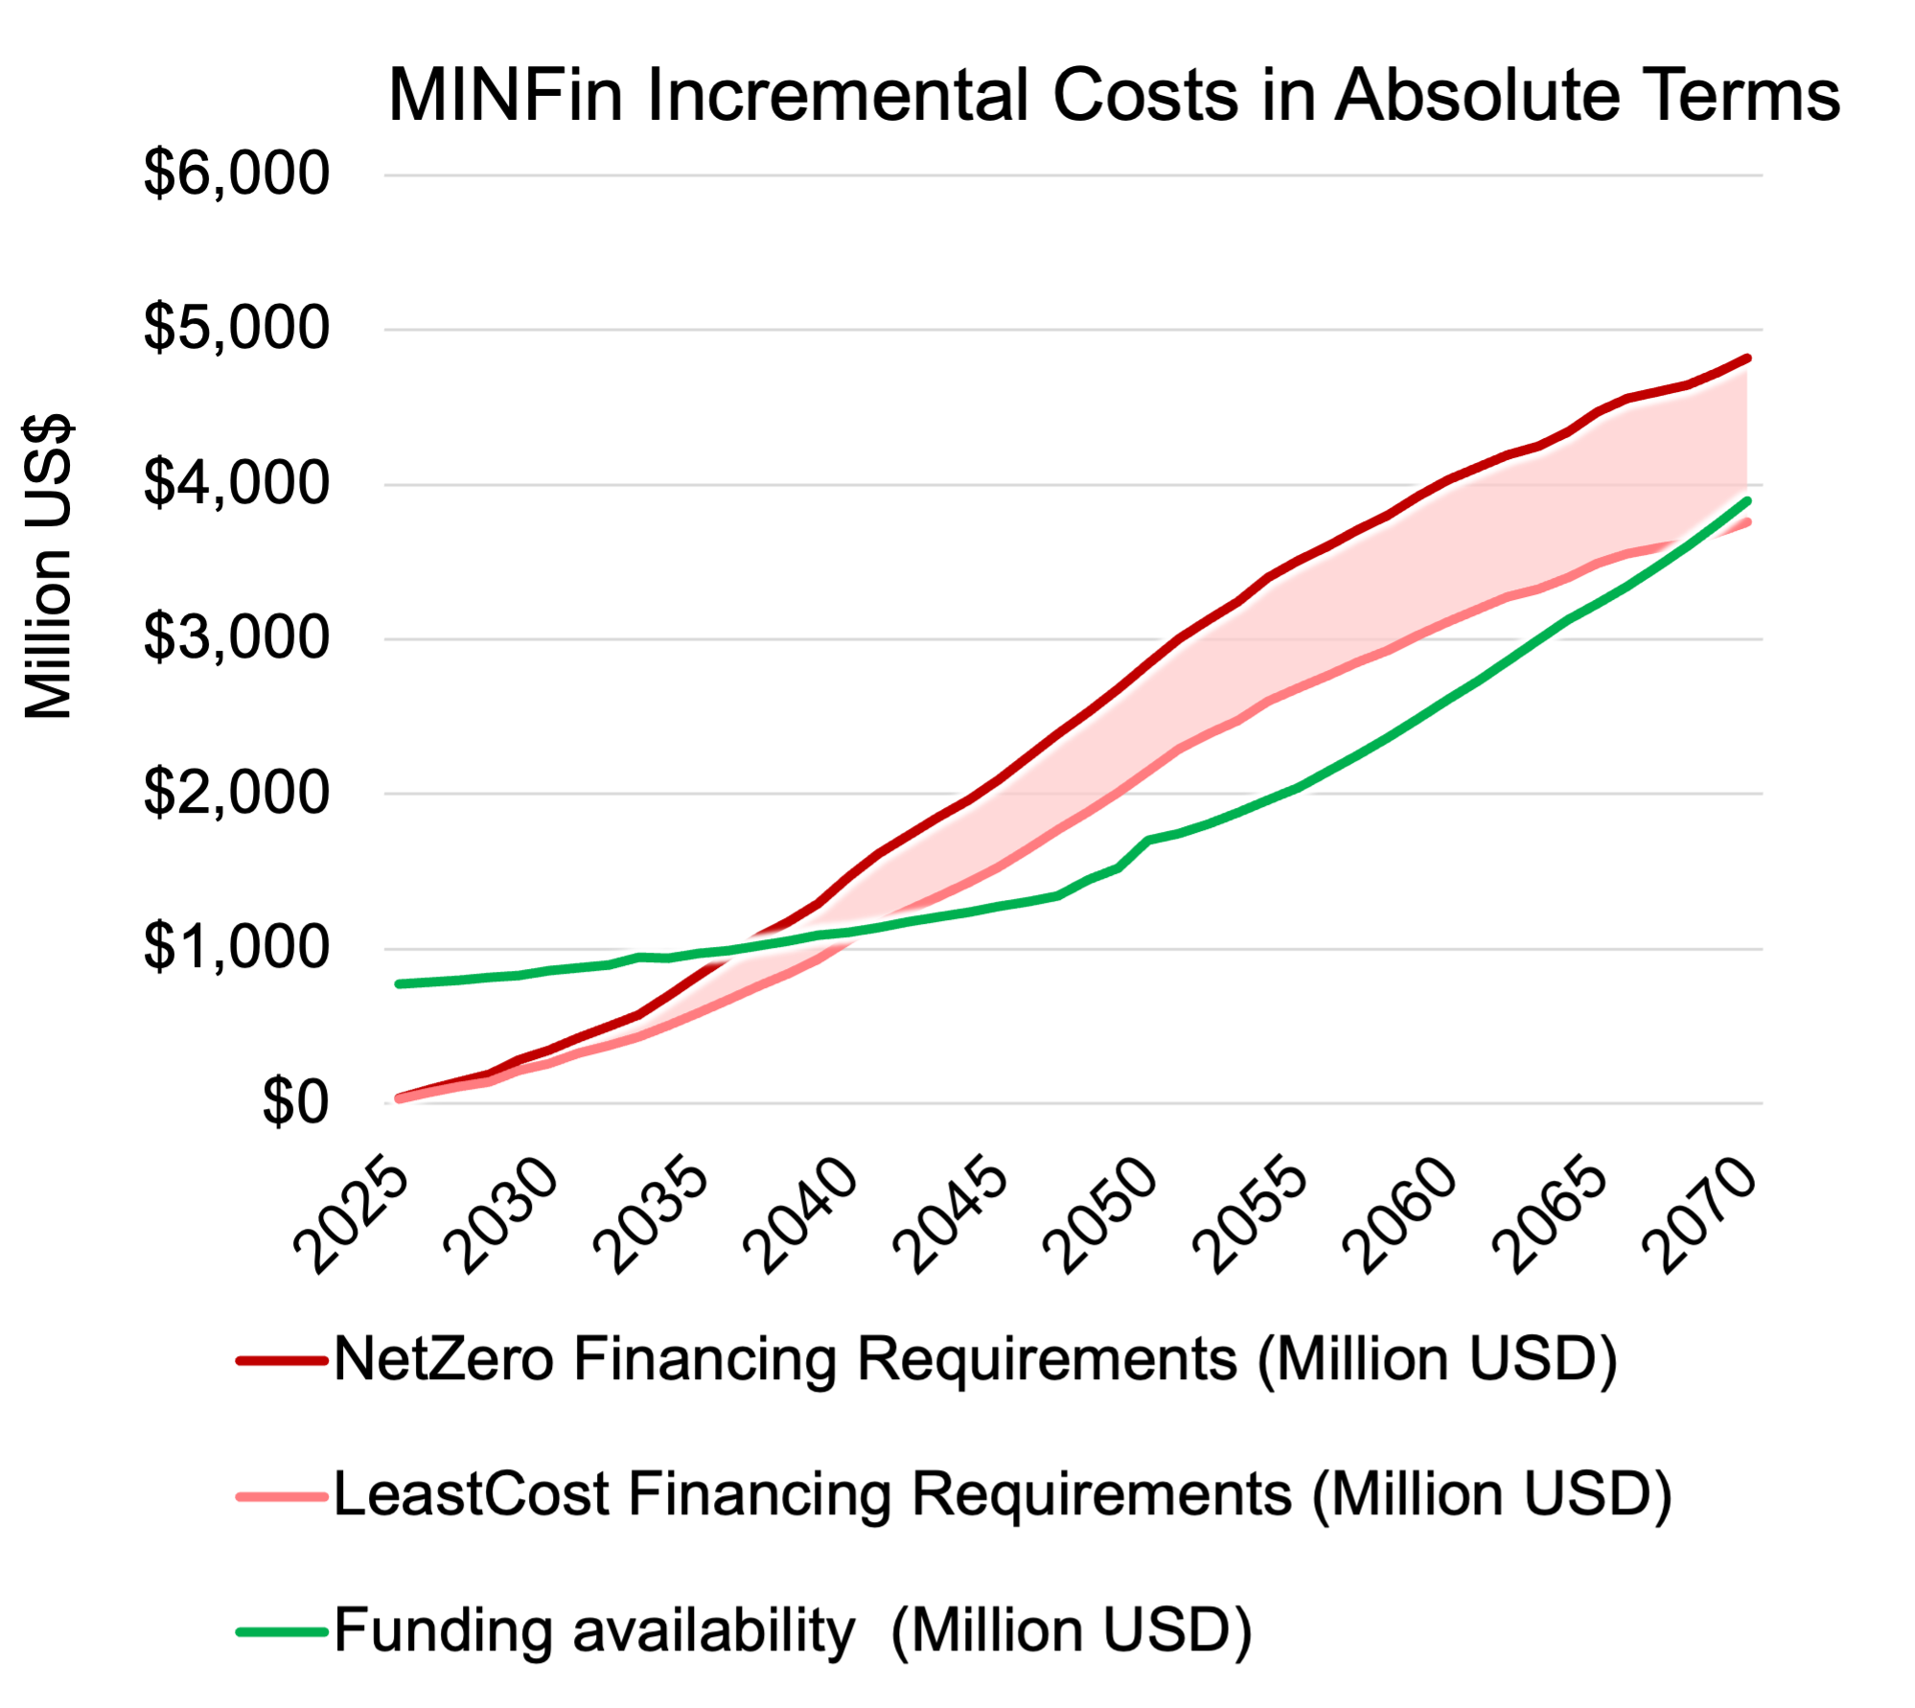
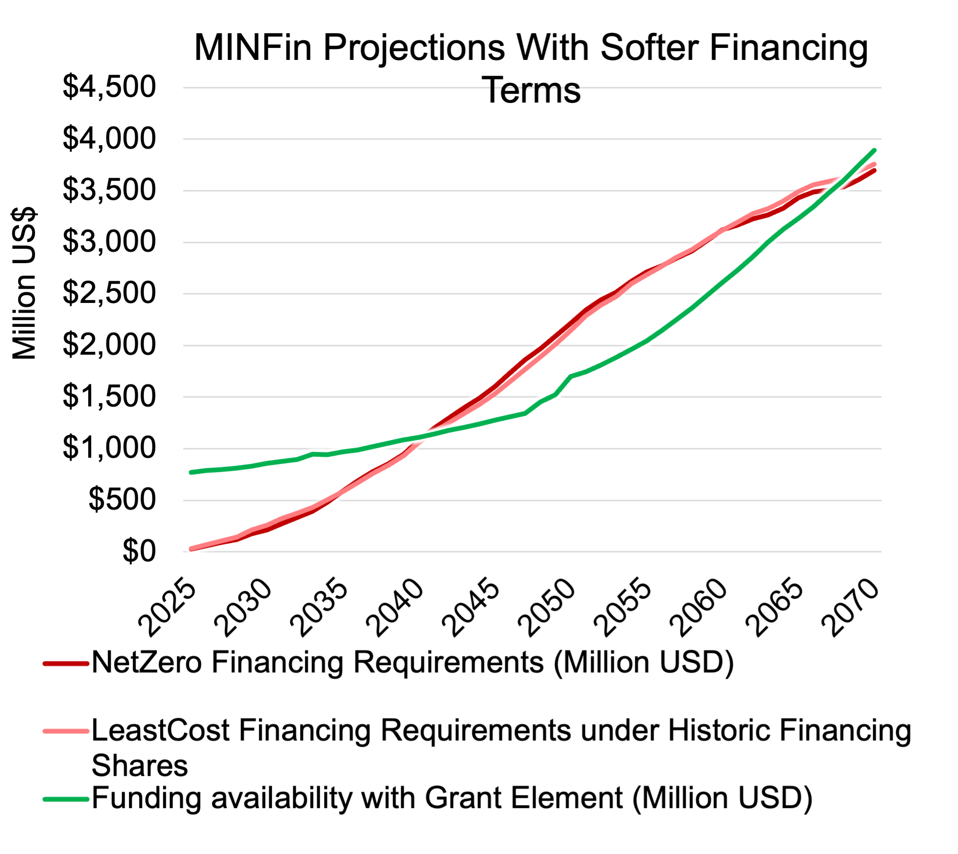

Modality 4: Softening Financing Terms
Notes:
Modality 4 is incorporated into the dashboard by adjusting the weighting of the four financing categories, typically increasing the share of concessional international finance— which has the highest concessionality— while reducing the other three, less concessional categories. This adjustment lowers the overall weighted average cost of capital for the net zero scenario, thereby reducing the net zero financing requirement, as shown by the red line.
This impact is illustrated in the two graphs on the slide. The left-hand graph displays the Net Zero and Least Cost Financing Requirement lines under the historical financing weightings. In contrast, the right-hand graph applies the financing weightings from Modality 4 to the Net Zero scenario. As a result, the net zero financing line drops significantly—from approximately 5 billion in 2070 in the left-hand graph to around 3.5 billion under the adjusted terms in the right-hand graph, aligning closely with the least-cost scenario. The two lines do not completely overlap because the adjustments ensure that the sum of the annual deltas equals zero across all years, rather than matching every individual year precisely.

Slide 27
Carbon Credits
Part 3

Slide 28
Modality 5: Carbon Credits
Previous methods have assumed a static world where the costs and benefits of the energy transition are fully predetermined. However, many key parameters—such as capital costs, fossil fuel prices, and carbon credit values—are subject to unpredictable changes.
To address this uncertainty, a pay-as-you-go approach could be adopted, where carbon credits are purchased as clean energy projects are implemented. This approach can be integrated into the funding baseline, allowing capital to be reinvested into the development of new clean infrastructure as it becomes available.
$$Annual Carbon Credit Requirement=\left[\frac{\left({Investment Need}_{LC, y}−{Investment Need}_{NZ, y}\right)}{\left({CO2}_{LC,y}−{CO2}_{NZ,y}\right)}\right]$$
Notes:
In previous methods, financing assumptions often relied on a static world, where key factors such as capital costs, fossil fuel prices, and carbon credit values were predetermined. However, these parameters are highly unpredictable and can change over time, creating uncertainty in the financing process.
To address this, a pay-as-you-go approach can be adopted, where carbon credits are purchased as clean energy projects are implemented. This approach allows financing to adapt to changing conditions, with capital reinvested into the development of new clean energy infrastructure as carbon credits are generated.
The carbon credit requirement is calculated based on the difference between the investment needs for a Business-as-Usual (BAU) and a Net Zero (NZ) scenario, adjusted for the difference in emissions reductions between the two scenarios. Specifically, the equation shown on this slide calculates the annual carbon credit requirement by comparing the investment needs and the CO₂ reductions achieved under each scenario. By incrementally purchasing carbon credits based on these calculations, the funding requirement aligns more closely with actual emissions reductions and project development.

Slide 29
Integrating Carbon Credits into the Dashboard
This figure shows the MinFin dashboard, featuring the optimised carbon credit instrument, which represents the carbon price needed to close the gap between Net Zero and Business-as-Usual scenarios.
It also illustrates how this carbon price affects the overall gap between the financing required and the available funding. While it helps close the gap between NZ and BAU, it does not fully close the gap between sector cash flow and the financing requirement.
Notes:
This figure illustrates the integration of carbon credits into the MinFin dashboard. It shows the optimised carbon credit instrument, which represents the carbon price needed to close the gap between the Net Zero and Business-as-Usual scenarios. This mechanism helps reduce the financing gap by making use of carbon credit revenue generated through clean energy projects.
While carbon credits play a crucial role in bridging part of the financing gap, they do not fully eliminate the discrepancy between the required funding and the available capital. This is shown in the figure, where the carbon credit mechanism helps close the gap between NZ and BAU scenarios but does not completely resolve the broader funding shortfall within the sector.
Thus, while carbon credits are an important tool, additional financial mechanisms are still needed to address the remaining financing needs for the energy transition.

Slide 30
Debt Write-Offs
Part 4

Slide 31
Modality 6: Debt Write-Offs
Finally, for countries with highly indebted energy sectors, climate finance may be best delivered through debt write-offs [5]. Such write-offs could alleviate debt stress, improve financing terms, and facilitate the energy transition.
Modality 6 determines the external debt amount to be forgiven to equalise NZ investment needs with BAU.
Notes:
In some cases, particularly for countries with heavily indebted energy sectors, a debt write-off can be a highly effective way to deliver climate finance. This modality of financing aims to alleviate the financial stress on these nations by reducing the amount of debt they owe, improving the terms of their remaining debt, and providing much-needed resources to support the energy transition.
Debt write-offs are especially relevant in situations where the country’s existing external debt burden is so high that it hinders the ability to invest in energy projects or pursue a Net Zero (NZ) path. By reducing or eliminating a portion of this debt, countries can free up budgetary resources that were previously allocated to debt servicing, thus increasing their capacity to finance the necessary investments for achieving their climate goals.
Modality 6 specifically determines the external debt amount that needs to be forgiven in order to align the financing requirements for Net Zero with the financing needs under a Business-as-Usual (BAU) scenario. By doing this, we ensure that the country's debt burden does not impede the transition to a low-carbon, sustainable energy future.

Slide 32
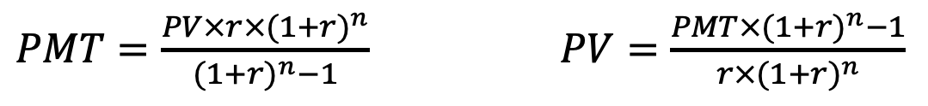
Modality 6: Debt Write-Offs
The debt-write off amount is calculated by treating the incremental financing cost as a repayment cost on debt.
It is integrated into the
funding baseline as the
increase in fund availability
comes from government
budget no longer spent
servicing this debt, which
can now be spent on power
projects.
Using this value and average loan terms on public external debt,
we are able to rearrange the PMT calculation formula to calculate the
principle (or debt write-off amount) needed to have repayments equal
to the incremental costs of financing a scenario.
$PMT=\frac{PV×r×{(1+r)}^{n}}{{(1+r)}^{n}−1}$ $PV=\frac{PMT×{(1+r)}^{n}−1}{r×{(1+r)}^{n}}$
PMT | Payments (incremental cost averaged across loan term)
PV | Present Value (debt write-off)
r | Rate (interest rate on public external debt)
n | Number of payments (term of public external debt)
Notes:
To calculate the required debt write-off, we treat the incremental cost of financing the transition to Net Zero as if it were a debt repayment obligation. The core idea is that the additional financial burden of pursuing Net Zero, compared to a Business-as-Usual (BAU) scenario, should be offset by a reduction in the country's external debt. This way, the country’s financial burden remains manageable, allowing it to invest more in energy transition efforts.
We begin by calculating the incremental cost of the Net Zero scenario relative to the BAU scenario. This incremental cost represents the additional financing required to implement energy transition projects, such as renewable energy investments, energy efficiency upgrades, and the development of sustainable infrastructure.
Once we have the incremental cost, we can treat it as a debt repayment obligation over a period of time. The question we need to answer is: How much external debt needs to be forgiven to offset this additional cost?
To calculate this, we use a common financial formula that allows us to determine the Present Value (PV) of a series of future payments, which in this case corresponds to the amount of debt that should be written off. The idea is that by reducing or forgiving the specified amount of debt, the country can reallocate those savings to invest in its energy transition.
In simple terms, we need to rearrange the formula for calculating the payment amount (PMT) on a loan, which is based on the interest rate and the term of the debt. This will allow us to calculate the Present Value (PV), or the total amount of debt that needs to be written off to achieve the financial balance between Net Zero and BAU scenarios.
This calculation assumes that the incremental financing costs of Net Zero will be paid in installments over the term of the debt, just like traditional debt repayment schedules. The formula essentially tells us how much external debt should be forgiven so that the debt payments on the reduced debt are equivalent to the additional financing costs.
The key benefit of this approach is that, by writing off a portion of external debt, the country frees up its budget from servicing that debt. These released funds can now be used to finance energy transition projects, which are crucial for achieving the country’s climate goals.
Thus, the debt write-off amount becomes the equivalent amount of debt that would result in an annual payment (or financing cost) equal to the incremental costs of pursuing a Net Zero pathway. The government can then reallocate the funds that were previously earmarked for debt servicing toward investment in power sector projects, helping to make the energy transition more financially viable.
This mechanism of using debt forgiveness to offset incremental transition costs is a critical tool for countries with high levels of external debt, enabling them to focus on sustainable development without being overburdened by past financial obligations.

Slide 33
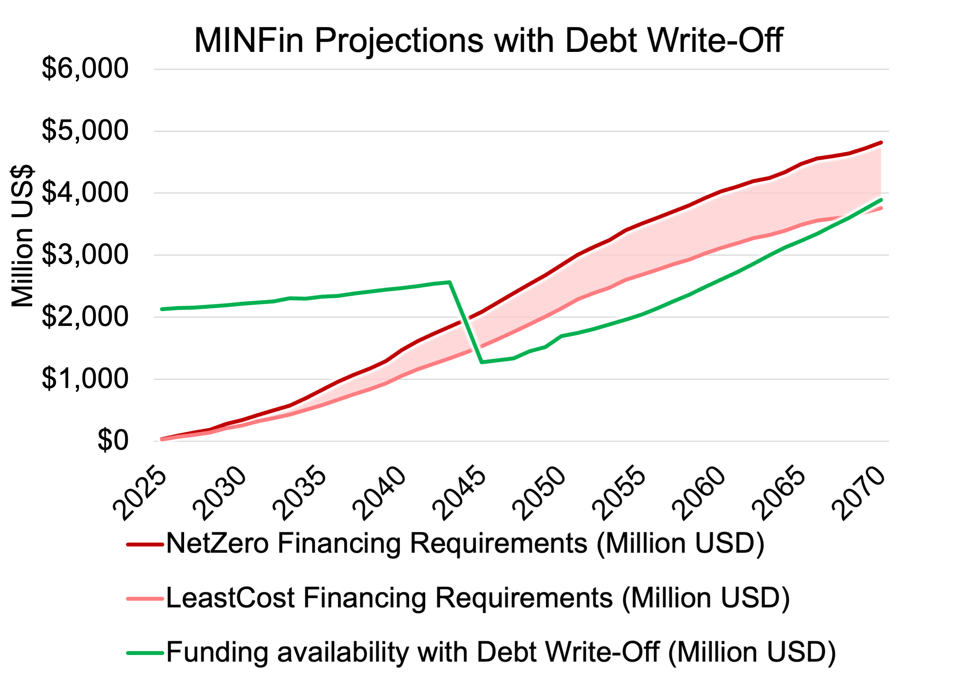
Modality 6: Debt Write-Offs
This figure shows the funding availability, featuring the optimised debt write-off instrument, which represents the debt write-off needed to close the gap between Net Zero and Business-as-Usual scenarios.
It also illustrates how this debt write-off contributes to the overall sector cash flow.
Notes:
This figure shows the impact of the optimised debt write-off instrument, designed to close the financing gap between the Net Zero (NZ) and Business-as-Usual (BAU) scenarios. The debt write-off reduces the external debt burden, making it easier for the country to manage the additional costs of transitioning to Net Zero.
By forgiving a portion of the debt, the country frees up funds that would have been used for debt servicing. These released resources are then redirected to critical energy transition investments, improving overall sector cash flow. This approach helps ensure that the financial burden of achieving Net Zero is manageable and supports sustainable energy development.

Slide 34
Thank you
Contact Information: v.foster@imperial.ac.uk or hannah.luscombe@ouce.ox.ac.uk

