Slide 1
Energy system modelling using OSeMOSYS
LECTURE 7
BIOMASS, GEOTHERMAL, HYDRO, AND NUCLEAR POWER PLANTS

Slide 2
Learning Outcomes
By the end of this lecture, you will be able to:
ILO1: Understand key characteristics of biomass-fuelled technologies, their environmental and social impacts, and how to represent them in OSeMOSYS
ILO2: Understand key characteristics of geothermal technologies, their environmental and social impacts, and how to represent them in OSeMOSYS
ILO3: Understand key characteristics of hydropower technologies, their environmental and social impacts, and how to represent them in OSeMOSYS
ILO4: Understand key characteristics of nuclear technologies, their environmental and social impacts, and how to represent them in OSeMOSYS
2
Notes:
By the end of this lecture, you will be able to:
Understand the key characteristics of biomass, geothermal, hydropower, and nuclear power plants, their environmental and social impacts, and how to represent them in OSeMOSYS

Slide 3

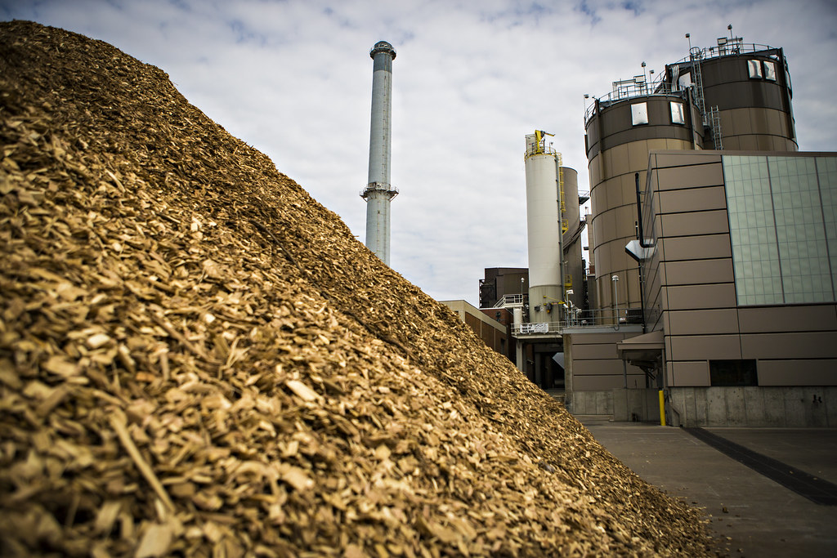
7.1 Intro to Biomass power plants
7.1.1 Overview of Biomass Power Plants
(Mizzou CAFNR, image, licensed under CC BY-NC 2.0)
3
Notes:
In lecture 6, we looked at fossil power plants, which fall into the category of thermal power plants. Another type of thermal power plant are biomass power plants. These are power plants in which biomass is burned in order to drive a turbine, which drives a generator to produce electricity. Biomass power plants can use different types of biomass as the fuel, often wood pellets or biological waste. To use biomass for power, it first has to be sourced, either from waste or from agriculture or forestry. Then it must be processed, for example through conversion to pellets, and finally it must be transported to the power plant. This biomass can then be burned in a conventional thermal power plant to generate electricity. Alternatively, the biomass can fuel a Biomass Combined Heat and Power Plant. This is a type of power plant where the amount of energy wasted is reduced as useful heat can be produced and passed to a heating system, rather than large amounts of energy being lost as waste heat, increasing the efficiency of the power plant.

Slide 4
7.1 Intro to Biomass power plants
7.1.2 Environmental & Social Impacts of Biomass Power Plants
Deforestation
Reduced biodiversity
Soil erosion
Groundwater pollution
Conflicts with food supply
Environmental & Social Impacts of Biomass Power Plants
Concepts from: Usher, W. (2021)
4
Notes:
Biomass power plants are considered as a form of renewable energy generation since the biomass removes carbon dioxide from the air as it grows, accounting for the carbon dioxide released when the biomass is burned to generate power. This means that replacing fossil power generation with biomass can lead to carbon dioxide emission reductions. However, there are complexities to this and biomass production can have negative environmental and social impacts that are important to consider. Firstly, producing biomass for power generation can drive deforestation, as well as cause declines in biodiversity and increased soil erosion. The use of fertilizers to grow biomass crops can also lead to groundwater pollution. On the social side, there can be conflicting needs; for example, the use of large areas of land for biomass production can reduce the amount of land available for agriculture, potentially threatening the secure supply of food for growing populations. It is important to remember these potential impacts and consider them when interpreting model results and creating policy recommendations.

Slide 5
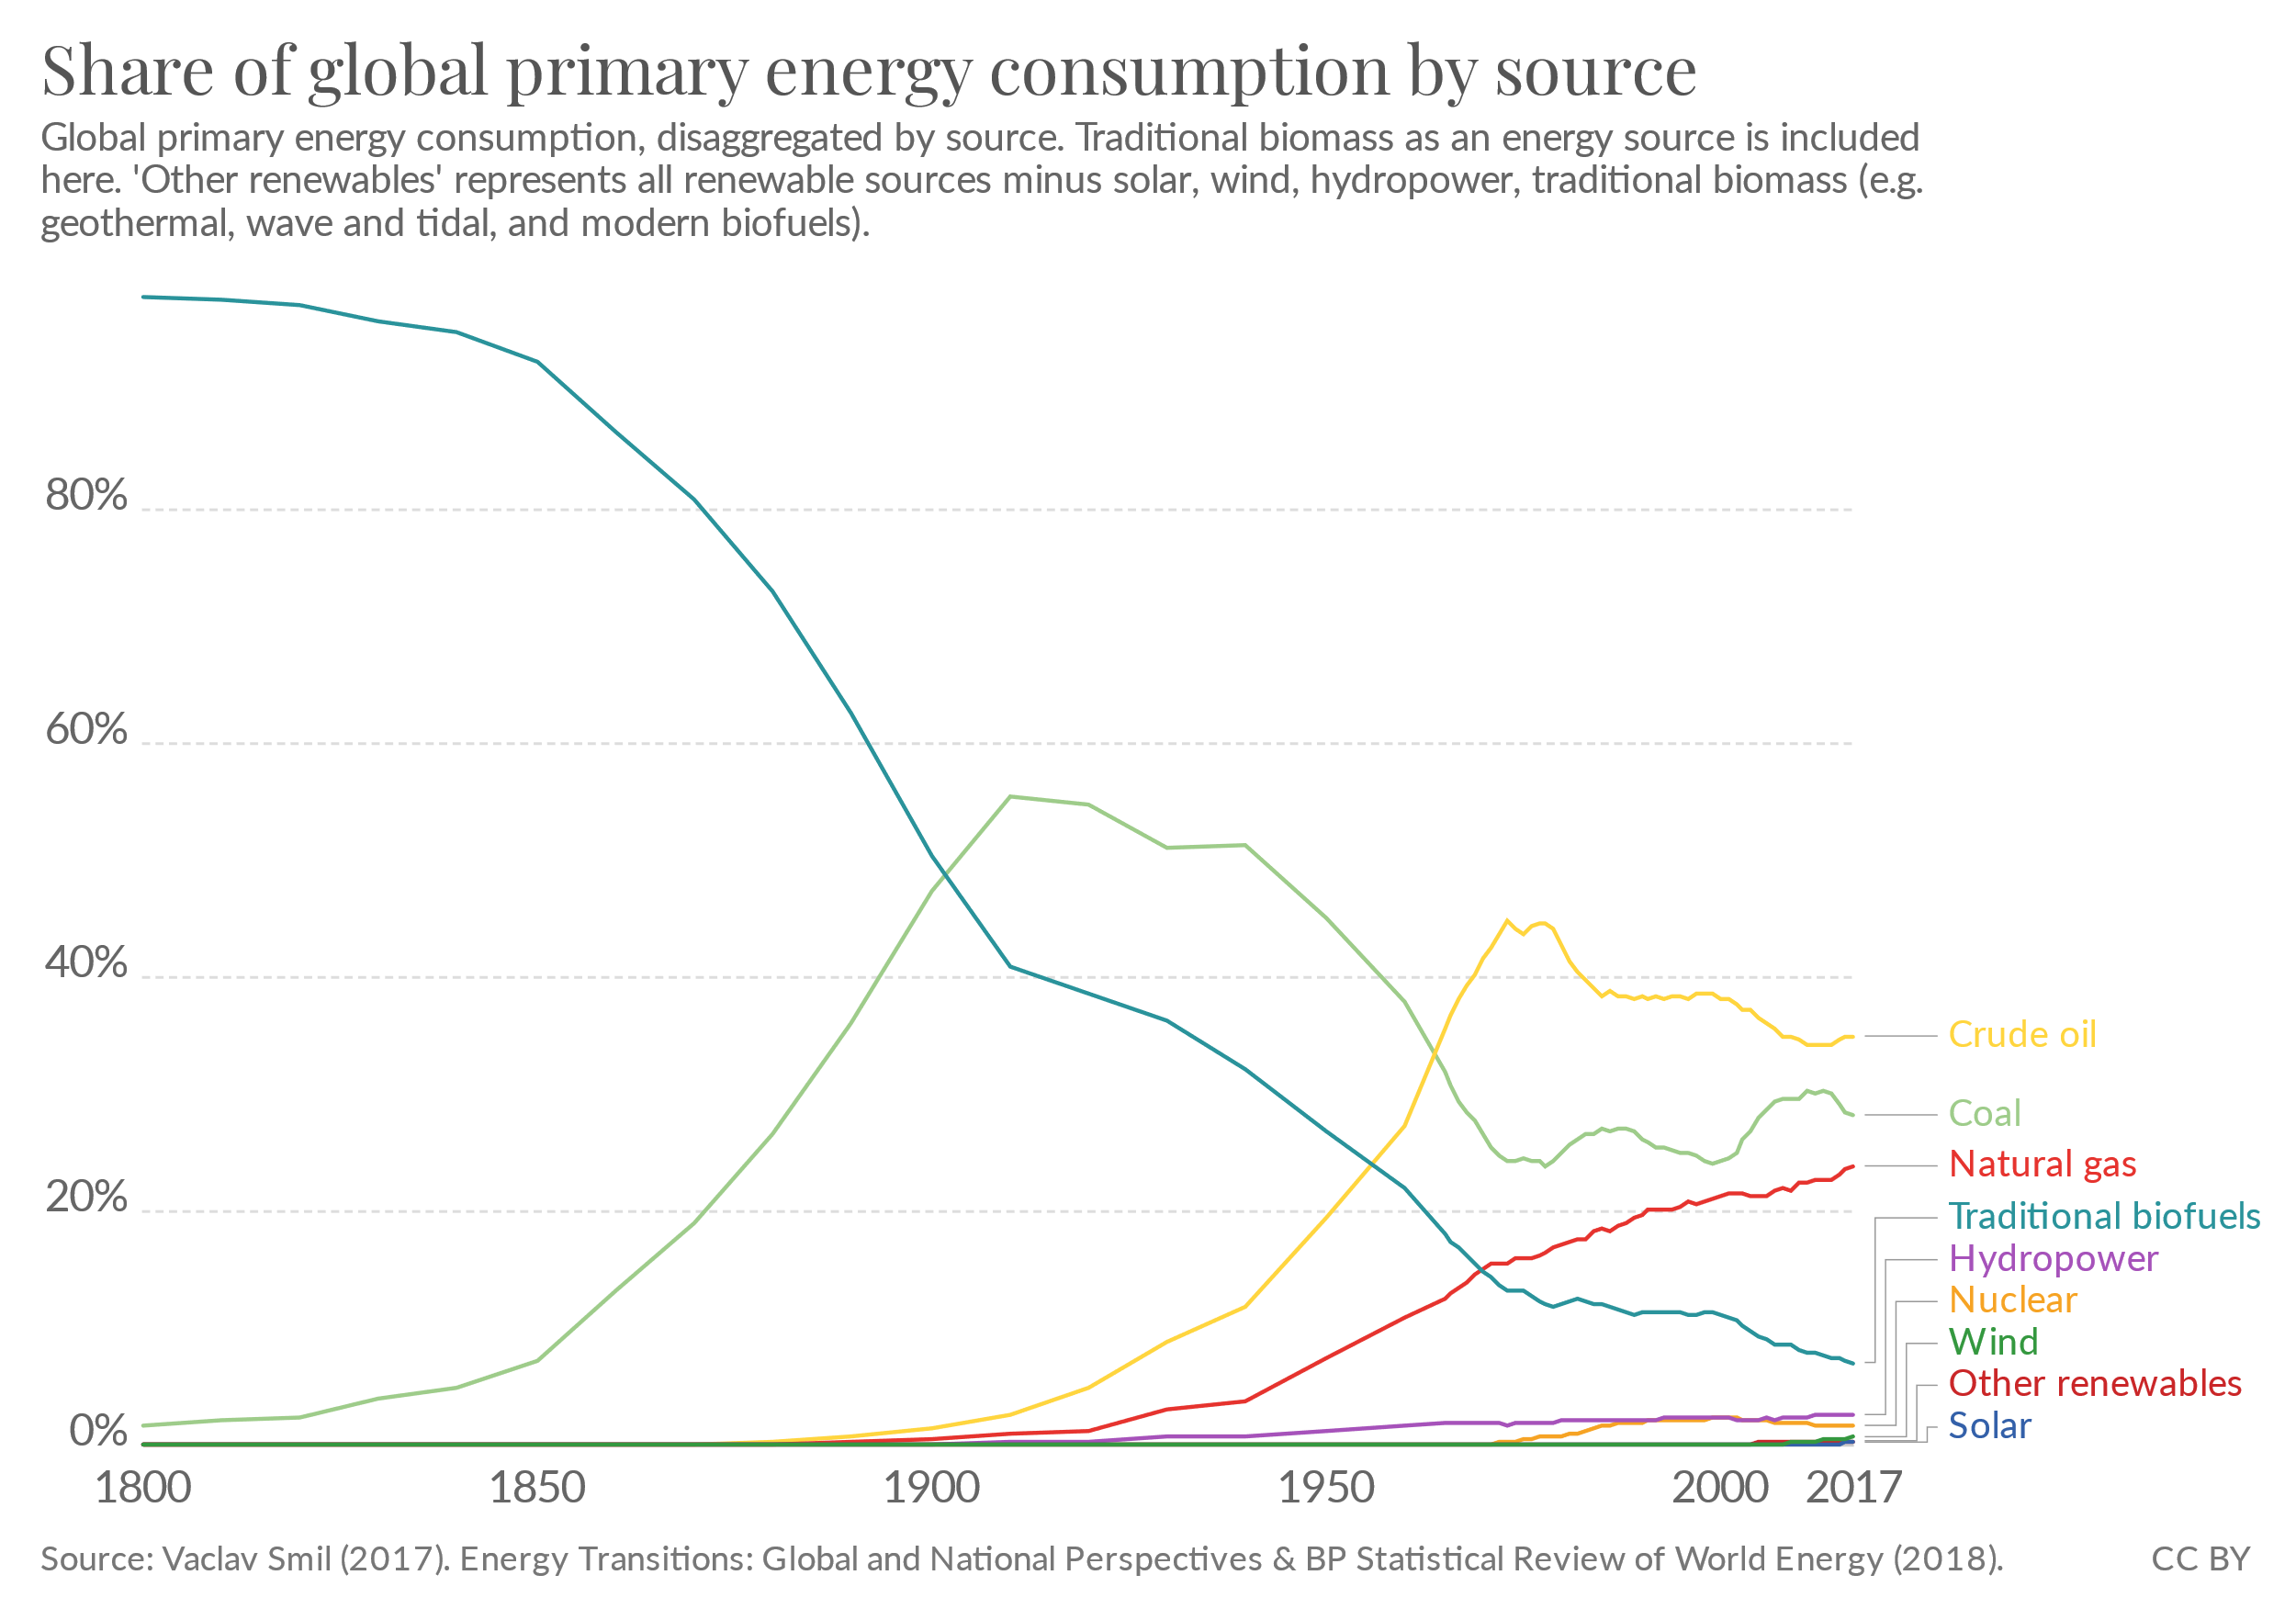
7.1 Intro to Biomass power plants
7.1.3 Role of Biomass Power Plants in Energy Systems
(Our World in Data, image, licensed under CC BY 3.0 )
5
Notes:
As we can see on this chart, the world's energy system is heavily reliant on fossil fuels, with high consumption of crude oil, natural gas, and coal. Although it is important to remember that this includes consumption outside of the power sector, for example a significant amount of oil consumption is for transport, the power sector is a key consumer of fossil fuels. Biomass power plants may have a role in mitigating this, helping to reduce greenhouse gas emissions when they are used to replace fossil power plants. One advantage of biomass power plants over some other renewable energy technologies is that they can be used to provide baseload electricity generation, meaning that they can run at any time and are not reliant on variable weather conditions. This means biomass power plants can help to maintain the stability of the power system as reliance on fossil fuels is reduced. However, we must remember the potential issues associated with biomass power generation, including the impacts on land use, biodiversity, and agricultural productivity. This is one example of how the energy system interacts with multiple Sustainable Development Goals, for example the demand for biomass for electricity generation can conflict with S.D.G 2, which aims to end hunger, and S.D.G. 15, which aims to protect life on land. As we go through the lectures and learn about other renewable energy generation technologies we will see that they all have advantages and disadvantages; there is no one best solution, and we are likely to require a mixture. Energy modelling with OSeMOSYS can help us to understand what that mixture might look like; however, we should bear in mind the factors OSeMOSYS cannot consider, like the additional environmental and social impacts discussed on the previous slide.

Slide 6
7.1 Intro to Biomass power plants
7.1.4 Biomass Power Plants in OSeMOSYS Part 1
Example biomass power plant data for key OSeMOSYS parameters:
Capacity Factor: 0.5
Efficiency: 35%
Capital Cost: $2100/kW
Fixed Cost: $75/kW
Operational Life: 40 years
Source: Pappis, I. et al. (2019) Energy Projections for African Countries)
6
Notes:
The key parameters for defining biomass power plants in OSeMOSYS are the same as those that we discussed in lecture 6 in relation to fossil power plants. This slide includes some example data for a biomass power plant, sourced from a 2019 report that used OSeMOSYS to model the African energy system. Let's quickly remind ourselves of what these parameters are, since we will use them again later in this lecture and the wider course. The capacity factor refers to the fraction of the total installed capacity factor available in each modelled time slice, ranging from 0 to 1. We can see in our example data that the biomass power plant has a capacity factor of 0.5, meaning that on average 50% of its total installed capacity is available for use in each time slice. There are many reasons why this capacity factor might be only 0.5; for example, restricted availability of biomass fuel or technical factors which mean the plant only operates at certain times. The second piece of data on this slide is the efficiency. In lecture 6, we learnt that power plant efficiency is considered in OSeMOSYS using the input and output activity ratios and we will look at how this would work for our biomass power plant in the next slide. One cause of the biomass power plant only having an efficiency of 35% is likely to be that a significant amount of energy is lost as waste heat, and the efficiency would likely be higher for a biomass combined heat and power plant, as discussed earlier. We then move to the cost parameters: firstly we have the capital cost, which we learnt is the one-off investment cost of the power plant, and then we have the fixed cost, which is the fixed annual cost of operations and maintenance. In this case no variable cost was assigned to the biomass power plant. Finally we have the operational life, which is the expected life time of the technology in years. Our example data show that the biomass power plant is expected to operate for 40 years.

Slide 7
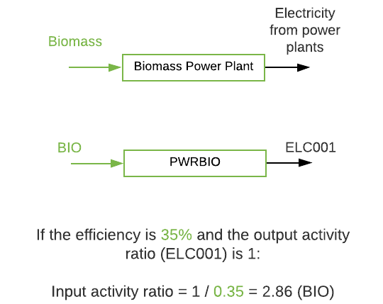
7.1 Intro to Biomass power plants
7.1.5 Biomass Power Plants in OSeMOSYS Part 2
7
Notes:
Here we can see a close-up of how a biomass power plant would be represented in a Reference Energy System, including using the generic naming convention codes. We can see that the biomass power plant is a technology with an input fuel of biomass and an output fuel of electricity. In a model, we may want to model multiple types of biomass power plant, for example a conventional biomass power plant and a combined heat and power plant. In this case we could distinguish between the technology types by adjusting their code names, for example using the terms P. W. R. B. I. O. 0 0 1 and P. W. R. B. I. O. 0 0 2. This slide also shows an example calculation of the input activity ratio for a biomass power plant. We know the output fuel is electricity, and we will define the output activity ratio to have a value of 1 by default as in previous examples. Therefore, as for fossil power plants in lecture 6, we can calculate the input activity ratio using the formula 1 divided by efficiency, in this case 1 divided by 0.35, which gives an input activity ratio of 2.86. This would be assigned to biomass, since we know that this is the input fuel for a biomass power plant.

Slide 8
Lecture 7.1 References
1. Usher, William. (2021, March). Wind, solar and biofuels: social, environmental and economic concerns (Version 1). Zenodo. http://doi.org/10.5281/zenodo.4585632
2. Pappis, I., Howells, M., Sridharan, V., Usher, W., Shivakumar, A., Gardumi, F. and Ramos, E., Energy projections for African countries, Hidalgo Gonzalez, I., Medarac, H., Gonzalez Sanchez, M. and Kougias, I., editor(s), EUR 29904 EN, Publications Office of the European Union, Luxembourg, 2019, ISBN 978-92-76-12391-0, doi:10.2760/678700, JRC118432
8

Slide 9
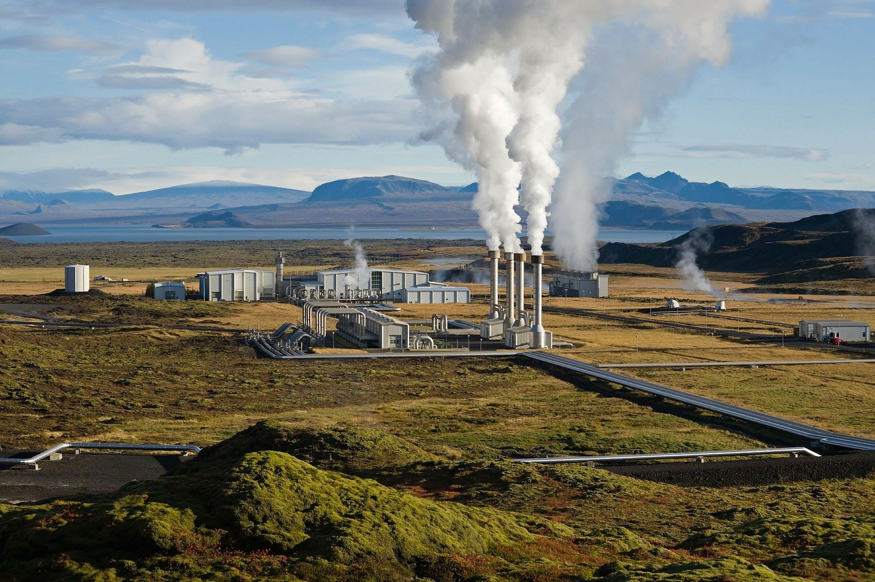
7.2 Intro to Geothermal Power Plants
7.2.1 Overview of Geothermal Power Plants
9
Notes:
Geothermal power plants make use of natural heat within the Earth. As we go below the Earth's surface towards its core, temperatures increase and we can find subsurface hot water and steam. Geothermal power plants make use of this hot water and steam to drive turbines which then drive a generator to produce electricity. The geothermal activity needed to generate power in this way is concentrated around areas with high tectonic and volcanic activity. This means that only certain locations have sufficient geothermal resource for geothermal power plants. Global geothermal power capacity is concentrated in the USA, Philippines, Indonesia, Kenya, and New Zealand (IRENA, 2017).

Slide 10
7.2 Intro to Geothermal Power Plants
7.2.2 Environmental and Social Aspects of Geothermal Power Plants
Administrative barriers
Capital Intensive
Exploration is High Risk
Local Community Impacts
Land-Use
Environmental & Social Aspects of Geothermal Power Plants
(Concepts from IRENA, 2017)
10
Notes:
Although there is great potential for geothermal power generation in countries that have large geothermal resources, there are potential environmental and social barriers that we should be aware of, as is the case for all power generation technologies. Firstly, geothermal power plants often have high capital investment costs and the exploration processes required to assess potential geothermal resources can be high risk and costly. These factors can make it difficult to obtain the initial funding required for a geothermal project, as can administrative barriers associated with the exploration process. Additionally, the creation of a geothermal power plant can involve the conversion of previously unused natural land. This may affect local biodiversity and landscapes as well as potentially creating disruption for local communities, for example due to noise or visual pollution. Although these environmental and social aspects should be considered, impacts can be minimized and there are also many advantages of geothermal power generation, which can have a key role in national energy systems.

Slide 11
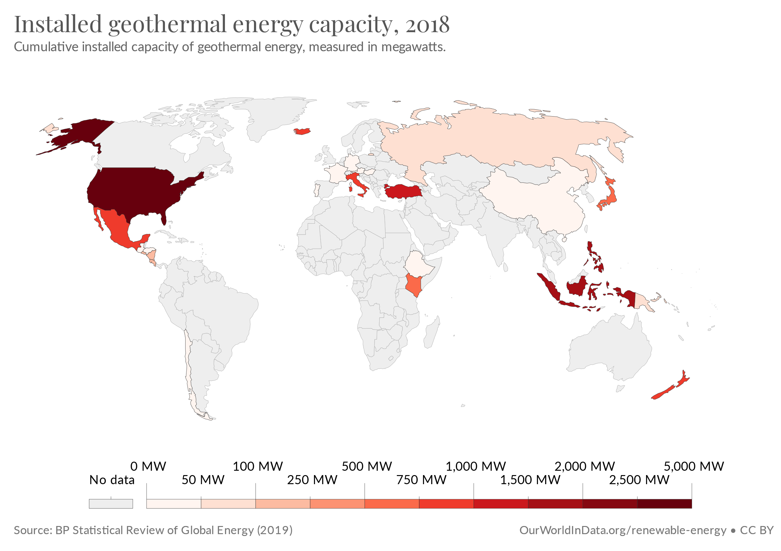
7.2 Intro to Geothermal Power Plants
7.2.3 Role of Geothermal Power Plants in Energy Systems
(Image source: Our World in Data, image, license: CC BY 3.0)
11
Notes:
Geothermal energy has many potential advantages. Firstly, geothermal energy is a renewable resource that can help countries to reduce the carbon intensity of their power systems, since it is not associated with combustion-related carbon dioxide emissions like fossil power plants. Some forms of renewable energy, such as solar PV and wind, are intermittent, meaning their availability varies significantly throughout the day and the year, as discussed in previous lectures. However, geothermal energy is available throughout the year, meaning it can act as reliable baseload electricity generation. Geothermal energy can therefore be highly useful for ensuring the stability of electricity systems whilst also reducing emissions and reducing reliance on finite and polluting fossil fuels. Additionally, although we have learnt that geothermal power plants can be capital intensive, there are no fuel costs and the operating costs are stable and expected to drop in coming years.

Slide 12
7.2 Intro to Geothermal Power Plants
7.2.4 Geothermal Power Plants in OSeMOSYS Part 1
Example geothermal power plant data for key OSeMOSYS parameters:
Capacity Factor: 0.85
Efficiency: 80%
Capital Cost: $3100/kW
Fixed Cost: $60/kW
Operational Life: 25 years
Source: Pappis, I. et al. (2019) Energy Projections for African Countries
12
Notes:
In the first section of this lecture we recapped the meanings of some key parameters for defining power plants in OSeMOSYS, including the capacity factor, efficiency, capital and fixed costs, and operational life. This slide shows some example data for these parameters for geothermal power plants. We can see that geothermal power plants have high capacity factors, with our example data giving a capacity factor of 0.85, compared to a value of 0.5 for biomass power plants. This means that nearly all of the installed capacity of a geothermal power plant is likely to be available for use in each time slice of an energy model. We can also see a relatively high efficiency of 80%, meaning most of the geothermal energy is successfully converted to electrical energy. In terms of cost, the example capital cost shown here is quite a lot higher than the value for our biomass power plant example, reflecting the high capital intensity of geothermal power plants discussed in previous slides. However, we can see that the fixed cost is relatively moderate. Finally, the operational life is 25 years, which is around the average for most power plant types.

Slide 13
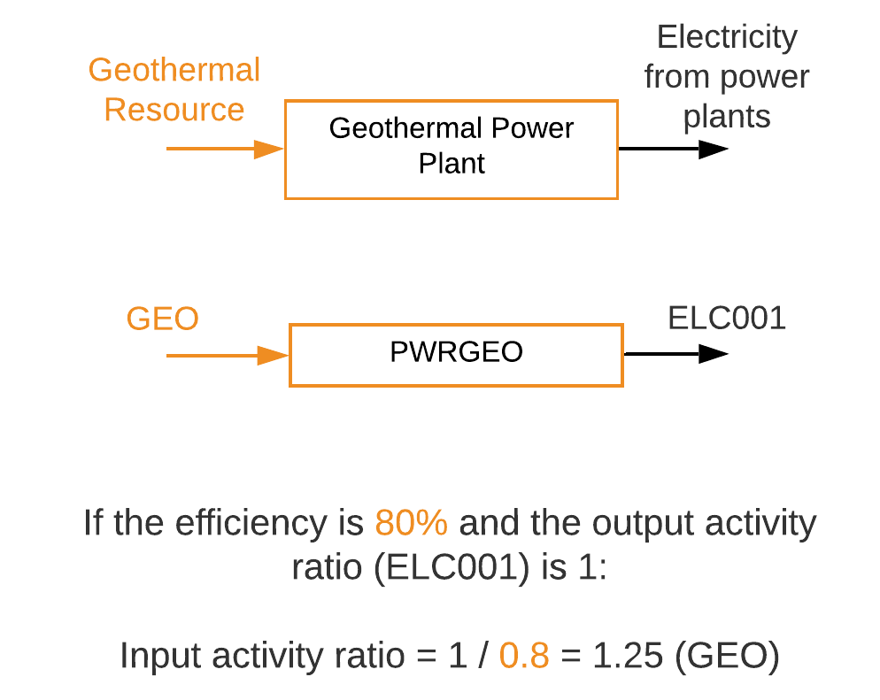
7.2 Intro to Geothermal Power Plants
7.2.5 Geothermal Power Plants in OSeMOSYS Part 2
13
Notes:
As we did for biomass power plants, let's take a closer look at how geothermal power plants are represented in Reference Energy Systems and example data for their input and output activity ratios. On this diagram, we can see that geothermal power plants are represented as a technology with the geothermal resource as the input fuel and electricity as the output fuel. We can also see the relevant generic code names for the geothermal power plant technology and its input and output fuels. Our example data gave us an efficiency of 80% for a geothermal power plant, so now we can use this to calculate the input and output activity ratios. As in all of our previous examples, we will keep the output activity ratio equal to 1, and it will be assigned to E. L. C. 0 0 1 since this is the output fuel. If this is the case, the input activity ratio is determined by calculating 1 divided by the power plant efficiency as a decimal: this equates to 1 divided by 0.8, giving us an input activity ratio of 1.25 for G. E. O., which is the input fuel for our geothermal power plant technology.

Slide 14
Lecture 7.2 References
IRENA (2017), Geothermal Power: Technology Brief, International Renewable Energy Agency, Abu Dhabi. https://www.irena.org/publications/2017/Aug/Geothermal-power-Technology-brief
Pappis, I., Howells, M., Sridharan, V., Usher, W., Shivakumar, A., Gardumi, F. and Ramos, E., Energy projections for African countries, Hidalgo Gonzalez, I., Medarac, H., Gonzalez Sanchez, M. and Kougias, I., editor(s), EUR 29904 EN, Publications Office of the European Union, Luxembourg, 2019, ISBN 978-92-76-12391-0, doi:10.2760/678700, JRC118432.
14
14

Slide 15
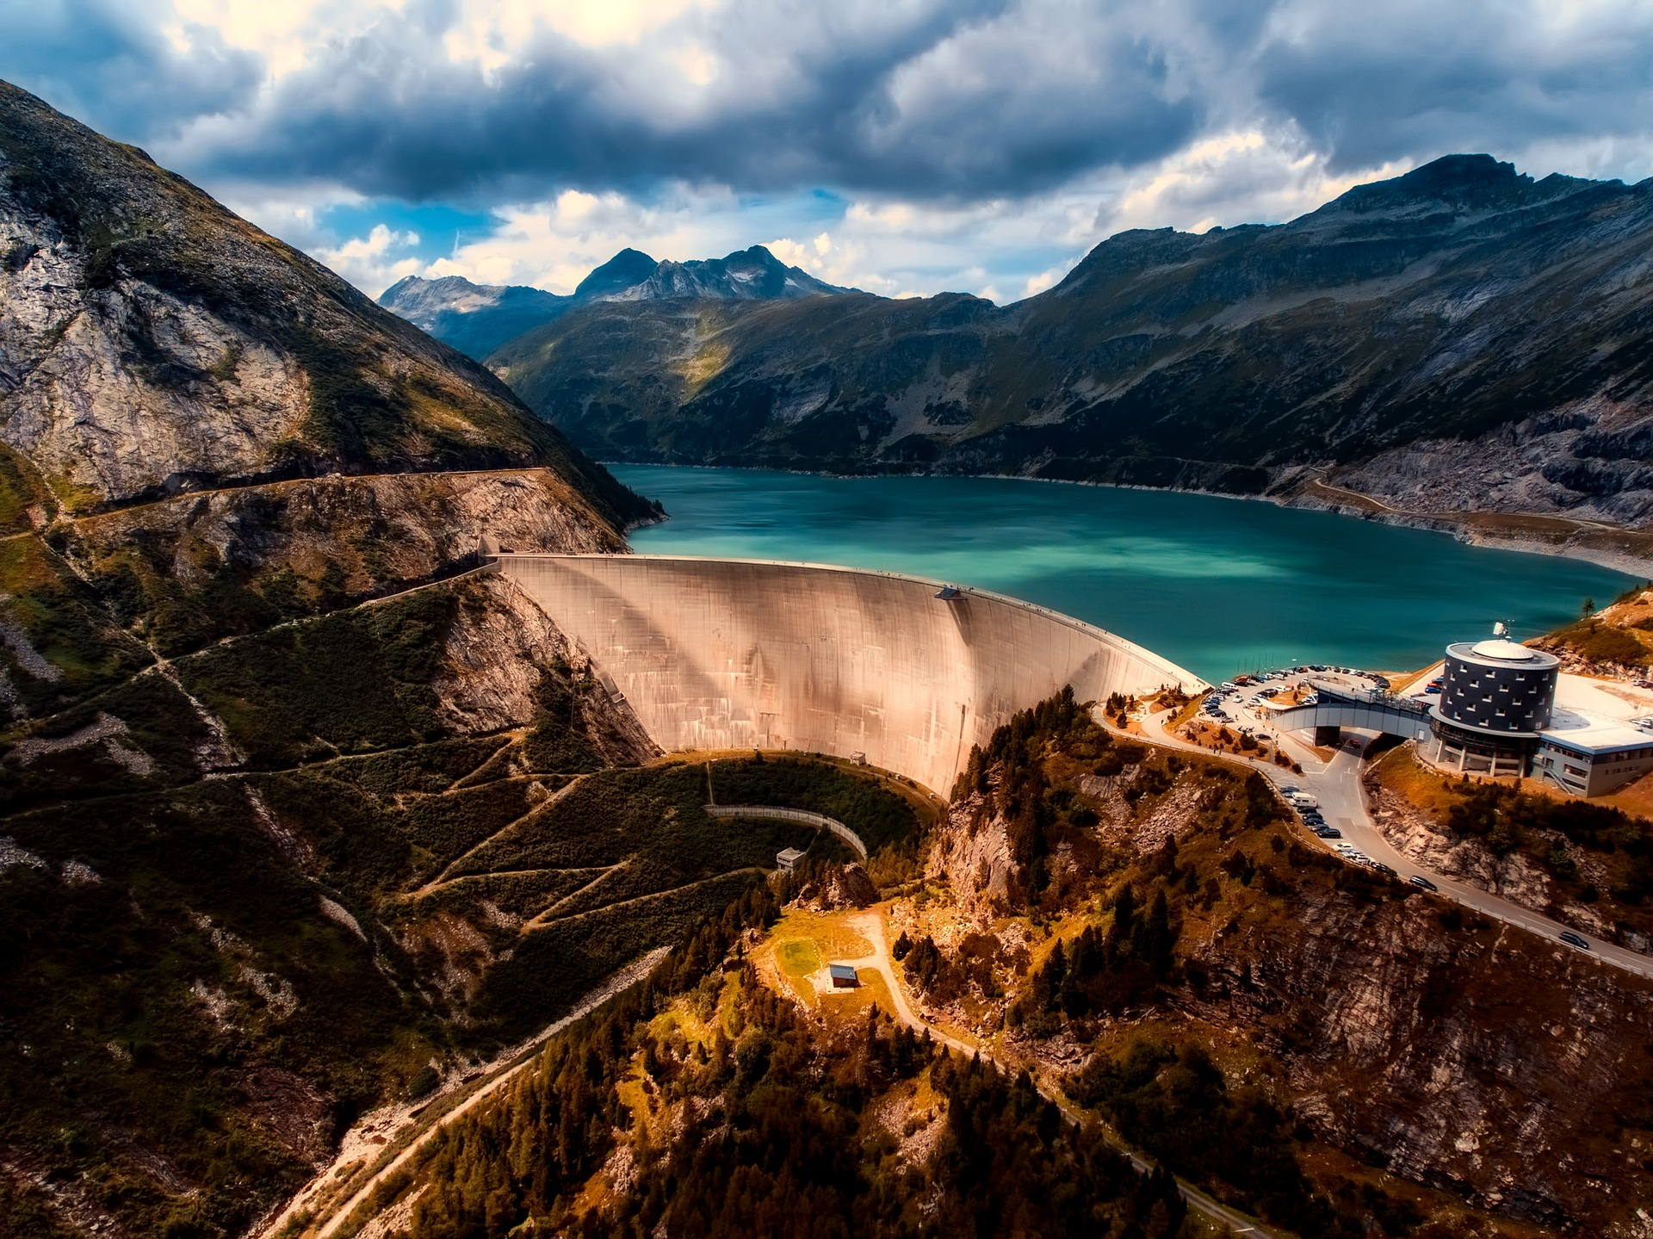
7.3 Intro to Hydropower Plants
7.3.1 Overview of Hydropower Plants
Concepts from: Shivakumar et al. (2021)
15
Notes:
There are several types of hydropower plant, including Run of River, Storage, and Pumped Storage varieties, which will be briefly overviewed now. Run of River hydropower plants make use of the power of flowing water in a river to drive a turbine which drives electrical generators. These plants do not usually have the ability to store significant amounts of energy. In contrast, storage hydropower plants, such as the one shown in this image, have water stored in a reservoir, which can be released on demand to drive a turbine and generate electricity. This storage capacity is useful as it means the hydropower plant can still produce electricity even when there is little natural inflow of water. Finally there are Pumped Storage Hydropower Plants. These are often used specifically to provide storage and flexibility in the electricity system. This is done by pumping water from a lower reservoir to a higher reservoir when electricity demand is low, and then releasing this water to flow back down to the lower reservoir and drive a turbine to generate electricity when demand is high. As we will see in later slides, different types of hydropower plant can have different roles in energy systems. Hydropower plants are also often classified based on their capacity: plants with over 100MW of capacity are deemed Large, those with 25–100MW of capacity are deemed Medium, those with 1–25MW are deemed Small, and those less than 1MW are deemed Mini.

Slide 16
7.3 Intro to Hydropower Plants
7.3.2 Environmental and Social Impacts of Hydropower Plants
Reduced Water Quality
Changes in Hydrological Regime
Ecosystem Damage
Community Displacement
Competition for Water
Environmental & Social Impacts of Hydropower Plants
Concepts from: Shivakumar et al. (2021)
16
Notes:
As with all types of power plant, hydropower plants can have several environmental and social impacts that we should be aware of when thinking about their role in energy systems. We will first look at some of the potential environmental concerns with hydropower development. The construction of hydropower plants, especially large ones, can cause damage to local ecosystems and habitats and loss of productive land. Additionally, hydropower development can cause changes to the flow patterns of rivers and reduced water quality. These impacts can affect local communities. Further potential social issues include the displacement of local communities to make room for a hydropower plant and increased competition for water resources, which may reduce the amount of water available for crop irrigation. As discussed earlier in the lecture, these potential impacts should be considered when planning energy systems, allowing steps to be taken to reduce their severity.

Slide 17
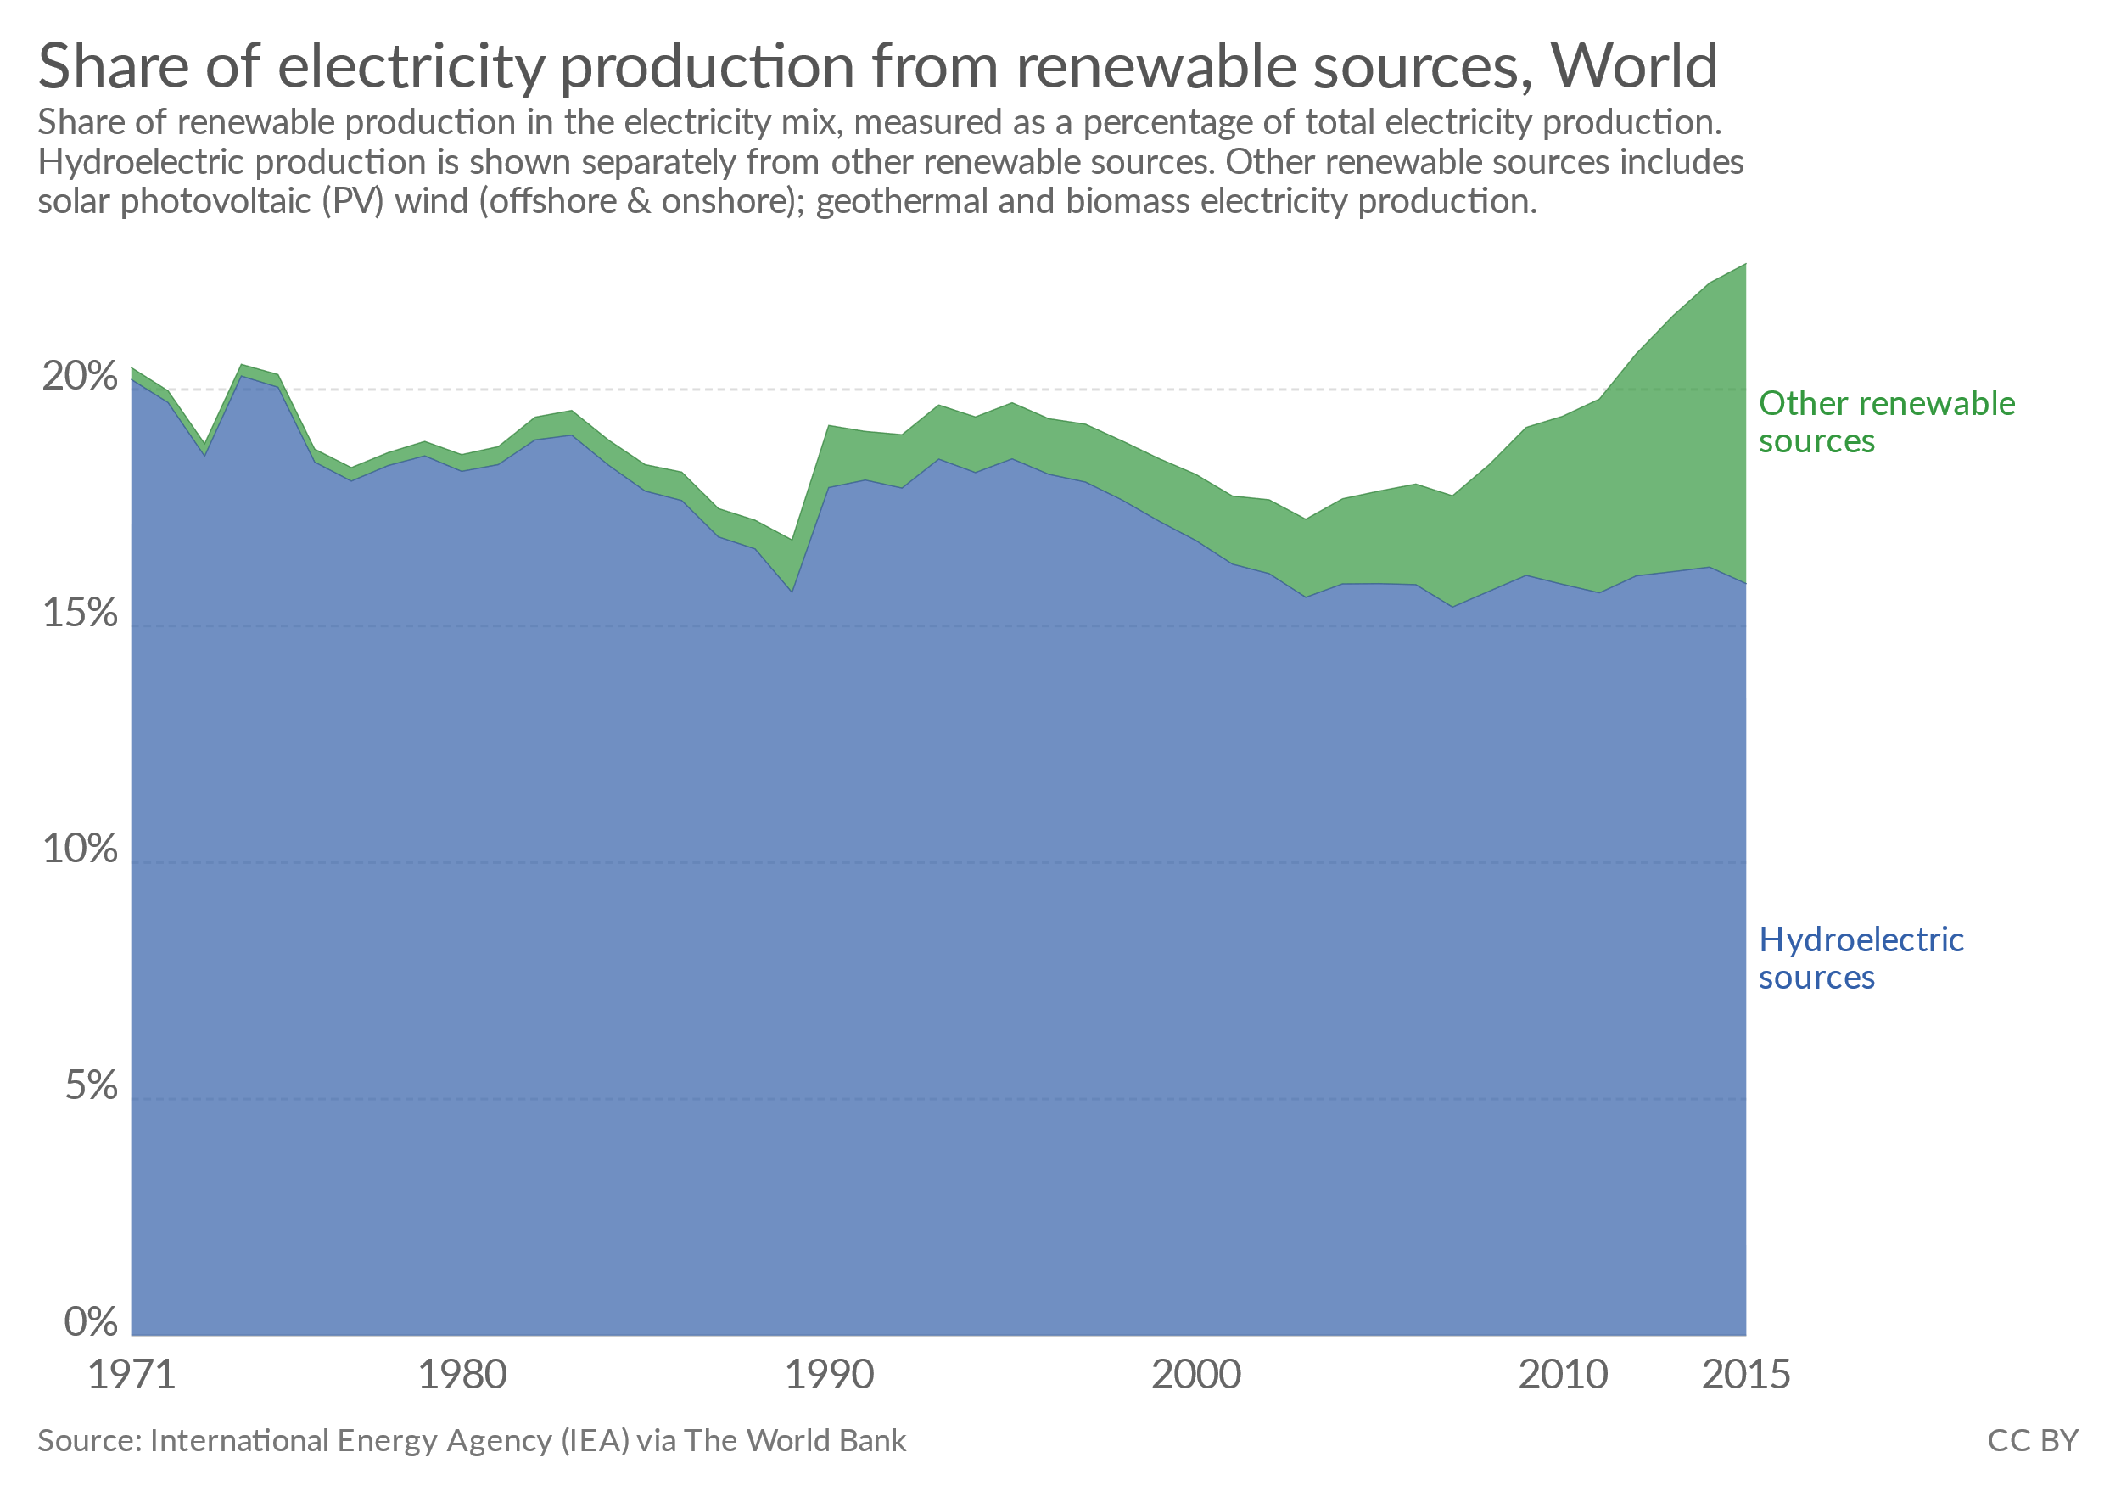
7.3 Intro to Hydropower Plants
7.3.3 Role of Hydropower Plants in Energy Systems
(Our World in Data, image, licensed under CC BY 3.0 )
17
Notes:
We can see from this diagram that the development of hydropower has historically far outweighed the development of other renewable energy generation technologies. Although this is beginning to change as technologies like solar PV and wind continue to grow rapidly, there are several reasons for hydropower having a key role in the energy systems of many countries. From a climate change perspective, the use of hydropower can help reduce reliance on fossil fuels, reducing carbon dioxide emissions. Hydropower can be particularly useful for ensuring the stability and flexibility of electricity systems while reducing reliance on fossil fuels. This is because hydropower plants can provide near-continuous supplies of electricity (unlike more intermittent renewables) and both storage and pumped storage hydropower plants offer additional flexibility. This storage capacity can be used to provide extra electricity at times of peak demand, helping to balance the electricity system.

Slide 18
7.3 Intro to Hydropower Plants
7.3.4 Hydropower Plants in OSeMOSYS Part 1
Example large hydropower power plant data for key OSeMOSYS parameters:
Capacity Factor: varies by country
Efficiency: 100%
Capital Cost: $2100/kW
Fixed Cost: $55/kW
Operational Life: 50 years
Source: Pappis, I. et al. (2019) Energy Projections for African Countries)
18
Notes:
As for geothermal and biomass power plants, this slide shows example data for some key OSeMOSYS parameters for hydropower. It is important to note that these data will be different for different sizes of hydropower plant, and here we are using example data for a large plant, which would be greater than 100MW in capacity. We can see that the capacity factor for hydropower plants varies quite significantly by country. This is because the capacity factor is dependent on the specific hydrological factors in each country. For example, if a country had a very long dry season which would inhibit hydropower generation, the capacity factor for hydropower would be lower than that for a country with a shorter dry season. This is because a smaller fraction of the installed capacity would be available to generate electricity in each time slice. We can see that hydropower is given an efficiency of 100% by convention, as is the case for solar PV and wind technologies too. Moving to the costs, our example data suggest that the costs are similar to those of biomass power plants and less capital-intensive than geothermal power plants. However, please note that these are example data and exact costs will vary by country and context. Finally, the example operational life is 50 years, which is longer than the expected life time of most other types of power plant.

Slide 19
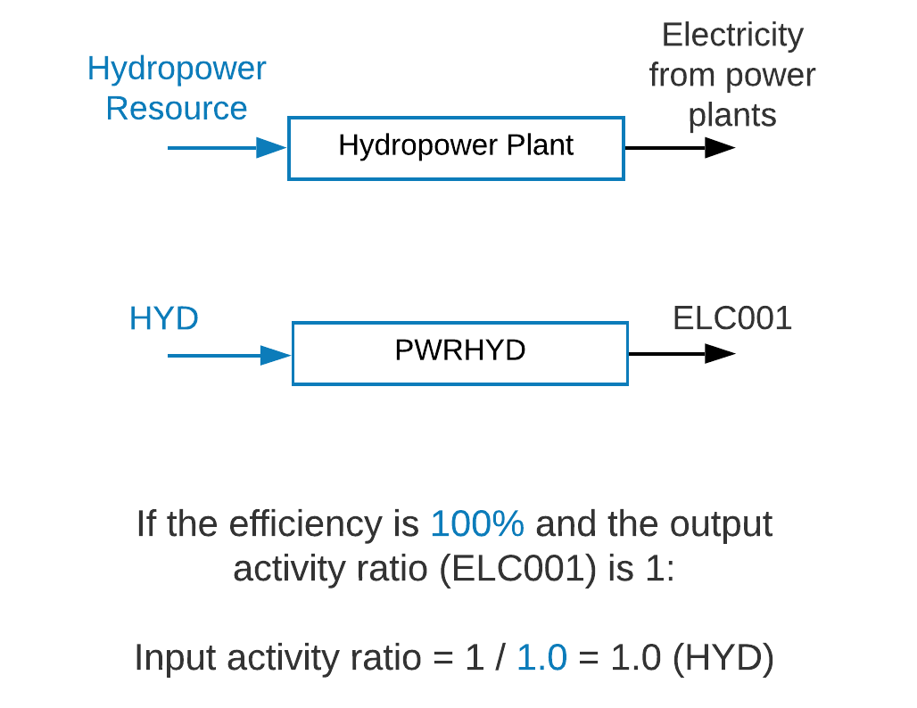
7.3 Intro to Hydropower Plants
7.3.5 Hydropower Plants in OSeMOSYS Part 2
Example of naming different sizes of hydropower plant using the generic naming convention:
Large hydropower (>100MW) = PWRHYD001
Medium hydropower (25-100MW) = PWRHYD002
Small hydropower (<25MW) = PWRHYD003
19
Notes:
In the final slide on hydropower, let's think about how hydropower plants are represented in OSeMOSYS. A hydropower plant is represented as a technology with the input fuel being the hydropower resource and the output fuel being electricity. We can see how this maps to the generic naming convention in this diagram too. It is important to note that we often model different sizes of hydropower plant as different technologies, since they have different costs and performance parameters. This slide shows how we can distinguish between different sizes of hydropower plant using the generic naming convention. Additionally, we can represent dams for storage hydropower and pumped-storage hydro facilities using storage technologies, as we will study in upcoming lectures. Finally, let's think about the input and output activity ratios for hydropower plants. As we have been doing previously, we will define the output activity ratio to be 1 and this will be assigned to E. L. C. 0 0 1 which is the output fuel. On the previous slide we saw that hydropower plants are usually modelled with 100% efficiency. We can then work out the input activity ratio using the calculation 1 divided by efficiency, which in this case is 1 divided by 1, giving an input activity ratio of 1. This will be assigned to H. Y. D., since this is the input fuel.

Slide 20
Lecture 7.3 References
Shivakumar, Abhishek, Sundin, Caroline, Pappis, Ioannis, Sridharan, Vignesh, & Almulla, Youssef. (2021, March). Hydro and nuclear: social, environmental and economic concerns (Version 1). Zenodo. http://doi.org/10.5281/zenodo.4585607
Pappis, I., Howells, M., Sridharan, V., Usher, W., Shivakumar, A., Gardumi, F. and Ramos, E., Energy projections for African countries, Hidalgo Gonzalez, I., Medarac, H., Gonzalez Sanchez, M. and Kougias, I., editor(s), EUR 29904 EN, Publications Office of the European Union, Luxembourg, 2019, ISBN 978-92-76-12391-0, doi:10.2760/678700, JRC118432.
20

Slide 21
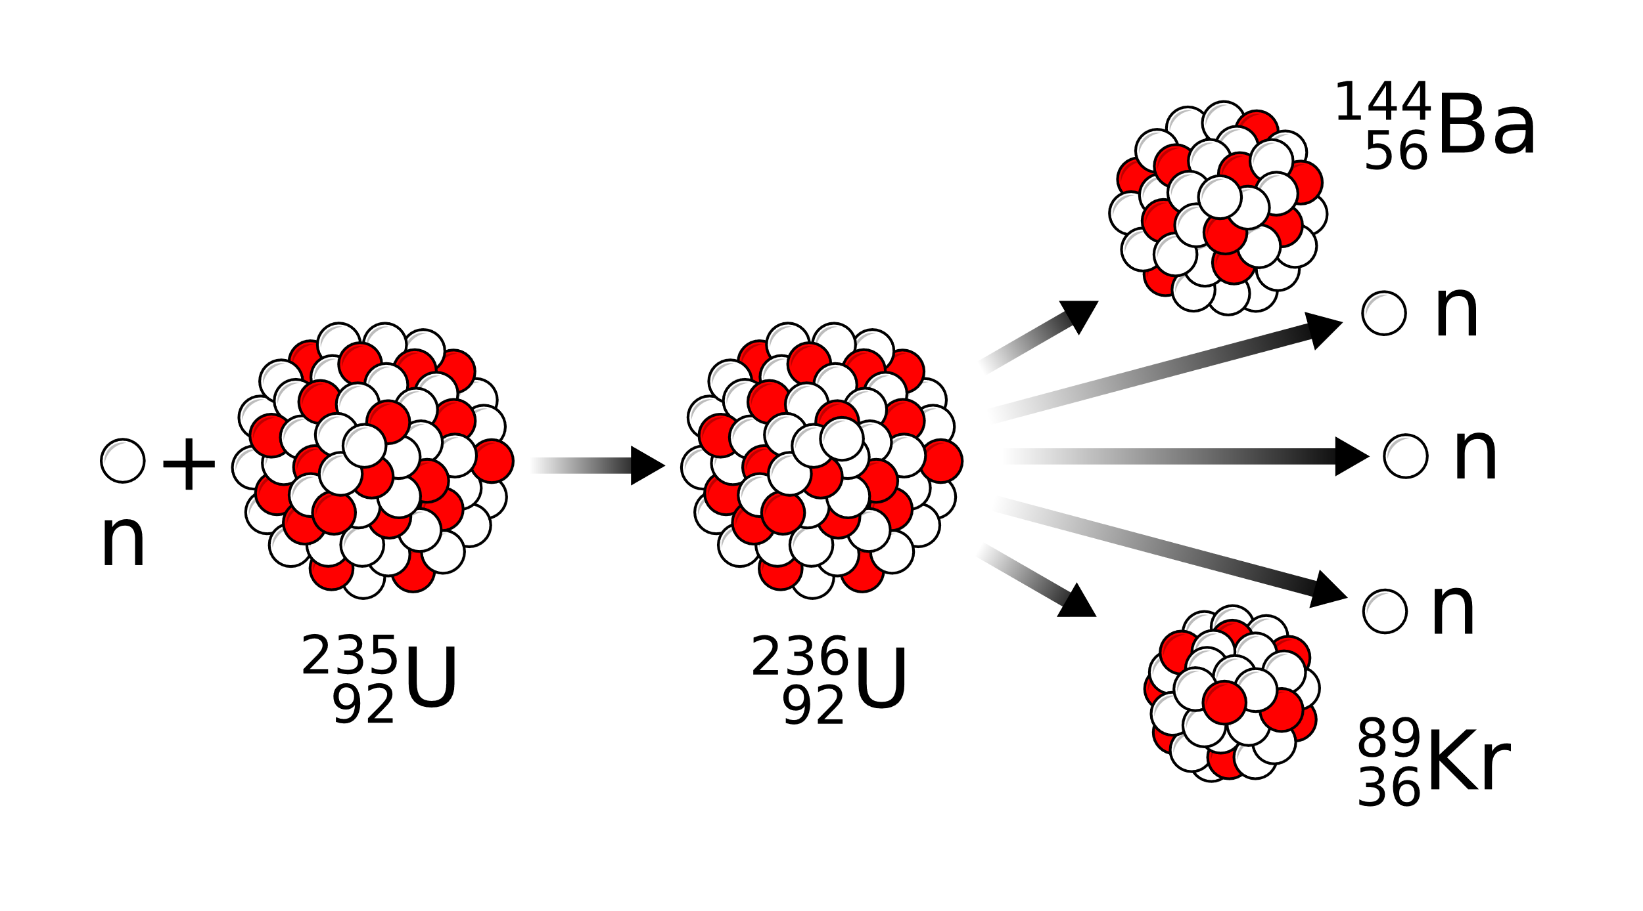
7.4 Intro to Nuclear Power Plants
7.4.1 Overview of Nuclear Power Plants
(MikeRun, image, license: CC BY–SA 4.0)
21
Notes:
Nuclear power generation is a very complex process and this lecture does not intend to provide a detailed explanation of this. However, we will go over a simplified description of the nuclear process. All nuclear power plants in operation today are based around the process of nuclear fission, which is shown in this diagram. This process essentially involves firing neutrons at large atomic nuclei, such as uranium-235, causing each large nucleus to eventually split into two smaller nuclei. This is useful for power generation since the process releases a large amount of energy. At a nuclear power plant, this nuclear fission reaction is set up inside a nuclear reactor. The energy produced is used to heat water, creating steam which drives a turbine, driving an electrical generator to produce electricity. There are several different types of nuclear reactor; however, they are all based around this process. The next slide will discuss potential environmental and social aspects of nuclear power generation.

Slide 22
7.4 Intro to Nuclear Power Plants
7.4.2 Environmental and Social Aspects of Nuclear Power Plants
Capital Intensive
Public Perception
Nuclear Waste
Historical Accidents
Political Concerns
Environmental & Social Aspects of Nuclear Power Plants
Concepts from: Shivakumar et al. (2021)
22
Notes:
There is quite a complex dialogue on nuclear power, with many people having very strong views either in favour of or against nuclear power. This lecture does not aim to present a certain viewpoint, but simply to give an objective view of some of the potential concerns associated with nuclear power, as well as some of the potential advantages in the next slide. One of the major potential issues with nuclear power is the negative public perception, which is often due to safety concerns based on historical nuclear accidents. The three major nuclear accidents often discussed are Three Mile Island in 1979, Chernobyl in 1986, and Fukushima in 2011. We will not delve into the specific causes of these accidents; however, we will note that their effects have included radiation exposure, displacement of communities, and expensive clean-up operations. Another potential challenge with nuclear power is the disposal of the waste. Although nuclear power plants produce small amounts of waste relative to many other power plants, and only a small percentage of this waste is considered highly dangerous to humans, storage and disposal of nuclear waste can be challenging and costly. This means that decommissioning costs can be very high, and the capital costs of nuclear power are also often very high, creating potential economic challenges. Finally, there can be concerns over the risks of nuclear proliferation, with concerns that development of nuclear power could influence the development of nuclear weapons.

Slide 23
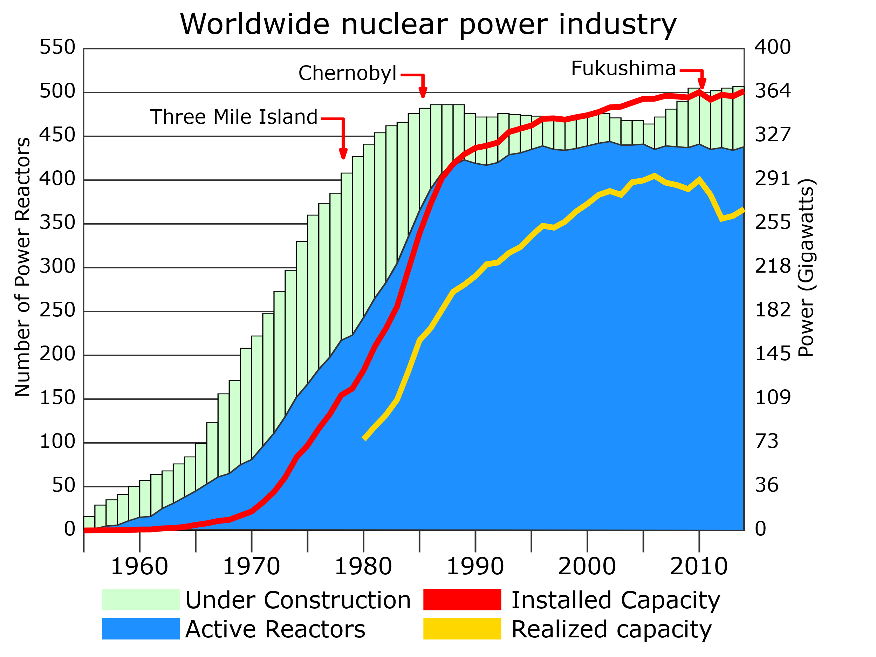
7.4 Intro to Nuclear Power Plants
7.4.3 Role of Nuclear Power Plants in Energy Systems
Concepts from: Shivakumar et al. (2021)
23
Notes:
This slide shows the installed nuclear capacity globally. We can see that there is a significant amount of capacity across the world, and nuclear power is estimated to provide 11% of total electricity production and one third of the total low-carbon electricity. Similarly to the other technologies discussed in this lecture, nuclear power offers a way to reduce carbon dioxide emissions and dependence on finite fuels. One of the main advantages of nuclear power is the fact that it is a flexible and controllable form of generation. This means that a nuclear power plant can produce electricity whenever it is required, rather than being reliant on the weather conditions like some other renewables. Nuclear power plants therefore offer a way to ensure the stability and reliability of the electricity system, while reducing reliance on fossil fuels. Nuclear power could complement intermittent renewables like solar PV and wind, by providing reliable baseload generation at all times, similar to the other technologies discussed in this lecture. Another potential pro for nuclear power is the fact that nuclear fuel has a very high energy density, meaning it requires smaller amounts of fuel and land than other technologies.

Slide 24
7.4 Intro to Nuclear Power Plants
7.4.4 Nuclear Power Plants in OSeMOSYS Part 1
Example nuclear power plant data for key OSeMOSYS parameters:
Capacity Factor: 0.85
Efficiency: 33%
Capital Cost: $4000/kW
Fixed Cost: $170/kW
Operational Life: 60 years
Source: Pappis, I. et al. (2019) Energy Projections for African Countries)
24
Notes:
Again this slide shows example data for some key OSeMOSYS parameters for nuclear power plants. We can see that the capacity factor is quite high, as for geothermal power plants. This reflects the fact that most of the installed capacity of a nuclear power plant is likely to be available in all time slices. We can see that the example efficiency is 33%, reflecting energy lost as waste heat from the nuclear reactor. This efficiency may be higher for certain types of reactor which are adjusted to reduce the amount of energy wasted. Moving to cost, the high capital intensity of nuclear power discussed earlier is reflected here, with these example data giving a higher capital cost for nuclear than for biomass, geothermal, or hydropower. The fixed cost for nuclear power is also relatively high. Finally, we can see that the operational life in our example data is 60 years, which is quite long compared to the life times of fossil power plants and most renewables aside from hydropower.

Slide 25
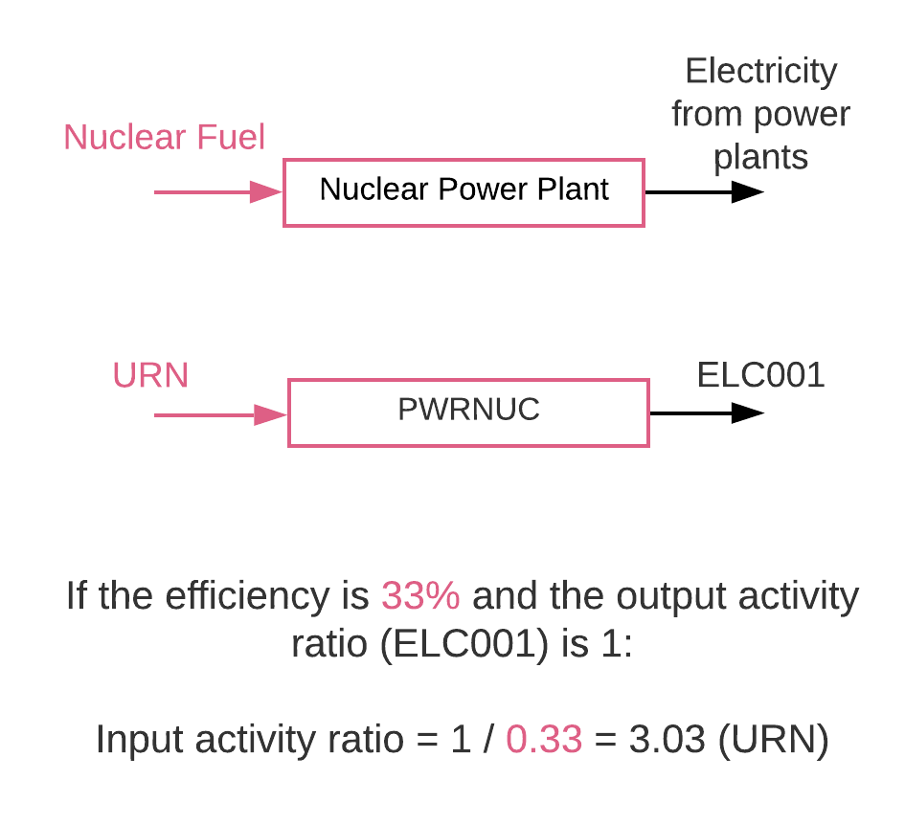
7.4 Intro to Nuclear Power Plants
7.4.1 Nuclear Power Plants in OSeMOSYS Part 2
25
Notes:
In this final slide on nuclear power we will look at how it can be represented in Reference Energy Systems and example output and input activity ratios. Nuclear power plants are represented as a technology with an input fuel of nuclear fuel, or uranium specifically, and an output fuel of electricity. The relevant generic code names are also shown on this slide. On the previous slide we saw that an example efficiency of a nuclear power plant is 33%. Again, we will define the output activity ratio to equal 1, assigned to E. L. C. 0 0 1. We can then calculate the input activity ratio using our calculation of 1 divided by the efficiency as a decimal, which in this case is 1 divided by 0.33, giving an input activity ratio of 3.03, assigned to U. R. N. since this is the input fuel.

Slide 26
Lecture 7.4 References
Shivakumar, Abhishek, Sundin, Caroline, Pappis, Ioannis, Sridharan, Vignesh, & Almulla, Youssef. (2021, March). Hydro and nuclear: social, environmental and economic concerns (Version 1). Zenodo. http://doi.org/10.5281/zenodo.4585607
Pappis, I., Howells, M., Sridharan, V., Usher, W., Shivakumar, A., Gardumi, F. and Ramos, E., Energy projections for African countries, Hidalgo Gonzalez, I., Medarac, H., Gonzalez Sanchez, M. and Kougias, I., editor(s), EUR 29904 EN, Publications Office of the European Union, Luxembourg, 2019, ISBN 978-92-76-12391-0, doi:10.2760/678700, JRC118432.
26

Slide 27
Thank you
www.climatecompatiblegrowth.com

