Slide 1
Energy system modelling using OSeMOSYS
LECTURE 6
FOSSIL POWER PLANTS, TRANSMISSION & DISTRIBUTION

Slide 2
Learning Outcomes
By the end of this lecture, you will be able to:
ILO1: Understand the concepts of fossil power plants and fossil fuel supply chains
ILO2: Learn how to represent fossil power plants in OSeMOSYS
ILO3: Understand key characteristics and impacts of fossil power plants and their interactions with the wider energy system
ILO4: Understand key characteristics of transmission and distribution technologies and how to represent them in OSeMOSYS
2
Notes:
By the end of this lecture, you will:
1) Understand the concepts of thermal power plants and fossil fuel supply chains
2) Learn how to represent thermal power plants in OSeMOSYS
3) Understand key characteristics and impacts of thermal power plants and their interactions with the wider energy system
4) Understand key characteristics of transmission and distribution technologies and how to represent them in OSeMOSYS

Slide 3

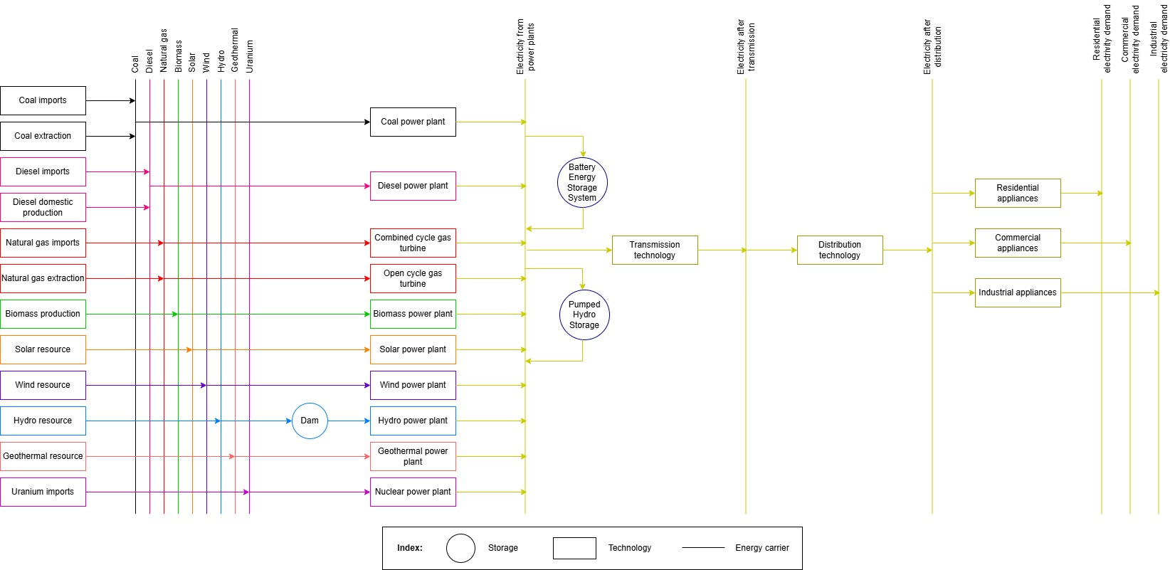
6.1 Introduction to Fossil Power Plants
6.1.1 Introducing Fossil Power Plants
3
Notes:
In this lecture we will cover fossil power plants, namely coal, oil, and gas power plants. These are all types of thermal power plants. Note that biomass power plants are also thermal power plants; however, they will be covered separately in a later lecture. We will first look at a basic overview of coal, diesel, and gas power plants, then look at their technical characteristics and representation in OSeMOSYS, before finally exploring their impacts, both environmental and societal. In the last part of this lecture, we will learn more about Power Transmission and Distribution technologies, which are also highlighted on this diagram.

Slide 4
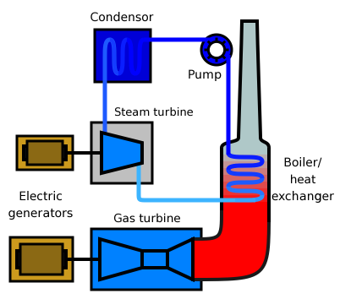
6.1 Why is energy planning important?
6.1.2 How do Fossil Power Plants Work?
Fuel is burned to produce heat
High pressure steam drives a turbine
Turbine drives a generator to produce electricity
4
4
Notes:
Thermal power plants are power plants where thermal energy, generated by burning a fuel, is converted to electrical energy. This includes fossil power plants, where the fuel burnt is a fossil fuel, such as coal, natural gas, or oil. Although the fuel used can vary, these power plants are based around similar processes: the fuel is burnt to produce heat which generates steam. This steam then drives a turbine, which drives a generator to produce electricity. It is important to note that different fuels release different amounts of energy when burned. This is measured by the fuel's calorific value, which is the amount of energy released when 1kg of the fuel is burnt.

Slide 5
6.1 Why is energy planning important?
6.1.3 Fossil Power Plants in the Wider Energy System
Power Transmission & Distribution
Fossil Power Plants
Electricity Demand
Fossil Fuel Extraction or Imports
Fuel Processing
Fossil Fuel demands for:
- Transport
- Cooking & Lighting
- Heating
Fuel Transport & Distribution
5
Notes:
As we can see on this diagram, fossil power plants are just one part of the wider energy system, and several interactions with other technologies are needed in order to meet final energy demands. Firstly, we must understand the processes required to source the fossil fuels burned in these power plants: these fuels must either be extracted domestically or imported from other countries. It is important to remember that the supply of these fuels is associated with costs, as discussed in lecture 5. Additionally, it is important to remember that these fuels cannot be infinitely supplied since fossil fuels are non-renewable energy sources, with only a finite amount of reserves globally. The supply of these fuels also has environmental and social aspects, as discussed later in this lecture. In some cases the fuels also have to be further processed before they can be supplied to power plants, for example crude oil has to be refined at an oil refinery. In addition, once these fuels have been burned to generate electricity in fossil power plants, that electricity has to be transported to end-users via transmission and distribution networks. It is also important to remember that fossil fuels have several roles in the energy system, not just electricity generation, which are discussed in more detail in the next slide.

Slide 6



6.1 Why is energy planning important?
6.1.4 Roles of Fossil Fuels
As well as for electricity generation, fossil fuels are used heavily in transport, cooking, heating, and lighting
6
Notes:
Whilst we have so far discussed fossil fuels in relation to electricity generation, they have several other key roles in energy systems. Firstly, transport systems are often almost entirely based on fossil fuels, with cars, buses, and motorcycles in most countries being fuelled by oil products. Secondly, fossil fuels can be important for cooking and lighting, with many stoves and lamps being fuelled by kerosene, an oil products. Thirdly, fossil fuels often have a role in heating systems, with many countries having residential heating systems that rely on natural gas, and some industrial processes requiring high temperatures that can be difficult to achieve without burning fossil fuels. In developing countries, all of these demands are likely to grow as transport infrastructure evolves, populations increase, and industrial productivity grows. Together these factors mean that, even if we were to generate electricity with renewable technologies, energy systems could create increasingly large demands for fossil fuels in the future unless we switch to cleaner technologies in the transport, cooking, lighting, and heating sectors. This is a key element of the energy transition, which will be introduced next.

Slide 7
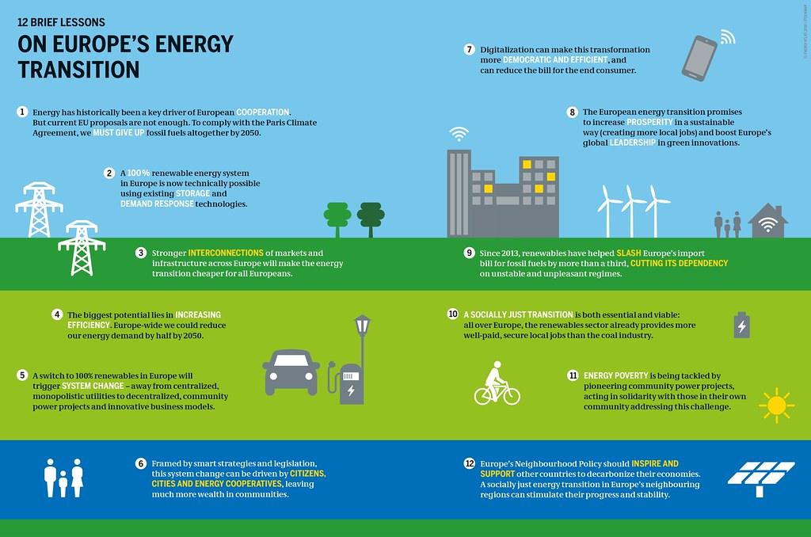
6.1 Why is energy planning important?
6.1.5 Energy Transition
Example of the Energy Transition concept from Europe:
(Bartz/Stockmar, image licensed with CC BY 4.0)
7
Notes:
The energy transition refers to the transformation of the energy sector from being reliant on fossil fuels to using low-carbon and renewable energy sources. There are several drivers of this transition, with greenhouse gas emissions and environmental impacts at the core. Burning fossil fuels releases greenhouse gases, which drive global warming, and creates harmful air pollution. Thus, there is a need to transition away from fossil fuels in order to mitigate climate change and protect the environment. Additionally, as discussed previously, fossil fuels are finite resources and will not last forever, meaning that a system reliant on these fuels in the long-term cannot be resilient or sustainable. Therefore, the energy transition calls for greater uptake of renewable energy technologies, which avoid some of the negative impacts of fossil power plants discussed in more detail later in this lecture. However, as we saw on the previous slide, fossil fuels are also used for transport, cooking, lighting, and heating. So, we must consider how we can transform these sectors to use renewable resources. For this reason, energy system models are often developed to allow us to study fuel switching, such as using electric vehicles. We will also cover this later in the course.

Slide 8
Lecture 6.1 References
Slide 6 images: free for commercial use, sourced from https://pixabay.com/
Slide 7 image courtesy of Bartz/Stockmar, licensed under CC BY 4.0, available at: https://www.boell.de/en/2018/04/24/energy-atlas-graphics-and-license-terms
Taliotis, C., Gardumi, F., Shivakumar, A., Sridharan, V., Ramos, E., Beltramo, A., Rogner, H., Howells, M., 2018. Electricity supply system in OSeMOSYS I (Thermal power plants and T&D), KTH-Desa and OpTIMUS.community. Available at: https://zenodo.org/record/1942510#.YC5VjehKhPY. [18/02/2021] DOI: 10.5281/zenodo.1942510
8

Slide 9
6.2 Fossil Power Plants in OSeMOSYS
6.2.1 Fossil Power Plants in Reference Energy Systems
Coal
Electricity
COA
ELC001
Coal power plant
PWRCOA
Diesel
Electricity
DSL
ELC001
Diesel power plant
PWRDSL
Natural gas
Electricity
NGS
ELC001
Combined cycle gas turbine
PWRNGS001
Natural gas
Electricity
NGS
ELC001
Open cycle gas turbine
PWRNGS002
9
Notes:
Now we will look at how fossil power plants are represented in OSeMOSYS. Firstly, let's think about how they are represented in Reference Energy Systems. Fossil Power Plants are technologies and so are represented by boxes, as shown on this diagram. These power plants have both an input fuel, which is the specific fossil fuel they burn, and an output fuel, which is electricity. For example, we can see that the coal power plant has an input fuel of coal and produces electricity as its output. This diagram also shows the generic code names used for all of these technologies and fuels, which we will use when building our own model in hands-on exercises. It is important to note that this diagram shows two types of gas power plant: Combined Cycle Gas Turbines and Open Cycle Gas Turbines. In a Combined Cycle Turbine, waste heat generated by burning the gas can be recycled, increasing the efficiency of the power plant compared to Open Cycle Gas Turbines. In our code naming convention, these types of power plants are named P. W. R. N. G. S. 0 0 1 and P. W. R. N. G. S. 0 0 2 respectively.

Slide 10
6.2 Fossil Power Plants in OSeMOSYS
6.2.2 Defining Fossil Power Plants in OSeMOSYS
Key parameters for defining fossil power plants:
Output Activity Ratio
Input Activity Ratio
Capital, Fixed, and Variable Costs
Availability Factor
Capacity Factor
Operational Life
10
Notes:
In OSeMOSYS, fossil power plants are mainly characterized by the parameters shown on this slide. These are:
Output Activity Ratio: this is used to define the output fuel of the power plant, usually electricity (or, in the naming convention, E.L.C. 0 0 1) and has a value of 1 by default.
Input Activity Ratio: this is used to define the input fuel of the power plant and, since the Output Activity Ratio is set to 1 by default, defines the number of units of input fuel needed to produce 1 unit of electricity.
Capital, Variable, and Fixed Costs: these parameters are used to represent the costs of power plants.
Availability Factor: this is the maximum time a technology can run in the whole year, as a fraction of the year ranging from 0 to 1.
Capacity Factor: this defines the amount of capacity available during each time slice, as a fraction of the total capacity.
Operational Life: this is how many years the plant is expected to operate for.
We will look at these parameters in more detail in the following slides.

Slide 11
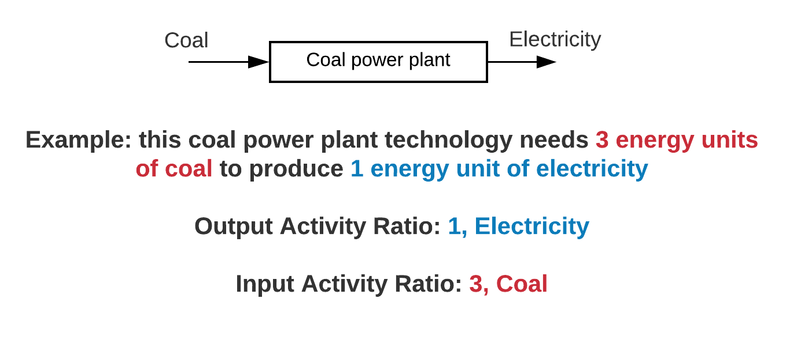
6.2 Fossil Power Plants in OSeMOSYS
6.2.3 Input & Output Activity Ratios
11
Notes:
Let's explore the Output Activity Ratio and Input Activity Ratio parameters a little more. The Output Activity Ratio is the parameter used to define the output fuel produced by the power plant and is given a value of 1 by default. So, for the example on this slide, the output activity ratio for our coal power plant would be 1 for electricity. The Input Activity Ratio parameter is then used to define the input fuel and how many energy units of input fuel are needed to produce 1 energy unit of output fuel. So, in this case we want to define how many energy units of coal, the input fuel, are needed to produce 1 energy unit of electricity, the output fuel. In our example, we can see that 3 energy units of coal are needed to produce 1 energy unit of electricity, so the Input Activity Ratio for the coal power plant would be 3 for coal. It is also important to note that power plants can have more than one input or output fuel, for example some models are set up to consider the water consumption of power plants, meaning water would also have to be defined as an input fuel using Input Activity Ratio.

Slide 12



6.2 Fossil Power Plants in OSeMOSYS
6.2.4 Fossil Power Plant Costs
Capital Costs ($/kW):
One-time costs of building the power plant
Fixed Costs ($/kW/yr):
Fixed annual costs, e.g., workers' salaries, taxes, and insurance
Variable Costs ($/GJ):
Costs incurred when the power plant runs, e.g., fuel costs
12
Notes:
Fossil power plant costs are represented in OSeMOSYS using three parameters. Firstly, the Capital Cost parameter is used to define the one-time costs associated with building and setting up the power plant. This includes things like planning and design, construction and buying machinery, and commissioning and certification. Capital costs are defined using the unit $/kW, referring to the cost in dollars per kW of power plant capacity. The fixed costs parameter is used to consider regular costs occurring in every year that the power plant operates, including the costs of workers' salaries, taxes, insurance, and any fuel costs which are fixed every year. This is defined in $/kW/yr, referring to the cost in dollars per kW of power plant capacity per year. Finally, the variable costs parameter represents costs that are only incurred when the power plant runs to produce electricity. This is often mainly the cost of the input non-fuels or consumables that are needed for the power plant to run, such as chemicals. Variable costs are defined using the unit $/GJ, referring to the cost per GJ of energy produced.

Slide 13
6.2 Fossil Power Plants in OSeMOSYS
6.2.5 Availability Factor, Capacity Factor, and Operational Life
Availability Factor: maximum time a technology can operate over the year, as a fraction of the year ranging from 0 to 1. This can account for planned power plant outages.
Capacity Factor: capacity available in each time slice expressed as a fraction of the total installed capacity ranging from 0 to 1. This accounts for unplanned power plant outages.
Operational Life: the useful lifetime of the power plant in years
13
Notes:
Other key parameters for defining fossil power plants in OSeMOSYS include the availability factor, capacity factor, and operational life. This slide includes definitions for these parameters in relation to power plants. The availability factor represents the maximum time that a power plant is able to operate over the year, as a fraction of the whole year, ranging from 0 to 1. This value is set to 1 by default, meaning the power plant would be able to operate over the whole year; however, it can be adjusted to less than 1 to account for planned outages. For example, if we knew that a coal power plant would be out of operation for 10% of the year due to planned maintenance, we would give the technology an availability factor of 0.9. The capacity factor represents the power plant capacity available in each modelled time slice, as a fraction of the total installed capacity, ranging from 0 to 1. This parameter is used to account for unplanned outages. If 100% of a power plant's capacity could run to produce power 100% of the time, the power plant would have a capacity factor of 1. However this is not the case in reality as power plants do not always run at full capacity or all the time. For example, a coal power plant may have a capacity factor of 80%. Finally, the operational life parameter is the useful lifetime of the power plant in years. For example, a typical fossil power plant might have an expected life time of 25 years.

Slide 14
Lecture 6.2 References
Taliotis, C., Gardumi, F., Shivakumar, A., Sridharan, V., Ramos, E., Beltramo, A., Rogner, H., Howells, M., 2018. Electricity supply system in OSeMOSYS I (Thermal power plants and T&D), KTH-Desa and OpTIMUS.community. Available at: https://zenodo.org/record/1942510#.YC5VjehKhPY. [18/02/2021] DOI: 10.5281/zenodo.1942510
14
14

Slide 15
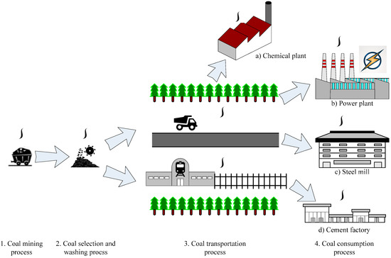
6.3 Impacts of Fossil Power Plants
6.3.1 Coal Supply Chain
(Luo et al. 2017, image, licensed under CC BY 4.0)
15
Notes:
The coal supply chain is made up of different stages, including:
Mining and preparation (underground or surface).
Transportation. this accounts for a large part of the total cost of the delivered product. It usually occurs via railways, large vessels through oceans, pipelines as a mixture of coal and water, and trucks (for short distances).
Combustion-based power plants. Two main technologies are used in coal power plants: Super-critical pulverized coal (or S. C. P. C.) and the Integrated Gasification Combined Cycle (or I. G. C. C.). Additionally, Carbon Capture and Storage (or C. C. S.) can be applied.
End-use of electricity in all sectors of society.
In many countries, coal is a source of energy security and jobs, as it is:
•Relatively inexpensive,
•Simple to extract and transport,
•Capable of providing baseload power generation,
•Located in politically stable regions and abundant in many countries.
However, there are challenges associated with coal, discussed next.

Slide 16
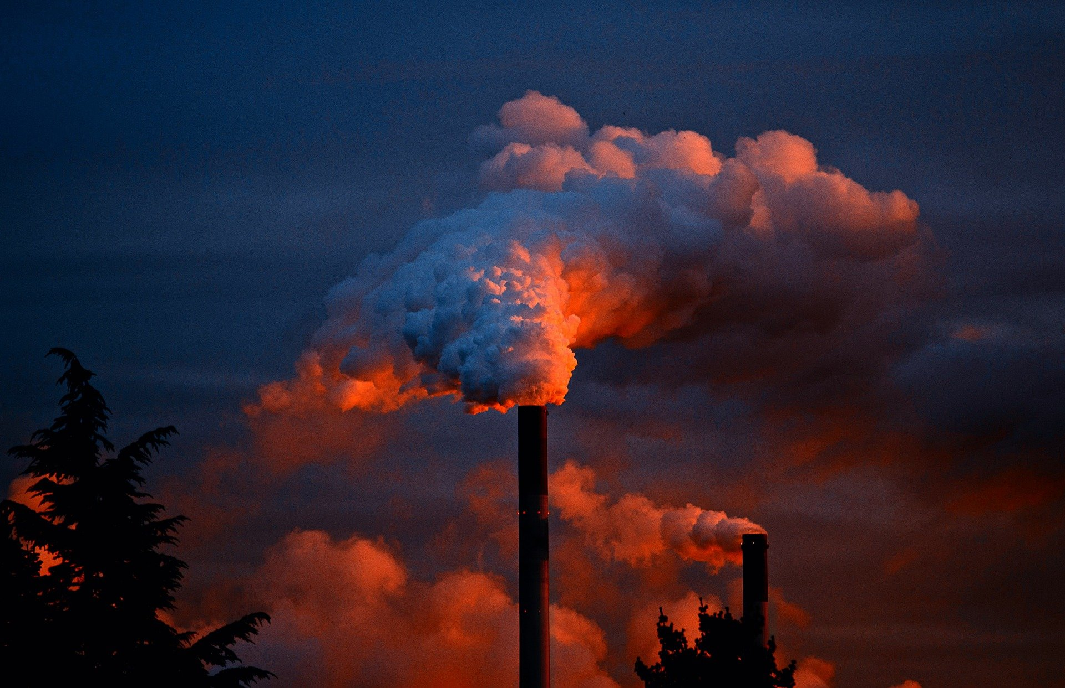
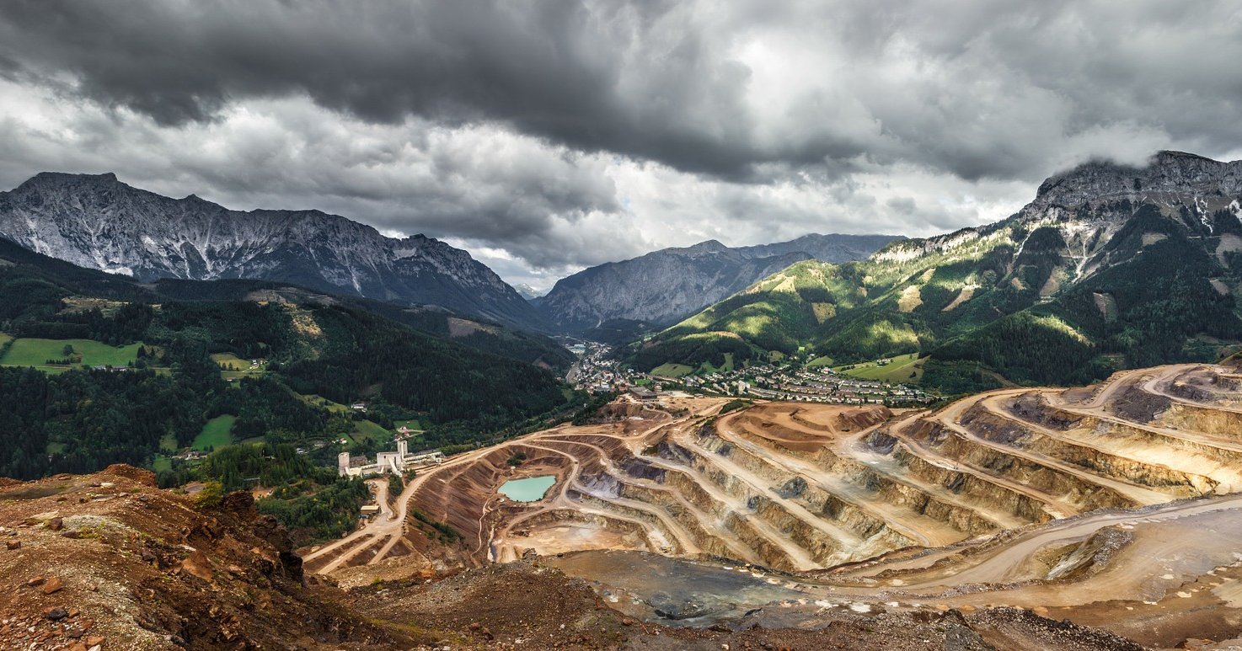

6.3 Impacts of Fossil Power Plants
6.3.2 Damaging impact of Coal
Climate | Land-use | Water
CO2 emissions | Degradation of vegetation | River water alkalinity
SO2 – related acidification of ecosystems | Loss of wildlife habitats | Fly ash stored in impoundment ponds
Mercury emissions (concentration at higher levels of the food chain) | Damage due to mine collapses | Degradation of aquatic habitats
Acid rain | Loss of topsoil leads to infertile wastelands | Cooling water requirements
16
Notes:
This slide shows some of the negative impacts of the coal supply chain and coal-fired power plants.
The continuing trend of year-on-year growth in coal-fired power needs to be reversed to meet ambitious carbon dioxide emissions targets. Indeed, the entire coal supply chain has negative impacts on:
Climate, due to Carbon Dioxide, Sulphur Dioxide, and mercury emissions which cause acidification and contribute to global warming.
Land-use, as mining activities degrade the vegetation, harm wildlife, and reduce crop fertility.
Water, though increased alkalinity, which degrades aquatic habitats.
We should bear in mind that Coal has strong advantages and disadvantages. We need to understand what drives governments to use it and what the trade-offs are in order to find feasible alternatives. Policy incentives such as carbon pricing and regulation are imperative to control pollution and limit generation from inefficient coal-fired power plants. A systems perspective may allow us to see non-obvious risks and opportunities of shifting away from coal or maintaining it.

Slide 17
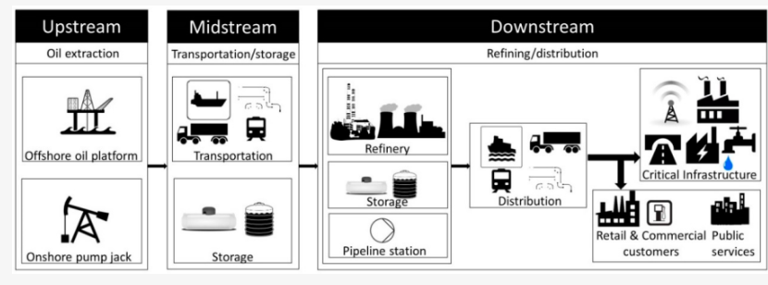
6.3 Impacts of Fossil Power Plants
6.3.3 Oil and Gas Supply Chains
(Katopodis et al. (2019), image, licensed under CC BY 4.0)
17
Notes:
This time let's look at the oil and gas supply chains.
Oil and gas prices have been subject to oscillations, caused by geopolitical factors and related supply–demand balances. This raises questions of
energy supply security and import dependency for individual countries, but also of the resilience of the global economy to oil prices and vice versa.
The oil supply chain includes the following stages:
Extraction, using conventional wells, deep-water production, and enhanced oil recovery methods.
Transportation (using oil tankers, pipelines, trucks, and railways) and storage.
Refining, which is the industrial process that transforms crude oil into useful products such as petroleum naphtha, gasoline, and diesel fuel.
Combustion-based power plants.
Utility-scale power generation from oil products like heavy fuel oil or diesel has recently declined and is now responsible for only minor shares of generation in many regions. Small diesel generators are still used as backup (for example, in hospitals, factories, or households), especially in developing countries with unreliable electricity supply.
The gas supply chain includes:
Extraction, using conventional wells, deep-water production, or hydraulic fracturing.
Transportation (with pipelines and ships) and storage (underground storage or on-board Liquefied Natural Gas fleets).
Combustion-based power plants: Open Cycle Gas Turbines (O. C. G. Ts) and Combined Cycle Gas Turbines (C. C. G. Ts), the latter of which has a Heat Recovery Steam Generator (H. R. S. G.) to make use of waste heat, increasing efficiency.

Slide 18
6.3 Impacts of Fossil Power Plants
6.3.4 Environmental Impacts of Oil and Gas Power Plants
Concerns about waste-water disposal, pollution of underground water, and increased seismic activity due to hydraulic fracking.
High number of oil spills due to accidents.
Methane (CH₄) is a Greenhouse Gas with a warming effect 20 times stronger than Carbon Dioxide (however, methane is shorter lived in the atmosphere). Any direct emission of methane from leaks in the gas production chain contribute to global warming.
Combustion of oil & gas is responsible for emissions at local, regional, and global levels, including CO2, NOx, SOx and particulate matter.
The transport sector, which is based on oil products, accounts for a large share of global CO2 emissions
18
Notes:
Oil and Gas have a negative impact on the environment at all the stages of the supply chain from production to transportation and final uses:
Hydraulic fracking, which consists of fracturing rocks with pressurized liquid to produce oil and gas, causes significant environmental concerns. These are related to waste-water disposal, pollution of underground water, and increased seismic activity.
After being extracted, oil is often transported using ships. Several oil spills in the sea have resulted in destruction of the ecosystem and loss of biodiversity, as well as pollution of the water.
If there are any leaks in the natural gas production chain, methane (CH4) is released, contributing to global warming. This greenhouse gas has a 20-times stronger warming effect than CO2, though it has a shorter lifespan in the atmosphere.
When the oil or the gas is finally burnt in power plants, emissions at local, regional, and global levels are released. These include CO2, NOx and particulate matter.
Oil products are the main fuels in the transport sector (cars, buses, trucks, motorbikes, and so on), which is responsible for a large share of global emissions.

Slide 19
6.3 Impacts of Fossil Power Plants
6.3.5 Social Impact of Oil & Gas power plants
Oil, gas, and coal have long contributed to the development of economies and their security of supply. However, as well as environmental impacts, they have significant economic and social consequences:
Oil & gas are often produced in politically unstable regions
Reported cases of large displacement of local populations for oil extraction activities and harm to local societies and activities
Shifting away from oil and gas may have system impacts which need to be considered when supporting governments in decarbonization strategies:
We need models to quantify potential impacts of continuing current trends or shifting away from them. They can help us understand synergies and trade-offs between supply chains.
19
Notes:
Demand for oil and especially gas is expected to increase if policies do not change drastically. This demand is driven by large and fast-growing economies. Technological solutions which could avert this are emerging, but they could have deep impacts on the system, which are not always known. There are also social factors that slow down the shift from oil and gas resources, including the need for fast growth (which can be easier to achieve using fossil fuels), the conservative trust in mature solutions, and the need for security.
Oil, gas, and coal have long contributed to the development of economies and their security of supply. However, they have important economic, social, and environmental consequences. Oil and gas are often produced in politically unstable regions, where sometimes wars, civil conflicts, or turmoil are related to control of the fossil fuel reserves. Moreover, there are many reported cases of large displacements of local populations for oil extraction activities, which can harm local societies.
From an environmental point of view, there is an urgent need to reduce global reliance on fossil fuels, but shifting away from these sources may have system impacts that need to be considered when supporting governments' decarbonization strategies. We need models to quantify potential impacts of continuing current trends or shifting away from them.

Slide 20
Lecture 6.3 References
Gardumi, F. (2021, March). Oil, gas and coal: social, environmental, economic and system impacts (Version 1). Zenodo. http://doi.org/10.5281/zenodo.4585626
20

Slide 21
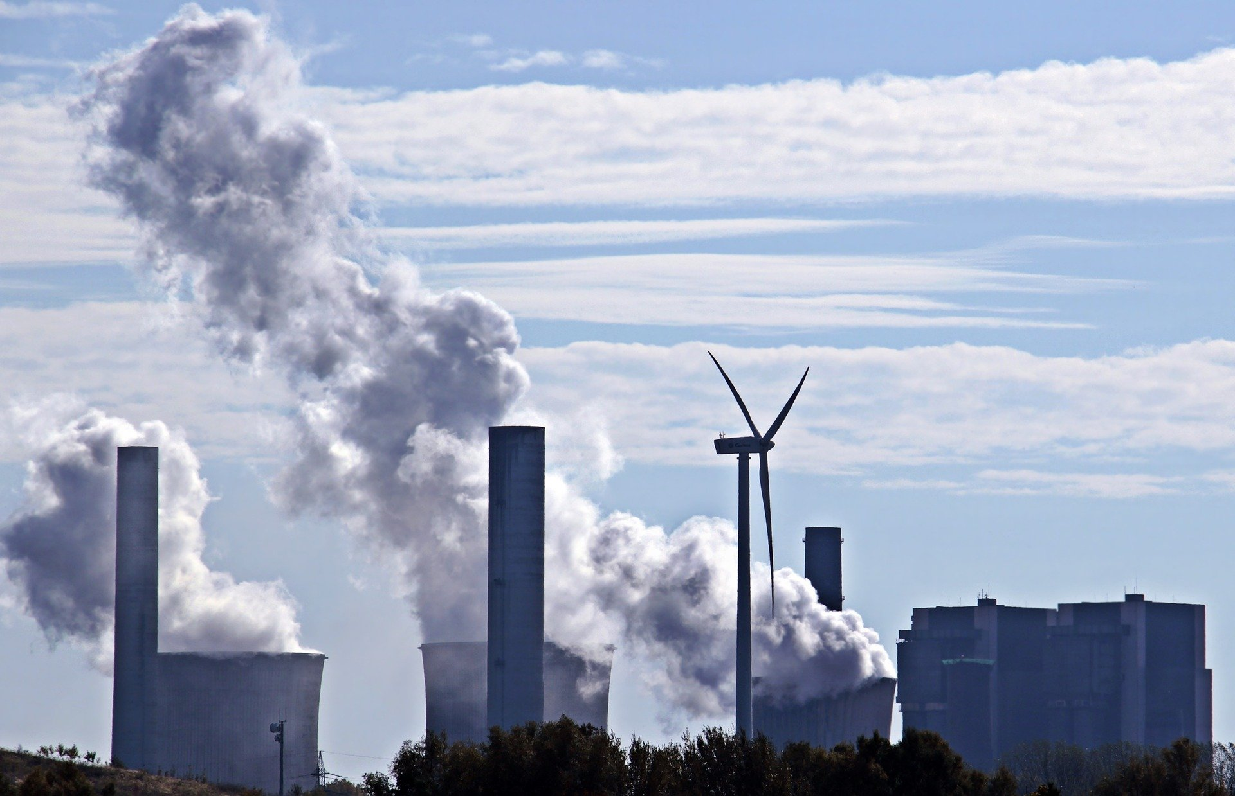
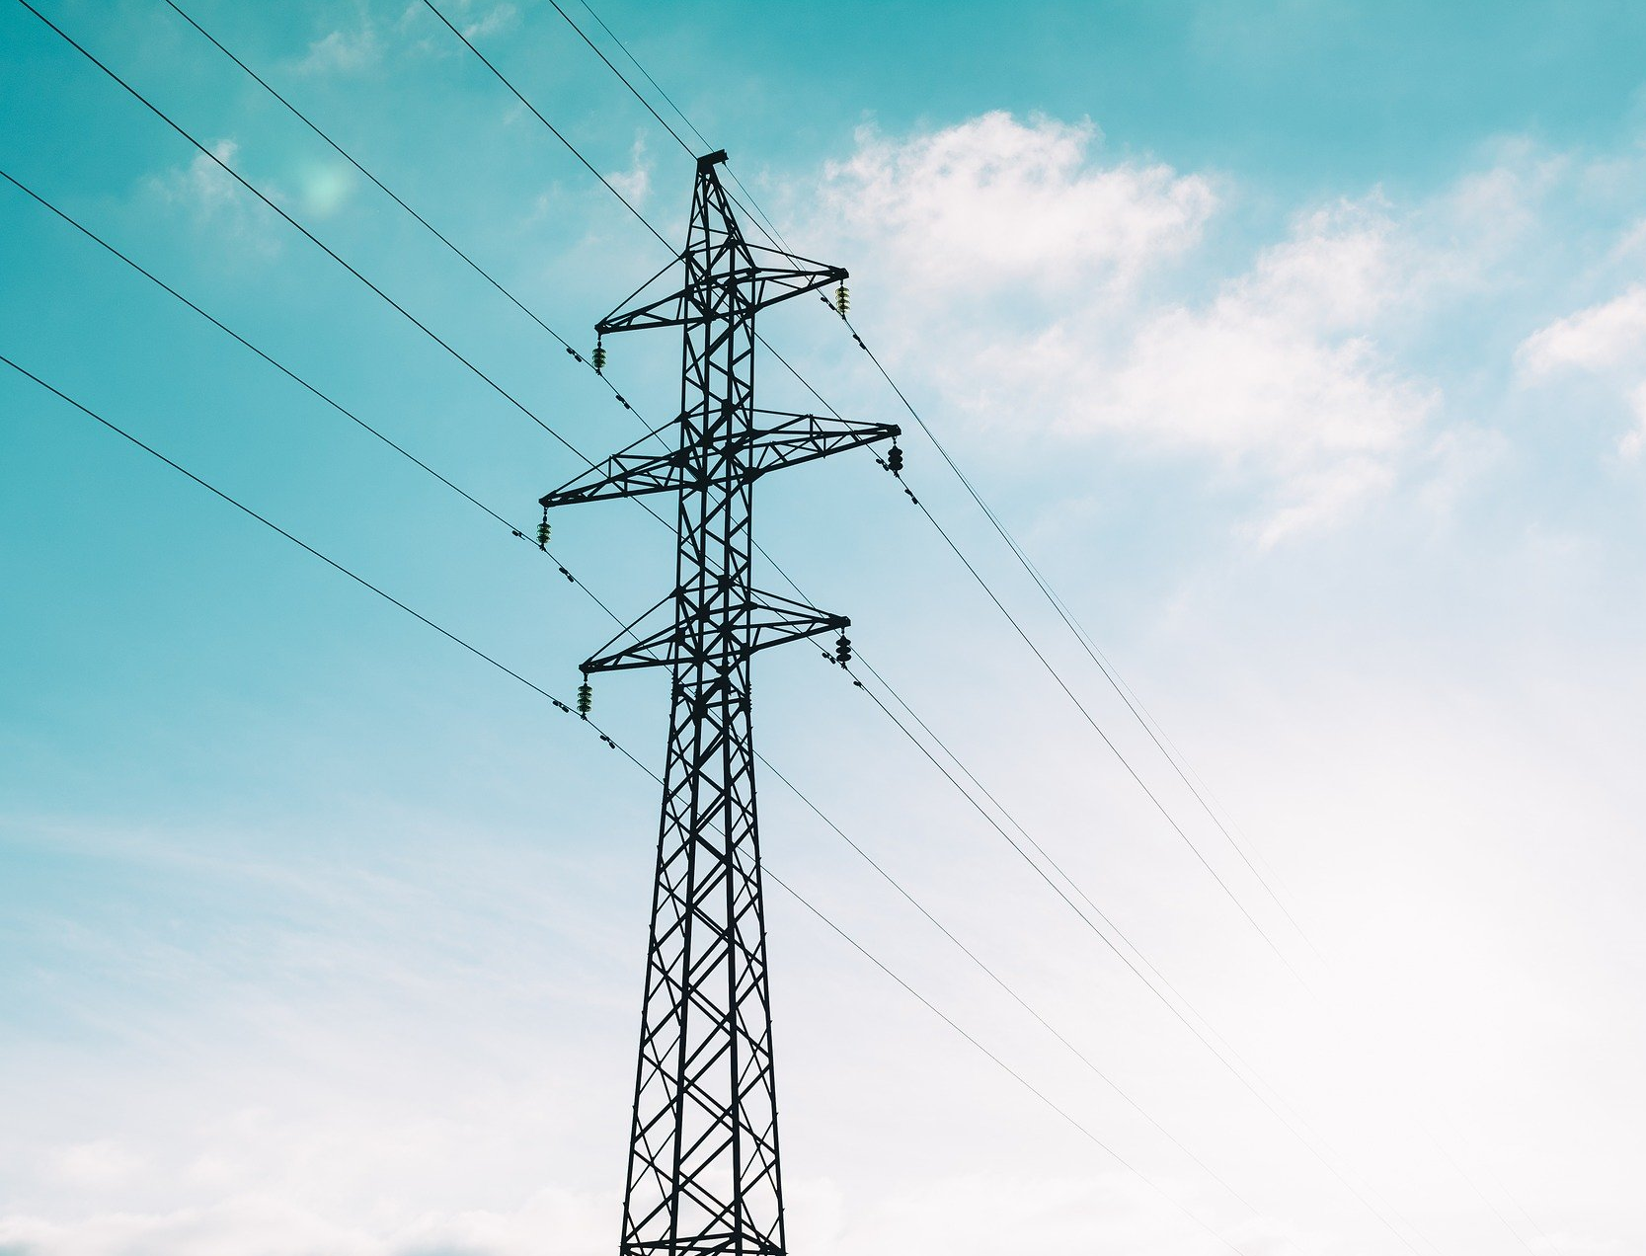
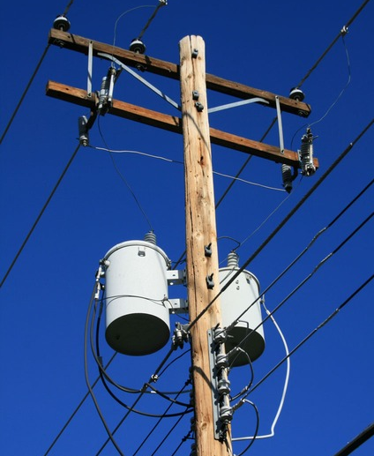
6.4 Transmission and Distribution
6.4.1 Introducing Transmission and Distribution
Power is transmitted over large distances
Power is distributed to consumers
Power is generated
21
Notes:
Once electricity has been produced by power generation technologies, it has to be transported to consumers for use. This process is done by power transmission and distribution technologies. Power transmission occurs over large distances and at high voltages, transporting electricity from the site of generation to areas where it is used, such as cities. Distribution occurs over much smaller distances and at lower voltages, taking power from the transmission system and distributing it to individual buildings.

Slide 22
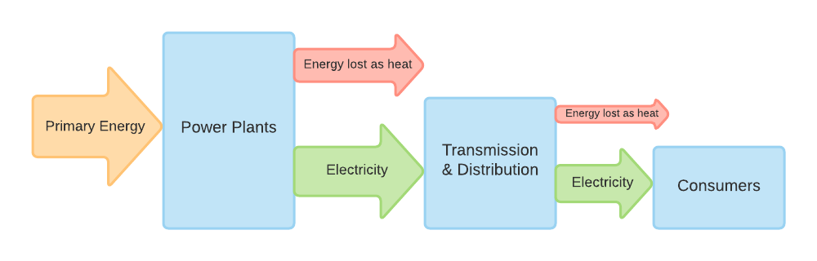
6.4 Transmission and Distribution
6.4.2 Efficiency of Transmission and Distribution
22
Notes:
In earlier lectures we have mentioned the energy losses that occur in the power system. While a large source of energy losses is in thermal power generation, where energy is lost as waste heat, significant losses can also occur in transmission and distribution. Transmission and distribution are not 100% efficient: often losses are up to 5% in transmission and in developing countries losses in distribution can reach 20% or higher. Some level of loss will always occur due to heating of wires; however, these losses are often made worse by ageing technology components, operational issues, and even illegal tapping of power. Losses of energy in transmission and distribution can lead to large financial losses and result in wasted power generation, meaning improving the efficiency of these systems is of prime importance.

Slide 23
6.4 Transmission and Distribution
6.4.3 Transmission & Distribution in Reference Energy Systems
23
Notes:
Now we understand a little more about transmission and distribution technologies, let's think about how we represent them in Reference Energy Systems and OSeMOSYS. On this diagram, the transmission and distribution technologies are highlighted. We can see that they are each modelled as a separate technology represented by a box on the reference energy system. We can also see what the input and output fuels for each of these technologies are. The input fuel for the transmission technology is the electricity from power plants, which is transported by the transmission technology to produce the output fuel of electricity after transmission. This electricity is then ready to be distributed to users, so it is taken in by the distribution technology as the input fuel. The distribution technology then produces the output electricity which is ready to be used – in this diagram this is named electricity after distribution. We will look at how these technologies are modelled in more detail in the following slides.

Slide 24
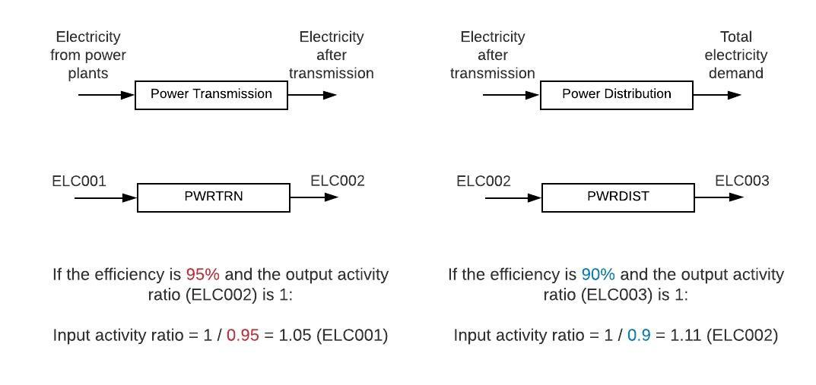
6.4 Transmission and Distribution
6.4.4 Transmission and Distribution in OSeMOSYS Pt1
Electricity after distribution
24
Notes:
Here we can see a close up of the power transmission and distribution technologies as they appear in Reference Energy System diagrams, as well as the generic naming convention used to name the technologies and their input and output fuels. We can see that power transmission is named P. W. R. T. R. N., with an input fuel of E. L. C. 0 0 1, and an output fuel of E. L. C. 0 0 2, while power distribution is named P. W. R. D. I. S. T., with an input fuel of E. L. C. 0 0 2, and an output fuel of E. L. C. 0 0 3. The first important parameters for defining power transmission and distribution technologies in OSeMOSYS are the input activity ratio and output activity ratio, with examples shown on this slide. As with previous examples, we will set the output activity ratio to 1 by default. For power transmission, the output activity ratio will therefore be 1 for E. L. C. 0 0 2, since this is the fuel produced by power transmission. With the output activity ratio set to 1, we can calculate the input activity ratio using the technology's efficiency, which in this case is 95% or 0.95 as a decimal. The input activity ratio is 1 divided by the efficiency as a decimal, so 1 divided by 0.95, giving us an input activity ratio of 1.05 for the power transmission technology, assigned to E. L. C. 0 0 1, since this is the input fuel for power transmission. The same method can be used to calculate the input activity ratio for power distribution, as shown on the slide.

Slide 25
6.4 Transmission and Distribution
6.4.5 Transmission & Distribution in OSeMOSYS Pt2
Other important parameters for defining transmission and distribution in OSeMOSYS:
Capital Cost ($/kW)
Fixed Cost ($/kW/yr)
Variable Cost ($/GJ)
Operational Life (years)
25
Notes:
Other important parameters for defining transmission and distribution technologies in OSeMOSYS are Capital, Fixed, and Variable Costs, and Operational Life. We discussed all of these parameters earlier in the lecture in relation to power plants, and we will now look at their meaning for power transmission and distribution technologies. The capital cost, in $/kW, defines the one-off investment costs of the power transmission or distribution technologies, mainly including the costs of the electrical equipment required. The fixed cost, in $/kW/yr, represents the fixed annual costs of operating and maintaining the transmission and distribution systems, for example the costs of workers' salaries. Thirdly, the variable cost, in $/GJ, represents costs that only occur when the transmission and distribution technologies actively transport electricity, defining the cost per GJ of electricity transmitted or distributed. Finally, the operational life refers to the lifetime of the power transmission or distribution technology in years. These technologies can have quite a long life time, for example 30 or 50 years. We will practise adding these technologies to our own model in the hands-on exercises.

Slide 26
Lecture 6.4 References
Taliotis, C., Gardumi, F., Shivakumar, A., Sridharan, V., Ramos, E., Beltramo, A., Rogner, H., Howells, M., 2018. Electricity supply system in OSeMOSYS I (Thermal power plants and T&D), KTH-Desa and OpTIMUS.community. Available at: https://zenodo.org/record/1942510#.YC5VjehKhPY. [18/02/2021] DOI: 10.5281/zenodo.1942510
26

Slide 27
Thank you
www.climatecompatiblegrowth.com

