Slide 1
Energy system modelling using OSeMOSYS
LECTURE 5
PRIMARY ENERGY SUPPLY

Slide 2
Learning Outcomes
By the end of this lecture, you will be able to:
ILO1: Understand the general representation of technologies in OSeMOSYS
ILO2: Understand the technology parameters: Input Activity Ratio, Output Activity Ratio, and Capacity to Activity Unit
ILO3: Understand how technology costs are represented in OSeMOSYS
ILO4: Learn how to represent Primary Energy Supply technologies in OSeMOSYS
2

Slide 3

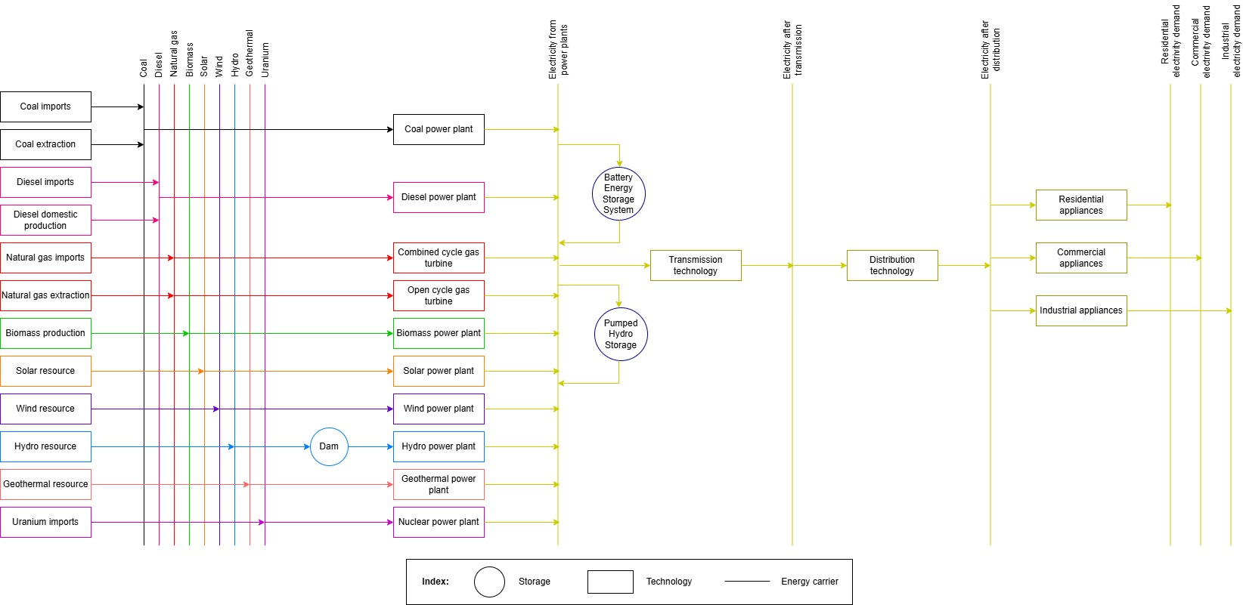
5.1 Technologies in OSeMOSYS
5.1.1 What are technologies in OSeMOSYS?
Each box = 1 technology
3
Notes:
A technology represents a process (or group of processes) that:
Supplies or produces a form of energy or energy service, for example oil imports or extraction, or a natural gas stove to supply cooking service
Converts one form of energy into another or into an energy service, for example conversion of crude oil to oil products, oil products to electricity or electricity to heat
Transfers, transmits or distributes a form of energy, for example electricity transmission technologies
As we have seen previously, each box in a Reference Energy System represents a technology.

Slide 4
5.1 Technologies in OSeMOSYS
5.1.2 Technology Examples
Natural gas
Natural gas extraction
Coal
Electricity
Coal power plant
Diesel
Electricity
Diesel power plant
Electricity 001
Electricity 002
Transmission technology
4
Notes:
This diagram shows some example technologies taken from the previous Reference Energy System diagram. Let’s look at how these technologies are represented:
The Natural Gas Extraction technology has an output fuel of natural gas, since this is what the technology produces. It has no input fuel as this is a primary energy supply technology found on the far left of our Reference Energy System. This will be covered in more detail later in this lecture.
The Coal Power Plant has an input fuel of coal and an output fuel of electricity, since this technology converts the energy in coal to electricity.
Similarly, the Diesel Power Plant converts the energy in diesel to electricity and so has an input fuel of diesel and an output fuel of electricity.
It is important to note that not all technologies have one input fuel and one output fuel. For example, fuel extraction technologies do not typically have an input fuel (just like the natural gas example on this diagram), and some technologies can have more than one input or output fuel, such as a refinery with crude oil as the input fuel, producing both gasoline and diesel as output fuels.

Slide 5
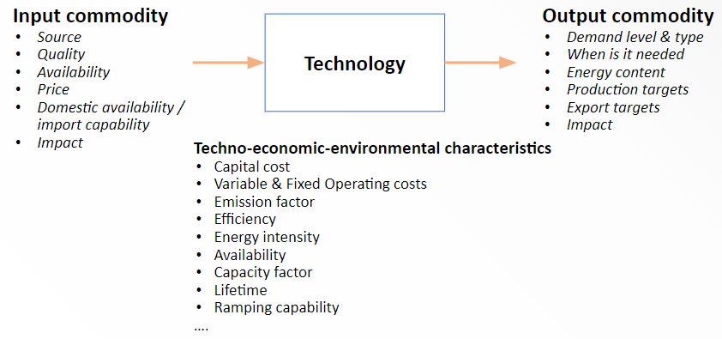
5.1 Technologies in OSeMOSYS
5.1.3 Parameters that Define Technologies
(Taliotis et al. (2018), image, licensed under CC BY 4.0)
5
Notes:
There are three main groups of data that are used to define technologies. These include the input commodity, which refers to the fuel supply to the technology. Important data on the input commodity include its price, availability and impacts. For example, the greenhouse gas emissions associated with using the fuel. Secondly, we need data on the techno-economic and environmental characteristics of technologies. These include technology costs, efficiency, lifetime and availability. Finally, we need to define each technology’s output commodity, which is the commodity it produces. Important data on output commodities include their demand, energy content and impacts.

Slide 6
5.1 Technologies in OSeMOSYS
5.1.4 Representing Technologies in OSeMOSYS
Represents all nuclear power plants
6
Notes:
Since models are abstractions of reality, we can define technologies at different levels of abstraction depending on the nature of our energy model. In OSeMOSYS, one technology can therefore represent different things, for example a technology could represent one single process or power plant e.g. a named coal power plant. A technology could also represent a group of processes or power plants with similar characteristics, for example one technology could be used to represent all existing coal power plants if no further detail is needed. In our examples and hands-on exercises, we will use this grouping approach, with one technology to represent all power plants of the same type. This is shown in this diagram and highlighted for nuclear power plants as an example. We will also aggregate transmission and distribution networks into single transmission and distribution technologies.

Slide 7
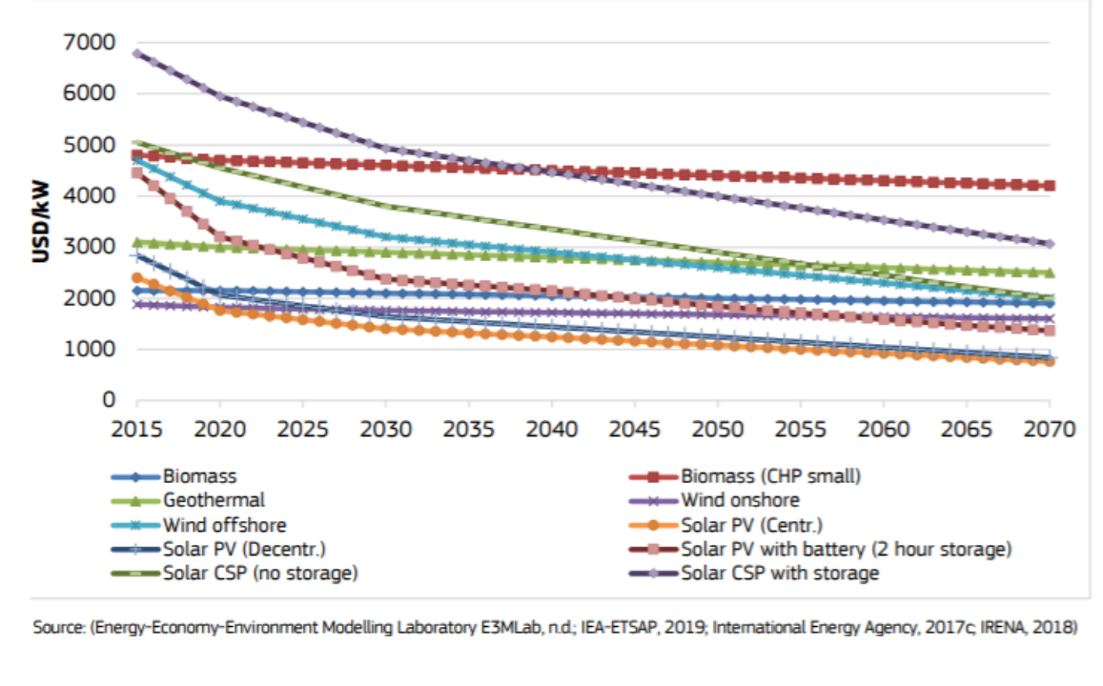
5.1 Technologies in OSeMOSYS
5.1.5 Considering Key Characteristics of Technologies
(Pappis et al. (2019), image licensed under CC BY 4.0)
7
Notes:
There are several important technology characteristics that should be considered in capacity expansion planning. Models developed using OSeMOSYS have the capability to consider several of these characteristics, including:
Variation in the availability, efficiency and costs of a technology over both short and long timescales. For example, new technologies that have high costs now may be expected to become significantly cheaper in the future. This diagram, which presents capital cost projections for renewable energy technologies, shows that some technology costs are expected to fall in the future. These technologies may therefore become more important for cost-effectiveness in the future, so it is important that OSeMOSYS can consider time-variable cost data.
Models can also consider limits on production by technology and capacity constraints. For example, there is a limit to how much power can be generated by solar PV in a given country based on the intensity of the sunlight over the year. It is important that OSeMOSYS can consider this so that its results are aligned with reality.
Additionally, we can consider the emissions associated with technologies and limits that may be placed on them. For example, we may want to develop a model scenario to understand how the Carbon Dioxide emissions associated with a country’s energy system can be reduced to a certain level, so it is important that OSeMOSYS can consider the emissions associated with each technology and has the capability to impose limits on them.

Slide 8
Lecture 5.1 References
Taliotis, Constantinos, Gardumi, Francesco, Shivakumar, Abhishek, Sridharan, Vignesh, Ramos, Eunice, Beltramo, Agnese, … Howells, Mark. (2018, December). Representing primary energy supply in OSeMOSYS. Zenodo. http://doi.org/10.5281/zenodo.4558799
Pappis, I., Howells, M., Sridharan, V., Usher, W., Shivakumar, A., Gardumi, F. and Ramos, E., Energy projections for African countries, Hidalgo Gonzalez, I., Medarac, H., Gonzalez Sanchez, M. and Kougias, I., editor(s), EUR 29904 EN, Publications Office of the European Union, Luxembourg, 2019, ISBN 978-92-76-12391-0, doi:10.2760/678700, JRC118432
8

Slide 9
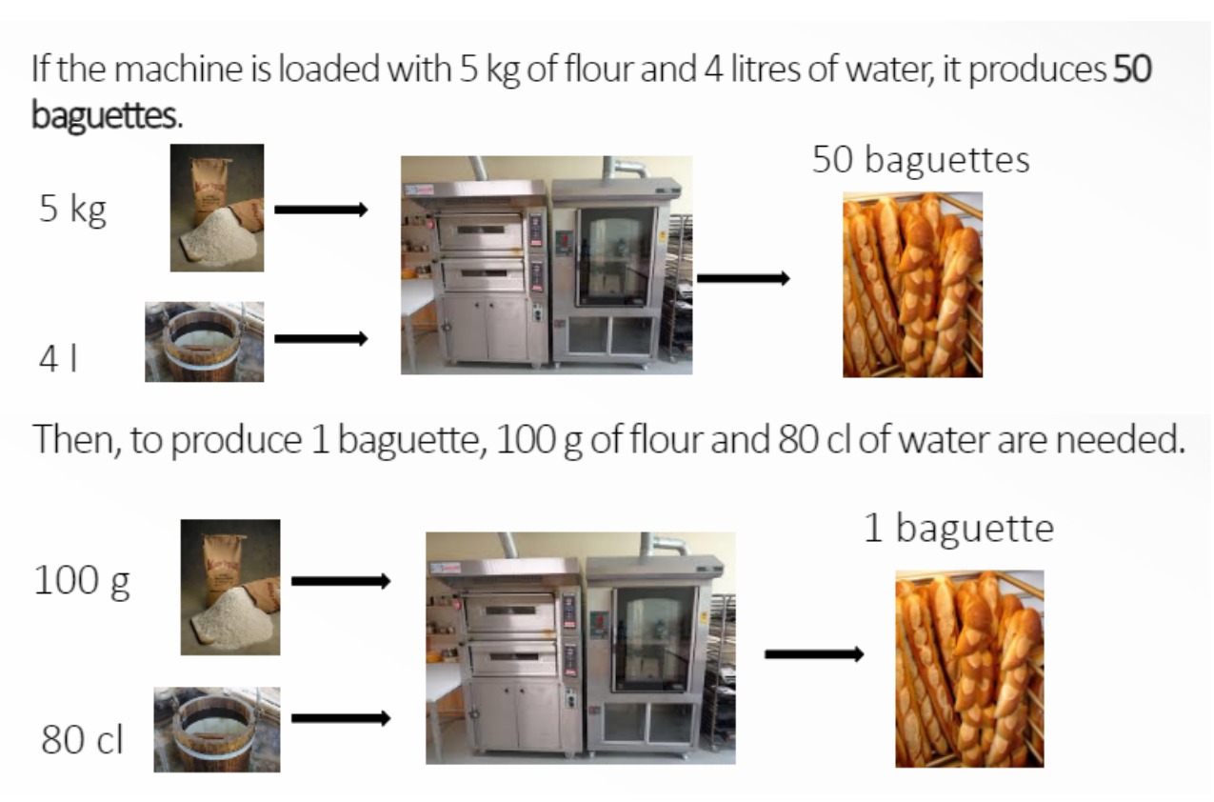
5.2 Input & Output Activity Ratios
5.2.1 Introducing Input & Output Activity Ratios
(Taliotis et al. (2018), image, licensed under CC BY 4.0; made using images from: R. Strickler, image, CC-BY-SA 3.0; A. Engels, image, CC BY 2.0; A Klink, image, CC BY 4.0; Turaids, image, CC-BY-SA 4.0)
9
Notes:
The input and output activities of technologies are defined in OSeMOSYS using two parameters: Input Activity Ratio and Output Activity Ratio.
We will explain these two parameters using an example, where the technology is a bread-making machine. If the machine is loaded with 5 kg of flour and 4 litres of water, it produces 50 baguettes, as shown in the diagram. From this information, we can calculate that to produce 1 baguette, we need 100g of flour and 80cl of water.
If we were to model this bread-making machine as a technology in OSeMOSYS, this would translate to an Output Activity Ratio of 1 for baguettes and an Input Activity Ratio of 100 for flour and 80 for water - this is because we calculated that we need 100g of flour and 80cl of water as inputs to produce 1 baguette as an output from the bread-making machine. The flour and water are the technology’s input fuel, while baguette is the output fuel.

Slide 10
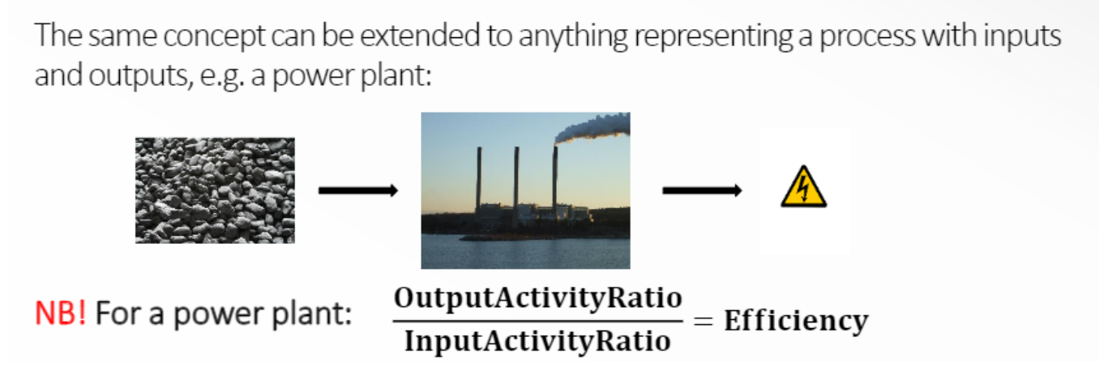
5.2 Input & Output Activity Ratios
5.2.2 Input & Output Activity Ratios for Power Plants
(Taliotis et al. (2018), image, licensed under CC BY 4.0; made using images from: D Harris, image, CC BY SA 2.0; Zygimantus, image, CC BY SA 4.0; Party Pop, image, CC BY-SA 3.0)
10
Notes:
This concept can be used to define any technology with inputs and/or outputs, such as power plants. For example, a coal-fired power plant takes the input fuel of coal and produces the output fuel of electricity. It is important to remember that the efficiency of a power plant is equal to the Output Activity Ratio divided by the Input Activity Ratio. In OSeMOSYS it is usually convention to set the Output Activity Ratio to be 1 and adjust the Input Activity Ratio accordingly, just as we did for the bread-making machine example. We knew how much flour and water was needed to make 50 baguettes, and then we divided this by 50 to work out how much is needed to make 1 baguette, allowing us to define the Output Activity Ratio to be 1. If the Output Activity Ratio is 1, the efficiency of a power plant is therefore equal to 1 divided by the Input Activity Ratio. We will practise using these parameters in hands-on exercises.

Slide 11
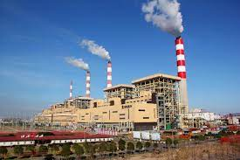
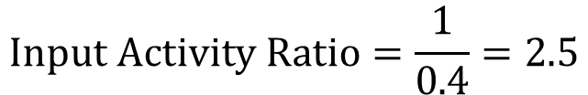
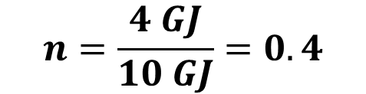
5.2 Input & Output Activity Ratios
5.2.3 Input & Output Activity Ratios - Exercise
For the example given of a coal power plant, if the amount of electricity produced is 25 GJ, how much coal in GJ was utilized?
4 GJ of electricity
$$n=\frac{4 GJ}{10 GJ}=0.4$$
10 GJ of coal
Coal power plant
$$Input Activity Ratio=\frac{1}{0.4}=2.5$$
$$2.5 GJ of coal produce 1 GJ of electricity$$
$$25 GJ of electricity∗\frac{2.5 GJ of coal}{1 GJ of electricity}=62.5 GJ of coal$$
11
Notes:
In this example, we have data indicating that a coal power plant produces 4 GJ of electricity using 10 GJ of coal. To calculate the plant’s efficiency, we divide the output energy by the input energy, yielding a value of 0.4 or 40%. The input activity ratio is then computed as the inverse of the efficiency, which is 1 divided by 0.4, equaling 2.5. The output activity ratio remains 1.
This means that 2.5 GJ of coal is required to produce 1 GJ of electricity. To calculate the coal needed to produce 25 GJ of electricity, we use the input/output activity ratio, resulting in 62.5 GJ of coal.

Slide 12
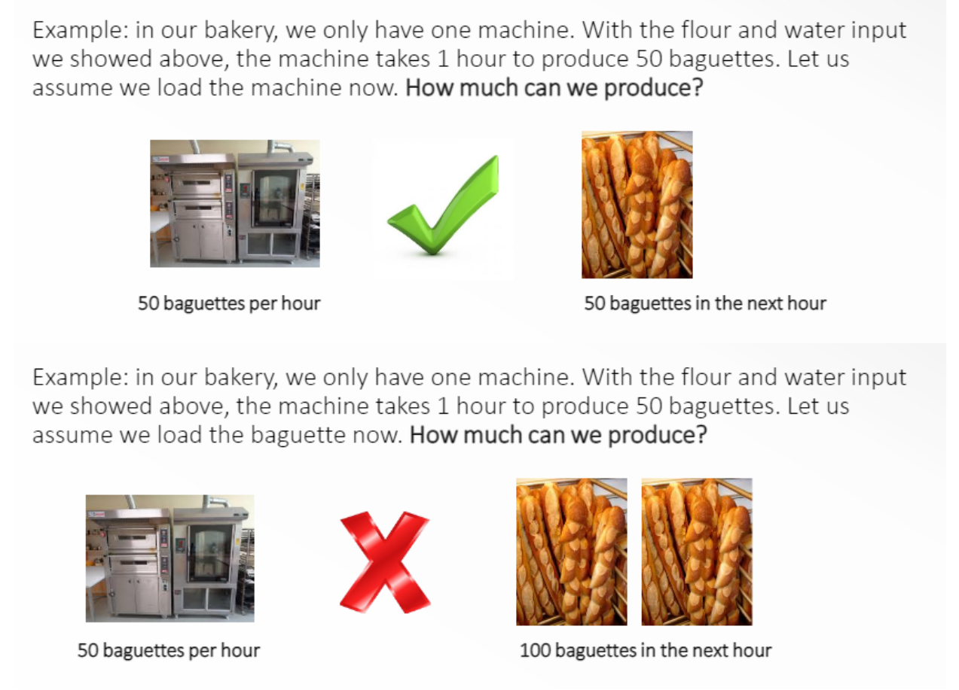
5.2 Input & Output Activity Ratios
5.2.4 Defining Capacity & Activity
(Taliotis et al. (2018), image, licensed under CC BY 4.0; made using images from: A. Engels, image, CC BY 2.0;; Turaids, image, CC-BY-SA 4.0)
12
Notes:
It is important to understand the difference between capacity and activity of technologies. If we return to the bread machine example, let’s say we have 1 machine that can make 50 baguettes in one hour. The capacity of the technology is therefore 50 baguettes per hour (1 machine) and the activity would be the amount of baguettes produced, so 50 baguettes in one hour, or 100 baguettes in two hours etc. Production of baguettes is limited by the machine’s ability to only produce 50 baguettes in one hour. Therefore, if we wanted to produce 100 baguettes, we would either need to allow 2 hours to produce them with one machine or buy an extra machine to produce them in 1 hour.

Slide 13
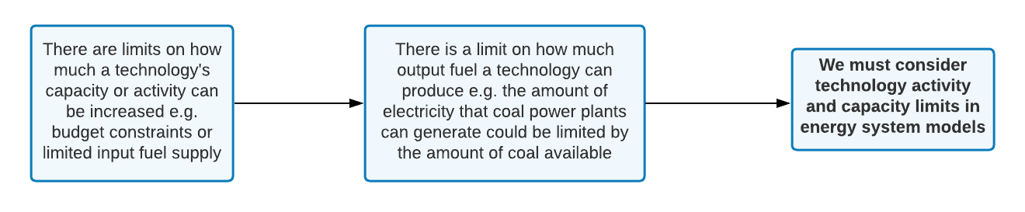
5.2 Input & Output Activity Ratios
5.2.5 Introducing Limits on Activity & Capacity
13
Notes:
So, we could increase our activity (the number of baguettes produced), if we increased the capacity (number of bread machines). However, there could be limits on:
How much the capacity can be increased, for example due to lack of space or money for extra machines
How much activity the bakery can have, for example due to limits on the availability of flour or water
If we were modelling this bread machine, it would be important to be able to consider these limits in the model so that the model results were realistic. The same concepts apply for power plants, as explained next.

Slide 14
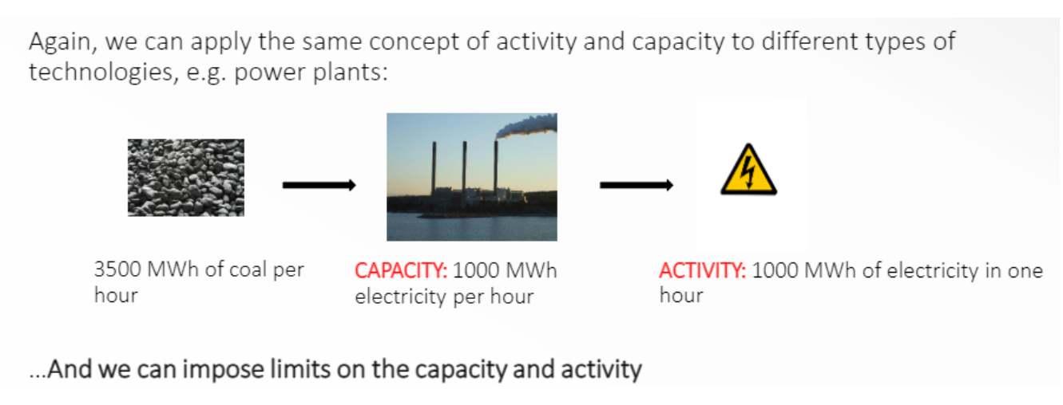
5.2 Input & Output Activity Ratios
5.2.6 Capacity & Activity for Power Plants
(Taliotis et al. (2018), image, licensed under CC BY 4.0; made using images from: D Harris, image, CC BY SA 2.0; Zygimantus, image, CC BY SA 4.0; Party Pop, image, CC BY-SA 3.0)
14
Notes:
Looking at our example of a coal power plant, the diagram shows that the amount of coal that can be supplied to the power plant is 3500MWh per hour, and using this coal the power plant can produce 1000MWh of electricity per hour. The capacity of our coal power plant is therefore 1000MWh of electricity per hour, and the activity would be 1000MWh of electricity in one hour, 2000MWh of electricity in 2 hours, and so on. Just as we discussed that there could be limits to the capacity and activity of bread machines, there are often limits on the capacity and activity of power plants. For example, the capacity of coal power plants may be limited by budget constraints or the activity may be limited by the amount of coal available.

Slide 15


5.2 Input & Output Activity Ratios
5.2.7 Capacity factor
Capacity Factor (CF): Capacity available per each TimeSlice expressed as a fraction of the total installed capacity, with values ranging from 0 to 1.
Capacity
Energy/Time
Service/Time
Activity
Energy
Service
$$Activity \left(energy production\right)=Capacity∗time∗CF$$
$$Installed Capacity=50 MW=50\frac{MJ}{s}$$
$$Activity during one hour working at 100\%$$
$$=50 MW∗1 h=50 MWh$$
$$=50\frac{MJ}{s}∗3600 s=180000 MJ=0.18 TJ$$
Coal power plant
$$Activity during one hour working at 80\% (CF=0.8)$$
$$=50 MW∗0.8∗1 h=40 MWh$$
$$=50\frac{MJ}{s}∗0.8∗3600 s=144000 MJ=0.144 TJ$$
15
Notes:
An important parameter in the relationship between capacity and activity is the capacity factor, which represents the ratio of available capacity for energy production to the total installed capacity. For most plants, installed capacity is not utilized at 100% due to factors like operational constraints for fossil fuel plants or meteorological conditions affecting solar, wind, and hydro plants. The energy produced varies based on the capacity factor, as shown in the example.
If we have 50 MW of installed capacity, it would produce 50 MWh in one hour, or the equivalent of 0.18 TJ. However, with a capacity factor of 80%, only 80% of the installed capacity is available, resulting in 40 MWh, or 0.114 TJ.

Slide 16

5.2 Input & Output Activity Ratios
5.2.8 Capacity Factor - Exercise
If a hydroelectric plant has an installed capacity of 240 MW, what level of activity can it provide in one day in MWh assuming CF equal to 0.55?
$$1 day=24 hours$$
$$Activity \left(energy production\right)=Capacity∗time∗CF$$
$$Activity \left(energy production\right)=240 MW∗24 h∗0.55$$
$$Activity \left(energy production\right)=3168 MWh$$
16
Notes:
In this example, the first step is to calculate the number of hours for the given time, as the final unit is MWh. Since one day equals 24 hours, we then calculate the energy produced by multiplying the installed capacity of 240 MW by the 24-hour period and by the capacity factor of 0.55. This results in an energy production of 3,168 MWh.

Slide 17
Lecture 5.2 References
Taliotis, Constantinos, Gardumi, Francesco, Shivakumar, Abhishek, Sridharan, Vignesh, Ramos, Eunice, Beltramo, Agnese, … Howells, Mark. (2018, December). Representing primary energy supply in OSeMOSYS. Zenodo. http://doi.org/10.5281/zenodo.4558799
17
17

Slide 18
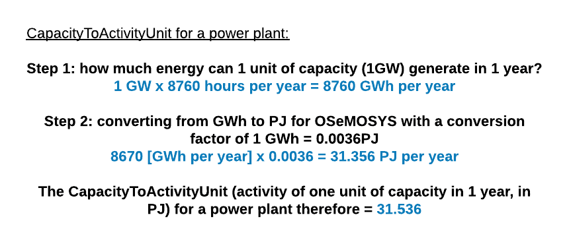
5.3 Capacity to Activity Ratio & Costs
5.3.1 Capacity to Activity Ratio
18
Notes:
The default unit of measure for energy in OSeMOSYS is PJ or Petajoules. The Capacity To Activity Unit is a parameter in OSeMOSYS that is used as conversion factor relating the energy that would be produced when one unit of capacity (usually 1GW) is fully used in one year. This parameter is used to convert data related to the Capacity of a technology (for example installed capacity of a power plant in GW) into the Activity it can generate, i.e. a certain amount of energy given to the system (to be reported in PJ). This diagram shows an example of calculating the Capacity To Activity Unit for a power plant. For power plants, one unit of capacity is 1GW. If we want to calculate how much energy this unit can generate in one year we need to multiply this by the number of hours in a year (8,760), giving 8,760GWh of electricity per year. However, in OSeMOSYS activity has to be reported in PJ, so we need to convert GWh to PJ, which is done by multiplying by 0.0036. This gives us an end result of 31.536PJ produced by one unit of capacity in one year, which is the Capacity To Activity Unit. All power plant technologies in OSeMOSYS will have the same Capacity To Activity Unit of 31.536.

Slide 19
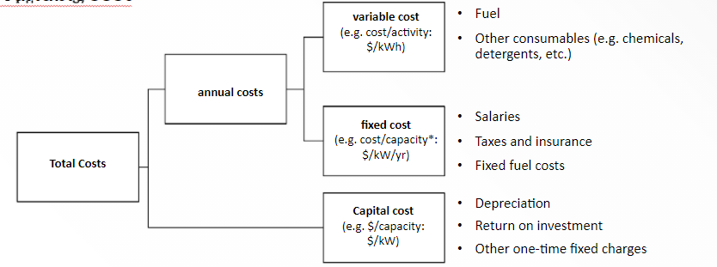
5.3 Capacity to Activity Ratio & Costs
5.3.2 Introducing Technology Costs in OSeMOSYS
In OSeMOSYS, costs are split into Capital Costs, Fixed Costs, and Variable Costs
(Taliotis et al. (2018), image, licensed under CC BY 4.0)
19
Notes:
As well as defining the performance of a technology, it is important to define its costs. Technologies have some costs which occur annually and others which are only initial costs. In OSeMOSYS technology costs are split into 3 categories: variable costs (occurring annually), fixed costs (occurring annually) and capital costs (initial costs of the technology). This diagram shows the units of each of these costs and some examples of what they represent - we will look at each cost in more detail in the following slides.

Slide 20
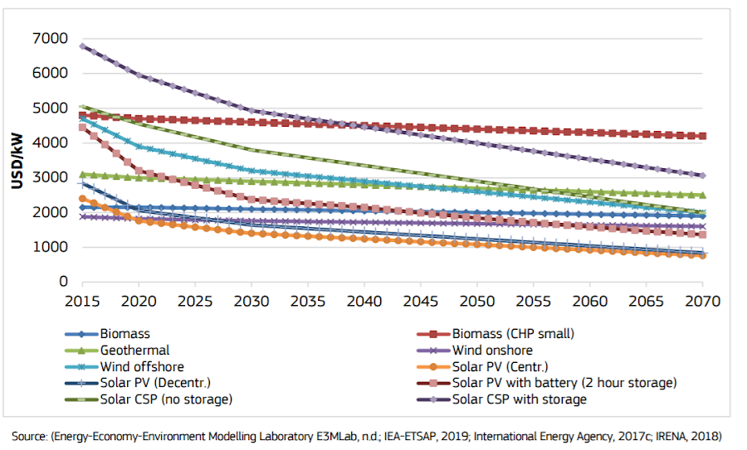
5.3 Capacity to Activity Ratio & Costs
5.3.3 Capital Costs
(Pappis et al. (2019), image licensed under CC BY 4.0)
20
Notes:
The Capital Cost represents the initial cost of buying the technology and is defined as a function of technology capacity, using the unit $/kW. This includes the costs of the initial investments for the technology up until the point where it can start running. For example, the capital cost for a power plant would typically include the costs of planning and design; parts, machinery and building; construction; and commissioning and certification. Capital costs for some technologies, for example renewable technologies like solar PV, are likely to change in the future as shown in this diagram, and so the capital cost is defined for each model year in OSeMOSYS.

Slide 21
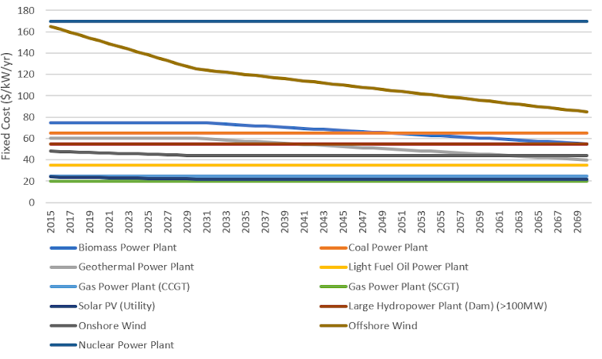
5.3 Capacity to Activity Ratio & Costs
5.3.4 Fixed Costs
(Created using data from Pappis et al. (2019), report licensed under CC BY 4.0)
21
Notes:
The Fixed Cost is an annual cost defined as a function of technology capacity per year, using the unit $/kW/yr. This includes regular costs associated with the technology every year. For example, the fixed cost for a power plant would typically include the costs of paying workers’ salaries; regular operations and maintenance;taxes and insurance. As for capital costs, fixed costs for some technologies may be expected to change in the future, and so the fixed cost is also defined for each model year in OSeMOSYS. This diagram shows the fixed costs for different power plant types used in the TEMBA energy modelling study for Africa.

Slide 22
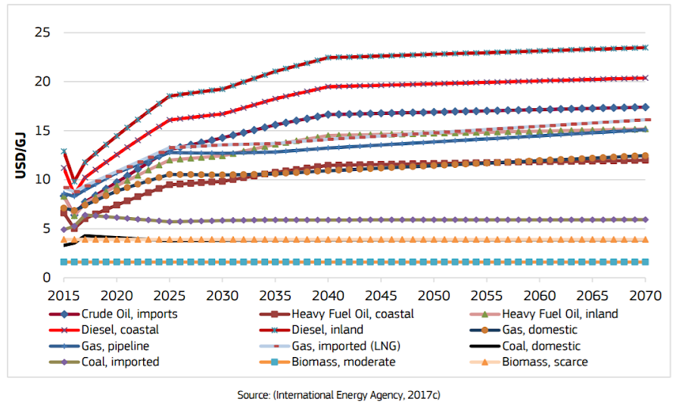
5.3 Capacity to Activity Ratio & Costs
5.3.5 Variable Costs
(Pappis et al. (2019), image licensed under CC BY 4.0)
22
Notes:
The Variable Cost is defined as a function of technology activity, using the unit $/GJ. This includes the costs only associated with the technology’s activity, namely costs only incurred when a technology produces its output fuel/commodity. For example, the variable cost for a power plant is largely the cost of the power plant’s input fuel, as well as the costs of any other consumables like chemicals that are needed for the power plant to operate. This means that wind, solar PV and hydropower technologies often have variable costs of 0 as they do not require any fuels. As we will see in the next part of this lecture, the variable cost for primary energy supply technologies is the price of the commodity/fuel being supplied. For example, a Coal Imports technology would have a variable cost equal to the price of imported coal in each year. This diagram shows example fuel cost projections, which could be used for the variable costs for primary energy supply technologies. As we can see in the diagram, variable costs, especially fuel prices, may also change over time and so are defined for each model year in OSeMOSYS.

Slide 23
Lecture 5.3 References
Taliotis, Constantinos, Gardumi, Francesco, Shivakumar, Abhishek, Sridharan, Vignesh, Ramos, Eunice, Beltramo, Agnese, … Howells, Mark. (2018, December). Representing primary energy supply in OSeMOSYS. Zenodo. http://doi.org/10.5281/zenodo.4558799
Pappis, I., Howells, M., Sridharan, V., Usher, W., Shivakumar, A., Gardumi, F. and Ramos, E., Energy projections for African countries, Hidalgo Gonzalez, I., Medarac, H., Gonzalez Sanchez, M. and Kougias, I., editor(s), EUR 29904 EN, Publications Office of the European Union, Luxembourg, 2019, ISBN 978-92-76-12391-0, doi:10.2760/678700, JRC118432
23

Slide 24
5.4 Primary Energy Supply Technologies
5.4.1 Introducing Primary energy Supply Technologies
24
Notes:
Primary energy supply technologies typically represent one of two processes:
The domestic extraction or production of fuels, for example domestic coal production.
Importation of fuels, for example coal imports.
Fuels can include: coal, oil, oil products (such as diesel), natural gas, uranium, biomass, and more. By convention, for each fuel considered we typically include one import technology and one domestic production technology, as shown in this diagram. However, sometimes we may want to adjust this. For example if we are modelling for a country with no domestic coal reserves, we could simply exclude the domestic coal production technology. Or we may want to include two versions of a technology to represent different options. For example we could have separate technologies for importing natural gas via pipeline and via Liquefied Natural Gas transport, since these have different costs.

Slide 25
5.4 Primary Energy Supply Technologies
5.4.2 Primary Energy Supply Technologies in Reference Energy Systems
Coal
Coal imports (IMPCOA)
Coal
Coal extraction (MINCOA)
Diesel
Diesel imports (IMPDSL)
Diesel
Diesel domestic production (MINDSL)
25
Notes:
As shown in this diagram, Primary Energy Supply Technologies are typically represented in Reference Energy Systems by a technology (box) with only output fuels/commodities (lines) and no input fuel/commodities. For example, the coal extraction technology has no input fuel and produces coal as its output fuel. Usually positioned furthest left on Reference Energy System diagrams, we can think of primary energy supply technologies as the first step in the energy system; they produce the fuels used by other technologies to provide energy services and meet the demands usually found on the far right of Reference Energy System diagrams. As a reminder of our generic naming convention, primary energy supply technologies typically have a 6-letter name with the first segment being M.I.N for domestic fuel extraction or production technologies or I.M.P for import technologies, and the second segment being the code for the commodity/fuel being produced. Examples can be seen on this diagram.

Slide 26
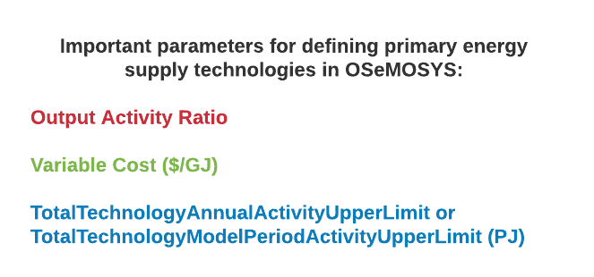
5.4 Primary Energy Supply Technologies
5.4.3 Primary Energy Supply Technologies in OSeMOSYS
26
Notes:
In OSeMOSYS, primary energy supply technologies are typically characterized by these key parameters:
Output Activity Ratio: as explained earlier, this defines which fuel the technology provides and at what rate.
Variable Cost [dollars per gigajoule]: this represents the costs of extraction or importation of the fuel.
Total Technology Annual Activity Upper Limit or Total Technology Model Period Activity Upper Limit [petajoules]: these are the parameters that can be used to define the level of proven reserves available for extraction or the maximum quantity that can be imported.

Slide 27
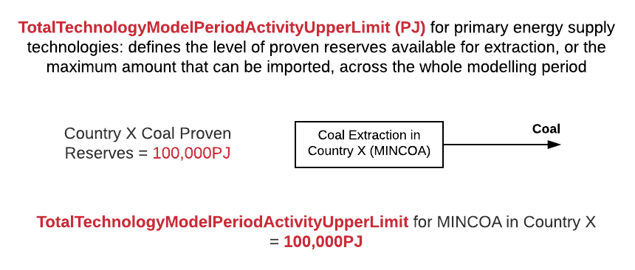
5.4 Primary Energy Supply Technologies
5.4.4 Total Technology Model Period Activity Upper Limit
27
Notes:
For primary energy supply technologies, the Total Technology Model Period Activity Upper Limit parameter can be used to define the level of proven reserves of the fuel that can be extracted or the maximum quantity that can be imported, across the whole modelling period. For example, if we were creating a model for Country X with a modelling period of 2015-2070, the Total Technology Model Period Activity Upper Limit for the domestic coal extraction technology (M.I.N.C.O.A.), would be the level of proven reserves available for extraction in country X from 2015-2070 as shown in this diagram.

Slide 28
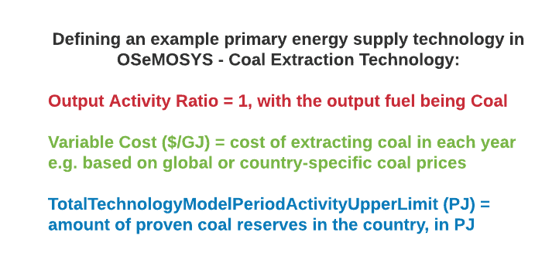
5.4 Primary Energy Supply Technologies
5.4.5 Summing Up with an Example
28
Notes:
To summarize, let’s think about how we would define an example primary energy supply technology, a coal extraction technology, in OSeMOSYS using the parameters we have covered in today’s lecture. First, we need to define the output activity ratio. The coal extraction technology produces coal as its output fuel and the output activity ratio is set to 1 by convention, so the output activity ratio will be 1 for the fuel coal. Then, let’s define the cost of the coal extraction technology. We do this by setting its variable cost equal to the cost of extracting coal in dollars per gigajoule for each year in the model period. Finally, we need to think about any limits that apply to this technology. If we know the amount of proven coal reserves in the country, we can include this in the model using the parameter Total Technology Model Period Activity Upper Limit, defined in petajoules. We will practice using data like this in a real OSeMOSYS model in the hands-on exercises.

Slide 29
Lecture 5.4 References
Taliotis,Constantinos, Gardumi, Francesco, Shivakumar, Abhishek, Sridharan, Vignesh, Ramos, Eunice, Beltramo, Agnese, … Howells, Mark. (2018, December). Representing primary energy supply in OSeMOSYS. Zenodo. http://doi.org/10.5281/zenodo.4558799
29

Slide 30
Thank you
www.climatecompatiblegrowth.com

