Slide 1
Energy system modelling using OSeMOSYS
LECTURE 4
ENERGY DEMANDS & THEIR REPRESENTATION

Slide 2
Learning Outcomes
By the end of this lecture, you will be able to:
ILO1: Learn about the characteristics of energy demands
ILO2: Learn the different types of energy demands
ILO3: Understand how energy demands are considered in energy models
ILO4: Learn how to represent energy demands in OSeMOSYS
2

Slide 3






4.1 Energy Demand Characteristics
4.1.1 Energy Sectors
Industrial
Residential
Commercial
Transport
Agriculture
3
Notes:
We all need energy, and we need it in different forms depending on the specific application. The demands for energy come from all sectors of society such as:
The residential sector (rural and urban) – for cooking, heating, cooling, lighting, and appliances
Industry – for chemical processes, steam production, and heating
Commerce – for lighting, heating, and cooling buildings or keeping products at low temperatures
Transport – for cars, trucks and buses, aviation, shipping, and trains
Agriculture – for tractors and machinery or pumping water
Because energy is used for different services in different sectors, the characteristics of energy demands vary by sector.

Slide 4
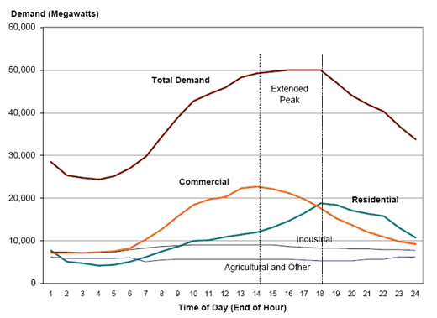
4.1 Energy Demand Characteristics
4.1.2 Variations in Daily Energy Demand
(Taliotis et al. 2018, image, licensed under CC BY 4.0)
4
Notes:
In lecture 3, we learnt that energy demands can vary on daily, weekly, and monthly timescales, mainly reflecting the schedule of consumers’ activities. In addition, this diagram also shows that energy demands vary by sector. We can see that the magnitude of demand varies by sector, with agricultural demand being significantly lower than residential and commercial demand in this example. This means that the commercial and residential sectors are consuming more electricity, perhaps because their activities are more energy intensive or on a larger scale. In addition, we see that the daily profile of demand varies by sector. For example, here, in the displayed graph, there is a clear evening peak in residential demand, while agricultural and industrial demands are quite consistent throughout the day. This is likely because agricultural and industrial machinery operates constantly, while energy use in homes peaks in the evening when consumers use more electricity for cooking, lighting, and appliances.

Slide 5
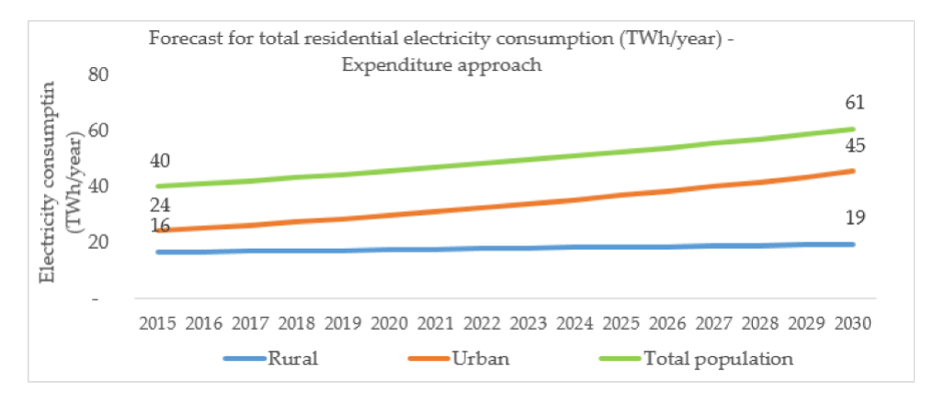
4.1 Energy Demand Characteristics
4.1.3 Importance of Sector-Specific Demands
(Olaniyan et al. (2018), image, licensed under CC BY 4.0)
5
Notes:
The differences between sectors discussed in the previous slide mean it can sometimes be important to model demands separately by sector, so that our models can consider the specific characteristics of each demand.
Additionally, within each of these sectors, the energy demand varies over time and across different classes of consumers. For example, within the residential sector, demands may differ between rural and urban households, as shown on this diagram, or between grid-connected and off-grid areas. Energy planners must make sure that the energy demand is met at any point in time for all classes of consumers. Thus, the key characteristics of demands must be represented in energy models.

Slide 6
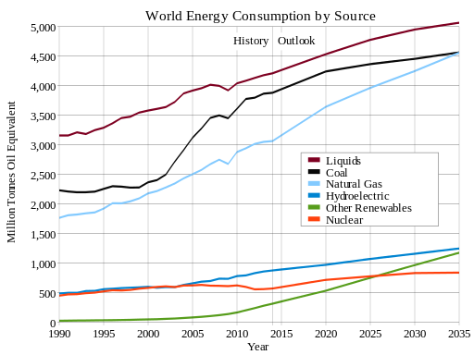
4.1 Energy Demand Characteristics
4.1.4 Long-Term Variations in Energy Demands
6
Notes:
One of the key challenges in energy planning is that these energy demands change over time, for example, owing to population growth or the creation of new industries. On this diagram, we can see historical variations in energy demands which are likely correlated to changes in society. For example, increases in energy demand likely reflect increased industrial activity. In energy planning, it is important that we think about how energy demands are likely to change in the future. This is often done using forecasts of energy demand, such as the future projections shown in this figure. These forecasts can be created using estimates of the key influencers of energy demand, such as population growth and economic activity. Future projections are often also based on how energy demands have changed historically.

Slide 7
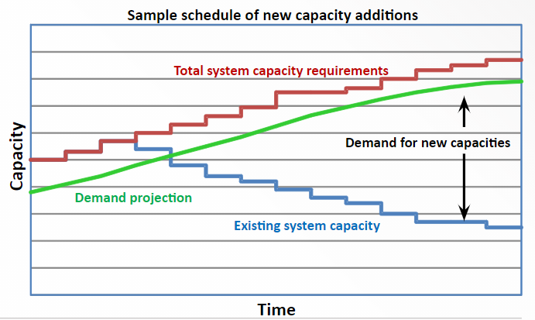
4.1 Energy Demand Characteristics
4.1.5 Capacity Expansion Planning
(Taliotis et al. 2018, image, licensed under CC BY 4.0)
7
Notes:
The key purpose of modelling in OSeMOSYS is to plan capacity expansion. In order to do this, we need to consider these long-term changes in energy demands and use a projection of future demand, such as that shown by the green line in this diagram. An existing demand projection created from existing data, or using another tool, is used as input data for OSeMOSYS. In addition to a demand projection, we need data on the existing system capacity. Using the capacities and lifetimes of existing power plants, we can create a forecast of system capacity if there were no new capacity additions; this is represented by the blue line on the diagram, which shows gradually decreasing system capacity as power plants are retired. We can now see that there is a need for new capacity expansion in the future, as demand increases and existing system capacity decreases. As discussed in Lecture 3, there are losses in energy systems, and we always need capacity to be slightly higher than demand to account for this. Thus, the red line in this diagram shows the total system capacity requirements as demand increases. The gap between the red and blue lines therefore shows the required capacity expansion over time. OSeMOSYS can be used as a tool to plan such capacity expansion considering technical, economic, and environmental constraints.

Slide 8
Lecture 4.1 References
Taliotis, Constantinos, Gardumi, Francesco, Shivakumar, Abhishek, Sridharan, Vignesh, Ramos, Eunice, Beltramo, Agnese, … Howells, Mark. (2018, November). Defining final energy demands in OSeMOSYS. Zenodo. http://doi.org/10.5281/zenodo.4559206
Olaniyan K, McLellan B, Ogata S, Tezuka T. Estimating Residential Electricity Consumption in Nigeria to Support Energy Transitions. Sustainability [Internet]. 2018 May 5;10(5):1440. Available from: http://www.mdpi.com/2071-1050/10/5/1440
8

Slide 9
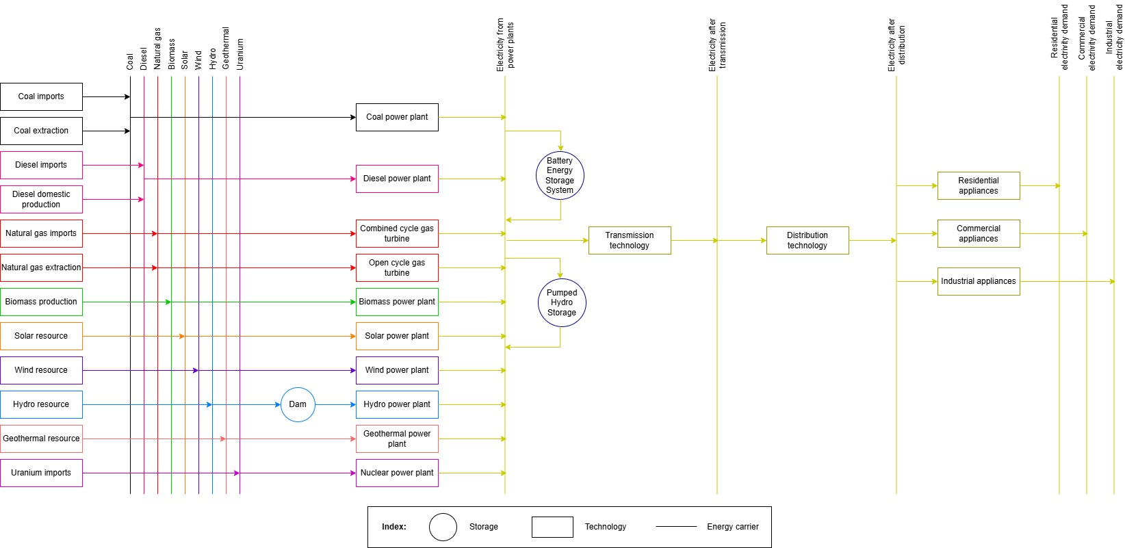
4.2 Energy Demands in Modelling
4.2.1 Energy Demands in Reference Energy Systems
9
Notes:
Energy demands are represented on the right-hand side of the Reference Energy System (RES), highlighted in green on this example RES.
As we can see in the picture, there are several steps to get to the final demand split by sector:
The electricity from power plants, which represents the aggregated stream of electricity coming from all the power plants in the model;
Electricity after transmission, which accounts for the losses of the transmission lines;
Electricity for use or total electricity demand, which represents the electricity that arrives to final consumers after distribution.
Total demand can then be split by sector, for example in this RES we have the following demands:
Industrial Electricity Demand
Residential Electricity Demand
Commercial Electricity Demand

Slide 10
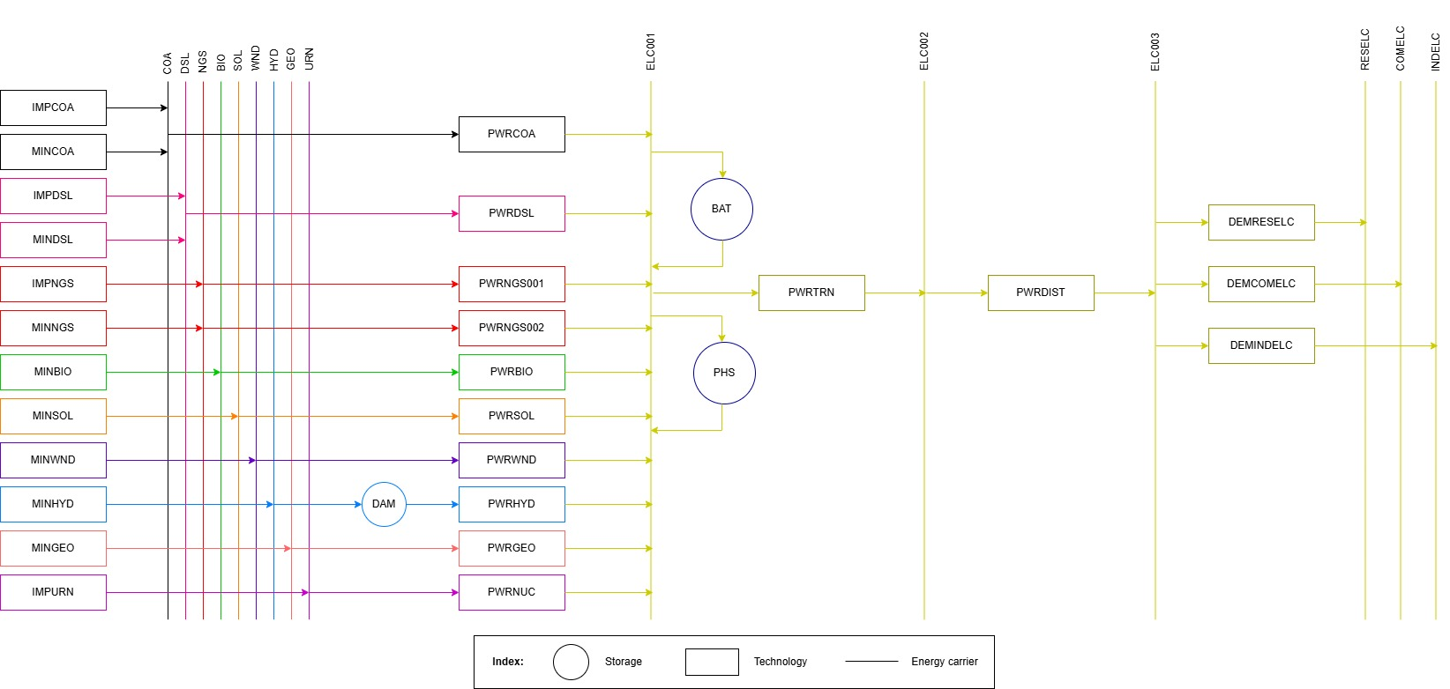
4.2 Energy Demands in Modelling
4.2.2 Generic Naming Convention for Demands
10
Notes:
Before we go any further, let’s quickly remind ourselves of the naming convention introduced in Lecture 3 and think about how this is relevant to defining our energy demands. This diagram is the same as the previous diagram; however, the names of commodities and technologies have been replaced by the codes specified in the naming convention. We can see that:
The electricity from power plants is named E.L.C.0 0 1
Electricity after transmission is named E.L.C.0 0 2
Electricity after distribution, or total electricity demand, is named E.L.C.0 0 3
Sector-specific electricity demands have the following names:
Industrial Electricity Demand = I.N.D.E.L.C
Residential Electricity Demand = R.E.S.E.L.C
Commercial Electricity Demand = C.O.M.E.L.C

Slide 11
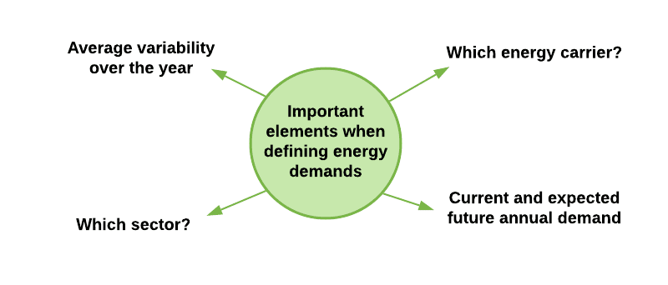
4.2 Energy Demands in Modelling
4.2.3 Introduction to Defining Energy Demands
11
Notes:
When defining an energy demand, it is important to identify:
The energy carrier or energy service which the demand arises for: e.g, electricity, passenger transportation, or cooking.
The sector the demand arises from: e.g., residential (urban and/or rural, off- or on-grid), industrial, or commercial.
The average variability of such demand within a year, which is typically expressed using average demand profiles, explained in more detail later in this lecture.
The current and expected future annual average demand.
It is hard to predict future demands, and there is naturally uncertainty in our predictions. This is one reason why we model different scenarios.

Slide 12
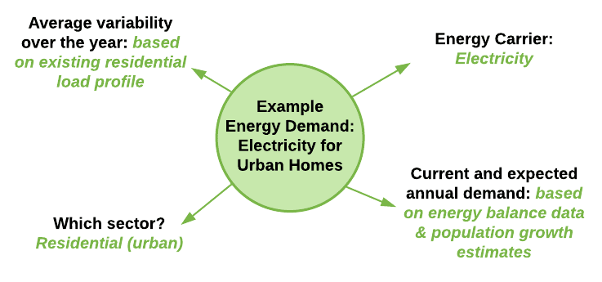
4.2 Energy Demands in Modelling
4.2.3 Example Energy Demands
12
Notes:
Let’s think about what we would need to identify when defining an example energy demand. In this example, we will think about the electricity consumed in urban homes. So, what do we need to identify based on the previous slide?
The energy carrier which the demand arises for: in this case this is electricity.
The sector the demand arises from: in this case this is the residential sector, or the urban residential sector if we want to be more specific.
The average variability of the demand over the year: here we would look at daily and yearly electricity load profiles for a residential urban area, which will tell us how the demand varies daily and in different seasons. From what we have learnt, we might expect this residential demand to be higher in the evening, and the seasonal variation would depend on the country’s climate.
The current and expected annual demand: here we would look at an energy balance (covered in more detail later) to get data for the current and historical residential electricity demand. We could use these data, potentially combined with an estimate of population growth, to create a future projection for the demand too.

Slide 13
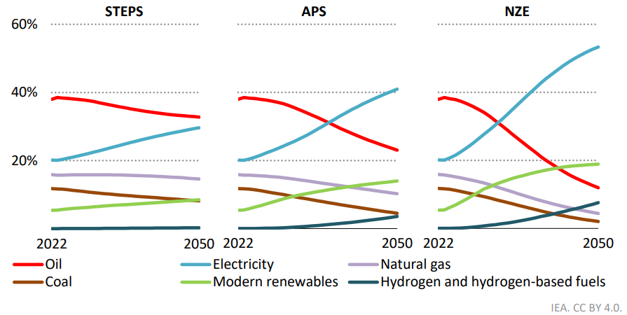
4.2 Energy Demands in Modelling
4.2.5 Introducing Scenarios
STEPS: Stated Policies Scenario
APS: Announced Pledges Scenario
NZE: et Zero Emissions by 2050 Scenario
Source: IEA, 2023
13
Notes:
Scenarios are useful for exploring different energy demand projections and their impacts on capacity expansion planning. Since the future is uncertain, it is common to consider what might happen if the future plays out in different ways, which are represented in different scenarios. In this figure we can see three different scenarios showcasing an outlook for fuel consumption in future years designed by the Internation Energy Agency in its World Energy Outlook 2023. We might want to consider multiple scenarios to assess how demand could vary in the future. Key predictors of energy demand, such as population growth, economic development, and energy policy, can be varied across scenarios. This means that each scenario has a different energy demand projection. Since we cannot be certain of which scenario will be the best predictor of the future, it is useful to model several scenarios and consider the implications of each of them to give useful insights for policymaking.

Slide 14
Lecture 4.2 References
Taliotis, Constantinos, Gardumi, Francesco, Shivakumar, Abhishek, Sridharan, Vignesh, Ramos, Eunice, Beltramo, Agnese, … Howells, Mark. (2018, November). Defining final energy demands in OSeMOSYS. Zenodo. http://doi.org/10.5281/zenodo.4585689
IEA (2023), World Energy Outlook 2023, IEA, Paris https://www.iea.org/reports/world-energy-outlook-2023, Licence: CC BY 4.0 (report); CC BY NC SA 4.0 (Annex A)
14
14

Slide 15
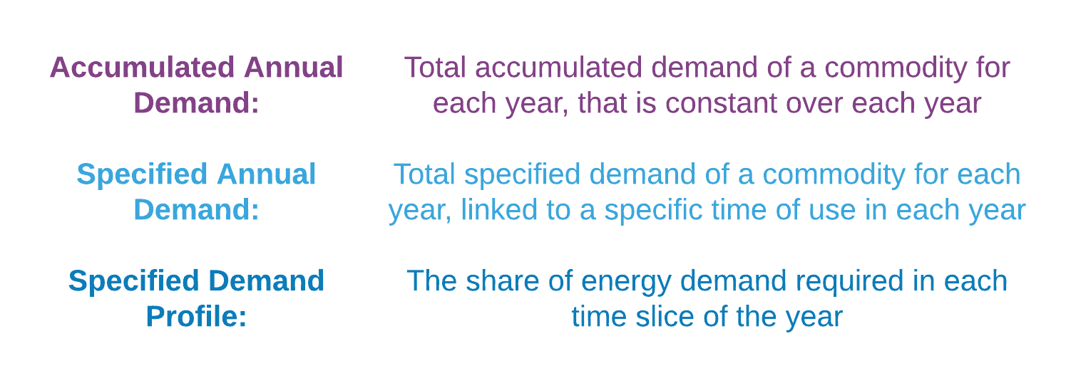
4.3 Energy Demands in OSeMOSYS
4.3.1 Defining Final Demands in OSeMOSYS
15
Notes:
There are several new parameters to introduce that are used to define final demands in OSeMOSYS:
Accumulated Annual Demand: This defines the total accumulated demand of a commodity that is constant throughout the year, for each modelled year.
Specified Annual Demand: This defines the total specified demand for each modelled year, linked to a specific ‘time of use’ during the year.
Specified Demand Profile: This defines the share of energy demand required in each particular time slice.
It is important to note that one commodity demand cannot be defined using both Accumulated Annual Demand and Specified Annual Demand. Additionally, if a commodity demand is defined using Specified Annual Demand, data must also be entered for the Specified Demand Profile for that commodity demand. Finally, demands in OSeMOSYS are usually entered using units of Petajoules (PJ), meaning we may need to change the units when taking demand data from other sources. For example if we have an electricity demand profile in GWh, we would need to convert this to PJ, which using a conversion factor of 1 GWh = 0.0036 PJ. Do not worry if this sounds confusing, we’ll practise adding demands to an OSeMOSYS model in the hands-on exercises.

Slide 16
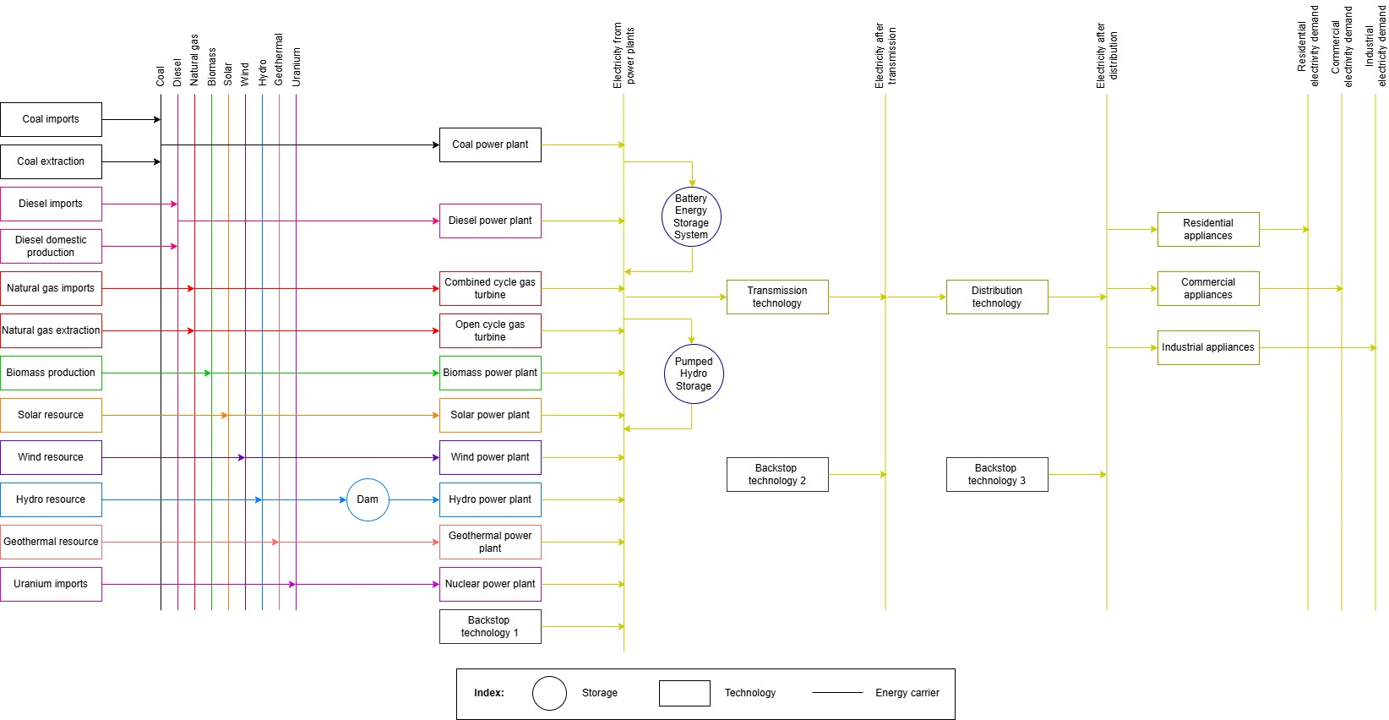
4.3 Energy Demands in OSeMOSYS
4.3.2 Backstop Technologies
16
Notes:
A Backstop technology is a fictitious technology that we model as an alarm bell. It is typically characterized by very high costs so that the model only chooses to use it if no other technology is available.
Whenever model results show that a Backstop technology comes into the system to produce electricity, this means that either:
The model is too constrained (i.e., there are not enough primary resources and conversion technologies in the system to produce enough electricity to satisfy the demand).
Or the model is not set up correctly (i.e., some technology parameters are defined in the wrong way).
It is useful to create one Backstop technology for each demand, as shown on the diagram above, so that we can quickly recognize where the problem is if we see that a Backstop technology is running.

Slide 17
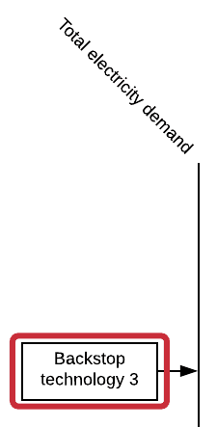
4.3 Energy Demands in OSeMOSYS
4.3.4 Backstop Technology Parameters
Output Activity Ratio (for final electricity demand) = 1
Capital Cost [$/kW] = 999999
Variable Cost [$/GJ] = 999999
Operational Life [years] = 1
17
Notes:
A Backstop technology is characterized by the key parameters shown on this slide. These parameters will be explained in more detail in later lectures; however, we can understand the logic behind these values. The Output Activity Ratio tells us which commodity a technology produces, and it usually has a value of 1 by default. Because the Output Activity Ratio for this Backstop technology is for final electricity demand, we know that this is the commodity produced by the backstop. We can see that both the capital and variable costs for the Backstop technology are very high; this is because OSeMOSYS will seek to find the solution with the lowest cost, so by assigning very high costs to the Backstop technology, we can be sure that the model will only use the Backstop when there is a problem with our model setup. The operational life is set to 1 year, which again ensures that the Backstop is less cost-effective than any other technologies in the model, providing the model is set up correctly. We will learn how to add a backstop technology to a model in the hands-on exercises.

Slide 18
4.3 Energy Demands in OSeMOSYS
4.3.4 Sourcing Data for Energy Demands
Providers of energy balance data and/or demand projections:
International Energy Agency [link]
International Renewable Energy Agency [link]
United Nations Statistics [link]
Asia-Pacific Economic Cooperation [link]
18
Notes:
Energy demand data for use in energy models can come from several sources. Particularly useful sources include energy balances and Sankey diagrams. Energy balances tell us the amount of each commodity that is used by a country or region in a given year, usually broken down by sector. Sankey diagrams are a useful way of understanding the transformations between different energy commodities going from primary commodities to final consumption. Several organizations produce energy balance data that are publicly available, such as the International Energy Agency.

Slide 19
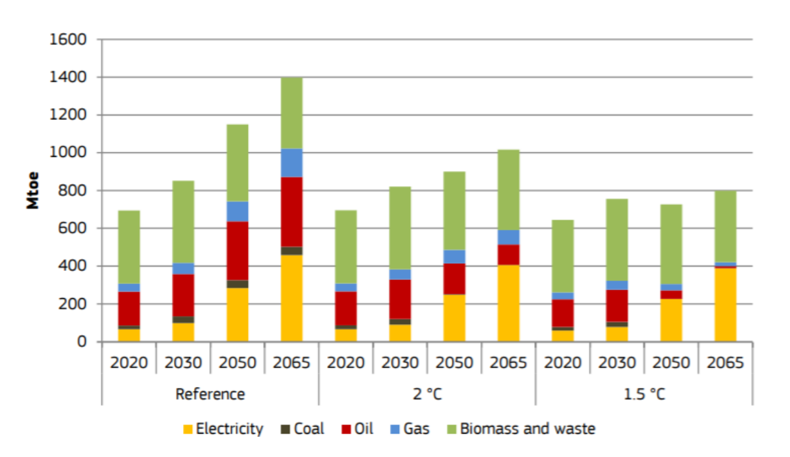
4.3 Energy Demands in OSeMOSYS
4.3.5 Model Demand Projections
(Pappis et al. 2018, image licensed under CC BY 4.0)
19
Notes:
We can look to existing modelling studies for examples of demand projections and demand data that we can use in our own models. For example, this slide shows demand projections for different fuels in Africa under three different scenarios from The Electricity Model Base for Africa (or TEMBA for short). This study considered a reference scenario, which considers business-as-usual conditions, and 1.5 degree and 2 degree scenarios that explore the investments and changes in consumption needed for energy sector emissions to be in line with 1.5 degree and 2 degree temperature rise targets relative to pre-industrial levels. The demand projections differ significantly by scenario. This is because changes in demand patterns relative to the business-as-usual scenario would be needed to meet the 1.5 degree and 2 degree targets, including reducing electricity consumption and shifting away from fossil fuels.

Slide 20
Lecture 4.3 References
Pappis, I., Howells, M., Sridharan, V., Usher, W., Shivakumar, A., Gardumi, F. and Ramos, E., Energy projections for African countries, Hidalgo Gonzalez, I., Medarac, H., Gonzalez Sanchez, M. and Kougias, I., editor(s), EUR 29904 EN, Publications Office of the European Union, Luxembourg, 2019, ISBN 978-92-76-12391-0, doi:10.2760/678700, JRC118432
20

Slide 21
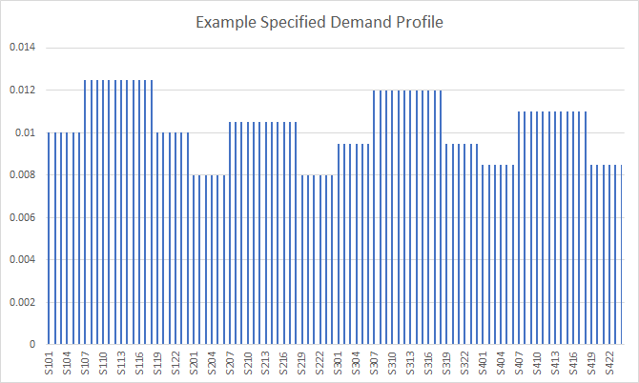
4.4 Demand Examples & Units
4.4.1 Example Specified Demand Profile for OSeMOSYS
Day
Day
Day
Night
Night
Day
Night
Night
Night
Night
Night
Night
Winter
Spring
Summer
Autumn
21
Notes:
This chart shows an example specified demand profile for electricity in OSeMOSYS. There are 96 bars, 1 for each of the 96 time slices used in this OSeMOSYS model, as explained in lecture 3. In this example, we have four seasons (Winter, Spring, Summer, and Autumn), each represented by 24 time slices in OSeMOSYS, with 12 time slices for daytime and 12 time slices for nighttime. The Specified Demand Profile parameter is used to represent the proportion of demand occurring in each time slice, with the values for all 96 time slices adding up to 1.
From the chart we can see that the electricity demand in this example is highest in Winter Days, because the Winter Day time slices have the highest Specified Demand Profile values, while demand is lowest in Spring Nights. It is important to recognize that this is a simplification: in reality demand will vary within seasons and with each hour of the day. Our simplification means that we model one representative day of each season, and we assume equal demand within days and nights of those seasons. Although this is a simplification, it allows us to consider the variation in demand across seasons and day parts without having an incredibly complex model structure.

Slide 22
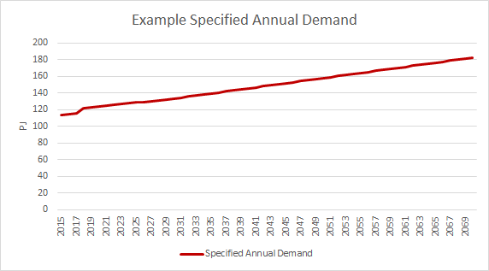
4.4 Demand Examples & Units
4.4.2 Example Specified Annual Demand
Notes:
While the Specified Annual Demand Profile parameter is used to indicate the proportion of the demand occurring in each time slice, the Specified Annual Demand parameter is used to indicate the amount of demand in each year of the model period. This parameter has units of Petajoules. We usually source the data for this parameter from existing demand forecasts, which may be based on key determinants of demand such as expected population growth. If we source demand data from existing sources, we must remember to convert the data into Petajoules for use in OSeMOSYS.

Slide 23
4.4 Demand Examples & Units
4.4.3 Accumulated Annual Demand vs Specified Annual Demand
We use the parameters Specified Annual Demand and Specified Annual Demand Profile when we want to consider the temporal variability of the demand within the year, e.g., electricity demand.
However, there are some demands that do not have specific temporal variability within the year. In this case, we use the parameter Accumulated Annual Demand, which allows us to specify the amount of demand for every model year, without specifying how that demand is spread throughout the year, e.g., passenger transport demand or cooking energy service.
Specified Annual Demand + Specified Annual Demand Profile
Yes
Do we need to consider demand variability within years?
No
Accumulated Annual Demand
Notes:
We use the parameters Specified Annual Demand and Specified Annual Demand Profile when we want to consider the temporal variability of the demand within the year, e.g., electricity demand, since we know this varies relatively predictably across seasons and between day and night. However, there are some demands that do not have specific temporal variability within the year. In this case, we use the parameter Accumulated Annual Demand, which allows us to specify the amount of demand for every model year, without specifying how that demand is spread throughout the year, e.g., passenger transport demand or cooking energy service

Slide 24
4.4 Demand Examples & Units
4.4.4 Power vs Energy
Power is like the rate at which water is poured into the glass
Energy is like the total amount of water in the glass
Notes:
When we are using energy modelling tools, it is important to remember the difference between power and energy. These terms are sometimes used interchangeably; however, there is an important difference between the two. Energy is essentially the total amount of work done or the total capacity for doing work. In contrast, power is the rate at which this energy is supplied or used. This means that energy and power have different units, for example energy is often measured in Joules, while power is often measured in Joules per Second (referred to as Watts), because power has a time element. Let's look at a quick example. Providing the weight stays the same, lifting a weight requires the exact same amount of energy no matter how quickly we lift it. However, if we lift the weight more quickly, the power has increased, since we have used the same amount of energy but over a shorter amount of time. Or we could think about filling up a glass of water: energy would be the total amount of water that is poured into the glass, while power would be the rate at which the water flows into the glass.

Slide 25
4.4 Demand Examples & Units
4.4.5 Units for Demand
1 Petajoule (PJ) = 1000 Terajoules (TJ)
1 Petajoule (PJ) = 1,000,000 Gigajoules (GJ)
3.6 Petajoules (PJ) = 1 Terawatt hour (TWh)
0.0036 Petajoules (PJ) = 1 Gigawatt hour (GWh)
Notes:
When we are defining demands in OSeMOSYS, we are defining amounts of energy; for example, the specified annual demand for electricity is the total amount of electrical energy required in each year of the model period. Therefore all of our demands will have units of energy. A special case for transport demands will be analyzed later in this course. In OSeMOSYS, the standard unit of energy is Petajoules. This unit is used to define all commodities, including all energy demands and fuels used in the model. For this reason, it is important to remember to convert data from other sources to Petajoules before we include it in OSeMOSYS. Example conversion factors are shown on this slide. For example, it is common for electricity demand profiles to be published in Terawatt hours or Gigawatt hours, in which case we need to convert to Petajoules as shown on this slide. For small energy systems with low energy demands, alternative units like terajoules or gigajoules can be used, but all other units must also be standardized accordingly.

Slide 26
Lecture 4.4 References
Taliotis, Constantinos, Gardumi, Francesco, Shivakumar, Abhishek, Sridharan, Vignesh, Ramos, Eunice, Beltramo, Agnese, … Howells, Mark. (2018, November). Defining final energy demands in OSeMOSYS. Zenodo. http://doi.org/10.5281/zenodo.4585689
26

Slide 27
Thank you
www.climatecompatiblegrowth.com

