Slide 1
Energy system modelling using OSeMOSYS
LECTURE 3
NAMING CONVENTION & TIME REPRESENTATION

Slide 2
Learning Outcomes
By the end of this lecture, you will be able to:
ILO 1: Learn how to use the generic model naming convention
ILO 2: Understand the variability of energy demand
ILO 3: Understand the variability of renewable energy resources and energy prices
ILO 4: Learn how to represent time in an energy system model using MUIO and OSeMOSYS
2
Notes:
Welcome to Lecture 3 of this course. This lecture focuses on several important concepts including:
Generic model naming convention
Variability of energy demand
Variability of renewable energy resources and energy prices
Time representation

Slide 3

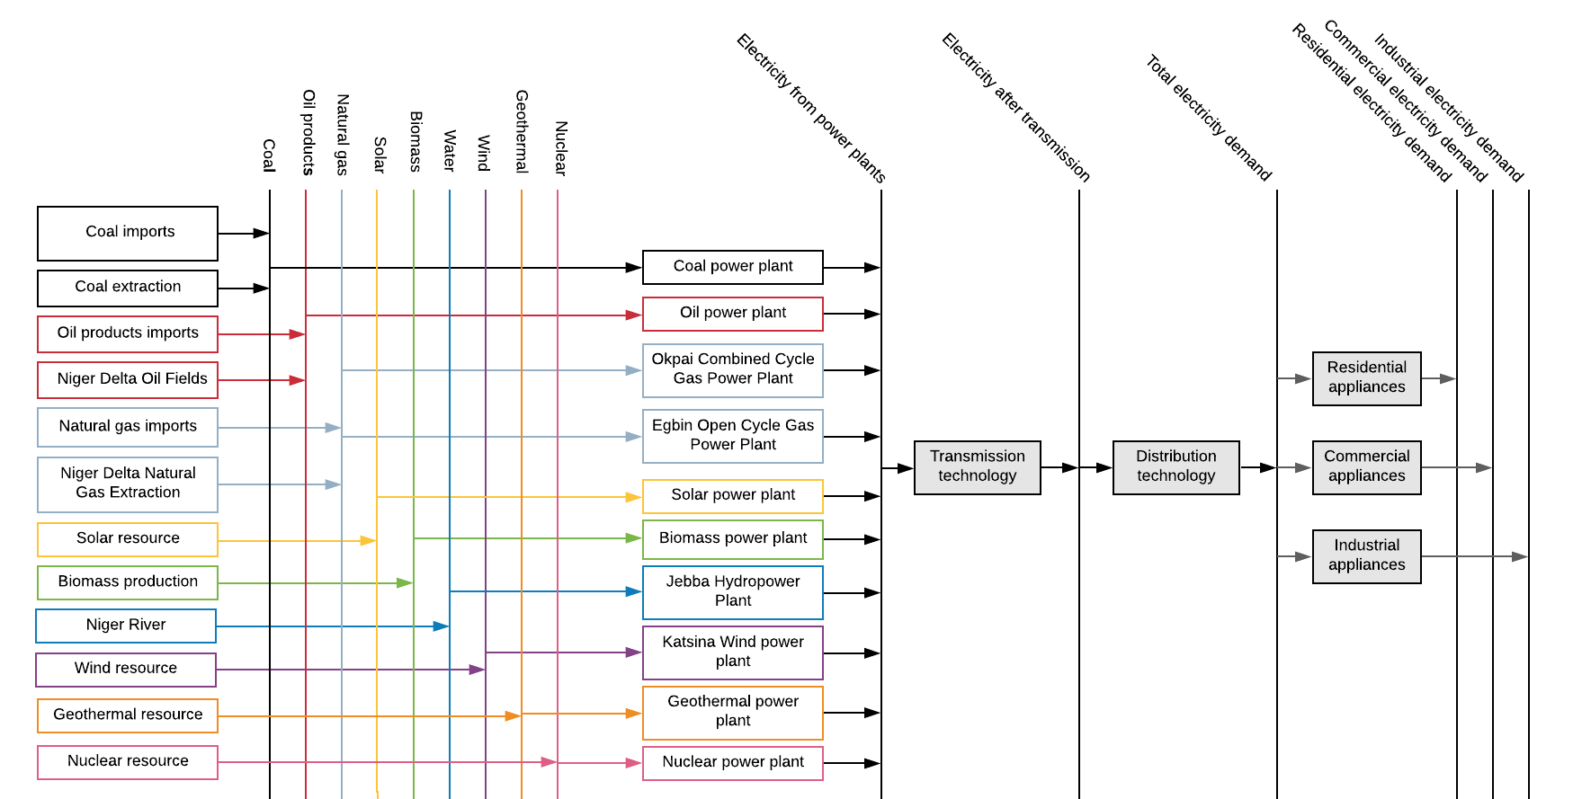
3.1 Naming Convention
3.1.1 Importance of Generic Naming
3
Notes:
This diagram shows an example Reference Energy System constructed for Nigeria. Here we can see total electricity demand divided into the residential, commercial, and industrial sectors, as well as all the technologies that could meet those demands. Since we want to consider all technologies that may become available in the future, the diagram includes power plant types that are not currently active in Nigeria, such as biomass power plants.
In this Reference Energy System, technologies have been given specific names that are relevant to Nigeria, for example Katsina Wind Power Plant is named, rather than using a generic term for all wind power plants. While this may make sense to somebody with knowledge of the Nigerian power system, using specific names can make it harder for other people to identify technologies and understand all of the components in a Reference Energy System. For this reason, we will use a generic naming convention when creating our Reference Energy Systems. This has other benefits, which are explained later.

Slide 4
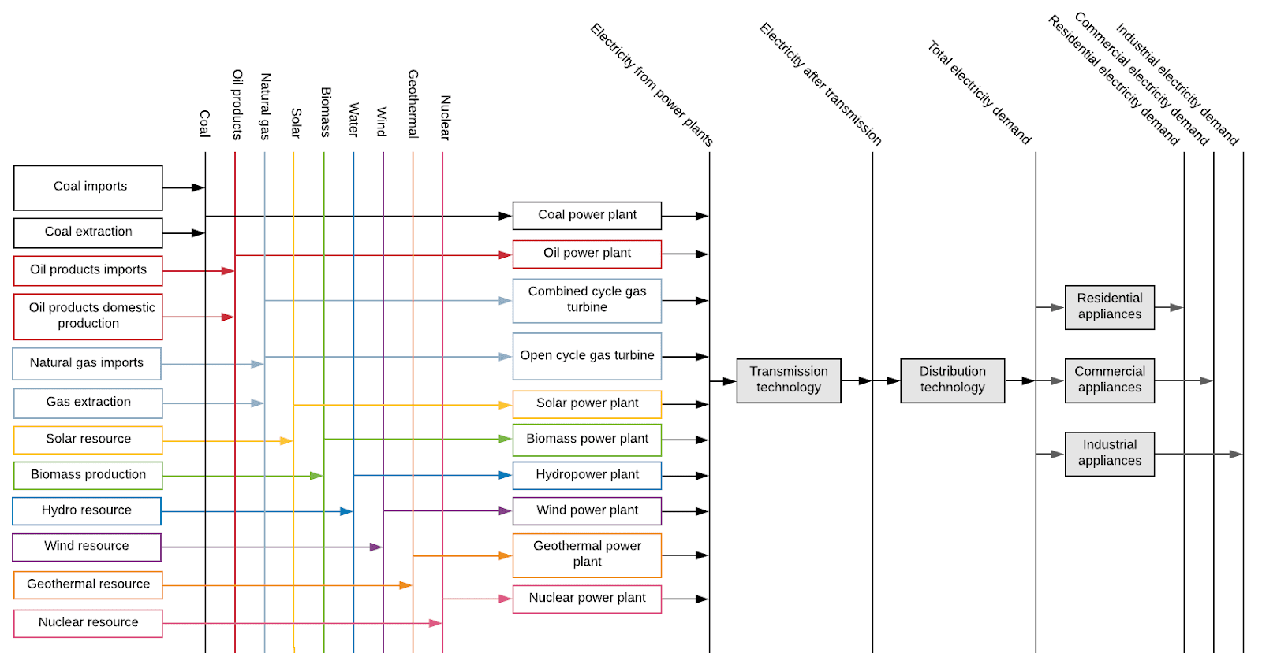
3.1 Naming Convention
3.1.2 Importance of Code Names
4
Notes:
We can now see that all of the specific names in the Reference Energy System diagram have been replaced with generic names. This means that the diagram can now be easily understood by all users, with no confusion over specific power plant names. The use of generic naming also means that technologies can be identified quickly and easily. However, these names are too long to be used in our modelling system, and so short standard codes are used, as explained next.

Slide 5
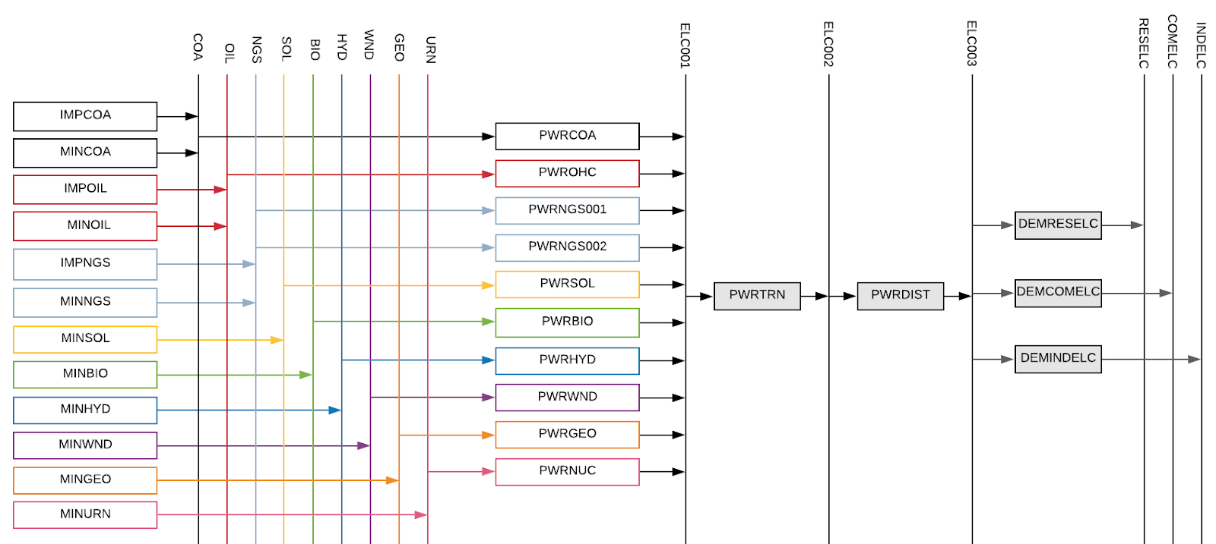
3.1 Naming Convention
3.1.3 Why use a naming convention?
5
Notes:
In this version of the Reference Energy System, technologies and commodities are names using short standard codes. These codes are generated using a standard naming convention, the structure of which is explained in the remaining part of this mini-lecture. The use of a standard naming convention like this is advantageous because it:
Allows quick and easy technology identification
Is easily replicable
Facilitates comprehension of model components and structure
Allows for structuring data in the model and results during post-processing

Slide 6
3.1 Naming Convention
3.1.4 OSeMOSYS Naming Convention Part 1
DEMRESCKNNGS001
Sector/Category
Examples:
DEM=Demand
PWR=Power
MIN=Mining
IMP=Imports
UPS=Upstream
Subsector
Examples:
RES=Residential
IND=Industry
TRA=Transport
COM=Commercial
Energy service
Examples:
CKN= Cooking
CAR= Car transport demand
HET=heating
Input fuel
Examples:
NGS= Natural gas
BIO= Biomass
ELC= Electricity
Number
Identifier for different types of a same technology
Q: What technology is represented in the example?
6
Notes:
The structure of the generic convention for naming technologies is shown in this figure. The technology name is composed of five segments: the first identifies the category of the technology, the second identifies the subsector if applicable, then the third identifies energy service or demand being produced if applicable, and the fourth is the fuel or commodity it uses. Each segment is made up of 3 letters which identify the term. The technology name therefore has 6 or 12 letters in total, depending on whether it is assigned a subsector or an energy service. For example a coal power plant can be named P.W.R.C.O.A: P.W.R identifies the category as the power generation, and C.O.A identifies that the commodity used by this technology is Coal. If there is more than one type of a technology, a 3-digit number at the end is used to distinguish between types e.g. P.W.R.C.O.A.0.0.1 would be Coal Power Plant type 1 and P.W.R.C.O.A.0.0.2 would be Coal Power Plant type 2. The example on the slide represents a natural gas stove in the residential sector.

Slide 7
3.1 Naming Convention
3.1.4 OSeMOSYS Naming Convention Part 2
Examples of commodities as final demands
TRACAR=Car transport demand
RESELC=Electricity demand in the residential sector
COMHET=Heat demand in the commercial sector
INDHHT=High heat demand in the industrial sector
AGRDSL=Diesel demand in the agriculture sector
Additional examples of commodities/fuels
SOL=Solar energy
WND=Wind energy
HYD=Hydro energy
GEO=Geothermal energy
COA=Coal
CRU=Crude oil
BAG=Bagasse
LPG=Liquified Petroleum Gas
DSL=Diesel
GSL=Gasoline
FOL=Fuel oil
JET=Jet fuel
HDG=Hydrogen
7
Notes:
Commodities or fuels are assigned 3- or 6-letter names, as illustrated in some examples on this slide. For sector-specific commodities, particularly final demands, the first three letters of the name represent the subsector, while the second three letters indicate the energy service. For instance, diesel used in the transport sector would be labeled as TRADSL. Commodities or fuels associated with primary sources or transformation processes are generally represented using only three letters. It's important to note that energy services or final demands are also modelled as commodities within OSeMOSYS.

Slide 8
Lecture 3.1 References
Taliotis, Constantinos, Gardumi, Francesco, Shivakumar, Abhishek, Sridharan, Vignesh, Ramos, Eunice, Beltramo, Agnese, … Howells, Mark. (2018, November). Time representation in OSeMOSYS. Zenodo. http://doi.org/10.5281/zenodo.4585695
8

Slide 9
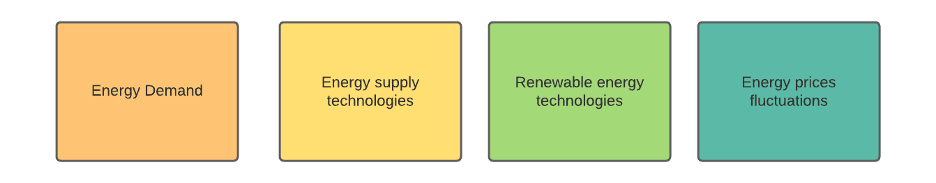
3.2 Importance of Time Representation
3.2.1 Time Variability in Energy Systems
Sources of Time Variability:
9
Notes:
All characteristics of the energy system vary over different time scales (days, weeks, seasons), both on the demand and the supply side.
These include:
Energy demand;
Availability of energy supply technologies;
Availability of renewable energy sources (such as water or solar irradiation) and storage;
Energy price.
We therefore need to ensure there is enough capacity to meet the demand at all times. This means ensuring that everyone has access to energy when they need it.

Slide 10
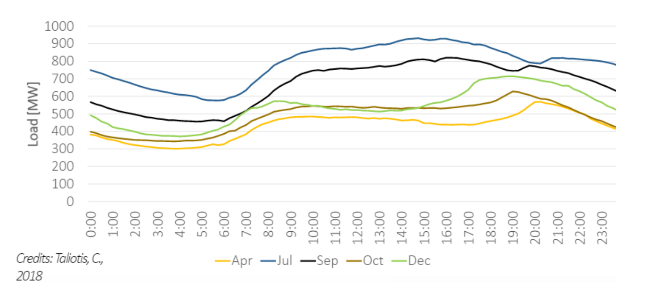
3.2 Importance of Time Representation
3.2.2 Variability of Energy Demand
(Taliotis et al. (2018), image, licensed under CC BY 4.0)
10
Notes:
In most cases, energy demand varies over time. This occurs on several scales. Firstly, energy demand is rarely constant throughout the day. Demand varies as consumers’ activities occur at different times of the day. For example, in many countries, we see the highest electricity demand in the late afternoon and early evening. This can be when consumers use most power, for example to cook a meal or turn lamps on as it gets dark. Secondly, energy demand is rarely constant throughout the year. Demand changes as the seasons change. For example, in cold countries, residential electricity demand may be higher in the winter than in the summer as consumers use more power for heating and lighting. This diagram shows an example of how electricity demand may vary on both daily and monthly timescales within a country.
It is often important to model these variations in demand over time in order to ensure sufficient energy can be supplied at all times.

Slide 11
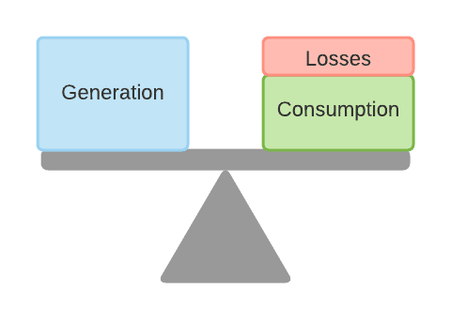
3.2 Importance of Time Representation
3.2.3 Balancing the Electricity System
11
Notes:
At all times the electricity system has to be balanced. This means that generation has to equal consumption plus losses. Losses occur in energy systems for several reasons, for example power transmission technologies are not 100% efficient. This means that some energy is lost at several stages of the chain from electricity generation by power plants to electricity consumption by consumers. To ensure there is sufficient energy available, these losses must be considered in the balance of the system, meaning generation must equal the sum of consumption plus losses.
Because there is often no economically viable way to store very large quantities of electricity, it is important that this balance is maintained at all times, so in any one instance the total electricity generated should equal the sum of consumption plus losses. This has implications for the planning of energy supply, because some electricity generation technologies have limited flexibility, meaning they cannot be relied upon to produce electricity at all times. It is important that we model time variability so we can ensure that the system is balanced at all times.

Slide 12
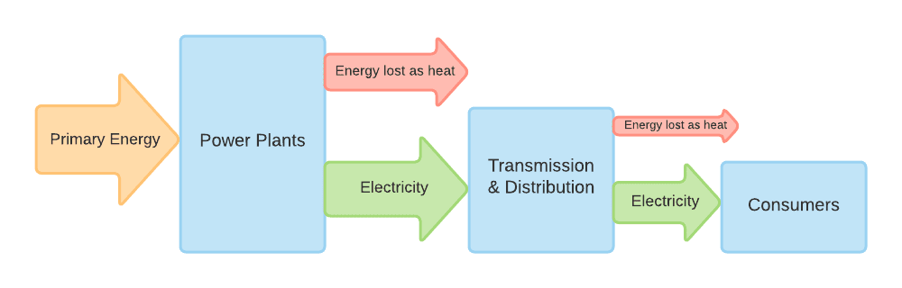
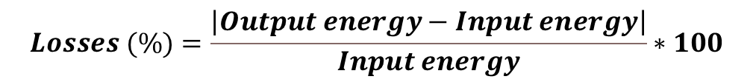
3.2 Importance of Time Representation
3.2.4 System Losses & Reliability
$$Losses (\%)=\frac{\left|Output energy−Input energy\right|}{Input energy}∗100$$
12
Notes:
So, electricity systems are not completely efficient and contain several losses. This means that not all of the primary energy entering an electricity system is used by consumers. It is important to understand where these losses come from and consider them when modelling energy systems. The first source of losses is thermal energy losses in the generation of electricity; thermal electricity generation by power plants is not 100% efficient and some of the primary energy put in is lost as heat. These are usually the largest losses in the system. For example, not all of the energy in the coal burned at a coal power station is converted to electricity as a proportion of it is lost as heat. The concept of power plant efficiency is explored further in Lecture 4. A further source of energy losses is in the transmission and distribution of electricity, which again is not a 100% efficient process. Losses can be estimated as a percentage by calculating the difference between the output and input energies, then dividing this difference by the input energy, as illustrated in the equation on the slide.
Because of these system losses, electricity systems must always generate more electricity than is actually consumed to ensure demand is met. In some cases, electricity systems can fail to meet demand, for example because there is insufficient generation capacity. This has significant impacts on society.

Slide 13
3.2 Importance of Time Representation
3.2.5 Unreliable Electricity Supply
Reduced quality of life
Limited healthcare provision
Problems associated with unreliable electricity supply
Loss of industrial productivity
Reduced access to education
13
Notes:
Unreliable electricity supply is a critical problem that has several serious societal impacts. Firstly, an unreliable electricity supply limits citizens’ quality of life and inhibits progress towards the Sustainable Development Goals. Without reliable supply, opportunities for education and business are limited, and provision of healthcare is challenging. Reliable electricity supply is also critical for industry and businesses to function and grow. If supply is unreliable, industrial production will be disrupted by blackouts and businesses may have to spend large amounts of money on back-up generators, which are also highly polluting. Unreliable electricity supply therefore forms a critical barrier to economic growth.
For these reasons, it is important that energy systems are planned in a way that ensures reliability. A critical element of this is considering the time variability of demand as well as system losses in energy modelling.

Slide 14
Lecture 3.2 References
Taliotis, Constantinos, Gardumi, Francesco, Shivakumar, Abhishek, Sridharan, Vignesh, Ramos, Eunice, Beltramo, Agnese, … Howells, Mark. (2018, November). Time representation in OSeMOSYS. Zenodo. http://doi.org/10.5281/zenodo.4558793
14
14

Slide 15
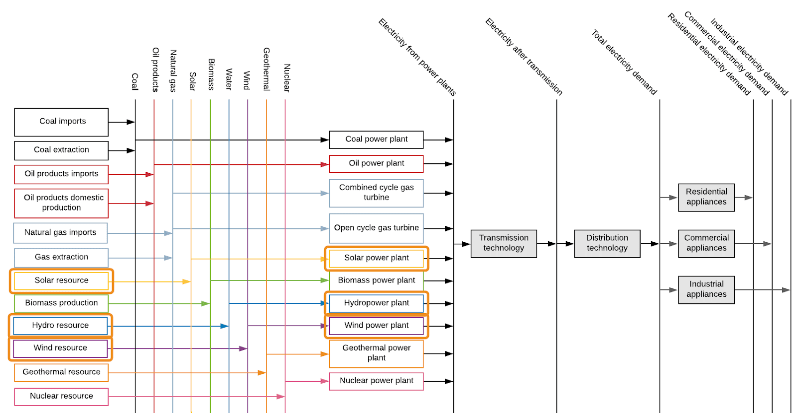
3.3 Additional System Variability
3.3.1 Variability of Renewable Energy Part 1
15
Notes:
So, we have learnt that energy demand varies with time and that this must be considered in energy modelling. Another important consideration is that the availability of renewable energy resources also varies with time. This refers to the fact that the amount of energy available from solar, wind, and hydropower resources is not constant. For example, the amount of solar energy that can be converted to electricity by a solar PV panel is dependent on the strength of the sunlight (otherwise known as solar irradiance). Since it is often sunniest in the middle of the day and dark at night, a solar PV panel can therefore produce most electricity in the middle of the day and no electricity at night. Renewable energy availability will also vary by season, as the strength of the sunlight, wind conditions, and water flow all vary throughout the year. To ensure electricity systems are reliable and capable of meeting demand, it is important to model this variability.

Slide 16
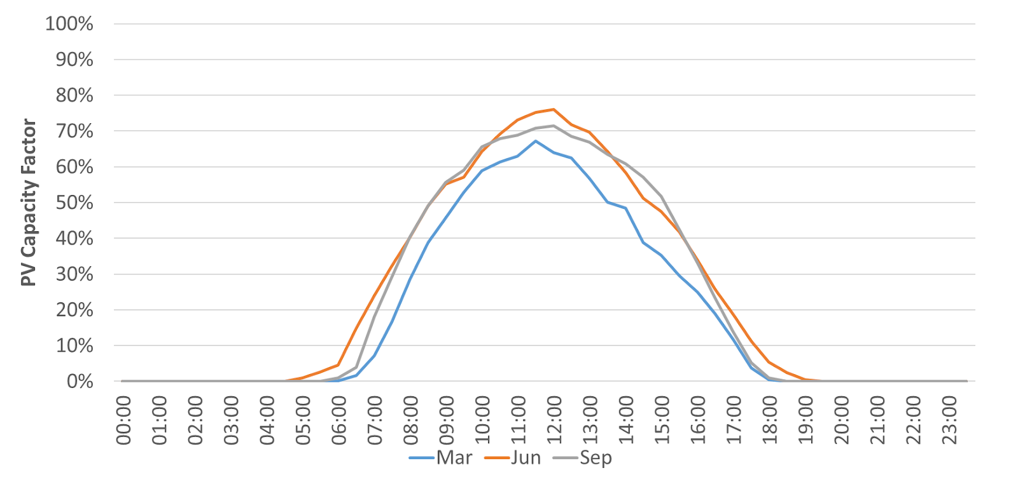
3.3 Additional System Variability
3.3.2 Variability of Renewable Energy Part 2
(Taliotis et al. (2018), image, licensed under CC BY 4.0)
16
Notes:
This diagram exemplifies the variability of renewable energy generation. The Y axis is the solar PV capacity factor, which is essentially a measure of the availability of the PV power plant to generate electricity. Capacity factors are covered in more detail in later lectures. When the capacity factor is 0, this means the PV plant cannot generate any electricity, so this diagram shows that no electricity can be generated from approximately 7:00pm in the evening to 5:00am in the morning. The diagram then shows that the PV capacity factor rises throughout the day and peaks at midday before falling back down to 0 in the evening, tracking the strength of the sunlight. A key message from this diagram is that this PV plant could not be relied upon to produce electricity from approximately 7:00pm to 5:00am, whilst it would be a useful source of generation during the day. We must therefore consider this in energy system modelling, and this is another key reason why we model time variability in OSeMOSYS.

Slide 17
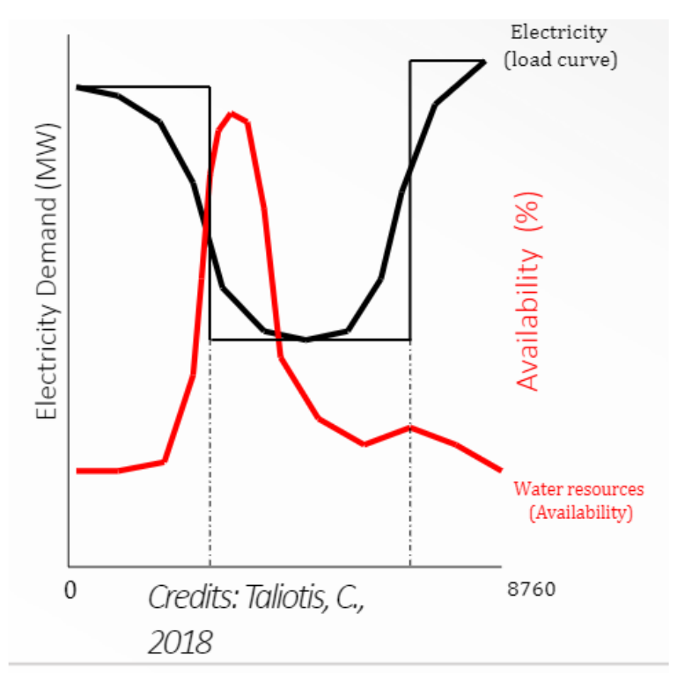
3.3 Additional System Variability
3.3.3 Introduction to the Importance of Flexibility
(Taliotis et al. (2018), image, licensed under CC BY 4.0)
17
Notes:
This graph shows example data on the availability of water resources for producing electricity at hydropower plants and the electricity demand profile. We can see that the peak water availability does not match the peak demand, so demand could not be met using hydropower alone. To ensure demand can always be met, even when there is variability in resource availability as shown on this figure, it is important that the system has sources of flexibility. Flexibility can come from several sources, such as energy storage. Energy storage refers to the idea of storing energy for use at a later time. In electricity systems, it is often helpful to store electricity produced when demand is low, so that the stored electricity can be used when demand is higher and/or less supply is available.
There are several types of energy storage. A common option is pumped storage hydropower, where water is pumped from a lower reservoir to a higher reservoir in order to store power, which is then released when the water is discharged back to the lower reservoir. Electricity systems may also contain standalone batteries, which store electricity from the transmission grid at times of low demand for release when demand is higher, or batteries are commonly combined with renewable energy generation technologies. For example, it is common to have battery storage at solar farms as this allows excess electricity generated during sunny periods to be stored and released when the solar intensity may be lower. Storage and flexibility are covered in more detail in later lectures.

Slide 18
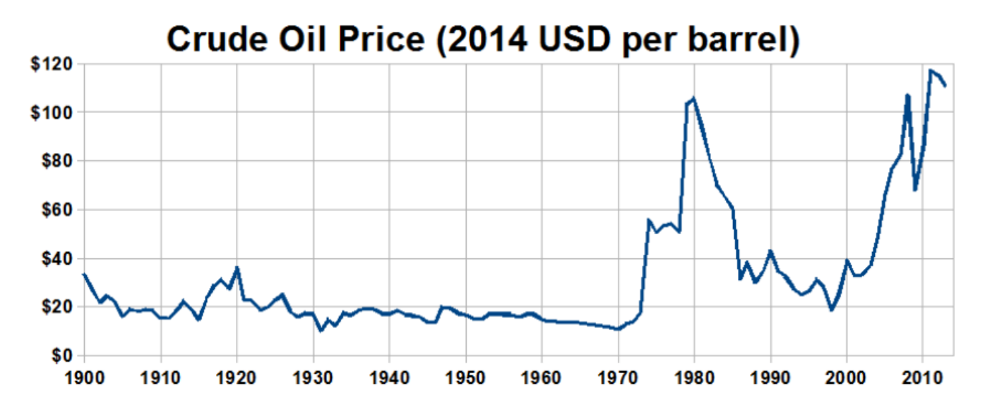
3.3 Additional System Variability
3.3.4 Price Variability
(Travelplanner, image, licensed under CC BY-SA 3.0)
18
Notes:
Another source of temporal variability in energy systems comes from the costs of commodities. Commodity prices can vary strongly over time due to changes in supply and demand. As a general rule, when the supply of a commodity exceeds the demand, prices fall, and when demand exceeds supply, prices rise. Supply and demand can be influenced by several external factors, such as economic downturns, which reduce demand, or geopolitical events and natural disasters, which can temporarily slow production. We can see the volatility of commodity prices in the figure above. It is important that we consider this variation in commodity prices in energy system models in order to make our models more aligned with reality. In OSeMOSYS, this is done by specifying commodity prices in each year of the modelling period based on price forecasts, as outlined in lecture 4.

Slide 19
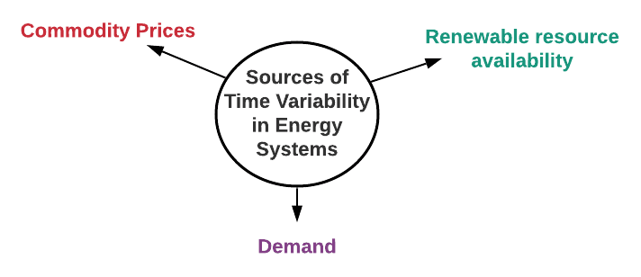
3.3 Additional System Variability
3.3.5 Overall Importance of Modelling Time Variability
19
Notes:
To summarize this and the previous mini-lecture, we have firstly learnt that several elements of energy systems vary over time. These include demand, which varies as power-consuming activities occur at different times of the day and differently in each season, electricity generation, which can vary as renewable resource availability varies over time, and energy prices. We have also seen the importance of balancing electricity supply and demand and the critical impacts that unreliable supply can have. To help mitigate these impacts, we must consider time variability when planning energy systems. This is therefore modelled in OSeMOSYS. The method of modelling time variability in OSeMOSYS is covered in more detail in the next section.

Slide 20
Lecture 3.3 References
Taliotis, Constantinos, Gardumi, Francesco, Shivakumar, Abhishek, Sridharan, Vignesh, Ramos, Eunice, Beltramo, Agnese, … Howells, Mark. (2018, November). Time representation in OSeMOSYS. Zenodo. http://doi.org/10.5281/zenodo.4558793
20

Slide 21
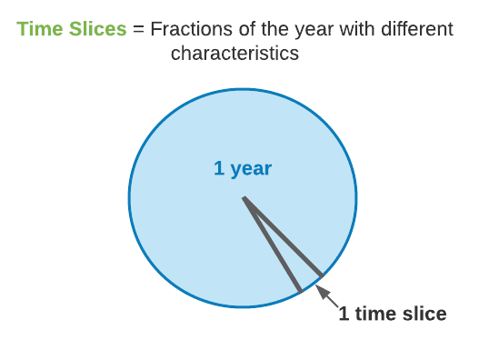
3.4 Time Representation in OSeMOSYS
3.4.1 Introduction to Representing Time Part 1
21
Notes:
In OSeMOSYS we represent time variability by dividing a year into ‘time slices’. Before we talk more about using time slices in OSeMOSYS, it is important to appreciate what we are trying to consider when we use this time slice approach. Time slices are intended to be fractions of the year with different characteristics, typically representing different seasons, different day types, and different times of the day. For example one time slice could represent all the evenings in weekends in summer and another could represent all the evenings in weekends in winter. The ultimate aim of this approach is to capture the variability in demand and resource availability over time in the country we are modelling. This means that the most appropriate definition of time slices may vary by country. For example, some countries have 4 clearly defined seasons, each of which has different weather patterns. For a country like this, we would probably want to ensure each of these seasons was represented by a different time slice in OSeMOSYS, because demand and renewable resource availability will be different in each one. However, other countries only have two seasons which need to be represented, for example countries with only a wet and a dry season.

Slide 22
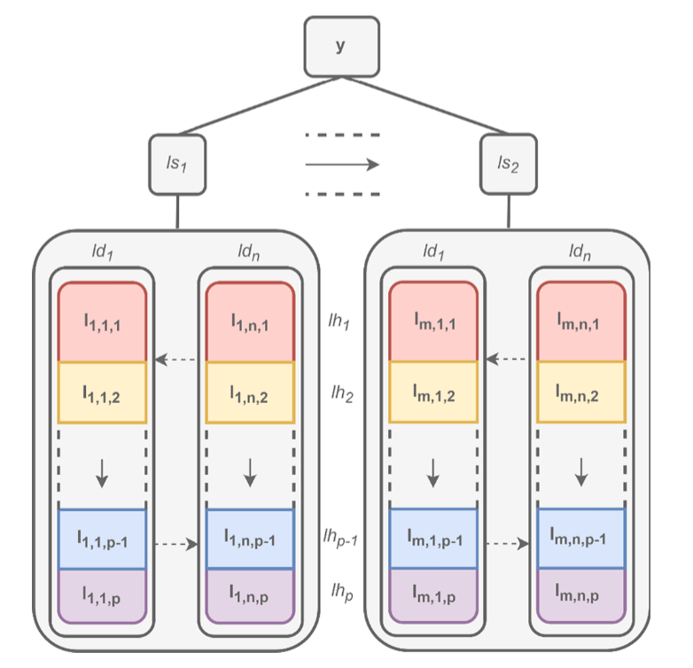
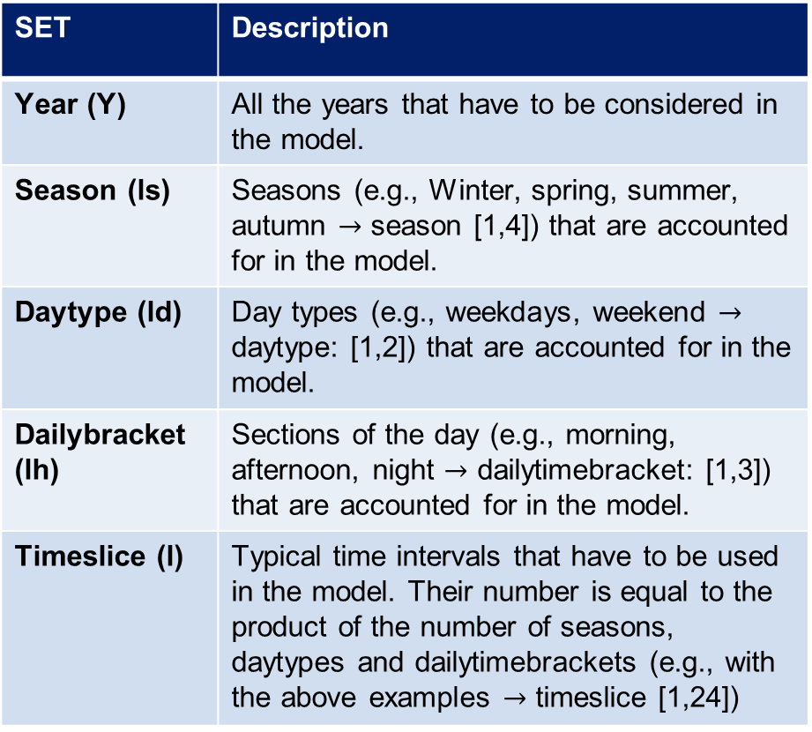
3.4 Time Representation in OSeMOSYS
3.4.2 Introduction to Representing Time Part 2
SET | Description
Year (Y) | All the years that have to be considered in the model.
Season (ls) | Seasons (e.g., Winter, spring, summer, autumn $→$ season [1,4]) that are accounted for in the model.
Daytype (ld) | Day types (e.g., weekdays, weekend $→$ daytype: [1,2]) that are accounted for in the model.
Dailybracket (lh) | Sections of the day (e.g., morning, afternoon, night $→$ dailytimebracket: [1,3]) that are accounted for in the model.
Timeslice (l) | Typical time intervals that have to be used in the model. Their number is equal to the product of the number of seasons, daytypes and dailytimebrackets (e.g., with the above examples $→$ timeslice [1,24])
Novo et al., 2022
22
Notes:
A broader description of how the model divides time into several hierarchical sets is given here:
Year (Y) – This represents all the years we’re considering within the model.
Season (Is) – Each year is broken down into seasons. For instance, we could divide the year into four seasons: winter, spring, summer, and autumn. This seasonal division helps capture variations in energy needs, like heating in winter or air conditioning in summer.
Daytype (Id) – Within each season, we also differentiate between types of days, such as weekdays and weekends. This allows us to reflect changes in energy consumption patterns, as weekends may have a different demand profile compared to weekdays.
Dailybracket (Ih) – Each daytype is further split into sections of the day, known as daily brackets. Common divisions might include morning, afternoon, and night, helping us capture intraday variations in energy demand and supply.
Timeslice (I) – Finally, these divisions come together to form timeslices. Timeslices are the fundamental time intervals in the model, representing the smallest time unit OSeMOSYS will consider. The number of timeslices is the product of seasons, daytypes, and daily brackets. For example, if we have four seasons, two day types, and three daily brackets, we end up with 24 timeslices.
On the right side, the diagram visually represents this breakdown, showing how a year is divided into seasons, each season into day types, and each day type into daily brackets, resulting in the final timeslices used for analysis.

Slide 23
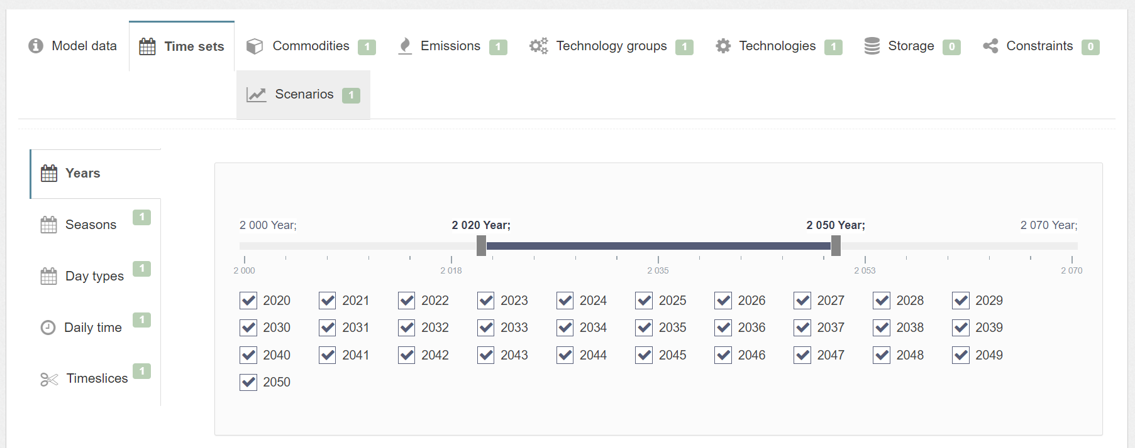
3.4 Time Representation in OSeMOSYS
3.4.3 Time representation in MUIO
In MUIO, we can define timeslices alone if we are not modeling storage technologies. Otherwise, we need to define seasons, day types, and daily time brackets, each of which must be linked to a timeslice.
23
Notes:
In MUIO, we have the flexibility to define different timeslices. On the left, you can see the main time set categories described in the previous slide: Years, Seasons, Day types, Daily timebrackets, and timeslices.
In the timeline view to the right, we see a list of years selected for this example, which span from 2020 to 2050. By selecting specific years, we can customize which periods are analyzed, making the model more efficient.
Importantly, in MUIO, we have the option to define timeslices alone if we’re not incorporating storage technologies. However, if we are modeling storage, we need to specify the seasons, day types, and daily time brackets, as each must be linked to a timeslice.
This flexibility allows MUIO to adapt time representation based on the model’s specific requirements, ensuring we have the appropriate granularity without unnecessary complexity.

Slide 24
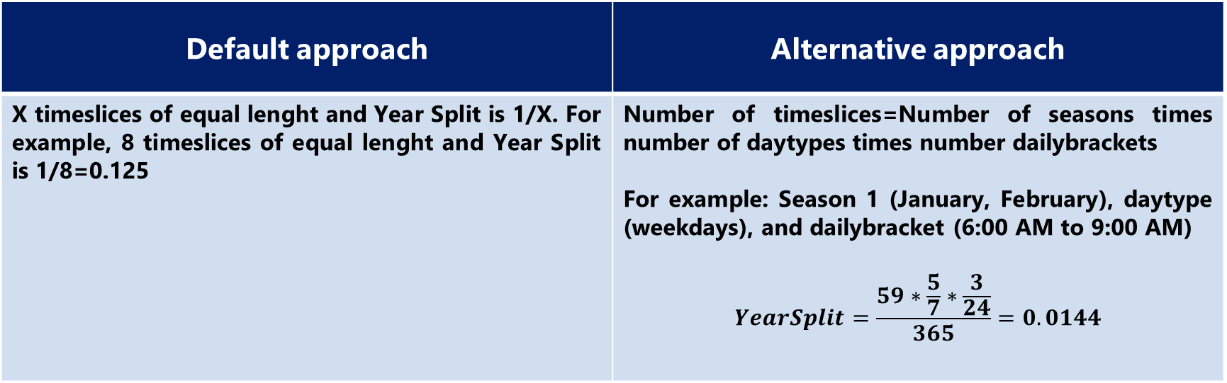
3.4 Time Representation in OSeMOSYS
3.4.4 Year Split
Year Split
Duration of a modelled timeslice, expressed as a fraction of the year. The sum must be equal to 1.
Default approach | Alternative approach
X timeslices of equal lenght and Year Split is 1/X. For example, 8 timeslices of equal lenght and Year Split is 1/8=0.125 | Number of timeslices=Number of seasons times number of daytypes times number dailybrackets For example: Season 1 (January, February), daytype (weekdays), and dailybracket (6:00 AM to 9:00 AM) $$YearSplit=\frac{59∗\frac{5}{7}∗\frac{3}{24}}{365}=0.0144$$
24
Notes:
The Year Split is the proportion of the year represented by each timeslice. It’s important to check that Year Split values sum to 1. If specific data isn’t available, we can assume each timeslice is of equal length, making the Year Split equal to 1 divided by the total number of timeslices. For example, with 8 timeslices, each would have a Year Split of 1/8 or 0.125.Alternatively, if we have a precise definition of each timeslice, we can estimate the Year Split value. For example, a season covering January and February consists of 59 days (31 in January plus 28 in February). If we consider only weekdays (i.e., 5 out of 7 days) and a daily time bracket from 6 AM to 9 AM (i.e., 3 out of 24 hours), the Year Split would be the product of these ratios divided by 365 days in a year, as shown in the example. These values are then input into MUIO, which you can try in Hands-On Exercise 2.

Slide 25

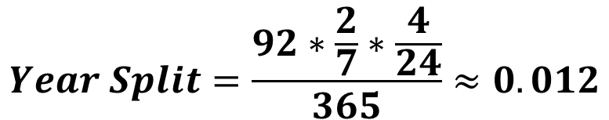
3.4 Time Representation in OSeMOSYS
3.4.5 Year Split Exercise
A timeslice is defined as:
Season 3: June, July, August
Daytype: weekends
Dailytimebracket: 2:00 PM to 6:00 PM
What is the value of the YearSplit for this timeslice?
$$Number of days in season 3=30 \left(June\right)+31 \left(July\right)+31 \left(August\right)=92$$
$$Proportion of days in weekends=\frac{2}{7}$$
$$Proportion of hours 2:00 to 6:00 PM in 1 day=\frac{4}{24}$$
$$Year Split=\frac{92∗\frac{2}{7}∗\frac{4}{24}}{365}≈0.012$$
25
Notes:
This is a second example of how to calculate the Year Split once the timeslice features are defined. In this case, a season covering June through August consists of 92 days (30 in June, 31 in July, and 31 in August). If we consider only weekends (i.e., 2 out of 7 days) and a daily time bracket from 2 PM to 6 PM (i.e., 4 out of 24 hours), the Year Split is the product of these ratios divided by the 365 days in a year, as shown on the slide.

Slide 26
3.4 Time Representation in OSeMOSYS
3.4.6 Additional Parameters: Discount Rates
Global discount rate or social discount rate (SDR) to account for public investments. SDR is the expected return from a central planner perspective. Used to calculate the net present value of costs in the model.
Decimal value between 0 and 1
Discount rate
Individual discount rates or hurdle rates (HR) for every single generation technology. In other words, HR is the expected return from an investor perspective. Used to calculate an annualized cost of capital.
Decimal value between 0 and 1
Discount rate Idv
Potential sources: National energy planning assessments, National bank reports
26
Notes:
In the final slide of this lecture, we will briefly introduce two parameters used in setting up a model in OSeMOSYS, which we’ll practice using in Hands-On Exercise 2. While we don’t need to study discounting in depth for this course, we’ll provide a quick explanation of how it is applied in OSeMOSYS.
The purpose of discounting is to account for the time value of money, where it is generally more advantageous to have a given amount now rather than in the future. For example, if given the choice between receiving $100 now or in two years, it is more beneficial to have it now since it could be invested to grow beyond $100 over two years. This concept is captured by the Discount Rate, which is used to determine the present value of future cash flows. In OSeMOSYS, the Discount Rate parameter, represented as a decimal, serves this purpose. A typical discount rate might be 10%, which we represent in OSeMOSYS with a value of 0.1 for the Discount Rate parameter. Additionally, individual discount rates can be defined for each technology to calculate the annualized capital cost.

Slide 27
Lecture 3.4 References
Taliotis, Constantinos, Gardumi, Francesco, Shivakumar, Abhishek, Sridharan, Vignesh, Ramos, Eunice, Beltramo, Agnese, … Howells, Mark. (2018, November). Time representation in OSeMOSYS. Zenodo. http://doi.org/10.5281/zenodo.4558793
27

Slide 28
Thank you
www.climatecompatiblegrowth.com

