Slide 1
Energy system modelling using OSeMOSYS
LECTURE 2
BASICS ON ENERGY SYSTEM MODELLING

Slide 2
Learning Outcomes
By the end of this lecture, you will be able to:
ILO1: Understand what energy system modelling is and why it is important
ILO2: Sketch a Reference Energy System and understand its contents
ILO3: Recall the different types of energy modelling tools
ILO4: Understand what OSeMOSYS is and its applications
2
Notes:
By the end of this lecture, you will be able to:
ILO1: Understand what energy system modelling is and why it is important
ILO2: Sketch a Reference Energy System and understand its contents
ILO3: Recall the different types of energy modelling tools
ILO4: Understand what OSeMOSYS is and its applications

Slide 3

2.1 Energy System Modelling
2.1.1 Introducing Energy Systems
Energy resources
Energy conversion
Transportation and distribution
Final demands
Energy systems include everything from fuel production to final energy consumption
3
Notes:
This mini-lecture contains an overview of both energy systems and the concept of energy system modelling. Energy systems are complex systems containing many components and interactions. The main components of energy systems include fuel production and energy resources, energy conversion, energy transportation, and final demands for energy services. Primary energy resources include fossil fuels, such as coal or natural gas, alongside renewable energy resources, such as solar or wind energy. These resources often undergo conversions; for example, solar and wind energy are converted to electricity, while crude oil is often converted to more useful oil products like diesel. The products of these conversion processes then need to be transported and distributed to where they are used. Energy systems include a range of final demands that can be divided by sector, for example residential electricity demand or demand for oil products in the transport sector. It is important to recognize that society demands energy services, such as lighting, heating, or transport, that are provided by fuels such as electricity or oil products.

Slide 4
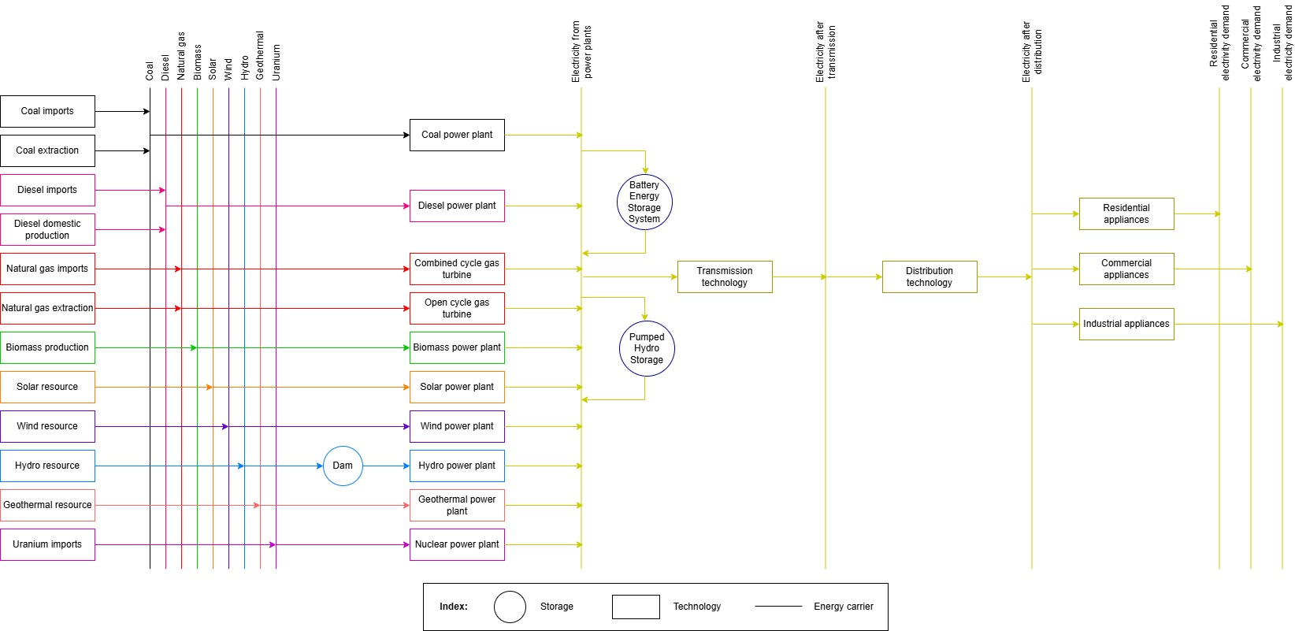
2.1 Energy System Modelling
2.1.2 Components of power systems
4
Notes:
This slide shows a simplified diagram of an example electricity system, which is part of the wider energy system. The diagram shows the key components of electricity systems. These include primary resources, such as coal, natural gas, biomass, and solar energy. In many cases these resources have to be extracted or imported; for example, this diagram includes the domestic extraction and importation of coal. These primary resources are then converted to electricity by power plants. There are many types of power plants, each using different fuels to generate electricity, as shown on this diagram. Once electricity has been generated, it can be stored or transported to end-users, where it is used in a range of sectors, including the residential, commercial, and industrial sectors shown on this diagram. All elements of this system will be explored in more detail throughout this course.

Slide 5
2.1 Energy System Modelling
2.1.3 Introduction to Energy System Models
Models are simplified representations of reality
Energy systems can be simplified and represented in organized model structures
Energy system models aim to represent all components and processes in energy systems with mathematical equations
This allows different future scenarios to be assessed
Crucially, energy system models provide useful insights, but cannot predict the future with certainty
5
Notes:
We will now explore the concept of energy system modelling. All models are simplifications of reality, in which complex systems are represented in an organized and simplified manner. In energy system models, all components and processes within an energy system are distilled into mathematical equations. The model can then be used to simulate the energy system under different scenarios and assess its properties, such as its costs, environmental impacts, or flexibility. Energy modelling tools provide critical analyses of both existing energy system configurations and alternative future scenarios. One example use of energy system models is the creation of scenarios in line with global climate change targets, which can then be used to understand which investments might be important for meeting such targets. It is critical to remember that energy system models can provide very useful insights to support policymaking; however, they are fundamentally simplifications of reality and cannot predict the future with exact certainty. Modelling results should also be viewed in the context of the type of model used. There are many forms of energy system models, as we will see within this course.

Slide 6
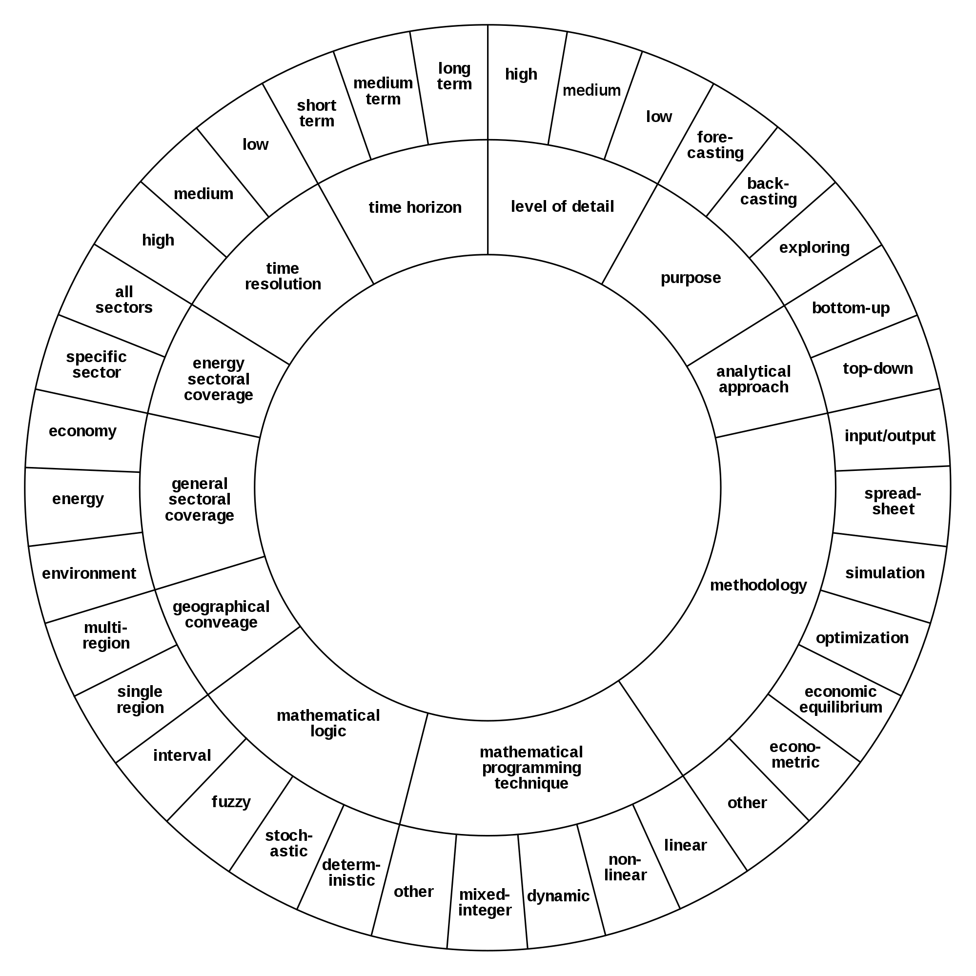
2.1 Energy System Modelling
2.1.4 Classifications of Energy Models
(R Morrison, image license: CC BY SA 4.0)
6
Notes:
This diagram shows ways in which energy models can be classified. Energy models can vary significantly and can be classified in multiple ways. Firstly, models can have different geographic scales; for example, some may focus on country-level analysis while others may look at individual villages or the global energy system as a whole. Secondly, models can include a range of sectors – some may only focus on the power sector, while others may look at the whole energy system and include demands from a range of end-use sectors, such as transport and industry. Thirdly, models can operate on different timescales – some models may only assess the system within one year or less, while others are used to create scenarios running to 2050 or beyond. Models also vary in many other ways, for example using different mathematical approaches, methodologies, and levels of detail. The classification of a model should be compatible with its purpose; for example, electrification models may need to use a regional scale and geospatial approach because of the differences in access and resource availability between different regions of the same country.

Slide 7
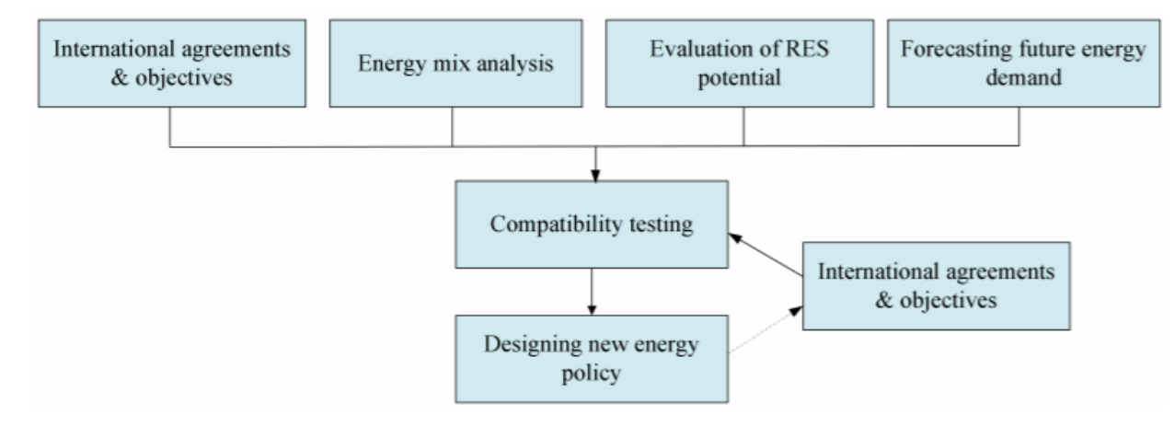
2.1 Energy System Modelling
2.1.5 Modelling & Policymaking
(Lu et al. (2020), image license: CC BY 4.0)
7
Notes:
Energy system models can be highly effective tools for supporting policymaking. Governments often have existing national policy goals as well as the aim of working towards international agreements and objectives. These goals and objectives often set the course for the country's energy system. However, there are many other considerations needed; for example, the energy system needs to be technically capable of meeting future energy demand whilst also satisfying climate change goals. Other factors that should be considered in energy system planning include the future availability of resources, changes in technology costs and performance, and policy goals in other sectors that often interact with the energy system. Energy system models can aid such a holistic approach to energy planning by allowing quantitative analysis of different scenarios, including assessment of environmental and socio-economic implications of different policy tools.

Slide 8
Lecture 2.1 References
Lu, Y.; Khan, Z.A.; Alvarez-Alvarado, M.S.; Zhang, Y.; Huang, Z.; Imran, M. A Critical Review of Sustainable Energy Policies for the Promotion of Renewable Energy Sources. Sustainability 2020, 12, 5078. https://doi.org/10.3390/su12125078
8

Slide 9
2.2 Reference Energy Systems
2.2.1 What is a reference energy system?
A reference energy system (RES) is a simplified and aggregated graphical representation of the real energy system under analysis.
RES can cover possible development paths.
Shows all existing and potential new energy supply chains, from primary energy resources to final demand.
The level of simplification depends on the issues which will be analysed and data availability
RES should be a minimum representation of reality needed to answer the policy questions addressed.
Source: (OpTIMUS.community, 2019)
9
Notes:
Reference energy systems are an important foundation for energy system modelling. A reference energy system (or R.E.S.) is a simplified and aggregated graphical representation of the real energy system under analysis.
Reference energy systems can cover possible development paths and not just the present configuration of the system. For example, with the introduction of electric vehicles, higher electricity demand is required for the transport sector.
A reference energy system shows all the existing and potential new energy supply chains, from primary energy resources to final energy demand. Specifically, energy comes from energy extraction or import to conversion, then transmission and distribution and conversion into a final energy demand.
The level of simplification of the reference energy system depends on the issues which will be analysed and the data availability. Thus, different use-cases require different levels of simplification.
A reference energy system should be a minimum representation of reality which is required to answer the policy questions addressed.

Slide 10
2.2 Reference Energy Systems
2.2.2 An example of a Reference Energy System
Extraction or import
Conversion
Transmission and distribution
Final use
Primary
Secondary
Final
Useful
Oil
Gas
Coal
Water
Wind
Solar
Diesel
Kerosene
Gas
Electricity
Coal
Diesel
Kerosene
Gas
Electricity
Coal
Heat
Lighting
Mechanical energy
10
10
Notes:
Presented here is an example reference energy system.
The primary energy level, typically, contains all technologies and fuels which are related to raw energy resources. Such as natural gas, coal, oil, and wind.
The resources which are either extracted or imported at the primary energy level are then processed at the secondary energy level. The secondary energy level is where the raw commodities are transformed into more refined commodities, such as oil to diesel, or wind to electricity.
These refined commodities are then distributed to the demand side to be used for useful services for the final consumer. The consumer uses these refined commodities for services such as heat, lighting, or mechanical energy.

Slide 11
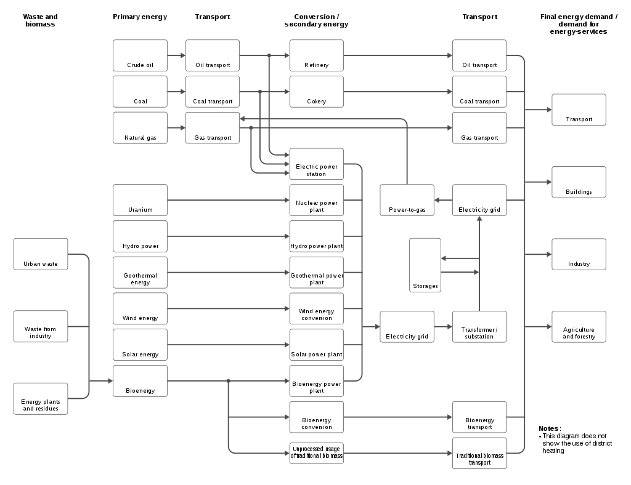
2.2 Reference Energy Systems
2.2.3 Progress on SDG7: Access to Electricity & Clean Cooking
Primary energy to secondary energy system, to distribution and final energy demand.
Primary energy system made up of major raw commodities.
Conversion into refined commodities such as electricity, oil, coal, gas.
Refined commodities used for transport, buildings, industry, and agriculture and forestry.
11
Notes:
An example reference energy system is displayed on the right. Whilst the system looks quite complicated at first glance, it is very similar to the energy system presented in the previous slide.
The arrows refer to energy carriers or fuels, whilst the boxes refer to energy technologies.
We start from a primary energy system which contains raw commodities on the left-hand side. These commodities are then converted into refined commodities such as electricity, oil, coal, and gas. Finally, these refined commodities are distributed for the final energy demand, which can be seen on the right-hand side.
The final energy demand, or demand for energy-services in this example, is made up of transport, buildings, industry, and agriculture and forestry.
Notice that this reference energy system is larger than the one on the previous slide; however, this is just to account for additional service demands.

Slide 12
2.2 Reference Energy Systems
2.2.4 Energy balance of a country
Commodities grouped by type
Primary energy
Transformation and losses
Final consumption
Source: (International Renewable Energy Agency, 2019)
12
Notes:
In this example energy balance, the energy balance of renewable energy is accounted for in the United Kingdom.
Firstly, the different commodities are grouped by type at the top of the table. Next, primary energy is accounted for. Here, we can see an energy balance for hydro, wind, photovoltaics, thermal, geothermal, and others.
Below the primary energy row, there is the transformation of the primary energy. As this energy balance is for renewable energy, the transformation is mainly into electricity.
Finally, the energy consumption is accounted for in the final consumption, by sector and end-use.

Slide 13
2.2 Reference Energy Systems
2.2.5 How to create a reference energy system
The energy balance can be used as a starting point for drawing a RES.
The main steps are:
Identification of energy levels and energy carriers,
Identification of existing technologies.
Identification of potential new energy carriers and technologies.
You can check the energy balance of your country here
13
Notes:
To create a reference energy system, an energy balance can be used as a starting point.
The main steps involve identifying energy levels and energy carriers, as well as the technologies used in the energy system. Additionally, it is necessary to identify potential new energy carriers and technologies that could be used in the future.
Using these data, a reference energy system can be created.

Slide 14
Lecture 2.2 References
Taliotis, C., Gardumi, F., Shivakumar, A., Sridharan, V., Ramos, E., Beltramo, A., Henke, H., Rogner, H., Howells, M., 2019. Designing a representative Reference Energy System, KTH-dESA and OpTIMUS.community. Available at: https://www.youtube.com/watch?v=9L1mqC8WuUw. 03/03/21
International Renewable Energy Agency (IRENA). Renewable Energy Statistics. 2019
14
14

Slide 15
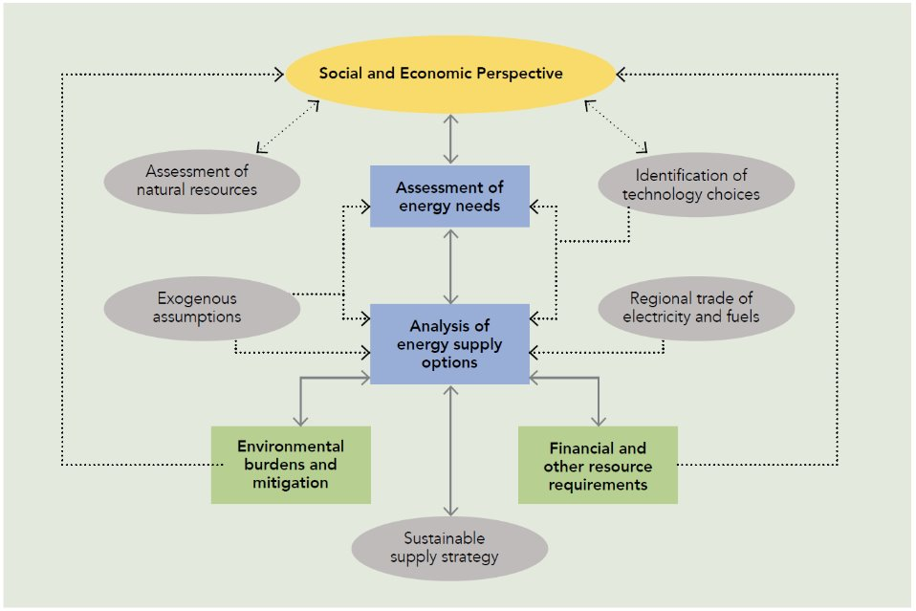
2.3 Energy Modelling Tools
2.3.1 Comprehensive Energy Planning
(Howells et al. (2017), image)
15
Notes:
Achieving sustainable development goals will require fundamental transformation of the energy system. This transformation is complex and involves interactions both within the energy system and with other sectors and systems. For these reasons, comprehensive energy planning is essential. Such comprehensive planning can allow countries to transform their energy systems in the most cost-effective way and ensure that investments made now are effective and supportive of the long-term trajectory. Comprehensive energy planning is complex and challenging; however, frameworks that make use of energy modelling tools can help to simplify the process. This diagram shows a framework for comprehensive energy planning. We can see the interactions between analyses of energy needs and energy supply options, and how these analyses are constrained by resource availability, technology options, sustainability goals, and financial constraints. We can also see how these analyses are fundamentally affected and driven by social and economic perspectives. Energy modelling tools provide frameworks to undertake these analyses.

Slide 16
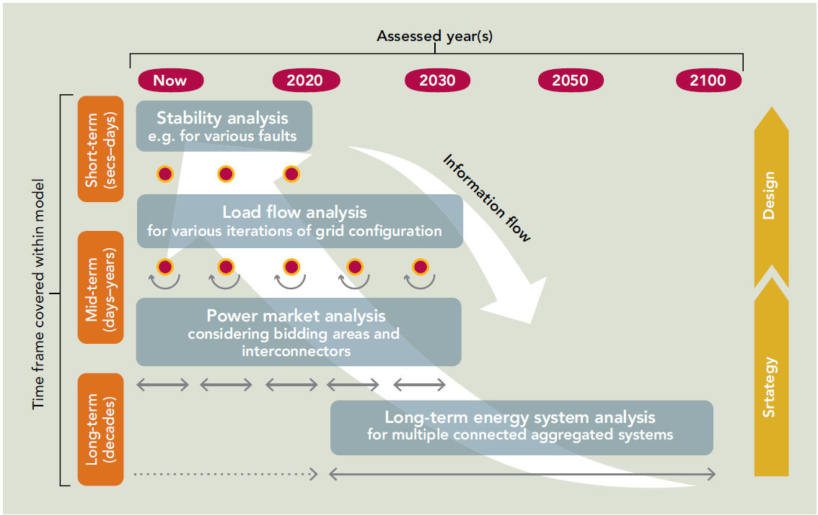
2.3 Energy Modelling Tools
2.3.2 Temporal Scope of Energy Models
(Howells et al. (2017), image)
16
Notes:
Energy modelling tools are often characterized by their temporal scope. This can range from short-term, with time frames of seconds to days; mid-term, with time frames of days to years; and long-term, with decadal time frames. Different temporal scopes are used for different types of analysis; for example, stability analyses, which focus on maintaining the voltage of the electricity system, usually have short time frames of seconds to days, while long-term energy analyses that assess future investment requirements often have decadal time frames.

Slide 17
2.3 Energy Modelling Tools
2.3.3 Bottom-Up and Top-Down Models
Top-Down (Macroeconomic) Models:
Driven by projections of economic indicators
Used to gain insights into relationships between economic development and energy demand and supply
Bottom-Up Models:
Detailed representation of technologies and infrastructure
Driven by an externally-determined demand that must be met
Source: (Howells et al. (2017))
17
Notes:
Energy models are also often classified as either top-down or bottom-up. Top-down, or macroeconomic, energy models are driven by projections of economic indicators such as energy prices. These models are used for analyses that focus on the broad relationships between economic development and energy demand and supply. Such models do not usually focus on detailed representation of technologies. In contrast, bottom-up energy models focus on the physical configuration of energy systems, representing technologies with a high level of detail, including their performance and cost parameters and environmental impacts. Such models often use an externally-determined energy demand, which may be provided by a top-down model. The most common bottom-up energy models are optimization models. These are models that identify the optimal way of meeting the externally-defined demand, for example, in terms of minimizing the cost or environmental impact, or maximizing the access to energy services.

Slide 18
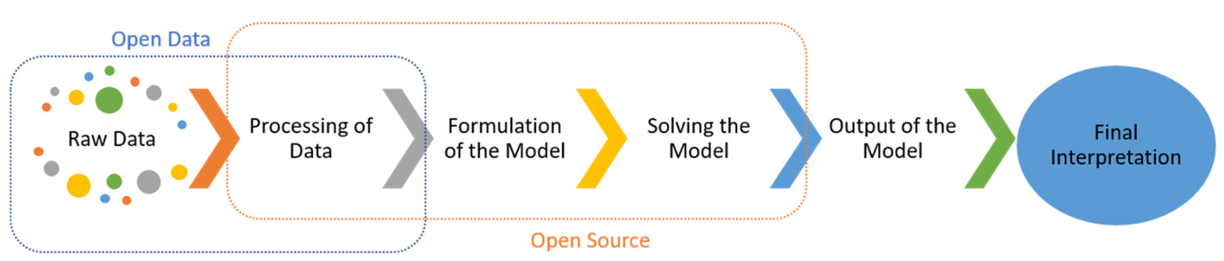
2.3 Energy Modelling Tools
2.3.4 Key Steps in Modelling
(Maruf et al. (2019), image license: CC BY 4.0)
18
Notes:
This diagram shows some of the key steps in an energy modelling analysis. The first stage is usually sourcing the raw data, in this case the diagram focuses on units or analysis and so open data are used. The raw data then have to be processed, which usually means manipulating the data into a form that can be used to develop the model. This might include converting the data format or units or using the raw data to create estimates for model parameters.
Once the data have been processed, the model can be formulated. This step varies depending on the modelling system being used, for example there is a spreadsheet-based interface that can be used to input data for OSeMOSYS models. The model then has to be solved. In the case of optimization models, this involves using a solver on your computer that can find the optimal solution. Once the solution has been found, model outputs will be produced. Model outputs vary and the user can often choose what type of outputs they would like, including results csv-files or automatically-generated graphs and charts. The final step is usually the interpretation of model outputs. This should be done in the context of the specific country, region, or system in question and with consideration of the simplifications and adjustments made in the modelling process.

Slide 19
2.3 Energy Modelling Tools
2.3.5 Applications of Energy Modelling Tools
Exploring interactions between energy access, resource use, and sustainable development
Geospatial electrification planning
Technical assessment of energy systems, e.g., electricity system flexibility
Long-term capacity expansion planning
Insights into the economic and environmental implications of different scenarios
Considering interactions between different systems, e.g., climate, land, energy, and water (CLEWs)
19
Notes:
We have touched on some of the applications of energy modelling tools already. This slide provides some examples of how energy modelling tools are currently used to support policymaking. Broadly, energy system modelling allows a greater understanding of the interactions between energy access, resource use, and sustainable development. By considering these interactions, energy planners can adopt a more holistic approach that maximizes the synergies between different goals. In relation to energy access, one particularly useful type of energy modelling is geospatial electrification modelling, which can be used to gain insights into the most economic pathways for increasing access. Energy modelling tools are frequently employed to support long-term capacity expansion planning as they provide insights into the economic and environmental implications of different scenarios and can be used to suggest the optimal configuration to meet future demand. Finally, energy modelling tools are increasingly used to assess the interactions between different systems. For example, the CLEWs modelling framework, which we will see later in the course, is used to explore the interactions between the climate, land, energy, and water systems.

Slide 20
Lecture 2.3 References
Howells M, Rogner HH, Mentis D, Broad O. SEAR ENERGY ACCESS AND ELECTRICITY PLANNING SPECIAL FEATURE. 2017. Available from: http://documents1.worldbank.org/curated/en/628541494925426928/pdf/115065-BRI-P148200-PUBLIC-FINALSEARSFElectricityPlanningweb.pdf
Maruf, M..N.I. Sector Coupling in the North Sea Region—A Review on the Energy System Modelling Perspective. Energies 2019, 12, 4298. https://doi.org/10.3390/en12224298
20

Slide 21
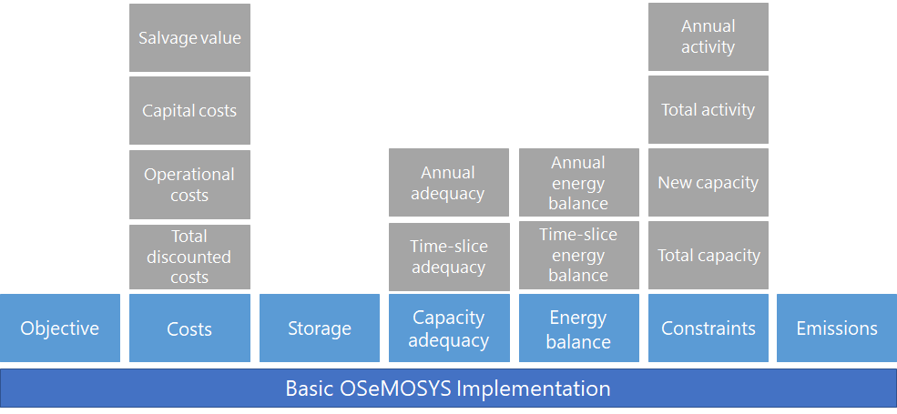
2.4 Basics on OSeMOSYS
2.4.1 OSeMOSYS Structure
(Adapted from Loffler et al. (2017), image, licensed under CC BY 4.0)
21
Notes:
In lecture 1 we introduced OSeMOSYS as an open source energy modelling system used to support long-term capacity expansion planning. OSeMOSYS is a bottom-up energy modelling system which focuses on detailed representation of technologies and flows in the energy system, considering performance, costs, resource use, and environmental impacts. Like other bottom-up models, OSeMOSYS models are driven by an externally-defined demand. We will explore how demands can be defined in OSeMOSYS later in the course. OSeMOSYS was designed to have a modular structure. This means that it is structured in stand-alone blocks that can be added or removed. Each of these blocks is described in plain English, increasing the accessibility of the tool. This diagram shows the seven core blocks of OSeMOSYS.

Slide 22





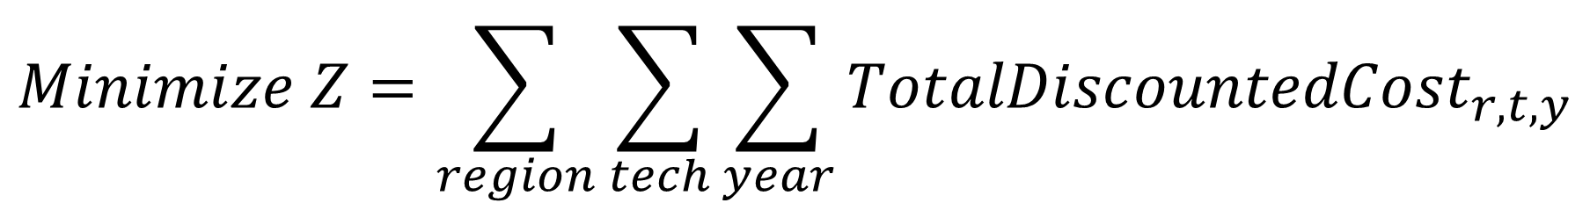

2.4 Basics on OSeMOSYS
2.4.2 OSeMOSYS from a mathematical viewpoint
$$Minimize Z=\sum_{region}{\sum_{tech}{\sum_{year}{{TotalDiscountedCost}_{r,t,y}}}}$$
$$s.t.$$
Linear programming / Optimization model
Languages: GNU MathProg, Python and GAMS
$$Energy balance$$
$$Capacity balance$$
$$Emission limits$$
$$Capacity/Activity constraints$$
$$Storage constraints$$
$$Other constraints$$
Readthedocs:
Welcome to the OSeMOSYS’ documentation! — OSeMOSYS 0.0.1 documentation
22
Notes:
The main objective of OSeMOSYS, from a mathematical viewpoint, is to minimize the total discounted cost of an energy system. In other words, we aim to find the least-cost pathway for the energy system by optimizing over various regions, technologies, and years.
To ensure that the solution remains practical and feasible, we also have several constraints, such as energy balance, capacity balance, and emission limits. These constraints ensure that energy supply meets demand, capacity is sufficient, emissions stay within prescribed limits, and other requirements, like storage and activity constraints, are met.
OSeMOSYS is implemented in various programming languages, including GNU MathProg, Python, and GAMS, making it highly flexible and accessible.
Finally, we encourage everyone to check out the OSeMOSYS documentation on ReadtheDocs for more in-depth details.

Slide 23
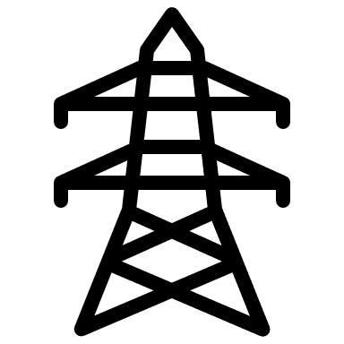






2.4 Basics on OSeMOSYS
2.4.3 Applications of OSeMOSYS
Power sector capacity expansion planning
Sector coupling assessment
Transport sector planning
Climate, Land, Energy, Water systems (CLEWs)
Regional energy integration analysis
Economic analysis of energy policies
23
Notes:
OSeMOSYS is a versatile tool applied across various critical areas of energy and economic planning. In the power sector, it’s used for capacity expansion planning, helping identify the most cost-effective generation mix to meet future demands while accounting for constraints like emissions and resources. It also supports sector coupling assessments, which explore the integration of different energy sectors—such as electricity, heating, and transportation—to enhance efficiency and reduce emissions.
Beyond the energy sector, OSeMOSYS is valuable for transport planning, regional energy integration analysis, and CLEWs (Climate, Land, Energy, and Water systems) studies. These applications enable a holistic understanding of resource interdependencies and cross-border energy opportunities. Additionally, it supports economic analysis of energy policies, helping policymakers evaluate the financial impacts of regulations and incentives, and guiding balanced, sustainable growth in the energy landscape. Each link provides an example of research articles in the mentioned areas.

Slide 24
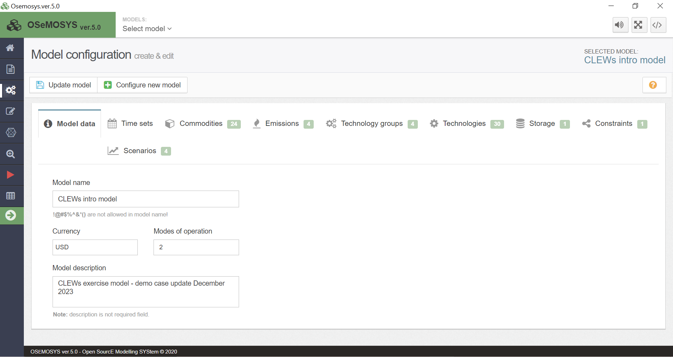
2.4 Basics on OSeMOSYS
2.4.4 Modelling User Interface for OSeMOSYS (MUIO)
User-friendly interface for teaching and development of basic and intermediate models
24
Notes:
The latest graphical user interface developed to use OSeMOSYS is called Modelling User Interface for OSeMOSYS, also known as MUIO. This interface has been designed to make energy system modelling with OSeMOSYS more accessible and user-friendly, particularly for those involved in teaching and developing basic to intermediate models.
MUIO addresses a critical need within the OSeMOSYS community by providing an intuitive interface that guides users through the modelling process without requiring extensive programming experience. This makes it an ideal tool for students, educators, and practitioners who are learning about energy systems and optimization for the first time. With MUIO, users can set up, run, and analyze energy models with ease, focusing on the essentials of modelling rather than getting bogged down by technical complexities.

Slide 25
2.4 Basics of OSeMOSYS
2.4.5 Advantages of OSeMOSYS as energy modelling tool
Fast learning curve
Flexible and adaptable code formulation
No upfront financial investment
Community of practice
Open data principles
25
Notes:
OSeMOSYS stands out as a user-friendly and accessible energy modelling tool with a fast learning curve that makes it easy for beginners to start modelling without extensive training. Its flexible and adaptable code allows users to tailor the model to specific needs, making it valuable for diverse applications, from academic research to policy analysis. Importantly, it’s free and open-source, meaning there’s no upfront financial investment, which lowers barriers to entry and makes it accessible to a global audience.
Beyond its technical advantages, OSeMOSYS is supported by a strong community of practice where users can collaborate, share resources, and gain support from other energy modellers worldwide. Additionally, its commitment to open data principles promotes transparency and data-sharing, which fosters innovation and credibility in energy modeling. Together, these features make OSeMOSYS a unique tool that empowers users to engage with and contribute to the field of energy systems modelling effectively and inclusively.

Slide 26
Lecture 2.4 References
Gardumi F, Shivakumar A, Morrison R, Taliotis C, Broad O, Beltramo A, et al. From the development of an open-source energy modelling tool to its application and the creation of communities of practice: The example of OSeMOSYS. Energy Strateg Rev. 2018 Apr 1;20:209–28.
Löffler, K.; Hainsch, K.; Burandt, T.; Oei, P.-Y.; Kemfert, C.; Von Hirschhausen, C. Designing a Model for the Global Energy System—GENeSYS-MOD: An Application of the Open-Source Energy Modeling System (OSeMOSYS). Energies 2017, 10, 1468. https://doi.org/10.3390/en10101468
Taliotis C, Giannakis E, Karmellos M, Fylaktos N, Zachariadis T. Estimating the economy-wide impacts of energy policies in Cyprus. Energy Strateg Rev. 2020 May 1;29:100495.
Rocco M V., Tonini F, Fumagalli EM, Colombo E. Electrification pathways for Tanzania: Implications for the economy and the environment. J Clean Prod. 2020 Aug 1;263:121278.
United Nations Economic Commission for Europe. Assessment of the water-food-energy-ecosystems nexus and benefits of transboundary cooperation in the Drina River Basin. 2017
Pappis, I., Howells, M., Sridharan, V., Usher, W., Shivakumar, A., Gardumi, F. and Ramos, E., Energy projections for African countries, Hidalgo Gonzalez, I., Medarac, H., Gonzalez Sanchez, M. and Kougias, I., editor(s), EUR 29904 EN, Publications Office of the European Union, Luxembourg, 2019, ISBN 978-92-76-12391-0, doi:10.2760/678700, JRC118432.
26

Slide 27
Thank you
www.climatecompatiblegrowth.com

