Slide 1
Energy system modelling using OSeMOSYS
LECTURE 10
EMISSIONS AND CAPACITY RESERVE REPRESENTATION

Slide 2
Learning Outcomes
By the end of this lecture, you will be able to:
ILO1 : Learn the importance of emissions accounting and the anthropogenic nature of climate change
ILO2: Learn how to represent emissions and how to constrain emission levels in OSeMOSYS in line with climate targets
ILO3: Understand the importance of reserve margin in the energy system
ILO4: Learn how to represent reserve margin in OSeMOSYS
2

Slide 3

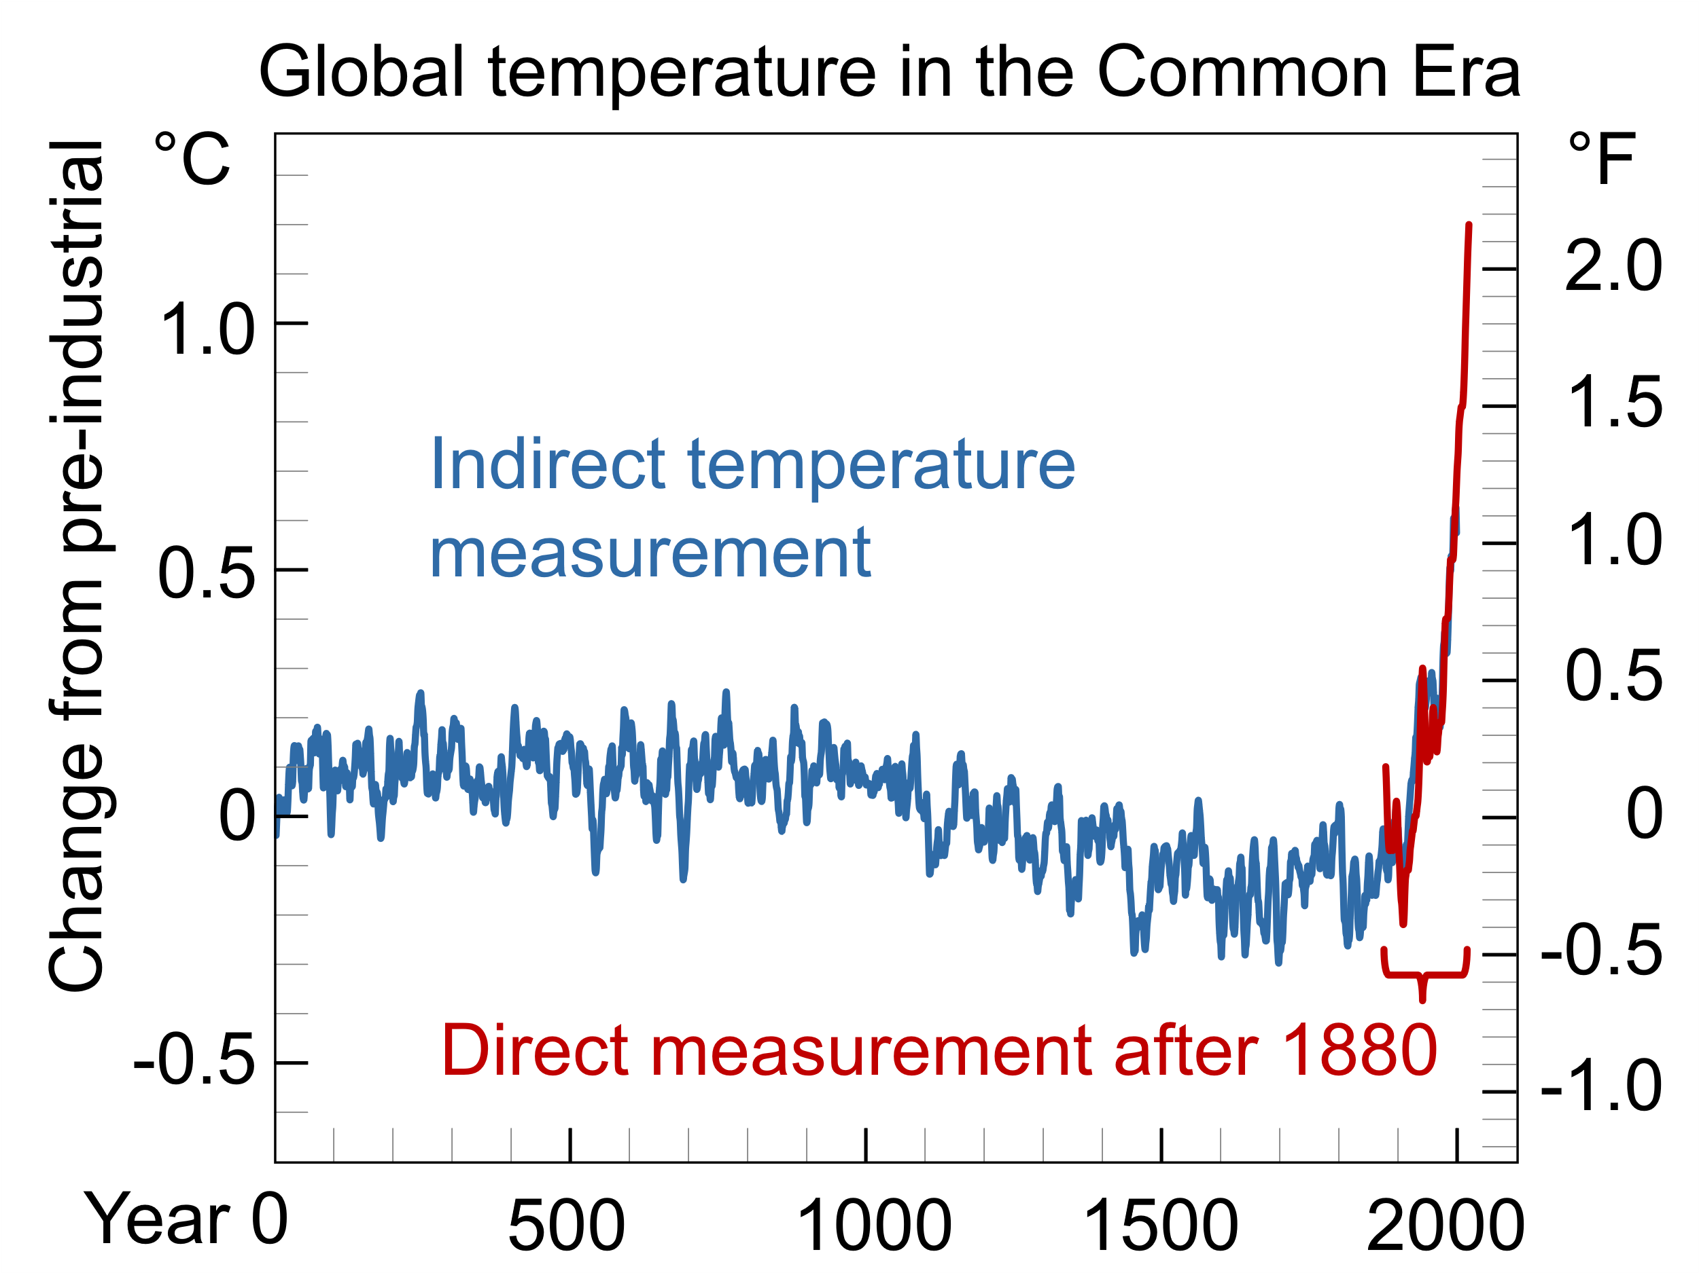
10.1 Anthropogenic Causes of Climate Change
10.1.1 What is Climate Change?
(Efbrazil, image, license: CC BY-SA 4.0)
(Concepts: Usher, W. (2021))
3
Notes:
Climate change is most often thought of as the rise in global temperatures since the 20th century, shown on this figure. This global warming has multiple impacts that are also elements of climate change, including sea level rise, ice mass loss, ocean acidification, changes in animal and plant life, and extreme weather conditions. Whilst there has historically been natural climate variability, the changes since the 20th century cannot be explained by this alone and are attributed directly or indirectly to human activities which have altered the composition of the atmosphere, in addition to the natural climate variability. These human activities are known as anthropogenic causes of climate change, which we will discuss next.

Slide 4
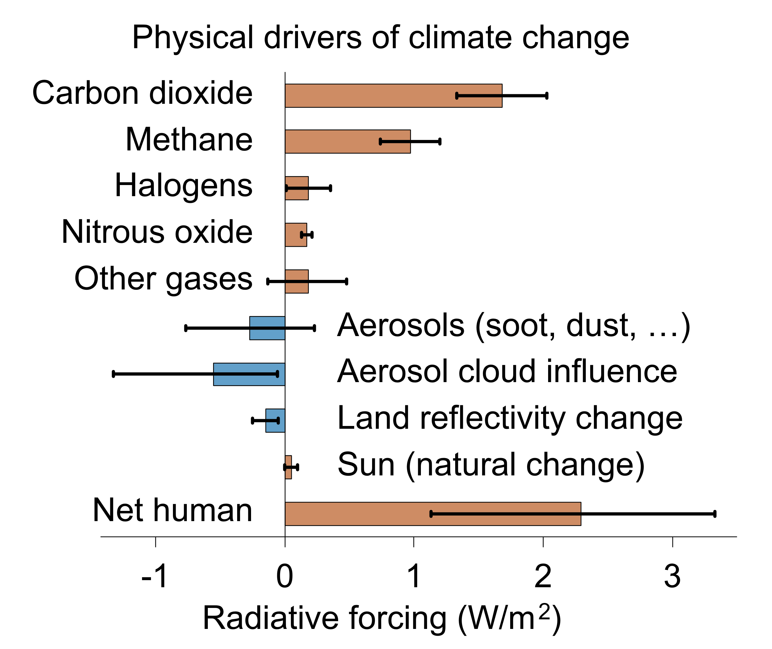
10.1 Anthropogenic Causes of Climate Change
10.1.2 Global Warming and the Greenhouse Effect
(Femke Nijsse & Eric Fisk, image, license: CC BY-SA 4.0)
(Concepts: Usher, W. (2021))
4
Notes:
Human activities are thought to cause climate change through the greenhouse effect. This is where heat naturally radiating from the earth is trapped in the atmosphere due to the presence of greenhouse gases (GHGs). GHGs occur naturally. However, human activities have significantly increased their concentration in the atmosphere, hence amplifying the greenhouse effect and causing global warming. GHGs include carbon dioxide (CO2), methane (CH4), and nitrous oxides (NOx). The concentrations of all these gases have increased significantly since the pre-industrial era.
The capacity of a GHG or other agent to contribute to climate change is measured using the concept of radiative forcing. A positive radiative forcing indicates that the gas or agent increases global warming, with higher values signifying a greater effect. From this graph, we can see that all the GHGs mentioned above contribute to climate change. However, carbon dioxide is the focus of most analyses, because it has a large radiative forcing and it is the most emitted GHG by volume.
Next, we will look at which human activities emit GHGs.

Slide 5
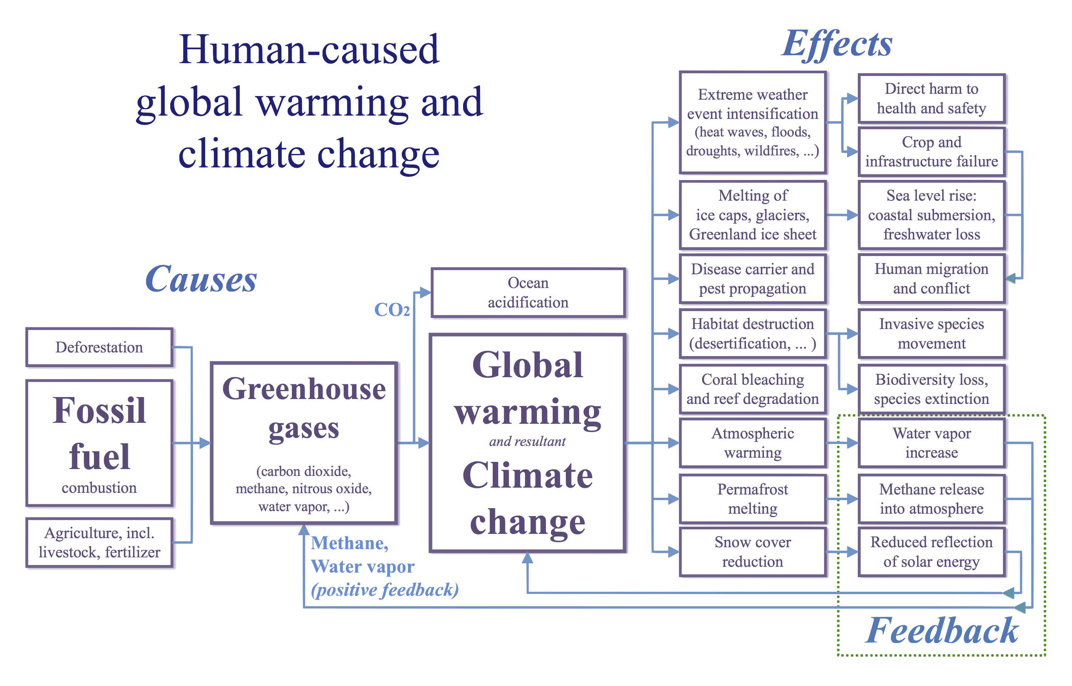
10.1 Anthropogenic Causes of Climate Change
10.1.3 Introduction to Anthropogenic Causes of Climate Change
(RCraig09, image, license: CC BY-SA 4.0)
(Concepts: Usher, W. (2021))
5
Notes:
This slide introduces the links between human activities, global warming, and climate change effects. Several human activities, across multiple sectors, are responsible for emitting greenhouse gases. Most of these activities relate to the burning of fossil fuels, including electricity, heat production, cooking, and transportation. The retrieval, processing, and distribution of fossil fuels before they are used are also responsible for emitting greenhouse gases. Other activities creating significant levels of greenhouse gas emissions include industrial processes and agriculture, forestry, and land-use change.

Slide 6
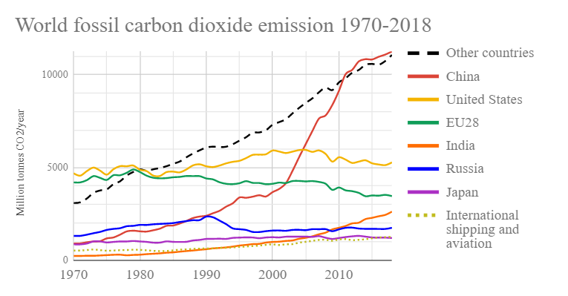
10.1 Anthropogenic Causes of Climate Change
10.1.4 Carbon Dioxide Emissions by Country
(Tomastvivlaren, image, license: CC BY-SA 4.0)
6
Notes:
This chart shows that some countries emit more carbon dioxide than others. Emissions from China, the United States, and the European Union alone far outweigh those from all other countries combined. Developed countries are responsible for the majority of historical emissions, and it follows that they bear a large part of the responsibility for mitigating climate change. However, although many developing countries are taking steps to decarbonise their economies, the pace of progress is insufficient to avoid dangerous levels of global warming. Furthermore, climate change is a global issue with global impacts, and there are opportunities for all countries to play a part in its mitigation. It is often thought that developing countries must choose between economic development and protecting the environment, but there is the opportunity to avoid mistakes made by developed countries and instead pursue sustainable, low-carbon economic growth. Renewable energy technologies are rapidly declining in cost, so developing countries could support growth with affordable low-carbon energy systems. Importantly, small shares of fossil generation could play a role in developing countries to stabilize the system and allow incorporation of variable renewables, especially since developing countries have historically had low emissions. This can be pictured as an intermediate step, where small shares of fossil fuels are used to support the system whilst shares of renewables are increased, after which the system would ideally become 100% renewable to meet climate change goals. OSeMOSYS is helpful in assessing the cost and emissions implications of such scenarios to support policymaking.

Slide 7
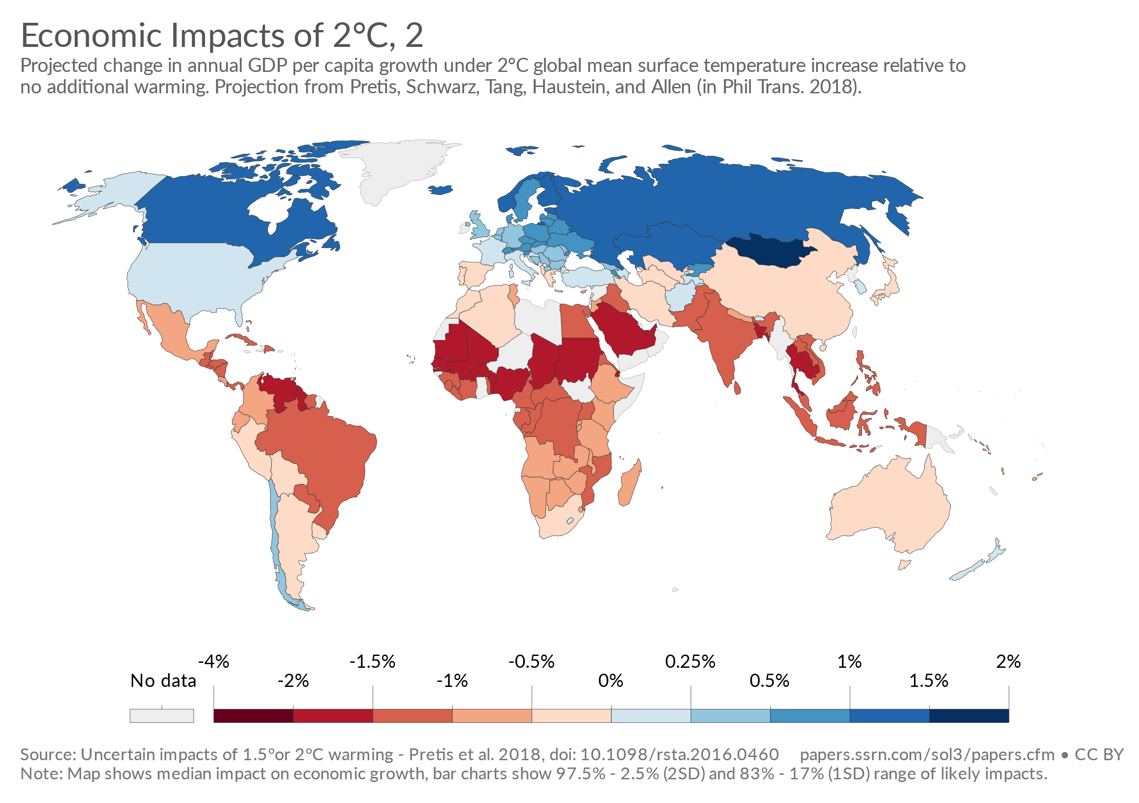
10.1 Anthropogenic Causes of Climate Change
10.1.5 Effects of Climate Change
Global temperature rise
Sea level rise
Ocean acidification
Extreme weather events
Reduced biodiversity
Human health impacts
Reduced agricultural yields
Economic consequences
(Concepts: Usher, W. (2021))
(Our World in Data, image, license: CC BY 3.0)
7
Notes:
Climate change and sea level rise impact all human, animal, and plant life. Many of these effects are already measurable and will continue to worsen. They include:
uninhabitable areas, causing displacement of communities and mass migration;
reduced biodiversity, increased species extinctions rates, and changes in life ecosystems;
poorer human health, for example due to rising temperatures in cities or reduced agricultural yields that threaten food supplies;
higher frequency of extreme weather events such as floods and hurricanes, threatening lives and infrastructure;
Via these impacts, climate change will have enormous economic consequences, especially in the global south. For example, this graph shows that GDP in Africa, Asia, and South America is forecast to be up to 4% lower under a scenario with 2 degrees of warming relative to a scenario with no additional warming.
The negative effects of climate change are grounds for rapid and extensive action on climate change, with the transformation of global energy systems being a key step due to the emissions they currently produce.

Slide 8
Lecture 10.1 References
Usher, William. (2021, March). Climate Change: Mitigation - Adaptation (Version 1). Zenodo. http://doi.org/10.5281/zenodo.4585597
8

Slide 9
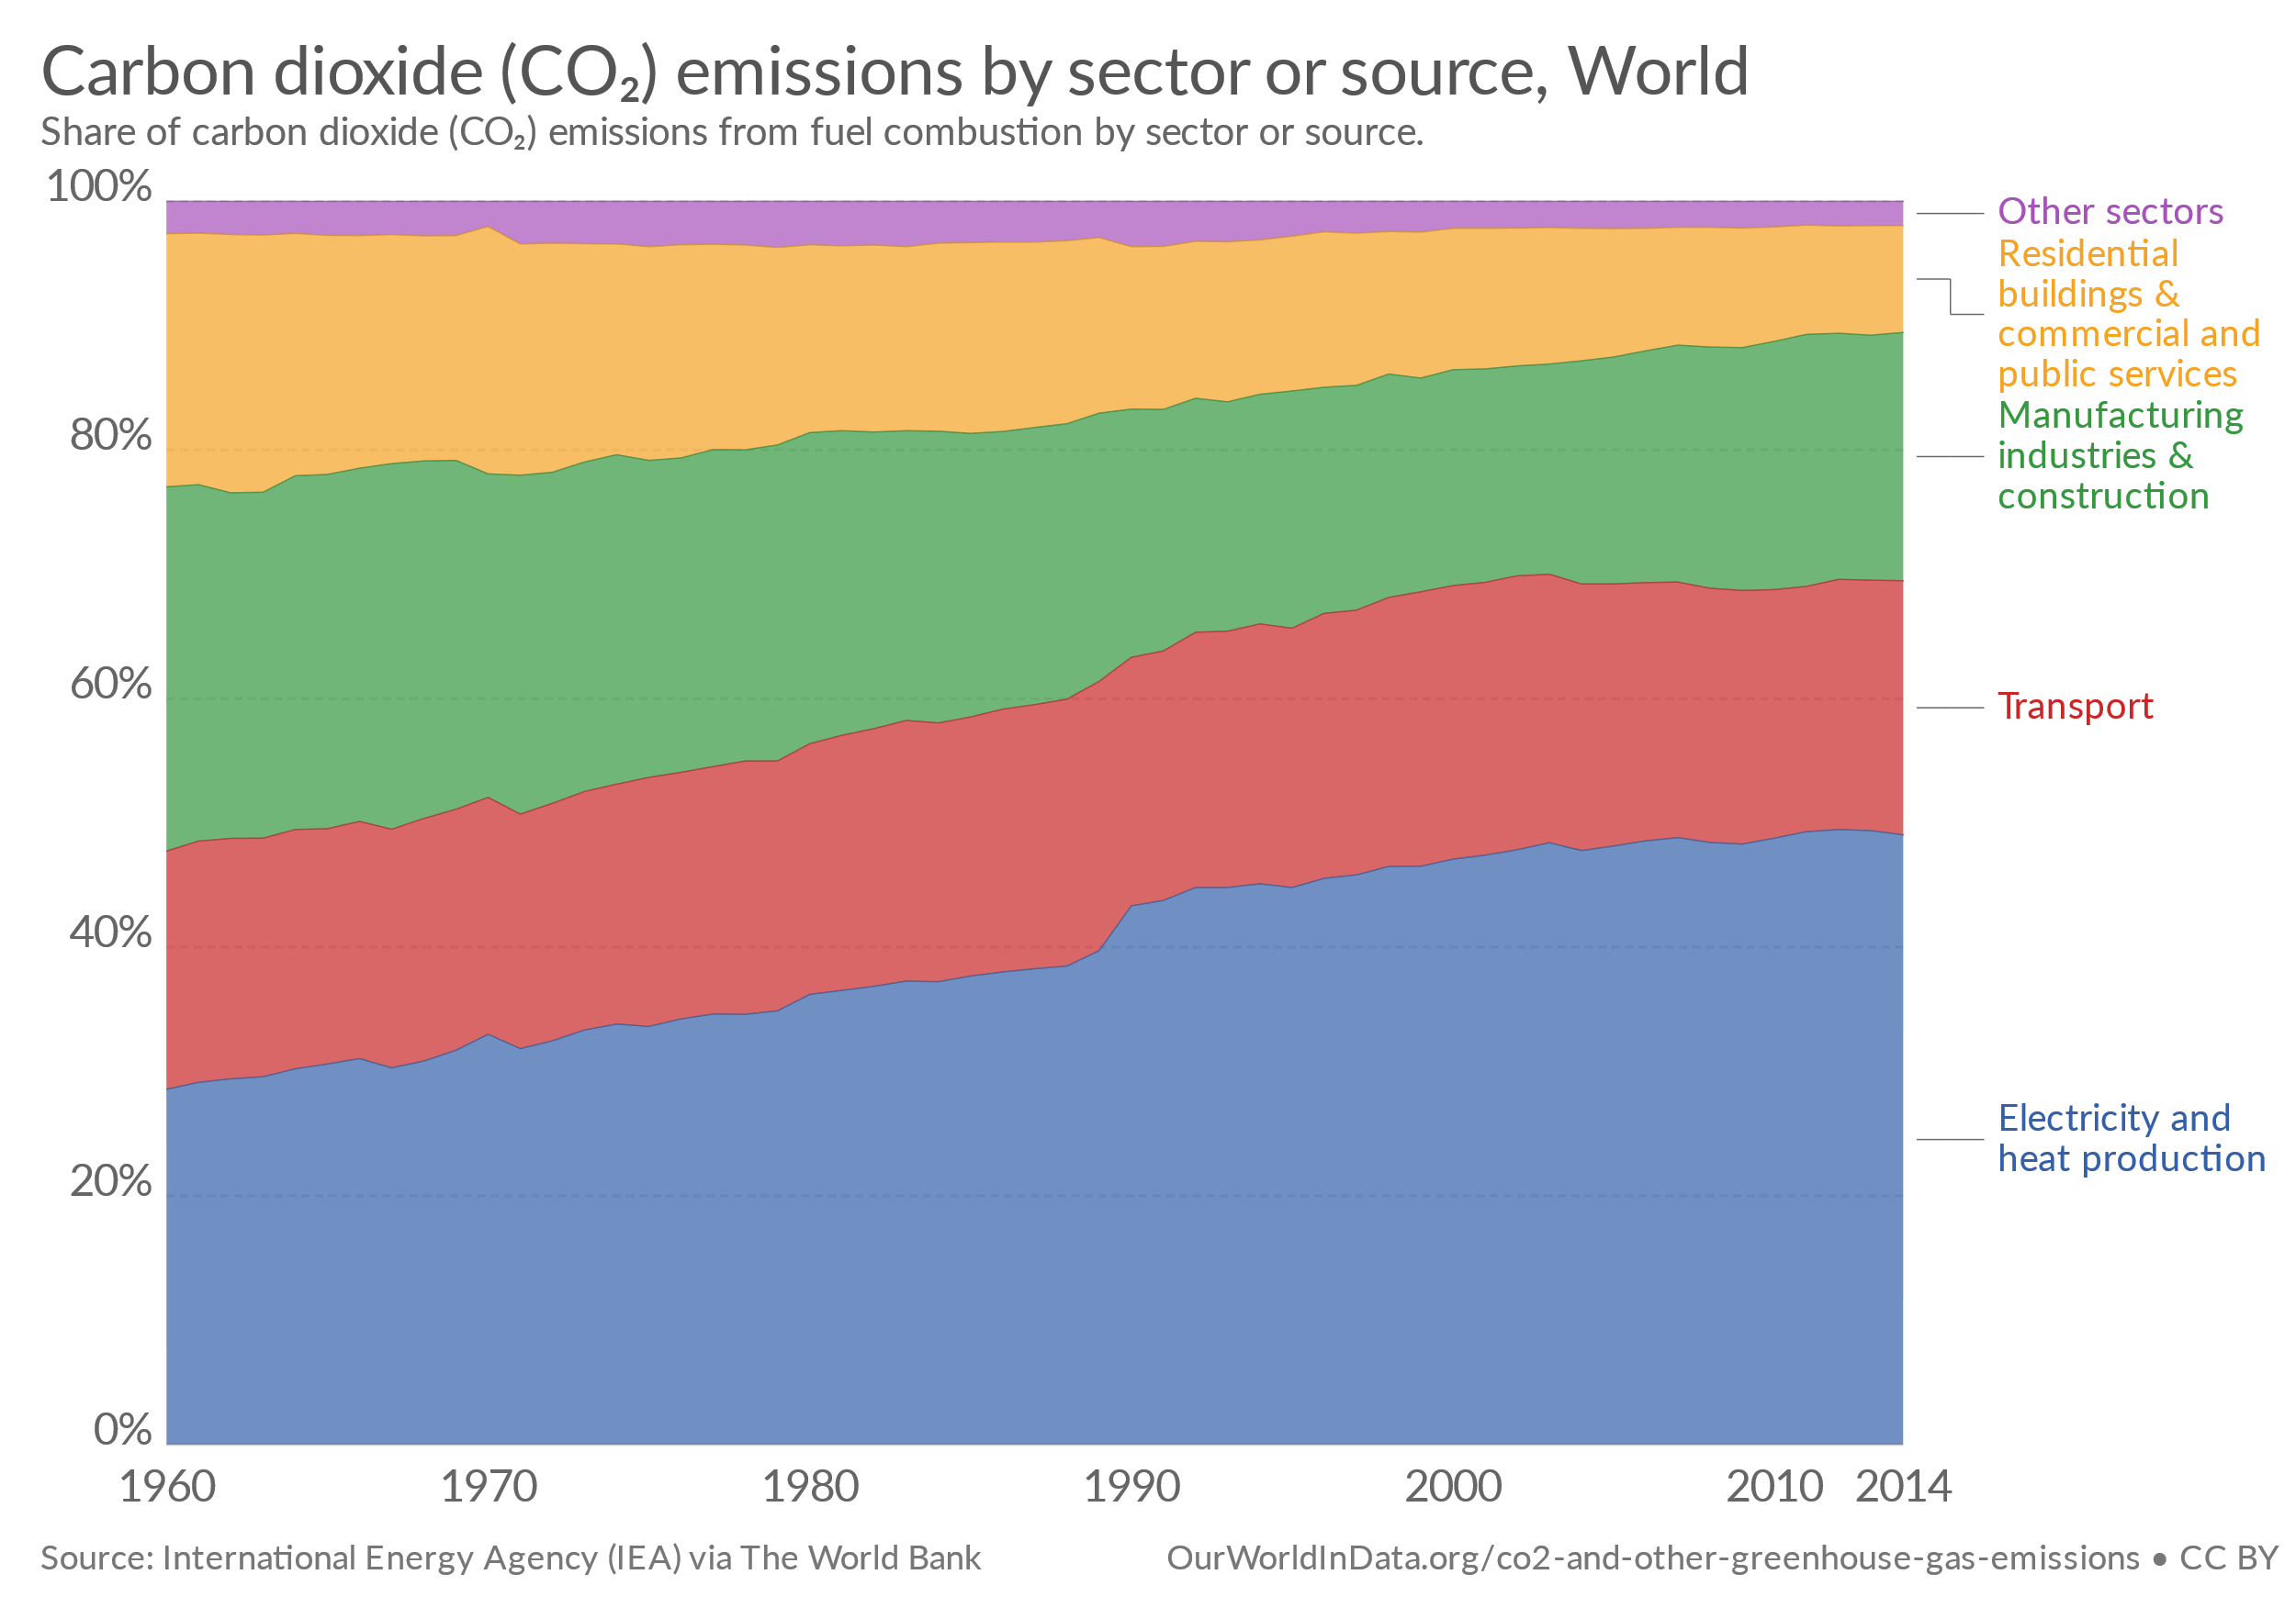
10.2 Emissions Representation
10.2.1 The Need for Emissions Representation in Energy System Models
(Our World in Data, image, license: CC BY 3.0)
9
Notes:
In an effort to mitigate climate change and prevent the severe impacts mentioned previously, representatives from 195 nations at the 'COP' 21 in Paris agreed to a long-term goal of limiting the global average temperature rise to well below 2 degrees Celsius relative to pre-industrial levels. Achieving this goal will require a global transition to a low-carbon economy. The energy sector will play a crucial role, since it is responsible for a large share of total historical anthropogenic GHG emissions. In addition, it is important to reduce emissions of other pollutants such as nitrous oxides, which also have public health and environmental impacts.
Energy system modelling using tools like OSeMOSYS can support the transformation of energy systems by providing insights into the implications of different scenarios. In order to use modelling to support policymaking in line with climate change goals, it is crucial that we can represent emissions in OSeMOSYS.

Slide 10
10.2 Emissions Representation
10.2.2 Introduction to Emissions Representation in Energy System Models
Fuel-Dependent Emissions:
Emissions that can be estimated fairly accurately based on the total amount of fuels combusted and the averaged carbon content of the fuels
E.g., Carbon Dioxide
Technology-Dependent Emissions
Emissions depend significantly on the combustion technology and operating conditions used, such as the specific type of power plant
E.g., Nitrous Oxides
10
Notes:
In energy system models, emissions are represented either in fuels or in technologies. Carbon dioxide emissions are usually modelled in fuels, because emissions can be estimated fairly accurately based on the total amount of fuels combusted and the average carbon content of those fuels. In contrast, some pollutants such as nitrous oxides, are commonly represented in technologies. This is because these emissions depend on the combustion technology and its operating conditions.

Slide 11
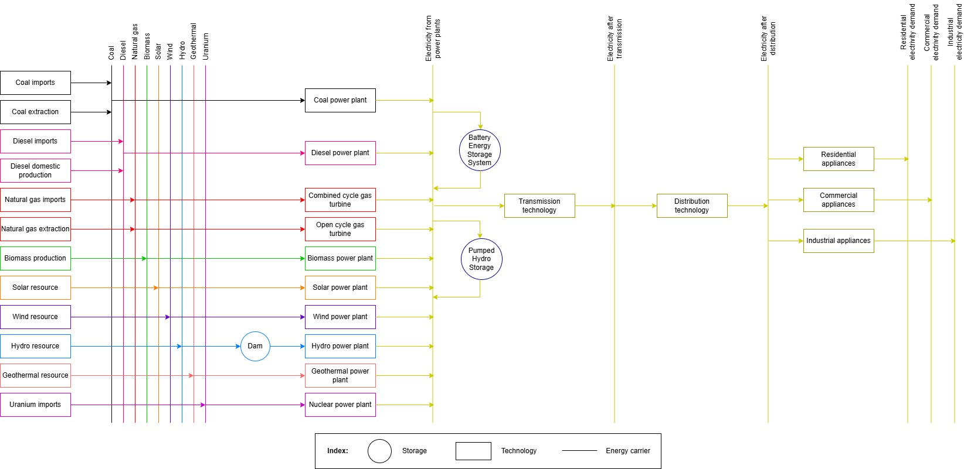
10.2 Emissions Representation
10.2.3 Representing Emissions in OSeMOSYS
Fuel-dependent emissions are accounted for in primary energy supply technologies
Technology-dependent emissions are accounted for in technologies using fuels e.g. power plants
11
Notes:
As mentioned in the previous slide, different emissions are represented in different parts of the Reference Energy System.
Fuel-dependent emissions, such as carbon dioxide, can be accounted for by primary energy supply technologies, such as the coal extraction and imports technologies. Therefore, we do not need to add a carbon dioxide emissions factor to coal power plant technologies, as their emissions are already represented in the coal primary fuel technologies.
In contrast, technology-dependent emissions are accounted for by the emitting (i.e. fuel-burning) technologies. For example, to represent nitrous oxides emissions from power plants, we assign emissions factors to each power plant technology that produces nitrous oxides.
We will discuss emissions factors and the parameters used to represent emissions in OSeMOSYS in more detail next.

Slide 12

10.2 Emissions Representation
10.2.4 Emission Activity Ratio
Emission Activity Ratio [Mt/PJ]: defines the rate of emission by each technology. We can estimate the emission activity ratio by dividing the input fuel emission factor by the technology efficiency.
$$Emission Activity Ratio\left[\frac{Mt}{PJ}\right]=\frac{Fuel Emission factor\left[\frac{Mt}{PJ}\right]}{Technology efficiency}$$
Note that for primary technologies, the emission activity ratio is equivalent to the fuel emission factor.
12
Notes:
In OSeMOSYS, all emissions are accounted for using the same parameter: the Emission Activity Ratio. This parameter defines the rate of emission of a pollutant by a technology in units million tonnes per petajoule or gigawatt hour of energy. The Emission Activity Ratio is defined for each combination of technology and pollutant in OSeMOSYS.
For example, the Emission Activity Ratio for carbon dioxide (the pollutant) for the coal extraction technology (the technology) would be equal to the amount of carbon dioxide released (in million tonnes) from burning 1 petajoule of coal.
For technology-dependent emissions, instead of requiring one emission ratio per fuel and pollutant, we ideally need emissions data for each technology which emits the pollutant. If this data is not available, we can estimate the emission activity ratio by dividing the average fuel emission factor by the technology efficiency. We will go through examples using these parameters in hands-on exercises.

Slide 13
10.2 Emissions Representation
10.2.5 Example Emissions Factors
Fuel | Emission factor (kg/TJ)
 | CO₂ | CH₄ | N₂O
Coal | 88136.0 | 10.0 | 1.5
Fuel oil | 80460.3 | 3.0 | 0.6
Diesel | 74233.4 | 3.9 | 3.9
Natural gas | 55539.1 | 92.0 | 3.0
Gasoline | 69323.7 | 33.0 | 3.2
LPG | 67185.1 | 5.0 | 0.1
Jet fuel-Kerosene | 73939.6 | 10.0 | 2.0
Source: IPCC (2006)
13
Notes:
This slide shows some emissions factors for different fossil fuels and pollutants. These are the kind of data that we would use to define the Emission Activity Ratio in OSeMOSYS. In this case, we would use the emissions factors to define the Emission Activity Ratio for the technologies that produce the fuels listed, such as the coal extraction technology or coal imports technology. Looking at the data themselves, we can see that coal has the highest carbon dioxide emissions factor of the fuels listed, with oil products having slightly lower values and natural gas having the lowest. This is one of the reasons why coal power plants are often considered the most controversial in light of climate change goals, since coal has a very high carbon content.

Slide 14
Lecture 10.2 References
Taliotis, Constantinos, Gardumi, Francesco, Shivakumar, Abhishek, Sridharan, Vignesh, Ramos, Eunice, Beltramo, Agnese, … Howells, Mark. (2018, December). Emissions representation in OSeMOSYS. Zenodo. http://doi.org/10.5281/zenodo.4585676
IPCC (2006) Guidelines for National Greenhouse Gas Inventories, Volume 2: Energy, Table 1.3; available from: https://www.ipcc-nggip.iges.or.jp/EFDB/find_ef.php
14
14

Slide 15



10.3 Importance of Reserve Margin
10.3.1 Introducing Reserve Margin
Reserve Margin: planned excess supply capacity that is installed in comparison to the peak load (in MW or GW)
Reserve Margin is important as it helps to ensure reliability by avoiding shortages in power supply
Reserve Margin can protect against supply issues caused by the unavailability of renewable generation, e.g., due to weather or unexpectedly high demand
However, reliability cannot always be ensured, because it is difficult to precisely project future demand and there can be delays in building new capacity
15
Notes:
We will now look at the concept of the reserve margin in electricity systems. Reserve margin is defined as the planned excess supply capacity that is installed in comparison to the peak load (i.e. peak demand), in units of capacity such as megawatts or gigawatts. The aim of having a reserve margin is to ensure that there is always sufficient power supply to meet demand, even when demand is unexpectedly high or supply is unexpectedly low.
Supply may be reduced, for example, if unfavorable weather conditions lead to particularly low renewable generation, if a power plant breaks down, or if a transmission line is damaged during a severe storm. If in these circumstances there is no reserve margin to increase supply, a significant imbalance may arise between available supply and demand for power, which can damage essential equipment. In these cases, load shedding is used to maintain balance between supply and demand, whereby parts of the power-distribution system are shut down, disconnecting sources of power demand. Load shedding protects equipment, but it means that some customers temporarily lose power, which can have important economic and social consequences. Hence, planning a reserve margin is essential to ensuring customers do not experience blackouts.

Slide 16
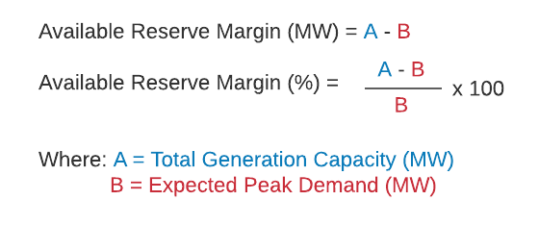
10.3 Importance of Reserve Margin
10.3.2 Defining the Reserve Margin Mathematically
16
Notes:
This slide shows how reserve margin is defined mathematically. We can calculate the available reserve margin for a given electricity system by taking the total generation capacity in megawatts and subtracting the expected peak demand in megawatts. This then gives us the amount of extra generation capacity available compared to the expected peak demand.
Reserve margin is often expressed as a percentage of the expected peak demand. It can be calculated, as shown on this slide, by dividing the reserve margin in megawatts by the expected peak demand in megawatts, and then multiplying by one hundred to give us a percentage. In long-term energy system planning, we often aim to maintain the reserve margin at a certain percentage of expected peak demand, with a typical value being 15%.

Slide 17
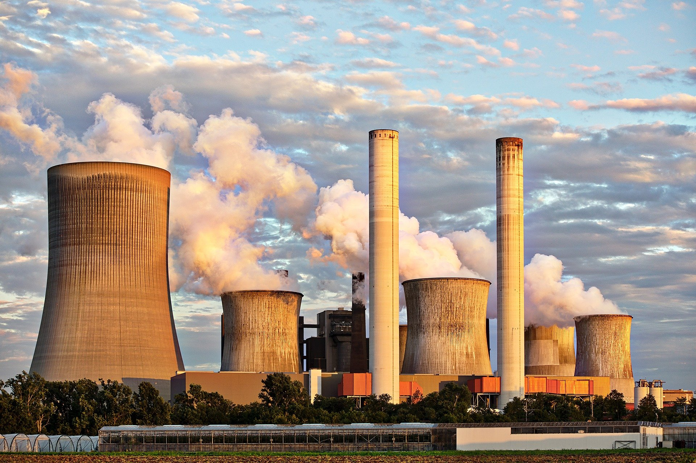
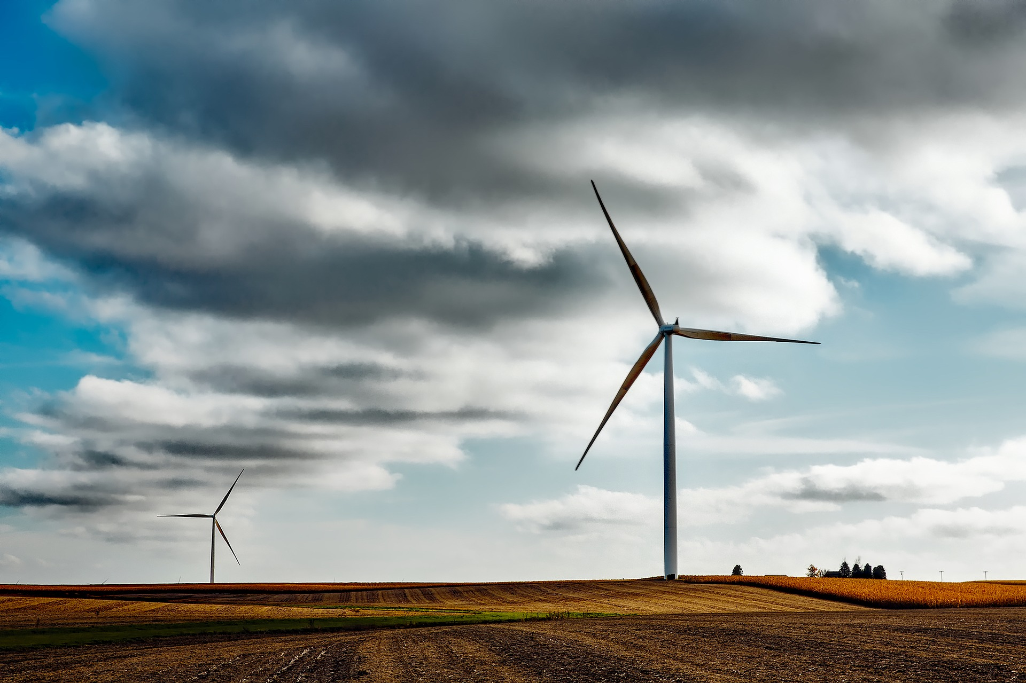
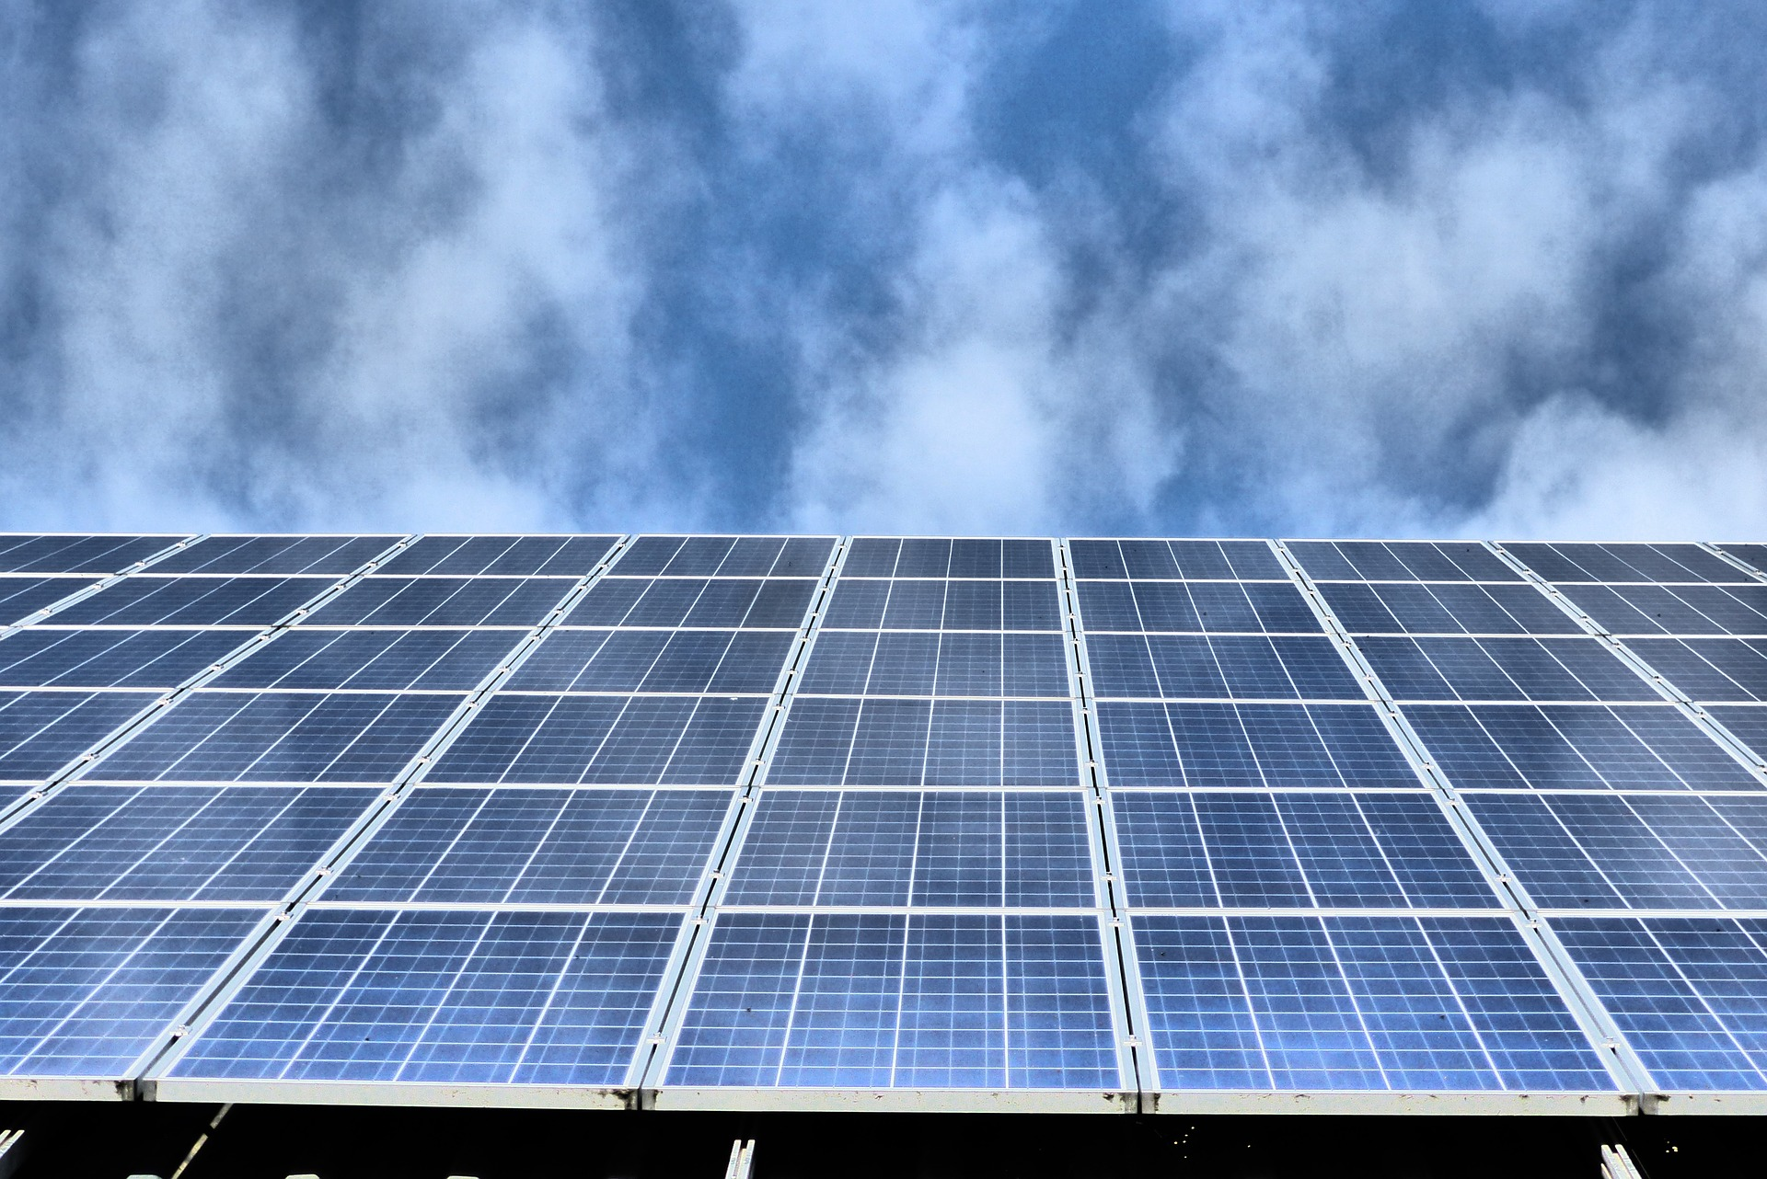
10.3 Importance of Reserve Margin
10.3.3 Which Technologies can Contribute to the Reserve Margin?
Dispatchable Generation
Non-Dispatchable Generation
17
Notes:
In the equation in the previous slide, we used the system’s total generation capacity to calculate the reserve margin. This assumed all megawatts of generation capacity contributed equally to the reserve margin. However, in practice, megawatts from different technologies do not contribute equally to the reserve margin. This is because different technologies have different performance characteristics and levels of control.
When talking about reserve margin, it is useful to group technologies into two categories: dispatchable generation and non-dispatchable generation. Dispatchable technologies are those whose production rate can be controlled to adapt to demand and the needs of the electricity grid. Production can be switched on and off as well as ramped up and down. Examples of dispatchable technologies include gas and coal power plants as well as storage technologies such as batteries. These technologies can typically contribute up to 100% of their capacity to the reserve margin. This means that a 1 GW coal plant can contribute 1 GW to the reserve margin.
In contrast, non-dispatchable technologies are those whose outputs cannot be controlled, because they depend on uncontrollable factors such as the weather. For example, the amount of electricity produced by a wind turbine at a given time is dependent on the windspeed conditions at that time, and the turbine cannot be controlled to produce more electricity if windspeed is low. Because non-dispatchable technologies cannot always be relied on to provide supply at any moment they may be needed, they contribute much less than 100% of their capacity to the reserve margin. This means that a 1 GW wind farm contributes far less than 1 GW to the reserve margin.

Slide 18
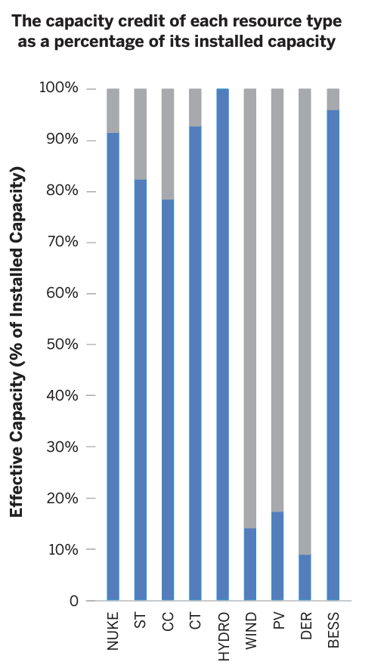
10.3 Importance of Reserve Margin
10.3.4 Capacity Credits & Variable Renewables
Capacity Credits: measure to what extent each technology can contribute to the reserve margin
Technology | Capacity credit
Nuclear | 91%
Steam turbine | 82%
Combined-cycle plant | 78%
Combustion turbine | 92%
Hydro | 100%
Wind | 14%
Solar PV | 17%
Distributed energy resources | 9%
Batteries | 96%
Source: Energy Systems Integration Group (2023)
18
Notes:
The extent to which a technology can contribute to the reserve margin is measured using the concept of capacity credits. The capacity credit of a technology is the percentage of its total capacity that can contribute to the reserve margin. As explained in the previous slide, the capacity credit of dispatchable technologies like a coal power plant can be up to 100%, whereas for non-dispatchable technologies like wind power, this value could be between 0 and 20%. Capacity credits depending on the resource availability and characteristics of the country.
The figure and the table in the slide shows the capacity credit of different technologies in an example system. Note that values will differ by system as well as by method used to calculate capacity credits. Nevertheless, there is still a clear divide as expected, where dispatchable technologies have much higher values than non-dispatchable technologies.
Note that methods to calculate capacity credits are not covered here as they are outside the scope of this course.

Slide 19
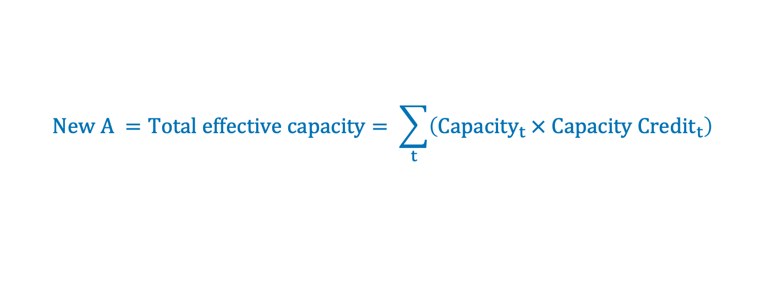
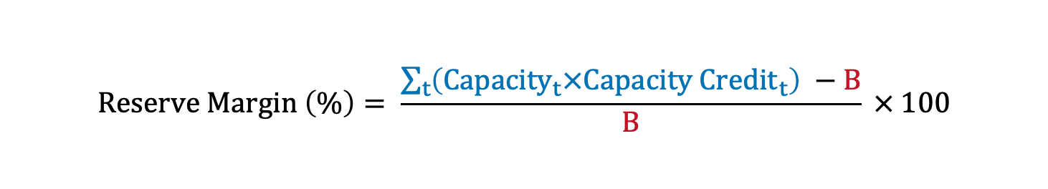
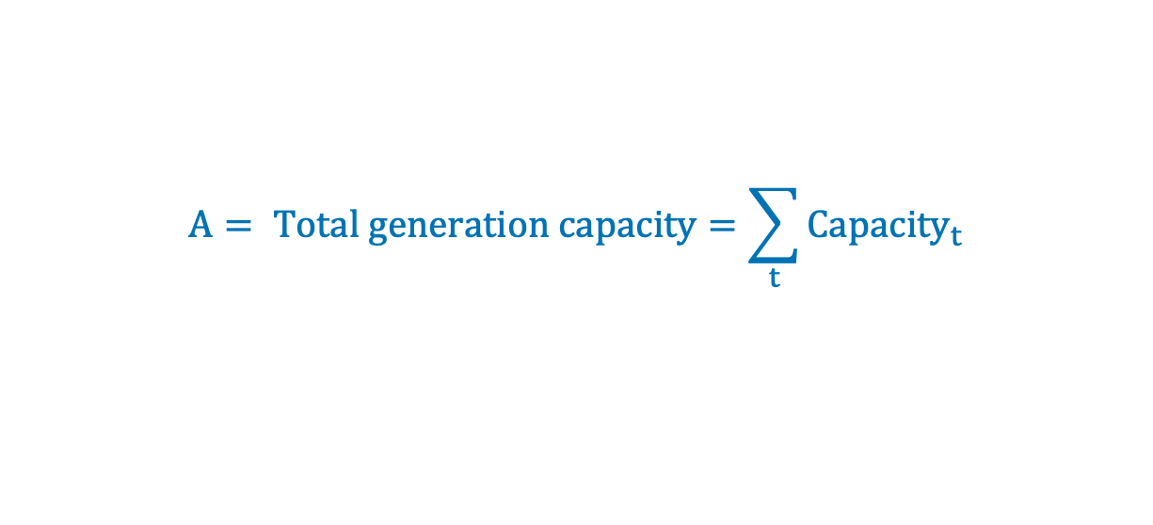
10.3 Importance of Reserve Margin
10.3.5 Defining the Reserve Margin Mathematically with Capacity Credits
Original equation:
Edit to equation:
$$A= Total generation capacity=\sum_{t}{{Capacity}_{t}}$$
    $$New A =Total effective capacity= \sum_{t}{\left({Capacity}_{t} × {Capacity Credit}_{t}\right)}$$
    Where $t$ is technology
Updated equation:
$$Reserve Margin \left(\%\right)= \frac{\sum_{t}{\left({Capacity}_{t}×{Capacity Credit}_{t}\right)} −B}{B} × 100$$
19
Notes:
Let’s now update our reserve margin equation from slide 10.3.2 to include capacity credits.
In the original equation, we used total generation capacity, which is found by summing the nameplate capacities of all technologies. To include capacity credits, we multiply each technology’s nameplate capacity by its capacity credit before the summation. This capacity-credit-adjusted capacity is called the effective capacity.
The next slide illustrates this with a practical example.

Slide 20
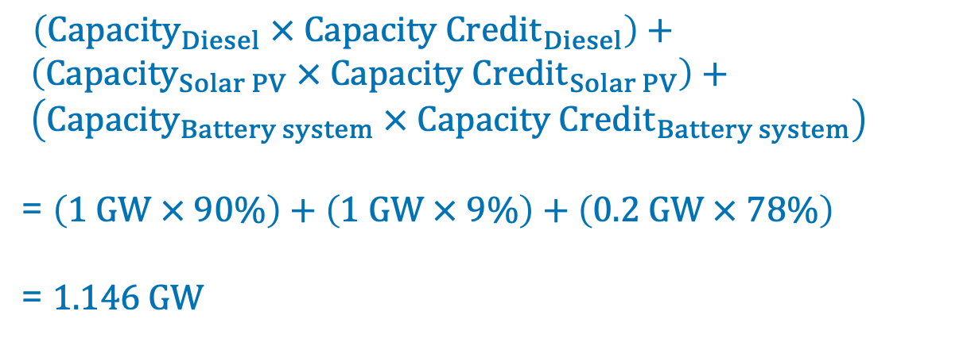
10.3 Reserve Margin in OSeMOSYS
10.3.6 Reserve Margin Example Calculation
Consider a system with three technologies (see table), and a peak demand of 1 GW.
Technology | Capacity (GW) | Capacity credit
Diesel | 1 | 90%
Solar PV | 1 | 9%
Battery system | 0.2 | 78%
Total effective capacity =
$\left({Capacity}_{Diesel} × {Capacity Credit}_{Diesel}\right)+ \left({Capacity}_{Solar PV} × {Capacity Credit}_{Solar PV}\right)+ \left({Capacity}_{Battery system} × {Capacity Credit}_{Battery system}\right)$
= $\left(1 GW × 90\%\right)+\left(1 GW × 9\%\right)+\left(0.2 GW × 78\%\right)$
= 1.146 GW
Reserve Margin (%) $= \frac{ 1.146 GW − 1 GW}{1 GW} × 100=14.6\%$
20
Notes:
In this example, we consider a basic system comprising
• a diesel power plant,
• a solar power plant,
• and a battery system.
The table shows each technology’s installed capacity as well as its capacity credit.
The system has a peak demand of 1 GW.
To calculate the reserve margin, we first calculate the total effective capacity. We do so by multiplying each technology’s installed capacity by its capacity credit to find each technology’s effective capacity, and then summing the technologies’ effective capacities to find the total. This gives a total effective capacity of 1.146 GW.
Then, we plug this into the reserve margin equation, which gives us a reserve margin 14.6%, which is a healthy reserve margin.

Slide 21
Lecture 10.3 References
Taliotis, Constantinos, Gardumi, Francesco, Shivakumar, Abhishek, Sridharan, Vignesh, Ramos, Eunice, Beltramo, Agnese, … Howells, Mark. (2018, December). Implementing capacity reserve in OSeMOSYS. Zenodo. http://doi.org/10.5281/zenodo.4585673
Energy Systems Integration Group. 2023. Ensuring Efficient Reliability: New Design Principles for Capacity Accreditation. A Report of the Redefining Resource Adequacy Task Force. Reston, VA. https://www.esig.energy/new-design-principles-for-capacity-accreditation.
21

Slide 22
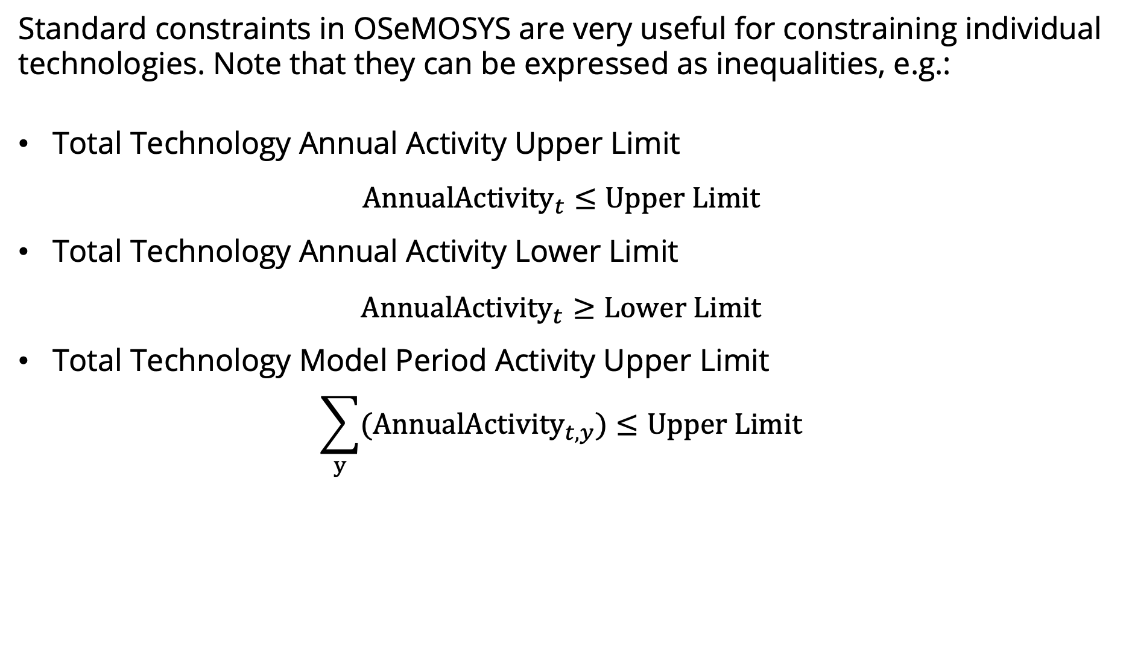
10.4 Reserve Margin in OSeMOSYS
10.4.1 Refresher of standard constraints
Standard constraints in OSeMOSYS are very useful for constraining individual technologies. Note that they can be expressed as inequalities, e.g.:
Total Technology Annual Activity Upper Limit
$${AnnualActivity}_{t}≤Upper Limit$$
Total Technology Annual Activity Lower Limit
$${AnnualActivity}_{t}≥Lower Limit$$
Total Technology Model Period Activity Upper Limit
$$\sum_{y}{({AnnualActivity}_{t, y})}≤Upper Limit$$
22
Notes:
Most of the standard constraints in OSeMOSYS are inequalities. These include:
Activity upper and lower limits
Minimum and maximum capacities
Minimum and maximum new capacities
These are very useful in constraining individual technologies. For example, using TotalAnnualMaxCapacity, we can constrain PWRSOL001 capacity (GW) in each year.
Note that all constraints can be expressed as inequalities that the model results must abide by. Let’s look at some examples with activity limits.
Total Technology Annual Activity Upper Limit is an inequality that says that the Annual Activity of a specified technology in a specified year must be smaller than the value set by the user.
Total Technology Annual Activity Lower Limit is an inequality that says that the Annual Activity of a specified technology in a specified year must be larger than the value set by the user.
Total Technology Model Period Activity Lower Limit is an inequality that says that the sum across all model years of the Annual Activity of a specified technology must be smaller than the value set by the user.
In these standard constraints, the constraint already exists in the model for all technologies and years, and the user only needs to choose its value, i.e. the value of the limit.

Slide 23
10.4 Reserve Margin in OSeMOSYS
10.4.2 Why UDCs?
However, the standard constraints have several limitations:
Constraints can only be applied to individual technologies, and not groups of technologies
The constraints need to be absolute values (GW, PJ), and cannot be relative values (% of other technologies’ GW/PJ)
User-defined constraints (UDCs) overcome both of these limitations.
23
Notes:
Despite the standard contraints’ usefulness, they have several limitations.
Constraints can only be applied to individual technologies. In other words, constraints cannot be applied to groups of technologies, for instance limiting aggregate capacity of solar technologies to 10 GW
The constraints need to be absolute values such as gigawatts and petajoules. In other words, constraints cannot be relative/percentage values, such as limiting the activity of PWRCOA001 to 10% of total electricity production
User-defined constraints (UDCs) overcome both of these limitations.

Slide 24
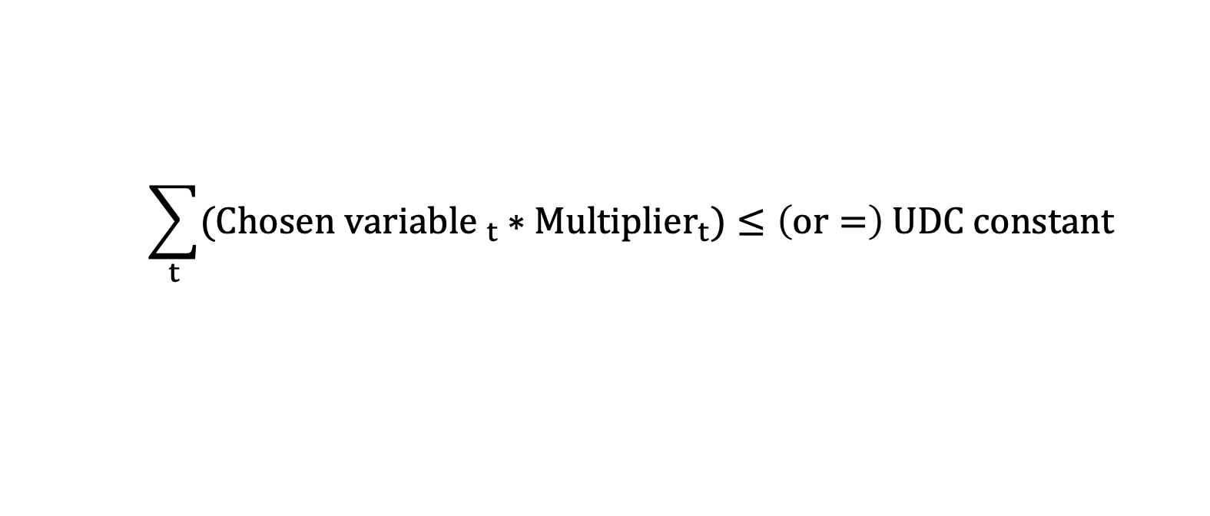
10.4 Reserve Margin in OSeMOSYS
10.4.3 UDC general equation
In simple terms, UDCs have the following generation equation:
$$\sum_{t}{{(Chosen variable }_{t} ∗{Multiplier}_{t})}≤\left(or=\right) UDC constant$$
24
Notes:
In simple terms UDCs have the following generation equation.
The sum for all technologies of the chosen variable multiplied by the mutiplier must be less than or equal to, or simply equal to, the UDC constant.
The summation symbol ($\sum{)}$ indicates that the expression in the parentheses (i.e. the multiplication of the two terms) is carried out for each technology ($t$) in the model, and then the resulting values are summed.

Slide 25

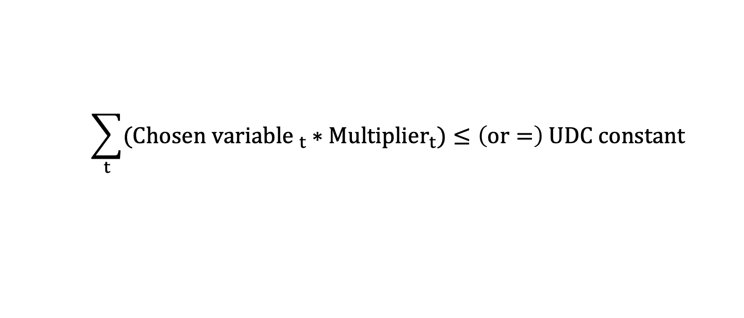
10.4 Reserve Margin in OSeMOSYS
10.4.4 UDC general equation
To create and customise the UDC, the user chooses:
$$\sum_{t}{{(Chosen variable }_{t} ∗{Multiplier}_{t})}≤\left(or=\right) UDC constant$$
which variable the constraint applies to
New capacity,
Total capacity, or
Activity
the value of the multiplier for each technology
whether the equation is an inequality ($≤$) or an equality (=).
the value of the UDC constant
25
Notes:
The user can create as few or as many UDCs as they like. For each UDC created, the user must define the different elements of the UDC.
The user decides:
which variable the constraint applies to, i.e. either new capacity, total capacity, or activity;
the value of the multiplier for each technology in the model;
whether the equation is an inequality ($≤$) or an equality (=);
and finally, the value of the UDC constant.
Multipliers and UDC constants are time-dependent, i.e. they are defined for each year of the model period.
The model results must abide by the resulting equation.

Slide 26
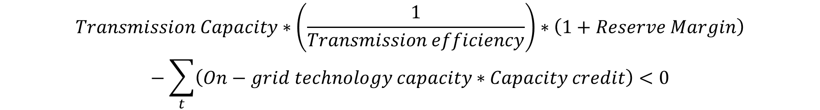
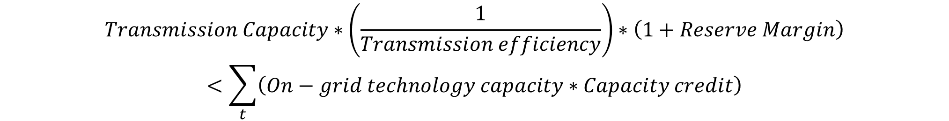
10.4 Reserve Margin in OSeMOSYS
10.4.5 Reserve Margin Representation Part 1
Assuming a capacity factor of 1 for transmission technology, transmission capacity can serve as a proxy for the required total generation capacity.
$$Transmission Capacity∗\left(\frac{1}{Transmission efficiency}\right)∗\left(1+Reserve Margin\right)<\sum_{t}{\left(On−grid technology capacity∗Capacity credit\right)}$$
Reorganizing to adhere to the standard format of UDC:
$$Transmission Capacity∗\left(\frac{1}{Transmission efficiency}\right)∗\left(1+Reserve Margin\right)−\sum_{t}{\left(On−grid technology capacity∗Capacity credit\right)}<0$$
26
Notes:
For the reserve margin, we need to determine a value in terms of capacity for total generation. In OSeMOSYS, this value is input through demand parameters (i.e., SpecifiedAnnualDemand and SpecifiedDemandProfile) in energy units, as previously studied. An alternative approach to link total generation with a capacity variable is through the transmission technology. Transmission is supplied by ELC001, representing electricity from power plants or total generation for our purposes.
However, to account for losses in the transmission stage, it is necessary to adjust the transmission capacity using the inverse of its efficiency. Note that we assume no installed overcapacity in transmission, as determined by the residual capacity, and the capacity factor for this technology is assumed to be 1.
The left side of the inequality therefore considers the product of transmission capacity, inverse of efficiency, and the planned reserve margin (expressed in decimal form). The right side of the inequality represents the contributions to the reserve margin from on-grid technologies, adjusted by their capacity credits. These contributions must be greater than the intended expected demand peak given by the reserve margin.
Finally, the inequality can be rewritten by moving the right-hand term to the left side, isolating a constant on the right-hand side. We will clarify the application of this concept with an example in the next slide.

Slide 27
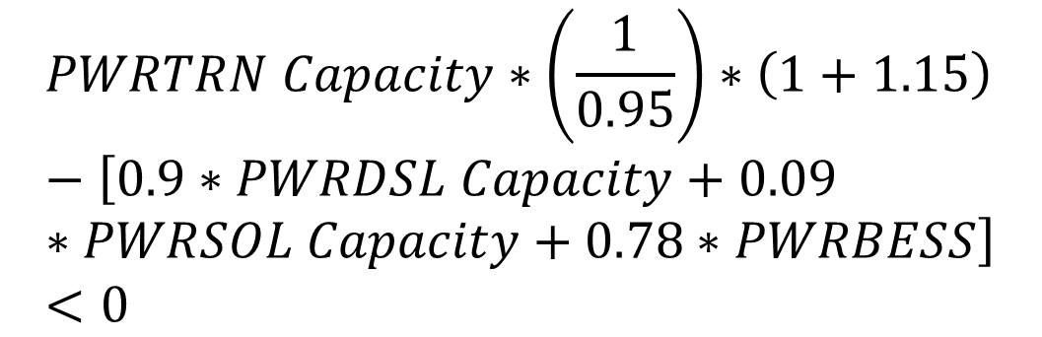
10.4 Reserve Margin in OSeMOSYS
10.4.6 Reserve Margin Representation Part 2
Let’s consider a scenario with a diesel power plant (PWRDSL), a solar power plant (PWRSOL), and a battery system (PWRBATT). The capacity credits are detailed in the accompanying table. Given a transmission technology (PWRTRN) efficiency of 95% and a reserve margin of 15%, the inequality would be as follows:
Technology | Capacity credit
Diesel PP | 90%
Solar PP | 9%
Battery system | 78%
$$PWRTRN Capacity∗\left(\frac{1}{0.95}\right)∗\left(1+1.15\right)−\left[0.9∗PWRDSL Capacity+0.09∗PWRSOL Capacity+0.78∗PWRBESS\right]<0$$
27
Notes:
In this illustrative example, we consider a basic system comprising a diesel power plant, a solar power plant, and a battery system. The technical parameters include a transmission efficiency of 95% and a reserve margin of 15%.
Using the equation described in the previous slide, we substitute the values accordingly. First, the transmission capacity, referred to as ‘PWRTRN Capacity,’ is multiplied by the inverse of the efficiency (1/0.95) and by the sum of 1 plus the reserve margin, which is 1 + 0.15. Note that all percentages are expressed in decimal form for these calculations.
Next, we compute the sum of the products of the capacities of the power plants and their respective capacity credits. The capacity credits may vary depending on the system, and the values provided here are indicative. Again, percentages are expressed in decimal form, and the naming conventions are summarized for each power plant.
During the hands-on exercise, we will practice building and incorporating these inequalities in MUIO.

Slide 28
Lecture 10.4 References
1. Climate Compatible Growth. (2024). MUIO (Version v5.0.0). GitHub. https://github.com/ClimateCompatibleGrowth/MUIO
28

Slide 29
Thank you
www.climatecompatiblegrowth.com

