Slide 2

LECTURE 9 THE CLIMATE SYSTEM – Part I
Introduction to CLEWs

Slide 3
Learning outcomes
By the end of this lecture, you will be able to:
ILO1: Understand the basics of climate change and its causes
ILO2: Understand the basics of greenhouse gas emissions
ILO3: Learn about significant sources of greenhouse gas emissions
ILO4: Learn about pathways to reduce greenhouse emissions
Notes:
By the end of this lecture, you will be able to: 1) Understand the basics of climate change and its causes
2) Understand the basics of greenhouse gas emissions
3) Learn about significant sources of greenhouse gas emissions
4) Learn about pathways to reduce greenhouse emissions

Slide 4
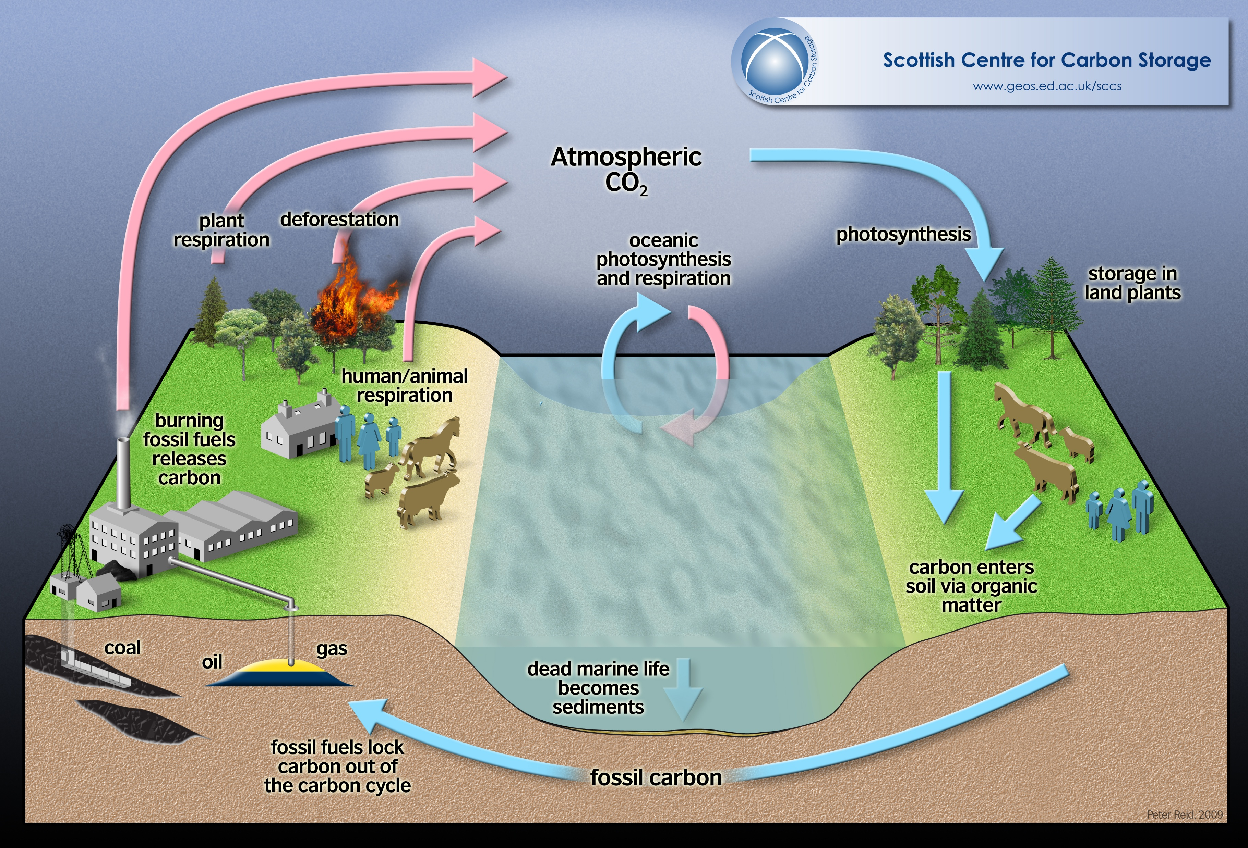
9.1. Basics of climate change
Carbon cycle
The natural flows of carbon between the atmosphere, ocean, terrestrial ecosystems, and sediments are fairly balanced so that carbon levels would be roughly stable without human influence
Photo Source: Harry C; Creative Commons — Attribution 4.0 International — CC BY 4.0
Notes:
The carbon cycle describes the process in which carbon atoms continually travel from the atmosphere to the Earth and then back into the atmosphere.
Since our planet and its atmosphere form a closed environment, the amount of carbon in this system does not change. Where the carbon is located — in the atmosphere or on Earth — is constantly in flux.
Along with the nitrogen cycle and water cycle, the carbon cycle comprises a sequence of events that are key to making Earth capable of sustaining life.
Movement of carbon between land, atmosphere, and ocean includes natural fluxes, human contributions, and stored carbon. The effects of volcanic and tectonic activity are not included.
Since the industrial revolution, and especially since the end of World War Two, human activity has substantially disturbed the global carbon cycle by redistributing massive amounts of carbon. Humans have also continued to introduce changes to vegetation and other land use, which in turn further impact the carbon cycle.

Slide 5
9.1. Basics of climate change
Carbon sources and carbon sinks
Sources
Sinks
Respiration
(from living organisms)
Decomposition
(from decaying matter)
Geological processes
Burning of Fossil Fuels
Land-use change
Forests and vegetation
Lithosphere
(top layer on the earth’s mantle)
Oceans
Atmosphere
Notes:
Carbon sources include the following processes:​
1) All living organisms release carbon dioxide as part of a cellular process known as respiration. This is true for plants as well. Although plants use carbon dioxide along with sunlight and water to grow, through a process known as synthesis, they release carbon dioxide at night.​
2) The decomposition of organic matter releases carbon into the atmosphere.
3) Volcanic eruptions and tectonic plate movements also release carbon dioxide in the atmosphere.​
4) The burning of fossil fuels like coal, gas, and oil leads to the release of stored carbon into the earth and oceans.​
5) Conversion of land from forests to agricultural land, as one example, results in the release of carbon emissions. When soil is cultivated, carbon dioxide is released into the atmosphere. This is principally as a result of the oxidation of the soil organic matter.
Carbon sinks include the following:
1) All forms of vegetation store carbon. And long-standing forests are a major sink for carbon.
2) The lithosphere is the rocky outer part of the Earth. It is made up of the brittle crust and the top part of the upper mantle. Carbon moves through the lithosphere in two forms, inorganic and organic carbon. Inorganic carbon is carbon that originates from non-living things, such as rocks. Organic carbon on the other hand is derived from living organisms, such as plants and animals.
3) In the case of the ocean, carbon is continually exchanged between the ocean’s surface waters and the atmosphere, or is stored for long periods of time in the ocean depths. Some of this eventually is turned into fossil fuels.
4) Carbon dioxide is present in the atmosphere as a gas.

Slide 6
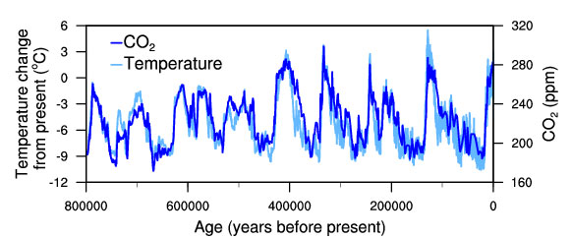
9.1. Basics of climate change
What causes climate change?
Temperature change (light blue) and carbon dioxide change (dark blue) measured from the EPICA Dome C ice core in Antarctica
Source: Jouzel et al. 2007; Lüthi et al. 2008
Notes:
There is now strong scientific consensus on the correspondence between temperature and the concentration of carbon dioxide in the atmosphere observed during the past several hundred thousand years. When the carbon dioxide concentration goes up, temperature goes up. When the carbon dioxide concentration goes down, temperature goes down. A small part of the correspondence is due to the relationship between temperature and the solubility of carbon dioxide in the surface ocean, but the majority of the correspondence is consistent with a feedback between carbon dioxide and climate.
While it might seem simple to determine cause and effect between carbon dioxide and climate from which change occurs first, or from some other means, the determination of cause and effect remains exceedingly difficult. This is due to the fact that other changes may be involved, including altered vegetation, land surface characteristics, and ice sheet extent. Therefore, it is clear that temperate and carbon dioxide concentration in the atmosphere are closely correlated, but the causal link between the two is complex to prove.
Finally, historical glacial data reveal that climate change is not just about temperature. As carbon dioxide has changed in the past, many other aspects of the climate have changed too. During glacial times, snow lines were lower, continents were drier, and the tropical monsoons were weaker. Some of these changes may be independent; others may be tightly coupled to the changing level of carbon dioxide. Understanding which of these changes might occur in the future, and how large those changes might be, remains a topic of vigorous research.

Slide 7
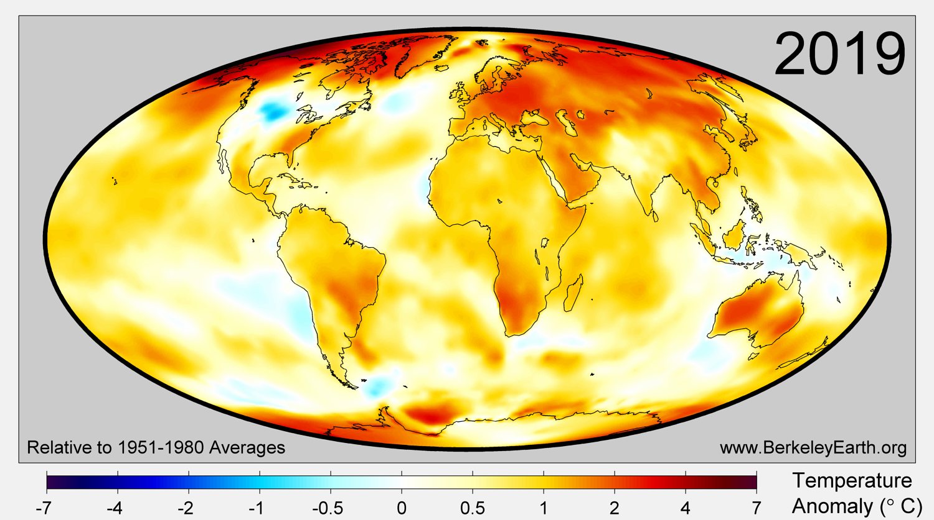
9.1. Basics of climate change
Impact of growing emissions on global average temperatures
Source: Berkley Earth via OurWorldinData.org
Notes:
Global warming, caused by greenhouse gases, leads to an increase in temperature over the globe, with nearly all land and ocean areas affected. The map here compares local temperatures in 2019 based on how different they were from historical averages after accounting for the typical climate variability at each location.
In 2019, 88% of the Earth’s surface was significantly warmer than the average temperature during 1951 to 1980, 10% was of a similar temperature, and only 1.5% was significantly colder.
Scientists estimate that 9.9% of the Earth’s surface set a new local record for the warmest annual average temperature. However, no places on Earth experienced a record cold annual average in the same year of 2019.
In a stable climate only 2.5% of the Earth would be expected to have temperatures “Very High” or higher in any given year. In 2019, 52% of the Earth had annual averages that would rate as “Very High” compared to the historical climate, including large portions of the tropics.

Slide 8
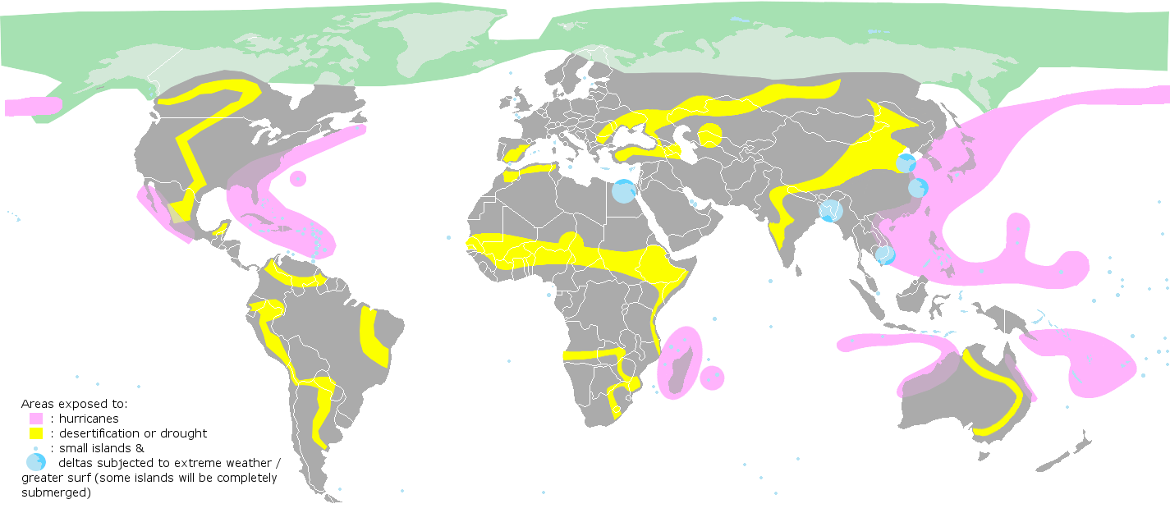
9.1. Basics of climate change
Definition of climate change and how it is manifested
Source: KVDP via Wikimedia Commons
8
Notes:
Climate change is a long-term change in the average weather patterns that have come to define Earth’s local, regional, and global climates. These changes have a broad range of observed effects that are synonymous with the term. These include global land and ocean temperature increases; rising sea levels; ice loss at Earth’s poles and in mountain glaciers; frequency and severity changes in extreme weather such as hurricanes, heatwaves, wildfires, droughts, floods, and precipitation; and cloud and vegetation cover changes, to name but a few.
Scientists use observations from the ground, air, and space, along with theoretical models, to monitor and study past, present, and future climate change. Climate data records provide evidence of climate change key indicators.
Global warming is the long-term heating of Earth’s climate system observed since the pre-industrial period (between 1850 and 1900) due to human activities, primarily fossil fuel burning which increases heat-trapping greenhouse gas levels in Earth’s atmosphere. The term is frequently used interchangeably with the term climate change, though the latter refers to both human and naturally produced warming and the effects it has on our planet. Global warming is most commonly measured as the average increase in Earth’s global surface temperature.

Slide 9
Lecture 9.1. References
Jouzel, J., V. Masson-Delmotte, O. Cattani, G. Dreyfus, S. Falourd, G. Hoffmann, B. Minster, J. Nouet, J.M. Barnola, J. Chappellaz, H. Fischer, J.C. Gallet, S. Johnsen, M. Leuenberger, L. Loulergue, D. Luethi, H. Oerter, F. Parrenin, G. Raisbeck, D. Raynaud, A. Schilt, J. Schwander, E. Selmo, R. Souchez, R. Spahni, B. Stauffer, J.P. Steffensen, B. Stenni, T.F. Stocker, J.L. Tison, M. Werner, and E.W. Wolff. 2007. Orbital and Millennial Antarctic Climate Variability over the Past 800,000 Years. Science, Vol. 317, No. 5839, pp.793-797, 10 August 2007.
Lüthi, D., M. Le Floch, B. Bereiter, T. Blunier, J.-M. Barnola, U. Siegenthaler, D. Raynaud, J. Jouzel, H. Fischer, K. Kawamura, and T.F. Stocker. 2008. High-resolution carbon dioxide concentration record 650,000-800,000 years before present. Nature, Vol. 453, pp. 379-382, 15 May 2008.
NASA, https://climate.nasa.gov/resources/global-warming-vs-climate-change/
NOAA-NCDC, https://www.ncdc.noaa.gov/global-warming/temperature-change
9

Slide 10
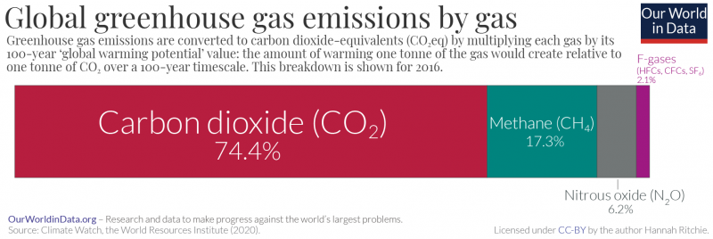
9.2. Greenhouse gas emissions
Comparing different types of greenhouse gas emissions
Global Warming Potentials (GWPs): relative ‘greenhouse impact’ or radiative forcing over a period of time from a unit mass of gas relative to a reference gas (CO₂).
GWP values and lifetimes | Lifetime (years) | GWP time horizon
 |  | 20 years | 100 years
Carbon Dioxide (CO₂) | - | 1 | 1
Methane (CH₄) | 12.4 | 84 | 28
Nitrous oxide(N₂O) | 121.0 | 264 | 265
Hydrofluorocarbon (HFC – 134a) | 13.4 | 3,710 | 1,300
Chlorofluorocarbon (CFC-11) | 45.0 | 7,020 | 5,350
Sulfur Hexafluoride (SF₆) | 3,200 | 17,500 | 23,500
Source: OurWorldinData.org based on data from Climate Watch - World Resources Institute (2020)
Notes:
It is important to recognize that there are other types of greenhouse gases apart from carbon dioxide. These include methane, nitrous oxide, H.F.C, C.F.C., and S.F. ₆.
Each of these greenhouse gases has a different relative contribution to global warming; for example, one tonne of methane does not have the same impact on warming as one tonne of carbon dioxide.
These differences are captured with the ‘Global Warming Potential’ (or G.W.P.) metric. G.W.P. can be defined on a range of time periods; however, the most commonly used is the 100-year timescale (G.W.P. ₁₀₀). This is what has been adopted by the I.P.C.C. or the Intergovernmental Panel on Climate Change, a key UN body.
The table shows the G.W.P. ₁₀₀ value of key greenhouse gases relative to carbon dioxide. G.W.P. ₁₀₀ values are used to combine greenhouse gases into a single metric of emissions called carbon dioxide equivalents (or C.O. ₂ e). C.O. ₂ e is derived by multiplying the mass of emissions of a specific greenhouse gas by its equivalent G.W.P. ₁₀₀ factor. The sum of all gases in their C.O. ₂ e form provides a measure of total greenhouse gas emissions.
In the chart we see the breakdown of global emissions in 2016, measured on the basis of carbon dioxide equivalents. Carbon dioxide was the largest contributor, accounting for around three-quarters (74.4%) of total emissions. Methane contributed 17.3%; nitrous oxide 6.2%; and other emissions (H.F.C., C.F.C., S.F. ₆), 2.1%.

Slide 11
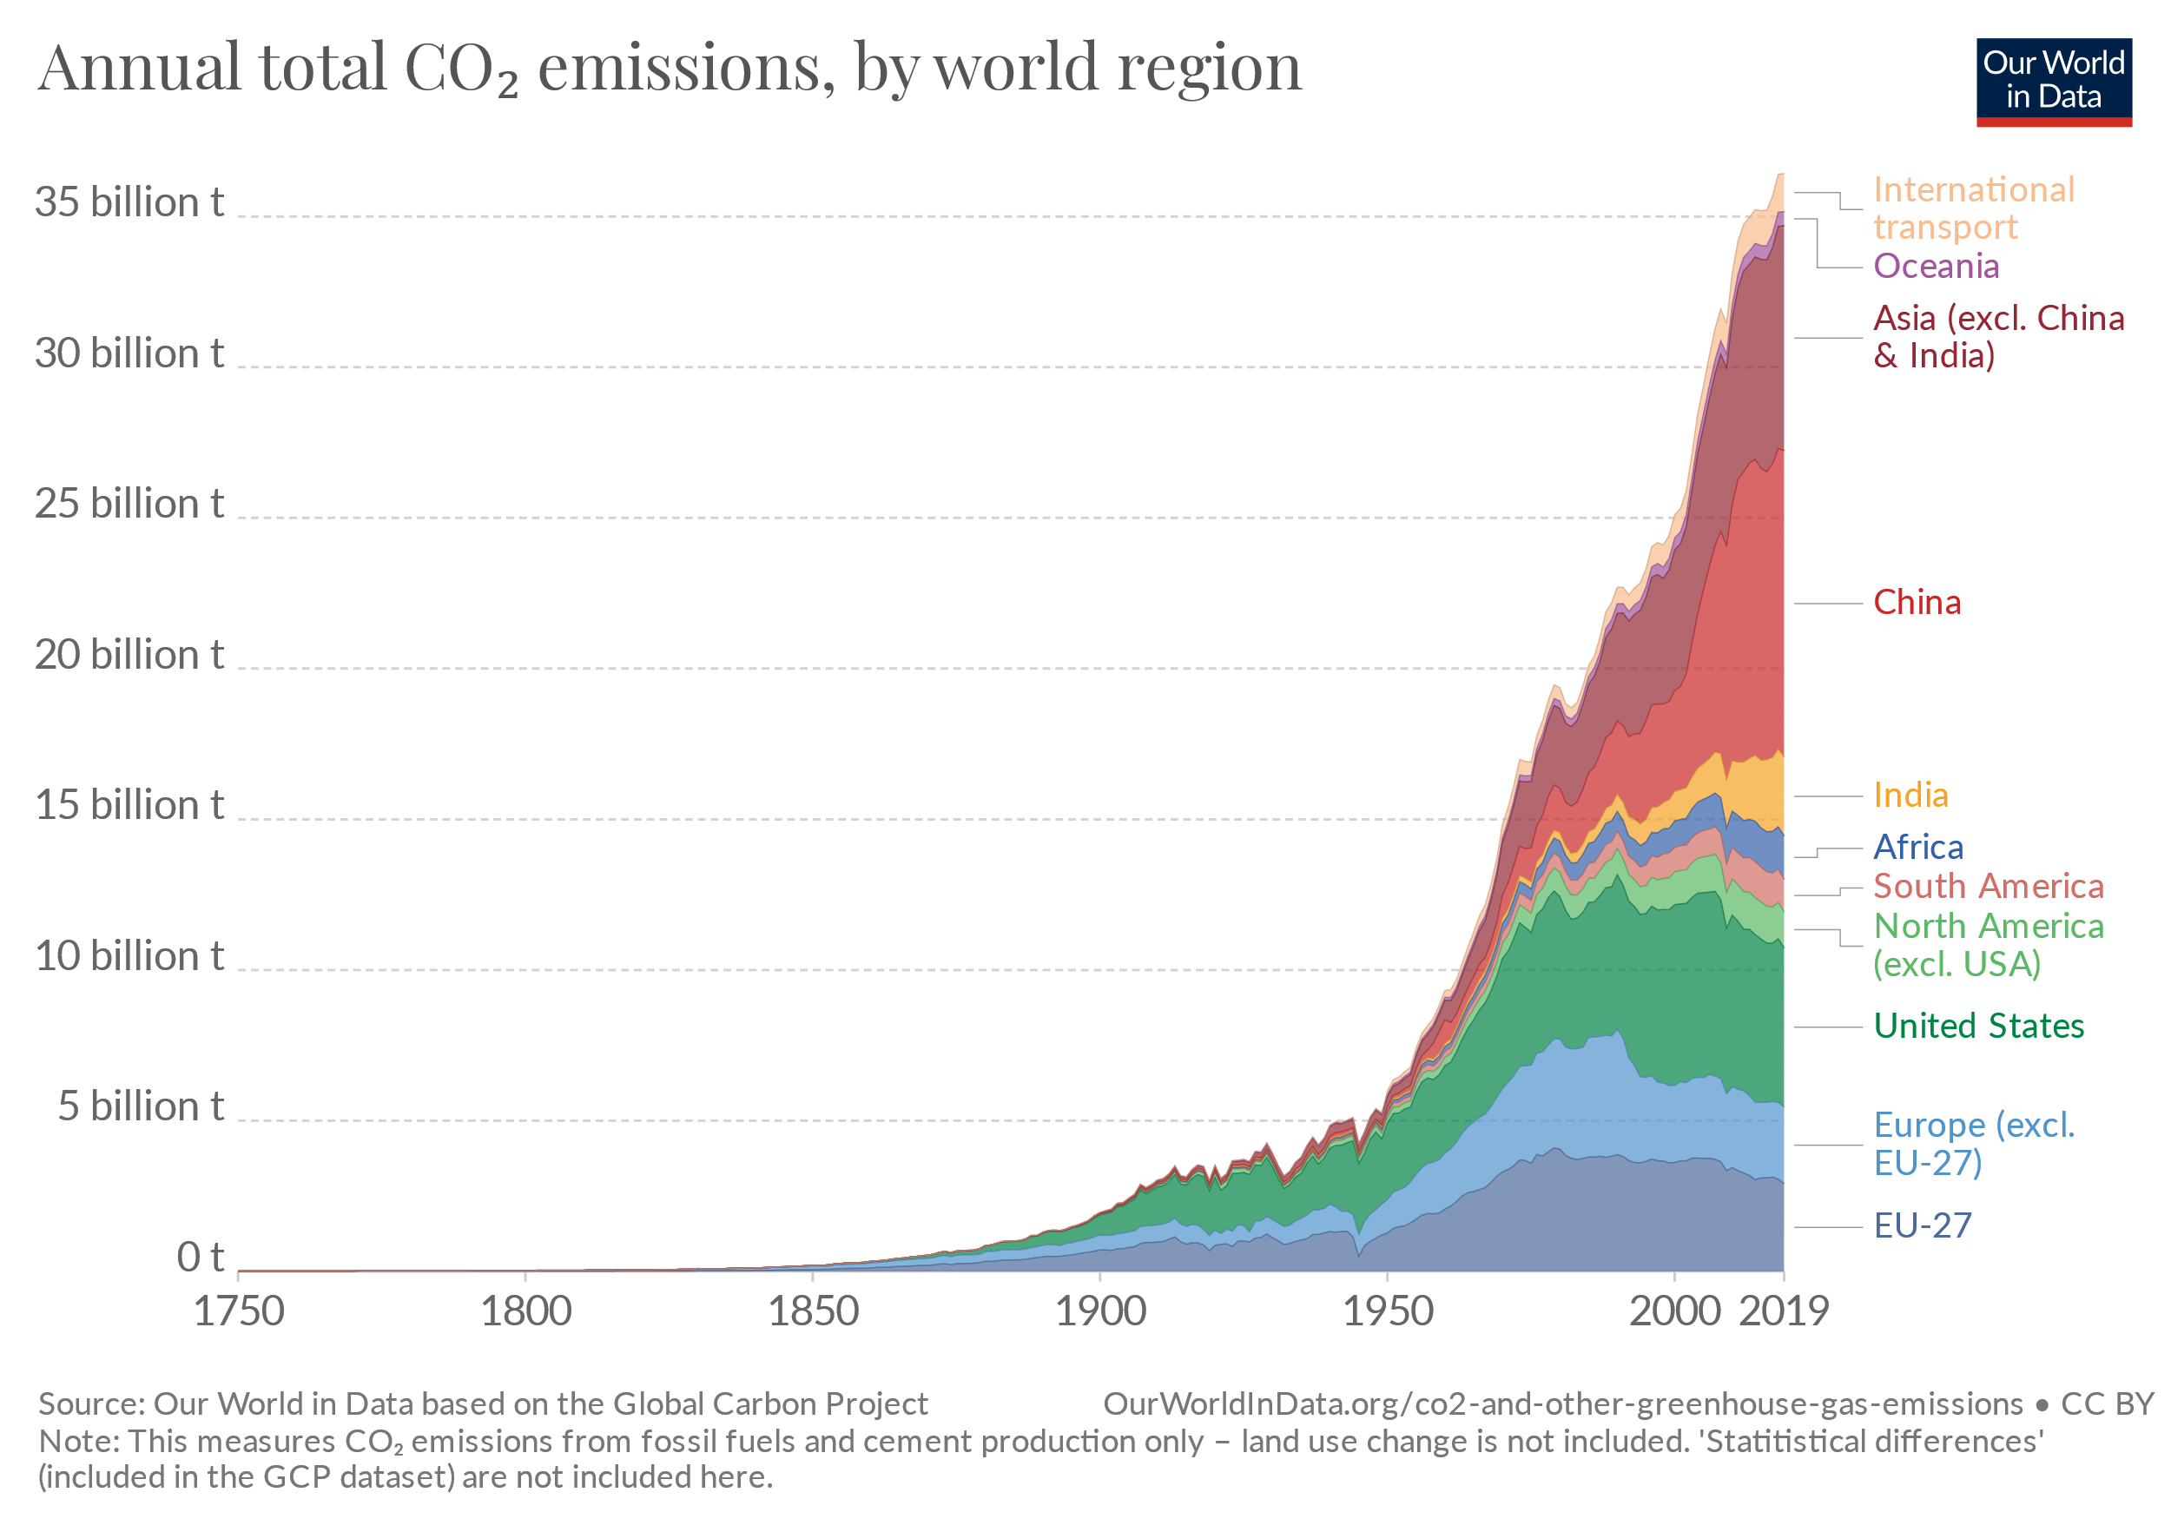
9.2. Greenhouse gas emissions
Anthropogenic emissions
Note: This measures CO₂ emissions from fossil fuels and cement production only – land-use change is not included
Source: OurWorldinData.org based on data from Global Carbon Project
Notes:
Global emissions have not yet peaked. About half of the anthropogenic – human-caused – carbon dioxide emissions since the beginning of the industrial revolution in 1750 and 2011 have occurred in the last 40 years.
To stabilize (or even reduce) concentrations of carbon dioxide in the atmosphere, the world needs to reach net-zero emissions. This requires large and fast reductions in emissions. One common argument is that those countries which have added most to the carbon dioxide in our atmosphere should take on the greatest responsibility in tackling it. A few key points from this perspective, which can also be seen in the figure on this slide - are as follows:
The United States is responsible for 25% of historical emissions, more than any other country;
This is twice as much as China – the world’s second largest contributor to cumulative emissions;
The European Union – which consists of 28 countries – is also a large historical contributor at 22%;
Many of the large annual emitters today – such as India and Brazil – are not large contributors in a historical context;
Africa’s regional contribution – especially relative to its population size – has been very small.

Slide 12
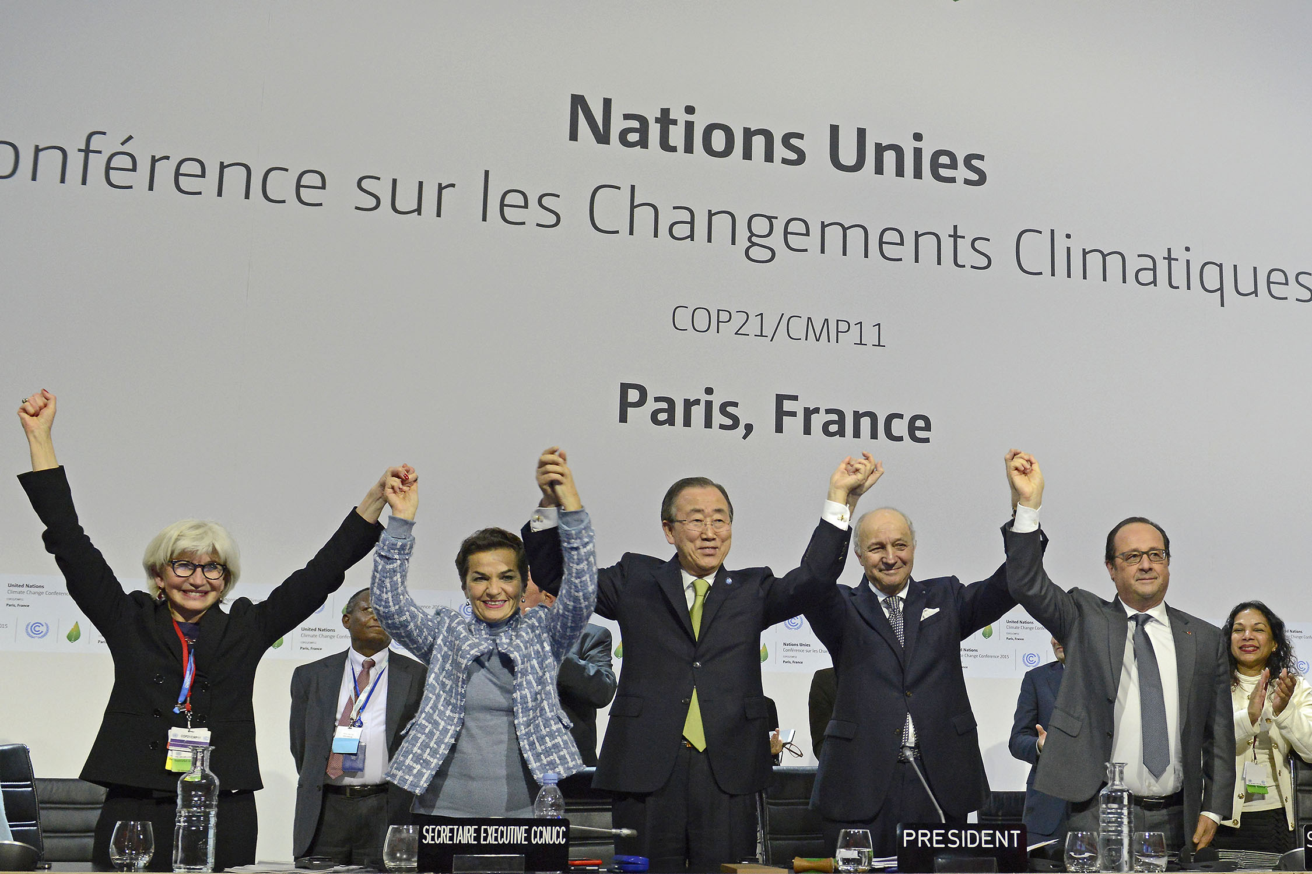
9.2. Greenhouse gas emissions
Paris Agreement
What is it? A legally binding international treaty on climate change.
What is its goal? To limit global warming to well below 2, preferably to 1.5 degrees Celsius, compared to pre-industrial levels.
How can it be achieved? By reaching a global peak of greenhouse gas emissions as soon as possible to achieve a climate neutral world by mid-century.
Who is a part of it? It was adopted by 196 Parties at COP 21 in Paris, on 12 December 2015.
Photo Source: UNclimatechange; https://creativecommons.org/licenses/by/2.0/
Notes:
The Paris Agreement is a landmark in the multilateral climate change process because, for the first time, a binding agreement brings all nations into a common cause to undertake ambitious efforts to combat climate change and adapt to its effects.
Implementation of the Paris Agreement requires economic and social transformation, based on the best available science. The Paris Agreement works on a 5-year cycle of increasingly ambitious climate action carried out by countries. Countries have submitted their plans for climate action, known as nationally determined contributions (N.D.Cs).
In their N.D.Cs, countries communicate actions they will take to reduce their greenhouse gas emissions in order to reach the goals of the Paris Agreement. Countries also communicate in the N.D.Cs actions they will take to build resilience to adapt to the impacts of rising temperatures.
The Paris Agreement also provides a framework for financial, technical, and capacity building support to those countries who need it.

Slide 13
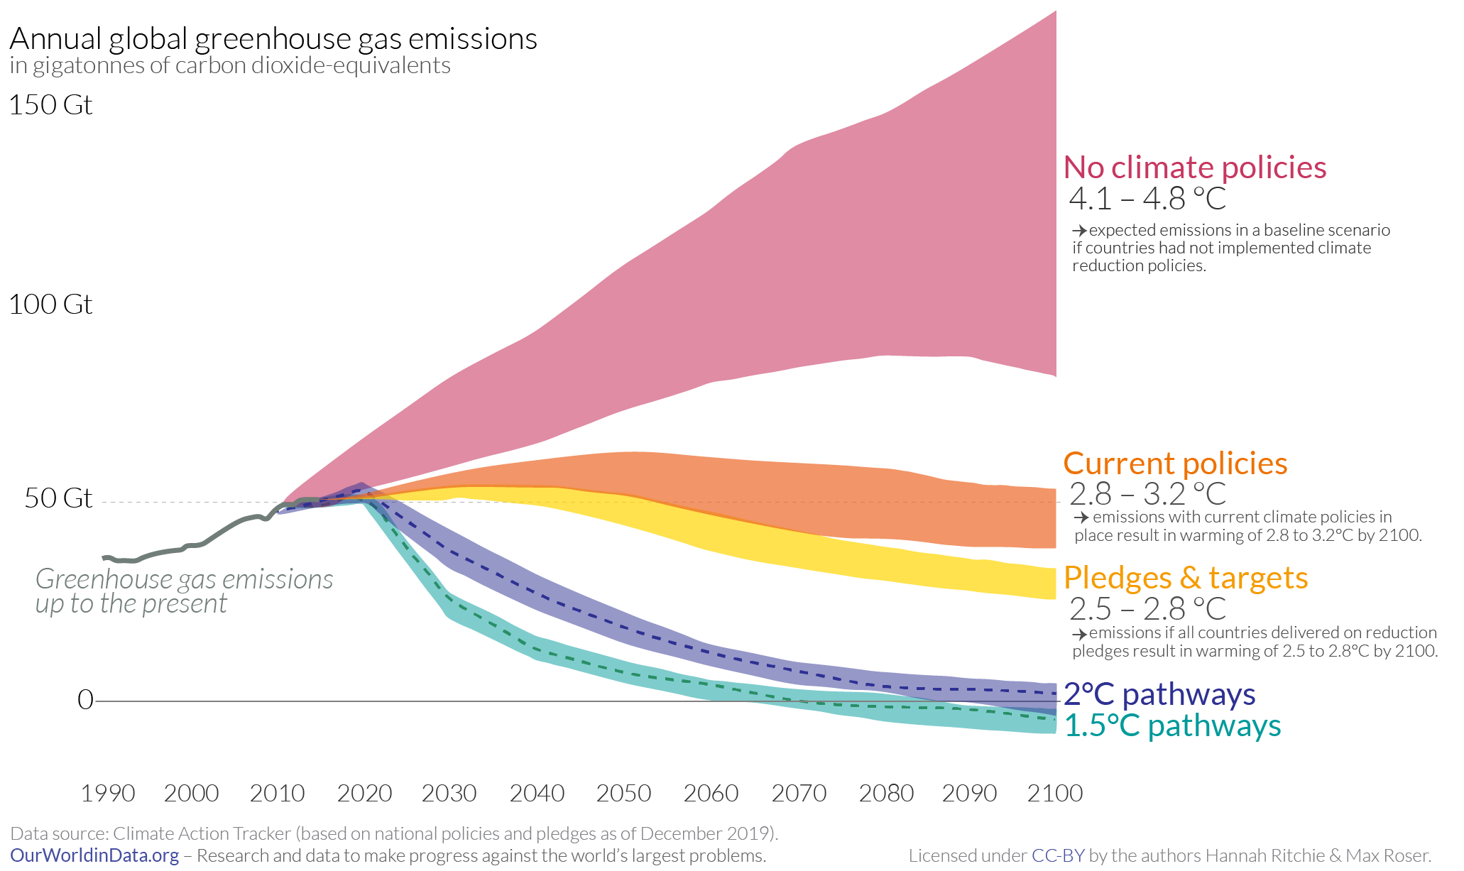
9.2. Greenhouse gas emissions
Pathways to emissions reduction
Global greenhouse gas emissions and warming scenarios.
Each pathway comes with uncertainty, marked by the shading from low to high emissions
Warming refers to the expected global temperature by 2100 relative to pre-industrial levels
Source: OurWorldinData.org based on data from Climate Action Tracker
Notes:
This chart shows future greenhouse gas emissions trajectories under a range of scenarios: if no climate policies are implemented; a ‘current policies’ scenario; a scenario where all countries achieve their current pledges for emissions reductions; and pathways that would be compatible with limiting warming to 1.5 degrees Celsius or 2 degrees Celsius of warming this century.
The chart shows that currently implemented climate and energy policies would indeed reduce warming relative to a world with no climate policy actions.
In addition, if countries achieved their current ‘Pledges’, it would lead to a further reduction in emissions. From this perspective, the world is making some progress.
However, we are well off-track from our stated aim of limiting warming to “well below 2 degrees Celsius”, as is laid out in the Paris Agreement.
This figure shows that urgent and rapid reductions in emissions would be needed to limit warming to 1.5 degrees Celsius or 2 degrees Celsius this century. And the longer we delay a peak in emissions, the more drastic these reductions would need to be.

Slide 14
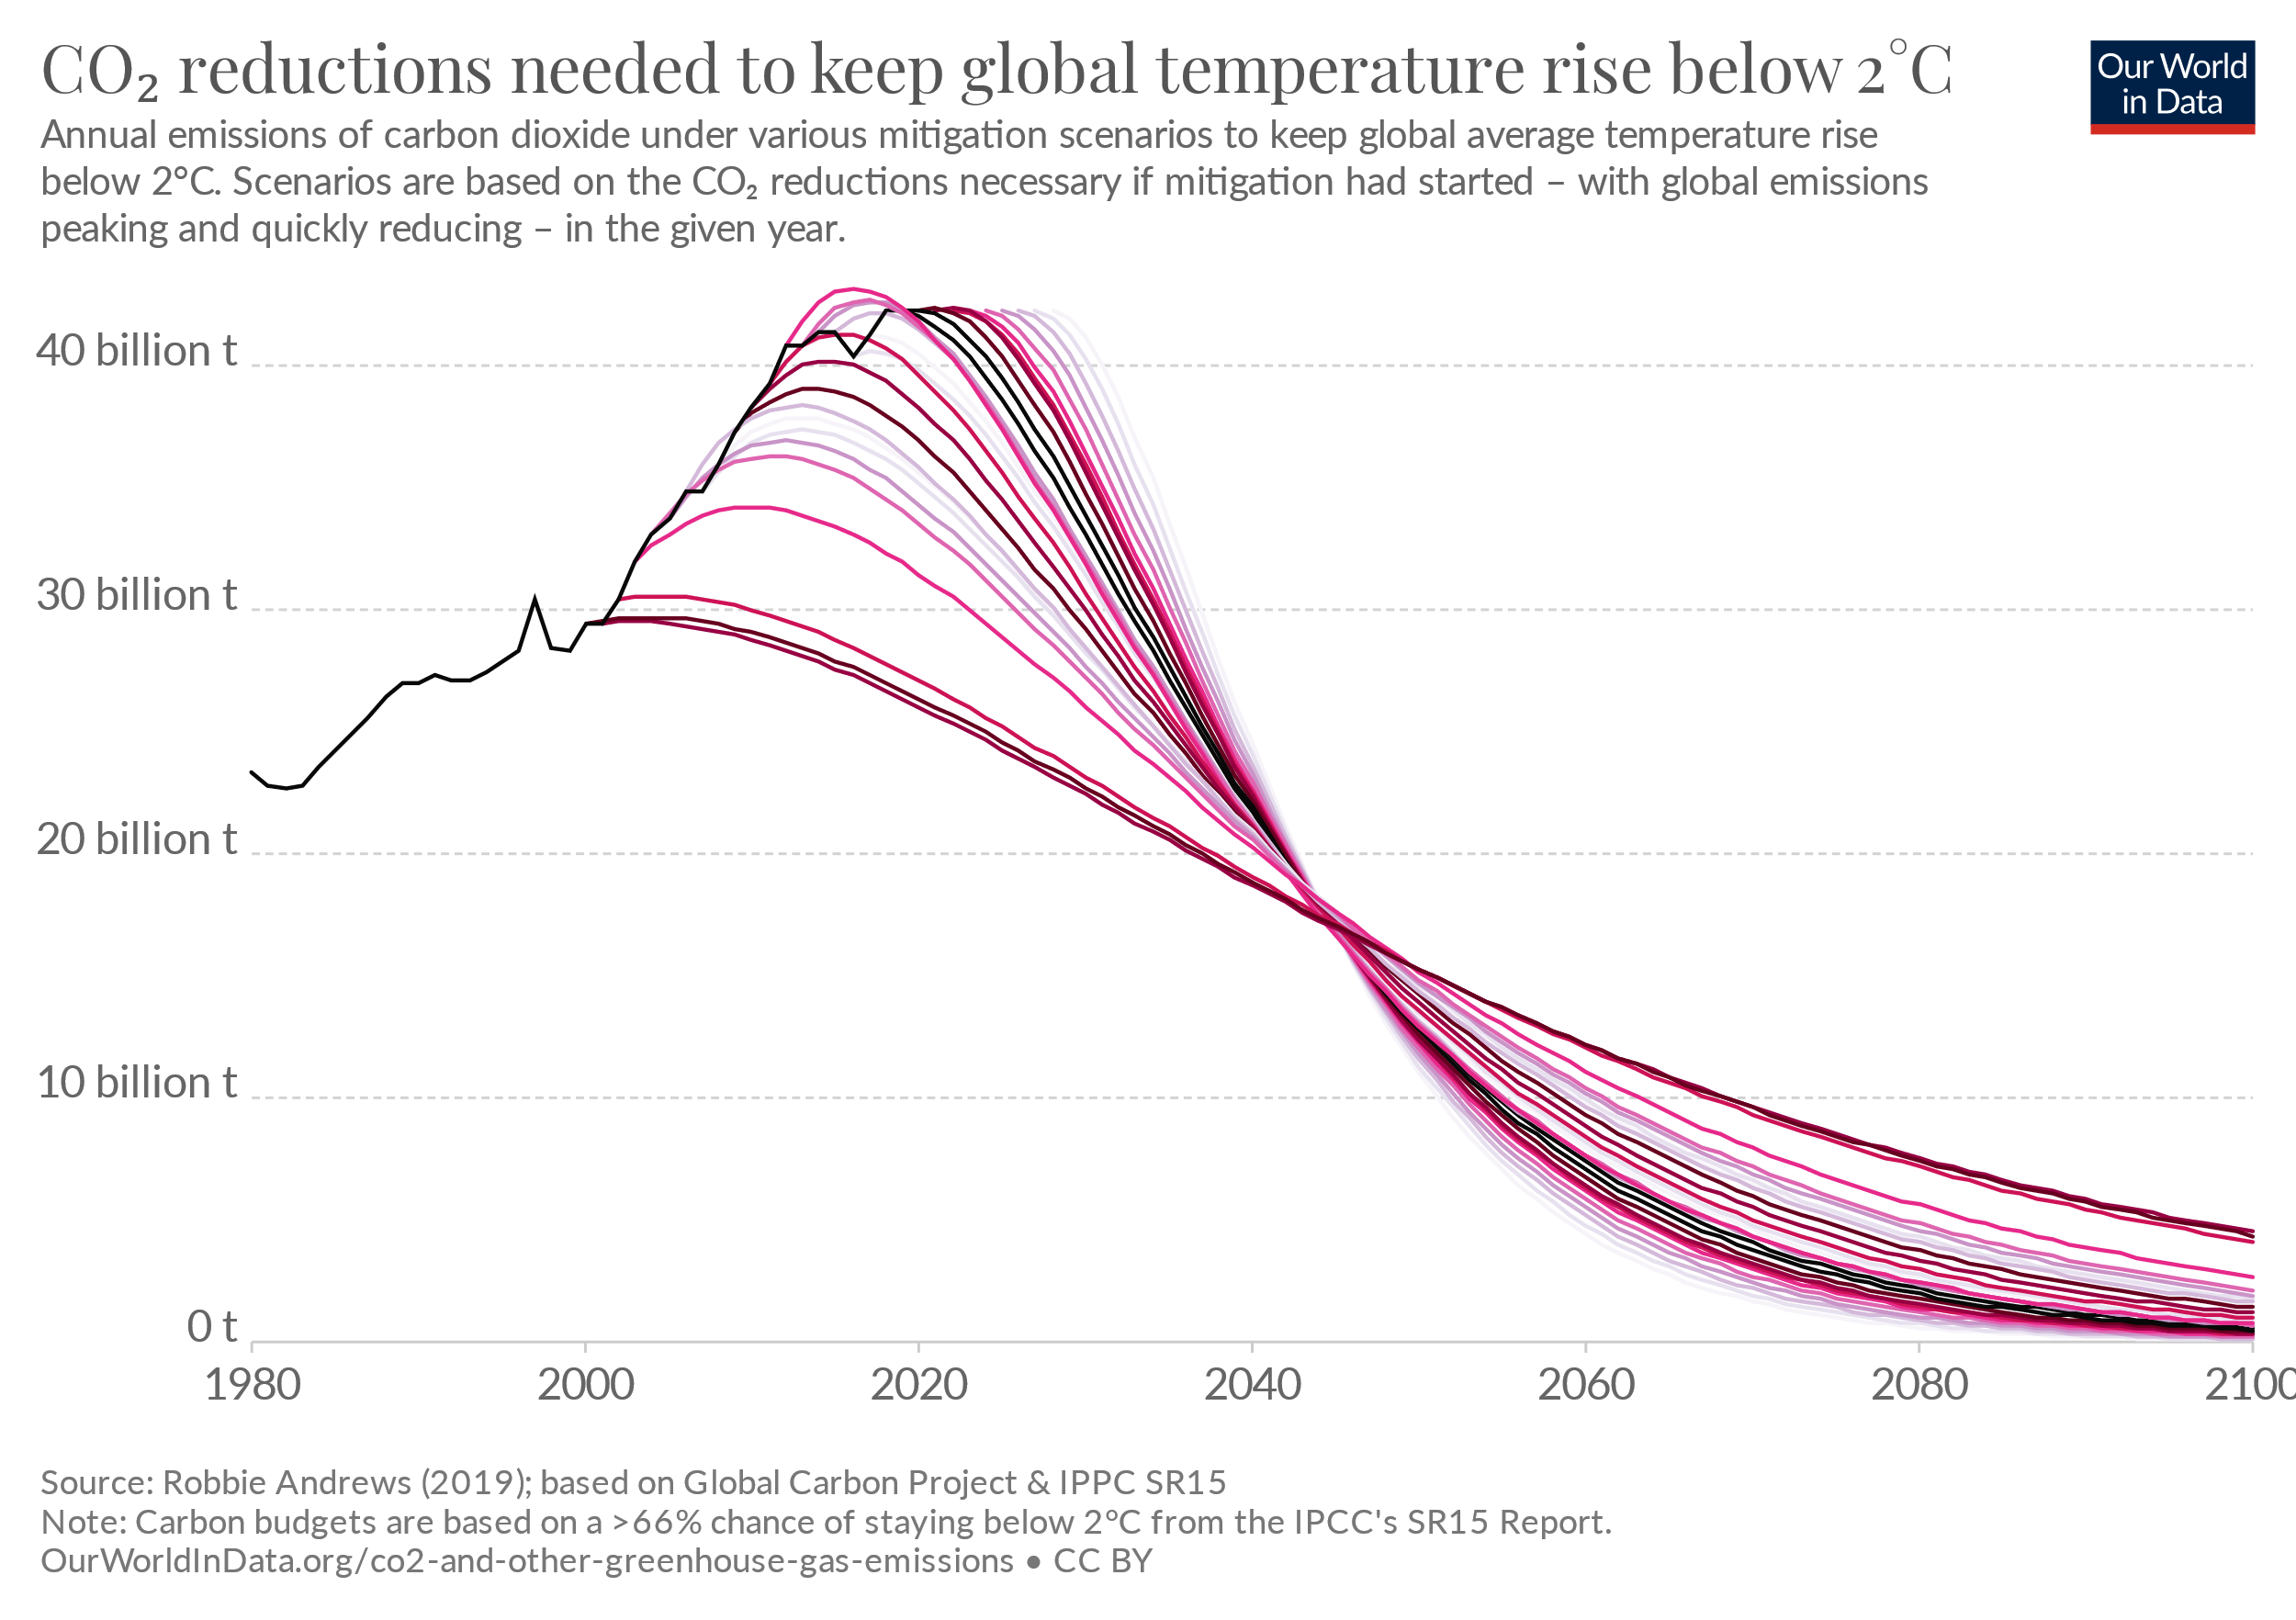
9.2. Greenhouse gas emissions
The need for urgent action
Infrastructure lock-in
Lost emission reductions for each year of delay
Lower emission reduction potential in the future with delayed action
Source: OurWorldinData.org based on Robbie Andrews, Global Carbon Project, and IPCC SR15
Notes:
The figure here shows trajectories of carbon emission reductions required to keep global temperatures below 2 degrees C. The different pathways correspond to different years of when peak emissions are reached. As mentioned earlier, keeping global warming below 2 degrees Celsius will need urgent action. And the window for an effective response is relatively narrow – the next five to ten years according to some estimates. This urgency is not only about missing an opportunity to reduce emissions for a single year or short span of time. Rather, by not taking immediate action, the world could lock itself into carbon-intensive infrastructure for several decades into the future. For example, coal-fired power plants often have a lifespan of 40 to 50 years, and many industrial plants a lifespan of 20 to 30 years. There would be three major impacts from delaying action to reduce emissions. First, the potential future reduction in emissions could reduce – by around 40% according to some estimates. Second, it would result in lost emission reductions for each year of delay. And finally, the lock-in to infrastructure could persist for several decades into the future depending on the sector.

Slide 15
Lecture 9.2. References
UNFCCC, https://unfccc.int/process-and-meetings/the-paris-agreement/the-paris-agreement
Ritchie, H. and Roser, M. (2020) - "CO₂ and Greenhouse Gas Emissions". Published online at OurWorldInData.org. Retrieved from: 'https://ourworldindata.org/co2-and-other-greenhouse-gas-emissions' [Online Resource]
McKinsey&Company (2009) – Pathways to a low-carbon economy: Version 2 of the global greenhouse gas abatement cost curve. Available at: McKinsey&Company
15

Slide 16
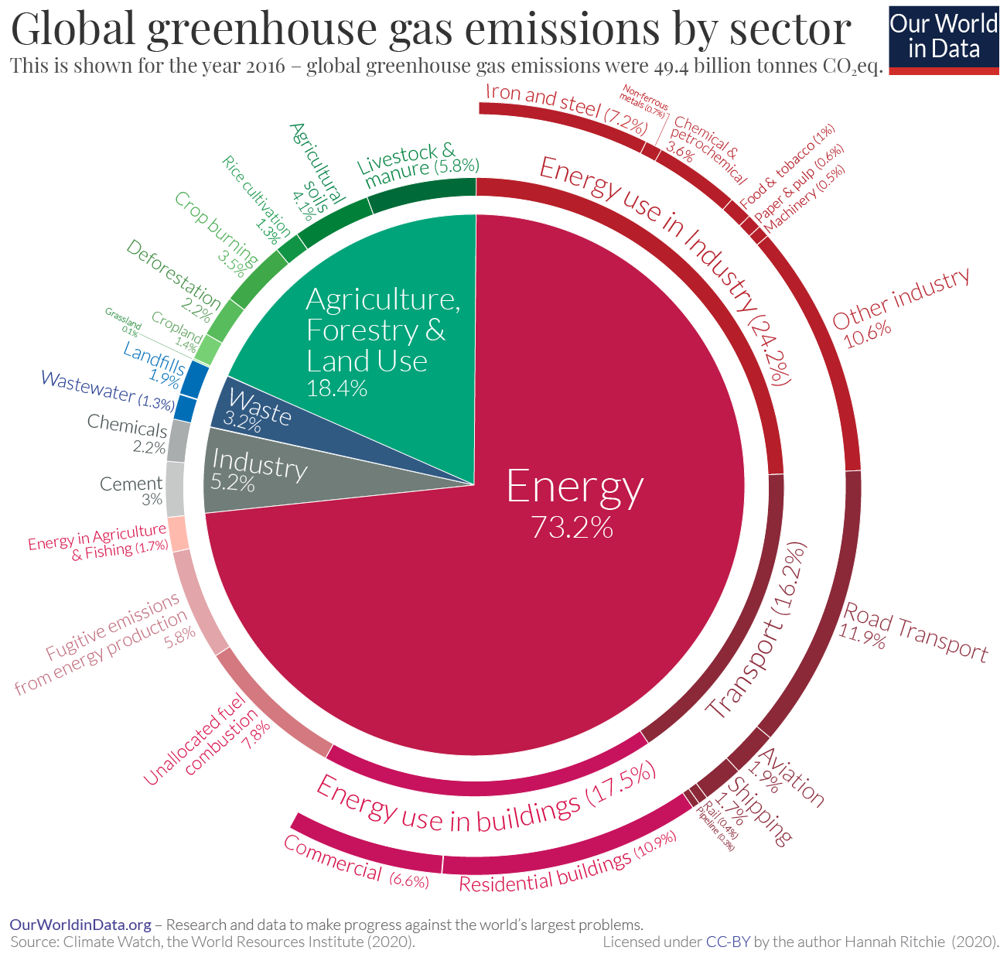
9.3. GHG emission sources
Greenhouse Gas (GHG) emissions by sector
It is clear from this breakdown that a range of sectors and processes contribute to global emissions. This means there is no single or simple solution to tackle climate change. Focusing on electricity, or transport, or food, or deforestation alone is insufficient.
Source: OurWorldinData.org based on data from Climate Watch, World Resources Institute (2020)
Notes:
It is clear from this breakdown that a range of sectors and processes contribute to global emissions. This means there is no single or simple solution to tackle climate change. Focusing on electricity, or transport, or food, or deforestation alone is insufficient.
Even within the energy sector – which accounts for almost three-quarters of emissions – there is no simple fix. Even if we could fully decarbonize our electricity supply, we would also need to electrify all of our heating and road transport. And we’d still have emissions from shipping and aviation – which we do not yet have low-carbon technologies for – to deal with.
Agriculture, Forestry, and Land Use directly accounts for 18.4% of greenhouse gas emissions. The food system as a whole – including refrigeration, food processing, packaging, and transport – accounts for around one-quarter of greenhouse gas emissions.
In this lecture, the energy and food production sectors will be considered more closely.

Slide 17
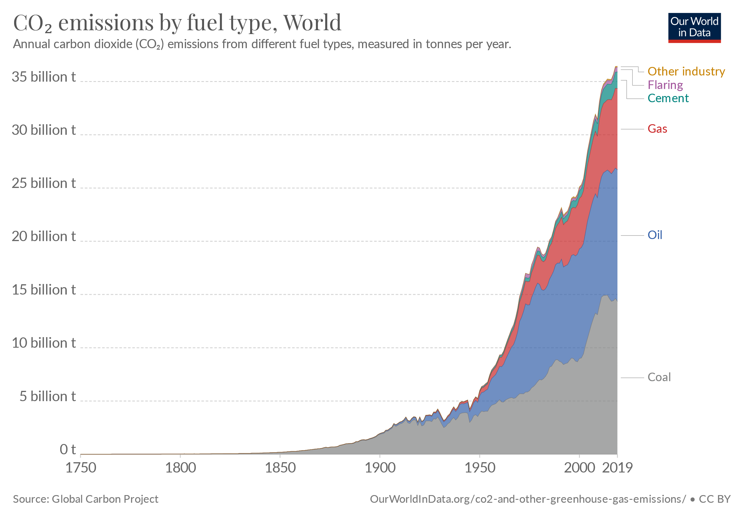
9.3. GHG emission sources
Emissions from energy
Emissions from fossil fuels continue to increase as we burn more each year for energy. Energy now accounts for around three-quarters of total greenhouse gas emissions
Source: OurWorldinData.org based on data from Global Carbon Project
Notes:
First, let us look at the energy sector. Burning fossil fuels – coal, oil, and gas – emit carbon dioxide. Fossil fuels are the largest source of global carbon dioxide emissions.
In the figure shown we see the amount of carbon dioxide emitted each year from different fuel sources. Emissions from fossil fuels continue to increase as we burn more each year for energy. Energy now accounts for around three-quarters of total greenhouse gas emissions.
To reduce global emissions, it is essential that we shift our energy systems away from fossil fuels towards low-carbon sources of energy. Increased availability of energy is important for raising the living standards of many across the world. But it also makes the transition to low-carbon energy systems more challenging: additions of clean energy have to outpace this growth in demand and displace fossil fuels already in the energy mix. The share of energy we get from low-carbon sources is increasing. But unfortunately, this progress is slow.

Slide 18
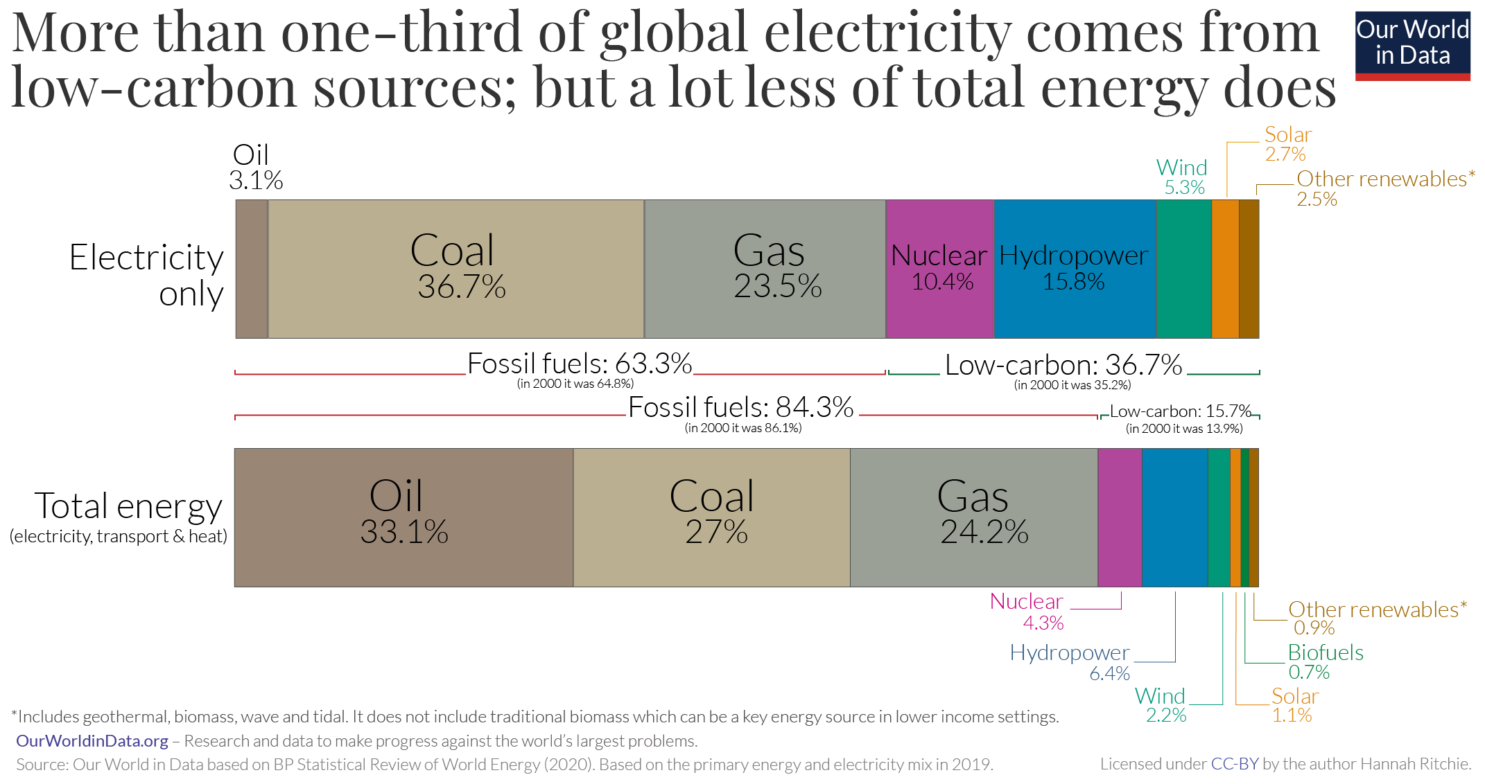
9.3. GHG emission sources
Emissions from energy
In 2019, low-carbon energy accounted for only 16% of global primary energy – around 11% from renewables and just over 4% from nuclear energy.
Source: OurWorldinData.org based on data from BP Statistical Review (2020) values in 2019
Notes:
Since three-quarters of global greenhouse gases come from energy – the burning of coal, oil, and gas – we need to rapidly transition to low-carbon sources of energy.
Whilst we continue to add more renewables, the majority of the world’s energy still comes from fossil fuels. In 2019, fossil fuels accounted for 84% of energy supply.
This is shown in the chart which gives a breakdown of the global energy mix by source. Low-carbon energy accounted for only 16%. Around 11% was from renewables and just over 4% from nuclear energy.
One of the reasons that the energy mix is so dominated by fossil fuels is that transport and heating are often harder to decarbonize than electricity. Transport relies heavily on oil and heating on gas. There are fewer energy options available to substitute in these sectors.
In the electricity system, however, we have more options: nuclear power, hydropower, wind, and solar. This means the electricity mix tends to have a higher share of low-carbon sources.
This comparison is shown in the chart: in 2019, just over one-third of global electricity came from nuclear or renewables [more than double the share in the total energy mix, at 16%].
This provides one important pathway for progress: if we can shift some activities towards electricity we may see greater progress on decarbonization. One example of this is electric vehicles: if we can shift oil-dependent transport to electrification then we have more options for powering them in a low-carbon way. This will, however, require massive increases in nuclear and renewable generation to make up for rising demand for electricity.

Slide 19
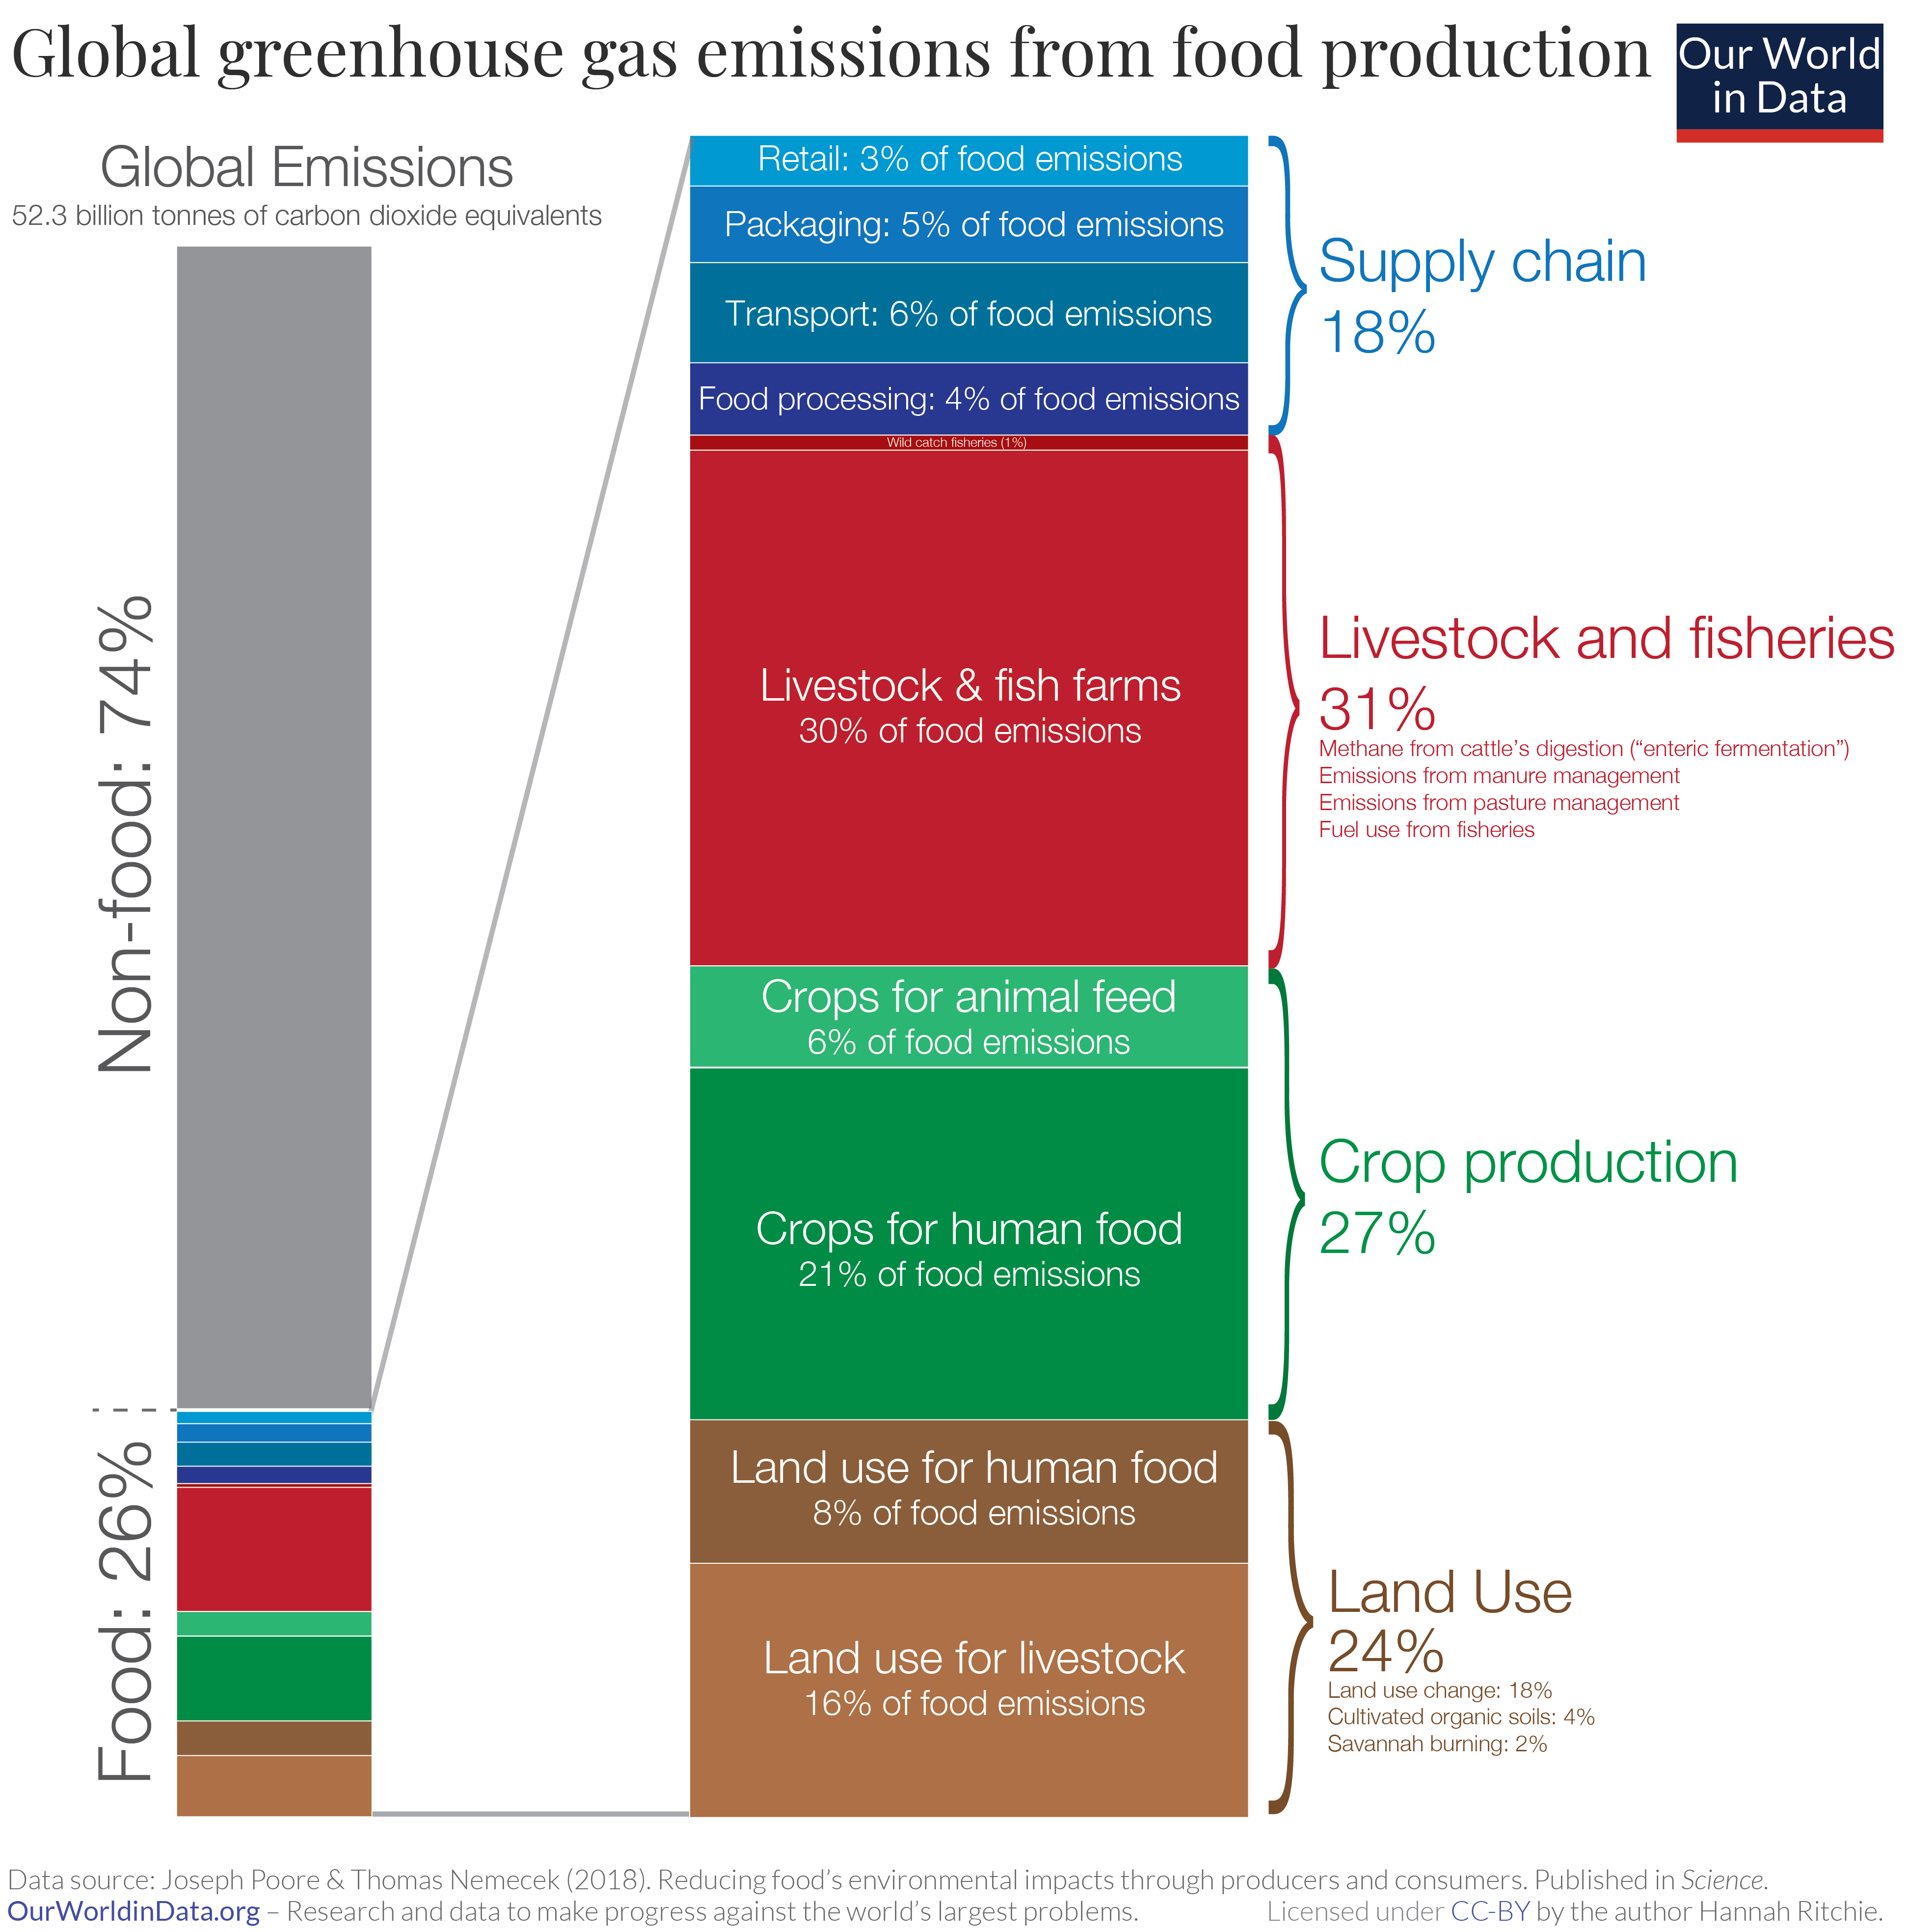
9.3. GHG emission sources
Emission from food production
Reducing emissions from food production will be one of our greatest challenges in the coming decades. Unlike many aspects of energy production where viable opportunities for upscaling low-carbon energy – renewable or nuclear energy – are available, the ways in which we can decarbonize agriculture are less clear.
Source: OurWorldinData.org based on data from Poore, J., & Nemecek, T. (2018).
Notes:
The global food system, which encompasses production, and post-farm process such as processing, and distribution is a key contributor to emissions. And it is a problem for which we do not yet have viable technological solutions.
Food is responsible for approximately 26% of global greenhouse gas emissions.
There are four key elements to consider when trying to quantify food GHG emissions. These are shown by category in the visualization:
Reducing emissions from food production will be one of our greatest challenges in the coming decades. Unlike many aspects of energy production where viable opportunities for upscaling low-carbon energy – renewable or nuclear energy – are available, the ways in which we can decarbonize agriculture are less clear. We need inputs such as fertilizers to meet growing food demands, and we ca not stop cattle from producing methane. We will need a menu of solutions: changes to diets; food waste reduction; improvements in agricultural efficiency; and technologies that make low-carbon food alternatives scalable and affordable.

Slide 20
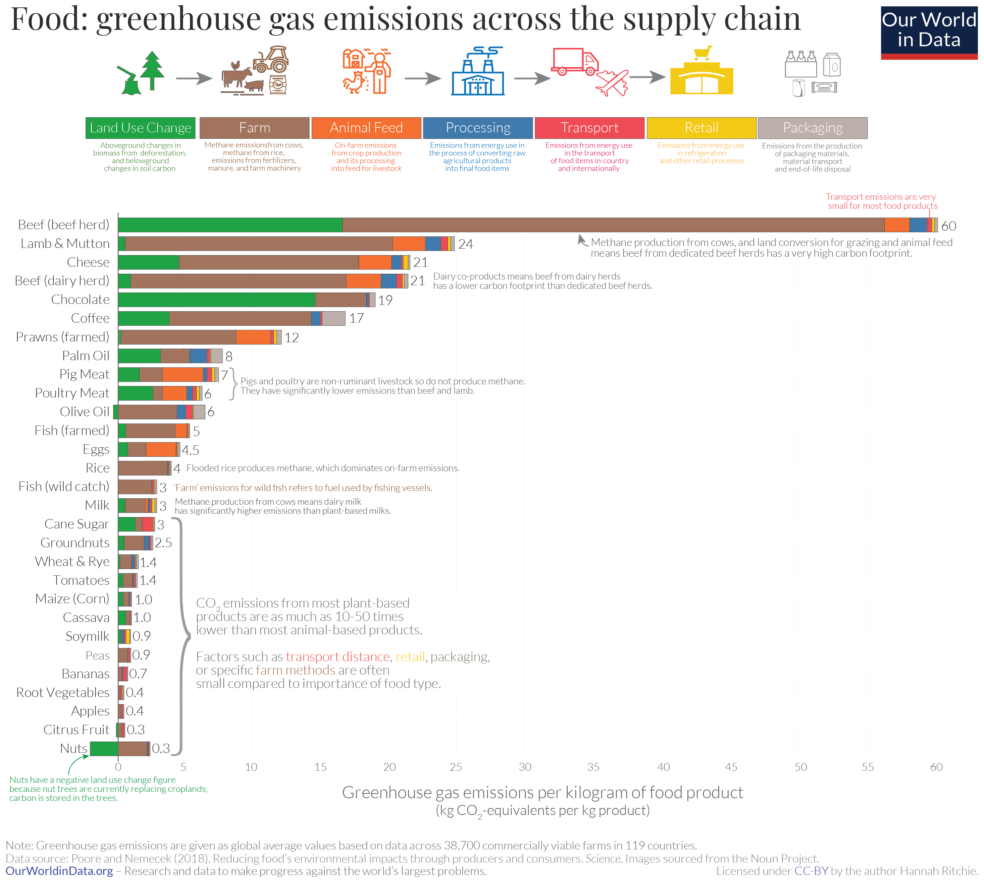
9.3. GHG emission sources
Emission from food production
Eating local beef or lamb has many times the carbon footprint of most other foods. Whether they are grown locally or shipped from the other side of the world seems to matter very little for total emissions.
Source: OurWorldinData.org based on data from Poore, J., & Nemecek, T. (2018).
Notes:
This comparison shows the total greenhouse gas emissions per kilogram of food product. Agriculture is a large source of methane and nitrous oxide in addition to carbon dioxide. The chart shows that here are large differences in the greenhouse emissions of different foods: producing a kilogram of beef emits 60 kilograms of greenhouse gases (carbon dioxide equivalents). Peas emits just 1 kilogram.
Overall, animal-based foods tend to have a higher footprint than plant-based. Lamb and cheese both emit more than 20 kilograms carbon dioxide equivalents per kilogram. Poultry and pork have lower footprints but are still higher than most plant-based foods, at 6 and 7 kilograms carbon dioxide equivalents, respectively.
For most foods – and particularly the largest emitters – most GHG emissions result from land-use change (shown in green on the chart), and from processes at the farm stage (brown). Farm-stage emissions include processes such as the application of fertilizers – both synthetic and organic (I.e.,“manure management”), and enteric fermentation (which is the production of methane in the stomachs of cattle). Combined, land-use and farm-stage emissions account for more than 80% of the footprint for most foods.

Slide 21
Lecture 9.3. References
Poore, J., & Nemecek, T. (2018). Reducing food’s environmental impacts through producers and consumers. Science, 360(6392), 987-992.
Hannah Ritchie and Max Roser (2020) - "CO₂ and Greenhouse Gas Emissions". Published online at OurWorldInData.org. Retrieved from: 'https://ourworldindata.org/co2-and-other-greenhouse-gas-emissions' [Online Resource]
21

Slide 22
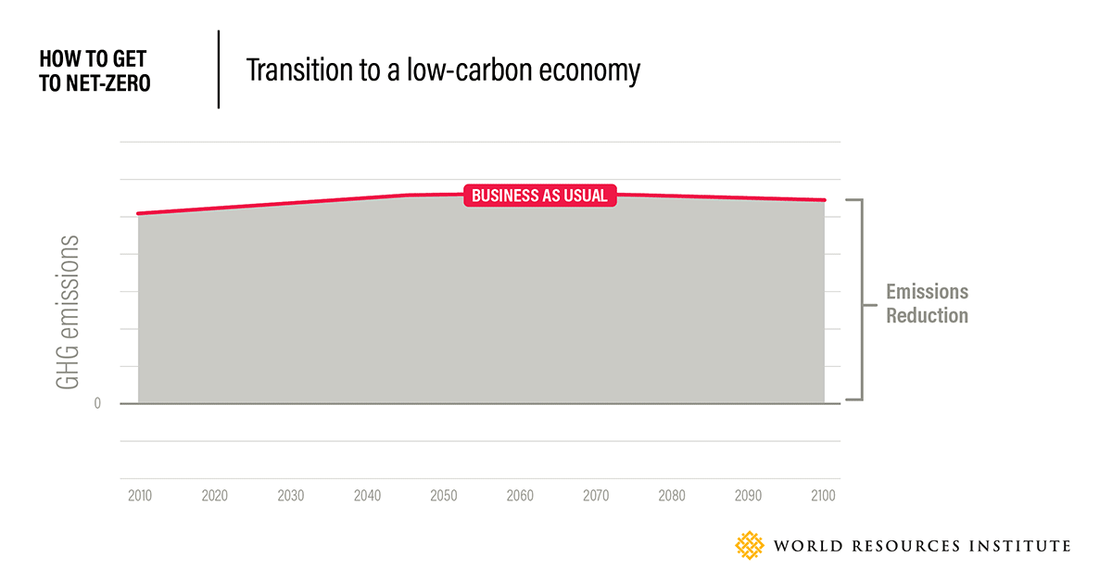
9.4. GHG mitigation
What does net zero mean?
Net-zero emissions will be achieved when all GHG emissions released by humans are counterbalanced by removing GHGs from the atmosphere
Source: World Resources Institute
Notes:
Several studies have shown that global greenhouse gas emissions will need to halve by 2030 and reach net-zero by around 2050. An increasing number of governments – both national and local – as well as businesses are announcing their pledges to reach net-zero emissions within their jurisdictions or businesses. This list includes China and the United States, two of the world’s largest emitters
But what does a ‘net-zero target’ mean and what’s the science behind net-zero?
Net-zero emissions will be achieved when all greenhouse gas emissions released by humans are counterbalanced by removing greenhouse gases from the atmosphere in a process known as carbon removal.
First and foremost, human-caused emissions (such as those from fossil-fuelled vehicles and factories) should be reduced as close to zero as possible. Any remaining greenhouse gas emissions should then be balanced with an equivalent amount of carbon removal, which can happen through things like restoring forests or using direct air capture and storage technology. Reaching net-zero emissions can be likened to achieving "climate neutrality."

Slide 23
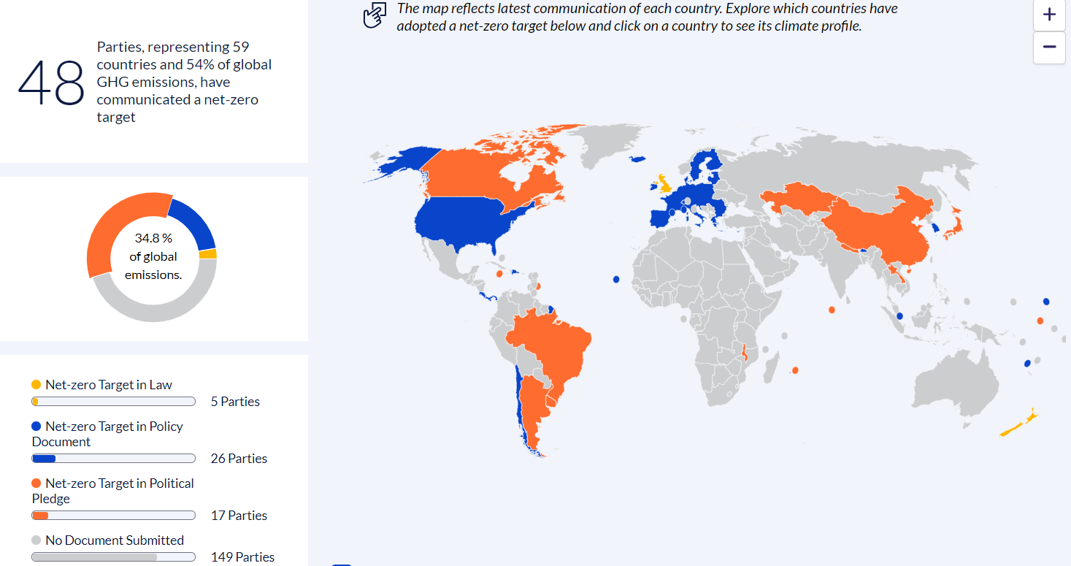
9.4. GHG mitigation
Net zero targets
Net-zero commitments must be robust and clearly defined in order to advance climate action.
Clarity on emission reductions occurring within country borders
Separate emission reduction targets
Intermediate milestones
Source: Net-Zero Tracker from Climate Watch, World Resources Institute (2020)
Notes:
Bhutan was the first country to set a net-zero target in 2015. Now over 50 countries, representing more than half of global emissions, have set a net-zero target. However, not all net-zero targets mean the same.
For instance, some countries’ net-zero targets rely on purchasing emissions reductions, delaying reductions within their own boundaries. This raises the issue that governments might use this strategy to avoid reducing their own emissions in the long-term. This concern can be addressed by setting clear and meaningful emission reduction targets that explicitly avoid or limit using offsets to achieve their goals.
Another issue is the potential over-reliance on nascent technologies such as carbon dioxide removal, allowing governments to use net-zero targets to avoid emission reductions in the near-term. This concern can be addressed by setting absolute reduction targets – which do not depend on removals – along with long-term net-zero targets.
Finally, the stated time horizon to achieve net-zero targets – often 2050 – may appear distant. However, as mentioned earlier, infrastructure built today is likely to last for decades and can therefore have a significant impact on achieving a target around three decades away. However, intermediate milestones can be established on the pathway to the ultimate goal of net-zero emissions.
Overall, net-zero commitments must be robust and clearly defined in order to advance climate action. And countries must therefore take concrete steps to set such robust net-zero targets.

Slide 24
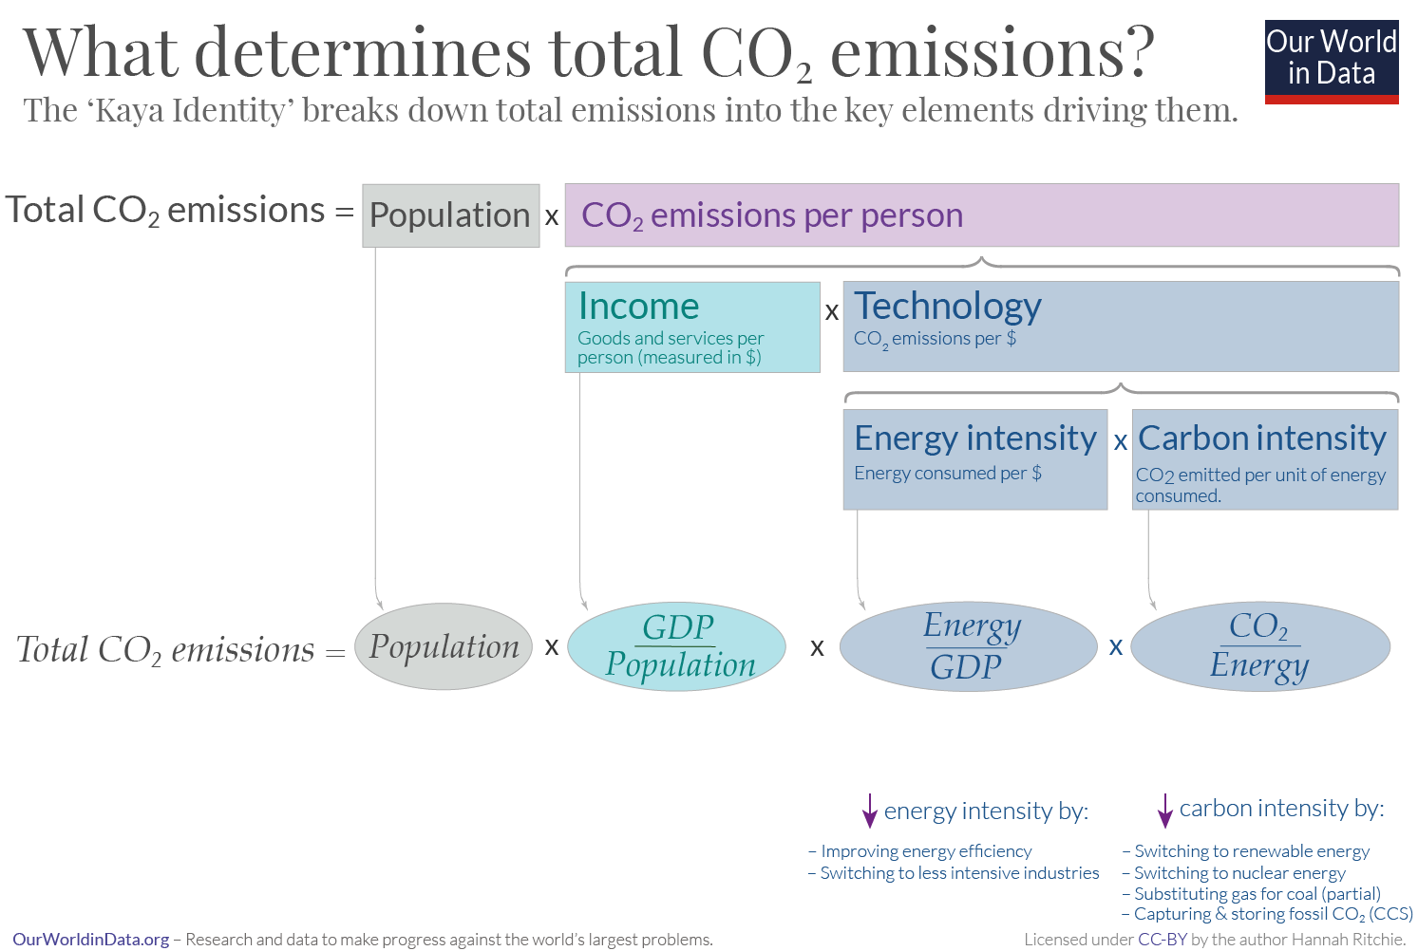
9.4. GHG mitigation
Emission drivers
Source: OurWorldinData.org
Notes:
In order to achieve emission reductions, it is important to identify what drives, and ultimately determines, the total amount of carbon dioxide emissions – across global, regional, national, or local levels.
Total carbon dioxide emissions are driven by four fundamental factors, outlined in the well-known equation: the ‘kayaah Identity‘. The breakdown of the kayaah Identity equation is shown in the graphic here. In the sections below we look at the role of these different factors in driving emissions.
Total emissions, in the simplest description, are determined by the following:
Population, or the total number of people; and per capita impact, or average emissions per person
Per capita emissions are determined by:
Income, measured as G.D.P. per capita, as richer people tend to emit more carbon dioxide; and technology, or how much carbon dioxide is emitted per dollar spent.
The term ‘Technology’ is determined by two factors:
Energy intensity, or the amount of energy consumed per unit of G.D.P.; and carbon intensity, or the amount of carbon dioxide emitted per unit of energy.

Slide 25
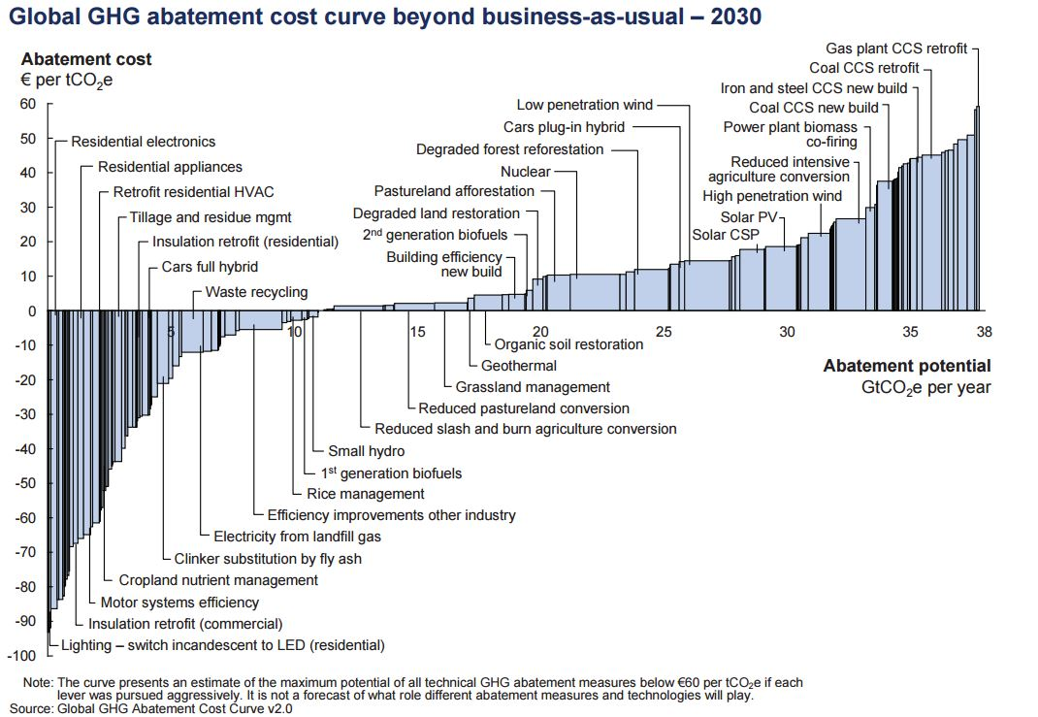
9.4. GHG mitigation
Cost of abatement
Pursuing all of the low-cost abatement opportunities currently available, the total global economic cost would be 200 to 350 billion euros per year by 2030, which is less than one percent of the forecasted global GDP in 2030.
Source: McKinsey and Company via OurWorldinData.org
25
Notes:
A common way of estimating the economic cost of mitigating climate change — by considering various options and their costs of reducing our greenhouse gas emissions — is to use the so-called ‘abatement cost curve’, which is sometimes referred to as the ‘marginal abatement curve’. Here we will explore what these curves are and how we use them. But before proceeding, it is important to note that these curves can be used at a range of levels to assess the best and most economic options we have for reducing GHG emissions. In particular, they can be constructed at global, regional, nationalm or city levels. Here, a global abatement curve developed by McKinsey & Company is shown.
On the x-axis is the abatement potential for a range of options to reduce greenhouse gas emissions; here, each bar represents a specific technology or practice. The wider the bar, the greater its potential for reducing emissions. On the y-axis is the abatement cost. This measures the cost of reducing greenhouse gas emissions by one tonne by the year 2030, and in this case is given in euros per tonne of carbon dioxide equivalents saved.
Using such an approach can provide some key insights. For instance, pursuing all of the low-cost abatement opportunities currently available, the total global economic cost would be 200 to 350 billion euros per year by 2030, which is less than one percent of the forecasted global GDP in 2030.

Slide 26
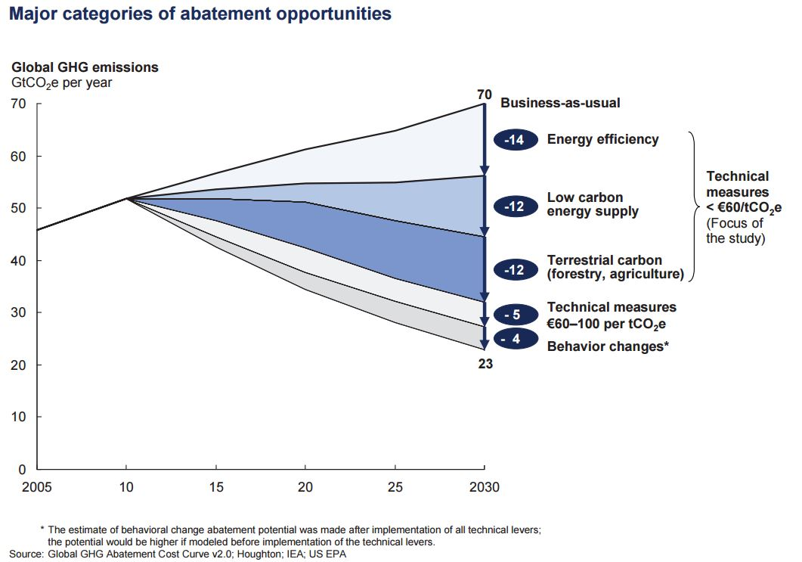
9.4. GHG mitigation
Measures to achieve abatement
Only options costing less than 60 euros/tonne: 38 billion tonnes of reduction by 2030
Including two additional options (technical options costing between 60-100 euros/tonne and behavioural change): 47 billion tonnes of reduction by 2030
Source: McKinsey and Company via OurWorldinData.org
26
Notes:
The abatement cost curve in the previous slide showed a total abatement potential of 38 billion tonnes of carbon dioxide equivalents per year with options costing less than 60 euros per tonne. This total potential has been summarized in the chart here.
The first line in this chart is the ‘business-as-usual’ (or B.A.U.) pathway. In this pathway, annual emissions are expected to be to be 70 billion tonnes of carbon dioxide equivalents by 2030.
Below this line are options for emissions reduction in five categories. The first three categories – energy efficiency, low-carbon energy supply, and terrestrial carbon options – cost below 60 euros per tonne of carbon dioxide abated. Together these three measures would translate to avoiding 38 billion tonnes of emissions.
But two additional types of opportunities for emission reduction are also showing. The first type consists of opportunities that are considered more expensive technical measures, costing 60 to 100 euros per tonne avoided. But such options are not unattainable. As a result, it is expected that the range of cheaper options will have a significantly greater uptake before more expensive technologies are adopted. The second type of additional opportunity lies in social and behavioural changes which influence energy consumption and consumer choices towards lower-carbon options.
Including these additional opportunities results in a maximum technical abatement potential by 2030 of 47 billion tonnes of carbon dioxide equivalents per year. The maximum global potential is therefore a 65 to 70% reduction relative to the current projected pathway.

Slide 27
Lecture 9.4. References
McKinsey&Company (2009) – Pathways to a low-carbon economy: Version 2 of the global greenhouse gas abatement cost curve. Available at: McKinsey&Company
27

Slide 28
Take Quiz
Shivakumar A. (UNDESA), Sridharan V. (KTH), Niet T. (SFU), Ramos E.P., Gardumi F. (KTH), Alfstad T., (UNDESA) 2021. Lecture 9: The climate system – Part I. Release Version 1.0. [online presentation]. Climate Compatible Growth Programme, United Nations Development Program and United Nations Department of Economic and Social Affairs.
CCG courses (this will take you to the website link http://www.ClimateCompatibleGrowth.com/teachingmaterials)

Slide 29

This document was updated on 01.11.2024

