Slide 1

LECTURE 8
Interlinkages
Introduction to CLEWs

Slide 2
Learning outcomes
By the end of this lecture, you will:
ILO1: Become familiar with the contribution of land-use, land-use change, and the energy sector in climate change, as well as the vulnerability of land, energy, and water systems to climate change
ILO2: Learn the ways in which energy and water systems are interlinked and what the associated policy questions are
ILO3: Learn the ways in which energy and land systems are interlinked and what the associated policy questions are
ILO4: Learn the ways in which land and water systems are interlinked and what the associated policy questions are
Notes:
By the end of this lecture, you will:
1: Become familiar with the contribution of land-use, land-use change, and the energy sector in climate change, as well as the vulnerability of land, energy, and water systems to climate change
2: Learn the ways in which energy and water systems are interlinked and what the associated policy questions are
3: Learn the ways in which energy and land systems are interlinked and what the associated policy questions are
4: Learn the ways in which land and water systems are interlinked and what the associated policy questions are

Slide 3
8.1 CLEWs interlinkages
Interlinkages exist between climate, land, energy and water systems.
  Positive and negative feedback may exist between goals in different sectors
  The objective of CLEWs analysis is to study and assess these interlinkages to help manage these interlinkages to best protect our environment, while securing food, energy, and water security
Notes:
The central objective of analysis with the CLEWs model is the study of the interactions and interplay between the land, energy, and water systems, as well as the impact on climate change and the vulnerability to climate change. This means it can be used to inform coherent and cohesive policies and strategies in these areas. In previous lectures these systems have been addressed individually, while in this lecture the interlinkages between them will be explored in more detail.
Interlinkages refers to interactions between these systems where developments in one sector affect developments in another. As we will see in this lecture, these interactions can be synergistic – that is, an intervention has a positive impact in more than one area – or there may be trade-offs – where action in one area works against policy goals in another. The ultimate goal when conducting CLEWs analysis is to look at ways in which synergies can be leveraged and trade-offs can be minimized in pursuit of overall coherent and effective strategies for sustainable development.

Slide 4
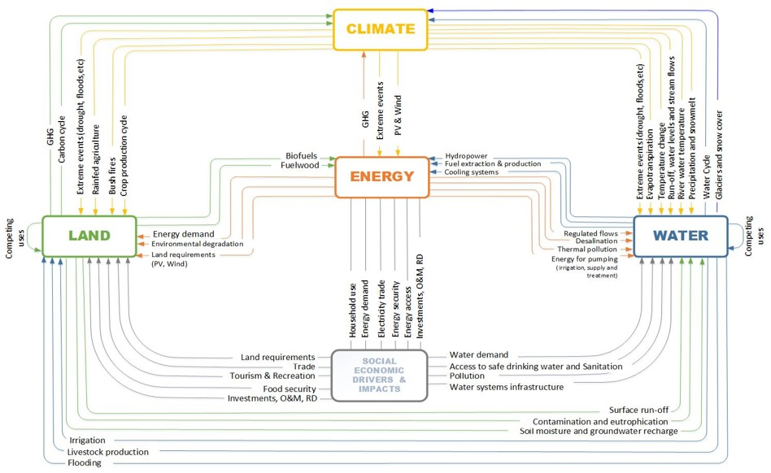
8.1 CLEWs interlinkages
Interlinkages exist between climate, land, energy and water systems.
Notes:
This diagram illustrates many of the interlinkages that will be addressed in more detail in this lecture. It shows how the systems are tied together and how each is dependent on the others. Energy is used in land preparation and processing of crops as well as to operate water infrastructure. Land is closely related to water through the link between land cover and hydrology and provides bioenergy as a fuel for energy applications. Water is used for irrigation of agriculture and also for hydropower, cooling, and other applications in the energy system. At the same time, these sectors are contributing to climate change as major sources of greenhouse gas emissions, and they are also highly vulnerable to changes in climate.
It is then clear that changes or perturbations introduced in one area can have implications for others, and these impacts will ripple through the integrated systems. These cross-sectoral dependencies may be both synergistic or antagonistic, meaning that actions taken in pursuit of policy goals in one area or sector may be either conducive or detrimental to progress in another. The aim of this lecture is to help detail the main interlinkages that exist between these sectors to provide the basis for a systematic approach to identify relevant linkages across the sectors and domains for a specific policy or intervention under consideration.

Slide 5
8.1 CLEWs interlinkages
Interlinkages exist between climate, land, energy and water systems.
Energy, agriculture, land-use change, and forestry are responsible for over 90% of GHG emissions [1]
Notes:
The diagram on the slide shows a breakdown of greenhouse gas emissions by sector. The energy, agriculture, and land-use change sectors are the major contributors to anthropogenic greenhouse gas emissions and any effective strategy to achieve major reductions in emissions will have to target all of these sectors. Combined they are responsible for over 90% of emissions.
The largest individual source of greenhouse gas emissions is the energy sector, which is responsible for almost two-thirds of all emissions. Carbon dioxide is released during combustion of fossil fuels such as coal, natural gas, and oil products.
Agricultural emissions make up about 14% of the total. The largest source of emissions is from soil management, but enteric fermentation – release of methane gas produced during the digestive process of livestock and manure management – is also an important source. Unlike the energy sector, where carbon dioxide emissions make up the vast majority of greenhouse gas emissions, methane and nitrous oxide make up a large share of emissions from agriculture.
When natural carbon sinks such as forests and wetlands are destroyed, much of the stored carbon is released to the atmosphere. Such emissions are attributable to land-use change and make up about 12% of total greenhouse gas emissions.

Slide 6
8.1 CLEWs interlinkages
Impact of climate change on food, energy and water security
Water cycle
  The magnitude and timing of precipitation may change
  Increased frequency of extreme weather events
  Impacts on crop suitability and crop productivity
  Impacts on hydropower
Temperature changes
  Impact on crop suitability and crop productivity
  Impact on energy demand
Sea level rise
  Impact on land use
  Impact on infrastructure
  Impact on water resources
Notes:
At the same time as the manner and extent to which the exploitation of land, energy, and water resources is contributing to climate change, the related systems are also highly vulnerable to changes in climate.
A key aspect of how climate change is likely to be felt is through its impact on the water cycle, which – as will be seen in this lecture – will also have knock-on effects in the other sectors. Changes in the water cycle may affect magnitude and timing of precipitation with serious ramifications for watershed management, crop production, and hydroelectric power generation. Extreme weather events may threaten water and energy infrastructure and both flooding and drought may damage crops and compromise food security and livelihoods.
Changes in temperature may impact crop suitability and productivity, as well as energy demand for cooling and heating of buildings.
Sea level rise can have major impacts on land use, as coastal regions are flooded or need to be protected. This will extend to energy and water infrastructure. Water resources may also be impacted as seawater is pushed up rivers, bringing saltwater into rivers and lakes currently used as water resources. This may also lead to saline intrusion of aquifers.

Slide 7
8.1 CLEWs interlinkages
Selected policy issues for climate interaction with land, energy, and water systems
Climate change mitigation
  Reduce emissions from fossil fuels
  Reduce emissions from land use and land-use change
  Sequester carbon
Climate change adaptation
  Reduce vulnerability of infrastructure
  Increase climate resilience
Notes:
Policy regarding climate change generally falls into two categories: mitigation and adaptation.
Mitigation is aimed at avoiding or limiting the changes to our climate by reducing emissions. The key strategy for this is to reduce the combustion of fossil fuels by switching to lower or zero carbon alternatives in electricity generation, transportation, industry, agriculture, and in buildings. Better soil management and sustainable farming practices, limiting destruction of natural carbon sinks, such as forests and wetlands, and moving to more plant-based diets are also strategies that can help reduce emissions. Sequestration – the removal of carbon from the atmosphere through reforestation and promotion of other natural sinks or artificial means – is another viable strategy for climate mitigation.
Climate adaptation refers to strategies and actions to prepare for and adjust to climate change. This can mean strengthening infrastructure and homes to cope with extreme weather events, investment in natural disaster preparedness, development of crop variants and farming practices better adjusted to cope with higher temperature and more erratic rainfall, and a host of other measures. The aim is to make our economies and societies more resilient and robust in the face of changing climates.

Slide 8
Lecture 8.1 References
World Resources Institute, ClimateWatch, https://www.climatewatchdata.org/

Slide 9
8.2 Energy–Water interlinkages
Water is needed for energy conversion
Hydropower is a major contributor to global electricity production [1]
Contributes 16% to global electricity supply
Contributes more than 50% to electricity supply in 51 countries
Contributes more than 75% to electricity supply in 23 countries
Is the only source of electricity (>99%) in 5 countries
Water is required to cool thermal power generation technologies such as coal, natural gas, solar thermal, geothermal, and nuclear power plants.
The water intensity varies widely between technologies
Notes:
Water is needed for energy conversion. The clearest example of this is the use of hydropower for electricity generation. Hydroelectric power plants produce about 16% of electricity globally, but the dependence varies greatly from country to country and region to region, as the potential is highly dependent on water availability and topography. When the potential for hydropower exists, it has often been a preferred source of electricity. In 51 countries hydropower contributes more than 50% of power supply, and in 23 it contributes more than 75%. In 5 countries it is virtually the only source of electricity.
However, water is also required for other types of power generation. Thermal power stations with a steam cycle such as coal, natural gas, solar thermal, geothermal, or nuclear power plants need large amounts of water for cooling. The amount of water required varies by technology. A modern combined-cycle power plant, for instance, may only use a third of the water of a sub-critical coal fired power plant per unit of electricity produced. There is therefore a clear link between technology choice in the power sector and the water footprint of electricity generation.

Slide 10
8.2 Energy–Water interlinkages
Water is needed for energy conversion
Approximately 20% of freshwater withdrawals globally are for industrial purposes, the majority of which are related to energy use and conversion.
  Cooling thermal processes in the manufacturing sector,
  Fuel refining and conversion,
  Biofuel production
  Primary fuel extraction,
  Emissions control
Notes:
The industrial sector is responsible for approximately 20% of water withdrawals worldwide. This share tends to be lower for low-income countries with a more limited industrial base and higher for high-income countries. The majority of this is for the power sector as discussed on the previous slide, but other energy-related applications also require cooling water. In a similar manner to how water is used to cool in thermal power plants, other industrial thermal uses, such as steam heat in the manufacturing sector, also require water for cooling. Energy sector applications can be particularly steam intensive, such as oil refineries that convert crude oil into petroleum products and biofuel refineries. Water is also required for primary fuel extraction, such as in coal mines, in oil extraction – in particular for enhanced oil recovery – and in natural gas production. Water is also needed for emission control, such as desulphurization of flue gas from burning fossil fuels.

Slide 11
8.2 Energy–Water interlinkages
Energy is needed for water supply and conveyance
The water supply chain is energy intensive (4% of electricity consumption worldwide, up to 10% in Middle East and India)
Supply:
  Surface water: 0–2,400 kWh per million litres for transportation depending on distance and change in elevation [3]
  Groundwater: Varies with depth (e.g., 140 kWh per million litres at 35 metres and 530 kWh per million litres at 120 metres) [3]
Distribution:
  Average of 290 kWh per million litres, but varies widely depending on distance and change in elevation [3]
Notes:
Conversely energy, in particular electricity, is required to operate water infrastructure. Approximately 4% of electricity demand worldwide – and significantly higher shares in some regions – is used in the water supply chain.
A prominent component of this is the conveyance of water from the source to the demand centre. The energy requirement is largely determined by the distance and terrain over which the water needs to be transported, and it will therefore vary widely from one system to another. In particular, for systems where water needs to be lifted to higher altitudes the energy cost of water supply will be high. Conversely, if the source of water is higher than the demand centre, gravitational forces may be sufficient for delivery. If groundwater is used as the water source, for either public water supply or irrigation, the water needs first needs to be pumped to the surface, with corresponding energy demand proportional to the depth of the water source.
Once water is delivered to a public water supply system or other water distribution network, energy for pumping will usually still be required to deliver it to end users. The energy cost of water distribution is highly site-specific, with topography and distance as the main determinants.

Slide 12
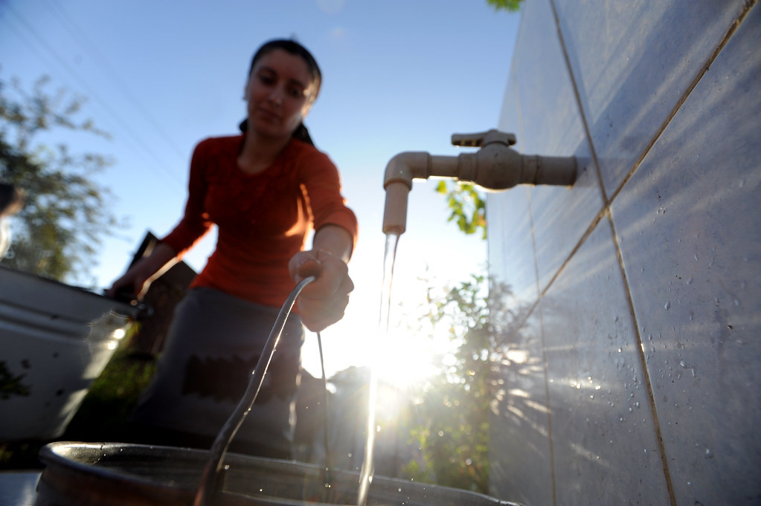
8.2 Energy–Water interlinkages
Energy is needed for water treatment
Treatment:
  26 kWh per million litres for high-quality groundwater
  300–1400 kWh per million litres for brackish groundwater desalination
  3,600–4,500 kwh per million litres for seawater desalination
Photo source: "National Water and Sanitation Program brings better water and sanitation services to rural parts of Azerbaijan" by World Bank Photo Collection is licensed under CC BY-NC-ND 2.0
Notes:
Energy is also used to treat water to make it safe for human consumption. The energy requirement is largely determined by the quality of the water source, with high quality water sources requiring relatively little energy, while energy demand will increase progressively with lower quality sources. An extreme case is seawater which requires desalination before it can be used for public water supply. In certain water scarce areas, such as the Middle East, this highly energy intensive process is used to ensure sufficient water supply for the populace. Different technologies for desalination are in use. These are mainly based on two processes. The first is distillation, such as multi-stage flash distillation, which requires energy to heat water to produce water vapor. The second are membrane processes, such as reverse osmosis, which are more energy efficient and the most widely used technology today.
Energy is also required to treat wastewater from industrial and public water systems before it is returned to the environment.

Slide 13
8.2 Energy–Water interlinkages
Selected policy issues for energy–water interlinkages
  The timing and magnitude of water withdrawals and releases for energy applications can compete with, or interrupt, other uses
  There are important linkages between technology choice in the power sector and water demand
    Some low carbon technologies (e.g., solar PV or wind) have a small water footprint
    Others have a large water footprint (e.g., nuclear, geothermal, and solar thermal)
  Several factors can lead to increasing energy intensity of water supply
    Urbanization
    Lower quality water sources
    More water treatment
Notes:
These interlinkages highlight a number of cross sectoral impacts that decision-makers need to consider when formulating polices and strategies, if both energy and water security goals are to be effectively managed.
A non-exhaustive list of these might include water withdrawals for energy purposes. These need to be considered in relation to other uses with which they may be in competition for scarce resources. Water for energy applications might be drawn from sources that also serve agricultural uses or public water supply. This may compromise food security if overall supply is insufficient.
Beyond direct competition there may be other ways in which detrimental interactions occur. This could, for instance, be the case for dams that are used both for power generation and to provide water for irrigation. The ideal timing of water releases may differ for the various applications and therefore mean that there are trade-offs that operators need to manage.
Further to this is the important connection between technology choice in electricity generation and water intensity. As highlighted earlier, low carbon power technologies can both be water efficient and water intensive. Which type of power generation technology is chosen will therefore help determine if a shift to clean energy will improve water security or be detrimental to it.
Furthermore, several trends are driving the energy intensity of water supply higher. Urbanization involves congregation of people into demand centers, leading to a concentration of demand, often away from water resources. This increases the distance water will need to be transported. Similarly, higher demand levels and demand concentration may necessitate the use of lower quality water resources that it will take more energy to treat. Finally, expansion of access to clean water as well as concerns about the environment will likely increase the level and extent of water treatment.

Slide 14
Lecture 8.2 References
BP (2021), BP Statistical Review of World Energy 2021 and Ember https://ember-climate.org/data/
World Economic Forum (2011), Water Security: The Water-Food-Energy-Climate Nexus

Slide 15
8.3 Energy–land interlinkages?
Land is used to provide energy in the form of solid biomass
Bioenergy accounts for a little more than 10% (60 EJ) of the world’s total primary energy supply [1]
35% of the world population have no access to safe and clean energy for cooking and many rely on wood fuel and charcoal for their energy needs [2,3]
Land is used to provide bioenergy for electricity generation
About 500 TWh of electricity is produced from biomass annually. This is equivalent to about 2% of world electricity generation [1]
Notes:
Bioenergy is an important source of energy, which by extension means that land is important for energy supply. Around 10 exajoules of energy – equivalent to roughly 10% of the world total primary energy supply – is in the form of bioenergy. Biomass is used for a wide range of energy applications by households, industries, and power companies.
For instance, almost two-thirds of the world population does not have access to safe modern fuels for cooking. Many of these people rely on biomass in the form of wood fuel or charcoal for their energy needs. In many developing countries, biomass is the largest source of energy, dominated by residential uses.
Biomass is used to generate around 500 Terawatt hours of electricity, corresponding to about 2% or world electricity supply. Co-generation of electricity from industrial facilities, such as sugar or pulp and paper mills, is an important part of this. However, co-firing in coal fired power stations or dedicated biomass power plants also contribute.

Slide 16
8.3 Energy–land interlinkages
Land is used to provide energy in the form of liquid biofuels
Many countries have pursued mandates, subsidies, or other support measures to increase biofuel production with the aim to:
  Reduce dependence on liquid fuel imports
  Reduce GHG emissions
  Boost income of farmers
Approximately 15% of harvested maize and over 20% of sugarcane are used to produce bioethanol
Approximately 15% of harvested oil seeds are used to produce biodiesel
Notes:
An aspect of bioenergy that has received a lot of attention is the increased use of liquid biofuels for blending into gasoline and diesel.
Over the past couple of decades many countries have pushed for an increase in biofuel production through mandates, subsidies, or other support measures. The aim of such policies has been to reduce dependence on imported petroleum fuels such as gasoline, diesel, and jet fuel and thereby improve both the balance of payment as well as energy security. Reducing greenhouse gas emissions has also been an important driver in some cases, as has a desire to support the income of farmers by giving them an additional market for their crops.
Around 15% of maize and 20% of sugarcane is now used to produce bioethanol as a substitute for gasoline, and about 15% of oil seeds are now used to produce biodiesel as a substitute. This is evidence of an increasing land footprint and a link between markets for land, crops, and energy.

Slide 17
8.3 Energy–land interlinkages
Energy in the form of electricity or fuel is used directly in agriculture to:
Power agricultural machinery for field preparation, crop harvesting, drying, and processing
Pump water for irrigation
Heat or cool buildings
Lighting
Livestock operations consume direct energy for ventilation systems, refrigeration, lighting, heating, watering, motors, and waste handling
In 2018 about 2.2% of final energy demand was used directly in agriculture [1]
Notes:
Energy is needed to produce crops, livestock, and other agricultural outputs, such as fibre and fuel. A major driver behind the large increases in productivity in agriculture over the past century has been mechanization and the use of energy intensive inputs such as fertilizer and pesticides.
Petroleum fuels, electricity, and biomass are used to power agricultural machinery, such as tractors, combine harvesters, and other equipment for field preparation, crops harvesting, drying, and processing. Electricity is also needed to run the pumps that lift, transport, and pressurize water to irrigate fields. Furthermore, energy is also needed to heat or cool farm buildings and to provide inside and outside lighting.
While consuming significantly less energy than crop production globally, livestock operations require energy inputs for ventilation systems, refrigeration, lighting, heating, watering, motors, and waste handling,
In total this adds up to around 9 exajoule of energy, which is equivalent to 2.2% of global final energy demand.

Slide 18
8.3 Energy–land interlinkages
Energy in the form of electricity and fuel is used in the food value chain to:
Produce fertilizer, pesticides, and other agricultural inputs
Transport crops and food products
Process foods (e.g., dairy, milling, etc.)
Refrigeration
Preparation/cooking
In total the FAO estimates that the direct and indirect energy use related to the food value chain account for around 30% of total energy consumption [4]
Notes:
Beyond the direct uses in agriculture, energy is also used throughout the rest of the food value chain.
Many of the inputs to modern farming are energy intensive. The production of fertilizers, for instance, requires large amounts of energy and is responsible for around 1.2% of global energy demand. The manufacture of other inputs such as pesticides also has significant energy needs.
Energy in the form of liquid fuels is required for transportation of food crops and food products at various stages of the value chain. This can include transport from farms to markets or for further processing and then to wholesalers or retailers and finally to peoples’ homes.
The food manufacturing sector, which transforms agricultural produce into products for intermediate or final consumption, also requires energy for operations. This includes dairies, flour mills, meat processing plants, bakeries, and many other facilities.
Throughout the various stages energy is required for refrigeration to keep products from spoiling, as well as for other building services such as ventilation, heating, and lighting.
Finally, energy is required for food preparation and cooking.
In total the United Nation’s Food and Agriculture Organization estimates that the entire food value chain consumes about 30% or global final energy demand.

Slide 19
8.3 Energy–land interlinkages
Selected policy issues for energy–land interlinkages:
Food vs fuel. Competition for land (and water) between energy and other uses and potential detrimental impacts on food (and water) security
Bioenergy as a strategy to reduce carbon emission
Food loss/waste and impact on energy use and emissions
Deforestation due to unsustainable biomass harvesting or land conversion for energy applications
Notes:
A key concern for policy for land and energy is the use of agricultural land and food crops to produce biofuels. Often referred to as the “food versus fuel debate”, the concern is that biofuel policies are increasing the commercial pressures on agricultural land and creating direct competition for cropland between energy and food, potentially compromising food security. The question of whether it is strategic and ethical to divert food for energy uses in this way has caused many countries to scale back or reverse the push for biofuels.
Since sustainable bioenergy harvest in principle could be carbon neutral, bioenergy is considered as a emission reduction option for many sectors and applications. By using biomass and land that is not otherwise used for food production the negative impacts on food security can be managed.
Around 14 percent of food produced is lost between harvest and retail. Significant quantities are also wasted in the retail sector or at the consumption level. Given the significant contribution of the food value chain to both energy demand and greenhouse gas emissions, reducing food loss and waste could have significant benefits for energy security and climate as well.
Bioenergy has a large land footprint relative to most other energy sources and can have significant impact on land use and land cover. Overexploitation of wood fuel resources or clearing of forests for oil palm plantations or other biofuel operations can be significant drivers of deforestation.

Slide 20
Lecture 8.3 References
International Energy Agency (2020), World Energy Balances
United Nations (2020), The Sustainable Development Goals Report 2020, https://unstats.un.org/sdgs/report/2020/The-Sustainable-Development-Goals-Report-2020.pdf
United Nations, SDG Indicators - United Nations Global SDG database https://unstats.un.org/sdgs/indicators/database/
Food and Agriculture Organization (2011), “Energy-Smart” Food For People And Climate http://www.fao.org/3/i2454e/i2454e.pdf

Slide 21
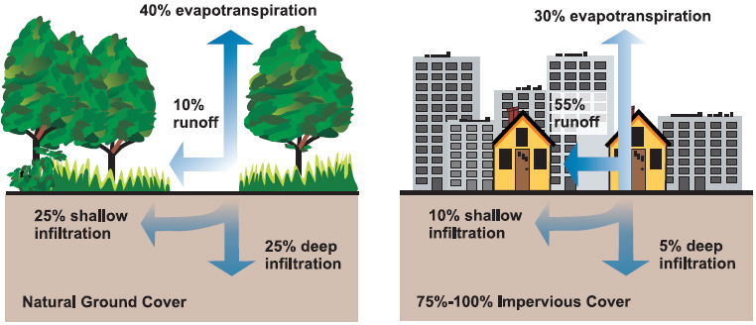
8.4 Land–water interlinkages
Land use is closely interlinked with water use and the water cycle:
The water balance is closely linked with land use (refer to lecture 7)
Evapotranspiration, run-off, groundwater infiltration, and storage capacity are all dependent on land cover
The type of land use and land-use change will consequently have major impacts on the hydrology in a watershed
Photo Source: U.S. Environmental Protection Agency, natural and impervious cover diagrams, Public domain, via Wikimedia Commons
Notes:
An important link between land and water is the important role of land use and land cover for the hydrology of a watershed. As discussed in lecture 7, different land covers will have different water balances and a change in land cover will therefore affect water fluxes.
For instance, natural land cover such as woodlands and grasslands have very different hydrological properties than built-up land, such as cities, roads, or other infrastructure, where much of the surface is covered with asphalt or concrete. Land with vegetation will consume more water as evapotranspiration to support plant growth and will allow more water to be stored in the soil or infiltrate through to ground water. For built-up land the surface is less permeable, and the evapotranspiration is lower; however, this means that run-off will be higher as less water is absorbed by soil and plants. Cities will usually have dedicated infrastructure to manage rainfall, discharge run-off, and prevent flooding.

Slide 22
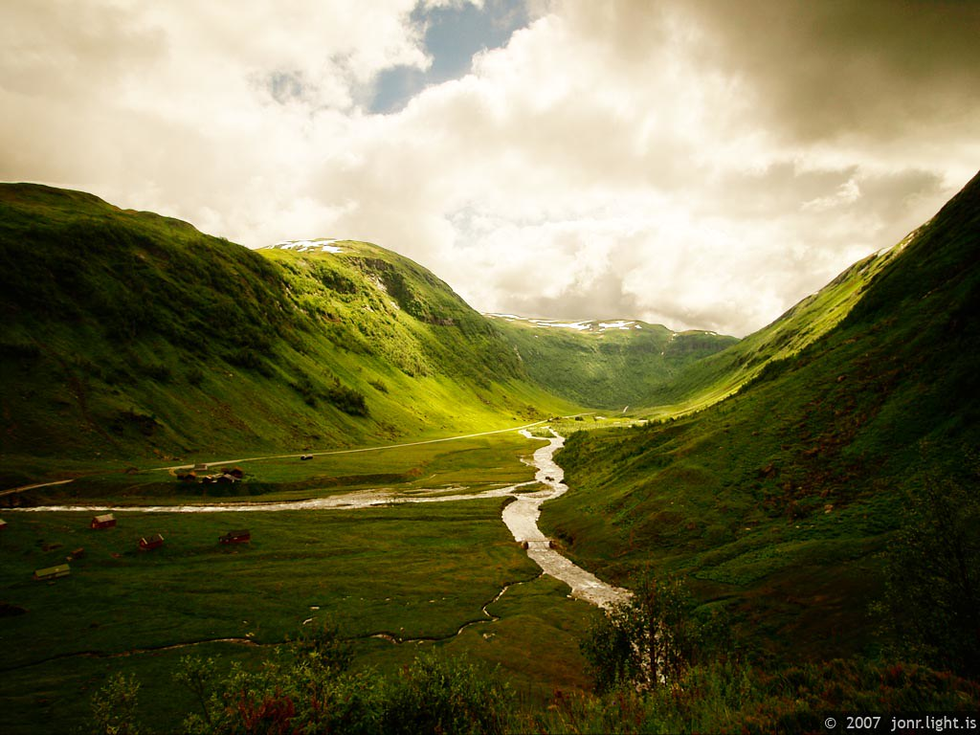
8.4 Land–water interlinkages
Land use is an integral part of watershed management
Land-use influences hydrology, water availability, water quality, ecosystem functions, land productivity, stream-channel morphology, and flood protection
Sustainable watershed management necessitates a broad and integrated view of activities in a watershed
This includes regulation and management of land use and land cover
Photo Source: "Hola Valley, Norway" by Jon Ragnarsson is licensed under CC BY-NC-ND 2.0
Notes:
Virtually all central elements of watershed management such as hydrology, water availability, water quality, ecosystem functions, land productivity, stream-channel morphology, and flood protection are impacted by land use and land use change. It follows that sustainable watershed management necessitates a broad and integrated view of activities in a watershed, including how land is used and converted.
However, watershed management is not the action of one entity or actor. Government agencies, municipal, and private and individual actors and entities all conduct activities that influence land cover and hydrology within the watershed. The challenge is then not only to manage the hydrological and biophysical elements of the watershed, but also the interplay between a range of different stakeholders with different views and priorities. Physical, regulatory, and economic tools and actions can be used to manage and influence the behaviour and decisions of these stakeholders in the pursuit of sustainable use of the land and water resources of the watershed.

Slide 23
8.4 Land–water interlinkages
Agriculture is responsible for a large share of:
Approximately 70% of freshwater withdrawals worldwide are for agriculture [1]
The majority of this is for irrigation of cropland to boost productivity and protect against droughts
Irrigated agriculture represents 20% of cultivated land and accounts for 40% of global food production [2]
Water withdrawals are from both surface and groundwater resources
Water is also withdrawn to support livestock populations
Photo Source: U.S. Environmental Protection Agency, natural and impervious cover diagrams, Public domain, via Wikimedia Commons
Notes:
Beyond the links between land cover and watershed management, land uses – in particular crop cultivation – are major users of water. Around 70% of water withdrawals worldwide are for agricultural purposes. The majority of this is for irrigation of crops, although water to support livestock populations is also an important contributor.
Around 20% of global cropland is irrigated and 40% of all crops are grown on cultivated lands, illustrating both the extent of irrigation as a tool to improve land productivity as well as the efficacy of it. Water supply is critical for plant growth, and irrigation can ensure adequate supply of water to support plant growth even in dry weather.
Water for irrigation can be drawn from surface water resources such as rivers, streams, or lakes. Dams are often built to help provide irrigation water when it is needed. In areas where surface water is not available, or it is cheaper of more convenient to use ground water, wells may be used to provide water.

Slide 24
8.4 Land–water interlinkages
Selected policy issues for land–water interlinkages :
Hydrology, water availability, water quality, ecosystem functions, land productivity, stream-channel morphology, and land use as integral parts of watershed management
Competition for water
Food security/water security trade-offs
Land degradation
Notes:
The central issue in management of land and water interlinkages is the close relationship between land use and hydrology and the integral role land use plays in integrated watershed management, natural resource protection, and sustainable development more broadly, as has been discussed in previous slides as well as in lecture 7.
Beyond this, a central point is that there is competition for water between agriculture, which often holds rights to water use, and other uses. These other uses often are higher in value, if value is either measured in terms of the marginal monetary value for productive uses or by the willingness to pay for it.
Related to this, we also have trade-offs in water security versus food security where additional food production, or security of production, can be gained at the expense of water security and availability for alternative uses.
Land degradation resulting from unsustainable land use can also have impacts on a watershed. Erosion and degradation of land can negatively impact water quality, cause damage to wildlife habitats, increase sediment flow rates and siltation, and reduce natural flood protection.

Slide 25
8.4 Land–water interlinkages
Summary of lecture 8 on interlinkages:
Energy, land-use and land-use change are major contributors to climate change
Land, energy and water systems are highly vulnerable to changes in climate
Land, energy and water systems are closely interlinked
Notes:
Previous lectures have introduced central themes in energy, land and water analysis and policy. This lecture has explored the ways in which these systems are interlinked and how actions and decisions taken in pursuit of objectives and goals in one sector can have consequences in others.
The key takeaways are that:
Energy, agriculture, land-use change, and forestry are the major sources of greenhouse gas emissions, comprising more than 90% of total anthropogenic emissions. Meaningful action to reduce emissions and limit climate change will therefore need to target these sectors.
Land, energy and water systems are highly vulnerable to changes in climate such as shifting precipitation patterns, increases in temperature, more frequent extreme weather events and rising sea levels. To make our societies and economies more resilient to face climate change, action is needed in these sectors to adapt to such changes.
Land, energy and water systems are interlinked and dependent on each other. Energy is required to treat and deliver water, water is required to convert energy, water is required to grow crops, land is required to supply bioenergy and land use is a critical element of management of watersheds and water resources. Food, energy and water security are therefore inseparably linked and sustainable development necessitates integrated and coherent approach to policy and strategy formulation.
This concludes lecture 8 on interlinkages between climate, land, energy and water. Lecture 9 will take a closer look at climate change

Slide 26
Lecture 8.4 References
Food and Agriculture Organization, AquaStat Database, http://www.fao.org/aquastat/statistics/query/results.html
UNESCO (2014), The United Nations world water development report 2014: water and energy; facts and figures

Slide 27
Take Quiz
Alfstad T., Shivakumar A. (UNDESA)., Niet T. (SFU)., Gardumi F., Sridharan V. (KTH)., 2021. Lecture 8: Interlinkages. Release Version 1.0. [online presentation]. Climate Compatible Growth Programme, United Nations Development Program and United Nations Department of Economic and Social Affairs.
CCG courses (this will take
you to the website link http://www.ClimateCompatibleGrowth.com/teachingmaterials)

Slide 28

This document was updated on 01.11.2024

