Slide 1

LECTURE 7 THE WATER SYSTEM
Introduction to CLEWs
Notes:
This lecture is intended to explore basic concepts of the water system.

Slide 2
Learning outcomes
By the end of this lecture, you will:
ILO1: Gain familiarity with components of the water cycle and the state of water availability on earth
ILO2: Understand the need for sustainable utilization and management of water resources
ILO3: Understand the basics of global water balance
ILO4: Gain familiarity with the role of Precipitation and Evapotranspiration in maintaining the water balance
Notes:
This lecture has four intended Learning outcomes. By the end of this lecture, you will:
Gain familiarity with the components of the water cycle and the state of water availability on earth.
Understand the need for sustainable utilization and management of water resources
Understand the basics of global water balance
Gain familiarity with the role of Precipitation and Evapotranspiration in maintaining the water balance

Slide 3
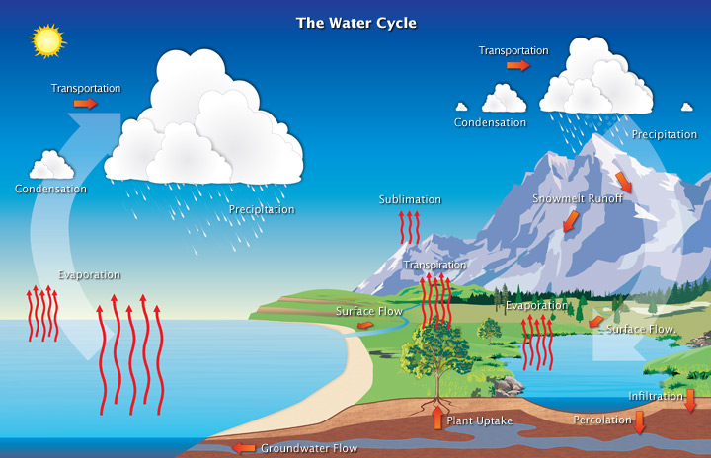
7.1 The water cycle and the challenges in water use
What do we mean by ‘Water cycle’?
In what form does water exist?
Where does water exist?
How does it change its form?
How does it move?
Photo Source: "The Water Cycle" by Atmospheric Infrared Sounder is licensed under CC BY 2.0
Notes:
Water can be found all over Earth in the ocean, on land, and in the atmosphere. The water cycle is the path that all water follows as it moves around our planet. To understand the water cycle, it is important to know how and where water exists. Water exists in three main states: liquid water, solid water in the form of snow and ice, and in the gaseous state as water vapour. We are most familiar with water in tis liquid form. When water freezes, its molecules move further apart, forming ice, which is less dense than water. When water absorbs energy, it changes from a liquid state to water vapour. In terms of location, water exists in different places. In its liquid form, on the surfaces, it is found in oceans, rivers, lakes, and streams. Below ground, it exists as groundwater in aquifers and as soil moisture. It is also found in all living beings. It is a well-known fact that approximately 60% of the human body weight comes from liquid water. In its solid state as ice or snow, it exists as glaciers and snow on the mountains. Water in its gaseous form or vapour is always present in the air around us. When we talk about the water cycle, we refer to the movement of water between the different locations as a result of transforming from one state to another. This movement is primarily driven by the energy from the sun. The cycle starts with the evaporation from the surface water sources like oceans, streams and rivers, and transpiration from trees. The water vapour then forms clouds, cools downs, and condenses back to form snow or liquid water. This water then flows back into rivers and streams and also seeps underground to recharge the aquifers and completes the cycle. The processes discussed above will be revisited during this module.

Slide 4
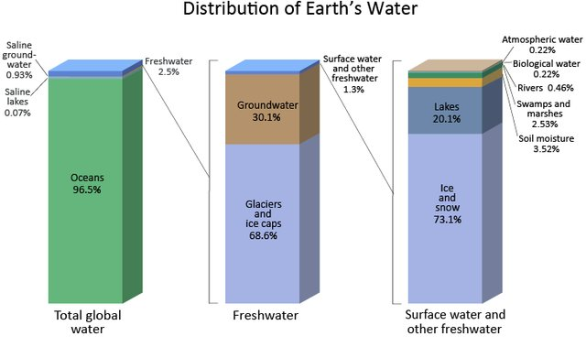
7.1 The water cycle and the challenges in water use
Where is the earth’s water?
Predominantly salt water
Fresh water sources are scarce
Relatively small share of fresh
Photo source: USGS, Earth’s water, available on Public domain, via Wikimedia Commons
Notes:
Where and in what form does water exist on earth? Approximately 97 percent of the earth’s water is in the oceans. And it exists in the form of salt water. Fresh water, which is critical for the survival of living beings, occupies a meagre share of 2.5 percent. A major share of this fresh water resource is in the earth’s glaciers and ice caps. Following the glaciers, fresh water is also found underground either in confined or unconfined aquifers. It is also found on the earth’s surface as rivers, lakes, ponds, and swamps. It is also important to know that water is also present in living beings and in the atmosphere as water vapour. However, this share is less than 1% of the total fresh water available on earth.

Slide 5
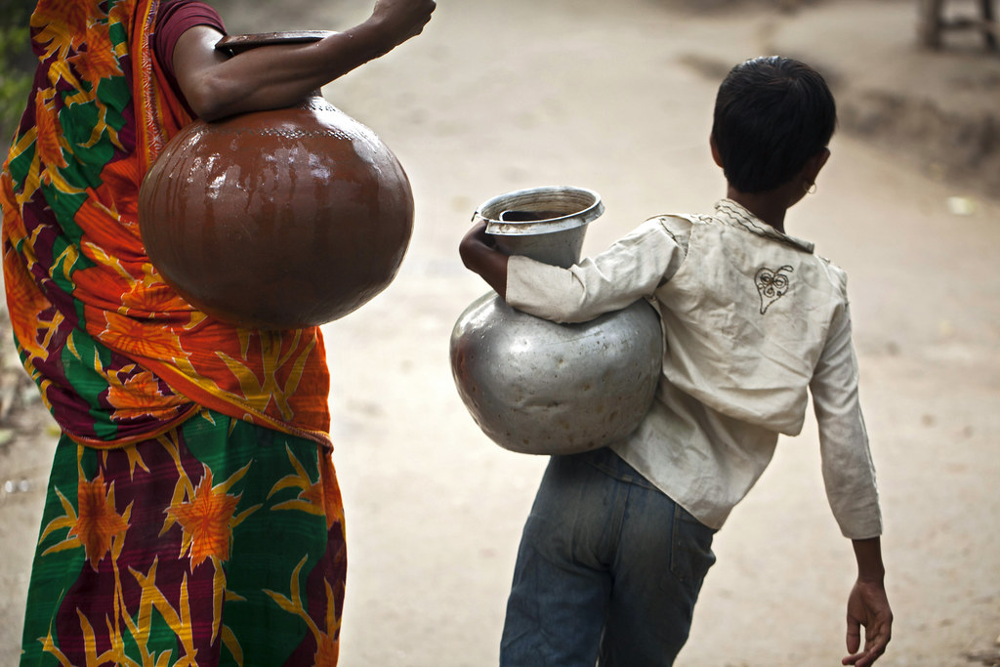
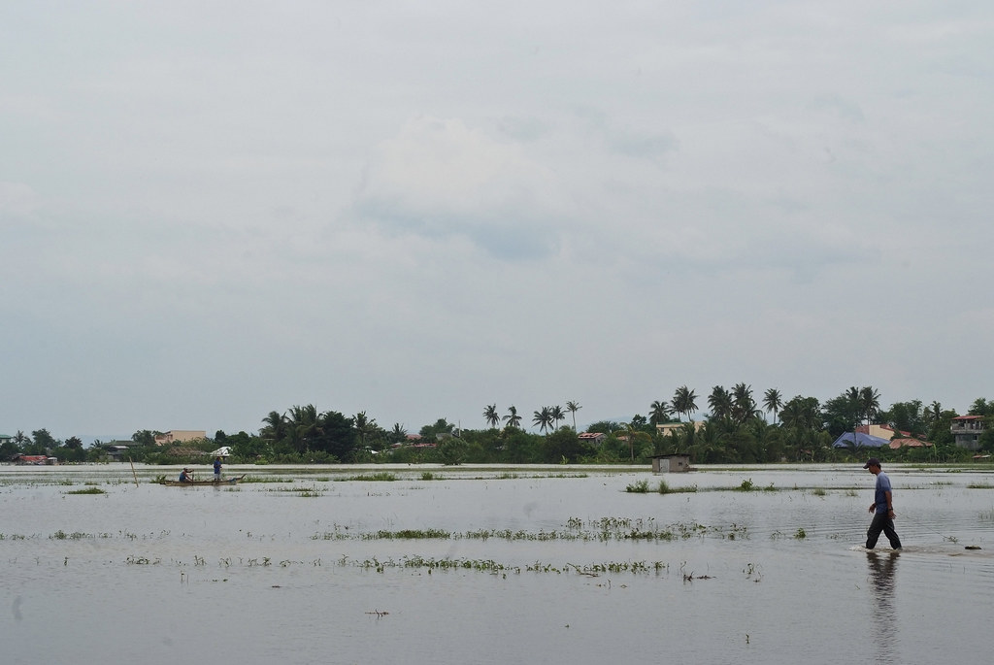
7.1 The water cycle and the challenges in water use
What are the challenges for sustainable water use?
3 in 10 people lack access to safely managed drinking water services
Water scarcity affects more than 40 per cent of the global population and is projected to rise
Over 1.7 billion people are currently living in river basins where water use exceeds recharge
More than 80 per cent of wastewater resulting from human activities is discharged into rivers or sea without any removal of contaminants
Floods and other water-related disasters account for 70 per cent of all deaths related to natural disasters
Photo: "Bringing back water using pitchers in Khulna, Bangladesh. Photo by Felix Clay/Duckrabbit." by WorldFish is licensed under CC BY-NC-ND 2.0
Photo: "This field of water used to be a field of rice." by IRRI Images is licensed under CC BY-NC-SA 2.0
Notes:
What are the main challenges when it comes to the sustainable utilization of the scarce water resources? 3 in 10 people lack access to safely managed drinking water services. Safely managed refers to uncontaminated water that can be accessed within reasonable distances. Water scarcity affects more than 40 per cent of the global population and is only projected to rise. This scarcity can be interpreted in three ways. First, in terms of lack of availability of water. Second, in terms of the lack of infrastructure to supply and treat water for the masses. Third, in terms of failure of policies and institutions that has led to the scarcity. Over 1.7 billion people are currently living in river basins where water use exceeds recharge. In other words, water is being abstracted at a faster rate than the rate of replenishment in many parts of the world. More than 80 per cent of wastewater resulting from human activities is discharged into rivers or sea without the removal of any contaminants. Finally, floods and other water-related disasters account for about 70 per cent of all deaths related to natural disasters. The aforementioned issues are only some of the challenges regarding the water system, effectively resulting in water stress in many parts of the world.

Slide 6
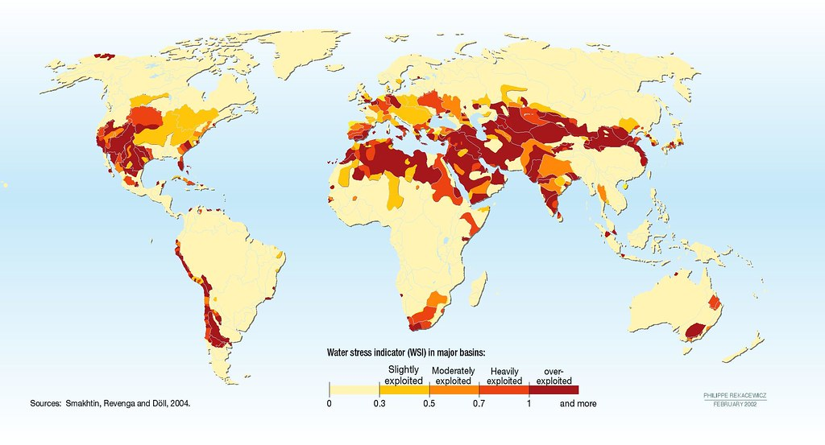
7.1 The water cycle and the challenges in water use
Water stress
Photo source: "Water Scarcity Index" by GRIDArendal is licensed under CC BY-NC-SA 2.0
Notes:
Water stress index, shown in this figure, is an indicator of how vulnerable certain countries and regions are to water availability. This indicator is the ratio of the quantity of water abstracted to the quantity of renewable water available within the same location. The indicator takes into consideration the local precipitation – that is, snow and rain – available ground water, transboundary water – both inflows and outflows – and all the types of water withdrawal in the location. The index starts from zero, where the countries with the least water stress are represented. Countries above the threshold of one are considered under severe stress, as they are overexploiting their natural water resources. The figure demonstrates that several Central Asian, American, and North African States are under severe water stress. We should also bear in mind that these water stress indices can vary from time to time based on local precipitation. However, prolonged dry seasons in many parts of the world will only exacerbate the stress. It is expected that water availability will be a crucial factor in geopolitical dialogues and debates in the future, with possibilities for potential conflicts.

Slide 7
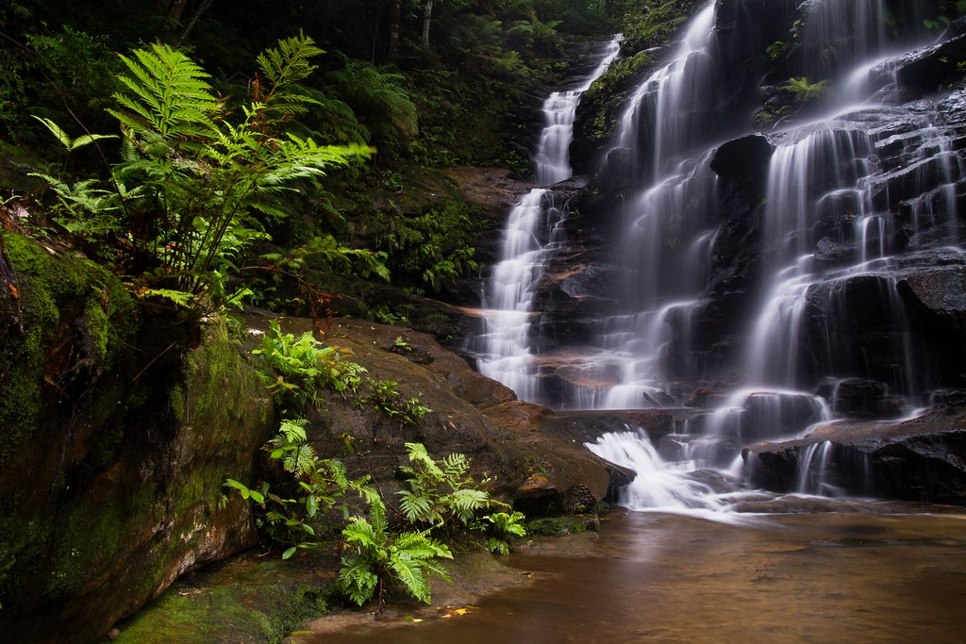
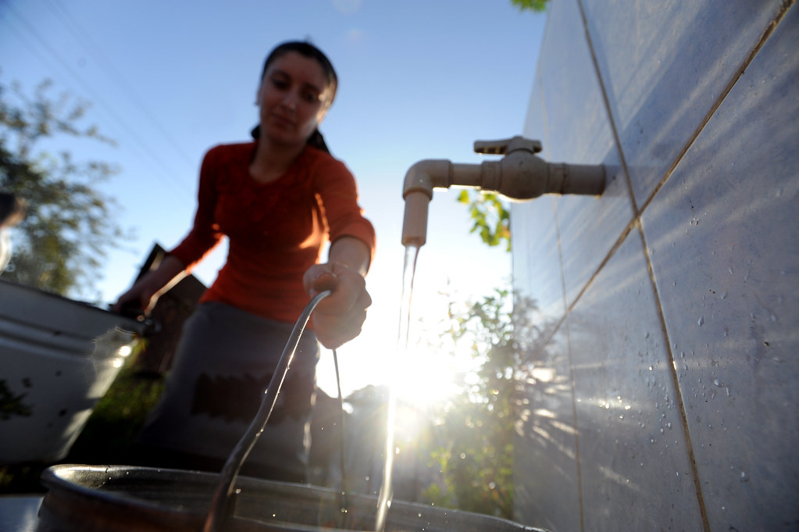
7.1 The water cycle and the challenges in water use
Goals for sustainable water use
Achieve universal and equitable access to safe and affordable drinking water for all
Improve water quality by reducing pollution, increased treatment of wastewater, recycling, and safe reuse
Increase water-use efficiency across all sectors and ensure sustainable withdrawals and supply of freshwater
Protect and restore water-related ecosystems, including mountains, forests, wetlands, rivers, aquifers, and lakes
Implement integrated water resources management at all levels, including through transboundary cooperation as appropriate
Photo: "Waters" by danpalmer is licensed under CC BY-ND 2.0
Photo source: "National Water and Sanitation Program brings better water and sanitation services to rural parts of Azerbaijan" by World Bank Photo Collection is licensed under CC BY-NC-ND 2.0
Notes:
The increase in water stress across the world has raised the alarm and led to the formulation of broad goals for the sustainable withdrawal and consumption of water. SDG6, the sixth sustainable development goal under the UN’s agenda for 2030, is dedicated to providing clean water and sanitation for all. Selected targets from SDG6 related to water systems are detailed. The first target relates to achieving universal and equitable access to safe and affordable drinking water for all. The second relates to improving the water quality by reducing pollution, increasing the treatment of wastewater and promoting safe recycling of water. The third relates to increasing the water-use efficiency across all sectors and ensuring sustainable withdrawals and supply of freshwater. The final two targets spread outside the sphere of SDG6 and step into other interlinked SDGs, like SDG13 on climate action and SDG15 on protecting land based ecosystems. They focus on Protecting and restoring water and land related ecosystems, including mountains, forests, wetlands, rivers, aquifers, and lakes. This can be achieved by implementing integrated water resources management at all levels, including through internal and transboundary cooperation. This is where integrated resource management methodologies like CLEWs are useful in exploring synergies and trade-offs in policies and decisions related to water management.

Slide 8
Lecture 7.1 References
Narasimhan TN. Hydrological Cycle and Water Budgets. In: Likens GE, editor. Encycl. Inland Waters, Oxford: Academic Press; 2009, p. 714–20. https://doi.org/10.1016/B978-012370626-3.00010-7

Slide 9
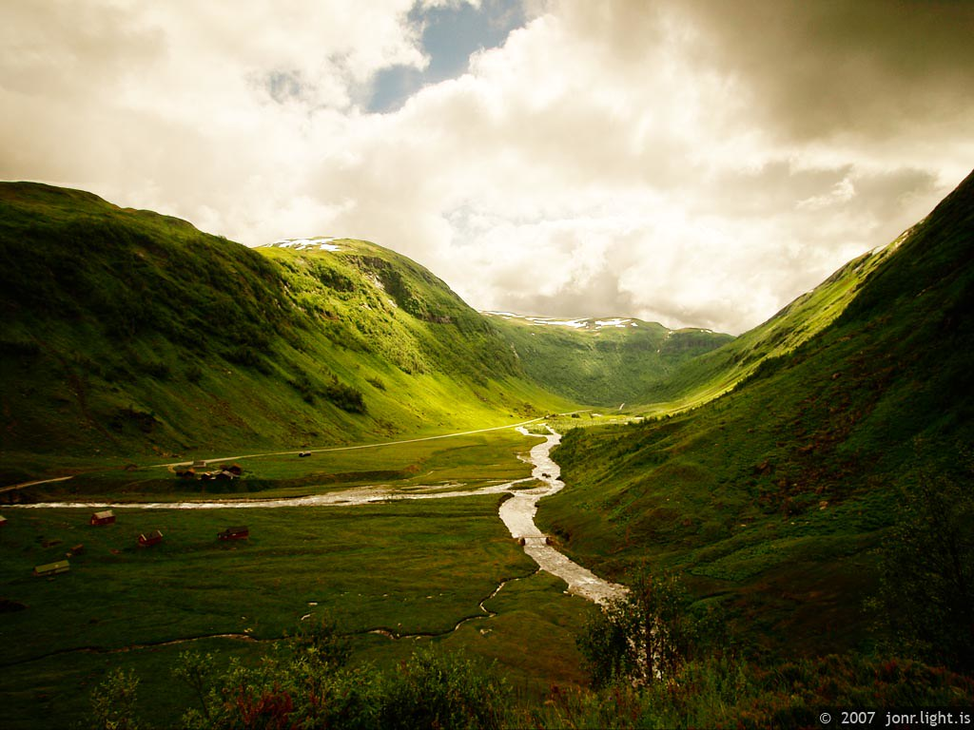
7.2 Watershed and its management
What is a watershed?
Watersheds are biophysical systems that define the land surface that drains water into a point in a stream or river
Mainly determined by topography:
The contours of a watershed is called a watershed divide and are typically ridges and hills that separate two watersheds.
Rain falling on one side of the ridge drains into one watershed and rain falling on the other drains into another
The word "watershed" is sometimes used interchangeably with drainage basin or catchment.
A river basin usually consists of many different watersheds
Photo Source: "Hola Valley, Norway" by Jon Ragnarsson is licensed under CC BY-NC-ND 2.0
Notes:
A watershed is the basic unit that one works with when it comes to water management. Watersheds are biophysical systems that define the land surface that drains water into a point in a stream or river. The directional flow of water is determined by the contour of the watershed. The concept of water flow in a watershed is similar to that of a bathtub. In a bathtub, all the water that falls inside its walls get collected and flows down into the drain through the valve. Similarly, all the precipitation inside a watershed gets collected and flows downstream as streams and rivers. The hills and mountains which form the boundaries of a watershed are analogous to the side-walls of a bathtub. The word "watershed" is sometimes used interchangeably with drainage basin or catchment. A river basin is a collective term that consists of many watersheds. For example, the Amazon River Basin is the largest basin in the world with an area more than 7 million square kilometres,. The entire basin contributes to the flow of water in the Amazon river and its tributaries.

Slide 10
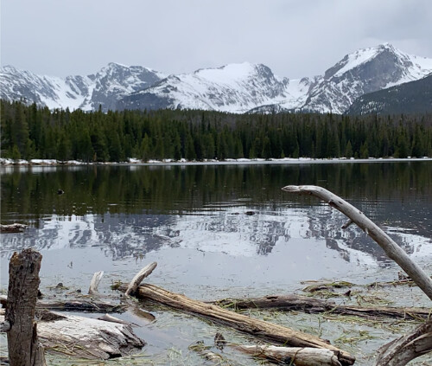
7.2 Watershed and its management
Watershed management is defined as any human action aimed at ensuring the sustainable use of natural resources in a watershed
Origins of watershed management is closely linked to forestry in the 1950s
Deforestation led to change in hydrological regimes leading to accelerated erosion and hazardous consequences to downstream populations
The recognition between upstream and downstream dynamics led to the development of watershed management
It usually warrants integrated/combined action across multiple sectors. Sometimes this may involve two or more nations
What is a watershed management?
Photo Source: "Real-Time Water Management in the Rockies" by NASA/Thaddeus Cesari; is licensed under CC BY 2.0
Notes:
Watershed management refers to the management of any activity that interacts with or has impacts on the water within the catchment. This primarily refers to the actions and policies taken inside the watershed and the impact on the flora and fauna that depend on water inside its boundaries. For example, cutting of forests affects the hydrology of the watershed. It affects flood control in the region affecting sedimentation and soil erosion. The building of a dam affects the flow of water downstream. Water used for irrigation in upstream regions will have an impact on the settlements living downstream. Therefore, a balance needs to be struck between the withdrawal and consumption of water in the upstream and downstream areas of a watershed. Practices that promote this balance and regulate the flow of water can be categorized under the umbrella of watershed management. Usually, these management practices warrant an integrated and/or combined action across multiple sectors. Sometimes these may involve two or more nations.

Slide 11
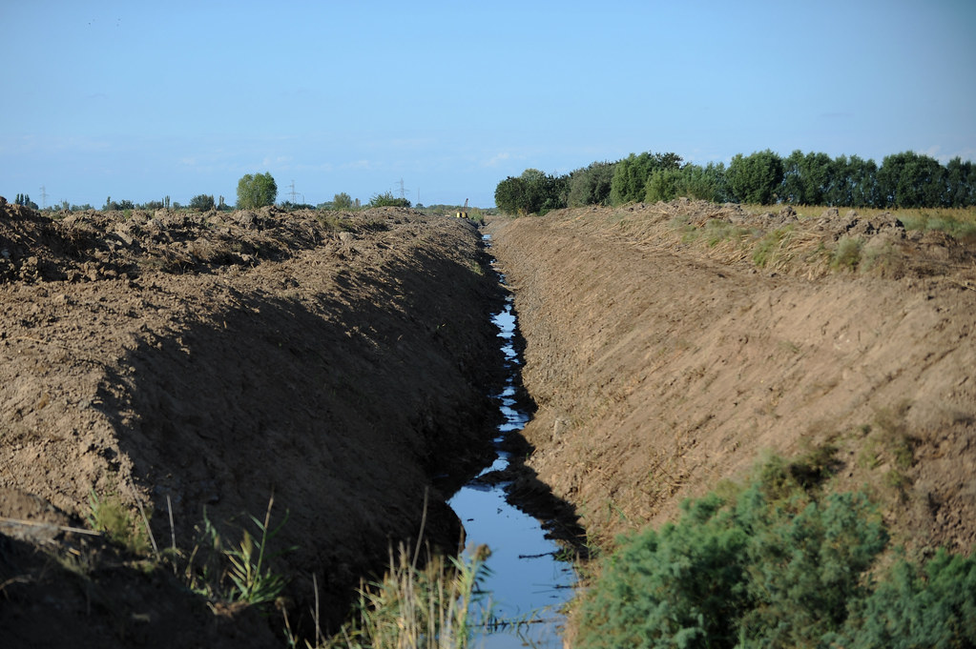
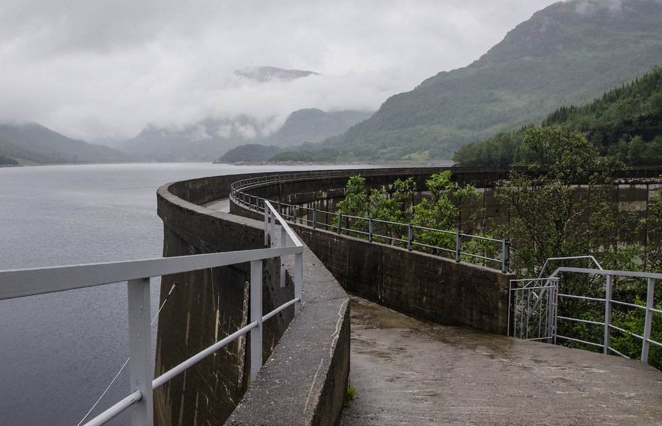
7.2 Watershed and its management
What is integrated watershed management?
Sustainable watershed management necessitates a broad and integrated view of activities in a watershed
Hydrology, water availability, water quality, ecosystem functions, land productivity, stream-channel morphology, and land use are integral parts of watershed management.
Watershed management is not the actions of one entity/actor; government agencies, municipal, private, and individual actors and entities all conduct activities that influence the watershed
Physical, regulatory, and economic tools and action can be used to manage watersheds
Photo Source: "Water Users Associations Development Project helps to improve irrigation and drainage in rural Azerbaijan" by World Bank Photo Collection is licensed under CC BY-NC-ND 2.0
Photo Source: "Dam" by AstridWestvang is licensed under CC BY-NC-ND 2.0
Notes:
Integrated watershed management takes an integrated view of activities inside a watershed or a catchment. This can involve a range of activities or elements as follows. Hydrology and water availability consider the amount of water available for withdrawal and consumption. Water quality refers to meeting the quality standards required for safe drinking purposes. Ecosystem functions and stream channel morphology include activities that could range from maintaining a minimum flow in the rivers to making sure that small streams and their shapes do not change by a large extent over time. The elements mentioned above are only selected aspects of the activities involved in integrated watershed management. It is important to understand that it is not the actions of one entity or actor that manage the elements mentioned above. Instead, it is a combination of government agencies, municipal, private, and individual actors and entities that influence the watershed. The mechanisms that are used to manage a watershed are of different types. They could include physical measures like building a dam, establishing pipelines to bring water to houses, and irrigation infrastructure. Regulatory measures could include policies that prevent deforestation, establishment of minimum environmental flows in rivers, and so forth. The economic tools could include financial mechanisms, pricing, and taxes to facilitate the necessary behaviour. Overall the aim is to have an efficient, harmonious, and equitable management of resources to meet the needs of the population without inflicting irreparable damage to the environment.

Slide 12
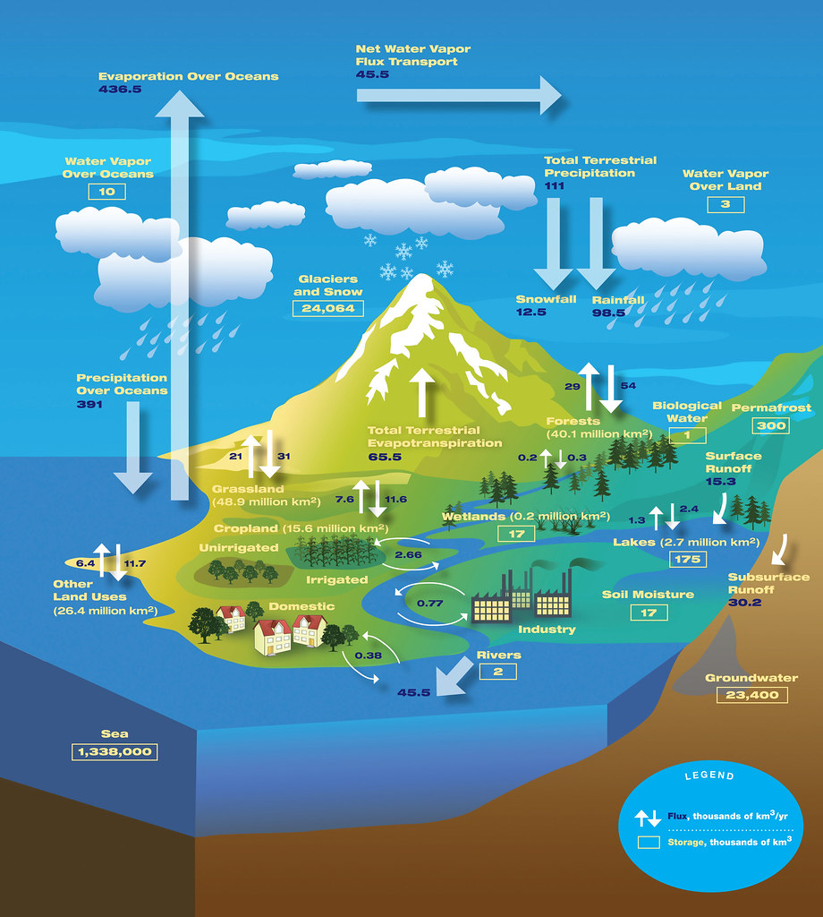
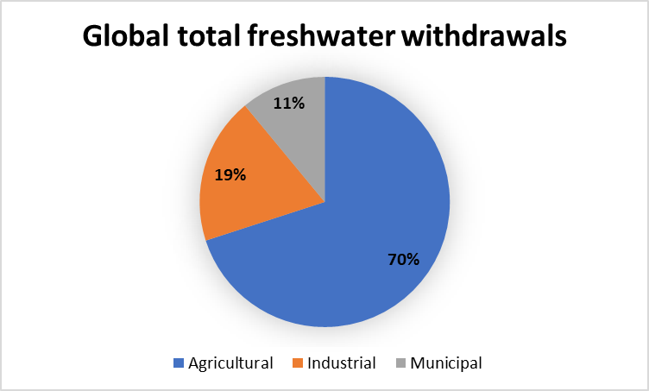
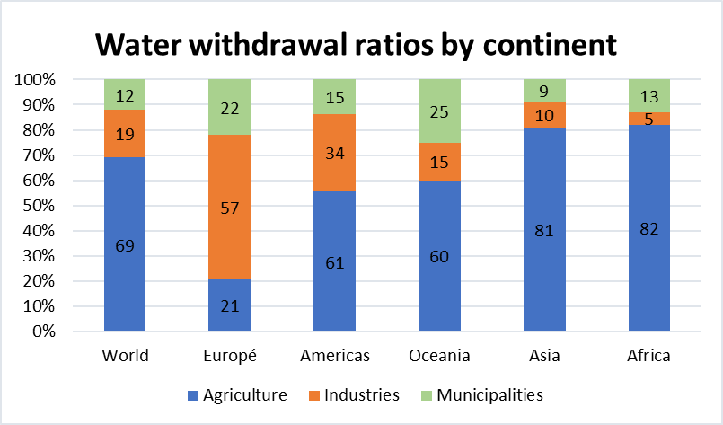
7.2 Watershed and its management
How much water is available?
How much water is needed?
Diagram Source: Author’s interpretation of FAO Aquastat data
Photo Source: "The Water Cycle" by NASA/JPL is licensed under CC BY 2.0
Notes:
Similar to the energy system, the water system has a demand and supply side. Two main questions can help in exploring these two components of the water system.
The first one regards the availability is water, which refers to the supply side. The second, on quantifying the need for water, refers to the demand side. On the one hand, the supply of water is dependent on many physiological processes involving precipitation in the form of rain, snow, or hail. It also involves the formation of surface waters in the form of rivers, streams, and lakes and the creation of underground aquifers. On the other hand, human actions play a critical role in affecting the supply side of the equation. The figures presented in this slide provide shares of water withdrawal across different sectors in the different continents. It is interesting to observe from the figure that the agricultural sector accounts for approximately 70% of global fresh water withdrawals. The industrial sector accounts for 19% which includes both power generation and manufacturing subsectors. The municipal water withdrawals account for about 11%. In parallel, we can also see the water withdrawal ratios in different continents classified by sectors. We can notice that agrarian economies in Asia and Africa have a high withdrawal ration for the agricultural sector. Whereas, the focus is on the industrial sector in Europe and the Americas.

Slide 13
7.2 Watershed and its management
How is the water balance maintained?
Precipitation (P)
Evapotranspiration (ET)
Run-off (R)
Watershed
Groundwater recharge (GWR)
P = ET + R + GWR
Diagram Source: Author’s interpretation
Notes:
In the diagram, different components of a water balance in a catchment are presented in a schematic form. There are four main processes that are critical to maintaining this balance. They are: Precipitation, Evapotranspiration, Run-off, and Groundwater recharge. It is important to know that a balance is always maintained in the system irrespective of the land cover in the respective catchment. It is also worth reminding ourselves of the criticality of human actions in affecting this balance. Activities that contribute to land-use change, such as damming of rivers and deforestation, are examples where human decisions have significantly affected this balance.

Slide 14
Lecture 7.2 References
Watersheds, Hydrologic Processes, and Pathways. Hydrol. Manag. Watersheds, John Wiley & Sons, Ltd; 2012, p. 3–5. https://doi.org/10.1002/9781118459751.part1

Slide 15
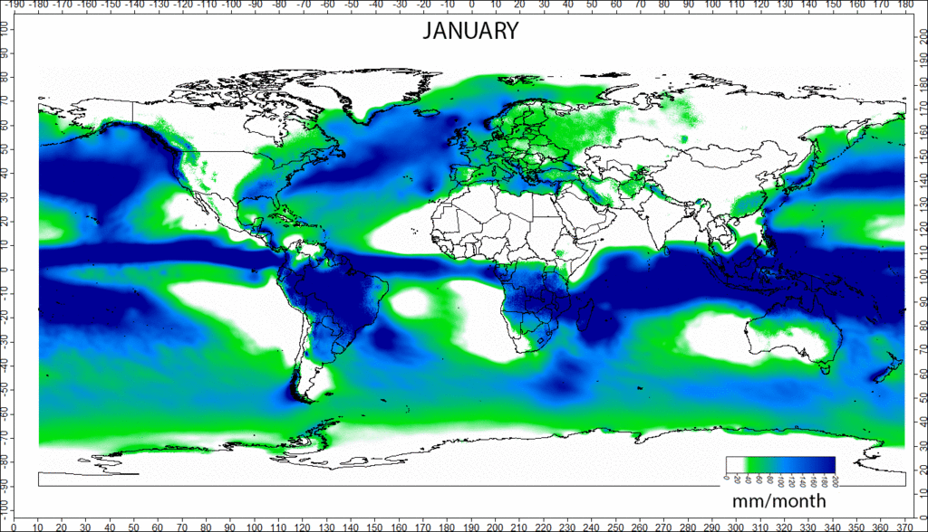
7.3 Precipitation and Evapotranspiration
What is precipitation?
Photo Source: Greenmind1980, Precipitation_longterm, CC BY-SA 4.0, via Wikimedia Commons
Notes:
The first component in the water balance is precipitation. Precipitation is any product of the condensation of atmospheric water vapour that falls under gravity from clouds. Common forms of precipitation include rain, snows and hail. In the figure here, the long term monthly mean precipitation across the world is presented in millimetres per month. We can notice in a graphical form how the monthly precipitation varies, the darker colour indicating more rain and vice-versa. Many countries experience a single wet and dry season per year, but in some countries, two wet and dry seasons per year may occur signalling a bimodal precipitation pattern. According to the latest weather information, the wettest place on earth is a small town call Masynram in India with a precipitation of approximately 12000 millimetres per month. And the driest place is in the Atacama desert in Chile.

Slide 16
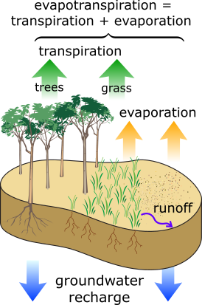
7.3 Precipitation and Evapotranspiration
What is Evapotranspiration?
It is a combination of evaporation (from land surfaces) and transpiration (from plant surfaces)
It is a function of different meteorological factors
Solar radiation
Air temperature
Air humidity
Wind speed
Photo Source: Evapotranspiration by M. W. Toews, is licenced under CC BY 4.0
Notes:
The second component is called Evapotranspiration. It is a combination of two processes: evaporation from land surfaces and transpiration from plant surfaces.
Evaporation is the process whereby liquid water is converted to water vapour, also called vaporization, and removed from a surface, also called vapour removal. Water evaporates from a variety of surfaces, such as lakes, rivers, pavements, soils, and wet vegetation. Transpiration consists of the vaporization of liquid water contained in plant tissues and the vapour removal to the atmosphere. Crops predominately lose their water through their stomata. These are small openings on the plant leaf through which gases and water vapour pass. Evapotranspiration is a function of many meteorological factors. Solar radiation and air temperature assist in the process of absorbing energy by the evaporating surfaces. Air humidity regulates the amount of moisture that the air can hold. Humidity and Temperature are also related. The higher the air temperature, the greater the moisture capacity in the air, which eventually results in higher evapotranspiration. Wind speed increases the rate of transpiration from leaf surfaces.

Slide 17
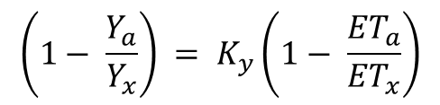
7.3 Precipitation and Evapotranspiration
What affects evapotranspiration and its impact on crop-yield?
The greater the Leaf-Area-Index (LAI), the higher the transpiration component in evapotranspiration
Crop yields can be directly related to water use and evapotranspiration plays a critical role in this relationship
$$\left(1− \frac{Y_{a}}{Y_{x}}\right) = K_{y}\left(1− \frac{{ET}_{a}}{{ET}_{x}}\right)$$
Y_{a} & Y_{x}: Actual and maximum Crop Yields
ET_{a} & ET_{x} : Actual and maximum evapotranspiration
K_{y}: Crop Yield response factor
Photo Source: Evapotranspiration by M. W. Toews, is licenced under CC BY 4.0
Notes:
It is now established that the term evapotranspiration is a combination of evaporation and transpiration.
Since transpiration is the loss of water from the leaves of plants, its share only increases with the increase in plant leaf area which is measured by an indicator called the Leaf-Area-Index. The Leaf-Area-Index is a dimensionless parameter that defines the ratio of plant leaf area to the area of the ground it occupies. It is important to note that all surfaces either evaporate or transpire; the share varies depending on the growing stages when vegetation is considered. Evapotranspiration plays a critical role in the relationship between crop yields and water use. The relationship varies between crops and seasons and is not linear. This relationship is also governed by a dimensionless number called the crop yield response factor that details the how a crop responds to water deficit. In the slide, the formula used to estimate actual crop yields is provided. From the temperature measurements in the area, the values for actual and maximum evapotranspiration can be estimated. The maximum crop yield is also a known entity. The values for crop yield response factor can be obtained from the database of the food and agricultural organization of the United Nations.

Slide 18
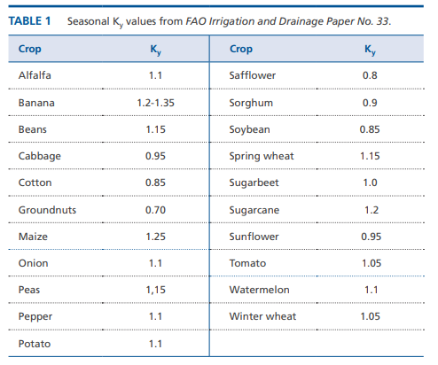
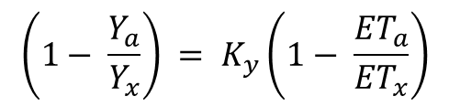
7.3 Precipitation and Evapotranspiration
What is the crop-yield response factor?
Crop yield response factor
Relationship between Evapotranspiration and Yield is not linear, it is dependent on the Crop-yield response factor (K_{y})
K_{y} >1: crop response is very sensitive to water deficit
K_{y} <1: Crop is tolerant o water-deficit
K_{y} =1: crop yield directly proportional to reduction in water use
$$\left(1− \frac{Y_{a}}{Y_{x}}\right) = K_{y}\left(1− \frac{{ET}_{a}}{{ET}_{x}}\right)$$
Table Source: Crop Yield Response factor table, Source: Food and Agriculture Organization of the United Nations. Reproduced with permission.
Notes:
This slide looks at the Crop-yield response factor or (Ky). This is an empirical yield response value used to integrate the complex linkages between crop production and the water use required for it. This factor is not a set number. Adjustments for site-specific conditions would be needed to improve the accuracy of the formulae. In the table, average response factors for some common crops is provided. This data is compiled from the Food and Agriculture Organization of the United Nations (or F.A.O.) publication number 66 that focuses on crop yield responses to water availability. For crops with Ky values greater than 1, the crop response is very sensitive to water deficit. For crops with Ky values lesser than 1, the crop is tolerant to water deficit. For crops with Ky values equal to 1, the crop yield is directly proportional to the reduction in water use. For example, crops like Sorghum and Soybean can handle drought better in comparison to crops like Bananas and Sugarcane. The slide also highlights the

Slide 19
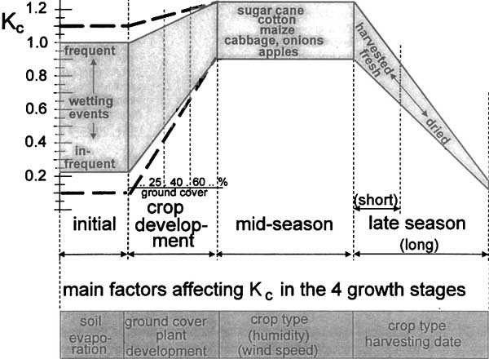
7.3 Precipitation and Evapotranspiration
Crop coefficients and crop cycles
Crop coefficients (Kc) are crop and season dependent.
Kc is directly proportional to the total evapotranspiration.
Photo Source: Crop Coefficients (Kc), Source: Food and Agriculture Organization of the United Nations. Reproduced with permission.
Notes:
The evapotranspiration in crops depends on many factors. It varies from crop to crop and also depends on its stage in the growing cycle. The figure here presents a number called the crop coefficient or Kc, which is directly proportional to the crop evapotranspiration. The value of the coefficient is low during the initial sowing stage. This can also be partly attributed to the Leaf-Area-Index that we discussed in the earlier sessions. As and when the crop grows, the Kc value increases and reaches a maximum during the mid season and values go down during the late season, as shown in the figure on this slide. The F.A.O. provides standard Kc values for crops in different stages of their growing cycle and also for different regions of the world. This Kc value is then multiplied with another standard called reference crop evapotranspiration to arrive at the final value of crop evapotranspiration. The evapotranspiration rate from a reference surface, not short of water, is called the reference crop evapotranspiration or reference evapotranspiration. The reference surface is a hypothetical grass reference crop with specific characteristics. More information on the reference crop evapotranspiration can be obtained from the references provided as part of this section. In the hands-on-lecture, more information on crop-specific evapotranspiration and it usage in CLEWs modelling will be provided.

Slide 20
Lecture 7.3 References
Steduto, P.; Hsiao, T.C.; Fereres, E.; Raes, D. Crop Yield Response to Water; FAO: Rome, Italy, 2012.
Allen R.G.; Pereira, L.S.; Raes, D.; Smith, M; FAO Irrigation and Drainage Paper No. 56 Crop Evapotranspiration 1977.

Slide 21
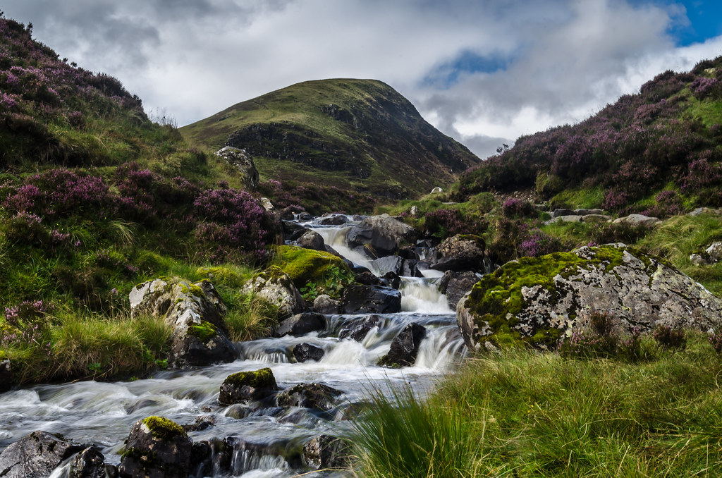
7.4 Runoff and Groundwater recharge
What is Runoff?
Runoff is that portion of the precipitation that makes its way toward stream channels, lakes, or oceans as surface flow.
Meteorological factors affecting runoff
Type of precipitation (rain, snow, sleet, etc.)
Rainfall intensity
Rainfall amount
Rainfall duration
Distribution of rainfall over the watersheds
Photo Source: "Loch Skeen Runoff" by daedmike is licensed under CC BY-NC-SA 2.0
Notes:
Runoff is that portion of the precipitation that makes its way downstream in a catchment or watershed in the form of stream channels, lakes, or oceans as surface flow. It has different components ranging from surface and sub-surface runoff to base flow, which is underground. A set of meteorological factors govern the quantity of the runoff. The first is the type of precipitation in the form of rain, snow, sleet, etc. Rain falling on the earth's surface gets transformed into surface runoff based on the slope and the saturation level of soil moisture in the region. Snow falling on the ground will either remain as snow or melt and transform into water to flow downstream. The intensity of precipitation affects runoff. The quantity and the duration of a precipitation event could have disastrous effects like flash floods. Distribution of rainfall varies across a watershed and thereby affects the runoff. In a large watershed, there are high chances that precipitation in the form of snow is more prevalent at high altitudes and as rainfall in low lying areas.

Slide 22
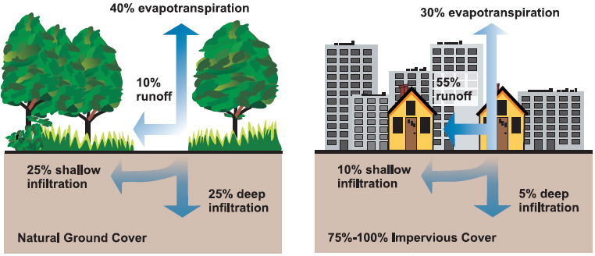
7.4 Runoff and Groundwater recharge
What is Runoff?
Physical characteristics affecting runoff
Land cover
Vegetation
Soil type
Drainage area
Elevation
Slope
Topography
Photo Source: U.S. Environmental Protection Agency, natural and impervious cover diagrams, Public domain, via Wikimedia Commons
Notes:
Despite the meteorological factors playing an important role in determining runoff, physical factors like land cover play a critical role.
In particular, human actions, such as building urban infrastructure, have a big impact on surface runoff. This is one of the key aspects to be represented in the CLEWs models. Management of land cover such as the total built-up area, forest and woodland cover, and the area under irrigation is critical to the quality and quantity of water flowing downstream. In the figure, a simple example is presented to illustrate the impact of land cover on surface runoff. On the leftmost figure, a natural land cover consisting of forest and grasslands is presented, and, on the right, a built-up area is shown. It is apparent that due to the artificial build up, the infiltration rate of water going underground is restricted, thereby increasing the runoff. This is one of the main factors contributing to floods across major cities in the world. There is an incentive in maintaining natural land covers in the region to help regulate the flow of water and thereby increasing the protection against floods. Factors like vegetation, soil type, slope, and elevation are also equally important in determining runoff.

Slide 23
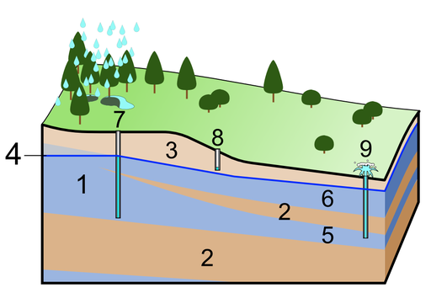
7.4 Runoff and Groundwater recharge
What is groundwater?
Groundwater recharge
Groundwater is the water present beneath the earth’s surface in soil pore spaces and in the fractures of rock formations
30% of global freshwater is in the form of groundwater. 40% of all the irrigation in the world is from groundwater
1. Aquifer 2. Aquitard 3. Unsaturated zone 4. Water table 5. Confined aquifer
6. Unconfined aquifer 7. Deep well 8. Sort well
9. Artesian well
Photo Source: Shigeru23, Groundwater licensed under CC BY-SA 3.0 via Wikimedia Commons
Notes:
Groundwater is the water present beneath the earth’s surface in soil pore spaces and in the fractures of rock formations. In the figure, the different layers beneath the earth’s surface are shown. Just below the surface, there is an unsaturated zone in the soil through which the water seeps. The water table starts at the point where the unsaturated zone ends. There are two types of aquifers underground. Unconfined aquifers are those that are not confined by any impermeable rocky layer. The confined aquifers are those that are separated from the other layers by hard impermeable rocks also called aquitards. The unconfined aquifers are also easily accessible and our modern water pumps usually tap water from this layer. The confined aquifers usually require deep and artesian wells to access the water within. It is also interesting to note that about 30% of global freshwater is in the form of groundwater. And 40% of all the irrigation in the world is from groundwater sources. These are one of the main reasons why frameworks like CLEWs are used to explore sustainable pathways for using and managing our groundwater resources.

Slide 24
7.4 Runoff and Groundwater recharge
What is groundwater recharge?
Groundwater recharge
Groundwater recharge is a hydrologic process, where water moves downward from the surface to underground.
Factors affecting recharge
Land cover, Vegetation, Soil type, Slope
Rainfall intensity, Subsurface geology
1. Aquifer 2. Aquitard 3. Unsaturated zone 4. Water table 5. Confined aquifer
6. Unconfined aquifer 7. Deep well 8. Sort well
9. Artesian well
Photo Source: Shigeru23, Groundwater licensed under CC BY-SA 3.0 via Wikimedia Commons
Notes:
Groundwater recharge is a hydrologic process, where water moves downward from the surface to underground. Groundwater recharge and runoff are processes that go hand-in-hand. Factors, like land cover, vegetation, and slope, play a significant role in affecting the recharge rates. The recharge rates are typically lower in an inclined terrain compared to a flat surface. The amount of soil moisture affects the rate at which the recharge takes place. If the soil is saturated, no extra water can seep through the surface, and therefore the runoff increases and vice versa. Land cover types like forests and marsh lands help in regulating the runoff by absorbing more water and thereby reducing the occurrences of floods. Sub-surface geology is also a contributing factor that affects groundwater recharge. A confined aquifer forms when water collects, by pressure or gravity, between two layers of impermeable rock and is stored for millennia. Some water stressed regions of the world actually depend exclusively on these non-renewable ground water resources. One prominent example is the North Western Saharan Aquifer system, where a large portion of the Northern African countries depend on one large confined aquifer for most of their domestic and agricultural water use. This concludes the discussion on water balance and its core components.

Slide 25
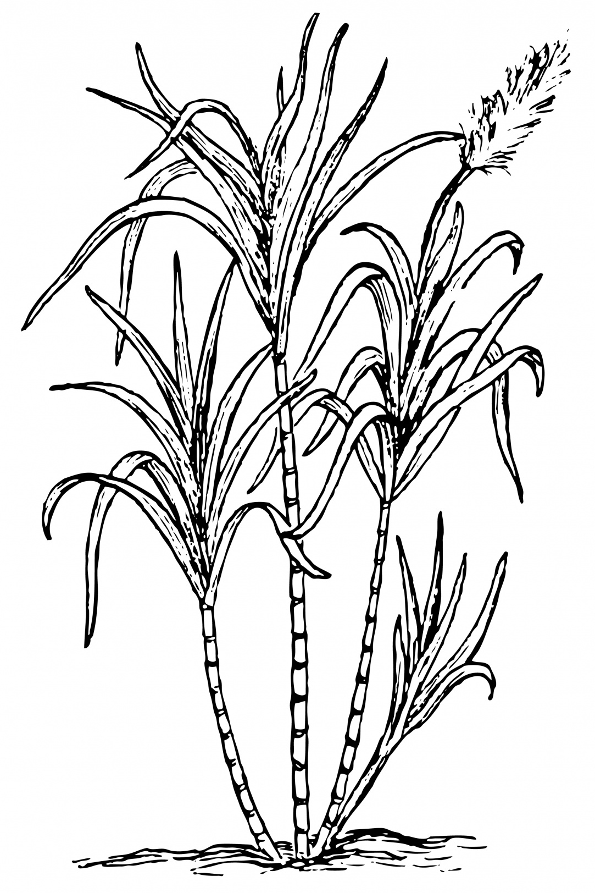
7.4 Runoff and Groundwater recharge
How much water can be expected? (Representation in a CLEWs model)
Sugar
Sugarcane plantation
/ cultivated area
Land resource
Evapotranspiration (ET)
/ cultivated area
/ cultivated area
Precipitation (p)
Runoff (R)
/ cultivated area
/ cultivated area
Groundwater recharge (GWR)
/ cultivated area
Photo Source: Karen Arnold "Sugar Cane Clipart Illustration“ released under CC0 1.0 Public Domain license.
P = ET + R + GWR
Notes:
The schematic here illustrates the representation of the water balance inside the CLEWs models. Here, the example of a rainfed sugarcane plantation is provided. All the four components discussed in the previous slides are represented. For each of the inputs and outputs, the respective ratios will be calculated, specific to the crop and the region and implemented inside the CLEWs model. For the irrigated option, there will be an extra input of artificially supplied water, which will include its own energy requirements for pumping. It is important to bear in mind that the water balance exists for all land cover types. It is not specific to agricultural land. In the model, the rates of groundwater recharge are usually kept constant, assuming that a certain geology will have only a constant recharge rate. This assumption is used to simplify the representation of groundwater recharge in the example model. In country scale models, measured values can be used to accurately represent the actual recharge rate. This concludes the lecture on the introduction to water systems. The next lecture will focus on the climate system.

Slide 26
Lecture 7.4 References
Steduto, P.; Hsiao, T.C.; Fereres, E.; Raes, D. Crop Yield Response to Water; FAO: Rome, Italy, 2012.
Allen R.G.; Pereira, L.S.; Raes, D.; Smith, M; FAO Irrigation and Drainage Paper No. 56 Crop Evapotranspiration 1977.

Slide 27
Take Quiz
Sridharan V. (KTH)., Shivakumar A. (UNDESA)., Gardumi F. (KTH)., Niet T. (SFU)., Ramos E.P. (KTH)., Alfstad T., (UNDESA) 2021. Lecture 7: The water system. Release Version 1.0. [online presentation]. Climate Compatible Growth Programme, United Nations Development Program and United Nations Department of Economic and Social Affairs.
CCG courses (this will take you to the website link http://www.ClimateCompatibleGrowth.com/teachingmaterials)

