Slide 1

LECTURE 6 LAND USE REPRESENTATION
Introduction to CLEWs

Slide 2
Learning outcomes
By the end of this lecture, you will:
ILO1: Understand the distinction between land cover and land use, and the need to model land use
ILO2: Explore an example of land use modelling (CLEWs-Ethiopia)
ILO3: Learn how land use can be represented in OSeMOSYS
Notes:
This lecture introduces the second system in the climate, land, energy, and water representation: land. The lecture focuses especially on how land use can be modelled using OSeMOSYS. This lecture has three intended learning outcomes. First, is to understand the distinction between land cover and land use, as well as to understand the importance and relevance of modelling land use. Second, is an exploration of an example of modelling land use in order to better understand its applications. And finally, during this lecture you will learn the basics of how to model land use in OSeMOSYS.

Slide 3
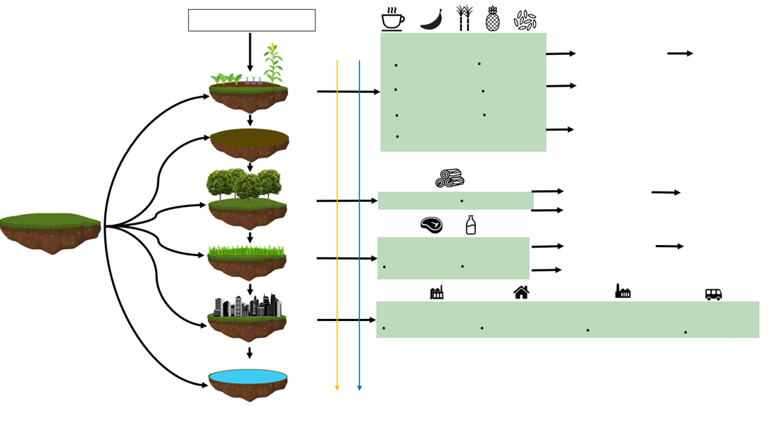
6.1. Why is modelling land use important?
Multiple, competing uses for land
Land uses
Production
Maize Bananas
Rice Sugarcane
Coffee
Other crops
Crop land
Total land
Barren land
Production
Wood and other forest products
Forests
Pastures / Grasslands
Production
Meat
Dairy
Built-up land
Production
Residential, Industrial, Commercial, Transport
Water bodies
3
Notes:
Land is a critical resource which humans rely on for several reasons. This includes agriculture, forests, inland water bodies, pastures or grasslands, and built-up land, among others. Each type of land cover has one of more uses. For instance, fertile land may be used for crop production, grasslands for grazing livestock, built up land supports cities, and so on. Societies around the world shape and are shaped by the type of land they live on. Since the total amount of land is finite, the multiple uses of land are in competition with one another. For example, wetlands that are biodiversity hotspots may be paved over due to rapid urbanization. Or forests may be cleared and replaced with crops to meet food demand instead. It is therefore important to better understand how best to allocate available land sustainably across these multiple uses. Here, we use a model – specifically, OSeMOSYS – to represent land use and help identify scenarios of its ‘cost-optimal’ allocation.

Slide 4
6.1. Why is modelling land use important?
What is the difference between land use and land cover?
Land use | Land cover
Represents the purpose of the land | Represents the physical characteristics of the land
Examples: Recreation, crop production, wildlife | Examples: Forests, water bodies, urban infrastructure
Notes:
Understanding both land use and land cover is a fundamental component of the planning and decision-making processes for many countries because it helps decision makers to understand better where to plan for different types of growth and where to preserve existing land cover. It is therefore important to first differentiate land use and land cover. In addition, it is important to map the linkages between different land cover types and land uses.
The same type of land cover might support multiple uses (for example, forest land for timber production, recreation, and wildlife conservation). Similarly, the same type of land use could occur on different types of land cover. For example, recreation in forests, grasslands, and urban infrastructure. Further, the mapping between land cover and land uses is likely to evolve over time. Land that was once fertile and therefore suitable for agriculture may become barren, or grasslands may transform into wetlands after flooding.

Slide 5
6.1. Why is modelling land use important?
Land use planning
Land is required to support human and ecosystem needs.
Land is a finite resource
With growing populations, land-use planning is important so as to optimize the share of land allocated to different types of uses
Land-use planning can help prevent land-use conflicts and reduce environmental impacts.
Successful land-use planning involves a balanced mix of analysis of the existing conditions and constraints; extensive public engagement; practical planning and design; and financially and politically feasible strategies for implementation
Notes:
This brings us to land-use planning. Land is a critically important as well as finite resource. The allocation of land to different types of uses has significant implications on society and the environment. Land-use planning ensures that resources are used sustainably such that the needs of the people are met while safeguarding future resources. Successful land-use planning involves a balanced mix of analysis of the existing conditions and constraints; extensive public engagement; practical planning and design; and financially and politically feasible strategies for implementation.
Examples of land-use planning include: remote sensing to identify areas susceptible to flood risk, policies to improve cycling infrastructure, urban zoning plans to reduce noise pollution, and identifying techno-economically viable areas for renewable energy technologies, such as solar photovoltaic farms. These examples highlight the breadth of information that land-use planning can provide, as well as the range of tools and data required in order to carry it out effectively.

Slide 6
6.1. Why is modelling land use important?
Types of land-use planning
After world war II
Traditional planning
1960s–70s
Advocacy and equity planning
Future
Integrated resource systems planning with community participation?
1950s–70s
Systems planning
1960s–present
Strategic planning
1960s
Democratic planning
1960s–present
Environmental planning
Notes:
David Walters defines 6 main typologies of land-use planning in his book ‘Designing Community’:
1. Traditional or comprehensive planning is focused on producing clear statements about the form and content of new development. It is a centralized, top-down approach.
2. Systems planning resulted from the failure of comprehensive planning to deal with the unforeseen growth post-World War II. It takes a more analytical view of the planning area as a set of complex processes, but is less interested in a physical plan.
3. Democratic planning gave more citizens a voice in planning for the future of their community.
4. Advocacy and equity planning is an off-shoot of democratic planning that sought specifically to address social issues of inequality and injustice in community planning.
5. Strategic planning recognizes small-scale objectives and pragmatic real-world constraints.
6. Environmental planning developed as many of the ecological and social implications of global development were first widely understood

Slide 7
Lecture 6.1. References
Ryan Coffey, The difference between “land use” and “land cover”, 2013, Michigan State University Extension
Southwestern NC Planning and Economic Development Commission, 2009, Community Foundation of WNC, & the Lawrence Group Architects of NC, Inc
GIZ, Land Use Planning: Concept, Tools and Applications, 2011, GIZ
David Walters, Designing Community, 2007, ISBN 9780750669252
7

Slide 8
6.2. CLEWs-Ethiopia example – part I
Model scope and thematic focus
Ethiopia’s 10-year development plan (2020–2030)
Rapid population growth, economic growth, and urbanization
Growing and competing demands for resources (energy, water, and land)
Vulnerable to climate change impacts
Model horizon: 2030
Integrated representation of energy, land-use, water, and climate
9 regions (sub-divided into 21 agro-climatic ‘clusters'
Built in OSeMOSYS: an open-source linear optimization tool
Model data from government sources supplemented with international datasets
Focus on policy priorities across 2 thematic areas:
Climate Resilient Green Economy
Agriculture Modernization
Notes:
Here we present an example of how land use can be modelled and used to support policy making. A CLEWs model of Ethiopia was co-developed by the U.N. and analysts from the Ethiopian government. The aim of the modelling exercise was to help inform Ethiopia’s ten-year development plan. The broader context of this work includes the rapid economic and population growth in Ethiopia, which in turn is leading to growing competition for resources such as energy, land, and water. Further, these natural resources in Ethiopia are especially vulnerable to climate change impacts in the form of crop yields and hydropower availability.
Given this context, the CLEWs-Ethiopia model is built with a time horizon until 2030 and includes an integrated representation of energy, land, water, and climate impacts. In order to capture the spatial aspects of land and water resources in particular, the model is regionalized into twenty-one agro-climatic ‘clusters’ across nine regions. The model is built using OSeMOSYS and is populated with a combination of data from government sources and best available international datasets.
The results of modelling the policies in two thematic areas are discussed in this example: Climate Resilient Green Economy and Agriculture Modernization.

Slide 9
6.2. CLEWs-Ethiopia example – part I
‘Climate Resilient Green Economy’ scenarios
Reforestation scenario:
Forest cover doubles from current area by 2030
Climate change impacts:
Two extreme climate futures explored, A2 (~RCP8.5) and B1 (~RCP4.5)
Notes:
Two scenarios are considered within the thematic area of ‘Climate Resilient Green Economy’: Reforestation and Climate Change Impacts. In the first, we assess the impact of meeting the government’s target of doubling forest cover by 2030 as compared to current levels. In the latter, we assess the impact of climate change on crop yields and associated land-use implications.
For the climate change case, we consider two extreme climate futures A.2. and B.1. The A.2. and B.1. scenarios are considered to be aligned with the R.C.P. 8.5 and R.C.P. 4.5 scenarios from the I.P.C.C.’s latest projections respectively. I.P.C.C. is the Intergovernmental Panel on Climate Change and is a body of the United Nations. R.C.P stands for a ‘Representative Concentration Pathway’, a term used to represent a greenhouse gas concentration trajectory. Four such pathways were used for climate modeling and research for the I.P.C.C. fifth Assessment Report (A.R.5.) in 2014. R.C.P. 4.5 is described as an intermediate scenario. Global emissions in this scenario peak around 2040, then decline. It is more likely than not to result in global temperature rise between 2 degrees C and 3 degrees C by 2100. In R.C.P. 8.5 emissions continue to rise throughout the 21st century and is considered a ‘worst-case’ climate change scenario. It would be expected to lead to an global temperature rise of around 5 degrees C by 2100.
Here, the aim is to identify the possible range of implications that these two climate futures could have on Ethiopia’s resource systems.

Slide 10
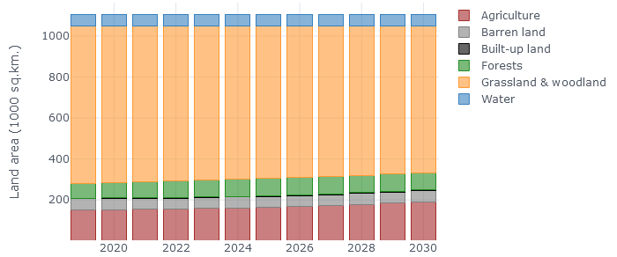
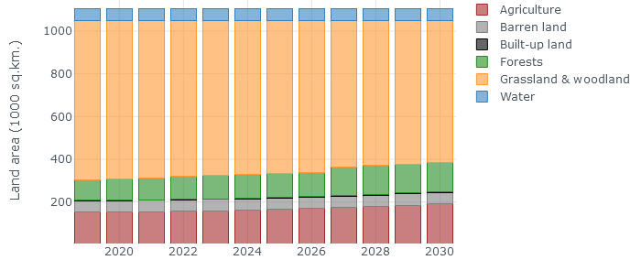
6.2. CLEWs-Ethiopia example – part I
Land use - BAU
Land use - Reforestation
Reforestation
GHG emissions (Mt of CO₂-eq.)
Notes:
The results from the Reforestation scenario are shown here and compared with a Business-As-Usual scenario. The main finding here is the significant increase in the capture and storage, also known as sequestration, of greenhouse gas emissions in the reforestation scenario. The land-use figures on the top row show that the increased forest area comes from the vast grasslands available in the country.
The bottom row compares the greenhouse gas emissions in 2019 to that for the Business-as-usual and Reforestation scenarios in 2030 across a range of sectors. L.U.C.F. refers to land-use change and forestry. A negative value in this figure represents the net sequestration of greenhouse gas emissions. While the net greenhouse gas emissions remain positive in both cases, an additional 55 million tonnes of carbon-dioxide-equivalent greenhouse gas emissions are sequestered through reforestation in 2030. This helps offset the significant growth in emissions expected from other sectors such as livestock herding, transport, and industry.

Slide 11
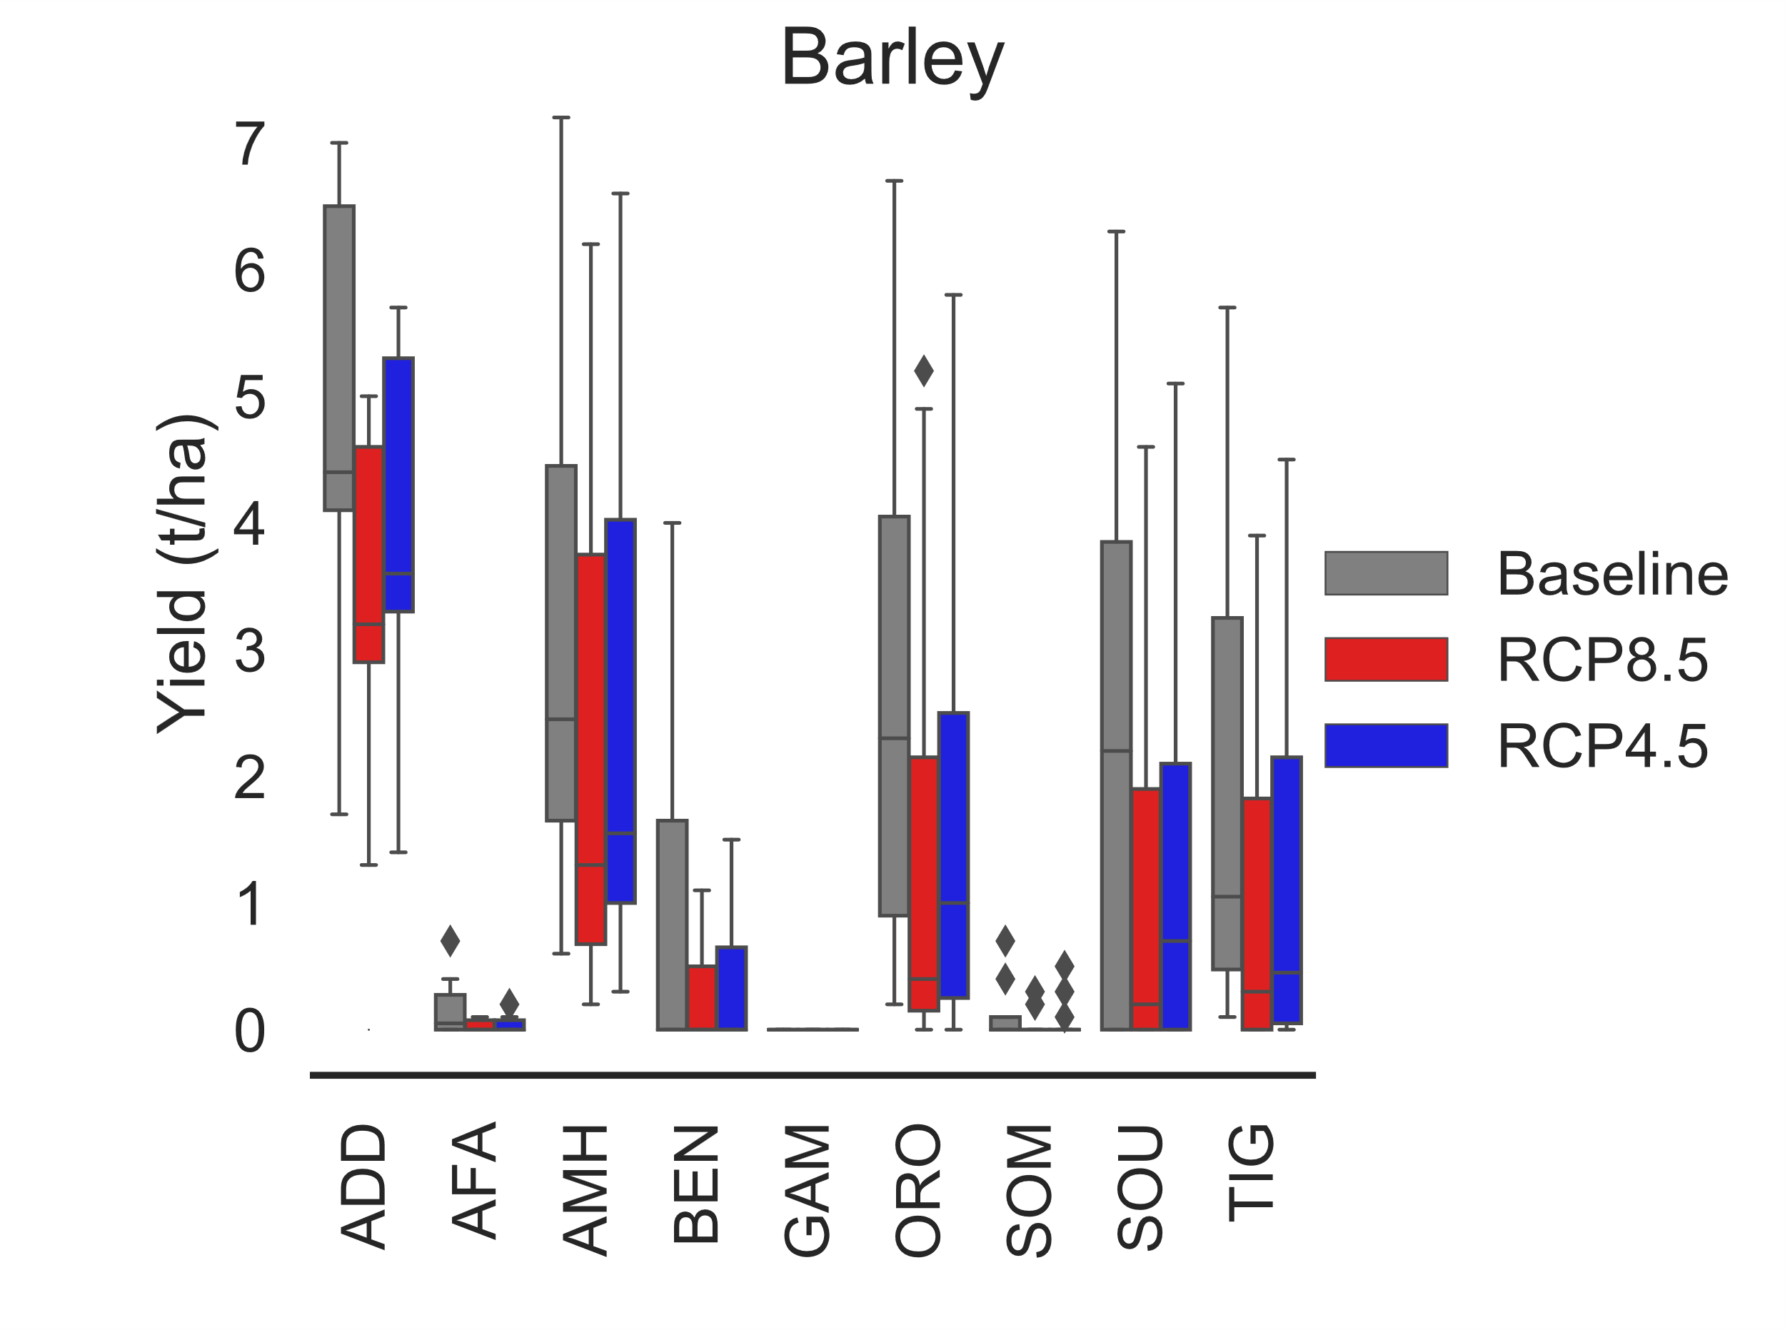
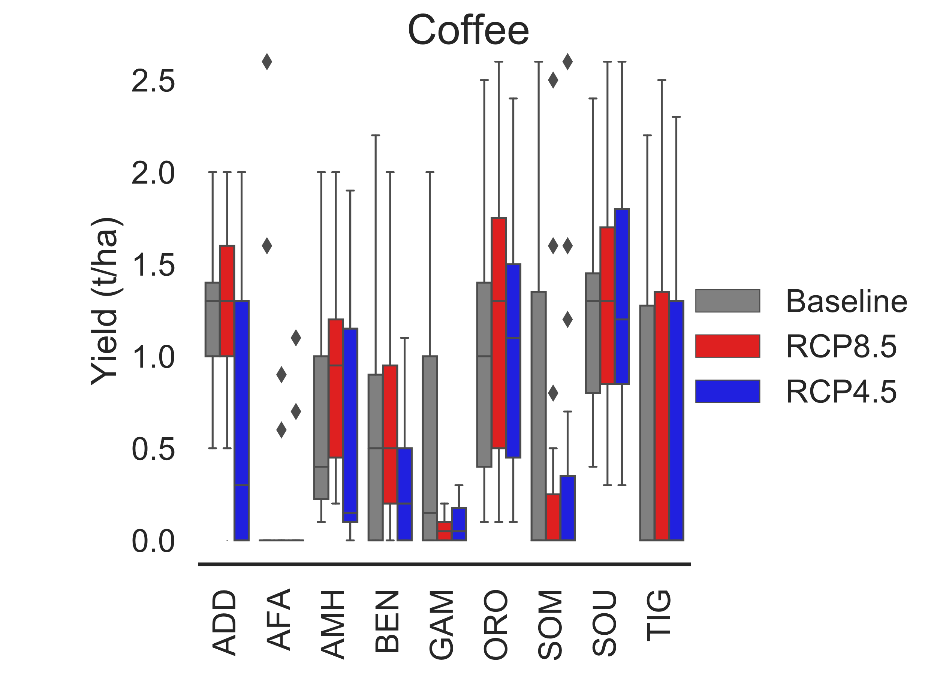
6.2. CLEWs-Ethiopia example – part I
Climate change impacts
Notes:
Another aspect considered in the Climate Resilient Green Economy thematic area is that of climate impacts. The two figures above show the yield, in tonnes per hectare, for barley, on the right, and coffee, on the left, across three climate futures and Ethiopia’s nine regions.
The results of the modelling analysis show that climate change could significantly alter crop yields. However, the direction of this impact varies for different crops and under different climate futures. For instance, barley yields appear to be highest in the baseline scenario and lowest in the R.C.P. 8.5 scenarios across all regions. And the difference between the expected yields in both R.C.P. 4.5 and R.C.P. 8.5 scenarios appear to be marginal in all scenarios as well.
At the same time, coffee yields show greater variation in trends across regions. In most regions, coffee yields are highest in the RCP8.5 scenario. However, there are two regions which are notable exceptions to this, where the yields in the baseline scenario are significantly greater than either the R.C.P. 4.5 or R.C.P. 8.5 scenarios.

Slide 12
6.2. CLEWs-Ethiopia example – part I
Key messages – ‘Climate Resilient Green Economy’ scenarios
Reforestation allows for increased sequestration of CO₂, offsetting emissions from other sectors.
Crop yields at a national level not significantly affected by climate change (potential overall increase due to increased rainfall in both climate futures studied)
However, impacts vary by crop and region -> important to consider negative regional impacts for farmers of vulnerable crops
Notes:
The modelling results from the ‘Climate Resilient Green Economy’ scenarios considered in the CLEWs-Ethiopia model provide some key insights. First, they highlight the benefit and extent to which reforestation allows additional carbon dioxide sequestration, which can help offset emissions from other sectors. This is especially salient given the projected growth in energy- and emissions-intensive sectors such as transport and industry by 2030. Second, it highlights the impact of climate change on crop yields. The results show that at the national level it appears that climate change may not significantly affect crop yields in both the climate futures considered. However, there appears to be significant heterogeneity in these impacts by region and crop. This highlights the importance of spatial resolution and representation of land use in such models. A model with only a national scope may not identify such regional differences. Including this additional granularity in the model helps assess and inform more targeted and regionally differentiated policies.

Slide 13
Lecture 6.2. References
IPCC, 2014: Climate Change 2014: Synthesis Report. Contribution of Working Groups I, II and III to the Fifth Assessment Report of the Intergovernmental Panel on Climate Change [Core Writing Team, R.K. Pachauri and L.A. Meyer (eds.)]. IPCC, Geneva, Switzerland, 151 pp
13

Slide 14
6.3. CLEWs-Ethiopia example – part II
‘Agriculture Modernization’ scenarios
Current targets. Output of agricultural production meets goals of the national plan
Fixed food basket. Per capita consumption of agricultural produce stays constant and production increases with population growth
Improved diets. Per capita consumption of agricultural products shifts towards the pattern of the richest 20%, with higher consumption of animal products and lower reliance on cereals.
Notes:
Under the second thematic area, ‘Agriculture Modernization’, we consider three scenarios. The first is ‘Current targets’, which represents the baseline or ‘business-as-usual’ scenario. In this scenario, the crop production meets the goals set out in the national plan. The model optimizes the overall system to achieve these national targets at the least cost over the modelled period. The second scenario is the ‘Fixed food basket’, in which per capita consumption of agricultural produce stays constant and production increases with population growth. This scenario represents a combination of the status quo, in terms of diet composition, and a projected growth in the demand based on population trends. The final scenario, ’Improved diets’, assumes that per capita consumption of agricultural products shifts towards the pattern of the richest 20%. This scenario represents a significant shift in diet composition for 80% of the current population. The aim of studying these three scenarios is to identify the implications of diet compositions on land use, water, energy, and emissions.

Slide 15
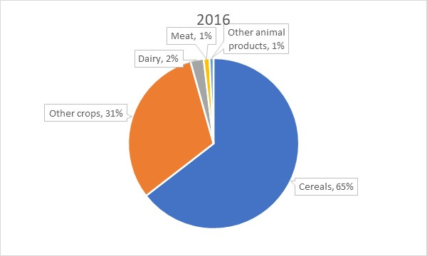
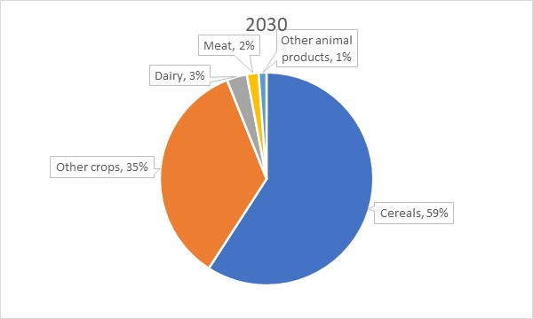
6.3. CLEWs-Ethiopia example – part II
‘Agriculture Modernization’ diets
Fixed Food Basket
Improved Diet
2245 kcal/day/person
2585 kcal/day/person
Notes:
Two of the diets mentioned in the previous slide are compared here. These are the ‘Fixed Food Basket’ and ‘Improved Diet’. The ‘Improved diet’ represents a higher total calorific diet than the ‘Fixed food basket’. The ‘improved diet’ is characterized by higher consumption of animal products and lower reliance on cereals. As mentioned previously, the ‘Improved Diet’ represents the diet of the richest 20% of Ethiopia’s population. The diet also resembles that of many developed countries with a higher relative consumption of animal products as compared to cereals. It should be noted, however, that the scenario name ‘Improved diet’ does not imply that the diet is an improvement on the ‘Fixed Food Basket’ in every way. It is simply meant to represent a higher calorie diet which is the likely progression of diet compositions in Ethiopia based on current trends. The impact of other diets could also be considered within the existing modelling framework.

Slide 16
6.3. CLEWs-Ethiopia example – part II
‘Agriculture Modernization’ scenario results
Energy use for agriculture (PJ)
Crop area by input level (1000 sq.km.)
Water use by sector (bcm)
GHG emissions by sector (Mt of CO₂-eq.)
Notes:
The CLEWs-Ethiopia model was used arrive at the ‘least-cost’ optimal systems for each of the scenarios considered. The results shown here compare the three diet scenarios in terms of their implications on resource use (energy, land, and water) as well as emissions. In terms of resource use, the current targets scenario results in the highest level of the three scenarios for energy, land, and water consumption. It is followed by the ‘Improved diet’ scenario, with the ‘Fixed food basket’ having the lowest resource use. However, in terms of greenhouse gas (or GHG) emissions, the ‘Improved diet’ scenario represents the highest level, followed by the ‘Current targets’ and ‘Fixed food basket’ scenarios. This is due to the increased emissions from the livestock sector resulting from the higher requirement of animal products in the ‘Improved diet’ scenario. The energy use is predominantly represented by diesel consumption and water use by consumption for the irrigation sector.

Slide 17
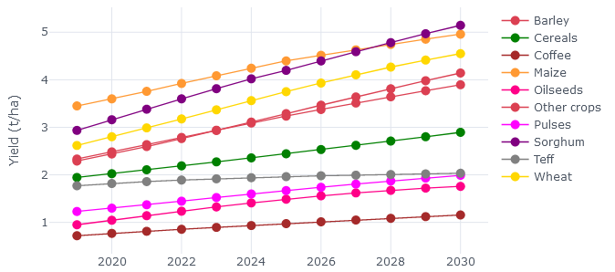
6.3. CLEWs-Ethiopia example – part II
‘Agriculture Modernization’ scenario results
Crop yields in ‘Current targets’ scenario (tonnes/hectare)
Improvement in yields from 2019 to 2030 (%)
Notes:
The CLEWs-Ethiopia model optimizes the overall integrated energy, land use, and water systems subject to resource and other constraints in order to achieve a ‘least cost’ configuration. As part of this, the model selects pathways that lead to increasing yields of all crops, as shown in the figure on the left.
However, the extent of these increases varies by crop and scenario as shown by the figure on the right. It highlights the difference in agricultural modernization pathways chosen by the model for each scenario. For instance, crop yield increases for barley and coffee are lowest for the ‘Baseline’ scenario and highest for the ‘Improved diet’ scenario. However, for several other crops such as oilseeds and wheat, they are highest in the ‘Baseline’ scenario. Overall, the crops show increases between 20 % and 100 % across the range of crops considered.
This result highlights the need to consider each crop individually when developing policies to modernize agriculture.

Slide 18
6.3. CLEWs-Ethiopia example – part II
Key messages – ‘Agriculture Modernization’ scenarios
Substantial potential for modernization of agriculture. Yields (tonnes produced per hectare) could improve by 50 to 110% through greater use of inputs and mechanization
Productivity improvements would limit the need for additional cropland, but does require additional inputs in the form of energy, water, pesticides, and fertilizer
Requires substantial increase in investment and inputs. Annual investment would need to be 2–3 times higher than present average
Notes:
The results from modelling the ‘Agriculture Modernization’ scenario provide three key insights.
First, there is substantial potential for modernization of agriculture in Ethiopia – between 50 and 110 % – which can be achieved through greater mechanization, use of improved seeds, and fertilizers. This is based on a shift from ‘low input’ agriculture to ‘intermediate input’ and ‘high input’.
Second, increasing crop yields will limit the need for additional cropland. As crops produced per unit of land increase between 20% and a 100% over the range crops considered, growing food demands across all three scenarios can be met with less land through agriculture modernization. There will, however, be implications for increased inputs in terms of energy, water, pesticides, and fertilizer use.
Finally, modernization of the agriculture sector would require investments that are 2 to 3 times the current level. These investments will need to be strategically targeted by crop and region. The importance of this is even greater considering the heterogeneity of climate impacts by crop and region as was highlighted in the previous thematic area ‘Climate Resilient Green Economy’.

Slide 19
6.4. Modelling land use in OSeMOSYS
Multiple, competing uses for land
Land uses
Production
Maize Bananas
Rice Sugarcane
Coffee
Other crops
% of X
Crop land
Total land
% of X
Barren land
Production
Wood and other forest products
% of X
Forests
X units of land
Pastures / Grasslands
Production
% of X
Meat
Dairy
% of X
Built-up land
Production
Residential, Industrial, Commercial, Transport
% of X
Water bodies
Notes:
The previous section presented an example of a CLEWs model that includes a representation of land use. This section will cover the basic steps in order to create a similar representation of land use in OSeMOSYS. The first step in this process is to identify the multiple, competing uses for land. Here, six categories of land use are shown. They consist of cropland (to produce crops), barren land (unproductive and generally useable land), forests, pastures, or grasslands (to sustain grazing livestock), built-up land (towns, cities, powerplants, etc.), and water bodies (lakes, rivers etc.). The total amount of land available in any modelled area is finite and needs to be divided between the aforementioned uses. The shares of land allocated to different uses vary over time based on incentives of each type of land use. For example, rapid urbanization may lead to an increase in the share of built-up land and a decrease in that of forest land. Similarly, shares of cropland may increase over time to meet growing food demands in the absence of agricultural modernization.

Slide 20
6.4. Modelling land use in OSeMOSYS
Modes of operation
A technology can be set to work in more than one ‘mode of operation’. (Default ‘mode of operation’ is 1).
Example
A gas powerplant is usually powered by natural gas.
However, other fuels such as fuel oil may also be used.
The efficiency of the powerplant differs depending on the fuel used.
Gas
field
Natural gas
Electricity
High efficiency
Mode 1
Light fuel oil import
Light fuel oil
Electricity
Mode 2
Low efficiency
20
Notes:
This brings us to the concept of ‘modes of operation’, which is a default set in OSeMOSYS. In OSeMOSYS a technology can operate in more than one ‘mode of operation’. A mode of operation is characterized by its inputs and outputs, and associated ratios for each of these.
The example here shows a system with three technologies. A gas field that produces the commodity ‘natural gas’, a light fuel oil import technology that produces the commodity ‘light fuel oil’, and a gas powerplant.
The gas powerplant can use either natural gas or fuel oil as an input to produce electricity at different efficiencies. These two pathways to utilize either available fuel to produce electricity can be represented through two modes of operation in OSeMOSYS. The default mode of operation is ‘1’, and there is no technical limit in OSeMOSYS on the number of user-defined modes of operation that a technology can operate in.

Slide 21

6.4. Modelling land use in OSeMOSYS
Modes of operation – energy
The technology can choose to use
only mode 1 or
only mode 2 or
a combination of the two modes
Total Technology Activity = 100
Gas
field
Natural gas
Electricity
Activity = 40
Light fuel oil import
Light fuel oil
Electricity
Activity = 60
21
Notes:
Here, the example from the previous slide is continued. A technology with two or more modes of operation can choose to use only 1 mode or a combination of modes. For instance, a technology with a total technology activity of 100 can divide this activity between its two modes: 40 units of activity in mode 1 and 60 units of activity in mode 2, as is the example shown here. In order to operate in these two modes, the associated levels of input fuels – natural gas in mode 1 and light fuel oil in mode 2 – must also be supplied. For instance, a constraint could be set on the upstream gas field technology that prevents it from producing any natural gas. This will in turn prevent the gas powerplant from operating in mode 1 since that would require natural gas as an input. The gas powerplant can, however, continue to operate in mode 2 due to the unconstrained supply of light fuel oil.

Slide 22
6.4. Modelling land use in OSeMOSYS
Modes of operation – land use
Modes of operation can also be used for the allocation of land within a land ‘technology’
Land uses
Total available land
Land
Maize
Mode 1
Rice
Mode 2
22
Notes:
Modes of operation can be used flexibly in an OSeMOSYS model. Here, it is used to represent the allocation of land within a land technology. Land can be thought of as a technology with inputs and outputs that must be balanced.
In this example, land can be allocated to either maize production in mode 1 or rice production in mode 2 or a combination of the two. If a user sets demands for both crops, the model will need to allocate sufficient land to each of the modes to the extent that the demands for maize and rice are met. The ‘activity’ in each mode represents the land allocated to each type of crop production. In this case, the input land commodity, and the activity within the land technology, may be in units of land such as hectares or square kilometers, while the two output crop commodities may be in kilograms or tonnes.

Slide 23
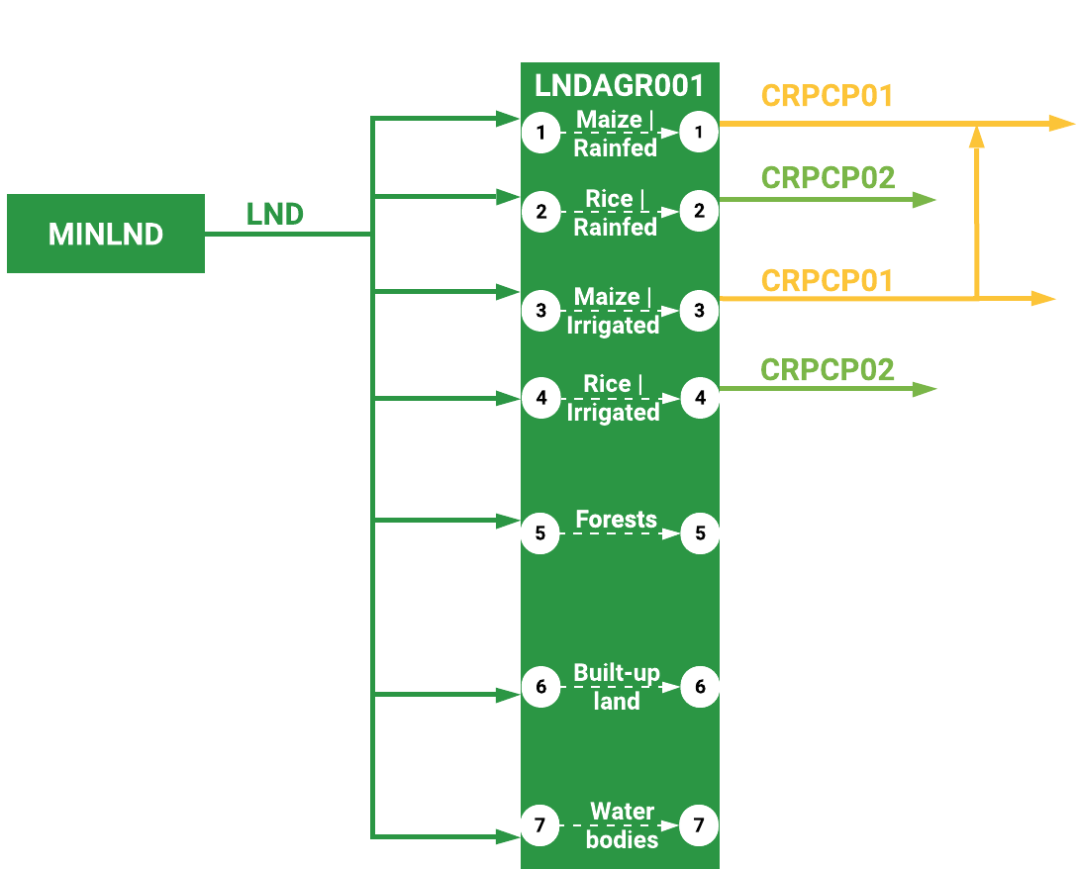
6.4. Modelling land use in OSeMOSYS
Linking technologies and commodities
InputActivityRatio
OutputActivityRatio
23
Notes:
Expanding on the approach from the previous slide, additional modes of operation can be used to represent other land uses such as built-up land, forests, grasslands, water bodies, and so on. In this example, there are four modes, 1 to 4, that together represent ‘cropland’. Modes 1 and 3 produce maize and modes 2 and 4 rice. These can be thought to represent rainfed and irrigated cropland for maize and rice. Modes 5, 6, and 7 do not produce any output. Here, a naming convention is introduced as well. M.I.N.L.N.D. represents a technology that supplies the commodity land, called L.N.D. here. This commodity is an input a technology that can be used to represent a sub-unit of land, L.N.D.A.G.R.0.0.1. Additional technologies following the same naming technology can be used in case multiple sub-units are to be represented. The crops maize and rice are named C.R.P.C.P.0.1. and C.R.P.C.P.0.2. respectively.
However, all modes will require an input of land. This input land represents the total available land to be allocated in, for example, a country or region.
Therefore, modes 1 to 4 will have both Input- and OutputActivityRatios while modes 5 to 7 will only have an input of land but no output. This is only an example, however. A user may, of course, decide to represent additional land uses and outputs from other modes as well. This simple example provides a basic framework for the representation of land use in an OSeMOSYS model.

Slide 24
Take Quiz
Shivakumar A. (UNDESA), Sridharan V. (KTH), Niet T. (SFU), Ramos E.P., Gardumi F. (KTH), Alfstad T., (UNDESA) 2021. Lecture 6: Land use representation. Release Version 1.0. [online presentation]. Climate Compatible Growth Programme, United Nations Development Program and United Nations Department of Economic and Social Affairs.
CCG courses (this will take you to the website link http://www.ClimateCompatibleGrowth.com/teachingmaterials)

