Slide 1

LECTURE 4
MODELLING ENERGY TECHNOLOGIES
Introduction to CLEWs

Slide 2
Learning Outcomes
By the end of this lecture, you will obtain:
ILO1: Familiarity with components and processes in an energy system model
ILO2: Conceptual understanding of the most important parameters related to the representation of technologies
ILO3: Conceptual understanding of different costs associated with energy technologies
ILO4: Conceptual understanding of the impact of technology costs on their role in the energy supply
Notes:
This lecture dives deeper into how technologies are modelled. The concepts explained in the lecture apply to OSeMOSYS, but can be seen as general and also applicable to several other tools. The focus will lie on the representation of energy technologies, but similar concepts can also be applied to the representation of water and land uses. This will become clearer further into the course.
By the end of this lecture you are expected to gain: familiarity with components and processes of an energy system model; conceptual understanding of the most important parameters for the representation of technologies in an energy system model; conceptual understanding of different costs associated with energy technologies; and finally, conceptual understanding of the impact of technology costs on the role of technologies in the energy supply.

Slide 3


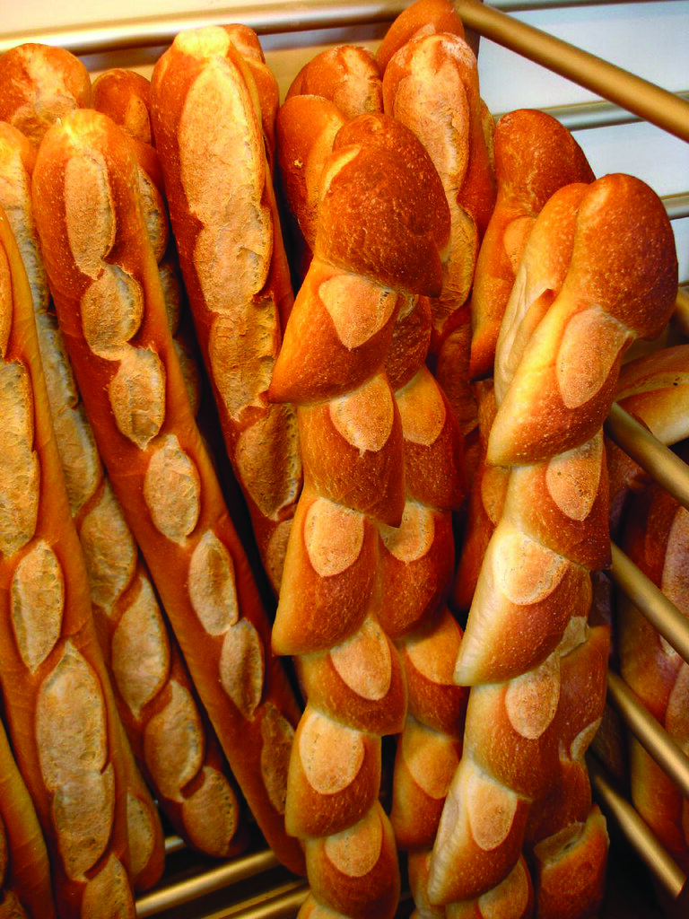

4.1 Capacity and activity
Starting with an example
A bakery has one bread-making machine.
If the machine is loaded with 5 kg of flour and 4 litres of water, after one hour it produces 50 baguettes.
50 baguettes
5 kg flour
4 l water
Picture source: Olga Kudriavtseva, photo from Unsplash; Laura Mitulla, photo, from Unsplash; Frédéric Dupont, photo, form Unsplash; CampusFrance , photo, licensed under CC 0
Notes:
The first key concept is the one of capacity and activity. The definitions of capacity and activity and the difference between the two are best illustrated with an example. Since the concepts are applicable not only to energy, but to any type of machinery or activity, an example unrelated to energy is chosen. Let us imagine a bakery that has one bread-making machine. The machine is represented at the centre of the figure. Let us assume that, when the machine is loaded with 5 kg of flour and 4 litres of water, after one hour it produces 50 baguettes. Of course, reality is more complicated and also yeast, salt, and several other stages would be involved. These are omitted for simplicity of representation. Two important concepts are implied in the figure. When flour and water are given as inputs, baguettes are obtained as output. And there is a precise ratio between input and output. When defining the role of a technology in a model, the nature of the inputs, the nature of the outputs related to those inputs, and the ratio between outputs and inputs will always have to be defined.

Slide 4
4.1 Capacity and activity
Starting with an example
Machine capacity: how much it can produce in a unit of time (e.g., 1 hour)
Machine activity: how much it does produce in any given time
CAPACITY: 50 baguettes per hour
ACTIVITY: 150 baguettes in the next 3 hours
Picture source: Frédéric Dupont, photo, form Unsplash; CampusFrance , photo, licensed under CC 0
Notes:
The concept that the machine can produce 50 baguettes in one hour is fundamental. It helps one understand what the capacity and the activity of the machine are. The capacity is defined as how much bread the machine is able to produce in a certain unit of time. In this case, the capacity is 50 baguettes per hour. The activity is defined as how much bread the machine produces in any given time horizon. For example, if the machine works for three hours it produces 150 baguettes. 150 baguettes is its activity. The value of the capacity does not change. It is linked to the specific machine that was bought by the owners of the bakery. The value of the activity normally changes and depends on the time frame we look at. If the machine keeps working, its activity after one hour will be 50 baguettes, after two hours 100 baguettes, after three hours 150 baguettes and so on. The activity could also be less than the maximum the machine can achieve. For example, if less flour and water are added, fewer baguettes will come out after one hour.

Slide 5
4.1 Capacity and activity
Starting with an example
If we want more bread within one hour, we need to increase our capacity, i.e., install more machines in the bakery
CAPACITY: 150 baguettes per hour
ACTIVITY: 150 baguettes in the next 1 hour
Picture source: Frédéric Dupont, photo, form Unsplash; CampusFrance , photo, licensed under CC 0
Notes:
The previous example showed that the machine allows the baker to obtain at most 50 baguettes per hour, if it is fully loaded. That means that the baker cannot sell more than 50 baguettes every hour. Let us now imagine that the bakery is becoming very popular and has an increasing number of clients. The demand for bread increases and the baker notices that there is the possibility to sell more than 50 baguettes per hour. How could the baker be able to sell more? By increasing the capacity of the bakery, that is, by investing in more bread-making machines. If the baker buys two more machines of the same type as the first one, there will be three machines in the bakery, each able to produce 50 baguettes per hour. Therefore, the total capacity of the bakery, in other words the number of baguettes the bakery can produce in one hour, will increase to 150. When the capacity is increased to 150 baguettes per hour, then also the activity in one hour can increase. Now, this investment will have implications on other expenses in the bakery: for instance, there will likely be need to hire more bakers to attend to all the machines at the same time. These implications will be discussed later in the lecture.

Slide 6
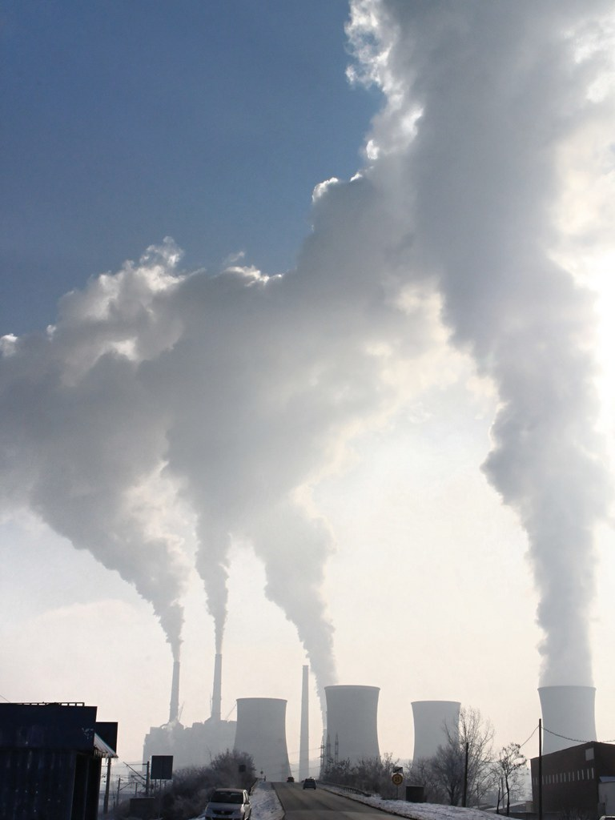

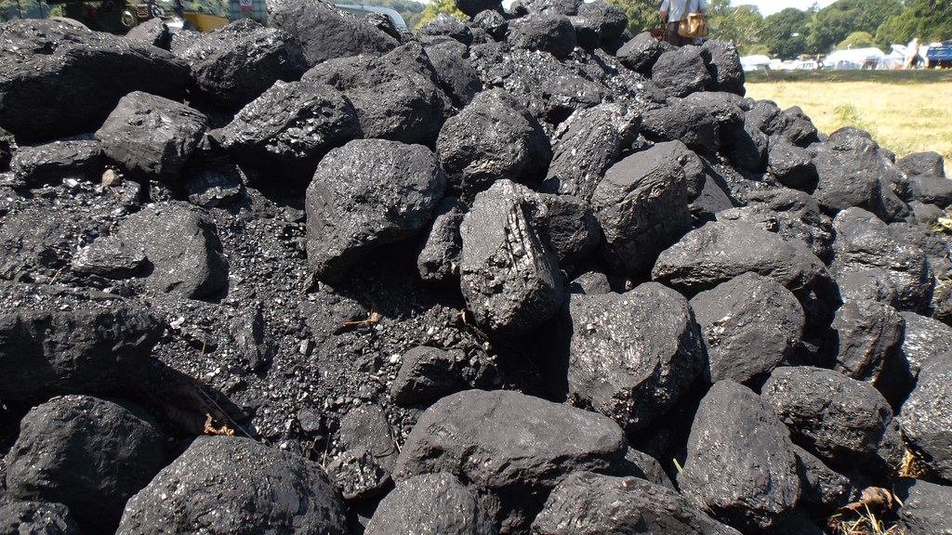
4.1 Capacity and activity
Applying to the energy system
ACTIVITY: 3000 GJ of coal in one hour, 6000 GJ in two hours, and so on…
CAPACITY: 1000 GJ electricity per hour
= 1000 GJ / 3600 seconds
= 0.2778 Gigawatts (GW)
CAPACITY: 0.2278 GW
ACTIVITY: 1000 GJ of electricity in one hour, 2000 GJ in two hours, and so on…
Picture source: oatsy40 , photo, licensed under CC BY; Public Domain Photos, photo, licensed under CC BY; Bernt Rostad , photo, licensed under CC BY
Notes:
The concepts of capacity and activity are key in the type of modelling carried out in this course. First and foremost, they are important in the process of modelling the energy system. For instance, when looking at the electricity supply, a central type of asset or technology is power plants. Power plants are also defined by their capacity and their activity, exactly in the same way as the bread-making machine. The figure on this slide depicts a coal power plant. In the example, its capacity, that is, the electricity it is able to supply in a unit of time, is 1,000 GJ per hour. With a couple of operations we find that this means around 0.23 GJ per second, otherwise described as 0.23 GW. If this is the capacity, the power plant can supply 1,000 GJ of electricity in one hour, or 2,000 GJ in two hours, and so on. The power plant can also supply less than this, if it does not operate to the maximum possible extent. But it cannot supply more. However much the power plant actually supplies is its activity. At the same time, for the power plant to be able to supply that much electricity, it needs to be fed with coal. The coal input necessary for the power plant to produce 1,000 GJ in one hour is 3 times as much, namely 3000 GJ of coal are needed for one hour, or 6000 GJ for two hours.

Slide 7
4.1 Capacity and activity
Capacity-to-activity-unit
Sets the relationship between capacity and activity
The activity that could be generated by one unit of capacity running at 100% load for 1 year)
Example: If the capacity and activity of a refinery are both measured in barrels per year, then the Capacity-to-activity-unit is 1
However, if you use the capacity is measured in barrels per day and the activity in barrels per year, then the Capacity-to-activity-unit is 365
Picture source: Frédéric Dupont, photo, form Unsplash; CampusFrance , photo, licensed under CC 0
Notes:
In OSeMOSYS the modeller needs to set the value for a parameter called Capacity-to-activity-unit. This parameter is needed because of how OSeMOSYS is structured and it is essential. It represents a fixed ratio between the activity and the capacity of a technology. Specifically, its value is equivalent to the activity that could be generated by one unit of capacity running at the maximum possible extent for one year. The value depends on the units that the modeller chooses for the capacity and the activity. For example, let us imagine that a refinery is modelled which has a capacity and activity measured in barrels per year. Let us imagine that the capacity equals 365 barrels per year. The activity, which is the number of barrels delivered in one year, will again be 365. This means that the Capacity-to-activity-Unit, which is the ratio between the activity in one year and the capacity, is equal to 1. If the capacity is measured in barrels per day and the activity is still measured in barrels per year, things change. For the same refinery, the value of the capacity is now 1 barrel per day (which is the same as saying 365 barrels per year). The value of the activity is still 365 barrels per year. This means that the Capacity-to-activity-unit is equal to 365. Now the importance of this parameter may become clearer: if the modeller sets the value of the parameter wrong, there is a wrong representation of how much activity can come from one unit of capacity. This may entail very unreasonable modelling results.

Slide 8
Lecture 4.1 References
Taliotis, Constantinos, Gardumi, Francesco, Shivakumar, Abhishek, Sridharan, Vignesh, Ramos, Eunice, Beltramo, Agnese, … Howells, Mark. (2018, December). Representing primary energy supply in OSeMOSYS. Zenodo. http://doi.org/10.5281/zenodo.4585692

Slide 9
4.2 Cost parameters
Overview
Costs are split into CapitalCost, FixedCost, and VariableCost
Fuel
Other consumables (e.g., chemicals, detergents, etc.)
Salaries
Taxes and insurance
Fixed fuel costs
Depreciation
Return on investment
Other one-time fixed charges
Notes:
Another family of input parameters deserving particular attention is the cost parameters. OSeMOSYS is a cost optimization tool. It finds the technology mix that has the lowest cost. Therefore, the way the mix looks and the role of each technology in the mix will depend on the costs of each technology. In energy engineering, as well as in other fields of production engineering, technologies or physical assets incur typically two categories of costs: capital costs and operation and maintenance costs. The capital costs consist mostly of capital to build the asset (both loans borrowed from banks or investment by shareholders) and one-time expenses for permission of construction, environmental assessments, and so on. They are usually incurred during the planning and construction phase, over a few years. Therefore, they do not depend on the level of activity of the asset, but rather its capacity. On top of the investment costs, the interest rates are also considered. Interest rates ensure return on investments for the creditors or investors.

Slide 10
4.2 Cost parameters
Overview
Costs are split into CapitalCost, FixedCost and VariableCost
Fuel
Other consumables (e.g., chemicals, detergents, etc.)
Salaries
Taxes and insurance
Fixed fuel costs
Depreciation
Return on investment
Other one-time fixed charges
Notes:
The operation and maintenance costs are further divided into variable costs and fixed costs. There are various definitions for each of these cost types. Generally, however, the variable costs include costs that vary with the level of activity of a technology. These could be, for instance, fuel expenses or other consumables. The use of fuel or consumables is directly proportional to the level of output of the technology, or in other words, proportional to the activity. Fixed costs usually include costs incurred every year, but these vary mostly with the capacity of the technology. These include, for example, labour costs and salaries. An example may help understand this cost item. When a power plant is built and starts operation, the owners need to hire staff to run the power plant. Even though there may be some level of turnover in the staff, more or less the same number of people will need to be paid salaries every month and every year for running the power plant independently of whether the power plant works more or less in one specific month. Therefore, the salary costs can be seen as depending more on how big the power plant is, that is its capacity, than the activity.

Slide 11
4.2 Cost parameters
Time-dependency
A technology only incurs capital costs when there is an investment
 | Year 1 | Year 2 | Year 3 | Year 4
CapitalCost [M$/GW] | 2000 | 1900 | 1800 | 1700
IF there is an investment in year 2,
then a cost of million $ 1900 per unit of installed capacity is incurred.
E.g., an investment of 0.1 GW would incur a cost of 1900 M$/GW * 0.1 GW = $ 190 million
IF the same investment took place in year 4 the cost would be 1700 M$/GW * 0.1 GW = $ 170 million
Notes:
It is important to understand a few more attributes of the cost items described in the previous slides. These attributes are represented in OSeMOSYS, and they significantly influence the cost-competitiveness of different technologies. The most important notion is that all the cost items are time-dependent. Often, costs tend to decrease with time due to technological developments, economies of scale, increase of competitiveness, and many other market factors. This is particularly true for capital costs. The example shows capital costs that decrease sharply year after year. This decrease has a high impact on when it is best to make an investment. In the example, representing a fictitious energy supply technology, if an investment is made in year 2, the capital cost incurred will be 1900 US million dollars per unit of capacity (GW). For example, if an investment in a power plant of 0.1 GW of capacity is made, the total investment cost will be 190 million US dollars. If the same investment is made two years later, in year 4, the cost per unit of capacity is lower, 1700 US dollars. In that case, the total investment cost for a 0.1 GW power plant would be 170 million US dollars. There may be several reasons why an investment occurs in year 2 anyway, despite the higher cost. However, it is important to be aware of the impact cost variations may have on the competitiveness of technologies.

Slide 12
4.2 Cost parameters
Time-dependency
A technology incurs fixed costs during any year when there is any installed capacity
 | Year 1 | Year 2 | Year 3 | Year 4
FixedCost [$/MW] | 50,000 | 55,000 | 60,000 | 65
E.g., capacity of 100MW incurs a cost of 50,000 $/MW * 100 MW = $ 5 mill in year 1
IF the retired capacity is retired before the beginning of the 4th year, no costs will be incurred in the 4th year
Notes:
Also the fixed operation and maintenance costs may vary with time. This could be related, for instance, to annual variations of the costs of labour and reorganization of the work structure in production sites. However, here the dynamics generated by cost variations are slightly different from those linked to the capital costs. Fixed costs are not incurred once like capital costs. Fixed costs are incurred every year and they are proportional to the installed capacity. Let us imagine a case where a power plant of 100 MW has been installed before and is in place during years 1, 2, and 3. During those years, the fixed costs per unit of installed capacity increase, from 50,000 US dollars per MW to 60,000 US dollars per kW. This means that the power plant will incur increasing fixed costs each year. The first year, the fixed costs will amount to 100 times 50,000, that is, 5 million US dollars. Making the same calculation for years 2 and 3 will deliver respectively 5.5 million US dollars and 6 million US dollars. Even if fixed costs are projected to increase again in year 4, no costs will actually be incurred in year 4. The reason is that the power plant will not be there anymore in year 4. Its capacity will be 0.

Slide 13
4.2 Cost parameters
Time-dependency
A technology incurs variable costs for every unit of activity
 | Year 1 | Year 2 | Year 3 | Year 4
VariableCost [$/GJ] | 2 | 2 | 2 | 2
IF there is activity in any year
then a cost of 2 M$/PJ is incurred
E.g., activity of 1 PJ would incur a cost of 2M$ / PJ * 1 PJ = $ 2 million
IF there is no activity no costs are incurred
Notes:
Finally, also the variable operation and maintenance costs vary over time. This variation is related to variations of the market prices of all the consumables that the technology uses during its operation, for instance chemical substances or fuels. Ideally, there will be many variations of these costs during one year. However, often fuels and chemicals are purchased by a production site in big stocks, with long-term and fixed-price contracts. This means that the cost may be considered constant as long as the contract is not renegotiated. In OSeMOSYS there is the possibility to change the variable costs every year. It is important to remember that the variable costs are very different from the capital or the fixed costs and they affect the competitiveness of a technology in a very different way. Variable costs are not proportional to the installed capacity like the capital or the fixed costs, but to the activity. In the example, a power plant is assumed to have an activity and produce an output in years 1, 2, and 3, but not in year 4. The cost per unit of output is 2 million US dollars per PJ. The annual output is 1 PJ. Therefore, the power plant incurs 2 million US dollars of variable costs every year, from year 1 to 3. Since the power plant is not active in year 4, it will not have variable costs in that year. However, if it still exists and is installed, it will incur fixed costs in the same year.

Slide 14
Lecture 4.2 References
Taliotis, Constantinos, Gardumi, Francesco, Shivakumar, Abhishek, Sridharan, Vignesh, Ramos, Eunice, Beltramo, Agnese, … Howells, Mark. (2018, December). Representing primary energy supply in OSeMOSYS. Zenodo. http://doi.org/10.5281/zenodo.4585692

Slide 15


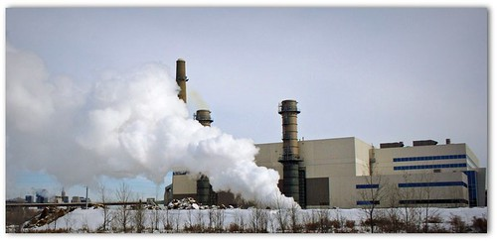
4.3 Impact of cost structures
A simple energy system example
Coal power plant
Island Energy system
Power plant options | Yearly fuel Availability (PJ) | Variable cost (USD/PJ) | Fuel use (PJ of fuel/PJ electricity) | Electricity generation variables (PJ)
Coal | 600 | 350 | 3 | X_{CL}
Natural gas | 300 | 300 | 2 | X_{GS}
Natural gas power plant
Picture source: Public Domain, photo, licensed under CC BY; Picture source: TBoard, photo, licensed under CC BY; Picture source: Hrvoje_Photography, photo, licensed under Unsplash
Notes:
This module explores how the cost parameters discussed in the previous slides may affect a mathematical optimization problem that is related to energy planning. The discussion is based on a very simple example, representing the energy system of an island. Let us assume that the annual electricity demand on an island is 250 PJ. Basically the people and industries living on the island consume 250 PJ in a year. There are two power plants that can be used to meet the annual electricity demand: a coal and a natural gas power plant. In the table, some characteristics of the power plants are given. First, the efficiency of the coal power plant is lower than the one of the gas power plant. That means that the coal power plant uses more fuel to obtain the same output. Secondly, the variable cost is higher for the coal power plant. In synthesis, it is more expensive and less efficient to run the coal power plant. However, the yearly availability of natural gas is smaller compared to coal: there is less gas. The objective is to estimate how much electricity should be produced from each of the plants to meet the annual demand, so that the total system cost can be minimized.

Slide 16
4.3 Impact of cost structures
A simple energy system example
Problem structure and data
X_{CL} = Electricity generation variable (in PJ) for coal PP
X_{GS} = Electricity generation variable (in PJ) for Gas PP
Total yearly demand: 250 PJ
Availability of Coal: 600 PJ/Year
Availability of Gas: 300 PJ/Year
Cost of using the coal power plant: 350 * XCL
Cost of using the coal power plant: 300 * XGS
Notes:
Now the discussion becomes a bit more complicated. Yet, it is important because it shows the basic working principles of any energy system modelling tool. The first step in solving the problem stated in the previous slide is to break it down into its fundamental parts and fundamental data and then write a mathematical formulation for it. One can start from the fundamental parts. These are shown in the square. Let us assume that X C.L. is the electricity generation variable (in PJ) for the coal power plant and X G.S. is the electricity generation variable (in PJ) for the gas power plant. The total demand to be met is 250 PJ. The availability of coal and gas is restricted to 600 and 300 PJ per year respectively. The cost of generating one PJ of electricity from gas and coal is 300 and 350 US dollars respectively.

Slide 17
4.3 Impact of cost structures
A simple energy system example
Mathematical formulation
Objective function: Minimize total electricity production cost
Minimize total cost (Z) = 350 * X_{CL} + 300 * X_{GS}
Demand constraint: X_{CL} + X_{GS} ≥ 250
Coal availability constraint: 3* X_{CL} ≤ 600
Gas availability constraint: 2* X_{GS} ≤ 300
Positive production constraint: XCL ≥ 0, XGS ≥ 0
Notes:
Now, let us look at the mathematical formulation. First, the objective function needs to be written. The objective is minimizing the total electricity production cost. This is the sum of the cost for producing electricity with the coal and gas power plants. The cost for the coal power plant equals the unit cost, 350, multiplied by the coal-fired generation (which is the unknown variable). Similarly, the cost for the gas power plant equals the unit cost, 300, multiplied by the gas-fired generation. This minimization needs to happen respecting some constraints. The first constraint is that the demand must be met. That is, the sum of the annual generation by the two power plants needs to be at least equal to 250 PJ, the annual demand. The second and third constraints state that the total uses of coal and gas need to be lower than the availability of coal and gas. The use is defined by the generation (X) multiplied by the use of fuel per unit of generation. Finally, since the generation is a physical quantity, it is assumed to be greater than or equal to 0.

Slide 18
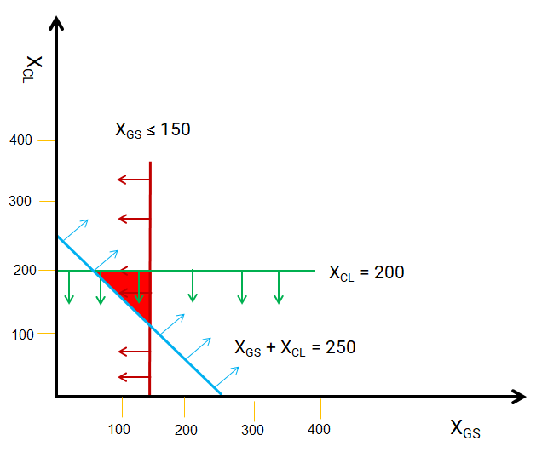
4.3 Impact of cost structures
A simple energy system example
Mathematical formulation
Graphical representation
X_{CL} ≥ 0, X_{GS} ≥ 0
Demand constraint: X_{CL} + X_{GS} ≥ 250
Gas availability constraint: 2* X_{GS} ≤ 300
Coal availability constraint: 3* X_{CL} ≤ 600
Notes:
For this simple problem the process of finding a solution can be represented graphically. Finding a solution means finding the values of X C.L. and X G.S., that is, the electricity supply by the coal and gas power plants. On the graph on the right one may first represent the constraints that state that X C.L. and X G.S. must have positive values. The two axis show only the region of positive values. Secondly, one may represent the demand constraint. This states that the combined production by the coal power plant must be at least equal to the demand, 250 PJ. Recalling concepts of linear algebra, this inequality is met by any value of X C.L. and X G.S. above the blue line. Then, one may represent the constraint by which 2 times X G.S. must be less than 300, or otherwise said, X G.S. must be less than 150. This constraint is met by any value to the left of the red line. The same reasoning can be applied to the values of X C.L.. They must lie below the green line.

Slide 19
4.3 Impact of cost structures
A simple energy system example
Solution pool
Graphical representation
(50,200)
(150,200)
Optimal solution
(150,100)
Cost minimization
Minimize z = 300 * X_{GS} + 350 * X_{CL}
Notes:
The couple of values of X C.L. and X G.S. representing the solution of the problem must obey all the constraints at the same time. Therefore, it must lie within the red triangle defined by the blue, red, and green lines in the graph. Its exact position is determined through the cost minimization function. The cost of gas generation is lower than the cost of coal generation. The solution will then be the one using gas as much as possible and then coal to cover the remaining part of the demand. The solution is then the bottom-right corner of the triangle.
This illustrative example shows the essential dynamics of any energy system optimization problem. An application of OSeMOSYS works the same way, except that it usually considers many more years, many more technologies and commodities, and potentially different demands, and so on. Typically, an OSeMOSYS problem has thousands of constraints. Therefore, it is difficult to find a solution graphically, and powerful software needs to be used instead.

Slide 20
Lecture 4.3 References
Taliotis, Constantinos, Gardumi, Francesco, Shivakumar, Abhishek, Sridharan, Vignesh, Ramos, Eunice, Beltramo, Agnese, … Howells, Mark. (2018, December). Representing primary energy supply in OSeMOSYS. Zenodo. http://doi.org/10.5281/zenodo.4585692

Slide 21
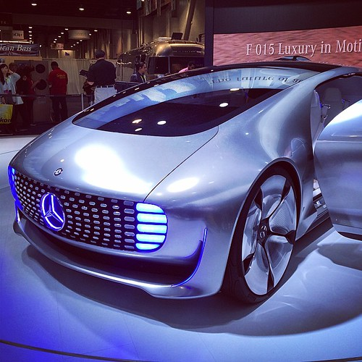
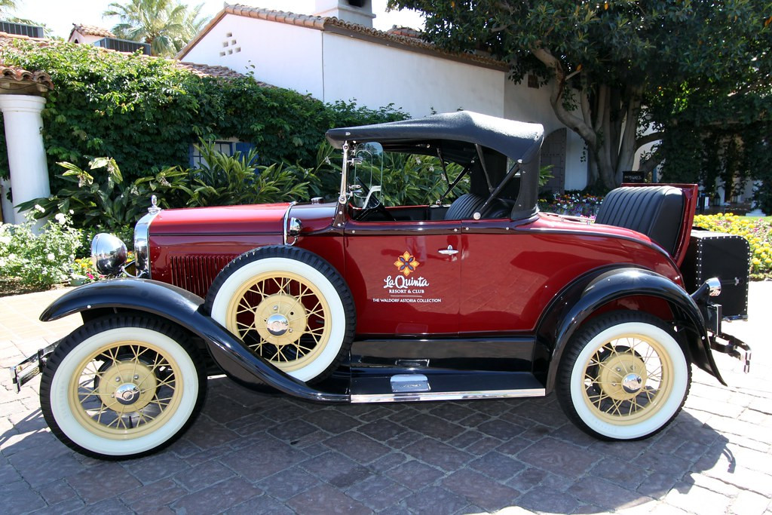
4.4 Other parameters
Operational life
$10,000 capital cost
10-year operational life
$15,000 capital cost
20-year operational life
Picture source: motorblog, photo, licensed under CC BY; Prayitno, photo, licensed under CC BY
Notes:
Technologies have more characteristics that impact their competitiveness. These are also commonly taken into account in energy system modelling tools and in OSeMOSYS, so that reality can be represented more closely. This module will illustrate the most important of these characteristics.
Let us start with the operational life. It is common knowledge that an asset or technology works well for a certain time, after which it starts having many problems due to ageing. At that point, one may say that the operational life of the technology is over and the technology needs to be decommissioned. Some technologies are more robust and live longer. Whereas others have shorter lifespans. This affects their competitiveness, because it affects how much it is worth investing in them. The example in the figure shows this. Let us imagine that the car on the left costs 10,000 US dollars, while the one on the right costs 15,000 US dollars. The car on the right costs 1.5 times the one on the left. However, the car on the right lives double the time of the left one, 20 years. If you were to disregard the performance for a minute and just aim to secure a car for the longest possible time with the least money, which one would you choose? It would make sense to choose the one on the right. To have a car for 20 years, only 15,000 dollars would be needed in this case. In the case on the left one would need to buy the car again after 10 years and the total expense would rise to 20,000 dollars.

Slide 22
4.4 Other parameters
Availability and capacity factor
Used to account for maintenance/outages – how much of its theoretical maximum can the plant produce?
Picture source: Public Domain Photos, photo, licensed under CC BY
Notes:
Other parameters significantly affecting the competitiveness of a technology are the availability factor and the capacity factor. These are very important in OSeMOSYS, but often complicated to determine. You will carry out exercises to understand their meaning. The availability and capacity factor represent, in general, how much a technology can actually produce, as a ratio of its maximum theoretical potential. The availability factor accounts for hours of planned maintenance. That is, it accounts for time during the year when the owners will stop production to carry out regular maintenance activities. The capacity factors accounts for hours of unplanned outages. That is, time when the technology unexpectedly breaks. The planned maintenance can occur any time the owner decides during the year. The unplanned outages may occur any moment, with a certain probability. The higher the downtime for planned or unplanned events, the less profitable a technology is.
Let us take the example of a coal power plant. Typically, it needs to be shut down around 1,000 to 2,000 hours a year for maintenance, depending on how old it is. Since the maximum number of hours it could produce in one year is 8,760, this means around 15% of planned downtime, or an 85% availability factor.

Slide 23
4.4 Other parameters
Efficiency
3 PJ coal
(33% efficiency)
1 PJ electricity
2 PJ coal
(50% efficiency)
Picture source: oatsy40 , photo, licensed under CC BY; Public Domain Photos, photo, licensed under CC BY; Bernt Rostad , photo, licensed under CC BY
Notes:
Another characteristic strongly affecting the competitiveness of a technology is its efficiency. The efficiency is defined as the ratio of output to input. The simplest way to illustrate the concept of efficiency is by looking at a fossil fuel fired power plant. This typically uses energy coming from the combustion of a fuel as input and provides energy in the form of electricity as output. The efficiency is the ratio between the output energy and the input energy. In this case, the efficiency is always lower than one. That is, due to the law of thermodynamics, the output energy is lower than the input one, because part is ’lost’ in the process. The best case would be for the efficiency to be equal to 1. That would mean that all the input energy has been turned into electricity and that the highest possible worth has been squeezed out of the fuel. Efficiency strongly affects the competitiveness of power plants because it affects how much fuel will need to be bought in order to produce a certain amount of electricity. Let us imagine that two coal power plants are available for providing electricity to a region. One is newer and more efficient than the other. Both use the same type of coal as input. It is then best in terms of costs to use the more efficient coal power plant, because less coal needs to be used for supplying the same electricity. This saves costs for buying the coal and emissions from burning the coal.

Slide 24
4.4 Other parameters
Discount rate
Discount Rate accounts for the future value of money
If we owe $15 every year for the next 10 years, how much money do we need to put in the bank now to pay for this?
Discount Rate | 6%
Year | 1 | 2 | 3 | 4 | 5 | 6 | 7 | 8 | 9 | 10
Payment | $15 | $15 | $15 | $15 | $15 | $15 | $15 | $15 | $15 | $15
Current Value | $15.00 | $14.15 | $13.35 | $12.59 | $11.88 | $11.21 | $10.57 | $9.98 | $9.41 | $8.88
Notes:
The discount rate is another key parameter, because it is related to costs. In the standard version of OSeMOSYS, it is not related to a specific technology, but it applies to all technologies in the same way. Deep understanding of the discount rate would need dedicated lectures, but these are also outside the scope of this course. For the moment, only a definition is included. Economics teaches us that the value of money decreases with time. That is, it is better value to have a certain amount today than to have the same amount a few years from now. The discount rate accounts for the decrease in future value of money. It reduces the value by a certain percentage every year. It is decided by the user and depends, among other factors, on the region where the application is set. Let us imagine that a certain technology has a fixed cost of 15 dollars per year and that the owner wants to put in the bank today the money to pay the fixed costs for the next 10 years. How much money does the owner need to put aside, if the annual discount rate is assumed to be 6%? For the expenses of the first year, 15 dollars need to be put aside. However, for the following years gradually decreasing amounts need to be put aside. In year 2, 15 dollars decreased by 6%, that is, 14.15 dollars. In year 3, 14.15 dollars decreased by another 6%, and so on.
OSeMOSYS minimizes all present costs, meaning all costs expected to be incurred in following years are discounted by the assigned discount rate.

Slide 25
4.4 Other parameters
Capacity and activity limits
Minimum and maximum capacity limit: it limits how much capacity of a technology can be in place each year
Minimum and maximum capacity investment limit: it limits how much capacity of a technology can be added each year.
Lower and upper activity limit: it limits how much a technology can operate each year
Notes:
Two more sets of parameters are worth introducing: lower and upper bounds to capacity and activity. The user can (but does not need to) include them in OSeMOSYS. They allow representation of investment or policy targets. For example, the user may introduce lower and upper capacity limits for a technology to represent targets of installed capacity that a government may have for a certain year. Or the user may introduce lower and upper capacity investment limits to represent committed projects in specific years. Or again the user may introduce lower and upper activity limits to represent strong decisions to make certain technologies work a fixed amount in certain years. The activity limits may also be used to restrict the technical potential of certain technologies to realistic values.
Introducing such constraints is like adding equations in the island, example seen in other modules. It restricts the range of possible solutions of the optimization and it drives the optimization towards a certain direction decided by the user. In a sense, it overrules the cost-competitiveness criteria. Therefore, if the aim of an exercise is to really find freely the least-cost solutions for future energy supply, the user must be careful not to introduce too many of these constraints.

Slide 26
Lecture 4.4 References
Taliotis, Constantinos, Gardumi, Francesco, Shivakumar, Abhishek, Sridharan, Vignesh, Ramos, Eunice, Beltramo, Agnese, … Howells, Mark. (2018, December). Representing primary energy supply in OSeMOSYS. Zenodo. http://doi.org/10.5281/zenodo.4585692

Slide 27
Take Quiz
Gardumi F (KTH)., Shivakumar A. (UNDESA)., Sridharan V., Roberto Heredia (KTH), Niet T. (SFU)., Ramos E.P. (KTH)., Alfstad T., (UNDESA) 2021. Lecture 4: Modelling energy technologies. Release Version 1.0. [online presentation]. Climate Compatible Growth Programme, United Nations Development Program and United Nations Department of Economic and Social Affairs.
CCG courses (this will take
you to the website link http://www.ClimateCompatibleGrowth.com/teachingmaterials)

