Slide 1

LECTURE 3
ENERGY MODELLING TOOLS AND OSeMOSYS
Introduction to CLEWs

Slide 2
Learning outcomes
By the end of this lecture, you will be able to:
ILO1: Describe different types of energy modelling tools and their use
ILO2: Describe OSeMOSYS and its role among different energy modelling tools
ILO3: Reflect upon key applications and uses of OSeMOSYS
ILO4: Identify key characteristics and elements of OSeMOSYS
Notes:
This lecture aims to provide background knowledge about energy modelling tools. The first part introduces common classifications of energy modelling tools. The second part introduces OSeMOSYS and its scope. The third part illustrates key applications of OSeMOSYS. The fourth part describes the structure and characteristics of an OSeMOSYS model.
By the end of this lecture, you will be able to: describe different types of energy modelling tools and their use; describe OSeMOSYS and its role among different energy modelling tools; reflect upon key applications and uses of OSeMOSYS; identify key characteristics and elements of OSeMOSYS.

Slide 3
3.1 Energy modelling tools
Bottom-up and top-down tools
MODELLING TOOLS
TOP-DOWN
ECONOMETRIC
INPUT/OUTPUT
CGE
BOTTOM-UP
ACCOUNTING
SIMULATION
OPTIMIZATION
Notes:
There exists numerous energy system modelling tools, analysing different aspects of the energy system. They can be categorized in many ways. One common way is shown in the figure. There are top-down and bottom-up tools. Top-down tools usually have a macroeconomic perspective. They look at economy as a whole and the relations between parts of the economy (for instance, monetary flows from the working base to services). Bottom-up tools usually have a technological perspective. They look at the deployment and use of different technologies and represent in detail their characteristics. That is why they are also called technology-rich models. These two categories are further divided. Econometric models typically look at relationships between trends (e.g., between household income and energy use) and then use these for future projections. Input Output models show interdependencies between sectors of a national economy or regional economies. They account for monetary in-flows and out-flows of each sector. They are based on an Input Output matrix of the country, representing what flows from each sector to the others. Computable General Equilibrium (or C.G.E.) models determine an equilibrium in the entire economy, and they adjust prices to get there. Accounting models take snapshots of physical flows and energy balances. Examples include MAED and LEAP. They are used particularly for building scenarios. They have the strong advantage that they are simple and transparent. Simulation tools simulate the energy system and its operation. They can consider the decisions of individuals within the system. Finally, optimization tools calculate how an energy system ‘should run’ to reach a certain objective. Optimization tools will be the focus of this lecture.

Slide 4
3.1 Energy modelling tools
Optimization tools
Calculate how an energy system ‘should run’ to reach a certain objective
Objective can be cost minimization, but also others
They calculate what should be invested in, when and how it should be operated
Unlike simulation models they investigate the global ‘optimum’
Assume perfect competition, foresight, and consumer behaviour are ‘rational’
Notes:
This course makes use of optimization tools, which are one type of bottom-up tools. They are useful when the aim is calculating how an energy system should look like and should operate to reach a certain objective. This objective can be, for instance, the minimization of the total net present value of all investment and operation costs in an electricity system in the next years. This objective is one of the most commonly used, because it reflects the reality that often the development of an energy system happens under budget constraints. However, there can be other objectives, for instance the minimization of emissions, the minimization of life cycle impacts, or others. The most common energy system optimization tools calculate what energy supply options should be invested in every year, as well as when and how they should operate within each year. Optimization models are different from accounting or simulation models in that they do not take a simple snapshot of the energy system. On the contrary, they calculate how the energy system should change in order to reach a global optimum or, to put it differently, the best possible outcome for one particular objective. Usually, but not exclusively, optimization tools assume perfect competition, perfect foresight, and rational behaviour by consumers.

Slide 5
3.1 Energy modelling tools
Characteristics of optimization tools
Common (but not exclusive!) characteristics:
Perfect competition: all actors (e.g., all technologies) compete against each other based on their costs;
Perfect information: the actors (e.g., the optimization solver) make decisions with perfect information about all parameters;
Perfect foresight: subset of the above; the actors are assumed to know everything that will happen in the future;
Dynamic: the tools gives solutions for different points in time;
Economically rational consumer behaviour: technologies with the cheapest life-cycle costs are invested in.
Notes:
On this slide is a list of common, but not exclusive, characteristics of energy system optimization tools. The first one is that they usually represent perfect competition. This is a term used in the domain of energy markets, and it means that all actors in the market compete freely, under the same conditions. No actor is in a privileged position, or in other words, there is no monopoly or oligopoly. In modelling terms this translates into different technology options competing only on the basis of their costs and characteristics. Secondly, often usually information is assumed. This means that the agent optimizing the market (in this case the solver) knows perfectly the real costs and characteristics of all technology options and calculates the best energy system accordingly. Further, these models usually assume perfect foresight. This is a subset of the previous point. It implies that even the future is known and the optimization solver computes the least-cost energy system based on what happens today and in the future. Perfect foresight is not always assumed, but this is a topic for other, more advanced courses. These models are dynamic. That is, they calculate how the energy system evolves in different points in time (for instance, in different years). Finally, these models assume that every actor in the system behaves rationally. This means that decisions are made only on the basis of cost and not subjective preferences, biases, fears, perceptions, et cetera.

Slide 6
3.1 Energy modelling tools
Why use optimization tools?
To identify least-cost energy systems
To identify cost-effective responses to restrictions on emissions
To evaluate new technologies and priorities for R&D
To evaluate the effects of regulations, taxes, and subsidies
To project inventories of greenhouse gas emissions
To estimate the value of regional cooperation
Investigate scenarios (possible futures);
Explore alternatives to business as usual practices;
Inform decisions (policy and strategic planning)
Notes:
Energy system optimization tools can help energy planners and investors in different ways. They can be used to identify the most cost-competitive solutions for developing and extending the energy system or for complying with emission restrictions. They can also be used to understand which technological developments could make certain sources (for instance solar or wind) more competitive. This in turn will help understand priorities for Research and Development. These tools can be used in a normative way, that is, to evaluate the effects of new norms, regulations, taxes, subsidies, and so on. They can be used to create projections of emissions of greenhouse gases by a country or a region under different scenarios. They can be used to estimate the costs and benefits of regional cooperation in the creation of energy supply infrastructure, or of energy import and export infrastructure. In synthesis, they are powerful tools for cost-benefit analyses of technology or policy developments at different scales. They provide insights for energy planners and investors on possible futures, alternatives to current practices, or strategic planning decisions.

Slide 7
3.1 Energy modelling tools
Scope
Reference: M. Welsch, Enhancing the Treatment of Systems Integration in Long-term Energy Models, KTH Royal Institute of Technology, 2013
Picture source: M. Welsch, 2013, I, Author permission
Notes:
Energy system optimization tools and other types of energy modelling tools can have different scopes. In his work, Welsch summarizes the different scopes as in this figure. Starting from bottom-right, some energy models perform long-term analyses, covering a time span of decades. These tools are used mostly for strategic planning, in view of long-term goals. Proceeding towards the top, tools for power market analysis usually focus on shorter time periods, relevant for existing or committed power system infrastructure. They typically cover fewer years than long-term tools, but have higher technological detail, in order to assess the numerous dynamics occurring in energy markets. They are used for purposes between mid-term strategic planning and design of electricity systems. Models for load-flow and stability analysis focus on issues that happen on the scale of a few days, hours, or even seconds. They have high technological detail and are used specifically for design and operation purposes, for instance by Transmission System Operators. The tools used in this course are long-term tools.

Slide 8
Lecture 3.1 References
Taliotis, Constantinos, Gardumi, Francesco, Shivakumar, Abhishek, Sridharan, Vignesh, Ramos, Eunice, Beltramo, Agnese, … Howells, Mark. (2018, November). Introduction to linear optimization and OSeMOSYS. Zenodo. http://doi.org/10.5281/zenodo.1493112
Herbst, A., Toro, F., Reitze, F., Jochem, E., Introduction to Energy Systems Modelling, Swiss Journal of Economics and Statistics, 148 (2), 2012, pp. 111.135
Welsch, M., Enhancing the Treatment of Systems Integration in Long-term Energy Models, KTH Royal Institute of Technology, 2013

Slide 9
3.2 OSeMOSYS
What is it?
  www.osemosys.org
  Model generator converting the energy system structure represented by equations into a matrix to be solved by specific solvers
    Linear optimization
    Paradigm comparable to MESSAGE and TIMES
    Freely available and open source
    Dynamic
    (Usually) Perfect foresight
    (Usually) Deterministic
Reference: M. Howells et al., OSeMOSYS: The Open Source Energy Modeling System: An introduction to its ethos, structure and development, Energy Policy, 39(10), 2011, p.5850-5870
Notes:
OSeMOSYS is the tool used in this course. It is a long-term modelling tool for the optimization of energy system investments. It was originally created as an energy system modelling tool, but we will use it also to analyse dynamics relative to climate, land, and water. OSeMOSYS stands for Open Source energy Modelling System. It was first presented at the International Energy Workshop in Paris in 2008, and it was published in 2011 by a pool of authors and institutions led by Mark Howells. OSeMOSYS is a model generator, that is, a tool that can be used to create different models using different inputs. On this slide are listed its main characteristics, which are important to understand its main uses. It is a linear optimization modelling tool. This means that it carries out an optimization of the energy system’s configuration using only linear relations. It is very similar to other energy system optimization tools such as MESSAGE and TIMES. As opposed to them, however, it was specifically created to provide a fully accessible resource for all, without upfront investments. This is why it is freely available online for any interested user and it has an open source license: Apache 2.0. Like many other energy modelling tools, it is dynamic. In most of its applications, it assumes perfect foresight and is deterministic. Deterministic means that it is normally not used for stochastic analyses, but instead it assumes certain inputs and it gives certain outputs. However, these two characteristics are not necessarily part of OSeMOSYS: there exist applications where non-perfect foresight and stochastic approaches are used.

Slide 10
3.2 OSeMOSYS
What does it do?
It determines the energy system configuration with the minimum total discounted cost for a time domain of decades, constrained by:
Demand for commodity (e.g., electricity, heating, cooling, km-passengers, etc.) that needs to be met
Available technologies and their techno-economic characteristics
Emission taxations and generation targets (e.g., renewables)
Other constraints (e.g., ramping capability, availability of resources, investment decisions, etc.)
Notes:
OSeMOSYS is an energy system optimization tool and as such it has an objective function: it finds the set of investments in energy infrastructure and the set of energy uses that may meet future energy needs at the least cost. It is usually applied for time domains of decades, relevant for strategic energy planning. This objective is met while meeting several constraints, which can all be defined by the user. These constraints relate to several aspects that need to be taken into account in energy planning: the need to meet current and future energy demands; the possibility to use technologies that are technically available now or may become available in the future, with their technical and economic characteristics; the need to respect policy mandates, such as emission limits, emission taxations, or generation targets for specific types of technologies; and finally, the need to comply with other potential constraints such as investment decisions, budget constraints, availability of resources, possibility of trade, or more specific technical constraints.

Slide 11
3.2 OSeMOSYS
Interpreting its results
The results provide insights on questions such as:
Which technologies are phasing out? By when?
What are the optimal investments in new technologies to meet the demand in the future? When is it best to invest?
What are the key generation technologies in the total energy mix?
What costs will the energy system incur?
Notes:
The direct outputs of an optimization provide the modeller with insights on the future of the system that the modeller is representing. These insights can say, for example, which technologies are not cost-competitive and are going to be phased out as soon as possible; or they give insights on how large investments in new technologies would be needed to meet future energy demands and when; they highlight whether the key generation options remain the same as today or change in the future; they present all the capital expenses and operation and fuel costs that would be incurred in the whole system if the least-cost path were pursued. All these results are given for every year of the time domain assessed in the model and for a customizable number of time steps within each year. The spatial, technological, and temporal scope and resolution are also customizable and depend on the type of inputs provided by the modeller.
The direct results can be used to provide insights for policy makers or investors on several questions of strategic energy planning or energy policy.

Slide 12
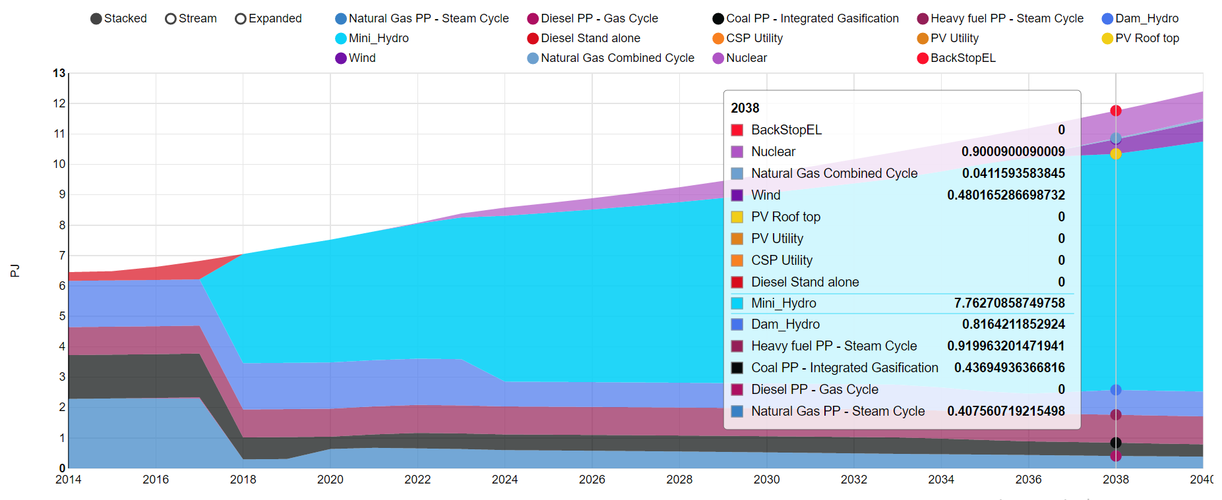
3.2 OSeMOSYS
Interpreting its results
Electricity Supply (PJ)
Picture source: Open Energy system Models, image, license under CC-BY-SA 4.0
Notes:
This figure shows one simple example of how results of OSeMOSYS may look like. It represents a simple energy system where the main sources of electricity supply are hydro power, wind, natural gas, coal, and heavy fuel oil. In this simple model, the demand for electricity is expected to grow in the future, so there needs to be enough infrastructure in place to meet the increasing demand. The cost optimization suggests that the most cost-competitive source to invest in to meet the increasing demand is mini-hydro. Investments in mini-hydro start in 2018 and continue in the years to follow, gradually. Therefore, the largest share of electricity is supplied by hydro and this share increases year after year. Natural gas (at the bottom of the figure) is less competitive than hydro, under the assumptions of this case, and it loses almost entirely its share of electricity supply in 2018, as soon as mini-hydro becomes part of the mix. A worse fate comes for diesel generators (the red stripe at the top-left), which are not needed anymore from 2018 onwards. Coal-fired and oil-fired generation maintain a certain share of electricity supply throughout the period, because they are less costly and can back up mini-hydro when it is not available. This figure is exemplary and shows a simplified case. In reality, many more sources may be analyzed. Also, many more types of results can be viewed, for example regarding annual installed capacities, annual emissions, and annual costs incurred.

Slide 13
3.2 OSeMOSYS
Use in CLEWs models
Coal mine
Coal
Coal
Power plant
Minimize:
Total system cost
Over a given time period (e.g., 2020 – 2050)
Subject to a set of constraints (e.g., demand requirements, resource limits)
Electricity
Gas field
Gas
Gas
Power plant
Heat
Water resource
Water
Water
Treatment
Potable Water
Land resource
Land
Agricultural land
Maize
Notes:
OSeMOSYS can be used also for analyses that go beyond the domain of energy. It has also been used for example to model water and land uses and their linkages with the energy system. This type of application is called CLEWs, that is, Climate, Land, Energy and Water systems analysis. This type of application is the object of this course and you will be guided through all its elements. What is included in one such application? The objective of the model does not change: it still calculates a way of organizing the system that minimizes all costs over a, usually, long time period, under several constraints. However, this time the system includes also water and land systems. For example, as shown in the figure, CLEWs applications may include the use of water resources to meet a demand for potable water, but also to make power plants work and to cultivate. They may also include the use of land resources for cultivating crops and meeting demands for food (for instance maize). Also the types of constraints used in the optimization will be more diverse and not only related to the energy system. For instance, constraints can be included that are related to the availability of water and land resources. Additionally, policies on the use and pricing of water and land resources can be represented, and so on. The analysis shown in the figure is only a simple example to illustrate the concept. Climate, Land, Energy and Water models usually include many more details and resource uses.

Slide 14
Lecture 3.2 References
Taliotis, Constantinos, Gardumi, Francesco, Shivakumar, Abhishek, Sridharan, Vignesh, Ramos, Eunice, Beltramo, Agnese, … Howells, Mark. (2018, November). Introduction to linear optimization and OSeMOSYS. Zenodo. http://doi.org/10.5281/zenodo.1493112
Howells, M., et al., OSeMOSYS: The Open Source Energy Modeling System: An introduction to its ethos, structure and development, Energy Policy, 39(10), 2011, pp- 5850-5870

Slide 15
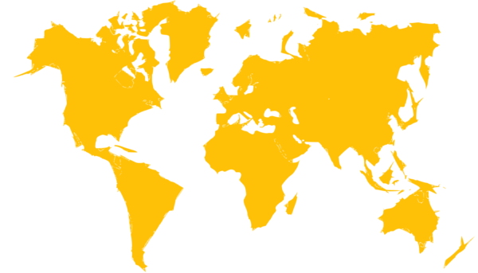
3.3 OSeMOSYS applications
Where and who?
Research and teaching
Capacity development
Only some key uses!
Picture source: search.creativecommons.org/, image, license under CC0 1.0
Notes:
Since its creation in 2008, OSeMOSYS has been widely used worldwide by different types of institutions. In academia, it has been used for research, teaching, and thesis works around energy systems analysis, energy-economy analysis, climate land energy, and water systems. Its uptake by teaching staff and researchers was facilitated particularly by the fact that it is freely available. This has been true especially in developing countries. Often, it has functioned as an entrance point for researchers to the field of systems analysis. International organizations such as U.N.D.P., U.N.D.E.S.A., U.N.E.C.E., World Bank and others have promoted the use of OSeMOSYS as a low-threshold tool for technical capacity programmes in developing countries and regions. The capacity development programmes involved providing training to technical staff in governments on the concepts behind the tool, the use of the tool, and the development of locally owned energy and CLEWs models. This has led to direct or indirect use of insights from OSeMOSYS models in the preparation of some national energy and climate plans.

Slide 16
3.3 OSeMOSYS applications
What
TEMBA – The Energy Model Base for Africa. Link
IRENA African Power Pools: Planning and Prospects of Renewable Energy.
IEA WEO 2014 – Africa Energy Outlook.
World Bank – Enhancing the Climate Resilience of African Infrastructure. Link
Among the UN Modelling Tools for Sustainable Development. Link
Used by UNECE for assessment of water-energy cooperation benefits in transboundary river basins. Link
Used by UNDP, UNDESA in CLEWs technical capacity development programmes for update of NDCs
Notes:
Here a few examples of applications of OSeMOSYS are listed to demonstrate the type of insights the tool supports. OSeMOSYS was used to develop models of the energy systems of all Sub-Saharan Africa countries and the trade links between them. These models have been used to run assessments that work as background to a series of publications by IRENA on prospects of renewable energy in the African Power Pools. They have also been used for the background assessments informing the 2014 Africa Energy Outlook by the International Energy Agency and a study by the World Bank Group on climate resilience in African electricity infrastructure. OSeMOSYS was further featured among the United Nation’s online platform called ’Modelling Tools for Sustainable Development’. The platform was used during high-level workshops informing ministries of developing countries on the role of modelling tools in supporting policy. OSeMOSYS has been used in numerous other technical assessments and capacity development programmes run by UN Agencies focusing on the links between Climate, Land, Energy and Water.

Slide 17

















3.3 OSeMOSYS applications
Example: climate mitigation and adaptation policies
Question: a number of countries in the world need to write their Nationally Determined Contributions (i.e., the pledges to the Paris Agreement). They need a scientific grounding to set new climate mitigation and adaptation targets.
Picture source: UN, 2021, I,
Notes:
Two further examples of OSeMOSYS applications are given in the rest of this mini-lecture to further the understanding of the type of strategic planning questions OSeMOSYS can help with. The first application stems from the need of several countries to back the new climate change mitigation and adaptation actions proposed in their Nationally Determined Contributions with model-based analyses. This case is driven by a specific demand, forwarded by the countries to national contact points of UNDP. Starting from this need, UNDP, U.N.D.E.S.A., K.T.H. and Simon Fraser University have delivered training for staff from ministries and planning units of several countries on the use of modelling tools for assessing the links between Climate, Land, Energy and Water. During this training, multi-disciplinary teams from these institutions were guided in the independent creation of CLEWs models using OSeMOSYS. The use of OSeMOSYS made it especially easy for the trainers to demonstrate ground concepts of energy and multi-resource planning and to ensure ownership of the model applications.

Slide 18
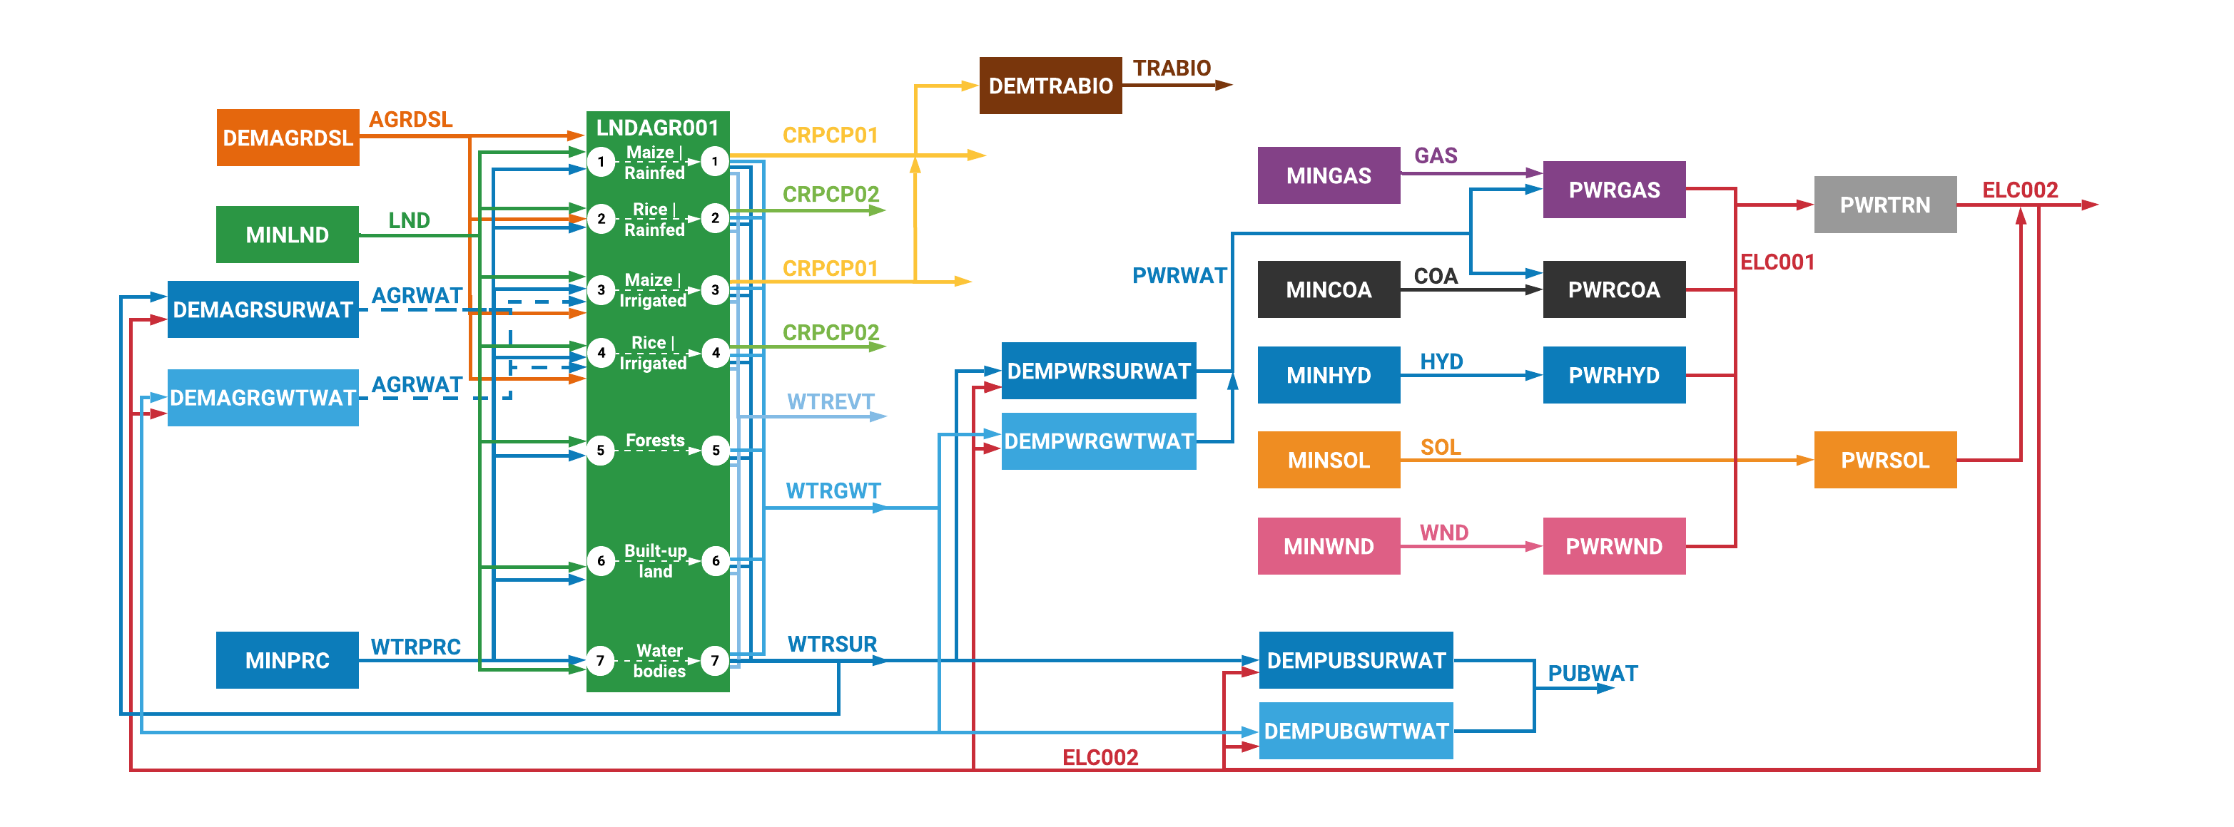
3.3 OSeMOSYS applications
Example: climate mitigation and adaptation policies
Notes:
The CLEWs trainings delivered using OSeMOSYS are usually divided into two parts. During the first part, all teams learn key concepts and apply them to the creation of one simple Climate, Land, Energy and Water model application that is the same for all teams. During the second part, each team uses the knowledge and tools acquired to develop a more advanced application, representing issues of climate, land, energy, and water that are relevant in their own country or in a specific region. In both parts, the structure of the models used resembles more or less the one in the figure. The figure is complicated, but it shows a few key points. The infrastructure making up the energy system is modelled, as traditionally done in OSeMOSYS. You can see it in the right-hand part of the figure, circled in blue. However, together with this, land uses and water uses are also modelled. These appear on the central and left-hand part of the figure, circled in red. Through this course, you will learn how each of these parts is modelled, how they are connected, and what insights are drawn from the model.

Slide 19
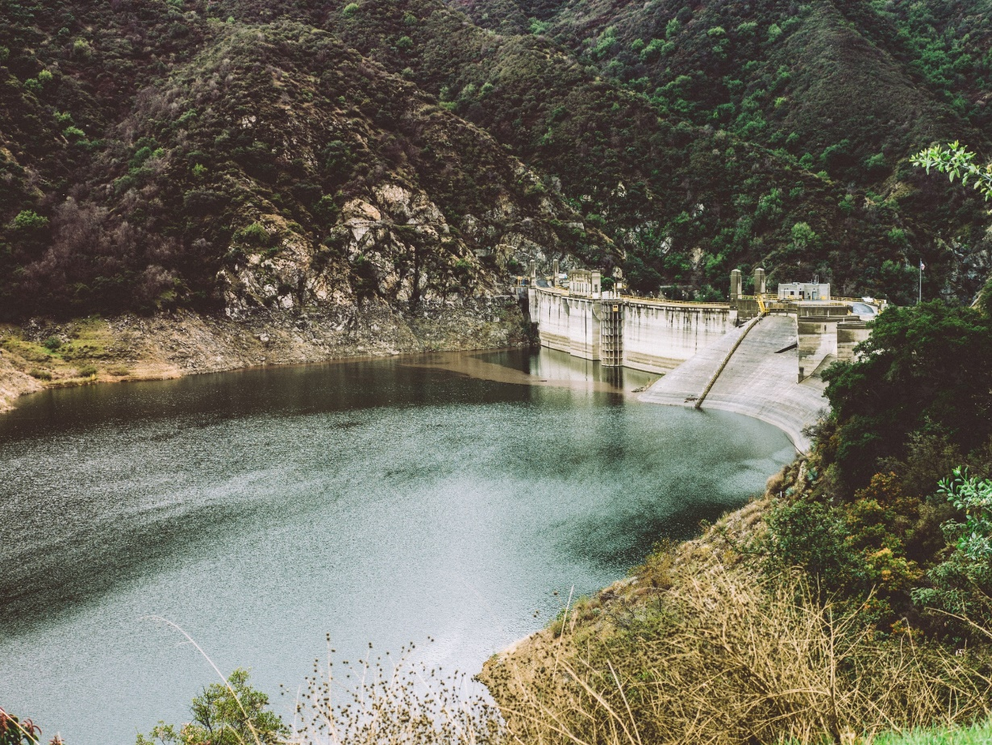
3.3 OSeMOSYS applications
Example: water-energy cooperation
Question: can the coordinated operation of cascaded dams and hydro power plants in transboundary river basins help mitigate climate extremes (e.g., floods) and support water-energy diplomacy?
Picture source: Photo by Avi Richards on Unsplash
Notes:
The second application is about the dynamics happening between the energy and the water system. It is motivated by challenges in water diplomacy, where neighbouring countries own different pieces of hydro power infrastructure across a river basin. In these cases, if there is no coordination between the countries in the use of the hydro power infrastructure, there is a risk that water may not be available at times in parts of the river basin. Without coordinated operation some climate extremes such as floods or droughts may pose threats for the security of citizens, for the security of energy supply, and for the infrastructure. The question to be addressed is whether coordinating the operation of dams and hydro power plants between countries can bring benefits both in terms of resilience of the infrastructure and sales of electricity. U.N.E.C.E. and the Global Water Partnership led technical assessments of the benefits of cooperation in the management of transboundary water and energy resources in the Western Balkans. The assessments were carried out using several tools, one of which was OSeMOSYS.

Slide 20
Lecture 3.3 References
Pappis, I., Howells, M., Sridharan, V., Usher, W., Shivakumar, A., Gardumi, F., Ramos, E.P., Energy projections for African countries, European Commission Joint Research Centre, 2019
Cervigni, R., Liden, R., Neumann, J.E., Strzepek, K.M., Enhancing the Climate Resilience of Africa's Infrastructure : The Power and Water Sectors, Washington, DC, World Bank, 2015, https://openknowledge.worldbank.org/handle/10986/21875
UNECE, Reconciling resource uses in transboundary basins: assessment of the water-food-energy-ecosystems nexus in the Sava River Basin, 2016
UNDESA, UNDP, Modelling Tools for Sustainable Development, 2016
Almulla, Y., Ramos, E.P., Gardumi, F., Taliotis, C., Lipponen, A., Howells, M., The role of Energy-Water nexus to motivate transboundary cooperation:: An indicative analysis of the Drina River Basin, International Journal of Sustainable Energy Planning and Management, 18, 2018, pp. 3-28

Slide 21
3.4 Basics of OSeMOSYS
Structure
Sets
(Components)
Input data
(Parameters)
Output variables (Results)
  REGION
  YEAR
  TIMESLICES
  EMISSIONS
  COMMODITY
  TECHNOLOGY
  Historical capacity
  Annual Demand
  Load
  Efficiency
  Capital, fixed, variable costs
  Emission Activity Ratio
  Availability Factors
  New Capacity
  Total Annual Production by Technology
  Annual Emissions
  Discounted Costs
  Model Period Cost
Notes:
In this course you will be using OSeMOSYS to create climate, land, energy, and water models. The first steps towards using OSeMOSYS is understanding how it is structured, what types of objects the user needs to work with, what inputs need to be given, and what outputs can be obtained. First, the user needs to determine the components of the model. These are called ‘sets’. They will constitute the model structure. Examples of sets are: the set region, which is a vector containing the names of all regions that the user would like to model; the set year, which is a vector containing all years to be modelled; important sets are commodity and technology. The set commodity lists all the commodities to be included in the model. The set technology lists all the technologies and processes to be included. They are described in more detail later in this module. The other part the user will need to determine is all the input data. The user can provide numerical inputs for a number of different parameters, such as annual demands, conversion efficiencies for the different processes, emission factors, and, importantly, all costs. Finally, the user will receive from the model calculations several outputs, or results. These outputs relate, for instance, to newly installed capacities of the different technologies, or annual production by the different technologies, annual emissions, and annual costs.

Slide 22
3.4 Basics of OSeMOSYS
Set: Technology
Coal mine
Coal
power plant
A technology can be used to:
Supply or produce a resource
(e.g., biomass production, natural gas imports)
Convert one commodity into another
(e.g., conversion of natural gas to electricity, electricity to light)
A technology can represent:
A single process/plant or
A group of processes/plants with similar characteristics
Gas field
Gas
Power plant
Water resource
Water
Treatment
Land resource
Farm
Notes:
Let us go back to the definition of the set technology and the set commodity. They are both key components in OSeMOSYS and they deserve particular attention. 'Technology’ in OSeMOSYS refers to any type of process, plant, or asset that has some input and/or output. For example, a technology can be the process of production of a primary resource, such as a coal mine or a gas field, or also a land resource that, for example, provides land for farming. These are shown in the boxes on the left side of the figure. A technology can also be a process that converts one commodity into another. For instance, it can be a coal power plant converting energy from coal into electricity, or a water treatment plant converting source water into drinkable water. These are represented by the boxes on the right side of the figure. In schematic representations, technologies are often represented as boxes with some input and/or output commodities, like in the figure. It is important to understand that a technology in a model can represent one individual process or power plant, but also a group of processes or plants with similar characteristics.

Slide 23
3.4 Basics of OSeMOSYS
Set: Commodity
Coal mine
Coal
Commodities can be used to represent:
Flows between technologies
(e.g., electricity, natural gas, coal)
Final demands
(e.g., demand for lighting, cooling, heat, or clean water)
Coal
power plant
Electricity
Gas
Gas field
Gas
power plant
Heat
Water resource
Water
Water
Treatment
Potable Water
Land resource
Land
Farm
Maize
Notes:
The set commodity in OSeMOSYS lists any type of commodity entering or exiting a technology. It can represent flows between technologies, such as coal that is produced by coal mining and is fed to a coal power plant (shown on the left side of the figure). It can also represent final demands, such as demands for electricity, heat, potable water, or maize (shown on the right side of the figure). The flexibility in the definition of technology and commodity is what makes OSeMOSYS suitable not only for the representation of energy systems, but also for the representation of water and land resource systems. There is, in principle, no limit to how many and which technologies and commodities the user can create. The user can create the water commodity in the figure by simply adding a new item in the set commodity, naming it ’water’ and assigning some numerical inputs to it. These inputs could be, for instance, availability in different years, availability during one year, cost of production, processes that produce water and processes that use water. Through the course, you will be guided in the representation of many such elements, with increasing detail.

Slide 24
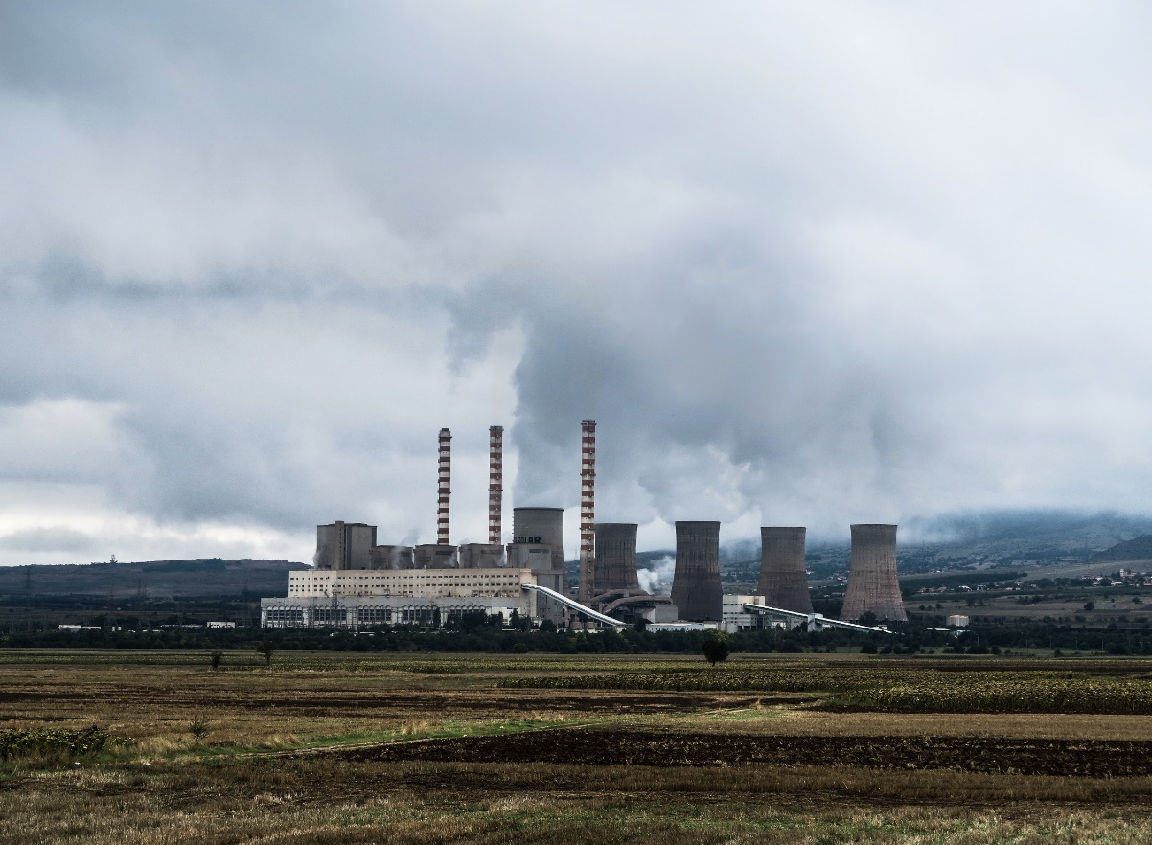
3.4 Basics of OSeMOSYS
Example #1 - Energy
Power station
A physical asset that turns an input fuel (e.g., natural gas) into one or multiple outputs (e.g., electricity and heat)
Electricity
Natural gas
Gas powerplant
Heat
Picture source: Photo by Jason Blackeye on Unsplash
Notes:
Two simple examples can be shown of what technologies and commodities can be represented in OSeMOSYS. A typical technology is a power station, used in energy system models. A power station is a physical asset that turns one or more input fuels (such as natural gas) into one or more outputs (such as electricity and heat). In the figure on the left, the technology representing the gas power plant is the box in violet; the input commodity is natural gas; the output commodities are electricity and heat. If the user decides to model a combined heat and power plant that uses gas, the user will have to introduce all these elements in the sets and then define numerical inputs for them. It is again important to remark that the gas power plant technology shown in the figure can represent one individual power plant in a country as well as all the gas power plants in the country. The choice of whether a technology represents one plant or an aggregation of plants sits with the user. It depends on whether the user is interested in finding results about individual assets or about the overall balances in the country. There is a trade-off between detail in the model and computational effort required to solve it. The more technologies and commodities the user introduces, the more time and resources the model will take to solve.

Slide 25
3.4 Basics of OSeMOSYS
Example #2 - Land
Maize farming
Application of physical equipment and management practices to transform takes a range of inputs (e.g., a land resource, water, energy, fertilizer etc.) into an output – maize.
Precipitation
Agricultural land
Maize
Land
Evapotranspiration
Diesel
Runoff
Irrigation
Groundwater
Notes:
Another example of the application of the concept of technology and commodity in OSeMOSYS comes from the land-use sector. With a specific choice of commodities and technologies, the modeller can represent the process of maize farming. Maize farming can be schematically seen as the application of physical equipment and management practices to transform a range of inputs (such as land resource, water, energy, and so on) into an output: maize. The figure on the right shows how maize farming can be represented in OSeMOSYS. A technology called agricultural land can be introduced. This represents the land where maize will be cultivated and is characterized by a certain extension. This technology takes as inputs some land area from the overall land available in the region, diesel for tractors, irrigation water, and also precipitation that naturally falls. It gives as outputs the desired product, maize, and some other byproducts. These are, for instance, the water gone into the growth of the plant (see the evapotranspiration output), water that has not been absorbed by the ground and that runs off, and water that has been absorbed by the ground and recharges the groundwater resources. This example aims only to illustrate how OSeMOSYS can be used. More concepts about land uses and water cycles will be given in the following classes of this course.

Slide 26
Take Quiz
Gardumi F., Sridharan V. (KTH)., Shivakumar A. (UNDESA)., Niet T. (SFU)., Ramos E.P. (KTH)., Alfstad T., (UNDESA) 2021. Lecture 3: Energy modelling tools and OSeMOSYS. Release Version 1.0. [online presentation]. Climate Compatible Growth Programme, United Nations Development Program and United Nations Department of Economic and Social Affairs.
CCG courses (this will take
you to the website link http://www.ClimateCompatibleGrowth.com/teachingmaterials)

