Slide 1

LECTURE 2
THE ENERGY SYSTEM
Introduction to CLEWs

Slide 2
Learning outcomes
By the end of this lecture, you will:
ILO1: Have familiarity with components and processes in energy planning
ILO2: Understand how to interpret and build Reference Energy Systems (RES)
ILO3: Have conceptual understanding of the OSeMOSYS tool and its most important parameters and variables
ILO4: Gain knowledge of the basic concepts of CLEWS/OSeMOSYS
Notes:
This lecture has four Intended Learning Outcomes. By the end of the lecture you will:
Have familiarity with components and processes in energy planning
Understand how to interpret and build a Reference Energy Systems
Have conceptual understanding of the OSeMOSYS tool and its most important parameters and variables
Gain knowledge of the basic concepts of CLEWS/OSeMOSYS
The lecture is structured in four parts. The first part explains the concepts of energy system and energy planning. The second part introduces the use of modelling tools to help energy planners. The third part dives into the first more technical concept: the Reference Energy System. Finally, the fourth part explains how a Reference Energy System can be designed.

Slide 3
2.1 Energy system and planning
What do we mean by ‘Energy System’?
Energy resources
Energy conversion
Transportation
Final demands
Notes:
The first component of the Climate, Land, Energy and Water nexus investigated in this course is the energy system. First, we need to clarify what we mean by Energy System in this course.
You may come across different definitions. Technology experts and process engineers may mean by energy system a component (for example, a turbine) or a process (for example, an entire coal power plant). In this course, by energy system we mean the complex set of infrastructure and processes making up the supply chains of energy vectors from primary sources to final demand. So, in this course an energy system will be constituted typically by the parts represented in the figure: the primary energy resources (such as coal, natural gas and oil, but also sun and wind); the energy conversion processes (such as a coal power plant processing coal to obtain electricity); the transportation infrastructure (such as the electricity transmission and distribution network); down to the final demands for energy or energy services (such as electricity for turning on a stove or diesel for driving a car).

Slide 4
2.1 Energy system and planning
What do we mean by ‘Energy System’?
The energy system is in place to help meet people’s energy needs. But…
When planning investments and policies for the energy system, Governments face constraints dictated by:
Budget;
Energy Supply Security;
Unexpected events (e.g. COVID-19);
Resource availability;
Climate change;
Infrastructure shared with neighbouring countries;
Global economic developments;
And much more…
Notes:
The energy system can therefore be seen as a big set of infrastructure at the service of people. It helps meet people’s needs for energy. It provides households with the electricity needed to turn on lights or stoves; it provides industries with fuels for running their production processes; it provides shops with energy to keep the ambient warm or cool, etc. Ultimately, it helps the economic development of countries and ensures the well-being of citizens. In order for all to have access to the energy they need, the investments in energy supply infrastructure need to be planned with a long-term perspective, so that not only the current but also the future energy needs may be met. However, there are many aspects to be considered when planning investments in energy infrastructure: for example availability of budget, energy supply security constraints, unexpected global events (such as the Covid 19 pandemic), availability of primary energy resources, effects of climate change and so on.

Slide 5

2.1 Energy system and planning
Energy policy
Energy policy is the manner in which a given entity has decided to address issues of energy planning including energy supply, distribution and end-use.
It includes aspects related to:
  Energy security
  Environmental protection
  Market structures
  Incentives or disincentives (e.g., FITs, carbon taxes)
  Energy conservation (e.g. measure for efficiency improvements)
Picture source: Photo by Peter Nguyen on Unsplash
Notes:
In order to have in place long-term plans for investments in energy infrastructure, governments make use of energy policies. Discussions on energy policies are constantly in the news: the European Commission’s Green New Deal, targeting net-zero greenhouse gas emissions in 2050, contains several examples of energy policy; all decisions of national leaders worldwide regarding emission targets, support to electric vehicles, or support to renewables are formalized through energy policies. And so on. Energy policy can be defined as the manner in which a given entity (for instance, a government) addresses issues of energy planning. Energy policies cover all parts of the energy system, from resources, to conversion, distribution and end uses. Aspects that are typically targeted by energy policies are: energy security (for instance, including independence of the energy supply from other countries), environmental protection (for instance, limits to emission of greenhouse gases), market structures (for instance, liberalisation of electricity supply), incentives or disincentives (like carbon taxes), energy conservation (such as measures for energy efficiency in buildings).

Slide 6
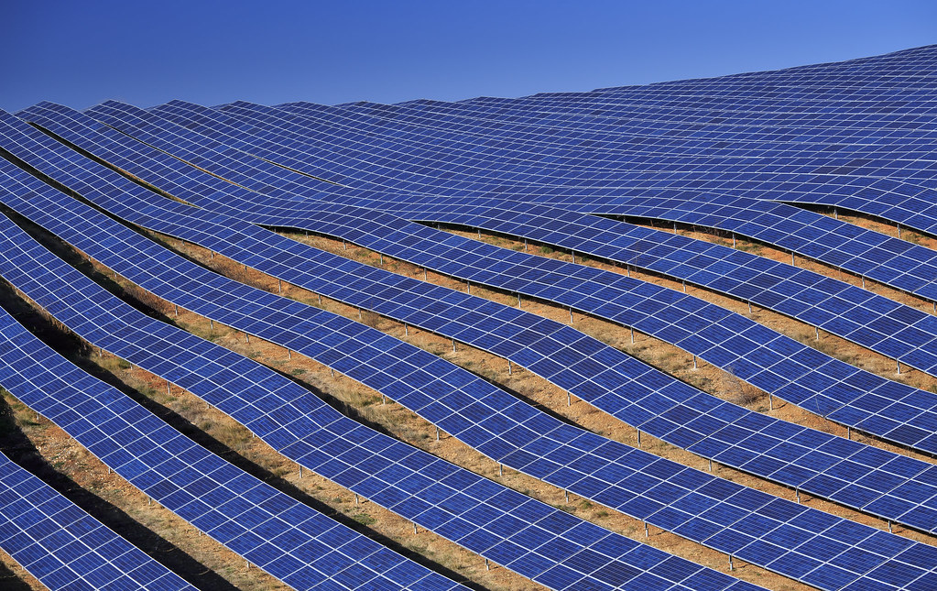
2.1 Energy system and planning
The energy trilemma in policy
Sustainability
What needs to be done to supply modern energy sources to remote areas?
What needs to be done to increase the share of renewable technologies?
Security
Should electricity import be allowed?
Should existing nuclear facilities be closed down?
Affordability
Can an energy conservation program help in reducing cost of energy supply?
Picture source: Iamme Ubeyou, photo, license under CC 0
Notes:
The issues dealt by energy policies may be summarised in three categories: sustainability, security and affordability. These three categories are tightly linked to the United Nation’s Sustainable Development agenda. One may then say that energy policy faces a so-called trilemma.
As far as sustainability is concerned, typical questions that energy policy has to address are: What needs to be done to supply modern energy sources to remote areas? Or: What needs to be done to increase the share of renewable technologies?
As far as security is concerned, energy policy has to address questions such as: Should electricity import be allowed? Should existing nuclear facilities be closed down?
Finally, regarding affordability, a typical question that energy policy will try to address could be: Can an energy conservation program help in reducing the cost of energy supply?
Addressing all these questions for a country or a region requires complicated decision making processes that involve many parts of the energy system and many actors. Understanding a-priori what the impacts of one decision could be in terms of sustainability, security and affordability is not trivial. This is why tools are created to help decision makers and investors understand the potential impacts of decisions aimed to address these questions.

Slide 7
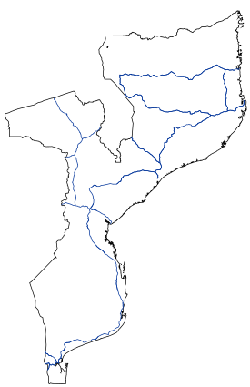
2.1 Energy system and planning
An example
Mozambique
Large gas reservoirs discovered in the past decade.
What role will gas have in the country’s development and achievement of SDGs?
Picture source: JCornelius, Image, license under CC 0
Notes:
Concrete examples of energy planning questions populate the newspapers daily. And they very often relate to the energy trilemma. One example is Mozambique. The country is developing fast but still suffers from lack of access to affordable, reliable, sustainable and modern energy for all. In the past decade, large natural gas reservoirs were found offshore the North coast. This discovery opened the possibility for the country to boost its energy access and its development. This will hopefully lead to faster achievement of the United Nations’s Sustainable Development Goal 7, on universal energy access. However, as exploitation of the resources starts, other questions arise: to what extent can gas be used for feeding the domestic energy and electricity needs? What investments will be required? How will opportunities for trade of gas and electricity with neighboring regions change? What impact will the use of gas have on the country’s greenhouse gases emissions? And, ultimately, will gas be competitive with renewable sources in the long range? These questions can be answered under a strategic planning perspective, looking far into the future.

Slide 8
2.2 Why model the energy system?
The need
Governments/public have to set targets for the future development of the country and its energy system:
  Policy goals
  Preferred technology options
Taking into account:
  Future availability and prices of energy forms
  Development of other sectors of the economy
  Geopolitical constraints…
Energy systems models facilitate these tasks and help quantitatively assess implications of policy decisions under constraints
Notes:
There are many tools to support energy planning and those this course focuses on are commonly called ’energy system modeling tools’. What are they and why do we need them? Through energy policies, governments set targets for the future development of their countries and the energy system. These targets can come in the form of policy goals (for instance, net zero greenhouse gas emissions by 2050), or preferred technology options (for instance, targets of penetration of renewables), or others. The targets must be achieved taking into account that the country may have constraints regarding the availability and cost of energy resources, the financial resources available for the energy sector, the geopolitics of the surrounding regions. Energy system models can help governments assess quantitatively the implications of their policy decisions under such constraints. For example, they can determine effectively if a certain plan for investments in renewables is going to be able to meet future energy demands, while replacing existing fossil fuel infrastructure and reducing emissions. And they can determine what the overall cost for this will be.

Slide 9
2.2 Why model the energy system?
The need
Models can help:
…Unveil potential effects of new investments on the whole country-system
…Discover new questions important for planning
…Identify and measure core uncertainties
…Reveal the apparently simple (complex) to be complex (simple)
…Discipline the policy dialogue
…Communicate with the general public
Notes:
More in general, energy system modeling tools can help unveil potential effects of new investments on the whole country-system: for instance, they can assess whether investments in 1 GW of wind turbines in the next 10 years will help meet increasing demands for electricity at lower cost;
They can help discover new questions that are important for planning and were not considered before. For instance, they can help understand if issues of energy supply security could arise and if the energy strategies should address such issues.
They can help identify and measure the impact of the uncertainty around the future. For example, they can assess how profitable an investment in new energy supply infrastructure in 10 years could be under different scenarios of energy demand.
They can reveal what is apparently simple to be complicated, or what is apparently complicated to be simpler than expected.
Ultimately, they can help discipline the policy dialogue and communicate the importance of energy policies to the general public.

Slide 10
2.2 Why model the energy system?
The potential
One important use of models is scenario analysis
Increase our understanding about the future;
Scan potential changes in the environment;
Build consensus for change;
Manage risks.
Reference: Maack, J.N., Scenario Analysis:
a Tool for Task Managers, 2001, World Bank
Notes:
One typical and powerful use of energy system models is scenario analysis. Scenarios are representations of how the future could play out. These representations can be supported by models, which create a quantitative picture of what could happen if certain conditions are met. Modeling different scenarios allows analysts to increase their understanding about the future. For instance, it allows them to understand what impacts certain decisions taken now could have. It also allows the analysts to scan potential changes in the environment, like climatic changes, and see what could happen with each of them. It allows analysts to build consensus for changes in the current practices. One well known example for this is the scenario analyses run by the Intergovernmental Panel on Climate Change (IPCC), that look at different scenarios of climate change with the aim to raise awareness and create political momentum. Finally, scenario analysis may allow the management of risks. This is a common use for investors.

Slide 11
2.2 Why model the energy system?
The scope
Models cannot predict the future
  But can help understand future better and stay prepared to take informed decisions
Models cannot make decisions
  The main task of an energy analyst is to evaluate different options and provide clear inputs for decision makers
Notes:
One important point must be kept in mind when designing or using energy system modeling tools (and other modeling tools): models cannot predict the future. They can help understand how the future could play out, given the information we have now. And they can help policy makers or investors take decisions to prepare for the future in the best possible way. Another point must be kept in mind: models cannot make decisions. They only support decisions and they should be seen as a tool to help dialogues between institutions and individuals. The decisions will always and only be taken by the institutions and individuals, hopefully with information coming from solid, well-developed and unbiased models. In this context, the main task of energy analysts producing or using models is to evaluate different policy options and provide clear, transparent and quantitative inputs for the devision makers.
While these concepts may seem trivial at first sight, it is easy for analysts to forget them when diving deep into the modeling work.

Slide 12
2.2 Why model the energy system?
The scope
To summarise…
Modeling for INSIGHTS, not numbers… (nor answers)
Huntington et al. (1982)
Reference: Huntington, H., Weyant, J.P., Sweeney, J.L., Modeling for insights, not numbers: the experiences of the energy modeling forum, Omega, 10 (5), 1982
Notes:
All the above concepts can be summarised with a well-known expression in the energy modeling community: ’Modeling for insights, not numbers’. This expression is part of the title of a publication by Hill Huntington, John Weyant and James Sweeney, presenting early experiences from the Energy Modelling Forum in USA. Although from 1982, the publication is still an important and relevant reference for the energy modeling community of today. It collected lessons from the first decades of energy modeling, where several tools were created to better understand why the oil crises of the 70s had occurred and whether such events could be avoided in the future. Many of those tools are still there today and are widely used worldwide. Their scope has not changed significantly: they have the same role of helping us understand how we can plan energy supply in a better way and prepare for unexpected outcomes.
The next module will start diving into how these modelling tools work and how a real energy system can be turned into a mathematical construct.

Slide 13
Lecture 2.2 References
Maack, J.N., Scenario Analysis: a Tool for Task Managers, 2001, World Bank
Huntington, H., Weyant, J.P., Sweeney, J.L., Modeling for insights, not numbers: the experiences of the energy modeling forum, Omega, 10 (5), 1982

Slide 14
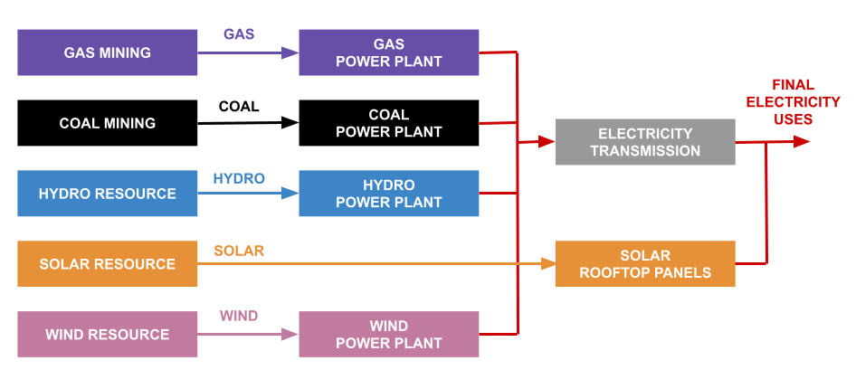
2.3 The Reference Energy System (RES)
What is it?
The complexity of the energy system can be simplified and represented in an organised model structure. We call it Reference Energy System
Notes:
The first step in the creation of a model of an energy system consists in making a conceptual scheme for it. To do so, like in many domains of physics and engineering, reality needs to be turned into a simplified, manageable and organised model structure. In the energy modeling field, this model structure is typically called Reference Energy System (abbreviated with ’RES’). One example of Reference Energy System is given in the figure. There, the complex set of supply chains constituting a real energy system has been translared into a sketch with few boxes and lines. Even though the structure of the energy system is greatly simplified in this scheme, the figure still shows that, essentially, there are primary energy sources that are connected to final energy needs by a number of processes. Note that it is very important to create this scheme at the very beginning of any modeling exercise. Without it, it will be very difficult to create an own idea of what we are modeling and to communicate it to anyone else. This module will now proceed to describe a few typical characteristics of a Reference Energy system.

Slide 15
2.3 The Reference Energy System (RES)
What is it?
  RES is a simplified and aggregated graphical representation of the real energy system under analysis;
  RES covers not just the present configuration of the energy system, but also possible development paths;
  It shows all existing and potential new energy supply chains, from primary energy resources to final demand;
  The level of simplification depends on issues to be analysed and data availability;
  RES should be a minimum representation of reality needed to answer the policy questions;
Notes:
A Reference Energy System is a simplified and aggregated graphical representation of the real energy system that is being analysed. Usually, the Reference Energy System represents not only the current energy supply and demand infrastructure, but also potential future infrastructure. That is, if the represented energy system does not feature wind turbines, but wind turbines may play a role in future years, the user should include them in the representation. This is important because the Reference Energy System shows the structure of the model and the model is supposed to look many years into the future. Another important characteristic of a Reference Energy System is that it represents entire energy supply-demand chains, from primary energy resources to final energy demands (or final energy services). The level of complexity of the Reference Energy System depends on what issues the user wants to analyse (and also on the data availability). The level of complexity should be the minimum one required to address the policy questions of interest. For instance, if the purpose is to analyse the relative role of offshore and onshore wind turbines, these two technologies should be represented separately in the model and in the Reference Energy system.

Slide 16
2.3 The Reference Energy System (RES)
Structure
RES consists of:
  Energy Levels
  Resources, Primary, Secondary,..., Final,…
    (extracted from resources, processed, converted, transmitted, distributed, …)
  Energy carriers / commodities
  Coal, oil, gas, wood, nuclear fuel, electricity, heat,…
  Technologies
  Which extract, process, convert energy from one to another form or to energy service, transmit and distribute
Notes:
This part looks more closely at how the Reference Energy System is usually structured. Firstly, it represents different levels in the energy supply-demand chains. That is, it represents the succession from resource import or extraction, to primary energy uses, to secondary energy uses, down to final energy uses or even final services. This will be shown in a figure shortly. It represents separately all the energy carriers and commodities that are used and transported in the part of the energy system that the modeler wants to analyse. For example, if the modeler wants to include the coal power supply chain, the Reference Energy System may include the coal primary resource, the coal processed for use in power plants, the electricity supplied by the power plants and the electricity distributed to the final users. Finally, the Reference Energy System includes the set of technologies, infrastructure and processes that are part of the energy system that is being analysed. These need not be represented individually, but they can also be represented in an aggregated way. The level of detail depends on the objective of the analysis.

Slide 17
2.3 The Reference Energy System (RES)
Structure
Primary
Secondary
Final
Commodity
Technology
Notes:
Here you may see an example of all that was described in the previous slide. In this very simple Reference Energy system you may see, in different colours, different electricity supply chains: in violet, the electricity supply from gas; in black, the one from coal; in blue, the one from hydro; in yellow-orange, the one from solar photovoltaic; in pink, the one from wind. Following a typical representation, the left-hand side of the figure shows the ’start’ of the chains, that is, the primary resources. These are, respectively, gas, coal, water, sun and wind. The centre features the secondary energy supply, that is, the supply of energy carriers coming from the conversion of the primary energy carriers. The secondary energy supply includes conversion processes like power plants, but also electricity transmission and distribution infrastructure. Finally, on the right there is the final energy demand (in this case a demand for electricity). Note that many more levels can be represented, in much higher detail. This is just an illustrative example. In the figure, the lines represent energy carriers or commodities that flow through the supply chains; the boxes represent technologies, or processes that use energy carriers and/or convert them into other carriers. In this example, the boxes on the left represent the mining of primary energy, the ones in the centre represent power plants and transmission infrastructure.

Slide 18
2.3 The Reference Energy System (RES)
How to use it
It should reflect all elements that are modeled;
It should be referred to when setting all the model inputs;
It can be changed!
Notes:
The Reference Energy System is very important in every energy system modeling exercise because it provides the modeler with guidance throughout the rest of the modeling exercise. It is a clear and easy-to-grasp image of the structure, scope and goal of the model, that the modeler may refer to at any point. For this to be true, however, the modeler needs to make the correct use of the Reference Energy System. The following indications may help in this direction: first, the Reference Energy System should actually include each and every element that is to be represented in the model. There should be complete correspondence between the structure of the model and this graphical representation. Secondly, it should be referred to when setting all the model inputs. For example, let us assume that the modeler is including the gas-fired electricity supply chain in the model as represented at the top of the figure. The figure might actually guide the modeler in the process: first, two types of assets representing gas mining and gas power plants should be created; then, a commodity representing gas should be created; this commodity should be somehow pinned as an output of the gas mining and an input to the gas power plant; in the same way, the gas power plant would provide electricity as an output. The last indication would be to remember that the Reference Energy System can be changed at any point. This becomes useful if the modeler finds out that one of the technological options included in the representation is not needed. The user may in such case go back to the Reference Energy System and remove that option.

Slide 19
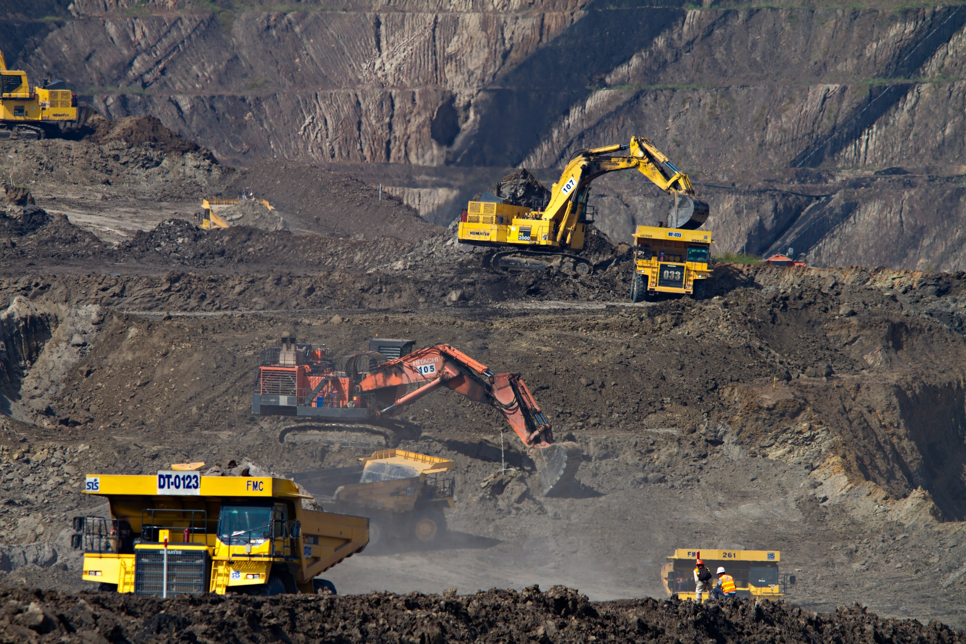
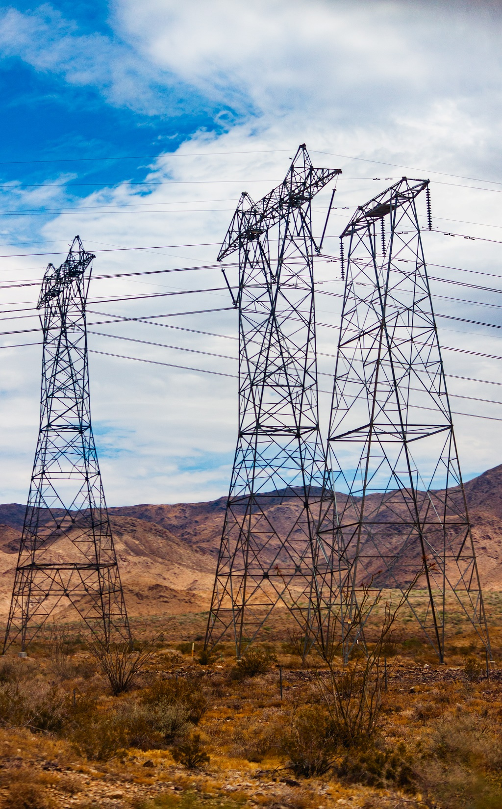
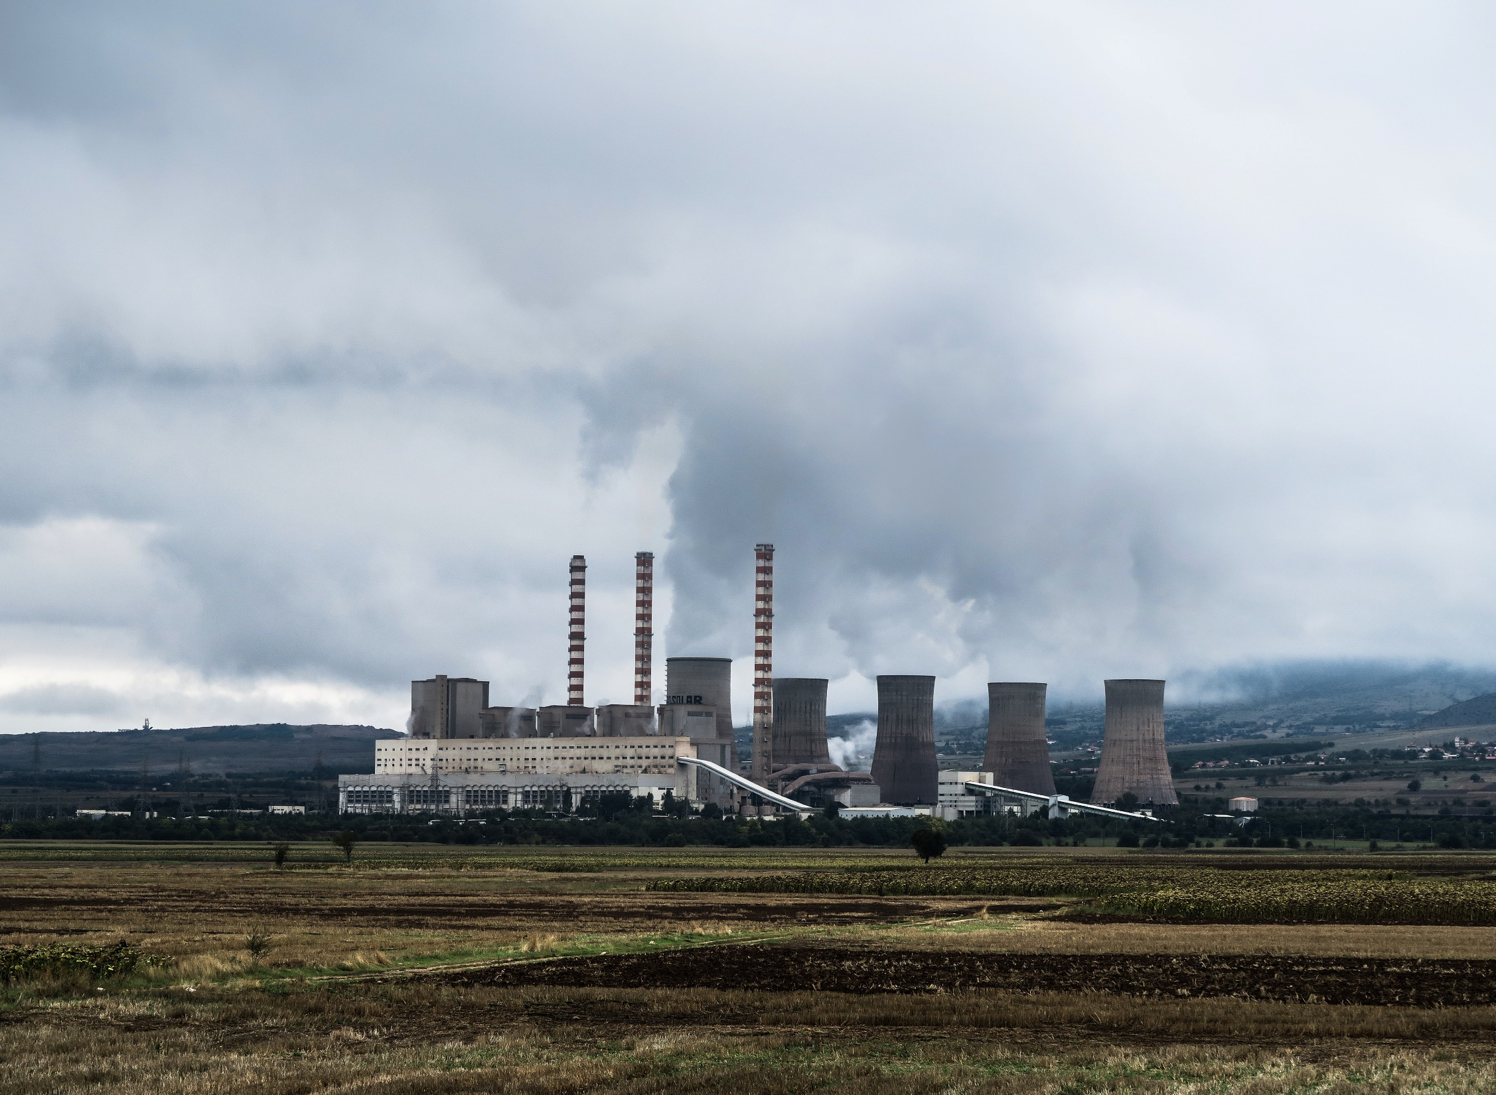
2.4 How to design an RES
a) Identify energy levels and carriers
Picture source: Iamme Ubeyou, photo, licensed under CC 0
Photo by Dominik Vanyi on Unsplash
Photo by Elijah Ekdahl on Unsplash
Photo by Jason Blackeye on Unsplash
Notes:
This module details how a Reference Energy System may be created. The creation of a Reference Energy System is one of the most important moments of the entire modeling effort, since it determines the structure that the model will have. There are five main steps in the design of an R E S. The first step consists in identifying energy levels and carriers. That is, it consists in separating all the parts of the real energy system we are analyzing in some standard categories such as primary energy supply, secondary energy supply, final energy demands, final services demands. For example, starting from the left we may categorize the examples shown in the figure as follows: the first one, coal mining, fits within the very beginning of the supply chain, on the side of primary energy sources; the second one, a power plant, fits more or less in the center, in the secondary supply; the third one, the transmission network, fits again more or less in the secondary supply; also the fourth one, a field of solar photovoltaic panels for centralised energy supply, fits in the secondary supply, at the same stage as the power plant.

Slide 20
2.4 How to design an RES
b) Identify the technologies
  Which energy conversion technologies are currently used to transform primary energy to final energy in every level and/or are planned for the future?
  Which energy transmission/transportation technologies are currently used and/or are planned for the future?
  Make list of technologies and group those that share similar characteristics
Notes:
The second step in the design of an R E S consists in further separating the parts of the supply chain previously identified into well-defined technologies or processes. This step identifies which conversion technologies are used to transform primary energy to final energy at the different levels of the supply chain and which transmission technologies are used to convey the energy carriers. Note that the word ’technology’ does not necessarily indicate each individual piece of infrastructure. For simplicity, it is also common practice to group under one label several individual pieces of infrastructure with similar characteristics. For example, the modeler may decide to group together all individual coal power plants in one country under one same category called power plants. This process of grouping (or aggregating) is very common in energy systems analysis and it is used to simplify the structure of the model and the computational effort in solving it. If done correctly, the aggregation of technologies or processes with similar characteristics may allow the modeler to address some research questions with limited computational effort and without losing significant information.

Slide 21
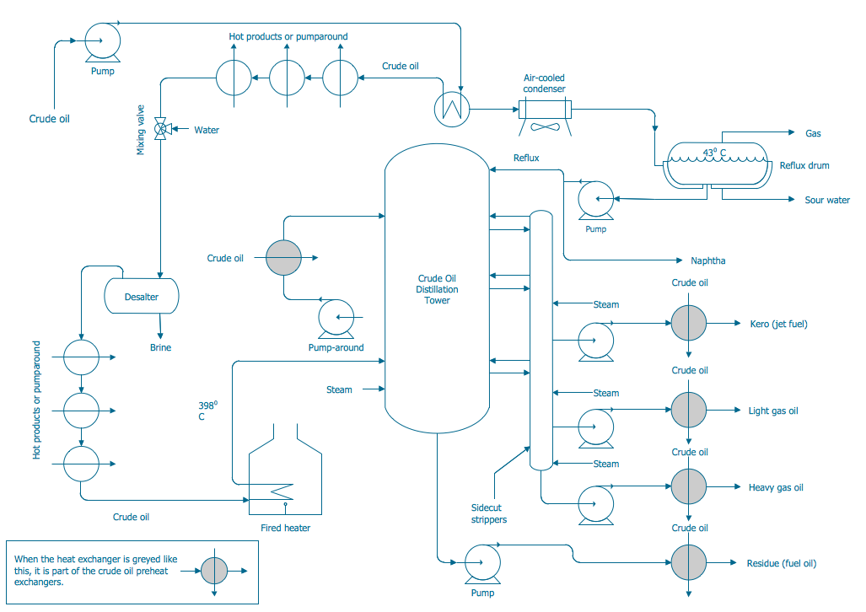
2.4 How to design an RES
c) Simplify and aggregate
Input
Output
LPG
Gasoline
Crude oil
Kerosene
Refinery
Diesel
HFO
Picture source: CS Odessa, search.creativecommons.org, diagram, licensed under CC BY 4.0
Notes:
The third step in the design of an R E S consists in introducing one more simplification: for each of the processes or technologies identified in the previous step, details or sub-processes of no relevance are removed and only one big box is kept, with inputs, outputs and some transfer functions. The example in the figures may clarify what this means. On the left, a rather complicated scheme of a refinery is shown. A refinery is per se a very complex network of processes exchanging energy and material inputs and outputs. In some cases the analyst may decide to look into each one of these processes. However, for the purposes of an energy system model on national scale, the analyst may decide to represent a refinery simply as a ’box’ which takes crude oil as input and which gives, after a series of steps, a number of oil products as outputs. This type of representation is shown on the right. Not looking at what happens inside the refinery does not mean that the representation of the overall inputs and outputs is necessarily inaccurate. The analyst can still reproduce the ratio of outputs to inputs accurately, according to the real data coming from the refinery. In the same way, the analyst can represent all the production costs accurately, from the accounts of the refinery. The only information that is lost is what happens inside the refinery, because the analyst is not interested in it, in this case. This process of simplification can be carried out for all other technologies or processes included in the model.

Slide 22
2.4 How to design an RES
d) Represent main inputs & outputs
Coal
Coal extraction
Gas
Electricity
Examples
Gas Power plant
Gasoline
Oil
Refinery
Diesel
Kerosene
Diesel
Transportation
Car
Notes:
The fourth and last step in the design of an R E S is the clear identification of the inputs and outputs of all the technologies (or technology groups) defined in the previous steps. This comes almost automatically from the third step. Once each set of processes has been represented with a box, according to the level of aggregation that the modeler deems best, the border of the box can be considered as the boundary of the specific process. Inputs are identified as anything that crosses the boundary inwards and outputs as anything that crosses the boundary outwards. With this type of representation the modeler can actually represent many types of technologies or even natural systems. Let us take the example in the figure, at the bottom. The user can represent a car by introducing in the model a box which takes as input diesel and gives as output a service called ’transportation’, expressed for example in units of passenger-km. The modeler can detail the ratio of output to input, so as to represent accurately how much fuel is used to provide a certain amount of service. Also the cost of providing the service can be detailed. More examples will be shown further into the course. Note that there is no particular constraint in what the modeler can represent. Even a piece of river could be represented, with a box that takes water as input and gives water as output.

Slide 23
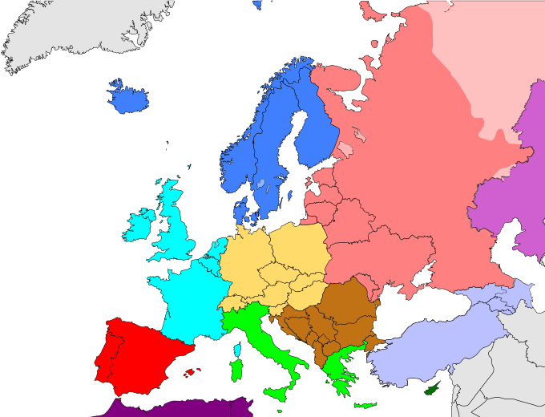
2.4 How to design an RES
e) Regionalise
Divide infrastructure by type and by country or region
Represent links between countries or regions through dedicated infrastructure
Electricity Spain
Electricity
France
Electricity export Spain
Electricity Spain
Electricity
France
Electricity import Spain
Picture source: Kolja21, Europe subregion map world factbook.svg, licensed under CC BY 3.0
Notes:
The fifth and last step is the regionalization. It is not always needed, but it can be useful in some types of application. When the aim of the model is to investigate the impact of regional infrastructure development on the energy system of individual countries, or the role of trade between different countries, then it could make sense to represent each country separately in the model. This can be done in two steps. The first one consists in modeling separately the energy supply infrastructure of each country, in the way shown in the previous slides. For example, if the model includes Spain and France and both have natural gas supply infrastructure, the model shall include two natural gas supply chains, one for Spain and one for France. The second step consists in representing the energy trade infrastructure between the countries. Again, if the model includes Spain and France and represents the electricity supply system of the two countries, the user may allow electricity to be traded between the two countries by introducing new technologies. Examples for these are shown on the left. The technologies represent in an aggregated fashion all electricity import/export infrastructure between the two countries. They take electricity supplied by one country as input and deliver electricity to the other country as output.
All these steps for the design of a Reference Energy System are not set in stone and they will be different according to the scope of the models. However, they provide good guidance regarding the type of reflections the modeler needs to make when starting any energy system modeling effort.

Slide 24
Take Quiz
Gardumi F., Sridharan V. (KTH)., Shivakumar A. (UNDESA)., Niet T. (SFU)., Ramos E.P. (KTH)., Alfstad T., (UNDESA) 2021. Lecture 3: Energy modeling tools and OSeMOSYS. Release Version 1.0. [online presentation]. Climate Compatible Growth Programme, United Nations Development Program and United Nations Department of Economic and Social Affairs.
.
CCG courses (this will take
you to the website link http://www.ClimateCompatibleGrowth.com/teachingmaterials)

