Slide 2

LECTURE 11
CLIMATE POLICIES IN CLEWs
Introduction to CLEWS

Slide 3
Learning outcomes
By the end of this lecture, you will be able to
ILO 1: Identify key types of direct climate policies and their application worldwide
ILO 2: Identify key types of indirect climate policies and their application worldwide
ILO 3: Analyse an example of the application of climate policies from the Asia and Pacific region
ILO 4: Reflect on the key elements of the European Union’s climate policies and their applicability to other contexts
Notes:
This lecture concludes the course. So far, the course focused on the representation of climate, land, energy, and water systems and their interlinkages in models. Now we conclude by mentioning some actions that governments can take to preserve these systems and mitigate climate change. The focus will lie on commonly adopted policies for climate change mitigation. By the end of the lecture, you will be able to:
1) Identify key types of direct climate policies and their application worldwide
2) identify key types of indirect climate policies and their application worldwide
3) analyse an example of the application of climate policies from the Asia and Pacific region
4) reflect on the key elements of the European Union’s climate policies and their applicability to other contexts.

Slide 4
11.1 Direct climate policies
Carbon tax
Demand curve
Price
A direct cost for emitting
Generally considered the most ‘economically efficient’ way to regulate carbon
By increasing the price of emitting, the supply curve moves up to a higher price, and therefore the equilibrium demand is lower
Supply curve
New price
New
quantity
Quantity sold
Notes:
The most commonly adopted policies in support of climate change mitigation can be categorised in two classes: direct and indirect. This module describes two examples of direct climate policies: carbon taxes and cap and trading schemes for emissions. The carbon tax is the most intuitive policy: it consists in a tax that must be paid for directly emitting greenhouse gases in the atmosphere. A tax per unit of emissions (in terms of CO2-equivalent) is established by law’, with different values for different types of emitters. The overall payment is therefore proportional to the quantity of greenhouse gases emitted. This type of policy is generally considered the most economically efficient way to regulate carbon-equivalent emissions. The reason is that it automatically pushes for a new supply-demand equilibrium in energy markets, as shown in the figure on the right. In the figure, the introduction of a taxation on the emissions for suppliers of gasoline would push the supply curve upwards. That is, supplying the same quantity of gasoline would cost more, due to the taxation. In such case, if the gasoline demand is elastic to the prices, the meeting point between supply and demand would settle on a lower quantity of gasoline. In short, for higher supply prices of gasoline, fewer consumers would use it.

Slide 5
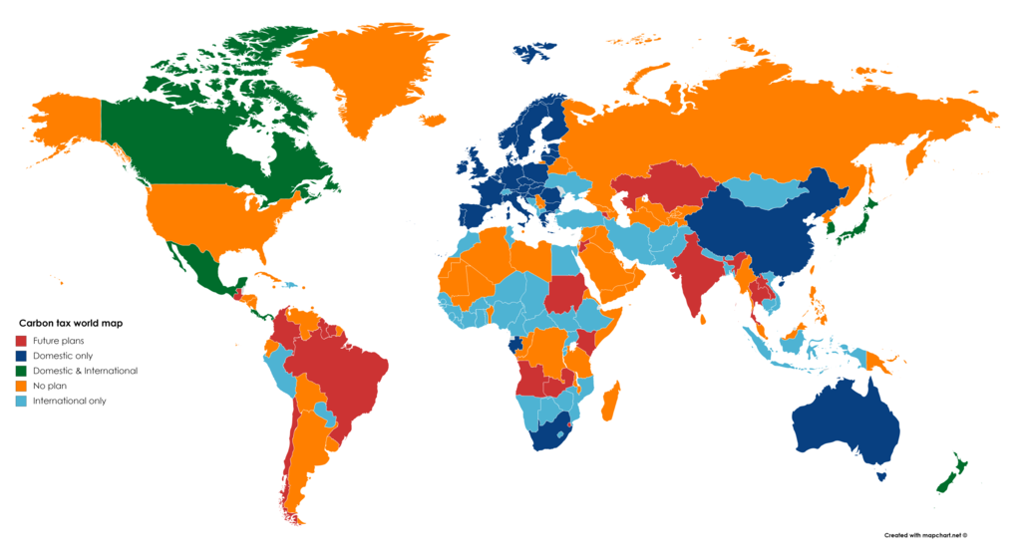
11.1 Direct climate policies
Carbon tax
Largely implemented policy, but:
Carbon leakage: high emitting industries may locate their operations in jurisdictions with lower tax.
Border tax adjustments to counter these: imports are taxed based on their carbon content.
Picture source: Ranamode, Picture, licensed under CC BY-SA 4.0
Notes:
The carbon tax has already been applied in several instances worldwide (see blue and green areas in the figure). Other countries have plans to apply it (see red areas in the figure). In many cases the tax is applied to the sale of fuels rather than to the consumer who burns the fuel, with the assumption that the fuel will be burned and emit the carbon. So, for instance for transportation fuels the tax would be applied at the pump.
Although this may seem a simple policy to implement, there are, however, several subtleties that need to be considered when applying it. With a carbon taxes system, ‘carbon leakage’ can occur if one jurisdiction has a high carbon tax and another does not. High emitting industries may re-locate their operations in the lower tax jurisdiction. To counter this, some countries (especially in the European Union) have considered ‘Border tax adjustments’, where imports are taxed based on their carbon content. Interestingly, there could be in some cases ‘negative leakage’, that is, carbon leakage having the effect of reducing emissions (for instance, inducing coal-rich countries to shift to gas or oil).

Slide 6
11.1 Direct climate policies
Carbon tax
Delayed effects, due to inertia in the substitution of old emitting technologies
Unpopular – taxes may be unwelcome if not properly explained
Inequalities might be enhanced by flat taxations that are not well thought through
Effectiveness depends on how the proceeds are recycled into the economy
Notes:
There are also other challenges associated with carbon taxes that need to be considered in planning. Firstly, the effects of carbon taxes may take a decade or more to emerge, because it takes time for inefficient technologies (vehicles, factory equipment, buildings) to be replaced by newer models and because many older models still filter through the system. Secondly, this is a direct taxation and, as with most taxations, it may be unpopular if not properly explained and justified. When proposed by governments, it might encounter strong opposition by associations of consumers and their representations. Third, if not carefully planned, it might have the unintended effect of weighing on income classes already struggling with the affordability of energy services. Finally, its effectiveness depends partly on how the proceeds from the carbon taxes are recycled into the economy. There are different ways they could be recycled and each has different impacts: the proceeds could be used to directly reduce income taxes. This is considered ‘economically efficient’. The income from taxes could be reused to support renewable development projects. Finally, recycling schemes could be put in place, and designed in a way that ensures disadvantaged populations receive the benefits and that the carbon tax does not increase inequalities.

Slide 7
11.1 Direct climate policies
Emission Trading Scheme
Picture source: (factory silhouette) Gabriel VanHelsing, picture, licensed under CC0
Notes:
Another type of direct climate policy is the so-called cap-and-trade emission trading scheme. The mechanism works as described in the picture. The government sets a cap on the total amount of greenhouse gases that can be emitted by installations in the system. This is represented by the horizontal red line in the figure. The cap is usually reduced over time so that total emissions fall. Within the cap, companies receive or buy emission allowances, which they can trade with one another as needed. They can also buy limited amounts of international credits from emission-saving projects around the world.
After each year a company must surrender enough allowances to cover all its emissions, otherwise heavy fines are imposed. If a company reduces its emissions, it can keep the spare allowances to cover its future needs or else sell them to another company that emitted more and is short of allowances. The economic theory suggests that, due to the limited quantity of allowances available, these have a non-negligible price. And it suggests that those who can easily reduce carbon will do so, while those with more challenges in the reduction of carbon emissions (for instance, steel production) will pay.

Slide 8
11.1 Direct climate policies
Emission Trading Scheme
CONs:
Offsets can be problematic
If worst polluters allowed to keep emitting, local air pollution impacts remain
PROs:
Economically efficient if same price across jurisdictions
Floor and ceiling prices for allowances can give some stability (so it partly resembles a carbon tax and is called a hybrid design).
Benefits from revenue recycling policies (similar to carbon taxes)
Notes:
There are Pros and Cons associated with emission trading schemes. Firstly, offsetting the emissions of large polluters may not always be efficient. There can be challenges with clearly confirming that an offset is valid: for instance, is reforestation after cutting down the trees really reducing carbon? In addition, offsets are usually not local, so the emission reductions do not benefit local populations. Third, sometimes the lifetime of carbon offsets is often not long enough to have a meaningful impact: for instance, it might happen that an area undergoes reforestation, the allowances are cashed in, then then the trees are cut down. Another challenge is that if the worst polluters can continue to emit, local air pollution impacts remain, usually hitting the most disadvantaged hardest. An advantage of this mechanism is that it can be economically efficient if it is implemented in a coordinated manner in two jurisdictions. If two jurisdictions agree to a mutual cap, and transferrable permits, the carbon price in the two jurisdictions will equalize. In addition, if minimum and maximum prices for allowances are set, they can give some stability (this type of scheme resembles a carbon tax and is called hybrid). Other advantages can come from recycling the revenues from the sale of the allowances, in a similar way as with the carbon taxes.

Slide 9
11.2 Indirect climate policies
Renewable Energy Support Schemes
Notes:
This mini-lecture describes a selection of commonly adopted indirect climate policies. By indirect we mean that they do not address emissions directly, but they favour low-emission solutions and thus make high-emission solutions less competitive. The first type of policies is renewable energy support schemes. These aim, in general, at ensuring that a given amount of renewable energy is supplied in the system. They can be divided into investment-based and production-based policies. The former mandate a certain amount of installed renewable energy supply capacity; the latter mandate a certain amount of energy supplied, as a share of the total supply. Examples of investment-based schemes include investment subsidies, that is, subsidies on installed capacity. Examples of production-based schemes include quantity-based and price-based schemes. The former are for instance green certificates. These imply that companies supplying more renewable energy than required can obtain certificates they can sell and companies supplying less can buy the certificates. Price-based schemes are usually based on fixed or variable subsidies. The next slide describes them in greater detail.

Slide 10
11.2 Indirect climate policies
Renewable Energy Support Schemes
Notes:
With the Feed-in Tariff (or Power Purchase Agreements) mechanism, a Government mandated fixed price is paid to renewable energy suppliers for every unit of electricity for a given period (usually from 10 to 30 years). With the Feed-in Premium mechanisms, generators sell at the market price but are given a premium for every unit of electricity they sell. Premiums may be fixed or change over time depending on market conditions. Finally, the Contract for Difference (or C.f.D.) mechanism is similar to a Feed-in premium, but it includes a clause that if the market price is higher than a ‘strike price’, the premium becomes negative. An Advantage of Feed-in premiums is that they incentivize generation when the price is high. The Contract for Difference reduces this incentive. One challenge associated to renewable energy support schemes in general is that it is difficult to estimate how much they actually contribute to the reduction of emissions.

Slide 11
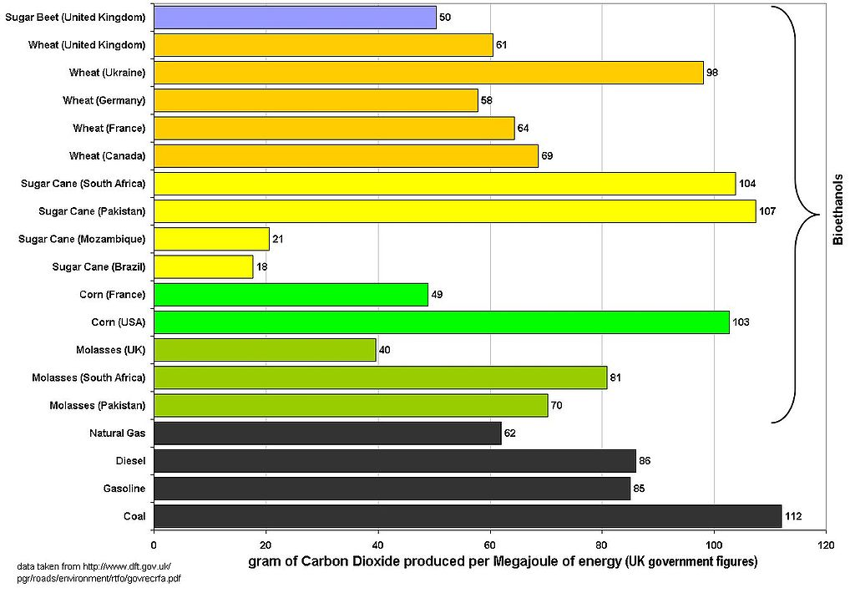
11.2 Indirect climate policies
Low-carbon fuel standards
Rule that enforces a maximum carbon intensity of a given fuel
Penalty for selling/importing fuels that do not meet the standard
British Columbia and California are common examples
Potential challenge: indirect land impacts
Picture source: Mike Young, picture, public domain
Notes:
Another type of indirect climate policy is low-carbon fuel standards. These address the carbon intensity of fuels. Carbon intensity is defined as the quantity of carbon dioxide emitted per unit of energy delivered by a certain fuel. As can be seen from the figure, the carbon intensity can vary significantly between fuels and across countries. For example, the figure shows that coal, the black bar at the bottom, emits the highest amount of carbon dioxide per unit of energy among all fuels commonly used. Low-carbon fuel standards are rules enforcing a maximum carbon intensity for fuels (usually and especially in the transportation sector). Examples of application include, for instance, British Columbia and California. Penalties apply for selling or importing fuels that do not meet the standards. These standards usually drive the fuel production and sale towards biofuels. A potential indirect consequence of these standards and the deployment of biofuels is the impact on land uses and, in turn, on food security and deforestation.

Slide 12
11.2 Indirect climate policies
Fuel substitution schemes
Schemes that encourage fuel substitution
They can impact both local air quality and global carbon emissions.
They can consist in subsidies or taxes on certain fuels
Notes:
Fuel substitution schemes are another type of indirect climate policy. These encourage fuel substitution (for instance, from charcoal for cooking to electricity or natural gas, or from oil-fired boilers to gas-fired boilers). As opposed to emission trading schemes, fuel-substitution schemes can both impact local air quality and broader carbon emissions. The incentives to fuel substitution can be created through subsidies (either on a fuel or on a technology using it) or through taxes on specific fuels (for instance, diesel for transportation, or charcoal for cooking). These mechanisms can be particularly effective in driving the electrification of certain services or the decarbonization of transportation. However, in some cases they may risk increasing inequalities, such as in the case of flat taxes on fuels that are essential for lower-income and energy-poor groups.

Slide 13
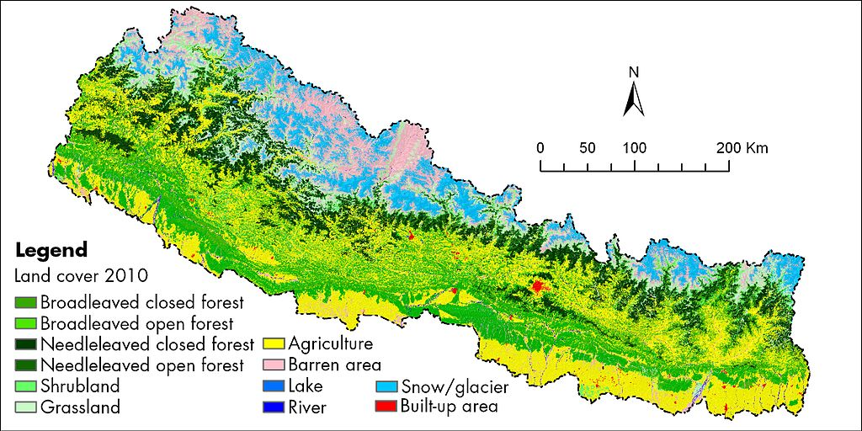
11.2 Indirect climate policies
Land use policies
As land use has a huge impact on the carbon cycle, government policies regarding land use impact carbon emissions
Picture source: Uddinkabir, picture, licensed under CC BY-SA 4.0
Notes:
The last type of indirect climate policy deserving mention is any policy regulating the use of land. As seen in previous lectures, the soil captures or releases greenhouse gases depending on the type of cover. Certain soils and land covers can function as large carbon sinks. Changing the land cover by replacing, for instance, forest land with buildings or crops causes a net release of carbon. Therefore, several governments are issuing policies that limit the deforestation or the use of land for agriculture, or issuing policies that support the restoration of natural reserves. These policies may be necessary, but they may also conflict with policies supporting the development of other sectors of the economy. For instance, they may cause conflicts in the use of land where policies are in place that mandate increases in the production of biofuels. This shows the importance of an integrated planning perspective, particularly in climate policies.

Slide 14
11.3 Examples - Indonesia
An overview
 | SDG7 | NDC | RUEN
Policy document | President Regulation N. 59 year 2017 on the implementation of the SDGs | Law N. 16 year 2016 on the ratification of the Paris Agreement to the UNFCCC | President Regulation N. 22 year 2017 on National Energy Planning (RUEN)
Key theme | Sustainable Development Goals (SDGs) | Nationally Determined Contribution (NDC) | National Energy General Plan (RUEN)
Content | A guide to achieve universal access to energy, increased energy efficiency, and expanded use of renewable energy | A guide to achieve the NDC targets of national emission reductions per sector | A guide to provide the direction of national Energy Management for achieving energy independence and energy security
Time frame | Up to 2019 | Up to 2030 | Up to 2050
Ministry of Energy and Mineral Resources, Indonesia, DEN, UNESCAP, National Energy Policy in Indonesia, 2019
Notes:
The next two mini-lectures discuss examples of climate policies in regions that are far apart and at different stages of their economic development. Climate policies are evolving fast and those shown here may become outdated quickly. Therefore, the examples must not be seen in any way as a judgement on the climate policy processes in these regions. They represent only a snapshot in a specific historical moment and they serve only the purpose of showing applications of the concepts described in the previous mini-lectures. The first example is from Indonesia. As of now, the country has in place policies that may directly or indirectly impact its contribution to climate change mitigation and to sustainable development at several time scales. The President Regulation 59, year 2017, regulates in the short term the implementation of the United Nation’s Agenda 2030 for sustainable Development. The Law 16, year 2016, ratifies the Paris Agreement to the U.N.F.C.C.C. and guides the country in the medium-term to the achievement of its Nationally Determined Contributions. The National Energy General Plan (R.U.E.N.) steers the sustainable development of the energy system up to 2050.

Slide 15
11.3 Examples - Indonesia
Direct climate policies
 | Emission Reduction Target by 2030
 | 29% (Unconditional) | 38% (Conditional)
Forestry and peatland | 59.3 | 60.2
Waste | 1.3 | 2.6
Energy and transportation | 37.9 | 36.6
Agriculture | 1.1 | 0.3
Industry | 0.3 | 0.3
Total | 100 | 100
Medium-term GHG emission limit
Relevant documents:
Intended Nationally Determined Contribution, 2015;
National Energy Policy;
Presidential Regulation No.61/2011.
Ministry of Environment and forestry, 2016 Annual report of the general directorate of pollution and environmental damage control, 2016
Notes:
Among the policy documents cited in the previous slide, Indonesia’s Intended Nationally Determined Contribution, submitted to the U.N.F.C.C.C. in 2015, includes direct climate policies in the form of emission reduction targets. As can be seen in the table, reporting data from the Presidential Regulation 61, year 2011, the country decided years ago upon two emission reduction targets, one unconditional and one conditional to receiving external financial support. The unconditional target was 29% reduction of carbon dioxide equivalent emissions by the whole economy in 2030 compared to a baseline assumed by the Government. This percentage reduction is then translated in absolute numbers for each sector. The conditional target is higher and set at 38%. This type of target is common in all Intended Nationally Determined Contributions. The targets have been revised in several countries at the time this lecture is published and are being revised in Indonesia and many more countries, to better reflect the urgency in the reduction of emissions worldwide.

Slide 16
11.3 Examples - Indonesia
Indirect climate policies
Renewable Energy Targets: 23% (2025) and 31% (2050) In Total Primary Energy Supply mix
Biofuels in transportation: 30% by 2020
Energy efficiency: 1% annual decrease of final energy consumption
Relevant documents:
National Energy Policy
Ministerial Regulation No.136/2015
Notes:
On the contrary, the National Energy Policy (published in 2017) includes a number of indirect climate policies. It includes a renewable energy support scheme, in the form of a mandatory renewable energy target. This requires that at least 23% of the total primary energy supply in 2025 be from renewable sources and 31% in 2050. Another indirect climate policy is introduced in the form of a low-carbon fuel standard. This mandates that at least 30% of the energy content of fuels in transportation be from biofuels by 2020. Finally, it includes another indirect climate policy, in the form of an energy efficiency target. This type of target was not covered in the previous mini-lectures, but it is very common and it can be seen as a form of fuel substitution scheme where the consumption of fossil fuels is replaced by non-consumption. In this case, the energy efficiency target mandates 1% annual decrease of final energy consumption through savings in all sectors. Energy efficiency measures are in some cases effective, because there are measures that have low-cost, significant potential for saving emissions and potential for reducing the consumer’s energy bills. However, they might need subsidizing, since the upfront capital and inconvenience costs for final consumers can also be significant.

Slide 17
11.3 Examples - Indonesia
Road ahead
Low emission development plan for 2050
Support scheme for renewables
2050 GHG emission targets
Emission Trading Scheme
Carbon Tax
Energy intensity (per unit GDP)
Carbon intensity (per unit primary energy supply)
Climate Analytics and NewClimate Institute, Climate Action Tracker, 2021
Notes:
In synthesis, the overall climate policy in Indonesia seems to be moving on with respect to the low-emissions development plan for 2050 and the support to renewables. Areas not yet explored are binding emission targets for 2050, emission performance standards in transportation and other direct climate policies, such as carbon tax or emission trading schemes. But, as said, policies evolve continuously and fast. The progress on all these dimensions is regularly updated for Indonesia and other countries by the Climate Action Tracker project. The whole policy package is currently delivering very positive steps towards the reduction of the energy intensity in the energy sector. The energy intensity is calculated as the use of energy per unit of G.D.P. The intensity has been decreasing since 2000, and it is below the level of the G 20 countries. On the contrary, though, the carbon intensity (calculated as the carbon emissions per unit of total primary energy supply), has been increasing in past years. This negative trend is due to the still high share of coal in the energy supply. Its change depends on the plans for coal-fired electricity expansion and potentially on the introduction of stricter policies.

Slide 18
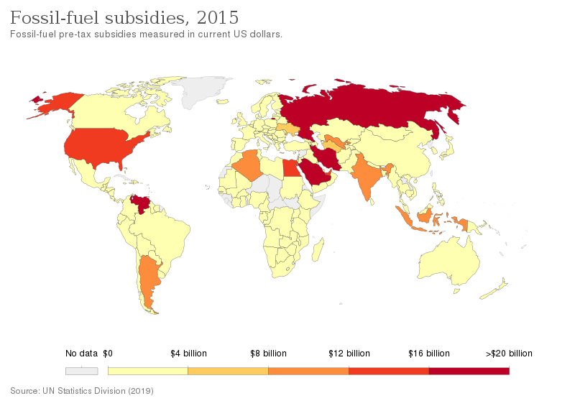
11.3 Examples - Indonesia
Road ahead
Picture source: Our world in data, picture, licensed under CC BY 3.0
Notes:
A successful and significant reduction of carbon emissions in line with the overall policy direction of the country might also require a change in existing policies. The graph shows fossil-fuel subsidies distributed in each country worldwide in 2015, from data by the UN Statistics Division. Although with far lower subsidies than other countries, Indonesia featured in the middle of the scale. The presence of fossil fuel subsidies may have indirectly concurred with the increase of carbon intensity in the energy sector. In the light of a stronger commitment to sustainable development, this policy would need to be carefully reconsidered and evaluated jointly with the others in place. This is just an example and a similar discussion applies to many more countries. The core concept emerging is the need for higher policy coherence across sectors of the economy as well as across all the domains of climate policy.

Slide 19
Lecture 11.3 References
Ministry of Energy and Mineral Resources, Indonesia, DEN, UNESCAP, National Energy Policy in Indonesia, 2019, URL: https://www.unescap.org/sites/default/files/UN%20ESCAP%20Workshop%20Indonesia%20Mr.%20Budi%20Cahyono.pdf
Ministry of Environment and forestry, 2016 Annual report of the general directorate of pollution and environmental damage control, 2016
Climate Analytics and NewClimate Institute, Climate Action Tracker, 2021, URL: https://climateactiontracker.org/countries/indonesia/

Slide 20
11.4 Examples – European Union
An overview
Roadmap 2050
(2011)
Clean Energy for all Europeans
(2016)
Clean Planet for all
(2018)
A Roadmap for Carbon neutrality by 2050 in all sectors of European economies.
1 Trillion € investments
European
Green Deal
(2019)
European Commission, A European Green Deal: Striving to be the first climate-neutral continent, 2019
Notes:
This mini-lecture describes examples of climate policy from another region with a different background and at a different stage of the development of its economy: the European Union. The path of the European Union to deep decarbonization of its economy started earlier than elsewhere, but policy consolidated strongly in the past decade. The first roadmap for the long-term decarbonization of the Union was published in 2011. Its main feature was the proposal for a target 80% reduction of greenhouse gas emissions by 2050, compared to 1990. The roadmap was followed by other strategies, notably the Clean Energy for all Europeans in 2016 and the Clean Planet for all in 2018, which gradually increased the decarbonization ambitions. The latest and biggest step in the European Union’s climate policy was the publication of the European Green Deal at the end of 2019, which put forward an investment plan for 1 trillion euros to make the Union carbon neutral by 2050.

Slide 21
11.4 Examples – European Union
Direct climate policies
No GHG emissions by 2050.
55% reduction of GHG emissions by 2030 compared to 1990
2030 targets turned into national targets through an Effort Sharing Decision: here
Relevant documents:
European Green Deal
Clean Planet for All
Notes:
The European Green Deal introduces a number of policies that directly or indirectly push for the reduction of greenhouse gas emissions in the European Union. These policies are numerous and span across all sectors of the European economy. While key areas of intervention and key targets have been set since the beginning, the individual sectoral policies are still at different stages of design, discussion, and approval. Here, only the key policy targets, defined since the beginning, are presented. Starting with the direct policies, the first one is a target to reduce greenhouse gas emissions to zero by 2050. This is complemented by an interim target of 55% reduction of greenhouse gas emissions by 2030 compared to 1990, agreed upon through the 2030 Climate Target Plan. The emission reduction target for 2030, defined at the European Union level, has been turned into binding national emission reduction targets through a so-called Effort Sharing Decision. These targets have further been included in national policies through National Energy and Climate Plans that each government drafted and submitted to the European Commission.

Slide 22
11.4 Examples – European Union
Indirect climate policies
32.5% improvement in energy efficiency (compared to projections of energy use in 2030)
32% share of renewable energy in energy consumption by 2030
Relevant documents:
2030 climate & energy framework
Revised Renewable Energy Directive
Energy Efficiency Directive
Notes:
The European Green Deal also includes numerous indirect climate policies and confirms previous ones. Again, this slide only presents a selection of them, where overall targets for the entire European Union are established. All the targets are medium-term targets to 2030, part of the European Union’s 2030 climate and energy framework. Through the Energy Efficiency Directive, a target to increase energy efficiency by 2030 was set and this is thus far confirmed. The target mandates a reduction of energy consumption through energy efficiency measures by 32.5% in 2030, relative to a pre-defined business-as-usual scenario. Similarly, the Revised Renewable Energy Directive had set a target of 32% share of renewable energy in final energy consumption by 2030, which is also confirmed. All these targets are binding. Although they are not dissimilar from those adopted by other countries worldwide, they have the peculiar characteristic of being agreed upon by a union of countries.

Slide 23
11.4 Examples – European Union
European Union Emission Trading Scheme (ETS)
Established in 2005
Covers 45% of the EY’s GHG emissions
A cap-and-trade system
Challenges: surplus of allowances built up!
European Environment Agency, EU Emissions Trading System (ETS) data viewer, 2021
Notes:
One of the pillars of the emission reduction policies described in the previous slides is the European Union Emission Trading Scheme (E.T.S.). Set up in 2005, it was the world’s first international emissions trading schemes.
It operates in all EU countries, plus Iceland, Liechtenstein, and Norway. It currently covers 11,000 heavy energy-using installations and airlines and around 45% of the E.U.’s greenhouse gas emissions. It works as a cap and trade system, in the same way as described in mini-lecture 1 of this lecture. Started in 2005, it led to the gradual decrease of emissions in the E.U. (gray bars in the figure). At first, all allowances were freely allocated. Then, especially from 2013 on, part of the allowances was sold to the best bidders. The European Union's E.T.S. has inspired other countries or regions. National or sub-national emission trading schemes are already operating or under development in Canada, China, Japan, New Zealand, South Korea, Switzerland, and the United States. Challenges can arise also with the E.T.S. In the E.U., a surplus of emission allowances built up in the emissions trading system from 2009. The surplus of allowances is largely due to the economic crisis (which reduced emissions more than anticipated) and high imports of international credits. This has led to lower carbon prices and thus a weaker incentive to reduce emissions. In the short term, the surplus risks undermining the orderly functioning of the carbon market. In the longer term it could affect the ability of the E.T.S. to meet more demanding emission reduction targets cost-effectively. The European Commission addressed this by using the so-called Market Stability Reserve mechanism, where they withdrew a number of allowances from the market to boost the prices.

Slide 24
11.4 Examples – European Union
Road ahead
Carbon intensity compared to other G20 countries:
2013–2018 MEDIUM
After 2018 LOW
Share of renewables in primary supply, compared to G20 countries:
2013–2018 MEDIUM
After 2018 HIGH
Rating of coal phase-out in the power sector:
After 2018 MEDIUM
Climate Analytics and NewClimate Institute, Climate Action Tracker, 2021
Notes:
As a closure to this mini-lecture, one may look at snapshots of where all the described policies have brought the European Union to in the last decade, in terms of carbon emissions. These snapshots can be retrieved again from the climate action tracker project. Starting with the carbon intensity (per unit of primary energy supply), this has decreased in the most recent years, placing the European Union among the best performing countries in the G 20. The share of renewables in primary energy supply has increased, placing the E.U. again among the best performing countries in the G 20. Regarding the coal phase-out in the power sector, the EU scores medium. This is due to the amount of coal-fired power generation in the European Union, which is still significant due to many reasons. Among these are reasons of supply security (especially after the extensive shut down of nuclear power plants), energy independence, and not-least the importance of the carbon economy for the job market in some European regions.
This concludes the lecture on climate policies and the course. You have now acquired all the elements to reflect upon the interlinkages between climate, land, energy, and water and how they may be modelled in support of integrated planning. We thank you for your interest, look forward to your feedback, and invite you to complete the hands-on exercises.

Slide 25
Lecture 11.4 References
European Commission, A European Green Deal: Striving to be the first climate-neutral continent, 2021, URL: https://ec.europa.eu/info/strategy/priorities-2019-2024/european-green-deal_en
European Environment Agency, EU Emissions Trading System (ETS) data viewer, 2021, URL: https://www.eea.europa.eu/data-and-maps/dashboards/emissions-trading-viewer-1
Climate Analytics and NewClimate Institute, Climate Action Tracker, 2021, URL: https://climateactiontracker.org/countries/eu/

Slide 26
Take Quiz
Gardumi F. (KTH), Niet T. (SFU), Sridharan V. (KTH)., Shivakumar A. (UNDESA)., Ramos E.P. (KTH)., Alfstad T., (UNDESA) 2021. Lecture 11: Climate policies in CLEWs. Release Version 1.0. [online presentation]. Climate Compatible Growth Programme, United Nations Development Program and United Nations Department of Economic and Social Affairs.
CCG courses (this will take
you to the website link http://www.ClimateCompatibleGrowth.com/teachingmaterials)

Slide 27

This document was updated on 01.11.2024

