Slide 2

LECTURE 10
THE CLIMATE
SYSTEM –Part II
Introduction to CLEWs
Notes:
This lecture is intended to explore basic concepts of the climate system.

Slide 3
Learning outcomes
By the end of this lecture, you will:
ILO1: Understand the impact of climate change on key resource systems
ILO2: Understand the importance of climate change adaptation
ILO3: Learn about CLEWs case studies that focus on climate change mitigation
Notes:
This lecture has three intended Learning outcomes. By the end of this lecture, you will:
1) Understand the impact of climate change on key resource systems
2) Understand the importance of climate change adaptation
3) Learn about CLEWs case studies that focus on climate change mitigation

Slide 4
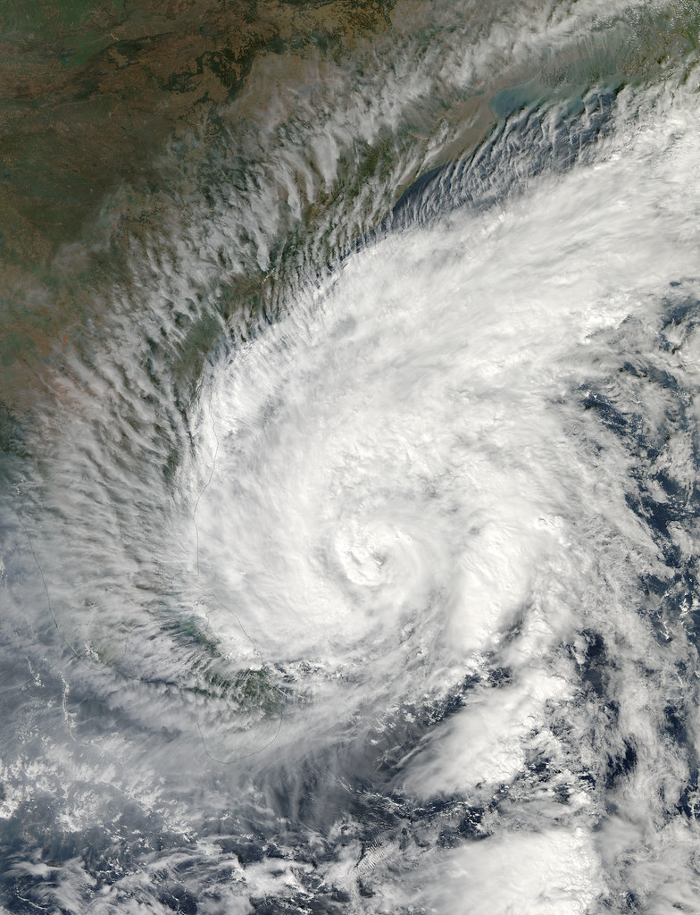
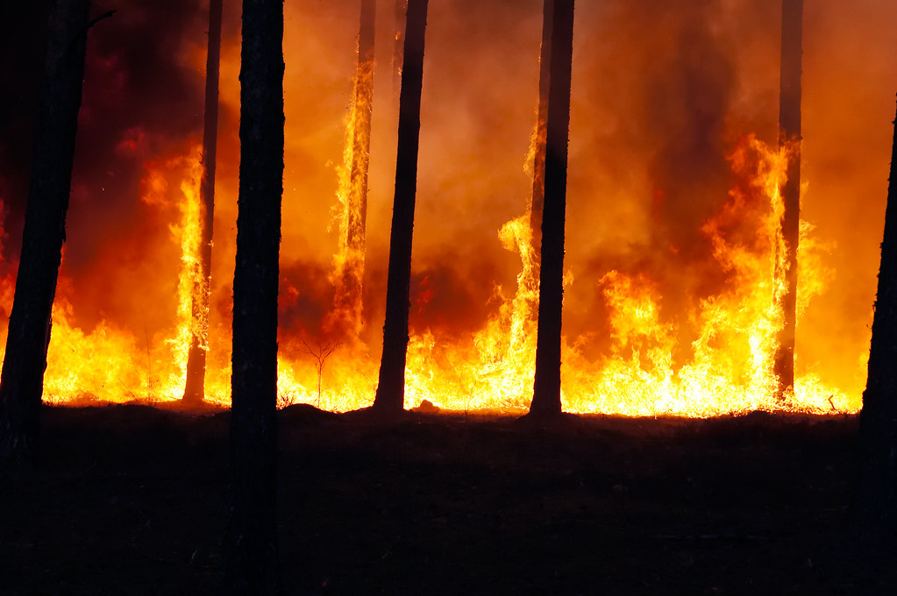

10.1 Climate change management
Basics of climate change: a recap
Upwards trends in global surface temperature
Erratic precipitation patterns
Ocean acidification
Sea level rise
Sudden changes in wind speed, humidity and pressure
Source: "Tropical Cyclone Madi Approaching India" by NASA Goddard Photo and Video is licensed under CC BY 2.0 (left), "2009 World Water Day: Effects of Water Scarcity" by United Nations Photo is licensed under CC BY-NC-ND 2.0 (center), "Forest fire" by Ervins Strauhmanis is licensed under CC BY 2.0 (right)
Notes:
To begin with, let us recap briefly on the basics of climate change. Climate change is any significant long-term change in the expected patterns of average weather of a region over a significant period of time. These changes usually manifest as upward trends in global surface temperature or global warming, erratic precipitation patterns, acidification of the oceans, rising sea levels, sudden changes in wind speed, and humidity and pressure resulting in extreme weather conditions, to name a few. Projections of different climatic variables like temperature and precipitation that are used to quantify climatic change are produced using Earth systems models that take into consideration the concentration of greenhouse gases (or GHGs) present in the earth over a period of time. In the previous lecture, the importance of greenhouse gas accounting and their sources of generation were discussed. The Earth systems models also project different scenarios with varying levels of GHG concentration in the Earth’s atmosphere. However, the projections from these models are fraught with uncertainties.

Slide 5
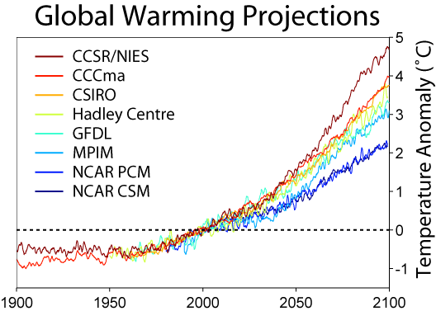
10.1 Climate change management
Uncertainty in climatic projections
Projections for temperature and precipitation are fraught with uncertainties
There are overlaps in scenario results
There is no one consensus among the scientific community
Source: Global warming projections by Robert A. Rohde licensed under CC BY-SA 3.0
Notes:
On the graph to the right, projections for global mean temperature from different Earth systems models are presented. This figure interprets the results from the latest assessment report of the Intergovernmental Panel on Climate Change, or IPCC. Each line corresponds to the ensemble mean of the temperature projections from different Earth systems models. The figure highlights the variability in projections from different models. It is noticeable that the projections vary by a big margin. Thus, even amongst the climate science community, there is no clear consensus on the projections for different climatic variables. Similar to temperature, the projections for global precipitation and sea level rise are also fraught with uncertainties. These uncertainties in climate models originate from their representation of the Earth’s different spheres. Each of these spheres, geosphere, atmosphere, biosphere, and hydrosphere have many parameters governing their dynamics. And, not one model can represent all of them at the highest possible spatial and temporal resolution. Therefore, inter-comparison projects between the different modelling groups are promoted, and the IPCC publishes the entire spectrum of results.

Slide 6


10.1 Climate change management
Who monitors global climate science dialogues?
Intergovernmental panel on climate change (IPCC)
IPCC contributes to the United Nations Framework Convention on Climate Change (UNFCCC)
The 6th assessment report (AR) will be published in late 2021
ARs are based on inputs from over 2,000 climate scientists
Source: IPCC and UNFCCC logo (Public domain freely available for identification under Fair use)
Notes:
The Intergovernmental Panel on Climate Change, or I.P.C.C., is an intergovernmental body of the United Nations that is dedicated to providing the world with a piece of objective scientific information relevant to understanding the scientific basis of the risk of human-induced climate change, its natural, political, and economic impacts and risks, and possible response options. The I.P.C.C. was established in 1988 by the World Meteorological Organization, or W.M.O., and the United Nations Environment Programme, or U.N.E.P. It was later endorsed by the United Nations General Assembly. Membership is open to all members of the W.M.O. and U.N. The I.P.C.C. produces reports that contribute to the work of the United Nations Framework Convention on Climate Change, or U.N.F.C.C.C., the main international treaty on climate change. The objective of the U.N.F.C.C.C. is to "stabilize greenhouse gas concentrations in the atmosphere at a level that would prevent dangerous anthropogenic or human-induced interference with the climate system". The I.P.C.C.'s Fifth Assessment Report was a critical scientific input into the U.N.F.C.C.C.'s Paris Agreement in 2015.

Slide 7
10.1 Climate change management
Policy responses to combat climate change
Responses to climatic change are two-fold:
Mitigation: Reducing emissions of and stabilizing the levels of heat-trapping greenhouse gases in the atmosphere (explored in lecture 9)
Adaptation: Adapting to the climate change already in the pipeline
Greenhouse gas concentrations
Climate change
Impacts
Responses
Mitigation
Adaptation
Source: Authors' interpretation
Notes:
Responding to climate change involves a two-pronged approach. The first one is called mitigation, which focuses on reducing emissions and stabilizing the levels of heat-trapping greenhouse gases in the atmosphere. The second is called adaptation, which focuses on adapting to the climate change already in the pipeline. The IPCC states that the goal of mitigation is to avoid significant human interference with the climate system and “stabilize greenhouse gas levels in a timeframe sufficient to allow ecosystems to adapt naturally to climate change, ensure that food production is not threatened and to enable economic development to proceed in a sustainable manner”. In contrast, adaptation aims to reduce our vulnerability to the harmful effects of climate change like sea-level encroachment, more intense extreme weather events, or food insecurity. Adaptation also encompasses making the most of any potential beneficial opportunities associated with climate change, for example, longer growing seasons or increased yields in some regions. Topics on green house gas mitigation were discussed in the ninth lecture.

Slide 8
10.1 Climate change management
Policy responses to combat climate change
Mitigation | Adaptation
Practice Energy efficiency Greater use of renewable energy Electrification of industrial processes Efficient means of transport implementation: electric public transport, bicycle, shared cars ... Carbon tax and emissions markets | More secure facility locations and infrastructures Landscape restoration (natural landscape) and reforestation Flexible and diverse cultivation to be prepared for natural catastrophes Research and development on possible catastrophes, temperature behaviour, etc. Preventive and precautionary measures (evacuation plans, health issues, etc.)
Notes:
Some common examples of adaptation and mitigation measures are detailed in this table. Mitigation efforts include practising energy efficiency measures at home and offices and using renewable sources of electricity generation. Automation and electrification of industrial processes also contribute to reducing greenhouse gas emissions. Buying and using energy-efficient transport mechanisms and promoting public transport goes a long way in limiting emissions. Taxing the greenhouse gas emitters and developing market mechanisms also facilitate the reduction of emissions. From the point of view of adaptation, climate resilience in infrastructures is very important. Diversifying our food pallet and growing crops adjusted to the local climate will reduce the impact of its vulnerable nature. Being prepared to deal with climate-induced disasters like floods and landslides is an essential step in embracing this uncertainty. In the following slides, climate change impacts and possible adaptation options will be discussed.

Slide 9
Lecture 10.1 References
Basics of climate change. https://www.ncdc.noaa.gov/global-warming/temperature-change
IPCC, 2018: Summary for Policymakers. In: Global Warming of 1.5°C. An IPCC Special Report on the impacts of global warming of 1.5°C above pre-industrial levels and related global greenhouse gas emission pathways, in the context of strengthening the global response to the threat of climate change, sustainable development, and efforts to eradicate poverty [Masson-Delmotte, V., P. Zhai, H.-O. Pörtner, D. Roberts, J. Skea, P.R. Shukla, A. Pirani, W. Moufouma-Okia, C. Péan, R. Pidcock, S. Connors, J.B.R. Matthews, Y. Chen, X. Zhou, M.I. Gomis, E. Lonnoy, T. Maycock, M. Tignor, and T. Waterfield (eds.)]. World Meteorological Organization, Geneva, Switzerland, 32 pp. https://www.ipcc.ch/sr15/
A simple guide to climatic change describing the impacts and responses. https://www.bbc.com/news/science-environment-24021772
9

Slide 10



10.2 Impacts of climate change
Climatic impact on resource systems
Shift in precipitation patterns
Droughts
Floods
Increase in cooling demand
Reduction in thermal power plant efficiencies
Hydropower vulnerability
Influences crop growth
Increase in pest infestation
Increase in CO2 fertilization
Source: Free Icon made by Manuel sax is licensed by CC BY 3.0 (left), Free Icon made by Rafael is licensed by CC BY 3.0 (centre), Free Icon made by Giovanni Battistini is licensed by CC BY 3.0 (right)
Notes:
Before exploring the possibilities to adapt to climatic change, it is essential to understand the impacts of climate change. The variability in parameters like temperature and precipitation brought about by climatic change affects different resource systems. In this course, the focus is on the water, energy, and land systems. The land system here has its focus on land use and crop production. In the climate change community, a common phrase goes as follows: “If climate change is the shark, then water is its teeth”. It is through the water cycle that many of the impacts of climate change manifest. Climate changes could result in the shifting of precipitation patterns leading to droughts and floods. With a specific focus on the power sector in the energy system, an increase in surface temperature could lead to higher cooling demand. The efficiencies of thermal power plants are also affected due to the increase in cooling water temperatures. Hydropower infrastructure is vulnerable to climate-induced water availabilities. In the land system, an increase in temperature is expected to affect crop growth. There is also a potential threat of an increase in pest infestation. Despite increasing levels of carbon dioxide leading to the greening of the earth, a high concentration of atmospheric carbon dioxide is expected to reduce the concentrations of essential minerals in many plant species. Despite some direct links between the resource systems and the climate, these systems are not isolated by nature.

Slide 11
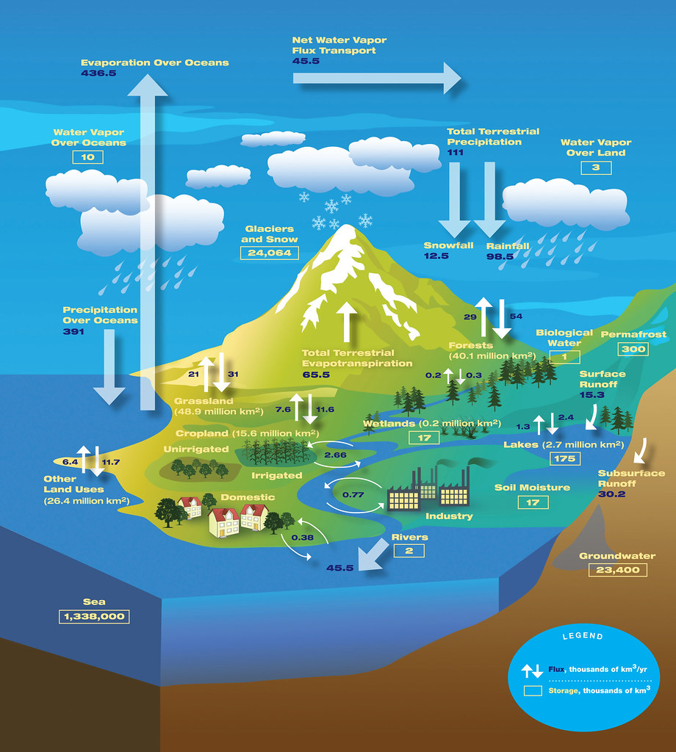
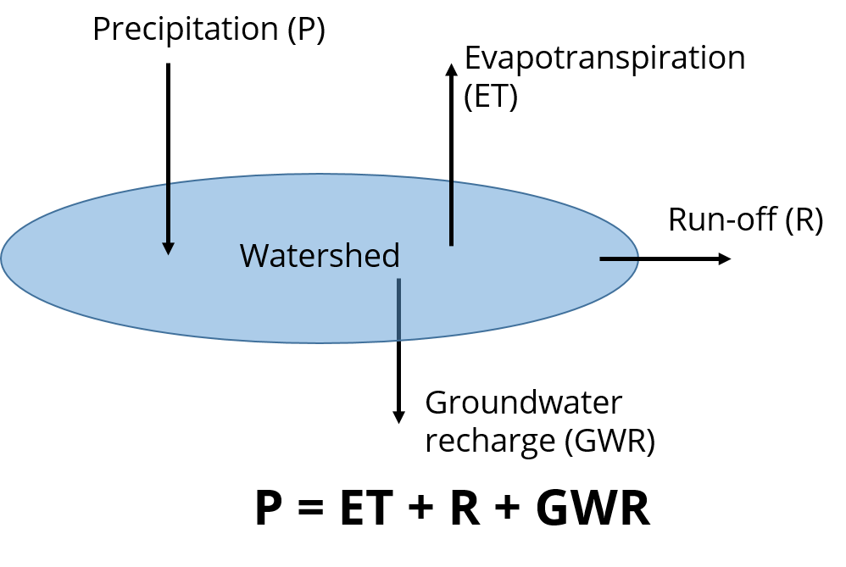
10.2 Impacts of climate change
Climatic impact on the water system
Source: "The Water Cycle" by Atmospheric Infrared Sounder is licensed under CC BY 2.0 (left), Authors interpretation of water balance (right)
Notes:
The concepts of the water cycle and its balance have been introduced in the previous lectures. The water cycle, as shown in the figure to the left, is the path that all water follows as it moves around our planet. It exists in different phases. It is present in different locations on earth. The figure to the right illustrates the four main processes critical to maintaining balance in the water system. They are Precipitation, Evapotranspiration, Run-off, and Groundwater recharge. It is essential to know that a balance is always maintained in the system irrespective of the land cover in the respective catchment. Many of the critical processes in the water cycle are actually driven by climatic changes. Starting from the phase change of water to its different forms is impossible without the absorption or release of heat and hence dependent on the sun. Wind speed is another critical factor that affects the rate at which the water cycle operates.

Slide 12
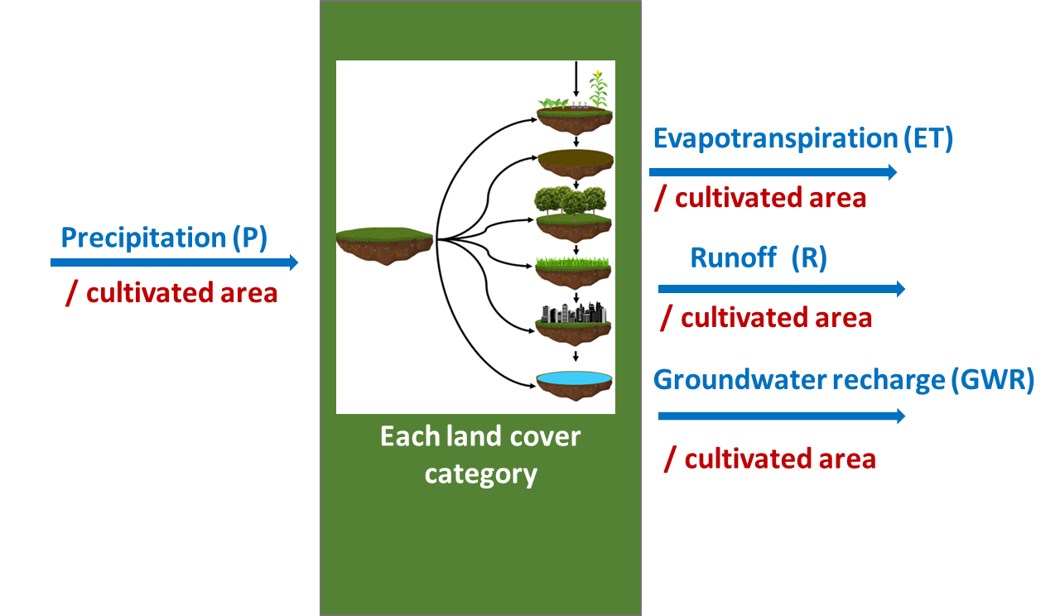
10.2 Impacts of climate change
Climatic impact on the water system
Increase or decrease in precipitation and temperature affects the water balance
Makes a big difference when it comes to planning reservoir levels (all sectors)
Has direct impact on irrigation demand (both energy and water)
High temperatures result in higher water demand in household and livestock
Source: Author’s interpretation. Insert figure: Image created by Abhishek Shivakumar in Slide block 6 available for free usage.
Notes:
Here, the water inputs and outputs from a land system are presented. Changes in precipitation and temperature in a region directly affect the water balance. High temperature leads to a higher rate of evapotranspiration and also results in a rapid decrease in soil moisture. This process affects the balance in the whole system. The overall balance will still be maintained. However, their shares will vary for each land class and region. Along with higher temperatures, reduced precipitation could result in increased water demand. Starting with irrigation, additional water may be needed to maintain or increase crop yields in arid regions. This need for irrigation has energy implications as well. An increase in temperature also affects living beings, affecting their water intake. Water in reservoirs is also a function of climatic events in upstream locations. A sudden precipitation event or localized high temperatures and eventual snowmelt could result in flash floods, resulting in considerable damage to downstream regions in a basin. Therefore, considering the climatic impact on the water system is of paramount importance to reduce the redundancies in water-related infrastructure.

Slide 13
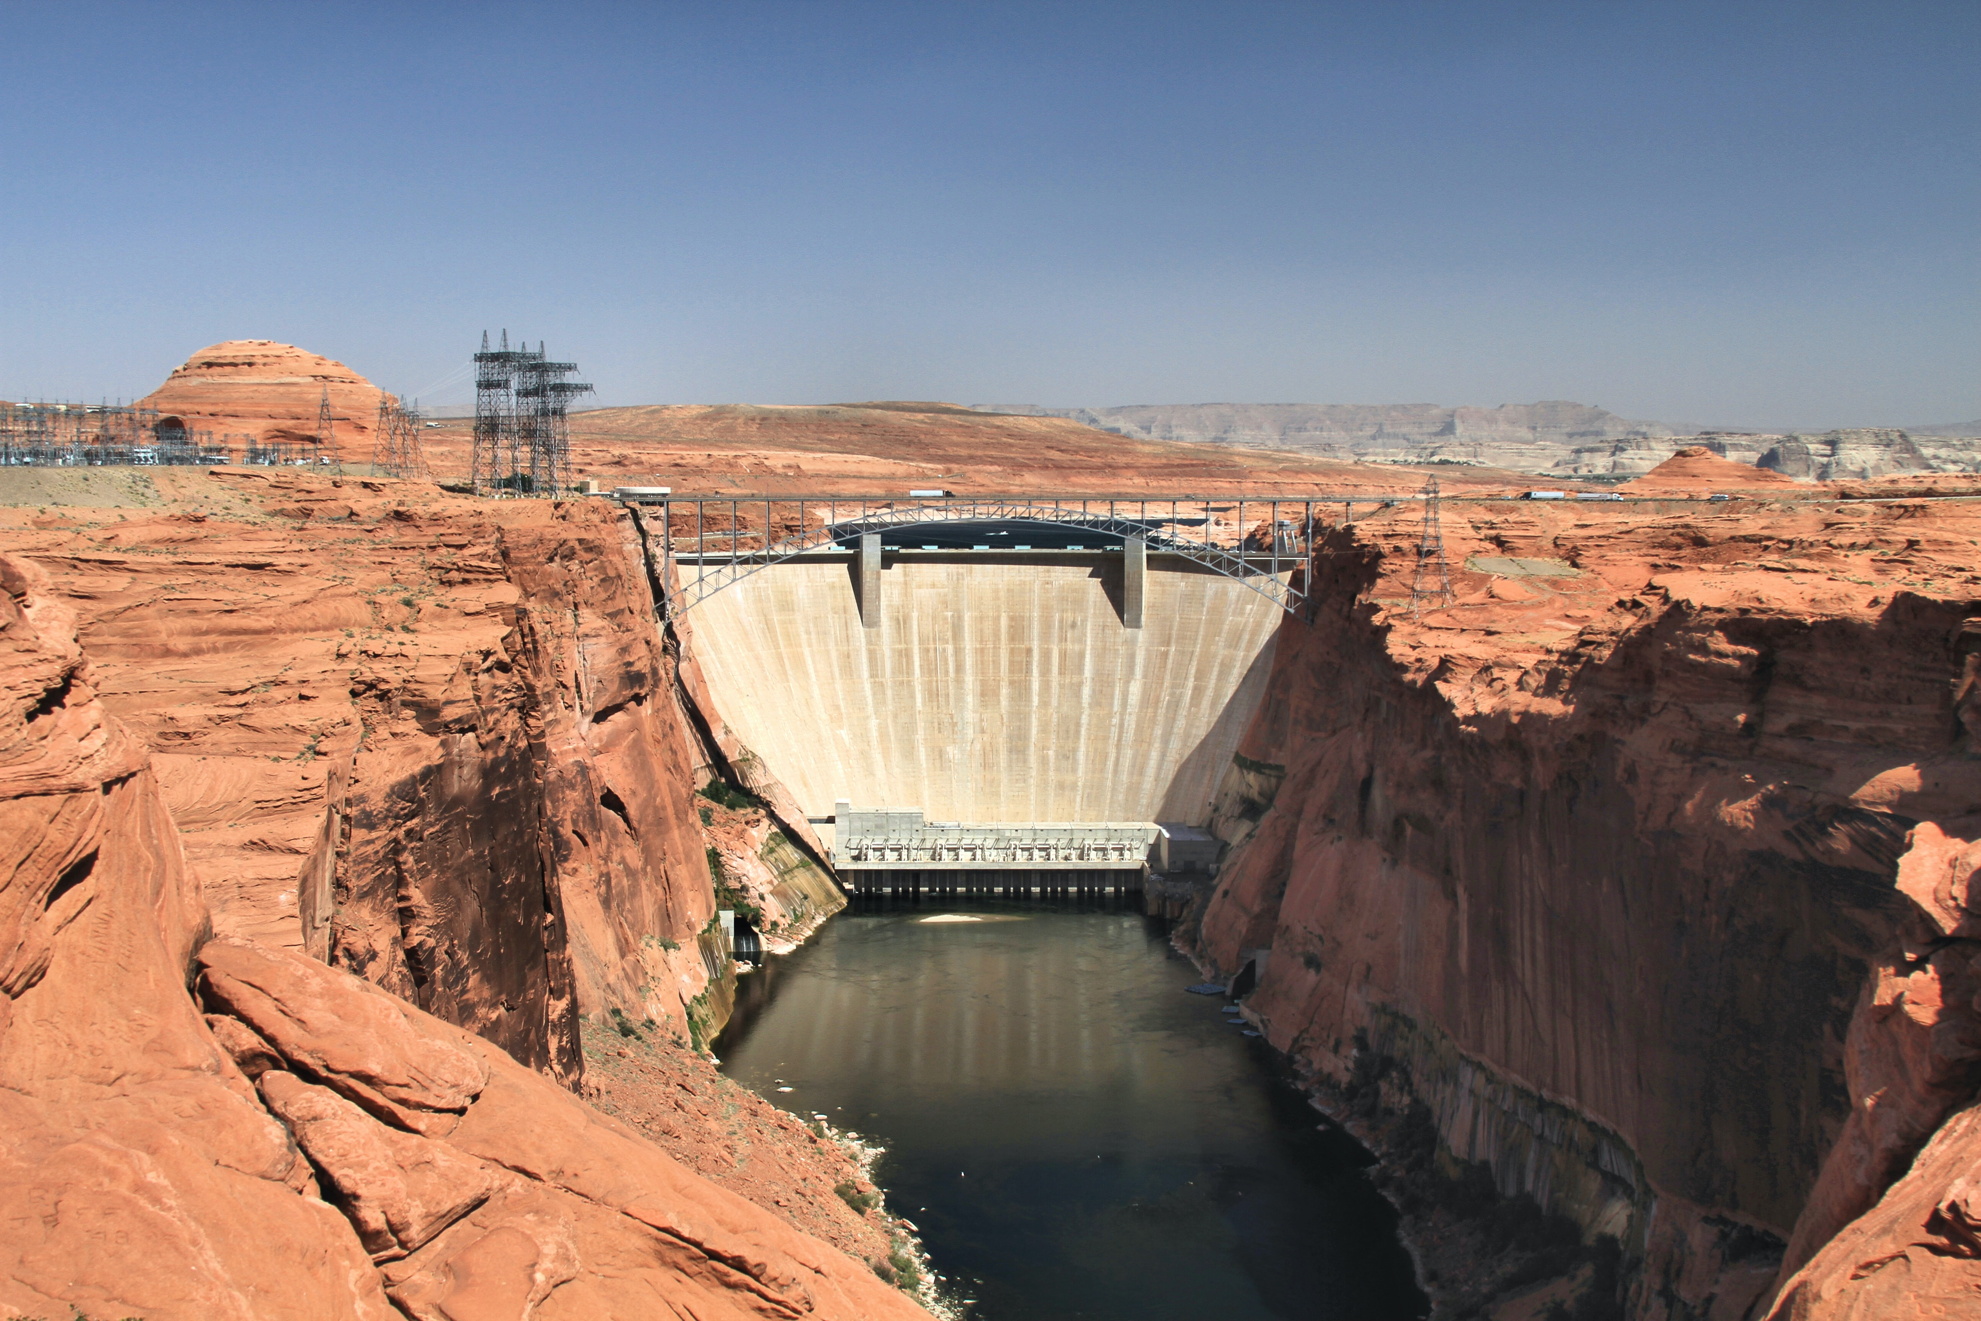
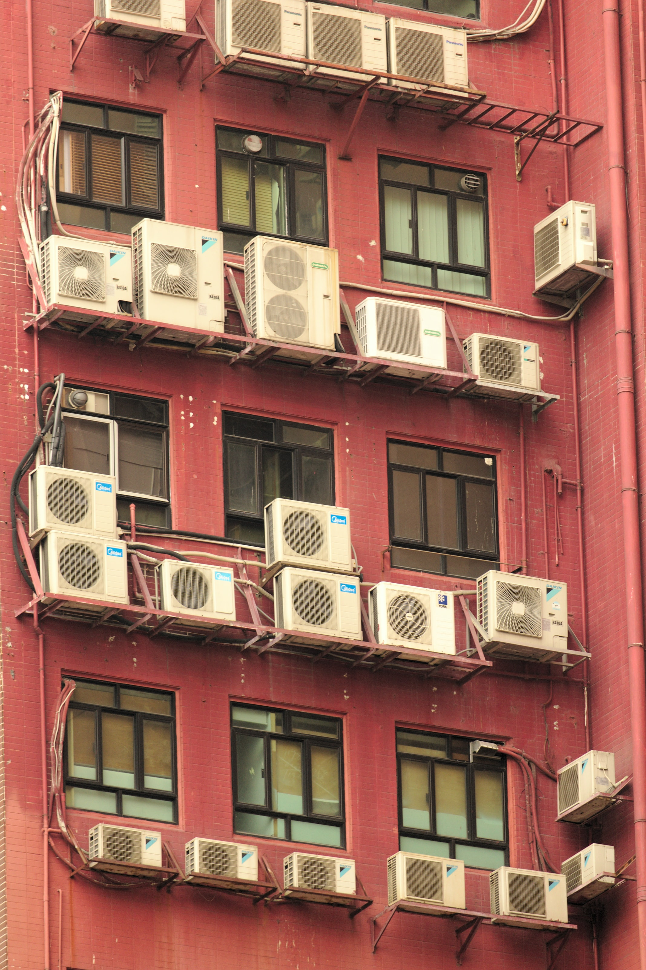
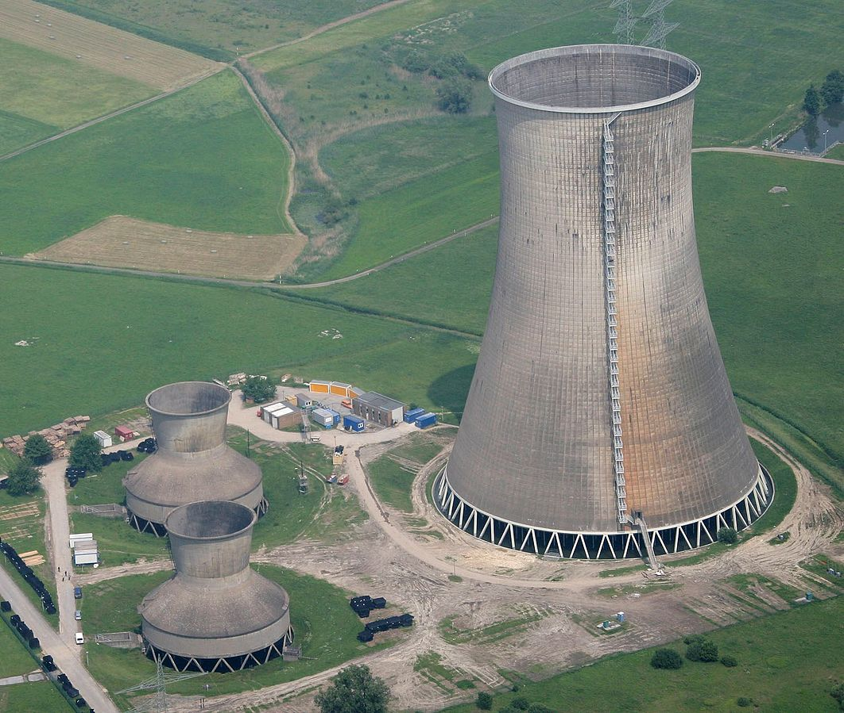
10.2 Impacts of climate change
Climatic impact on the energy system
Supply side
Demand side
Air conditioning demand increases due to temperature increase
Hydropower generation vulnerability
Variability in thermal power generation
Source: Photo by Gary Yost on Unsplash (Top left), photo by Tim Reckmann, licensed under CC BY-SA 3.0 via Wikimedia Commons (bottom left), Photo by chromatograph on Unsplash (right),
Notes:
From the perspective of the energy system, the climatic impacts can be differentiated between the supply and the demand sides. On the demand side, the energy demand, especially the demand for space cooling, is expected to increase in areas with a projected increase in average temperature. In its publication, “the future of cooling report”, the International Energy Agency estimates that the number of air conditioning units will quadruple by 2050 compared to present-day levels. This need will especially be higher in areas with increased temperatures during the summer season. On the supply side, hydropower generation is expected to feel the direct impact of climate change. Sudden and heavy precipitation is expected to be a significant threat to hydropower infrastructure in many parts of the world. In addition to this, prolonged dry seasons could make the infrastructure redundant. They could result in systems resorting to other rapidly deployable but expensive fossil fuel based sources for their power supply. Additionally, the water requirement for cooling in thermal power plants is also affected by higher temperatures. Higher water temperatures reduce the cooling efficiency and eventually that of the power generation process.

Slide 14
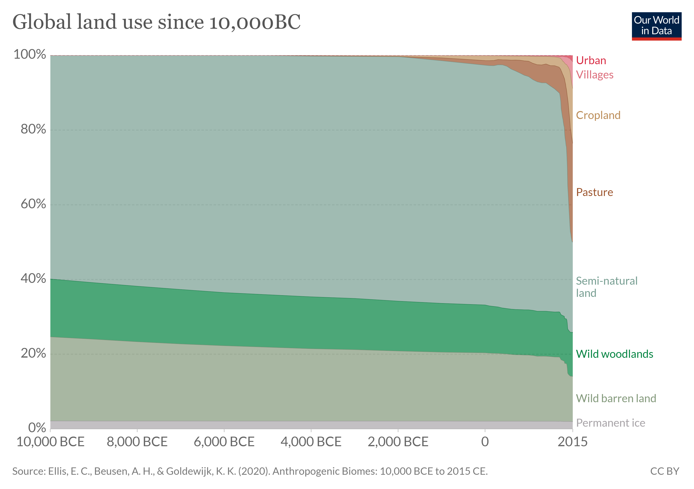
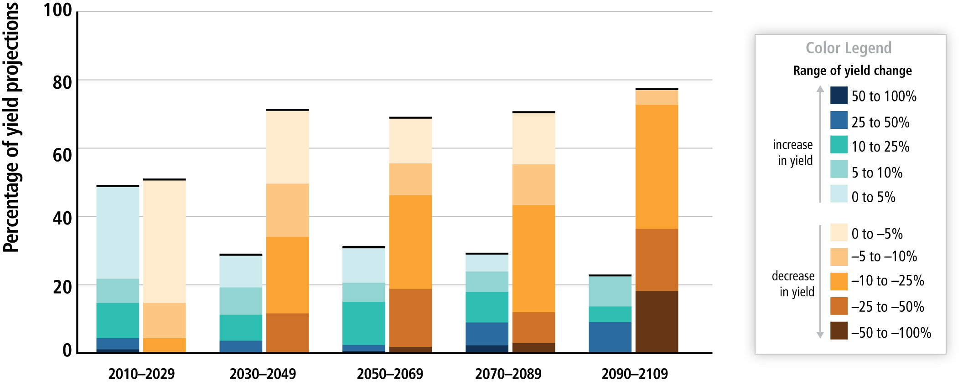
10.2 Impacts of climate change
Climatic impact on the land system
Crop yield reductions seem predominant in the future
The increase in yields (though small) is expected to occur in colder regions which become suitable for cultivation in the future
Crop Yield projections, IPCC AR5, WGII
Source: Ellis, E. C., Beusen, A. H., & Goldewijk, K. K. (2020). Anthropogenic Biomes: 10,000 BCE to 2015 CE. Land, 9 (5), 129 from Our world in Data published under the CC-BY license
Source: IPCC, Assessment report 5, Working group II, Summary to policymakers available for free use without request
Notes:
The direct climatic impacts on the land system are predominantly associated with the agricultural sector and some long-term land cover changes like desertification. The global land cover patterns have changed significantly in the last few centuries. On the figure to the left, the land cover changes from 10000 B.C. to the year 2015 are illustrated. We can notice how the share of pasture and cropland has increased in the last few centuries. This loss in natural land cover across the world is both a recipient and contributor to climatic change. Humans and their management of land resources have led to long-term changes in global evapotranspiration rates and downstream sedimentation effects, which, starting with the water balance, impact the climate. On the figure to the right, the impact of climate on crop yields from the fifth assessment report of the I.P.C.C. is presented. The range of changes in crop yield until 2100 is presented in comparison to a baseline. Towards the end of the century, it is expected that a significant share of the crops will experience a significant drop in yield due to climatic changes. Whereas some regions may experience minor yield improvements. This is predominantly expected to occur in colder regions that may become suitable for crop growth with increased surface temperatures. The I.P.C.C. also projects that increases in temperatures may lead to increased pest infestation in colder regions that may experience thawing of the permafrost. It is essential to highlight that the figures are averages for all crops and regions across the world. Therefore, the numbers will be different for individual region-specific crops.

Slide 15
Lecture 10.2 References
https://doi.org/10.1787/9789264301993-en (International Energy agency-Future of cooling report)
IPCC, 2019: Summary for Policymakers. In: Climate Change and Land: an IPCC special report on climate change, desertification, land degradation, sustainable land management, food security, and greenhouse gas fluxes in terrestrial ecosystems [P.R. Shukla, J. Skea, E. Calvo Buendia, V. Masson-Delmotte, H.- O. Pörtner, D. C. Roberts, P. Zhai, R. Slade, S. Connors, R. van Diemen, M. Ferrat, E. Haughey, S. Luz, S. Neogi, M. Pathak, J. Petzold, J. Portugal Pereira, P. Vyas, E. Huntley, K. Kissick, M. Belkacemi, J. Malley, (eds.)]. In press.
https://www.ipcc.ch/report/ar5/wg2/
15

Slide 16

10.3 Climate change adaptation
What is adaptation and how it is measured?
Adaptation measures prepare us to face impending climatic change with low regrets
Adaptation analysis starts with representing the climatic impacts
  Precipitation, hydrological balances, etc.
  Crop yield response
  Variability in hydropower generation
Adaptation response, in most cases, can be evaluated by the change in costs
The difference in costs between the baseline scenario and the climate change scenario can be attributed as the cost of adaptation to climate change
Source: climate change adaptation by Tommaso Sansone, licensed under CC0, available via Wikimedia Commons
Notes:
Adapting to climate change means taking action to prepare for and adjust to both the current effects and the predicted impacts of climate change in the future. The first step in deciding adaptation measures is to identify the range of climatic impacts. It is essential to analyse the resource system for the possible impacts. This could range from changes in hydrological balances in the water system, or variations in crop yield in the land system, to variability in hydropower generation in the energy system. When the impacts are assessed, the adaptation response in each of these resource systems can be evaluated. For example, this could range from water conservation and wetland protection in the water system, or adjusting the crop sowing season and changing crop varieties in the land system, to diversifying the sources of electricity generation in the energy system. It is essential to highlight that adaptation measures are not always for a worse future. A country may invest in hydro infrastructure to take advantage of the extra water available from a long wet season. Many of these responses can be evaluated and compared based on costs. The difference in costs between a climate change scenario with no adaptation measures and the baseline provides the extent of financial damages that the system has to bear. Similarly, the difference in costs between a climate change scenario with adaptation measures and one without adaptation provides an estimate of the costs that are required to do the necessary changes to prepare for a climate-resilient future.

Slide 17
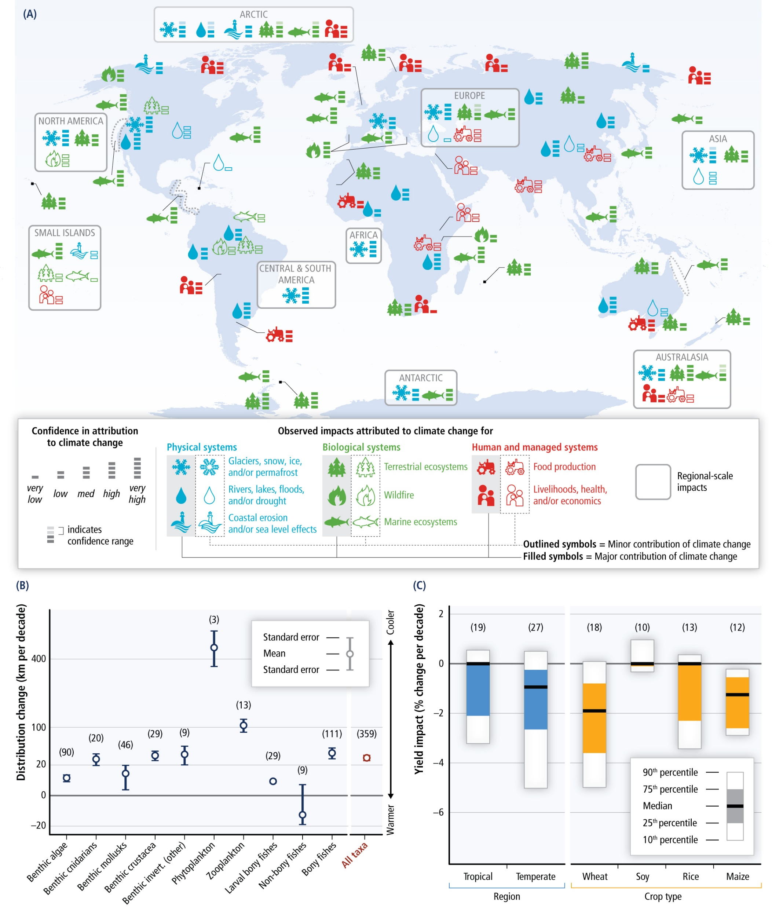
10.3 Climate change adaptation
Impacts are varied and diverse
The impact of climate change is varied across
  Geographic regions
  Resource systems
Source: IPCC, Assessment report 5, Working group II, Summary to policymakers available for free use without request (left & right)
Notes:
The impacts of climate change are diverse, and it is essential to understand this aspect before jumping into adaptation measures. The figures presented here are from the I.P.C.C. fifth assessment report on climate change. On the figure to the left, climate change impacts across different physical, biological, and human-managed systems are presented. The step levels and opaqueness of bars communicate the intensity impacts and the confidence level on those impacts worldwide. It is noticeable that the levels of intensity vary by a significant margin. The confidence ranges are derived out of consensus from scientific publication on the respective topic. The figure to the right informs about yield impacts for some chosen regions and crops. It is noticeable that the future climate will definitely affect the majority of crops. While some crops, like soy, might have positive impacts of increasing temperature, wheat and maize are expected to only experience negative impacts. This varied impact distribution warrants a varied approach from the side of adaptation responses.

Slide 18
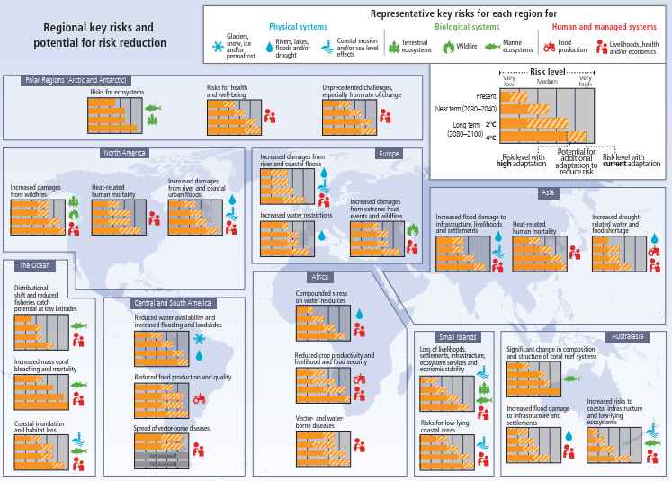
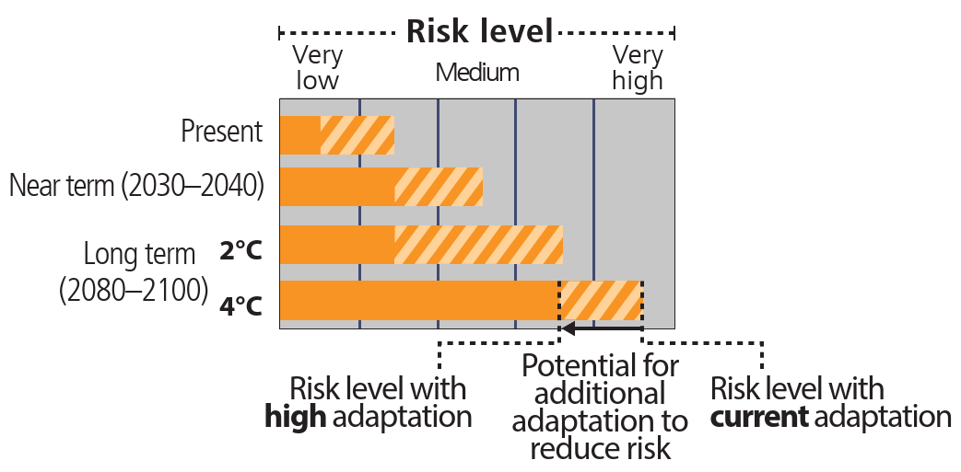
10.3 Climate change adaptation
Adaptation response is varied and diverse
Adaptation response is site specific
Source: IPCC, Assessment report 5, Working group II, Summary to policymakers available for free use without request (left & right)
Notes:
Following the region and system-specific climatic impacts, an adaptation overview is presented in these figures. The figure to the right indicates the risk level for the 4 main climate scenarios. The risk levels are indicated by the total length of the bars, and the shaded part of the bar graph indicates the potential for additional adaptation to reduce risk. The larger the shaded region in each bar, the greater is the possibility to implement adaptation measures. The figure to the left illustrates the climate risk levels for different system and regions across the world. For example, in Africa, climate-induced water-borne diseases could be significantly reduced by taking adequate water sanitation and hygiene measures, especially in rural and marginalized communities. Whereas, in Australasia, the marine ecosystems are under severe threat. They have been pushed beyond the point of no return, so that no adaptation measure is expected to reduce climate-induced risk. This illustration indicates the urgency in taking appropriate measures to prevent the physical, biological, and human-managed systems from going beyond the point of no return.

Slide 19
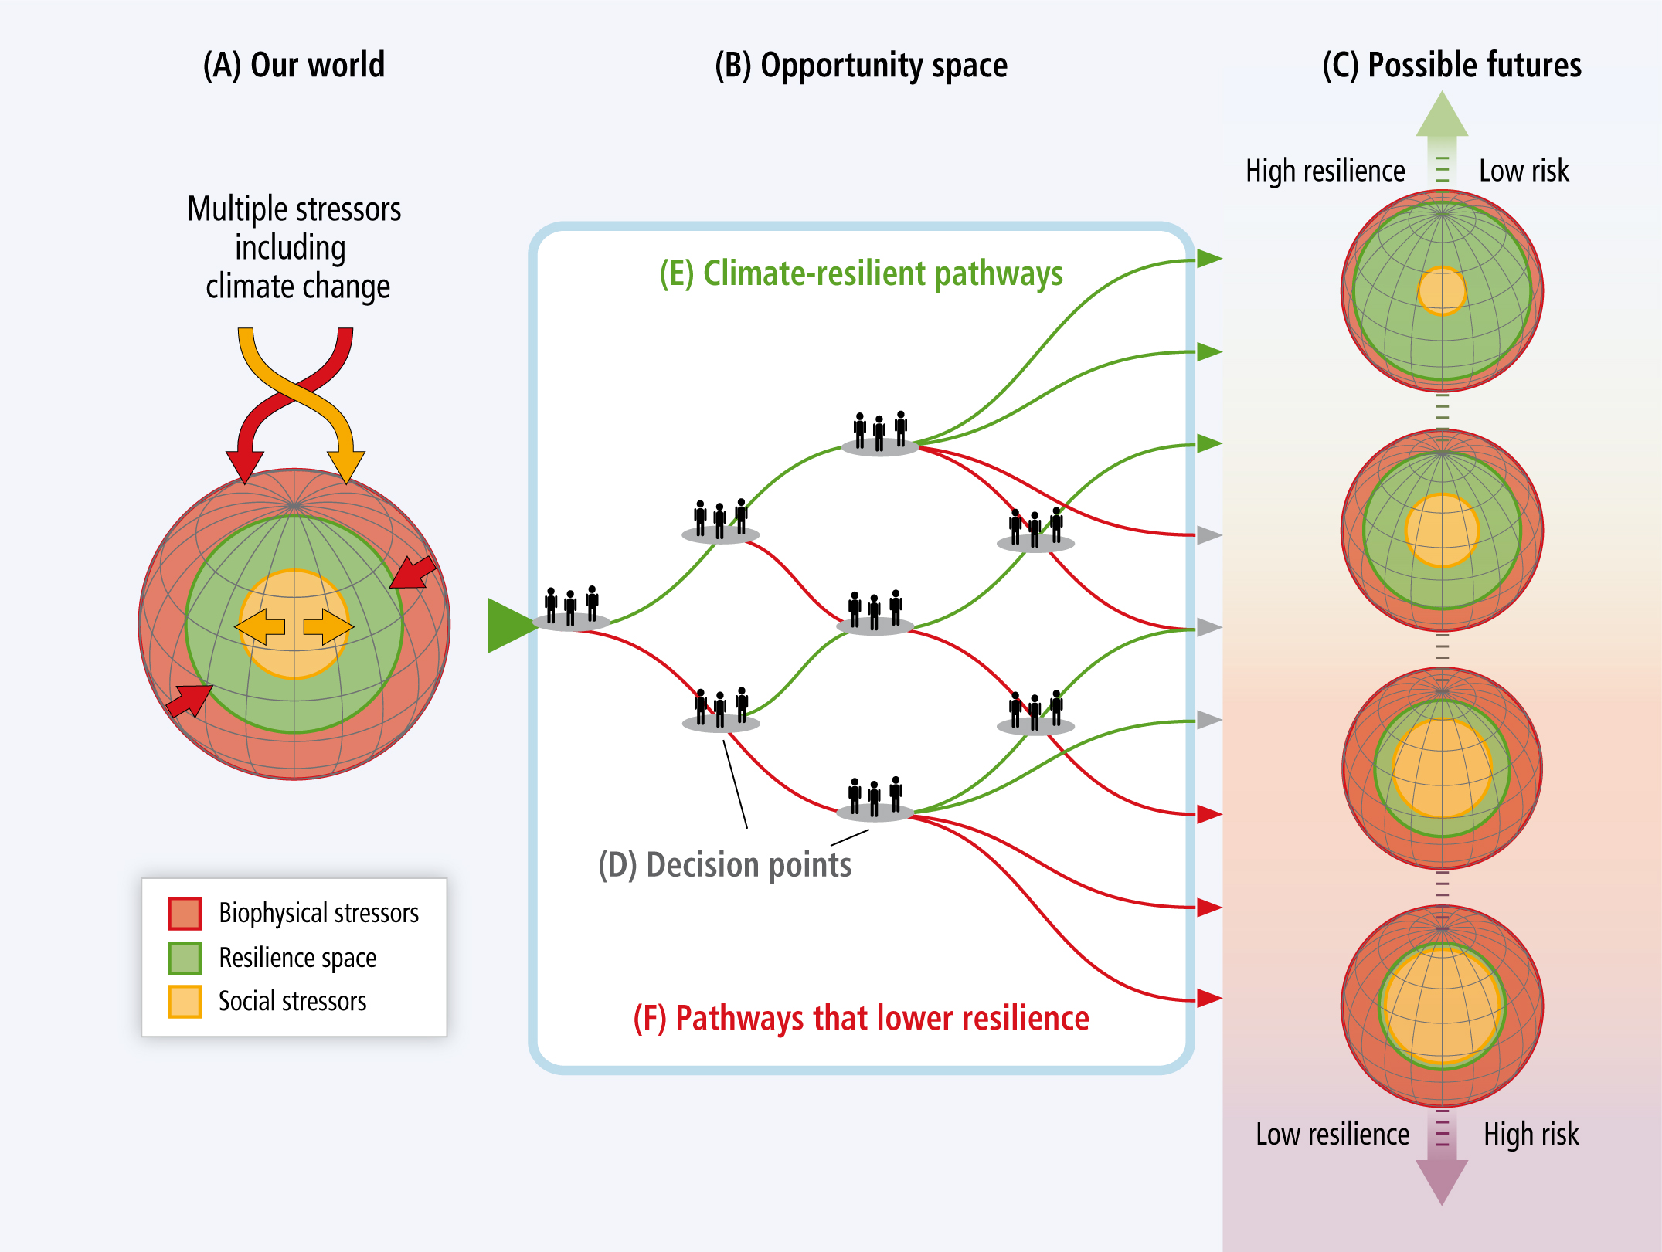
10.3 Climate change adaptation
Climate resilience
Our policy responses will decide the resilience of our resource systems to climate change
Sometimes resilience might be to find a middle ground
It may be that we will still have to depend on fossil fuels but in a sustainable manner
Source: IPCC, Assessment report 5, Working group II, Summary to policymakers available for free use without request (left & right)
Notes:
Adaptation measures help us to make our systems more climate resilient. Climate resilience refers to the ability to anticipate, prepare for, and respond to hazardous events, trends, or disturbances related to climate. Improving climate resilience involves assessing how climate change will create new or alter current climate-related risks, and then taking steps to better cope with these risks. The figure here, from the I.P.C.C., illustrates the importance of climate-resilient adaptation measures and their interplay between the biophysical and social stressors. There is an increasing need to explore and invest in decisions in this resilience space that lead to the path with the highest possible resilience. Each resilient decision is expected to lead to an overall robust system with lower climate risk going into the future. It is also essential to understand that a resilient decision may not always be the green option. For example, investing only in hydropower may make a power system less resilient to future climatic changes. Therefore, depending upon the future climate, a mix of fossil and renewable power sources may prove to be more resilient and reduce the stressors and eventually the risk.

Slide 20
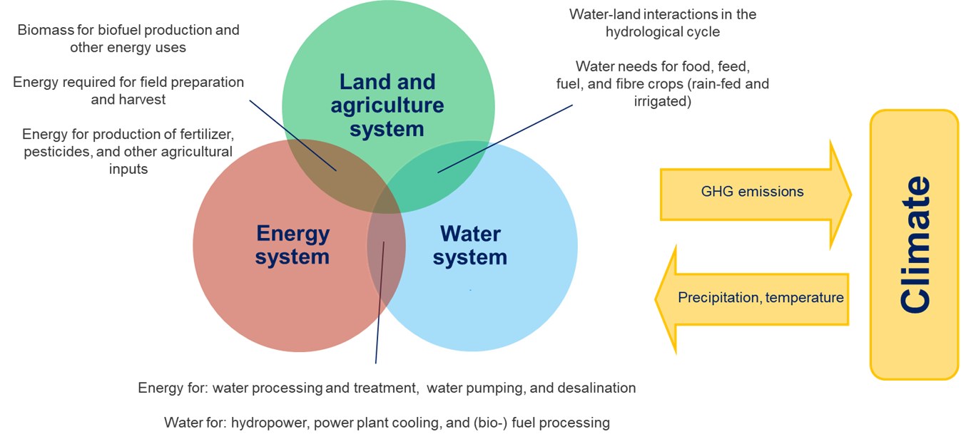
10.3 Climate change adaptation
Adaptation in CLEWs
Source: Author’s interpretation
Notes:
Climate change is global, but adaptation is local. Strategies need to be developed and deployed based on the local context and circumstances. Similar to mitigation, models or modelling frameworks are very useful in helping capture the dynamics of the problem and provide insights into anticipating current or imminent effects of climate change. The Climate, Land use, Energy and Water systems framework, or CLEWs, is one such example. It allows for integrated assessment of the climate, land use, energy, and water nexus. It enables the evaluation of the general robustness of a particular strategy or policy concerning risks of climate change. Additionally, it helps capture the unintended and cross propagation effects of adaptation measures in one system that may impact other interconnected systems. In the following mini-lecture, results from selected CLEWs work that involve climate change impacts will be presented.

Slide 21
Lecture 10.3 References
Folke C. Resilience: The emergence of a perspective for social–ecological systems analyses. Glob Environ Change 2006;16:253–67. https://doi.org/10.1016/j.gloenvcha.2006.04.002.
https://www.ipcc.ch/report/ar5/wg2/
21

Slide 22
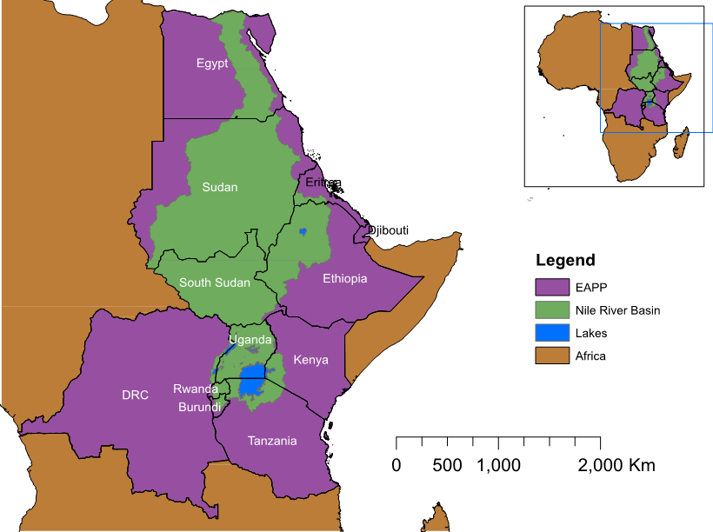
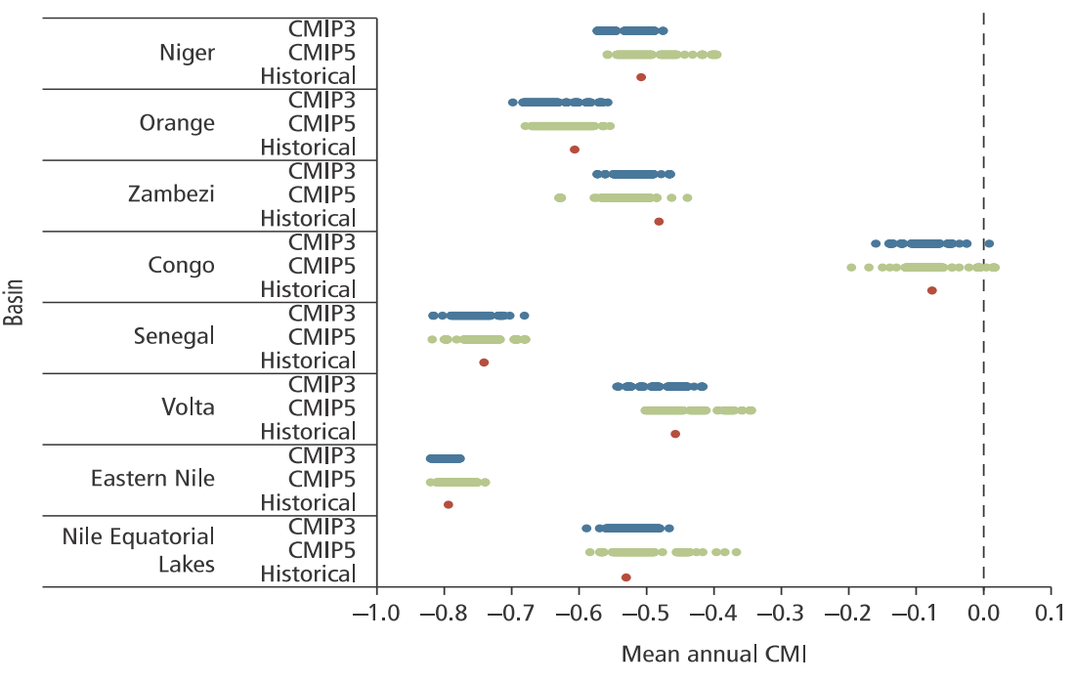
10.4 CLEWs Examples
Climate resilience in East Africa
Climate Moisture Index (CMI)
Nile River Basin
Blue Nile
White Nile
Source: Sridharan V, et al. Resilience of the Eastern African electricity sector to climate driven changes in hydropower generation. Nat Commun 2019;10:302. doi:10.1038/s41467-018-08275-7 (Author’s work)
Notes:
The figures presented here are from a CLEWs study evaluating the climate resilience of energy infrastructure in East Africa. The figure to the left illustrates the location of the Eastern African Power Pool countries and the Nile River Basin in Africa. To give some context, the Nile River basin has two main tributaries: the Blue and the White Nile. The Blue Nile originates in the Eastern Nile Sub-basin around Lake Tana in Ethiopia. The White Nile originates in the Nile Equatorial lakes region, in and around Lake Victoria. The uncertainty in climatic projections is highlighted using a metric called the Climate Moisture Index in the figure to the left. The C.M.I. of major African river basins is presented in this figure. The C.M.I. is a measure of aridity that combines the effect of rainfall and temperature projections. The index values vary between −1 and +1, with lower values representing more arid conditions. The chart reports C.M.I. values averaged over the period 2010–2050. The red dot denotes the average value of C.M.I. for historical climate trends. It is noticeable that the Eastern Nile basin has been significantly drier than the Nile Equatorial lake basin. It is essential to highlight here that the Eastern Nile basin provides about 70% of the total annual flow on the Nile River that reaches Egypt. The blue and green dots refer to the average C.M.I. of climatic projections from two climate models. Dots to the right of the historical value refer to projections of wetter climate; dots to the left indicate a drier projection. With 8.7 GW of installed capacity and 22 Gigawatts in the pipeline, hydro infrastructure is expected to contribute significantly to many countries in the Eastern African Power Pool or the E.A.P.P. And hence there is the need for climate-resilient infrastructure planning.

Slide 23
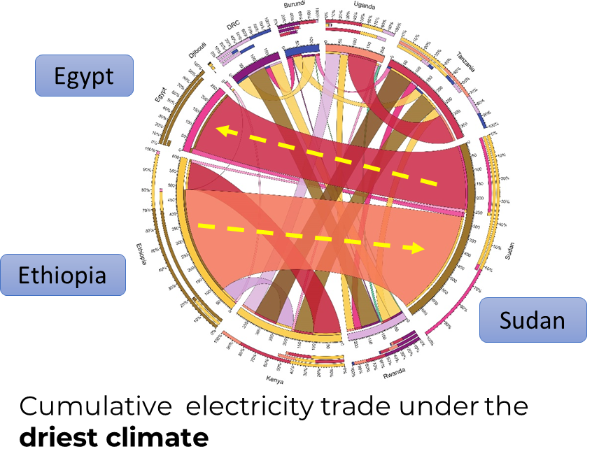
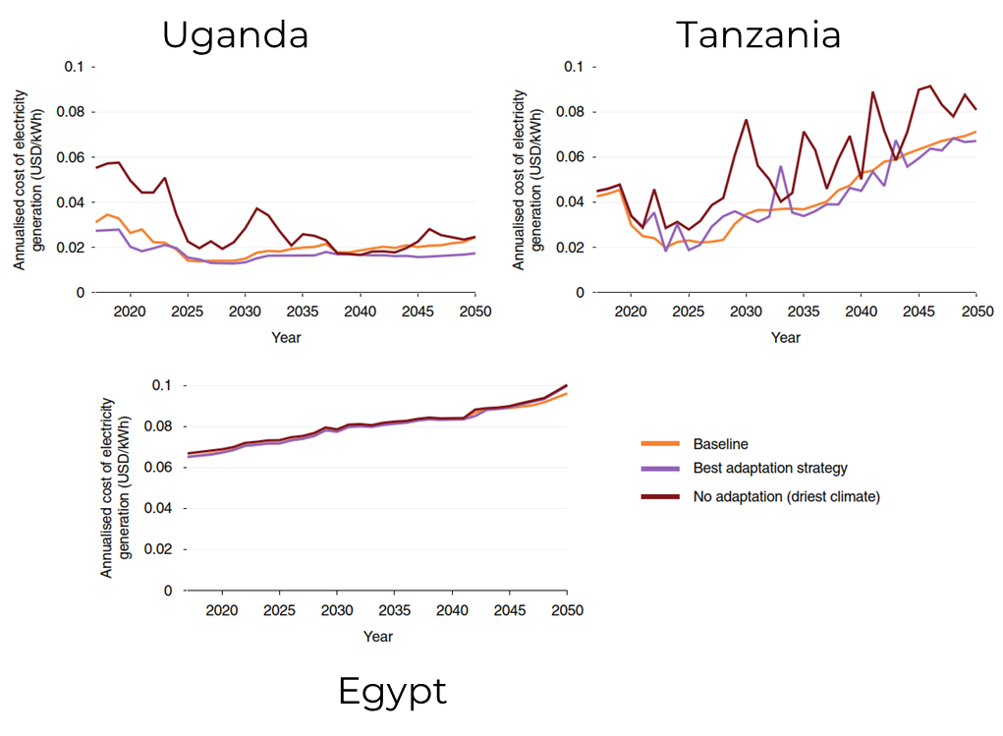
10.4 CLEWs Examples
Climate resilience in East Africa
Source: Sridharan V, et al. Resilience of the Eastern African electricity sector to climate driven changes in hydropower generation. Nat Commun 2019;10:302. doi:10.1038/s41467-018-08275-7 (Author’s work)
Notes:
Here, the results from the East African study are presented. A country like Egypt, which is expected to rely on natural gas to secure its electricity supply, is relatively less affected than the hydropower dependant countries like Uganda and Tanzania. This is evident from the three graphs on the left, where the fluctuations in the cost of electricity generation are presented for chosen climates futures. The 'no adaptation' scenario refers to a situation where no measures have been taken to address climate change. It is noticeable that the costs increase when proper adaptation is not implemented. The figure to the right illustrates the cumulative electricity trade under a perfect foresight strategy for the driest climate future. The main takeaway here is that some nations use electricity trade as an adaptation measure to tackle climate change. It is noticeable that Ethiopia exports electricity to Sudan, and Sudan exports almost half of it to Egypt as an adaptation measure to reduce the cost of electricity generation in Egypt. This study was performed using the same tool, OSeMOSYS, presented in the hands-on section of this CLEWs course.

Slide 24
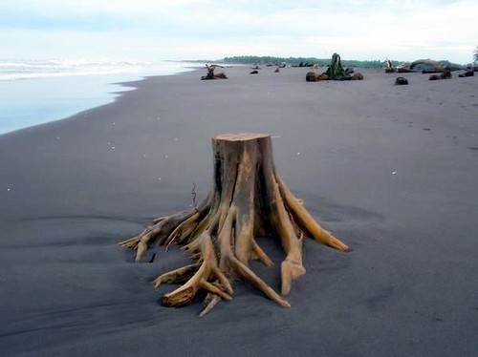
10.4 CLEWs Examples
Integrated resource analysis in Uganda
Forest cover: 24% (1990), 9% (2015)
Reasons for deforestation
  Agricultural expansion
  Logging for firewood
80% of final energy from biomass
National drive to reduce biomass consumption
Increase in irrigation, per capita water use, and electricity consumption
Scenario formulation
Baseline: Business as usual until 2050
Sus-Dev: Reduction in biomass in total final energy consumption; 80% (2020) to 50% (2050)
Source: "Deforestation in Guatemala" by Pati Gaitan is licensed under CC BY 2.0
Notes:
Here, Another CLEWs study focusing on Uganda is presented. This case study aims to analyse the three resource systems (namely, energy, water, and land) under one model shell and explore the ripple or cross propagation effects of policies in one system. To give some context, Uganda’s forest cover as a share of the total land area dropped from twenty-four per cent in 1990 to nine per cent in 2015. That is equivalent to the loss of 36,000 square kilometres of land. Two main reasons contributed to this change: cutting down forests for firewood and deforestation for agricultural expansion. It is interesting to note that biomass, primarily firewood, constitutes about eighty per cent of total final energy consumption in Uganda. Of late, to meet targets under the sustainable development goal number seven, there is an increasing push to reduce the dependency on woody biomass in Uganda. Additionally, ambitious irrigation plans and increased per capita water and energy consumption are expected to result in more stress on the different resource systems. Here, to explore the cross-system implications of a Ugandan national policy to reduce its dependence on firewood based biomass, two simple scenarios were developed. First, a baseline scenario, where the land, energy, and water systems have their business as usual trend leading up to 2050. Second, a Sustainable development scenario, where a shift to sustainable energy consumption is modelled. In this scenario, From 2020, the share of biomass in the total final energy consumption is expected to reduce from its current levels, approximately eighty per cent, to fifty per cent in 2050. Here, a subsequent increase in electricity demand is modelled to compensate for this transition.

Slide 25
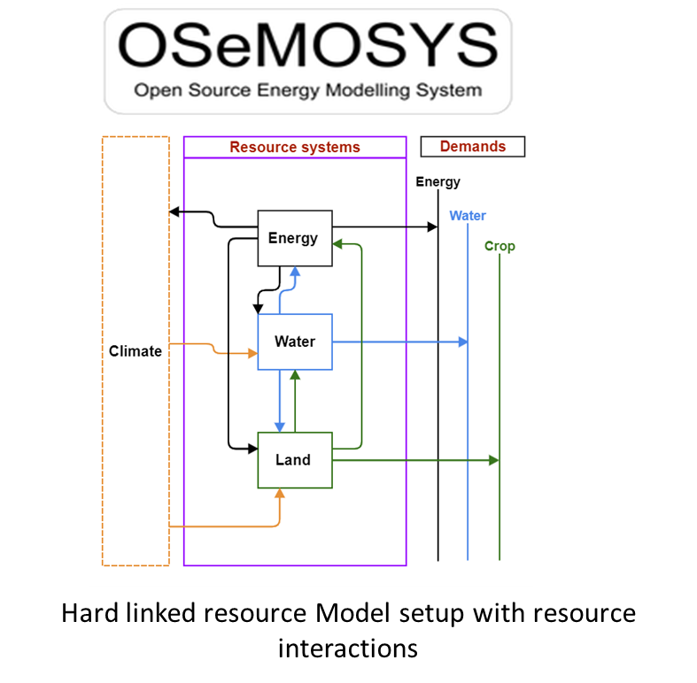
10.4 CLEWs Examples
Integrated resource analysis in Uganda
All land use and land cover types represented
Agro-climatically attainable crop yields obtained from global databases
Competition for water, land, and energy resources established
Source: From Left to right, Free Icon made by Manuel sax is licensed by CC BY 3.0, Free Icon made by Rafael is licensed by CC BY 3.0, Free Icon made by Giovanni Battistini is licensed by CC BY 3.0
Source: Author’s Interpretation
Notes:
In this study, a hard-linked model setup of the resource systems is developed using OSeMOSYS as illustrated on the diagram to the right. The energy, water, and land systems are represented here in good detail. The climate system is represented by its inputs to the water balance in Uganda, and in the calculations for maximum agro-climatically attainable crop yield. It consists of detailed, catchment specific land-use and land cover classifications. Site-specific and agro-climatically attainable crop yields and water deficit maps were included in the Global Agro ecological zoning database model. There is competition for water and energy resources amongst the different supply and demand sectors in the model. The objective here is to simulate a policy on biomass use in Uganda and analyse its impact on other interlinked resource systems.

Slide 26
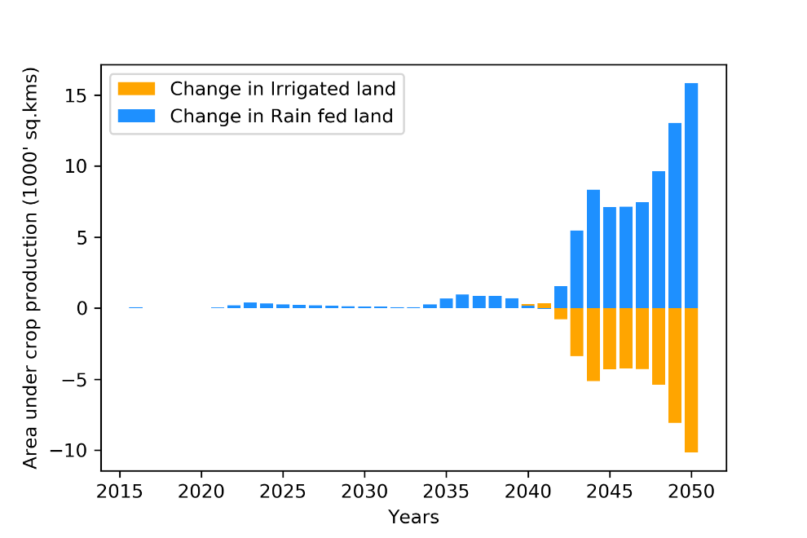
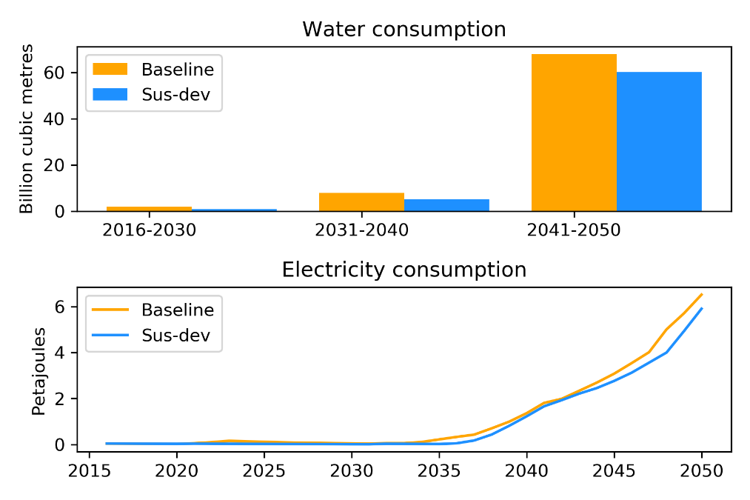
10.4 CLEWs Examples
Integrated resource analysis in Uganda
Shift in agricultural water-use types
(difference between the sus-dev and the baseline scenarios)
Water and electricity consumption
in the agricultural sector
Source: Sridharan V, et al. "Land, energy and water resource management and its impact on GHG emissions, electricity supply and food production- Insights from a Ugandan case study," Environ. Res. Commun., vol. 2, no. 8, p. 085003, Aug. 2020, doi: 10.1088/2515-7620/abaf38 (Author’s work)
Notes:
Here, selected results from the Uganda study are presented. The electricity and water consumption in the agricultural sector is presented in the figures to the left. The increase in the cost of electricity generation, due to the policy change in reduced biomass usage, results in lowering the electricity consumption in the agriculture sector. This, in turn, reduces the water used for irrigation purposes. This leads to a shift in agricultural water-use types, as shown in the figure to the right. By the year 2050, approximately ten thousand square kilometres of land that are expected to be irrigated in the baseline scenario are replaced by fifteen thousand square kilometres of rainfed land in the sustainable development scenario. It was interesting to find that the shift primarily happens in the three main staple crops in Plantain bananas, Maize, and Cassava. Coffee cultivation, which is predominantly irrigated in 2050, does not shift to rainfed. This study shows that one policy change in biomass consumption in the energy system may lead to ripple effects, resulting in unforeseen changes in agricultural water-use types. Therefore a mandatory understanding of the cross-system impacts during sectoral policy formulation will help mitigate future regrets. This concludes the lecture on climate systems. In the next lecture will examine the concept of introducing carbon taxes and greenhouse gas accounting.

Slide 27
Lecture 10.4 References
Sridharan V, Shivakumar A, Niet T, Ramos E.P, and Howells M, "Land, energy and water resource management and its impact on GHG emissions, electricity supply and food production- Insights from a Ugandan case study," Environ. Res. Commun., vol. 2, no. 8, p. 085003, Aug. 2020, doi: 10.1088/2515-7620/abaf38
Sridharan V, Broad O, Shivakumar A, Howells M, Boehlert B, Groves DG, et al. Resilience of the Eastern African electricity sector to climate driven changes in hydropower generation. Nat Commun 2019;10:302. doi:10.1038/s41467-018-08275-7.
27

Slide 28
Take Quiz
Sridharan V. (KTH)., Shivakumar A. (UNDESA)., Gardumi F. (KTH)., Niet T. (SFU)., Ramos E.P. (KTH)., Alfstad T., (UNDESA) 2021. Lecture 10: The climate system – Part II. Release Version 1.0. [online presentation]. Climate Compatible Growth Programme, United Nations Development Program and United Nations Department of Economic and Social Affairs.
CCG courses (this will take
you to the website link http://www.ClimateCompatibleGrowth.com/teachingmaterials)

Slide 29

This document was updated on 01.11.2024

