Slide 1
Data Requirements for CLEWs Modelling

Slide 2
Contents
The Role of Data in CLEWs Modelling
  System Characterisation
  Validation and interpretation of model results
  Scenario Definition
2. Sources of Data
3. Addressing Data Gaps
  Using Assumptions

Slide 3
1. The Role of Data in CLEWs Modelling…..

Slide 4

1. The Role of Data in CLEWs Modelling
Data underpins model credibility and relevance
Poor data = poor insights
Three core purposes of data:
  System characterisation
  Validation and interpretation of model results
  Scenario definition

Slide 5
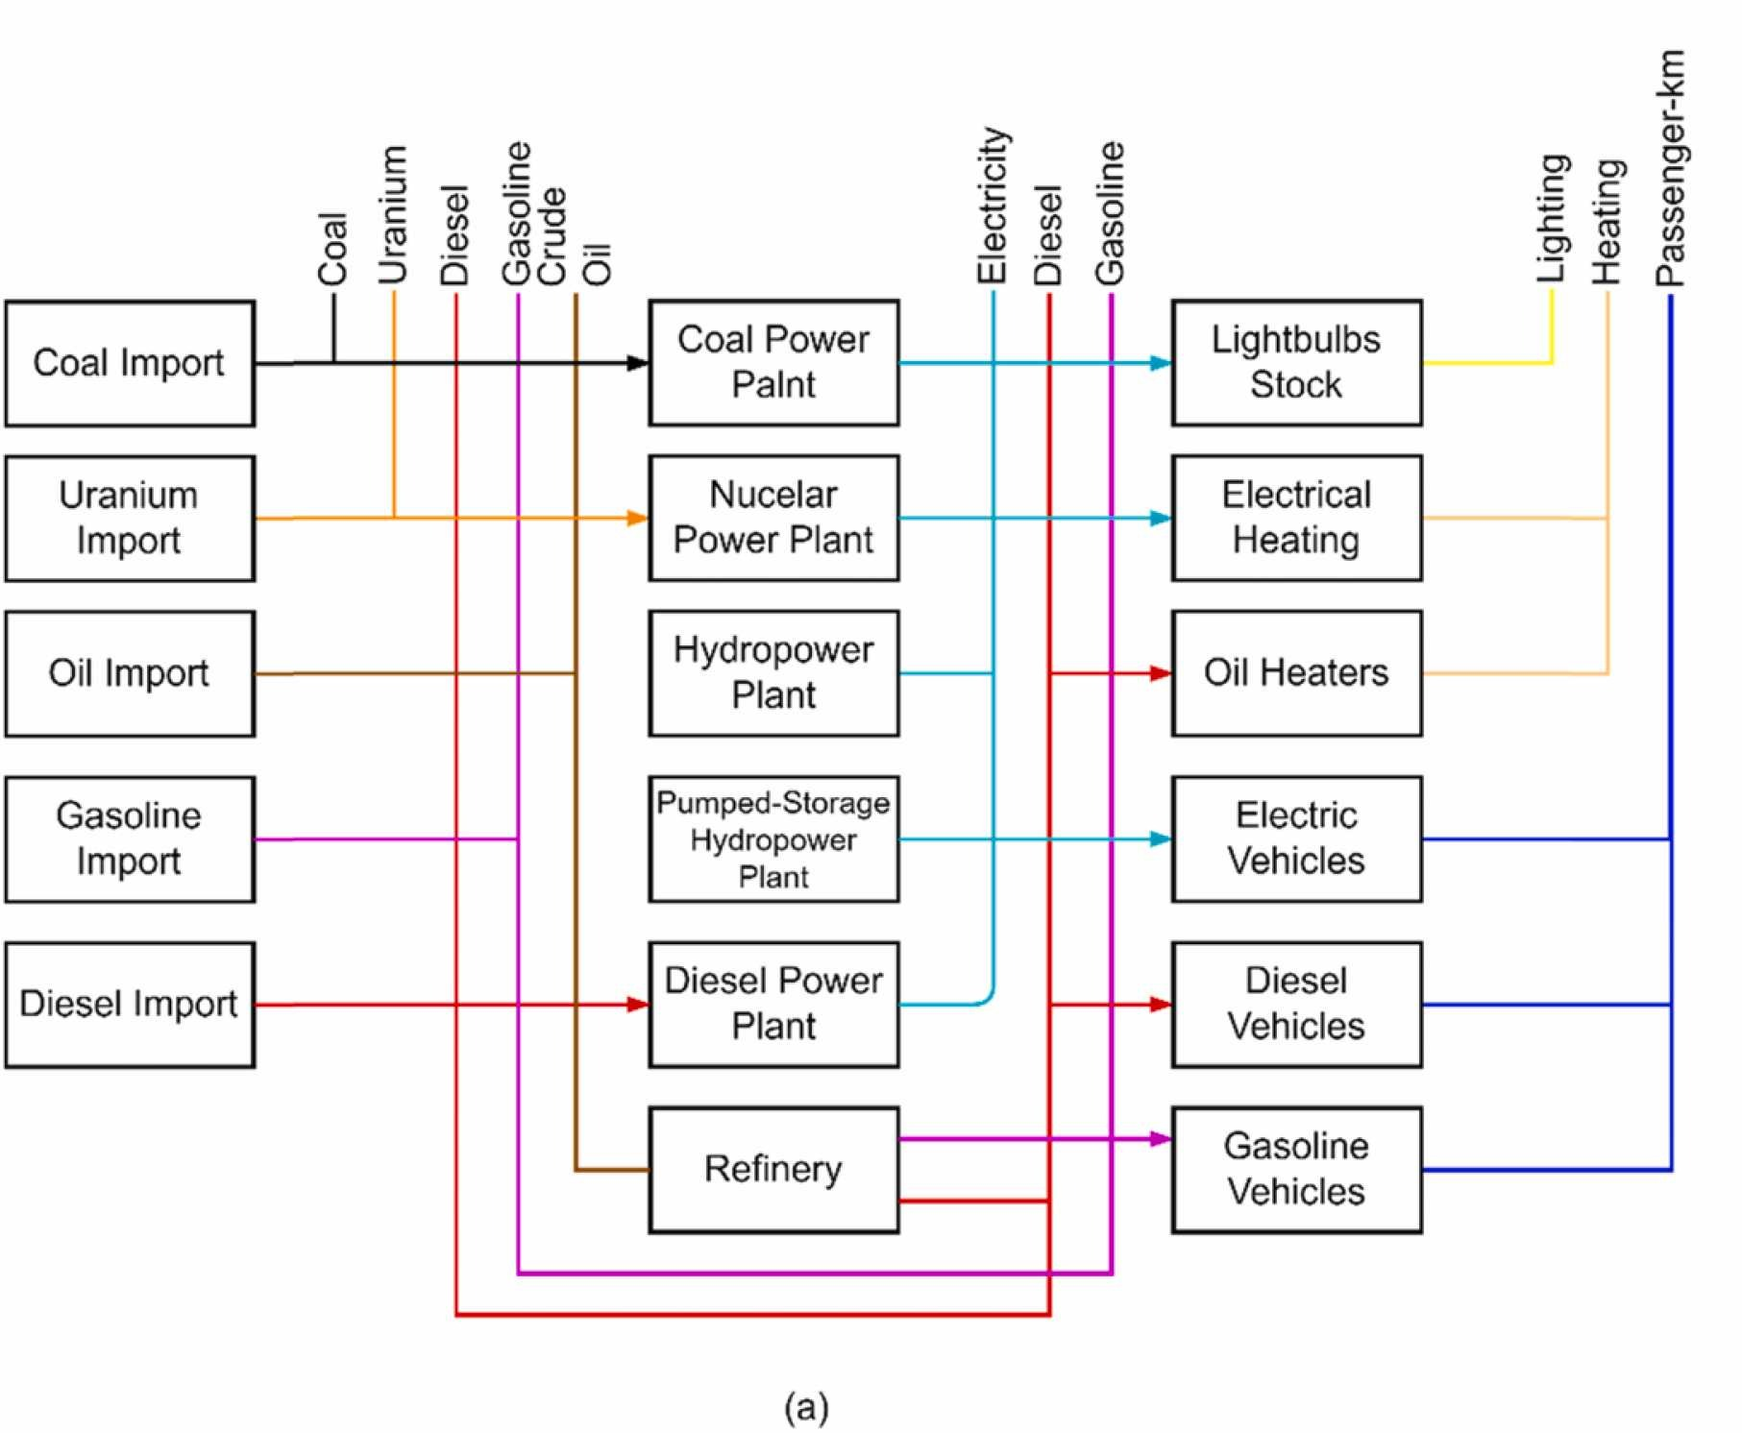
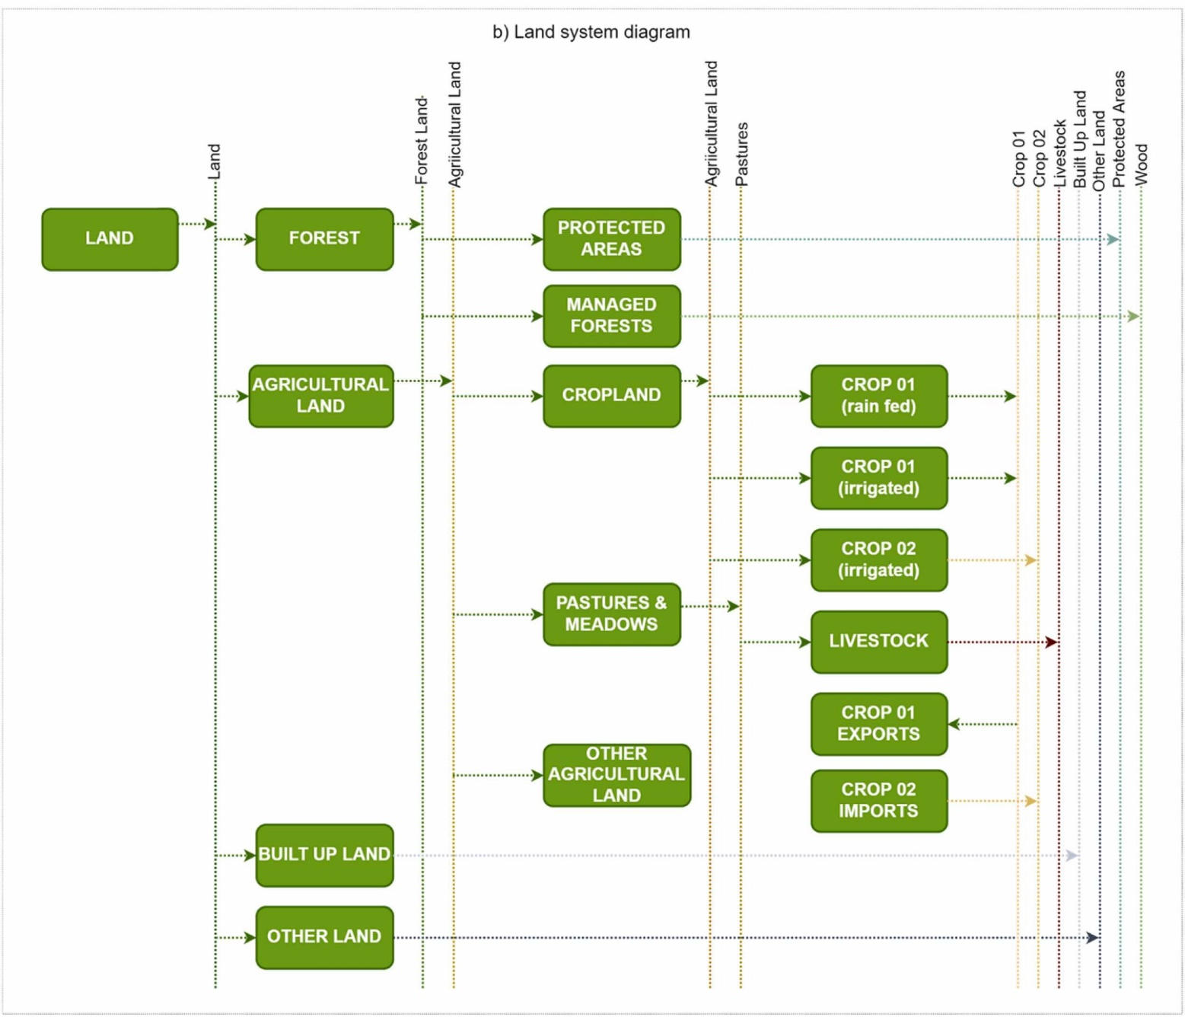
1.1 System Characterisation:
Reference CLEWs Diagram
This involves defining the structure and boundaries of each resource system:
What resources exist?
  E.g. energy types (biomass, solar), water availability (surface, groundwater), land use patterns
How are these used or transformed?
  E.g. diesel use in irrigation pumps, forest land used for biomass, precipitation feeding surface water sources.
What technologies or activities are involved?
  Includes technical and economic data on power plants, irrigation systems, treatment facilities, crops, and livestock systems.
What are the spatial and temporal scales?
  National or subnational resolution?

Slide 6
1.1.1 System Characterisation: Demand
A Cost-Optimization Model: So, Demand is Crucial
 | Resources | Conversion technologies | Transmission and Distribution; supply options | Exogenous Requirements (e.g. Demands,
 |  | (and/or processes)
Land | Land, land with different suitability. | Forestry activities, Agriculture (crop cultivation & livestock), protected areas /ecosystems, food production systems. | Transportation of goods. | Demand for agricultural products (crops, livestock), wood products, food, etc.
Energy | Coal, natural gas, oil. | Refinery, Power plants, etc. | Grid network, stand-alone generation infrastructure. | Electricity,
 |  |  |  | Demands for transportation /mobility (passenger-km), energy services (e.g. lighting, heating, cooking)
Water | Precipitation, Surface water, groundwater, seawater. | Water treatment and purification, water collection, wastewater treatment and disposal, run-off & groundwater recharge. | (Non-potable and potable) water distribution infrastructure, wastewater collection and distribution, storm water collection. | Agricultural water demands, non-agricultural water demands (domestic, public, industrial. commercial), environmental flows.
 |  | Unconventional (water reuse, rainwater harvesting).
“In OSeMOSYS, the objective function determines the least-cost configuration of technologies and resources to supply exogenous demands over the modelling period and these are defined for commodities of land, water, and energy systems.”
(Ramos et al., 2022: 700)

Slide 7
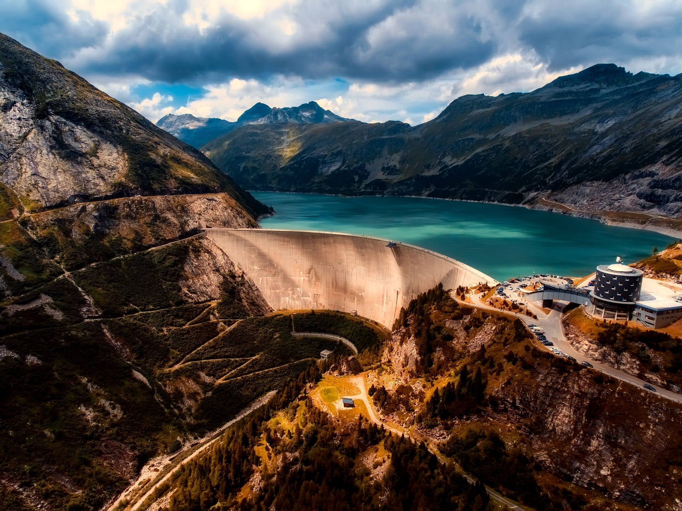
1.1.2 System Characterisation: Techno-economics
Example: large hydropower power plant data for key parameters
Capacity Factor: varies by country
Efficiency: 100%
Capital Cost: $2100/kW
Fixed Cost: $55/kW
Operational Life: 50 years
Availability: varies by country

Slide 8
1.1.3 System Characterisation: Temporal Concerns
Year: It represents the time frame of the model; it contains all the years to be considered in the study.
Any period of consecutive years can be considered, although the modelling approach is preferably used for medium to long-term analysis (i.e. from 1 to 2 decades to >2 decades, respectively).
Timeslice: Represent the number of partitions a year is split on.
Timeslices are defined based on the temporal variation of demands (e.g. electricity consumption profile) and/or processes (e.g. hydropower production).
They are usually aggregated (e.g. 2 seasons i.e. Wet/Dry and 2 day parts i.e. night and day, resulting in 4 time slices).
In CLEWs modelling, the seasonality needs to factor in the temporal variation of resources and demand across systems.

Slide 9
1.1.3 System Characterisation: Interactions
In the CLEWs-OSeMOSYS framework, the interactions between technologies – and systems (Climate, Land, Energy, Water) - are captured by describing how each technology uses certain inputs (resources or commodities) and produces certain outputs.
This is done using two key parameters:
  InputActivityRatio: How much of each input is required to operate the technology.
  OutputActivityRatio: How much of each output is produced by the technology.
These are defined per unit of activity for that technology.
These are Key Data Points For The Model
Coal mine
Coal
Coal
power plant
Electricity
Gas
Gas field
Gas
power plant
Heat
Water resource
Water
Water
Treatment
Potable Water
Land resource
Land
Farm
Maize

Slide 10
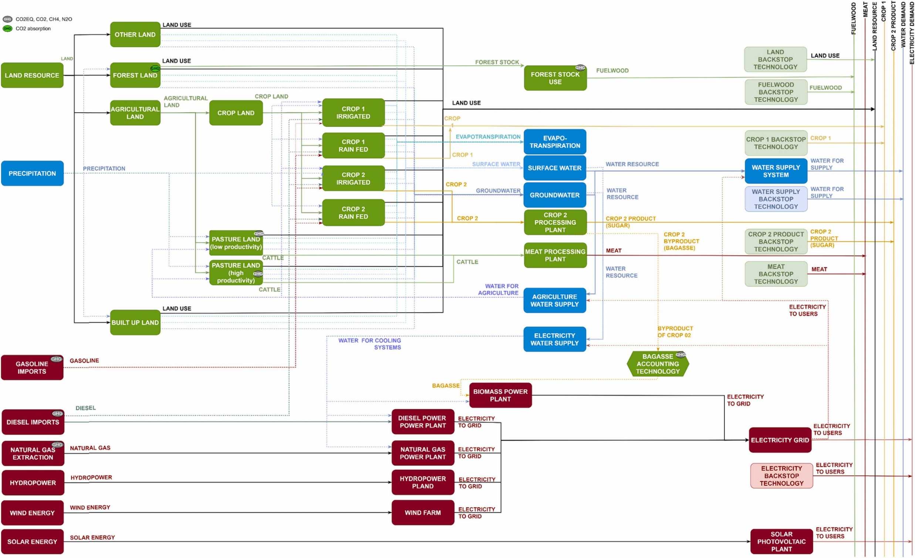

Slide 11
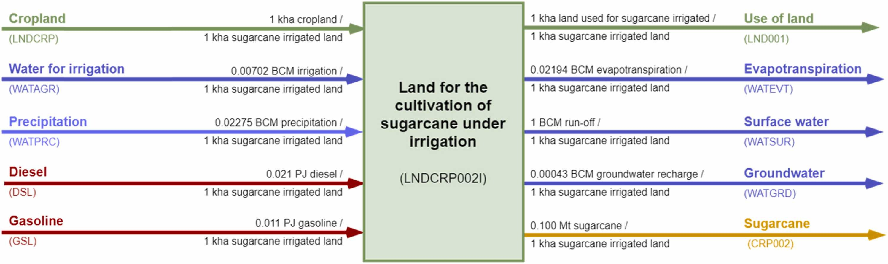
Inputs
Outputs

Slide 12
1.1.3 System Characterisation: Interactions
Data required for Inputs
Input | Unit | Data Required | Purpose
Land | kha per activity unit | N/A – model will optimise | …
Water for irrigation | BCM per kha | Volume of water needed per unit of land or output | Used for InputActivityRatio (water)
Diesel | GJ or litres per kha | Fuel used for machinery, irrigation pumps, transport | Used for InputActivityRatio (diesel)
Gasoline | GJ or litres per kha | As above (if used in combination with diesel) | Optional, depending on context

Slide 13
1.1.3 System Characterisation: Interactions
Data required for Outputs
Output | Unit | Data Required | Purpose
Sugarcane yield | Mt per kha | Tonnes of sugarcane produced per unit area | Used for OutputActivityRatio i.e. efficiency
Evapotranspiration | BCM per kha | Water lost to atmosphere during growth | Represents water use/loss
Runoff and recharge | BCM per kha | Water returning to surface or groundwater | Represents water use/loss needed for water balance

Slide 14
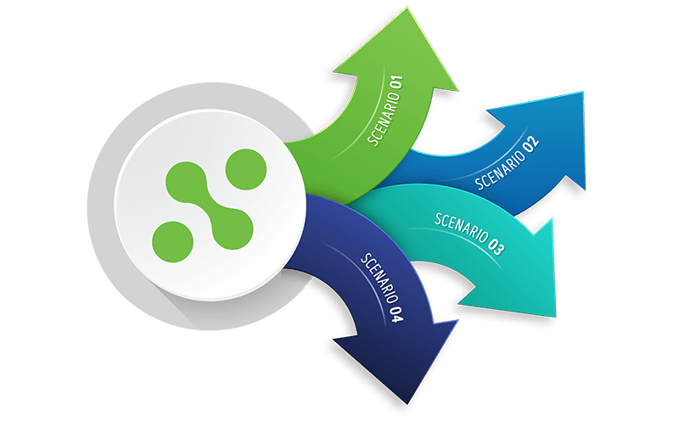
1. The Role of Data in CLEWs Modelling
Data underpins model credibility and relevance
Poor data = poor insights
Three core purposes of data:
  System characterisation
  Validation and interpretation of model results
  Scenario definition

Slide 15
1.2 Validation and Interpretation of Results
To ensure the model is producing realistic and useful outputs:
Calibration / Benchmarking:
  Comparing model outputs - in its historical years - with national statistics (e.g. energy balances, land use data, water accounts).
  In other words, does the model reproduce known system behaviour under historical inputs?
Trend Validation :
  Real-world context / stakeholder interpretation is needed to interpret outputs (e.g. land shifts, emissions changes) to ensure they re reasonable and reflect local realities
Identify policy implications.
  Only then is the model ready for scenario testing and to begin translating numbers into insights.
Purpose: To increase trust in model insights and facilitate informed decision-making.

Slide 16
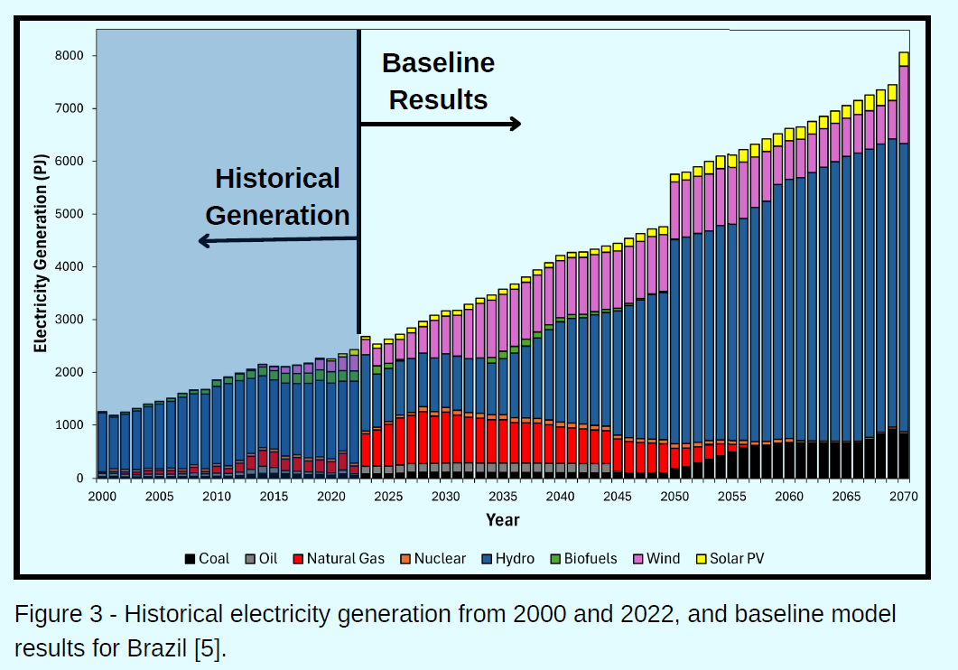

Slide 17
1. The Role of Data in CLEWs Modelling
Data underpins model credibility and relevance
Poor data = poor insights
Three core purposes of data:
  System characterisation
  Validation and interpretation of model results
  Scenario definition

Slide 18
1.3 Scenario Definition
Scenarios are alternative futures used to test policy options or resource strategies:
Baseline/future demands:
  E.g. energy needs under population growth, water needs under urbanisation.
Policy interventions:
  E.g. carbon pricing, irrigation expansion, forest protection targets.
Climatic or economic uncertainties:
  E.g. changing rainfall patterns, fuel price shocks.
Purpose: To explore the implications of choices and uncertainties across sectors, and to test the robustness of plans.

Slide 19
1.3 Scenario Definition
Example 1: Net-Zero CO2 Emissions by 2050
Example 2: Reduced Rainfall / Drought in certain years i.e. 2030 onwards
Data Required / Implementation:
Current / peak emissions
A reduction rate to 0 by 2050 (i.e. an emission cap per year decreasing to ‘0’ by 2050)
Data Required / Implementation:
Need to decide on severity of drought
Reduce Yield (output activity ratio) by a % amount
Reduce Rainfall (input activity ratio) by a % amount
Increase Agricultural Water (input activity ratio) by the same % amount

Slide 20
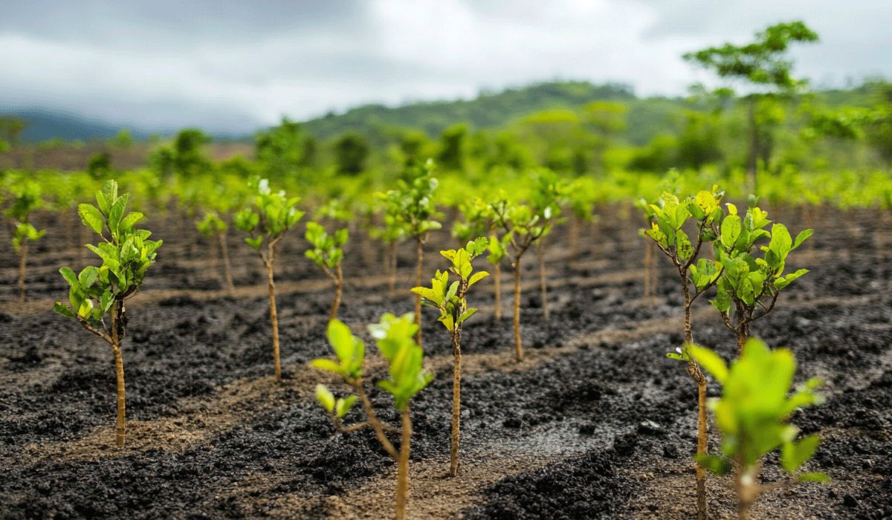
1.3 Scenario Definition
Example 3: Increase forested land by 10% that will lead to net profits of 200 USD/ha (carbon sequestration)
Data Required/Implementation:
Policy Information
Increase forest land in key years by 10% (TATLL)
Add a negative value to variable costs for forested land

Slide 21
2. Data Sources
Making Assumptions

Slide 22
Sources of Data
National sources (statistical offices, ministries)
International databases (FAO, IEA, AQUASTAT, World Bank, etc.)
Remote sensing, GAEZ (e.g., land cover, precipitation)
Open datasets and models
Aqua Stat - Turkey
/eurostat/
FAOStat Database
https://gaez.fao.org/

Slide 23
Energy balances and general country data:
UNSD — Energy Statistics
International - U.S. Energy Information Administration (EIA)
http://data.worldbank.org/indicator
https://www.iea.org/statistics/
Planned powerplants: Global Energy Monitor
Nationally Determined Contributions and policies:
http://www4.unfccc.int/ndcregistry/Pages/All.aspx
https://www.iea.org/policies
NDC Partnership - Provides profiles summarizing each country's NDC commitments and actions: NDC Partnerships
ClimateWatch - World Resources Institute platform tracking NDC targets and policies by country: climatewatch
Official database of all countries' NDCs under the Paris Agreement: NDCs
Electricity supply techno-economic data:
Nuclear Energy Agency (NEA) - Projected Costs of Generating Electricity - 2015 Edition
Cooking energy supply techno-economic data:
https://www.sciencedirect.com/science/article/pii/S0360544214012808
SDG 7 (access to electricity and modern cooking):
https://trackingsdg7.esmap.org/

Slide 24
3. Addressing Data Gaps
Making Assumptions

Slide 25
Addressing Data Gaps
Use of open-source data as proxies
  When national data is unavailable
Use of modelling assumptions
Stakeholder engagement to validate assumptions
Sensitivity analysis to test robustness
  Changing uncertain inputs (e.g. fuel prices, crop yields) to see how much they impact results.
  If a model’s conclusions remain stable across a range of values, it’s more robust and useful for decision-making — even with imperfect data.

Slide 26
Using Assumptions
When even proxies are lacking, we use transparent assumptions based on expert judgement or similar countries.
Example 1: Estimating Crop Productivity (Yield)
You need to model maize cultivation but don’t have national yield data for rain-fed and irrigated maize separately.
But you have:
A general average maize yield: 4 tonnes per hectare
Literature or regional studies suggest irrigated maize yields 50% more than rain-fed
There is a 50/50 split between rain-fed and irrigated maize cultivation
Assumption Approach:
After some maths……….You apply:
Rain-fed maize yield = 3.2 t/ha
Irrigated maize yield = 4.8 t/ha

Slide 27
Using Assumptions
Example 2: Estimating Household water use
Let’s say you’re building a CLEWs model and you don’t have national data on daily household water consumption in rural areas.
But you do have:
Data for urban households: 250 litres per person per day (Lppd)
No direct rural data
General understanding that rural consumption is lower due to less infrastructure and fewer appliances
Assumption Approach:
After research, you find that in your region rural water use is 75% of urban use — a common estimate used in many water assessments.
So:
Urban = 250 Lppd
Rural = 250 × 0.75 = 187.5 Lppd
This allows the model to proceed and estimate total water demand

Slide 28
4. Conclusion

Slide 29
What Good Data Enables…
Credible scenario analysis
  Future projections of energy demand or water stress become more reliable
  Policy simulations — such as subsidies for irrigation, bioenergy expansion, or fossil fuel phase-out — are grounded in evidence
  Uncertainty can be tested systematically through sensitivity analysis
And so improved reporting on SDGs and NDCs
  Help monitor and report progress on Nationally Determined Contributions (NDCs)
  CLEWs models supported by good data can quantify indicators for SDG 6 (Water), SDG 7 (Energy), SDG 13 (Climate), and others
But Requires Strong Data Management !!!!

Slide 30
Thank you
www.climatecompatiblegrowth.com

