Slide 1
Energy Systems Analysis using OSeMOSYS
Course Introduction
MSc. Fernando Plazas-Niño
February 2024

Slide 2
AGENDA
Course Overview
Why perform Energy Systems Modeling (ESM)?
National Energy Systems Models
Integrated Assessment Models

Slide 3
Course Overview

Slide 4
COURSE JUSTIFICATION
Energy systems modeling and analysis provide inputs based on scientific work for decision-making in energy planning processes and energy policy formulation.

Slide 5
COURSE OBJECTIVE
Modeling and analyzing the long-term expansion of energy systems.

Slide 6
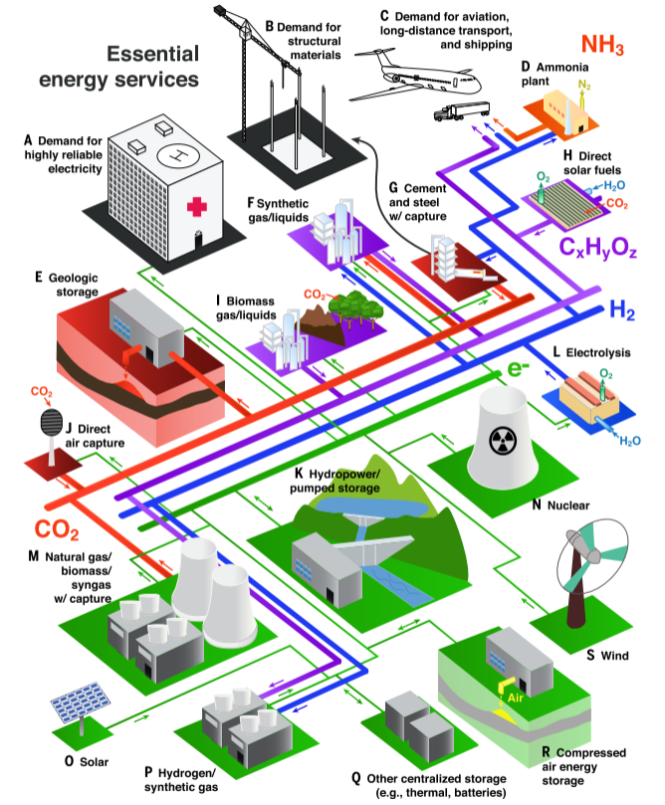
Macrovision
Energy transition
Mathematical modeling
Source: Davis et al., 2018

Slide 7
COURSE CONTENT
1. Basic concepts of energy systems modeling
2. Energy systems modeling using OSeMOSYS (OU)
3. Application projects

Slide 8
COURSE ASSESSMENT
Formative assessment
10%
Midterm I
10%
Midterm II
10%
Project I
35%
Project II
35%

Slide 9
Why perform Energy Systems Modeling (ESM)?

Slide 10
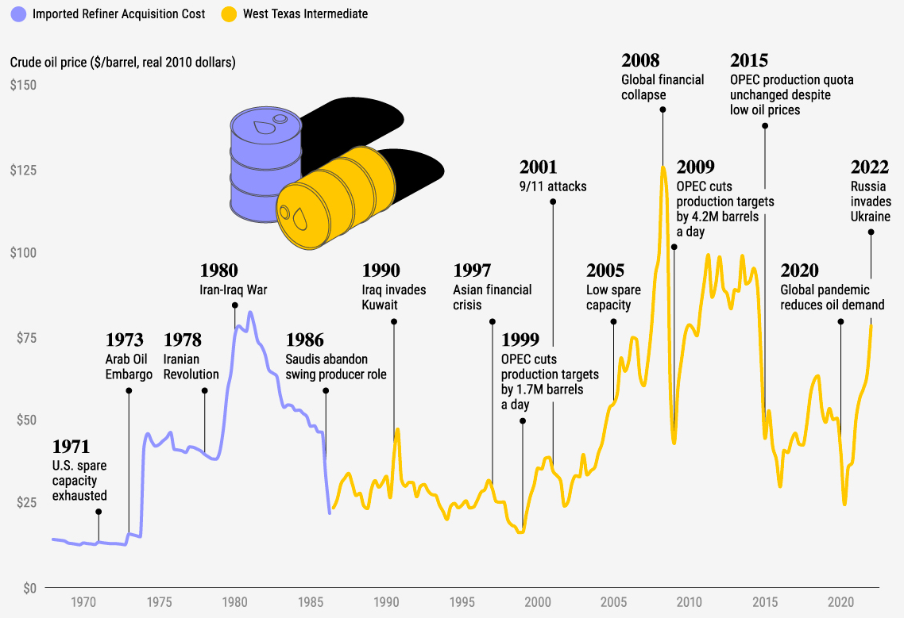
Where does ESM originate?
Need for national energy security
Long-term planning
How?
Source: Visual Capitalist (2022) [Accessed in July 2025]

Slide 11
ENERGY PLANNING
What types of technologies do I need?
What installed capacity do I need?
Where should the technologies be located?
When should the technologies be installed?
Source: Tovar-Facio et al., 2021

Slide 12
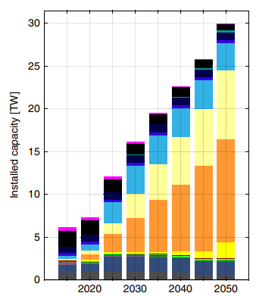
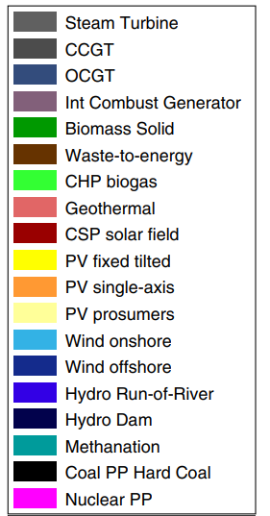
ENERGY PLANNING (2/2)
Other important results revolve around costs, benefits, and GHG emissions.
Source: Bogdanov et al., 2019

Slide 13

ENERGY PARADIGM
“Energy is central to sustainable development, where sustainability encompasses minimal environmental impact, energy security, and affordability to reach the poorest people..” (Spittler et al., 2019)

Slide 14
THE ENERGY PLANNING PATHWAY
  Scenario design and data gathering (stakeholder engagement)
Policy question (problem statement)
Quantitative / Qualitative assessment (energy modelling)
.
Result analysis (stakeholder engagement)
Energy policy making (action measures)
01
02
03
04
05
Source: Adapted from (Carvajal et al., 2022)

Slide 15
National Energy Systems Models

Slide 16
Energy systems models should be useful for providing ideas, not numbers.
Huntington et al., 1982

Slide 17
MODELING PROCESS
Data gathering
Data processing
Model formulation and software selection
Interpretation
Results processing
Model running
Source: Adapted from Pfenninger et al., 2018

Slide 18
TYPES OF ESMs
Energy system models
Optimization models
Normative Scenarios
Simulation models
Analytical evaluation
Quantitative reasoning
Qualitative assessment
Power sector models
Forecasting Predictions
Operational dynamics - Dispatch
Power market
Source: Adapted from (Pfenninger et al., 2014)

Slide 19
CHARACTERISTICS OF ESMs
Categories
Modeling Approach
Purpose of modeling (Forecasting | Exploration | Backcasting)
Analytical approach (Bottom-up | Top-down | Hybrid)
Economic approach (Partial equilibrium | General equilibrium)
License/Transparency (Proprietary | Commercial | Open code and access)
Model Resolution
Spatial resolution (Multi-node | Single node)
Geographic coverage (Local | National | Regional | Global)
Temporal resolution (Multi-period | Snapshot | Time slices | Long-term)
Sectoral coverage (Transport | Commercial | Industrial | Residential)
Technological Detail
Renewable energies (Hydro | Solar | Wind | Geothermal | Biomass | Waves | Tides)
Storage technologies (PHS | Batteries | Compressed air | Thermal)
Sectoral disaggregation
Commodities (Oil | Gas | Coal | Uranium | Electricity | Heat | Hydrogen)

Slide 20
MAIN INPUT AND OUTPUT DATA
Input data
(van Stralen et al., 2021; Azzuni et al., 2020; Pilpola & Lund, 2018; Napp et al., 2017; Yangka & Diesendorf, 2016; Younis et al., 2020; Hainoun et al., 2010)
Energy Service Demand Projections
Primary energy supply potentials
Installed capacity limits
Technical-economic characteristics of technologies
Energy prices
Output data
(Pilpola & Lund, 2018; Chiodi et al., 2015; Carvajal & Li, 2019; Hainoun et al., 2010; Börjesson et al., 2015; Dedinec et al., 2016; Burandt et al., 2019; Kueppers et al., 2021)
Primary Energy Production by Source Type
Electricity Production by Source Type
Installed Capacity by Technology Type
Carbon Dioxide Emissions
Total System Cost

Slide 21
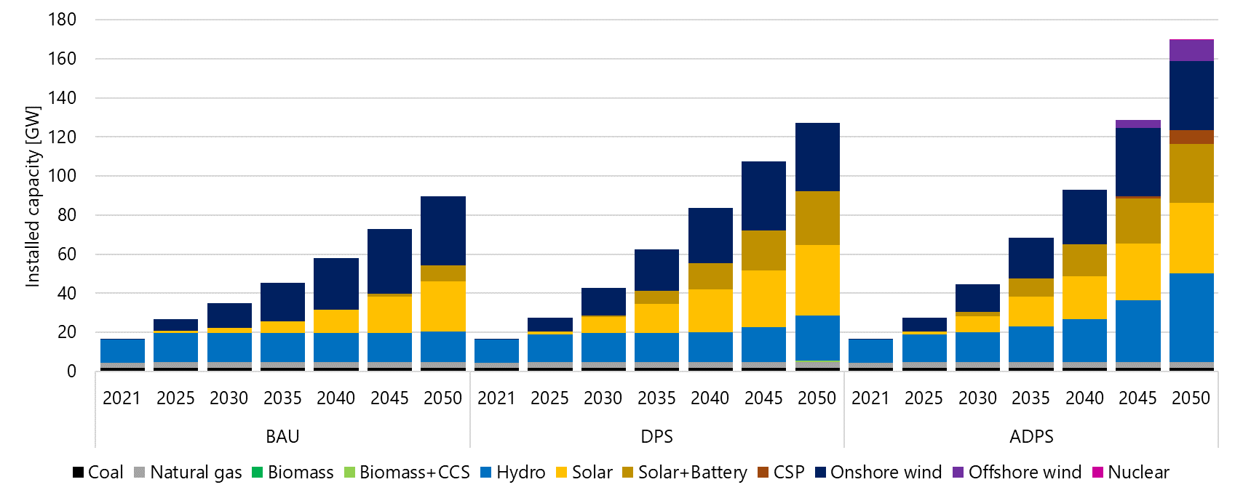
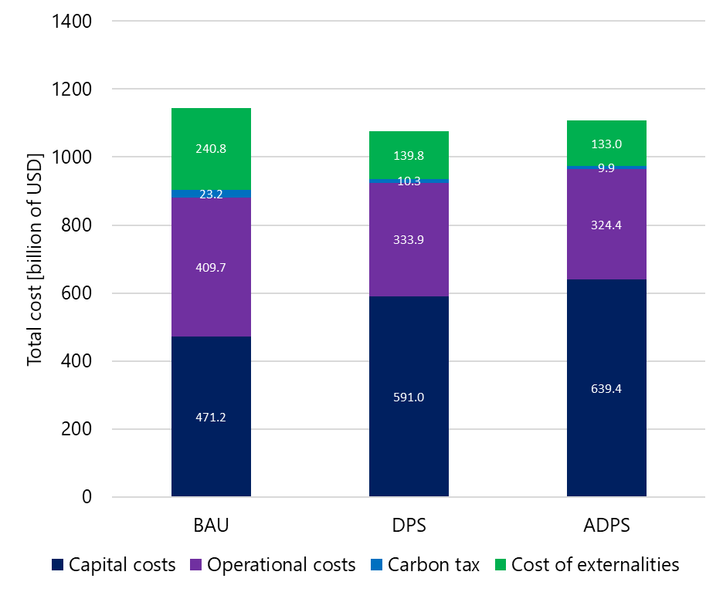
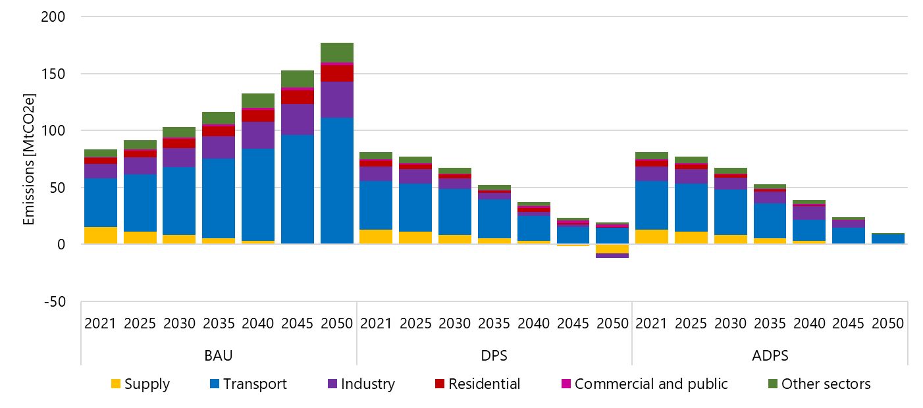
KEY OUTCOMES
Capacity expansion
Cost analysis
Emissions trajectory
Source: (Plazas-Niño et al., 2023)

Slide 22
TRENDS IN ESMs
Trayectorias de descarbonización
(Balyk et al., 2019; Burandt et al., 2019; Carvajal & Li, 2019; Chiodi et al., 2013; Dedinec et al., 2016; Ekins et al., 2011; Godínez-Zamora et al., 2020)
Sistemas basados en bioenergía
(Börjesson et al., 2015; Chiodi et al., 2015; Younis et al., 2020)
Rol de tecnologías
(Kato & Kurosawa, 2021; Hainoun et al., 2010; Yangka & Diesendorf, 2016)
Sistema energético 100% renovable
(Azzuni et al., 2020; Lawrenz et al., 2018; Limpens et al., 2020; Osorio-Aravena et al., 2020)
Seguridad energética
(Hainoun et al., 2010, Glynn et al., 2014, Anwar, 2016, Watts & Martinez, 2012)

Slide 23
Integrated Assessment Models (IAMs)

Slide 24
IAMs
GDP
Economy
Economic results
Population
Energy system
Emissions
Policies
Land and wáter systems
Energy mix
Other assumptions
Climate
Land and water uses
Source: Adapted from Carbon Brief, 2018

Slide 25
CLIMATE, LAND, WATER, ENERGY, ECONOMY NEXUS
 | Climate | Land | Water | Energy | Economy
Climate |  | Precipitations | Precipitations | Renewable energy potential | Attention to climate change consequences
Land | CO2 absortion, GHG emissions |  | Pollution | Biomass to energy | Exports/Imports
Water |  | Water for agriculture |  | Hydroelectric plants, water for cooling, hydrogen generation
Energy | GHG emissions | Energy for agriculture | Pollution, energy for water treatment and management |  | Exports/Imports
Economy |  | Investment, credit, subsidies | Investment, credit, subsidies | Investment, credit, subsidies
Source: Adapted from Ramos et al., 2022

