Slide 1
Introduction to CLEWs
Background, conceptual overview and examples

Slide 2
How would you answer these questions?
How would an increase in a carbon tax affect resource development?
How would 100,000 plug in vehicles impact the electrical grid?
Should your country rely on LNG imports/exports?
What is the best system for meeting the electrical demand in 2030?
If electrical demand increases because of electric vehicle charging, can the grid handle the additional load?
When considering how a country or region can achieve net zero by 2050, how much investment will be needed in energy infrastructure and how much water and land resources will be needed?
If my country experiences more frequent droughts and less rainfall in the future, how can we ensure food security and meet our energy needs?
If we are to power our vehicles by biofuels, how much land and water resources are needed to grow biofuel crops?

Slide 3
Overview
Why Model
Why CLEWs?
What is CLEWs?
How is it applied?

Slide 4
Why Model?
Fundamental limitation of human cognition:
  “our inability to simulate mentally the dynamics of complex nonlinear systems.”
Oreskes 1994:
  Synthesis and integration of data
  Guide observation and data
  Predicting or forecasting the future
Notes:
Models allow us to look at the world in ways we cannot do simply in our minds

Slide 5
In pairs….
What is a model?
Can models help to inform policy? Why or why not?
How can/do models influence public policy?
Why is it important to communicate effectively regarding modeling and analysis?
Notes:
What is a model?
A model is a simplified representation of a system or phenomenon, created to understand, analyze, or predict its behavior. In the context of CLEWs, a model represents the interconnected dynamics of Climate, Land, Energy, and Water systems. Models can be mathematical, conceptual, or physical. They abstract complex real-world systems into manageable components, allowing us to study and simulate scenarios without directly intervening in the actual system.
Can models help to inform policy? Why or why not?
Yes, models can significantly help inform policy. They provide a structured way to analyze potential outcomes of different policy decisions before they are implemented. By simulating various scenarios, policymakers can anticipate potential challenges, opportunities, and impacts. However, it's essential to remember that models are based on assumptions, and their predictions are subject to uncertainties. While they offer valuable insights, they should be used as one of many tools in the policymaking process, complemented by empirical data, expert judgment, and stakeholder input.
How can/do models influence public policy?
Models influence public policy in several ways:
Scenario Analysis: Models allow policymakers to test various "what if" scenarios, helping them understand potential outcomes and impacts of different policy options.
Quantifying Impacts: Models can estimate the magnitude of effects, such as economic impacts, environmental consequences, or societal changes, which can guide prioritization.
Risk Assessment: They help in identifying vulnerabilities and risks associated with certain policies or external factors, like climate change.
Cost-Benefit Analysis: Models can evaluate the cost-effectiveness of different policy interventions, aiding in resource allocation.
Communication: Visual outputs from models (graphs, charts, maps) can communicate complex issues to stakeholders, the media, and the public, making the case for certain policy directions.
Why is it important to communicate effectively regarding modeling and analysis?
Effective communication is crucial because:
Trustworthiness: Clearly explaining model assumptions, limitations, and uncertainties builds trust among stakeholders and decision-makers.
Informed Decision-Making: Decision-makers need to understand the insights from models to incorporate them into their strategies.
Transparency: Open communication ensures transparency in the policymaking process.
Stakeholder Engagement: Proper communication facilitates collaboration and buy-in from various stakeholders, ensuring policies are more holistic and well-received.
Public Perception: How modeling results are communicated can influence public perception and acceptance of policies. Miscommunication can lead to misunderstandings or skepticism.

Slide 6
Assumptions
Models have both explicit and implicit assumptions.
  Examples:
  What is assumed?
Population
+
Energy use (MJ)
GDP ($$$)
+
Energy use (MJ)
Notes:
Models are based on assumptions -
For example, in this course we will be using demand-based models – models which try and manipulated resources in the most efficient way to meet demand. This could be energy demand , demand for a certain of crops and water demand for public use
These models are done over a long time horizon and have to estimate future demand
But how do we work out demand – we have make assumptions.
Is there any issue with assuming as population grows we need a increased demand (could be a country with a rural population / population demographics )
So we might use GDP instead – but what if advanced economies are more likelly to adopt energy saving technologies
These are issues because models are abstractions – they are simplifications of reality

Slide 7
Abstractions
Abstraction | to abstract | to draw away
Only take into account those features are deemed essential for a process to occur
By disconnecting them from the concrete, abstractions become part of theories aiming explain similar phenomena in different places
Abstractions “travel” easier: Two places are never the same, but two places might be comparable along the same abstract phenomenon
Notes:
Models rely on abstracting
So what is an theoretical abstraction – it means to draw away- to isolate some aspects of reality that you consider important so you can explain it in detail
Eg. The relationship between energy demand and population
So you only take into account those features, of economic or social reality, which you deem necessary for a process to occur
What economists do all the time – abstracting, the richness of the market to create a supply and demand curve
Energy and CLEWs modelling – what we will be doing - undertake a similar process of abstraction
So by disconnecting from ‘reality’ you can use these theories to explain similar phenomenon happening in different places
If you look at the richness of social reality every place is unique – however if you look at only a set of relations – take energy demand and population you can assume the same relationship anywhere i.e. you can use the same assumption for the UK or Kenya
So in terms of energy demand these two places are having a similar relationship
So by abstracting in this way i.e. simplifying - you are able to make comparisons
AND this is why models are so powerful
They also travel easier as concepts
As two places are never the same – but they might be comparable alongside the same abstracted phenomenon
Two different countries might have very different types of demands - we abstract that for analysis despite there being a gazillion other differing variables.

Slide 8
Summary of Model Structures
Models allow us to look at the world in ways we cannot do simply in our minds
Lots of different ways of making decisions – all have their strengths and weaknesses…
Choice of model often impacts the results of the analysis through both implicit and explicit assumptions…

Slide 9

Which model to map the SDGs?
Part 2

Slide 10
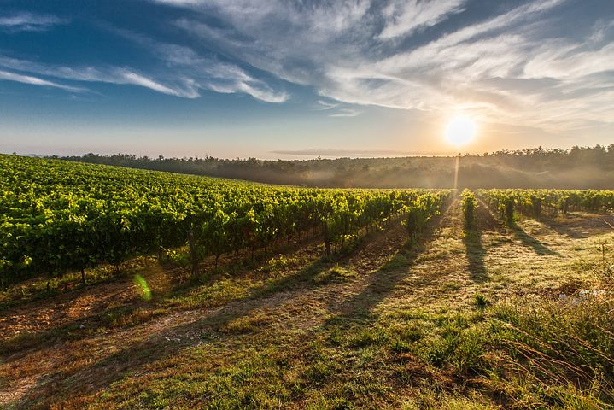
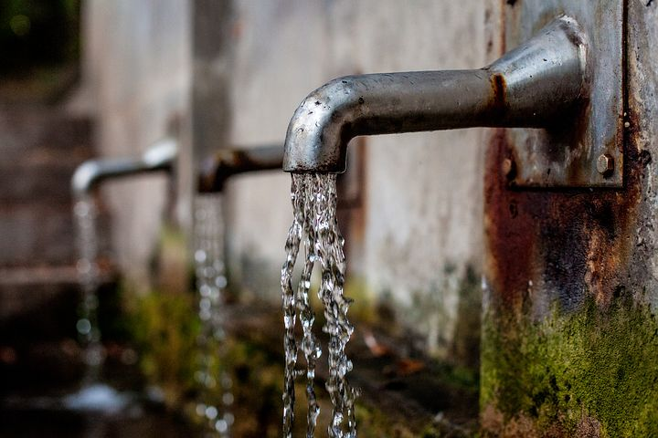

Why CLEWs?
Climate, land, energy and water are essential to sustainable development.
29% of the adult population globally suffers from moderate or severe food insecurity
25% of the world population live under conditions of high water stress
26% of the world population have no access to safe and clean energy for cooking
The world is not on track to meet the climate goals agreed to in Paris in 2015

Slide 11
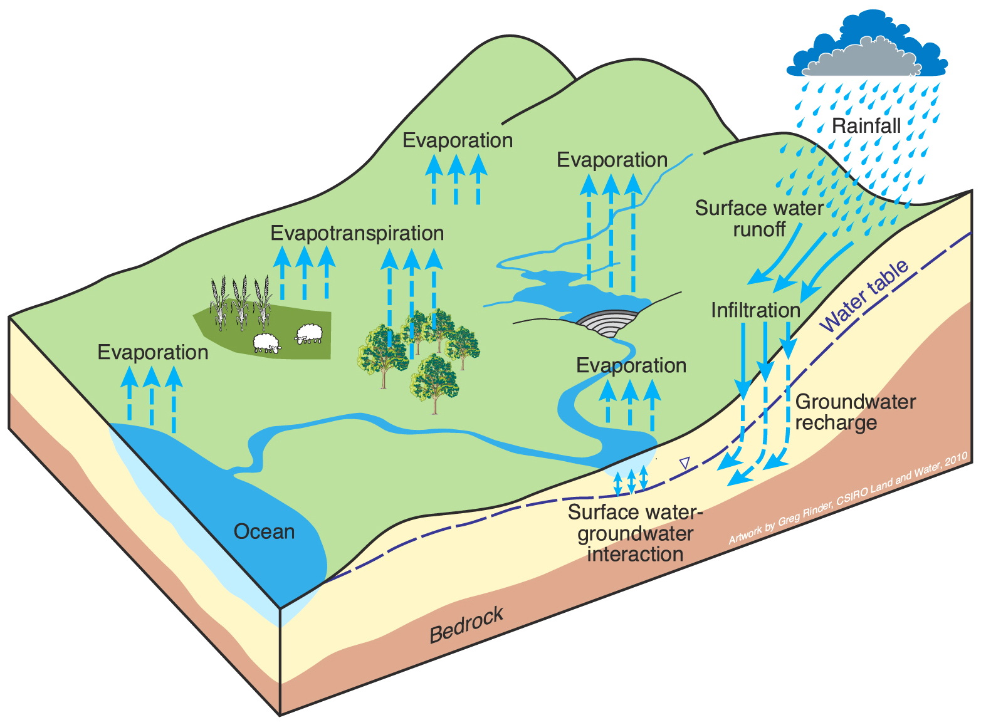
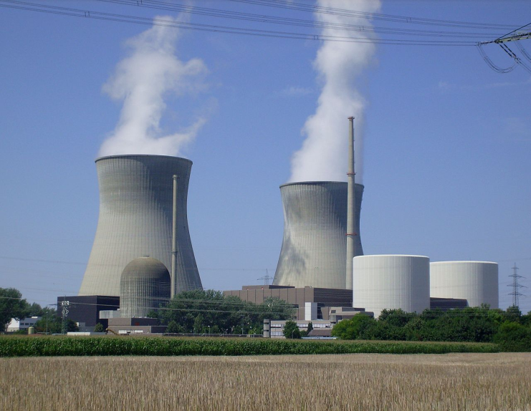
Why CLEWs?
Climate, land, energy and water systems are closely interlinked
Fundamental link between land-use and hydrology in watershed management
70% of freshwater withdrawals worldwide are for agriculture and 20% for energy applications
Hydropower contributes16% to global electricity supply
Bioenergy accounts for a little more than 10% (60 EJ) of the world’s total primary energy supply and about 2% of world electricity generation
15% of maize and oil seeds and over 20% of sugarcane are used for biofuel production

Slide 12
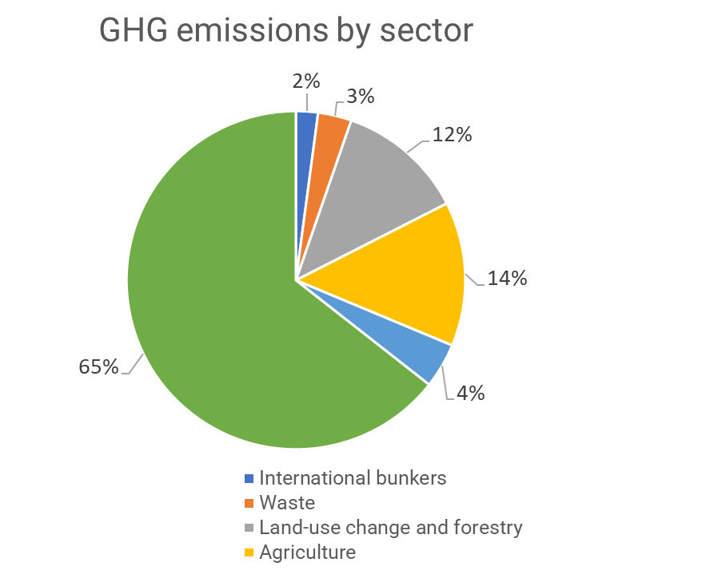
Why CLEWs?
Climate, land, energy and water systems are closely interlinked
Water supply requires energy for treatment and conveyance, equivalent to around 4% of global electricity demand
About 4-5% of global final energy supply is used directly or indirectly for crop production
Energy, agriculture and land-use change contribute more than 90% of GHG emissions
Food, energy and water security are vulnerable to climate change
Need for policy coherence to manage trade-offs and synergies

Slide 13
Key weaknesses of sector policy design done in isolation
Policy formulation and assessments are quite often done in isolation by separate and disconnected institutional entities. This contributes to:
Lack of communication and coordination
Distrust
Incoherent, counterproductive policy formulation and decisions
High probability of inefficient use of scarce resources
Absence of an institutional structure and buy-in for integrated analyses and planning

Slide 14
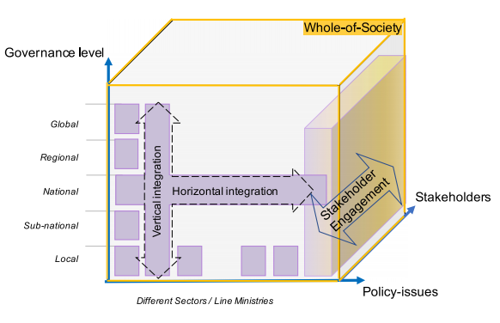
Need for policy coherence
Systematically identify relevant linkages across the sectors and domains and consider those linkages in design of policies;
Policies are consistent across sectors and scales (from local to global);
Involvement of relevant stakeholders in design, implementation, monitoring and evaluation;
Adequate resources are provided for implementation at all levels and at all scales

Slide 15
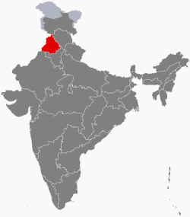
The need for policy coherence:
Punjab comprises only 1.5% of India’s land, but its rice and wheat production accounts for 50% of the grain the Government purchases and distributes to feed more than 400 million poor Indians.
Groundwater is being withdrawn faster than it can be replenished
  No restriction on landowners’ rights to pump water on their own land
  Government set prices incentivize planting of water-intensive crops
  Electricity provided free to farmers
Water levels drop; increased pumping is putting additional stress on an already fragile and overtaxed electricity grid
  Excessive pumping not only leads to overexploitation of aquifers, but also to high electricity demand
  Irrigation accounts for about 15-20% of Punjab’s total electricity use
Notes:
Another example of poor policy thinking – at a smaller scale
Punjab is a small region in India, making up just 1.5% of the country's land. However, it plays a huge role in the country's food supply, producing half of the grain used to feed a large portion of India's poor population. But there's a problem:
The region is using up its underground water faster than it's being replaced.
Farmers can freely pump water from their land, leading to overuse.
The government's pricing policies encourage farmers to grow crops that need a lot of water.
To support this, farmers get free electricity to pump water.
But, using so much water means farmers need more electricity, stressing the power system.
A significant chunk (15-20%) of Punjab's electricity is used just for watering crops.
In short, Punjab's efforts to grow lots of grain are causing water shortages and putting pressure on the electricity supply.

Slide 16







Joined up thinking needed….
Notes:
In other words, what’s the point in achieving SDG2 if is negatively effects multiple other SDGs

Slide 17
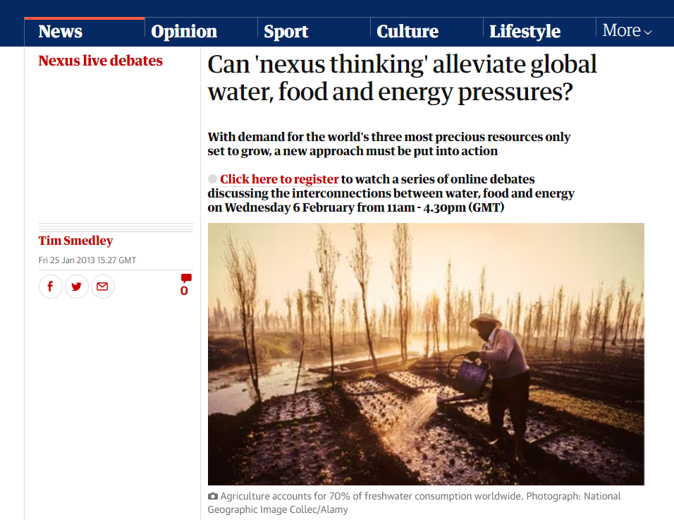
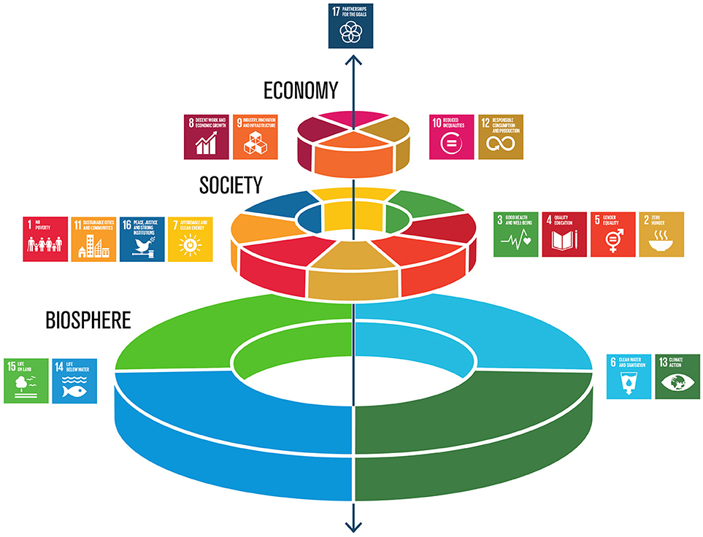
Nexus Thinking
Link
Interconnected Systems
Holistic Decision-making
Addressing Trade-offs
Enhancing Synergies
Resilience and Adaptation
Stakeholder Engagement
The Development of the Water-Energy-Food Nexus as a Framework for Achieving Resource Security: A Review
Link
Notes:
Here are some of the key features of nexus thinking –
We have covered the first two points already in the examples given – but to emphasise
is the importance of
Addressing Trade-offs: By understanding interdependencies, policymakers can better anticipate and navigate trade-offs. For instance, while a dam might be beneficial for energy production, it might impact water availability for agriculture downstream.
Enhancing Synergies: Beyond just managing trade-offs, nexus thinking also identifies synergies or win-win solutions. For instance, wastewater from cities can be treated and used for agriculture, providing a water source for crops and reducing pollution simultaneously.
Resilience and Adaptation: Understanding the nexus can also enhance a system's resilience to shocks. For instance, if an energy system is heavily dependent on water, a drought could disrupt energy supply. Nexus thinking would advocate for diversifying energy sources to minimize such vulnerabilities.
Stakeholder Engagement: Given the interconnected nature of the nexus, this approach often involves engaging a broad range of stakeholders, from different sectors and disciplines, to collaborate on solutions.

Slide 18
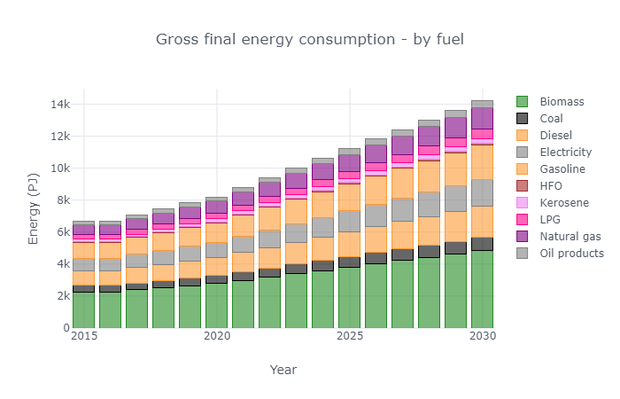
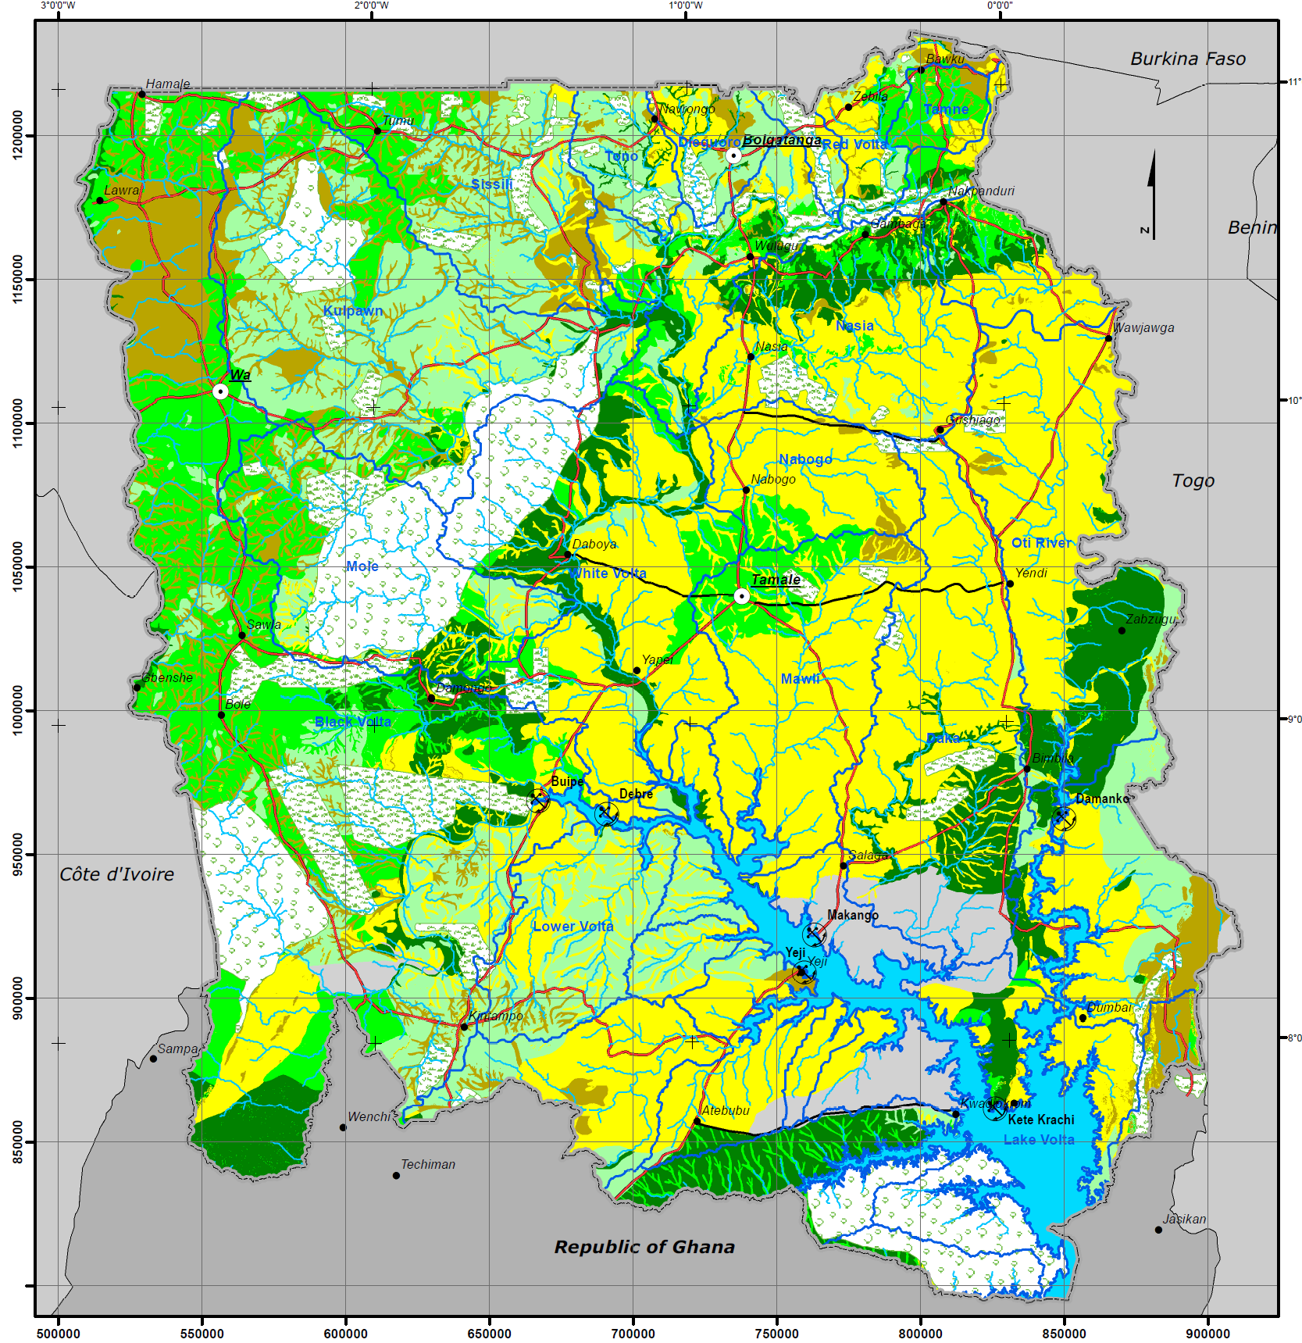
What are CLEWs models?
Techno-economic representations of real-world systems
Designed to assess the role of technology change and technology choice
Enables scenario-based analysis to evaluate risks and uncertainties
Intended for long-term analysis of sustainable development issues (e.g. one or more decades)
Highly customizable/flexible with respect to system boundaries, geographical coverage, level of detail and economic characteristics

Slide 19
Conceptual CLEWs diagram
Water-land interactions in the hydrological cycle
Water needs for food, feed, fuel and fibre crops (rain-fed and irrigated)
Biomass for biofuel production and other energy uses
Energy required for field preparation and harvest
Energy for production of fertilizer, pesticides and other agricultural inputs
Land and agriculture system
Climate
GHG emissions
Energy system
Water system
.
Precipitation, temperature
Energy for: water processing and treatment, water pumping, and desalination
Water for: hydropower, power plant cooling, and (bio-) fuel processing

Slide 20
Optimization model
CLEWs produces cost efficient pathways for the future energy-land-water-waste system through linear optimisation | CLEWs identifies least cost strategies for meeting climate/energy/food/water security goals, considering Capital costs Fixed and variable O&M costs External costs Subject to constraints Socio-political preferences Regulatory Environmental Market and supply chain scale up (e.g., clean energy) Resource availability
Solution space
Total cost
Least cost system

Slide 21
CLEWs-OSeMOSYS = ‘Capacity Expansion Modelling’
Capacity expansion models are generally formulated as linear programs
Allow for long term perspectives on the energy/resource system
Based on the cost optimal ‘build out plan’
Can be given constraints such as available resources, limits on GHG emissions, etc. to manipulate this ‘build out plan’
The major assumptions these models contain:
  all users will optimize their decisions,
  there are no economic feedbacks
  that it is possible to build a small fraction of a power plant
For many situations (centralized planning organizations) these assumptions are acceptable for the specific questions the planner wishes to use the model to evaluate.
Technical Details: https://osemosys.readthedocs.io/en/latest/manual/Create%20a%20model%20in%20OSeMOSY
Notes:
This is a more Technical explanation of what OSeMOSYS does and the language explained

Slide 22
Two Key Principles
OSeMOSYS results do not reflect reality, they reflect possibility
A Demand-Based Model
Cost Optimization
And also a third!
Notes:
All you need to know really for this course are these two key principles
I’ve also added a third because students sometimes forget this : OSeMOSYS does not reflect reality- reflects possibility

Slide 23
Simplified CLEWs diagram
Coal mine
Coal
Coal PP
Electricity
Home appliances
Gas
field
Natural gas
Gas
PP
Industrial equipment
Water
resource
Water
Water
Treatment
Treated Water
Drinking water
Land resource
Land type X
Maize farming
Maize
Household nutrition

Slide 24
Example Reference Energy System
Production and
Power Technologies
Fuel Transformation and
Distribution Technologies
Transformation
Technologies
End Use
Technologies
Uranium
Heat & Power Plants
(w/ or w/o CCS)
Low temp. process heat
Biomass
Sectoral (district) heat
Natural Gas
Sectoral electricity (post transmission)
Agricultural Units
Coal
Heat Technologies
Sectoral
heat
Oil
Electricity (pre transmission)
Housing Sector
Electrolyser
Hydrogen
Motive Energy Technologies
Motive energy
Service Sector
Direct Air Capture
Factories
Cement
Chemicals (split into 3 sub-sectors)
Iron and Steel
Aluminum
Other
Low Temp. Process Heat Techs.
Low temp. process heat
Biofuel Production
Biofuels
High Temp. Process Heat Techs. (w/ or w/o CCS)
High temp. process heat
Transport
Passenger:
Cars
2/3 Wheelers
Buses
Vans
Aviation
Rail
Freight:
Ships
Trucks
Note: This diagram is indicative, not complete

Slide 25


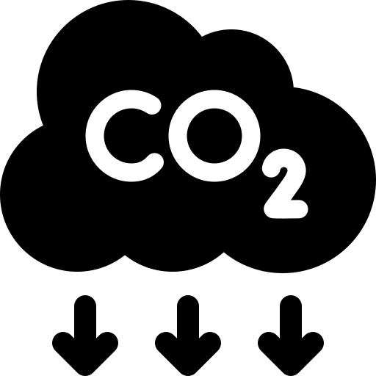


List of Major Data Flows
Input
Output
Technology costs
Fuel costs
Investment needs by year
Running costs by year
Costs
Energy demand (often service demand)
Initial conditions (calibration)
Energy intensities/efficiencies
Total demand by fuel and by sector
Total energy intensity by sector
Energy
Emission intensities
Emission limits
Emission prices
Emissions by sector/technology
Emission intensity by sector
Emissions
Total land area and initial breakdown
Crop demand
Land use change
Crop production
Land use
Waste
Waste production and initial treatment method breakdown
Future waste treatment method breakdown

Slide 26

Objective of CLEWs model?
Provide stakeholders with policy relevant:
  Insights into key inter-linkages and dynamics of the climate-energy-food-water nexus
  Robust findings to support cohesion in policies and measures
  Knowledge of risks and opportunities

Slide 27
Caveats
Are not crystal balls
  Rely on assumptions about markets, technology and the environment that cannot be known with certainty
  Assume all relevant information is readily available
Idealized representation
  Simplification is inevitable
  Rational economic actors
  Does not directly capture institutional and behavioural aspects
  Transaction costs, behavioural and other impediments to efficient solutions implemented through user defined constraints
Some policies and measures cannot be represented directly

Slide 28
Adapting CLEWs to a specific country and application
Each country has a set of specific circumstances, such as:
Unique geography and climate
Unique natural resources
Unique economy and society
Each case study has a set of specific policy and development objectives that will guide analysis
Unique challenges
Unique priorities and goals

Slide 29
Unique geography, climate and natural resources
Each country has a geography and climate that is unique and CLEWs models will need to be adapted accordingly.
Land resources and land cover
Water resources and hydrology
Climate variables
Land productivity
Energy resources
CLEWs models can be built from geospatial datasets which helps adapt the representation of related variables

Slide 30

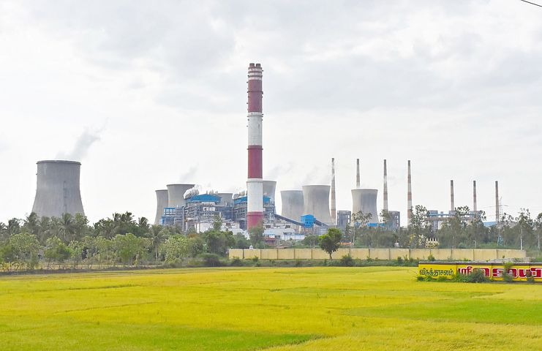
Unique economy and society
Each country has a distinct economy and society, which will need to be represented
Economic structure, as reflected in the use and conversion of energy, food and water
Technology choice and options
Cost and performance characteristics
CLEWs models are built from national statistics and other information and data resources

Slide 31
Simplified CLEWs diagram
Coal
Coal
Power Plant
Electricity
Home appliances
Coal
mine
Natural gas
Gas
field
Gas
Power Plant
Industrial equipment
Water
Water
Treatment
Treated Water
Drinking water
Water
resource
Land allocation
Maize farming
Maize
Household nutrition
Land resource

Slide 32
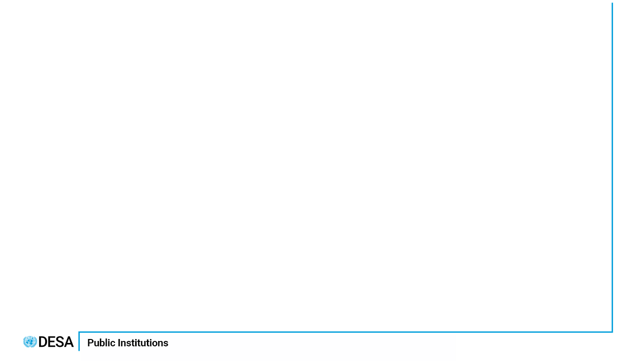

Simplified CLEWs diagram
Wind energy
Wind
Power Plant
Electricity
Home appliances
Wind resource
Solar energy
Solar resource
Solar
Power Plant
Industrial equipment
Water
Water
Treatment
Treated Water
Drinking water
Water
resource
Land resource
Land allocation
Wheat farming
Wheat
Household nutrition
Economic Analysis and Policy Division

Slide 33
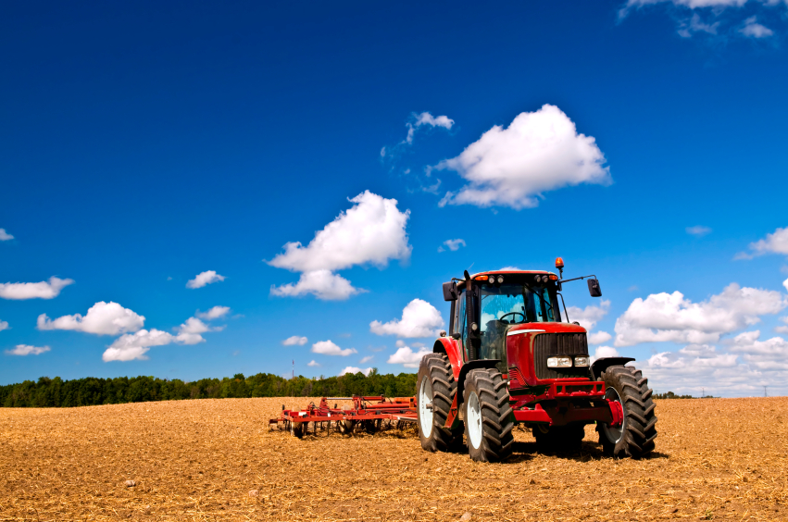
Adaptation example: land-use and agriculture
For each case study the following can be adapted:
Land cover categories as appropriate and aligned with national convention (e.g., forests, water bodies, cropland etc. )
Land cover calibrated to latest land-use maps and/or national statistics
Agricultural crops and commodities as appropriate
Demand for food, feed and other agricultural outputs
Land productivity for different crops and uses
Technology options (e.g., use of mechanization, fertilizer, improved seeds etc )
Trade options and prices

Slide 34
Adaptation example: water and hydrology
For each case study the following can be adapted:
Rainfall patters (across regions and time)
Hydrological balance for each land cover category
Surface water resources (calculated from precipitation and transboundary flows)
Groundwater resources (as stocks)
Water demands (by location, sector and or type of use)
Technology choice in water infrastructure

Slide 35
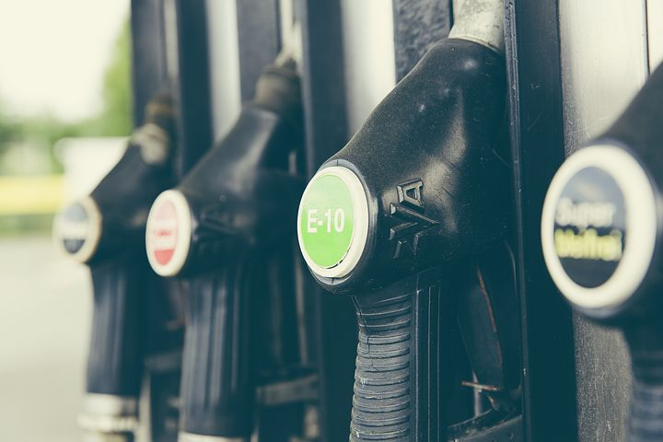
Adaptation example: energy
For each case study the following can be adapted:
Energy resources as stocks (e.g., natural gas, oil, coal) or distributed resource (biomass, solar, wind)
Energy commodities/carriers
Energy conversion technologies
Energy demands

Slide 36
Unique challenges, priorities and goals
For each case study the following can be adapted:
Time horizon and sub-annual
Regionalization
System boundaries
Level of detail

Slide 37
Adaptation example: level of detail - hydropower
Hydropower
resource
Hydropower
plant
Electricity
Reservoir Hydropower
plant
Hydropower
resource
Hydropower
Plant 2
Electricity
Run-of river Hydropower
plant
Hydropower
Plant 2
Hydropower
resource
Electricity
Hydropower
Plant n

Slide 38
Adaptation example: level of detail - agriculture
High input rainfed maize farming
Higher detail:
Simple:
High input irrigated maize farming
Water
resource
Maize farming
Maize
Land resource
Land resource
Medium input rainfed maize farming
Maize
Medium input irrigated maize farming
Low input rainfed maize farming
Economic Analysis and Policy Division

Slide 39
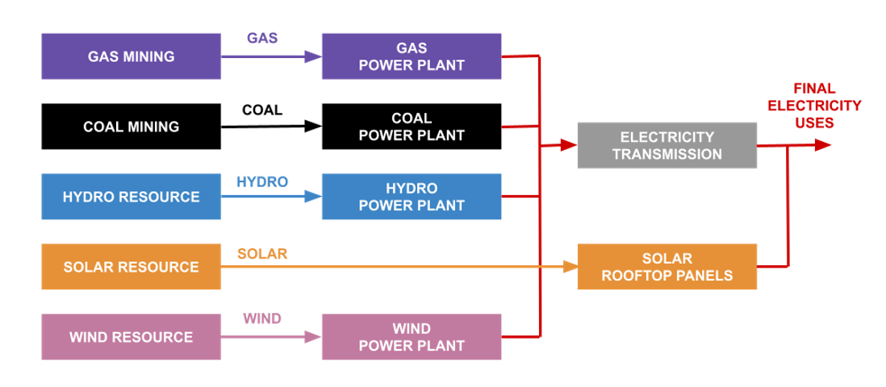
Next Week
SDGs and Policy
What is a Reference Energy/CLEW System (RES)
The schematic that underpins our CLEWs modelling
Mapping the input and output flows

