Slide 1
Building a Reference Energy System

Slide 2
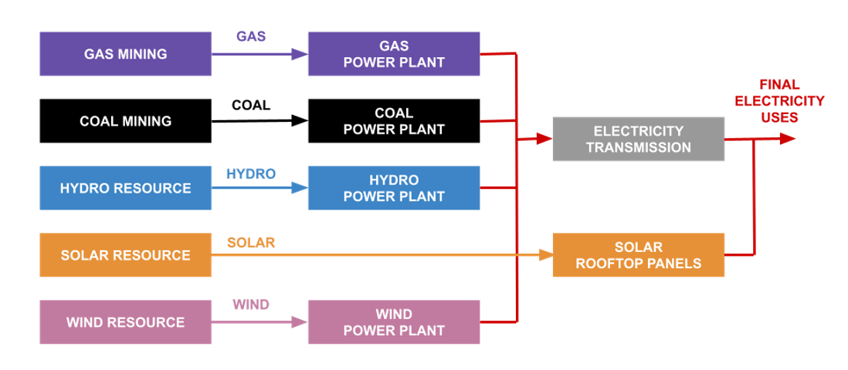
Reference Energy System
Technology
(Resource Creation)
Commodity
(Resource)
Technology
(Powerplant)
Commodity
(Electricity 1)
Technology
(Infrastructure)
Commodity
(Electricity 2)
GAS
MINGAS
PWRGAS
Demand
COA
PWRTRN
HYD
PVR
PWRPVR
WND

Slide 3
Go to CCG Starter Kits and find your assigned country.
Find your country and Click on the 2nd link across ( under EN-Pre-print) to open up the menu explaining the energy data acquired for that country.
Now under ‘EN-Pre-print’ click the drop down arrow on ‘data description’ and scroll down to the first table: ‘Installed Power Plants Capacity’.
With this information create a RES for your country using the naming conventions outlined on the right
PWRBIO | Biomass Power Plant
PWRCOA | Coal Power Plant
PWRGEO | Geothermal Power Plant
PWROHC001 | Light Fuel Oil Power Plant
PWROHC002 | Oil Fired Gas Turbine (SCGT)
PWRNGS001 | Gas Power Plant (CCGT)
PWRNGS002 | Gas Power Plant (SCGT)
PWRSOL | Solar PV (Utility)
PWRCSP001 | CSP without Storage
PWRCSP002 | CSP with Storage
PWRHYD001 | Large Hydropower Plant (Dam) (>100MW)
PWRHYD002 | Medium Hydropower Plant (10-100MW)
PWRHYD003 | Small Hydropower Plant (<10MW)
PWRWND001 | Onshore Wind
PWRWND002 | Offshore Wind
PWRNUC | Nuclear Power Plant
PWRSOL01S | Utility-scale PV with 2 hour storage
PWRWND01S | Onshore Wind power plant with storage
PWROHC003 | Light Fuel Oil Standalone Generator (1kW)
PWRPVR | Solar PV (Distributed with Storage) OFF GRID
PWRHYD004 | Off-grid Hydropower

Slide 4
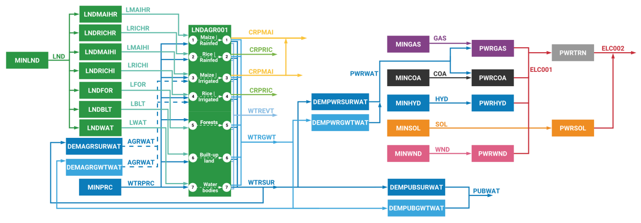
DEMAGRDSL
DEMTRABIO
TRABIO
AGRDSL
LNDMAIHR
CRPMAI
LNDRICHR
CRPRIC
LNDMAIHI
CRPMAI
MINLND
PWRWAT
LND
CRPRIC
LNDRICHI
LNDFOR
LFOR
DEMPWRSURWAT
LNDBLT
LBLT
DEMPWRGWTWAT
WTRPRC
LNDWAT
LWAT
WTREVT
ELC002
MINPRC
ELC002
AGRWAT
WTRGWT
WTRSUR
DEMPUBSURWAT
DEMAGRSURWAT
PUBWAT
MINPRC
DEMPUBGWTWAT
DEMAGRGWTWAT
ELC002
ELC002

Slide 5
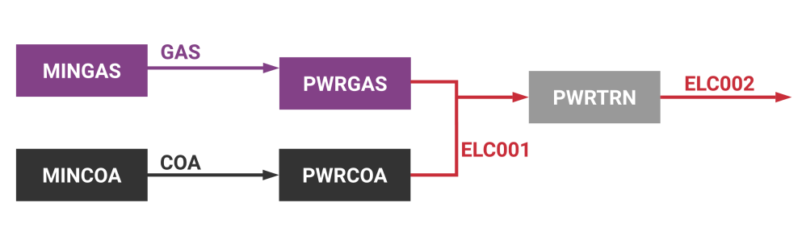

Slide 6
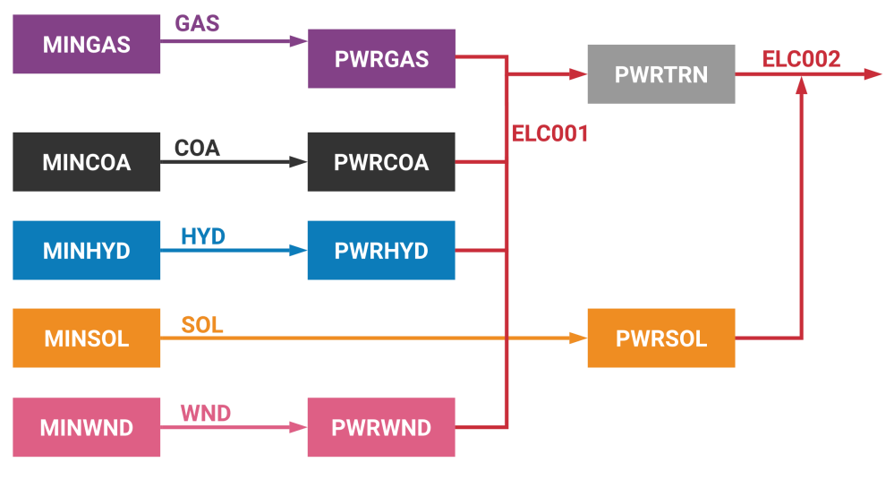

Slide 7
LNDMAIHR
CRPMAI
LNDRICHR
CRPRIC
MINLND
LND

Slide 8
LNDMAIHR
CRPMAI
LNDRICHR
CRPRIC
LNDMAIHI
CRPMAI
MINLND
LND
LNDRICHI
CRPRIC

Slide 9
LNDMAIHR
CRPMAI
LNDRICHR
CRPRIC
LNDMAIHI
CRPMAI
MINLND
LND
LNDRICHI
CRPRIC
LNDFOR
LFOR
LNDBLT
LBLT
LNDWAT
LWAT

Slide 10
LNDMAIHR
CRPMAI
LNDRICHR
CRPRIC
LNDMAIHI
CRPMAI
MINLND
LND
LNDRICHI
CRPRIC
LNDFOR
LFOR
LNDBLT
LBLT
LNDWAT
LWAT

Slide 11
LNDMAIHR
CRPMAI
LNDRICHR
CRPRIC
LNDMAIHI
CRPMAI
MINLND
LND
CRPRIC
LNDRICHI
LNDFOR
LFOR
LNDBLT
LBLT
WTRPRC
LNDWAT
LWAT
WTREVT
MINPRC
WTRGWT
WTRSUR
MINPRC

Slide 12
LNDMAIHR
CRPMAI
LNDRICHR
CRPRIC
LNDMAIHI
CRPMAI
MINLND
LND
CRPRIC
LNDRICHI
LNDFOR
LFOR
LNDBLT
LBLT
WTRPRC
LNDWAT
LWAT
WTREVT
MINPRC
AGRWAT
WTRGWT
WTRSUR
DEMPUBSURWAT
DEMAGRSURWAT
PUBWAT
MINPRC
DEMPUBGWTWAT
DEMAGRGWTWAT

Slide 13
LNDMAIHR
CRPMAI
LNDRICHR
CRPRIC
LNDMAIHI
CRPMAI
MINLND
PWRWAT
LND
CRPRIC
LNDRICHI
LNDFOR
LFOR
DEMPWRSURWAT
LNDBLT
LBLT
DEMPWRGWTWAT
WTRPRC
LNDWAT
LWAT
WTREVT
MINPRC
AGRWAT
WTRGWT
WTRSUR
DEMPUBSURWAT
DEMAGRSURWAT
PUBWAT
MINPRC
DEMPUBGWTWAT
DEMAGRGWTWAT

Slide 14
AGRDSL
LNDMAIHR
CRPMAI
LNDRICHR
CRPRIC
LNDMAIHI
CRPMAI
MINLND
PWRWAT
LND
CRPRIC
LNDRICHI
LNDFOR
LFOR
DEMPWRSURWAT
LNDBLT
LBLT
DEMPWRGWTWAT
WTRPRC
LNDWAT
LWAT
WTREVT
ELC002
MINPRC
ELC002
AGRWAT
WTRGWT
WTRSUR
DEMPUBSURWAT
DEMAGRSURWAT
PUBWAT
MINPRC
DEMPUBGWTWAT
DEMAGRGWTWAT
ELC002
ELC002

Slide 15
DEMAGRDSL
AGRDSL
LNDMAIHR
CRPMAI
LNDRICHR
CRPRIC
LNDMAIHI
CRPMAI
MINLND
PWRWAT
LND
CRPRIC
LNDRICHI
LNDFOR
LFOR
DEMPWRSURWAT
LNDBLT
LBLT
DEMPWRGWTWAT
WTRPRC
LNDWAT
LWAT
WTREVT
ELC002
MINPRC
ELC002
AGRWAT
WTRGWT
WTRSUR
DEMPUBSURWAT
DEMAGRSURWAT
PUBWAT
MINPRC
DEMPUBGWTWAT
DEMAGRGWTWAT
ELC002
ELC002

Slide 16
DEMAGRDSL
DEMTRABIO
TRABIO
AGRDSL
LNDMAIHR
CRPMAI
LNDRICHR
CRPRIC
LNDMAIHI
CRPMAI
MINLND
PWRWAT
LND
CRPRIC
LNDRICHI
LNDFOR
LFOR
DEMPWRSURWAT
LNDBLT
LBLT
DEMPWRGWTWAT
WTRPRC
LNDWAT
LWAT
WTREVT
ELC002
MINPRC
ELC002
AGRWAT
WTRGWT
WTRSUR
DEMPUBSURWAT
DEMAGRSURWAT
PUBWAT
MINPRC
DEMPUBGWTWAT
DEMAGRGWTWAT
ELC002
ELC002

Slide 17
Thank you
www.climatecompatiblegrowth.com

