Slide 1
Using FINPLAN Scenarios for Risk and Sensitivity Analysis
Notes:
Licence: This work is licensed under the Creative Commons Attribution 4.0 International License (CC BY 4.0). To view a copy of this license, visit https://creativecommons.org/licenses/by/4.0/.
Attribution: Please cite as: Tan, N. (2025) Using FINPLAN Scenarios for Risk and Sensitivity Analysis. Version 1. Climate Compatible Growth Teaching Kit Website, Climate Compatible Growth.

Slide 2
Contents
Risk
Sensitivity Analysis

Slide 3

Only after results are evaluated and case study appears financially solid

Slide 4
1. Risk
Risk Management
Risk
Possibility of something bad happening.
It involves uncertainty about the effects/implications of an activity with respect to something that humans value.
Technical Risks
Management Risks
Market Risks
External Risks
Others
Notes:
External Risks are generally something that is uncontrollable by the first party. Good examples of external risks are natural disasters such as earthquakes and volcanoes.

Slide 5
1. Risk
Risk Management
Identify the risks
→ risks stemming from physical or legal causes, market conditions etc.
Prioritize the risks according to the probabilities
Set strategy to cover the risk
→ apportion the risks to the stakeholder responsible for it

Slide 6
2. Sensitivity Analysis
Case Study
What risks have been identified?
How much will results change if input data changes slightly?
Helps identify assumptions with major impacts on results
20-30 years time frame
Uncertain input data
Lack of information
Unknown future
→ Assumptions

Slide 7
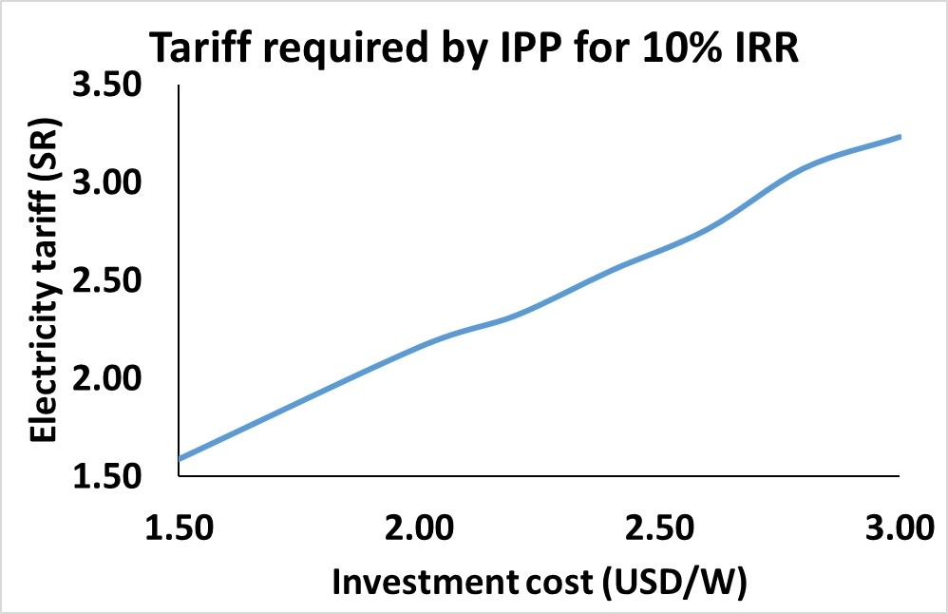
2. Sensitivity Analysis
Selected Input Parameters
Operation
Electricity generation
Fuel costs: fuel price (& efficiency)
O&M costs
Taxes
Rate
Type: e.g., carbon tax
Economy
Inflation rate
Exchange rate
Electricity prices
Investments
Investment Costs
Construction Period
Financing pattern (debt/equity)
Loan parameters
Interest rate
Loan term

Slide 8
2. Sensitivity Analysis
Results
To prepare recommendations from FINPLAN case:
Identify assumptions critical to results & associated uncertainty
Quantify possible range of values & prepare alternative set of values
Create new case by copying case study
Vary value of selected input
Compare results with original case study → check sensitivity
Summarize results – quantify impacts of risk

Slide 9
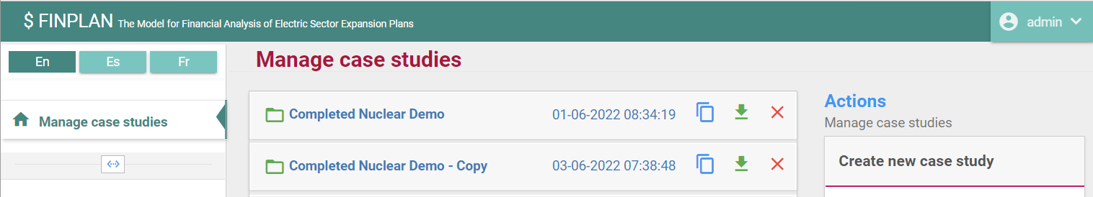
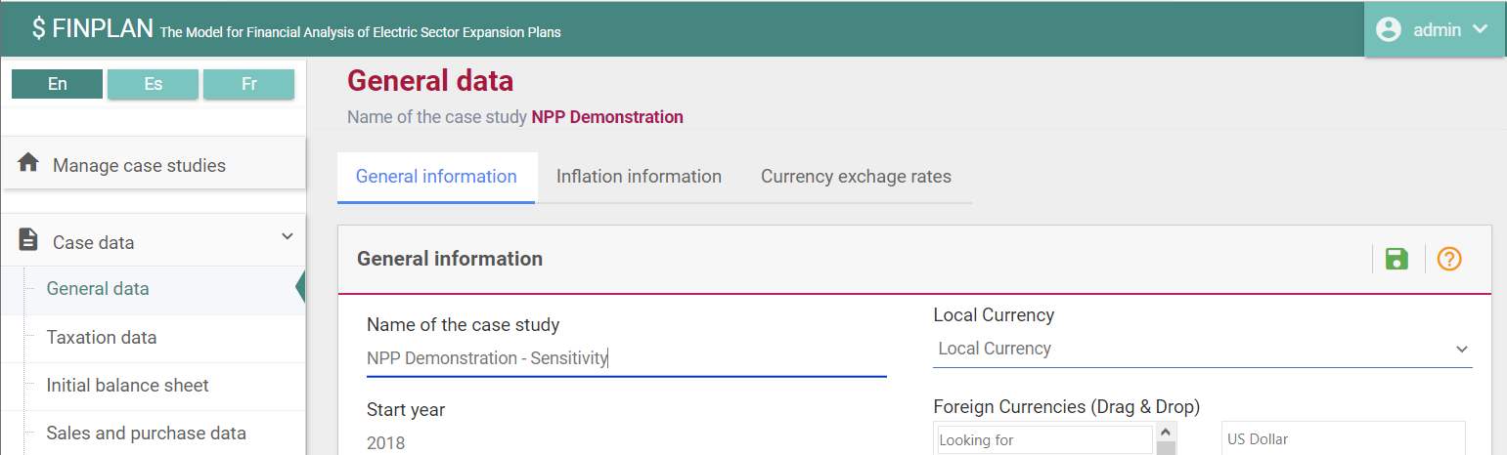
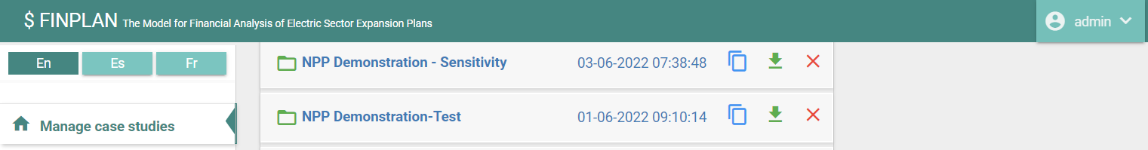
2. Sensitivity Analysis
Creating case studies
Copy file
Click to open
View your list of case studies
Save
Rename

Slide 10
Thank you!
Notes:
Thank you!

