Slide 1
Balancing a FINPLAN Case
Notes:
Licence: This work is licensed under the Creative Commons Attribution 4.0 International License (CC BY 4.0). To view a copy of this license, visit https://creativecommons.org/licenses/by/4.0/.
Attribution: Please cite as: Tan, N. (2025) Balancing a FINPLAN Case. Version 1. Climate Compatible Growth Teaching Kit Website, Climate Compatible Growth.

Slide 2
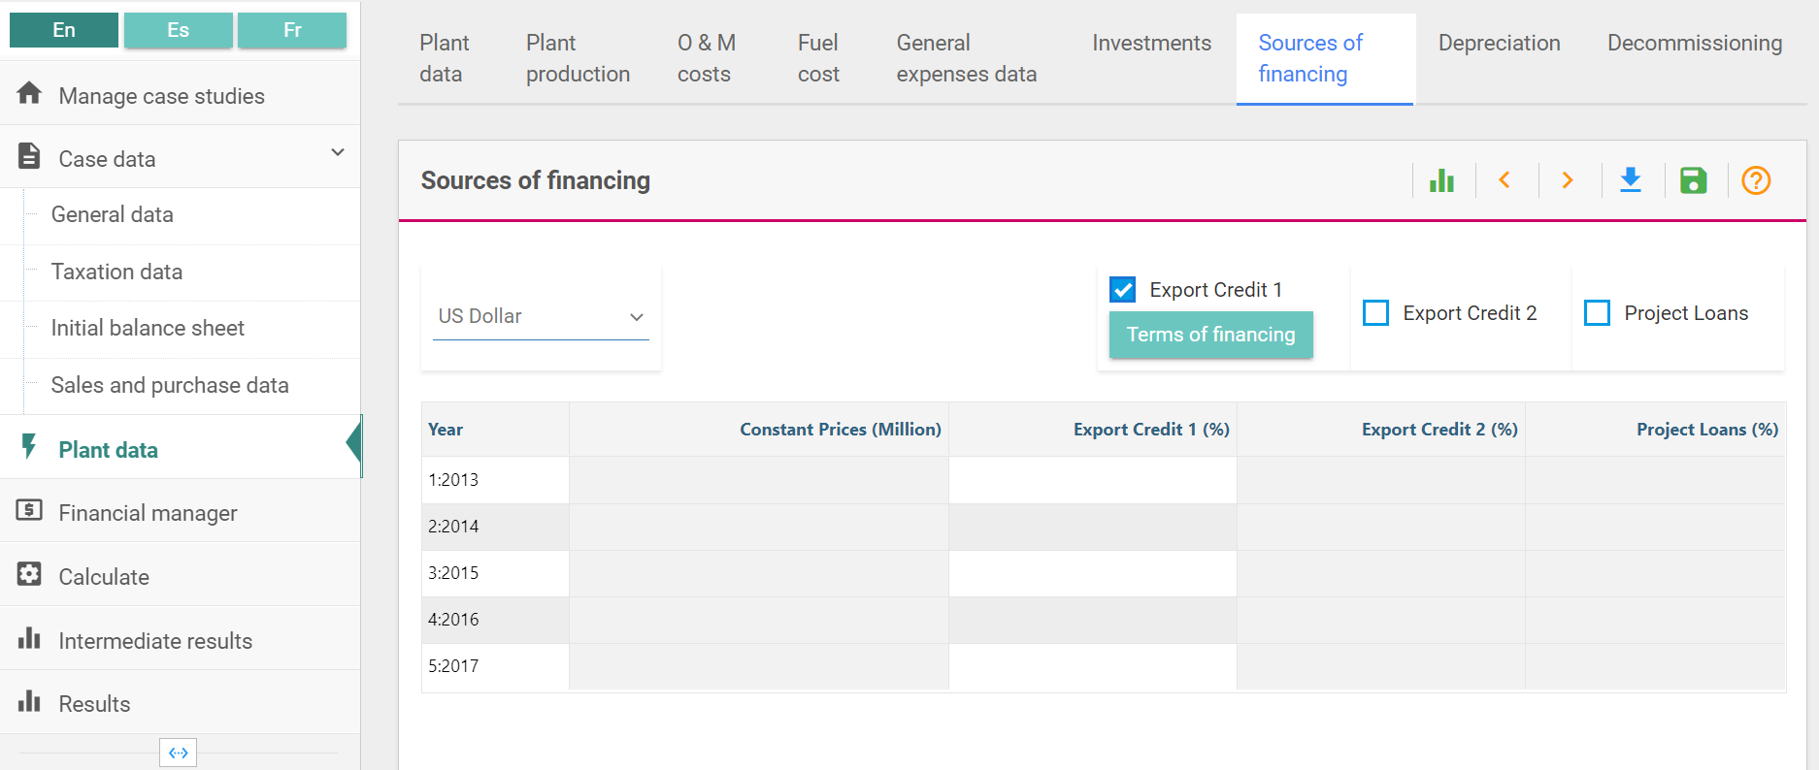
Balancing a FINPLAN Case
How to Fine Tune a Case Study
Set up appropriate equity and debt levels
If project is eligible for export credit, maximize it
Notes:
Under sources of financing, you can choose the option of an export credit. Export credit is a form of debt for the exporting company. It referes to financial support and services provided to facilitate and promote international trade. It is a form of financing that helps exporters mitigate the risks associated with selling goods and services to foreign buyers. Export credit is typically offered by governments, financial institutions, and export credit agencies to support businesses engaged in cross-border trade.

Slide 3


Balancing a FINPLAN Case
How to Fine Tune a Case Study
Set up appropriate equity and debt levels
If project is eligible for export credit, maximize it
Choose acceptable equity level (15 – 30% of total capital structure)
$$Total capital structure=equity+debt$$
$$15\% \text{≤} \text{(}\text{equity}\text{)/(}\text{total} \text{capital} \text{structure}\text{) }\text{≤} \text{30\%}$$
May vary!
Notes:
In terms of financing, equity refers to the ownership interest that investors hold in a company. Equity financing involves raising capital by selling ownership shares (equity) in the business. Investors who purchase these equity shares become partial owners and have a claim on the company's assets and future profits. Unlike debt financing, equity does not involve the obligation to make regular interest payments or repay a principal amount.
An acceptable equity level is somewhere around 15-30% in comparison to the total capital structure of a company. The total capital structure of a business is the combination of equity and debt that it uses to finance its operations, investments, and other financial obligations. The formula for the total capital structure is shown here. In the context of the suggested equity range (15-30%), it implies that equity should represent a proportion of the total capital structure within that range. The remaining portion would be comprised of debt.
For example, if a company has a capital structure within the 15-30% equity range, it means that: equity over total capital structure is more than or equal to 15% or less than or equal to 30%. The specific comparison is to the total capitalization, and the range indicates the proportion of that capitalization that should be in the form of equity. The remaining portion (100% - Equity%) would represent the proportion financed through debt. It's important to note that these ranges can vary based on industry norms, company-specific factors, risk tolerance, and strategic considerations. Some industries, such as those with capital-intensive operations, might have higher equity percentages, while others, like technology companies, might have lower equity percentages in their capital structures. Companies often tailor their capital structures based on their financial goals, risk management strategies, and prevailing market conditions.

Slide 4
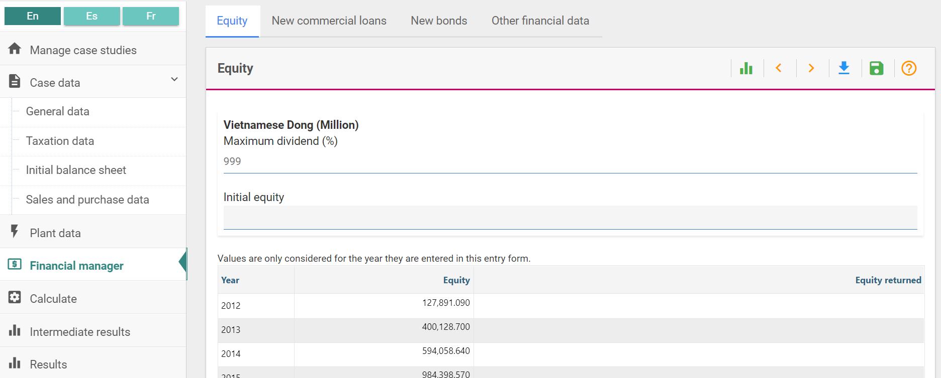
Balancing a FINPLAN Case
How to Fine Tune a Case Study
Set up appropriate equity and debt levels
If project is eligible for export credit, maximize it
Choose acceptable equity level (15 – 30% of total capital structure)
Notes:
In terms of financing, equity refers to the ownership interest that investors hold in a company. Equity financing involves raising capital by selling ownership shares (equity) in the business. Investors who purchase these equity shares become partial owners and have a claim on the company's assets and future profits. Unlike debt financing, equity does not involve the obligation to make regular interest payments or repay a principal amount.
An acceptable equity level is somewhere around 15-30% in comparison to the total capital structure of a company. The total capital structure of a business is the combination of equity and debt that it uses to finance its operations, investments, and other financial obligations.

Slide 5
Balancing a FINPLAN Case
How to Fine Tune a Case Study
Set up appropriate equity and debt levels
If project is eligible for export credit, maximize it
Choose acceptable equity level (15 – 30%)
Select financing options to ‘fill the gap’
Ensure short-term deposit and stand-by facility are the most expensive options
Notes:
"Selecting financing options to fill the gap" refers to the process of choosing suitable financial instruments or methods to address a funding shortfall or gap in a company's capital structure. This gap may arise when a company needs additional funds to meet its operational requirements, fund growth initiatives, or cover specific expenditures, but its existing financial resources are insufficient. Examples include equity, debt, working capital loans, government grants or subsidies, etc.
Next, ensure that short-term deposit and stand-by facility are the most expensive options. A short-term deposit typically refers to placing funds in a bank or financial institution for a relatively brief period, such as a few months. If a company is ensuring that short-term deposits are among the most expensive options, it means intentionally selecting deposit accounts or financial instruments with higher interest rates or fees. A stand-by facility is a financial arrangement where a lender commits to provide funds to a borrower if needed. The borrower may pay a fee for having access to this financial backstop, even if the funds are not actually used. Ensuring that the stand-by facility is one of the most expensive options suggests deliberately choosing a facility with higher associated costs. Higher-cost financing options may provide a greater degree of financial flexibility and risk mitigation. For example, a stand-by facility can act as a financial safety net, but the cost of having such a facility available even if not used might be higher.

Slide 6
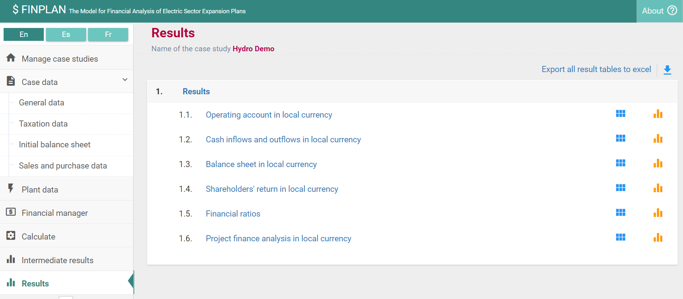
Balancing a FINPLAN Case
How to Fine Tune a Case Study
During the Construction, ensure short-term deposit & stand-by facility are rarely used
Check Cash Inflows and Outflows

Slide 7
Balancing a FINPLAN Case
How to Fine Tune a Case Study
During the Construction, ensure short-term deposit & stand-by facility are rarely used
Check Cash Inflows and Outflows
Check cash available in short-term deposits
Check flows from stand-by facility (and to short-term deposits)
(Check balance of stand-by facility in Intermediate Results)
Minimise them by readjusting debt and equity
i.e. the cash available in short-term deposit and money drawn from stand-by facility
Notes:
During construction, we need to ensure that the short-term deposit & stand-by facility are rarely used, so we need to check them regularly. A short-term deposit typically refers to placing funds in a bank or financial institution for a relatively brief period, such as a few months. A stand-by facility is a financial arrangement where a lender commits to provide funds to a borrower if needed. The borrower may pay a fee for having access to this financial backstop, even if the funds are not actually used. We want to minimize the amount in the short-term deposit and stand-by facility, as if we have money in the short-term deposit – the money is not doing anything, it is not being invested as its only there for a short-term. And with the stand-by-facility, we are borrowing money, which is expensive. To minimize, we need to readjust the debt and equity.

Slide 8
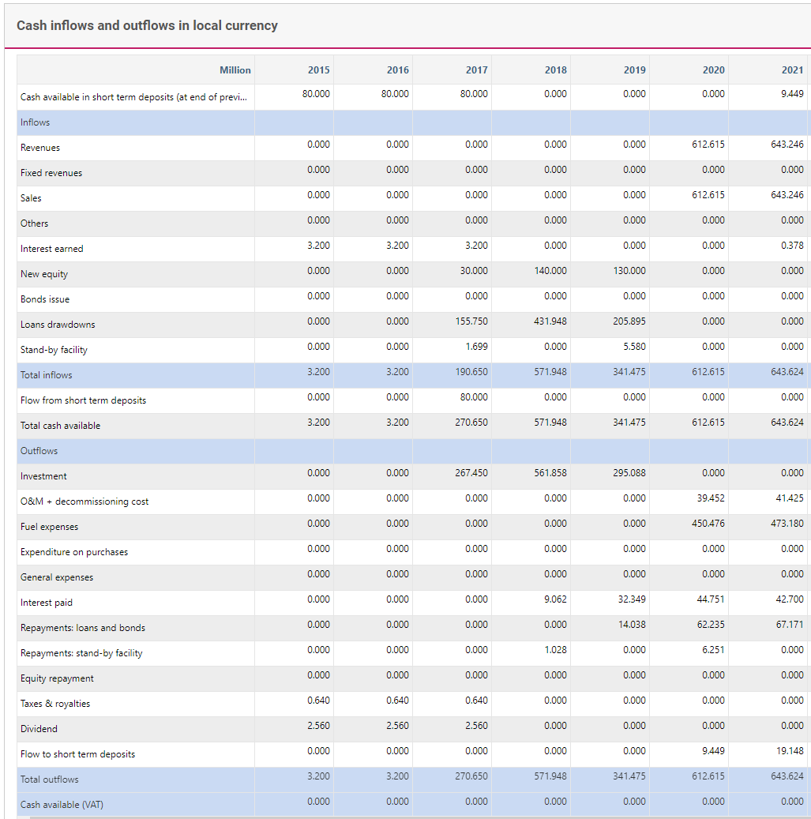
Balancing a FINPLAN Case
How to Fine Tune a Case Study
1
Construction time is 2017 - 2019
Short term deposit is emptied in first year
Stand-by facility is rarely used
Flows to (and from) short term deposit are (close to) zero (after short term deposit was emptied)
(Check also balance of stand-by facility Intermediate Results)
2

Slide 9
Thank you!
Notes:
Thank you!

