Slide 1
Evaluating Results from a FINPLAN Case
Notes:
Licence: This work is licensed under the Creative Commons Attribution 4.0 International License (CC BY 4.0). To view a copy of this license, visit https://creativecommons.org/licenses/by/4.0/.
Attribution: Please cite as: Tan, N. (2025) Evaluating Results from a FINPLAN Case. Version 1. Climate Compatible Growth Teaching Kit Website, Climate Compatible Growth.

Slide 2
Contents
Shareholder’s Return
Financial Ratios – Construction Period
→ Debt Equity Ratio & Leverage
Financial Ratios – Operation Period
→ Debt Service Coverage Ratio (DSCR), Exchange Risk, Working Capital Ratio, Breakeven Point, Debt Repayment Time

Slide 3
1. Shareholder’s Return
Overview
Check the Internal Rate of Return (IRR)
Should not be too low (depending on who invests)
If too low, a higher electricity price might be required (assuming debt cannot be increased)
→ requires readjustments, e.g., to ensure minimal flows to short-term deposit
(By definition, NPV will be negative if the discount rate entered is larger than the IRR)
Also, have a look at how far in the future the first dividends are being paid out
Notes:
Reminder - IRR is the discount rate that makes the NPV of an investment project equal to zero. In other words, it is the rate of return at which the present value of cash inflows equals the present value of cash outflows. IRR represents the project's expected rate of return. As investments happen mostly in the beginning and benefits in the future, the higher the IRR the better. (Theoretically) all projects with an IRR higher than the cost of capital should be undertaken

Slide 4
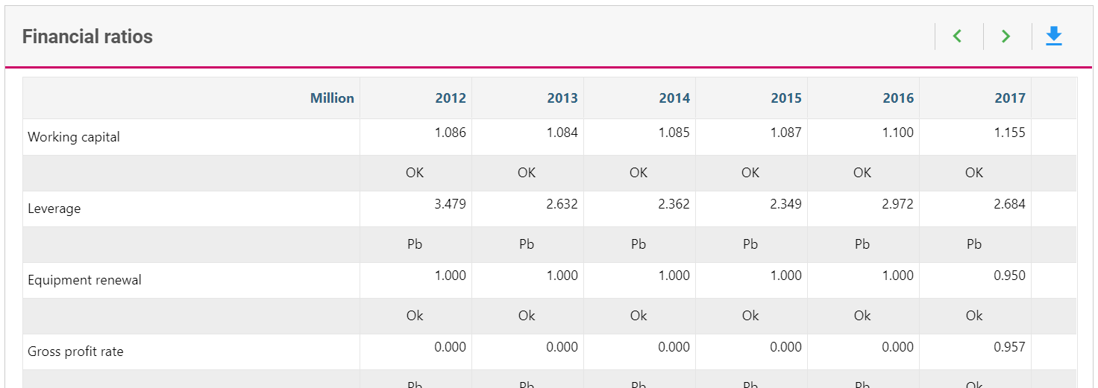
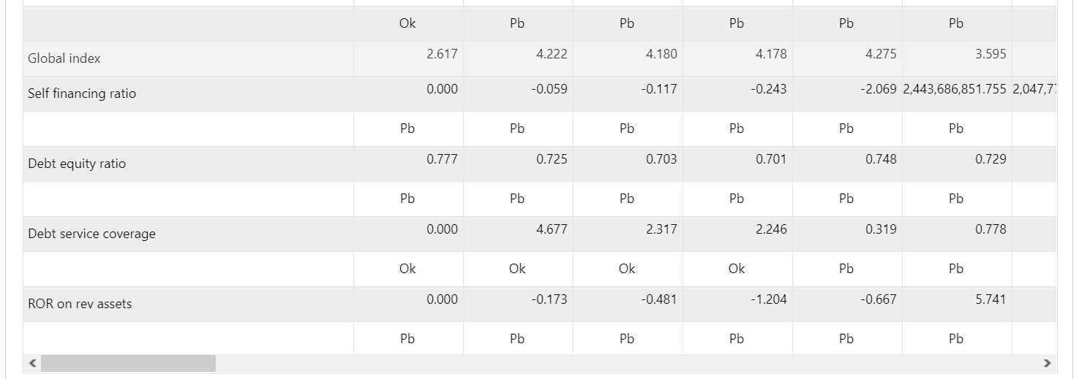
2. Financial Ratios – Construction Period
Debt Equity Ratio & Leverage
Debt Equity Ratio* | Leverage
= debt / (equity + debt) | = debt / equity
70% debt, 30% equity
Debt Equity Ratio of 70/100 = 0.7 | Leverage of 70/30 = 2.33
Construction period
* More commonly referred to as the debt ratio, however, FINPLAN names this indicator the ‘debt equity ratio’.
Notes:
What FINPLAN shows as debt/equity ratio is rather the debt ratio
In OU ppt slides, debt/equity ratio is debt/equity

Slide 5

3. Financial Ratios – Operation Period
Debt Service Coverage Ratio (DSCR)
Used to assess company’s ability to meet its debt obligations
>1 implies that the company is generating enough income to cover debt obligations
=1 implies income exactly covers debt service, leaving no surplus
<1 implies there is not enough income to cover its debt obligations
Lenders generally prefer higher DCSR values, <1.2 is often considered min acceptable level
If too low, consider increasing electricity price or equity injections
(Note that if a single project is analyzed and if in reality the project was invested in by a utility, cash may also be available from other incomes)
$$DSCR=\frac{Operating income}{Total debt service}$$
Operation
period
In this example, the DSCR is too low!
Notes:
The Debt Service Coverage Ratio (DSCR) is a financial metric used to assess a company's ability to meet its debt obligations. It is particularly important in project finance and corporate finance, where lenders use it to evaluate the borrower's capacity to service its debt through operating income. The Debt Service Coverage Ratio is calculated by dividing the operating income by the total debt service:
Operating Income: This represents the company's earnings before interest, taxes, depreciation, and amortization (EBITDA) or a similar measure. It reflects the income generated from the core operations of the business.
Total Debt Service: This includes all the obligations related to servicing the debt, such as interest payments, principal repayments, and other relevant costs associated with debt. The total debt service is essentially the sum of interest and principal payments due during a specific period.
A DSCR greater than 1 indicates that the company is generating enough operating income to cover its debt obligations. A ratio of 1 means that operating income exactly covers debt service, leaving no surplus.
A DSCR below 1 implies that the company's operating income is insufficient to cover its debt obligations. This is a red flag for lenders, suggesting a higher risk of default.
Lenders generally prefer higher DSCR values, as they indicate a more significant cushion or margin of safety for meeting debt obligations.
In project finance, a DSCR of 1.2 or higher is often considered a minimum acceptable level by lenders.
The Debt Service Coverage Ratio is a critical tool for lenders and investors because it provides insights into the financial health and risk profile of a borrower. It helps assess the ability of a company or project to generate enough cash flow to meet its debt obligations, contributing to the overall risk assessment and decision-making process in lending and investment. If the DSCR on finplan is too low, consider increasing elec price of equity injections. But also note that if a single project that you are modelling is actually a project that was invested in by a utility, cash may also be available from other incomes.

Slide 6
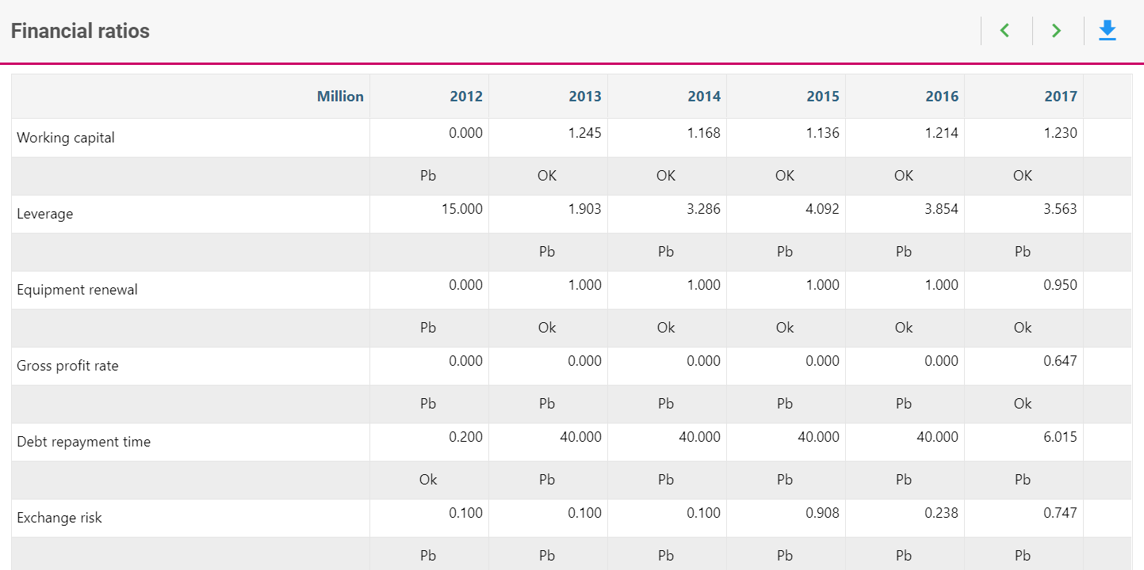

3. Financial Ratios – Operation Period
Exchange Risk
Identifies financial loss from exchange rate changes; risks for foreign financiers
If < 1, not enough cash available, should be above 1.2
Can be improved by increasing local loans & bonds (or electricity price)
$$Exchange risk=\frac{local cash}{foreign expenditures}$$
In this example, there is not enough cash available!
Notes:
Exchange risk, also known as currency risk or foreign exchange risk, refers to the potential financial losses that can arise from fluctuations in exchange rates. It is the risk that the value of a currency will change unfavorably between the time a financial transaction is initiated and when it is settled.
Companies and investors face exchange risk when they engage in international transactions, invest in foreign assets, or operate in multiple currencies. The risk arises because exchange rates can be volatile and are influenced by various factors, including economic indicators, geopolitical events, and market sentiment.
On finplan, if the exchange risk is <1, it means that there is not enough cash available - it should be above 1.2. But, it can be improved by increasing local currency loans and bonds or electricity price!

Slide 7
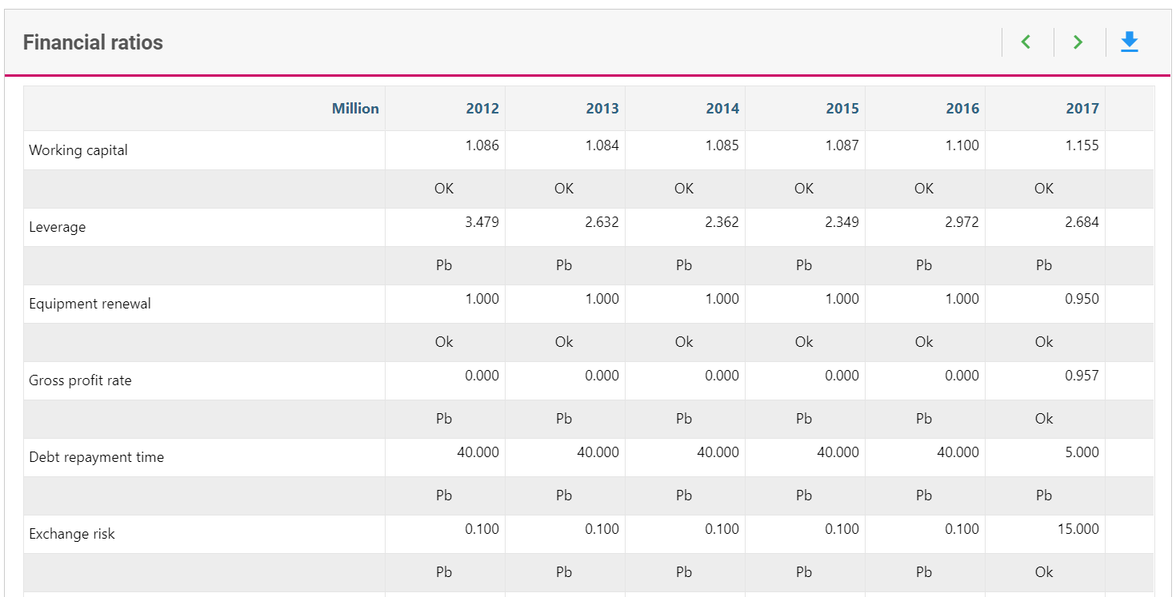


3. Financial Ratios – Operation Period
Working Capital Ratio
Liquidity ratio – how financially solid is company?
Important to creditors (i.e., if company was sold, could it pay for its debt?)
>1 implies that company has more current assets than current liabilities, able to meet short-term obligations
<1 implies potential liquidity problems, company may not have enough current assets to cover its short-term liabilities
$$Liquidity ratio=\frac{current assets}{liabilities}$$
note: FINPLAN
$$Liquidity ratio=\frac{current assets}{liabilities}$$
Notes:
The working capital ratio, also known as the liquidity ratio, is a financial metric that provides an indication of a company's short-term liquidity and ability to cover its short-term obligations with its short-term assets – in simple terms, how financially solid is the company? It is calculated by dividing a company's current assets by its current liabilities. The formula for the working capital ratio is shown here. But note that on finplan, instead of current assets, all assets are considered. Current assets typically include cash, accounts receivable, and inventory, while current liabilities include obligations such as accounts payable and short-term debt. The working capital ratio is expressed as a ratio, and a ratio greater than 1 indicates that a company has more current assets than current liabilities, suggesting it may be able to meet its short-term obligations.
A working capital ratio below 1 may indicate potential liquidity problems, as it suggests that a company may not have enough current assets to cover its short-term liabilities. However, it's essential to consider industry norms and the specific nature of the business when interpreting the working capital ratio, as different industries may have different working capital requirements.

Slide 8
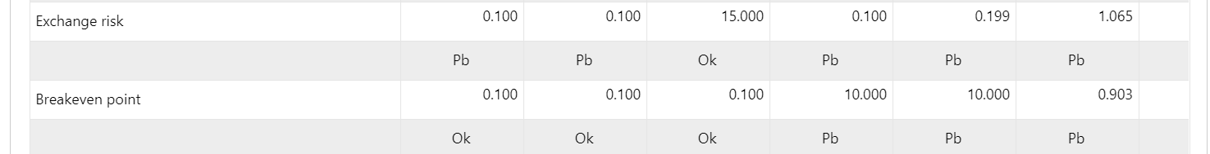
3. Financial Ratios – Operation Period
Breakeven Point
Provides insight to how close company is covering its fixed and variable costs based on its current level of production or sales
If 1 → costs can just be covered → Fixed Costs = Sales – Variable Costs
If 0.5 → even if plant would only generate 50% of the sales, it would still cover its costs
If 0.5 → Fixed Costs = 0.5 * (Sales – Variable Costs)
$$Breakeven point ratio= \frac{\left(Fixed \left(incl. financing\right) costs\right)}{Sales −Variable Costs associated with Electricity Sales}$$
Notes:
The breakeven point ratio is a variation of the breakeven analysis that expresses the breakeven point in terms of a ratio. Specifically, it is often represented as a percentage of capacity or sales. This ratio provides insight into how close a company is to covering its fixed and variable costs based on its current level of production or sales.
This ratio essentially tells you what percentage of your production or sales capacity needs to be utilized to cover all costs and break even. A lower breakeven point ratio indicates a lower risk, as the company needs to utilize a smaller portion of its capacity to cover costs. The breakeven point ratio is a useful tool for assessing risk, making production decisions, and understanding the relationship between fixed and variable costs in relation to total capacity or sales.

Slide 9
3. Financial Ratios – Operation Period
Debt Repayment Time
Time to repay current debt, assuming revenues remain constant
0.2 ≤ debt repayment time ≤ 40
$$Debt repayment time=\frac{Bonds and net loans outstanding}{Total revenues −Operational costs in cash −Royalties −Income tax}$$
Notes:
Debt repayment time refers to the period that the project is able to repay current debt, assuming the revenues remain constant. To calculate this, the debt is taken from the balance sheet, and the revenues are taken when one is considering operational costs and income tax payment

Slide 10
Thank you!
Notes:
Thank you!

