Slide 1


LECTURE 3
KEY GIS
CONCEPTS
Geospatial Clean Cooking access modelling using OnStove
Version 1.0

Slide 2
Learning Outcomes
By the end of this lecture, you will be able to:
ILO1: Explain the challenges of projecting data.
ILO2: Describe the difference between vector and raster
ILO3: List different vector data types
ILO4: Describe the trade-offs when defining spatial resolution (grid cell size) and explain the specific benefits of using geospatial energy modelling.
Course Name
Notes:
This lecture has four Intended Learner Outcomes. After this lecture, you will be able to
Explain the challenges of projecting data.
Describe the difference between vector and raster
List different vector data types
Describe the trade-offs when defining spatial resolution (grid cell size) and explain the specific benefits of using geospatial energy modelling.
These learning outcomes will be important for the basic understanding of the G.I.S aspects of OnStove modelling.

Slide 3
3.1 Coordinate systems in GIS
GIS tools
QGIS (Quantum GIS)
GRASS GIS …and many more
SAGA GIS
Mapnik …and many more
Autodesk - AutoCAD
ESRI – ArcGIS …and many more
Open Source Software – Desktop based tools
Open Source Software – Web based tools
(OpenStreetMap)
Commercial Software – Desktop based tools
Choose according to your needs!
Source: Khavari et al. 2021
Mentis et al., 2016: QGIS 2021
Notes:
In this segment, we will go through the concept of projection systems as that is important to understand if you're working with G.I.S. But before we do that, let us spend some time talking about available G.I.S-software. There are many software options to choose from and you will have to select one based on your needs. This is important because your G.I.S-software is the easiest way for you to manipulate and analyse your data. Make sure you choose the right software for the type of application that you wish to conduct.
There are open source software that are completely free, and then there are commercial alternatives that you need a licence for. There are desktop based tools that you can download and install on your computer and then use wherever you are. And then there are web-based tools that you need an online connection in order to use. We recommend to use Q.G.I.S, which also includes GRASS, SAGA, and G DAL.

Slide 4
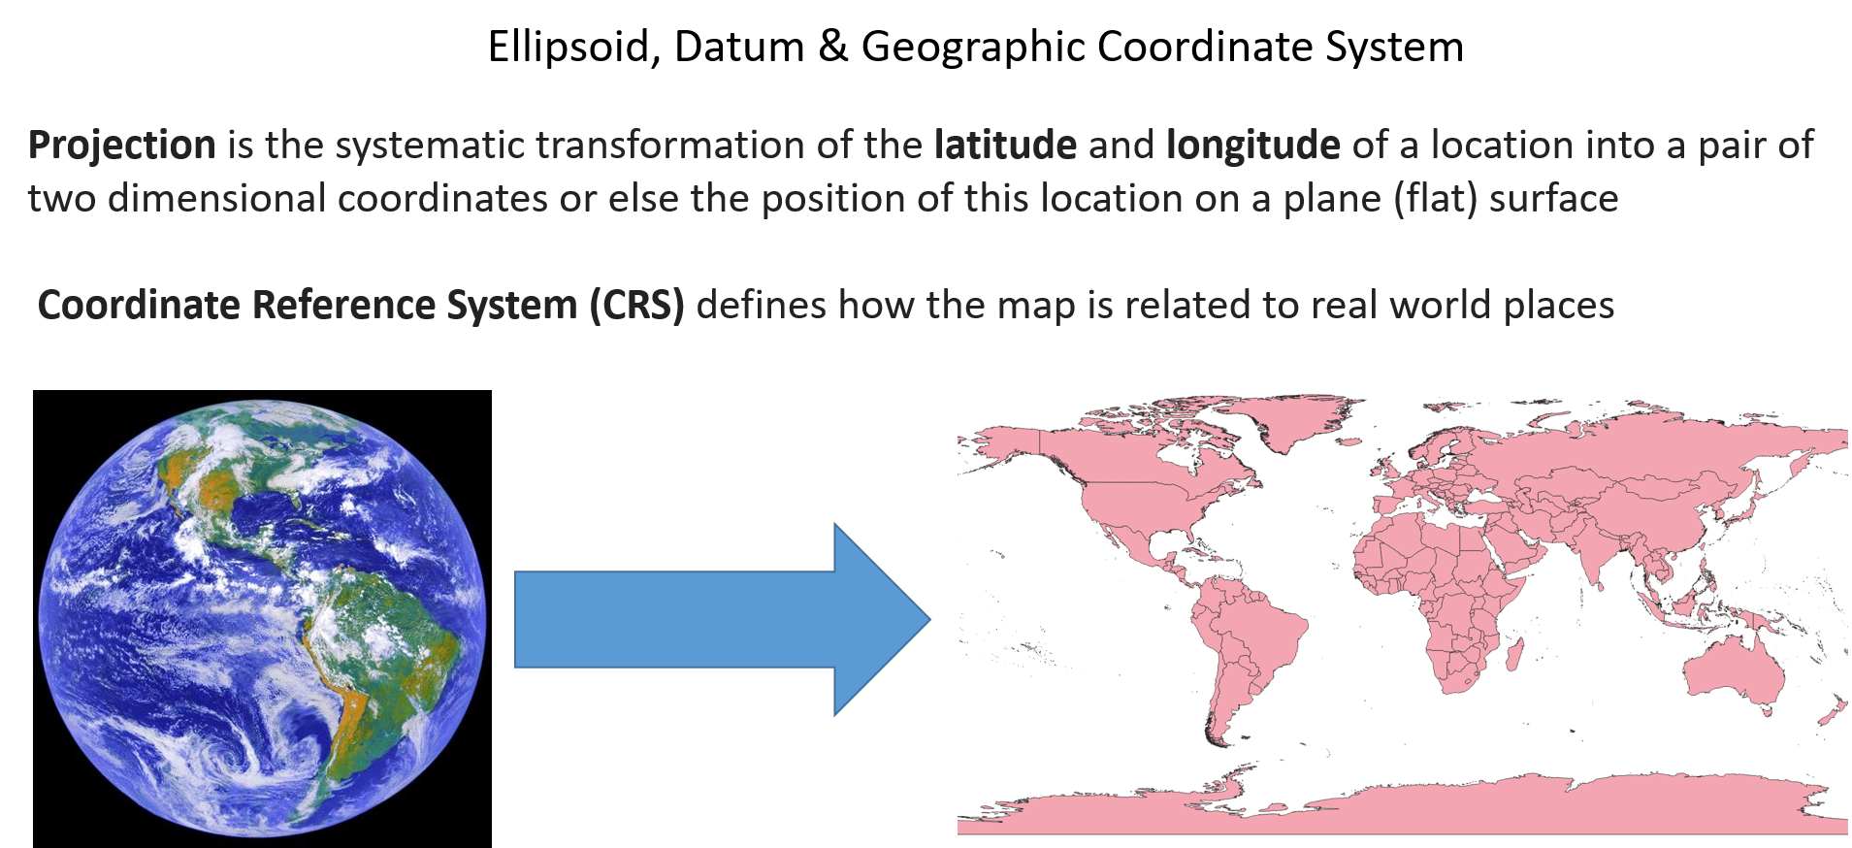
3.1 Coordinate systems in GIS
Basic GIS concepts
Picture source: Khavari et al. 2021, image, license under CC-BY 4.0
Source: Khavari et al. 2021
QGIS 2021
Notes:
Let us continue by going through some basic G.I.S concepts that are important to understand and master when working with G.I.S. We are going to start with projection systems.
Every geospatial dataset, no matter its type, has a projection system attributed to it. The projection system has large implications on your analysis. Let us spend some time to understand how it is used and its importance. The earth is in the form of a sphere. And what a map projection does is that it tries to visualize this spherical area onto a flat surface. In other words, it is used in order to turn a three-dimensional object into a two-dimensional representation. A coordinate system then defines how well your two-dimensional representation relates to the three-dimensional reality. How well have you managed to represent your area of interest?
Whenever you project a three-dimensional object onto a two-dimensional plane, there will be distortions. These distortions can be connected to area and scale, that is, certain regions of a map appear larger than what they actually are in comparison to others. Or, these distortions can have an effect on the direction and shape of different regions on your map. At least one of these aspects: area, scale, direction, or shape will always be distorted. Sometimes distortion can occur in all of them. In order to counter this, we define map projections. There are three major categories:
Cylindrical projections preserving distances and areas.
Conical projections preserving angles.
Planar projections preserving distances.
There are advantages and disadvantages no matter which one of these we choose.

Slide 5
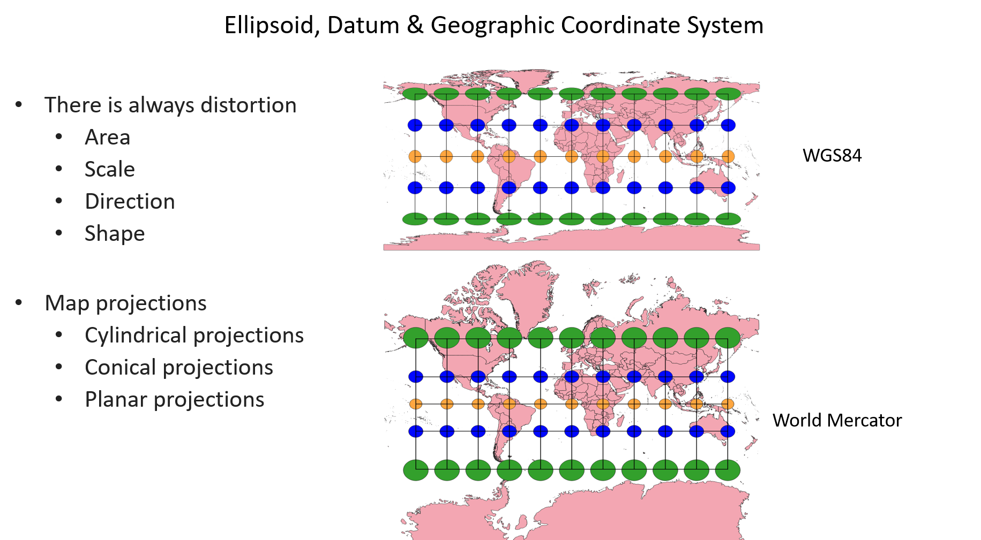
3.1 Coordinate systems in GIS
Comparison between different projections
Source: Khavari et al. 2021
Picture source: Khavari et al. 2021, image, license under CC-BY 4.0
QGIS 2021
Notes:
The image shows two maps of the world. Both maps are correct, but they are in a different coordinate system. One of them is WGS84 and the other one is in World Mercator. If you look at the maps, you see that they look very different, especially if you look in the northern and southern regions. This is because these two coordinate systems distort differently. Both of the maps are also overlaid with a grid of lines and circles. The orange circles (and the line intersecting them) go by the equator. 30 degrees north of the equator and 30 degrees south of the equator there are blue circles. 60 degrees north and south of the equator, there are green circles. This is called Tissot’s ellipse, and it is a method of understanding the distortion that is created by different coordinate system. If there were no distortions, all circles would be the same size as the orange circles. But you see that the circles get larger, the further away we get, the blue circles are a little bit larger than the orange ones and the green ones are very much larger than the orange ones. In WGS84, the shape of the green ones is also distorted. This means that the WGS84 distorts shape as well as size. In the World Mercator the shape of the green circles are still circle-like, meaning that the distortion in World Mercator does not have an effect on the shape, only size. That is the reason why the countries and regions in north and south have very different shapes between the two different maps.

Slide 6
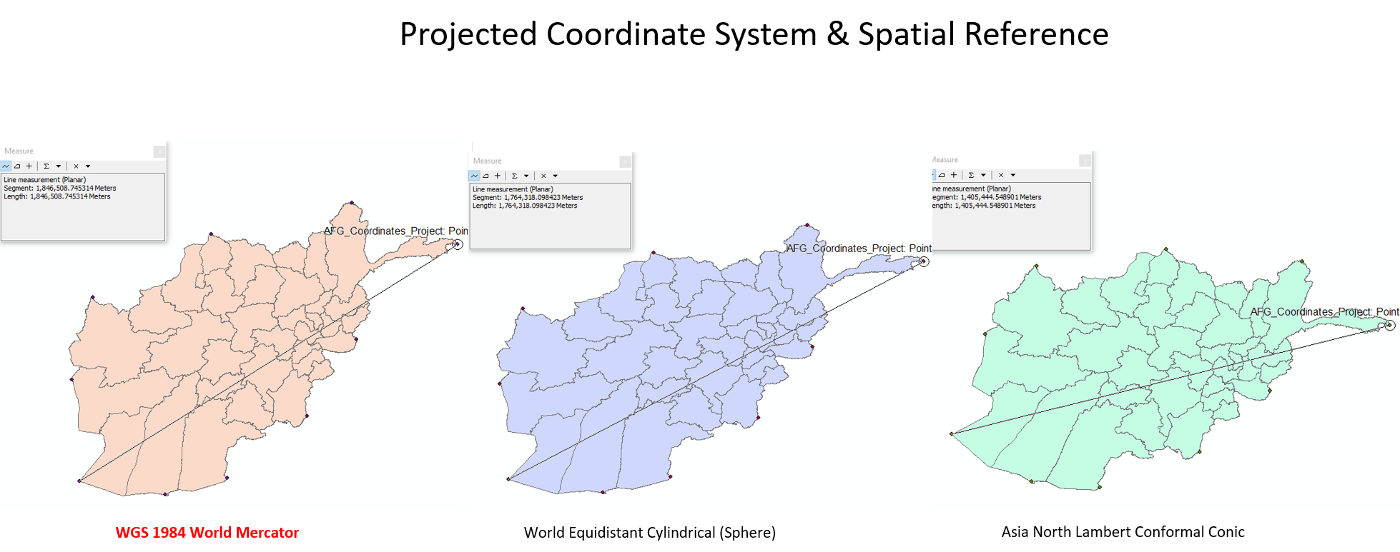
3.1 Coordinate systems in GIS
Example of Afghanistan
Source: Khavari et al. 2021
Picture source: Khavari et al. 2021, image, license under CC-BY 4.0
Notes:
On a national scale, the distortion might look like this image. In this image we have three maps of Afghanistan with three different coordinates systems, and we have measured the distance between point A and B (the same points in all maps). But based on which coordinate system we choose, the distance is very different. Comparing the maps there is a difference of more than 400 kilometers between the points. You can also see that the shape is very different between the green, purple and the orange map. Again, the shape has been distorted.
Some key takeaway messages:
When generating maps, there will always be distortions. You have to understand what type of distortions you're dealing with and you also have to understand which coordinate system you should choose in order for you to minimize these distortions. This means that you have to choose the projection system with a lot of care.

Slide 7
Lecture 3.1 References
Khavari, B., Sahlberg, A., Korkovelos, A., Mentis, D., n.d. Lecture 2: Introduction to the Theory and Application of GIS | OnSSET Teaching Kit [WWW Document]. URL https://onsset.github.io/teaching_kit/courses/module_1/Lecture%202/ (accessed 2.18.21).
Mentis, D., Andersson, M., Howells, M., Rogner, H., Siyal, S., Broad, O., Korkovelos, A., Bazilian, M., 2016. The benefits of geospatial planning in energy access – A case study on Ethiopia. Applied Geography 72, 1–13. https://doi.org/10.1016/j.apgeog.2016.04.009
QGIS, 2021. 8. Coordinate Reference Systems — QGIS Documentation documentation [WWW Document]. URL https://docs.qgis.org/3.16/en/docs/gentle_gis_introduction/coordinate_reference_systems.html (accessed 2.15.21).
Course Name

Slide 8
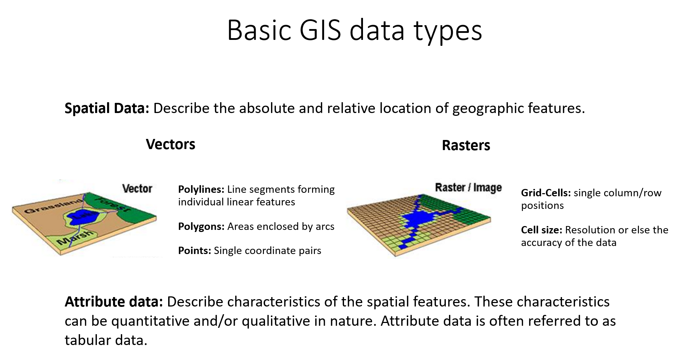
3.2 Vector data
Basic GIS data types
Source: Khavari et al. 2021
Picture source: https://onsset.readthedocs.io/en/latest/data_acquisition.html
QGIS 2021
Notes:
In this part of the lecture, we will introduce the basic data types that you might encounter while working with OnStove, and we will describe the characteristics that define them. There are two major types of data: spatial data and attributes. Spatial data describe the location, size, and shape of different objects. Spatial data can be represented as either vectors or rasters. There are three types of vector data: points, lines, and polygons. These different types are suited for describing different objects. Rasters often cover large areas and are built by the grid cells which are defined by coordinates, attributes, and cell size. Which data type you use is highly dependent on what you are trying to visualize. Some attributes are better visualized with rasters, while others are much better visualized with vectors. Spatial data contain more information than just the location of the features. Any additional information or non-spatial data that describe a feature are referred to as an attribute, which is the second major data type. An example of this is a point layer visualizing the buildings of an area. The spatial data are the location of these buildings, while the attribute data are any other information connected to them. This could be the year the buildings were built, the intended use of the buildings, or the number of floors.

Slide 9
3.2 Vector data
What are vector data?
Represent real world features (e.g., roads, rivers, power plants, transmission lines, etc.)
Data with discrete boundaries
Are defined by specific coordinates and come along with attributes
Three different types: points, lines and polygons
Source: Khavari et al. 2021
QGIS 2021
Notes:
Let's look a little bit into what the data are. Vector data represent real world features and features are anything you can see in a landscape such as houses, roads, rivers, and so on. The data that are best described by vectors are data that have discrete boundaries. In other words, by just looking at a feature, you should be able to distinguish it from its surroundings. You can distinguish a house from its surroundings. You can distinguish roads from their surroundings, rivers from their surroundings, and so on. These type of features are well represented with different types of vector data. Vector data consist of points. We call them vertices with X and Y coordinates that together form a vector layer. Vertices are basically just points for where multiple features meet. There are three different types of vectors. These are points, lines, and polygons.

Slide 10
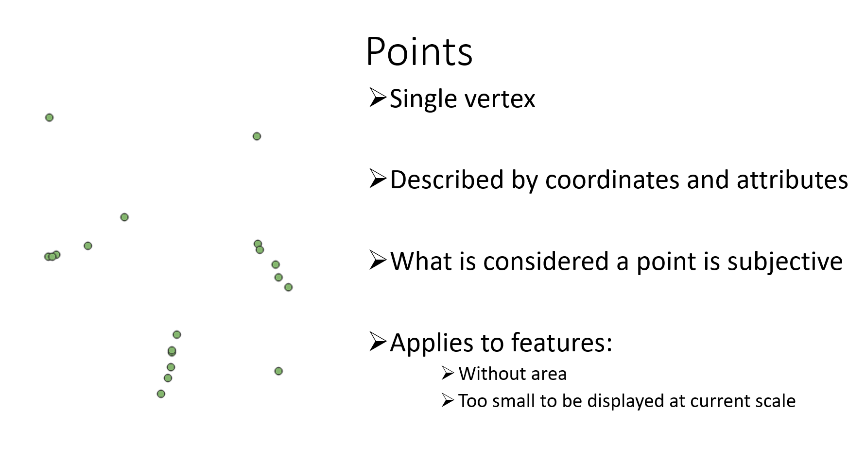
3.2 Vector data
Points
Source: Khavari et al. 2021
Picture source: Khavari et al. 2021, image, license under CC-BY 4.0
QGIS 2021
Notes:
Point data are described by a single vertex, none of these vertices are connected to one another. Instead, they all form their own units. Usually they have a single set of X and Y coordinates together with the spatial coordinates. In most cases, there is also attribute data that describe each point that helps the user to distinguish between one point to another. What is considered a point is subjective. Now, what do we mean by that? Well, a point represents the feature without an area. When a feature is missing an area it is highly dependent on the scale of the map. If you are representing a country, then every city in that country can be considered a point. If you, on the other hand, have a city map, then different buildings or points of interest can be visualized with points.

Slide 11
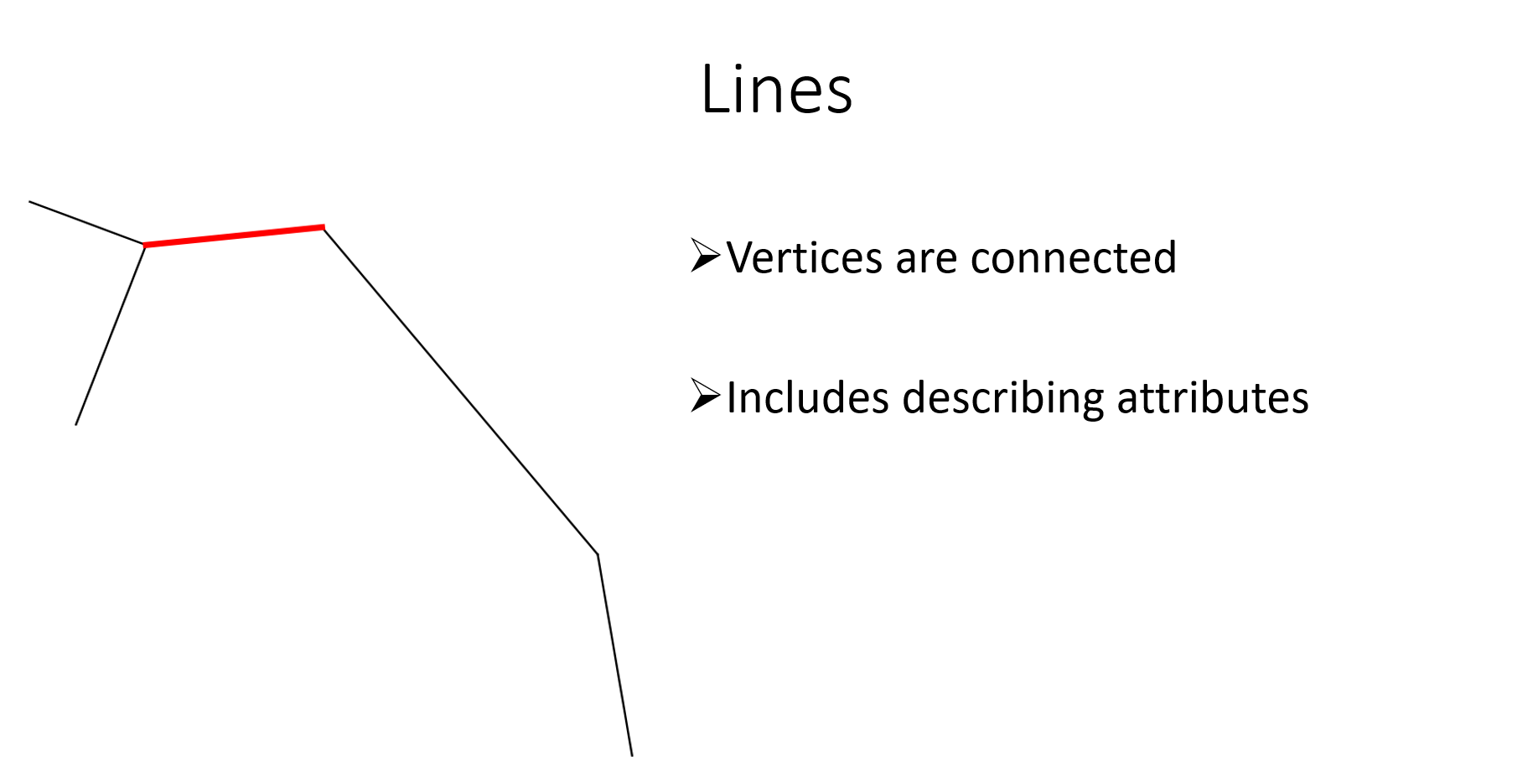
3.2 Vector data
Lines
Source: Khavari et al. 2021
Picture source: Khavari et al. 2021, image, license under CC-BY 4.0
QGIS 2021
Notes:
The second type of vector data is line data. Line data consist of at least two or more vertices that are connected to one another. In this image here, we have highlighted one of the lines in red. At each end of this red line, there is a vertex, and because they are connected to one another, they form a line. And just like the points, they include some describing attributes. If this had been a transmission line, maybe the voltage of the lines would have been an attribute. Lines have a length, but they do not have an area. Again, just like with the points, the scale is important. If you're representing a country, then the river network might be a line layer. If you zoom into a landscape, then the river network might very well be represented with a polygon.

Slide 12
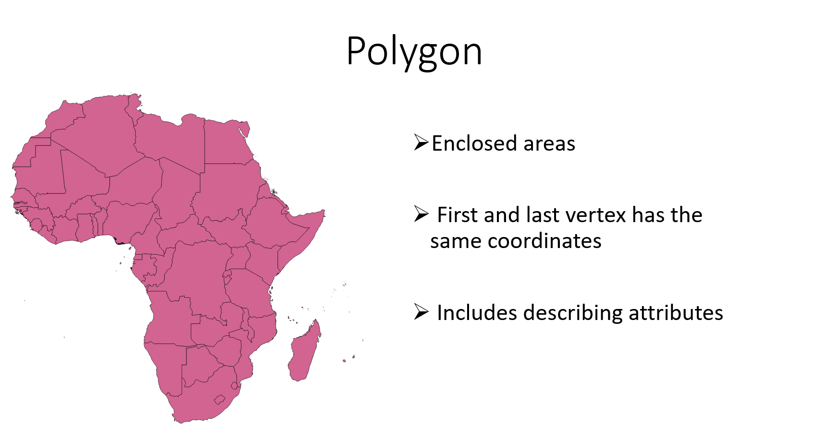
4.2 Vector data
Polygon
Source: Khavari et al. 2021
Picture source: Khavari et al. 2021, image, license under CC-BY 4.0
QGIS 2021
Notes:
Polygons are the last type of vector data. Polygons form closed areas. They are very similar to lines. The difference is that they consist of at least four vertices and the last and first vertex always shared the same coordinates, forming the same closed area. And just like points and lines they also include describing attributes. Here we have a map of Africa and every single country in the map is its own polygon. The attributes that could be tied to these polygons are, for example, the name of the country, the population size, and the electrification rate.

Slide 13
Lecture 3.2 References
3. Vector Data — QGIS Documentation [WWW Document], n.d. URL https://docs.qgis.org/3.16/en/docs/gentle_gis_introduction/vector_data.html (accessed 2.15.21).
Khavari, B., Sahlberg, A., Korkovelos, A., Mentis, D., n.d. Lecture 2: Introduction to the Theory and Application of GIS | OnSSET Teaching Kit [WWW Document]. URL https://onsset.github.io/teaching_kit/courses/module_1/Lecture%202/ (accessed 2.18.21).
Course Name
Mini Lecture Learning Objective

Slide 14
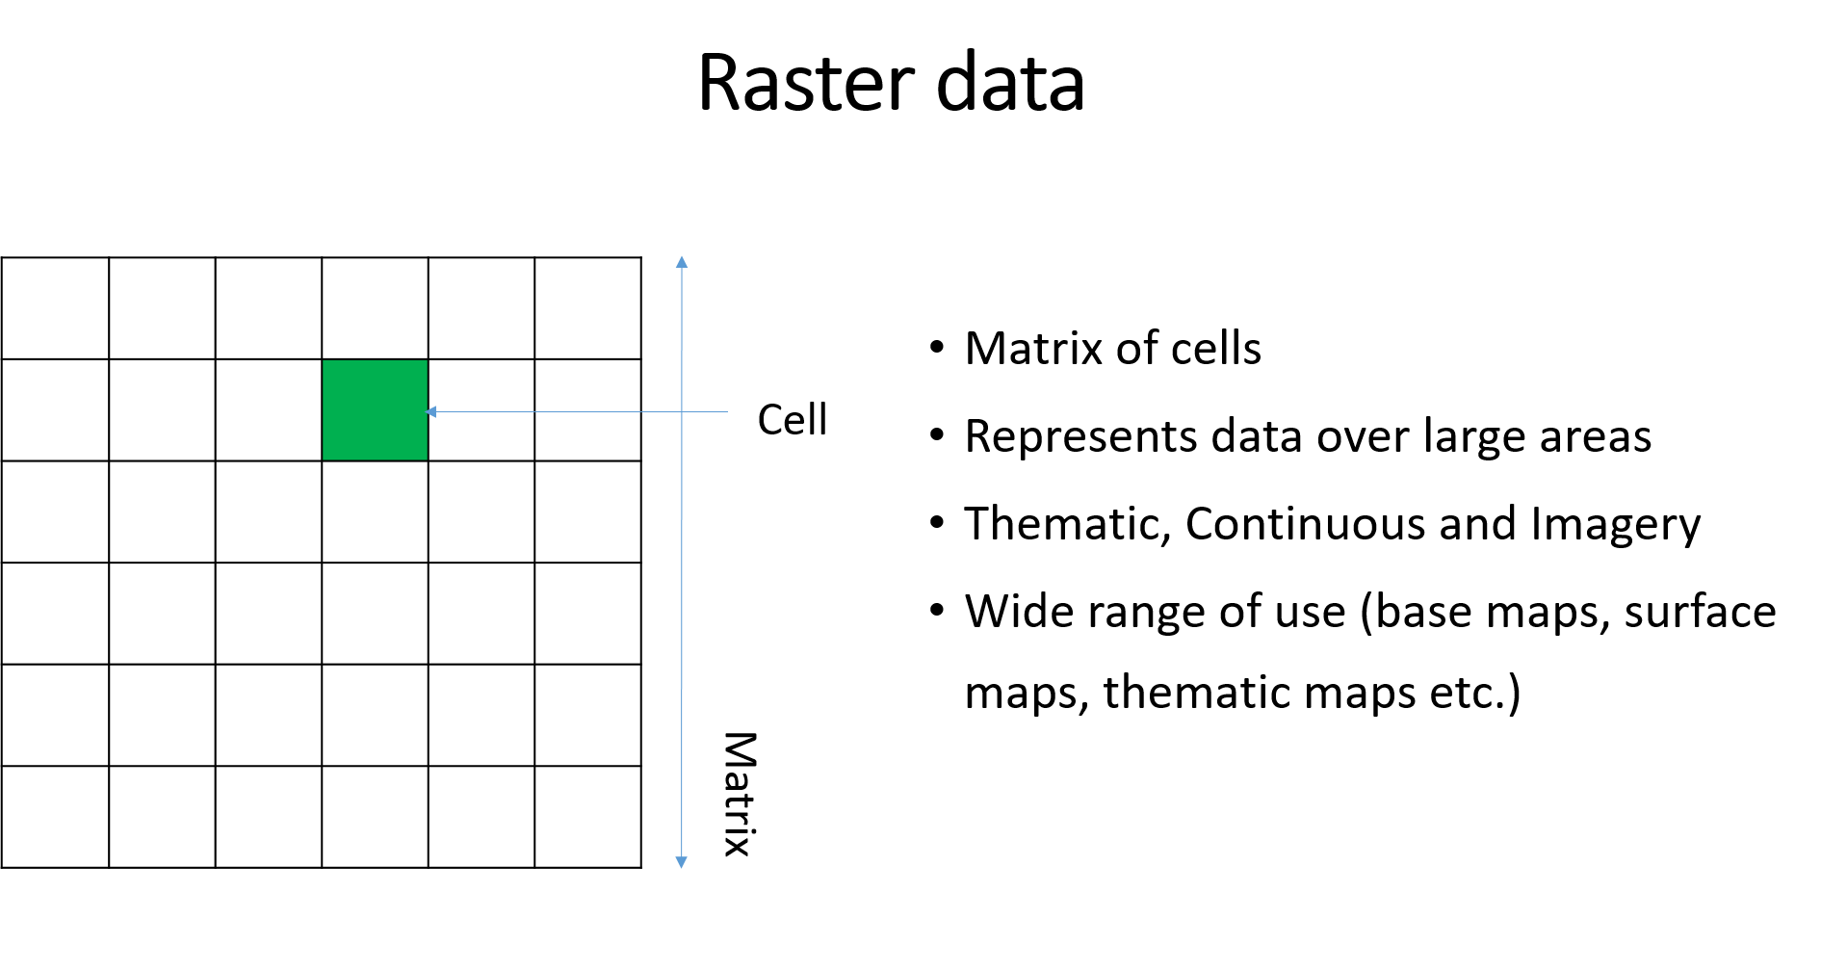
3.3 Raster data
Raster data
Source: Khavari et al. 2021
Picture source: Khavari et al. 2021, image, license under CC-BY 4.0
QGIS 2021
Notes:
Raster data differ from regular data in many aspects. Instead of representing real-life objects with clear boundaries, rasters are composed by cells. They form matrices, and together they represent surfaces. In this image the green square represents a cell, and together with the white cells around it, it forms a matrix. This matrix is what we call a raster. Every cell has its own data stored in the form of coordinates and attributes. This makes raster data a good option for representing continuous surfaces across large areas. That is because every single one of these squares can capture different attributes and convey a different message. Raster data are usually divided into three groups: Thematic, Continuous, and Imagery. Thematic rasters are usually representing datasets such as land cover, while continuous rasters represent data that lack sharp borders, whereas the thematic rasters usually have sharp borders. The continuous datasets tend to represent data such as temperature, elevation slope, and wind speeds. Imagery rasters are scanned maps that are common as base maps, and they can be used in order to make sure that the vertices in a vector dataset are correctly aligned. The different types of raster data that you use have large implications of how the datasets can be manipulated. We will look at this a little bit deeper in this course, but also in the exercises in this course. The use of raster data spans over a wide range of applications. You can use raster data as base maps underneath your vectors in order to validate them and give them context. You can use them as a surface map that provides an effective method of storing the continuity as a surface, or you can use them as the thematic maps, classifying a surface into different classes depending on an attribute of choice.

Slide 15
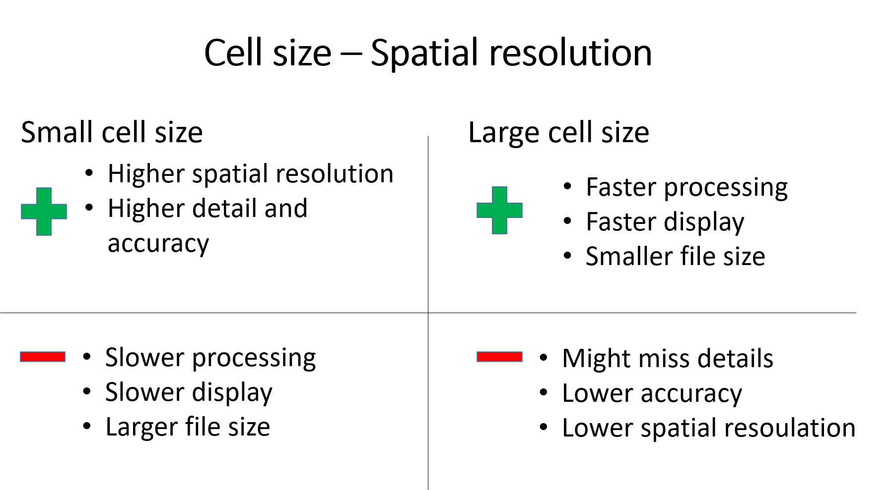
3.3 Raster data
Trade-off in the spatial dimension
Source: Khavari et al. 2021
Picture source: Khavari et al. 2021, image, license under CC-BY 4.0
QGIS 2021
Notes:
Let us have a look at the implications that each cell size has. The level of detail represented by a raster is often dependent on the cell size. Sometimes the cell size is also called pixel size or a spatial resolution. The cell must be small enough to capture the required detail, but large enough so computer storage and analysis can be performed efficiently. The more homogenous an area is for critical variables, such as topography and land use, the larger the cell size can be without losing accuracy. Determining an adequate cell size is very important in your GIS application. Images with a small pixel size are called high resolution because it is possible to make out a high degree of detail in the image. Images with a large pixel size are called low resolution because the amount of detail is lower. On this slide, some of the pros and cons of small and large cell size are listed. As you can see, the choice of resolution often comes down to a tradeoff between accuracy and computational time.

Slide 16
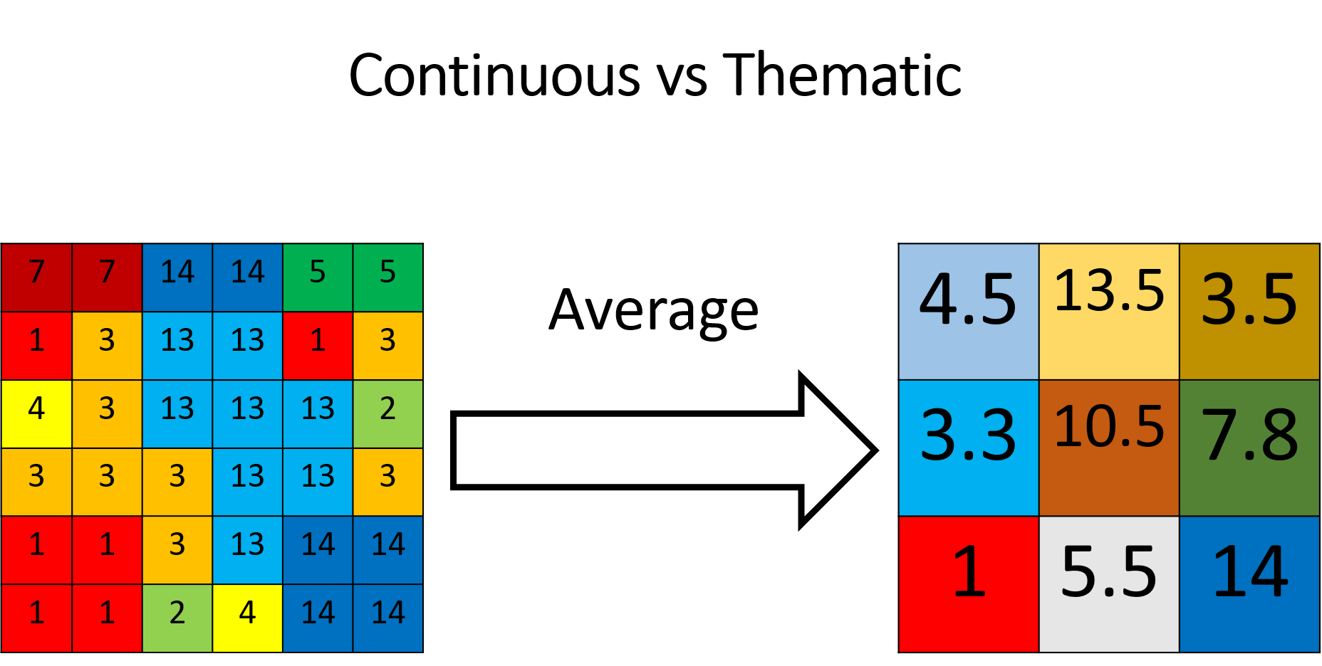
3.3 Raster data
Raster types
Source: Khavari et al. 2021
Picture source: Khavari et al. 2021, image, license under CC-BY 4.0
QGIS 2021
Notes:
Because cell size is so important, we will also take a look at how they can be altered when conducting an analysis. It is useful to have datasets that all have the same cell size. However, in many cases you will not be able to find all of your datasets with the same resolution. And in these cases, it is necessary to change the cell size. In QGIS this can be done with a tool called Translate. We will be looking at how this tool can be used to practice a little bit later during the exercise. We have previously mentioned that there are different types of raster datasets: thematic, continuous, and imagery. And we also talked about the fact that, depending on which type of raster you have, there are different implications regarding how datasets can be altered. Changing the cell size is one of these implications. If we have a continuous dataset, they can take any value within that range, no matter whether it is an integer or not. It could potentially be resampled using an average method. That's what is illustrated here with two rasters. Every cell has its own value, and then we resample it to a larger cell size. And the process will take the four cells corresponding to the larger cell, calculate the average of those four and return a larger cell size layer. This can be done because we are converting to a continuous raster.

Slide 17
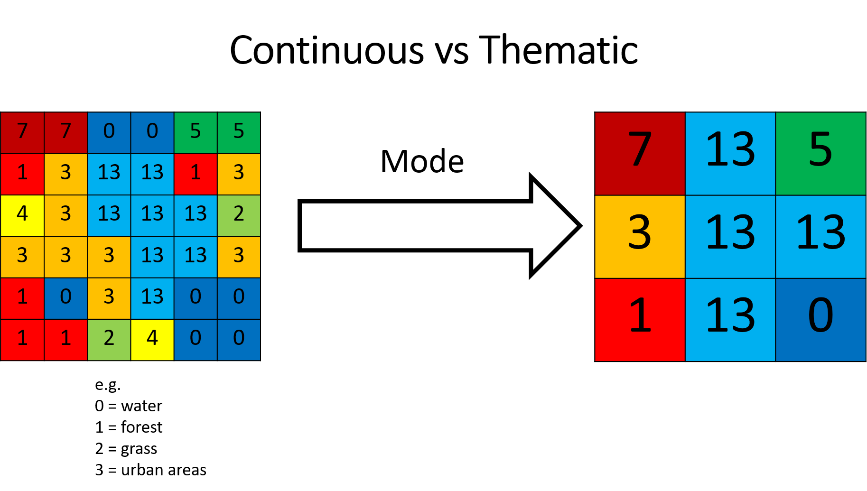
3.3 Raster data
Raster types
Source: Khavari et al. 2021
Picture source: Khavari et al. 2021, image, license under CC-BY 4.0
QGIS 2021
Notes:
Assuming that we have a thematic raster, such as a land cover raster, then every single area in your land will be coupled and classified into different groups. Each group will have its own number and characteristics. Let’s say zero is water, one is forest, two is grass, three is urban areas etc. These values are discrete. In other words, you can't have whatever value you like. In this case, zero is water and one is forest. However, values between zero and one don't mean anything. Therefore we need to resample in a different way as we can't use averages anymore. In this case, we have used Mode or Majority in Q.G.I.S. Here the four cells again become a larger cell. The operator looks at the four cells and it takes the value that is in majority. This is a good way of actually staying within the values that you have your classifications. We will be looking into how to do this more in depth during the exercises.

Slide 18
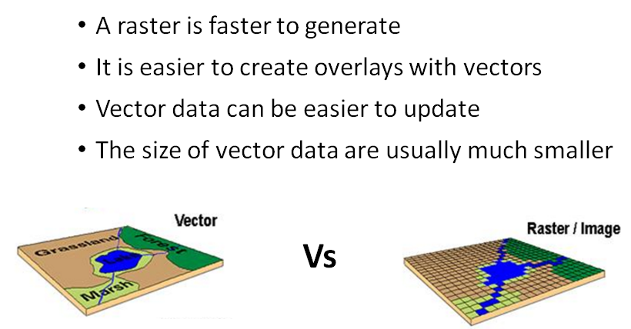
3.3 Raster data
Summary
Source: Khavari et al. 2021
QGIS 2021
Notes:
What are the differences between rasters and vectors? We've looked at a little bit what type of data they represent, but how do they compare to one another? Rasters are faster to generate. This is because the points, lines, and polygons need to be constructed from the geometry and topology, which takes longer than just generating a matrix with different colours. It is easier to overlap vectors since raster cover large areas. If you would like to overlay one raster with another, we would need to manipulate the transparency and there might be difficulty in combining rasters with different cell sizes. Vector data is easy to update whenever you need to update it. You just update the vertices that are connected to the part of the vector data you want to update (normally though, it is attributes). But if you would like to update a raster, you will have to update all of its cells. This takes longer time and might be more difficult. In vectors, we only store the vertices. For rasters, we have to store all of the pixels. Therefore, vectors don't take as much space on your computer as rasters do.
Some key takeaway messages: Vectors represent objects with discrete boundaries, meaning you can easily tell the feature apart from its surroundings. Rasters usually represent non-homogeneous data covering large areas. Cell size is very important in your analysis, and you have to choose it carefully. It has implications with regards to accuracy and time of your analysis. And there are three different types of vector data: points, lines, and polygons. You choose which one you want to use based on what you're trying to visualize.

Slide 19
Lecture 3.3 References
6. Raster Data — QGIS Documentation documentation [WWW Document], n.d. URL https://docs.qgis.org/3.16/en/docs/gentle_gis_introduction/raster_data.html (accessed 2.15.21).
Khavari, B., Sahlberg, A., Korkovelos, A., Mentis, D., n.d. Lecture 2: Introduction to the Theory and Application of GIS | OnSSET Teaching Kit [WWW Document]. URL https://onsset.github.io/teaching_kit/courses/module_1/Lecture%202/ (accessed 2.18.21).

Slide 20
3.4 The role of GIS modelling
Georeferencing
Determine the geographic location of the acquired data
Create a reference framework as a facilitator for the georeferencing process
Use the output raster layer as a complementary source of filling data gaps.
Create vector layers with all available information you can get (e.g., transmission line, power plans, sub-stations, roads etc.)
Source: Khavari et al. 2021
Notes:
We are briefly going to introduce another important G.I.S concept: georeferencing. Georeferencing is the process of turning data and imagery without spatial coordinates into G.I.S-data. This data can range from aerial photos to PDF maps from different reports. In simple terms, georeferencing is the process of aligning the data that you are working with to real-life objects.
Doing this, you can find out exactly which location on earth that your dataset represents. After georeferencing you have created a new dataset that can be used in any G.I.S software, just like any other geospatial data. The advantages of georeferencing are many. First and foremost, it can be used in order to validate your different datasets, but it can also be used in order to generate vector datasets that you would otherwise not have access to. And this is where we use it the most in energy modelling. In many situations you might be missing a dataset or your dataset might not be completely up to date. If you then can find a printed report with maps visualizing this information, you can georeference the image yourself. Then you can use this image to generate your dataset. Therefore georeferencing is a powerful tool for covering data gaps by taking maps and reports and turning them into G.I.S datasets that we would be missing otherwise.

Slide 21
3.4 The role of GIS modelling
The role of GIS modelling
The use of GIS serves multiple purposes:
Location based assessments: GIS tools enable assessments to analyse energy related geospatial information.
Remote sensing: The use of GIS tools facilitates the integration of remote sensing techniques to derive resource availability and energy potentials in cases where such data are not (publicly) available.
Illustration of results: GIS is used to illustrate results in interactive maps, providing an effective science–policy interface.
Source: Sahlberg et al. 2021
Notes:
In geospatial energy models, we use G.I.S or geographic information systems. The reasons we are using G.I.S are multiple. The first reason is that with the G.I.S tools, we can do location based assessments. We can analyse for different locations which is the best energy option, depending on the local characteristics. We can use some remote sensing techniques like satellite data. From that we can generate information that might not be available without the use of G.I.S. And we can also use G.I.S to illustrate the results on a map regarding which technology to use and where. This is especially useful in a science–policy interface where we use the models in a scientific way to generate energy transition scenarios. The map can then help us communicate this message to policy makers. There's a saying that a picture says more than a thousand words, and similarly we often talk about the power of a map.

Slide 22
3.4 The role of GIS modelling
Key take away messages for Lecture 3
Projected coordinate systems are always distorted, so choose carefully
Vectors represent objects with discrete boundaries
Rasters usually represent non-homogenous data covering large areas
Spatial resolution is very important in your analysis and has to be chosen carefully, considering trade-offs between accuracy and time
There are three types of vector data: points, lines, and polygons. They are best suited for identifying real-life objects
In energy modelling the geospatial dimension is important when addressing key questions about the spatial dimension
Source: Sahlberg et al. 2021
Notes:
A few key takeaway messages:
Projected coordinate systems are always distorted, so choosing them is important for your analysis. Vectors represent objects with discrete boundaries. You can easily tell the feature apart from its surroundings, whereas raster data usually represent non-homogeneous data covering large areas. Cell size is very important in your analysis and you have to choose it carefully. It has implications regarding the accuracy and time of your analysis. And there are three different types of vector data: points, lines, and polygons. You choose which one you want to use based on what you're trying to visualize. Finally, the geospatial dimension is important when addressing key questions such as distance to roads or electricity distribution lines.

Slide 23
Lecture 3.4 References
14.2. Lesson: Georeferencing a Map — QGIS Documentation documentation [WWW Document], n.d. URL https://docs.qgis.org/3.16/en/docs/training_manual/forestry/map_georeferencing.html?highlight=georeferencing (accessed 2.15.21).
Khavari, B., Sahlberg, A., Korkovelos, A., Mentis, D., n.d. Lecture 2: Introduction to the Theory and Application of GIS | OnSSET Teaching Kit [WWW Document]. URL https://onsset.github.io/teaching_kit/courses/module_1/Lecture%202/ (accessed 2.18.21).
Sahlberg, A., Khavari, B., Korkovelos, A., Mentis, D., n.d. Lecture 3: Application of GIS in electrification analysis in the OnSSET tool [WWW Document]. OnSSET Teaching Kit. URL https://onsset.github.io/teaching_kit/courses/module_2/Lecture%203/ (accessed 2.18.21).
Mini Lecture Learning Objective

Slide 24

Thank you
for your attention
in this lecture!
22

Slide 25

Khavari B., Ramirez C. 2021.
Lecture 3: Geospatial Clean Cooking access modelling using OnStove. Release Version 1.0. [online presentation]. Climate Compatible Growth Programme, Energy Sector Management Assistance Program and World Bank Group
CCG courses (this will take
you to the website link http://www.ClimateCompatibleGrowth.com/teachingmaterials)

