Slide 1
Financial Statements in FINPLAN
Notes:
Licence: This work is licensed under the Creative Commons Attribution 4.0 International License (CC BY 4.0). To view a copy of this license, visit https://creativecommons.org/licenses/by/4.0/.
Attribution: Please cite as: Tan, N. (2025) Financial Statements in FINPLAN. Version 1. Climate Compatible Growth Teaching Kit Website, Climate Compatible Growth.

Slide 2
Contents
Balance Sheet
Income Statement
Cash Flow Statement
Shareholder’s Return
Project Finance Analysis

Slide 3
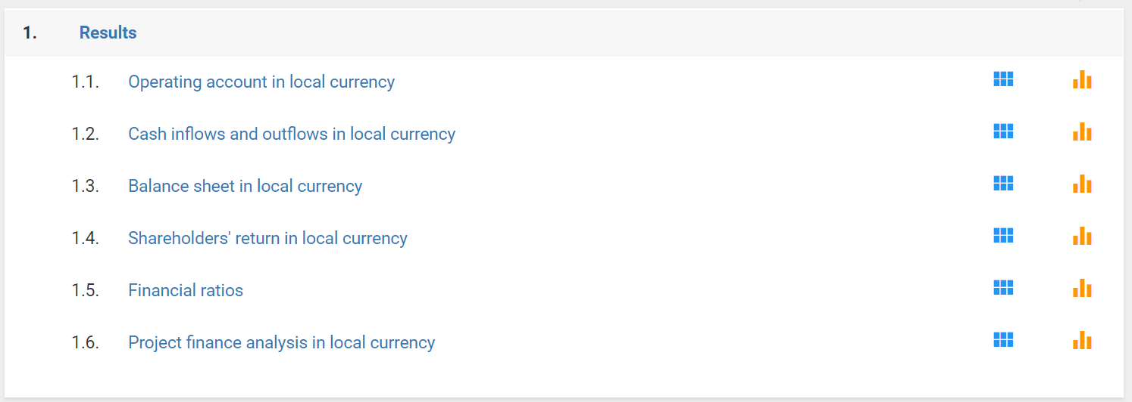
1. Balance Sheet
Overview
Snapshot of financial situation at a specific date, e.g., 31 Dec
Summarizes assets, liabilities, and equity
Accumulative amounts
Of interest, e.g., if someone would wish to buy the company
Notes:
A balance sheet is one of the fundamental financial statements that provides a snapshot of a company's financial position at a specific point in time. For example, the 31st Dec. It presents a summary of a company's assets, liabilities, and shareholders' equity. Assets are what a company owns or controls, Liabilities represent the company's obligations or debts, and Shareholders' equity represents the residual interest in the company's assets after deducting its liabilities. They are shown in accumulative amounts, and Understanding the balance sheet is crucial for financial analysis and decision-making, as it provides a comprehensive overview of a company's financial structure and resources. It is often presented alongside the income statement and cash flow statement to provide a complete picture of a company's financial performance. They can be of interest if someone would wish to buy the company.

Slide 4
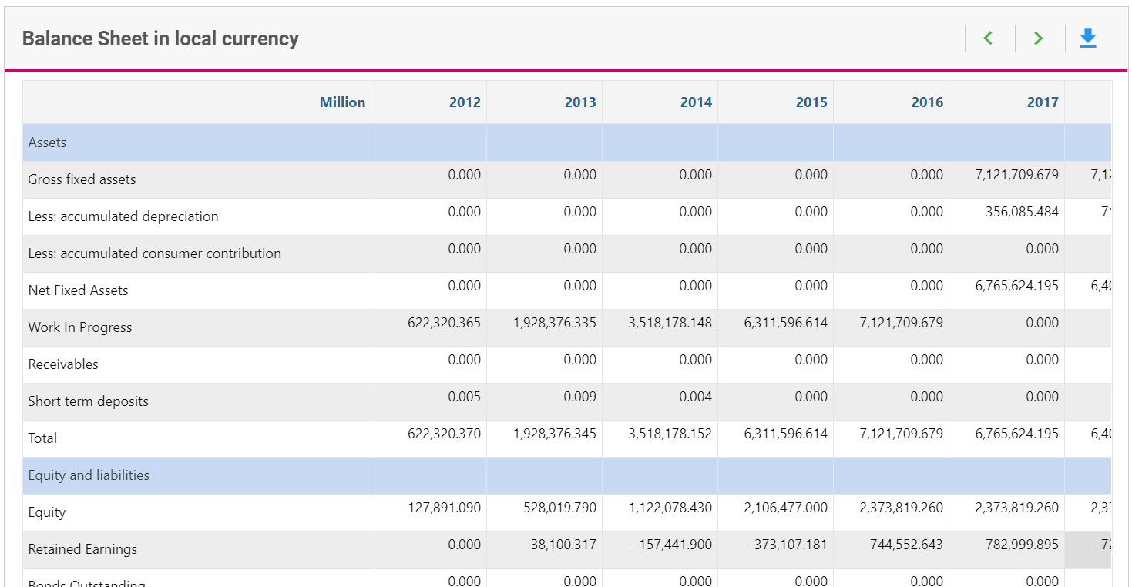
1. Balance Sheet
Overview
Notes:
Assets, liabilities, equity. Accumulative amounts.

Slide 5
1. Balance Sheet
Retained earnings
Also in Income Statement
Earnings which are not paid out
If negative:
  Accumulated net losses over time
  Distributed more in dividends than it has earned in profits
In FinPlan:
  The income statement shows retained earnings in yearly values
  The balance sheet shows retained earnings summed up
$$Retained earnings=Taxable Income −Income Tax −Dividends$$
Notes:
On finplan, retained earnings can be found in the balance sheet, and also in the income statement, which we will talk next. Retained earnings represent the cumulative net earnings or losses of a company that have been retained and not distributed as dividends to shareholders i.e. it is it earnings which are not paid out. It is a key component of shareholders' equity on the balance sheet and reflects the portion of profits that a company has chosen to reinvest in the business rather than distribute to its shareholders. If the company's retained earnings is negative, it means that a company has accumulated net losses over time or has distributed more in dividends than it has earned in profits. In finplan, the The income statement shows retained earnings in yearly values
and The balance sheet shows retained earnings summed up

Slide 6

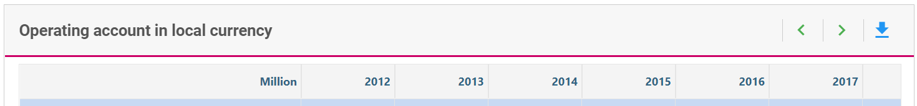
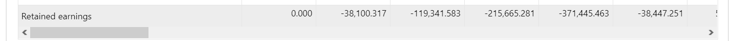
1. Balance Sheet
Retained earnings
Sum
Yearly
values

Slide 7
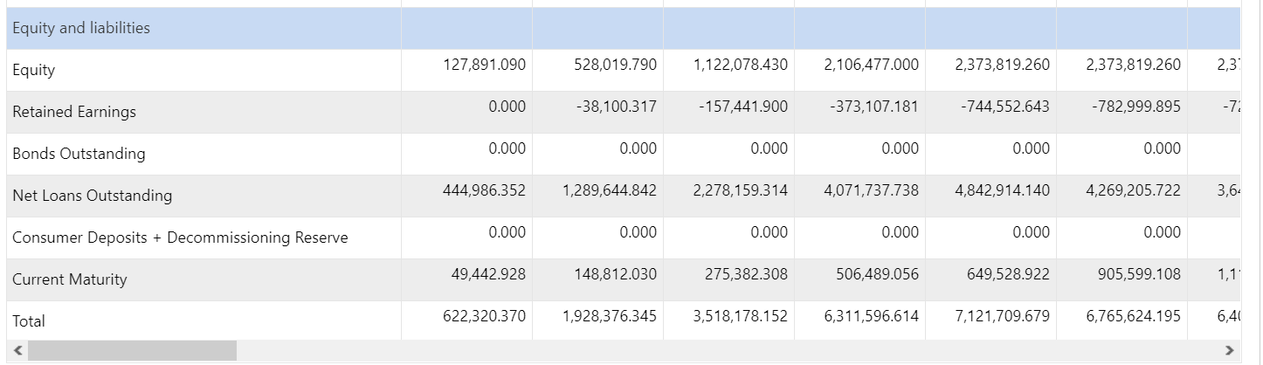

1. Balance Sheet
Current Maturity
Portion of company’s long-term debt that is expected to be repaid within the next accounting year
$$Current maturity=Repayments of principals of loans and bonds due next year+ending balance of standby facility$$
Notes:
Current maturity on a balance sheet typically refers to the portion of a company's long-term debt that is expected to be repaid within the next accounting year. It represents the principal (or repayment) portion of long-term debt that is due in the short term, usually within the next 12 months. This classification is important for assessing a company's short-term obligations and liquidity.

Slide 8
2. Income Statement
Overview
Also called Profit & Loss Statement or Operating Account
Summarizes revenues, expenses, and profits or losses of a company over a specific period (typically a year – as on FinPlan)
Provides comprehensive view of a company’s financial performance
Income basis for tax calculation & dividend payments
Notes:
An income statement, also known as a profit and loss statement or statement of earnings, is one of the fundamental financial statements that summarizes the revenues, expenses, and profits or losses of a company over a specific period of time, typically a year. Revenues, also known as sales or sales revenue, represent the total amount of money generated by the sale of goods or services during the reporting period, Expenses encompass all costs incurred by the company in its normal operating activities. The primary purpose of the income statement is to provide a comprehensive view of a company's financial performance during the reporting period. It helps investors, analysts, and other stakeholders assess a company's ability to generate profit and its overall financial health. Net income from the income statement is often used in financial ratios and metrics for performance analysis. And the income statement is also used for tax calculation and dividend payments.

Slide 9
3. Cash Flow Statement
Overview
Summarizes how cash moves in (i.e., money received) and out (i.e., money spent) of the company over a period
In FinPlan, it is called Cash Inflows & Outflows
Used to asses company’s ability to meet short- and long-term obligations, funding needs, and overall financial performance
Notes:
A cash flow statement is a financial statement that provides a summary of how cash and cash equivalents move in and out of a company over a specific period of time. It is an essential tool for understanding a company's liquidity, solvency, and overall financial health. Understanding the cash flow statement is crucial for assessing a company's ability to meet its short-term and long-term obligations, funding needs, and overall financial performance.

Slide 10
3. Income vs Cash Flow Statement
Overview
 | Income Statement | Cash Flow Statement
Purpose | To report profitability of company over a specific period. Details revenues, expenses, profits, losses. | Shows how cash is generated and used in operating, investing, and financing activities
Timing | Recognizes revenues and expenses when they are incurred, regardless of when cash is received or paid | Provides actual cash inflows and outflows during a specific period
Components | Revenues, expenses, income, interest, taxes, net income, etc. | Cash flows from operating activities, investing activities, financing activities
Non-cash | Includes depreciation and amortization | Depreciation are added back into the cash flow statement to combine net income with cash flow from operating activities
Investment | Does not directly provide information on cash used for investments or financing activities | Breaks down cash flows related to investments and financing
Notes:
The income statement and the cash flow statement are both important financial statements, but they serve different purposes and provide insights into different aspects of a company's financial performance. Here are the key differences between the income statement and the cash flow statement:
1. Purpose:
Income Statement:
The primary purpose of the income statement is to report the profitability of a company over a specific period, such as a quarter or a year. It details revenues, expenses, and profits or losses.
Cash Flow Statement:
The cash flow statement, on the other hand, focuses on the cash movements within a company. It shows how cash is generated and used in operating, investing, and financing activities.
2. Timing of Recognition:
Income Statement:
The income statement recognizes revenues and expenses when they are incurred, regardless of when the cash is received or paid. It is based on the accrual accounting method.
Cash Flow Statement:
The cash flow statement, however, reflects cash transactions when they occur. It provides a detailed account of actual cash inflows and outflows during a specific period.
3. Components:
Income Statement:
Components of the income statement include revenues (sales), cost of goods sold (COGS), gross profit, operating expenses, operating income, interest, taxes, and net income.
Cash Flow Statement:
Components of the cash flow statement include cash flows from operating activities, investing activities, and financing activities.
4. Non-Cash Items:
Income Statement:
The income statement includes non-cash items such as depreciation and amortization, which are accounting measures used to allocate the cost of assets over time.
Cash Flow Statement:
Non-cash items, like depreciation, are added back in the cash flow statement to reconcile net income with cash flow from operating activities.
5. Investment and Financing Activities:
Income Statement:
The income statement does not directly provide information on cash used for investments or financing activities.
Cash Flow Statement:
The cash flow statement specifically breaks down cash flows related to investments (e.g., capital expenditures) and financing (e.g., issuing or repurchasing stock, paying dividends, borrowing, or repaying debt).
While the income statement and cash flow statement provide valuable insights into a company's financial performance, they should be analyzed together to gain a comprehensive understanding. The income statement helps assess profitability, while the cash flow statement helps evaluate the actual cash movements and the company's ability to meet its short-term and long-term obligations.

Slide 11
3. Income vs Cash Flow Statement
Foreign Exchange Loss
Financial loss due to changes in exchange rates between local and foreign currencies
Income statement: needs to be accounted for to consider exchange rate changes
Cash flow statement: not required as actual repayments are considered
  E.g., you borrow 100 USD for 75 EUR for an investment. After 5 years: 100 USD = 100 EUR. Even if interest = 0, you have to pay back 25 EUR in addition, which do not show up in the depreciation charges.
Notes:
There is also foreign exchange loss that we need to consider. A foreign exchange loss occurs when a company experiences a financial loss due to adverse changes in exchange rates between the local currency and foreign currencies. This loss can impact a company's financial statements, affecting both the income statement and the balance sheet.
This needs to be accounted for in the income statement, to consider exchange rate changes. However, not required in cash flow statement as actual repayments are considered.

Slide 12
4. Shareholder’s Return
Overview
Financial gains or losses that shareholders receive from their investment
Assesses equity and dividends only, not the overall project
Not all yearly costs (e.g., investments, O&M) and benefits (e.g., electricity sales) considered
Notes:
Shareholders' return refers to the financial gains or losses that shareholders receive from their investment in a company. It is a measure of the profitability and performance of an investment in the company's shares. It assesses equity and dividends only, and not the overall project. It should also be noted that not all yearly costs like investments, o&m and benefits like electricity sales are considered.

Slide 13
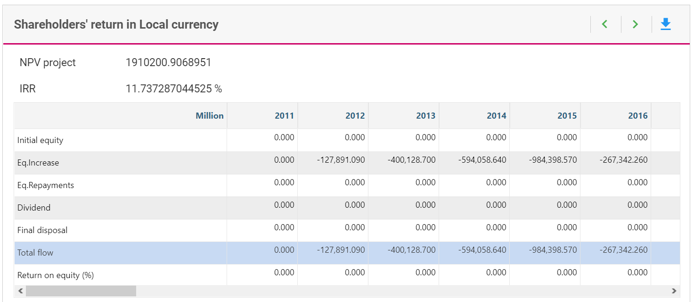
4. Shareholder’s Return
Overview
IRR and NPV are calculated purely from the shareholder’s perspective
Final Disposal:
  Assumes the entire project is sold in the disposal year
  Represents net cash flow that would be generated from the final disposal of the project
$$Final disposal=total assets −outstanding obligations$$
Notes:
Internal Rate of Return (IRR) and Net Present Value (NPV) are financial metrics commonly used in investment analysis, and they are calculated from the perspective of shareholders or investors. These metrics help assess the financial attractiveness of an investment project or opportunity.
On the FinPlan shareholder’s return in local currency tab, you will find a term called final disposal.
Final disposal: assumes that the entire project is sold in the disposal year, and the calculation involves subtracting outstanding obligations from all assets. This concept is related to the calculation of the net cash flow or proceeds from the final disposal of a project. Where:
Total Assets: The total value of all assets associated with the project, including tangible and intangible assets.
Outstanding Obligations: Any remaining liabilities or obligations associated with the project, such as outstanding debt, contractual commitments, or other financial obligations.
This calculation represents the net cash flow or proceeds that would be generated from the final disposal of the entire project, assuming the sale of all assets and the settlement of outstanding obligations.
In the context of project evaluation, this figure can be used in financial metrics such as Net Present Value (NPV) or Internal Rate of Return (IRR) to assess the financial attractiveness of the project over its entire life cycle, including the final disposal phase.
This assumes that the entire project is sold in disposal year. Calculated as all assets minus outstanding obligations. There is also the return on equity, which is the Yearly ratio of dividends to equity, as given in the Balance Sheet

Slide 14
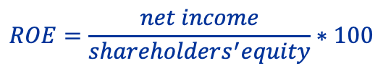
4. Shareholder’s Return
Overview
Return on Equity:
  Measures profitability and efficiency of a company in generating returns based on equity invested
  Expressed as a percentage, higher the better
  Provides insights into how effectively a company is utilizing its equity capital to generate profits
$$ROE=\frac{net income}{shareholders^{′}equity}∗100$$
Notes:
Return on Equity (ROE) is a financial metric that measures the profitability and efficiency of a company in generating returns for its shareholders based on the equity invested. ROE is expressed as a percentage and is calculated by dividing net income by shareholders' equity. It provides insights into how effectively a company is utilizing its equity capital to generate profits. The formale is shown here. Where:
Net Income: This is the company's net profit or net earnings after deducting all expenses, taxes, and interest.
Shareholders' Equity: This represents the equity attributable to the company's common shareholders and is calculated as the difference between total assets and total liabilities. Shareholders' equity is also known as book value. ROE provides shareholders with a measure of the return they are earning on their investment in the company. A higher ROE is generally considered favorable, indicating that the company is efficiently using its equity to generate profits.

Slide 15
4. Shareholder’s Return
Net Present Value (NPV)
The sum of all future discounted cash flows
Positive NPV: expected to generate more cash inflows than outflows
Notes:
. As a reminder, NPV is a measure of the present value of cash inflows minus the present value of cash outflows over a specified time period. It is the sum of all future discounted cash flows. A positive NPV indicates that the project is expected to generate more cash inflows than outflows, providing value to shareholders. It can suggest that the project can be invested in

Slide 16
4. Shareholder’s Return
Internal Rate of Return (IRR)
Rate of return at which NPV is zero, i.e., cash inflows equals cash outflows
As investments happen mostly in the beginning and benefits in the future, the higher the IRR the better
(Theoretically) all projects with an IRR higher than the cost of capital should be undertaken
Notes:
IRR is the discount rate that makes the NPV of an investment project equal to zero. In other words, it is the rate of return at which the present value of cash inflows equals the present value of cash outflows. IRR represents the project's expected rate of return. As investments happen mostly in the beginning and benefits in the future, the higher the IRR the better. (Theoretically) all projects with an IRR higher than the cost of capital should be undertaken

Slide 17
4. Shareholder’s Return
Discounting
Process of determining the present value of future cash flow
Common practice to discount future cash flows to reflect the time value of money
Allows comparing cash flows in different years
Takes into account opportunity costs which can be represented by the long-term real interest rate
How to choose?
  Weighted average cost of capital (WACC)
  Rate of return of investment alternative
  (In some cases not purely chosen from financial perspective -> Political/Strategic decision?)
0
t
FV = future value
PV = present value
r = discount rate
t = time
PV = FV / (1+r)^{t}
FV
Notes:
Discounting refers to the process of determining the present value of a future cash flow or series of cash flows. In finance and investment, it's a common practice to discount future cash flows to reflect the time value of money. The basic idea is that a certain amount of money today is worth more than the same amount of money in the future due to the opportunity to invest and earn a return. This process allows comparing cash flows in different years, and takes into account opportunity costs which can be represented by the long-term real interest rate. A high discount rate gives more weight or importance to present expenditures than to future ones, while a low discount rate reduces these differences and thus favours technologies that have high investment cost but low operation costs
Choosing an appropriate discount rate is a crucial aspect of financial analysis, as it significantly influences the present value of future cash flows. The discount rate reflects the time value of money and the risk associated with an investment. Here are some factors to consider when choosing a discount rate:
Weighted Average Cost of Capital (WACC):
If you're evaluating a company, you may use the WACC, which is a weighted average of the cost of debt and the cost of equity. The weights are based on the proportion of debt and equity in the company's capital structure. The formula for this is below.
Rate of return of investment alternative
the rate of return provides insights into expected performance and risk. When determining the discount rate, considering opportunity cost, risk-return relationship, cost of capital, benchmarking, market conditions, investor expectations, and the time horizon contributes to accurate financial evaluations and decision-making.
In some cases, the discount rate can also be chosen through a political or strategic decision
Political and strategic decisions can affect the discount rate by influencing the risk profile of an investment. Increased political or regulatory uncertainty may raise the perceived risk and necessitate a higher discount rate, while positive strategic decisions may lead to a lower perceived risk and a potentially lower discount rate. The relationship between these decisions and the discount rate underscores the importance of considering a wide range of factors when evaluating investments and making financial decisions.

Slide 18


4. Shareholder’s Return
Weighted Average Cost of Capital (WACC)
N = number of sources of capital
r = rate of return
MV = market value
D = debt
E = equity
Ke/d = cost of equity/debt

Slide 19
5. Project Finance Analysis
Overview
Helps to analyze if there is (more than) enough cash available to service the debt
Notes:
Lastly, we have the project financy analysis tab, which is in local currency. And this tab helps analyze if there is more than enough cash available to service the debt.

Slide 20
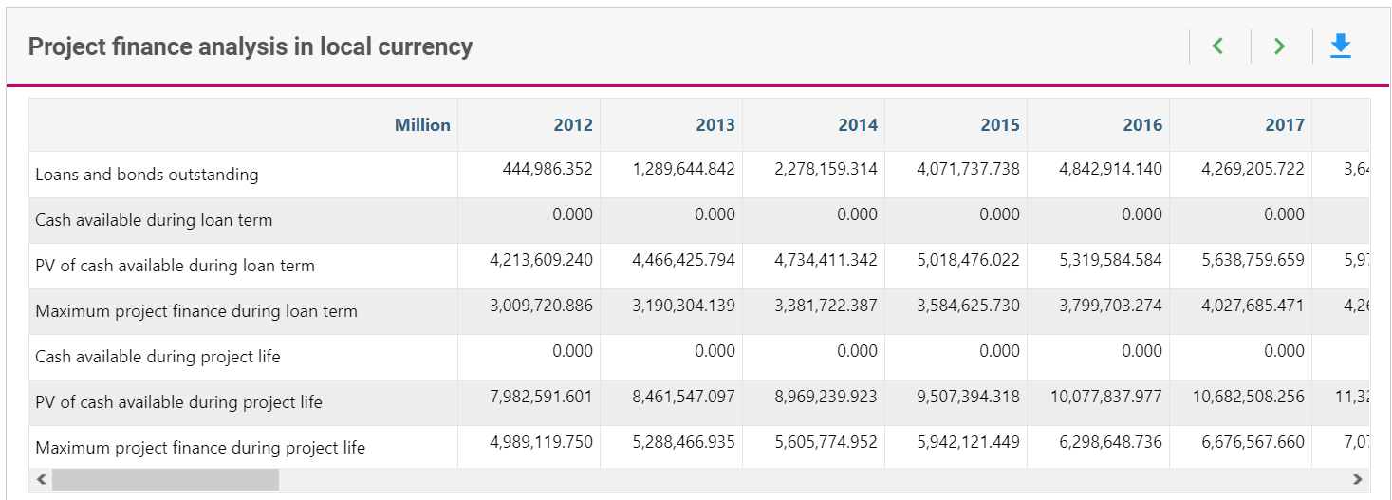
5. Project Finance Analysis
Overview
Looks at the present value of future cash
Takes security ratio into account
  A measure that assesses ability of project to service its debt obligations by assessing security available to support debt
  <1 suggests that assets is insufficient to cover outstanding debt
  >1 suggest assets have value to relative to outstanding debt, greate security for lenders
Main output: maximum project finance, to be compared with outstanding loans & bonds
Notes:
This tab looks at the present value of cash, and takes the security ratio into account. The security ratio is a measure that assesses the ability of a project to service its debt obligations by evaluating the security or collateral available to support the debt. The security ratio is a critical aspect of risk assessment in project finance, particularly in industries where projects involve significant capital investments and long-term financing.
The security ratio is often used to gauge the coverage or protection that the project's assets provide to lenders in case of default. It is calculated by comparing the value of the project's assets to the outstanding debt amount. If the security ratio is high (greater than 1), it suggests that the project's assets have substantial value relative to the outstanding debt, providing a greater level of security for lenders.
If the security ratio is low (less than 1), it indicates that the value of the project's assets may be insufficient to cover the outstanding debt fully. This could be a concern for lenders as it implies higher risk.
. The main output of this tab is maximum project finance during loan term and project life, which can be compared with outstanding loans and bonds.

Slide 21
Thank you!
Notes:
Thank you!

