Slide 1
Designing Case Studies in FINPLAN and Addressing Data Needs
Notes:
Licence: This work is licensed under the Creative Commons Attribution 4.0 International License (CC BY 4.0). To view a copy of this license, visit https://creativecommons.org/licenses/by/4.0/.
Attribution: Please cite as: Tan, N. (2025) Designing Case Studies in FINPLAN and Addressing Data Needs. Version 1. Climate Compatible Growth Teaching Kit Website, Climate Compatible Growth.

Slide 2
Contents
Review of Power System Expansion Plan
Data Collection
Assumptions regarding Future Developments
General Economic Parameters
Power Plant Related Parameters
Electricity Prices
Sources of Financing

Slide 3
Designing Case Studies in FINPLAN
Overview
Review the Power System Expansion Plan
To identify a project in terms of size of the project, type of technology, possible suppliers, etc.
To set the year when the project will be starting
2. Data collection
Adjusted to scope of study
Financial state of utility in base year (if corporate finance)
Review financial environment at national, regional & international level
Identify sources of financing

Slide 4
Designing Case Studies in FINPLAN
Overview
3. Required Assumptions regarding Future Developments
General economic parameters
Power plant related parameters
Electricity price
Sources of financing

Slide 5
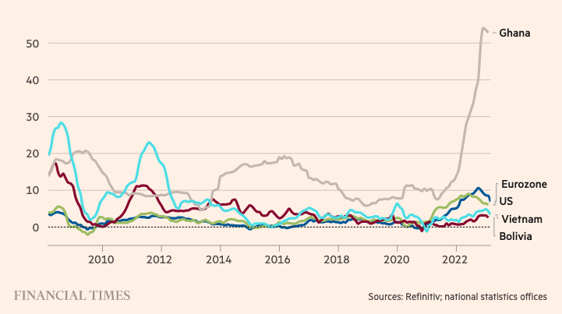
i. General Economic Parameters
Inflation
Current and future inflation rates for local & foreign currency [%]
Country comparison & historical data:
Croatia - Inflation rate (consumer prices) - Historical Data Graphs per Year (indexmundi.com)
http://data.worldbank.org/data-catalog/world-development-indicators
http://data.worldbank.org/indicator
→ many indicators, such as GDP, trade volumes, etc.
http://data.worldbank.org/data-catalog/global-financial-development
→ Global Financial Development Database
https://www.ft.com/content/088d3368-bb8b-4ff3-9df7-a7680d4d81b2
Notes:
http://www.investopedia.com/ask/answers/111314/what-methods-can-government-use-control-inflation.asp
Inflation is when the economy grows due to increased spending. When this happens, prices rise and the currency within the economy is worth less than it was before. This basically means that the currency won’t buy as much as it would before. When a currency is worth less, its exchange rate decreases when compared to other currencies. There are many methods used to control inflation, including some that work and some that don’t work without damaging consequences such as a recession. For example, controlling inflation through wage and price controls can cause a recession and hurt the people whose jobs are lost because of it. >>>>> extra
One popular method of controlling inflation is through contractionary monetary policy. The goal of a contractionary policy is to reduce the money supply within an economy by decreasing bond prices and increasing interest rates. This helps reduce spending because when there is less money to go around, those who have money want to keep it and save it, instead of spending it. It also means less available credit, which also reduces spending. Reducing spending is important during inflation because it helps halt economic growth and, in turn, the rate of inflation.
There are three main ways to carry out a contractionary policy. The first is to increase interest rates through the Federal Reserve. The Federal Reserve rate is the rate at which banks borrow money from the government, but, in order to make money, they must lend it at higher rates. So, when the Federal Reserve increases its interest rate, banks have no choice but to increase their rates as well. When banks increase their rates, less people want to borrow money because it costs more to do so if that money accrues interest. So, spending drops, prices drop and inflation slows.
The second method is to increase reserve requirements on the amount of money banks are legally required to keep on hand to cover withdraws. The more money banks are required to hold back, the less they have to lend to consumers. If they have less to lend, consumers will borrow less, which will decrease spending.
The third method is to directly or indirectly reduce the money supply by enacting policies that encourage reduction of the money supply. Two examples of this include calling in debts that are owed to the government and increasing the interest paid on bonds so that more investors will buy them. The latter policy raises the exchange rate of the currency due to higher demand and, in turn, increases imports and decreases exports. Both of these policies will reduce the amount of money in circulation because the money will be going from banks, companies and investors pockets and into the government’s pocket where they can control what happens to it.

Slide 6
1) General Economic Parameters
Inflation
Current and future inflation rates for local & foreign currency [%]
Country comparison & historical data
Croatia - Inflation rate (consumer prices) - Historical Data Graphs per Year (indexmundi.com)
http://data.worldbank.org/data-catalog/world-development-indicators
http://data.worldbank.org/indicator
-> many indicators, such as GDP, trade volumes, etc.
http://data.worldbank.org/data-catalog/global-financial-development
-> Global Financial Development Database
Notes:
http://www.investopedia.com/ask/answers/111314/what-methods-can-government-use-control-inflation.asp
Inflation is when the economy grows due to increased spending. When this happens, prices rise and the currency within the economy is worth less than it was before. This basically means that the currency won’t buy as much as it would before. When a currency is worth less, its exchange rate decreases when compared to other currencies. There are many methods used to control inflation, including some that work and some that don’t work without damaging consequences such as a recession. For example, controlling inflation through wage and price controls can cause a recession and hurt the people whose jobs are lost because of it.
One popular method of controlling inflation is through contractionary monetary policy. The goal of a contractionary policy is to reduce the money supply within an economy by decreasing bond prices and increasing interest rates. This helps reduce spending because when there is less money to go around, those who have money want to keep it and save it, instead of spending it. It also means less available credit, which also reduces spending. Reducing spending is important during inflation because it helps halt economic growth and, in turn, the rate of inflation.
There are three main ways to carry out a contractionary policy. The first is to increase interest rates through the Federal Reserve. The Federal Reserve rate is the rate at which banks borrow money from the government, but, in order to make money, they must lend it at higher rates. So, when the Federal Reserve increases its interest rate, banks have no choice but to increase their rates as well. When banks increase their rates, less people want to borrow money because it costs more to do so if that money accrues interest. So, spending drops, prices drop and inflation slows.
The second method is to increase reserve requirements on the amount of money banks are legally required to keep on hand to cover withdraws. The more money banks are required to hold back, the less they have to lend to consumers. If they have less to lend, consumers will borrow less, which will decrease spending.
The third method is to directly or indirectly reduce the money supply by enacting policies that encourage reduction of the money supply. Two examples of this include calling in debts that are owed to the government and increasing the interest paid on bonds so that more investors will buy them. The latter policy raises the exchange rate of the currency due to higher demand and, in turn, increases imports and decreases exports. Both of these policies will reduce the amount of money in circulation because the money will be going from banks, companies and investors pockets and into the government’s pocket where they can control what happens to it.

Slide 7
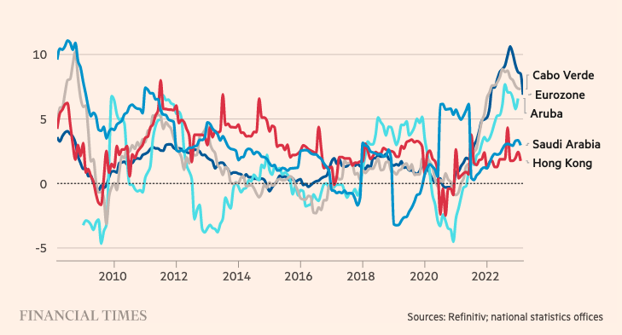
i. General Economic Parameters
Inflation
https://www.ft.com/content/088d3368-bb8b-4ff3-9df7-a7680d4d81b2
Notes:
https://www.investopedia.com/ask/answers/111414/what-causes-negative-inflation-or-deflation.asp
Deflation, or negative inflation, happens when prices generally fall in an economy. This can be because the supply of goods is higher than the demand for those goods, but can also have to do with the buying power of money becoming greater. Buying power can grow due to a reduction in the money supply, as well as a decrease in the supply of credit, which has a negative effect on consumer spending.

Slide 8
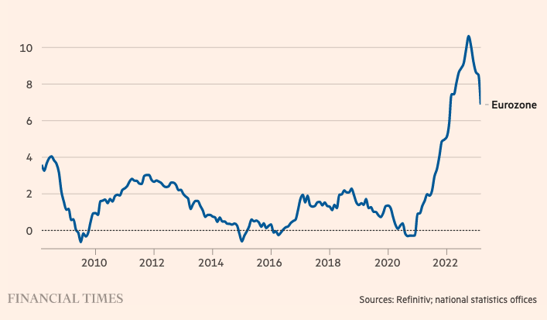
i. General Economic Parameters
Inflation
2021 Coronavirus pandemic:
Lower oil prices
Recent cut in Germany’s VAT
Delayed summer sales in France, Italy, and Belgium.
ECB took the following decisions:
Pandemic emergency purchase programme (PEPP)
Temporary asset purchase programme of private and public sector securities
Asset purchase programme (APP), etc.
https://www.ft.com/content/088d3368-bb8b-4ff3-9df7-a7680d4d81b2
Notes:
2021:
The eurozone slid into deflation for the first time in four years, heaping pressure on the European Central Bank to increase its support for the bloc’s faltering economic recovery from the coronavirus pandemic.
Headline consumer price inflation was minus 0.2 per cent in August, down from an increase of 0.4 per cent the previous month, according to data released by Eurostat on Tuesday, ahead of the ECB’s policy meeting next week.
Analysts blamed the fall on lower oil prices, the recent cut in Germany’s value added tax rate and the delayed summer sales in France, Italy and Belgium. Retailers in those countries usually cut clothing prices heavily between June and July to clear out summer ranges before the autumn season, but this year the sales were delayed until August.
https://www.ft.com/content/e1cfcc75-9349-43eb-b827-ad099a61a44c
Pandemic emergency purchase programme (PEPP)
In the first quarter of 2022, the Governing Council expects to conduct net asset purchases under the PEPP at a lower pace than in the previous quarter. It will discontinue net asset purchases under the PEPP at the end of March 2022.
The Governing Council decided to extend the reinvestment horizon for the PEPP. It now intends to reinvest the principal payments from maturing securities purchased under the PEPP until at least the end of 2024. In any case, the future roll-off of the PEPP portfolio will be managed to avoid interference with the appropriate monetary policy stance.
The pandemic has shown that, under stressed conditions, flexibility in the design and conduct of asset purchases has helped to counter the impaired transmission of monetary policy and made efforts to achieve the Governing Council’s goal more effective. Within our mandate, under stressed conditions, flexibility will remain an element of monetary policy whenever threats to monetary policy transmission jeopardise the attainment of price stability. In particular, in the event of renewed market fragmentation related to the pandemic, PEPP reinvestments can be adjusted flexibly across time, asset classes and jurisdictions at any time. This could include purchasing bonds issued by the Hellenic Republic over and above rollovers of redemptions in order to avoid an interruption of purchases in that jurisdiction, which could impair the transmission of monetary policy to the Greek economy while it is still recovering from the fallout of the pandemic. Net purchases under the PEPP could also be resumed, if necessary, to counter negative shocks related to the pandemic.
Asset purchase programme (APP)
In line with a step-by-step reduction in asset purchases and to ensure that the monetary policy stance remains consistent with inflation stabilising at its target over the medium term, the Governing Council decided on a monthly net purchase pace of €40 billion in the second quarter and €30 billion in the third quarter under the APP. From October 2022 onwards, the Governing Council will maintain net asset purchases under the APP at a monthly pace of €20 billion for as long as necessary to reinforce the accommodative impact of its policy rates. The Governing Council expects net purchases to end shortly before it starts raising the key ECB interest rates.
The Governing Council also intends to continue reinvesting, in full, the principal payments from maturing securities purchased under the APP for an extended period of time past the date when it starts raising the key ECB interest rates and, in any case, for as long as necessary to maintain favourable liquidity conditions and an ample degree of monetary accommodation.
https://www.ecb.europa.eu/press/pr/date/2021/html/ecb.mp211216~1b6d3a1fd8.en.html

Slide 9
i. General Economic Parameters
Inflation
In 2022, ECB:
Raised interest rates by bigger-than-expected half point
Unveiled a new bond purchase scheme called Transmission Protection Instrument
In 2016, ECB:
Cut interest rates in the eurozone to zero
Expanded money printing programme
Reduced a key deposit rate further into negative territory
https://www.ft.com/content/088d3368-bb8b-4ff3-9df7-a7680d4d81b2
Notes:
2022:
The European Central Bank has raised interest rates by a bigger-than-expeced half point, taking its key deposit rate (which was negative) to 0% and hinted at further rate hikes in the coming months. It was its first rate hike in 11 years and was triggered by soaring inflation, which reached 8.6% last month, far above its 2% target.
The central bank also unveiled a new new bond purchase scheme called Transmission Protection Instrument, which is intended to cap the rise in countries’ borrowing costs (particularly those of highly-indebted nations like Spain and Italy) and limit financial fragmentation.
The euro, bond yields and European bank shares all rose on the announcement, but the shares soon gave up their gains.
https://www.theguardian.com/business/live/2022/jul/21/russia-gas-supplies-europe-ecb-hike-interest-rates-economy-inflation-business-live
2016:
The European Central Bank has surprised financial markets by cutting interest rates in the eurozone to zero, expanding its money printing programme and reducing a key deposit rate further into negative territory as it seeks to revive the economy and fend off deflation.
https://www.theguardian.com/business/2016/mar/10/ecb-cuts-eurozone-interest-rate-to-zero

Slide 10
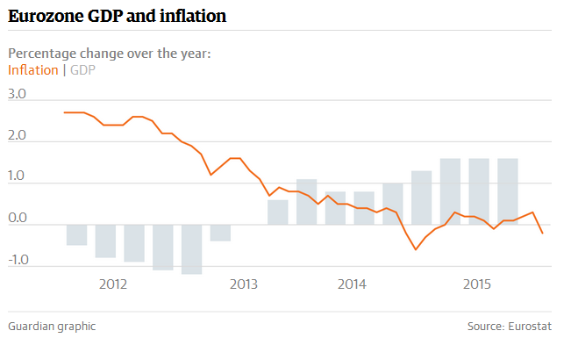
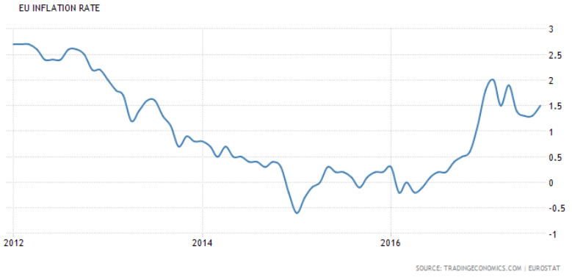
1) General Economic Parameters
Inflation
March 2016: ECB cut interest rates in the eurozone to zero, expanded its money printing & reducing key deposit rate further into negative territory
Notes:
ht

Slide 11
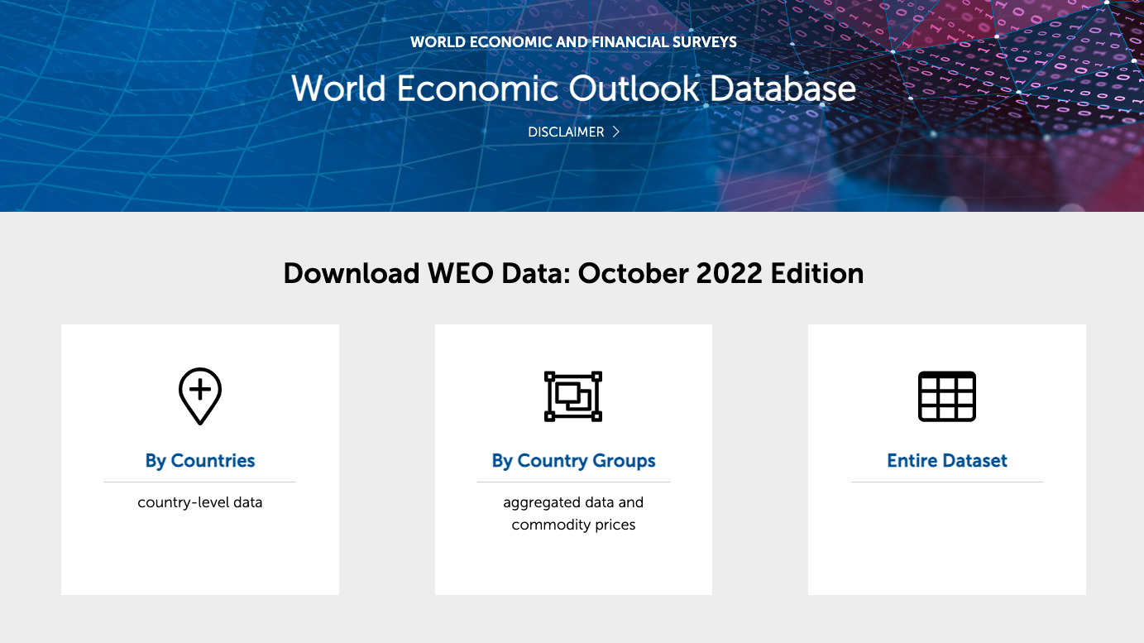
i. General Economic Parameters
Inflation
www.imf.org → Data → World Economic Outlook Databases
World Economic Outlook Databases (imf.org)

Slide 12
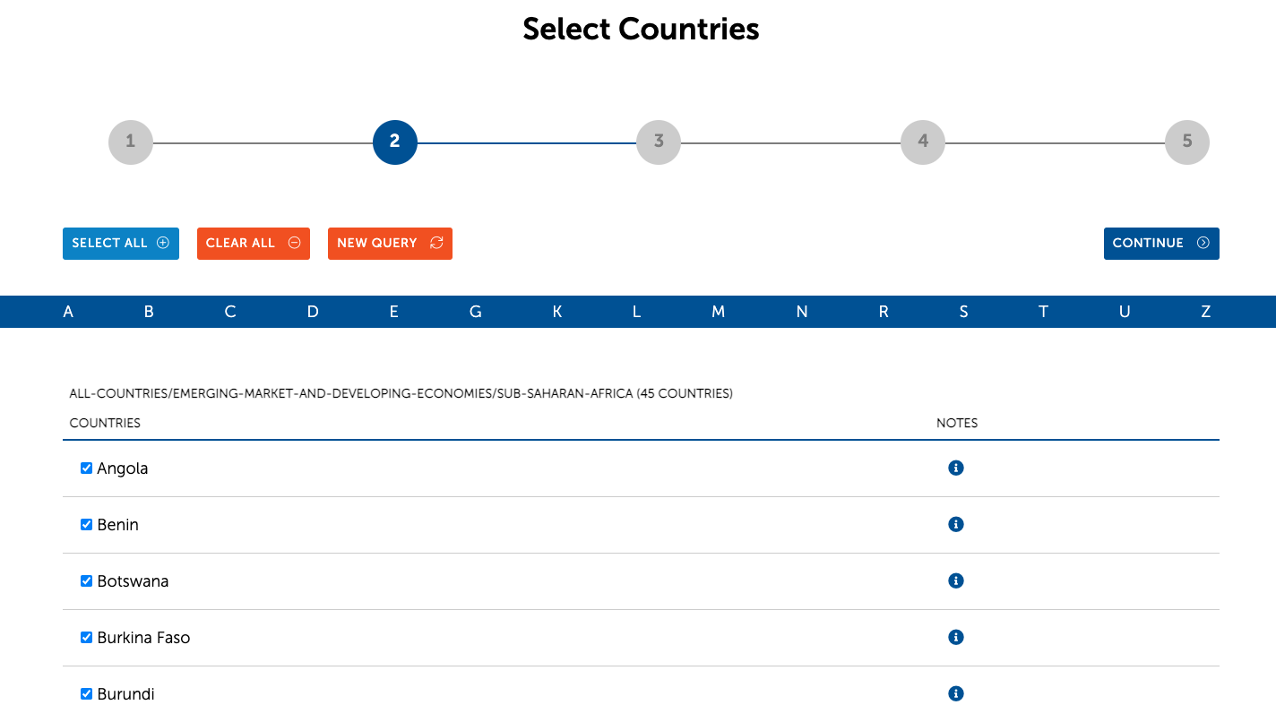
i. General Economic Parameters
Inflation

Slide 13
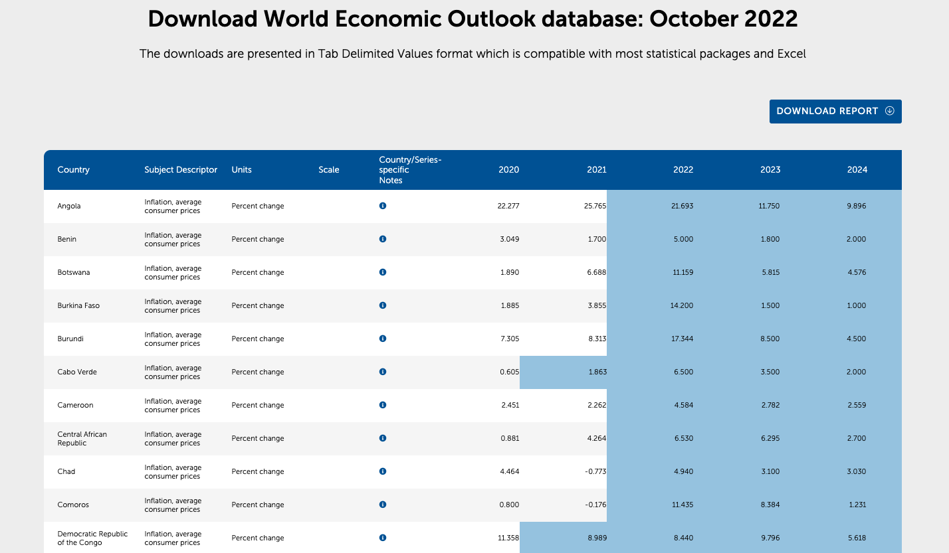
i. General Economic Parameters
Inflation

Slide 14
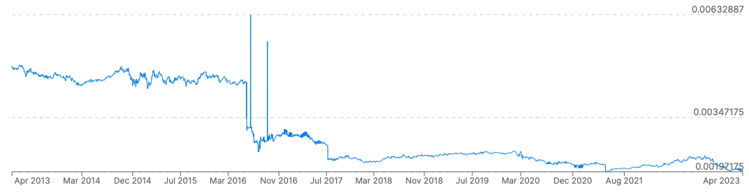
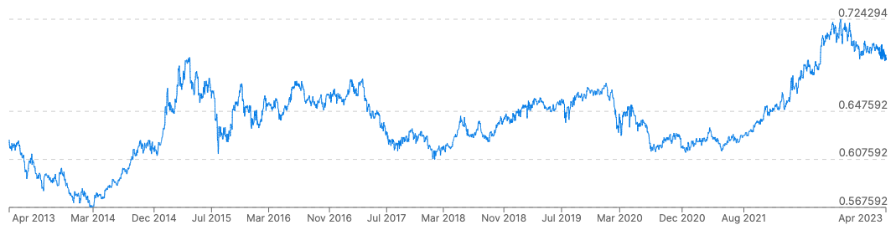
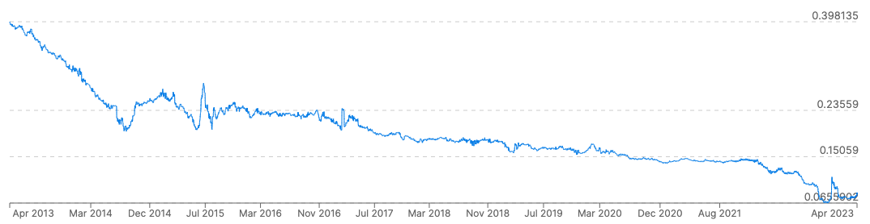
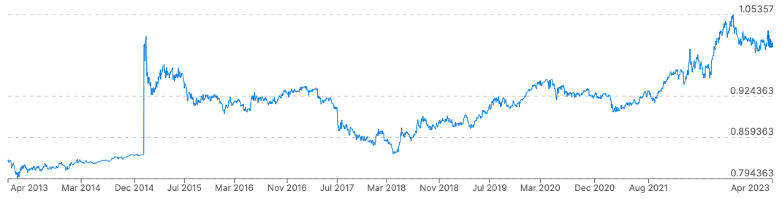
i. General Economic Parameters
Exchange Rates
Current & future exchange rate between local & foreign currency
1 Nigerian Naira in EUR
1 Singaporean Dollar in EUR
2015
2020
2023
2015
2020
2023
1 Ghanaian Cedi in EUR
1 Swiss Franc in EUR
2015
2020
2023
2015
2020
2023
https://www.xe.com/currencycharts/
Notes:
An exchange rate is the rate at which one currency can be exchanged for another. In other words, it represents the value of one currency in terms of another. Exchange rates are a crucial aspect of international trade and finance, influencing the costs of imported goods and services, the competitiveness of exports, and overall economic conditions.

Slide 15
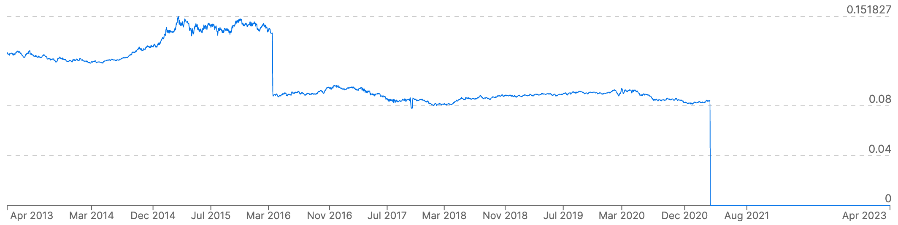
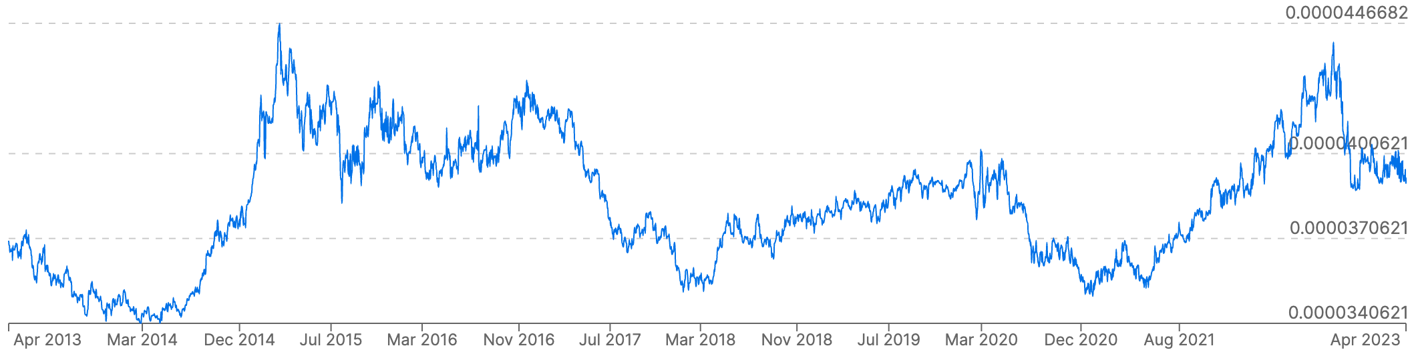
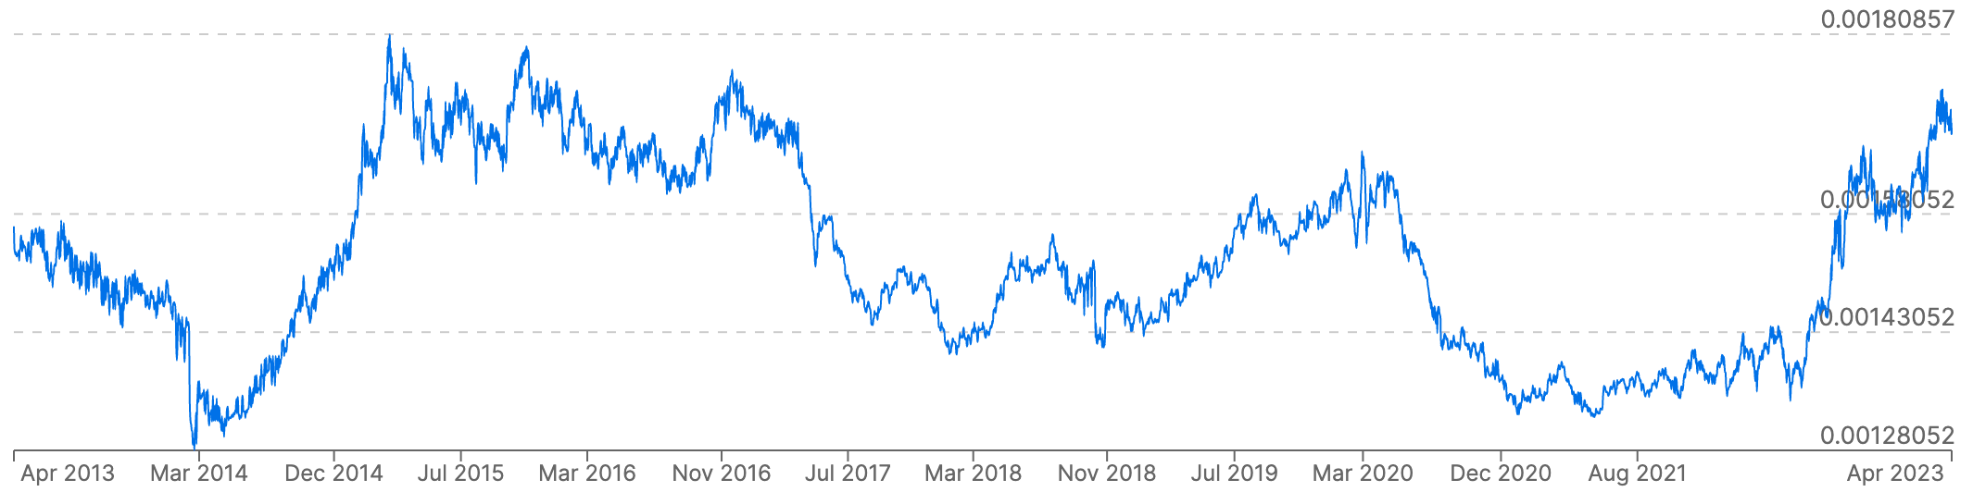
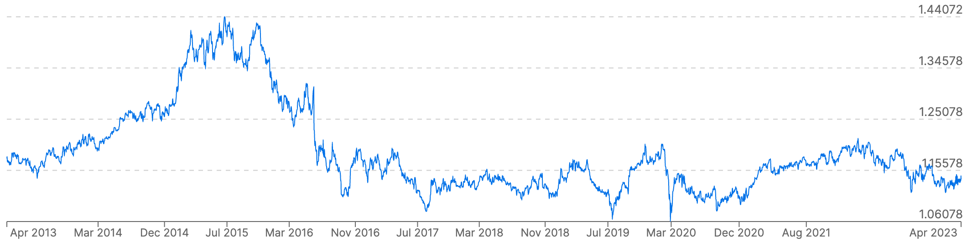
i. General Economic Parameters
Exchange Rates
Current & future exchange rate between local & foreign currency
1 Venezuelan Bolívar in EUR
1 Vietnamese Dong in EUR
2015
2020
2023
2015
2020
2023
1 Costa Rican Colon in EUR
1 British Pound in EUR
2015
2020
2023
2015
2020
2023
https://www.xe.com/currencycharts/

Slide 16
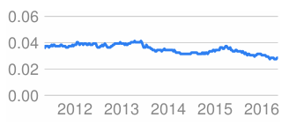
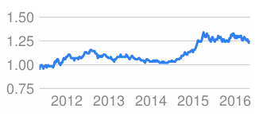
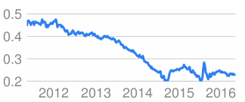
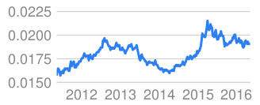
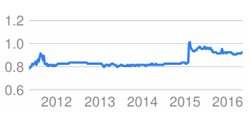
1) General Economic Parameters
Exchange rates
Current & future exchange rate between local & foreign currency
1 Uruguayan Peso in EUR
1 Jordanian Dinar in EUR
1 Ghanaian Cedi in EUR
1 Philippine Peso in EUR
1 Swiss Franc in EUR

Slide 17
i. General Economic Parameters
Exchange rates
Exchange rate regime
Floating
Determined by market forces, allowed to fluctuate based on changing economic conditions
Central banks do not intervene to control or stabilize the currency’s value
Most common globally (USD, Brazilian Real)
Fixed
Set relative to another major currency (USD or gold)
The central bank intervenes in the foreign exchange market to maintain fixed rate
Uncommon. Mostly small countries with significant external trade with strong, reserve currencies (e.g., Hong Kong dollar -> USD, Danish Krone -> EUR)
Pegged
Ties to value of another major currency
Rate maintained through intervention by the central bank
Used by several countries (e.g., Djibouti Franc -> USD, Chinese Yuan -> basket of currencies)
Notes:
https://en.wikipedia.org/wiki/Fixed_exchange-rate_system
There are various exchange rate regimes, including floating, fixed, and pegged exchange rates.
Floating exchange rates: currency values are determined by market forces, specifically supply and demand in the foreign exchange market. The exchange rate is allowed to fluctuate freely based on changing economic conditions. Central banks do not actively intervene to control or stabilize the currency's value. Instead, the exchange rate is determined by the foreign exchange market, where buyers and sellers interact. This is the most common exchange rate regime in the world.
Pros: Provides stability and predictability for international trade and investment. Reduces currency risk.
Cons: Requires significant foreign exchange reserves, limits flexibility in monetary policy, and may face challenges if economic conditions diverge from those of the reference currency.
Fixed exchange rates: country's currency value is set, pegged, or fixed relative to another major currency, such as the U.S. dollar or gold. The central bank actively intervenes in the foreign exchange market to maintain this fixed rate. Central banks buy or sell their currency in the foreign exchange market to ensure that the exchange rate remains close to the predetermined fixed rate. This is an uncommon regime, and is mostly used by small countries with significant external trade with strong, reserve currencies. E.g. Hong Kong dollar is pegged to the U.S. dollar within a narrow band, with the Hong Kong Monetary Authority actively intervening to maintain the peg. Denmark has fixed exchange rate policy relative to the euro through the Exchange Rate Mechanism (ERM II), with a narrow fluctuation band.
Pros: Provides stability and predictability for international trade and investment. Reduces currency risk.
Cons: Requires significant foreign exchange reserves, limits flexibility in monetary policy, and may face challenges if economic conditions diverge from those of the reference currency.
Pegged exchange rates: country's currency value is tied to the value of another major currency or a basket of currencies. The pegged rate is maintained through active intervention by the central bank. Similar to fixed exchange rates, the central bank intervenes in the foreign exchange market to keep the currency value close to the pegged rate. Used by several countries, examples are The Djiboutian Franc - pegged to the U.S. dollar. The Chinese Yuan (Renminbi) has a managed peg against a basket of currencies. The People's Bank of China (PBOC) sets a daily reference rate, and the yuan is allowed to fluctuate within a specified band.
Pros: Offers some stability and predictability while allowing for adjustments in the peg if economic conditions change.
Cons: Requires ongoing central bank intervention, and the effectiveness of the peg depends on the credibility and strength of the pegged currency.
the main difference between fixed and pegged lies in the flexibility of the exchange rate. A fixed exchange rate is rigid and remains constant, while a pegged exchange rate allows for periodic adjustments. Both systems involve a commitment by the authorities to maintain a specific value for the currency, but the degree of flexibility in response to changing economic conditions distinguishes them.

Slide 18
ii. Power Plant Related Parameters
Overview
Investment profile
Overnight costs
Distribution over the construction period
Fixed yearly costs (e.g., maintenance)
Variable yearly costs
Fuel costs → sensitivity analysis
Generation (e.g., hydropower)
Data sources: project/country studies, comparisons with international projects (e.g., IEA Costs of Generating Electricity – older issues are available for free online), World Energy Outlook for fuel price developments, etc.

Slide 19

iii. Electricity Prices
Overview
FINPLAN can be used to:
Calculate profitable electricity price; or
Show how much the state needs to subsidize a project at a given electricity price

Slide 20
iv. Sources of Financing
Overview
Equity
Export Credits
Commercial Loans
foreign
local
Bonds
foreign
local
Stand-by Loans
Others
Consumers’ Contribution
Deposits
Notes:
Equity: In the context of financing, particularly in business and corporate finance, "equity" refers to a source of capital that represents ownership in a company. Equity financing involves raising funds by selling ownership shares in the company to investors. These investors become shareholders and have a claim on the company's assets and future profits. Equity financing has both advantages and disadvantages. On the positive side, it does not involve repayment obligations and can provide a company with long-term capital. However, it dilutes existing ownership and may give shareholders a claim on future profits.
Export credits: Export credit, in the context of sources of financing, refers to financial assistance or credit facilities provided to support and facilitate international trade. It is a form of financing designed to mitigate the risks associated with exporting goods and services, helping businesses access working capital and expand their reach in the global market. Export credit is often provided by governments or specialized financial institutions to support domestic companies in their export activities. Export credit is a crucial element in promoting international trade, especially for small and medium-sized enterprises (SMEs) that may face challenges in accessing traditional financing. By mitigating risks and providing financial support, export credit facilitates the growth of exports and contributes to the economic development of exporting countries. It is important to note that the specific mechanisms and offerings may vary by country and the policies of the relevant ECAs or financial institutions.
Commercial loans: Commercial loans refer to debt-based financing provided by banks and financial institutions to businesses for various purposes related to their operations, expansion, or specific projects. These loans are a common source of financing for businesses and are typically repaid over a specified period with interest. Commercial loans play a crucial role in helping businesses access the capital needed for growth, expansion, and day-to-day operations. Businesses should carefully evaluate their financing needs, terms offered by lenders, and their ability to meet repayment obligations before taking on a commercial loan. Equity as a source of financing is distinct from debt financing, where funds are borrowed and must be repaid with interest. In equity financing, there is no obligation to repay the capital, but investors receive ownership stakes in return for their investment.
Bonds: Bonds are debt securities that represent a form of borrowing for both governments and corporations. When entities issue bonds, they are essentially borrowing money from investors. Bonds are considered a common source of long-term financing and can be an attractive option for investors seeking fixed income. Investors in bonds can include individual investors, institutional investors, and other entities seeking fixed income and relative safety compared to more volatile investments. Bonds provide a way for issuers to raise capital by accessing funds from a broad base of investors.
Stand-by loans: A standby loan is a type of financial arrangement where a lender agrees to provide funds to a borrower if needed, but the borrower is not obligated to draw on the loan immediately. It acts as a financial safety net or contingency plan for the borrower in case of unforeseen circumstances or funding needs. Standby loans are often used by businesses, governments, or individuals to ensure they have access to additional funds when necessary. Standby loans offer financial flexibility and can be an effective risk management tool for borrowers facing uncertain financial conditions. They provide a source of funds that can be quickly accessed when needed, helping borrowers navigate unexpected challenges or capitalize on opportunities.
Others: consumers’ contribution, deposits

Slide 21
iv. Sources of Financing
Financing for the Energy Sector
Government Infrastructure Bonds
Development Finance Institutions (DFIs)
Such as: World Bank, African Development Bank (AfDB), Asian Development Bank (ADB), etc.
International project finance banks
Commercial banks
Wider capital markets
Vendor finance
E.g., as shares in company, or export credits
Joint ventures
Concessions, Build-Operate-Transfer (BOT)
Notes:
Government infrastructure bonds: debt securities issued by a government to raise funds specifically for financing infrastructure projects. These bonds are a form of long-term financing that allows governments to fund the construction, maintenance, and development of public infrastructure, such as roads, bridges, airports, utilities, and other essential facilities.
Development finance institutions (DFIs): specialized financial institutions that provide long-term financing and investment to support economic development in emerging and developing countries. DFIs play a crucial role in promoting sustainable development by investing in projects that contribute to poverty reduction, job creation, infrastructure development, and the overall improvement of living standards.
International project finance banks: providing financing for large-scale infrastructure and development projects across borders. These banks specialize in structuring and funding projects that may involve significant capital expenditures and long-term commitments. While the terms "Development Finance Institutions (DFIs)" and "International Project Finance Banks" are sometimes used interchangeably, they can represent slightly different concepts, and their distinctions may vary depending on regional practices. Generally, DFIs are a broader category that includes various institutions supporting economic development, while international project finance banks specifically focus on financing large-scale projects across borders. Examples are ADB, AfDB, etc
Commercial banks: financial institutions that provide a wide range of financial services to individuals, businesses, and governments. They are key components of the financial system and play a crucial role in facilitating economic activities. Commercial banks are profit-driven entities, and their primary source of revenue comes from interest earned on loans and fees for various financial services.
Wider capital markets: refers to the broader financial markets where various financial instruments are bought and sold, providing a platform for raising capital and conducting investment activities. In the context of sources of financing, the wider capital markets include a range of instruments and venues beyond traditional banking channels. These markets allow entities, including governments, corporations, and financial institutions, to access funds from a diverse pool of investors. E.g. crowdfunding
Vendor finance: financial arrangement in which the seller of a property, business, or asset provides financing to the buyer. In other words, the seller takes on the role of the lender, offering credit to the purchaser to facilitate the sale. This type of financing is commonly used in real estate transactions, business sales, and equipment purchases.
JVs: collaborative business arrangements between two or more entities that come together to pursue a specific business opportunity. In terms of sources of financing, JVs can utilize various funding mechanisms to support their operations and achieve their objectives. The choice of financing sources depends on the nature of the joint venture, the industry, and the financial capabilities of the participating entities.
Concessions, BOT: Concessions and Build-Operate-Transfer (BOT) arrangements are specific project finance and delivery models often used in infrastructure projects. These models involve private sector participation in the development, financing, and operation of public infrastructure.

Slide 22
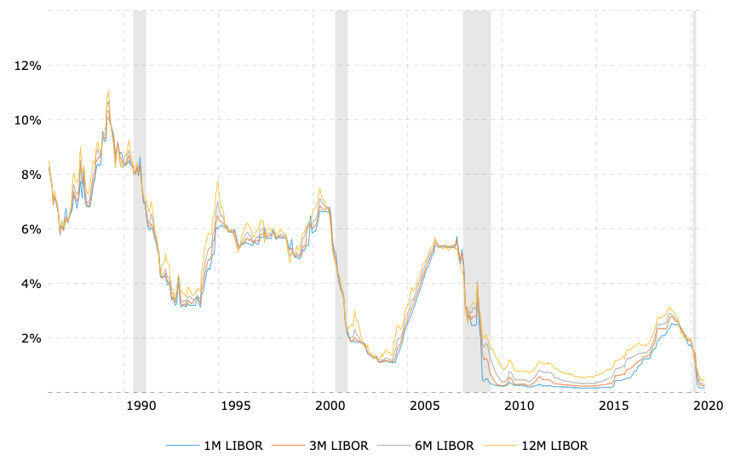
iv. Sources of Financing
Commercial Loans
Foreign currency loans
Foreign banks
Local currency loans
Local banks
Interest floating rates
Commonly used to provide flexibility
Spread above these rates (i.e., in addition to these rates) → based on credit rating
Benchmark interest rates used include LIBOR, EIBOR, IBOR
https://www.macrotrends.net/1433/historical-libor-rates-chart
Notes:
There are different types of loan that one can consider. There is foreign currency loans from foreign banks, and local currency loans from local banks. The choice between foreign or local or both deprends on various factors – borrower's risk tolerance, exposure to exchange rate fluctuations, and the nature of the borrowing transaction. Each type of loan has its advantages and considerations based on the specific circumstances of the borrower.
With commercial loans, there is normally an interest floating rate. Interest floating rates, in the context of commercial loans, refer to the interest rates that are not fixed but rather fluctuate or "float" based on changes in a reference interest rate or benchmark. These rates are commonly used in commercial loans to provide flexibility and to align the interest charged on the loan with prevailing market conditions. And there is normally a spread above these rates (in addition to the rates) - and this is based on the credit rating. It's important for borrowers and lenders to clearly define the terms of the floating rate in the loan agreement, specifying the benchmark rate, the spread, adjustment frequency, and any other relevant details. This transparency helps both parties understand how changes in market conditions will impact the cost of borrowing. Additionally, borrowers should carefully assess their risk tolerance and financial strategy when choosing between fixed and floating rate loans.
LIBOR (London Interbank Offered Rate), EIBOR (Emirates Interbank Offered Rate), and IBOR (Interbank Offered Rate) are all types of benchmark interest rates used in various financial markets. These rates represent the average interest rates at which banks can borrow unsecured funds from other banks in the interbank market. Each of these rates serves as a reference for a specific geographic region or currency.
London Interbank Offered Rate
Emirates Inter Bank Offered Rates
Norway Inter-bank Offered Rate
Sri Lanka Inter Bank Offered Rates
Etc

Slide 23
iv. Sources of Financing
Export Credit
Supports the export of goods and services
Often facilitated by specialized entities known as Export Credit Agencies (ECA)
Important in facilitating international trade
Offers financial assistance to exporters
Mitigates risk associated with cross-border transactions
Includes
Fixed interest rate
Term (repayment period)
Eligibility/Conditions!
Notes:
Export credit refers to financing provided to support the export of goods and services. This is often facilitated by specialized entities known as Export Credit Agencies (ECAs) with the goal of promoting exports, stimulating economic growth, and enhancing the competitiveness of domestic industries. It plays a crucial role in facilitating international trade by offering financial assistance to exporters and mitigating the risks associated with cross-border transactions. It normally includes a fixed interest rate, term (repayment period) as well as eligibility and conditions from the financial institution.

Slide 24
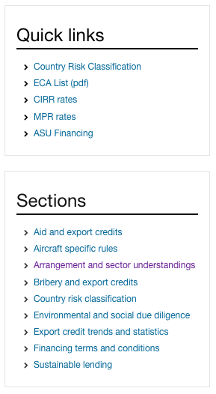
iv. Sources of Financing
Export Credit & “Sector Understandings”
“The Arrangement” sets the Financial Terms & Conditions
min 15% down payment
max 85% credit
max 30% local cost
max term 12 years (for NPP 18 years)
min interest rate CIRR (see OECD page)
min premium rate for credit risk
repayment ≤ 6 monthly
http://www.oecd.org/tad/xcred/ → Minimum interest rates (CIRR)
http://www.oecd.org/tad/xcred/ → Arrangement and sector understandings
Notes:
Now lets go into more details with the terms and conditions for export credits, looking at sector understandings! The terms "Export Credit" and "Sector Understandings" are closely tied to the financial terms and conditions governing international trade, particularly those established under the Organization for Economic Co-operation and Development (OECD). We know that Export Credit refers to financial assistance provided to support the export of goods and services. This support is often facilitated by specialized entities known as Export Credit Agencies (ECAs). The "Sector Understandings" refer to specific agreements and guidelines established under the OECD Arrangement on Officially Supported Export Credits. These agreements provide a framework for the provision of export credits by member countries, promoting fair competition and transparency.
The Arrangement is a set of rules and guidelines agreed upon by OECD member countries to govern the terms and conditions of officially supported export credits. Over here we have what an arrangement looks like. There is a minimum 15% down payment, max 85% credit, Official support provided for local costs shall not exceed 30% of the export contract value, max term 12 years, min interest rate CIRR (commercial interest reference rates), min premium rate for credit risk, and repayment is less than 6 monthly
The goal of the Arrangement and its Sector Understandings is to create a framework that balances the need for financial support to exporters with the aim of preventing unfair competition and avoiding distortions in the international trade arena. Compliance with these rules enhances transparency and contributes to a level playing field for exporters from different countries.
http://www.oecd.org/corruption/anti-briberymeasures.htm
http://www.oecd.org/tad/xcred/sustainable-lending.htm
http://www.oecd.org/tad/xcred/environmentalandsocialduediligence.htm

Slide 25

iv. Sources of Financing
Export Credit & “Sector Understandings”
“The Arrangement” sets the Financial Terms & Conditions
min 15% down payment
max 85% credit
max 30% local cost
max term 12 years (for NPP 18 yr)
min interest rate CIRR (see OECD page)
min premium rate for credit risk
repayment ≤ 6 monthly
The OECD also provides country risk classifications → sets EXIM bank fees to cover risk during construction, e.g., www.exim.gov → Resources for Learning & Doing → Exposure Fees → Fee Calculator

Slide 26
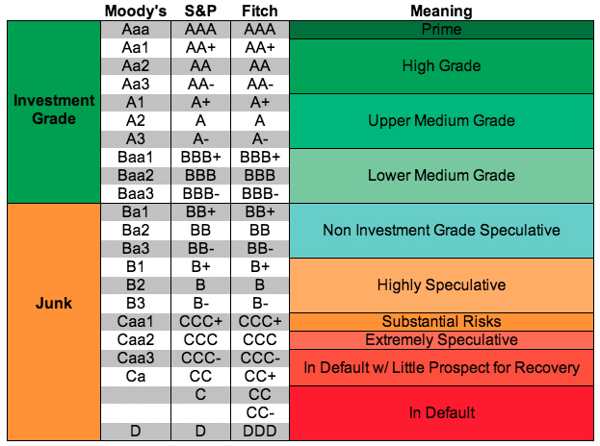
iv. Sources of Financing
Credit Ratings
Credit rating is applicable to both corporations & countries (called sovereign rating)
Used by investors, lenders, etc. to evaluate the likelihood that the borrower will meet its financial obligations
Investment-grade ratings suggest a lower risk of default, while non-investment-grade ratings indicate a higher risk
Financiers seek:
Partnerships – balance sheet strengthening
Increasing liquidity to help utilities maintain their credit rating
https://furtherafrica.com/2018/03/23/understanding-credit-ratings/
Notes:
Credit rating is an assessment of the creditworthiness of an individual, government entity, and can be applicable to both corporatins and countries (called sovereign rating). It is an important tool used by investors, lenders, and other financial institutions to evaluate the likelihood that the borrower will meet its financial obligations. Credit ratings are assigned by credit rating agencies, and they provide an indication of the risk associated with lending money to or investing in a particular entity. The Big Three credit rating agencies are listed on the table: Moody’s, Standard & Poor’s (S&P), and Fitch Group. Credit ratings are typically categorized into investment-grade and non-investment-grade (also known as speculative or junk). Investment-grade ratings suggest a lower risk of default, while non-investment-grade ratings indicate a higher risk. Credit ratings are also often denoted by letter symbols. Some factors that are considered in credit ratings are financial health, debt levels, cash flow etc.
Financiers often seek partnerships for balance sheet strengthening, which means that they are looking to collaborate with other entities or investors to collectively improve and fortify the financial position of a company. This approach is often taken to address specific financial challenges or capitalize on growth opportunities. Financiers also seek to increase liquidity to help utilities maintain their credit rating - financial entities, such as banks or investors, are interested in boosting the availability of liquid assets for utilities. This is done with the specific goal of assisting utilities in maintaining a favorable credit rating. Liquidity refers to the availability of cash and other easily convertible assets. Increased liquidity provides utilities with a financial cushion and the ability to meet short-term financial obligations.

Slide 27

4) Sources of Financing
Credit ratings
Credit rating is applicable to both corporations & countries (called sovereign rating)
Below investment grade rating (BBB+) increases the cost of finance and makes financing very difficult
Financiers seek:
Partnerships - balance sheet strengthening
Increasing liquidity to help utilities maintain their credit rating
Notes:
A credit rating is a quantified assessment of the creditworthiness of a borrower in general terms or with respect to a financial obligation.
27

Slide 28
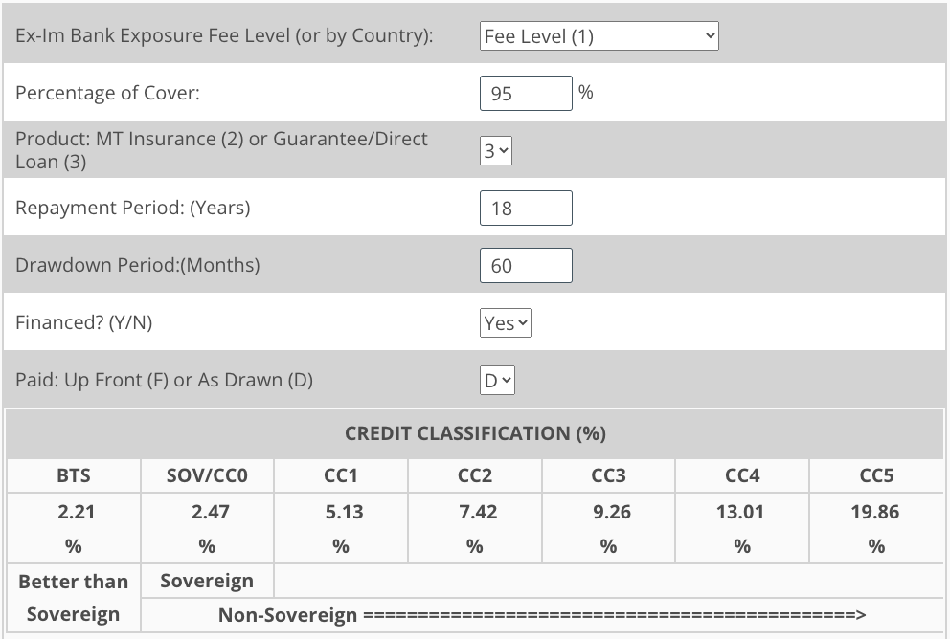
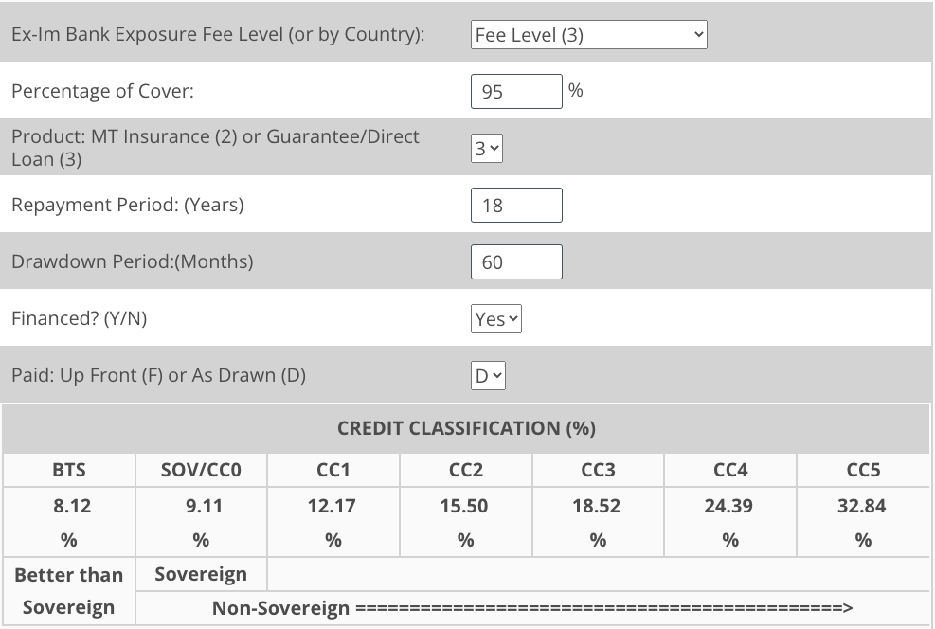

iv. Sources of Financing
Risk
High risk → High premium → High cost of financing
Example: US Exim Bank (https://www.exim.gov/resources/exposure-fees/long-term-exposure-fee-calculator)
Notes:
Now lets dive deeper into risk. All risk has financial impact! But generally, high risk will lead to high premium , which leads to high cost of financing. One can play around with this US Exim Bank link. Here, we choose fee level (1) for the exposure fee level and after adding in the necessary info, we see that the SOV/CCO credit classification is 2.47. "SOV/CCO" in credit classification typically refers to a specific credit rating or credit risk assessment for a financial instrument or investment
Sovereign (SOV): This part of the classification indicates that the credit risk assessment is related to a sovereign entity. A sovereign refers to a government or a country. In credit analysis, assessing the creditworthiness of a sovereign involves evaluating the country's ability to meet its financial obligations, including government debt.
Country Ceiling (CCO): The term "Country Ceiling" refers to the maximum credit rating that can be assigned to entities operating within a specific country. It serves as a cap on the credit rating for entities within that country, regardless of their individual creditworthiness. The country ceiling reflects the highest level of risk for creditors doing business in that country.
When combined, "SOV/CCO" suggests that the credit classification is specifically related to the credit risk associated with a sovereign entity, and it takes into account the country ceiling. This classification is often used by credit rating agencies to provide an overall assessment of the credit risk for debt instruments issued by a sovereign government or entities operating within that country.
And we can see that as we increase the fee level, SOV/CCO increases.

Slide 29
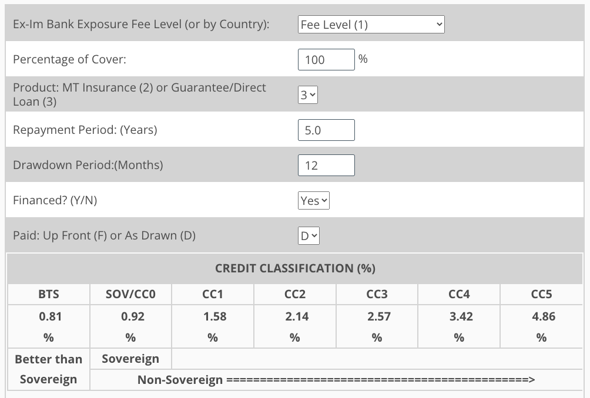
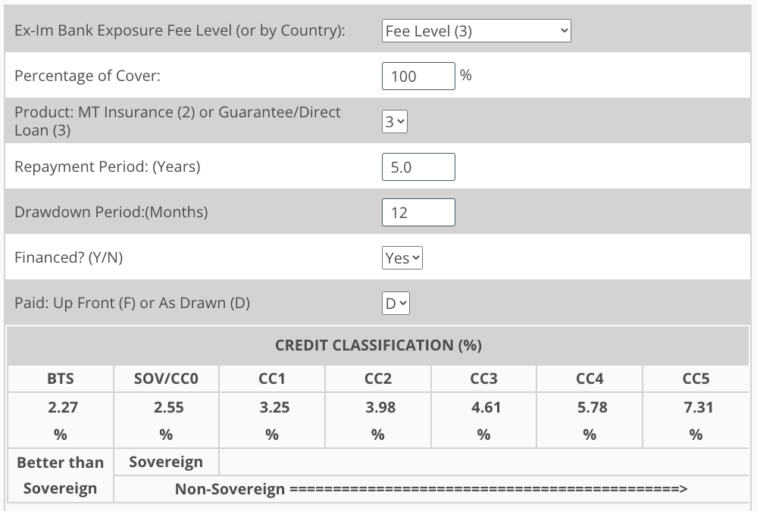

iv. Sources of Financing
Risk
High risk → High premium → High cost of financing
Example: US Exim Bank (https://www.exim.gov/resources/exposure-fees/long-term-exposure-fee-calculator)
Notes:
All risk has financial impact

Slide 30
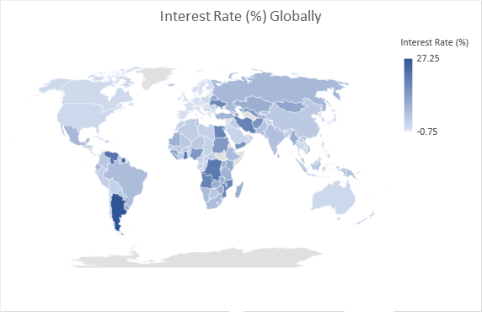
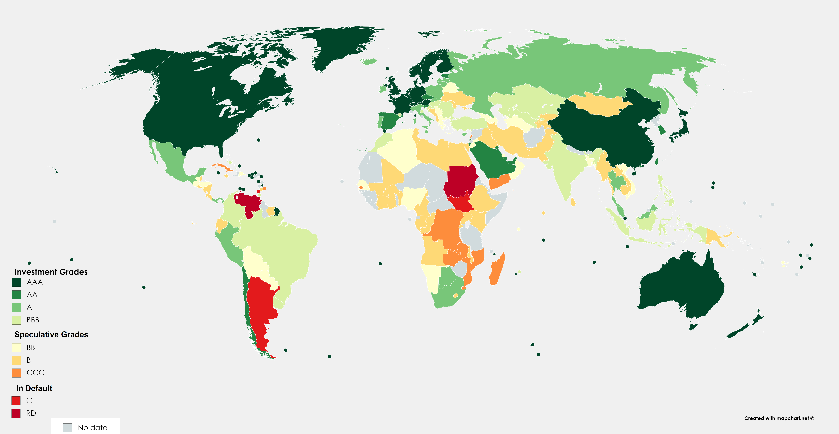
iv. Sources of Financing
Credit Ratings
Notes:
https://thistimeitisdifferent.com/interest-rates-around-the-world
https://www.reddit.com/r/MapPorn/comments/ejlel7/countries_by_credit_rating/

Slide 31
iv. Sources of Financing
Credit Ratings
Notes:
The relationship between bond spreads and credit ratings is a key aspect of the fixed-income market and reflects the perceived credit risk associated with a particular bond or issuer.
A bond spread refers to the difference in yields between a particular bond and a benchmark, typically a government bond with a similar maturity. It is a measure of the additional compensation investors demand for taking on the credit risk associated with the bond.
Credit ratings are assigned to bonds and issuers by credit rating agencies (e.g., Moody's, S&P, Fitch). These ratings assess the creditworthiness and likelihood of default for the issuer or the specific bond.
Generally, there is an inverse relationship between bond spreads and credit ratings. As the credit rating of a bond or issuer improves, the bond spread tends to narrow, indicating lower perceived credit risk. Bonds with high credit ratings (e.g., AAA, AA) are considered low-risk investments. Investors are more confident in the issuer's ability to meet its financial obligations, and as a result, the bond spread over the benchmark is relatively narrow. Bonds with lower credit ratings (e.g., BB, B, or below) are perceived as higher-risk investments. Investors demand a higher yield (wider spread) as compensation for taking on the increased credit risk associated with these bonds.
In summary, the relationship between bond spreads and credit ratings is fundamental to fixed-income markets. Investors use credit ratings and spreads to gauge the credit risk associated with bonds, make investment decisions, and seek an appropriate balance between risk and return in their portfolios. A narrower spread generally indicates higher credit quality, while a wider spread suggests higher perceived risk.

Slide 32
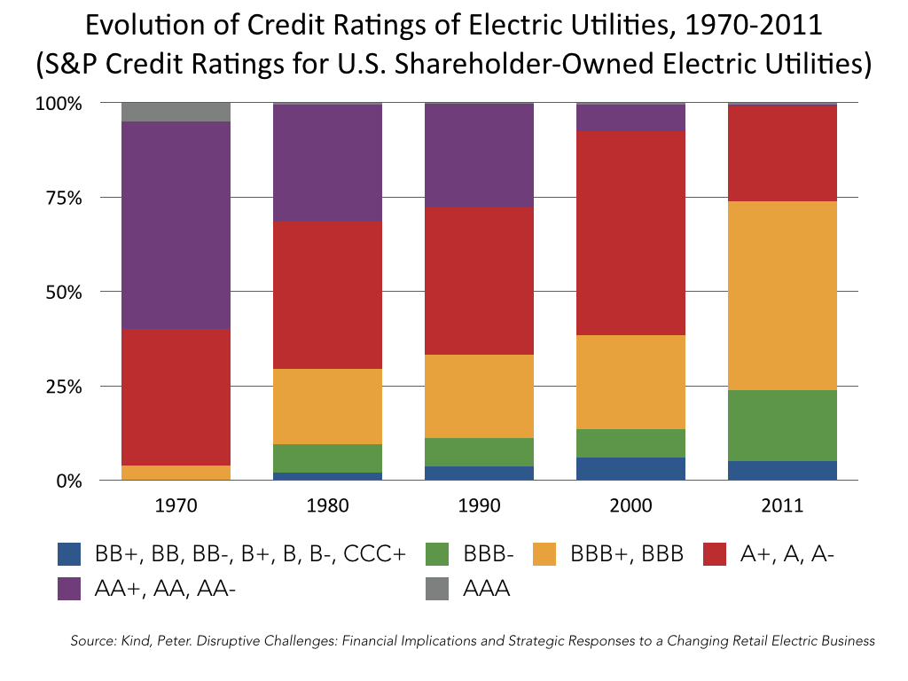
iv. Sources of Financing
Credit Ratings
Notes:
The credit ratings of electric utilities have evolved over time, influenced by various factors such as changes in the regulatory environment, market dynamics, technological advancements, and the financial health of individual utilities. In the early years, as you can see in this graph, there is a large proportion for AA- and above. This was due to a monopoly structure. In the early years, many electric utilities operated as regulated monopolies. They were granted exclusive rights to provide electricity in a specific geographic area.The regulated structure provided a stable and predictable revenue stream for utilities, as they could recover their costs and earn a reasonable return on investment through regulated rates. Then, In the 20th century, there was a trend toward deregulation and restructuring of the electric power industry in some regions. This aimed to introduce competition and potentially lower costs for consumers. The transition from a regulated to a competitive market created uncertainties for utilities. Credit ratings reflected the challenges and risks associated with this period of change.

Slide 33
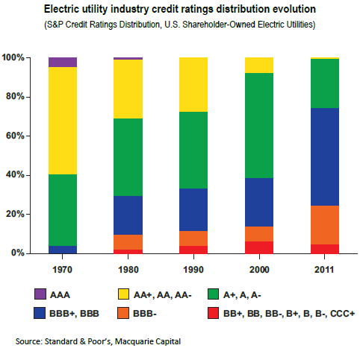
4) Sources of Financing
Credit ratings
http://www.eei.org/ourissues/finance/documents/disruptivechallenges.pdf

Slide 34
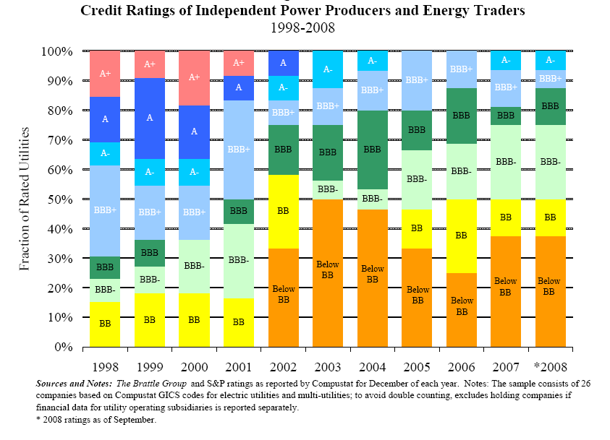
iv. Sources of Financing
Credit Ratings

Slide 35
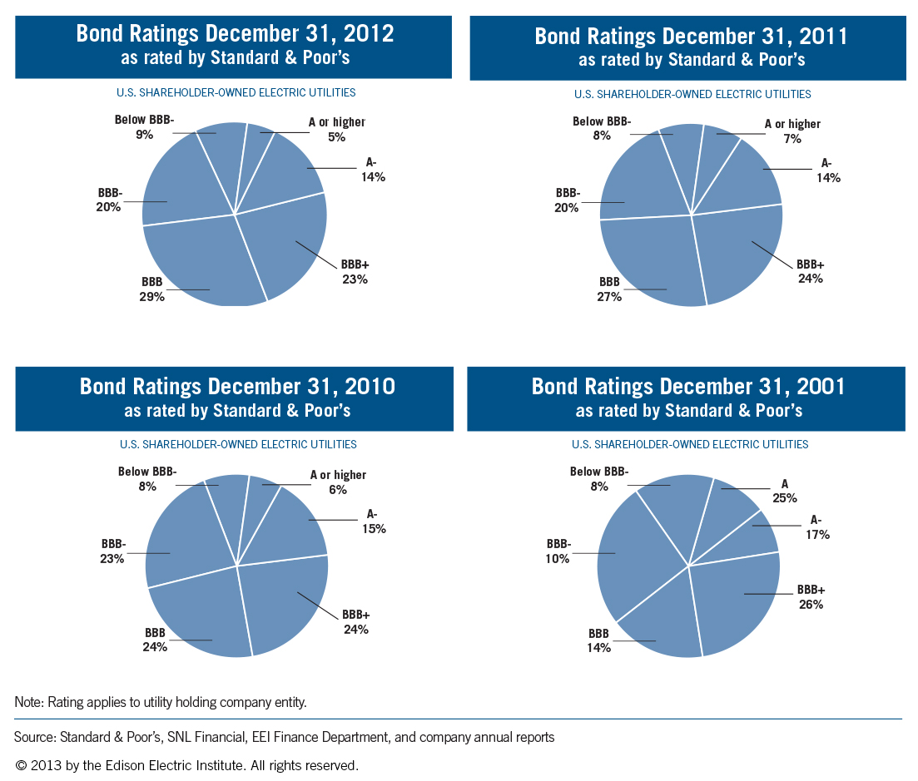
iv. Sources of Financing
Credit Ratings

Slide 36
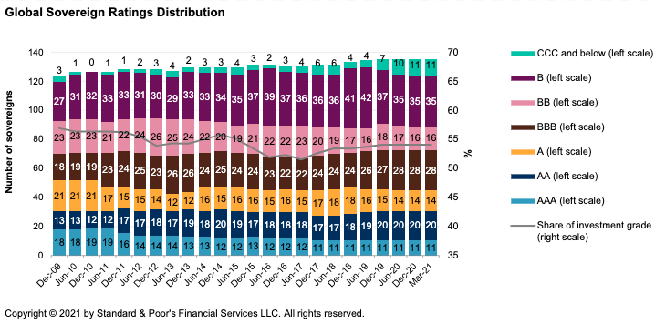
iv. Sources of Financing
Credit Ratings
Notes:
https://www.spglobal.com/ratings/en/research/articles/200730-global-sovereign-rating-trends-midyear-2020-outlook-bias-turns-negative-as-governments-pile-on-debt-to-face-11594719

Slide 37
Thank you!
Notes:
Thank you!

