Slide 1
Basic Financial Concepts
Notes:
Licence: This work is licensed under the Creative Commons Attribution 4.0 International License (CC BY 4.0). To view a copy of this license, visit https://creativecommons.org/licenses/by/4.0/.
Attribution: Please cite as: Tan, N. (2025) Basic Financial Concepts. Version 1. Climate Compatible Growth Teaching Kit Website, Climate Compatible Growth.

Slide 2
Contents
Discounting & Discounted Cash Flow Analysis
Net Present Value
Internal Rate of Return
Financial Comparison of Projects
Inflation & Escalation
Depreciation Methods

Slide 3
1. Discounting & Discounted Cash Flow Analysis
Discounting
Process of determining the present value of future cash flow
Common practice to discount future cash flows to reflect the time value of money
Allows comparing cash flows in different years
Takes into account opportunity costs which can be represented by the long-term real interest rate
(Opposite of compounding: calculating future value)
0
t
FV = future value
PV = present value
r = discount rate
t = time
PV
FV = PV * (1+r)^{t}
PV = FV / (1+r)^{t}
FV
Notes:
Discounting refers to the process of determining the present value of a future cash flow or series of cash flows. In finance and investment, it's a common practice to discount future cash flows to reflect the time value of money. The basic idea is that a certain amount of money today is worth more than the same amount of money in the future due to the opportunity to invest and earn a return. This process allows comparing cash flows in different years, and takes into account opportunity costs which can be represented by the long-term real interest rate.
The formula for discounting future cash flows is often expressed as: PV = FV / (1+r)^n. Where:
PV is the present value,
FV is the future value (cash flow),
r is the discount rate (interest rate), and
n is the number of time periods.

Slide 4
1. Discounting & Discounted Cash Flow Analysis
Discounting
Widely used in various financial calculations, such as:
Net Present Value (NPV): Used in capital budgeting to assess the profitability of an investment by comparing the present value of expected cash inflows and outflows.
Discounted Cash Flow (DCF) Analysis: A valuation method used to estimate the value of an investment based on its expected future cash flows.
Bond Valuation: In fixed-income securities, the present value of future coupon and principal payments is calculated to determine the bond's fair value.
Investment Appraisal: Businesses use discounting to evaluate the financial viability of potential projects or investments.
Time Value of Money (TVM): A fundamental concept in finance that recognizes the idea that a certain amount of money has different values at different points in time.
Notes:
Discounting is widely used in various financial calculations, such as:
Net Present Value (NPV): Used in capital budgeting to assess the profitability of an investment by comparing the present value of expected cash inflows and outflows.
Discounted Cash Flow (DCF) Analysis: A valuation method used to estimate the value of an investment based on its expected future cash flows.
Bond Valuation: In fixed-income securities, the present value of future coupon and principal payments is calculated to determine the bond's fair value.
Investment Appraisal: Businesses use discounting to evaluate the financial viability of potential projects or investments.
Time Value of Money (TVM): A fundamental concept in finance that recognizes the idea that a certain amount of money has different values at different points in time.
The discount rate used in these calculations is crucial, as it reflects the opportunity cost of investing the money elsewhere. Different situations may call for different discount rates, such as the risk-free rate for low-risk investments or a higher rate for riskier ventures.
Understanding discounting is essential for making informed financial decisions and evaluating the profitability and feasibility of various investments and projects over time.

Slide 5


1. Discounting & Discounted Cash Flow Analysis
Discounting
How to choose discount rate?
Weighted Average Cost of Capital (WACC)
Rate of return of investment alternative
(In some cases not purely chosen from financial perspective → Political/Strategic decision?)
Weighted Average Cost of Capital (WACC)
N = number of sources of capital
r = rate of return
MV = market value
D = debt
E = equity
K_{e/d} = cost of debt/equity
Notes:
Choosing an appropriate discount rate is a crucial aspect of financial analysis, as it significantly influences the present value of future cash flows. The discount rate reflects the time value of money and the risk associated with an investment. Here are some factors to consider when choosing a discount rate:
Weighted Average Cost of Capital (WACC):
If you're evaluating a company, you may use the WACC, which is a weighted average of the cost of debt and the cost of equity. The weights are based on the proportion of debt and equity in the company's capital structure. The formula for this is below.
Rate of return of investment alternative
the rate of return provides insights into expected performance and risk. When determining the discount rate, considering opportunity cost, risk-return relationship, cost of capital, benchmarking, market conditions, investor expectations, and the time horizon contributes to accurate financial evaluations and decision-making.
In some cases, the discount rate can also be chosen through a political or strategic decision
Political and strategic decisions can affect the discount rate by influencing the risk profile of an investment. Increased political or regulatory uncertainty may raise the perceived risk and necessitate a higher discount rate, while positive strategic decisions may lead to a lower perceived risk and a potentially lower discount rate. The relationship between these decisions and the discount rate underscores the importance of considering a wide range of factors when evaluating investments and making financial decisions.

Slide 6
1. Discounting & Discounted Cash Flow Analysis
Discounted cash flow analysis
DCF analysis is a method used to evaluate the value of an investment based on its expected future cash flows
The basic principle is that the value of money decreases over time due to factors like inflation and the opportunity to earn a return on investment
Future cash flows are discounted back to their present value to reflect their time value
Relies heavily on the accuracy of cash flow projections and the chosen discount rate
Notes:
Discounted Cash Flow (DCF) analysis is a method used to evaluate the value of an investment based on its expected future cash flows. The basic principle behind DCF analysis is that the value of money decreases over time due to factors like inflation and the opportunity to earn a return on investment. Therefore, future cash flows are discounted back to their present value to reflect their time value.
While DCF analysis is a powerful tool for valuation, it is important to note that it relies heavily on the accuracy of cash flow projections and the chosen discount rate. Small changes in these inputs can significantly impact the calculated value. Therefore, DCF analysis requires careful consideration and often involves sensitivity analysis to assess the impact of variations in key assumptions.

Slide 7
1. Discounting & Discounted Cash Flow Analysis
Discounted cash flow analysis
Key steps involved in DCF analysis:
Estimation of future cash flows
  Revenues, operating expenses, taxes, etc.
Determining the discount rate
Discounting the future cash flows
  PV = FV/(1+r)n
Summing present values
Comparison with initial investment
  If present value is higher than initial investment, the project may be considered financially viable
Interpretation and decision making
  If the present value is significantly higher than the initial investment, the project may be considered a good investment. If lower, may not be financially attractive
Notes:
Here are the key steps involved in Discounted Cash Flow analysis:
Estimation of Future Cash Flows:
Identify and estimate the future cash flows that an investment is expected to generate. This could include revenues, operating expenses, taxes, and capital expenditures.
Determining the Discount Rate:
Choose an appropriate discount rate, also known as the discount factor or required rate of return. This rate reflects the opportunity cost of investing in the project or investment under consideration. It incorporates factors such as the risk associated with the investment, prevailing interest rates, and the cost of capital.
Discounting Future Cash Flows:
Apply the discount rate to each future cash flow to calculate its present value. The formula for discounting future cash flows is often expressed as: ��=��(1+�)�PV=(1+r)nFV​ where ��PV is the present value, ��FV is the future value (cash flow), �r is the discount rate, and �n is the number of time periods.
Summing Present Values:
Sum up the present values of all future cash flows. This provides the total present value of the investment or project.
Comparison with Initial Investment:
Compare the total present value of future cash flows with the initial investment required for the project or investment. If the present value is higher than the initial investment, the project may be considered financially viable.
Interpretation and Decision Making:
Interpret the results and make decisions based on the comparison. If the present value is significantly higher than the initial investment, the project may be considered a good investment. If it's lower, the project may not be financially attractive.
Extra>>>>
Discounted Cash Flow analysis is commonly used in various financial applications, including:
Capital Budgeting: Evaluating the profitability of long-term investment projects.
Valuation of Businesses: Determining the intrinsic value of a company based on its future cash flows.
Stock Valuation: Assessing the fair value of a company's stock by estimating future cash flows to equity investors.
Real Estate Investment: Evaluating the value of real estate properties based on expected rental income and property appreciation.

Slide 8
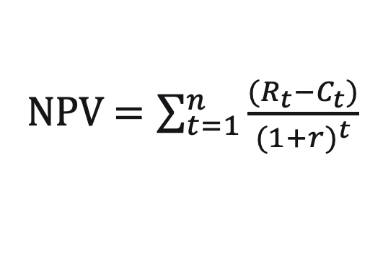
2. Net Present Value (NPV)
Overview
Used to evaluate the profitability of an investment of project
Measures the difference between the present value of cash inflows and the present value of cash outflows over a specific period
Fundamental concept is the time value of money, which recognizes that the value of money today is different from its value in the future
NPV = $\sum_{t=1}^{n}{\frac{(R_{t}−C_{t})}{{(1+r)}^{t}}}$
r = discount rate
t = time at which cash flow is occurring
n = total number of years considered
Rt = revenues (cash inflow)
Ct = costs (cash outflow)
Interpretation
NPV < 0 | Project causes a loss
NPV > 0 | Project creates a profit
NPV = 0 | Neither loss nor profit
Notes:
Net Present Value (NPV) is a financial metric used in capital budgeting and investment analysis to evaluate the profitability of an investment or project. It measures the difference between the present value of cash inflows and the present value of cash outflows over a specific period. The fundamental concept underlying NPV is the time value of money, which recognizes that the value of money today is different from its value in the future.
The NPV formula is shown here. Where:
NPV is the net present value,
r is the discount rate (the rate of return required on the investment),
t is the time at which cash flow is occurring
Rt is the revenues (cash inflow)
Ct is the costs (cash outflow)
If the NPV is positive, the project or investment is generally considered financially viable, as it indicates that the expected returns exceed the cost of capital. A negative NPV suggests that the investment may not meet the required rate of return.

Slide 9
2. Net Present Value (NPV)
Overview
Widely used in corporate finance, investment analysis, and strategic decision-making
Provides quantitative measure of the economic value of an investment
Should be used in conjunction with other financial metrics
NPV = $\sum_{t=1}^{n}{\frac{(R_{t}−C_{t})}{{(1+r)}^{t}}}$
r = discount rate
t = time at which cash flow is occurring
n = total number of years considered
Rt = revenues (cash inflow)
Ct = costs (cash outflow)
Interpretation
NPV < 0 | Project causes a loss
NPV > 0 | Project creates a profit
NPV = 0 | Neither loss nor profit
Notes:
NPV is widely used in corporate finance, investment analysis, and strategic decision-making. It provides a quantitative measure of the economic value of an investment and helps organizations allocate resources efficiently. It's important to note that while NPV is a powerful tool, it should be used in conjunction with other financial metrics and qualitative factors to make well-informed investment decisions.

Slide 10
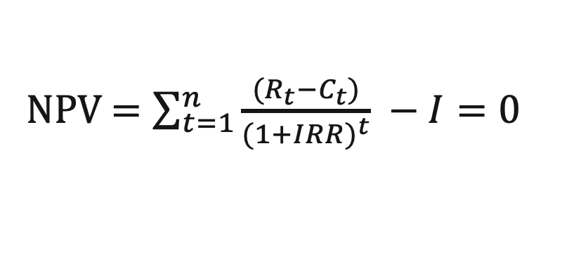
3. Internal Rate of Return (IRR)
Overview
Used to evaluate profitability of an investment or project (like NPV)
IRR expresses the rate of return as a percentage
  NPV provides a dollar amount representing the net value of an investment
IRR is the discount rate that makes the present value of a project’s cash inflows equal to the present value of its cash outflows
  Rate at which NPV = 0
t = time at which cash flow is occurring
n = total number of years considered
Rt = revenues (cash inflow)
Ct = costs (cash outflow)
I = total initial investment costs
NPV = $\sum_{t=1}^{n}{\frac{(R_{t}−C_{t})}{{(1+IRR)}^{t}} −I=0}$
Notes:
The Internal Rate of Return (IRR) is another important financial metric used in capital budgeting and investment analysis. Like Net Present Value (NPV), IRR is used to evaluate the profitability of an investment or project. However, while NPV provides a dollar amount representing the net value of an investment, IRR expresses the rate of return as a percentage.
The IRR is the discount rate that makes the present value of a project's cash inflows equal to the present value of its cash outflows. In other words, it is the rate at which the Net Present Value (NPV) of a project becomes zero. The IRR is often calculated using iterative methods or financial calculators.
The formula for IRR is shown here. It is similar to NPV.
Both IRR and NPV are widely used in financial decision-making, and their interpretation should often be considered together. While NPV provides a more direct measure of the net value of an investment, IRR offers a percentage rate of return, which can be intuitively appealing for decision-makers. It's important to recognize the strengths and limitations of each metric and use them in conjunction with other financial and qualitative considerations when making investment decisions.

Slide 11
4. Financial Comparison of Projects
Overview
Project A |  | Project B
Investment | $10,000 | Investment | $10,000 and $5,000 during first 2 years
Project life | 6 years | Project life | 6 years
Net benefits | From $5,000 down to $1,000 | Net benefits | $5,500 each year
Notes:
Financial comparison of projects involves assessing and comparing the financial viability and attractiveness of multiple investment projects. This is a critical process for businesses, organizations, and investors to make informed decisions about where to allocate resources. Two common tools used for comparing projects are Net Present Value (NPV) and Internal Rate of Return (IRR). Lets look at 2 different projects: A and B.
Project A has an investment of 10,000 in the first year, whilst project B has 10,000 and 5,000 covering the first and second year. Both have a project lifetime of 6 years. And the net benefits for project A is 5000 to 1000 in the 6 years, while project B has 5,500 each year. Now, using what we learnt about NPV and IRR, lets look at which is profitable and the better project.

Slide 12
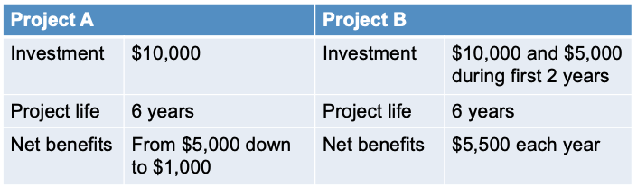
4. Financial Comparison of Projects
Cash Flows

Slide 13
4. Financial Comparison of Projects
Net Present Value (NPV)
Discount Rate = 5%
Year | Project A |  | Project B
 | Nominal | Discounted | Nominal | Discounted
1 | -10,000 | -10,000 | -10,000 | -10,000
2 | 5,000 | 4,762 | -5,000 | 4,762
3 | 4,000 | 3,628 | 5,500 | 4,989
4 | 3,000 | 2,592 | 5,500 | 4,751
5 | 2,000 | 1,645 | 5,500 | 4,525
6 | 1,000 | 784 | 5,500 | 4,309
Total | 5,000 | 3,410 | 7,000 | 3,812
NPV
Notes:
NPV first – and lets assume the discount rate is 5%. Taking this into account, we can calculate the discounted cost for all the years for project A. The equation to do this is in the top right. Then, when we sum the discounted costs, we get the NPV. Now we look at project B. After discountin and summing, our NPV is 3,812. so, we can see how the discount rate plays a major role. With this, project B is more profitable.

Slide 14
4. Financial Comparison of Projects
Net Present Value (NPV)
Discount Rate = 10%
Year | Project A |  | Project B
 | Nominal | Discounted | Nominal | Discounted
1 | -10,000 | -10,000 | -10,000 | -10,000
2 | 5,000 | 4,545 | -5,000 | -4,545
3 | 4,000 | 3,306 | 5,500 | 4,545
4 | 3,000 | 2,254 | 5,500 | 4,132
5 | 2,000 | 1,366 | 5,500 | 3,757
6 | 1,000 | 621 | 5,500 | 3,415
Total | 5,000 | 2,092 | 7,000 | 1,304
NPV
Notes:
Now what happened if we changed the discount rate? Doubled it to 10%?
We see that project A is actually the profitable one to go for! So, we can see how discount rate is a major factor and we now know how to calculate NPV to assess profitability

Slide 15
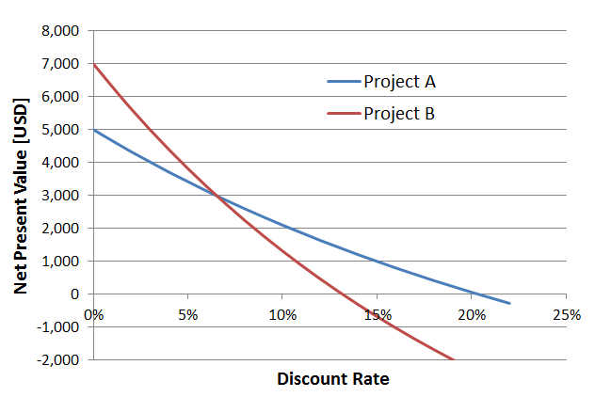
4. Financial Comparison of Projects
Internal Rate of Return (IRR)
What is the IRR of Project B?
Notes:
Now, we have plotted our NPV on a graph. And we want to take into account IRR. What is the irr of project B? can anyone tell me how we find this?

Slide 16
4. Financial Comparison of Projects
Internal Rate of Return (IRR)
Internal Rate of Return
Notes:
Remember, IRR is when NPV = 0. it is the rate at which the Net Present Value (NPV) of a project becomes zero. So, we see that IRR for project A is around 20.5% and project B around 13.5%. So, project A is more profitable!

Slide 17
4. Financial Comparison of Projects
Other

Slide 18
4. Financial Comparison of Projects
Other
 | Discount Rate | 5 |  | %
Year | Project C |  |  | Project D
 | Nominal | Discounted | Σ Discounted | Nominal | Discounted | Σ Discounted
1 | -15,000 | -15,000 | -15,000 | -1,500 | -1,500 | -1,500
2 | 2,000 | 1,905 | -13,095 | -1,500 | -1,429 | -2,929
3 | 2,000 | 1,814 | -11,281 | -1,500 | -1,361 | -4,289
4 | 2,000 | 1,728 | -9,554 | -1,500 | -1,296 | -5,585
5 | 2,000 | 1,645 | -7,908 | -1,500 | -1,234 | -6,819
6 | 2,000 | 1,567 | -6,341 | -1,500 | -1,175 | -7,994
7 | 2,000 | 1,492 | -4,849 | -1,500 | -1,119 | -9,114
8 | 2,000 | 1,421 | -3,427 | -1,500 | -1,066 | -10,180
9 | 2,000 | 1,354 | -2,074 | -1,500 | -1,015 | -11,195
10 | 2,000 | 1,289 | -784 | -1,500 | -967 | -12,162
11 | 2,000 | 1,228 | 443 | 5,000 | 3,070 | -9,092
12 | 2,000 | 1,169 | 1,613 | 5,000 | 2,923 | -6,169
13 | 2,000 | 1,114 | 2,727 | 5,000 | 2,784 | -3,385
14 | 2,000 | 1,061 | 3,787 | 5,000 | 2,652 | -733
15 | 2,000 | 1,010 | 4,797 | 5,000 | 2,525 | 1,792
16 | 2,000 | 962 | 5,759 | 5,000 | 2,405 | 4,197
17 | 2,000 | 916 | 6,676 | 5,000 | 2,291 | 6,488
18 | 2,000 | 873 | 7,548 | 5,000 | 2,181 | 8,669
19 | 2,000 | 831 | 8,379 | 5,000 | 2,078 | 10,747
20 | 2,000 | 791 | 9,171 | 5,000 | 1,979 | 12,726
21 | 2,000 | 754 | 9,924 | 5,000 | 1,884 | 14,610
22 | 2,000 | 718 | 10,642 | 5,000 | 1,795 | 16,405
23 | 2,000 | 684 | 11,326 | 5,000 | 1,709 | 18,114
24 | 2,000 | 651 | 11,977 | 5,000 | 1,628 | 19,742
25 | 2,000 | 620 | 12,597 | 5,000 | 1,550 | 21,292
26 | 2,000 | 591 | 13,188 | 5,000 | 1,477 | 22,769
27 | 2,000 | 562 | 13,750 | 5,000 | 1,406 | 24,175
28 | 2,000 | 536 | 14,286 | 5,000 | 1,339 | 25,514
29 | 2,000 | 510 | 14,796 | 5,000 | 1,275 | 26,790
30 | 2,000 | 486 | 15,282 | 5,000 | 1,215 | 28,005
Total | 43,000 | 15,282 |  | 85,000 | 28,005
IRR | 13% |  |  | 15%

Slide 19
4. Financial Comparison of Projects
Other
 | Discount Rate | 5 |  | %
Year | Project C |  |  | Project D
 | Nominal | Discounted | Σ Discounted | Nominal | Discounted | Σ Discounted
1 | -15,000 | -15,000 | -15,000 | -1,500 | -1,500 | -1,500
2 | 2,000 | 1,905 | -13,095 | -1,500 | -1,429 | -2,929
3 | 2,000 | 1,814 | -11,281 | -1,500 | -1,361 | -4,289
4 | 2,000 | 1,728 | -9,554 | -1,500 | -1,296 | -5,585
5 | 2,000 | 1,645 | -7,908 | -1,500 | -1,234 | -6,819
6 | 2,000 | 1,567 | -6,341 | -1,500 | -1,175 | -7,994
7 | 2,000 | 1,492 | -4,849 | -1,500 | -1,119 | -9,114
8 | 2,000 | 1,421 | -3,427 | -1,500 | -1,066 | -10,180
9 | 2,000 | 1,354 | -2,074 | -1,500 | -1,015 | -11,195
10 | 2,000 | 1,289 | -784 | -1,500 | -967 | -12,162
11 | 2,000 | 1,228 | 443 | 5,000 | 3,070 | -9,092
12 | 2,000 | 1,169 | 1,613 | 5,000 | 2,923 | -6,169
13 | 2,000 | 1,114 | 2,727 | 5,000 | 2,784 | -3,385
14 | 2,000 | 1,061 | 3,787 | 5,000 | 2,652 | -733
15 | 2,000 | 1,010 | 4,797 | 5,000 | 2,525 | 1,792
Notes:
Mention risk, e.g., that it takes 50% longer to build it.

Slide 20
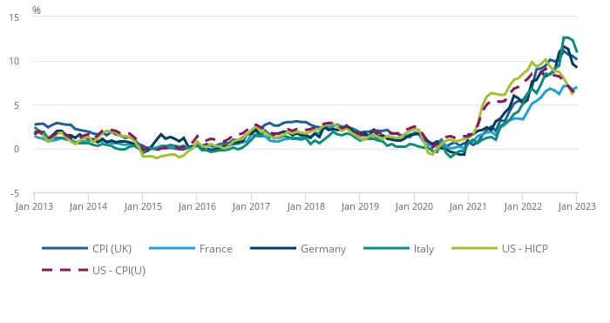
5. Inflation and Escalation
Inflation
Inflation refers to rise in general price levels in an economy
  e.g., consumer price index (CPI)
CPI compared with selected G7 annual inflation rates, January 2013 to January 2023
Largest upward contributions came from housing and household services (electricity, gas, other fuels), and non-alcoholic beverages
https://cy.ons.gov.uk/economy/inflationandpriceindices/bulletins/consumerpriceinflation/january2023/previous/v1
Notes:
Inflation is the rate at which the general level of prices for goods and services rises over time, leading to a decrease in purchasing power. Inflation erodes the real value of money, meaning that a unit of currency buys fewer goods and services than it did in the past. It is commonly expressed as an annual percentage, indicating the percentage increase in prices over a specific period.
Inflation is commonly measured using price indices, with the Consumer Price Index (CPI) being commonly used. The Consumer Price Index (CPI) is a widely used economic indicator that measures the average change over time in the prices paid by urban consumers for a market basket of consumer goods and services. In simple terms, it provides a way to track the inflation or deflation of prices for a standard set of goods and services commonly purchased by households.
Inflation is a complex economic phenomenon that impacts individuals, businesses, and governments. Central banks and policymakers carefully monitor inflation rates and take measures to achieve price stability while promoting sustainable economic growth. Understanding inflation is crucial for making informed financial decisions and managing the impact of changing prices on personal and economic well-being.

Slide 21
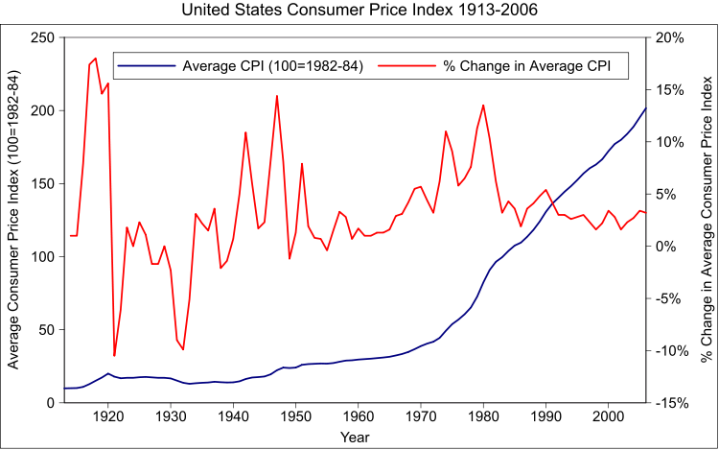
Inflation & Escalation
Inflation refers to rise in general price levels in an economy, e.g., consumer price index (CPI)

Slide 22
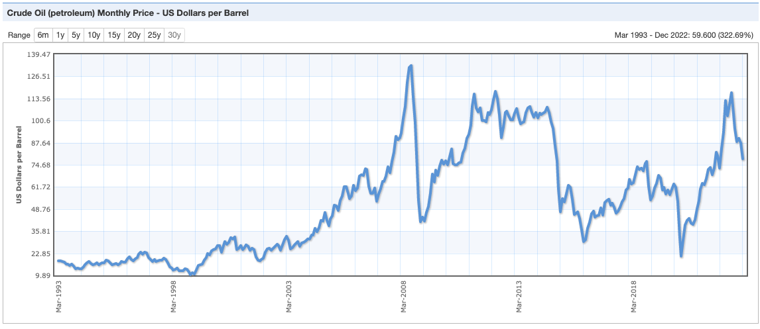
5. Inflation and Escalation
Escalation
Escalation refers to a rise in price of a certain commodity
  e.g., due to resource depletion, new regulation, increasing demand, supply shortages, etc.
Mar
1993
Mar
1998
Mar
2003
Mar
2008
Mar
2013
Mar
2018
https://www.indexmundi.com/commodities/?commodity=crude-oil&months=360
Notes:
Price escalation involves the upward movement of prices for goods or services over time. This can be influenced by factors such as resource depletion, new regulation, increasing demand, supply shortages, inflation, changes in production costs, etc. Businesses may use price escalation strategies to adjust their pricing models to account for increasing costs and maintain profit margins.

Slide 23
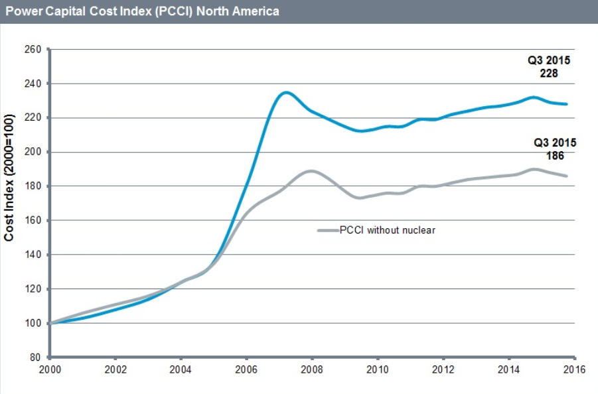
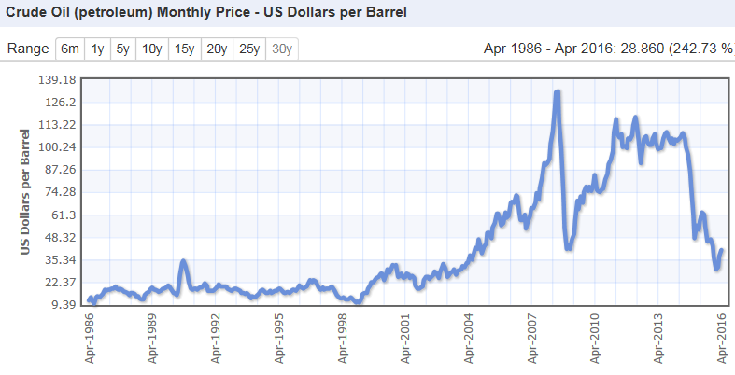
Inflation & Escalation
Escalation refers to a rise in price of a certain commodity (e.g., due to resource depletion, new regulation, increasing demand, supply shortages, etc.)
https://www.ihs.com/Info/cera/ihsindexes/index.html
http://www.indexmundi.com/commodities/?commodity=crude-oil&months=360

Slide 24
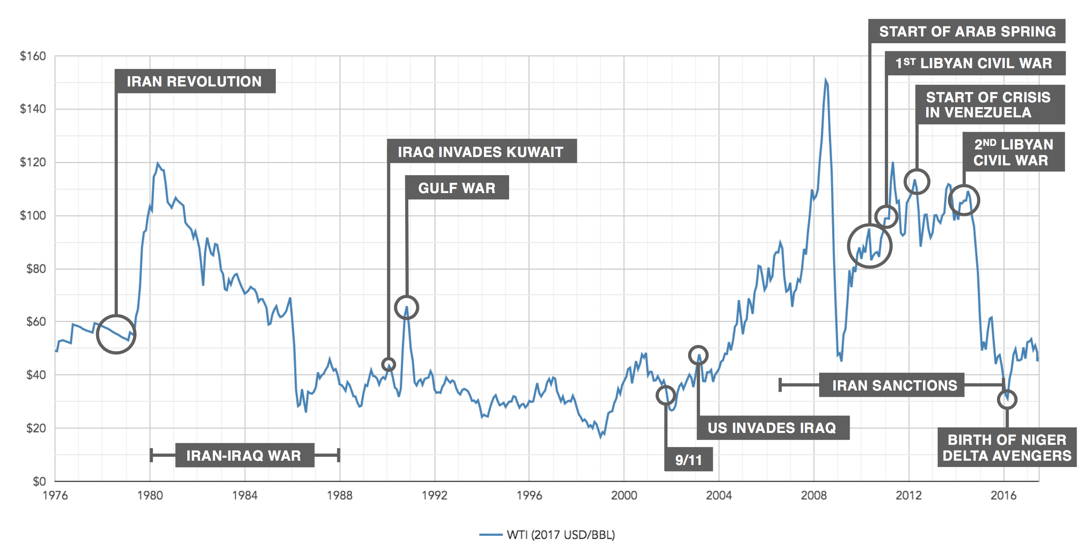
5. Inflation and Escalation
History of Oil Prices
https://www.oilsandsmagazine.com/market-insights/oil-prices-explained-how-to-value-a-barrel-of-crude
Notes:
An example of this is can be seen with the price of oil. Certain factors can contribute to inflation and escalation

Slide 25
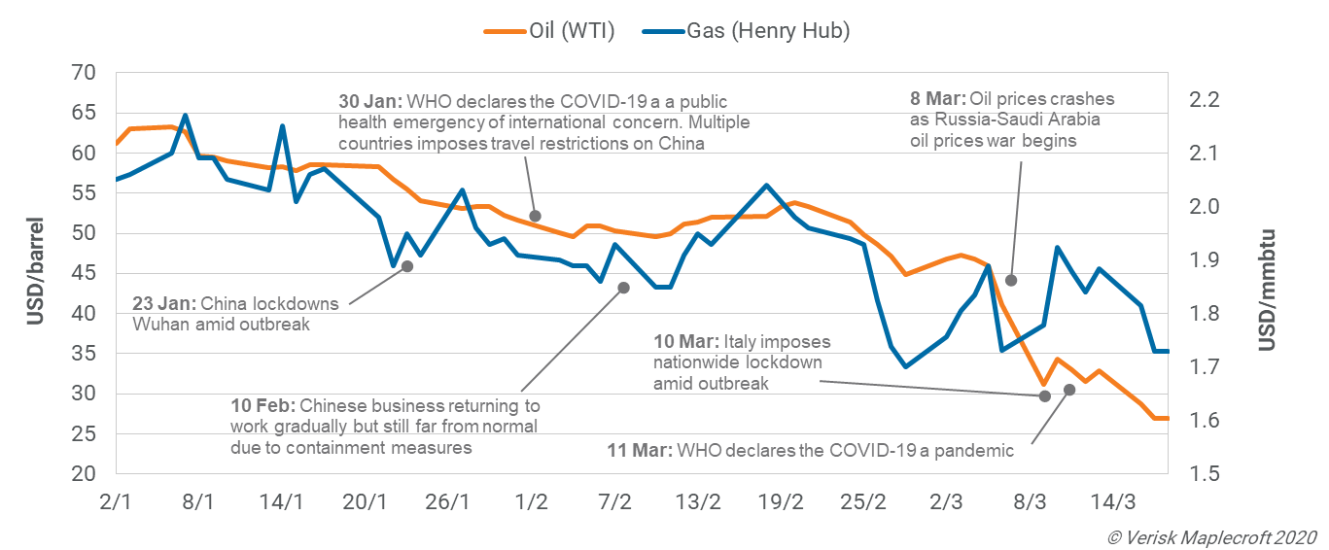
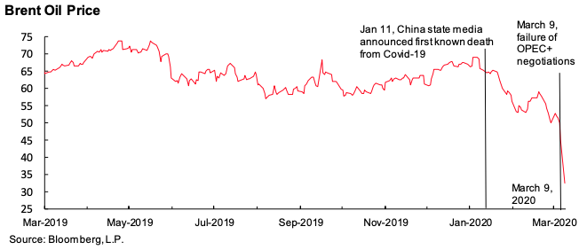
5. Inflation and Escalation
History of Oil Prices
Jan 2020
Mar 2020

Slide 26
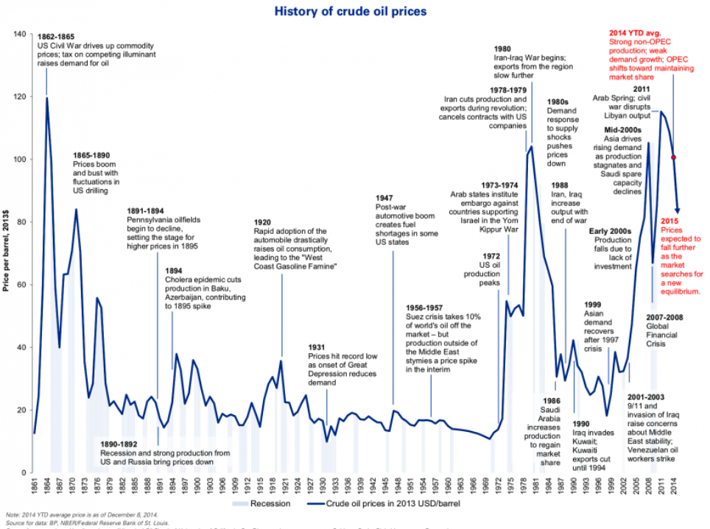
Inflation & Escalation
http://www.businessinsider.com/annotated-history-crude-oil-prices-since-1861-2014-12?IR=T

Slide 27
6. Depreciation Methods
Overview
Linear Depreciation
  Asset value depreciated as a straight line over depreciation period
  Declining balance
  Current asset value depreciated with a constant percentage
  Declining switching to linear
  Mix of declining balance and linear depreciation. Switch to linear occurs when linear depreciation in a year is larger than what is calculated with declining balance depreciation
  Sum-of-the-years’ digits
  Asset value depreciated by (remaining life time) / (Sum of each year of life time). E.g., over 3 years: 3/6 depreciation factor in first year, 2/6 in second & 1/6 in third.
Notes:
Depreciation is the accounting process used to allocate the cost of a tangible asset over its useful life. This allocation reflects the wear and tear, obsolescence, or reduction in value of the asset over time. Various methods exist for calculating depreciation, each with its own assumptions and considerations. Here are some common depreciation methods:
Linear depreciation – this is where asset value depreciates over a straight line over the depreciation period. Each year, the same amount is deducted from the asset's book value until it reaches the residual value. Straight-line depreciation is the simplest and most widely used method.
Declining balance – this is where current asset value depreciates with a constant percentage
Declining switching to linear - Mix of declining balance and linear depreciation. Switch to linear occurs when linear depreciation in a year is larger than what is calculated with declining balance depreciation
Sum of the years’ digits – this is an accelerated de[recitation method, where asset value depreciates by (remaining life time) / (sum of each year of life time) e.g. over 3 years: 3/6 depreciation factor in first year, 2/6 in second and 1/6 in third

Slide 28
6. Depreciation Methods
Overview
Notes:
Sum-of-the-years digit: The method is more appropriate than the more commonly-used straight-line depreciation if an asset depreciates more quickly or has greater production ca­pacity in the earlier years than it does as it ages. A problem with using this or any other accelerated depreciation method is that it artificially reduces the reported profit of a business over the near term. The result is excessively low profits in the near term, followed by excessively high profits in later reporting periods. Use of the method can have an indirect impact on cash flows, since accelerated depreciation can reduce the amount of taxable income, thereby deferring income tax payments into later periods.

Slide 29
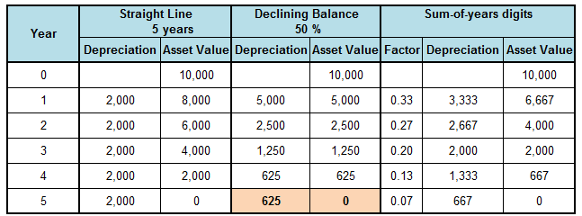
6. Depreciation Methods
Impacts on Tax Calculation in Income Statement

Slide 30
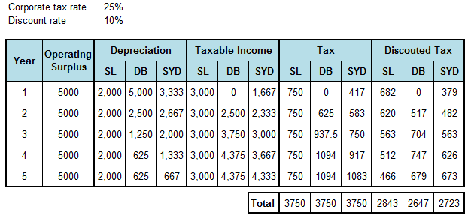
6. Depreciation Methods
Impacts on Tax Calculation in Income Statement
Notes:
Straight linear
Declining balance
Some of the years digit
Depreciation methods can have significant implications for taxes, affecting taxable income, cash flow, and the timing of tax payments. Different depreciation methods can result in varying amounts of depreciation expense over an asset's useful life, influencing the taxable income reported by a business.

Slide 31
Questions
How does the value of future cash flows change if discount rate is increased?
Which power plant type has high investment costs and low operating costs?
Which power plant type has low investment costs and high operating costs?
For which power plant type is a low discount rate preferable?
For which power plant type is a high discount rate preferable?
What phenomenon is shown on the next slide?

Slide 32
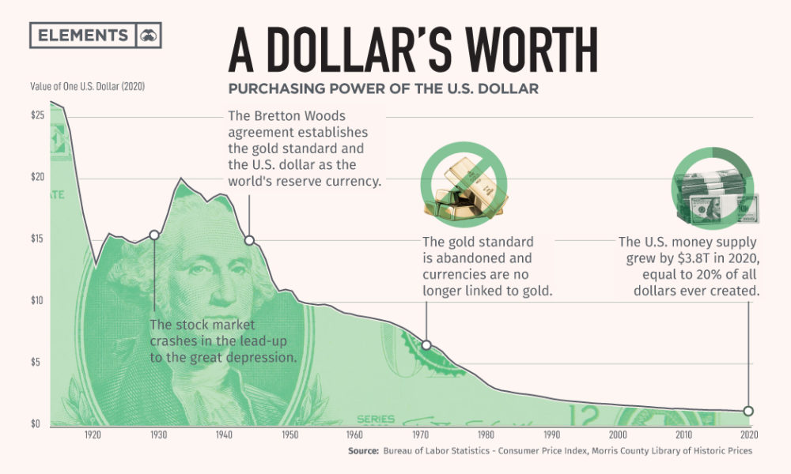
Questions

Slide 33
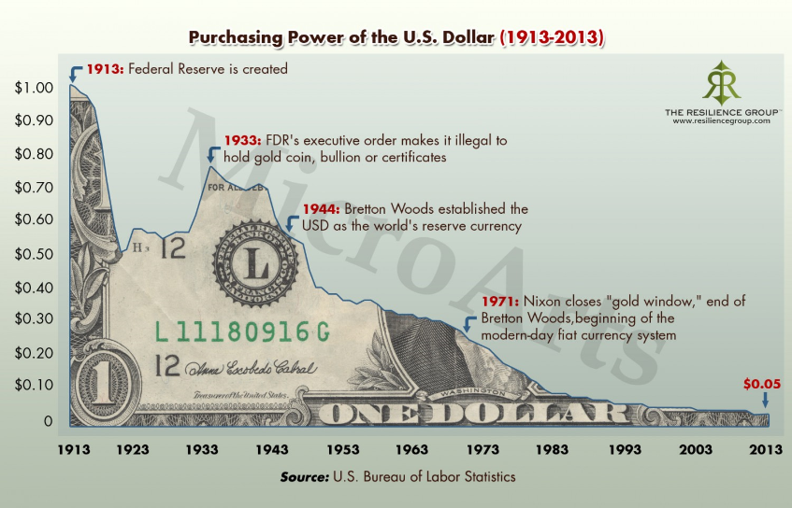

Slide 34
Thank you!
Notes:
Thank you!

Slide 35
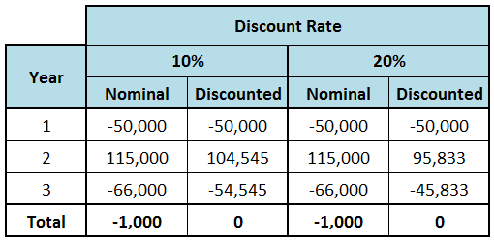
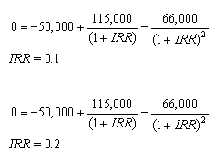
Limitations
New Project Cash Flow: -50,000 / 115,000 / -66,000
In reality, it is hard to create such a case for a power project

Slide 36
Financial Comparison of Projects
Criteria for Evaluation of Project
Criteria based on present value
  Maximum net present value
  Minimum present value of costs
  Minimum levelised cost of generation
  Maximum benefit-to-cost ratio
Criteria based on yield
  Internal rate of return

