Slide 1

Geospatial Clean Cooking access modelling using OnStove
LECTURE 6
RESULTS INTERPRETATION
Version 1.0

Slide 2
Learning Outcomes
By the end of this lecture, you will:
ILO1: Understand the results presented by the OnStove cost-benefit model
ILO2: Use the outputs of the OnStove model to formulate policy-relevant questions and support clean cooking strategies
Notes:
The final step in the OnStove modelling process, is to generate results, interpret them and use them to guide decision-making. After this presentation you will be able toä:
Understand the results presented by the OnStove cost-benefit model
Use the outputs of the OnStove model to formulate policy-relevant questions and support clean cooking strategies

Slide 3
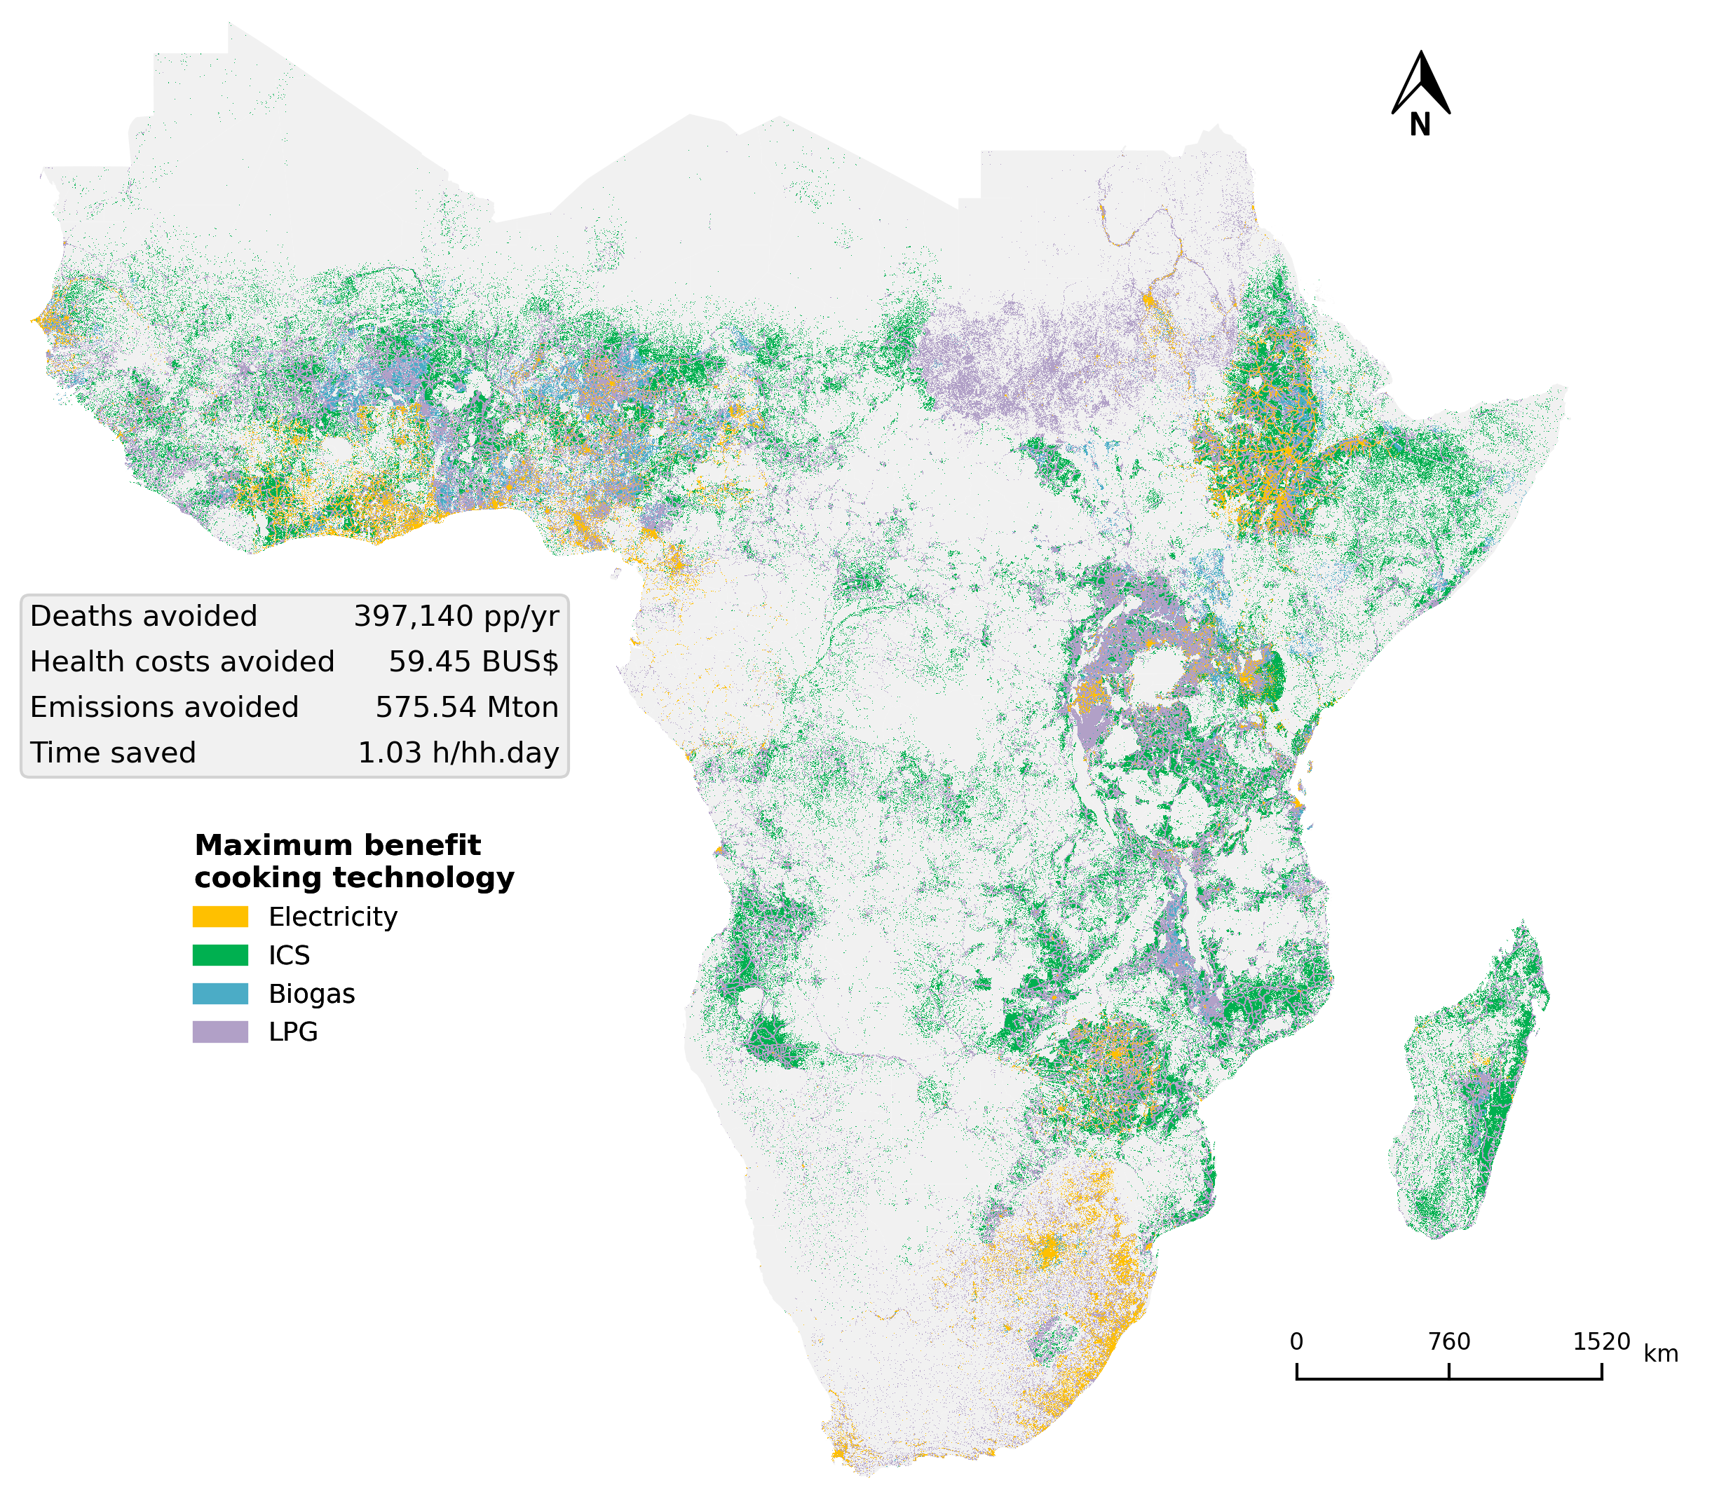
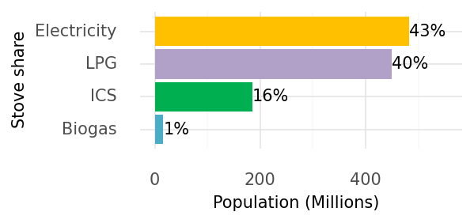
6.1 Spatial technology mix
Main result map of the OnStove analysis, showing the spatial distribution of the maximized net-benefit technology mix and the annual benefits achieved by the transition
The spatial technology mix needs to be read in combination with the stove share bar plot. The spatial distribution does not account for population density, showing a misleading view if seen alone.
The benefits presented in terms of deaths avoided, health costs avoided, emissions avoided and time saved, are relative to the effects of the current cooking practices in the region. This means that these numbers can also be seen as the cost of inaction.
Optimal clean cooking technology and distribution derived from OnStove (IEA, 2023)
Notes:
The main result of the OnStove model is in the form of a map showing the spatial distribution of stoves. This map has a resolution of 1 square kilometre and tells you which technologies ranked highest in every cell (i.e. every square kilometre) in terms of net-benefits. Reading this alone, however, can be misleading as the spatial distribution is basically showing area shares, but it does not consider the population density over each cell. It is important then to always read this map in combination with the bar-plot showing the aggregated population share of each stove.
Moreover, in the box the total benefits attained across the region are presented. These benefits are presented in terms of deaths avoided, health costs avoided, emissions avoided and time saved. All the calculations in OnStove are relative to the effects of the current cooking practices in the region. This means that these numbers can also be seen as the cost of inaction.
Due to this relative nature of the model, note how the optimal stove mix is very different from the current practices (no traditional stoves selected), meaning that no traditional stove achieved a net-benefit high enough to surpass a clean or transitional option, even if the costs are marginal.

Slide 4
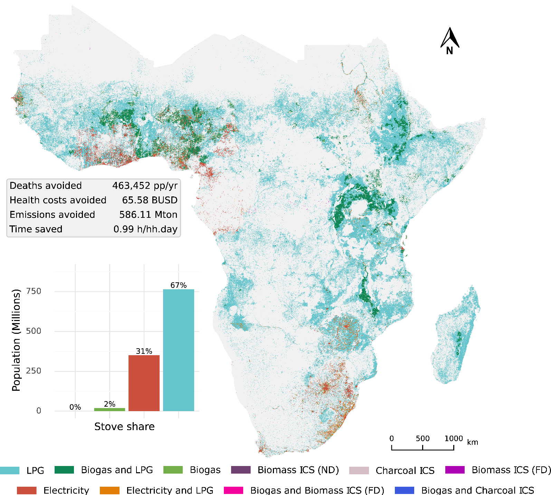
6.1 Spatial technology mix
Main result map of the OnStove analysis, showing the spatial distribution of the maximized net-benefit technology mix and the annual benefits achieved by the transition
When two technologies are presented in combination in the same cell, it does not indicates fuel stacking. Instead, it indicates that in such area it is not possible to supply clean cooking to all households with the highest net-benefit technology. This is due to supply constraints such as electricity access rates or biogas potential. Then, the second best technology is chosen to supply the remaining households.
Optimal clean cooking technology and distribution derived from OnStove (Khavari et.al., 2023)

Slide 5
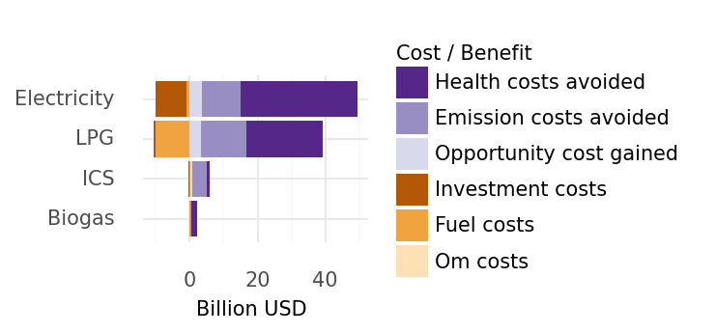
6.2 Costs and benefits
OnStove calculates the costs and benefits of transitioning to clean cooking alternatives relative to a baseline, i.e. the current cooking technologies used over the study area.
The total costs and benefits per stove are presented in the form of a bar plot where negative values are seen as costs (relative to the baseline) and positive values as monetary gains or benefits (relative to the baseline).
A cost e.g. fuel cost, can also be positive, meaning that the transition is less expensive regarding fuel expenses than the baseline. The same could happen to a benefit.
Optimal clean cooking technology shares derived from OnStove (IEA, 2023)
Total costs and benefits of the optimal clean cooking technology mix (IEA, 2023)

Slide 6
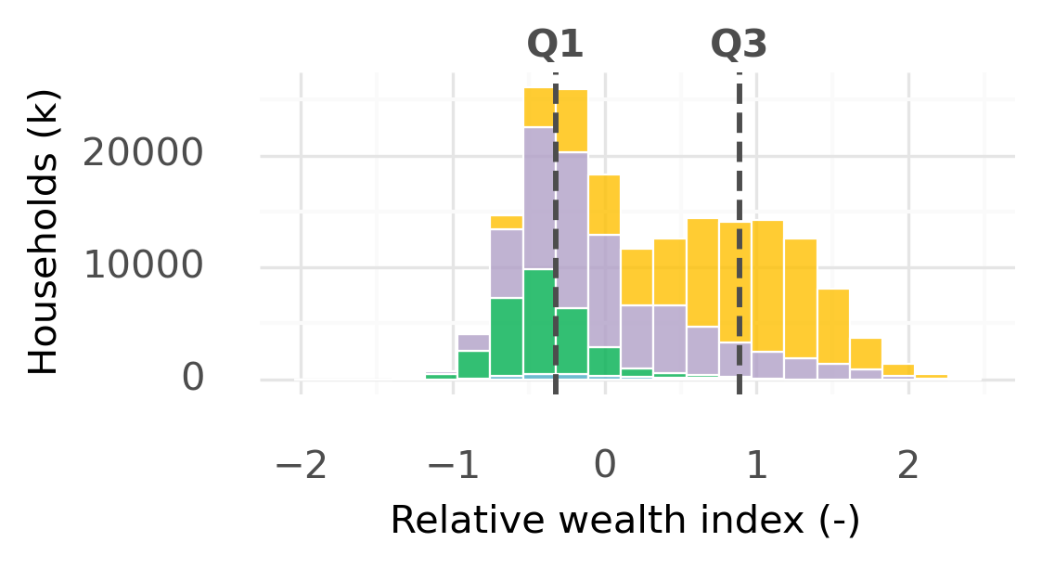
6.3 Wealth distribution
The distribution of cooking technologies over the relative wealth index, shows a visual and fast indication if the recommended transition may be affordable to the majority of the population.
A wealth index is a composite measure used to assess the economic well-being or wealth of individuals, households, or populations. It typically takes into account various indicators related to income, assets, and living conditions to provide a more comprehensive picture of economic status than income alone.
The Relative Wealth Index predicts the spatial relative living standards using anonymized connectivity data, satellite imagery and other nontraditional data sources.
Optimal clean cooking technology shares derived from OnStove (IEA, 2023)
Optimal clean cooking technology shares distributed over the wealth index (IEA, 2023)

Slide 7
6.3 Wealth distribution
The distribution of cooking technologies over the relative wealth index, shows a visual and fast indication if the recommended transition may be affordable to the majority of the population.
By looking at the distribution of households over the relative wealth, it can be seen how the different technologies fall within the distribution. For example, ICS technologies are mostly adopted in households below the first quantile of wealth, which present a realistic view as ICS technologies can be a more affordable solution to poorer households.
Moreover, electric stoves are adopted in the higher wealth quantiles, which indicates that this households could have a better economic capacity to pay for sustained use of electric cooking.
Optimal clean cooking technology shares derived from OnStove (IEA, 2023)
Optimal clean cooking technology shares distributed over the wealth index (IEA, 2023)

Slide 8
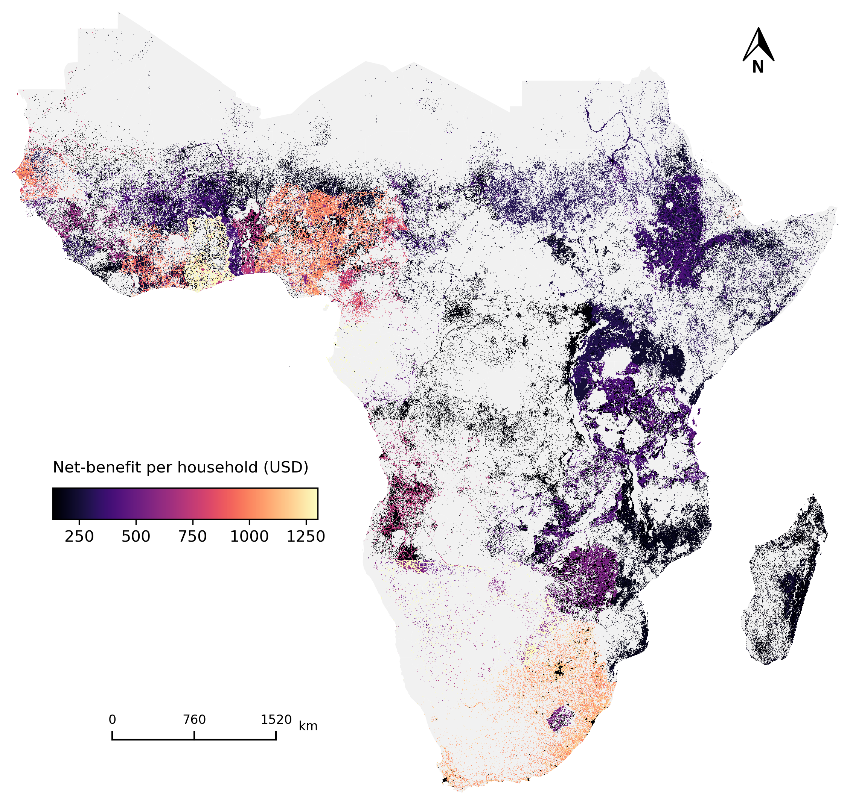
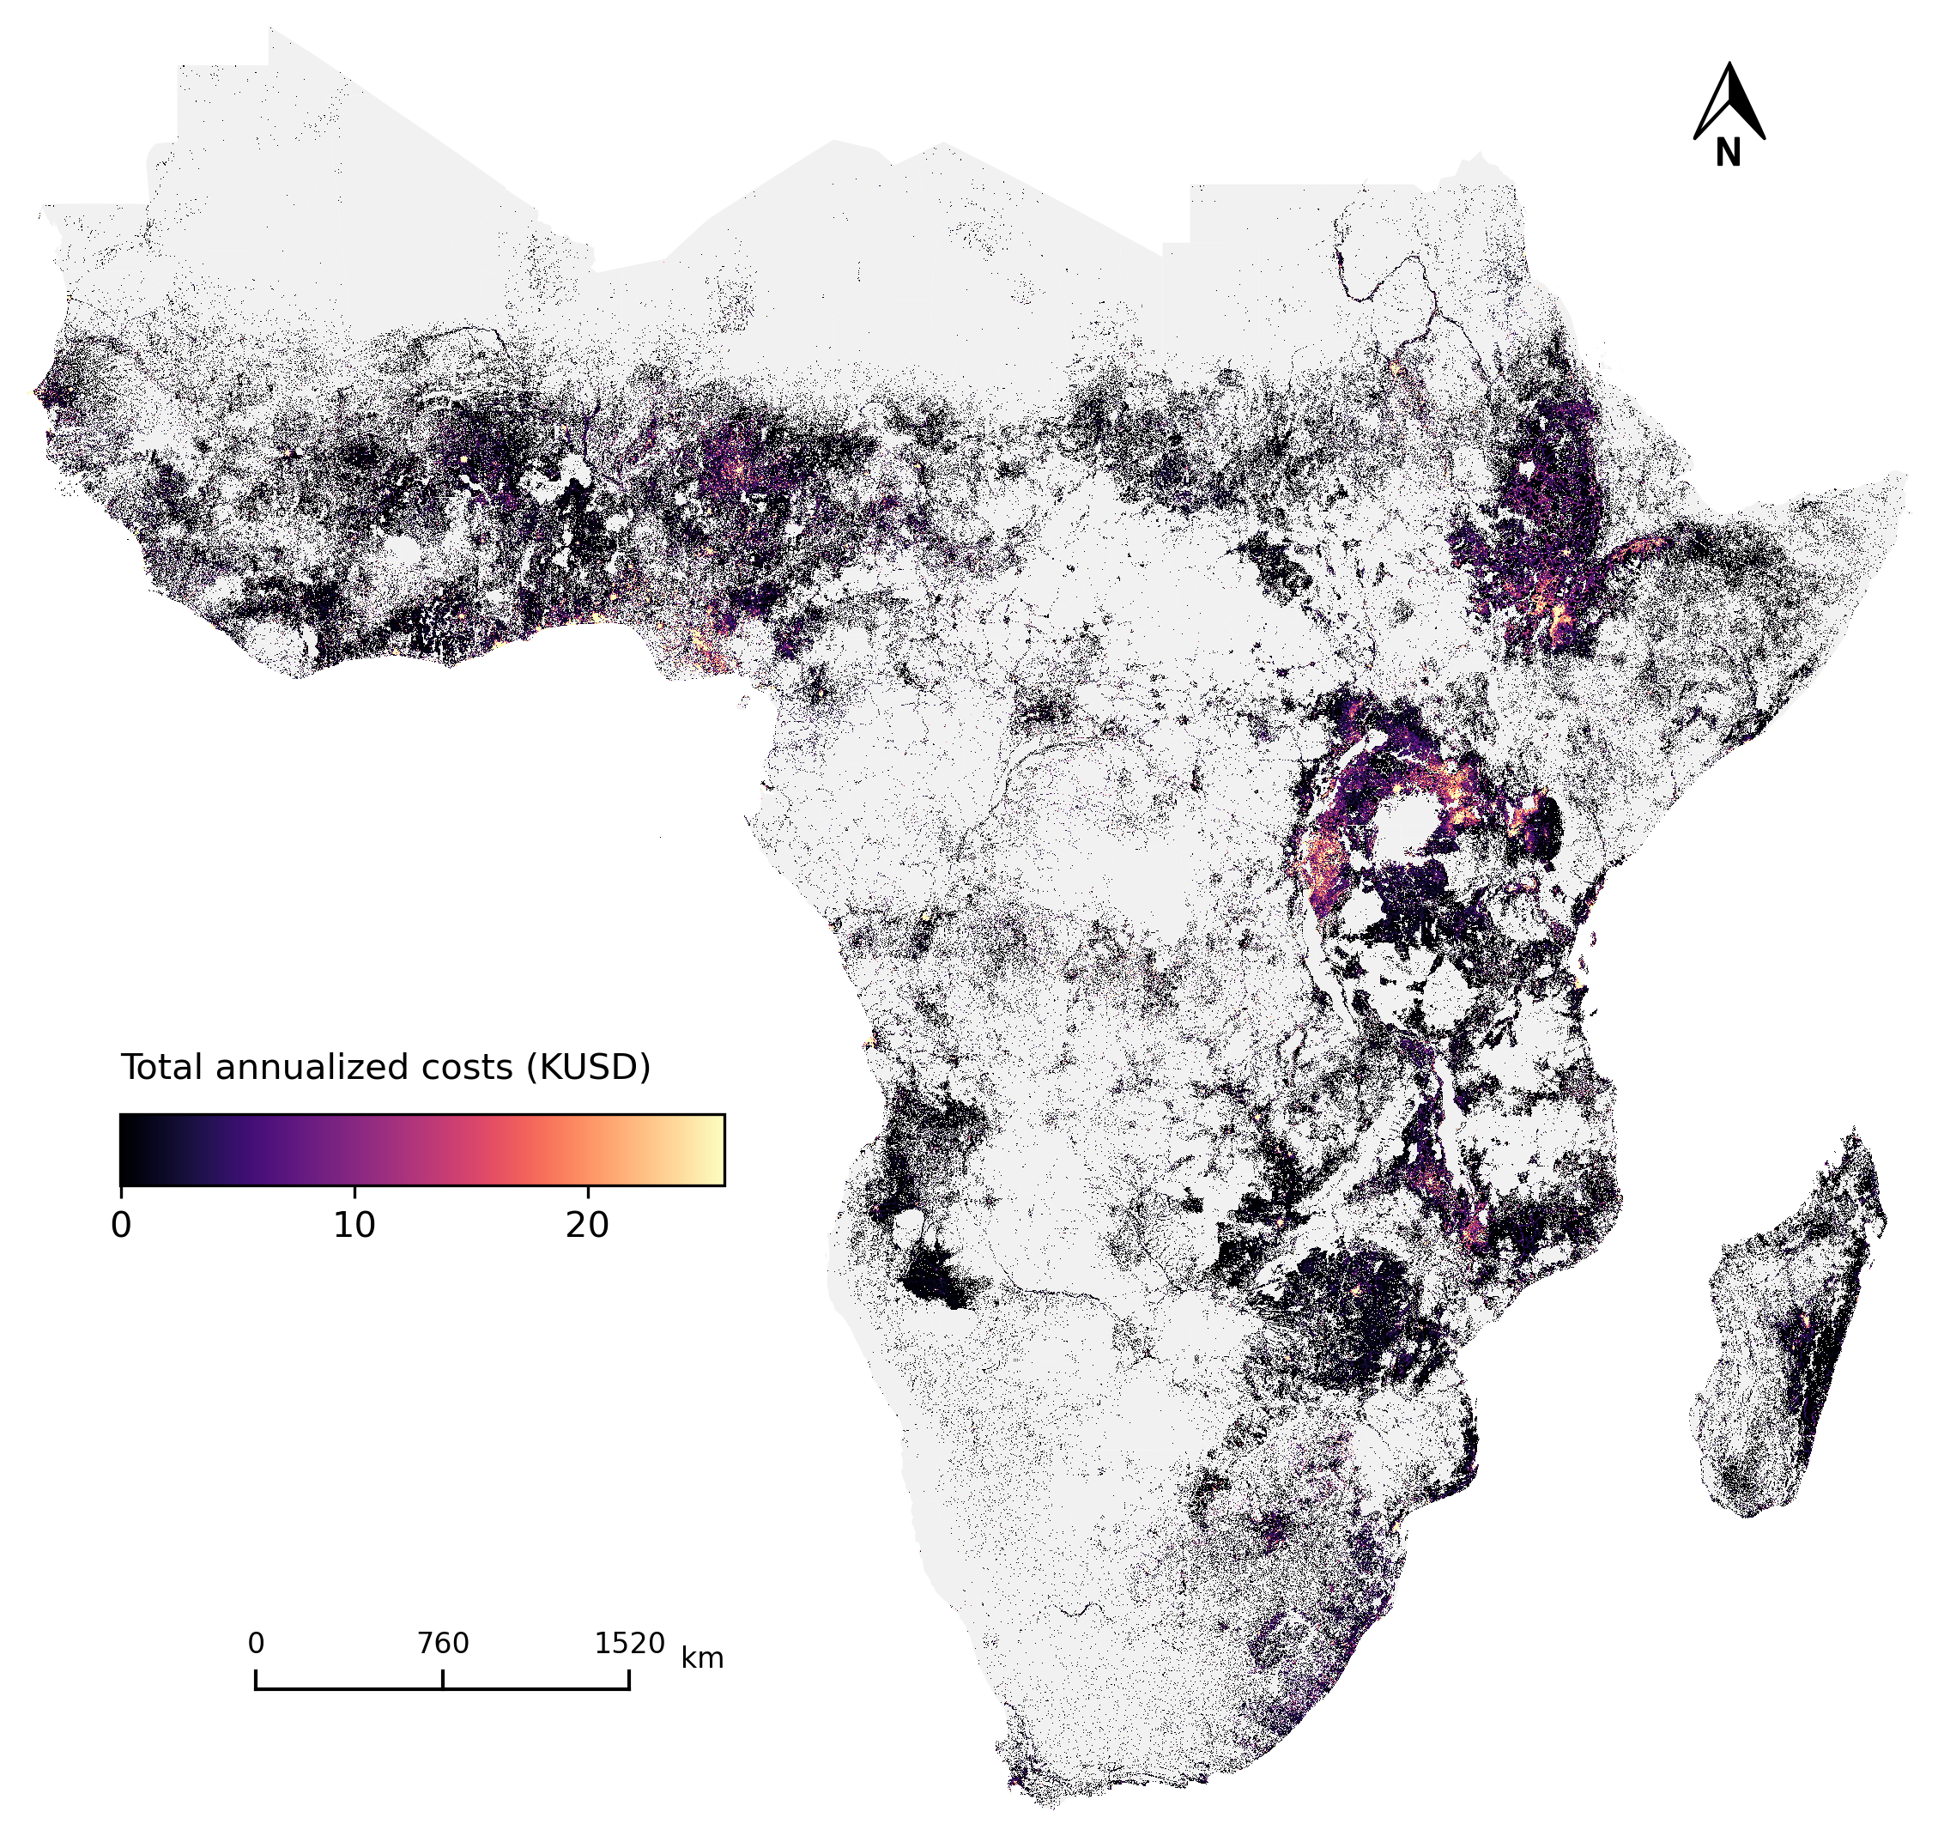
6.4 Other results
Net-benefits of the optimal clean cooking technology mix derived from OnStove (IEA, 2023)
Total annualized costs of the optimal clean cooking technology mix derived from OnStove (IEA, 2023)
Notes:
Finally, OnStove can produce other spatially explicit results, such as the spatial distribution of net-benefits achieved by the transition or the total annualized costs. This datasets can be used in order to prioritize areas of action. For example, a policy centered in maximizing the benefits of a transition, would prioritize the areas with highest net-benefits achieved, whereas a policy prioritizing lower costs would star with the areas where less investment in´s needed.

Slide 9
References
Khavari, B., Ramirez, C., Jeuland, M., & Fuso Nerini, F. (2023). A geospatial approach to understanding clean cooking challenges in sub-Saharan Africa. Nature Sustainability. https://doi.org/10.1038/s41893-022-01039-8
IEA. (2023). A Vision for Clean Cooking Access for All. IEA. https://www.iea.org/reports/a-vision-for-clean-cooking-access-for-all

Slide 10
Thank you
for your attention
in this lecture!

Slide 11

Khavari B., Ramirez C. 2023.
Lecture 6: Geospatial Clean Cooking access modelling using OnStove. Release Version 1.0.[online presentation]. Climate Compatible Growth Programme, Energy Sector Management Assistance Program and World Bank Group
CCG courses (this will take
you to the website link http://www.ClimateCompatibleGrowth.com/teachingmaterials)

